Slide 1


P.S. Shternin, D.D. Ofengeim
Transport coefficients of magnetized neutron star cores
XVth Quark Confinement and the Hadron Spectrum
Aug 1 – 6, 2022, University of Stavanger, Norway

Slide 2
Motivation
COMPOSE topical issue of EPJA.
Dependence of transport properties on EOS
Shternin & Ofengeim EPJA 58, 42 (2022)
Transport in NS cores in magnetic field is less elaborated than in the crust
Essentially, diffusion (electric conductivity) in connection to the magnetic field evolution problem
See, e.g., Schmitt &Shternin (2018) for a review

Slide 3
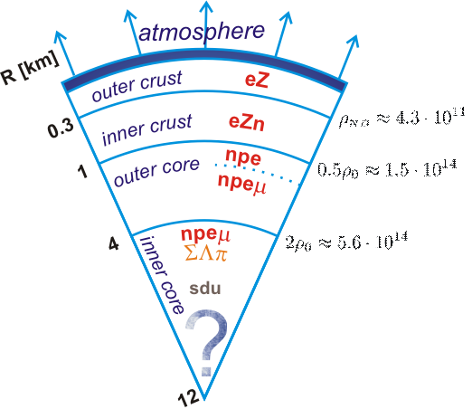
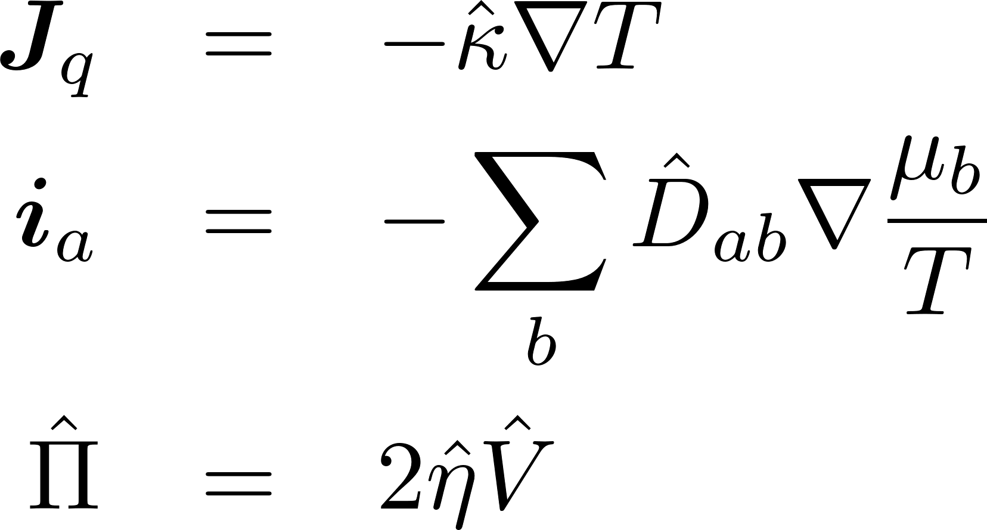
Transport coefficients in neutron star cores
Composition: npeμ matter in beta-equilibrium
Transport coefficients are mediated by quasiparticles collisions (weak coupling)
Strong interactions
Electromagnetic interactions
Thermal conductivity
Diffusion
Shear viscosity
No pairing
No reactions
Bulk viscosity is not considered

Slide 4
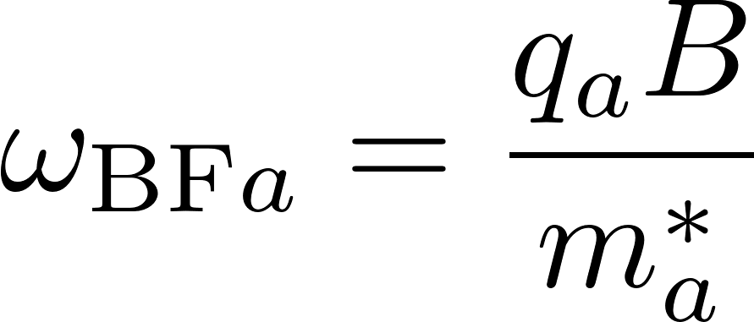
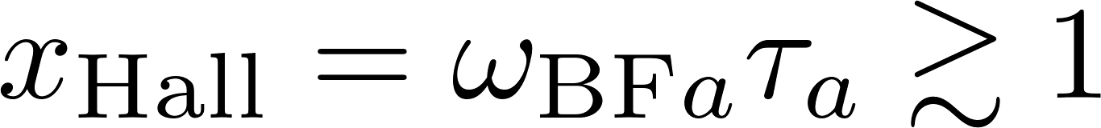
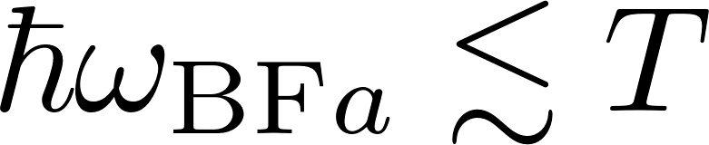
Transport in magnetic field
cyclotron frequency
magnetization
Non-quantizing B-field
Transport coefficients become tensors
Yakovlev & Shalybkov Ap&SS 176, 191 (1991)

Slide 5
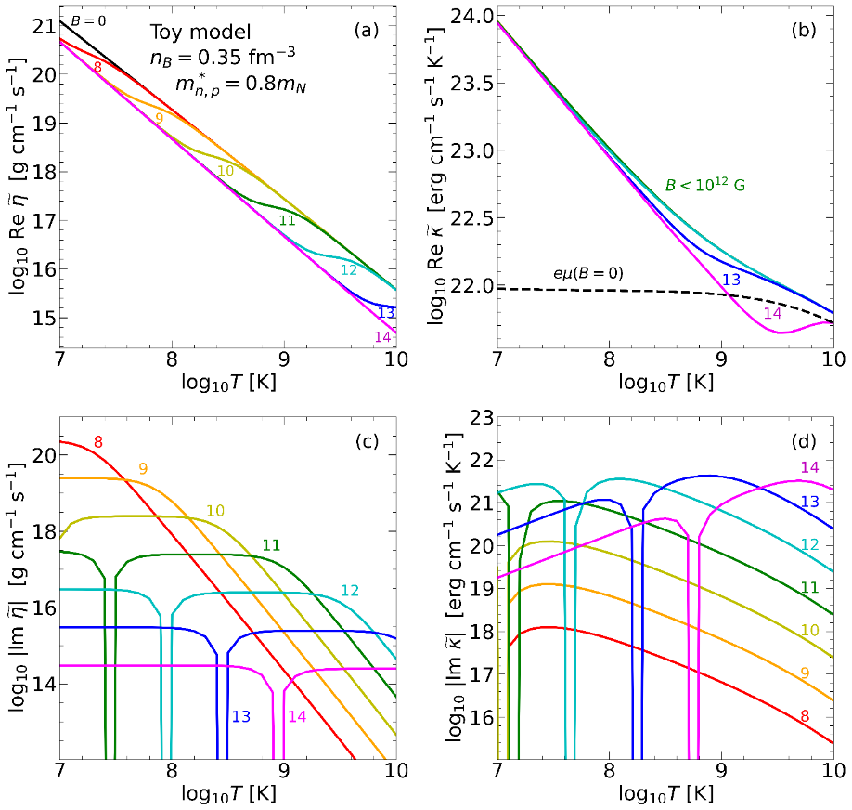
Plan of the talk
1. Formalism of the transport theory of multicomponent Fermi liquids in magnetic field.
complex transport coefficients.
relaxation time approximation
2. Results for a wide range of EOSs (COMPOSE+).
Strategies for in-medium scattering treatment for transport
Poor man approximations.
3. Results.
In the magnetized matter thermal conductivity is weakly modified, however the shear viscosity is affected strongly even in the moderate magnetic field.

Slide 6
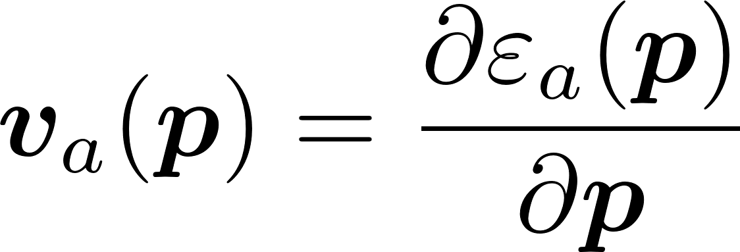
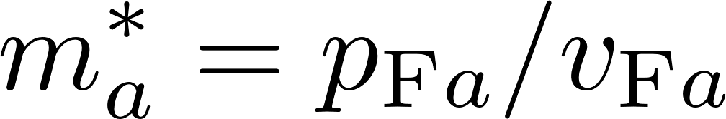
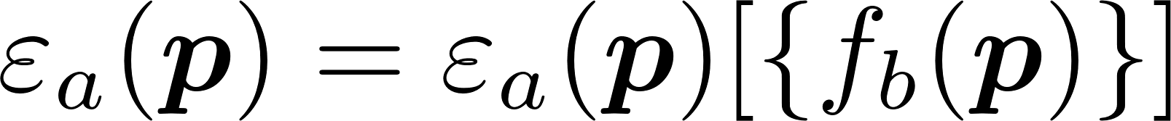
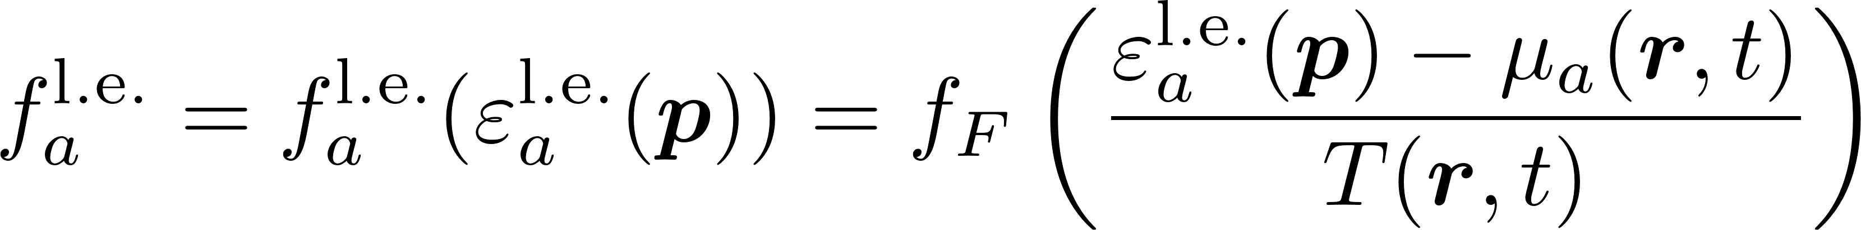
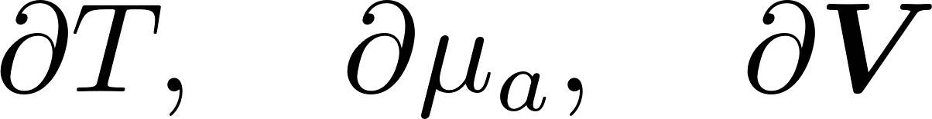
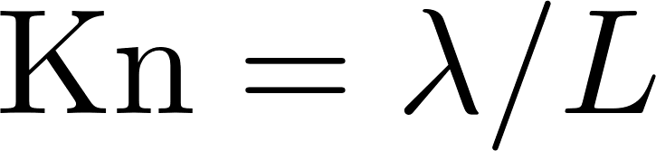
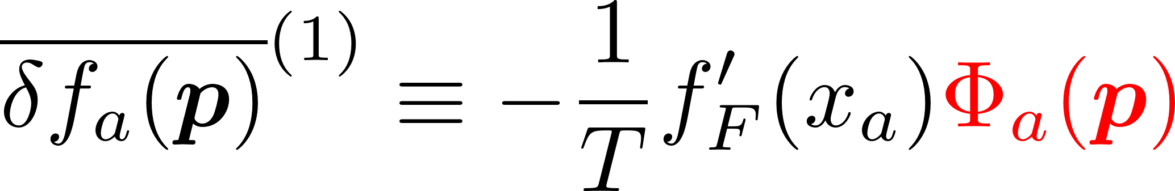
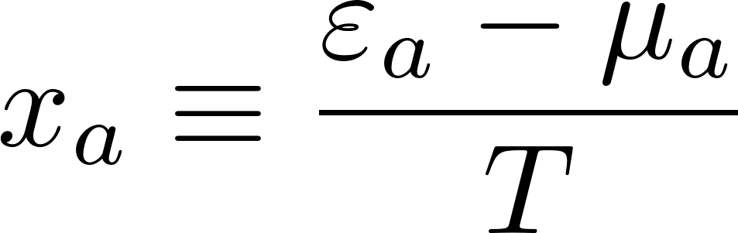
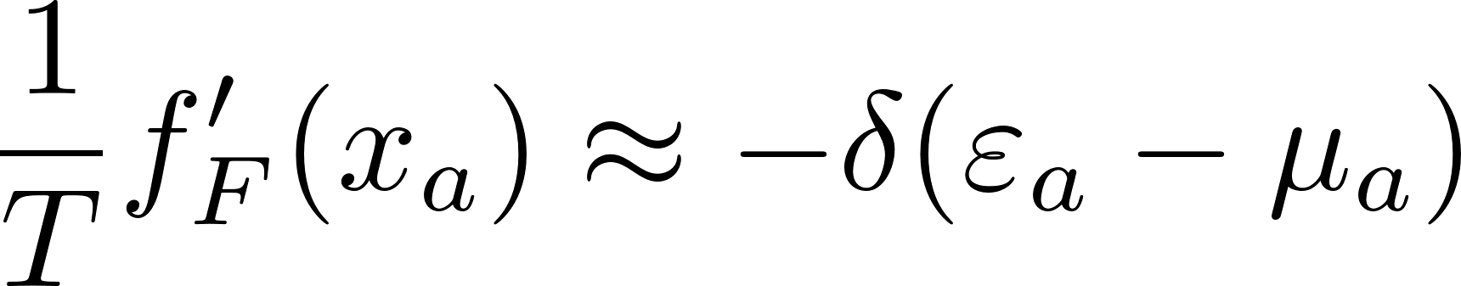

Formalism: Landau Fermi-Liquid theory
Landau Fermi-liquid theory for mixtures, $a=1…r$
Baym & Chin Nucl. Phys. A 262, 527 (1976)
In a local equilibrium (V=0)
Gradients of fields
Chapman-Enskog method

Slide 7
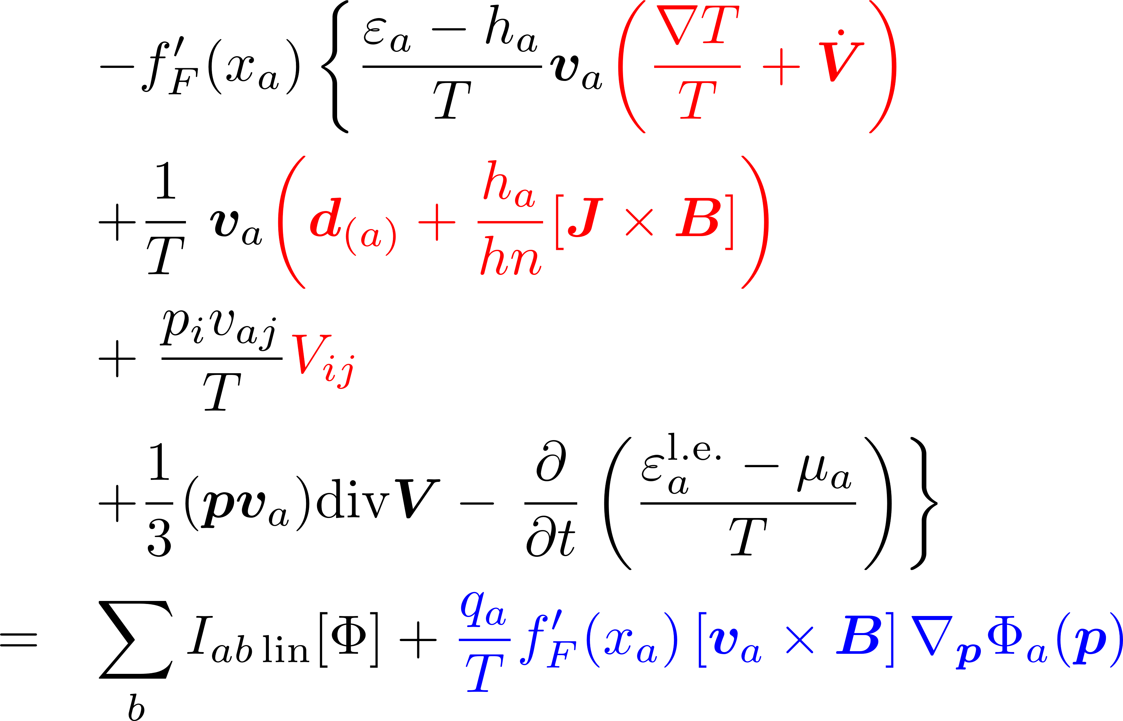
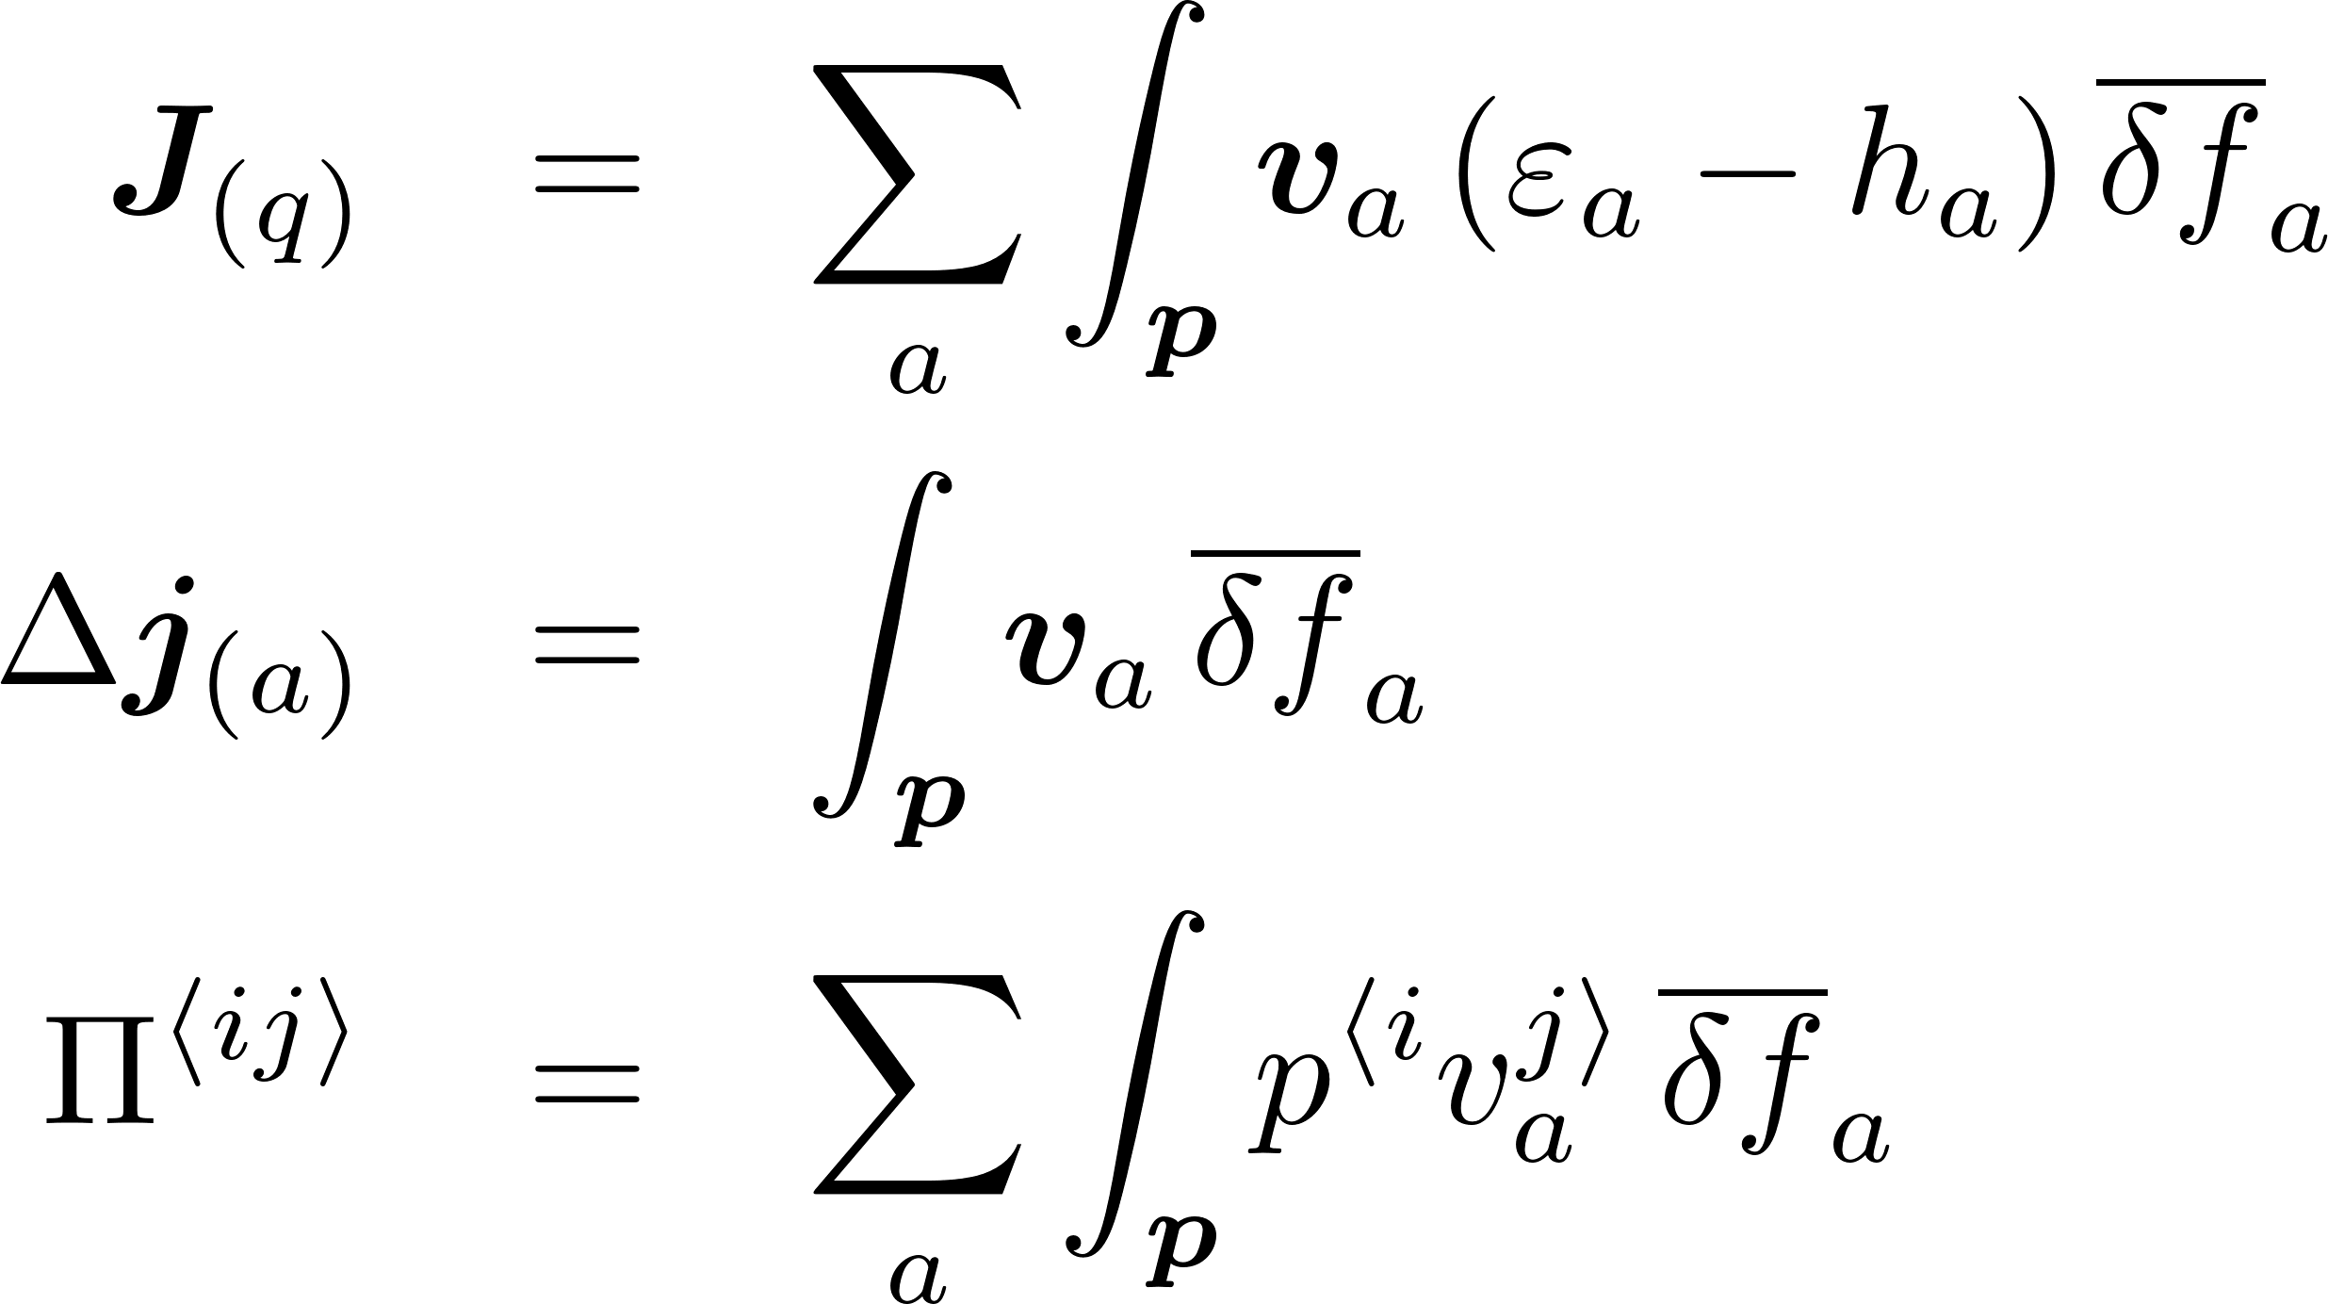
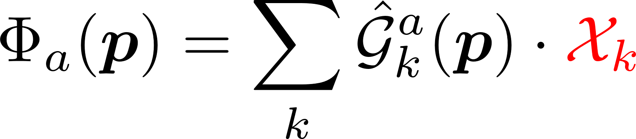
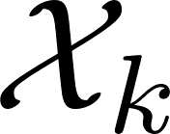
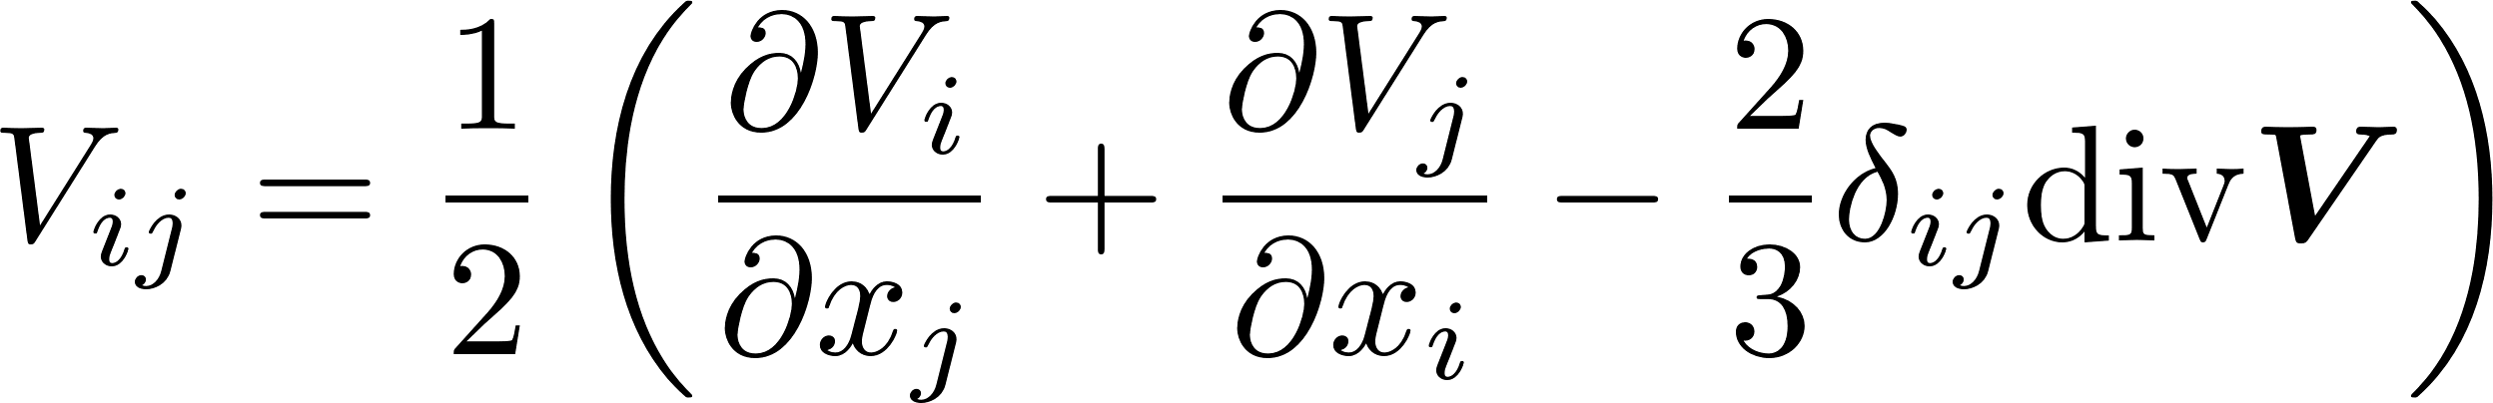
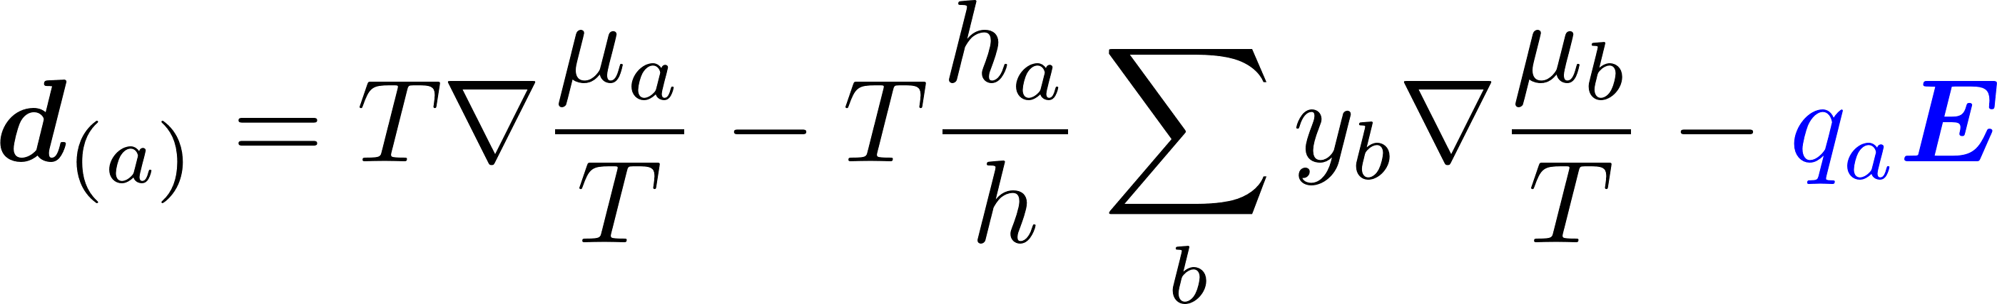
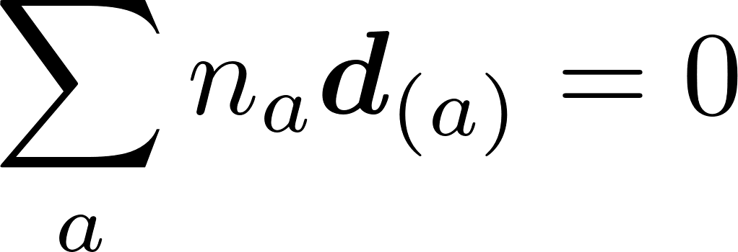
Linearized transport equation
Linearized transport equation in LRF (V=0)
Thermal conductivity
Diffusion
Shear viscosity
Bulk viscosity (not considered)
Linear equations
– thermodynamic forces
Rate-of-shear tensor
Generalized diffusion force

Slide 8
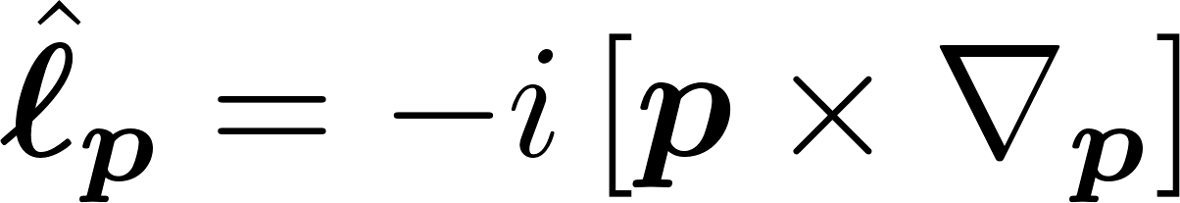
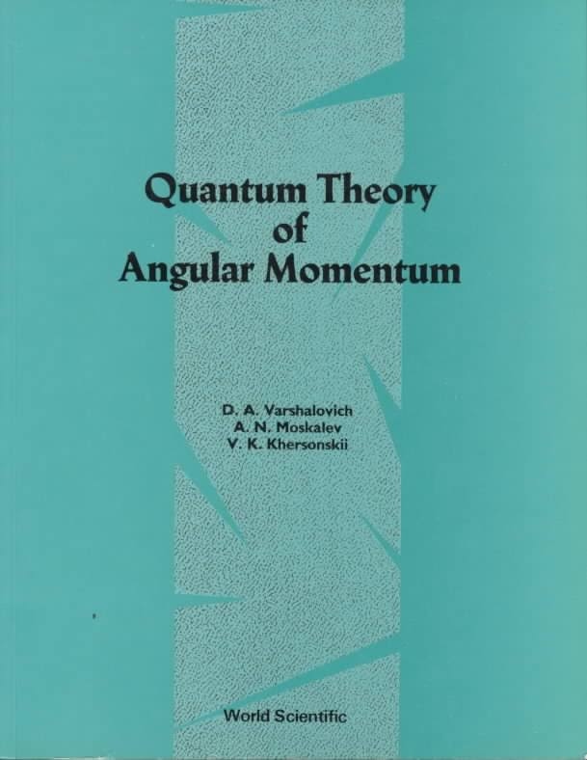
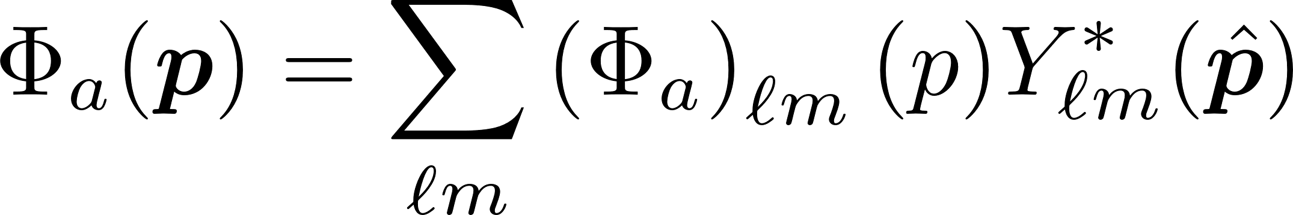
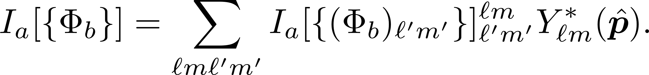
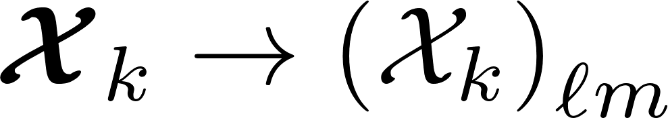
Tensor structure
Magnetic operator
Spherical harmonics expansion
Isotropic scattering
When Z is parallel to B equations diagonalize
It is convenient to use irreducible spherical tensors

Slide 9

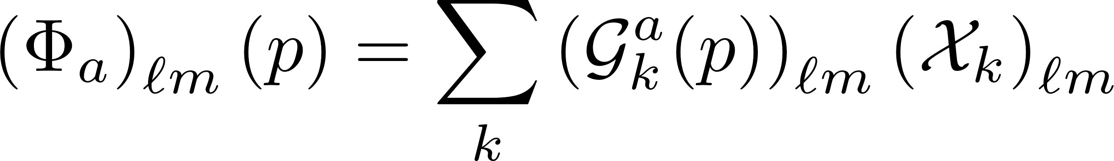
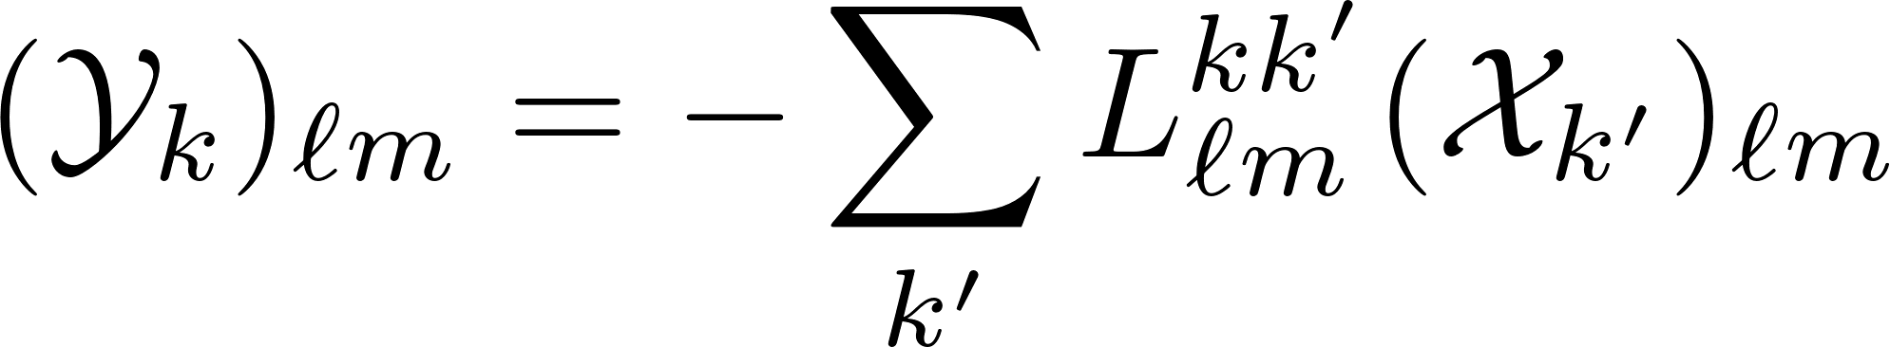
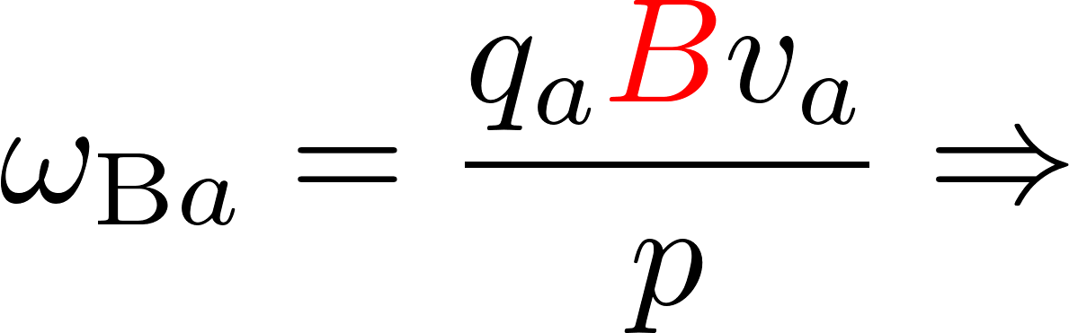
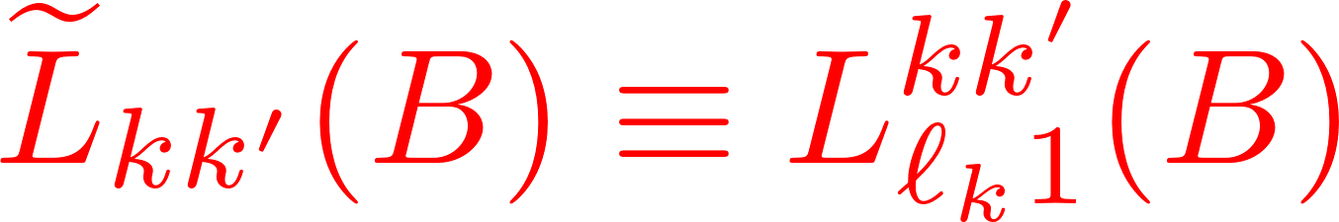
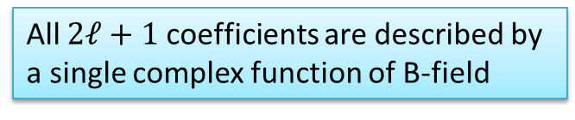
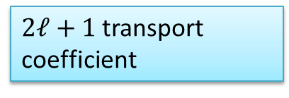
Transport equation in spherical basis
Decoupling of equations with different $ℓ$ and (in isotropic case),
$2ℓ+1$transport coefficient
“Scaling”
All $2ℓ+1$ coefficients are described by a single complex function of B-field
NB: This is a known fact, but its derivation in Cartesian formalism is much more involved
e.g., Ferziger&Kaper 1972

Slide 10
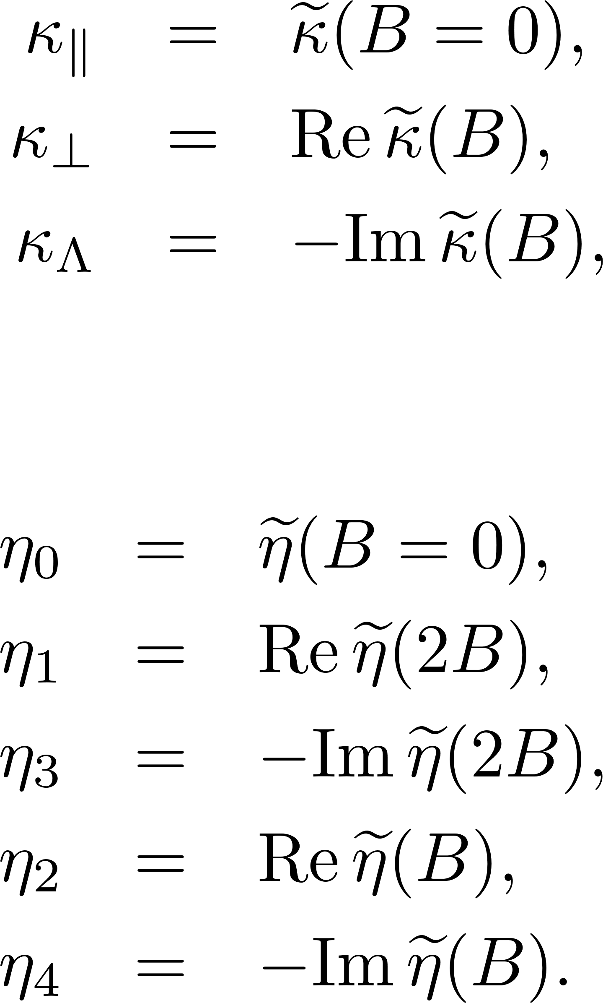
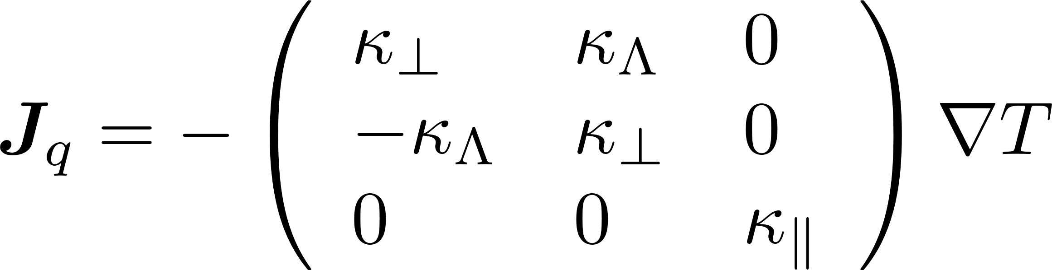
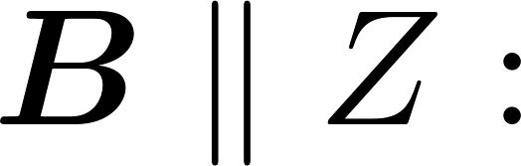
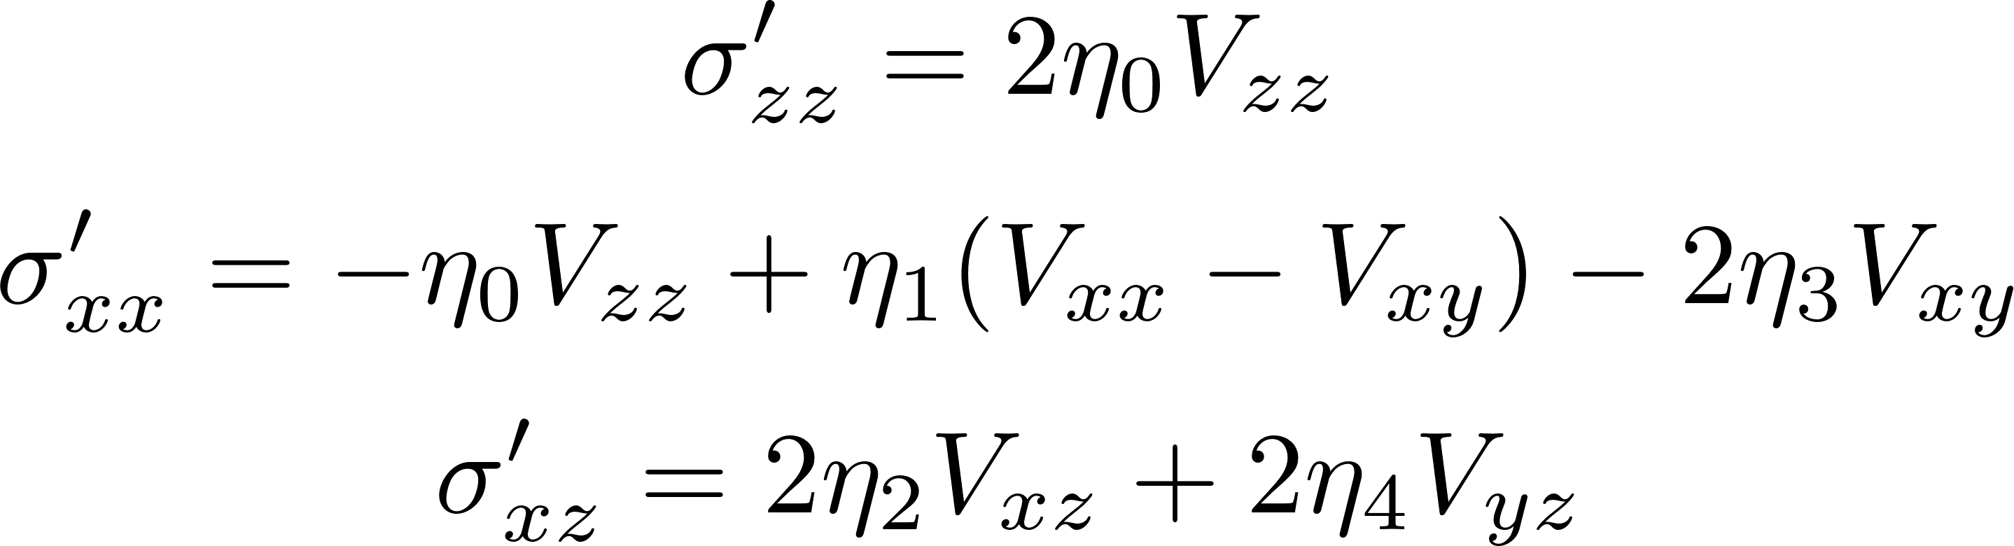
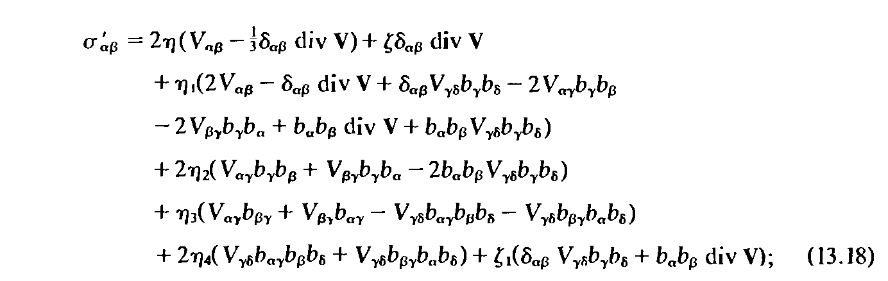
Relation to Cartesian formalism
Only one complex function of magnetic field is necessary for all components
Thermal conductivity
Shear viscosity
general frame
Lifshitz, Pitaevskii “Physical Kinetics” 1981

Slide 11
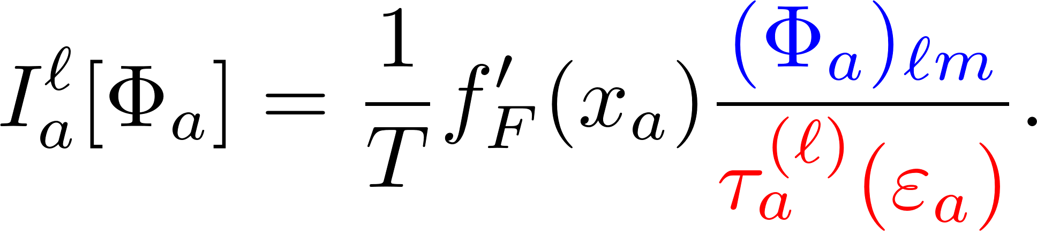
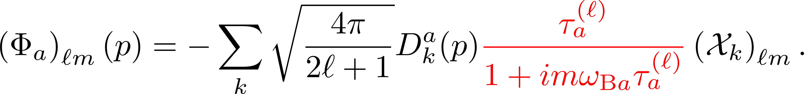
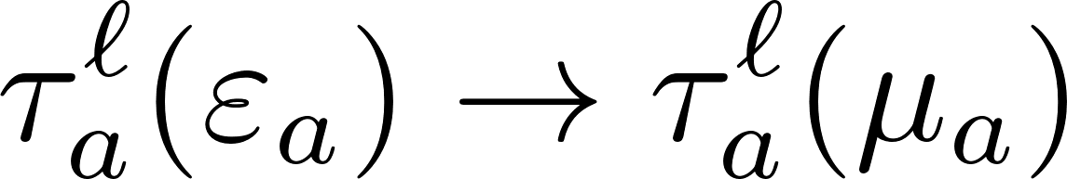
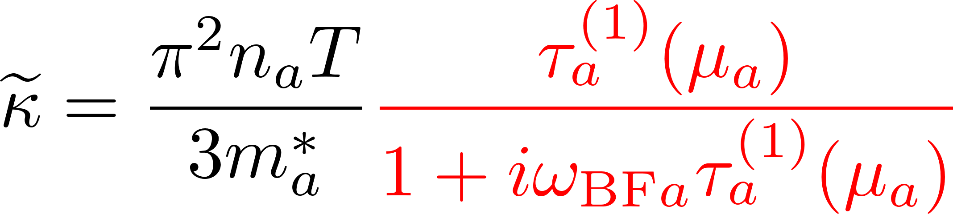
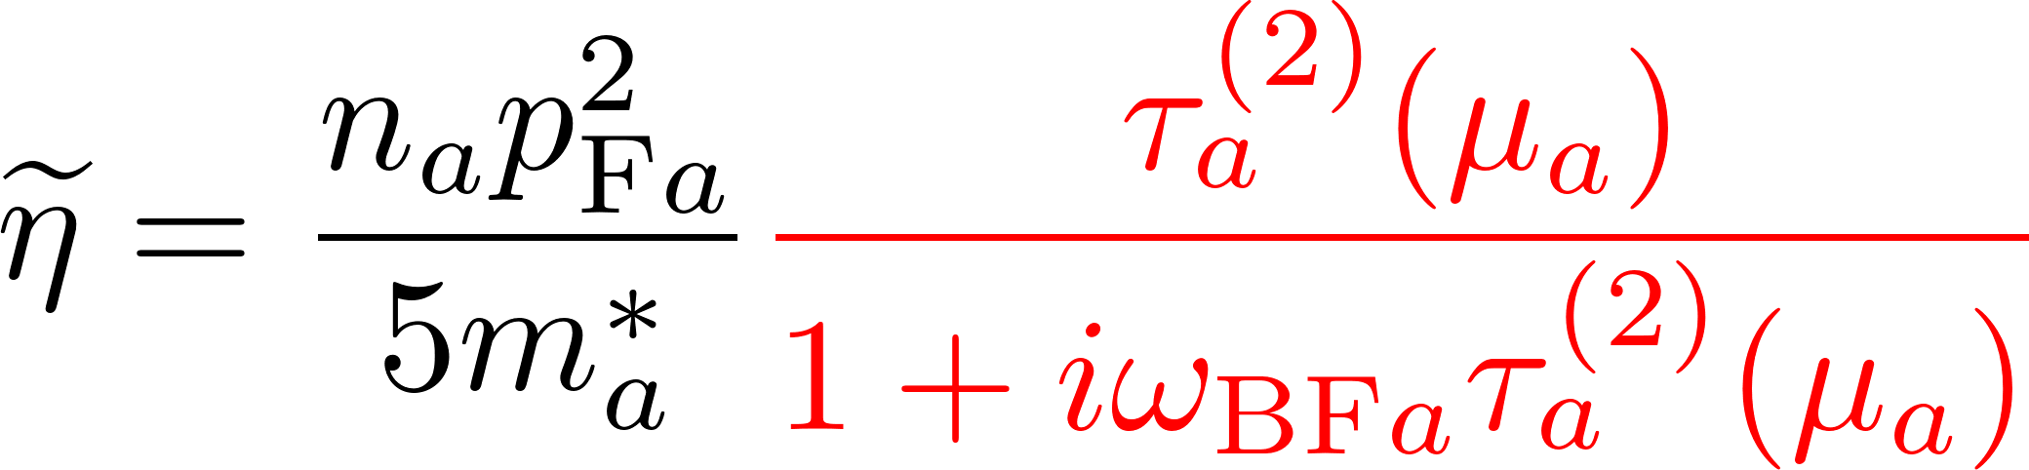
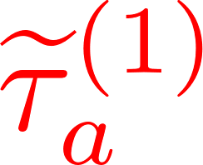
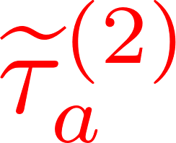


Relaxation time approximation. Single-component fluid.
Relaxation time approximation does not work in NS cores, however it gives the qualitative understanding of the behavior of transport coefficients
Collision integral in r.t.a
Solution
Degenerate matter
Thermal conductivity, $ℓ=1$
Shear viscosity, $ℓ=2$
Effective complex r.t.

Slide 12
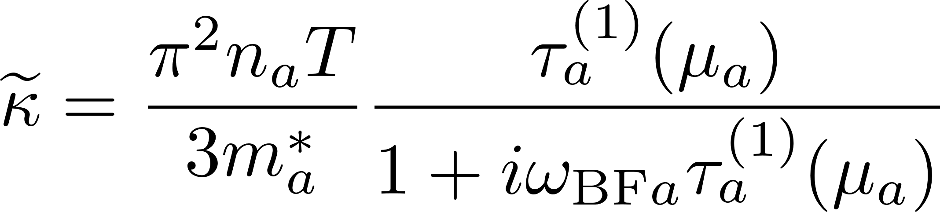
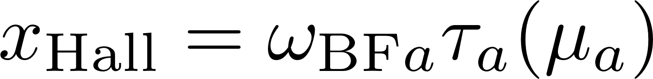
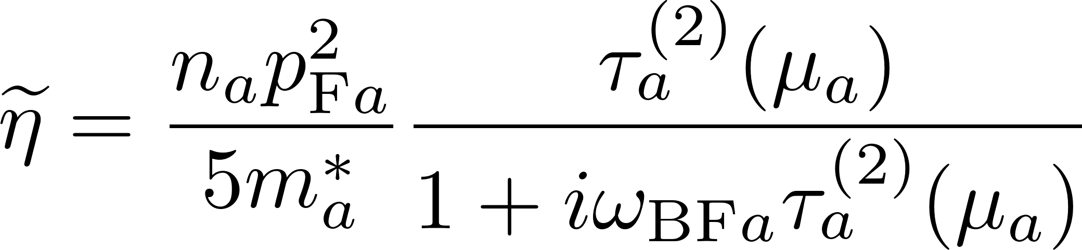
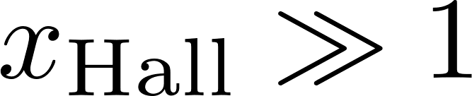
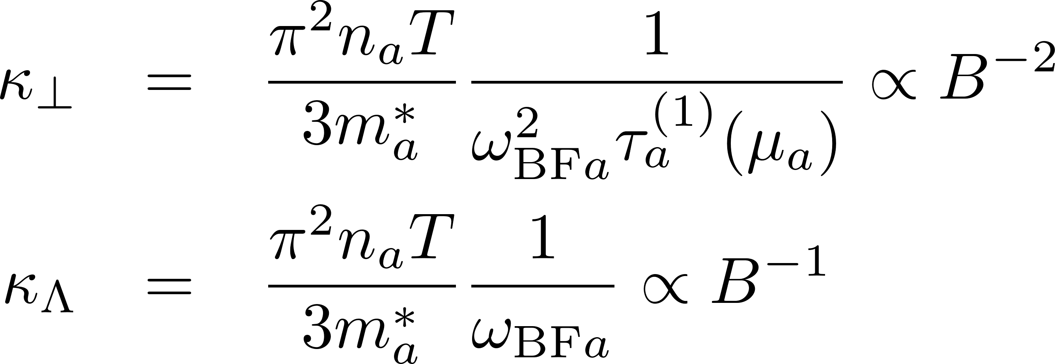

Relaxation time approximation
Hall parameter
Strong magnetization limit

Slide 13




Multicomponent nuclear matter in NS cores
For NS cores relaxation time approximation does not work. One uses the full collision integral
It turns out that the simplest variational solution of the kinetic equation with a single (complex) variational parameter – effective complex mean free path – is enough.
The system of integral transport equations reduces to a system of linear equations.
Quite similar to r.t.a.
Transport matrix
Thermal conductivity
Shear viscosity

Slide 14

Plan of the talk
1. Formalism of the transport theory of multicomponent Fermi liquids in magnetic field.
complex transport coefficients.
relaxation time approximation
2. Results for a wide range of EOSs (COMPOSE+).
Strategies for in-medium scattering treatment for transport
Poor man approximations.
3. Results.

Slide 15

EOS bank
CompOSE database http://compose.obspm.fr

Slide 16


EOS bank
20 CompOSE models
Proton fraction
+
6 BSk models (20—22; 24—26)
APR model and 4 variations (HHJ)
4 PAL models
Another 4 models
DDME2, NL3wr, SLy4, BHF (av14+uix)
=
39 models in total
Toy model
Ofengiem et al. PRD 96, 034002 (2017)

Slide 17





Transport coefficients in NS cores
“Transport equations”
Microscopic inputs: effective masses, scattering matrices
Strong interaction (np)
Strong dependence on the model (EOS)
Electromagnetic interactions (peμ)
Controlled dependence on the EOS

Slide 18
Possible strategies for nucleon sector
IDEAL (HARD): calculate EOS and transport on the basis of the same microscopic models
Not an option in this talk
CHEATING: calculate transport from some favorite microscopic model for in-medium scattering but using particle fractions (and probably m* if available) from all EOS
BHF calculations, 5 NN potentials, Interpolation of $Λ(n_{B},x_{p})$
Shternin & Baldo PRD 102, 063010 (2020)

Slide 19



Transport cross-sections
Vacuum (black and red) and in-medium (colored) transport cross-sections for 39 EOS
Only one many-body method: BHF calculations
5 NN potentials
Interpolation of $Λ(n_{B},x_{p})$
Shternin & Baldo PRD 102, 063010 (2020)
Unfortunate situation

Slide 20


Possible strategies for nucleon sector
IDEAL (HARD): calculate EOS and transport on the basis of the same microscopic models
Not an option in this talk
CHEATING: calculate transport from some favorite microscopic model for in-medium scattering but using particle fractions (and probably m* if available) from all EOS
BHF calculations, 5 NN potentials, Interpolation of $Λ(n_{B},x_{p})$
Shternin & Baldo PRD 102, 063010 (2020)
QUALITATIVE: use in-vacuum NN cross-sections
We provide fitting expressions to use for any $(n_{B},x_{p})$
Flowers & Itoh (1979); Baiko et al. (2001); Shternin & Yakovlev (2008); Shternin (2008)
POOR MAN: use in-vacuum NN cross-sections and toy model EOS
Single-parameter fitting expressions $(n_{B})$

Slide 21
Plan of the talk
1. Formalism of the transport theory of multicomponent Fermi liquids in magnetic field.
complex transport coefficients.
relaxation time approximation
2. Results for a wide range of EOSs (COMPOSE+).
Strategies for in-medium scattering treatment for transport
Poor man approximations.
3. Results.

Slide 22





Longitudinal shear viscosity and thermal conductivity
Different EOSs (but vacuum cross-sections)

Slide 23

Partial contributions to shear viscosity and thermal conductivity
Leptons dominate
Neutrons dominate

Slide 24


Results. Toy model. T-dependence
numbers show $\log_{10}{B[G]}$
when leptons become magnetized, `perpendicular’ shear viscosity switches from lepton-dominated to neutron-dominated regime
Hall components change sign when protons become magnetized

Slide 25

Results. Toy model. B-dependence

Slide 26
Conclusions
Based on the irreducible spherical tensor expansion a convenient formalism for calculating transport coefficients in the multicomponent Fermi-liquid in NS cores is described.
A large bank of EOSs is analyzed. The “poor-man approximations” are introduced which allow to calculate transport coefficients of NS core matter.
In the absence of magnetic field, thermal conductivity is mediated by neutrons, while shear viscosity is mediated by leptons.
In the magnetized matter thermal conductivity is weakly modified, however the shear viscosity is affected strongly even in the moderate magnetic field.
In ideal world, NS EOS databases should also contain information allowing for the transport properties calculations.

Slide 27
EXTRA SLIDES

Slide 28





Results. B-dependence

Slide 29





Results. Hall coponents
leptonsc
neutrons
protons

Slide 30





Diffusion. Simplest approximation.
Simplest approximate solution
Diffusion velocity
Multiplying by $p_{1}$ and integrating
One gets generalized Ohm law
Momentum transfer rates
The thermal diffusion is negligible for degenerate matter

Slide 31
Example: Momentum transfer rates

Slide 32









Transport matrix
Explicit expressions
General structure

Slide 33



Strong interactions
1) OPE
2) in-vacuum cross-sections
Flowers & Itoh (1979); Baiko et al. (2001); Shternin & Yakovlev (2008); Shternin (2008)
3) in-medium interaction within the Brueckner-Hartree-Fock approach
Shternin & Baldo PRD 102, 063010 (2020)

Slide 34






Strong interactions
in-vacuum cross-sections
Baiko, Haensel, Yakovlev (2001)
Effective transport cross-sections [mb]

Slide 35



Effective transport cross-sections
Transport matrix
Effective transport cross-sections [mb]

Slide 36




Results. Transport matrix for strong interactions
Protons weakly affect neutrons
Results are similar to r.t.a.

Slide 37










Electromagnetic interactions
Charged particles: Coulomb + Ampere (relativistic contribution ${{|J}_{t}|}/{J^{\left(0\right)}}∝v/c$)
Different screening behaviour
Small screening momenta ($q_{scr}∼ω^{1/3}∼T^{1/3}$)
Transverse channel dominates ($Λ_{t}≫Λ_{l}$)
Heiselberg et al. 1992
Heiselberg & Pethick 1993
Shternin & Yakovlev 2007, 2008

Slide 38


Transport matrix for em interaction
Non-diagonal matrix elements can be neglected

Slide 39





Tensor structure
Arbitrary orientation of the LRF
Different (more symmetric) set of $2ℓ+1$ transport coefficient

