Slide 1
The density of states method in Yang-Mills theories and first-order phase transitions
David Mason
Collaborators:
B. Lucini, M. Piai,
E. Rinaldi, D. Vadacchino

Slide 2
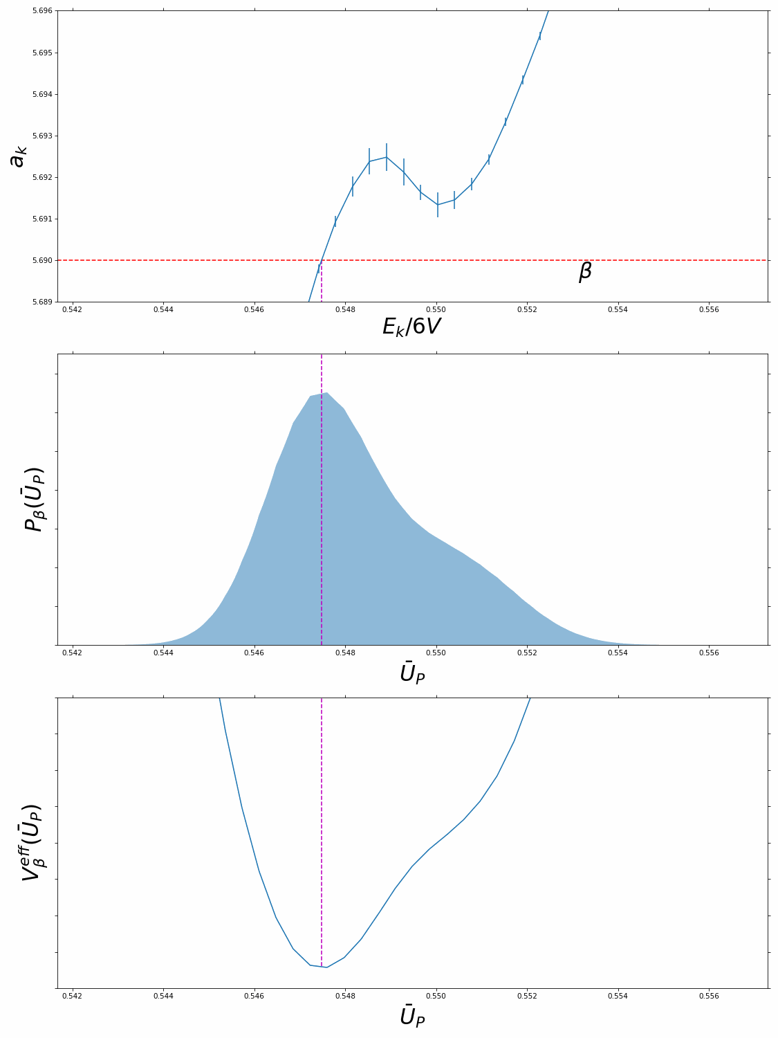
Overview
Why first order phase transitions?
The deconfinement transition
Metastability problems in lattice simulations
The linear logarithmic relaxation method (LLR).

Slide 3
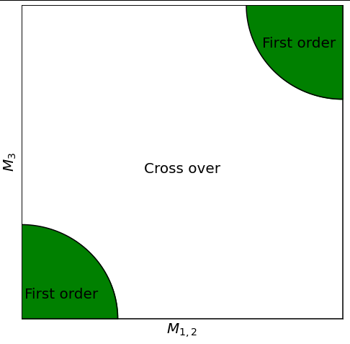
The Model
Prototype problem: SU(3) pure gauge theory
Lattice simulations suggest Quantum Chromodynamics this is a cross-over^{[1]}
All graphs shown will be for SU(3) pure gauge theory on a lattice of size 4x20x20x20.
Columbia plot of QCD. M_{i} correspond to the mass of the quarks.
[1]: Aoki, Yasumichi, et al. "The order of the quantum chromodynamics transition predicted by the standard model of particle physics." Nature 443.7112 (2006): 675-678.

Slide 4
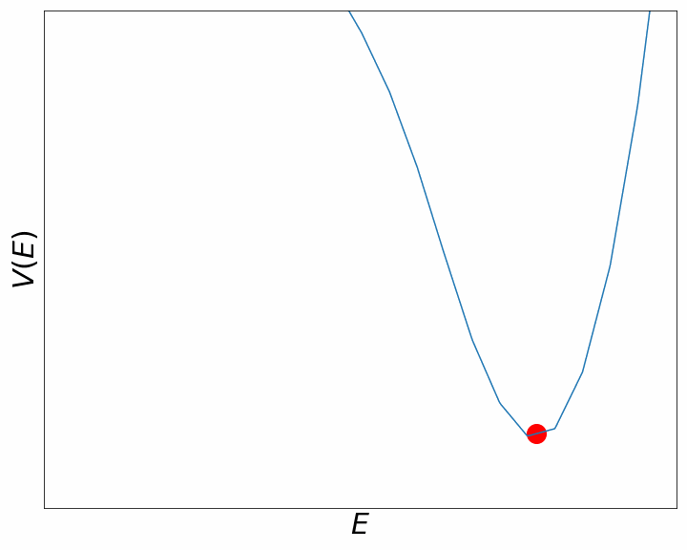
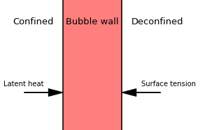
Why first order?
First order transitions have coexisting phases leading to bubble nucleation
Bubble nucleation in early universe can give rise to gravitational waves from:
Compression waves
Bubble collisions
Expected gravitational wave signatures can be modelled with the surface tension and latent heat of the transition^{[1]}.
[1]: Huang, Wei-Chih, et al. "Testing the dark SU (N) Yang-Mills theory confined landscape: From the lattice to gravitational waves." Physical Review D 104.3 (2021): 035005.

Slide 5
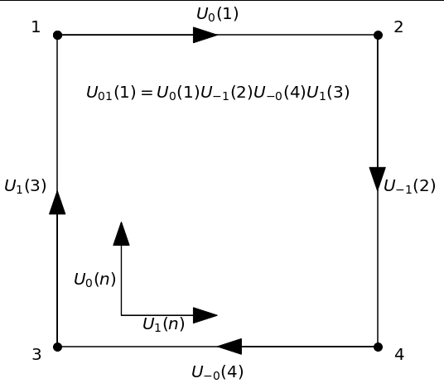
Lattice set-up
Discretise spacetime onto an isotropic hypercubic lattice with periodic boundary conditions of size:
with lattice spacing a
Replace gauge field with link variables U_{𝝻}
Temperature T= 1/aN_{t} set by changing 𝛽(a) for N_{t}<N_{s}
Diagram of Plaquette .

Slide 6
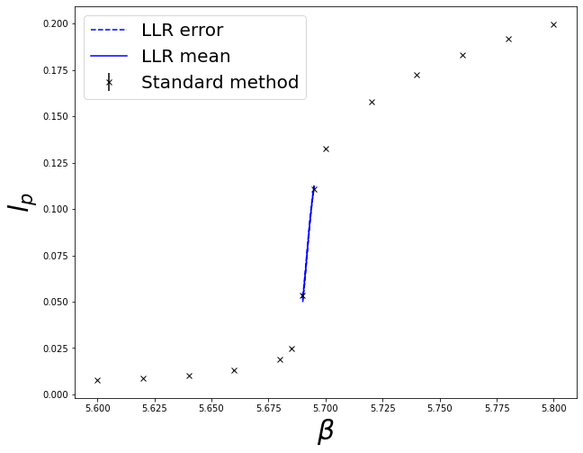
Deconfinement
F - free energy required to create an additional free colour source
l_{p} is the order parameter associated with the breaking of the centre symmetry in the transition

Slide 7
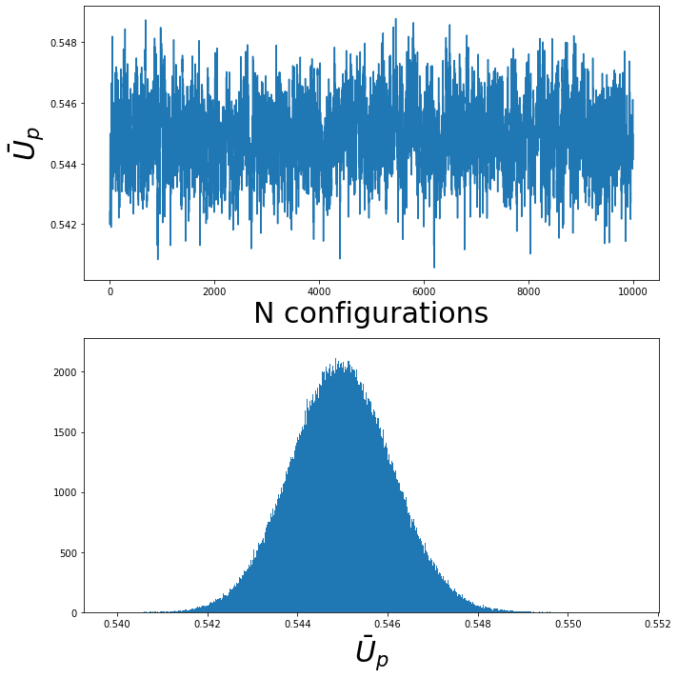
Simulating on the lattice
Update links with a probability distribution ∝exp(-ΔS), ΔS is the change in the action
Once full lattice is updated we have generated a new configuration {U_{μ}}_{i} with the required distribution.
Calculate expectation values by averaging over observables measured on configurations.

Slide 8
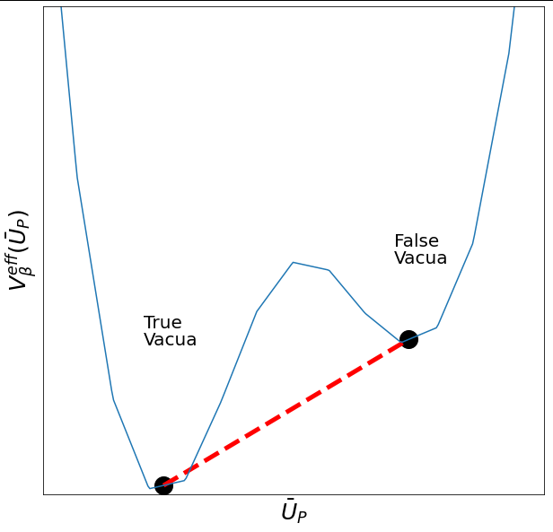
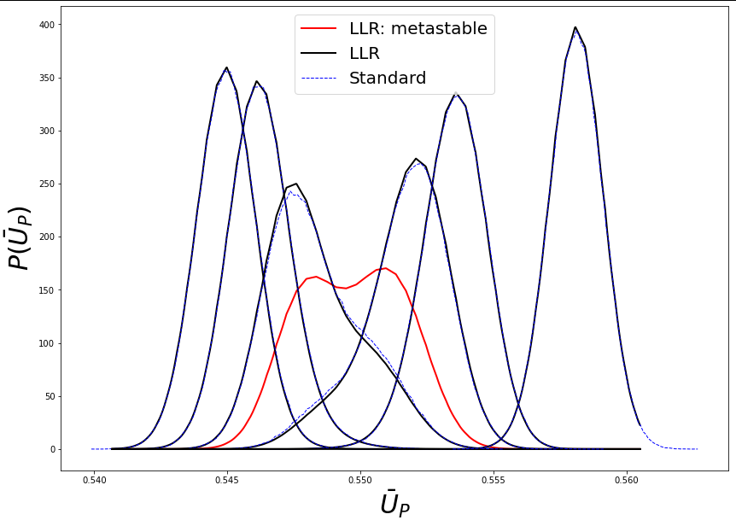
Simulating first order phase transitions
Around critical point there exists multiple coexisting phases separated by potential barriers
To get accurate expectation values we require the system to tunnel into all of the phases multiple times.
In the large volume limit the potential barriers increase, increasing the tunnelling times

Slide 9
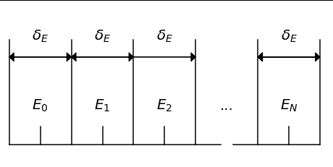
The Linear Logarithmic Relaxation method
Analyse micro-canonical information of the system through the density of states ρ(E) and reconstruct observables
^{[1]}
Use the total plaquette as the energy
Estimate ρ(E) by breaking system down into
intervals of finite size δ_{E}
Diagram showing energy intervals for range E₀-δ_{E}/2 to E_{N}+δ_{E}/2, with interval size δ_{E}
[1]: Langfeld, Kurt, et al. "An efficient algorithm for numerical computations of continuous densities of states." The European Physical Journal C 76.6 (2016): 1-18.

Slide 10
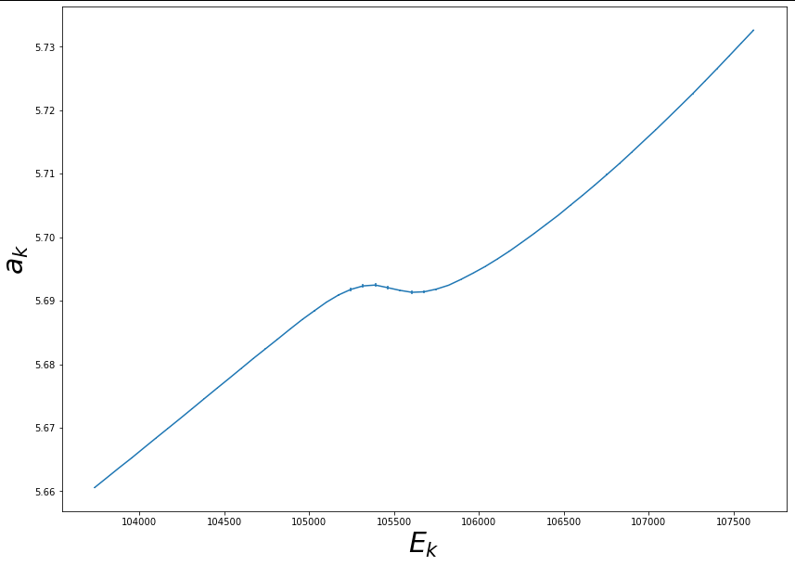
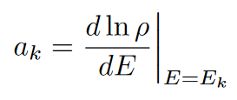
Estimating the density of states
^{[1]}
To build up ρ(E):
Iteratively Taylor expand ln(ρ(E)) in δ_{E} around the centre of each interval.
Select energy range we are interested in from E₀ - δ_{E}/2 to E_{N} + δ_{E}/2 and calculate Taylor coefficients for each interval
[1]: Langfeld, Kurt, et al. "An efficient algorithm for numerical computations of continuous densities of states." The European Physical Journal C 76.6 (2016): 1-18.

Slide 11
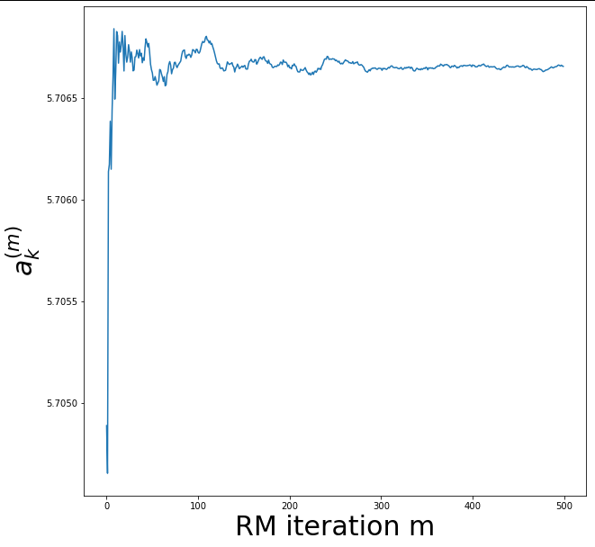
Estimating the density of states
^{[1]}
Use Robbins-Monro iterations to find ‘micro-canonical temperature’ a_{k}
《...》is expectation value with configurations restricted to the interval: E_{k} - δ_{E}/2 ≤ E < E_{k} + δ_{E}/2
Stochastic error on a_{k}^{(m)} found by repeating process
[1]: Langfeld, Kurt, et al. "An efficient algorithm for numerical computations of continuous densities of states." The European Physical Journal C 76.6 (2016): 1-18.

Slide 12
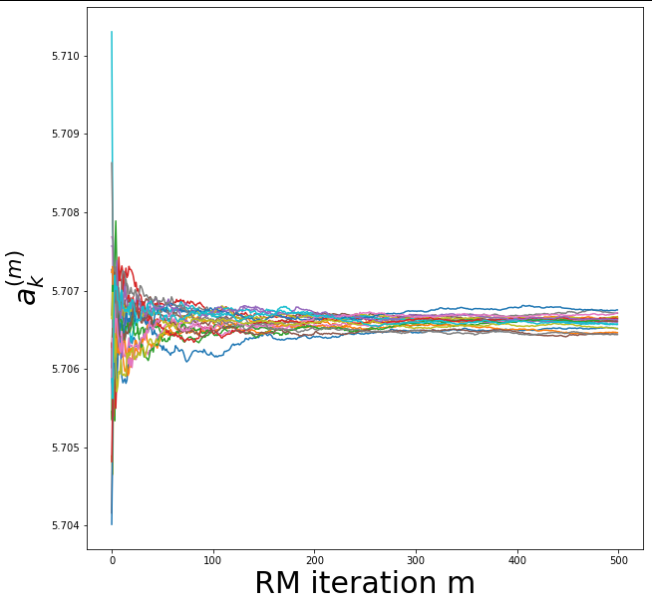
Estimating the density of states
^{[1]}
Use Robbins-Monro iterations to find ‘micro-canonical temperature’ a_{k}
《...》is expectation value with configurations restricted to the interval: E_{k} - δ_{E}/2 ≤ E < E_{k} + δ_{E}/2
Stochastic error on a_{k}^{(m)} found by repeating process
[1]: Langfeld, Kurt, et al. "An efficient algorithm for numerical computations of continuous densities of states." The European Physical Journal C 76.6 (2016): 1-18.

Slide 13
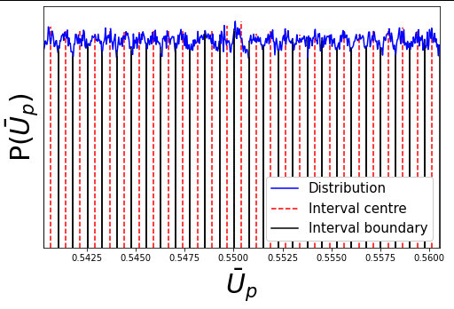
Estimating the density of states
^{[1]}
Use Robbins-Monro iterations to find ‘micro-canonical temperature’ a_{k}
《...》is expectation value with configurations restricted to the interval: E_{k} - δ_{E}/2 ≤ E < E_{k} + δ_{E}/2
Stochastic error on a_{k}^{(m)} found by repeating process
[1]: Langfeld, Kurt, et al. "An efficient algorithm for numerical computations of continuous densities of states." The European Physical Journal C 76.6 (2016): 1-18.

Slide 14
Probability distribution
^{[1]}
[1]: Langfeld, Kurt, et al. "An efficient algorithm for numerical computations of continuous densities of states." The European Physical Journal C 76.6 (2016): 1-18.

Slide 15
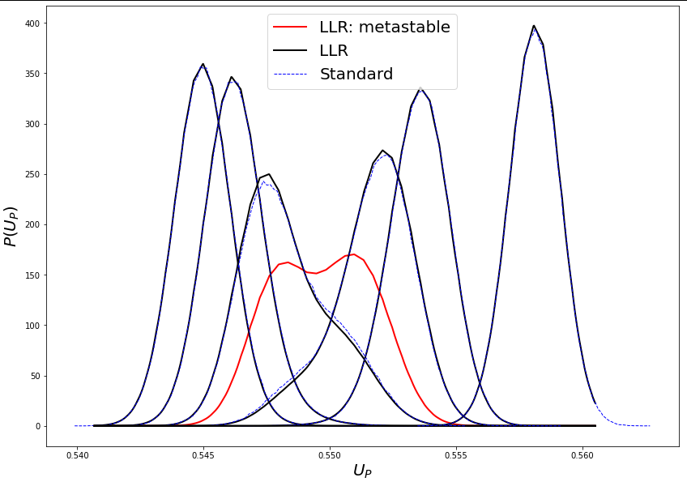
Probability distribution
^{[1]}
[1]: Langfeld, Kurt, et al. "An efficient algorithm for numerical computations of continuous densities of states." The European Physical Journal C 76.6 (2016): 1-18.

Slide 16
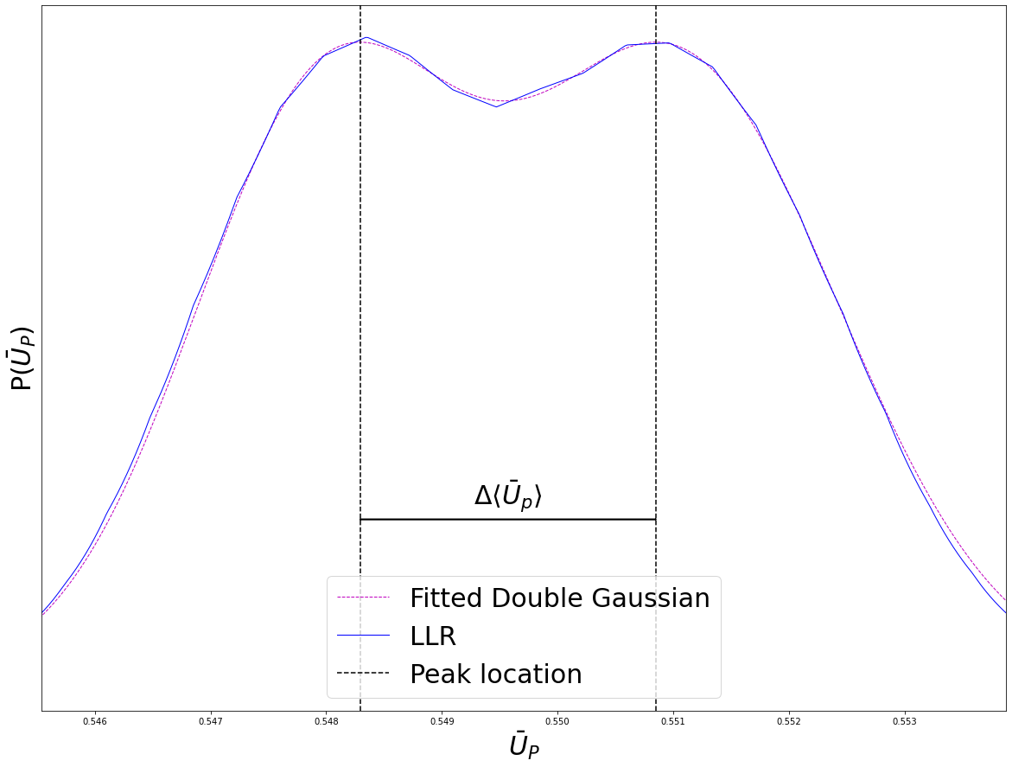
Latent heat
^{[1]}
We are focusing on measurement of the average plaquette jump
σ - string tension used for setting scale
a - lattice spacing
[1]: Lucini, Biagio, Michael Teper, and Urs Wenger. "Properties of the deconfining phase transition in SU (N) gauge theories." Journal of High Energy Physics 2005.02 (2005): 033.

Slide 17
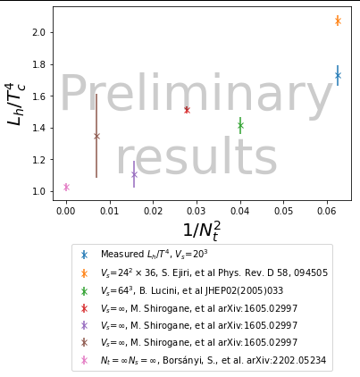
Latent heat
^{[1]}
We are focusing on measurement of the average plaquette jump
σ - string tension used for setting scale
a - lattice spacing
Some systematic errors relating to beta functions not considered in N_{t}=4 in current plot.
[1]: Lucini, Biagio, Michael Teper, and Urs Wenger. "Properties of the deconfining phase transition in SU (N) gauge theories." Journal of High Energy Physics 2005.02 (2005): 033.

Slide 18
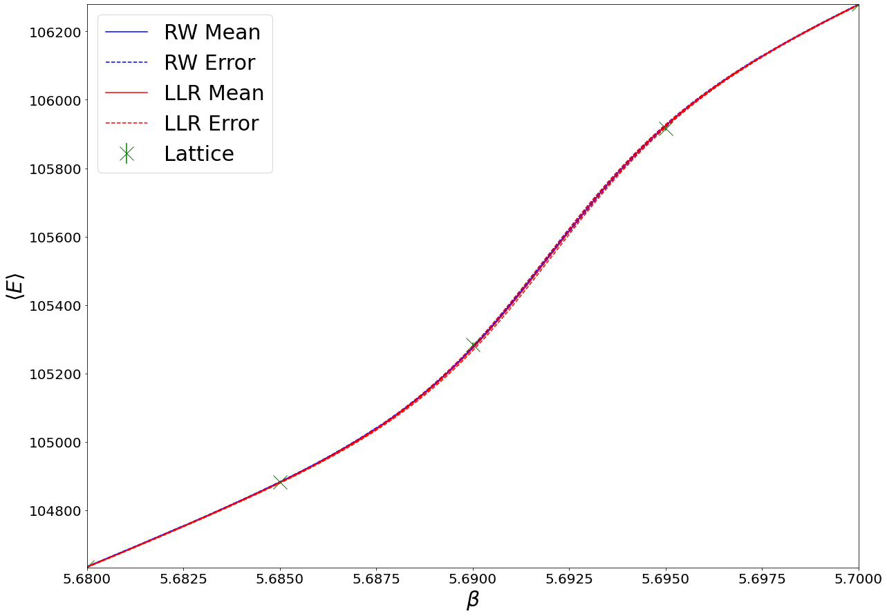
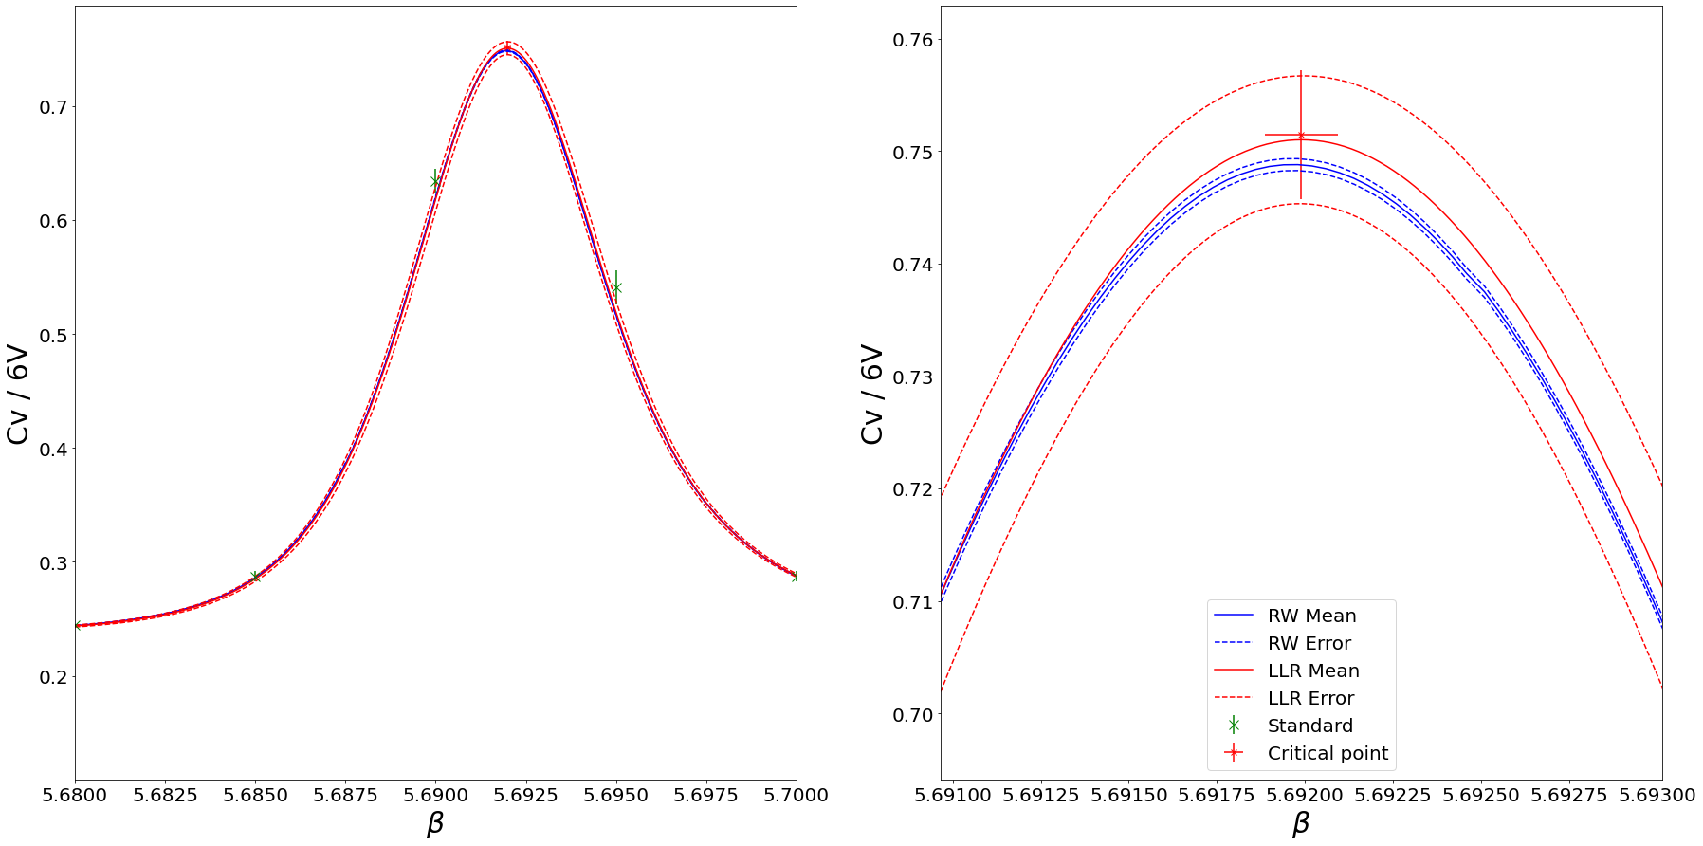
Observables

Slide 19
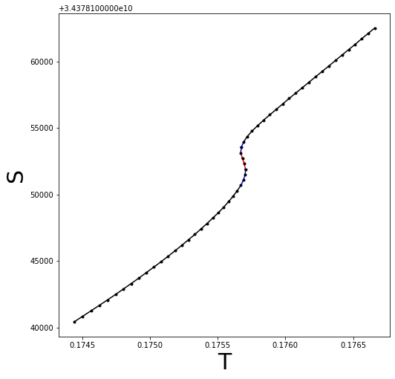
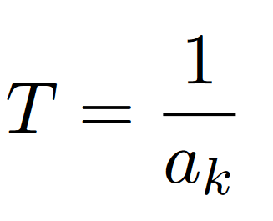
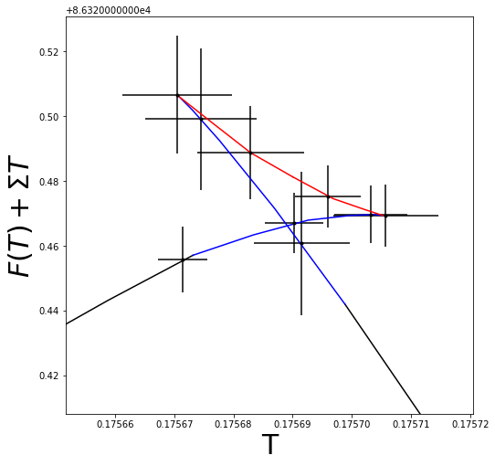
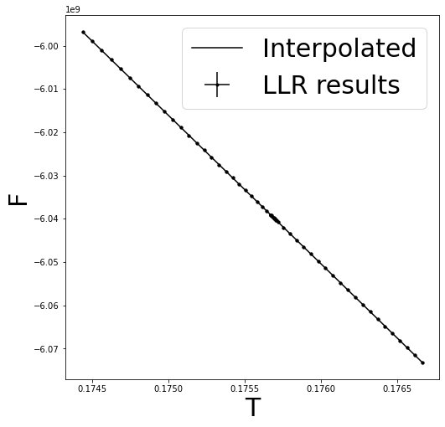
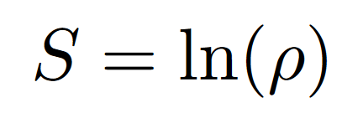
Thermodynamics

Slide 20
Conclusion
First order deconfinement transitions in the early universe may lead to gravitational waves with signatures dependent on the thermodynamic properties of the transition.
Standard lattice methods have a strong metastability problems around first order transition particularly with large volumes.
The LLR method allows the reconstruction of thermodynamic observables without these metastability problems.
Presented a first step of a program that aims to use the LLR method to compute more accurately and efficiently thermodynamic quantities in non-Abelian gauge theories.

Slide 21
Conclusion
First order deconfinement transitions in the early universe may lead to gravitational waves with signatures dependent on the thermodynamic properties of the transition.
Standard lattice methods have a strong metastability problems around first order transition particularly with large volumes.
The LLR method allows the reconstruction of thermodynamic observables without these metastability problems.
Presented a first step of a program that aims to use the LLR method to compute more accurately and efficiently thermodynamic quantities in non-Abelian gauge theories.
Thanks for listening.

Slide 22
General Observables
For more general observables, we require have to measure observables on the restricted lattice for fixed a and use:

Slide 23
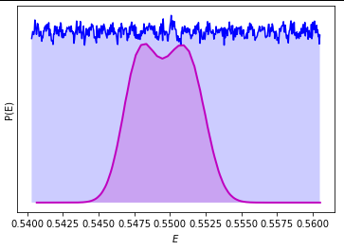
Meta-stability
Now analysing configurations with approximately flat distribution therefore configurations in both states.
Blue line: density of configurations analysed using LLR.
Magenta line: density of configurations that would be analysed from standard methods.

Slide 24
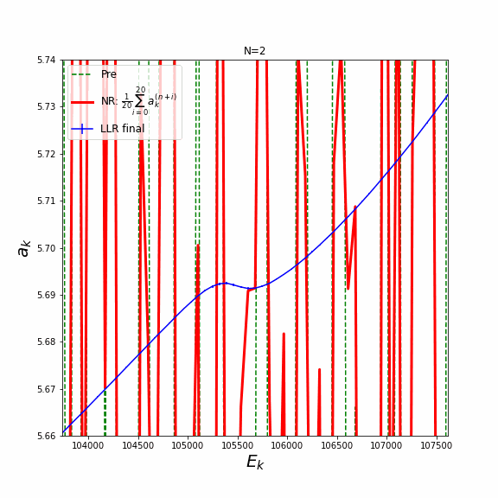
Convergence to single value
Newton-Raphson iterations (RM without 1/n suppression) have faster convergence.
Using randomised initial a_{k} values, it appears to converge to same value.

Slide 25
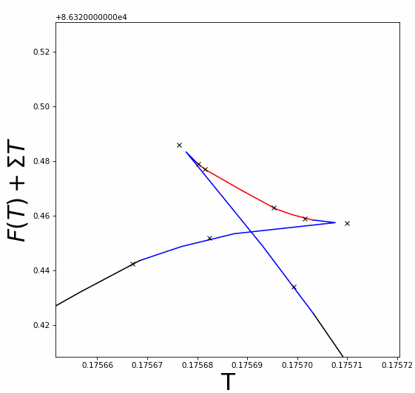
Thermodynamics

Slide 26
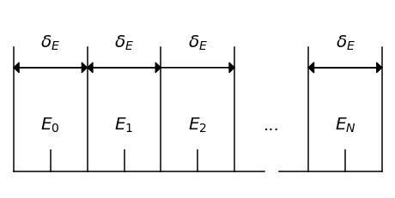
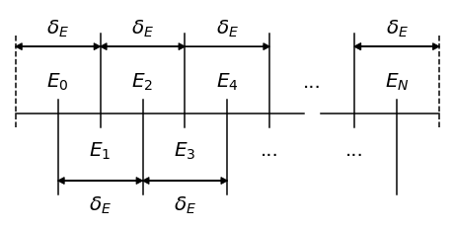
Ergodicity
Need to ensure the system can explore all possible configurations within a given energy interval.
This may require allowing lattice to move to energy outside interval before returning.
Give intervals an overlap and allow them to exchange configurations if they are in the overlap region.

Slide 27
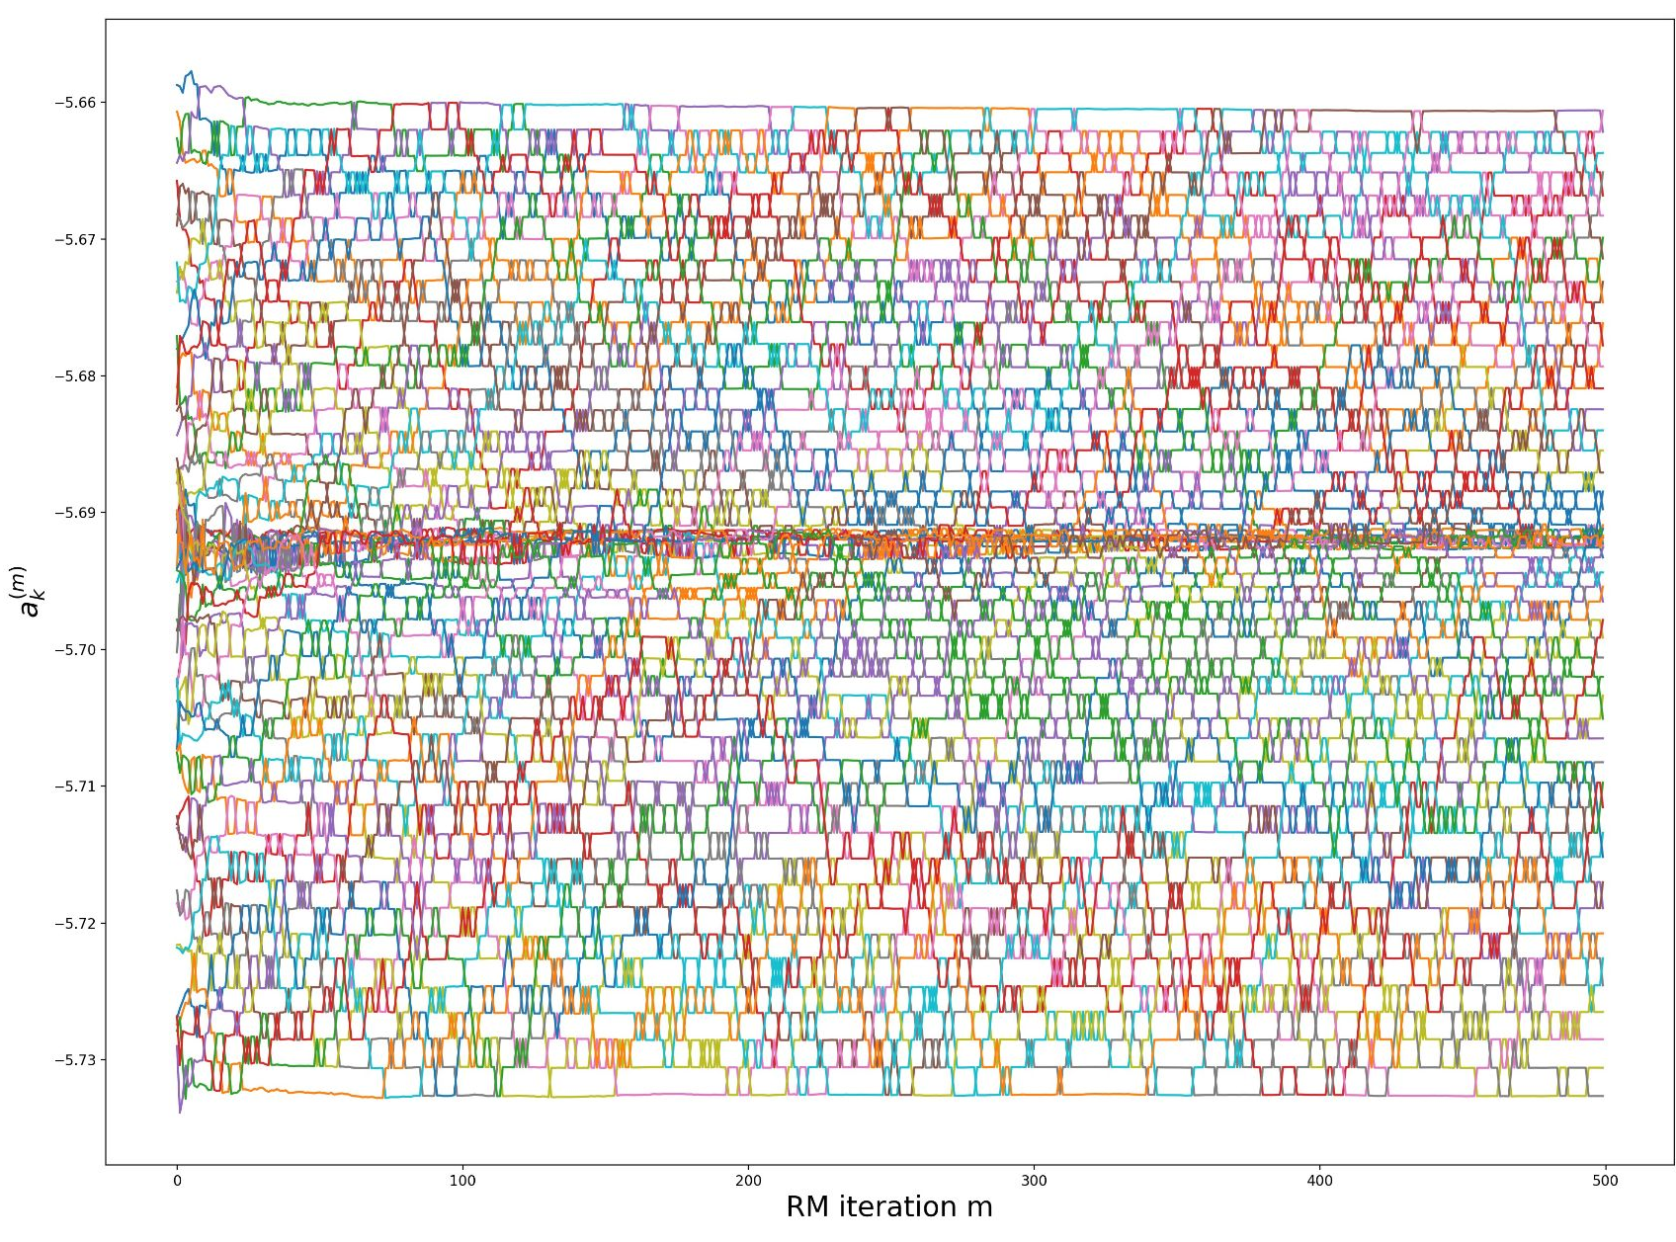
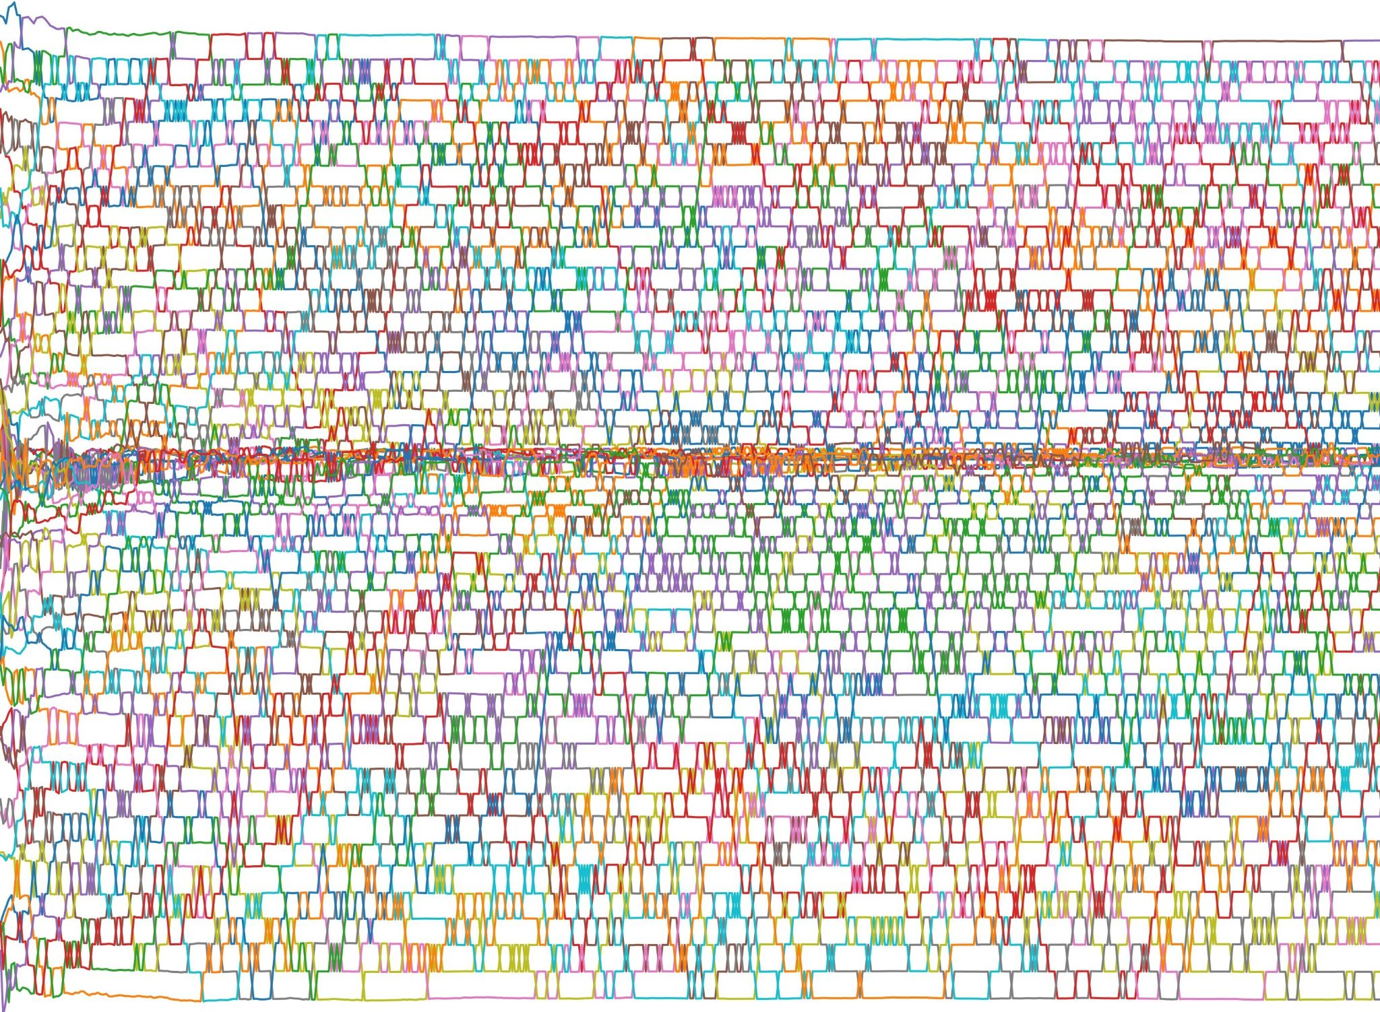
Ergodicity
Give intervals an overlap and allow them to exchange configurations if they are in the overlap region.
Plot of umbrella swapping of configurations between micro-states. The colour represents the evolution of a given lattice

Slide 28
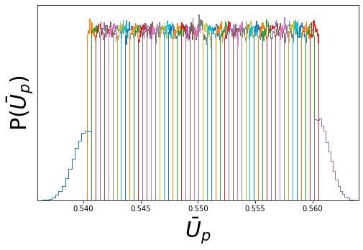
Ergodicity
At boundary intervals allow the energy lattice to move arbitrarily far away from energy range.

