Slide 1

Phi meson properties in nuclear matter from dilepton spectra in a transport approach
Philipp Gubler
Japan Atomic Energy Agency (JAEA)
Talk at the 15th Quark Confinement and
the Hadron Spectrum Conference
Stavanger, Norway
August 5, 2022
Based on work done in collaboration with
Elena Bratkovskaya (Frankfurt/GSI),

Slide 2
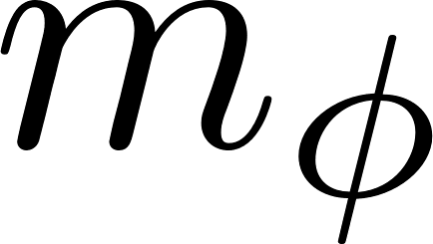
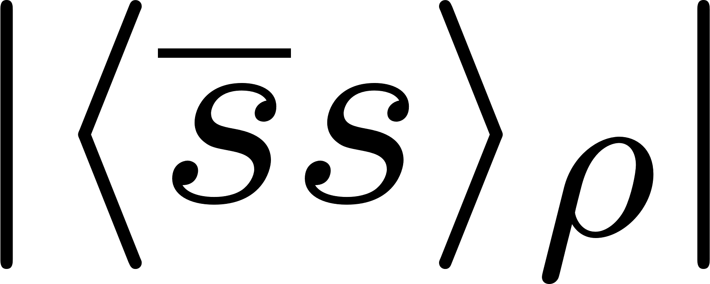
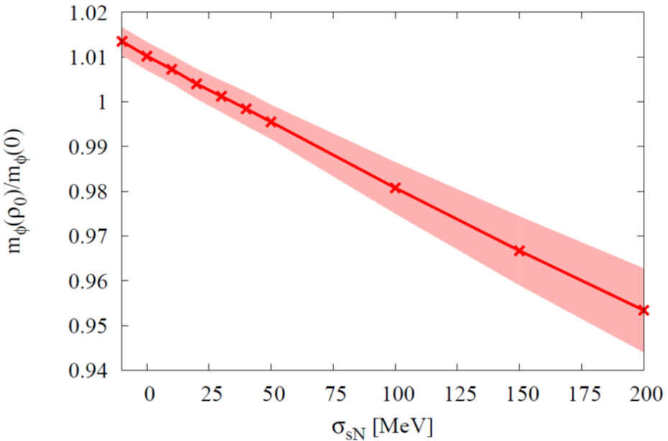


Why should we be interested?
The ϕ meson mass in nuclear matter probes the strange quark condensate at finite density!
?
P. Gubler and K. Ohtani, Phys. Rev. D 90, 094002 (2014).
ϕ meson mass at normal nuclear matter density from QCD sum rules
φ

Slide 3
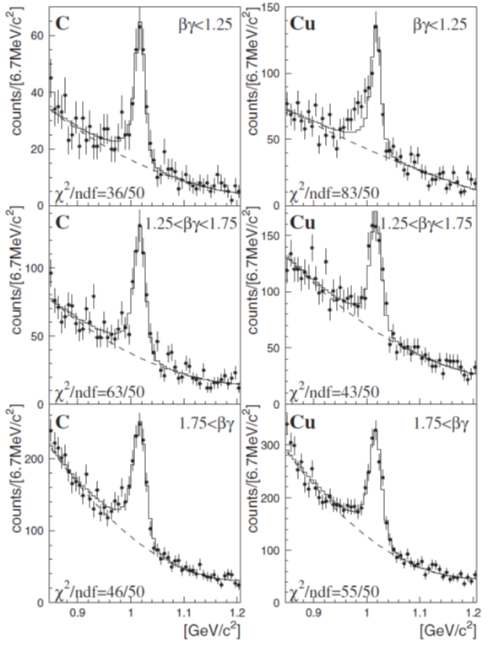
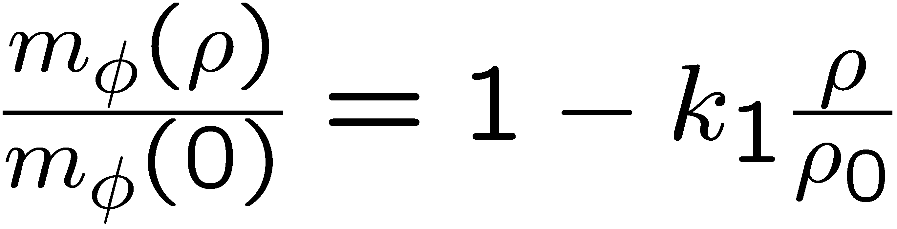
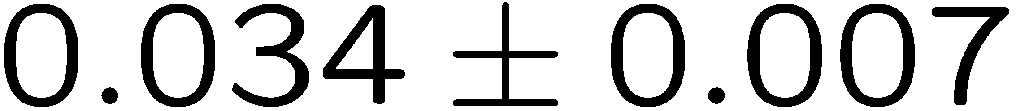
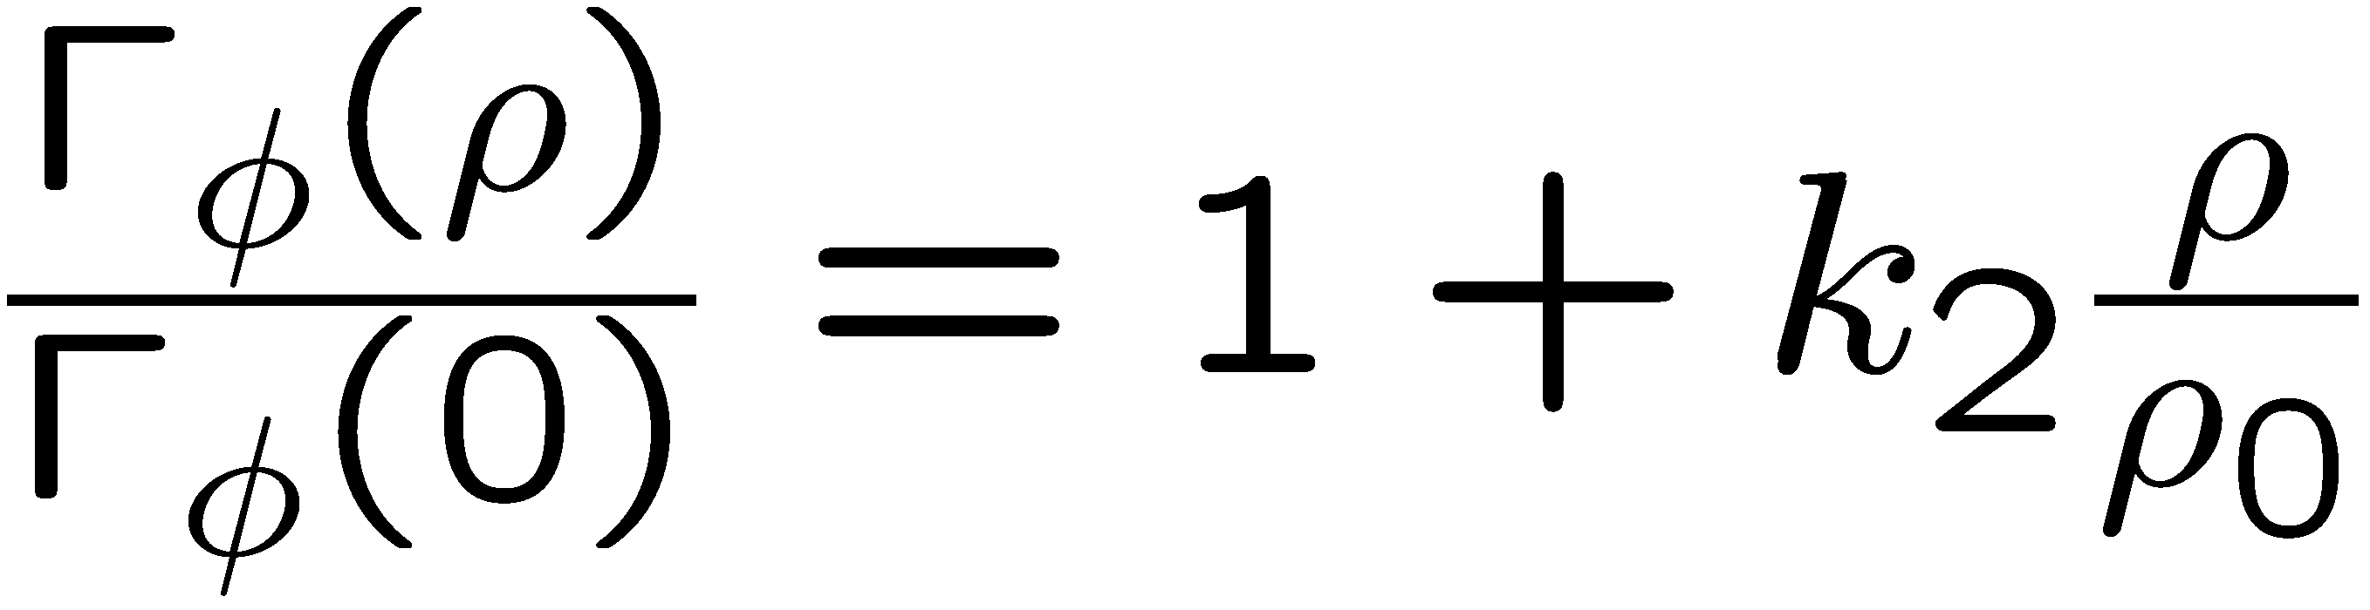
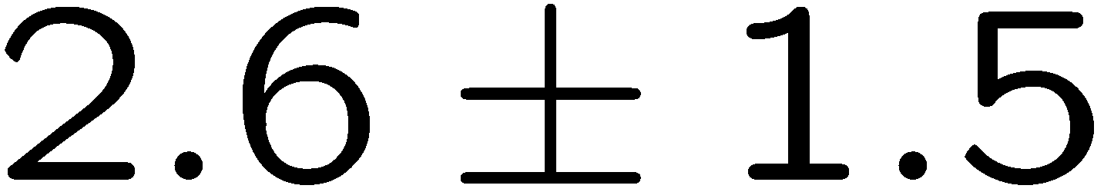
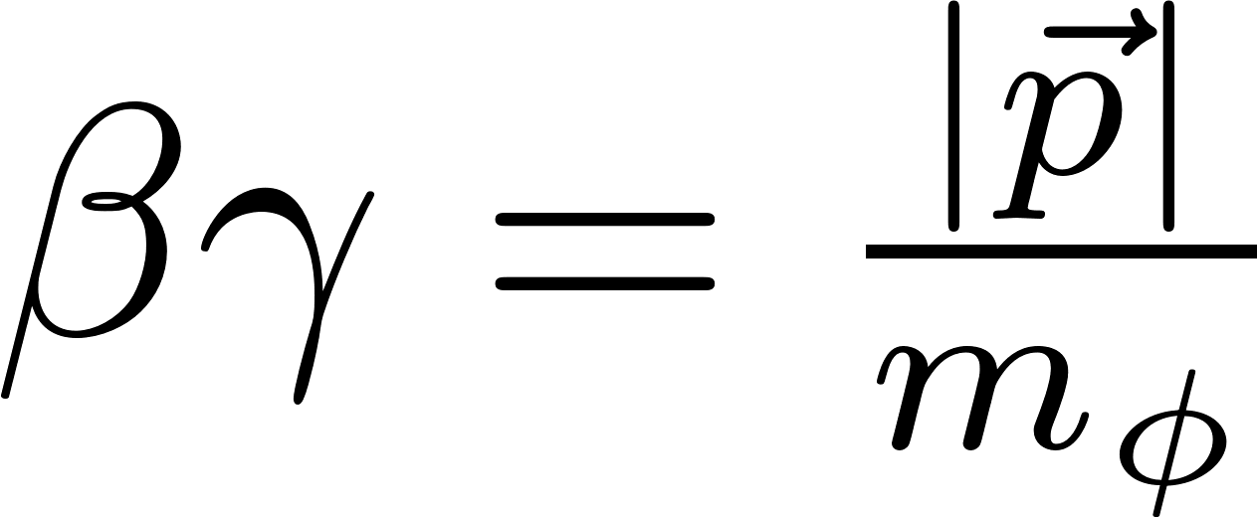
Previous experimental results
e
KEK
E325
12 GeV
pA-reaction
p
slow ϕs
φ
e
Pole mass:
intermediate ϕs
Pole width:
fast ϕs
Measurement is being repeated with 100x increased statistics at the J-PARC E16 experiment!
~
R. Muto et al. (E325 Collaboration), Phys. Rev. Lett. 98, 042501 (2007).

Slide 4
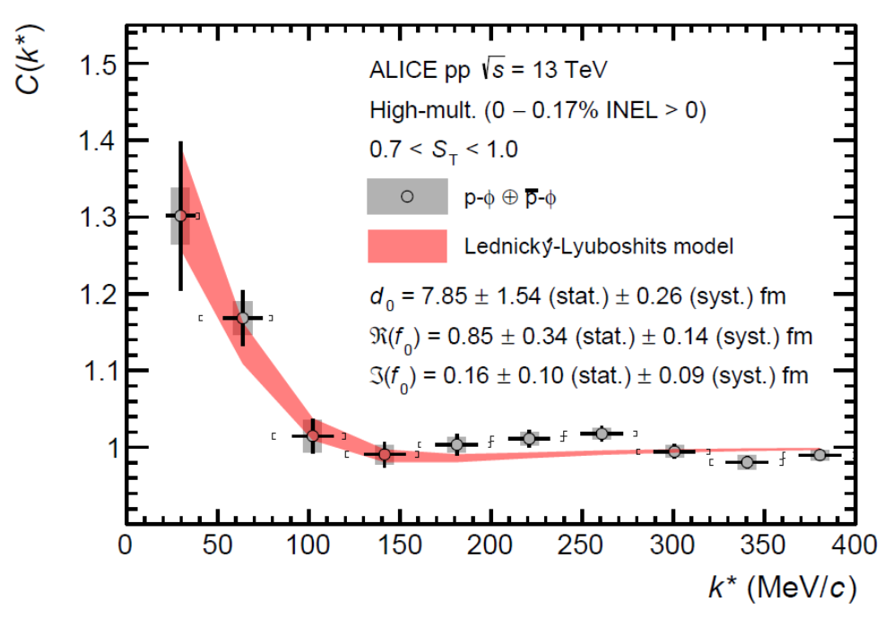
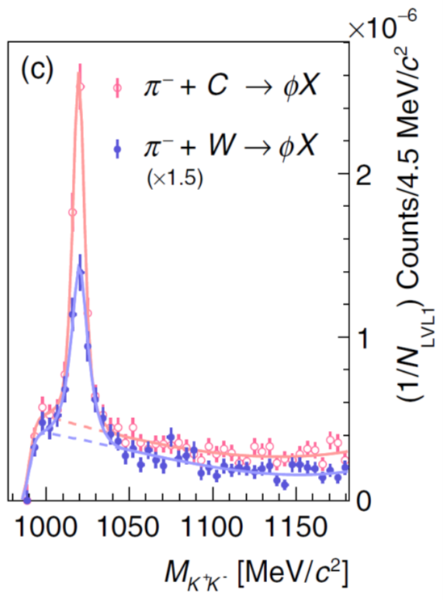
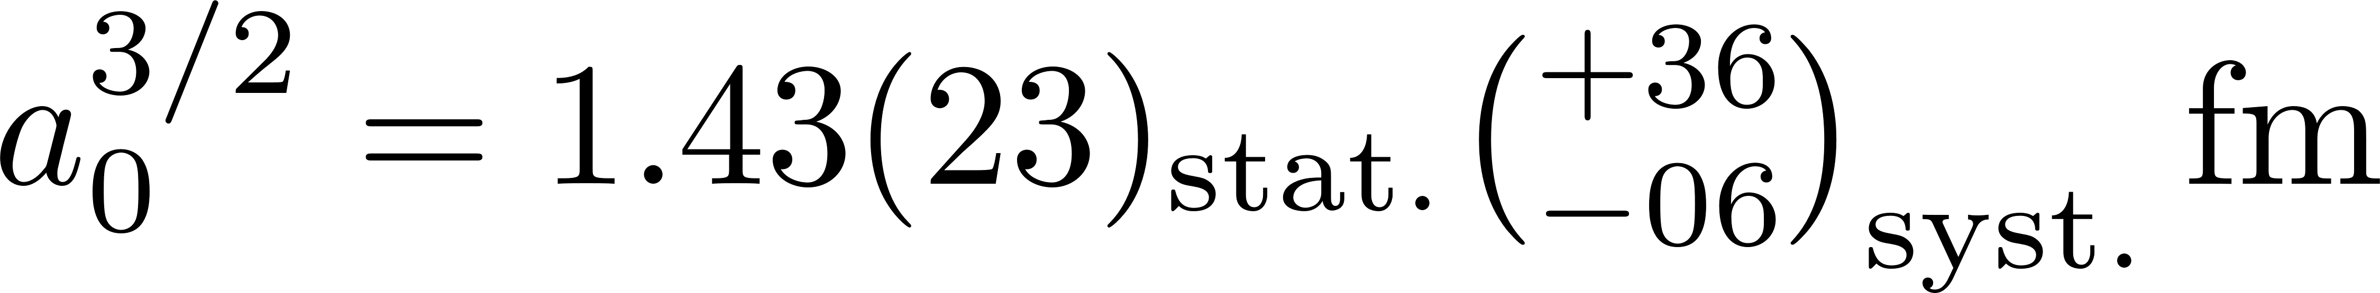
More recent results
ALICE: pp
HADES:
1.7 GeV π⁻A-reaction
Measurement of ϕN correlation
K⁺K⁻ - invariant mass spectrum
Broadening ?
Attraction!
Negative
mass shift ?
strong suppression
S. Acharya et al. (ALICE Coll.),
Phys. Rev. Lett. 127, 172301 (2021).
See also:
Y. Lyu et al. (Lattice QCD, HAL QCD Collaboration),
arXiv:2205.10544 [hep-lat].
J. Adamczewski-Musch et al. (HADES Coll.),
Phys. Rev. Lett. 123, 022002 (2019).

Slide 5
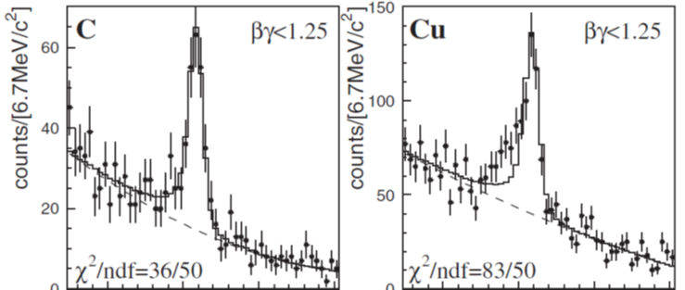
How compare theory with experiment?
Information useful for theory
Experimental data
Spectral function as a function of density
Mass at normal nuclear matter density
Decay width at normal nuclear matter density
e
Realistic simulation of pA reaction is needed!
p
e
φ

Slide 6
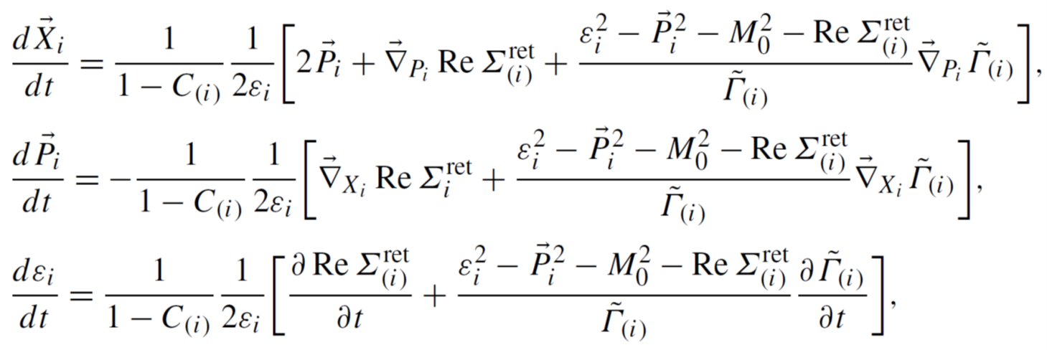
Our tool: transport simulation
HSD (Hadron String Dynamics)
E.L. Bratkovskaya and W. Cassing, Nucl. Phys. A 807, 214 (2008).
W. Cassing and E.L. Bratkovskaya, Phys. Rev. C 78, 034919 (2008).
Off-shell dynamics of vector mesons and kaons is included
(dynamical modification of the mesonic spectral function during the simulated reaction)
off-shell terms
Testparticle approach:

Slide 7
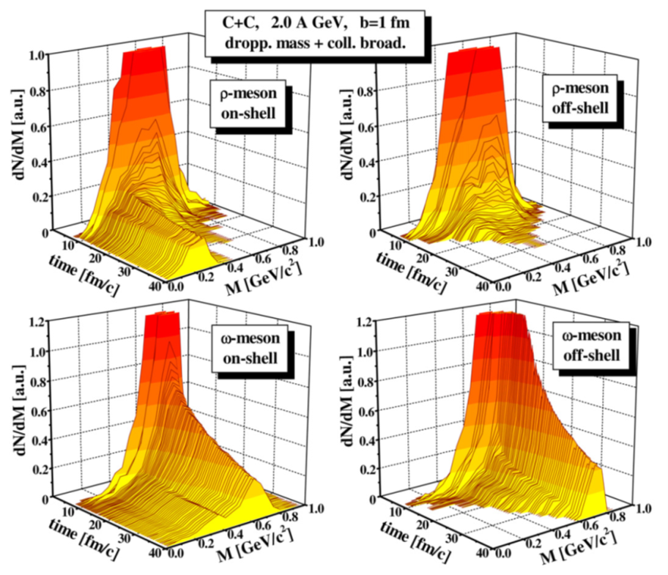
The importance of off-shell contributions
Only on-shell contributions:
Vacuum spectral function are not recovered at late time of the reaction
Off-shell contributions included:
correct behavior
Taken from: E.L. Bratkovskaya and W. Cassing, Nucl. Phys. A 807, 214 (2008).

Slide 8
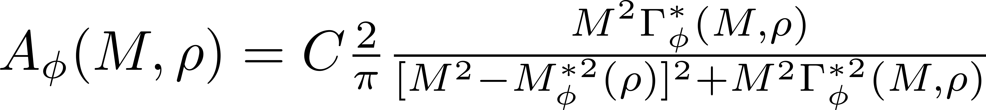
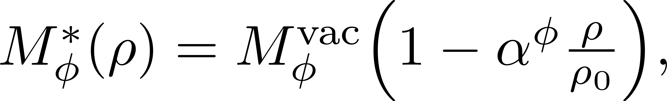
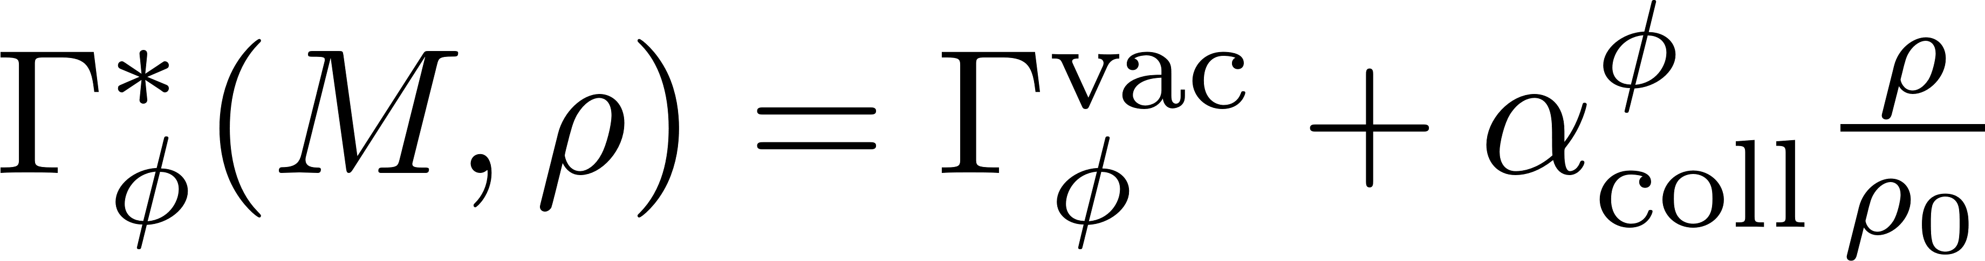
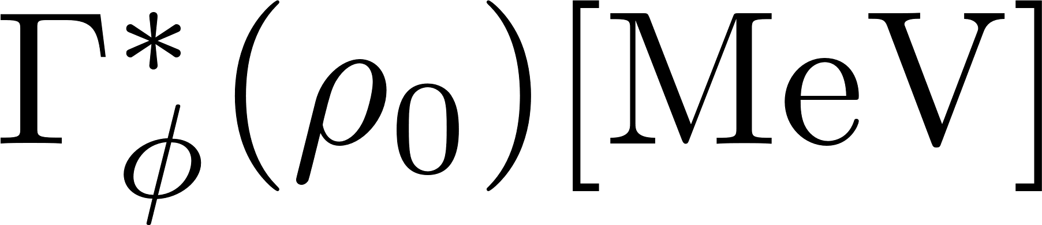
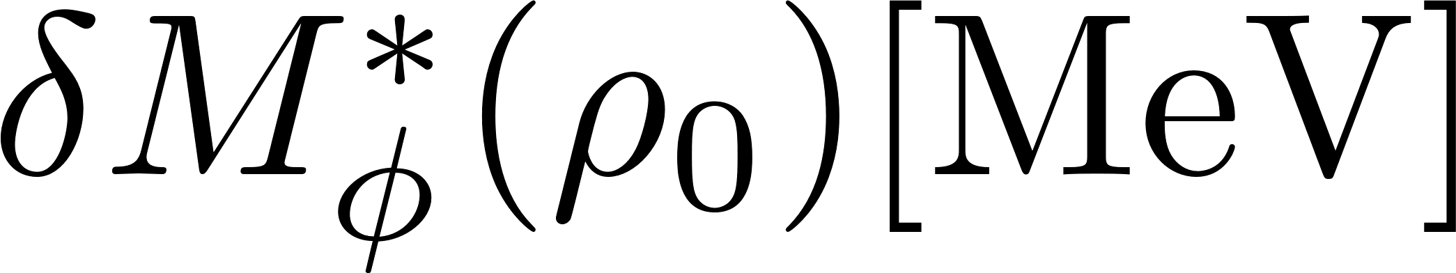
Advantage: vector meson spectra can be chosen freely
Our choice: a Breit-Wigner with density dependent mass and width
with
4.3
15.3
26.3
37.3
48.3
59.3
70.3
81.3
92.3
vacuum
-17
Simulated scenarios:
-34
E325 result
-51
-68

Slide 9
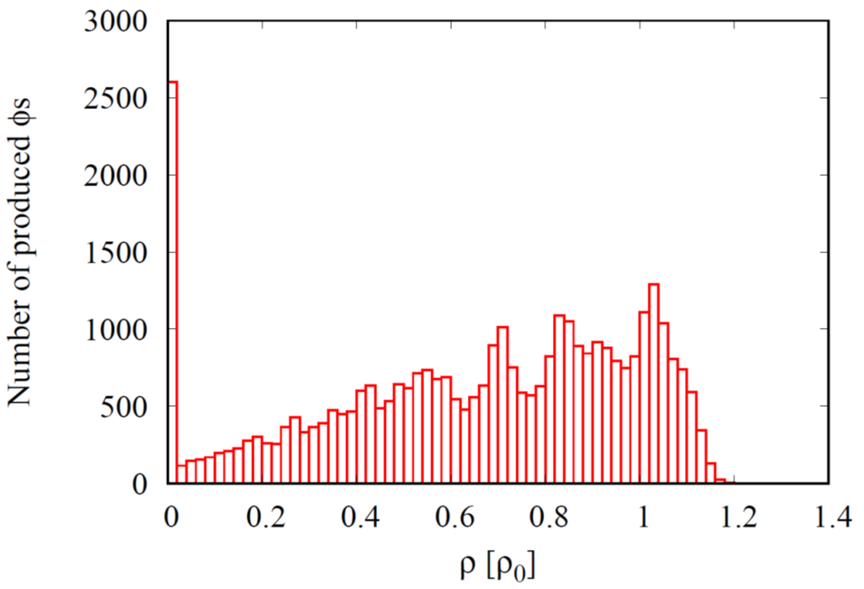
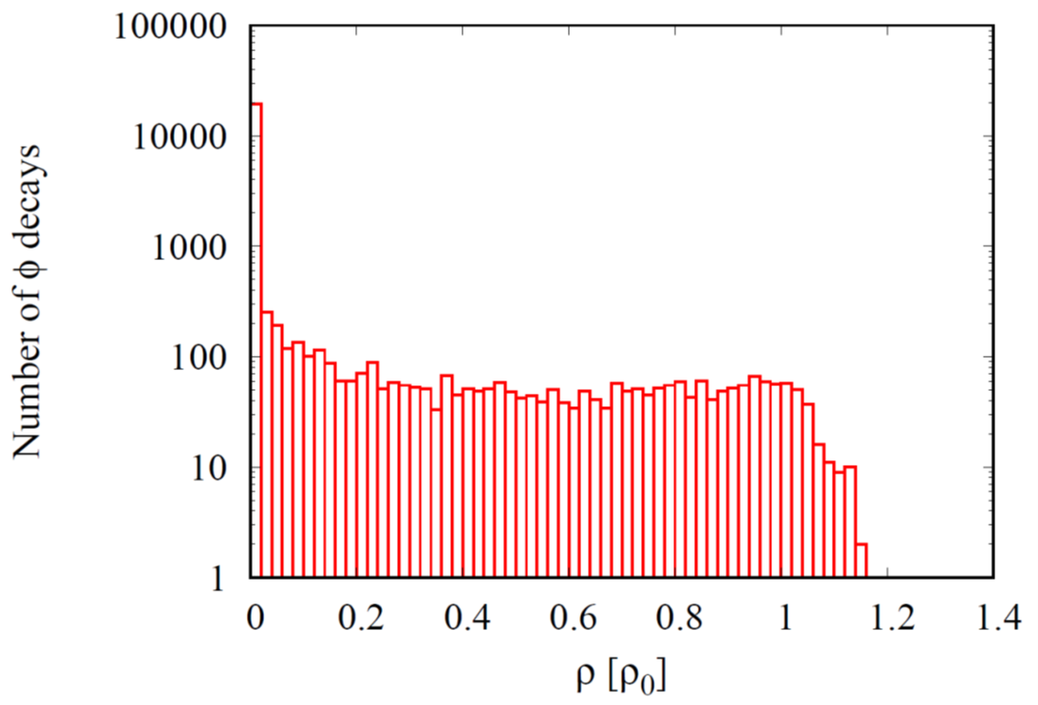
What density does the ϕ feel in the reaction (p+Cu at 12 GeV)?
Density distribution at time of production
Density distribution at time of decay
Majority of ϕ mesons are produced at densities around ρ₀
Majority of ϕ mesons decay in free space (note the log-scale!)

Slide 10
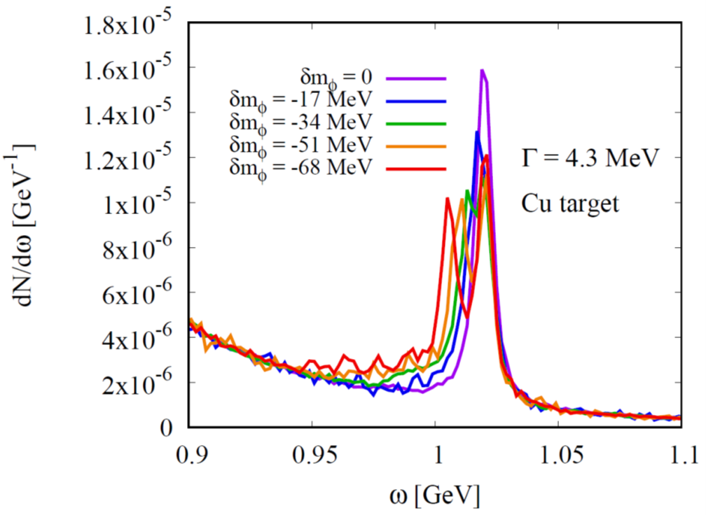
The dilepton spectrum in the ϕ meson region
p + Cu at 12 GeV
No acceptance corrections!
No finite resolution effects!
No QED effects!

Slide 11
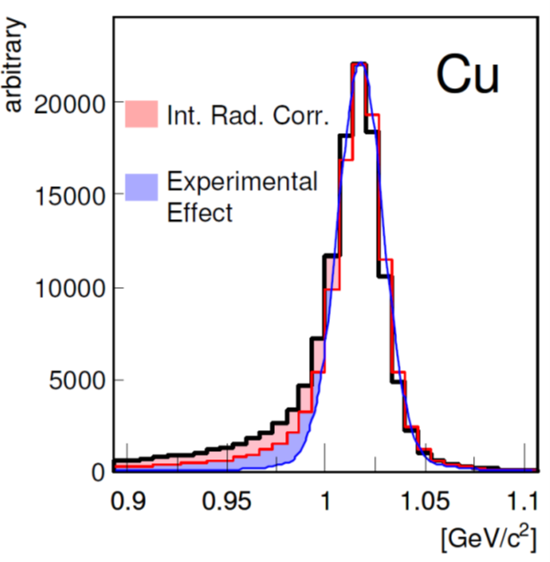
How do experimental rescattering and QED effects modify the dilepton spectrum?
PhD Thesis of R. Muto, Kyoto U., 2007
Rescattering effect
(multiple scattering, energy loss)
Similar to the shape expected for a negative mass shift

Slide 12
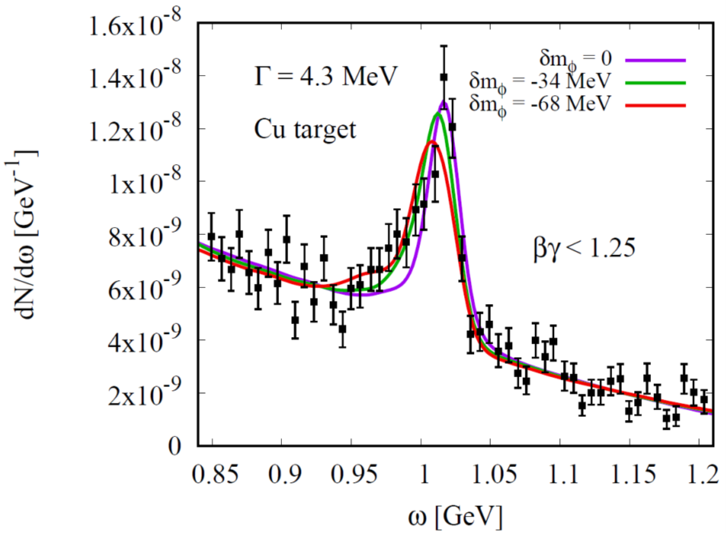
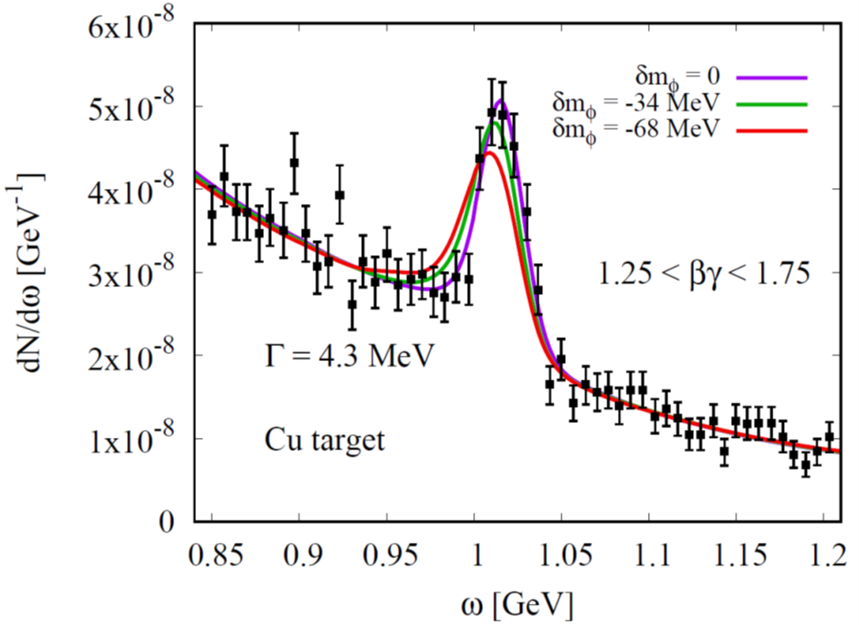
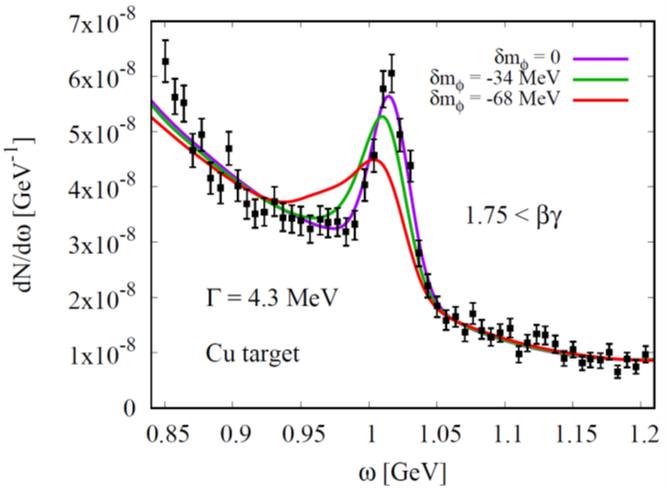
Preliminary
Fits to experimental Copper target data (E325)
Surprisingly large effect for fast ϕs with a large mass shift
Related to initial stage of the collision??
slow ϕs
intermediate ϕs
fast ϕs
Favors negative mass shift
Favor no mass shift scenario

Slide 13
Reason for large modification for fast ϕ mesons
Initial stage of ϕ meson production?
φ
ϕ mesons are generated from high energy collisions (via strings)
p
large momentum
high density
φ
ϕ mesons are generated from low energy hadronic collisions
K⁻
K⁺
p
small momentum
K⁻
low density

Slide 14
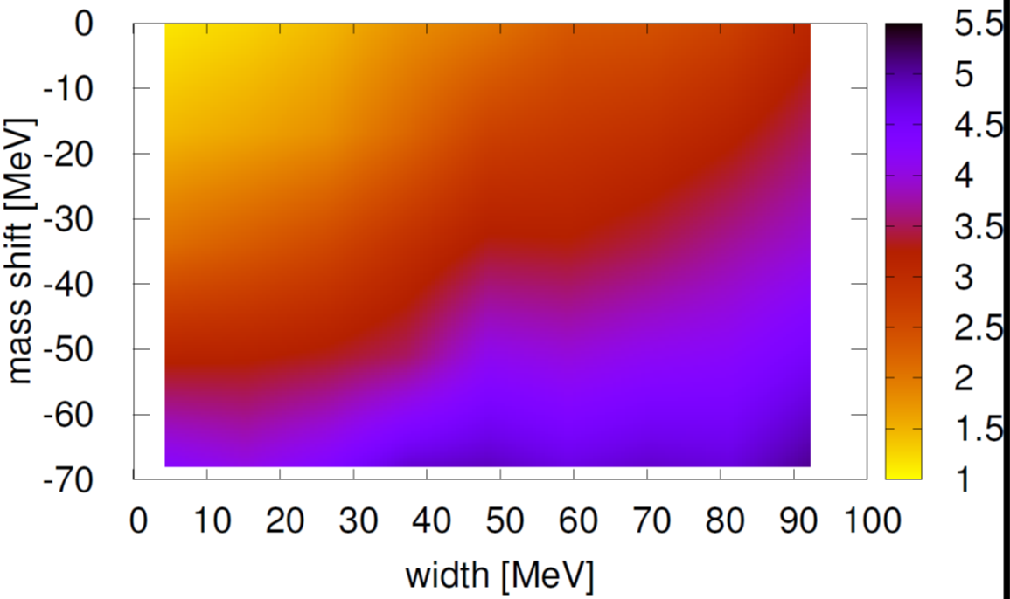
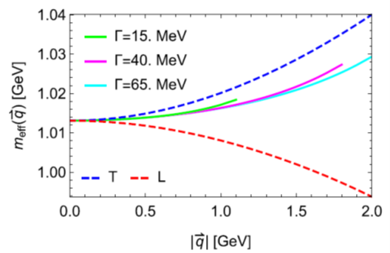
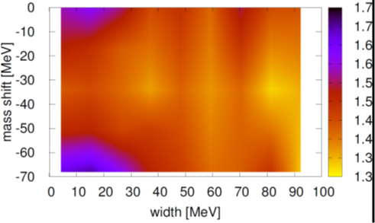
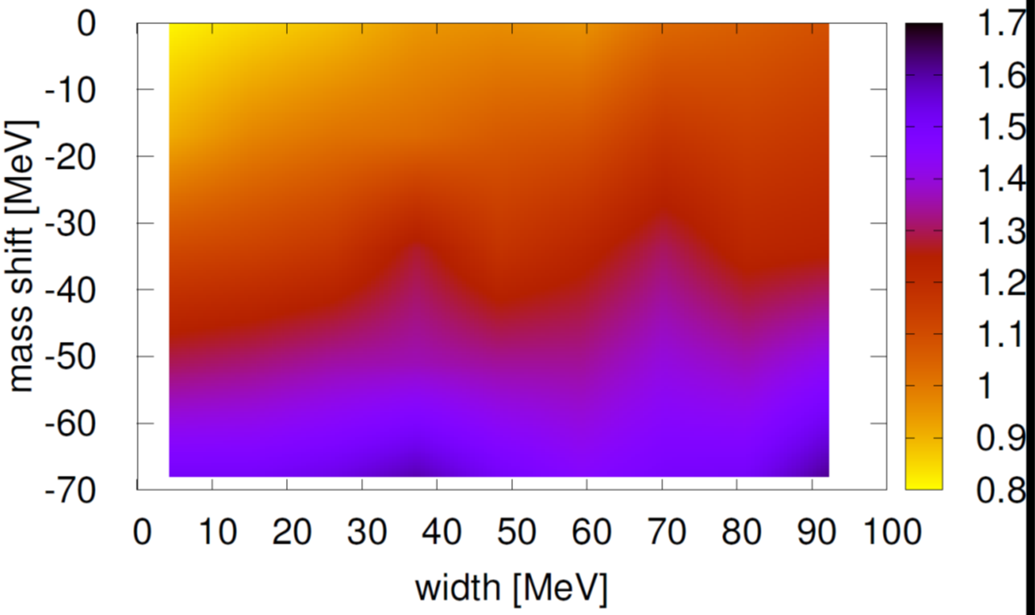
Most natural interpretation of our results
Momentum dependent mass shift
fast ϕs
negative mass shift at zero momentum
χ²/d.o.f values
slow ϕs
intermediate ϕs
χ²/d.o.f values
H.J. Kim and P. Gubler, Phys. Lett. B 805, 135412 (2020).
χ²/d.o.f values

Slide 15
Summary and Conclusions
Relating modification of QCD condensates with hadron properties in nuclear matter is a non-trivial multi-step process
QCD condensates
Hadronic spectrum
Experimental data
For studying the modification of the ϕ meson spectral function experimentally at finite density, a good understanding of the underlying reactions is needed
We conducted numerical simulations of the pA reactions measured at the E325 experiment at KEK, using the HSD transport code
Momentum-dependent mass shift is needed to explain the data

Slide 16
Backup slides

Slide 17
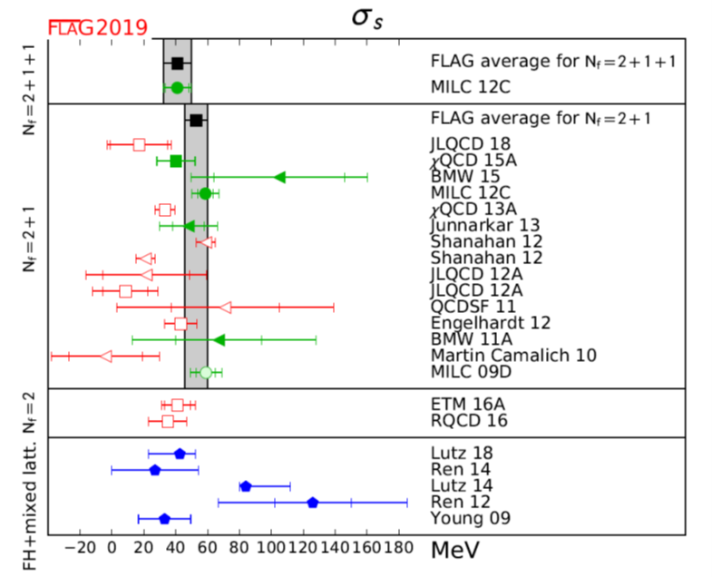
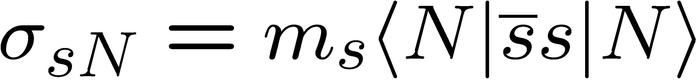
What does lattice QCD say about the strange sigma term?
http://flag.unibe.ch/2019/
See also the most recent result of the BMW collaboration: Sz. Borsanyi et al., arXiv:2007.03319 [hep-lat].

Slide 18

Combine QCD sum rules with lattice QCD
No mass shift in nuclear matter ??
Lattice QCD
P. Gubler and K. Ohtani, Phys. Rev. D 90, 094002 (2014).

Slide 19
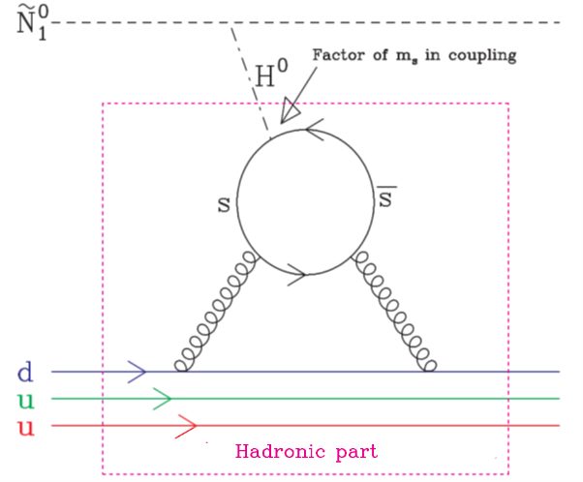
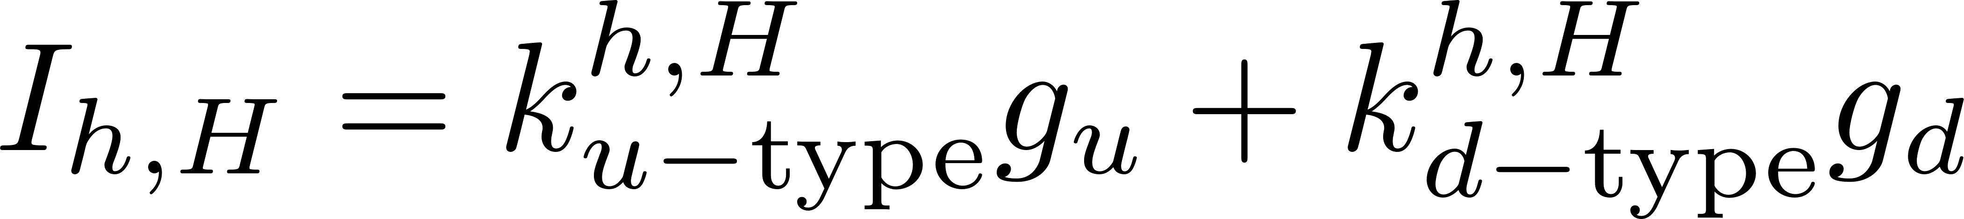
The strangeness content of the nucleon:
Important parameter for dark-matter searches!
Neutralino: Linear superposition of the Super-partners of the Higgs, the photon and the Z-boson
Adapted from:
W. Freeman and D. Toussaint (MILC Collaboration), Phys. Rev. D 88, 054503 (2013).
most important contribution
dominates
A. Bottino, F. Donato, N. Fornengo and S. Scopel, Asropart. Phys. 18, 205 (2002).

Slide 20
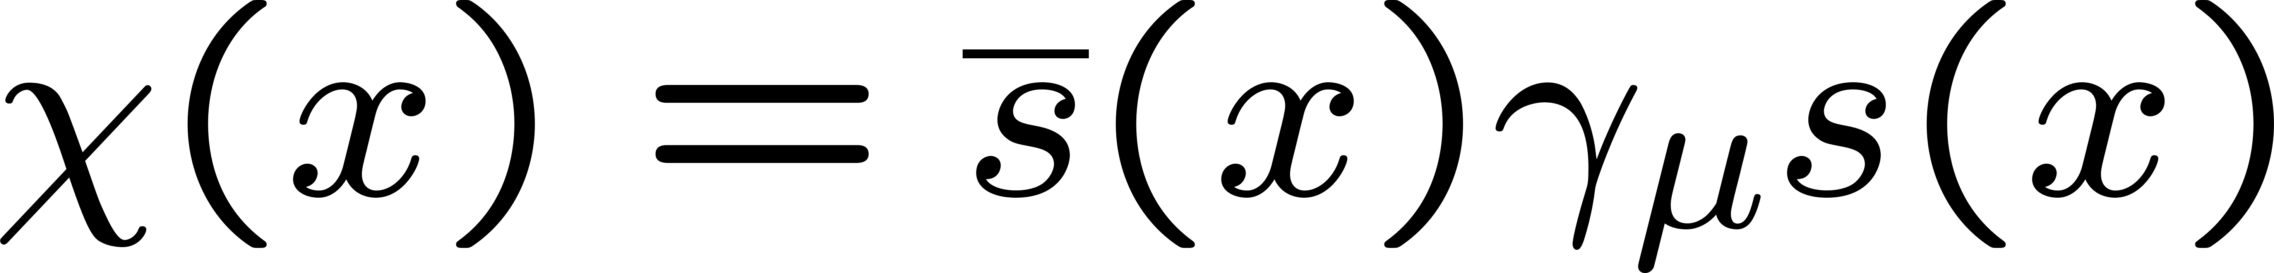
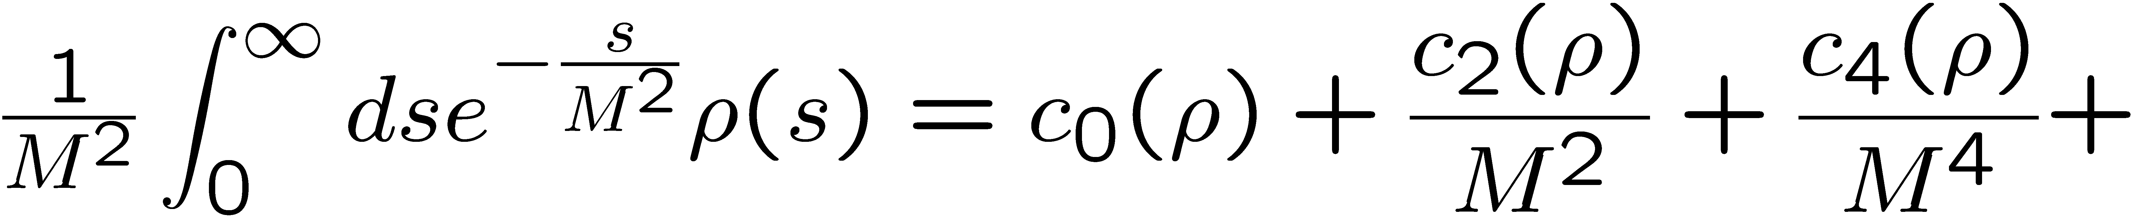
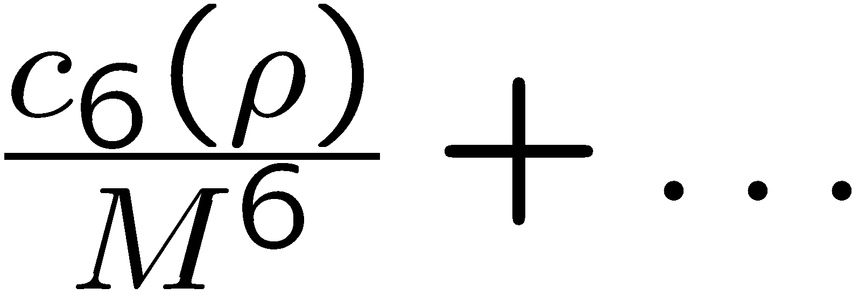
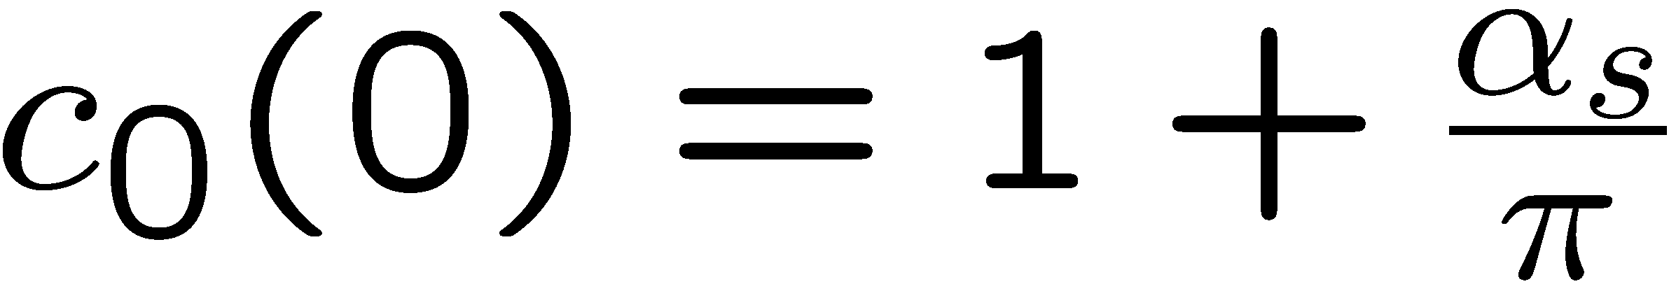
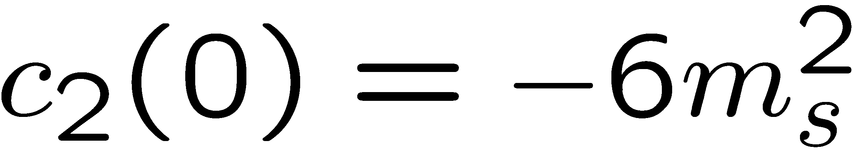
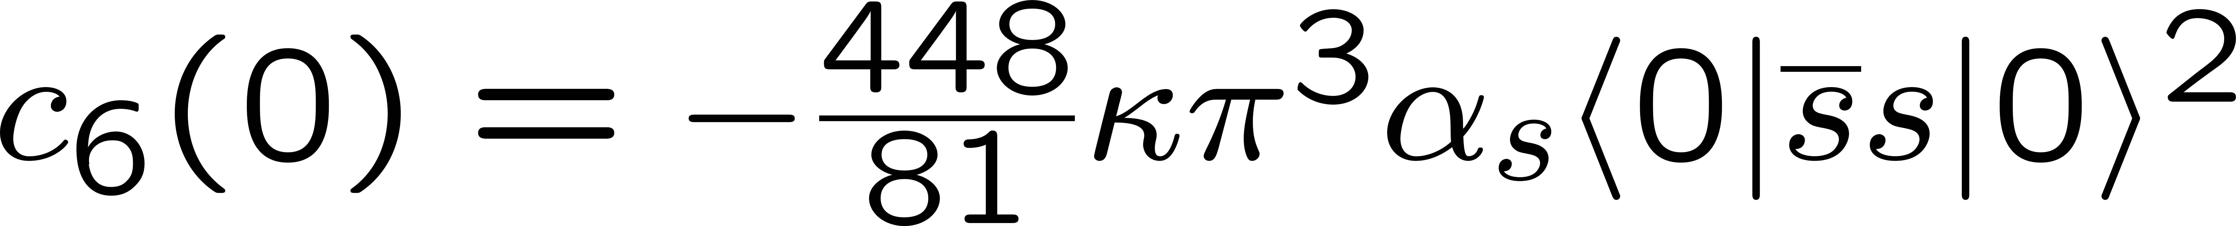
Structure of QCD sum rules for the ϕ meson channel
(after application of the Borel transform)
In Vacuum
Dim. 0:
Dim. 2:
Dim. 4:
Dim. 6:

Slide 21
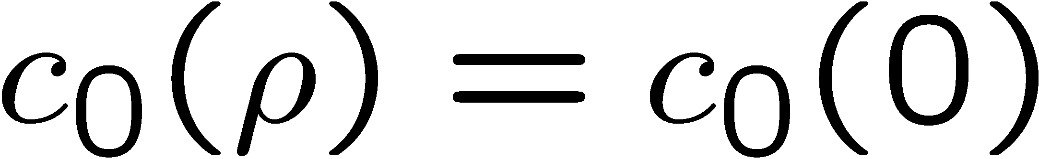
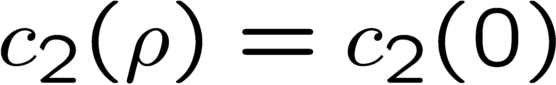
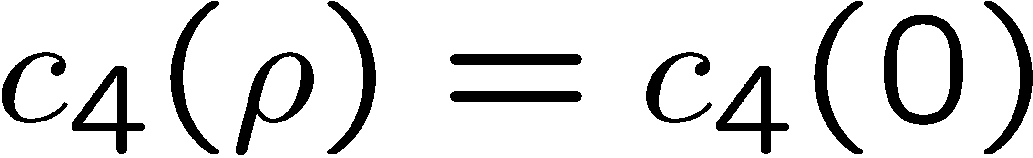
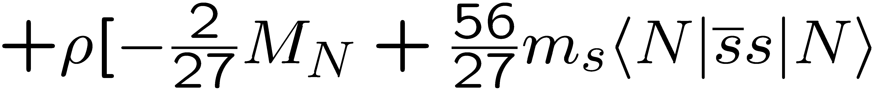
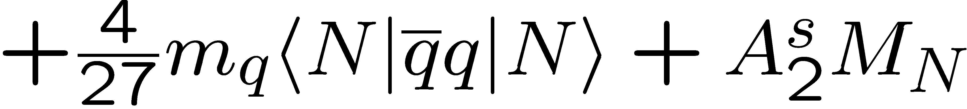
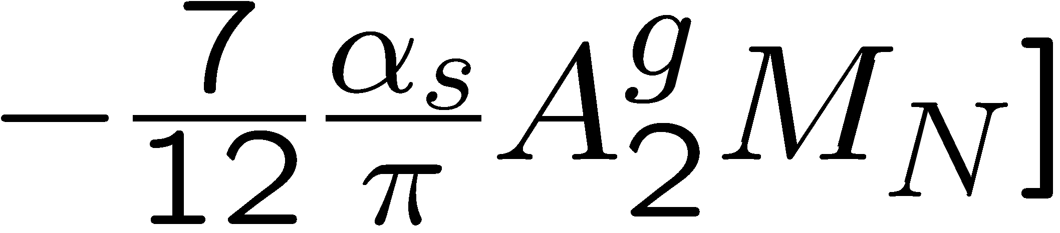
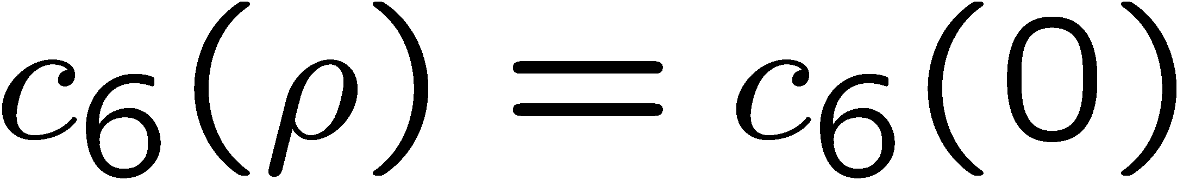
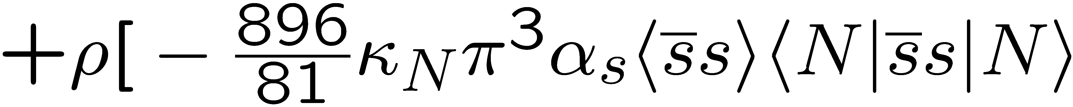
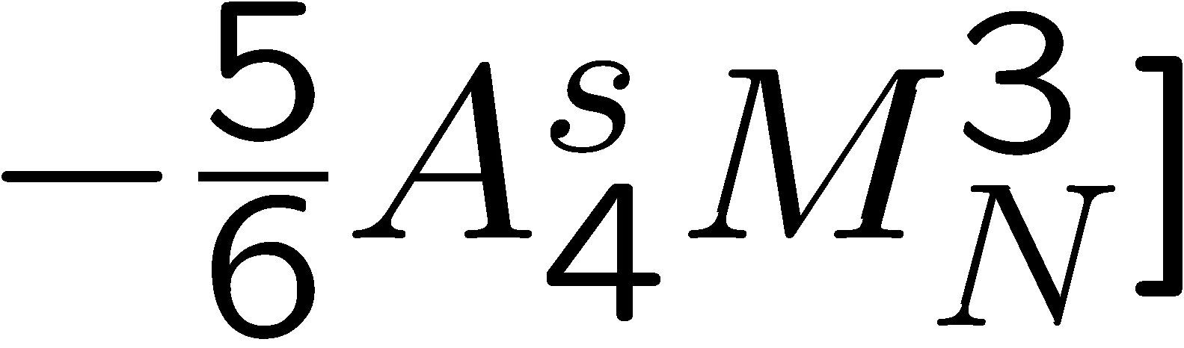
Structure of QCD sum rules for the ϕ meson
At finite density
(within the linear density approximation)
Dim. 0:
Dim. 2:
Dim. 4:
Dim. 6:

Slide 22

Results for the φ meson mass at rest
Most important parameter, that
determines the behavior of the φ meson mass at finite density:
Strangeness content of the nucleon
P. Gubler and K. Ohtani, Phys. Rev. D 90, 094002 (2014).

Slide 23
K⁺K⁻ - invariant mass spectrum
Recent experimental results
HADES:
1.7 GeV π⁻A-reaction
Larger suppression of K⁻ in the Tungsten target compared to the Carbon target
K⁻/ϕ ratio is similar for both Tungsten and Carbon targets
strong suppression
Observation of large suppression (broadening?) of the ϕ meson in large nuclei
J. Adamczewski-Musch et al. (HADES Collaboration), Phys. Rev. Lett. 123, 022002 (2019).

Slide 24




New experimental results
ALICE (Femtoscopy)
Interaction potential
Correlation function
The observable to be measured: the correlation function:
Emission source (Gaussian)
Relative momentum of the particle pair
S. Acharya et al. (ALICE Collaboration), Phys. Rev. Lett. 127, 172301 (2021).

Slide 25
New experimental results
ALICE
Measurement of ϕN correlation
Extracted ϕN scattering length
Real part:
Attraction!
Attractive
Imaginary part:
Small absorption/broadening ?
S. Acharya et al. (ALICE Collaboration), Phys. Rev. Lett. 127, 172301 (2021).

Slide 26







New experimental results
ALICE
Fit of the correlation function data to two simple phenomenological potentials
Larger attraction than what was observed at KEK 325, but large statistical and systematic uncertainties
S. Acharya et al. (ALICE Collaboration), arXiv:2105.05578 [nucl-ex].

Slide 27


Our tool: a transport approach
Basic Ingredient 1:
Solve a Boltzmann-Uehling-Uhlenbeck (BUU) type equation for each particle type
Includes mean field
(tuned to reproduce nuclear matter properties)
particle distribution function
Basic Ingredient 2:
„Testparticle“ approach

Slide 28






Example of a transport calculation
Au+Au collision at s^{1/2} = 200 GeV, b = 2 fm
nucleons
quarks
gluons
will not be included in the simulations shown in this talk

Slide 29
Final step: comparison to experimental data
Potential issues:
Experimental background is not included in the simulation
Normalization of the experimental dilepton spectrum is not given
Fit to experimental data is necessary!
Background
φ meson signal
Dilepton spectrum:
Fitted to the experimental dilepton spectrum independently for each βγ-region

Slide 30

What density does the ϕ feel in different pA (p+Cu) reactions?
Density distribution at time of production
Density distribution at time of decay
Larger densities are reached for larger incoming proton energy
Majority of ϕ mesons decay in free space (note the log-scale!)

Slide 31


Density and βγ distributions for the different production mechanisms
Density distribution at production
βγ distribution at production
Low energy hadronic production occurs dominantly at the nuclear surface
For βγ>1.5, high energy ϕ meson production via strings dominates

Slide 32
What about the K⁺K⁻ decay channel?
(new J-PARC proposal P88)
e-
K⁻
p
p
φ
φ
K⁺
e⁺
Kaons feel the strong interaction
Distorted in-medium ϕ meson signal
Kaons do not feel the strong interaction
Clear in-medium ϕ meson signal
Large branching ratio
Good statistics
Small branching ratio
Bad statistics

Slide 33


Treatment of KN-interactions
Density dependent cross sections based on the chiral unitary model (including coupled channels and s-/p-wave of KN interactions)
Vacuum and density dependent KN cross sections
Density dependent K spectral functions
T. Song et al., Phys. Rev. C 103, 044901 (2021).
See talk by Laura Tolos on Tuesday

Slide 34


Preliminary
Distortion of the in-medium ϕ meson signal in the K⁺K⁻ channel
(p + Cu at 30 GeV)
Small distortion effect from the strong KN interaction !?

