Slide 1



Neutron stars in hard-wall HQCD
Lorenzo Bartolini – Henan University, School of Mathematics and Statistics
Work in collaboration with: S. B. Gudnason, J. Leutgeb, A. Rebhan
XVth Quark Confinement and the Hadron Spectrum Conference
University of Stavanger, August 1, 2022

Slide 2
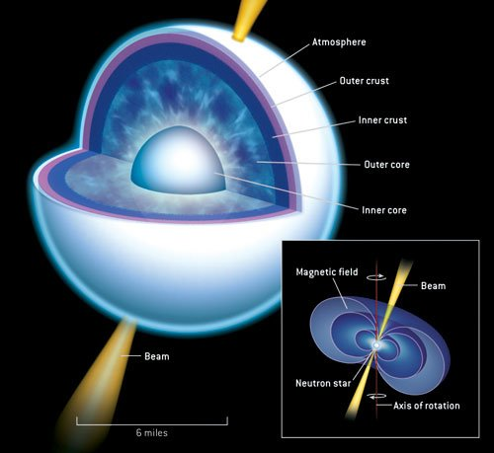
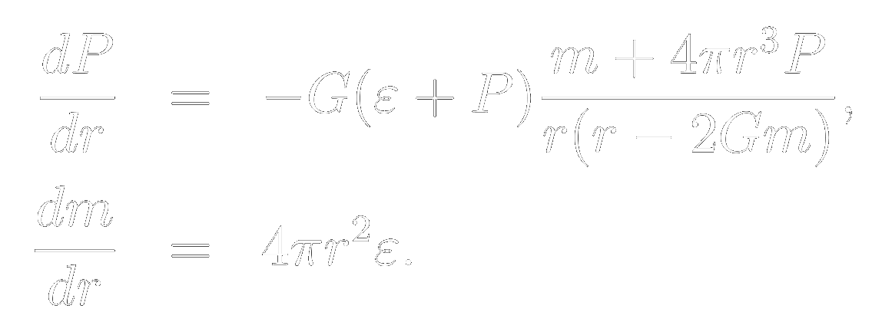
NEUTRON STARS
Remnants of supernovae of supergiant stars.
Most compact astrophysical objects (excluding BHs)
Tolman-Oppenheimer-Volkov equations:
PROBLEM: equation of state P(ε) for nuclear matter is not known at such densities.

Slide 3
observational bounds
RADIUS:
11.4 to 13.7 km for stars of about 2.1 M⊙ (PSR J0740+6620)
12.2 to 16.3 km for stars of about 2.1 M⊙ (PSR J0740+6620)
11.5 to 13.9 km for stars of about 1.4 M⊙ (J0030+0451)
12.0 to 14.3 km for stars of about 1.4 M⊙ (J0030+0451)
MASS: maximum measured is 2.08±0.07 M⊙ (PSR J0740+6620)
TIDAL DEFORMABILITY: 70 to 620 for stars of about 1.4 M⊙ (GW170817)

Slide 4
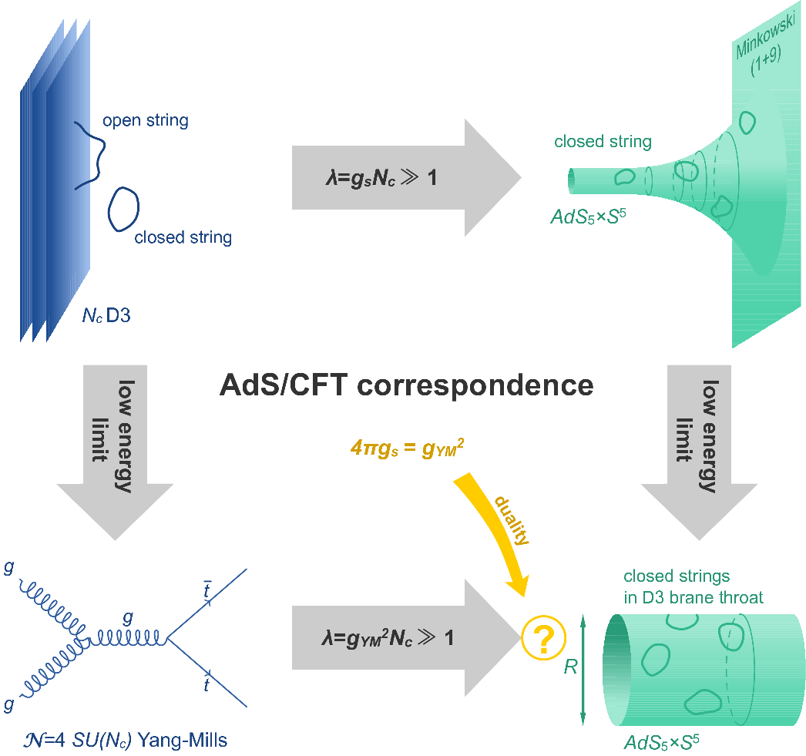
Holography in ONE PAGE
Duality between a QFT in flat spacetime and (Super-)gravity in higher dimension.
Weak/Strong duality: can study strong interactions with weakly coupled gravity.
Has natural field of application where LQCD and perturbative QCD fail to be precise: finite chemical potential, low energy.
Top-down models: embedded into string theory.
Bottom-up models: cook up a geometry and a handful of free parameters to fit data.

Slide 5
Holographic qcd
QCD IS NOT | HOLOGRAPHIC DUAL MUST:
 | TOP-DOWN | BOTTOM-UP
SUPERSYMMETRIC | Break SUSY | Not include SUSY to begin with
CONFORMAL | Generate a bounded geometry | Cook up a bounded geometry
PURE YANG-MILLS | Include flavor branes | Couple gravity to some flavor field

Slide 6
Some holographic RESULTS with neutron stars:
D3-D7
[C. Hoyos, D. Rodríguez Fernández, N. Jokela, A. Vuorinen]
[K. B. Fadafan, J. C. Rojas, N. Evans]
D4-D8 [N. Kovensky, A. Poole, A. Schmitt]
VQCD [N. Jokela, M. Järvinen, J. Remes]
Hard-Wall [L.B., S. B. Gudnason, J. Leutgeb, A. Rebhan ]
MERGER EVENTS SIMULATIONS FROM HOLOGRAPHY:
VQCD [C. Ecker, M. Järvinen, G. Nijs, W. van der Schee]
Hard-Wall [L.B., S. B. Gudnason, J. Leutgeb, A. Rebhan ]
THIS TALK

Slide 7
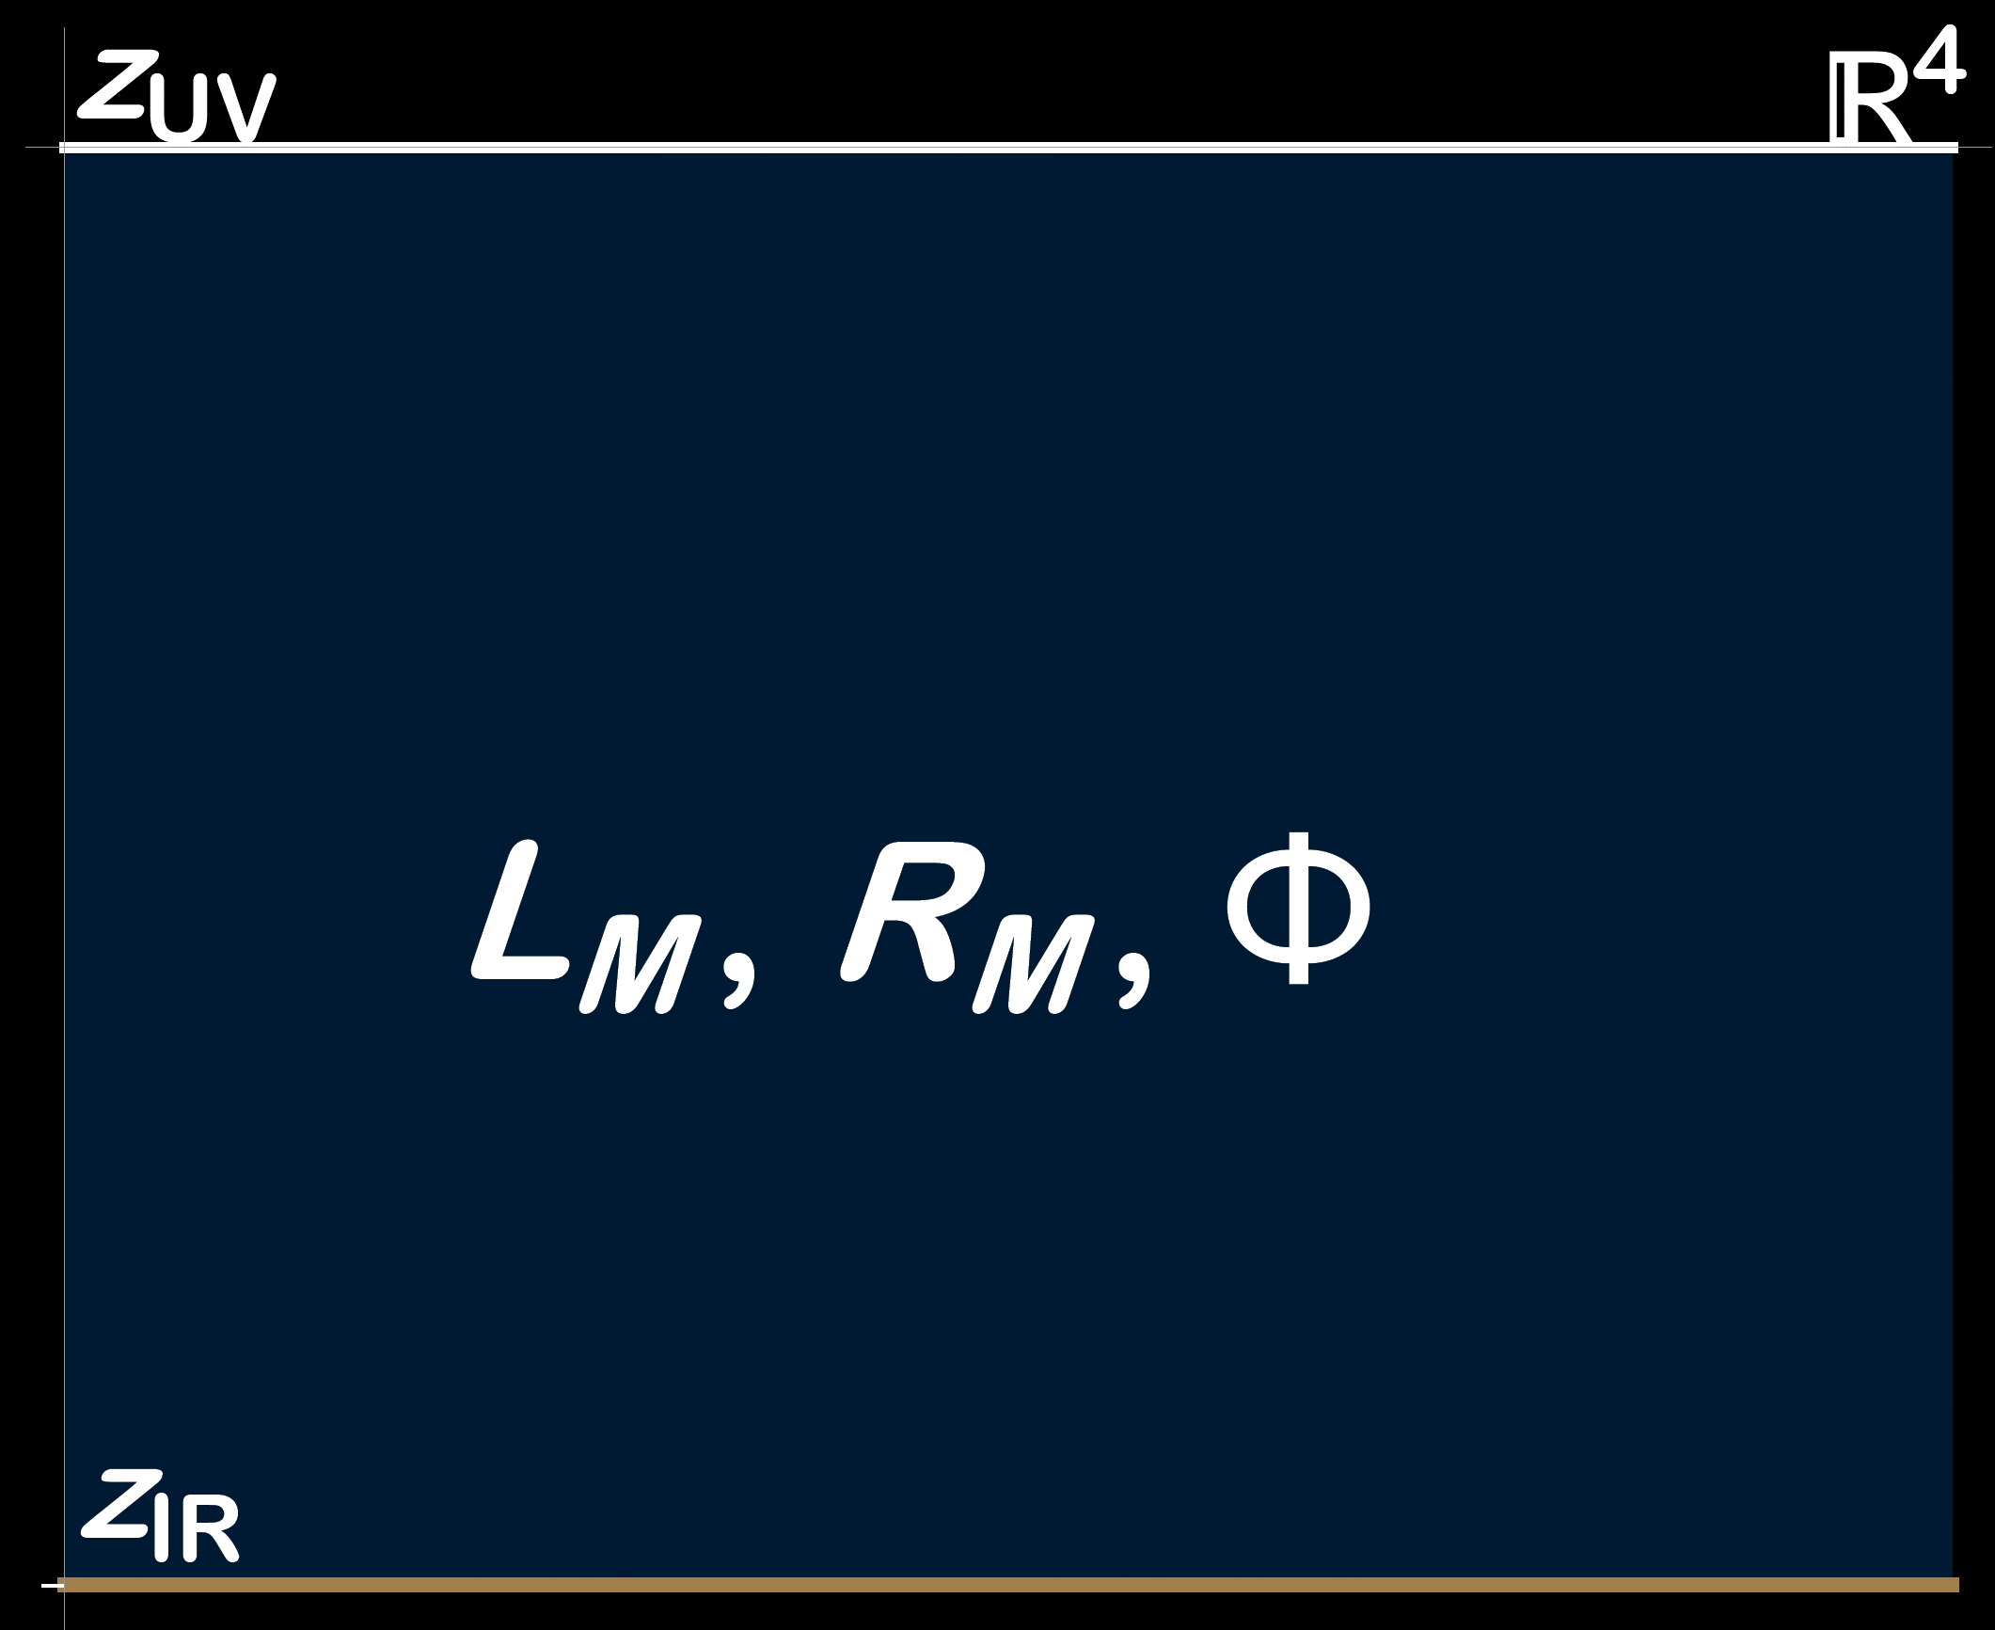
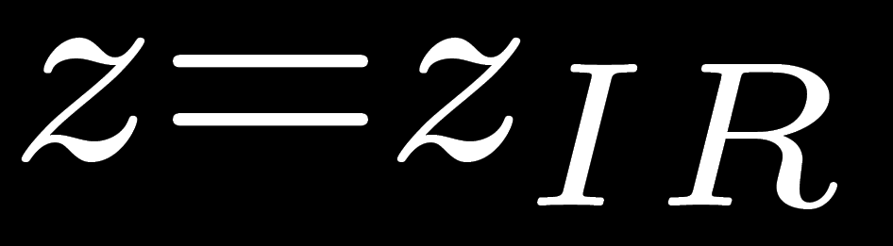
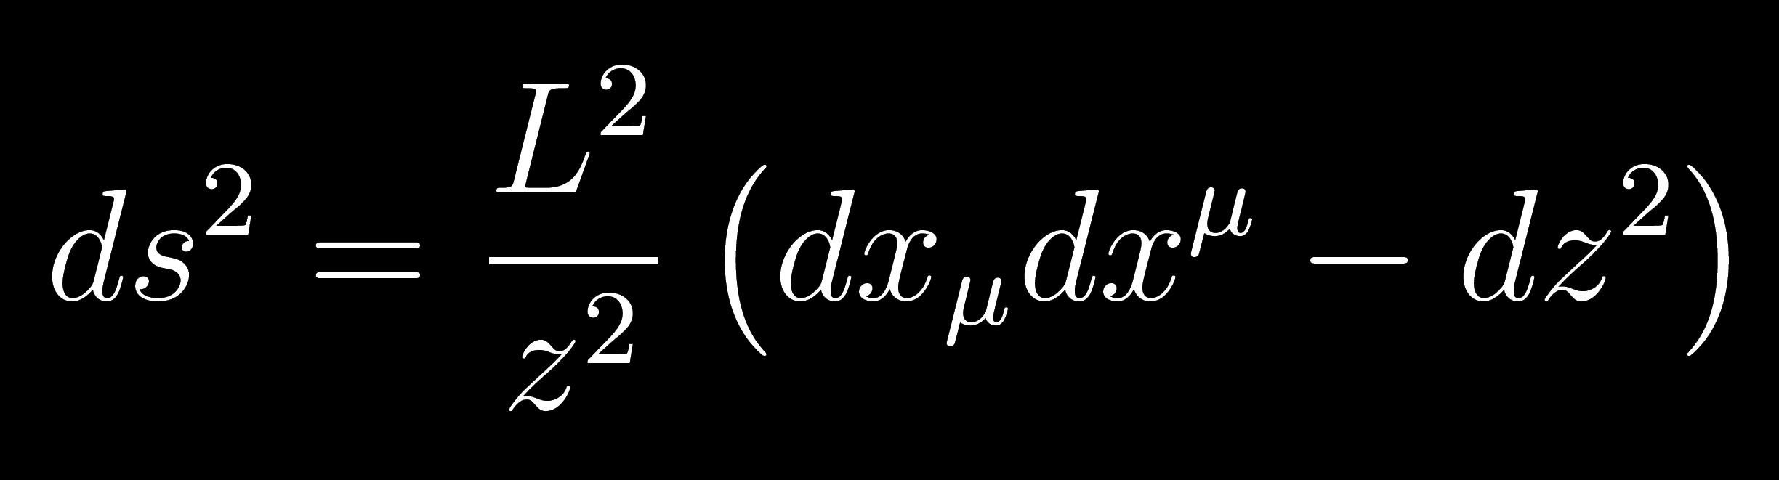
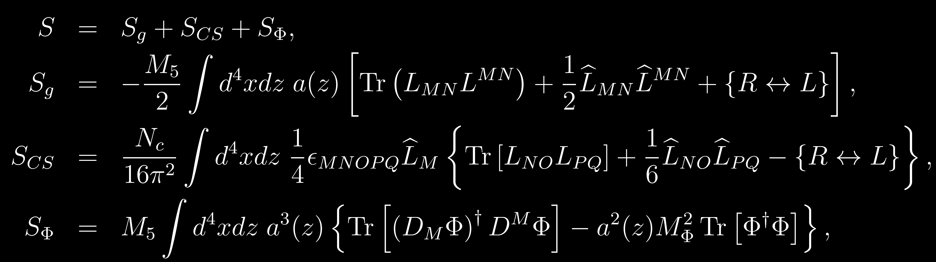
Hard-wall model (T=0)
Metric from AdS₅ with artificial cut-off at :
YM+CS+Scalar action:

Slide 8
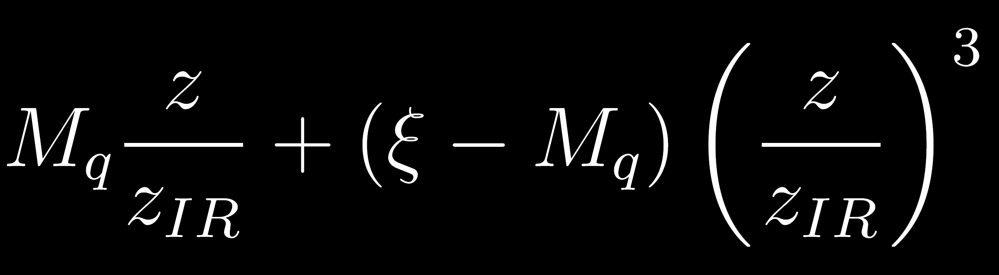
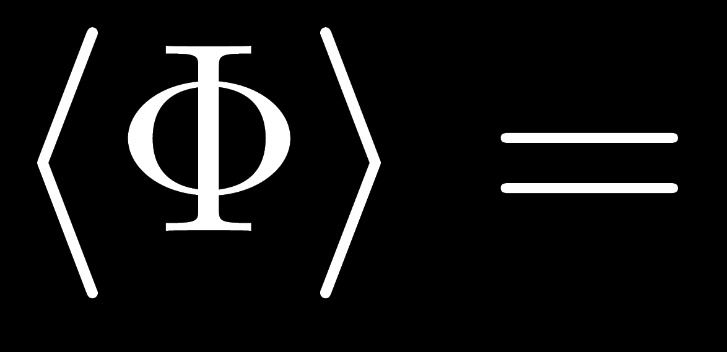
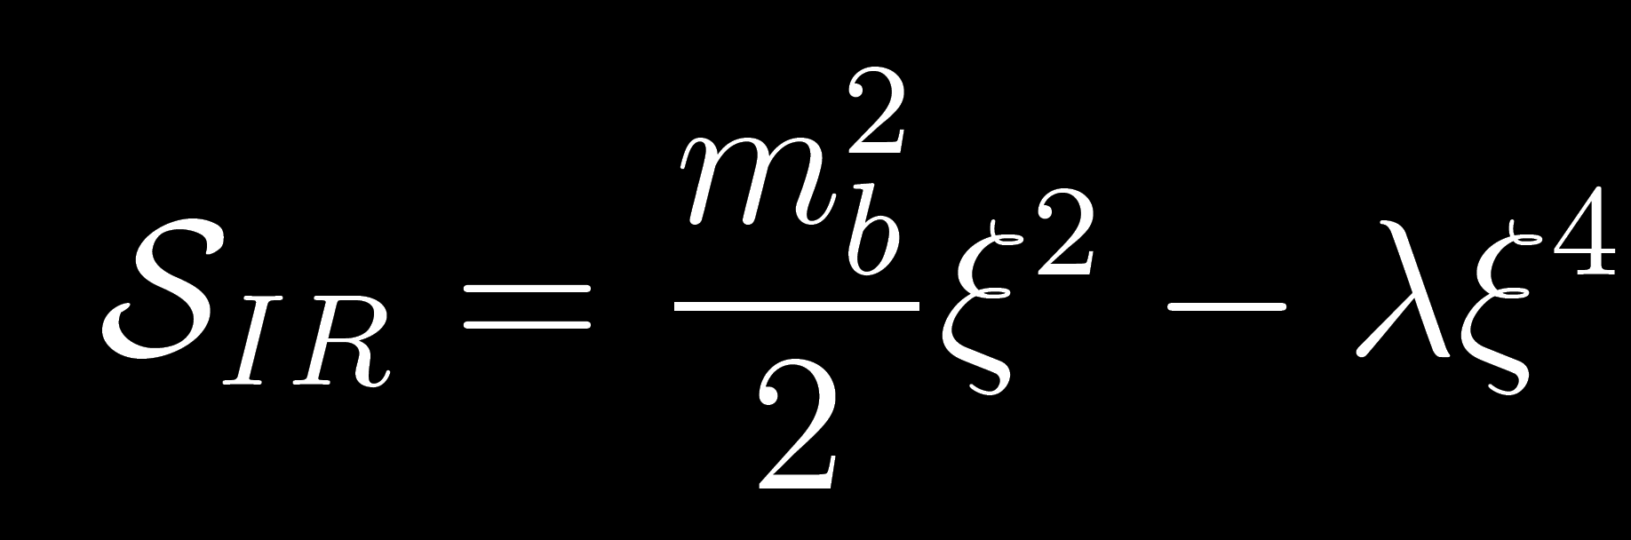
Infrared potential
In hard-wall models the chiral condensate is encoded in the scalar:
It is a free parameter of the theory: should originate from a boundary condition on the scalar.
Infrared potential to stabilize its value:
We are trading a free parameter for two, but we gain a dynamical ξ

Slide 9
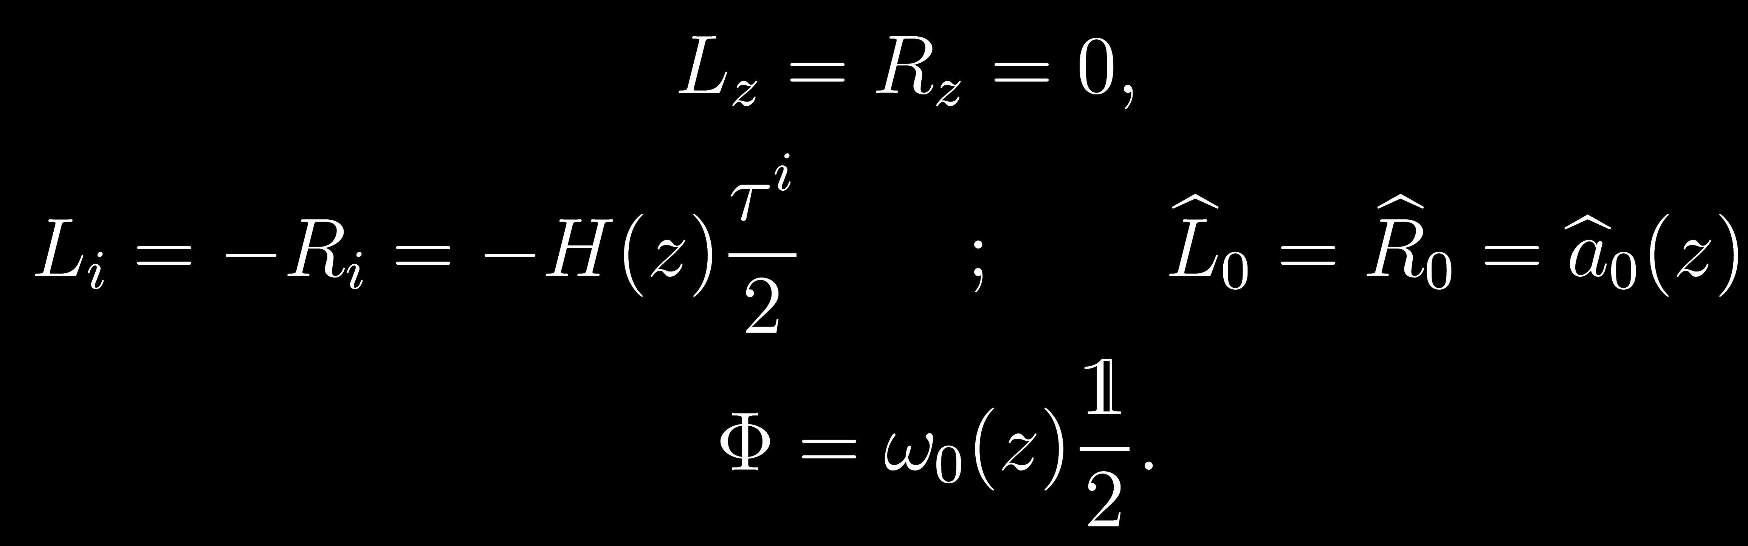
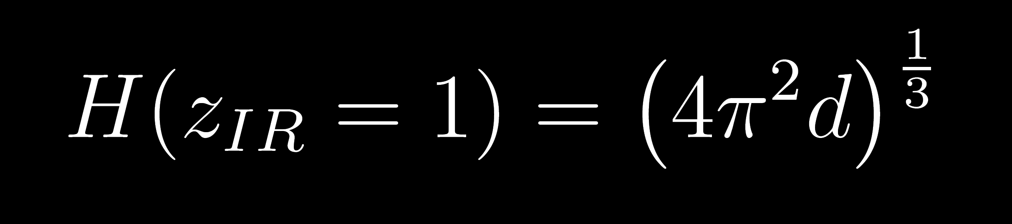
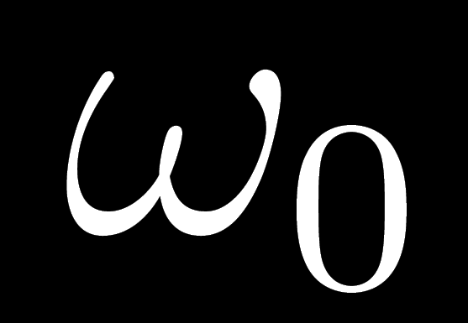
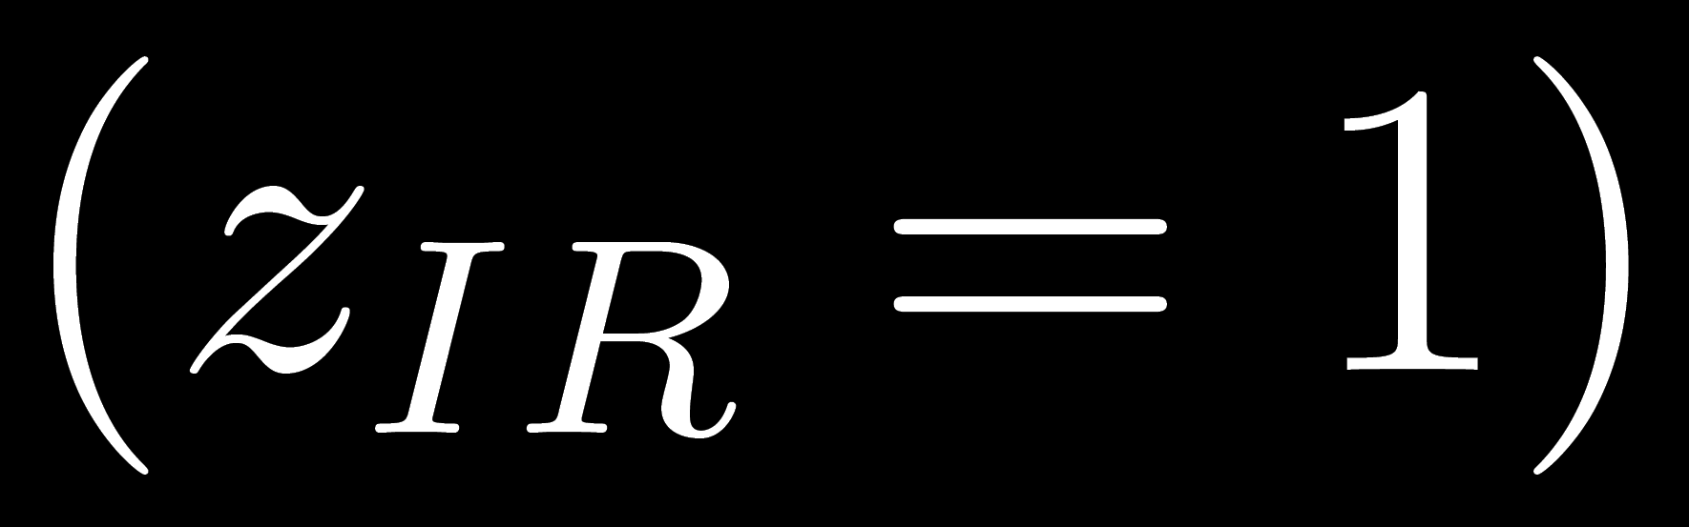
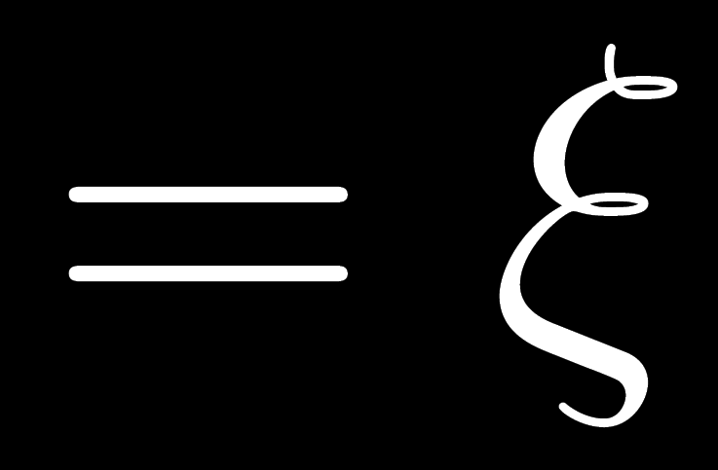
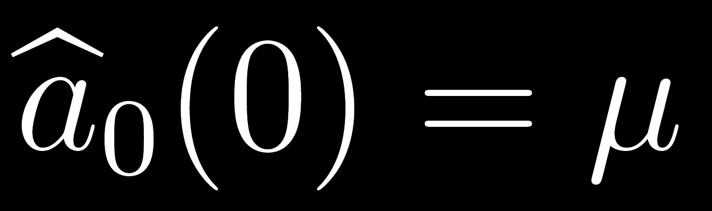
Homogeneous ansatz
Assume homogeneity in (x₁, x₂, x₃):
Good approximation for the core (high density)
PDEs ODEs
Density encoded in IR boundary condition:
Chiral condensate encoded in IR boundary condition:
Chemical potential encoded in UV boundary condition:

Slide 10
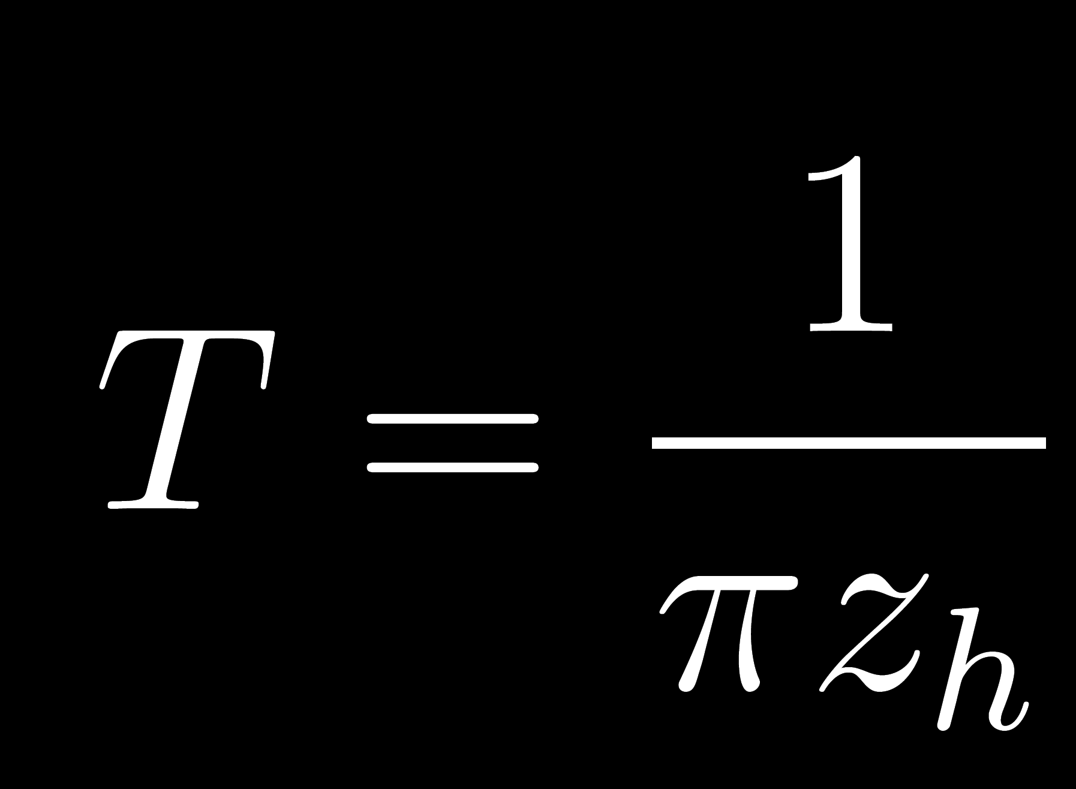
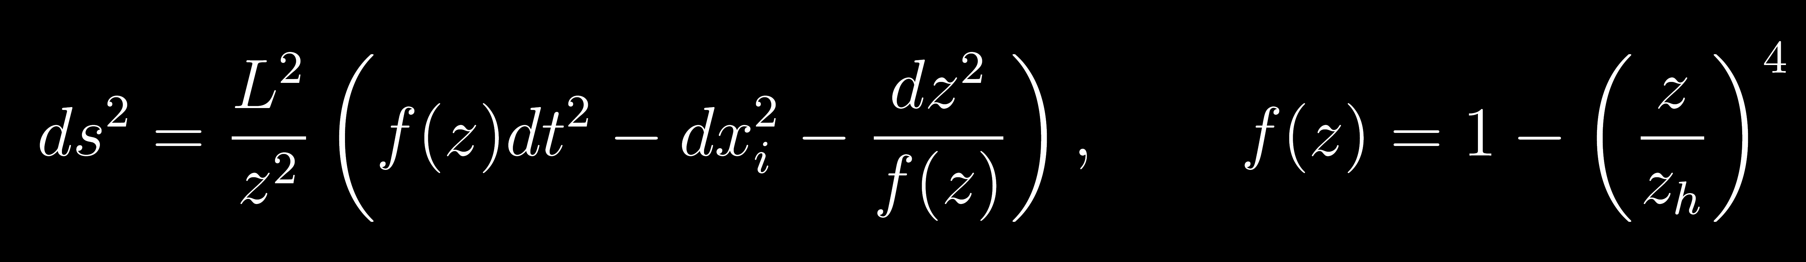
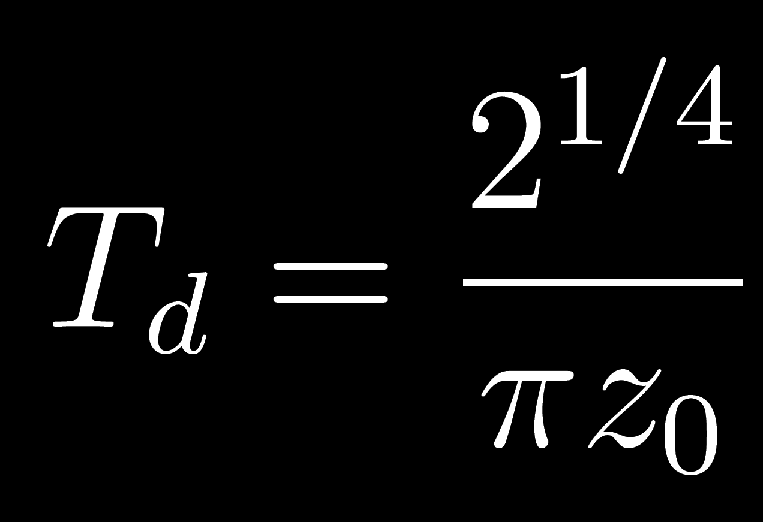
Finite temperature
Black-hole in AdS dual to thermal theory:
When z_{h}<z_{IR} :
Hard-wall disappears behind the horizon, deconfinement
Horizon sources a non-topological baryon density «k» QGP
Hawking-Page transition: happens at :
Temperature dependence only for deconfined phase
Deconfinement and chiral symmetry restoration coincide
TRIVIAL PHASE DIAGRAM

Slide 11

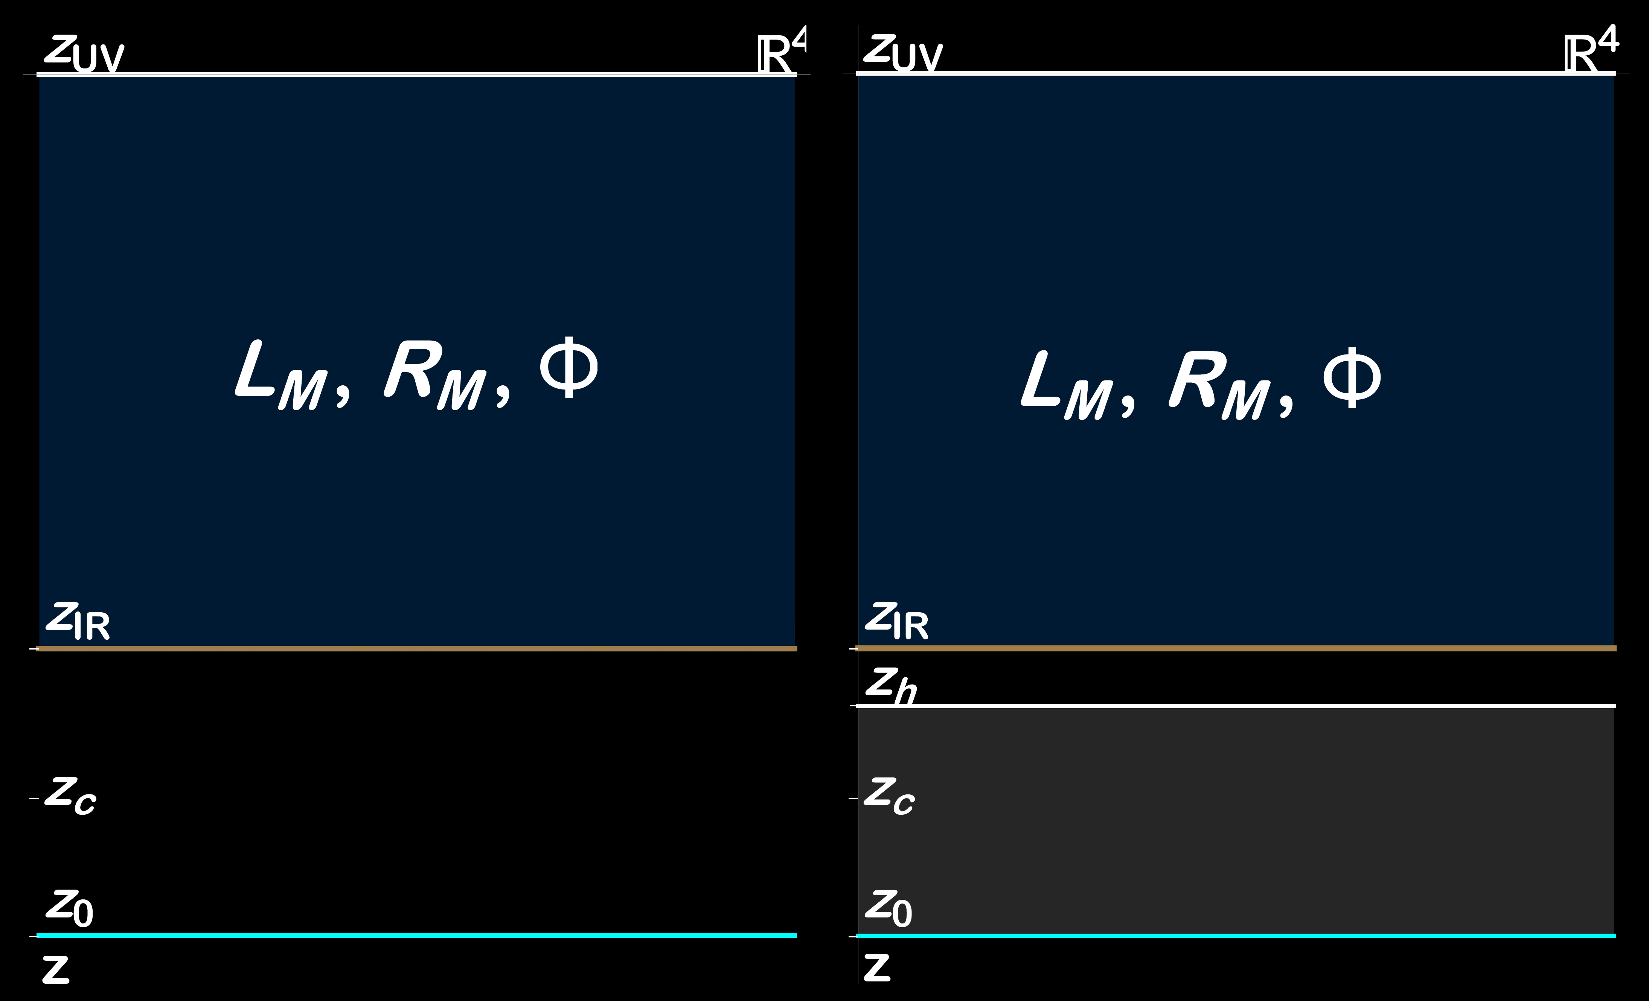
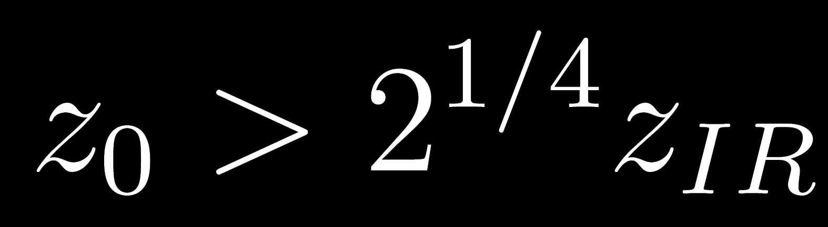
Double hard-wall
We introduce a second cut-off :
If , HP transition can
happen for T_{d}<T_{c}
Lowers T_{d}: effectively it is the same as treating T_{d} as a free parameter
Artificial construction? Present in top-down models (D4-D8)
No effects on neutron stars (T=0)
Richer phase diagram

Slide 12
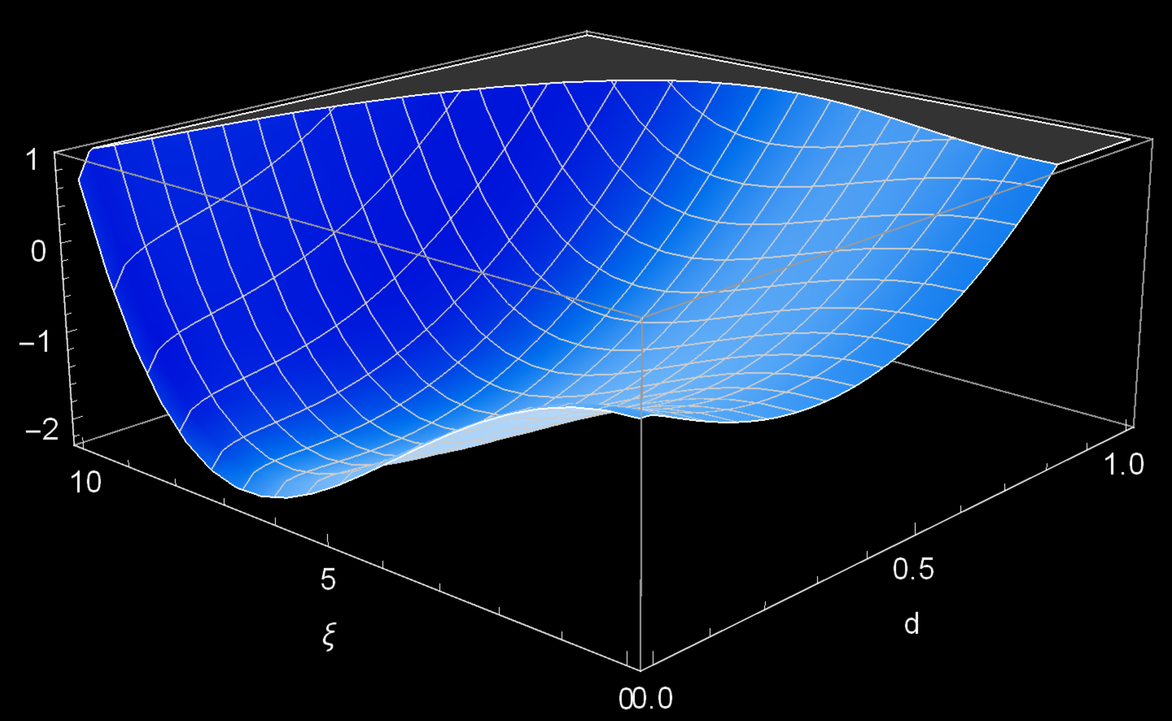
Chiral symmetry breaking and baryon onset
Thermodynamic equilibrium: for every μ minimize action wrt (d, ξ)
STRUCTURE OF VACUA:
Two local minima, at d=0 and ξ=0.
Temperature and μ determine which
vacuum has minimum energy.
This structure holds for all μ,T inspected.
Happy coincidence, easier numerics.

Slide 13
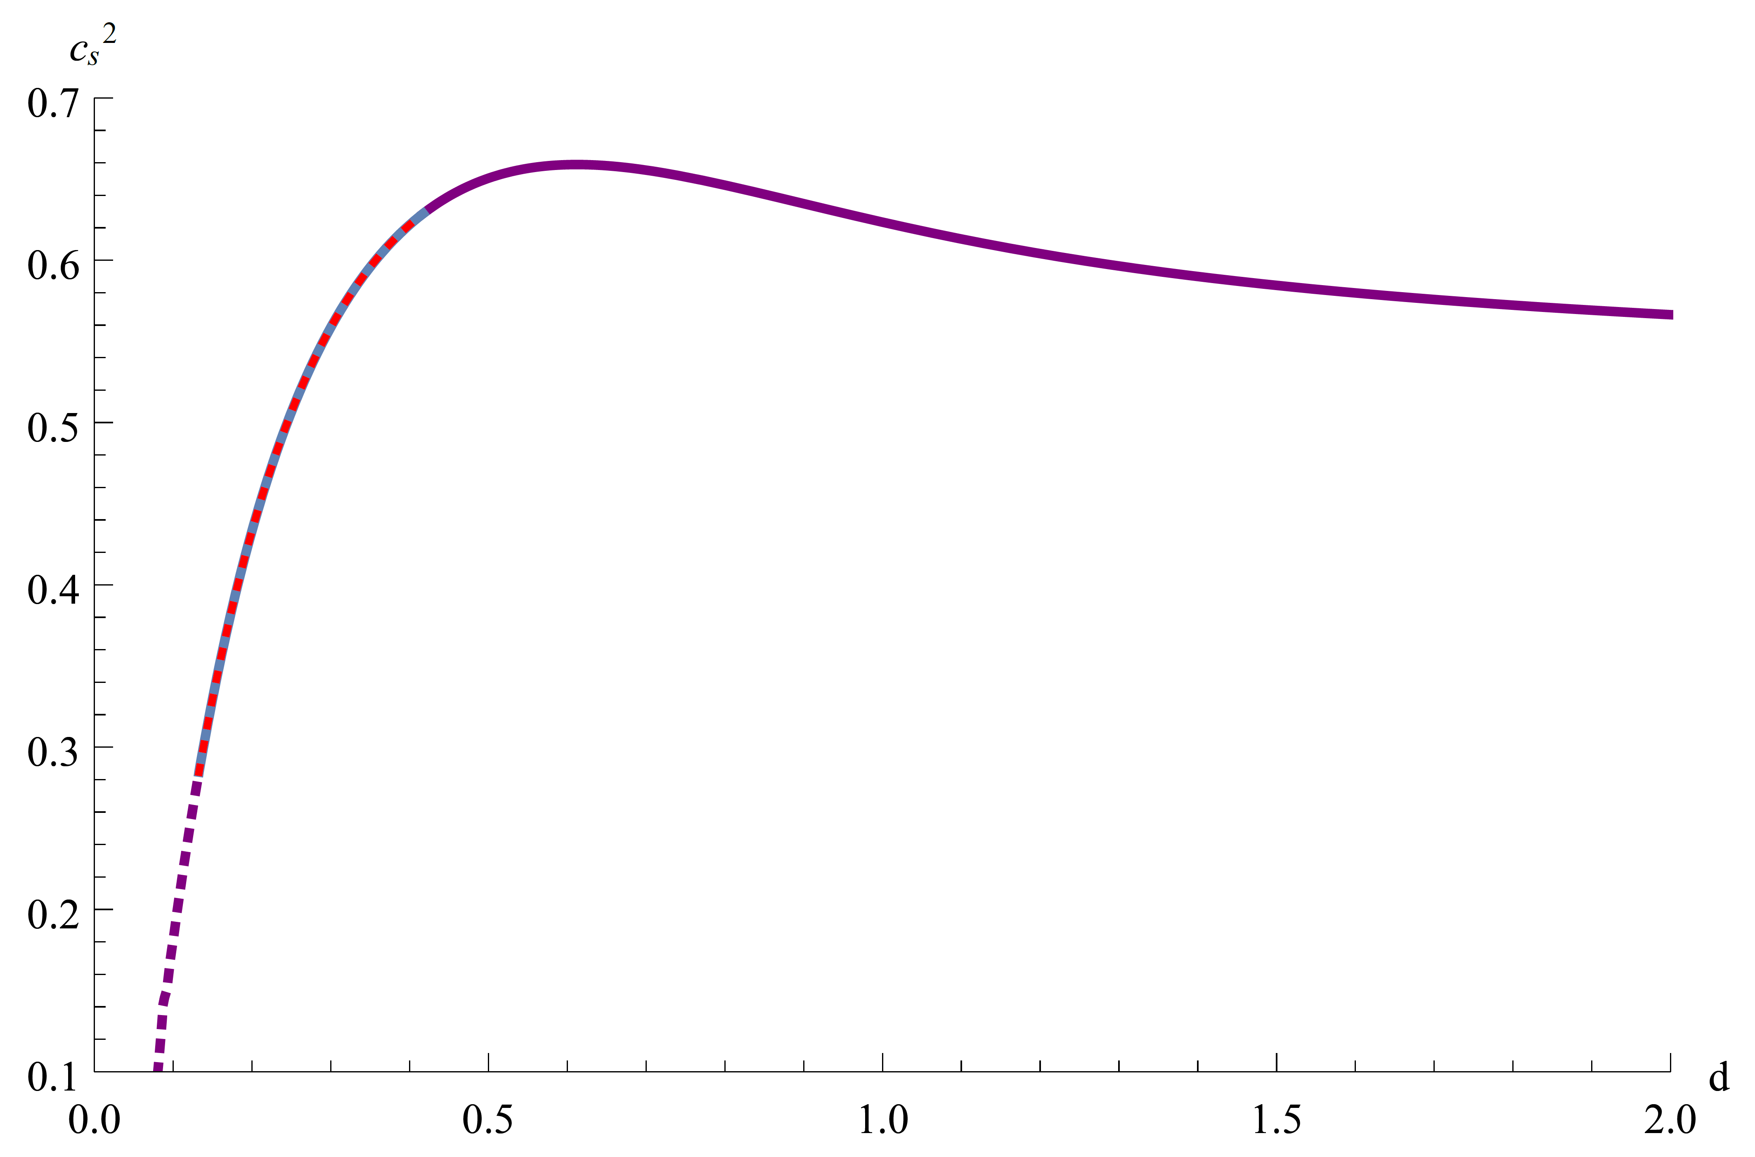
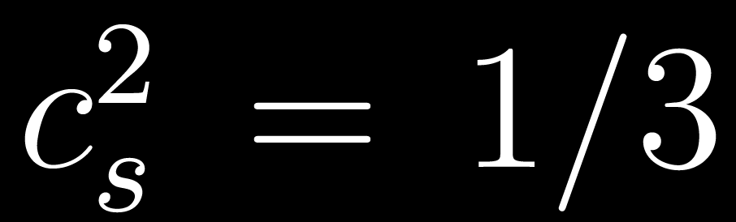
Speed of sound
Depends only on M5, NOT on other free parameters.
Not monotonic, has a peak above the sound barrier.
Reaches c²=0.659 The highest we encountered
among holographic models.
Asymptotically falls down to the conformal value:
BUT perturbative QCD should take over and eventually
the curve should approach 1/3 from below.

Slide 14
Homogeneous popcorn transition
Increase d the baryon number profile function b(z) develops a single peak.
The peak center moves towards the UV as d keeps increasing.
This is the homogeneous version of the «popcorn transition» for instantons (or excited states of n_{Z} in the WSS).
Is conjectured to point to a quarkyonic phase, as b(z) is interpreted as creating a Fermi surface of baryons with quarks inside.
HOWEVER NOTE: No density from free quarks (can be checked by holographic dictionary).

Slide 15
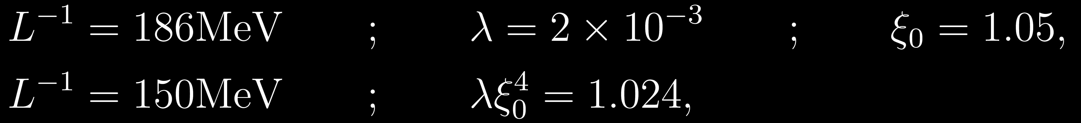
fit choices
WE EMPLOYED TWO DIFFERENT SETS OF PARAMETERS:
FIT A:
FIT B:
«FIT A» fits the baryonic onset and the baryon mass (computed with the AdS₅ soliton), leaving freedom to choose the best equation of state among the allowed ones.
IMPOSSIBLE to find satisfying EoS.
«FIT B» is purely chosen to reproduce the best compromise between the measured properties of neutron stars.
«Good» neutron stars can be found.

Slide 16
Phase diagram(s)
FIT A
FIT B
Free quarks when z_{h}<z_{IR}
Quarkyonic* is a phase with both baryons AND free quarks.
Quarkyonic has NO free quarks (baryon popcorn).
PHYSICAL ADIMENSIONAL

Slide 17
Results for Neutron stars
Equation of state
Mass-Radius curve
Tidal deformability
«FIT A» well outside radius measurements, within Λ, unrealistically massive stars.
«FIT B» just slightly small radius and Λ compared to measurements, lower masses but still very heavy.
We expect (supported by educated guesses) that refinement in the assumptions will move every curve into the experimentally admitted regions, and lower the highest mass for a stable star.

Slide 18
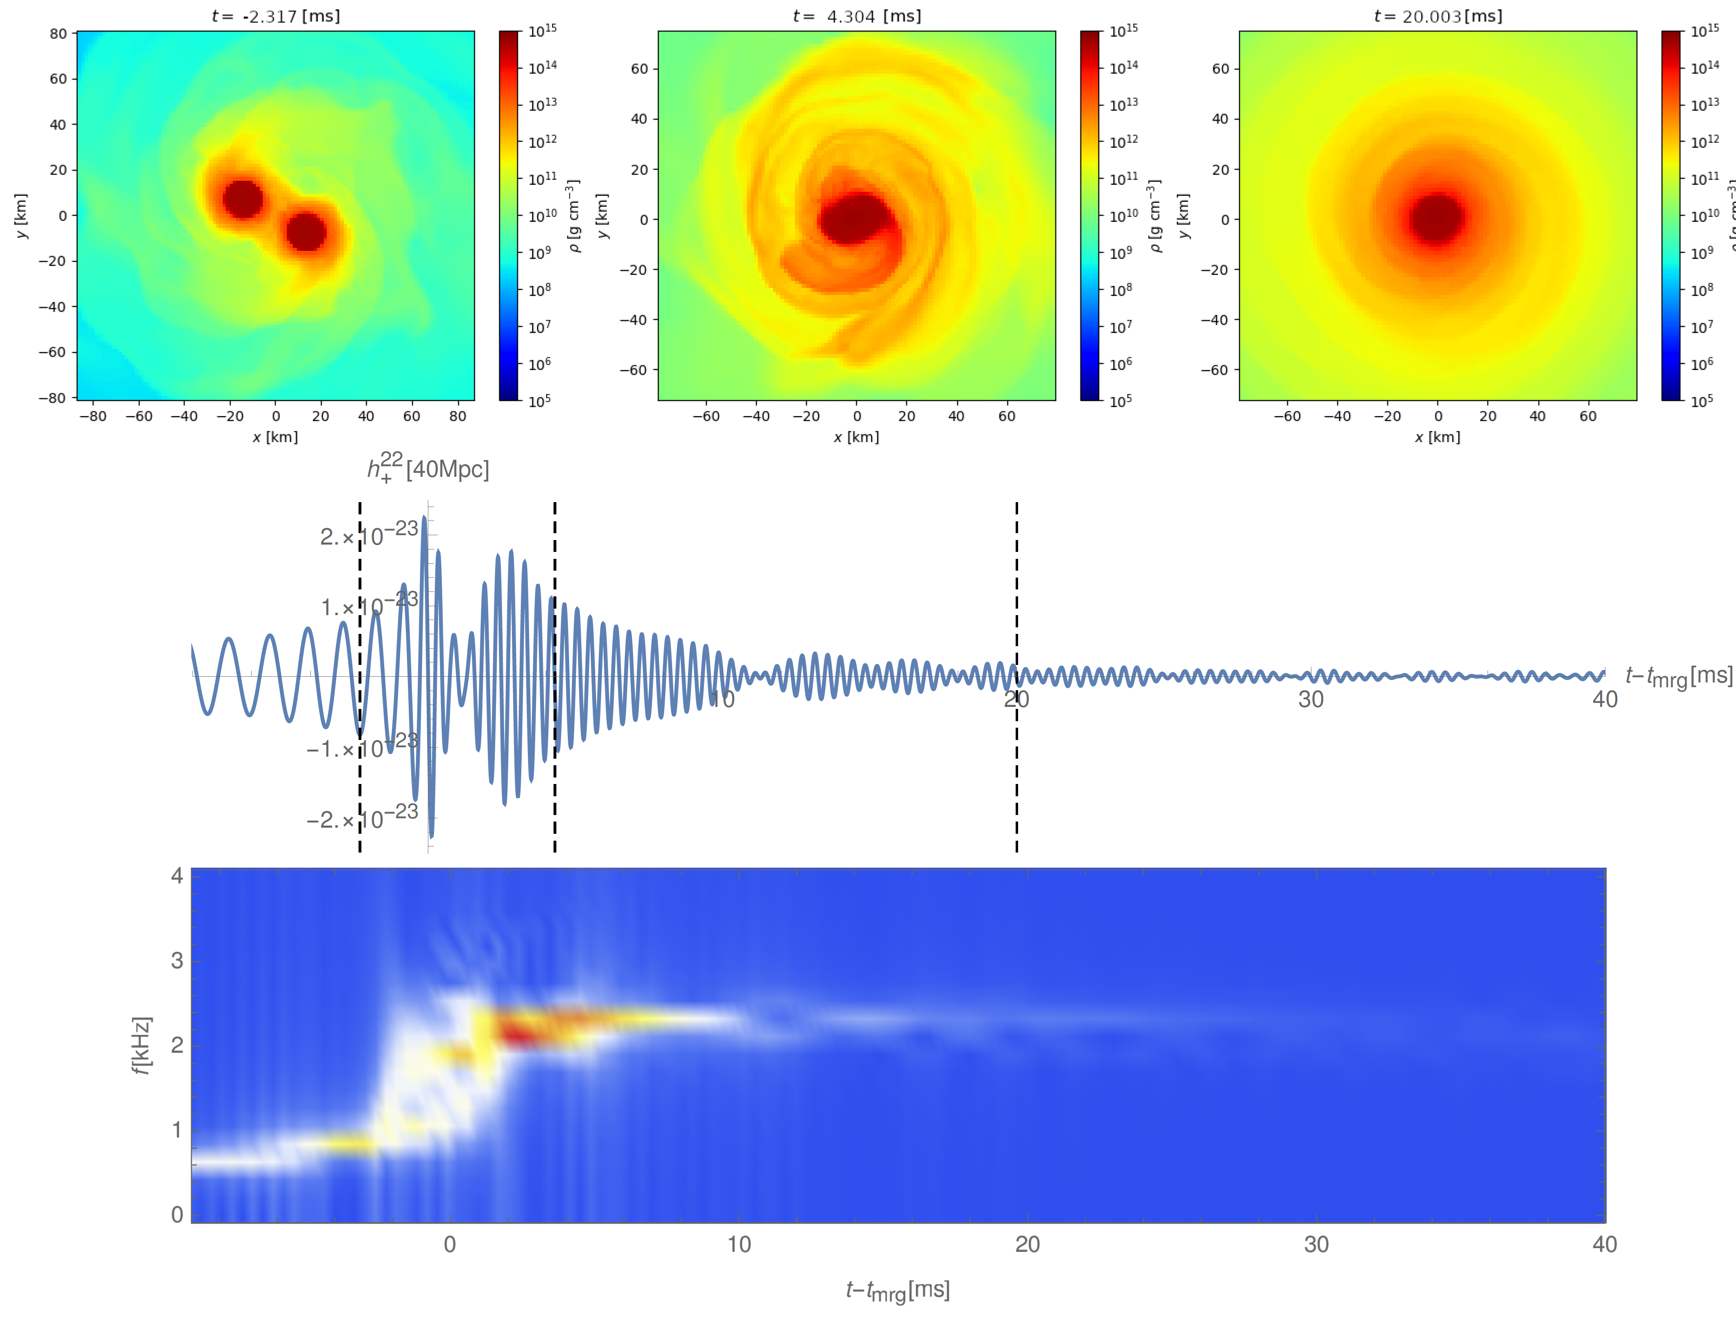
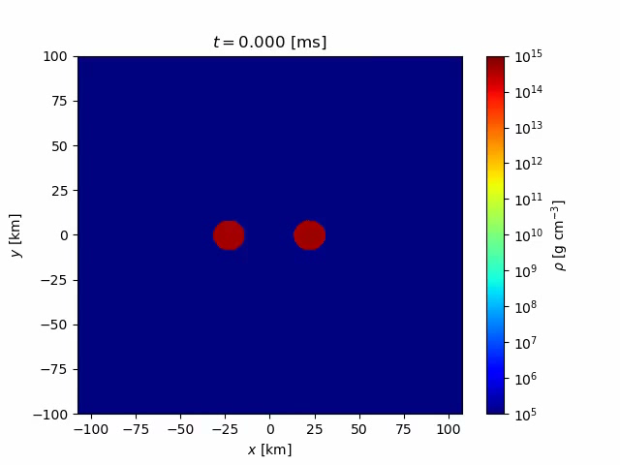
Neutron stars merger simulation (1.4 Solar masses, fit b)

Slide 19
Future directions
Priority for the future of our model: refine the assumptions on the structure of neutron stars
Step one is to give the stars a suitable crust.
The crust has low density and it is very unlikely to change the highest masses in the MR curves, BUT it:
Sensibly increases the radii
Qualitatively change the low mass behaviour of the MR curve
These two effects can be combined with the freedom to choose a fit for the free paramenters: larger radii would allow for lower masses just by changing calibration of the model.

Slide 20
What we expect
Small improvement in EoS (crust)
Find at least one set of parameters that satisfies every observational bound.
Perform simulations of neutron stars mergers with realistic masses that result in the formation of a black hole.
Inspect the differences in MR curves and gravitational wave signals, between fully holographic EoS, and hybrid ones.
… (we are open to suggestions)

Slide 21
Thank you for your attention!

