Slide 1
Decays of Heavy Quark Hybrids
XVth Quark Confinement and the Hadron Spectrum
University of Stavanger, Norway
Aug 01, 2022
Abhishek Mohapatra (TU Munich)
Nora Brambilla (TU Munich)
Wai Kin Lai (South China Normal university)
Antonio Vairo (TU Munich)

Slide 2
Outline
Introduction to X Y Z mesons
EFT for Quarkonium Hybrids
BO-EFT effective theory
Quarkonium Hybrid Spectrum
Decay Rates for hybrid
Summary and Outlook

Slide 3
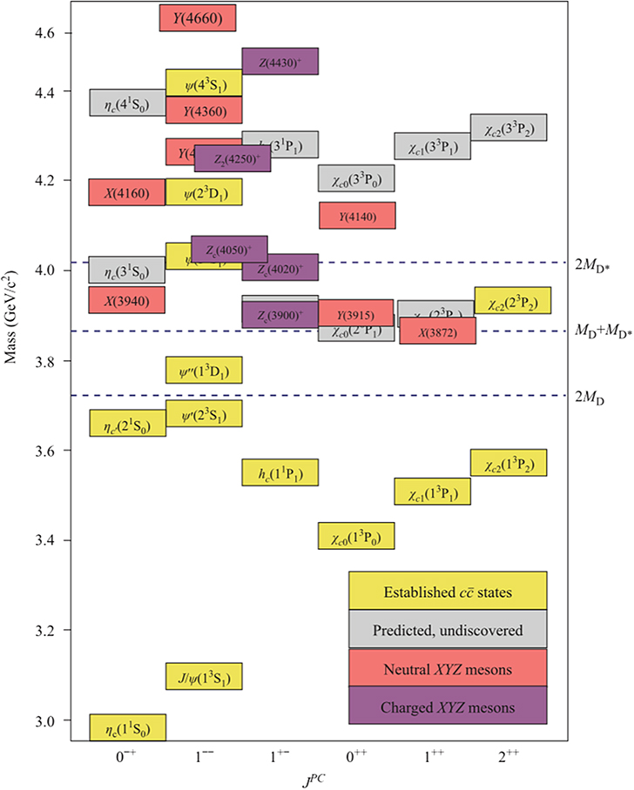
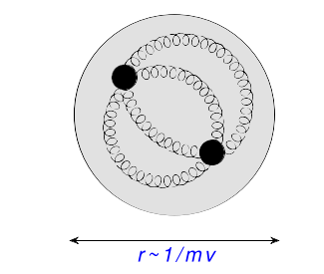
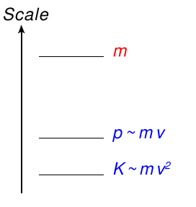
Introduction
Quarkonium: Color singlet bound state of $\text{Q}\overline{\text{Q}}$ (Q = c, b).
QCD
(Hard)
NRQCD
(Soft)
pNRQCD
(US)
Hierarchy of Energy Scales in $\text{Q}\overline{\text{Q}}$:
$$m≫mv≫mv^{2}, Λ_{QCD}$$
(perturbative dynamics: Weakly Coupled)
$$m≫mv,Λ_{QCD}≫mv^{2}$$
(nonperturbative dynamics: Strongly
Coupled)
pNRQCD: Relevant EFT for Quarkonium.
Mehen and Fleming, Phys. Rev. D73, 034502 (2005)
Bodwin, Braaten & Lepage (1994),
Brambilla, Vairo, and Rosch, Phys. Rev. D72, 034021 (2005)
Luke, Manohar & Rothstein (2000)
Front. Phys. 10 101401 (2015)

Slide 4
Introduction
Quark Model:
Mesons: quark-antiquark states
Baryons: 3-quark states
QCD spectrum also allows for more complex
structures called as Exotics.
Exotic states: XYZ mesons
Quarkonium-like states that don’t fit traditional $\text{Q}\overline{\text{Q}}$ spectrum.
In some cases exotic quantum numbers (charged ${\text{Z}}_{\text{c}}$ and ${\text{Z}}_{\text{b}}$ states)
For review see Brambilla et al. Phys. Reports. 873 (2020)
X(3872): First exotic state discovered in 2003 by Belle.
Phys. Rev. Lett. 91, 262001 (2003)
Several new heavy quark exotic states have been
discovered since 2003 (masses & decay rates measured in various channels).
PDG 2021
Front. Phys. 10 101401 (2015)
Notes:
For our case, we will focus on the heavy quark exotic states. Nature of these XYZ states still unknown.

Slide 5
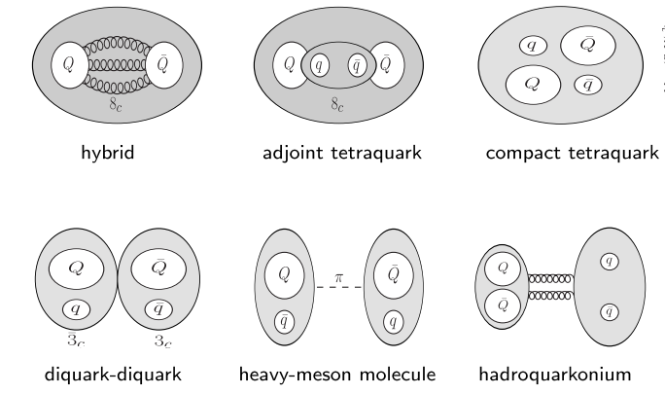
Introduction
Exotics broadly classified as
Structures with active gluons
Multiquark states
Several interpretations of Exotics:
Figure from W.K.Lai talk
No single model completely describes all the XYZ states.
Hybrids $\text{(}\text{Q}\overline{\text{Q}}\text{g}\text{)}$: Focus of this talk. Use EFT + lattice
to have model independent description.
Front. Phys. 10 101401 (2015)

Slide 6
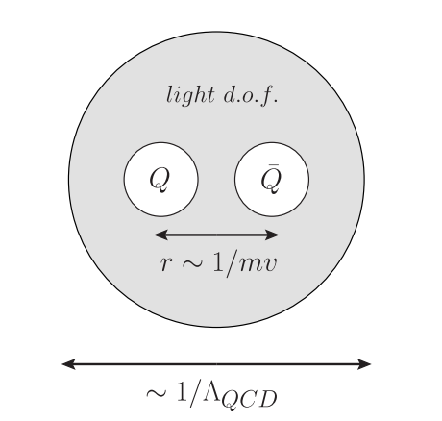
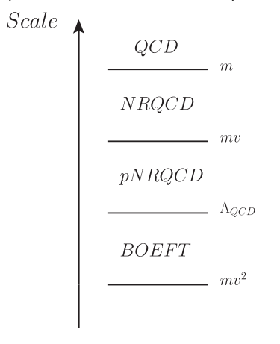
Quarkonium hybrids: EFT
Hybrids $\text{(}\text{Q}\overline{\text{Q}}\text{g}\text{)}$: Color singlet combination of color octet $\text{Q}\overline{\text{Q}}$ + gluonic excitations.
Separation of scales in hybrids:
light d.o.f: ${\text{Λ}}_{\text{QCD}}$
Relative separation between heavy quarks: $r∼1/mv$
Heavy Quark K.E scale: $mv^{2}$
Time-scale for dynamics of $\text{Q}\overline{\text{Q}}:∼\frac{\text{1}}{\text{m}{\text{v}}^{\text{2}}}\text{≫}\frac{1}{{\text{Λ}}_{\text{QCD}}}$
Born-Oppenheimer Approximation
Braaten, Langmack, Smith
Phys. Rev. D. 90, 014044 (2014)
Appropriate EFT framework for Hybrids: Born-Oppenheimer EFT (BOEFT)
Brambilla, Krein, Castellà , Vairo Phys. Rev. D. 97, (2018)
Berwein, Brambilla, Castellà , Vairo Phys. Rev. D. 92, (2015)
R. Oncala, J. Soto, Phys. Rev. D96 (2017)
Notes:
A complete understanding of exotic quarkonia in terms of these pictures has not yet been obtained

Slide 7
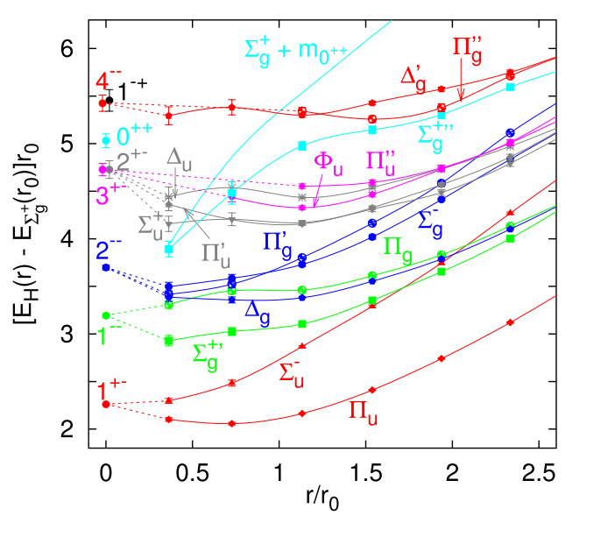
Quarkonium hybrids: BOEFT
Static limit $\text{(}\text{m}\text{→ ∞)}$: Quantum #’s for hybrid
Gluonic static energies
M. Foster and C. Michael, Phys. Rev. D59 (1999)
K. Juge, J. Kuti, C. Morningstar, Phys. Rev. Lett. 90 (2003)
Static Energies $(Σ, Π, Δ)$: Eigenvalue of NRQCD
Hamiltonian in the static limit.
For $\text{r}\text{→ 0}$: static energies are degenerate.
Characterized by $\text{O}\left(\text{3}\right)\text{×}\text{C}$ symmetry group.
Labelled by: ${\text{(}\text{K}}^{\text{PC}}\text{, }{\text{Λ}}_{\text{η}}^{\text{σ}}\text{)}$
Berwein, Brambilla, Castellà , Vairo Phys. Rev. D. 92, (2015)
Fig from G. S. Bali and A. Pineda,
Phys. Rev. D69 (2004)
Notes:
D_{infinity}h-→cyckindrical symmetry group. O(3)*C:spherical symmetry group.

Slide 8
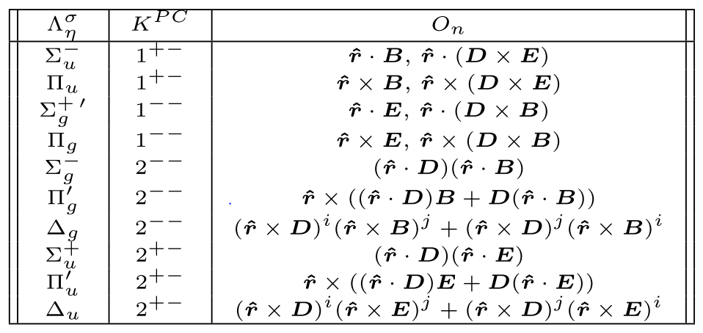
Quarkonium hybrids: BOEFT
Static limit $\text{(}\text{m}\text{→ ∞)}$: Quantum #’s for hybrid
Gluonic operators characterizing
Hybrids in Wilson loop
Static Energies $(Σ, Π, Δ)$: Eigenvalue of NRQCD
Hamiltonian in the static limit.
For $\text{r}\text{→ 0}$: static energies are degenerate.
Characterized by $\text{O}\left(\text{3}\right)\text{×}\text{C}$ symmetry group.
Labelled by: ${\text{(}\text{K}}^{\text{PC}}\text{, }{\text{Λ}}_{\text{η}}^{\text{σ}}\text{)}$
Berwein, Brambilla, Castellà , Vairo Phys. Rev. D. 92, (2015)
Focus on these two for low lying hybrids
Notes:
In Wilson loop description, the sigma_u and Pi_u states are characterized by the following gluonic operators.

Slide 9
Quarkonium hybrids: BOEFT
BOEFT d.o.f involve color singlet fields
: Gluelump operator. Eigenvector of NRQCD Hamiltonian in $\text{(}\text{m}\text{→ ∞)}$:
$Λ_{κ}$ : Gluelump energy
$P_{κλ}^{i}$: Projection operators of light d.o.f along heavy quark-antiquark axis.
BOEFT Lagrangian:
Schrödinger Eq: Dynamics of $\text{Q}\overline{\text{Q}}$ at scale $\text{m}{\text{v}}^{\text{2}}≪{\text{Λ}}_{\text{QCD}}$
Hybrid wf
Coupled Eq. due to projection operators. Mixes $Σ_{u}$ and $Π_{u}$ states.
Brambilla, Krein, Castellà , Vairo Phys. Rev. D. 97, (2018)
Berwein, Brambilla, Castellà , Vairo Phys. Rev. D. 92, (2015)
Notes:
Mixing between sigma and Pi states is something like lambda-doubling in atomic physics.

Slide 10
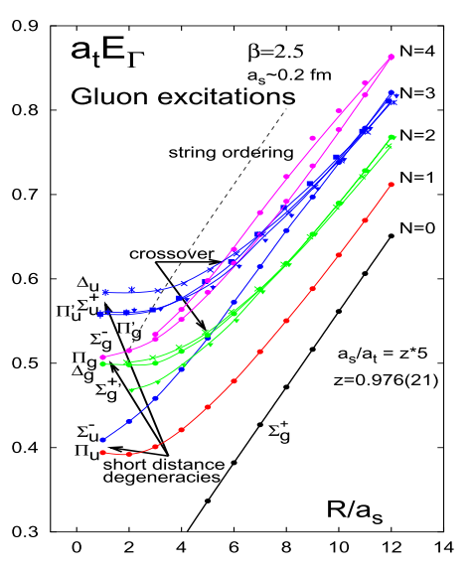
Quarkonium hybrids: Spectrum
Lattice potentials for solving the Schrödinger Eq:
N. Brambilla, W.K. Lai, AM, A. Vairo (in progress)
Gluonic Static energies from lattice:
Quarkonium Potential:
RS-Scheme Hybrid Potential:
K. Juge, J. Kuti, C. Morningstar, Phys. Rev. Lett. 90 (2003)
Perturbative RS-scheme potentials $V_{o}^{RS}$ upto order$α_{s}^{3}.$
Berwein, Brambilla, Castellà , Vairo Phys. Rev. D. 92, (2015)
Bali and Pineda Phys. Rev. D. 69, (2004)
Kniehl, Penin, Schroder , Smirnov, Steinhauser Phys. Lett. B 607, (2005)
Notes:
Short Range, we use perturbative RS-scheme potentials for both Quarkonium and Hybrids.
Parameters determined by ensuring a smooth transition between the short-range and the long-range pieces of the potential, we impose continuity up to first derivatives.

Slide 11
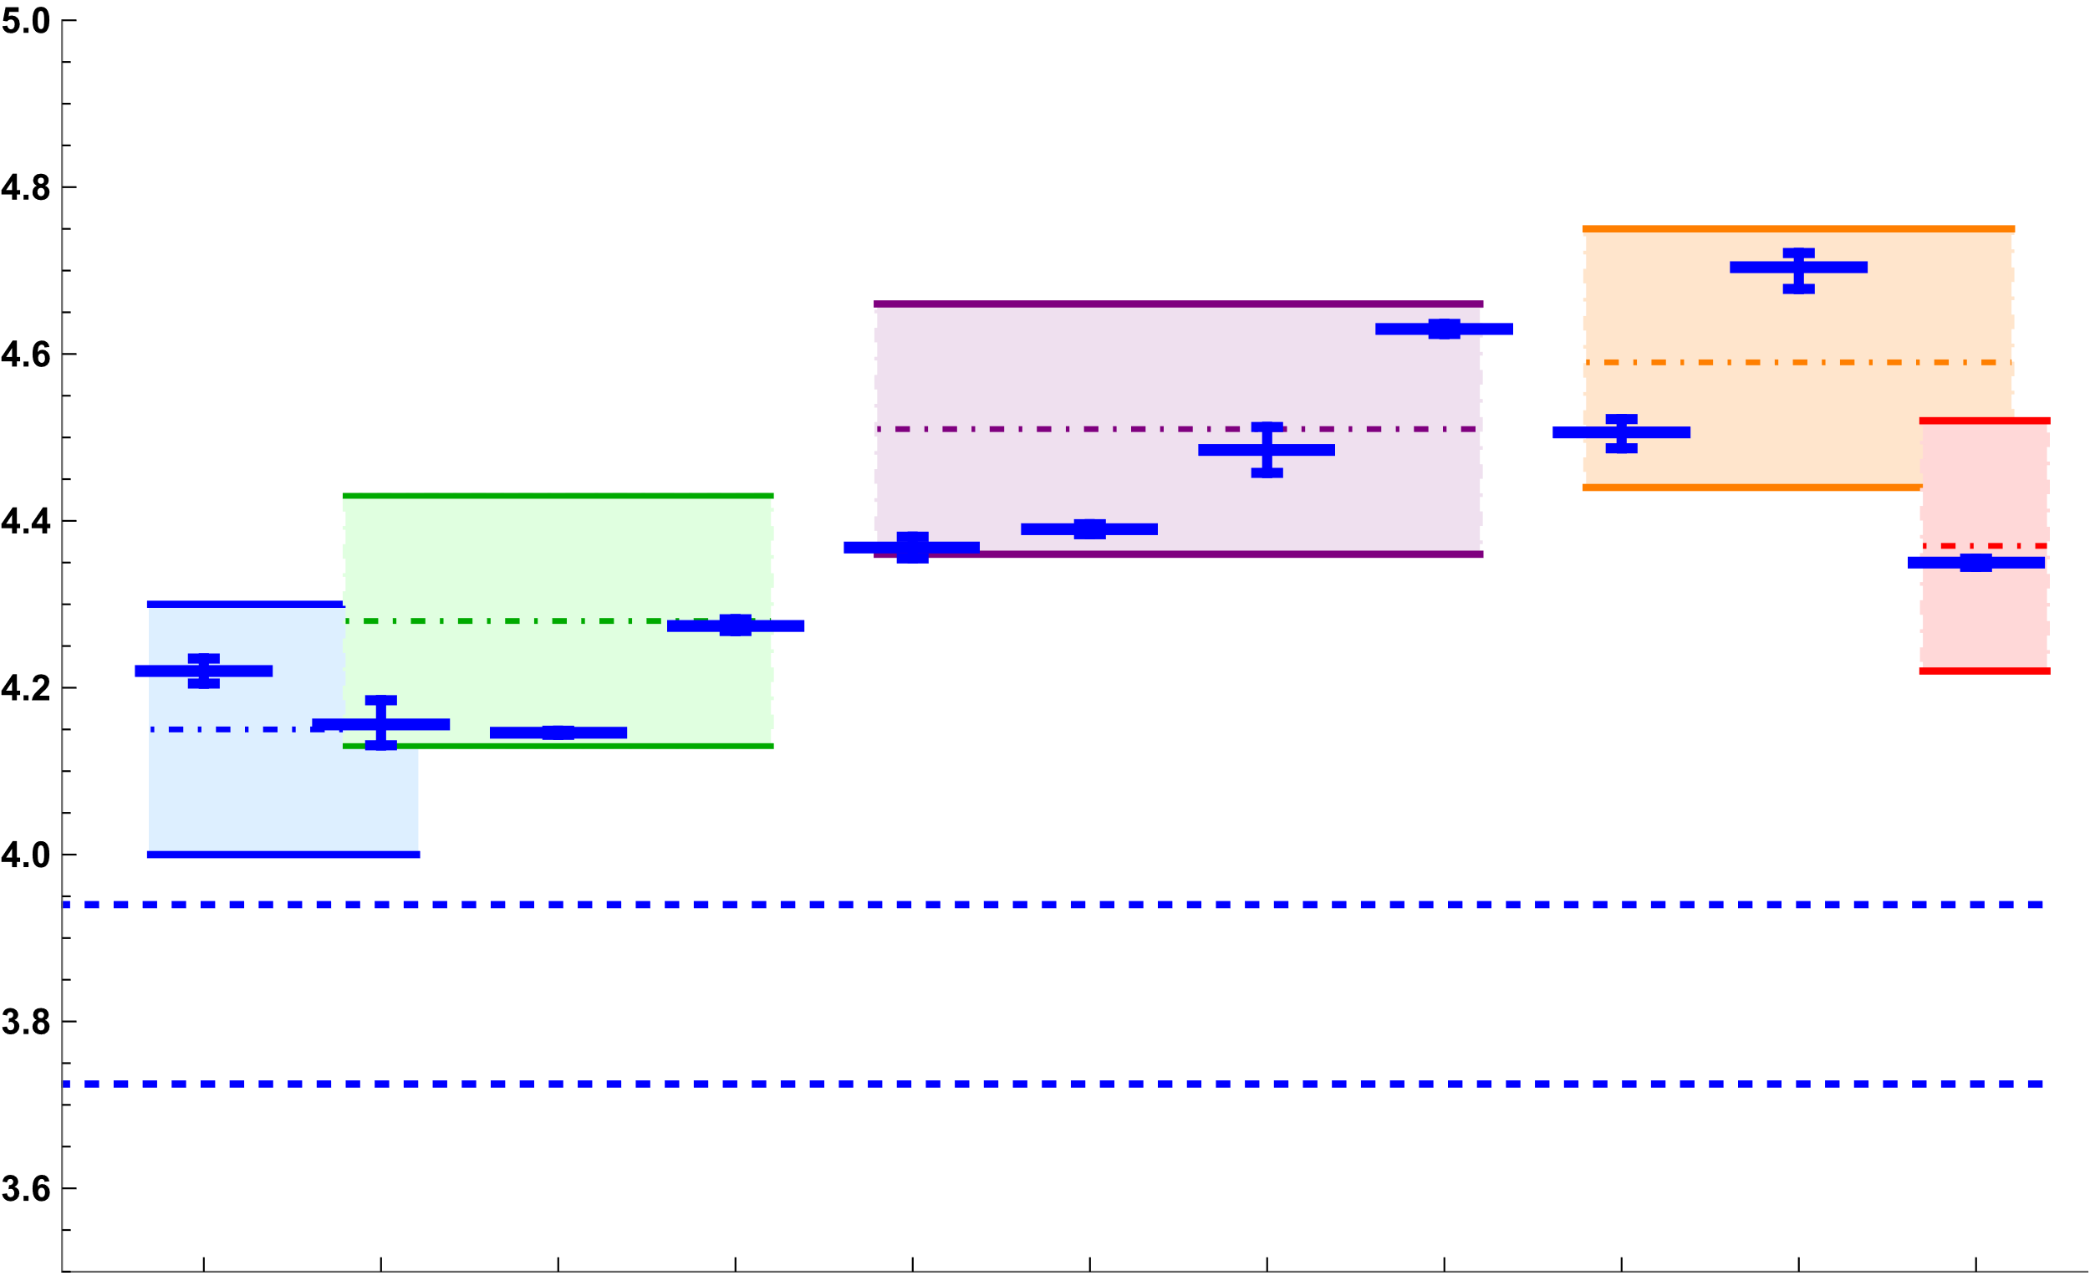
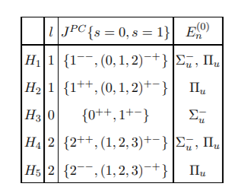
Quarkonium hybrids: Spectrum
Charmonium hybrids: comparison with experimental results:
$$H_{3}$$
Other notation of hybrid states
$$H_{1}^{′}$$
$$H_{2}$$
$$H_{1}$$
Mass (GeV)
$$N{\left(s/d\right)}_{1}$$
$$H_{4}$$
$$Np_{1}$$
$D_{s}{\overline{D}}_{s}$ threshold
$$Np_{0}$$
$D\overline{D}$ threshold
$$N{\left(p/f\right)}_{2}$$
$$Nd_{2}$$
$$ψ\left(4230\right)$$
$$[1^{−−}]$$
$$X\left(4160\right)$$
$$[?^{??}]$$
$$χ_{c1}\left(4140\right)$$
$$[1^{++}]$$
$$χ_{c1}\left(4274\right)$$
$$[1^{++}]$$
$$ψ\left(4360\right)$$
$$[1^{−−}]$$
$$ψ\left(4390\right)$$
$$[1^{−−}]$$
$$Y\left(4500\right)$$
$$[1^{−−}]$$
$$ψ\left(4660\right)$$
$$[1^{−−}]$$
$$χ_{c0}\left(4500\right)$$
$$[0^{++}]$$
$$χ_{c0}\left(4700\right)$$
$$[0^{++}]$$
$$X(4350)$$
$$[{(0/2)}^{++}]$$
Berwein, Brambilla, Castellà , Vairo Phys. Rev. D. 92, (2015)
Berwein, Brambilla, Castellà , Vairo Phys. Rev. D. 92, (2015)
$Λ$- doubling: opposite parity states non-degenerate.
Braaten, Langmack, Smith Phys. Rev. D. 90, 014044 (2014)
Braaten, Langmack, Smith Phys. Rev. D. 90, 014044 (2014)
PDG 2021
R. Oncala, J. Soto, Phys. Rev. D96 (2017)

Slide 12
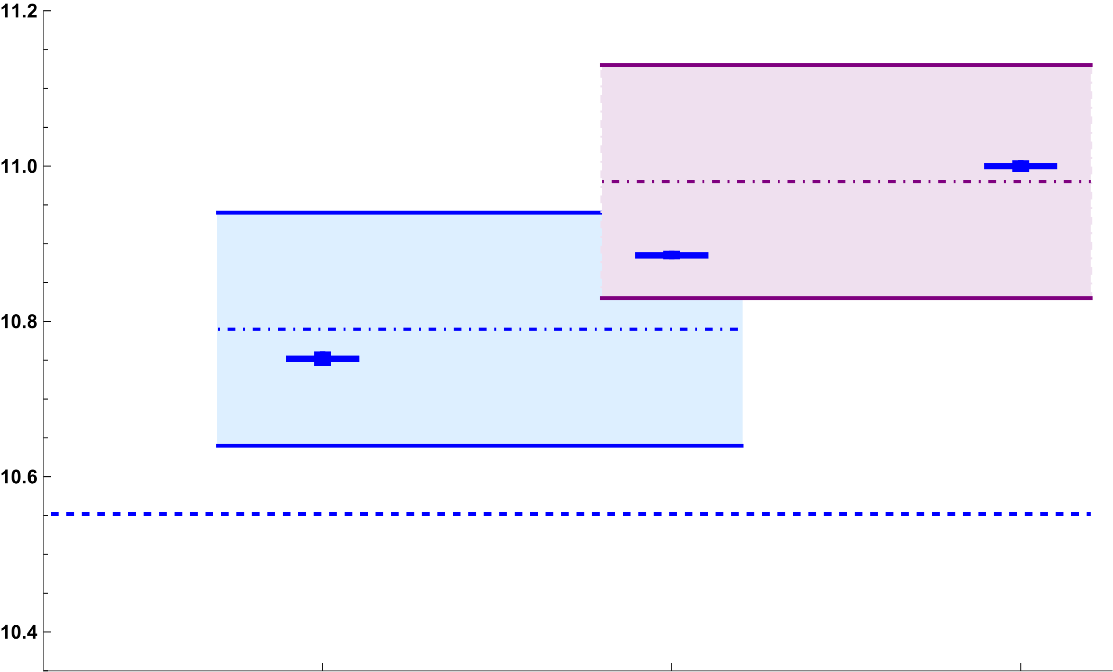
Quarkonium hybrids: Spectrum
Bottomonium hybrids: comparison with experimental results:
$$H_{1}^{′}$$
Other notation of hybrid states
$$H_{1}$$
Mass (GeV)
$$N{\left(s/d\right)}_{1}$$
$$Np_{1}$$
$$Np_{0}$$
$B\overline{B}$ threshold
$$N{\left(p/f\right)}_{2}$$
$$Nd_{2}$$
$$Υ\left(10753\right)$$
$$[1^{−−}]$$
$$Υ\left(10860\right)$$
$$[1^{−−}]$$
$$Υ\left(11020\right)$$
$$[1^{−−}]$$
Berwein, Brambilla, Castellà , Vairo Phys. Rev. D. 92, (2015)
PDG 2021
Braaten, Langmack, Smith Phys. Rev. D. 90, 014044 (2014)
R. Oncala, J. Soto, Phys. Rev. D96 (2017)

Slide 13
Inclusive Decays
Dozens of XYZ states have been discovered (mass and decay rates measured) but physics still unknown.
Several theoretical models for exotic states but no general consensus.
Most of the exotic states discovered from decays to quarkonium. Decays might provide essential information on the structure of XYZ.
Decay process of low-lying hybrids $H_{m}$:
Inclusive decays: $H_{m}→X$
Semi-inclusive decays: $H_{m}→Q_{n}+X$
Both processes are characterized by energy gap $ΔE$.
$ΔE≈$ Energy difference of quark-antiquark pair in gluelump and singlet $⇒ΔE∼E_{o}+Λ_{κ}−E_{s}$.
Assume hierarchy of scales: $\text{mv}\text{ ≫ ∆}\text{E}\text{ ≫ }{\text{Λ}}_{\text{QCD}} \text{≫} \text{m}{\text{v}}^{\text{2}}$
Start with pNRQCD effective theory and obtain BOEFT by matching: Integrate out modes
of scale $∼\text{∆}$ and $∼{\text{Λ}}_{\text{QCD}}$.
N. Brambilla, W.K. Lai, AM, A. Vairo (in progress)

Slide 14
Inclusive Decays
pNRQCD Lagrangian:
BOEFT:
Potential term in BOEFT
Decays are computed from local imaginary terms in the BOEFT Lagrangian.
Imaginary term in $V_{soft}^{ij}$ from 1-loop diagram in pNRQCD and then matching to BOEFT .
N. Brambilla, W.K. Lai, AM, A. Vairo (in progress)
Notes:
The potential term contains the imaginary term.

Slide 15
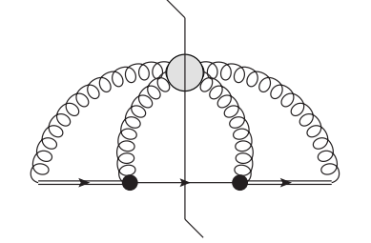
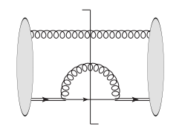
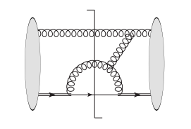
Inclusive Decays
N. Brambilla, W.K. Lai, AM, A. Vairo (in progress)
pNRQCD Lagrangian:
Spin preserving decays
Spin flipping decays
1-loop diagram in pNRQCD contributing to Im $V_{soft}^{ij}$ in BOEFT:
$$=$$
$$+$$
Black dot: vertex of pNRQCD
Spectator gluon approximation
example of $α_{s}$ correction
Notes:
LHS is the representation of the 1-loop diagrams we use in pNRQCD. RHS are the ones that we compute.

Slide 16
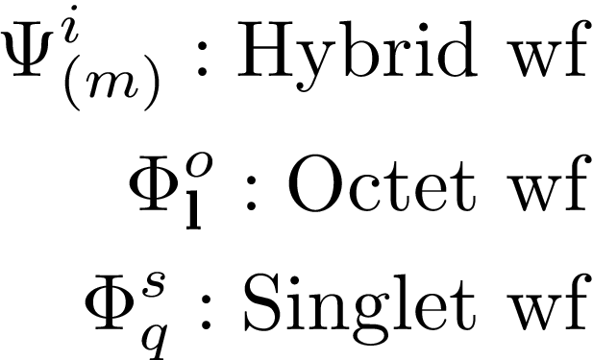
Inclusive Decays
N. Brambilla, W.K. Lai, AM, A. Vairo (in progress)
Spin-conserving decay due to $r⋅E$ term :
$|S_{H}=1> −−→|S_{Q}=1>$
$|S_{H}=0> −−→|S_{Q}=0>$
bound singlet
states
continuum singlet
states
Depends on several Overlap functions:
Cubic factor
Including continuum states can account for decay to meson-meson thresholds.
For singlet wf : $V_{s}=−{4 α_{s}(mv)}/3$, where $v∼1/\sqrt{3}$ for charm and $∼1/\sqrt{10}$ for bottom
Notes:
The computation of the decay rates with these overlap functions is still ongoing.

Slide 17
Semi-inclusive Decays
N. Brambilla, W.K. Lai, AM, A. Vairo (in progress)
Spin-conserving decay due to $r⋅E$ term :
bound singlet
states
continuum singlet
states
Depends on several Overlap functions:
Quarkonium wf
Significant overlap between quarkonium and continuum singlet states except for 1s quarkonium.
Decay rate different from R. Oncala, J. Soto, Phys. Rev. D96, 014004 (2017) and J. Castellà, E. Passemar, Phys. Rev. D104, 034019 (2021).
Notes:
The computation of the decay rates with these overlap functions is still ongoing.

Slide 18
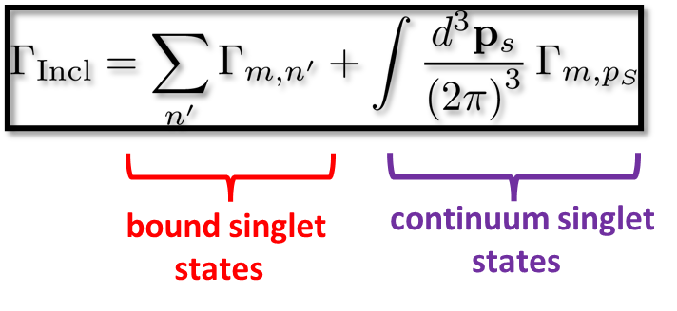
Inclusive Decays
N. Brambilla, W.K. Lai, AM, A. Vairo (in progress)
Spin-flipping decay due to $S.B$ term:
$|S_{H}=1> −−→|S_{Q}=0>$
$|S_{H}=0> −−→|S_{Q}=1>$
$|χ_{o,s}⟩$: Spin wf of octet
and singlet
Depends on several Overlap functions:
$Q_{m}→Q_{n}+X$ spin-flipping decays: Decay rate suppressed by additional ${\left(r⋅E\right)}^{2}∼v^{2}$
vertex factor.

Slide 19
Difficulties with continuum singlet states
Dipole matrix element:
W. Gordon, Ann. Phys. (Leipzig) 2, 1031 (1929)
A. Maquet, Phys. Rev. A 15, 1088 (1977)
After integrating over $dΩ$: $l^{′}=l+1$ or $l^{′}=l−1$
Continuum radial wf for Coulomb octet and singlet
Radial matrix element:
Smooth function of octet and
singlet momentum $k_{o}$ and $p_{s}$
Singular function:
“Diagonal Singularity” for $k_{o}→p_{s}$
Madajczyk, Trippenbach, J . Phys. A: Math. Gen. 22 2369 (1989)
Veniard, Piraux, Phys. Rev. A 41, 4019 (1989)

Slide 20
Difficulties with continuum singlet states
“Diagonal Singularity” for $k_{o}→p_{s}$: Singular Gauss hypergeometric$2F_{1}$ function

Slide 21
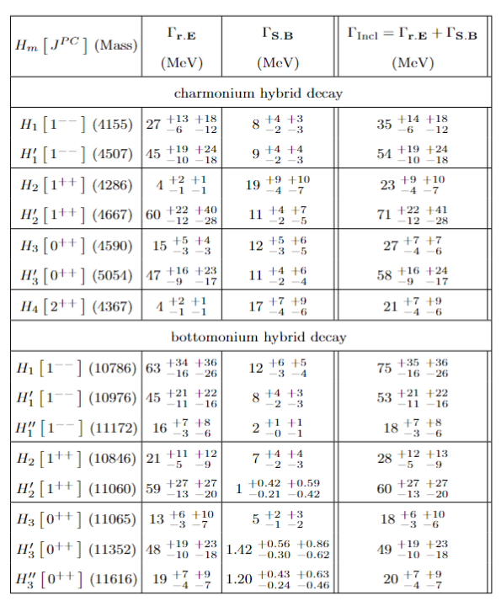
Preliminary Results
N. Brambilla, W.K. Lai, AM, A. Vairo (in progress)
Inclusive Rate:
Error bars from higher order corrections in $α_{s}$ + Error bar from gluelump mass ($±0.15$ GeV) .
Decays not allowed in
R. Oncala, J. Soto, Phys. Rev. D96, 014004 (2017)
The hybrid states with a prime and double prime denotes the first and the second excited state
Corrections from the contributions of the continuum singlet states not included here.

Slide 22
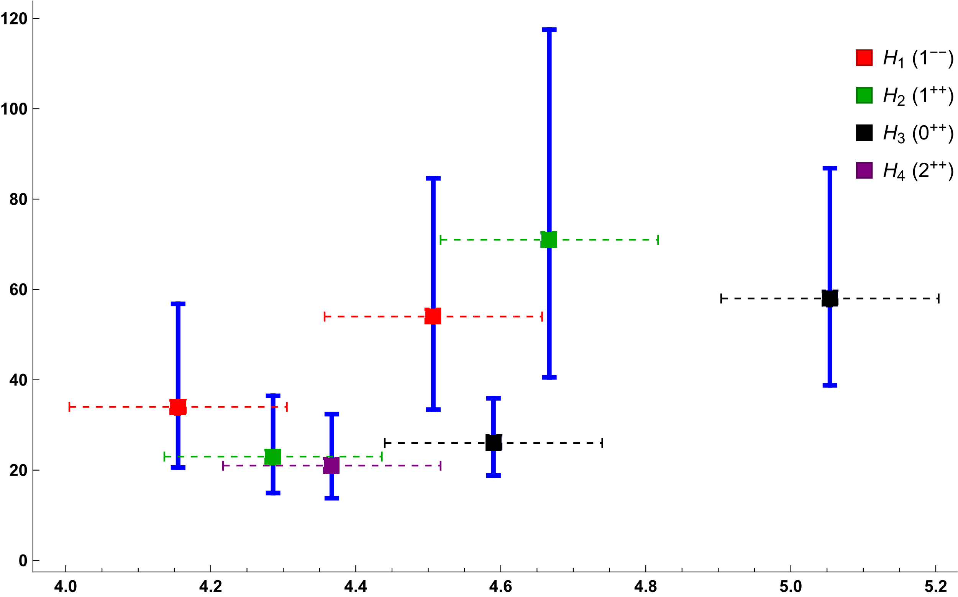
Preliminary Results
Preliminary Results
Inclusive Rate for Charmonium Hybrids:
Inclusive Rate for Charmonium Hybrids:
$Γ_{incl}$ (MeV)
Corrections from the contributions of the continuum singlet states not included here.
Mass (GeV)

Slide 23
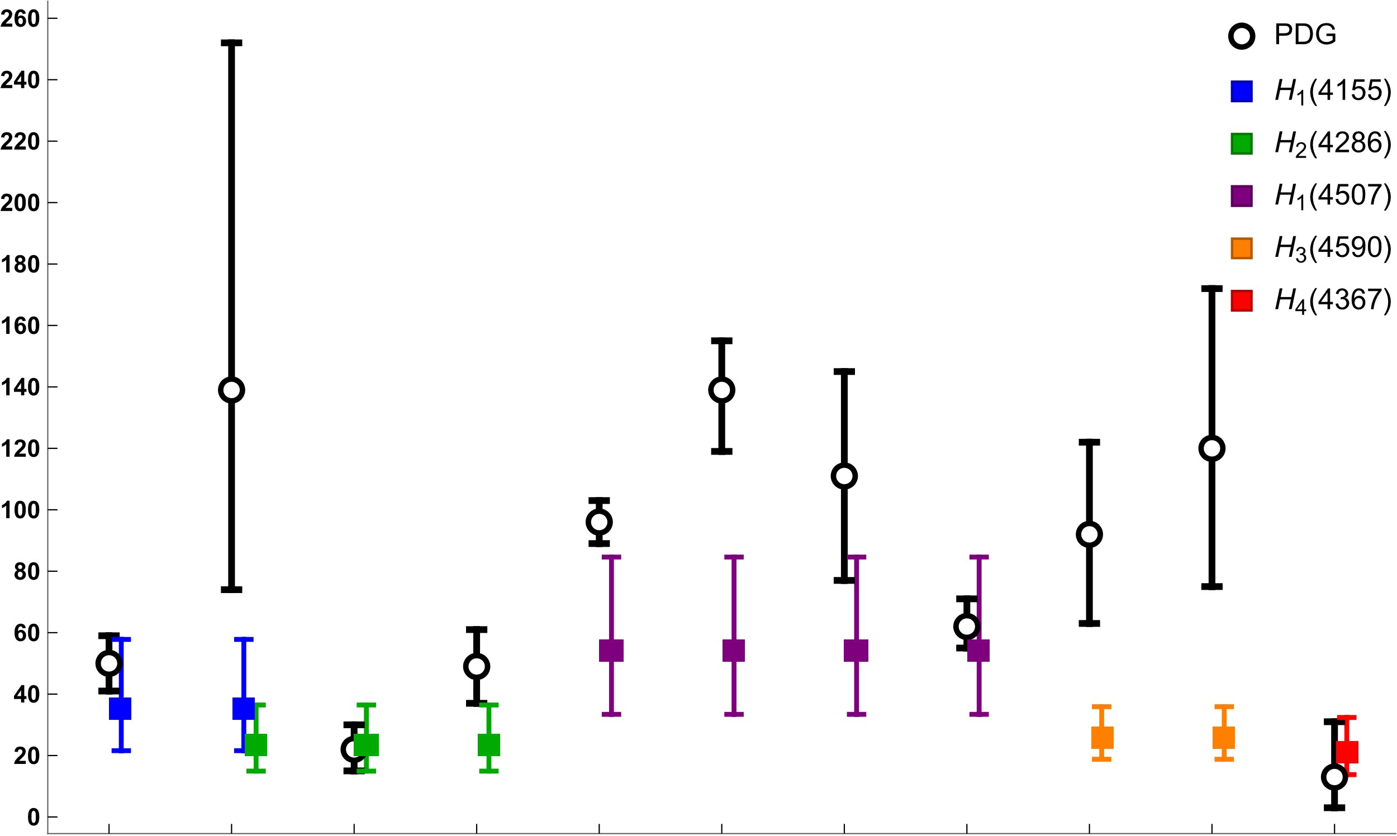
Preliminary Results
Comparison with PDG states:
$Γ_{incl}$ (MeV)
Corrections from the contributions of the continuum singlet states not included here.
$$ψ\left(4230\right)$$
$$[1^{−−}]$$
$$X\left(4160\right)$$
$$[?^{??}]$$
$$χ_{c1}\left(4140\right)$$
$$[1^{++}]$$
$$χ_{c1}\left(4274\right)$$
$$[1^{++}]$$
$$ψ\left(4360\right)$$
$$[1^{−−}]$$
$$ψ\left(4390\right)$$
$$[1^{−−}]$$
$$Y\left(4500\right)$$
$$[1^{−−}]$$
$$ψ\left(4660\right)$$
$$[1^{−−}]$$
$$χ_{c0}\left(4500\right)$$
$$[0^{++}]$$
$$χ_{c0}\left(4700\right)$$
$$[0^{++}]$$
$$X(4350)$$
$$[{(0/2)}^{++}]$$
Notes:
Spin singlet member of the H2 multiplet, the spin-conserving decay leads to spin singlet ηc(1S) quarkonium in the final state and the spin-flipping decay leads to spin triplet χc(1P) quarkonium in the final state. However, these 681 states: χc1(4140) and χc1(4274) only decays to ϕJ/ψ which disfavours the hybrid interpretation. It has been suggested that these states could be isospin−0 charmonium tetraquark state.
The JPC quantum number of X(4160) have not yet been determined. However, the charge conjugation and mass suggest that it can be a candidate for the spin triplet 1−+ member of the H1 multiplet or the spin singlet 1++ member of the H2 multiplet. Since, X(4160) only decays into D∗ ¯D∗ mesons, this disfavors hybrid interpretation and favors a molecular interpretation of this state

Slide 24
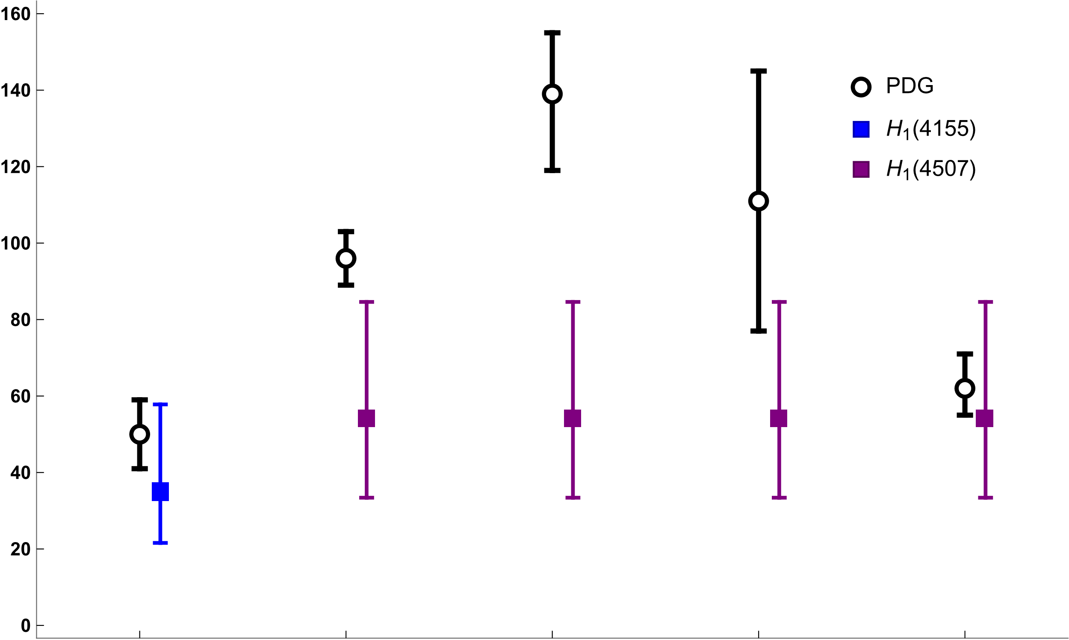
Preliminary Results
Comparison for Y-states:
$Γ_{incl}$ (MeV)
Corrections from the contributions of the continuum singlet states not included here.
$$ψ\left(4230\right)$$
$$[1^{−−}]$$
$$ψ\left(4360\right)$$
$$[1^{−−}]$$
$$ψ\left(4390\right)$$
$$[1^{−−}]$$
$$Y\left(4500\right)$$
$$[1^{−−}]$$
$$ψ\left(4660\right)$$
$$[1^{−−}]$$

Slide 25
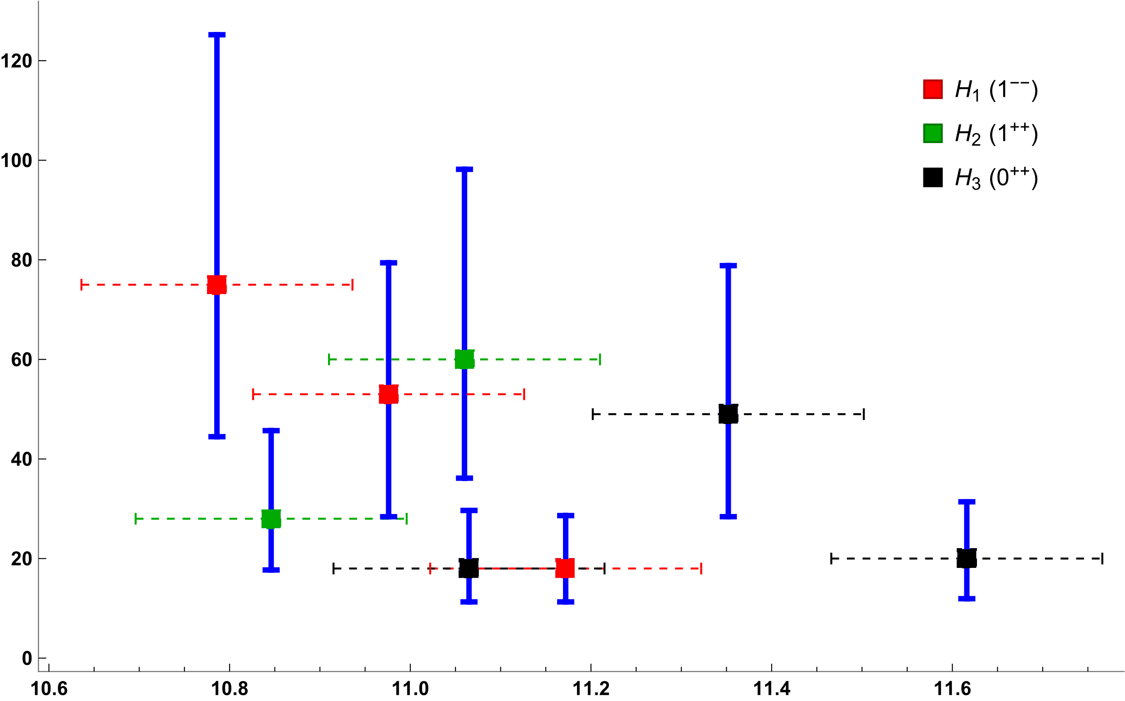
Preliminary Results
Inclusive Rate for Bottomonium Hybrids:
Corrections from the contributions of the continuum singlet states not included here.
$Γ_{incl}$ (MeV)
Mass (GeV)

Slide 26
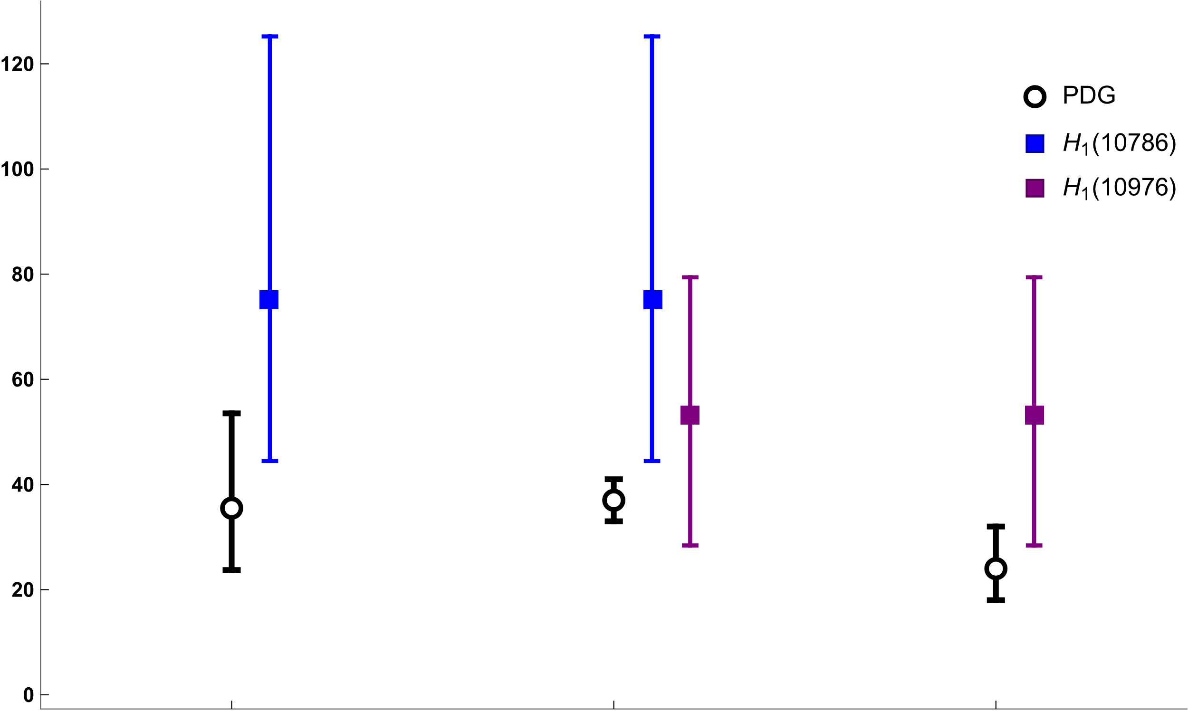
Preliminary Results
Comparison with PDG states:
$Γ_{incl}$ (MeV)
Corrections from the contributions of the continuum singlet states not included here.
$$Υ\left(10753\right)$$
$$[1^{−−}]$$
$$Υ\left(10860\right)$$
$$[1^{−−}]$$
$$Υ\left(11020\right)$$
$$[1^{−−}]$$

Slide 27
Summary/Outlook
BOEFT provides a model-independent & systematic way to study heavy quark hybrids (exotic) and decays.
General formula for the $H_{m}$ inclusive decay based on overlap functions:
Computed preliminary results on decay rates for spin-flipping and spin preserving decays.
Future and ongoing work includes:
Computing contributions to the inclusive rate from the continuum singlet states.
Quantifying errors in the decay rates & comparing with the PDG data for observed exotic states.
Include effect of mixing with excited quarkonia $Q^{′}→Q+X$ .
Thank you!!
Extending this analysis to study Quarkonium tetraquarks.
Notes:
the recent observation of the transition Y (4260) → X(3872)γ makes the identification of Y (4260) as a hybrid highly unlikely. Also in Soto and Oncala find Y(4260) mass to be close to the spin-1 2d charmonium state in their analysis.

Slide 28
Backup Slides

Slide 29
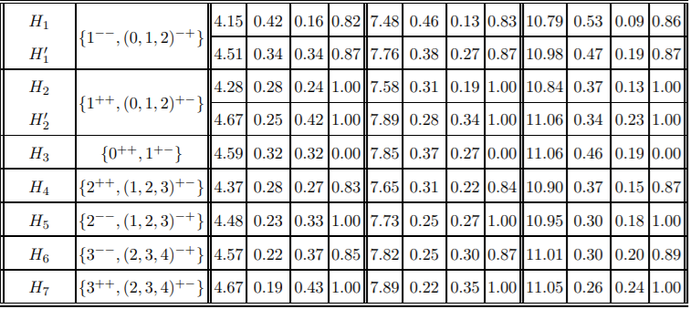
Quarkonium hybrids: Spectrum
Results for Hybrids from Berwein, Brambilla, Castellà , Vairo Phys. Rev. D. 92, (2015)
Other notation of hybrid states
$$N{\left(s/d\right)}_{1}$$
$$Np_{1}$$
$$Np_{0}$$
$$N{\left(p/f\right)}_{2}$$
$$Nd_{2}$$
Braaten, Langmack, Smith Phys. Rev. D. 90, 014044 (2014)
R. Oncala, J. Soto, Phys. Rev. D96 (2017)

Slide 30
Decay Rate: Calculation Details.
N. Brambilla, W.K. Lai, AM, A. Vairo (in progress)

Slide 31
Inclusive Decays
N. Brambilla, W.K. Lai, AM, A. Vairo (in progress)
Spin-conserving:
Using complete set of octet and singlet states
Notes:
The computation of the decay rates with these overlap functions is still ongoing.

Slide 32
Inclusive Decays
N. Brambilla, W.K. Lai, AM, A. Vairo (in progress)
Assumption:
$f_{mq}^{i}\left(E\right)≠0$ only for $E_{m} ≈ E + Λ$
$h_{nn′}≈1$ and $E_{m}^{Q} ≈ E_{m}^{s}$ (replace singlet with quarkonium)
Above result looks similar to the one in R. Oncala, J. Soto, Phys. Rev. D96, 014004 (2017). In general has
tensor structure $T^{ij}$ that agrees with J. Castellà, E. Passemar, arXiv:2104.03975.
Notes:
For our we are using the simplified expression of the decay rate. The computation with the overlap integrals is ongoing.

Slide 33
Inclusive Decays
N. Brambilla, W.K. Lai, AM, A. Vairo (in progress)
R. Oncala, J. Soto, Phys. Rev. D96, 014004 (2017): only diagonal elements $T^{ii}$ are considered
$T^{ii}$ leads to selection rule: Hybrids such as $Np_{1} (H_{2}$) where L=J don’t decay to quarkonium.
$T^{ij}$: allows for the decay of $Np_{1} (H_{2}$) hybrid decays.

Slide 34
Inclusive Decays
N. Brambilla, W.K. Lai, AM, A. Vairo (in progress)

Slide 35
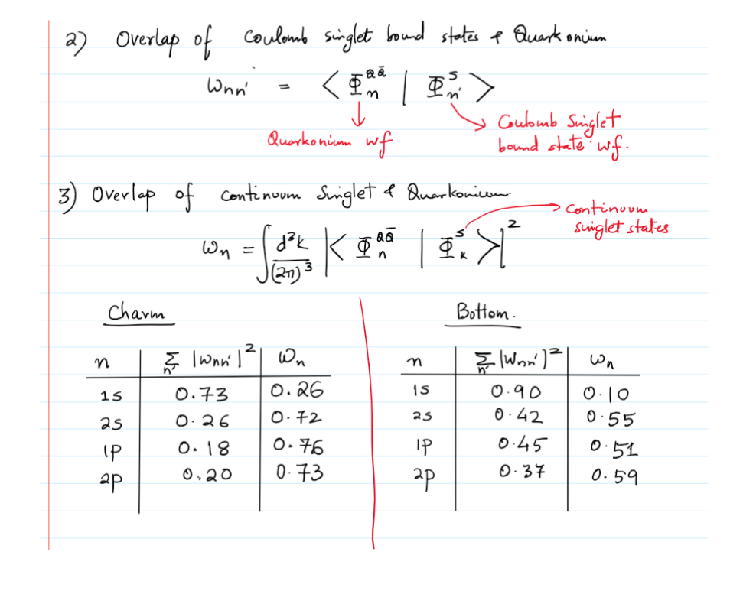
Singlet-Quarkonium overlap

Slide 36
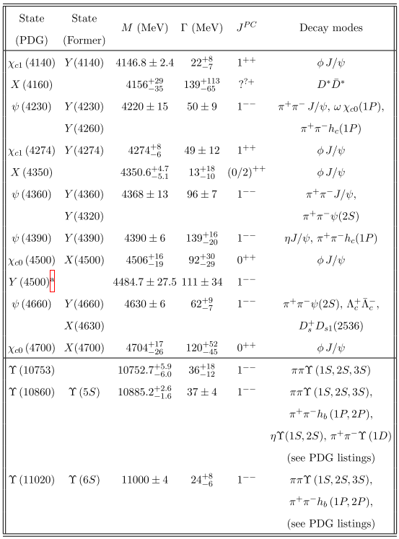
Exotic States
Neutral meson states above the open-flavor thresholds which are potential candidates for hybrids
Table adapted from PDG 2021

