Slide 1
Phys.Rept. 658 (2016) 1
Departamento de Física Teórica
Institute of Particle & Cosmos Physics (IPARCOS)
Universidad Complutense de Madrid
Light meson scattering: Spectroscopy & exotics
Where do we stand?
J. R. Peláez
JRP. Physics Reports 658-(2016)-1
JRP, A.Rodas, J. Ruiz de Elvira, Eur. Phys. J. Spec. Top. (2021) 230:1539
JRP & A.Rodas, Physics Reports 969-(2022)-1
Quark Confinement and the Hadron Spectrum XV
University of Stavanger-Norway. 1-6th August 2022
Supported by:

Slide 2
Motivation to study the scattering of pions, kaons and etas
π,K,η are Goldstone Bosons of QCD → Test Chiral Symmetry Breaking
π,K appear as final products of almost all hadronic processes: B,D, decays, CP violation…
SPECTROSCOPY: main or relevant source for PDG parameters of many resonances.
- Relevant for glueball identification
CRYPTOEXOTICS: The controversial light scalar resonances appear here:
f₀(500), f₀(980), a₀(980) and strange K*₀(700).
Strong indications for predominant non quark-antiquark nature of light scalars
EXOTICS: $π_{1}\left(1400\right)$ and $π_{1}\left(1600\right)$ controversy in πη and πη’ scattering

Slide 3
Non-ordinary spectroscopic classification
Lightest scalar SU(3) multiplets <2 GeV. Accepted picture at RPP
Light scalar nonet <1 GeV:
κ/K*₀(700)
σ
a₀
Non-strange heavier!!
Hugely Inverted $q\overline{q}$ hierarchy.
Cryptoexotics? (R.Jaffe 1976)
f₀(500) and f₀(980) octet/singlet mixtures
κ/K*₀(700) only recently “well established at PDG”
Only in 2021 on-line update “Needs Confirmation”
f₀
f₀ Singlet
f₀
a₀(980)
Scalar nonet >1 GeV:
One extra state f₀(1370), f₀(1500), f₀(1710)
K*₀ (1430)
f₀ singlet
f₀
f₀
a₀(1450)
A$lso, not quite q\overline{q}$ hierarchy
complicated mixtures
f₀(1370) worst determined and still contested
because hard to see
+ glueball?

Slide 4
Why cryptoexotics?
- Inverted hierarchy (tetraquarks, molecules) (Jaffe 76)
Scalar quark antiquark, expected above 1 GeV in QM but once
meson-meson interactions included, and additional companion pole appears
at low energies ( Van Beveren, Ribeiro, Rupp, Close, Tornqvist, Oller, Oset…. )
Contrary to vectors, do not saturate ChPT parameters, although being lighter (Gasser, Leutwyler, Ecker, De Rafael, Pich, Donoghue….)
Dynamically generated from LO Unitarized ChPT whereas vectors need NLO (Oller, Oset, Pelaez,Nieves, Arriola…)
- Do not fit in linear Regge trajectories (J,M²) (Anisovich, Sarantsev, Anisovich)
- Dispersively calculated Regge trajectories turn non-ordinary (Londergan, Nebreda, Peláez, Szczepaniak, Rodas)
- Non-ordinary 1/Nc leading behavior (Pelaez, Nebreda, Rios, Nieves, Pich, Oller, Ruiz de Elvira
DISCLAIMER: time is limited
Relatively old stuff, although now present in PDG review on “Spectroscopy of light mesons”
Here I concentrate on the existence and determination of parameters from meson-meson scattering

Slide 5
Two longstanding sources of trouble
In meson-meson scattering
DATA PROBLEM
MODEL-DEPENDENCE PROBLEM
THIS TALK
Overview of effort to discard inconsistent data and eliminate or reduce model dependence:
by using
DISPERSIVE/ANALYTICITY APPROACHES

Slide 6
DATA PROBLEM:
Meson-meson SCATTERING data are poor
π and K unstable. Beams NOT luminous enough for ππ and πK collisions: Indirect measurements
1) Very few good data from K→ππeν. But E<M_{K}. Geneva-Saclay (77), E865 (01), NA48/2 (2010)
2) ALMOST ALL DATA from Meson-Nucleon scattering (In the 70’s and 80’s)
CAVEATS: One-Pion-Exchange (OPE) Approximation
In initial state virtual pion not well defined, Chew-Low off-shell extrapolation
More contributions: absorption, A₂ exchange...
Needs Meson-N partial-wave extraction. Problems with phase shift ambiguities, etc...
As a consequence… VERY LARGE SYSTEMATIC UNCERTAINTIES

Slide 7
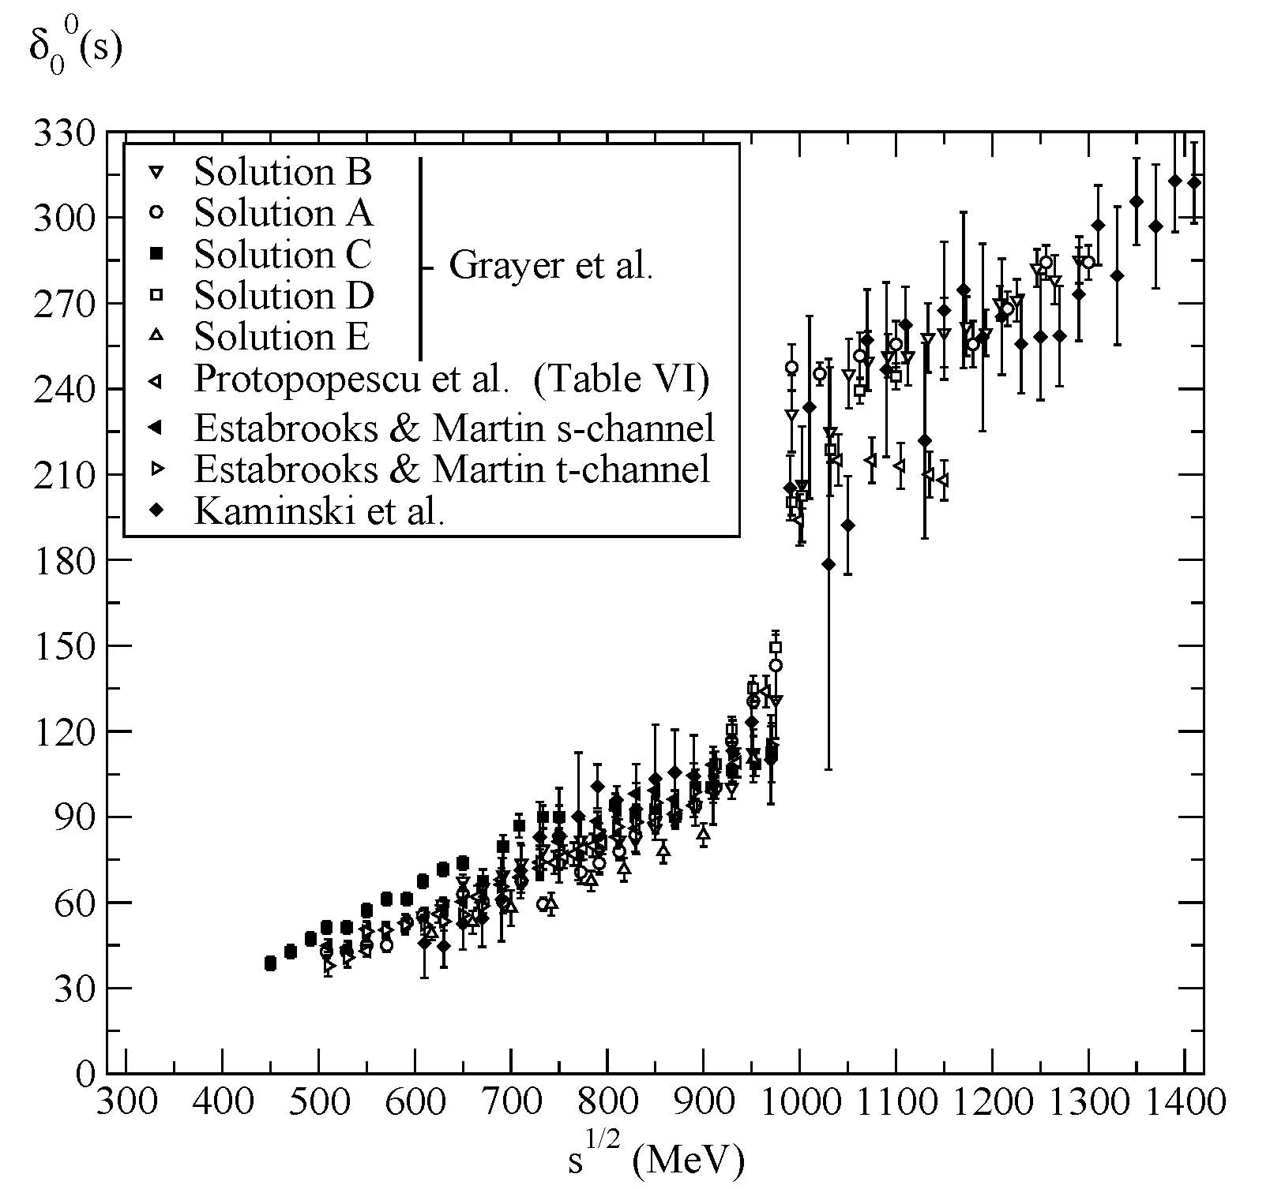
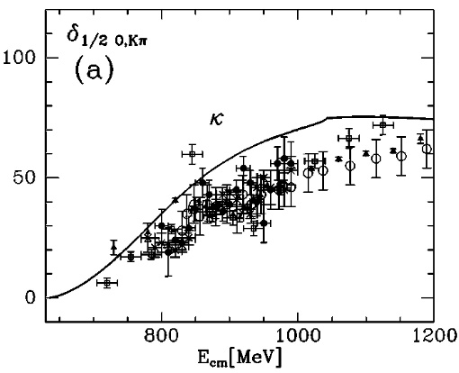
DATA PROBLEM
ππ and πK SCATTERING data are often in conflict
CONFLICTING DATA SETS &
SYSTEMATIC uncertainties larger than STATISTICAL
π π → π π, scalar-isoscalar partial-wave phase shift
K π → K π, scalar-isospin ½
partial-wave phase shift

Slide 8
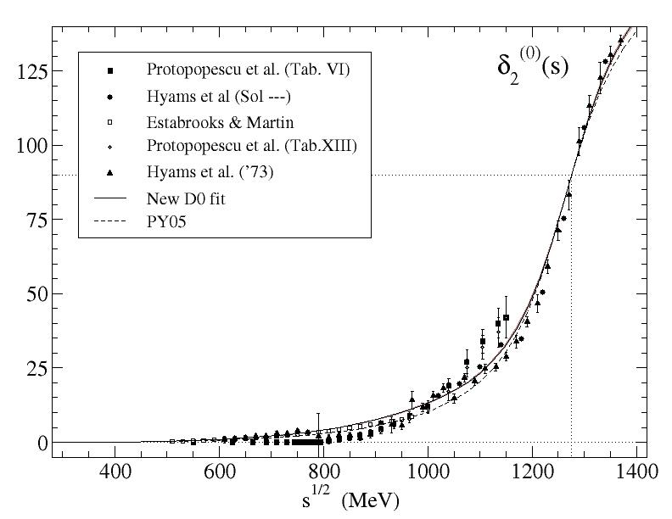
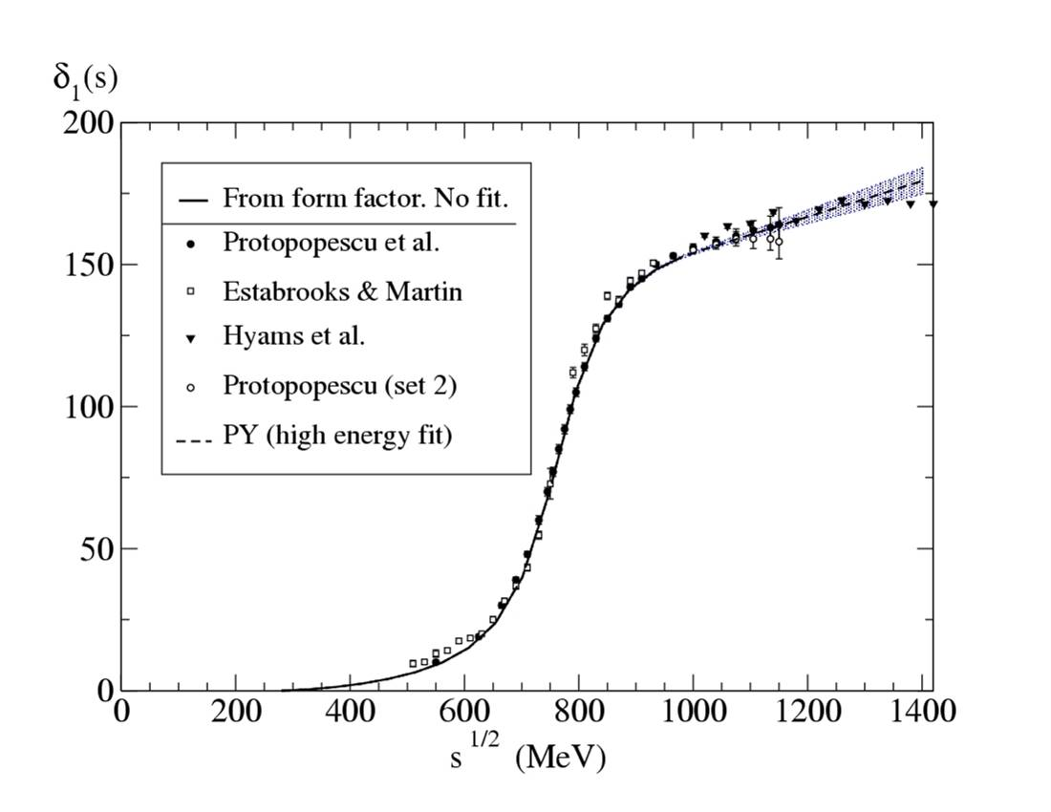
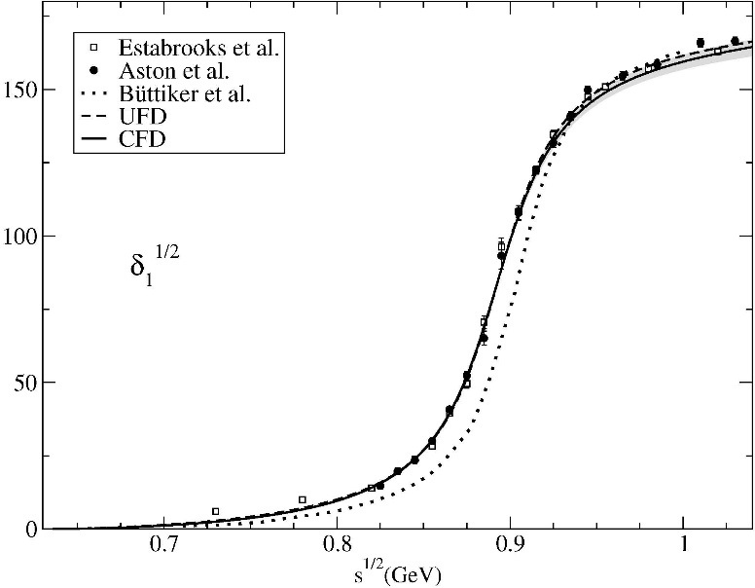
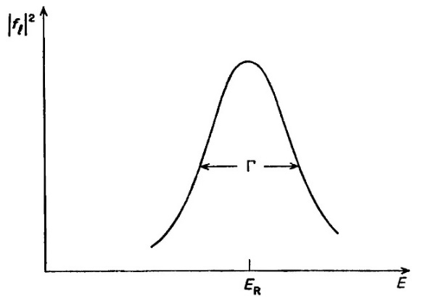
MODEL PROBLEM: many models used to fit data and extract resonances…
Narrow resonances when far from other resonances or singularities (thresholds, cuts, etc…)
produce typical peaks and rapid 180º phase motions
ρ(770)
f₂(1270)
K*(892)
/f₀(500)
These were the “easy ones” and models are usually fine.
For instance, they may be reasonably well approximated
by Breit-Wigner shapes
$$\sim \frac{M Γ(s)}{M^{2}−s−iM Γ(s)}$$

Slide 9
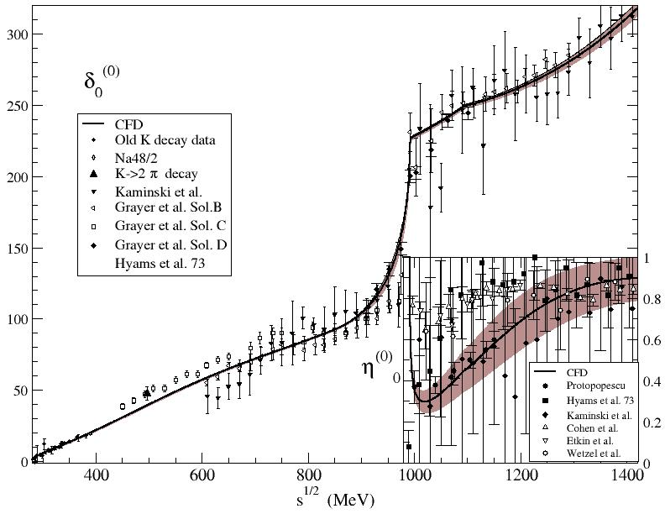
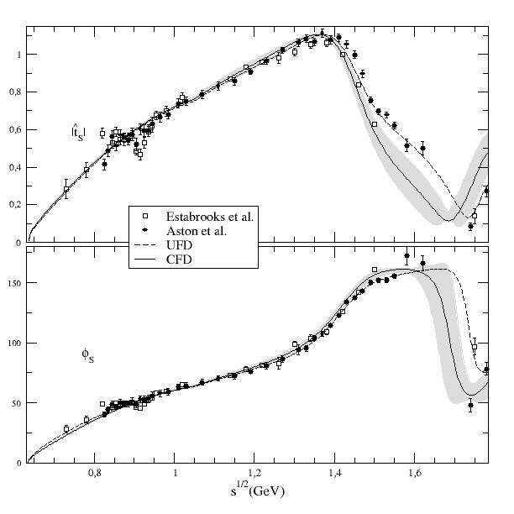
MODEL PROBLEM: Resonances in meson-meson scattering
“Breit-Wigner” shapes are easily recognizable… but life is not that easy
Do you see resonances there?
Nevertheless there are resonances (poles) in these regions: the σ/f₀(500), f₀(1370) and κ/K₀*(700) light scalars

Slide 10
MODEL PROBLEM: Resonance shapes process dependent
The not so easy ones…
Light scalars are wide, or even extremely wide and frequently overlap with one another or with thresholds like KK.
Very often they do not produce clear peaks, nor rapid phase motions, and “peak searching” not valid anymore
Moreover since they are not clear-cut peaks, their shape, apparent position, width… can be different depending on the process where they are observed.
Model fits to different process or partial data can yield different resonances
Meson-meson scattering has the strongest theory constraints and is the most reliable theoretically to go to the complex plane. (non-linear unitarity condition)

Slide 11
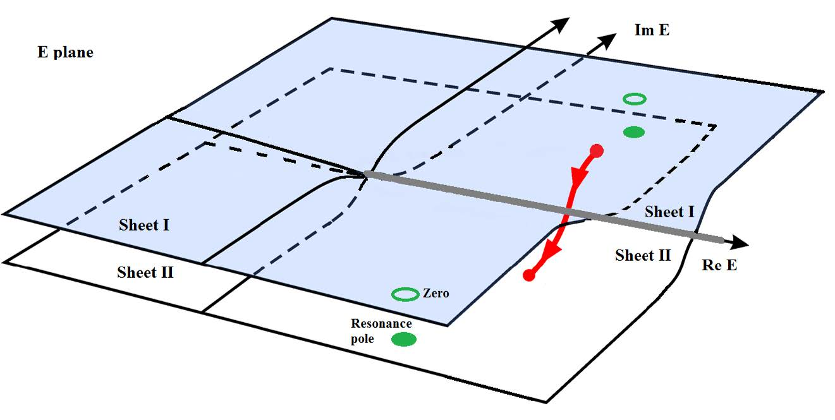
Process dependent peaks vs. Process independent poles
The universal features of resonances are their pole positions and residues *
$\sqrt{s_{pole}}≈$M-i Γ/2
*in the Riemann sheet obtained from an analytic continuation through the physical cut
s
s
s
The Review of Particle Physics has been adding pole determinations
for more and more resonances
unfortunately keeping also Breit-Wigner parameters even when not applicable
However, analytic continuations are a delicate mathematical problem and a good control of the analytic structure is needed. Many models fail at this.

Slide 12
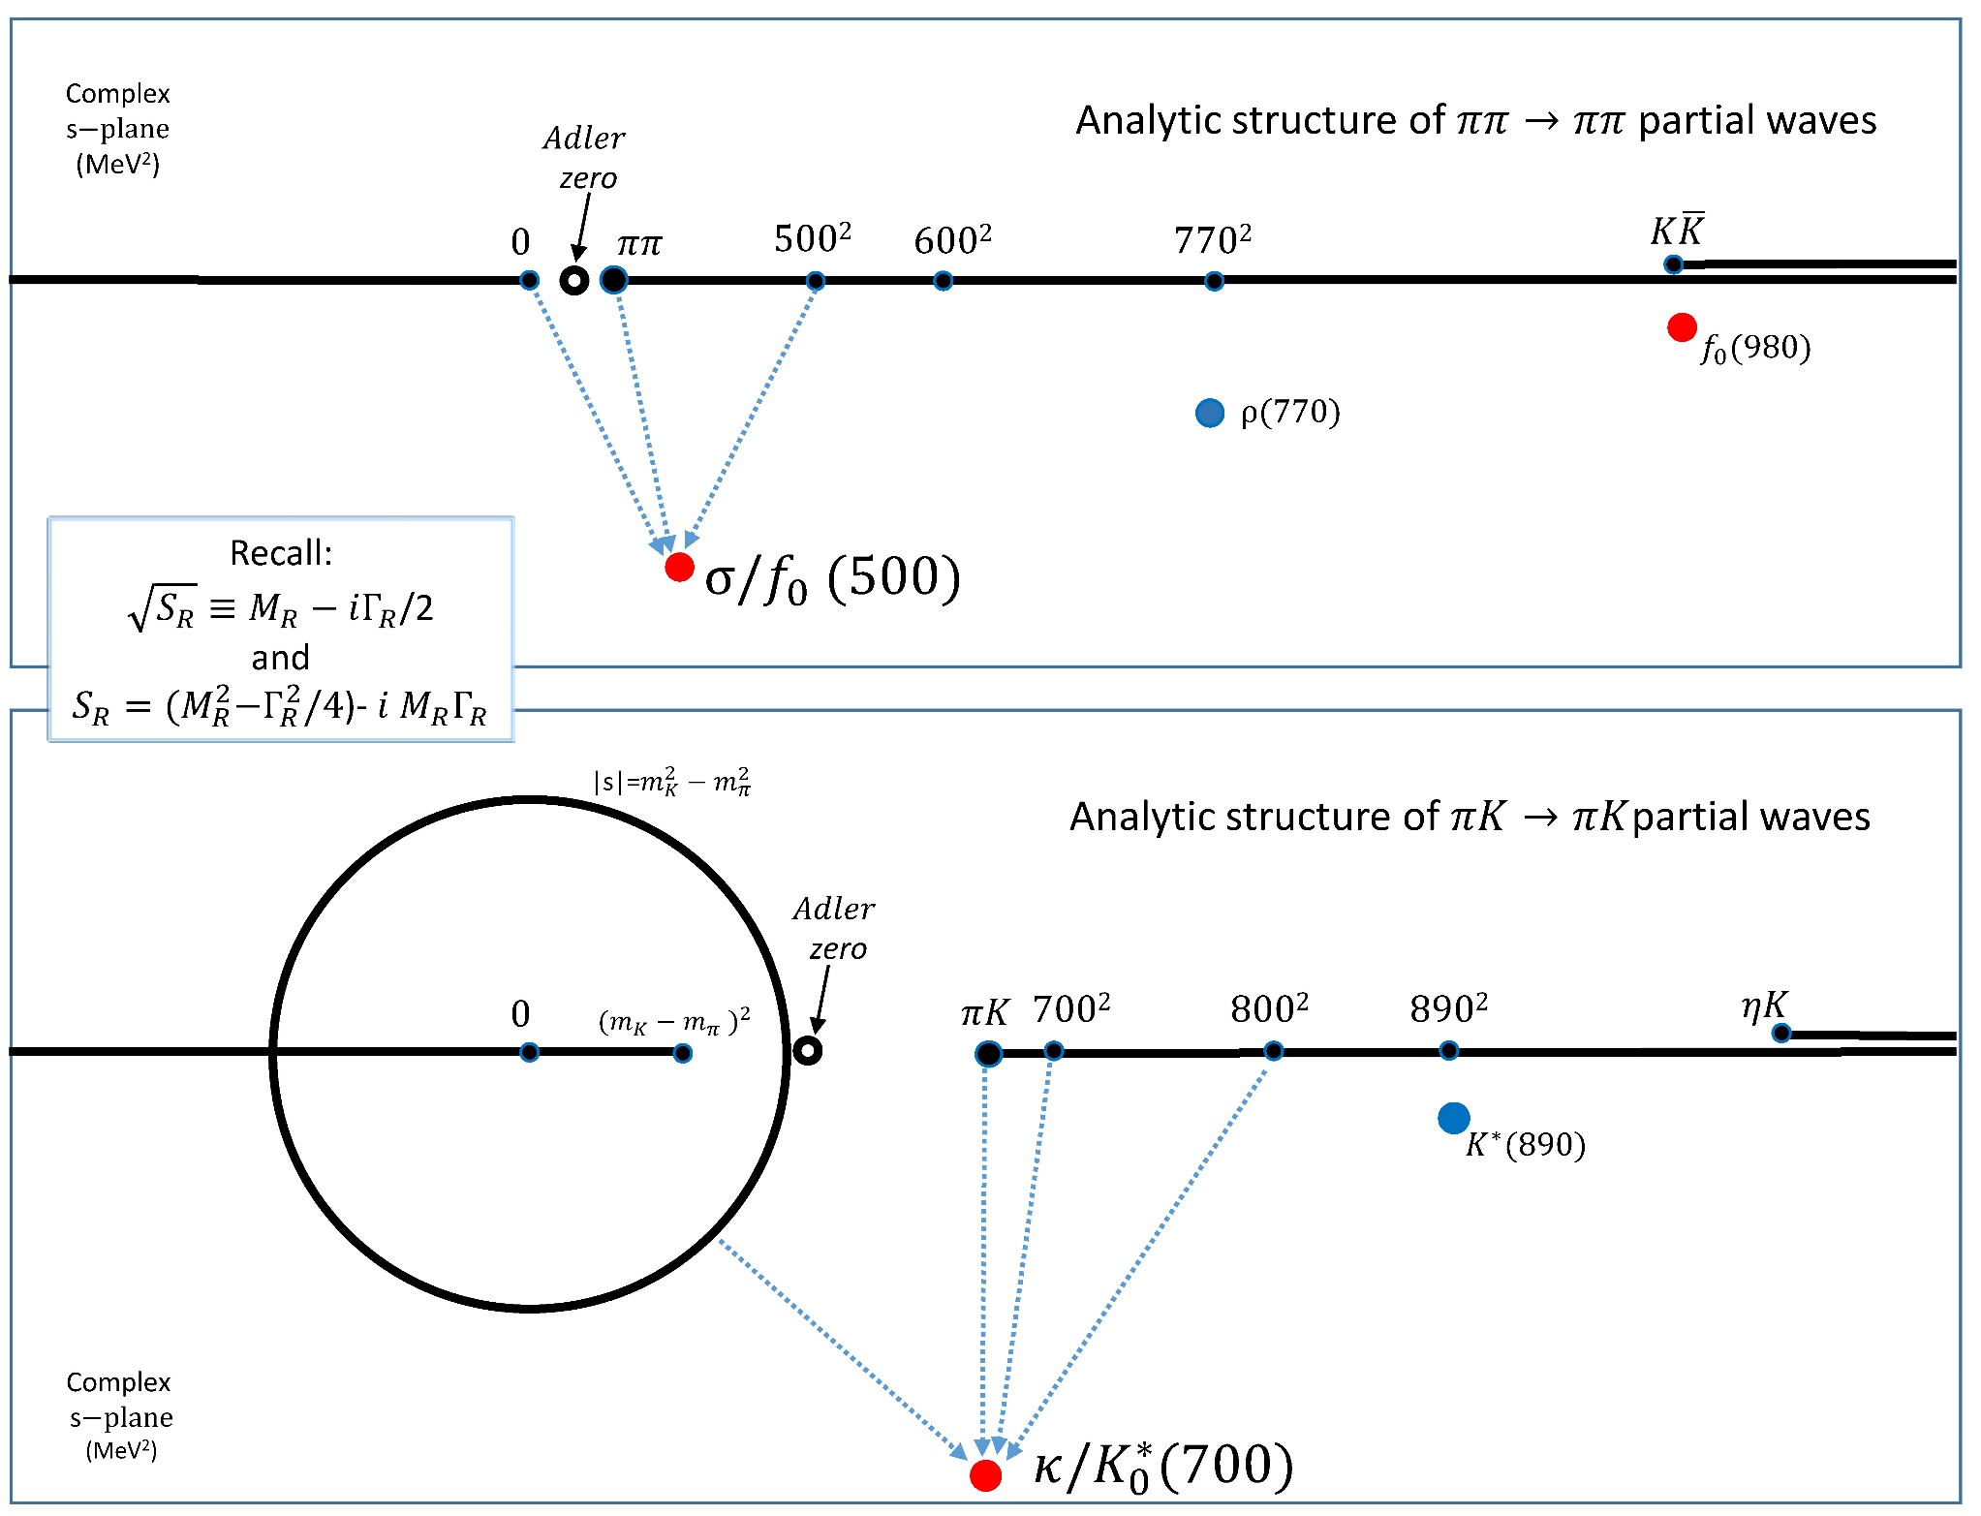
Why worry
about
low-energy
&
ANALYTIC
STRUCTURE
in s-plane?
Important for
σ/f₀(500)
$$\text{κ}\text{/}\text{K}\text{0}\text{∗(700)}$$
- Threshold behavior
Chiral symmetry
- Subthreshold behavior
Chiral symmetry→Adler zeros
- Other cuts
Left & circular

Slide 13
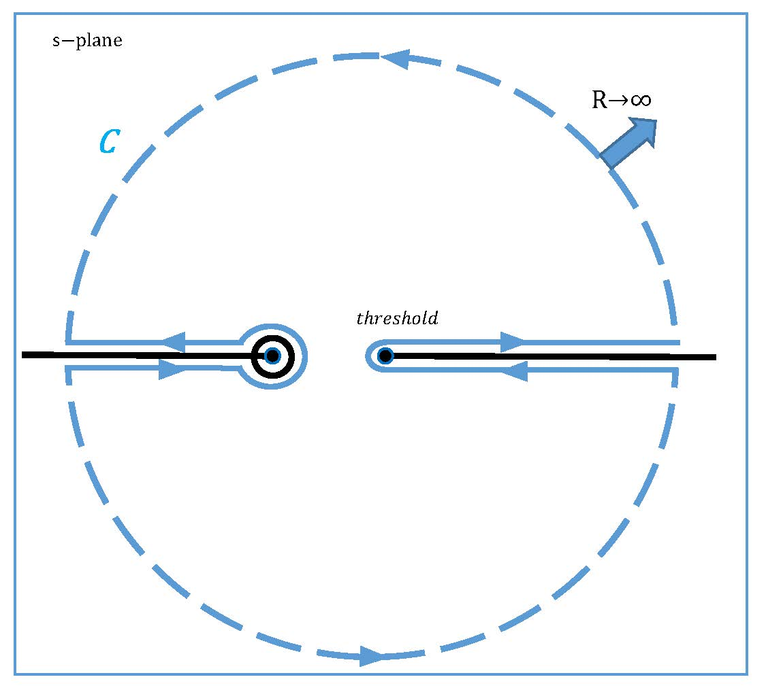
What is a dispersion relation.? Very Briefly and for π π
- CAUSALITY $⇒$ Amplitudes t(s)
are ANALYTIC in complex s plane
with cuts due to thresholds (also in crossed channels)
- Cauchy Theorem:
If t(s)→0 fast enough at high s, curved part vanishes
Otherwise, determined up to polynomial (subtractions)
1) Calculating t(s) as an integral where there is not data
Good for:
2) Constraining data analysis: Input =output
3) ONLY MODEL INDEPENDENT extrapolation to complex s-plane
Last decades
Effort to eliminate or reduce model dependence by using dispersive approaches
often combined with Chiral Perturbation Theory (ChPT).

Slide 14
Dispersion relations for meson-meson scattering
We need to get rid of one variable to write CAUCHY THEOREM for the other
1) Fix one variable in terms of the other (fixed-t, hyperbolic relations…)
Most popular: t₀=0, Forward Dispersion Relations (FDRs).
(Kaminski, Pelaez , Yndurain, Garcia Martin, Ruiz de Elvira, Rodas )
PROS: One eq. per amplitude. Simple. High energy reliable. Applicable to all energies
Precision
CONS: No direct access to poles… until recently (see below)
Precision
Dispersive
studies
2) Integrate one variable: Partial wave dispersion relations
- “Roy-like” equations. GKPY eqs, Roy Steiner Equation-
Crossing to rewrite Left/circular cuts with. crossing in terms of physical region.
CONS: Different partial waves or channels coupled. In practice, limited to a finite energy
PROS: Directly partial waves. Better to look for poles. Precision
Unitarized Amplitudes (IAM, N/D, Chew-Mandelstam…)
2-body unitarity exact on dispersion relation for inverse amplitude (single or coupled channels)
Ideally combined with ChPT for these approximations, but additional bare/preexisting resonances could
be added, simple models for real part, use of Lagrangians, effective theories etc…
CONS: Unphysical cuts, higher energies, multibody, approximated
PROS: Directly partial waves. Better to look for poles. Connection with QCD through ChPT in UChPT

Slide 15
Precision studies. Two strategies on real axis:
SOLVE equations: (Ananthanarayan, Colangelo, Gasser, Leutwyler, Caprini, Moussallam, Stern…)
S and P wave solution for Roy or GKPY equations unique at low energy
Needs input on other waves and high energy.
NO scattering DATA used at low energies ($\sqrt{s}≤0.8 \sim 1 GeV$)
Good if interested in low energy scattering and do not trust data.
Uses ChPT input for threshold parameters
Impose Dispersion Relations on fits to data. (García-Martín, Kaminski,JRP, Ruiz de Elvira, Ynduráin)
Also known as “DATA driven dispersive analyses”
Also needs input on other waves and high energy.

Slide 16
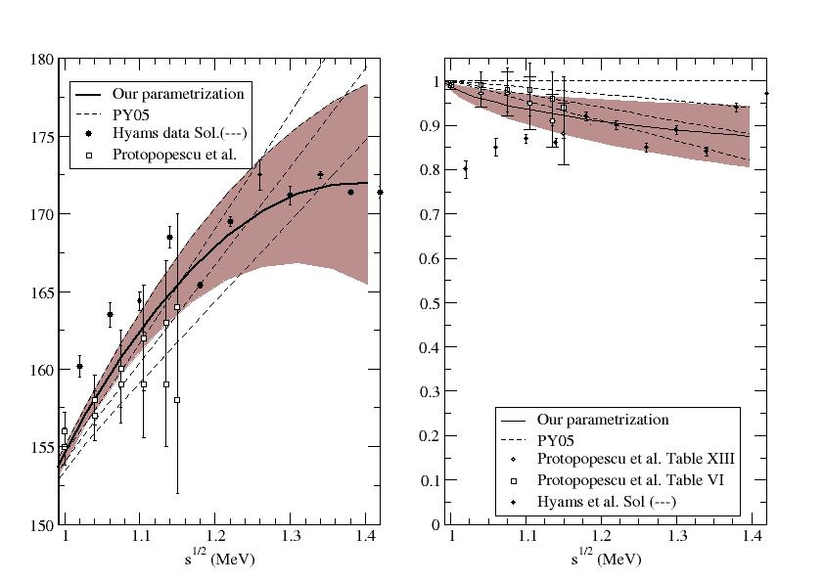
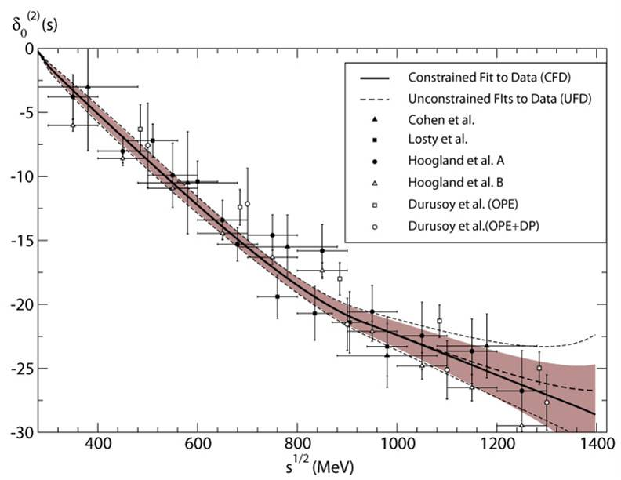
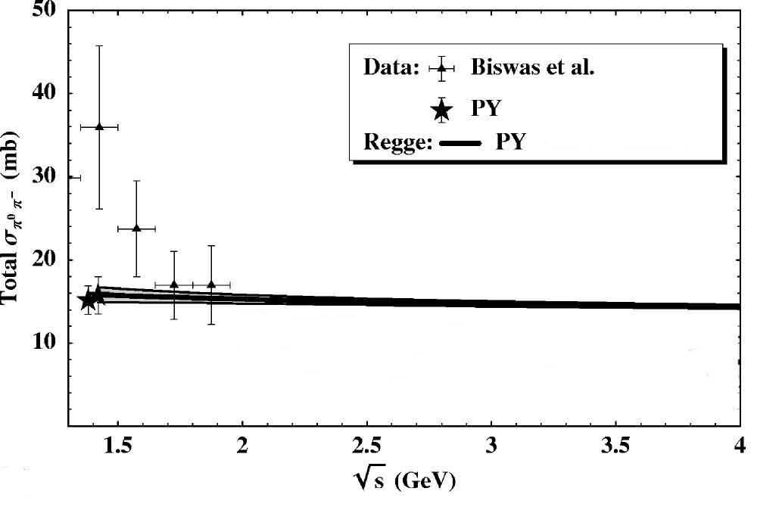
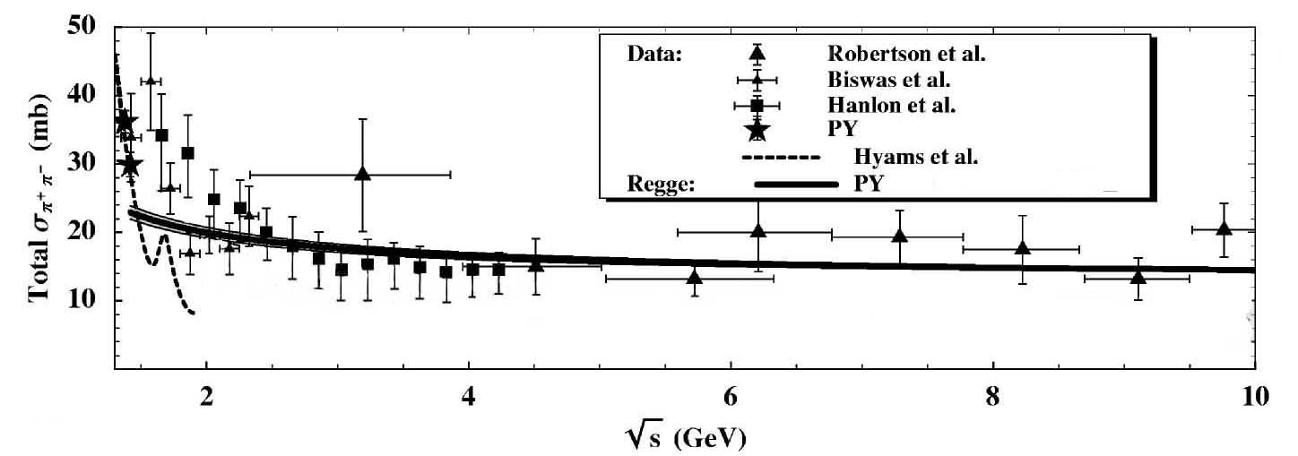
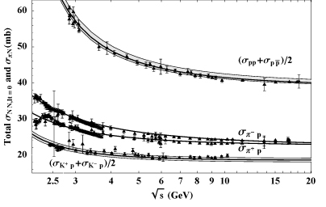
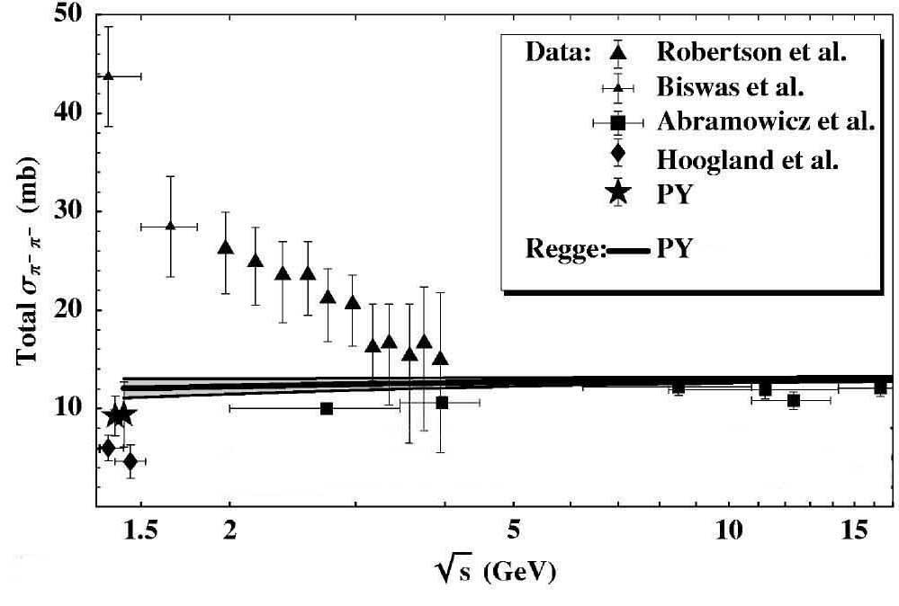
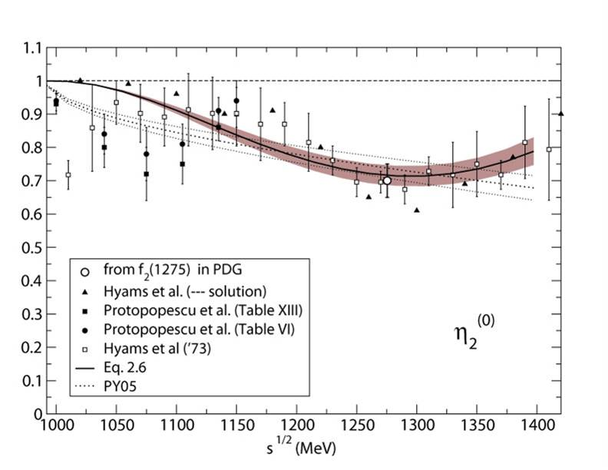
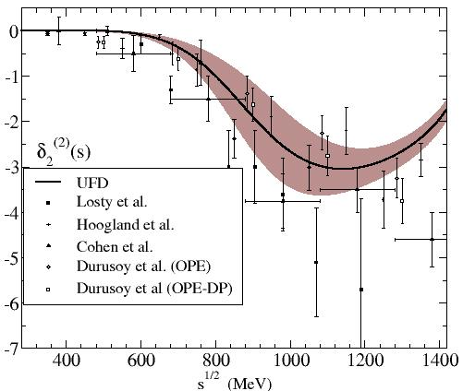
FIRST STEP: Simple Unconstrained Fits (UFD) to data
Estimation of statistical and SYSTEMATIC errors
ππ→ ππ partial-wave data
S-waves
P-waves
Regge at high energies
D-waves
F waves

Slide 17
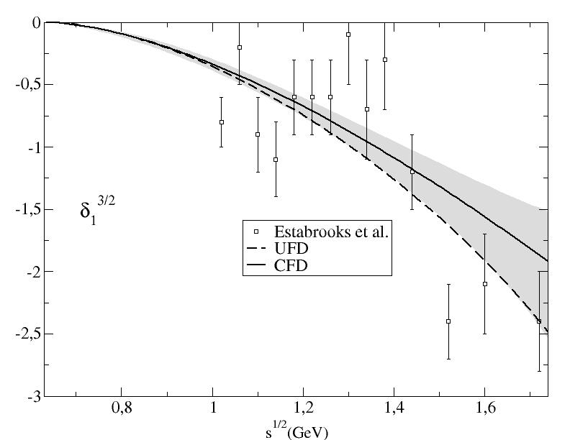
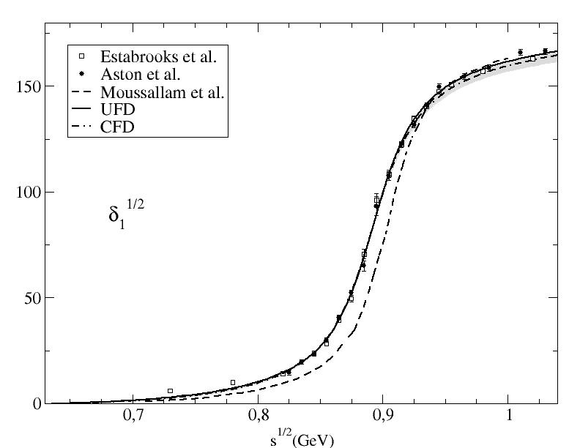
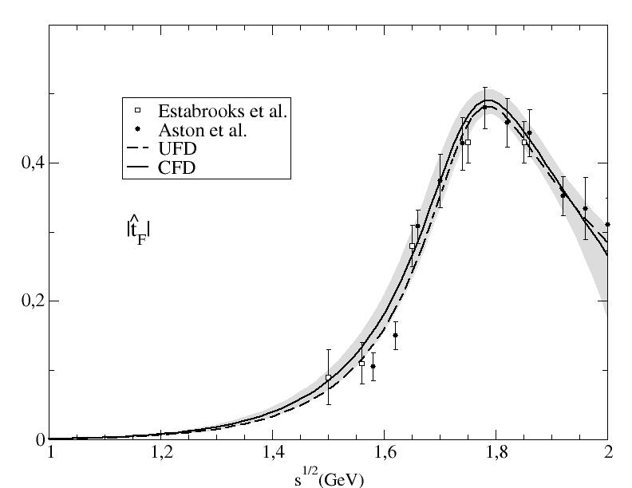
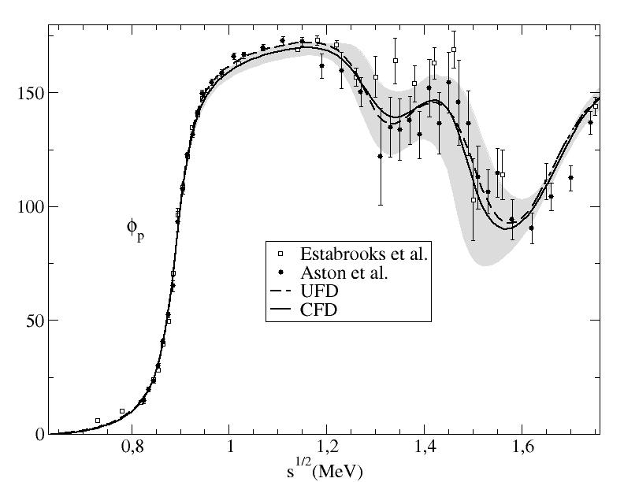
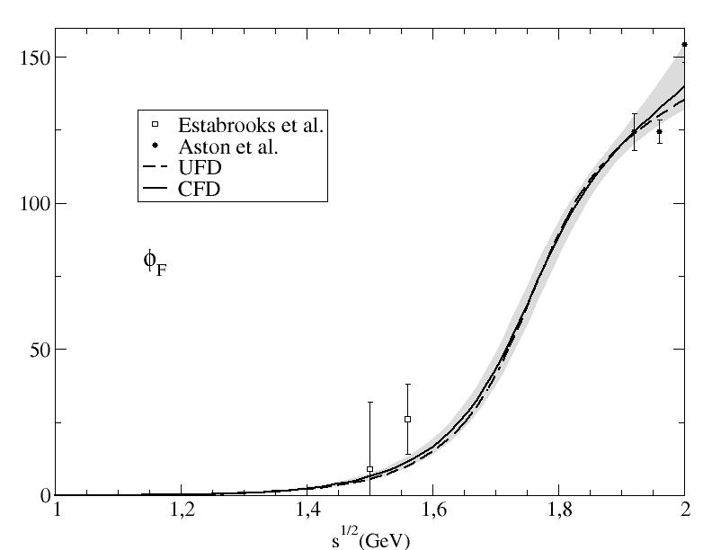
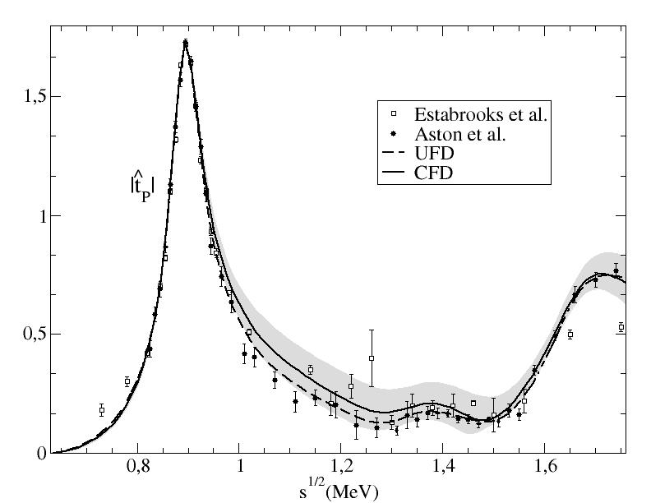
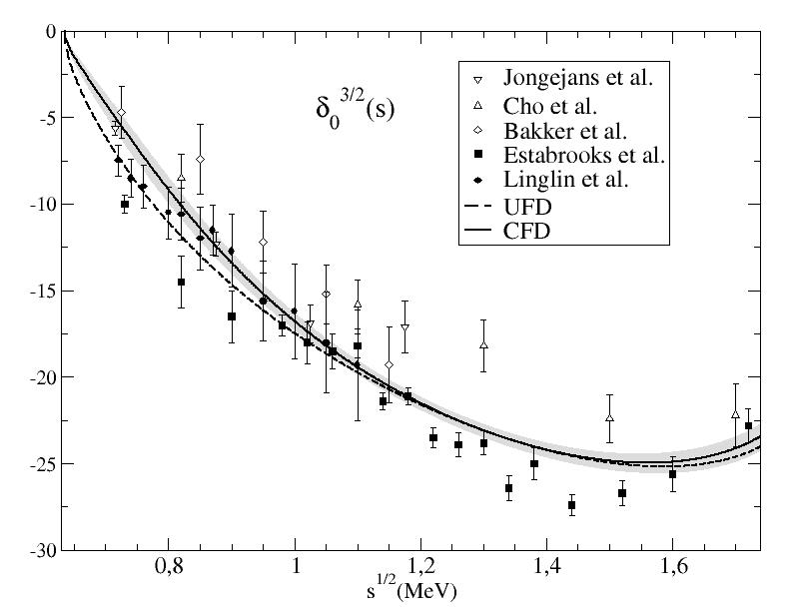
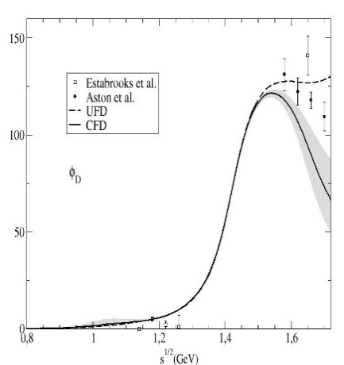
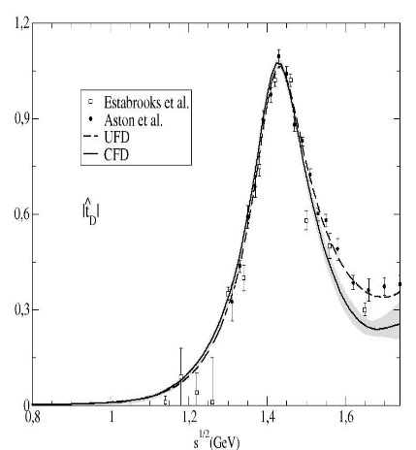
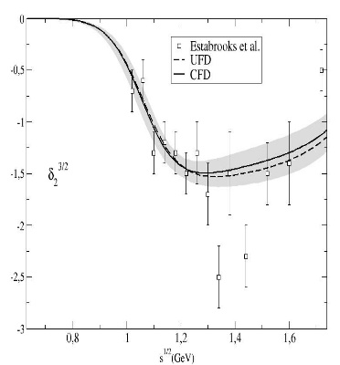
FIRST STEP: Simple Unconstrained Fits (UFD) to data
Estimation of statistical and SYSTEMATIC errors
πK and ππ→KK partial-wave Data
S-waves
P-waves
Even F-waves!!
D-waves

Slide 18
SECOND STEP: Check dispersion relations: ππ→ππ
In general, data does not satisfy well DR. Sometimes very badly indeed
FDRs
Roy
GKPY

Slide 19
THIRD STEP: Use dispersion relations as constraints for the fits: ππ→ππ
Very good fulfillment: Constrained Fits to Data
FDRs
Roy
GKPY

Slide 20
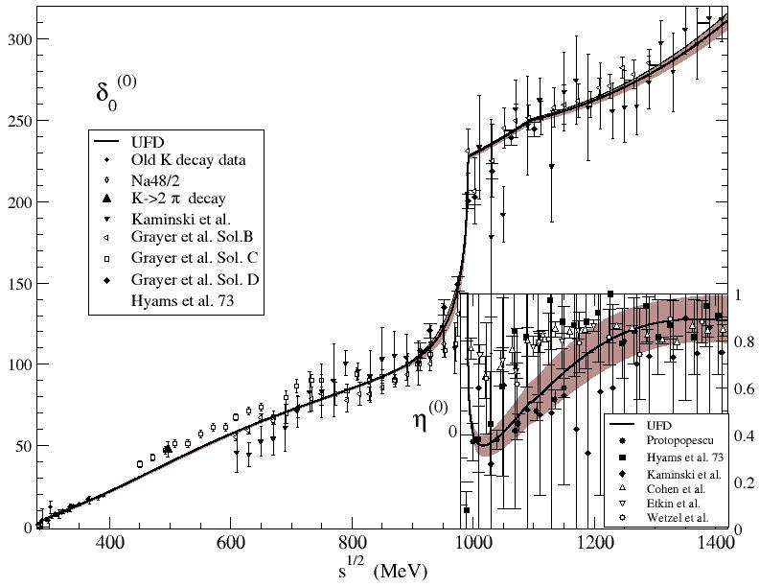
S0 wave: from UFD to CFD
The changes from Unconstrained to Constrained fits are not too large, but relevant in some regions
Only sizable change in f₀(980) region
Dip solution preferred

Slide 21
From Unconstrained (UFD) to Constrained Fits to data (CFD)
JRP, A.Rodas-PhysRevLett.124.172001-2020
S-waves. The most interesting for the K₀* resonances and the $K_{0}^{∗}\left(700\right)$ in particular
Largest changes from UFD to CFD
at higher energies

Slide 22
πK Partial Wave Hiperbolic Dispersion Relations. Roy-Steiner Equarions
JRP, A.Rodas-PhysRevLett.124.172001-2020
Unconstrained fits (UFD):
LARGE inconsistencies with 3 Roy-Steiner Eqs.
One or no subtraction for F⁻ lie on opposite sides of input
The most relevant wave for the kappa resonance.
Constrained fits (UFD):
Consistent within uncertainties

Slide 23
Let os move to the complex plane!!
Dispersion relations provide model-independent analytic continuation to first Riemann sheet,
but the most relevant resonance poles live in the CONTIGUOUS sheet
For elastic resonances, only second sheet, S^{II}=1/S^{I}
σ/f₀(500), κ/K₀*(700).
Purely Dispersive Determination

Slide 24
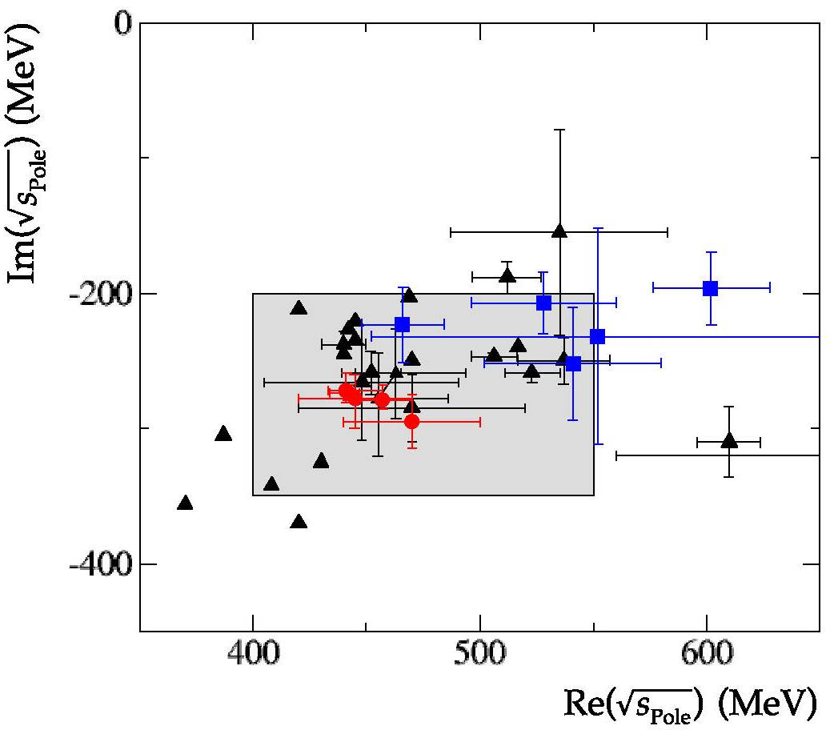
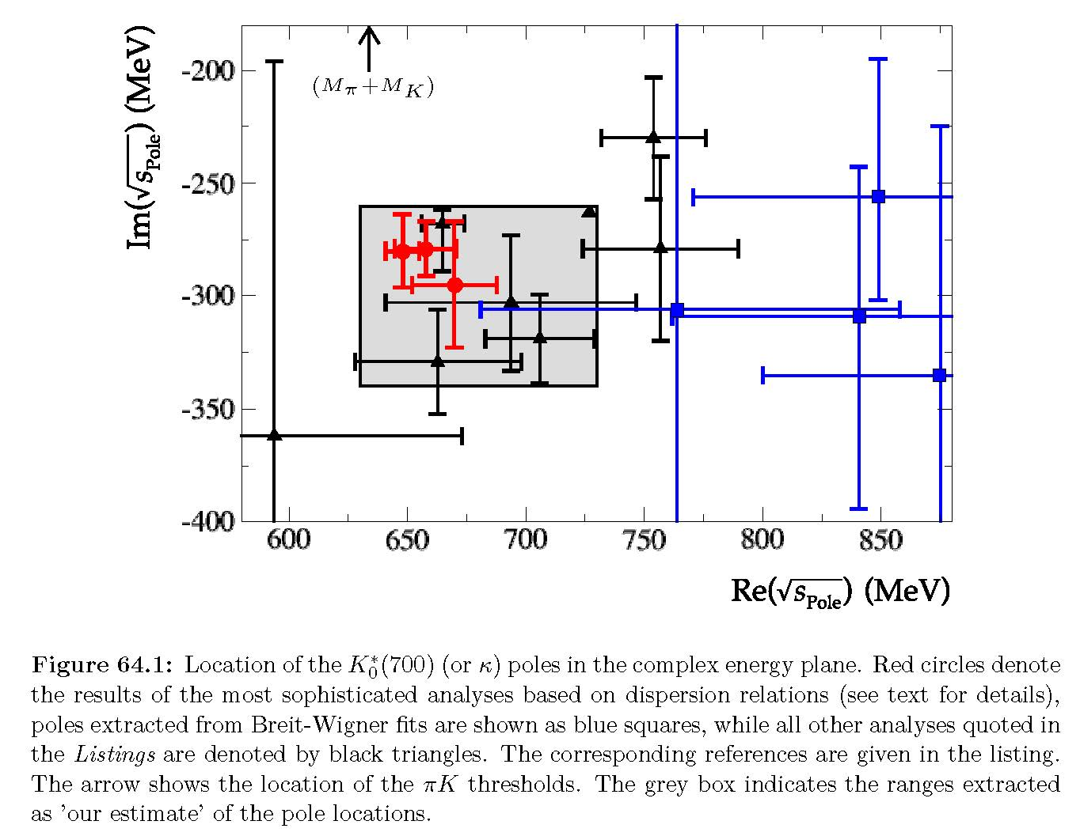
WHERE DO WE STAND? Light Scalars at RPP 2021 (on-line update). “Note on Light Scalar Mesons below 1 GeV”
“Roy-like” and “Breit-Wigner” poles identified separately from the rest
Not all from meson-meson scattering
κ/K₀*(700) estimate
2021 No longer “Needs Confirmation”
σ/f₀(500) estimate
(400-550)-i(200-350) MeV
(400-550)-i(200-350) MeV
“Roy-like”
“Roy-like”
σ/f₀(500)
κ/K₀*(700)
From our data driven Roy-Steiner analysis:
(My) Conservative Dispersive Estimate:
No sub: (648±6)-i(283±26) MeV
1 sub: (648±7)-i(280±16) MeV
${ (449}_{−16}^{+22}$)-i(275±15) MeV
JRP, Physics Reports 658-2016-1
*Typo fixed in uncertainty from 12 to 15 MeV
JRP, A.Rodas-PhysRevLett.124.172001-2020
☹ But still Breit-Wigners!!

Slide 25
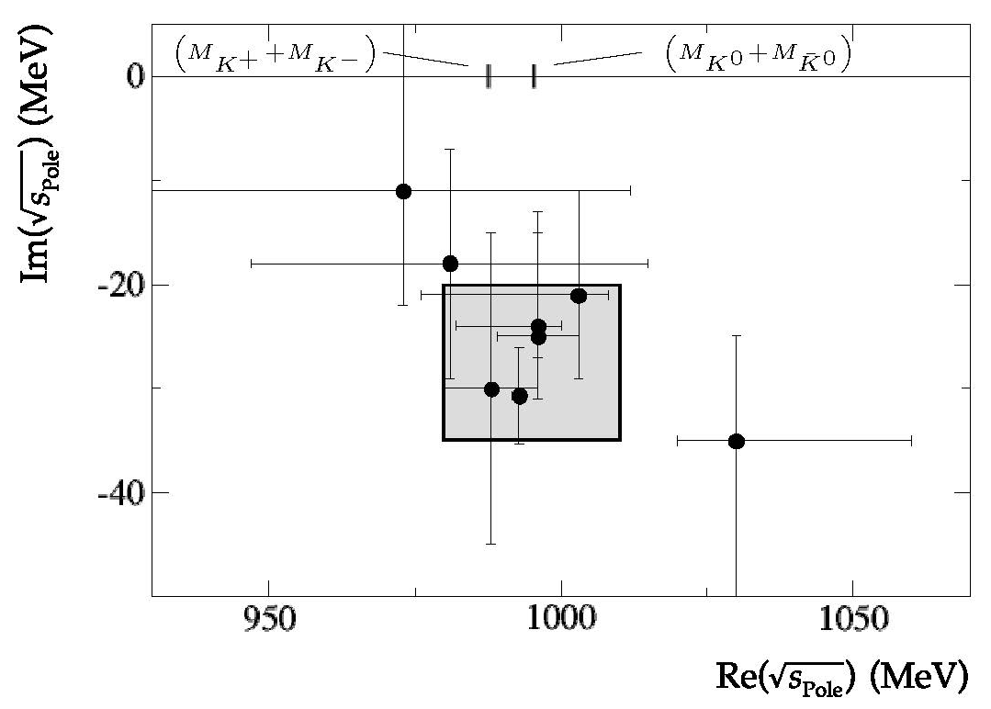
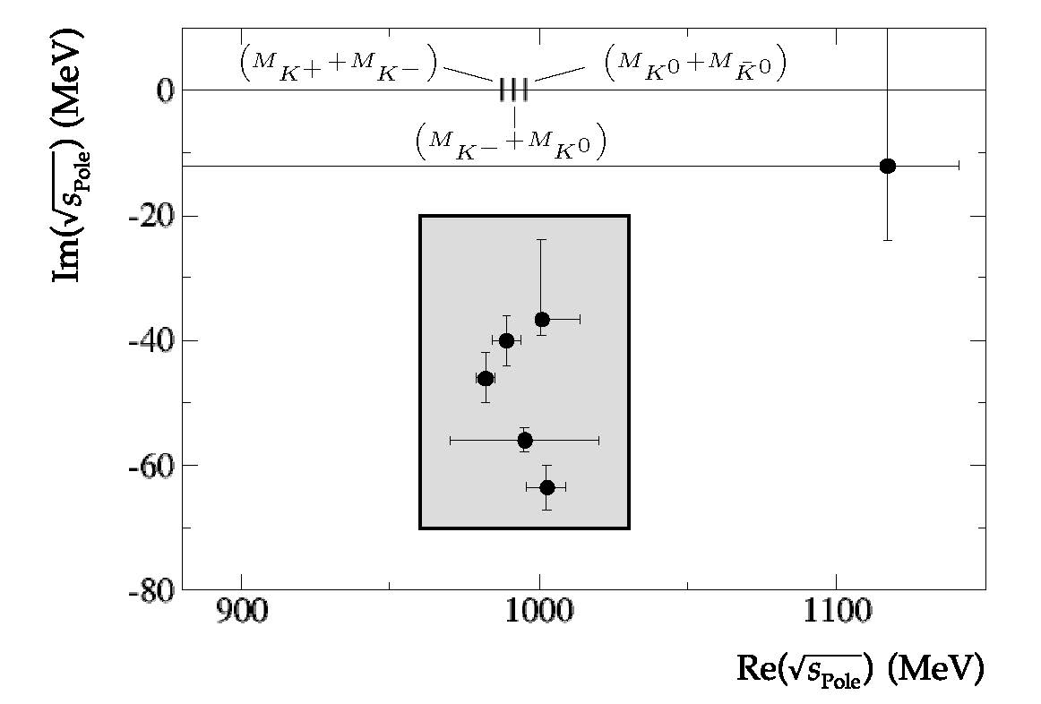
WHERE DO WE STAND? Light Scalars at RPP 2021 (on-line update). “Note on Light Scalar Mesons below 1 GeV”
f₀(980) and a₀(980) poles also provided. Less controversial, smaller uncertainties
Not all from meson-meson scattering
f₀(980) estimate
a₀(980) estimate
(980-1010)-i(20-35) MeV
(980-1030)-i(20-70) MeV
From scattering “Roy-like”

Slide 26
Analytic continuation to Contiguous (second) Riemann sheet
Dispersion relations provide model-independent analytic continuation to first Riemann sheet,
but the most relevant resonance poles live in the CONTIGUOUS sheet
For elastic resonances (only second sheet), S^{II}=1/S^{I}
σ/f₀(500), κ/K₀*(700), f₀(980),
Purely Dispersive Determination
from meson-meson scattering
To reach the contiguous sheet in the inelastic case, we need an analytic continuation to the second sheet by means of general analytic functions reproducing the Dispersion Relation in the real axis or the upper-half complex plane.
Several methods in the literature
Sequences of Padés
Continued Fractions
Laurent-Pietarinen functions
Conformal expansions…
These methods avoid specific parameterizations, reducing drastically the model-dependence
Tested then with the σ/f₀(500) and κ/K₀*(700). Compatible results.

Slide 27
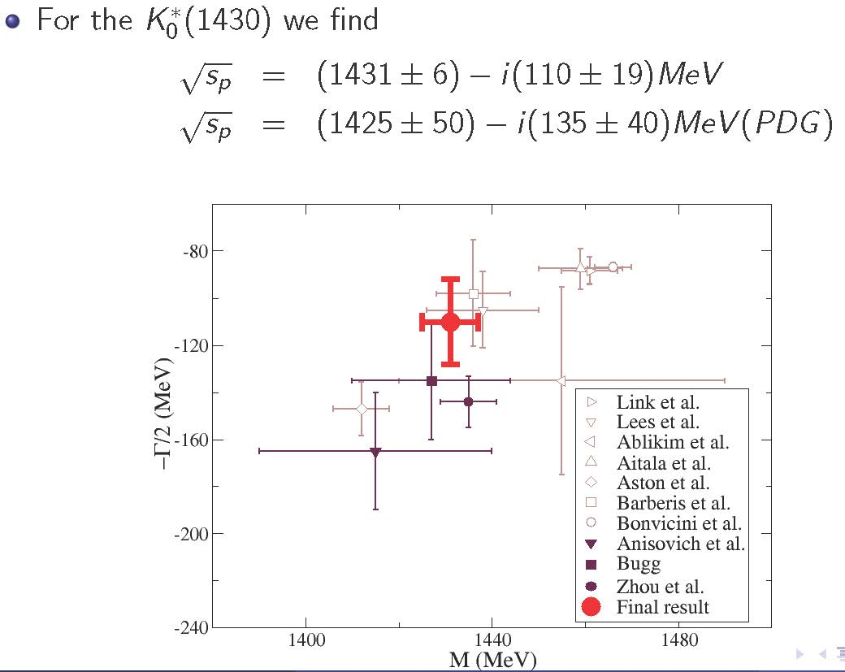
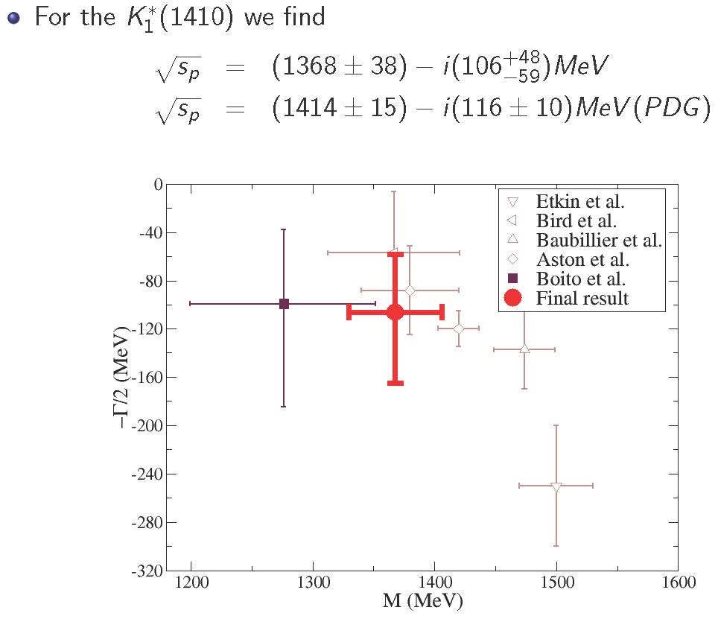
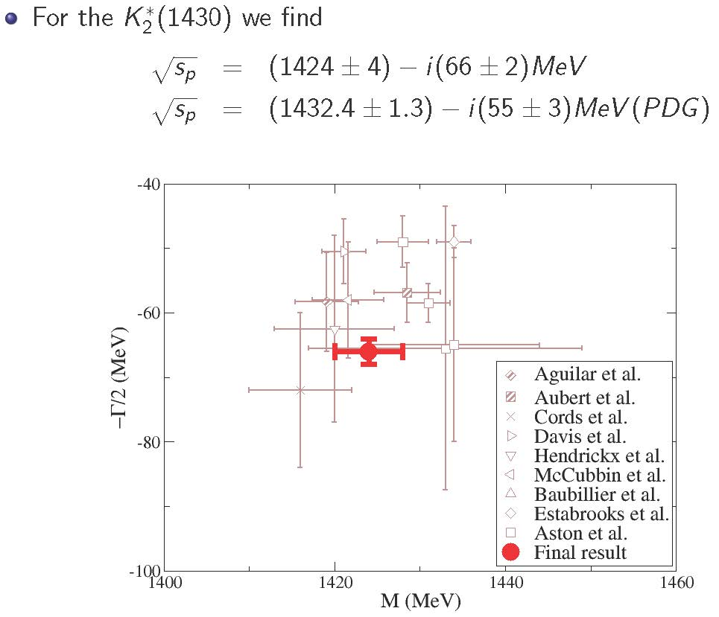
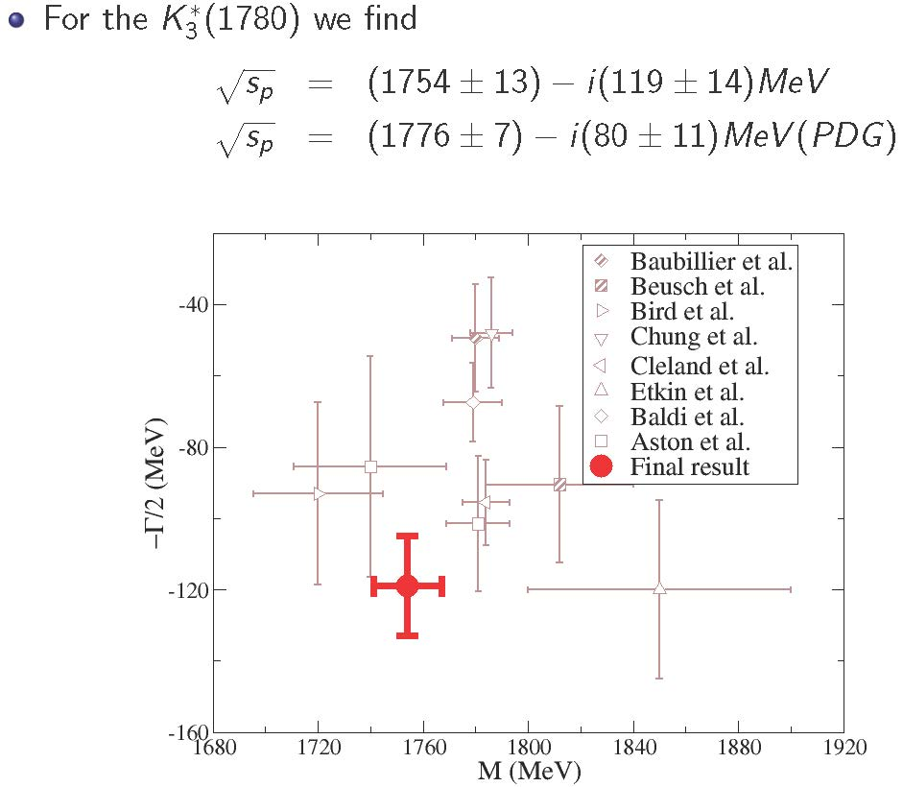
Strange resonance poles from CFD: Using Padé sequences JRP, A.Rodas & J. Ruiz de Elvira. Eur. Phys. J. C (2017)
The method can be used for inelastic resonances too. Provides resonance parameters WITHOUT ASSUMING SPECIFIC FUNCTIONAL FORM
Using Padé Sequences, the kappa:
JRP, A.Rodas & J. Ruiz de Elvira. Eur. Phys. J. C (2017) 77:91
(670±18)-i(295± 28) MeV Consistent with dispersive value

Slide 28
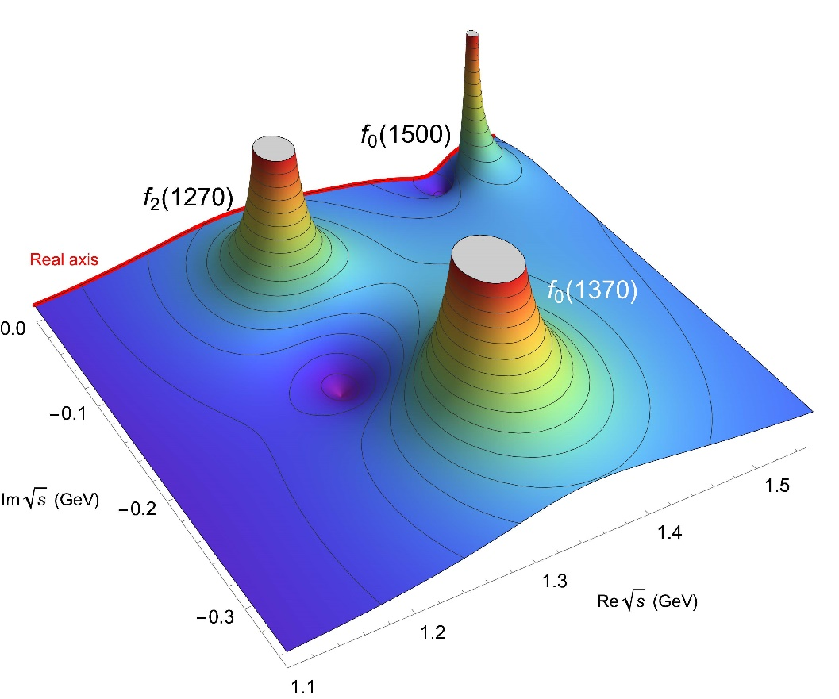
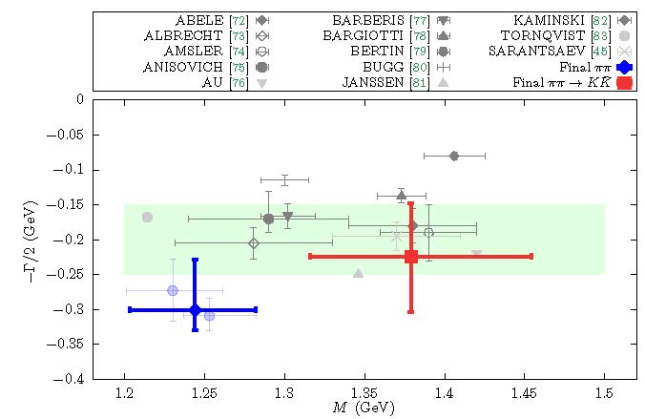
f₀(1370) and f₀(1500) poles from dispersive meson-meson + analytic continuation
JRP, A.Rodas & J. Ruiz de Elvira. e-Print: 2206.14822 [hep-ph]
Roy ππ→ππ equations strict applicability only up to 1.1 GeV.
NEW!
However, Forward Dispersion Relations applicability up to 1.42 GeV in our fits.
Complication, we see the isoscalar-wave with all spins
Roy-Steiner eqs. for ππ→KK are applicable there.
Analytically continued also find f₀(1370)
Larger uncertainty
But ~2σ tension on mass due to DATA
Continued fractions provide stable pole
description absent in original
experimental ππ→ππ data analyses.
Also in extrapolation of Roy-like equations

Slide 29
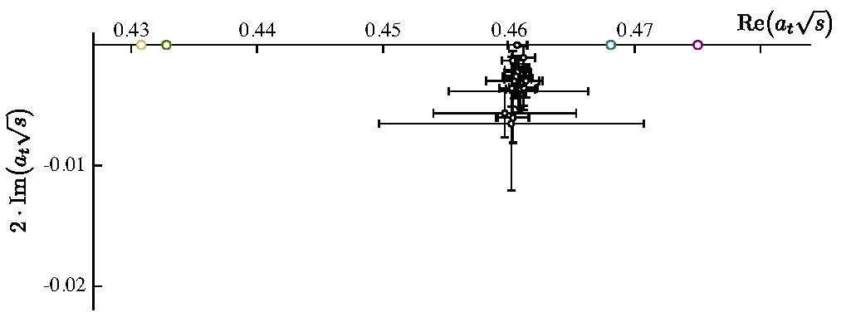
WHERE DO WE STAND? Recent developments on Exotics from meson-meson scattering
Candidates: π₁(1400) and π₁ (1600) with J=1⁻⁺ @Crystal Barrel, Brookhaven and COMPASS
Exotic P-wave in πη→πη and πη’→πη’ scattering coupled to other channels as well.
But not real data on scattering of πη and πη’. Just πp → ηπp, πp → η’πp
Various analyses used BW.
Recent “Analytic” methods:
Kopf et al. Eur. Phys. J. C (2021) 81:1056
K-matrix/Chew-Mandelstam
analytic parameterization
Input:Crystal Ball+COMPASS
Consistent with JPAC but slightly narrower
Rodas et al. (JPAC Collab) PRL122.042002 (2019)
N/D method for final state. Sampling of large # of models
Input: COMPASS data
Lattice: HadSpec Collab.PRD103, 054502 (2021)
Actual scattering (caveats:
in a box, dicretization, large pion mass, extrapolation)
Only one π₁
(1564±24±86)-i(246±27±51) MeV
Consistent with JPAC analysis
Largest BR to b₁π

Slide 30
SUMMARY
- Over the last years, and as late as 2021, the use of techniques based on analyticity and dispersion relations applied to meson-meson scattering has finally settled the longstanding controversy about the existence of two light scalar nonets below 2 GeV
- It is of the uttermost importance to characterize resonances by their poles.
Some simple parameterizations may be useful to describe data, but using them to characterize resonant states only creates confusion.
- Models should be consistent with the dispersive data analyses and with the poles found there.
- The present picture is that of a light scalar nonet below 1 GeV of a non-ordinary quark-antiquark nature (Criptoexotic). All its members are now identified
- Another nonet exists around 1.5 GeV, with one f₀ state too many. The f0(1370) is found in meson-meson scattering from dispersively constrained meson-meson scattering
Methods based on analyticity show that it is posible to describe the two exotic π₁
with just asingle pole/resonance

