Slide 1
Flow Over a Step Cylinder using Partially-Averaged Navier-Stokes Equations with Application Towards Dynamic Subsea Power Cables
Usman Shaukat, Presenter
U Shaukat, A Schnepf, KET Giljarhus
Notes:
Hi, Everyone I will wpresent the study on flow over step cylinder using Partially Averaged Navier stokes equation with Application towards Dyanmics Subsea power cable. The co authors of the paper are
Anja Schnepf in floating offshore wind turbine power cables.
Knut Erik Giljarhus, associate professor in fluid dynamics.

Slide 2
Agenda
Introduction
PANS methodology
PANS validation on wall-mounted cylinder
Results and discussion of step cylinder study
Conclusions
Usman Shaukat
Notes:
A short agenda will be presented.
I will cover the introduction phase in which I will talk about bluff bodies and how we can simulate them using a computational fluid dynamics models.
I will talk about the motivation behind simulating step cylinders and why we are simulating them.
Methodology I will discuss the Partially Averaged Navier Stokes equations, and how are they different from the RANS equation. Discuss the validation study that is done on a cantilever wall-mounted cylinder using the PANS equation.

Slide 3
Introduction
Computational Fluid Dynamics
Direct Numerical Simulation (DNS)
Large Eddy Simulation (LES)
Reynolds Averaged Navier-Stokes Equations (RANS)
Partially-Averaged Navier-Stokes Equation (PANS)
Detached Eddy Simulation (DES)
Flow over bluff bodies:
Flow separation
Vortex shedding
Boundary layer transition
Modelling Complexity
Higher Computational Resource
Hybrid Model
Common example:
Flow over cylinders
Usman Shaukat
Notes:
Flow around bluff bodies, such as circular cylinders and rectangular cylinders, is characterized by the phenomena of flow separation, vortex shedding, and boundary layer transition.
These are simulated using a computational fluid dynamics model. This pyramid shows the different techniques by which we can predict the fluid flow using CFD. With DNS we have high computational resource, we resolve all of the turbulence in the flud, With LES we only resolved the higher scale of turbulence while with RANS we model the turbulence equation.

Slide 4
Introduction - Step Cylinder
Power cable
Buoyancy module
Transverse drag force
Flow structure
Step cylinder
(Trelleborg’s Njord BS)
Usman Shaukat
Notes:
A step cylinder is a form of the bluff body that has not been studied extensively. It has one such application in the floating offshore wind turbine power cable. These cables stay afloat with the help of a buoyancy module. This configuration can be simplified as a stepped cylinder. As they are inside the water they are under the influence of fluid flow. Therefore, we want to know how the transverse forces are acting on this cylinder and what kind of flow structure this configuration produces. There is not enough literature on step cylinders particularly related to the drag forces acting on them.

Slide 5
PANS Methodology
$$f_{k}=\frac{k_{u}}{k}$$
$$f_{ε}=\frac{ε_{u}}{ε}$$
$$f_{ω}=\frac{ω_{u}}{ω}$$
$$\frac{Dk}{Dt}=\tilde{P_{k}}−β^{∗}kω+\frac{∂}{∂x_{j}}\left[\left(ν+ν_{t}σ_{k}\right)\frac{∂k}{∂x_{j}}\right] \\ \frac{Dω}{Dt}=\frac{γ}{ν_{t}}P_{k}−βω^{2}+\frac{∂}{∂x_{j}}\left[\left(ν+v_{t}σ_{ω}\right)\frac{∂ω}{∂x_{j} }\right]+2\left(1−F_{1}\right)\frac{σ_{ω}^{2}}{ω}\frac{∂k}{∂x_{j}}\frac{∂ω }{∂x_{j}}$$
$$ε=β^{∗}ωk$$
Menter $k ω SST$ RANS model
(Menter, 1992)
$$0{≤f}_{k}1 ,{ 0≤f}_{ε}1$$ Usually -->$f_{ε}=1$
Unresolved$\text{−}\text{to}\text{−}\text{total}$turbulence ratio
Where subscript u represents the unresolved quantity
$$\frac{{Dk}_{u}}{Dt}=\tilde{P_{k_{u}}}−β^{∗}k_{u}ω_{u}+\frac{∂}{∂x_{j}}\left[\left(ν+ν_{t}σ_{k}\frac{f_{ω}}{f_{k}} \right)\frac{∂k}{∂x_{j}}\right] \\ \frac{Dω_{u}}{D_{t}}=\frac{γ}{ν_{t}}\tilde{P_{k_{u}}}+\left(1−\frac{1}{f_{ω}}\right)\frac{γ}{ν}β^{∗}k_{u}ω_{u}^{2}−β\frac{{k_{u}ω}_{u}^{2}}{f_{ω}}+\frac{∂}{∂x_{j}}\left[ν+ν_{t}σ_{k}\frac{f_{ω}}{f_{k}}\right]+2\left(1−F_{1}\right)\frac{f_{ω} }{f_{k}}\frac{σ_{ω}^{2}}{ω_{u}}\frac{∂k_{u}}{∂x_{j}}\frac{∂ω_{u} }{∂x_{j}}$$
PANS$k ω SST$ model
(Girimaji, 2005)
Usman Shaukat
Notes:
Lets have a brief understanding of the PANS equation. In PANS instead of averaging the whole navier stoke equations. We partially average the Naveir stokes equation. How we do that with the help of the filter fk. Which is basically unsresolved to total turbulence ratio. After averaging the Navier-Stokes equation,, we get the additional modeling equations of RANS to model turbulence. The PANS equations are derived from the RANS equation. Any rans model can be converted into a PANS model if we multiply the parameter to the equations. It is important to note here, Now that the modeling equations only include the unresolved parts.

Slide 6
PANS Methodology
$f_{k}$ is a ratio of unresolved to total turbulent kinetic energy.
Blending factor
$$0$$
$$f_{k}$$
$$1$$
DNS
RANS
Dynamic or constant?
the present study constant ($f_{k}$) is chosen.
Which value to use? → Validation study
(Krajnović, 2011)
Usman Shaukat
Notes:
While f epsilon is fixed to 1. The important parameter that resolves the turbulence is f_k which is a unresolved to total turbulent kinetic energy. Fk is also known as blending factor it act as a bridge between DNS and RANS simulation. $F_{k}=1$ means RANS simulation where all of the turbulence is modelled while $F_{k}=0$ means DNS where all of the turbulence is resolved. This fk value can either be dynamic or constant. In Dynamic the fk varies as shown in the figure. It has value of 1 near field and far field. Therefore it acts as a detached eddy simulation like model, that can introduce modelling and discretization error.. Therefore, in the present, case a constant $f_{k}$ value is chosen in the present study. We validated which value to choose based on our validation study.

Slide 7
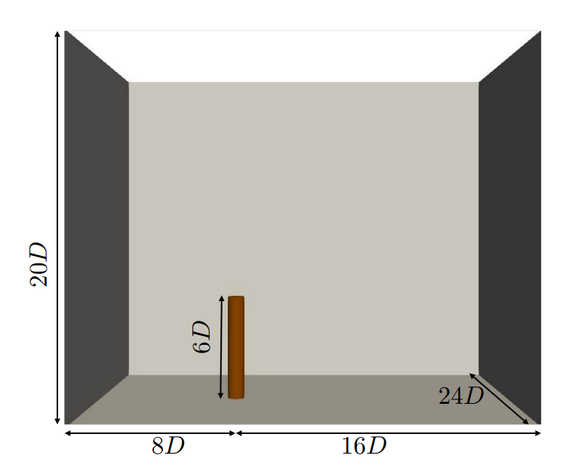
Validation of Wall-Mounted Cylinder
PANS implemented in OpenFOAM-v2206
Validation against wind tunnel experiment (Park and Lee, 2002)
Simulation parameters:
average $Y^{+}\sim 1$
Reynolds number $2×{10}^{4}$
2nd order schemes
Max. Courant number < 1
Computational domain
Usman Shaukat
Notes:
Simulation Setup:
This case has extensively been validated with LES studies and K-epsilon PANS studies.
Grid size chosen similar to previous studies for this specific case [ref].
average $Y^{+}\sim 1$
Numerical Schemes:
2nd order Schemes (for time and spatial discretization)
Max Courant No < 1
1.2 % blockage ratio.
Simulation time:
upto 445 vertex shedding cycles.
Field averaged:
112 vortex-shedding cycles.
Similar settings are applied to the step cylinder case:
Symmetry boundary condition at two ends of cylinder.

Slide 8
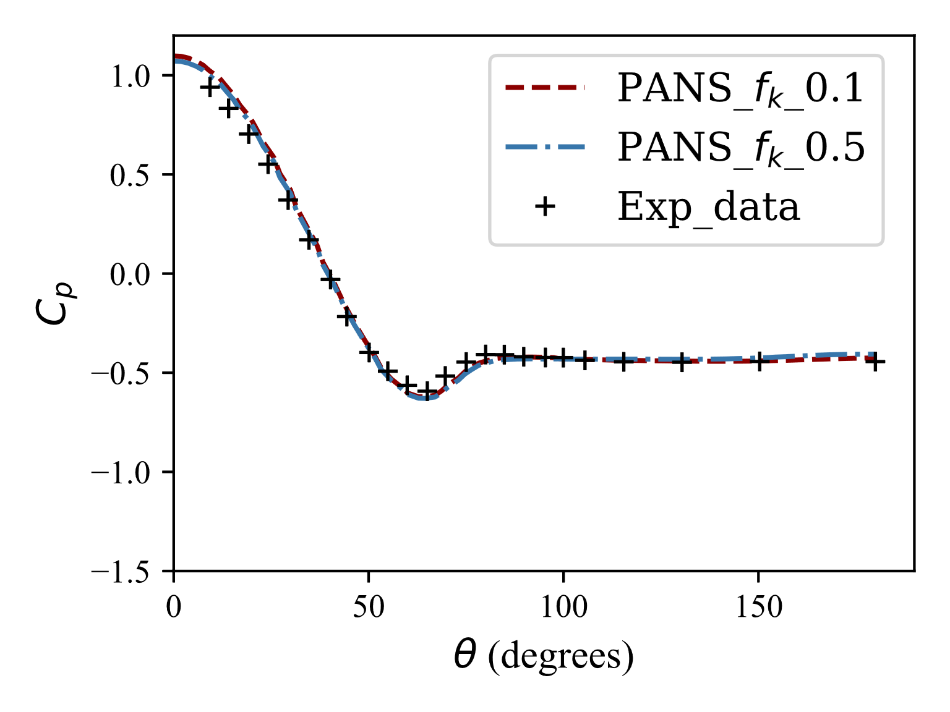
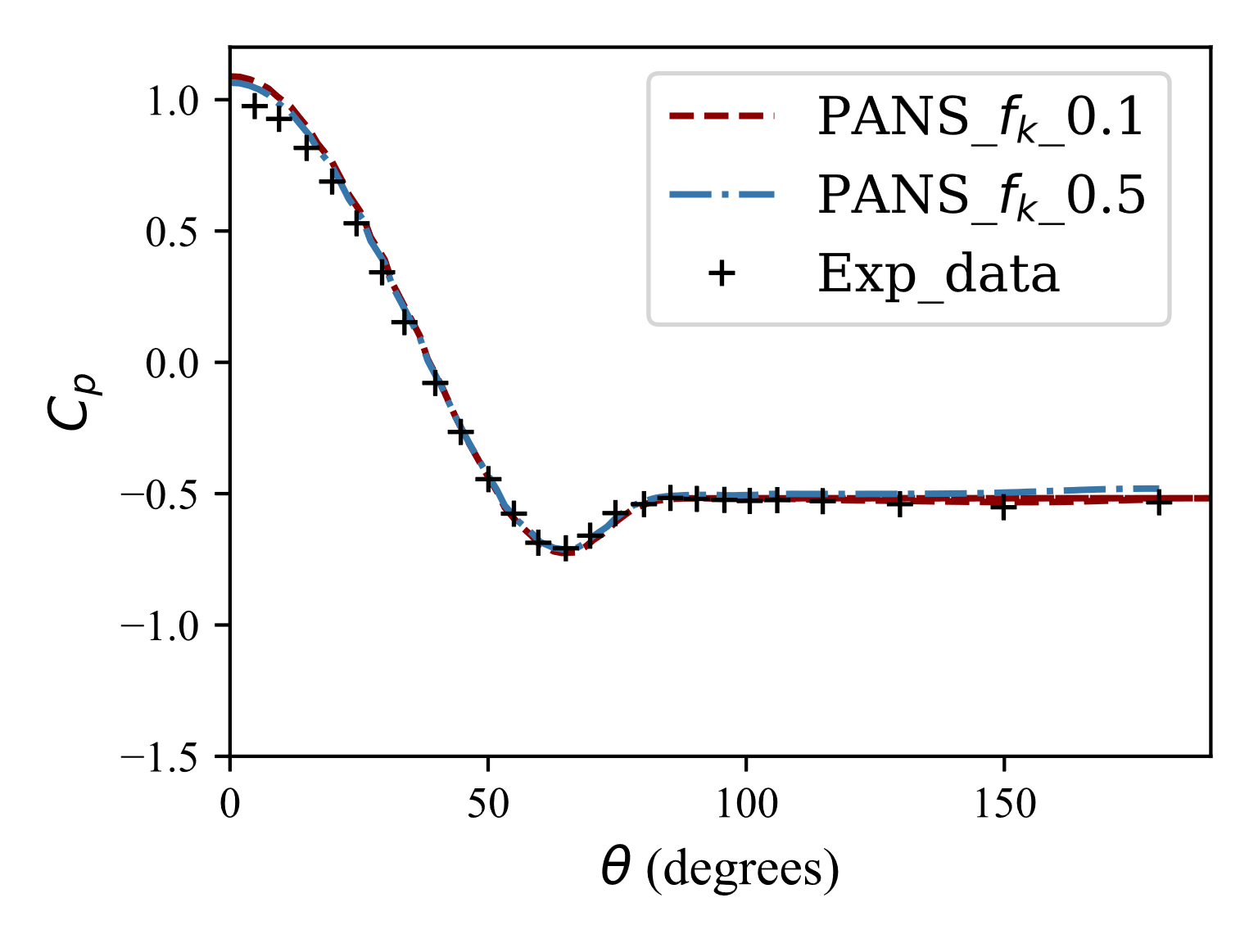
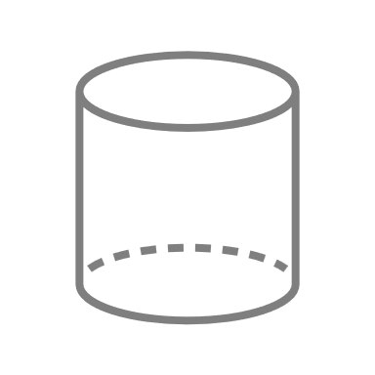
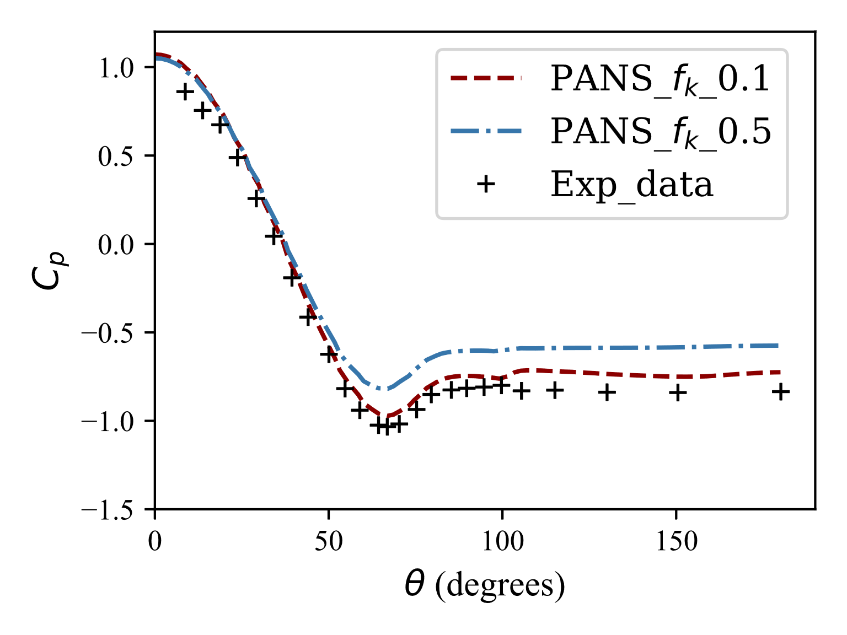
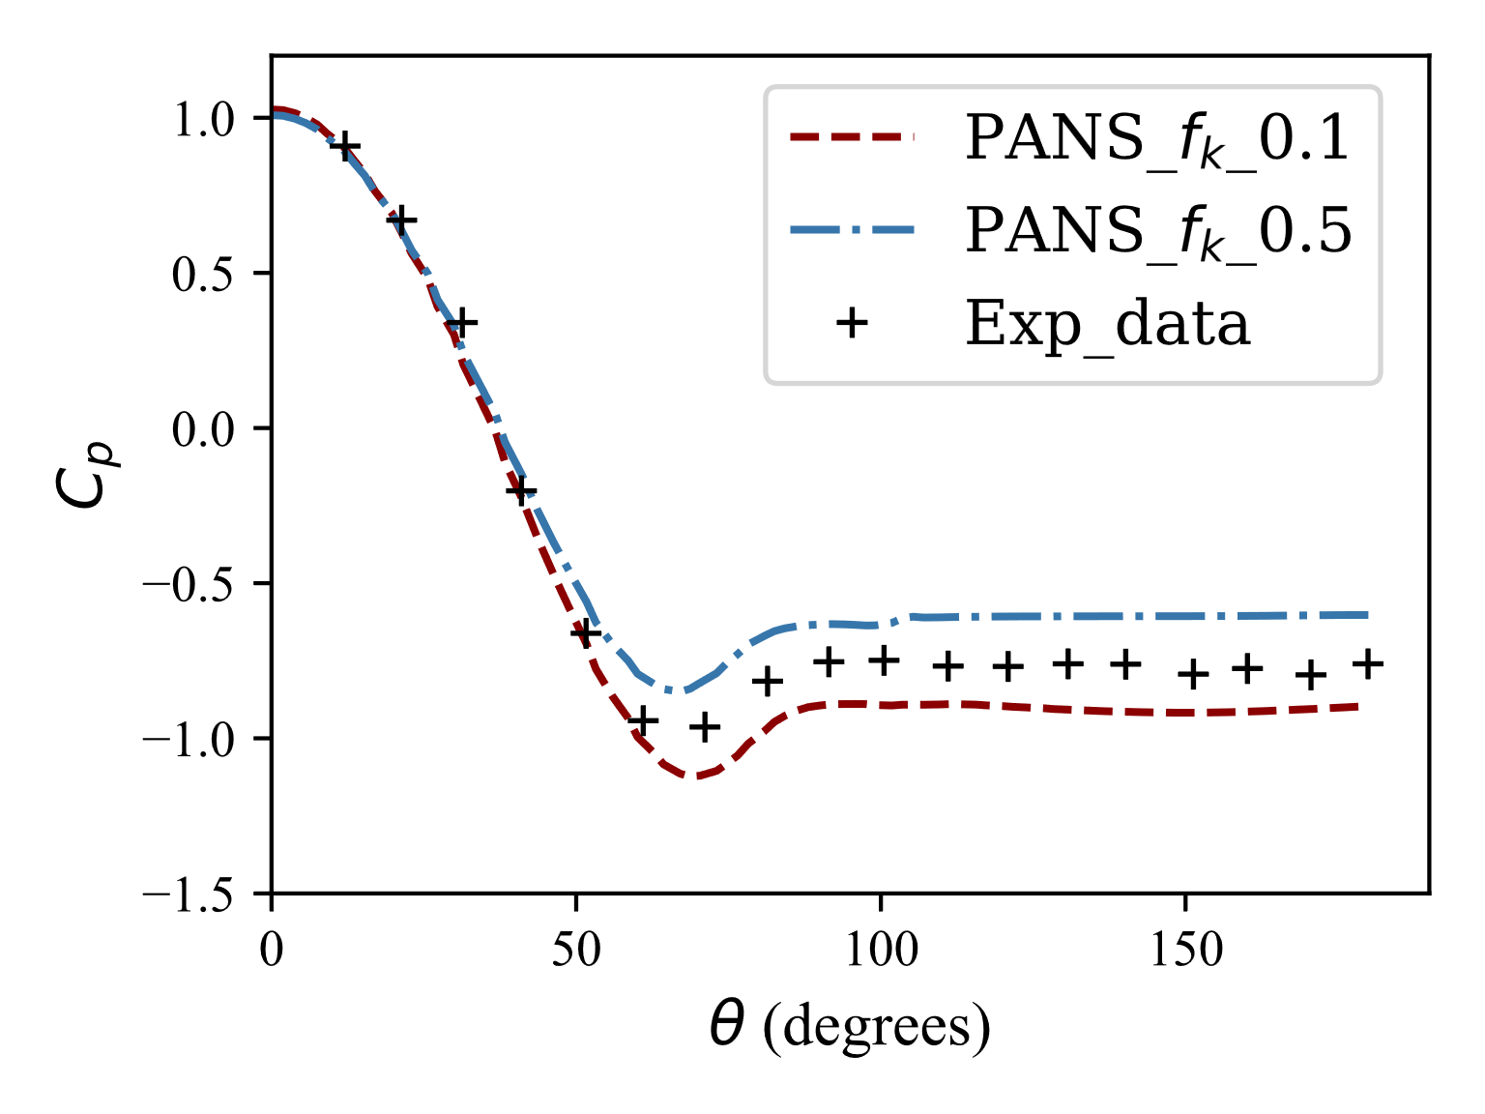
Validation Results -Pressure Coefficient
$$z/D=0.917$$
$$z/D=0.3$$
$$z/D=0.5$$
$z/D=0.$75
$$z/D=0.5$$
$$z/D=0.3$$
$$z/D=0.75$$
$$z/D=0.917$$
Usman Shaukat
Notes:
Coefficient of Pressure at different position along the cylinder
Capturing of separation include that.
Pressure coefficient decrease near the free end due to the movement of fluid towards the separation point at top.
Overall good comparison with experimental findings.
At z/d = 0.917 results in over prediction of Cp while 0.1 results in under prediction.
Better prediction with f_k = 0.1.

Slide 9
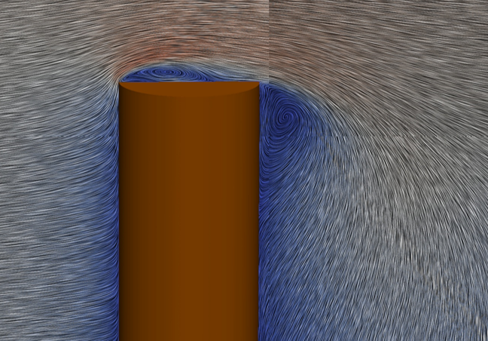
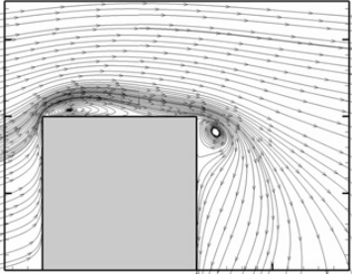
Results Validation Other LES Findings
Formation of separation bubble both at front and leeward side of cylinder
LES model (Afghan et al, 2007)
$K ω SST$ PANS model
Usman Shaukat
Notes:
Include other experimental finding.

Slide 10
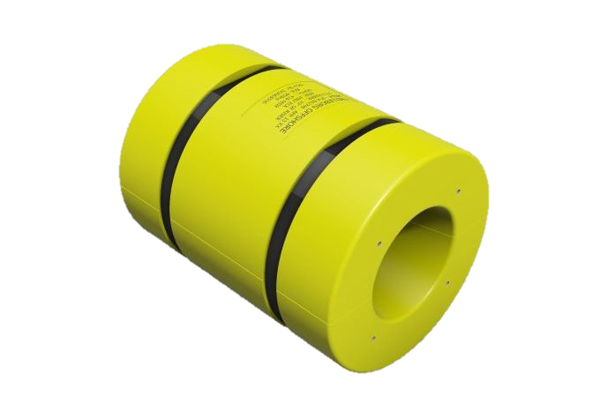
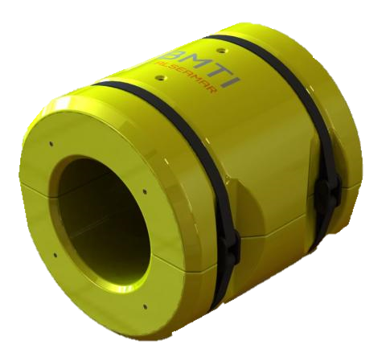
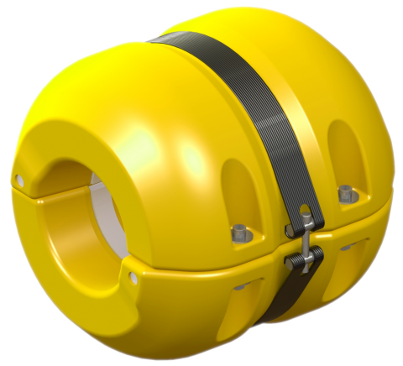
Step Cylinder Study
Sharp Edge
Chamfered Edge
Filleted Edge
Reynolds number $2.5 ×{10}^{4}$
Reynolds number 2.5 ×10^4
Diameter Ratio = 5
Usman Shaukat
Notes:
Add picture of different buoyancy module.

Slide 11
Step Cylinder-Drag Force Distribution Results
$$C_{d_l}=\frac{2F_{N}}{ρU^{2}D}$$
% Decrease of Drag at SDC after $2D$ |  | % Decrease of Drag at LDC after $3D$
Sharp Edge | ~2% | Sharp Edge | ~1%
Chamfer Edge | ~4% | Chamfer Edge | ~1%
Fillet Edge | ~8% | Fillet Edge | ~3%
Usman Shaukat
Notes:
Explain each abbreviation in the figure. Start with the buoyancy isolated. Then with the smaller cylinder. Explain the color scheme.
Finally explain which shows the most decrease in drag coefficient Addition of a step cylinder result in the reduction of drag across the smaller diameter cylinder.

Slide 12
Sharp Edge
Chamfered Edge
Filleted Edge
Usman Shaukat
Notes:
We can see vortex shedding from the Top cylinder.
Vortex shedding from the LDC
Vortex shedding from edges at the junction propagating between the two cylinders vortices. One advantage is that PANS has a much stronger theoretical foundation than DES. PANS is rigorously derived yet in contrast to Hybrid methods the blending is not location-dependent An advantage of PANS over LES is that the model offers a separation between modelling and discretisation error.

Slide 13
Comparison with Transverse Drag Coefficient in DNV-RP-C02 Standards
DNV-RP-C02
Buoyancy Module
CFD results align with the buoyancy module drag prediction
Power Cable
It does not account for the drag reduction observed in the simulation in the 2 x Diameter distance from the interface
Estimated as an infinite cylinder
Estimated as a finite cylinder with a reduction factor
Two- dimensional drag
Reduction factor
Drag estimation
Usman Shaukat
Notes:
Lets compare our step cylinder study with the industrial standard. For example, in DNV standards the drag estimated is based on a 2 dimensional drag coefficient of a circular cylinder and is multiplied by the reduction factor which then gives the drag estimate. What we found in our study is that the drag estimated on the buoyancy module aligns with the DNV standard using a reduction factor.

Slide 14
Conclusion
Validated PANS on wall-mounted cylinder
Simulated flow over step cylinders using PANS
Sharp, chamfered, and filleted edge
Drag reduction near the junction of the step cylinders
Dominance of filleted edge designs in reducing drag
Flow features like recirculation and vortices are identified
Recommended to include flow impact on smaller diameter cylinders in standards and guidelines for a more accurate assessment
Usman Shaukat
Notes:
PANS as a validated tool for accurate simulations.

Slide 15
usman.shaukat@uis.no
www.linkedin.com/in/usmanshaukat110
Thank you
References
DNV AS 2021 Environmental conditions and environmental loads Recommended Practice DNV-RP-C205 Det Norske Veritas
Huse E and Reitan O E 1989 Drag of Buoyancy Elements on Flexible Risers in Axial Flow Tech. Rep. 511171.00-1 MT51 89-0198 MARINTEK Trondheim, Norway
Girimaji S S 2005 Partially-Averaged Navier-Stokes Model for Turbulence: A Reynolds-Averaged Navier-Stokes to Direct Numerical Simulation Bridging Method J. Appl. Mech. 73 413–21 ISSN 0021-8936
Klapwijk M, Lloyd T and Vaz G 2019 On the accuracy of partially-averaged navier–stokes resolution estimates Int. J. Heat Fluid Flow 80 108484
Menter F R 1992 Improved two-equation k-omega turbulence models for aerodynamic flows Tech. rep. National Aeronautics and Space Administration Ames Research Center
Park C W and Lee S J 2002 Flow structure around a finite circular cylinder embedded in various atmospheric boundary layers Fluid Dyn Res 30 197
Floating wind turbine with Trelleborg’s Njord BS (Bend Stiffeners) and Trelleborg’s Njord DBM (Distributed Buoyancy Modules)
Krajnović, S. 2011. Flow around a tall finite cylinder explored by large eddy simulation. Journal of Fluid Mechanics, 676, 294–317. doi:10.1017/s0022112011000450
Usman Shaukat

Slide 16
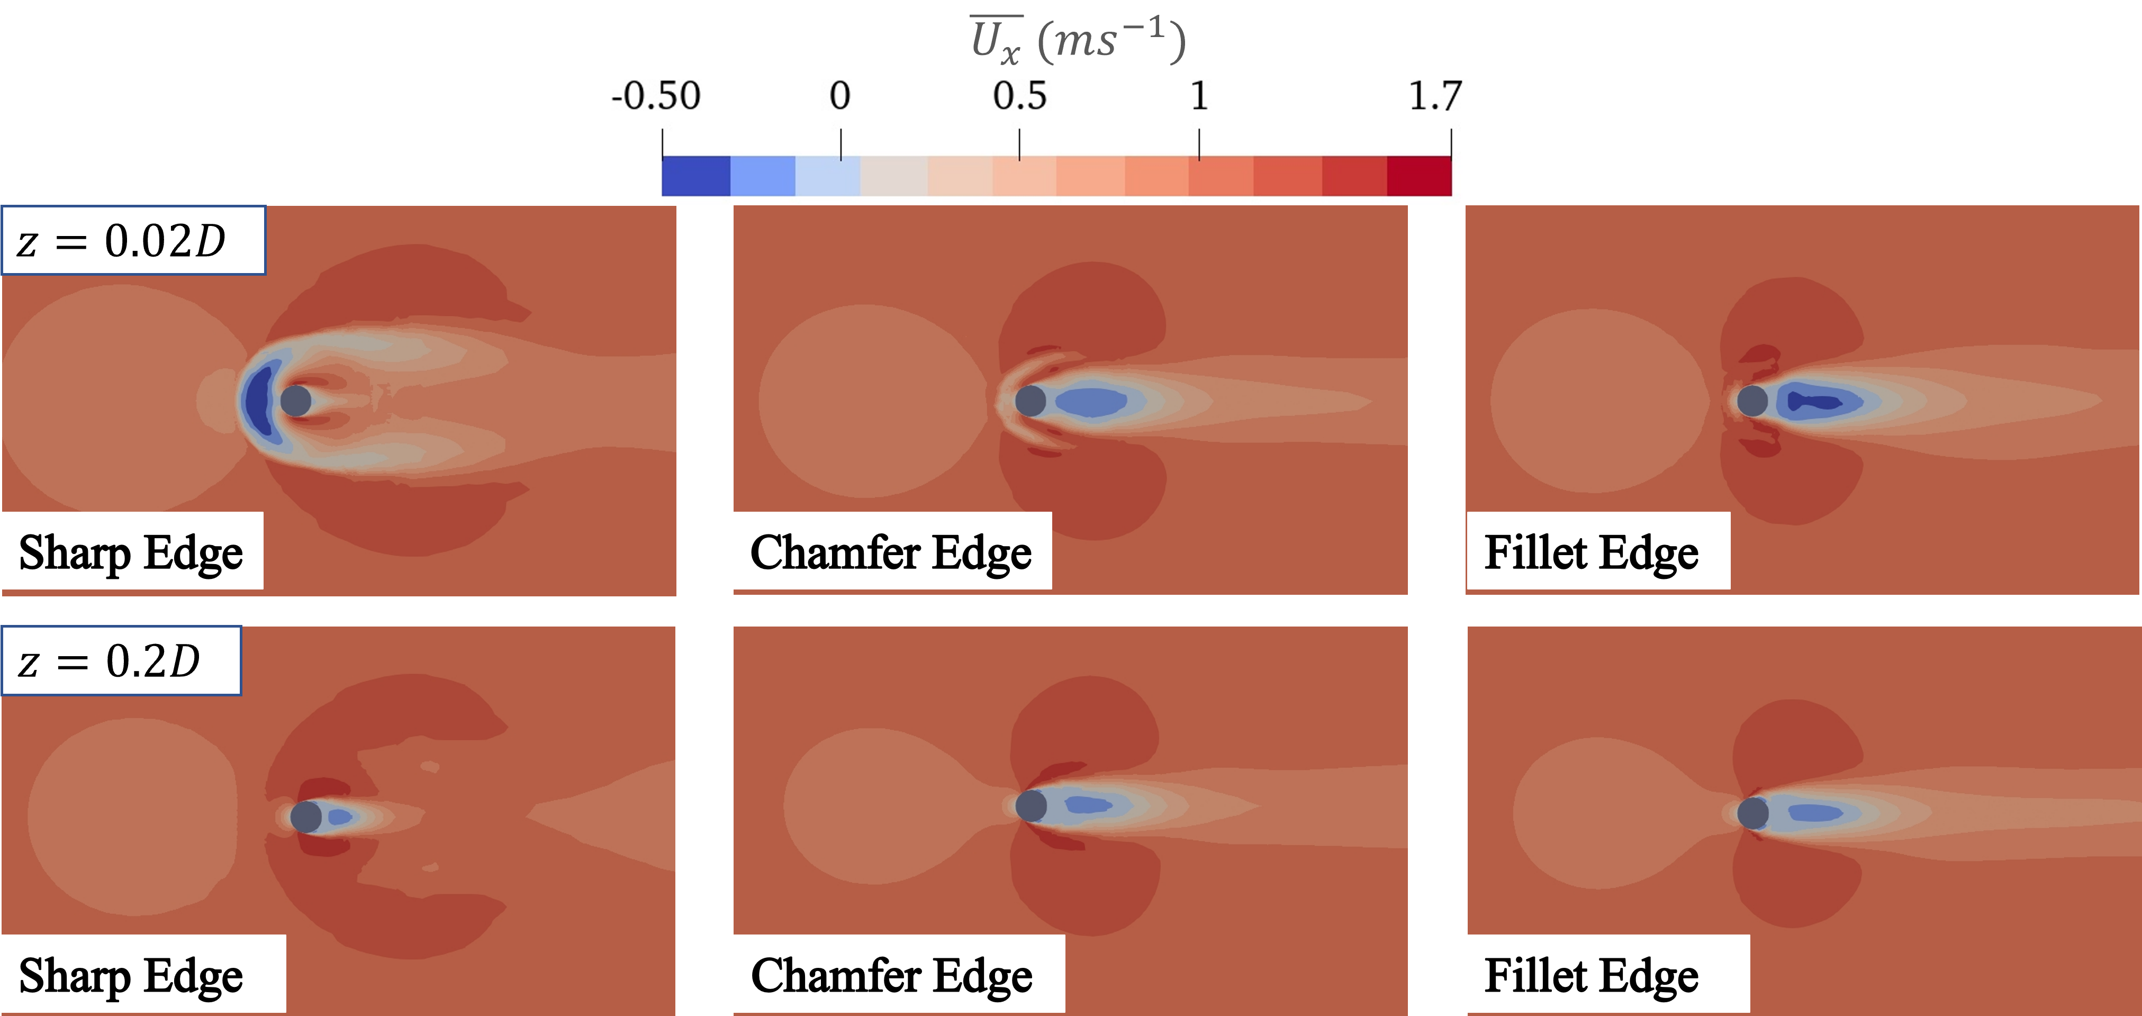
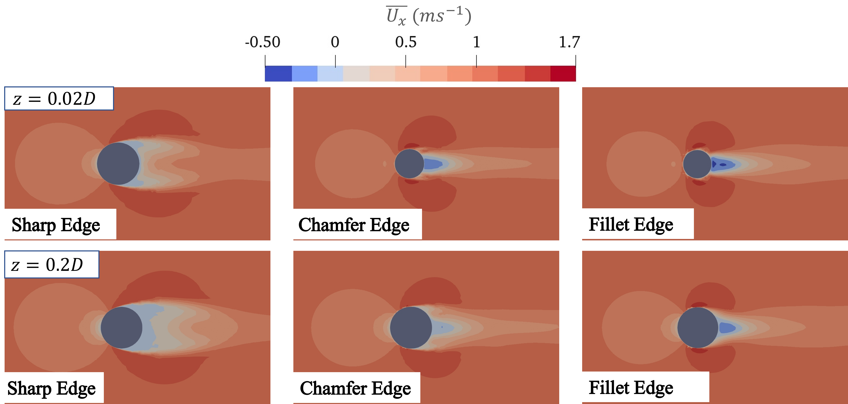
Step Cylinder - Velocity contours Results
Flow Patterns- Velocity contour plots
Sharp edges
Reverse flow upstream
Wider wake region
Chamfering and Filleting
Reduction in reverse flow
Thinner wake
Flow Over a Step Cylinder using Partially-Averaged Navier-Stokes Equations with Application Towards Dynamic Subsea Power Cables
Usman Shaukat
Notes:
Wider wake region characterized by extended flow disturbance.
Thinner wakes. Because the reduction of diameter near the end and guided flow introduce less turbulence.

Slide 17
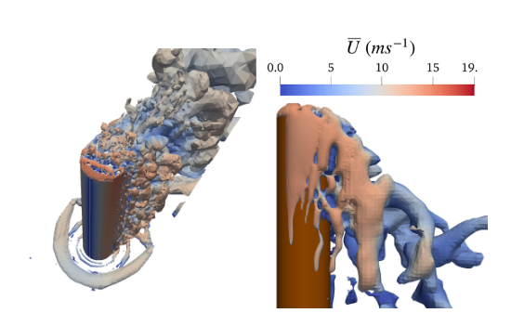
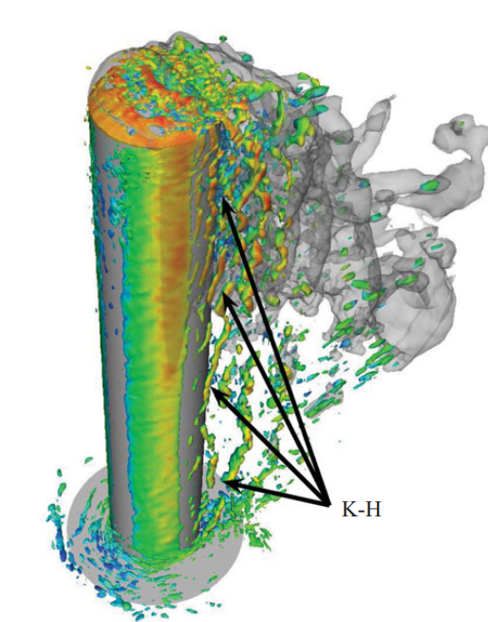
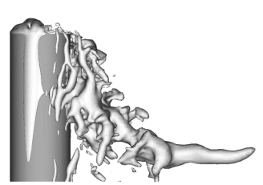
Results Validation against LES Findings
Q criterion and pressure coefficient similar to previous findings.
$K ω SST$ PANS model
LES model (Krajnović,2011)
Usman Shaukat

Slide 18
Step Cylinders - Flow Structures Results
Sharp Edge
Chamfered Edge
Filleted Edge
Notes:
We can see vortex shedding from the Top cylinder.
Vortex shedding from the LDC
Vortex shedding from edges at the junction propagating between the two cylinders vortices. One advantage is that PANS has a much stronger theoretical foundation than DES. PANS is rigorously derived yet in contrast to Hybrid methods the blending is not location-dependent An advantage of PANS over LES is that the model offers a separation between modelling and discretisation error.

