Slide 1
Ministry of EDUCATION
Assosa University
Production of Hybrid Composite Using Sisal and False Banana Fiber for Dashboard Application
Investigator (s):
Principal Investigator: Mr. Dawit W. (MSc.)
May, 2023
Arba Minch Ethiopia

Slide 2
The growing environmental concerns, global warming, waste management issues, dwindling fossil resources, and rising oil prices.
To overcome those problems, newer materials from different plants, animal and wood fibers that are friendly to our health and environment.
Hand Lay-up: manual laying of fiber reinforced material and application of resin to mold to build up the thickness.
INTRODUCTION
By Dawit Wami, Assosa University, College of Engineering, Mechanical Eng’g Dep. Assosa, Ethiopia

Slide 3
Fiber hybridization: is a promising strategy to toughen composite materials, by combining two or more fiber types.
Developing a new material for automotive application is to enhance vehicle efficiency and fuel economy by reducing the dead weight of the vehicle.
By the 10% weight decreasing, the fuel consumption of a vehicle decreases by 7%,
What also means that reducing the weight by about 1kg will measurable reduce the CO2 emissions.
Cont’d
By Dawit Wami, Assosa University, College of Engineering, Mechanical Eng’g Dep. Assosa, Ethiopia

Slide 4
In developing Country most of Automotive spares and Machine parts was imported from abroad.
These imported materials are heavy in weight, expensive and have a great impact on the environment.
False Banana fiber(FBF) and Sisal fiber (SF) are abundant in Ethiopia.
Therefore, the preparation NFs composite using FBF and SF by hand layup method, aligned with spars will plays a vital role to reduces the cost of manufacturing in developing countries.
Statement of the Problem
By Dawit Wami, Assosa University, College of Engineering, Mechanical Eng’g Dep. Assosa, Ethiopia

Slide 5
Objectives of the study
General Objective
To fabricate hybrid composite by hand lay up method, characterize and constructing PEUGEOT model dashboard for demonstration.
Specific Objectives
To produce hybrid composite from FBF and SF fibers reinforced composite material.
To characterize the tensile, compression, flexural, density & water absorption properties.
To fabricate the PEUGEOT model automobile vehicle dashboard using the composite.
By Dawit Wami, Assosa University, College of Engineering, Mechanical Eng’g Dep. Assosa, Ethiopia

Slide 6
Significance and beneficiaries of the study
Significance
NFs are emerging as low cost, lightweight and environmentally friendly.
Improve their overall production rate, mechanical performance, lightness, chemical stability, recovered energy and end-of-life recyclability.
FB and sisal are biodegradable and easily available.
Opportunity for the utilization agricultural product.
It also helps to develop rural industry.
They are non-abrasive, deforestation can be reduced.
By Dawit Wami, Assosa University, College of Engineering, Mechanical Eng’g Dep. Assosa, Ethiopia

Slide 7
Beneficiaries
Raw material suppliers
Researchers
Garage workers
Owners of vehicle,
Youth’s (Job opportunity),
Institutions (university, health centered, etc.)
Scope of the Study
Characterization of mechanical properties of hybrid composites which is made by hand lay up method.
Preparation of composite samples with varying composition proportion of FBF and SF.
Testing of the samples and analysis of the PEUGEOT model vehicle dashboard modeling using Solid Work 2017.
By Dawit Wami, Assosa University, College of Engineering, Mechanical Eng’g Dep. Assosa, Ethiopia

Slide 8
LITERATURE REVIEW
By Dawit Wami, Assosa University, College of Engineering, Mechanical Eng’g Dep. Assosa, Ethiopia

Slide 9
[Sapuana et al.,2011] studied material selection for natural fibers RPCs by using the software called Analytical Hierarch Process (AHP) for determining the most suitable NFs for automotive dashboard.
Depending on mechanical and Physical properties.
The test was conducted, Flax 36% + epoxy , Flax 36%+ vinyl ester , Kenaf 60%+ PP , Kenaf 85% + PP and Flax 36% + PE .
After a systematic steps to assist the designer or material engineers from those listed it provide that Kenaf 60% + PP is the most suitable material B/C it shows good tensile strength.
By Dawit Wami, Assosa University, College of Engineering, Mechanical Eng’g Dep. Assosa, Ethiopia

Slide 10
Cont’d
[Guru and Hari, 2013] reported the effect of an angle - ply orientation on tensile properties of Kevlar and glass with epoxy resin as an adhesive composite.
Three orientations viz. 0˚/90˚, 45˚/45˚ and 30˚/60˚ were considered for studies.
It was observed that angle ply orientation at 0˚/90˚ showed significant increase in tensile properties as compared to other orientation.
By Dawit Wami, Assosa University, College of Engineering, Mechanical Eng’g Dep. Assosa, Ethiopia

Slide 11
MATERIALS AND METHOD
FBF & SF Steam/Blast Collection
Generally, methodology flow chart for preparation of hybrid composite shown in Figure Below.
Fibers Extraction
Fibers Drying
Fibers treatment by 8 g of NaOH & 10L distilled Water
Purchase Resin & Hardener
Washing Fibers by Running Water Repeatedly and Dry in Air
Hybrid Fibers & Weaving by Ply Orientation of (0,90) degree
Mixing Resin and Hardener in 10:1 Ratio
Mould Preparation
By Dawit Wami, Assosa University, College of Engineering, Mechanical Eng’g Dep. Assosa, Ethiopia

Slide 12
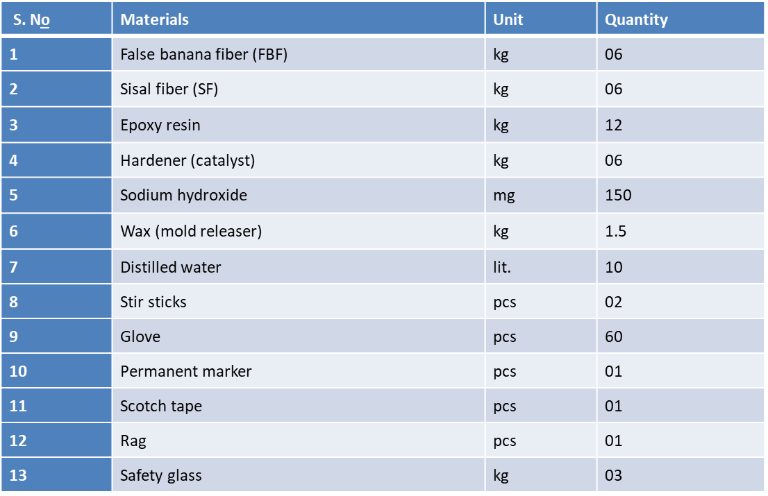
Cont’d
Table : Materials Used for the Production of Hybrid Composite from FBF and SF
Curing
Specimen Preparation
Conducting Test
Analysis Test
Preparation Dashboard for PEUGEOT Model Vehicle as Demonstration Purpose
By Dawit Wami, Assosa University, College of Engineering, Mechanical Eng’g Dep. Assosa, Ethiopia

Slide 13
Extraction Process of F.B /Ensete / Fiber
Fibers which extracted manually is greater than a fiber which extracted mechanically by 20 % strength (Bos et al., 2002).
Steps to extract FBF manually:
Cut the Enset plant which is ripe and ready for the process, from the ground level.
Cut the outer two layers of the plant into smaller pieces.
Attach the smaller piece on an inclined plane wood and hold it with right leg.
Between the right leg and the inclined plane wood scrap it with a tool made from wood to squeeze the size.
The one which is left on the inclined plane will be the fiber and the one which is left on the ground will be the food.
Figure 1: Manual extraction process of FBF. A) FB (Ensate) plant. B) During extraction process. C) Extracted FBF before washing. D) Dried FBF.
By Dawit Wami, Assosa University, College of Engineering, Mechanical Eng’g Dep. Assosa, Ethiopia

Slide 14
Extraction process of sisal fiber
Steps to extract SF manually:
Cut the leaves away from the bole of the plant.
After that gently remove the thorn.
Then, leaves are trimmed in a longitudinal direction into different strips for ease of fiber extraction.
The peeling part is clamped between the wood table and knife.
Then, the extracted fiber washed with water in order to loosen & separate the fiber until individual fibers are obtained.
Finally, the extracted fibers are then dried over the sun for three days.
Figure 2: Manual extraction process of sisal fiber.
Sisal plants.
Longitudinally trimmed sisal plant.
peeling of sisal plant for sisal fiber extraction.
Extracted sisal fiber before washing with water and drying.
Extracted sisal fiber in drying process after washing.
By Dawit Wami, Assosa University, College of Engineering, Mechanical Eng’g Dep. Assosa, Ethiopia

Slide 15
Alkali treatment of FBF and SF
Alkali treatment used to removal of waxes, hemicellulose, pectin and parts of lignin.
When, percentage of NaOH is increased, it affect the fibers properties by reduce the bonding capacity.
For this study, 8 gm of NaOH mixed with 10 liters of distilled water at ambient temperature to attain POH value of 12.
The FBF and SF then socked in the solution for 24 hours.
Then it washed repeatedly with runner water in order to neutralize fibers.
Lastly, the fibers were allowed to dry in sun light for at least 24 hours.
By Dawit Wami, Assosa University, College of Engineering, Mechanical Eng’g Dep. Assosa, Ethiopia

Slide 16
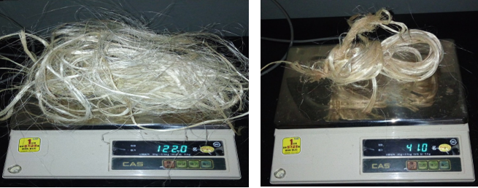
Determination of Fibers and Epoxy Resin Weight Fractions
According to (Ban, 2013) Fiber, weight fraction content of the composite material were calculated by the equation:
$$\frac{M_{fiber}}{M_{matrix}}=\frac{ρ_{fiber }× V_{fiber}}{ρ_{matrix}× V_{matrix}}$$
Mass of fiber
$$ρ_{f}×V_{f}$$
$$163.20 g let take 163g$$
Figure 3: Digital weight measurement device.
By Dawit Wami, Assosa University, College of Engineering, Mechanical Eng’g Dep. Assosa, Ethiopia

Slide 17
Hybridization Mechanism of FBF & SF
The term ‘hybrid composite’ is generally used to describe a matrix containing at least two types of reinforcements, but this paper is restricted to hybrid composites containing two types of reinforcing fibers (FBF& SF).
Those two fibers can be combined in many different configurations’ three most important configurations are visualized in Figure 4.
Figure 4: The three main hybrid configurations (Yentl et al., 2014).
Interlayer or layer-by-layer
Intralayer or yarn by-yarn
Intra yarn or fiber-by-fiber
By Dawit Wami, Assosa University, College of Engineering, Mechanical Eng’g Dep. Assosa, Ethiopia

Slide 18
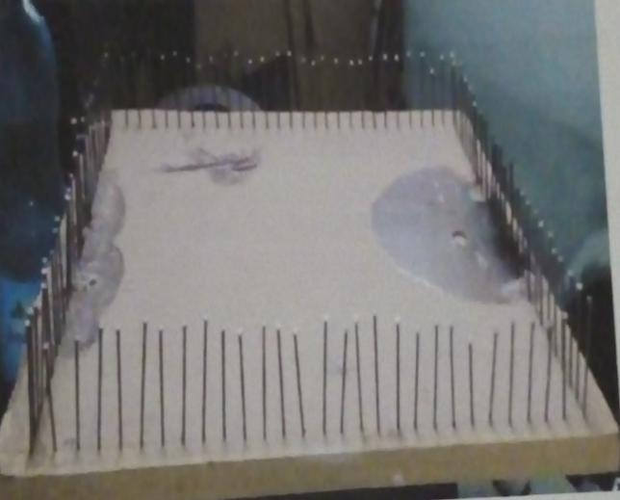
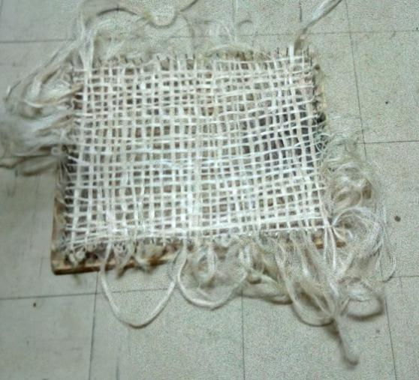
Cont’d
For this study, intrayarn or fiber- by - fiber hybridization mechanism of FBF and SF are used.
By weighting each fiber by desired ratios and co-mingled together, the best dispersion is achieved if the two fibers types are completely randomly distributed, as illustrated in Figure (c).
So, this type of hybridization mechanism, have advantage to get the desired thickness.
After that, by preparing local weaving (loom) equipment using 1m² wood plate and nail to produce different hybrid composition of FBF and SF ratios.
For fiber orientation of (0,90)⁰ .
Figure 5: Completely random dispersion (Yentl et al., 2014).
Figure 6: Weaving (loom) equipment.
Figure 7:Weaving (loom) orientation of (0,90)^{0.}

Slide 19
Epoxy Resin With Hardener
The most commonly used thermoset resins are GP, vinyl ester & polyester.
GP resins has a superior advantage over the other resin types; such as: • Curing convenience (0 - 180℃) temperature range curing • Low shrinkage during cure. • Strong adhesive properties
• Good mechanical properties (particularly strength and stiffness). • Improved resistance to fatigue and micro cracking. • Reduced diminution of properties due to water penetration.
For this study, 10 : 1 GP resin to hardener ratio are used.
By Dawit Wami, Assosa University, College of Engineering, Mechanical Eng’g Dep. Assosa, Ethiopia

Slide 20
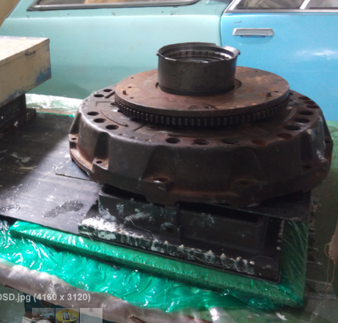
Compression & Curing
Hand Lay-up Method
High load materials are loaded on the mold to remove excess GP resin and curing for 24 hours at room temperature.
After curing period, the hybrid composite of FBF and SF GP matrix were removed from the mold.
Figure 8: Hand lay-up techniques (Esmael A. 2013).
Figure 9 : Compression and curing process.
By Dawit Wami, Assosa University, College of Engineering, Mechanical Eng’g Dep. Assosa, Ethiopia

Slide 21
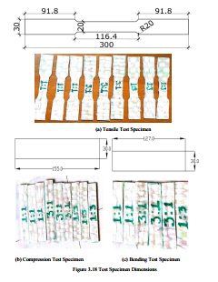
Fabrication of composite specimens
Dimension of Test specimens (ASTM Std)
Figure 10: Hybrid composite of FBF and SF fabrication procedures.
By Dawit Wami, Assosa University, College of Engineering, Mechanical Eng’g Dep. Assosa, Ethiopia

Slide 22
Fabrication of PEUGEOT Model Vehicle Dashboard From Hybrid Composite of FBF & SF
Based on the results obtained from the mechanical and physical properties laboratory tests of tensile, compression, bending, water absorption and density concluding that the best to manufacture vehicle dashboard using (0,90⁰) ply orientation with Hybrid composite of FBF and SF with 1:3 ratio is selected.
Generally, to manufacture the PEUGEOT model vehicle dashboard in this study follow manufacturing procedure listed below:
Prepare, cop and drag parts from the original dashboard by using E-glass fiber.
By Dawit Wami, Assosa University, College of Engineering, Mechanical Eng’g Dep. Assosa, Ethiopia

Slide 23
Cont’d
By arranging the FBF and SF according to the desired weight ratio then co-mingle together randomly by fiber - fiber and woven by (0,90)⁰ relative to the area dashboard.
Mix the GP resin with hardener with (10:1) ratio respectively and stir to gather for 15 minutes.
Clean and add mold releaser on the internal surface of cope and drug parts then accession (add) the mixed epoxy resin with hardener slightly on the mold then macadamize the plane woven on the mixed epoxy resin after that again accession (add) the mixed epoxy raisin at the top surface of the woven and then place cope on and up load a heavy materials for compression and wait for 24 hours, for curing time.
Finally composite was detached from the mold meticulously.
To get good surface finish rubbing the surfaces by sand paper after that clean and paint by Spray paint of black color.
By Dawit Wami, Assosa University, College of Engineering, Mechanical Eng’g Dep. Assosa, Ethiopia

Slide 24
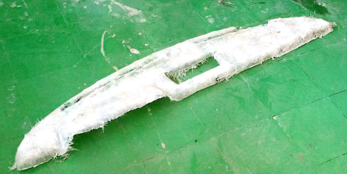
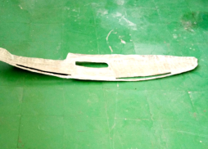
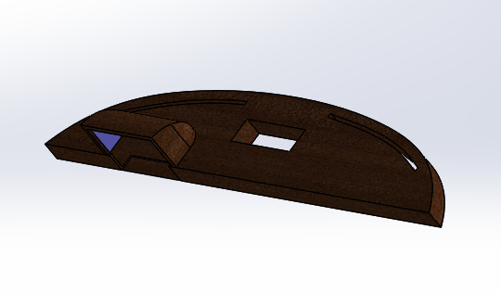
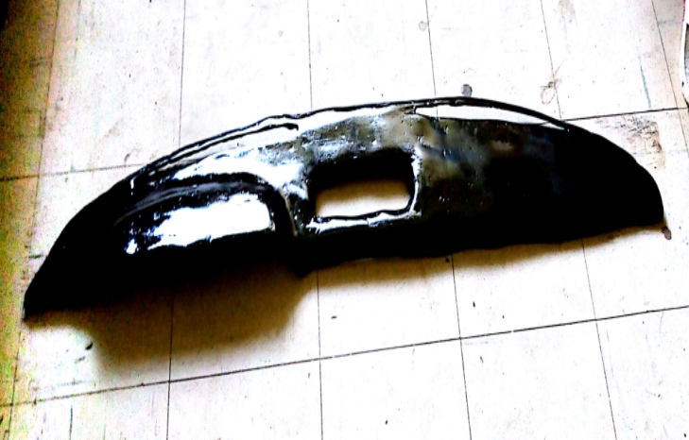
Cont’d
Figure 12: Cop molds for manufacturing of PEUGEOT model vehicle dashboard.
Figure 13 : Dashboard before paint.
Figure 14: Dashboard during painting.
Figure 15: Dashboard modeled by Solid Work 2017.
Figure 16: Dashboard after painting.
By Dawit Wami, Assosa University, College of Engineering, Mechanical Eng’g Dep. Assosa, Ethiopia

Slide 25
CONCLUSION & RECOMMENDATION
CONCLUSION
Hybrid composite of FBF and SF with 1:3 ratio exhibits excellent tensile strength.
The compression strength result indicates that hybrid composite of FBF and SF 3:1 ratio has the highest with average harness value of 12.30 MPa.
Results shows that the flexural strength of hybrid composite with 1:3 ratio has highest with average value of 380.9 Mpa.
Which is two times greater than 3:1 ratio and three times greater than 1:1 ratio.
This indicates that, more SF in hybrid composite to get a material which cannot be simply flexure.
By Dawit Wami, Assosa University, College of Engineering, Mechanical Eng’g Dep. Assosa, Ethiopia

Slide 26
Cont’d
Water absorption percentage also takes place in two types of water.
Ordinary tap water, in this type of water hybrid composite of FBF and SF with 3:1 ratio absorb more water relative to other ratios, this hybrid composite absorbs 4.21%.
Rain water again hybrid composite of FBF and SF with 3:1 ratio recorded more water absorption up to 3.80% & 1:1 ratio follow the 3:1 ratio by 3.21% result.
The least rain water absorption seen for hybrid composite of 1:3 ratio.
By Dawit Wami, Assosa University, College of Engineering, Mechanical Eng’g Dep. Assosa, Ethiopia

Slide 27
Cont’d
For both types of water, more water absorption is seen on hybrid composite of FBF and SF with 3:1 ratio and followed by 1:1 ratio & the list water absorption seen on 1:3 ratio.
In this case, for water absorption percentage as the list number is more preferable. So, 1:3 ratio has least value and preferable.
Shortly, for automotive dashboard application point of view hybrid composite of FBF and SF with 1:3 ratio has better mechanical and physical properties.
By Dawit Wami, Assosa University, College of Engineering, Mechanical Eng’g Dep. Assosa, Ethiopia

Slide 28
RECOMMENDATION
F.B & sisal plants of different aging, climatic condition & soil type those disposed throughout country, conducting further researcher on their mechanical, chemical, thermal & physical properties.
By changing fibers, fiber orientation, filler material, treatment medium & other parameters for output composite properties;
The trends of replacing heavy metals with low density, biodegradable, renewable & environmentally friendly should have to get attention in country dependent on agricultural sector like Ethiopia.
By Dawit Wami, Assosa University, College of Engineering, Mechanical Eng’g Dep. Assosa, Ethiopia

Slide 29
THANK YOU!!
By Dawit Wami, Assosa University, College of Engineering, Mechanical Eng’g Dep. Assosa, Ethiopia

