Slide 1


COTech 2023
Assessing Impact of Borehole Field Data’s Input Parameters on Hybrid Deep Learning Models for Heating and Cooling Forecasting: A Local and Global Explainable AI Analysis
(N Ahmed*, M Assadi, Q Zhang and A A Ahmed)
NAME, title
Naveed Ahmed, Department of Energy and Petroleum Engineering, UiS

Slide 2
Outline
Introduction and Background
Problem Statement
Methodology
Results
Conclusion
Research
Objectives

Slide 3
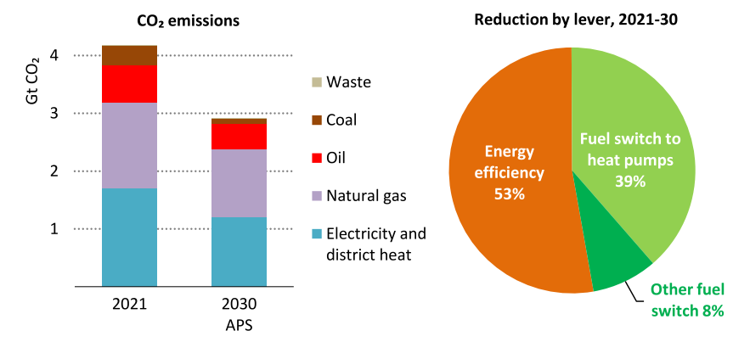
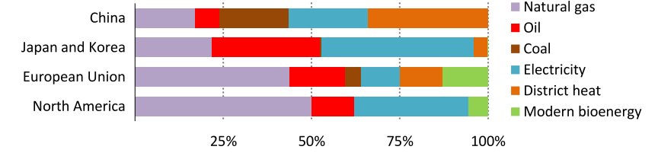
Background
Building sector's heating demands contribute significantly to global CO₂ emissions
Natural gas is the leading form of energy for space heating in buildings, meeting around 45% demand globally.
Heat pumps can be the main contributor to these declines
Fig. Household space and water heating [1]
[1] The future of heat pumps, IEA, World Energy Outlook, special report Nov, 2022

Slide 4
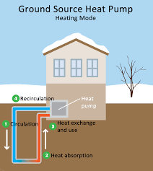
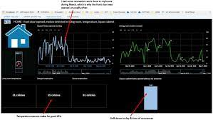
Background (Contd)
Ensuring accurate performance forecasting of borehole heat exchangers (BHE) becomes crucial for optimizing GSHP systems.
The performance of GSHP systems is influenced by several factors, including mass flow rates, heat transfer fluid temperatures, geological conditions, variable weather conditions and occupant behavior etc.
It is crucial to precisely forecast the energy output of BHEs to reduce energy waste and develop reliable models for assessing thermal characteristics [2].
Data-driven deep machine learning approaches offer an alternative to forecast heating and cooling load with fewer input parameters, utilizing historically measured data from borehole field.
[2] N. Ahmed et al.,. Energy for sustainable development, pp. 231–257, Jan, 2023

Slide 5
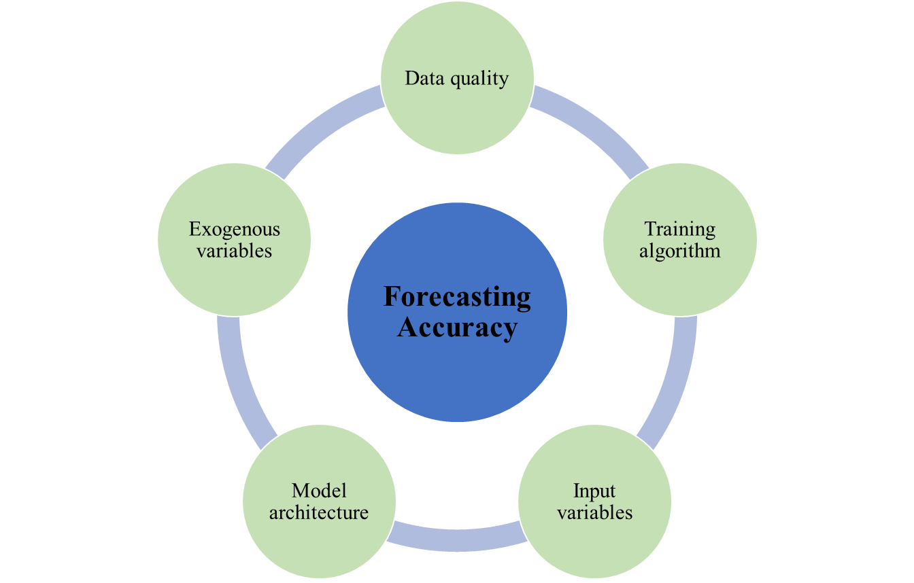
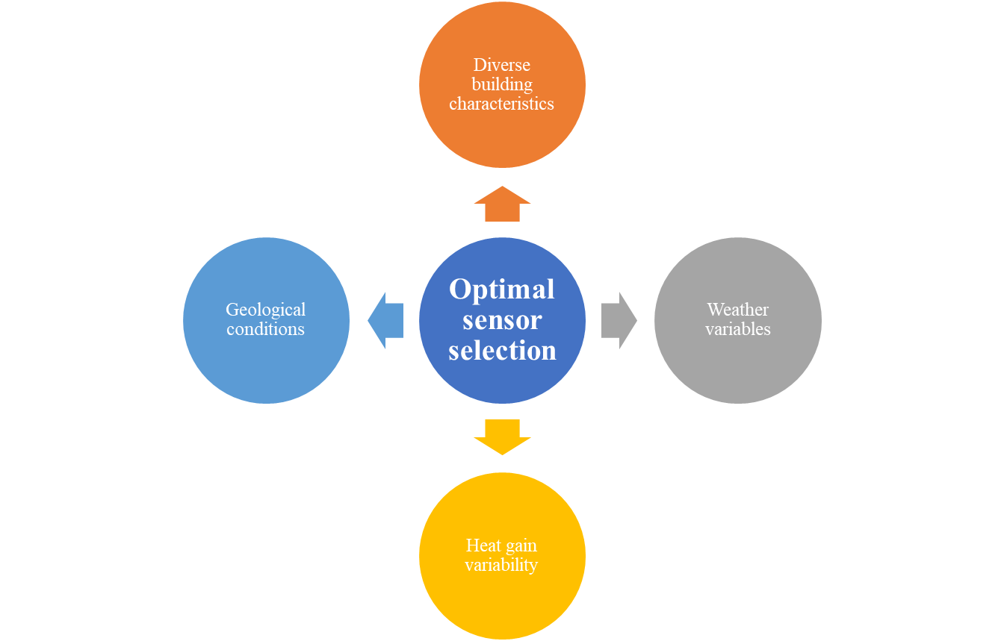
Problem statement
The accuracy of AI models is influenced by various factors
Determining the practical selection of sensors from the borehole field for deep machine learning forecasting models can be a challenging task [3]
The complexity of hybrid deep neural networks and "black-box" models [4]
The implications of this research are significant, as the proposed multistep prediction hybrid model (LSTM-CNN) can contribute to industry applications such as 24-hour ahead prediction of BHE output, demand-side management of heating and cooling, and building operations.
[3] N. Ahmed et al., Energy and Buildings Dec 2023
[4] Zhu J et al., Appl Energy 2022;321:119269

Slide 6
Objectives
To investigate and quantify the impact of model architecture, the number of input data sensors, and their accurate identification on multivariate hybrid deep learning models.
Moreover, the significance of incorporating a recent development in deep learning to pay selective attention to the input data i.e., attention-based mechanisms in LSTM-CNN and CNN-LSTM architectures is also investigated.
The significance of input parameters for the data-driven AI models is assessed through a parameters importance interpretability analysis utilizing Explainable-AI local and global-explanation methods

Slide 7
Methodology
Four architectures of hybrid deep learning models are investigated
LSTM-CNN
LSTM-CNN-At
CNN-LSTM
CNN-LSTM-At.
The constructed hybrid deep models are trained, validated, and tested using varying numbers of independent input parameters
Trained deep learning models are then utilized to predict the performance of borehole heat exchangers 24 hours in advance.
Ex-AI methods are used for results interpretations

Slide 8
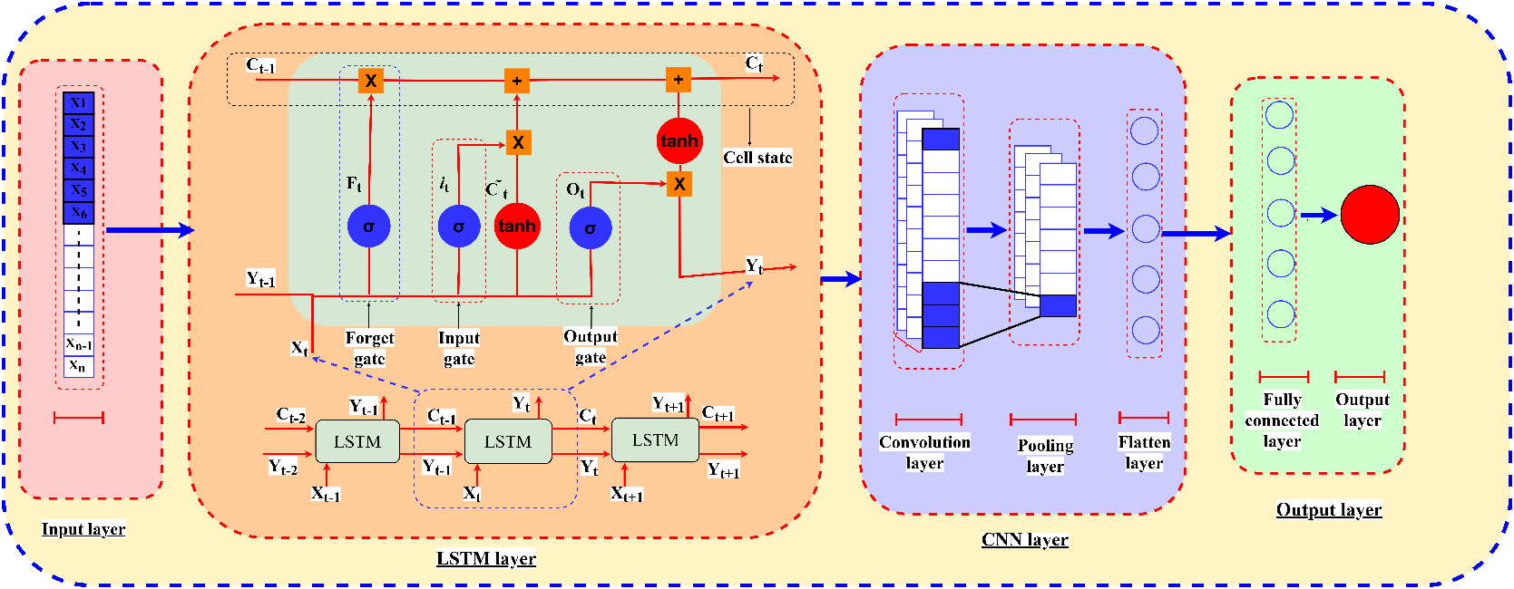
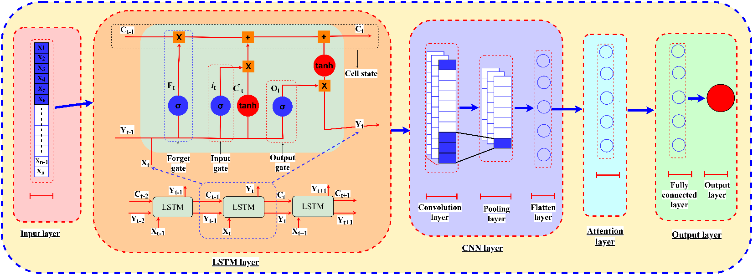
Methodology: Hybrid Deep Learning Models
LSTM-CNN
LSTM-CNN with attention mechanism

Slide 9
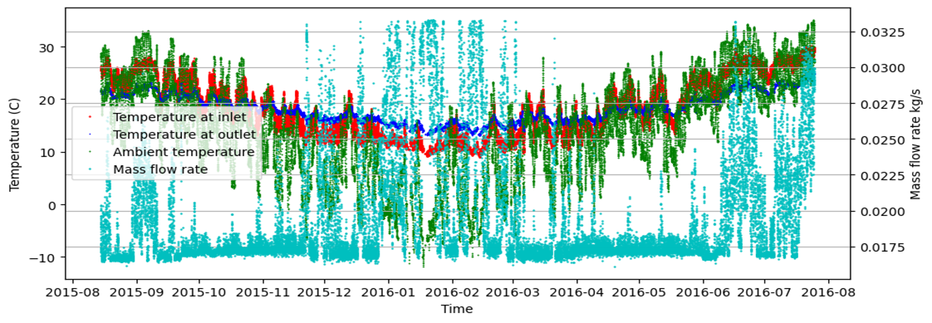
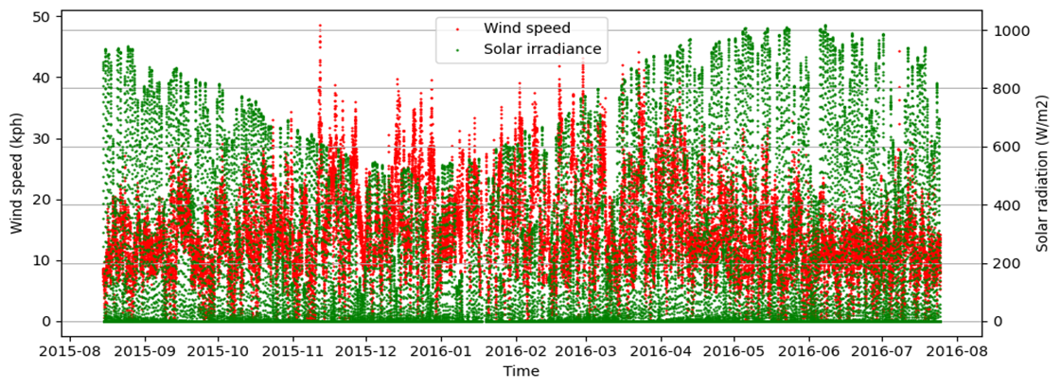
Methodology: Datasets
Parameter | Dataset
Location | Rolla, Missouri, USA [5]
Data duration | 14/08/2015 to 25/07/2016
No of boreholes | 144 , (h=122m)
Application | Space heating and cooling
Measured data duration | 1 Year
Collection interval | 15 Min
Datasets | input-parameters | No of Input-parameters
Variation-1 | T_{out}, T_{in}, T_{amb} , m⁰ | 4
Variation-2 | T_{out}, T_{in}, T_{amb}, m⁰, R_{sol} | 5
Variation-3 | T_{out}, T_{in}, T_{amb}, m⁰, R_{sol},V_{wind} | 6
[5 ]Smith et al., Geothermics 2018

Slide 10
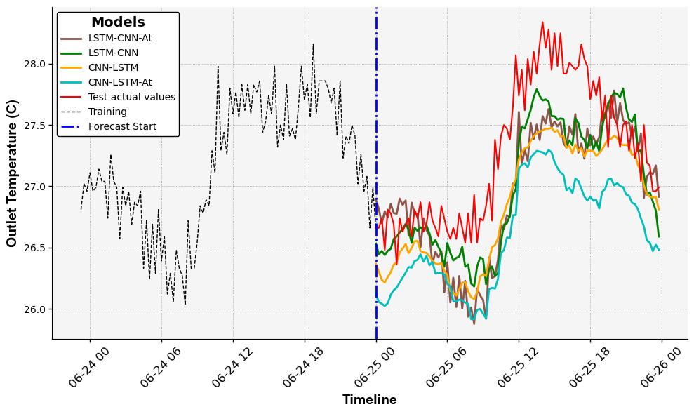
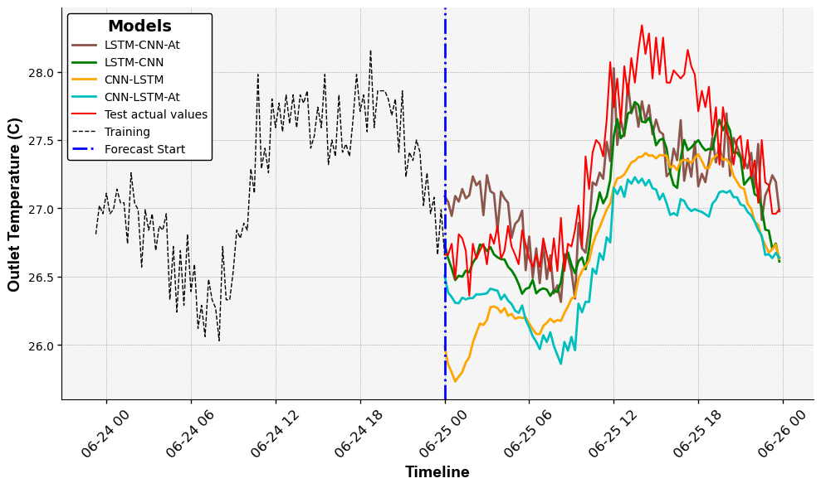
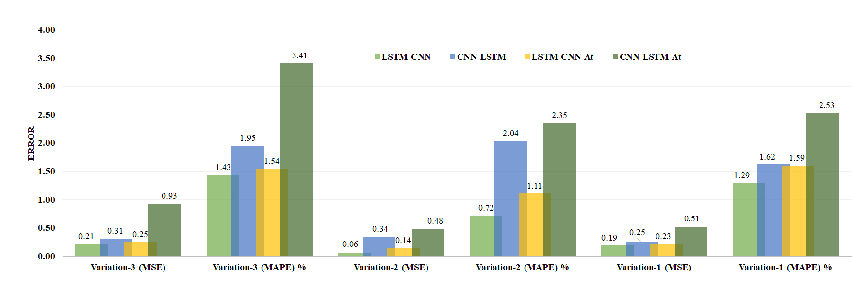
Results: Effect on multistep forecasting accuracy
LSTM-CNN> LSTM-CNN-At> CNN-LSTM> CNN-LSTM-At
Variation-1
Variation-2

Slide 11
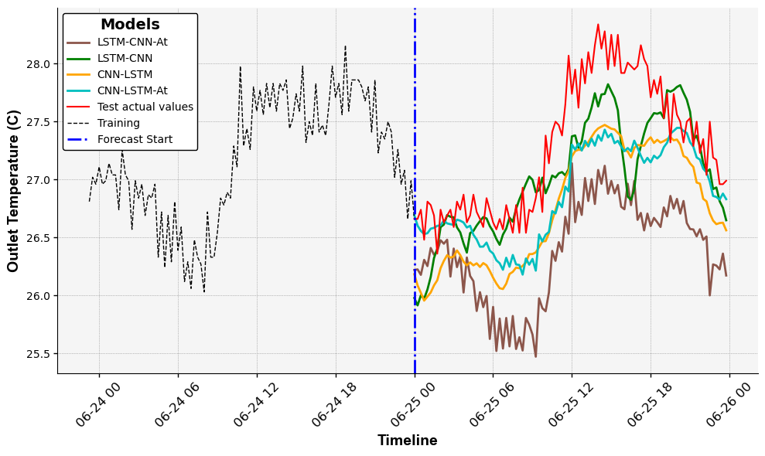


Results: Effect on multistep forecasting accuracy
Variation-3
$$MSE= \frac{1}{n}\sum_{i=1}^{n}{{\left({\hat{y}}_{i}−y_{i}\right)}^{2}}$$
$$MAPE=\frac{100}{n}\sum_{1=1}^{n}{\left|\frac{{\hat{y}}_{i}−y_{i}}{y_{i}}\right|}$$

Slide 12
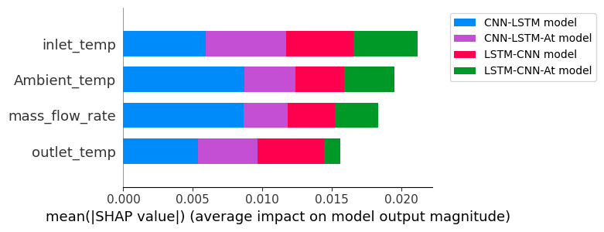
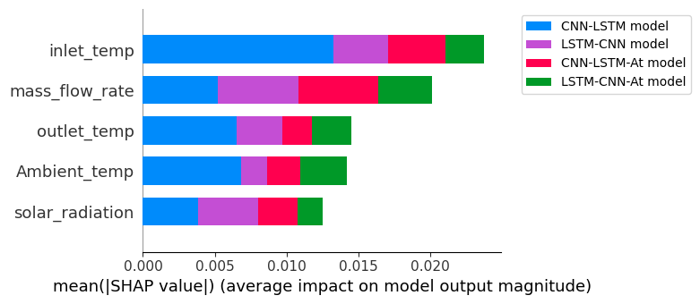
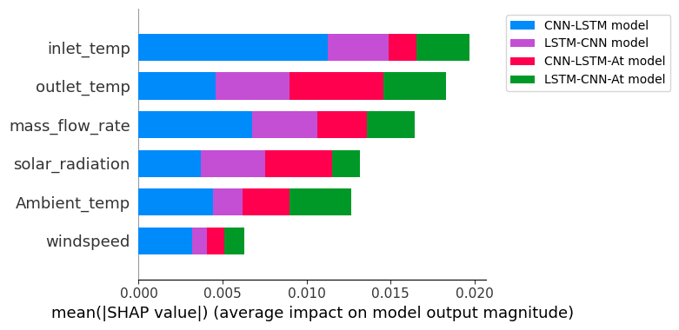
Results: Feature importance analysis
LSTM-CNN: T_{in} > T_{out} > m⁰ > T_{amb}
Local Ex-AI analysis
LSTM-CNN: m⁰ > R_{sol} > T_{in}> T_{out} >T_{amb}
CNN-LSTM-At: m⁰ >T_{amb} >T_{in} > T_{out}
CNN-LSTM: T_{in} > T_{amb} > T_{out} >m⁰ > R_{sol}
Variation-1
Variation-2
LSTM-CNN: T_{in} > T_{out}> m⁰ > R_{sol} >T_{amb}> V_{wind}
LSTM-CNN-At: T_{in} > T_{out}> T_{amb}> m⁰ > R_{sol} > V_{wind}
Variation-3

Slide 13
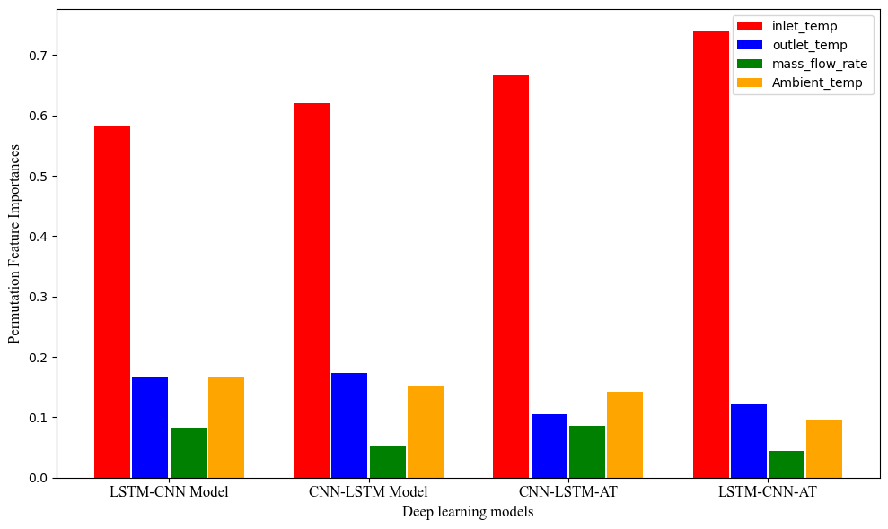
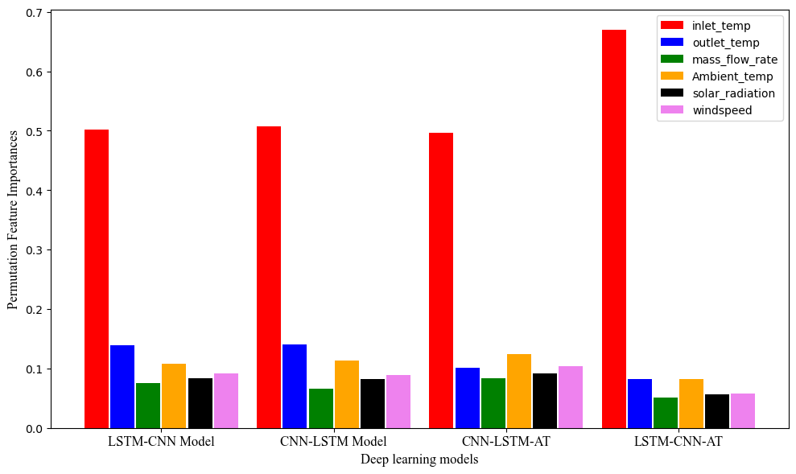
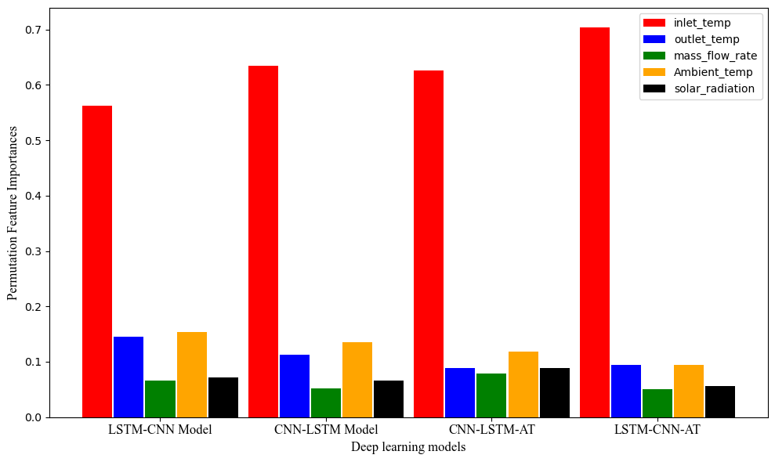
Results: Feature importance analysis
Global Ex-AI analysis
Permutation feature importance method is employed
Models | Rank
LSTM-CNN | 1.33
LSTM-CNN-At | 2.0
CNN-LSTM | 3.0
CNN-LSTM-At | 3.66
The Friedman test ranked the deep learning hybrid models based on their performance on multiple runs with various input data samples.
Variation-1
Variation-2
Variation-3
Variation-1:T_{in} > T_{out}> T_{amb} > m⁰
Variation-2:T_{in} > T_{out}> T_{amb} > m⁰ > R_{sol}
Variation-3: T_{in} > T_{out}> T_{amb}> R_{sol} > m⁰ > V_{wind}

Slide 14
Conclusions
This study explores the impact of hybrid training algorithms, variable input parameters and model architecture on multistep forecasting accuracy of data-driven models.
Key practically measurable input sensors are identified for deep learning-based performance forecasting models for BHE systems.
The findings highlight the efficacy of attention mechanisms in capturing temporal dependencies in LSTM-CNN-At and spatial patterns in CNN-LSTM-At, may not necessarily enhance their multistep forecasting capabilities for the borehole field data.
The findings emphasize that by carefully designing the model layers and selecting appropriate input parameters , it is feasible to remove redundant borehole field sensors for data measurement while maintaining the forecasting accuracy of the deep models for heating/cooling systems.

Slide 15
References
[1] The future of heat pumps, IEA, World Energy Outlook, special report Nov, 2022
[2] N. Ahmed et al., “Optimal design , operational controls , and data-driven machine learning in sustainable borehole heat exchanger coupled heat pumps : Key implementation challenges and advancement opportunities,” Energy for Sustainable Development, vol. 74, no. January, pp. 231–257, 2023
[3] N. Ahmed et al., Investigating the impact of borehole field data’s input parameters on the forecasting accuracy of multivariate hybrid deep learning models for heating and cooling, Energy and Buildings, vol. 301, no. January, 113706, Dec 2023
[4] Zhu J et al. Review and prospect of data-driven techniques for load forecasting in integrated energy systems. Appl Energy 2022;321:119269
[5 ]Smith DC, Elmore AC. The observed effects of changes in groundwater flow on a borehole heat exchanger of a large scale ground coupled heat pump system. Geothermics 2018;74:240–6 , j.geothermics.2018.03.008

Slide 16
Acknowledgements
We acknowledge POLNOR grant for funding the project. We are indebted to the staff of the department of energy and petroleum engineering (IEP) at the University of Stavanger and for allowing us to present this paper.

Slide 17


Thank you
COTech 2023
of sensors

Slide 18



IMPACT FACTOR 3.2
CITESCORE 5.5 SCOPUS
Special Issue "Renewable Energy Technologies for Grid Resilience in the Face of Climate Change“
Guest Editors:
Prof. Dr. Mohsen Assadi
Faculty of Science and Technology, University of Stavanger, 4021 Stavanger, Norway
Dr. Naveed Ahmed
1. Faculty of Science and Technology, University of Stavanger, 4021 Stavanger, Norway
2. US Pakistan Centre for Advanced Studies in Energy (USPCASE), National University of Sciences & Technology, H-12 Sector, Islamabad, Pakistan
SI Website: https://www.mdpi.com/journal/energies/special_issues/43E44655K9
Submission deadline: 11 April 2024
Guest editor Contact: Mohsen.assadi@uis.no
Naveed.ahmed@uis.no
MDPI Contact: filip.manojlovic@mdpi.com

