Slide 1



Combining Machine Learning Methods and Data Augmentation for Misaligned Journal Bearings Design
Computational Methods and Ocean Technology (COTech 2023)
University of Stavanger, November 30, 2023 to December 1, 2023
Konstantinos Arvanitis, Pantelis G Nikolakopoulos
DEPARTMENT OF MECHANICAL ENGINEERING & AERONAUTICS
Machine Design Laboratory

Slide 2





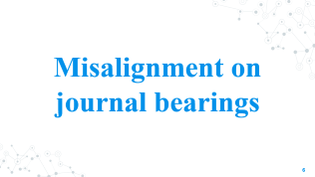
Table of Contents

Slide 3
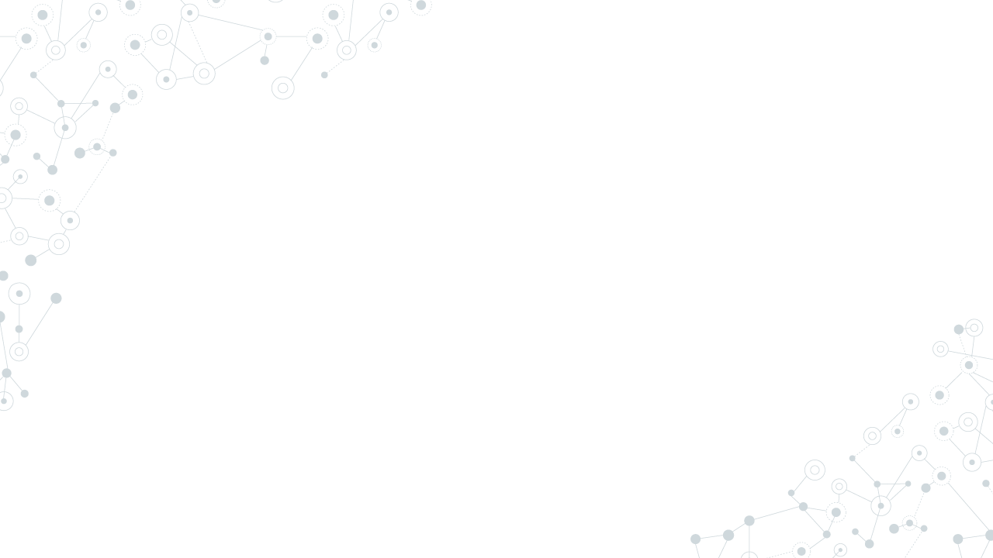
Introduction

Slide 4
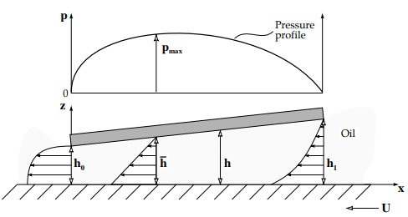
Introduction
Hydrodynamic journal bearings are prevalent engineering components in almost all types of rotating machinery.
They have been widely used to support high speed rotating machinery such as turbines and compressors because of their superior durability and load carrying capacity.
Their operation is based on the relative motion of two friction surfaces, inclined at some angle to each other.

Slide 5
Objectives
Shaft misalignment is one of the most common defects observed in rotating systems and has a substantial effect on dynamic behavior, stability, and lifetime.
Aim of this study is the binary identification of misalignment using Machine Learning techniques, when the provided dataset suffers from:
Limited data points.
Imbalance between the aligned and misaligned cases.
Leads to poor performance of the Machine Learning algorithms
Leads to overfitting of the Machine Learning algorithms.
The proposed methodology is novel and provides satisfying results.

Slide 6
Misalignment on journal bearings

Slide 7
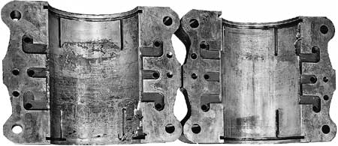
Misalignment on journal bearings
Traditional industry is shifting towards the ‘Industry 4.0 factory’ that incorporates automatic detection of faults and remaining lifetime prediction.
Machines often fail due to shaft misalignment as it creates excessive vibrations, as well as additional dynamic load on shafts.
The vibration spectra of the misaligned shaft are high and strongly harmonic compared to an aligned shaft.
Approximately 70% of the problems in mechanical machinery is caused by misalignment, which leads to downtime up to 30%.
Since it is common fault in rotating machinery, it must be diagnosed before failure occurs.

Slide 8
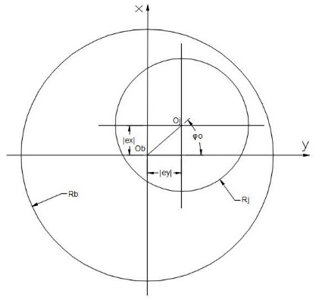
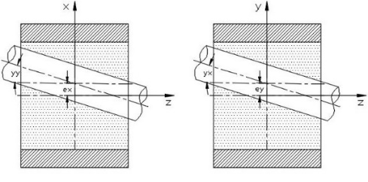

Misalignment on journal bearings
Hydrodynamic lubrication on journal bearings can be expressed mathematically in the form of Reynolds equation.
The steady-state simplified equation considering isoviscous lubricant with steady film thickness and unidirectional velocity approximation is used.
$$\frac{∂}{∂x}\left(h^{3}\frac{∂p}{∂x}\right)+\frac{∂}{∂y}\left(h^{3}\frac{∂p}{∂y}\right)=6Uη\frac{dh}{dx}$$
In practice, the shaft tends to suffer from some degree of misalignment while rotating inside its bushing.

Slide 9
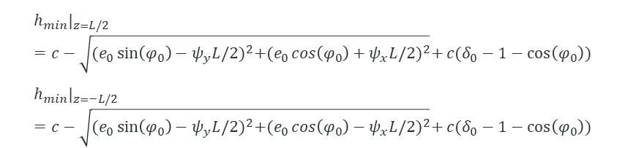
Misalignment on journal bearings
The most important effect of bearing misalignment is the drastic alteration of the protective film thickness.
The film thickness prediction plays a significant role in misaligned journal bearings.
Τhe following expression describing the film thickness with provision for misalignment is used.
$$h(θ,z)=c+e_{0}·cosθ+z·(yy·cos(θ+φ_{0})+yx·sin(θ+φ_{0}))$$
Another useful parameter, which indicates the bearing lubrication regime, is the minimum film thickness h_{min}.
$${h_{min}|}_{z=L/2}=c−\sqrt{{(e_{0}\sin\left(φ_{0}\right)−ψ_{y}L/2)}^{2}+{(e_{0}\cos\left(φ_{0}\right)+ψ_{x}L/2)}^{2}}+c(δ_{0}−1−\cos\left(φ_{0}\right))$$
$${h_{min}|}_{z=−L/2}=c−\sqrt{{(e_{0}\sin\left(φ_{0}\right)−ψ_{y}L/2)}^{2}+{(e_{0}\cos\left(φ_{0}\right)−ψ_{x}L/2)}^{2}}+c(δ_{0}−1−\cos\left(φ_{0}\right))$$

Slide 10
AI and ML in Tribology

Slide 11
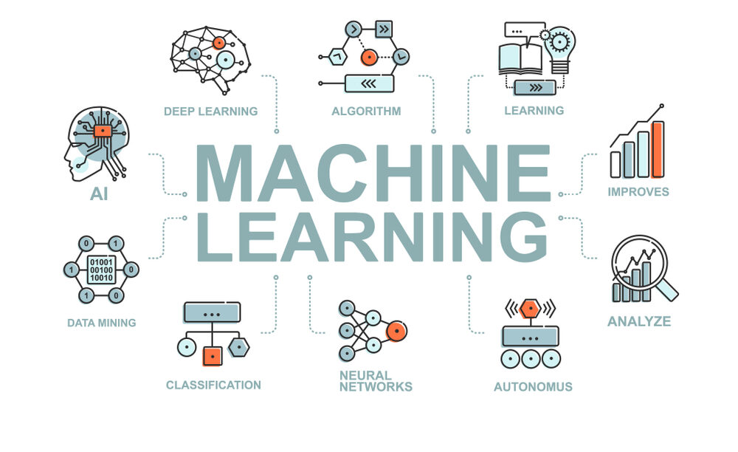
Artificial Intelligence and Machine Learning in Tribology
Modern machine learning (ML) or artificial intelligence (AI) techniques provide opportunities to explore the complex processes in tribological systems.
ML and AI methods’ potential also goes beyond purely academic aspects into actual industrial applications.
Especially in tribology, collecting extensive datasets can be costly, time-consuming, or even infeasible.
Oversampling techniques are widely used to handle the imbalance of datasets.
Data augmentation methods provide a pragmatic solution in engineering problems that suffer from limited data availability.

Slide 12
SMOTE-LOF

Slide 13
Synthetic Minority Oversampling Technique (SMOTE)
Imbalanced data occurs when the number of data samples representing a class is significantly lower than those in other classes.
Two traditional techniques for handling class imbalance:
Oversamping
Undersampling
Instances of the minority class are duplicated. Commonly used.
Involves removing instances of the majority class.
Synthetic Minority Oversampling Technique (SMOTE) is an oversampling technique, based on the idea of the nearest neighbor algorithm (kNN).
Assumes that a synthetic data sample can be interpolated between members of the minority class in “feature space”.
Synthetic minority data samples are different from the original ones, alleviating the impact of overfitting.

Slide 14
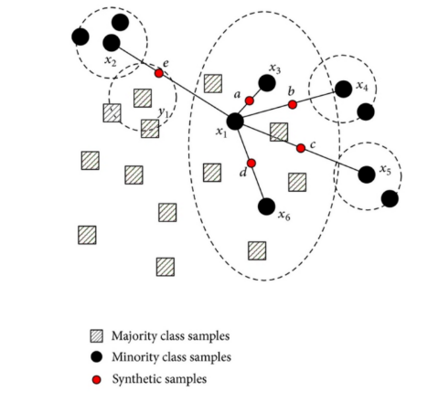
Synthetic Minority Oversampling Technique (SMOTE)
SMOTE algorithm chooses k nearest neighbors for each data point based upon the similarities in feature vectors.
Creates a synthetic sample at a random point on the line between each data point and chosen neighbor.
The minority class is over-sampled.

Slide 15
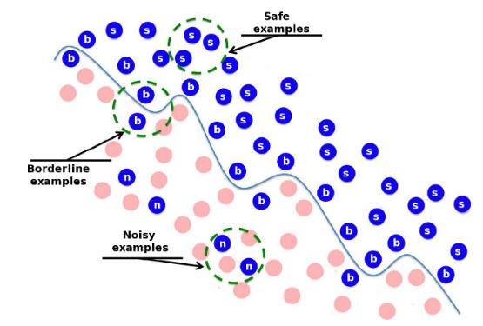
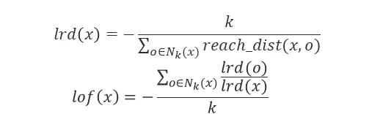
SMOTE - LOF
SMOTE can produce synthetic minority data samples considered as noise.
SMOTE-LOF is an improvement of the technique by adding the Local Outlier Factor (LOF).
An outlier is the odd point in a dataset, while noise can be defined as the wrong label (class noise) or errors in the attribute value (attribute noise).
Out of a number of outliers detected, the ones identified as noise are erased by LOF.
The LOF value is the mean ratio of mean reachability distance of each minority sample divided by the mean reachability distance of each k-neighbor.
 | $$lrd\left(x\right)=−\frac{k}{\sum_{o∈N_{k}(x)}{reach_dist(x,o)}}$$
 | $$lof\left(x\right)=−\frac{\sum_{o∈N_{k}(x)}{\frac{lrd(o)}{lrd(x)}}}{k}$$

Slide 16
CTGAN

Slide 17
Generative Adversarial Network (GAN)
The more data that a machine learning algorithm has access to, the more accurate its predictions will be.
Overfitting refers to the phenomenon when a network learns a function with very high variance such as to perfectly model the training data.
Small datasets are prone to overfitting.
Data Augmentation is a data-space solution to the problem of limited data.
Generative Adversarial Networks (GANs) are an approach to generative modeling using deep learning methods, such as convolutional neural networks.
Generative models can be used to generate or output new examples that plausibly could have been drawn from the original dataset.
The basic principle of GANs is inspired by two-player zero-sum game, in which the total gains of two players are zero, and each player’s gain or loss of utility is exactly balanced by the loss or gain of the utility of another player.

Slide 18
Generative Adversarial Network (GAN)
GANs often comprise a generator and a discriminator that adopt the structure of currently popular deep neural networks.
Generator
Discriminator
Tries to capture the potential distribution of real samples and generates new data samples.
Often a binary classifier, discriminating real samples from the generated samples as accurately as possible.

Slide 19
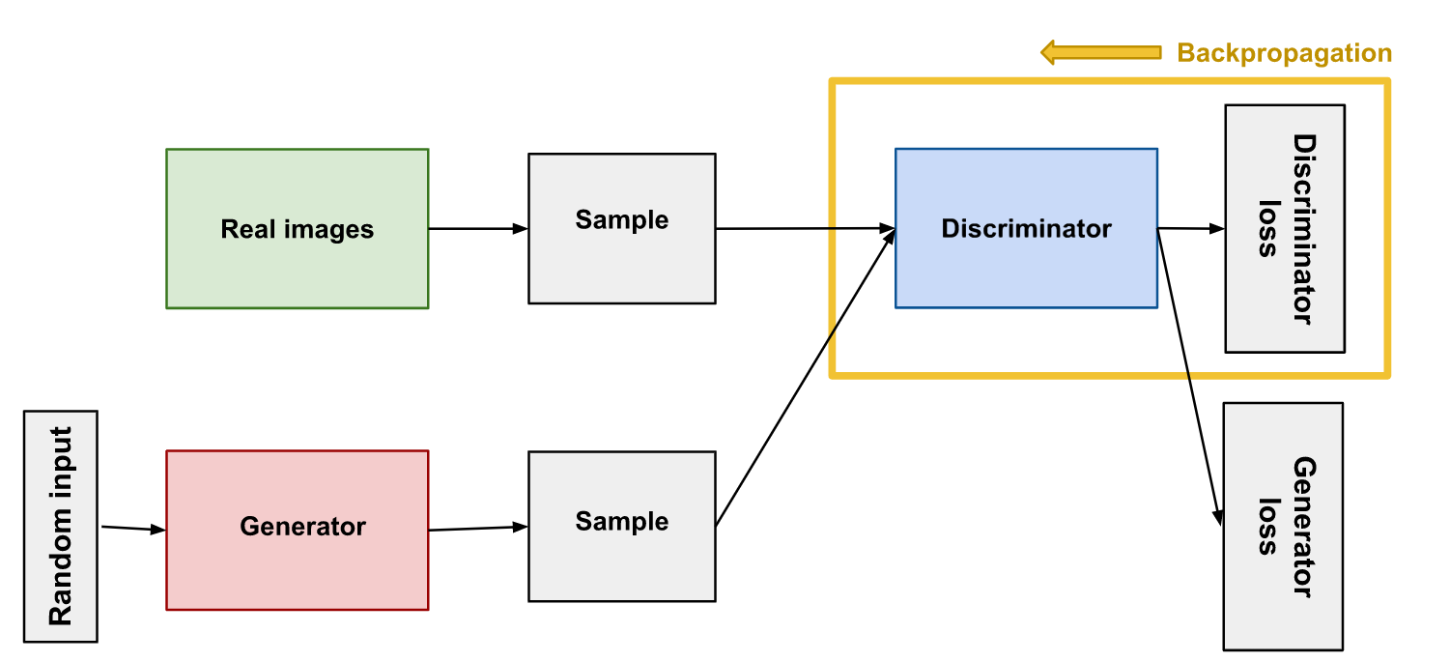
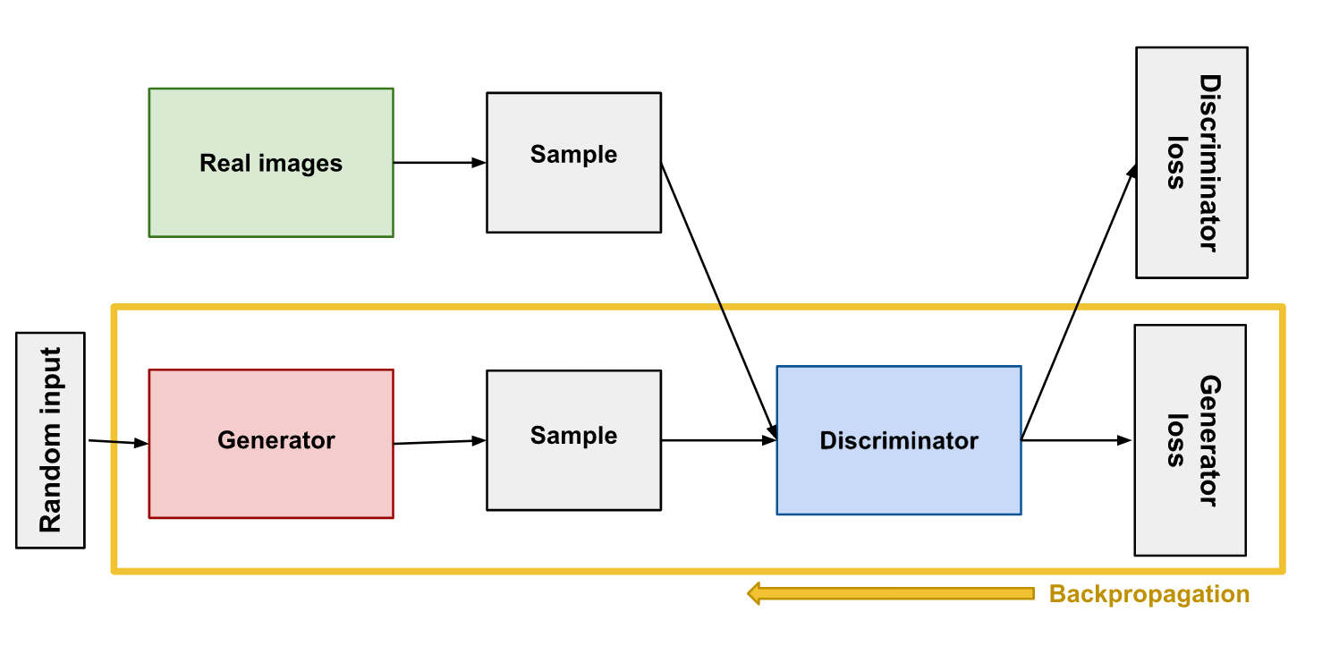
Generative Adversarial Network (GAN)
During the discriminator training phase, generator is constant and similarly, discriminator is constant during generator training phase.
Otherwise, the discriminator would not recognize the generator’s flaws and the generator would be trying to hit a moving target and might never converge.
For a GAN, convergence is often a fleeting, rather than stable, state.
The solution in the GANS’s minimax optimization problem is given by Nash equilibrium, a classical notion of equilibrium in the game theory literature in which no player can improve its individual gain by choosing a different strategy.

Slide 20
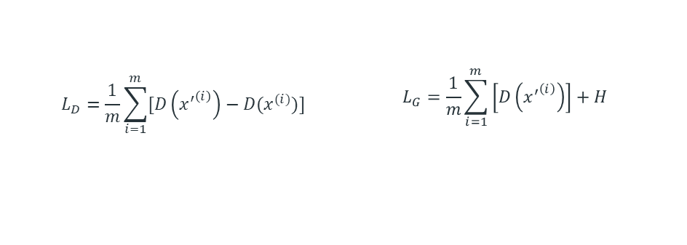
Conditional Tabular Generative Adversarial Network (CTGAN)
“Tabular data” is data that can be structured and organized in a table-like format and comprises both numeric and categorical features.
CTGAN (Conditional Tabular Generative Adversarial Network) was conceptualized to partially “capture” this heterogeneity of real-world data.
The "conditional" part of CTGAN refers to the fact that it can also generate synthetic data that is conditioned on certain input variables, such as gender or age.
Continuous features in tabular data are often non-Gaussian and tend to follow multimodal distributions. Mode-specific normalization is used to capture these behaviors.
The key to training a GAN and evaluate its performance over time are the loss functions, a set of formulas that indicate each network how to improve after each training iteration (or epoch).
 | $$L_{D}=\frac{1}{m}\sum_{i=1}^{m}{[D\left({x^{′}}^{\left(i\right)}\right)−D(x^{(i)})]}$$ | $$L_{G}=\frac{1}{m}\sum_{i=1}^{m}{\left[D\left({x^{′}}^{\left(i\right)}\right)\right]+H}$$

Slide 21
Results & Discussion

Slide 22
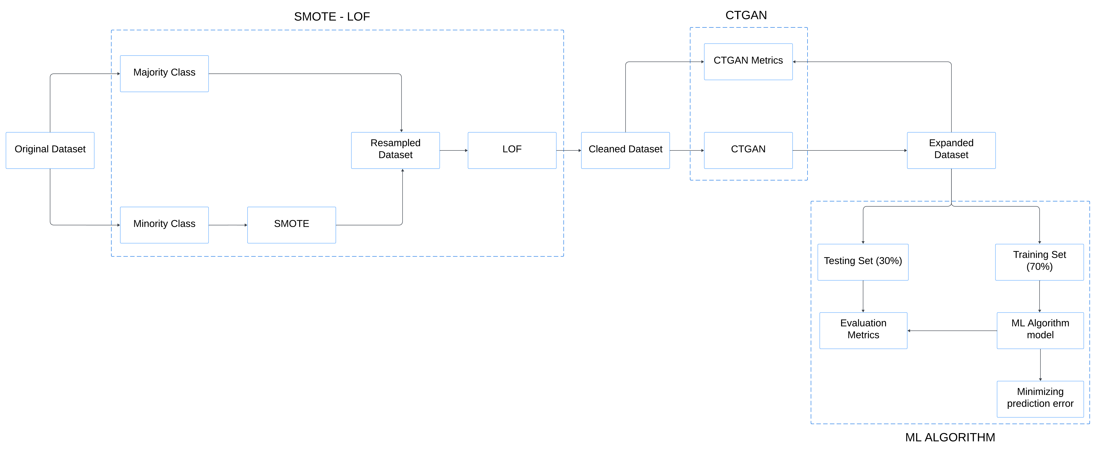
Flowchart of the study
SMOTE-LOF
CTGAN
ML ALGORITHM

Slide 23
Data Analysis
The proposed model uses values of journal bearing performance characteristics, such as eccentricity, attitude angle, maximum wear depth and film thickness.
The journal bearing was judged to be aligned if dimensionless misalignment angles were less than 0.05 and the binary column ‘Misaligned’ was added.
The columns of the angle of misalignment were not used in the training of the algorithms since it would be duplicate information.

Slide 24
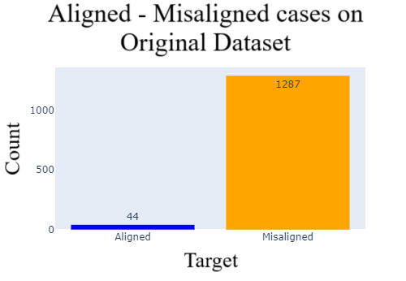
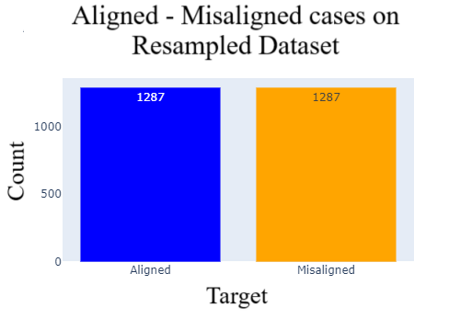
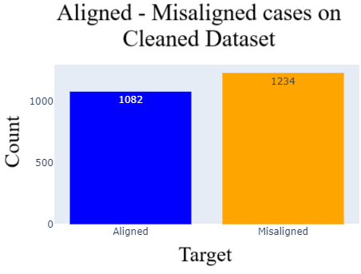
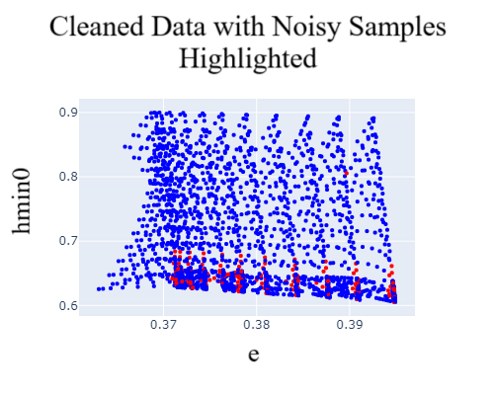
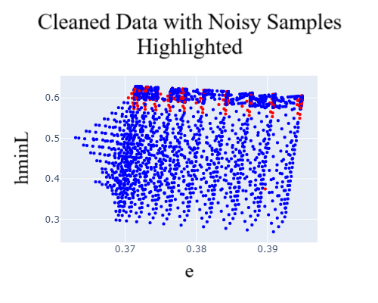
Results & Discussion
SMOTE-LOF implementation
SMOTE eliminates the imbalance of the original Dataset.
LOF factor erases a considerable number of noisy samples.

Slide 25
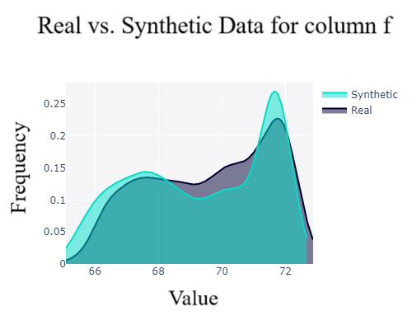
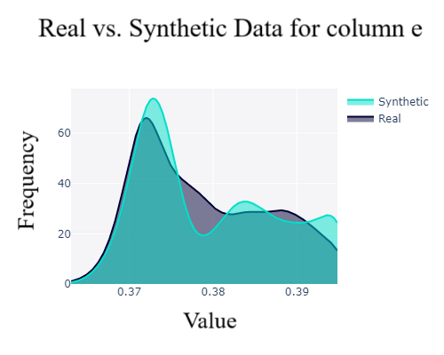
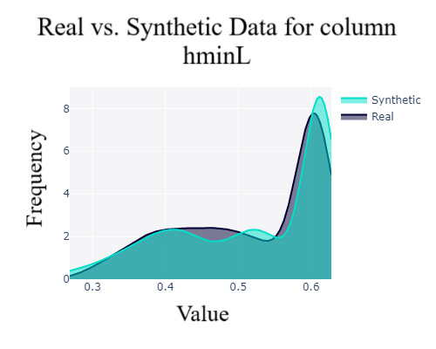
Results & Discussion
CTGAN implementation
Generating 3000, 4000, 5000 and 8000 synthetic samples.
The Expanded dataset consisted of 5000 synthetic samples has the best overall performance.
Best performance

Slide 26
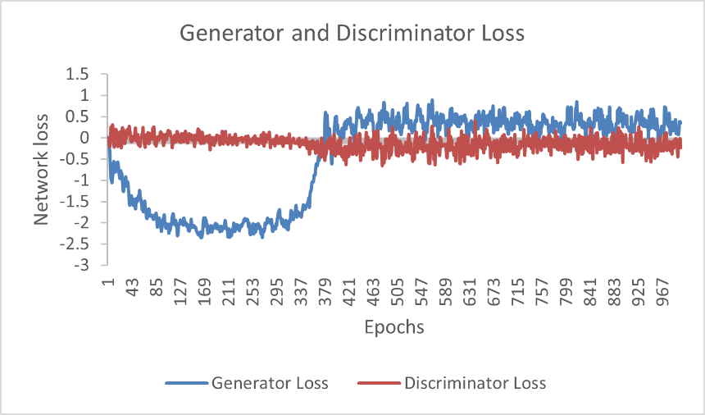
Results & Discussion
CTGAN implementation
Generator and discriminator loss stabilization over time indicates a good performance of the CTGAN.

Slide 27
Results & Discussion
Machine Learning algorithms implementation
The expanded dataset consisted of 4000 generated samples has the best overall performance.
KNN and SVM perform the best among all algorithms.
Best performance

Slide 28
Conclusions
SMOTE technique efficiently resolves the imbalance of the original dataset.
LOF factor removes a significant amount of noisy synthetic samples generated by SMOTE.
CTGAN’s good performance is indicated by the stabilization of both the discriminator and generator loss.
The augmented dataset consisted of 5000 generated data samples has the best quality compared to the original dataset.
The augmented dataset consisted of 4000 generated samples exhibits the superior performance on the Machine Learning algorithms.
KNN and SVM are the algorithms with the best performance on the augmented datasets.
In the context of monitoring applications, it is judicious to opt for the generation of 4000 synthetic samples.
The proposed methodology can effectively be employed for the identification of the misalignment of journal bearings, especially when dealing with limited and imbalanced data.

Slide 29
Future Research
Better quality of the experimental data.
More complicated Neural Network architectures of Generator and Discriminator.
Different Machine Learning Algorithms.
Different oversampling and noise reduction techniques.

Slide 30
Thank you for your attention!
Any questions?

