Slide 1
Machine learning for underground gas storage with cushion CO₂ using data from reservoir simulation
Johan Olav Helland, Helmer André Friis, Mohsen Assadi, Stanislaw Nagy
University of Stavanger
AGH University of Krakow

Slide 2
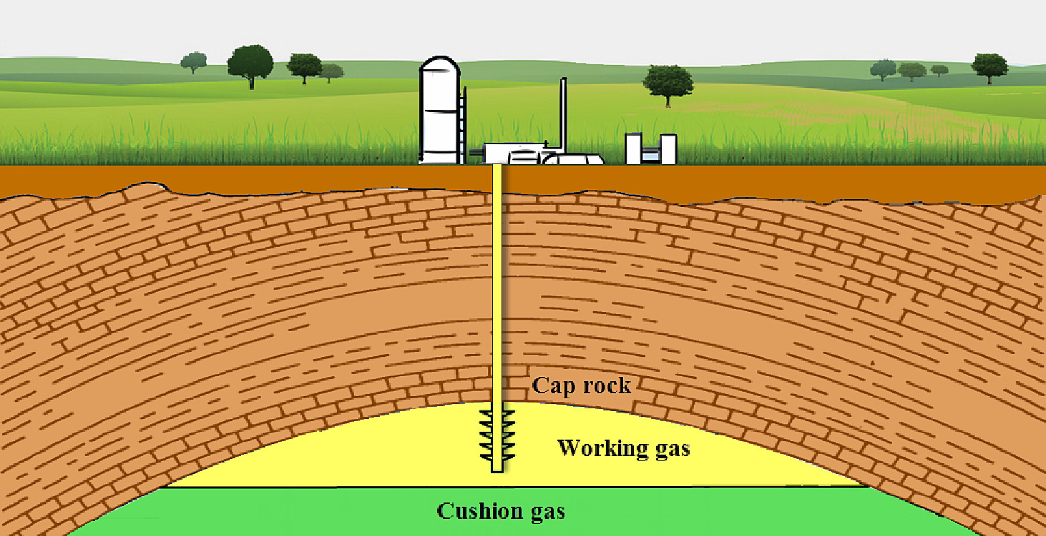
Underground natural gas storage (UNGS)
Temporary storage of natural gas (e.g., methane CH₄) in salt caverns, aquifers or depleted reservoirs, that is produced upon demand and/or to maintain a steady energy supply
Seasonal injection/production cycles
The use of a cushion gas contributes with pressure support and limits the extent of capillary trapping of the natural gas
Advantages with CO₂ as cushioned gas:
The compressible property improves the storage capacity and aids the CH₄ production
A possible solution for permanent CO₂ storage
Challenges with CO₂:
Mixing of CO₂ and CH₄ can lead to CO₂ production
CH₄ is less viscous than CO₂ (viscous fingering)
Shoushtari et al., (2023) Journal of Energy Storage 67, 107596

Slide 3
Objectives
Reservoir simulations of UNGS with cushioned CO₂ to gain insights and generate data for data-driven methods:
One-well CH₄ injection-production cycle:
Conditions for maximal CH₄ production and minimal CO₂ production
Seasonal CH₄ injection-production cycles with continuous CO₂ injection using different wells:
Investigate behaviour with respect to well placement and CO₂ injection rate.
Develop artificial neural network (ANN) models that describe the results and allows for fast estimation for different parameter combinations

Slide 4
Reservoir model
Simulations of two-component flow of CH₄ & CO₂ with gravity in 2D idealized reservoirs using the MRST simulator (Compositional module)
Rate-controlled, vertical wells with radius 10 cm
No-flow boundary conditions
Permeability anisotropy, $K_{v}=0.1K_{h}$.
Initially, the reservoir is filled with CO₂ and the pressure is 6 MPa
Size of grid blocks: $5×1×1$ m³
CH₄
$$H$$
CO₂
$L=1000$ m

Slide 5
One-well injection-production cycle
The well is placed on left side, 3 m from top boundary
Injection and production rates of 0.015 m³/s
Systematic variation of reservoir height ($H$), temperature ($T$), porosity ($φ$), horizontal permeability ($K_{h}$), injection time ($t_{inj}$), using 1200 simulations

Slide 6
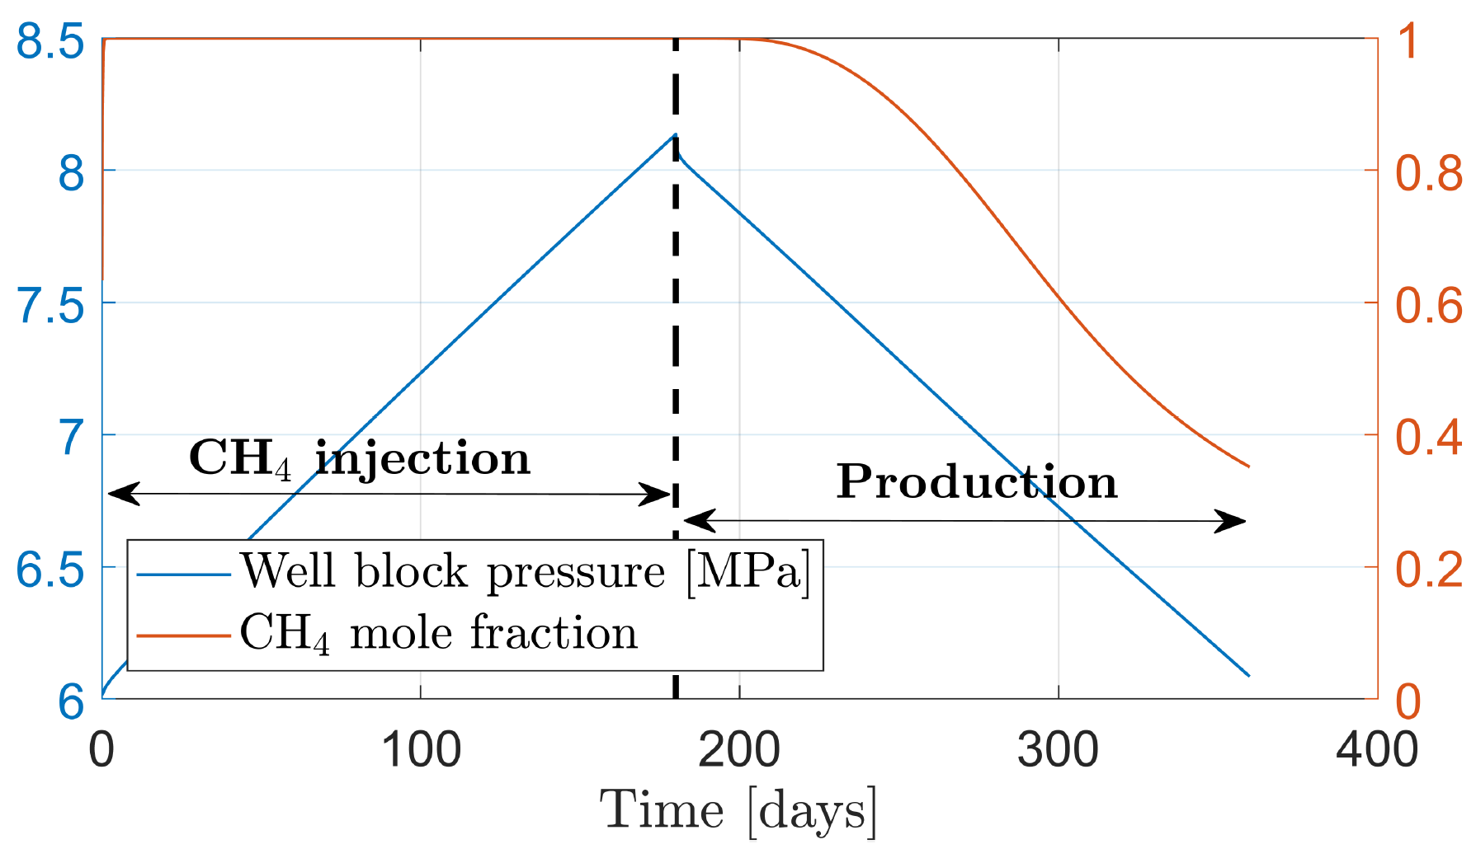
One-well injection-production cycle
90 days
240 days
Decline of CH₄ mole fraction in the well during production
How long can we produce CH₄ before the CO₂ mole fraction in the well exceeds 1%?

Slide 7
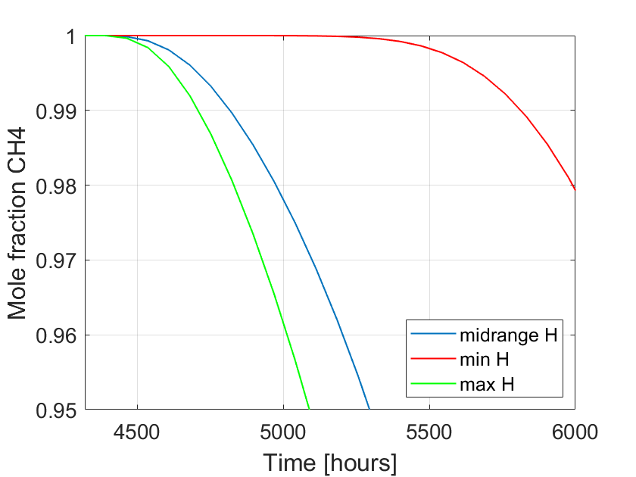
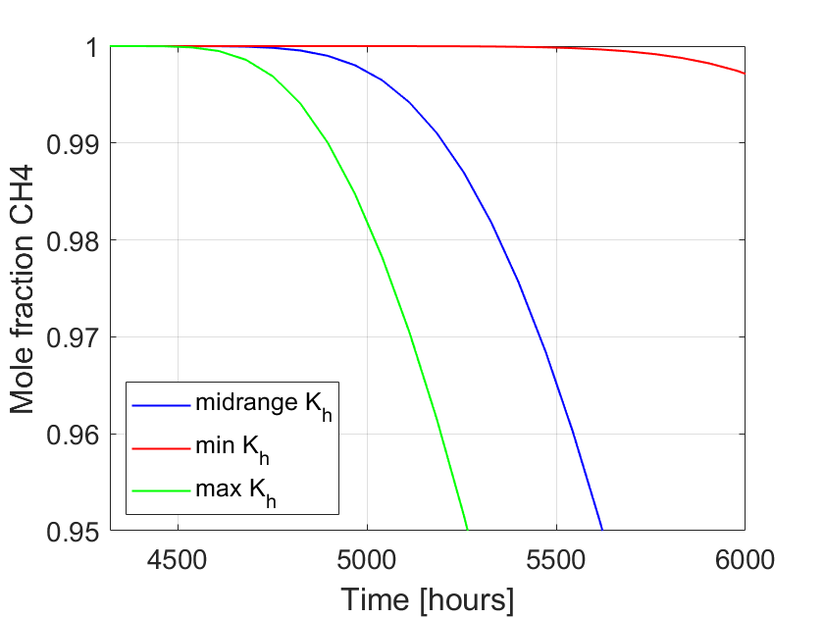
One-well injection-production cycle
A simulation with midrange parameters compared with new simulations where one parameter at a time was replaced by its maximum and minimum value
The results show that $H$ and $K_{h}$ have largest impact on well-block mole fraction over time:

Slide 8
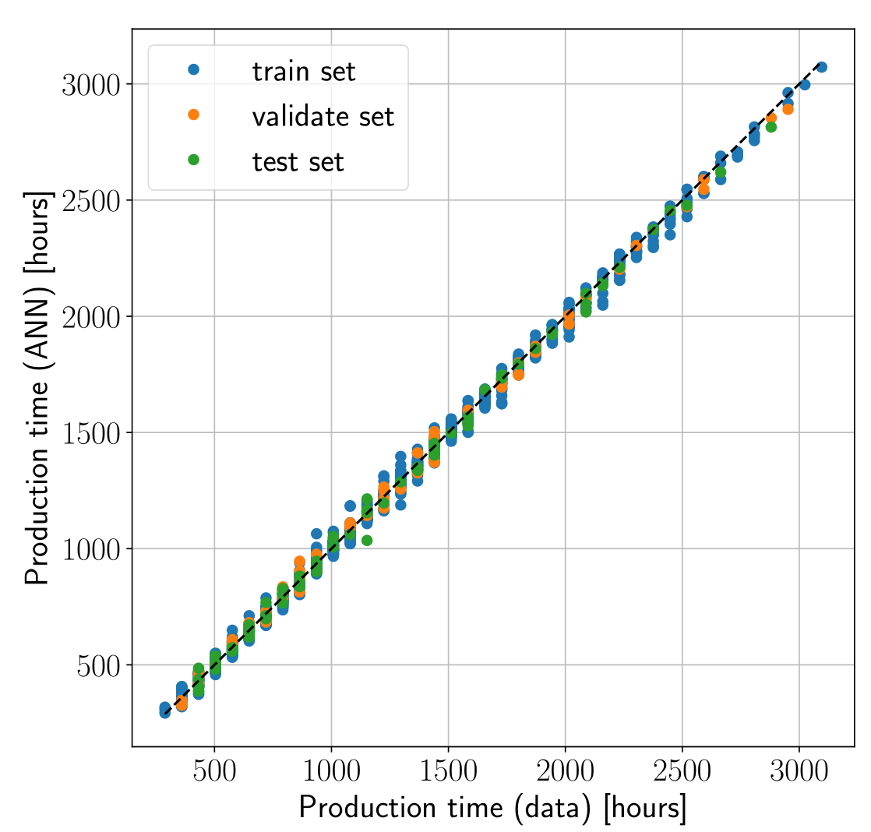
ANN model for «optimal» production time
Developed using TensorFlow in a Python environment
Input parameters: $H$, $T$, $φ$, $K_{h}$, $t_{inj}$
Output: Production time until CO₂ mole fraction in well exceeds 1%
Data from the 1200 simulations are split into training (87.5%), validation (6.25%), and test (6.25%) sets.
ANN model specifics:
Adam optimizer
Mean squared error as metric & loss function
Activation function: ReLu
Two hidden layers with 42 and 15 neurons
Trained for 200 epochs

Slide 9
Multiple storage cycles & wells
Same reservoir as before, with $H=40$ m, $T=323.15$ K, $φ=0.2$, $K_{h}=1000$ mD.
3 wells:
- CO₂ injection well: 37 m below the top seal at left boundary
- CH₄ injection well: 3 m below the top seal at a distance $d_{W}$ from left boundary
- Production well: 3 m below the top seal at right boundary

Slide 10
Multiple storage cycles & wells
Schedule of processes:
360 days of CH₄ injection with a rate of 0.025 m³/s in the CO₂-filled reservoir.
180 days of gravity segregation with all wells closed.
3 cycles of CH₄ injection (180 days) and withdrawal (180 days) with rate of 0.015 m³/s, while CO₂ injection occurs from the third well with a rate of $Q_{CO2}$.
Investigate behaviour for different well positions ($d_{W}$) and CO₂ injection rate ($Q_{CO2}$)

Slide 11
Multiple storage cycles & wells
Initial CH₄ injection (30 days)
End of 1st seasonal production (900 days)
30 days
End of initial CH₄ injection (360 days)
End of 3rd seasonal production (1620 days)
Increased CH₄/CO₂ mixing zone at the flanks and below production well
$d_{W}=400$ m, $Q_{CO2}=0.01$ m³/s

Slide 12
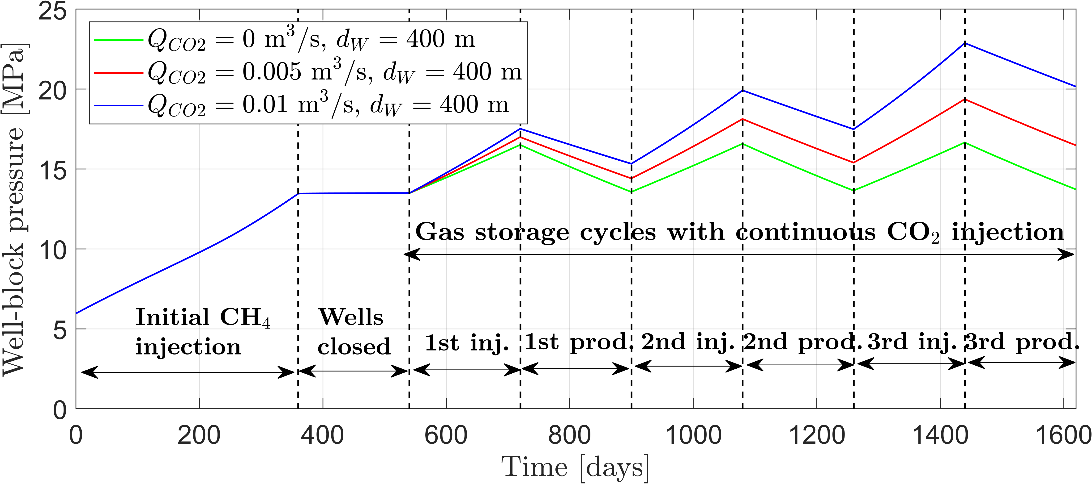
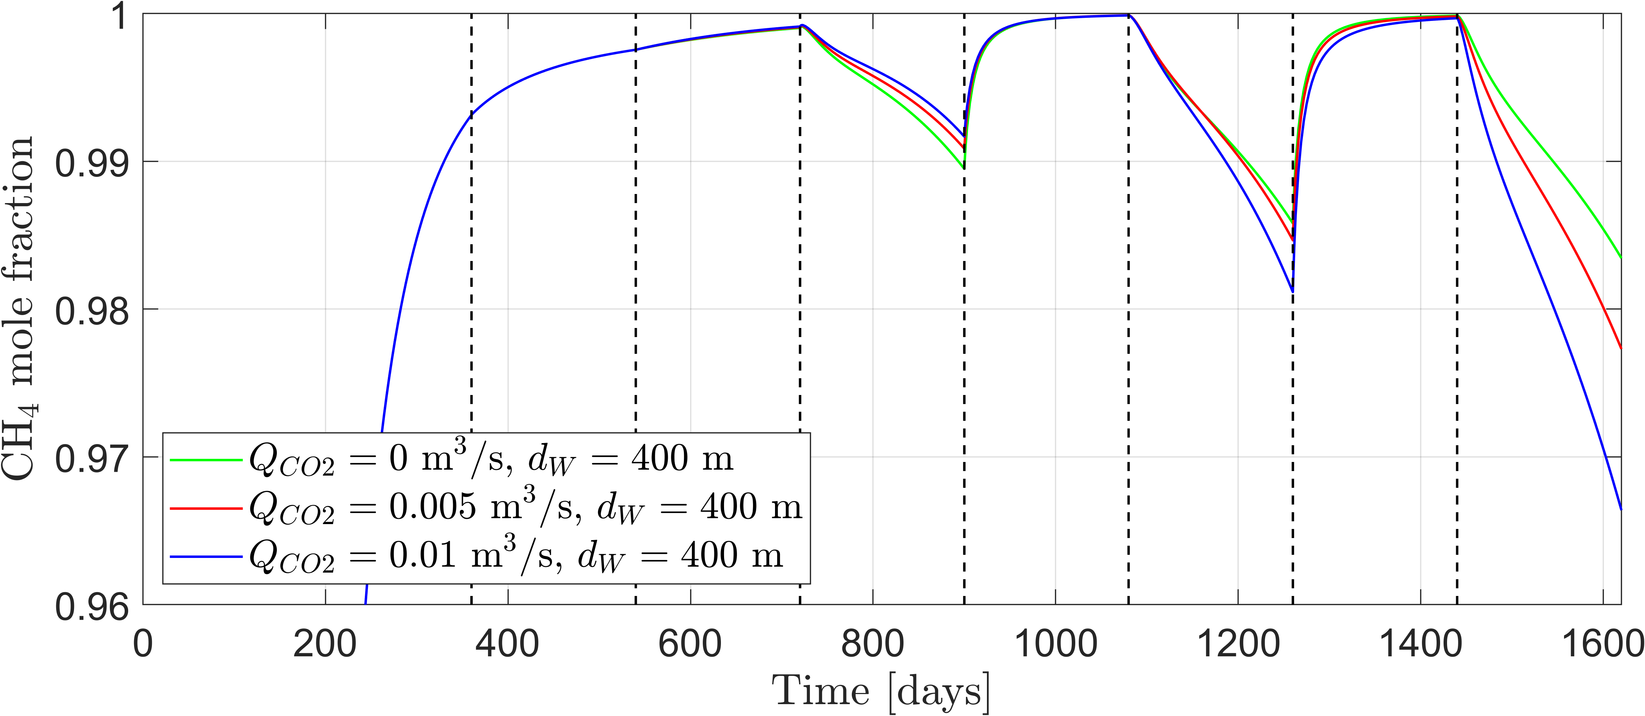
Multiple storage cycles & wells
Impact of CO₂ injection rate ($Q_{CO2}$) for constant well position ($d_{W}$)
Well-block pressure increases with seasonal cycle and CO₂ injection rate
Increased injection rate $Q_{CO2}$ leads to slightly lower CO₂ production in the first seasonal cycle but higher CO₂ production in later cycles

Slide 13
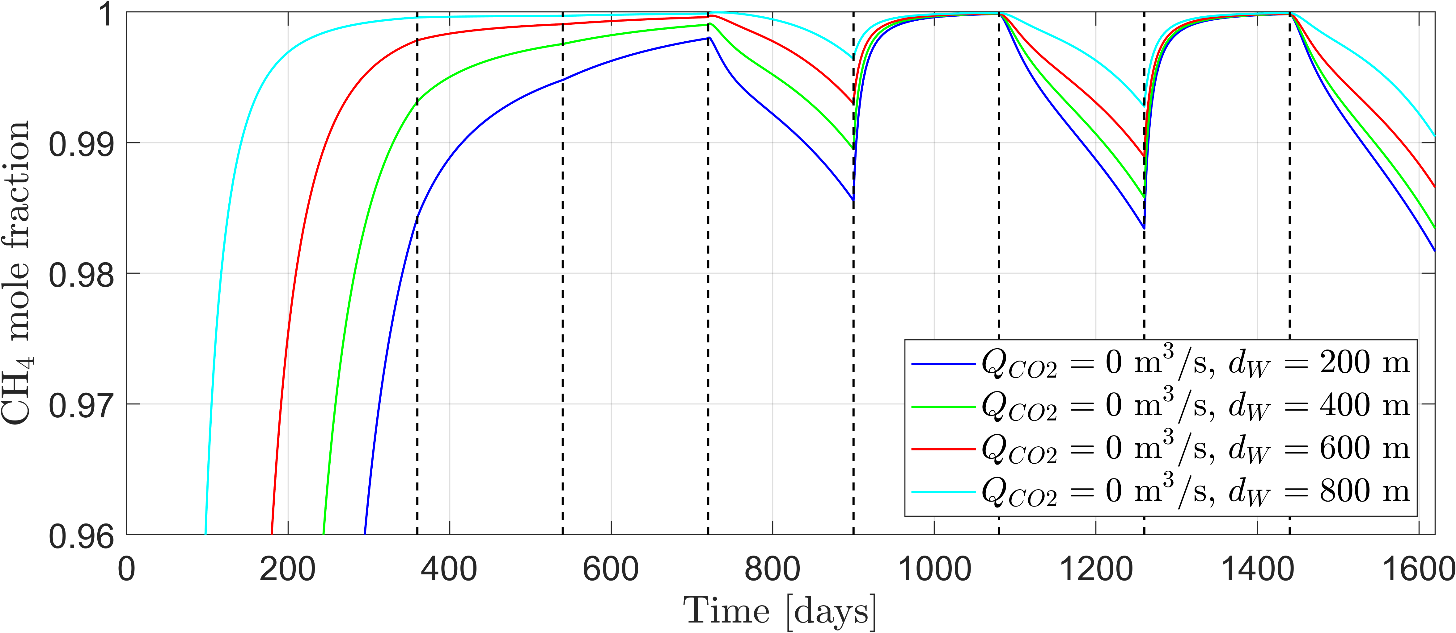
Multiple storage cycles & wells
Impact of well position ($d_{W}$) at constant CO₂ injection rate ($Q_{CO2}$)
Impact of $d_{W}$ on the pressure in production well is insignificant.
Smaller spacing between CH₄ injection & production wells leads to the least CO₂ production.

Slide 14
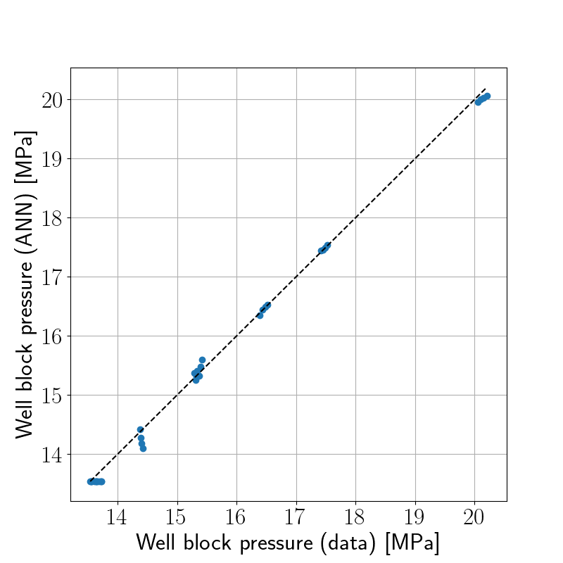
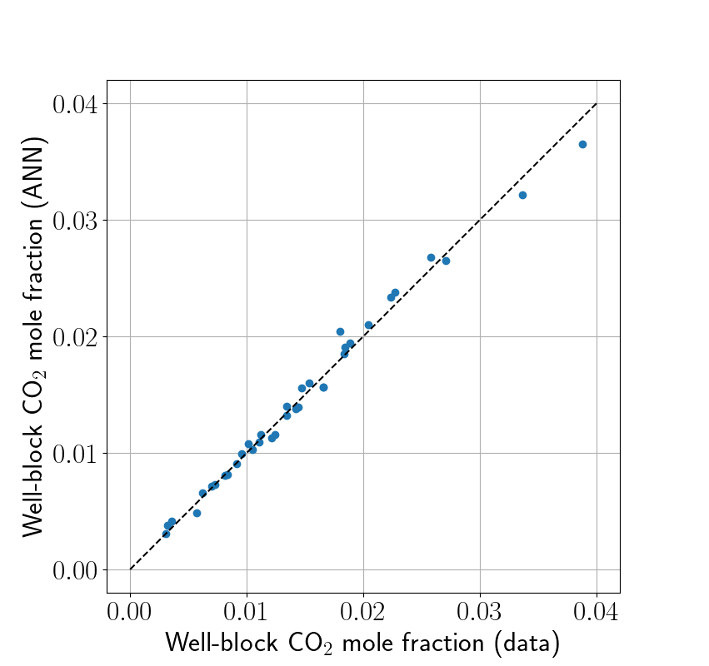
ANN model for well-block mole frac. & pressure
Input: $Q_{CO2}$, $d_{W}$, and seasonal cycle number
Output: CO₂ mole fraction & pressure in production well after each season
ANN performance on the training data:
ANN model specifics:
Adam optimizer
Mean squared error as metric & loss function
Activation function: ReLu
Two hidden layers with 27 and 15 neurons
Trained for 600 epochs

Slide 15
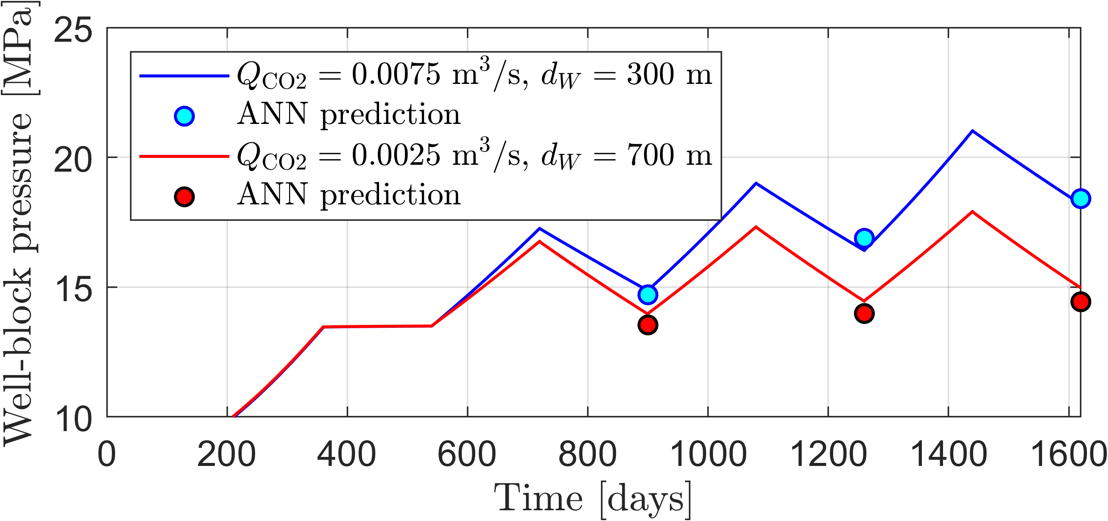
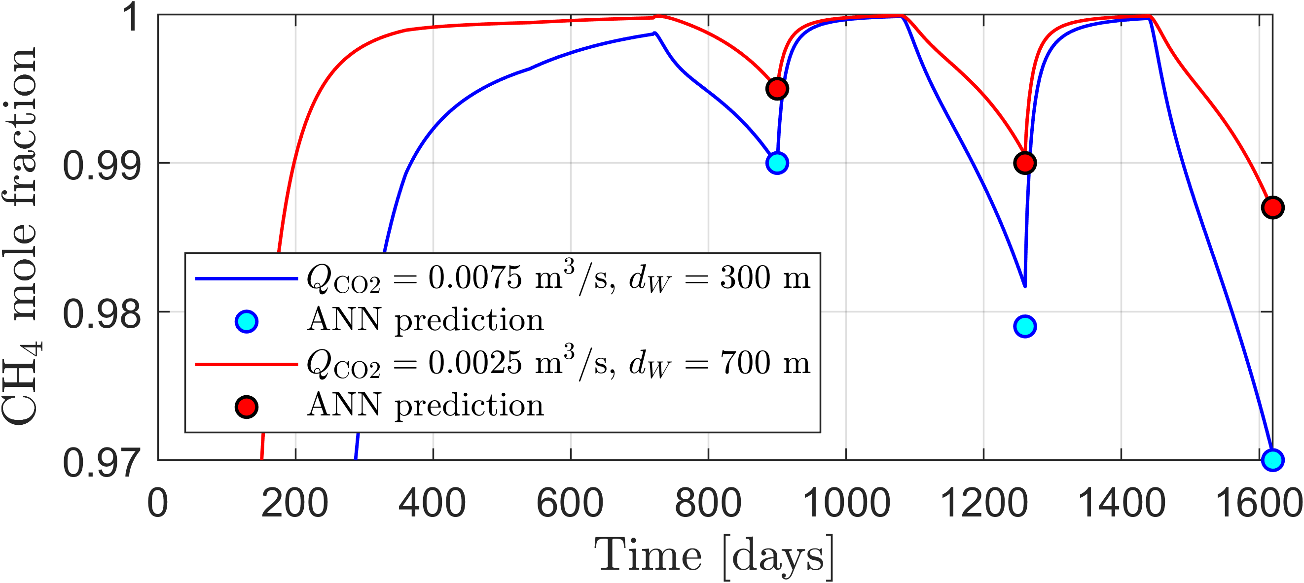
ANN model for well-block mole frac. & pressure
ANN performance on new reservoir simulations with other values of $Q_{CO2}$ & $d_{W}$:

Slide 16
Conclusions
Reservoir simulation and ANN models were used to explore seasonal injection & withdrawal cycles in UNGS with cushion CO₂.
To avoid CO₂ production, it is paramount to have a significant amount of CH₄ present in the reservoir before seasonal cycles begin.
Decreased spacing between CH₄ injection & production wells leads to the least CO₂ production during seasonal cycles. Hence, the optimal setting is to use the same well for production and injection.
Continuous CO₂ injection during UNGS has a marginal positive effect in the first cycle, while later cycles exhibit increased CO₂ production and undesired pressure build-up that worsen with increased CO₂ injection rate.
Trained ANN models describe the behavior of well-block mole fraction and pressure over time during UNGS. Hence, ANN models are useful tools to optimize UNGS operation with respect to increased gas deliverability and minimized CO₂ production.

Slide 17
Acknowledgments
This research was funded by EEA and Norway Grants, operated by The National Center for Research and Development, grant number NOR/POLNORCCS/AGaStor/0008/2019-00.

