Slide 1
Students’ Perspectives on Stakeholders’ Cooperative Efforts to Overcome Cyberbullying in Norwegian Primary Schools
Martyna Bell
Klara Øverland
World Antibullying Forum, Stavanger, Norway, 11th – 13th June 2025
KEY WORDS
cyberbullying, cooperative efforts, whole education approach, mesosystemic interactions, q methodology, exploratory factor analysis

Slide 2
Introduction
- rise of new societal issues and forms of aggression, such as cyberbullying (Cowie & Myers, 2023; Herweijer et al., 2020)
- the annual national student survey in Norway: 4,1% in grades 7th to 10th report having been subjected to cyberbullying (Utdanningsdirektoratet 2024)
- significant socio-economic costs associated with cyberbullying (O'Moore 2014)
- technological advances and the internet a fundamental part of children’s developmental ecology (Barr, 2019)
- a holistic, whole education approach to be preferred in reducing rates of cyberbullying (O'Higgins Norman, Berger et al. 2022)
Notes:
The annual national student survey in Norway reports higher than ever prevalence rates of cyberbullying among school-enrolled children. Numbers range from 4,6% to 5,9% in grades 5th to 10th of children who report having been subjected to cyberbullying with the use of a mobile phone, tablet or a PC (Utdanningsdirektoratet, 2024).
Significant socio-economic costs are associated with cyberbullying, making it a prioritized line of research. The available evidence suggests that a holistic, whole-school approach, encouraging active involvement of all adults, especially parents, is an effective means to reducing rates of cyberbullying. Yet, no research so far has focused on the experiences, needs and views of parents whose children have been involved in cyberbullying in order to inform future practices and interventions. Thus, the main objective of the study was to extract meaningful insights regarding parents’ views and experiences concerning cooperation among adults to overcome cyberbullying within Norwegian educational context.

Slide 3
Martyna Onyszko
Hildegunn Fandrem
Introduction
- approaching cyberbullying from a bioecological perspective widely acknowledged (Cross et al., 2015; Hong & Espelage, 2010; Marczak & Coine, 2019)
- schools are responsible for protecting children from (cyber)bullying, and the school staff are obliged to take action if someone is bullied ("The Education Act," 2024)
- limited research on cooperation between stakeholders in addressing cyberbullying, particularly from children’s perspective (Sjursø et al., 2020b; Støen & Jahnsen, 2018)
Focusing on the pedagogical potential of mesosystemic interactions in creating safe virtual environments, we aimed to investigate students’ perspectives regarding cooperative efforts among stakeholders to overcome cyberbullying in Norwegian elementary and middle schools (grades 7th to 9th).

Slide 4
Method and research question
Q METHODOLOGY
- beliefs and shared subjective views on a topic
- especially appropriate to explore children’s perspectives (Størksen et al., 2012; Brown & Montgomery, 2025)
-less intrusive method for studying bullying, may allow individuals to share sensitive experiences (Lundberg & Hellström, 2022)
Applied to answer the following research question:
What are school children’s perspectives on stakeholders’ cooperative efforts to overcome cyberbullying in an educational context?
Notes:
To answer the research question, 17 semi-structured interviews were conducted either in-person or online with parents of children and adolescents enrolled in Norwegian primary or lower secondary school, as these are the ages where cyberbullying is most prevalent (Kowalski et al., 2012). Seeing as cyberbullying is a phenomenon difficult to observe in real time or recreate, interviews allow for a retrospective recollection of the past events (Merriam & Tisdell, 2015). A pilot interview has been conducted in November 2022 to both test the interview guide, as well as test the first author in the role as interviewee (Dalen, 2011). Using probing questions, the participants were encouraged to elaborate on their experiences and dig deeped into their subjective opinions on the cooperation.
Purposive sampling was employed, with the population including parents of children involved in cases of cyberbullying. The 17 interviews that constituted the data material were carried out between November 2022 and January 2024 in either Norwegian, Polish or English. Parents interviewed must have met the following criteria: (1) parents of children enrolled in primary or lower secondary school in Norway, where children have been involved in cyberbullying or cyber harassment in some capacity, (2) the parents were willing to be interviews and (3) the parents had specific interest in creating safe cyber space for the children.
A semi-structured interview guide has been devised to direct the conversation, ensuring that the informants were allowed to subjectively manifest their personal experiences with cooperation to overcome cyberbullying (see Attachement 7.1). The four main topics included (1) definition of cyberbullying, (2) the bullying, (3) intervention and (4) prevention. Without compromising the confidentiality and comfort of the informants, the interviews were conducted at the location and time at the informants’ choice. The interviews lasted between 25 minutes to 1 hour and 37 minutes. The interview guide was purposefully designed to allow the participants to freely reflect on experiences they deemed most important, yet guiding the conversation to stay within the study’s shape.
Data analysis was facilitated using qualitative data software NVivo. The interviews were transcribed verbatim and uploaded into the software, then analyzed. Data analysis followed the thematic analysis framework by Braun and Clarke (2006, 2019, 2022, 2023), which involve six stages: (1) familiarizing oneself with the data, (2) creating codes, (3) generating themes, (4) reviewing potential themes, (5) defining and naming themes, and (6) producing the report. The coding process was further divided into three phases, as described in Corbin (2008): (1) open coding, (2) axial coding and (3) selective coding. A ‘code’ is a word or phrase summarizing a significant meaning to a chunk of data, and the streamlined codes-to-theory model was used, where observed codes in raw data are summed up into categories, and then into themes, with growing level of abstraction. Additionally, magnitude coding was employed to indicate frequency of active engagement of various stakeholders (Saldaña, 2009).

Slide 5
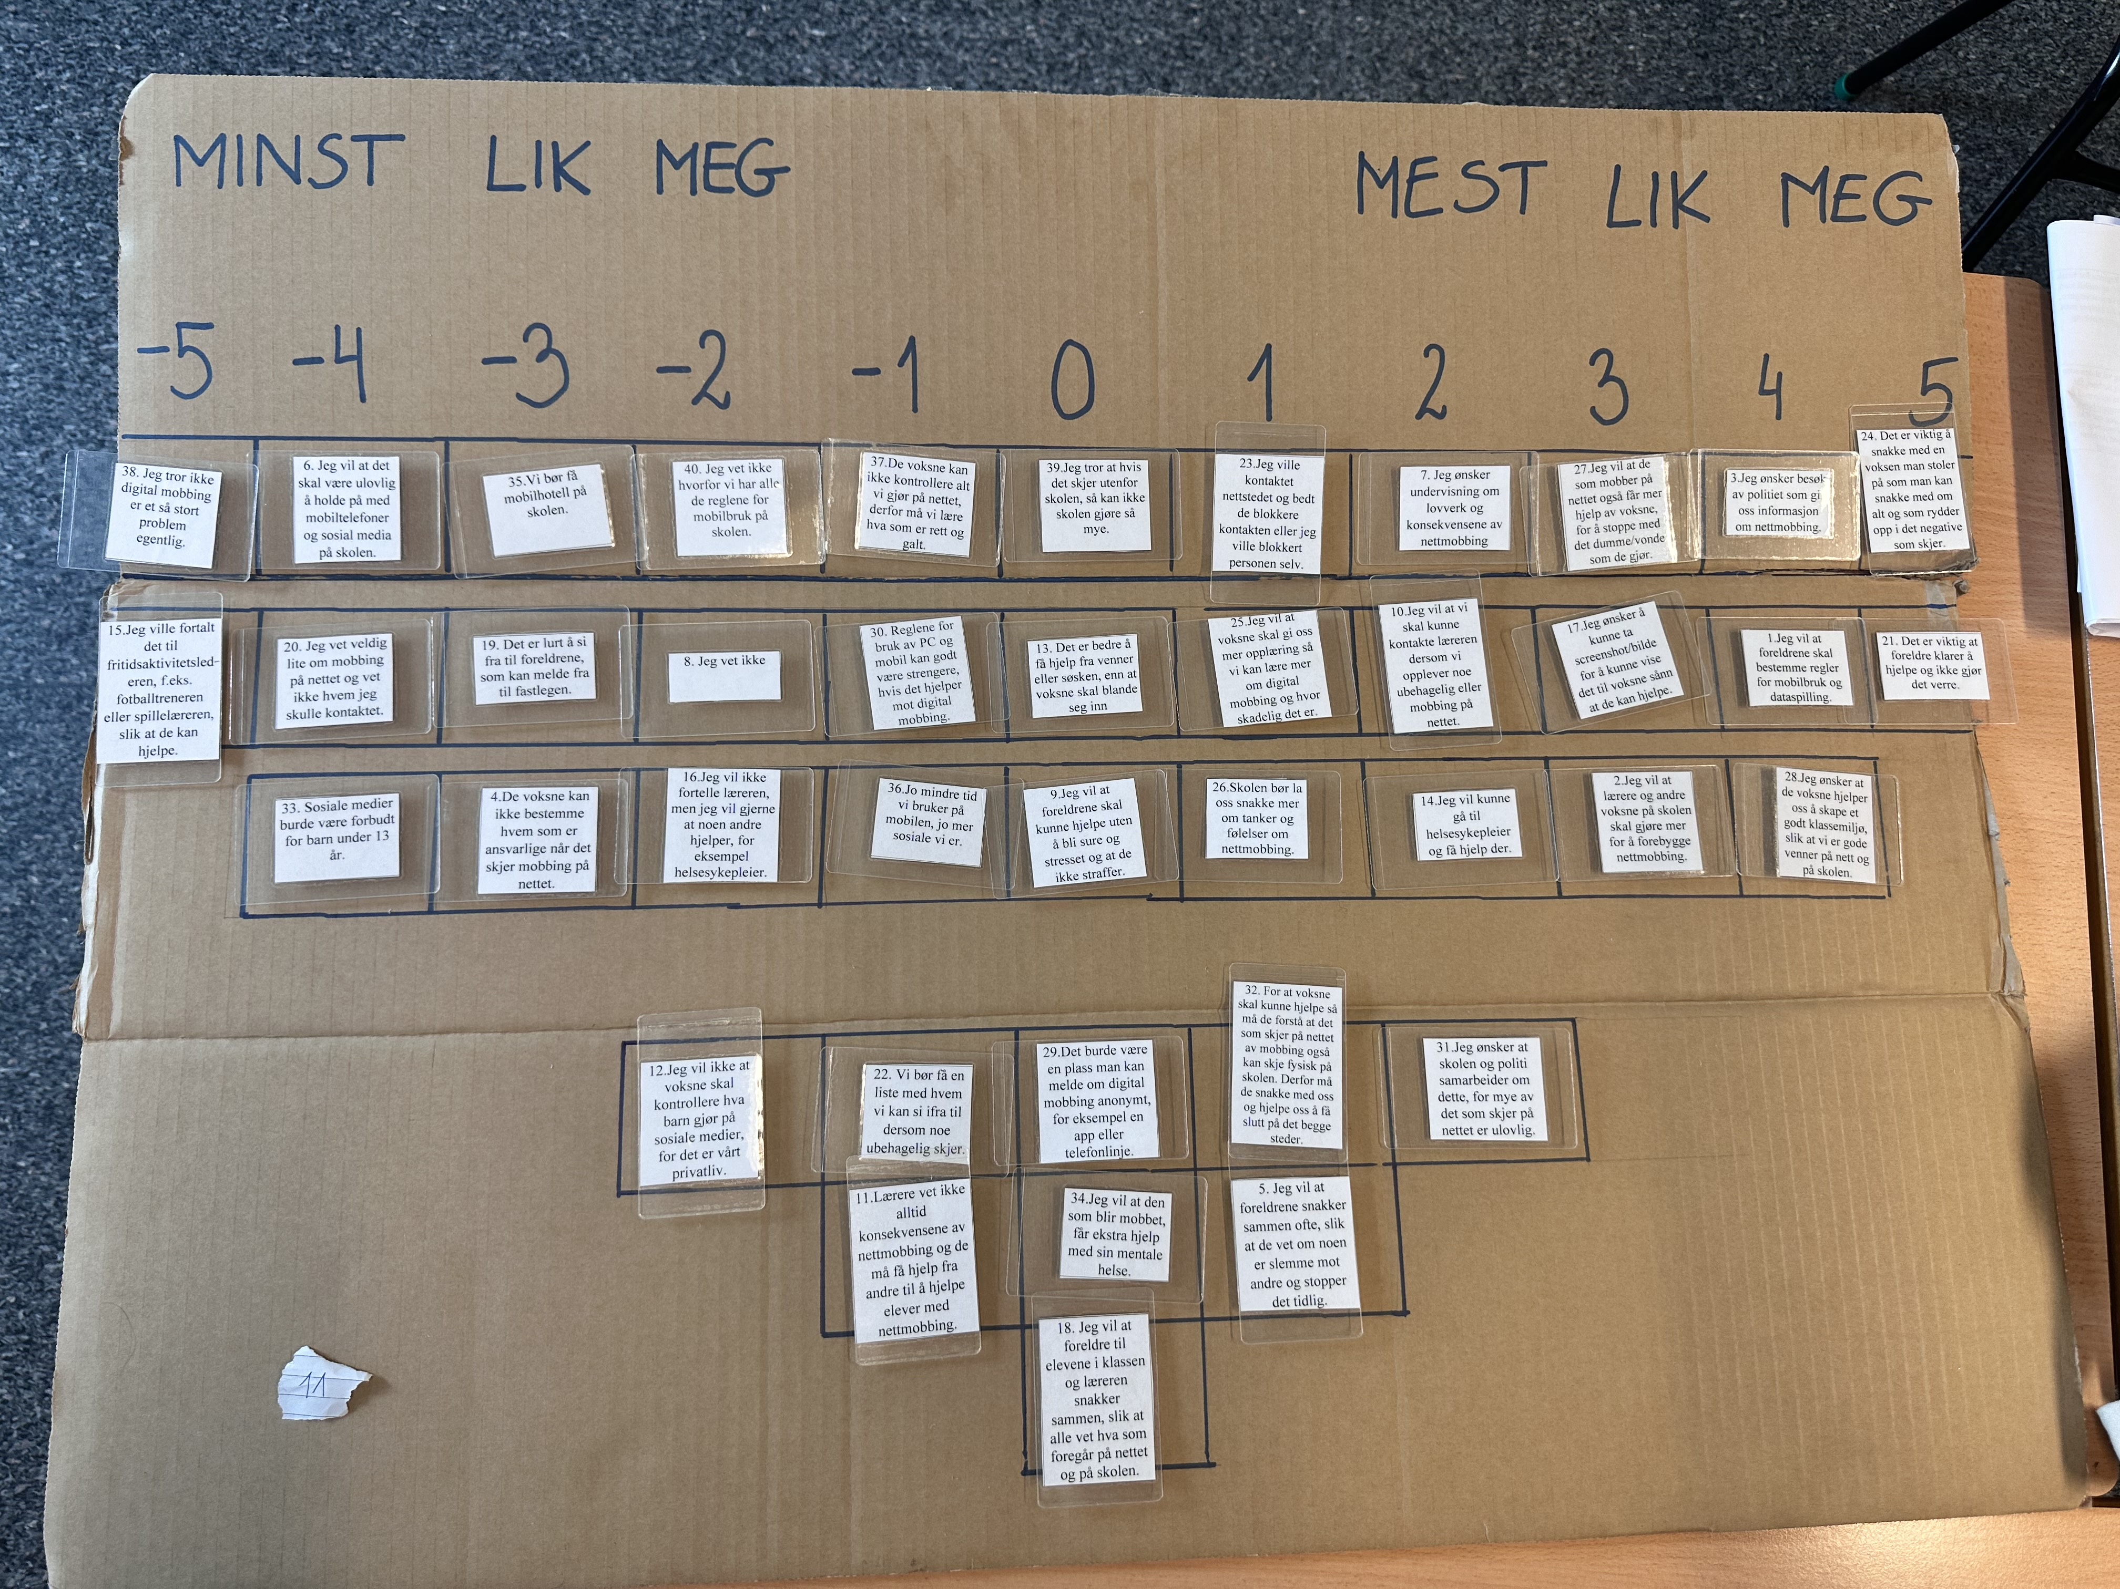
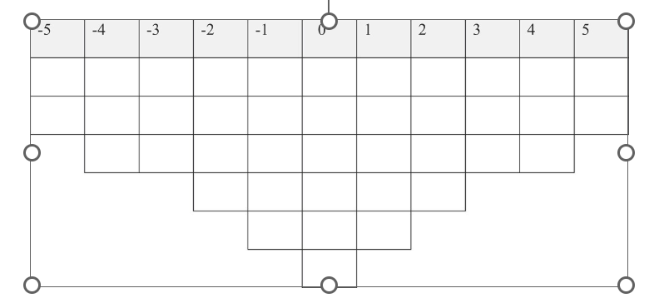
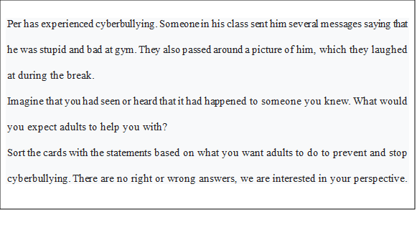
Method and research question
Six stages (van Exel & de Graaf, 205):
define the concourse
i) focus group interviews
(2) construct the Q set
(3) select the participants (p-set)
(4) conduct the q-sort
i) post-sort interviews
(5) factor analysis
(6) interpretation
Notes:
To answer the research question, 17 semi-structured interviews were conducted either in-person or online with parents of children and adolescents enrolled in Norwegian primary or lower secondary school, as these are the ages where cyberbullying is most prevalent (Kowalski et al., 2012). Seeing as cyberbullying is a phenomenon difficult to observe in real time or recreate, interviews allow for a retrospective recollection of the past events (Merriam & Tisdell, 2015). A pilot interview has been conducted in November 2022 to both test the interview guide, as well as test the first author in the role as interviewee (Dalen, 2011). Using probing questions, the participants were encouraged to elaborate on their experiences and dig deeped into their subjective opinions on the cooperation.
Purposive sampling was employed, with the population including parents of children involved in cases of cyberbullying. The 17 interviews that constituted the data material were carried out between November 2022 and January 2024 in either Norwegian, Polish or English. Parents interviewed must have met the following criteria: (1) parents of children enrolled in primary or lower secondary school in Norway, where children have been involved in cyberbullying or cyber harassment in some capacity, (2) the parents were willing to be interviews and (3) the parents had specific interest in creating safe cyber space for the children.
A semi-structured interview guide has been devised to direct the conversation, ensuring that the informants were allowed to subjectively manifest their personal experiences with cooperation to overcome cyberbullying (see Attachement 7.1). The four main topics included (1) definition of cyberbullying, (2) the bullying, (3) intervention and (4) prevention. Without compromising the confidentiality and comfort of the informants, the interviews were conducted at the location and time at the informants’ choice. The interviews lasted between 25 minutes to 1 hour and 37 minutes. The interview guide was purposefully designed to allow the participants to freely reflect on experiences they deemed most important, yet guiding the conversation to stay within the study’s shape.
Data analysis was facilitated using qualitative data software NVivo. The interviews were transcribed verbatim and uploaded into the software, then analyzed. Data analysis followed the thematic analysis framework by Braun and Clarke (2006, 2019, 2022, 2023), which involve six stages: (1) familiarizing oneself with the data, (2) creating codes, (3) generating themes, (4) reviewing potential themes, (5) defining and naming themes, and (6) producing the report. The coding process was further divided into three phases, as described in Corbin (2008): (1) open coding, (2) axial coding and (3) selective coding. A ‘code’ is a word or phrase summarizing a significant meaning to a chunk of data, and the streamlined codes-to-theory model was used, where observed codes in raw data are summed up into categories, and then into themes, with growing level of abstraction. Additionally, magnitude coding was employed to indicate frequency of active engagement of various stakeholders (Saldaña, 2009).

Slide 6
Ethical considerations
Assessed by the Norwegian Agency for Shared Services in Education and Research (SIKT) in Norway.
A child-friendly approach, age-appropriate information, and informed consent from both child and parent .
The scenario used to protect vulnerable participants (Bradbury-Jones et al., 2014)
Q method’s sorting activity allows for a more playful expression of children’s subjective experiences (Øverland, 2025)
Q methodology is well suited for children to express opinions and it is possible to take consideration for children’s development and wellbeing regarding data collection (Størksen, et. al, 2012, Øverland, 2013, Ellingsen et al., 2014; Brown & Montgomery, 2025)
Notes:
The study was Assessed by the Norwegian Agency for Shared Services in Education and Research (SIKT) in Norway.
A child-friendly approach, age-appropriate information, and informed consent from both child and parent .
The scenario used to protect vulnerable participants (Bradbury-Jones et al., 2014)
Q method’s sorting activity allows for a more playful expression of children’s subjective experiences (Øverland, 2025)
Q methodology is well suited for children to express opinions and it is possible to take consideration for children’s development and wellbeing regarding data collection (Øverland, 2013, Ellingsen et al., 2014; Brown & Montgomery, 2025)

Slide 7
Results
Table 1: Informant characteristics

Slide 8
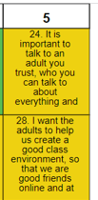
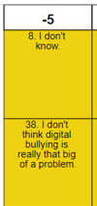
Summary of viewpoint 1
the active users who need capable adults
defined by 16 students (11 girls, five boys)
need for the presence of capable guardians they trust, who may help them in times of distress and play a role in creating safe environments.
students feel strongly about the problematic nature of cyberbullying and feel they do know what to do if it occurs.
“It is quite a big issue, where many students can get hurt. Not only at school, but outside, too. They end up not trusting anybody and isolating themselves” (S225)
“They have to teach us what is right and wrong, since they cannot see everything themselves” (S12)
Notes:
Note: The yellow color: significant different opinions from the other views

Slide 9
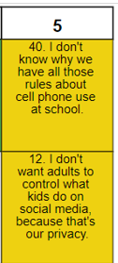
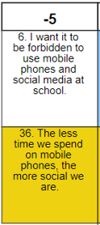
Summary of viewpoint 2
the independent digital enthusiasts
defined by six students (five boys, one girl)
the students do not know why there are all the rules about cell phone use at school, and they do not want the adults to control what kids do on social media, as they see it as their private life
students strongly disagree that mobile phones and social media should be forbidden at school
“It is a part of our education to be able to use the Internet. You can learn plenty of (useful) things by watching TikTok, for instance” (S226).
“The adults don’t know anything. They only know how to pay the bills” (S11).
Notes:
Note: The yellow color: significant different opinions from the other views

Slide 10
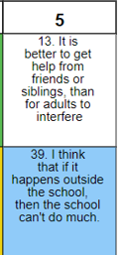
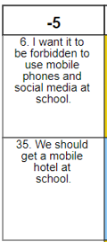
Summary of viewpoint 3
the peer-oriented users
defined by five students (three boys, two girls)
the students strongly agree that it is better to get help from friends and siblings, than adults
students strongly disagree that it should be forbidden to use mobile phones and social media at school and that there should be a mobile hotel at school
“Adults may make matters worse. The parents may contact the others and repeat the things that have been said. They can get really mad and make it even worse for us” (S216).
“Cyberbullying is not such a big issue. I play video games with friends. Sometimes we bully (there). But we don’t care really” (S233)

Slide 11
Results – consensus statements
Statement | F1 | F2 | F3
2. I want teachers and other adults at school to do more to prevent cyberbullying. | 1 | 1 | 2
7. I want education about legislation and the consequences of cyberbullying. | 0 | 1 | 2
9. I want the parents to be able to help without getting angry and stressed and that they do not punish. | 4 | 4 | 4
14. I want to be able to go to a public health nurse and get help there. | 0 | 0 | -1
16. I don't want to tell the teacher, but I would like someone else to help, for example a public health nurse. | 0 | -2 | -2
21. It is important that parents are able to help and do not make it worse. | 4 | 3 | 3
26. The school should let us talk more about thoughts and feelings about cyberbullying. | 0 | 0 | -1
37. The adults cannot control everything we do online, therefore we must learn what is right and wrong. | 2 | 4 | 3
Notes:
Statements that do not distinguish between any pair of factors

Slide 12
Discussion
The students need capable, trusted adults who may help in creating supportive environments, and understand the complexity of bullying (F1)
the students may need independence and potentially defy imposed rules and authorities (F2)
Using peers and siblings as mediators may be more appealing to adolescents (F3)
Notes:
On one hand there are some children who are searching for adult guidiance, who can help them when bullying occures. It is especially important that they have aduts they can talk to, who they trust and who understands what is going on and who can help them.
The children also belive that they need adult help in creating supportive environments, so that bullying does not occure as cyberbullying and other places.
The «active users» who rank the statements this way seem to rely on and search for adult help and cooperation to understand and solve some of the bullying that is happening. They seem to experience an overlap of what is going on in the classenvironment and bullying (online and other places) , and they do concider bullying as a big problem. The view raises questions about how adults can participate to help – to what degree, how the school and the teachers can do to prevent and stop bullying, and also how parents ought to be involved in the cooperation to stop bullying.
This is somewhat in contrast to «the indpendent enthusiastic users», who higly value their own independence and seem to impose rules and adult authorites. But remember: they were presented for a scenario of cyberbullying, perhaps they are so enthusiastic about their digetal world/doings that they forget to think about others beeing bullied or perhaps they do partipate in some bullying, or need adults to see the complexity – we don`t have data on this, but they seem to have several reasons for not wanting adult cooperative help.
The third vew is a more mixed viewpon t and they seem to find peers and silings more appealing than adults when it comes to cooperation to prevent and stop bulling. This is also a point to discuss – it is fine to trust friends and peers, but some of the cases are very serious when it omes to cyberbullying so they may need adult help.

Slide 13
Discussion
the students expect balance between the need to constantly monitor their technology use and allowing them to freely investigate its possibilities
children may prefer confiding in peers or siblings. Research indicates that children often rely on peers for digital development
children should know that there are people in their lives they may approach if cyberbullying occurs, and creating such awareness is the adult’s responsibility.
Notes:
The results also rise other discussion points, such as:

Slide 14
Take home message
- the students may opt for different coping strategies.
- adults may be allowed to offer guidance and support for the child
- the adults may lack competence or willingness to approach the issue appropriately
- students value their socializing and privacy
- the Q methodology enabled students to share their perspectives
Notes:
Children`s perspectives add important information about adult cooperation and how to prevent and solve cyberbullying:
adults may be allowed to offer guidance and support for the child, if they are trusted and expected to handle the issue with care and skill
- the adults may lack competence or willingness to approach the issue appropriately, and choose to punish, ignore or otherwise inadequately address cyberbullying.
- the Q methodology enabled students to share their perspectives, which may be used to support the stakeholders in their cooperative efforts to create spaces free from cyberbullying.

Slide 15
læringsmiljøsenteret.no
Thank you for your attention!
martyna.bell@uis.no
klara.overland@uis.no
Notes:
Each speaker has 17 minutes, including time for questions (max. 15 min. for speaking, remaining time for questions). • Time limits are strictly enforced. A WABF session facilitator will signal when you have 5 minutes, 2 minutes, 1 minute, and when the time is up.
Submission of Individual Oral Presentations/Workshops/Symposia
Submit Individual Oral Presentations/Workshops/Symposia to wabf@uis.no with subject field “Submission of Presentation” before June 9.
Make sure to name the file Contribution ID_PresenterName
Example: ID123_Firstname_lastname.pptx

Slide 16
Results – factor arrays

Slide 17
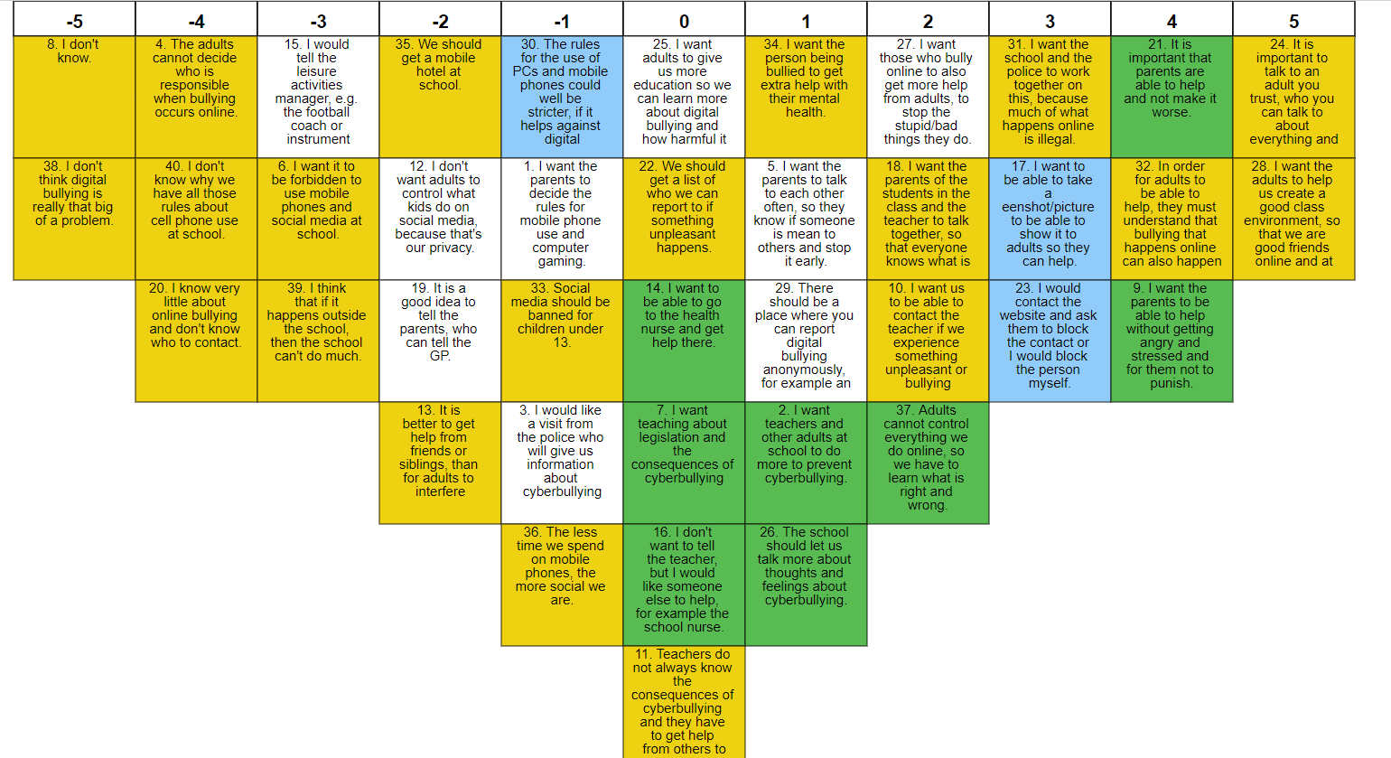
Results
Figure 1: Summary of viewpoint one– the active users who need capable adults

Slide 18
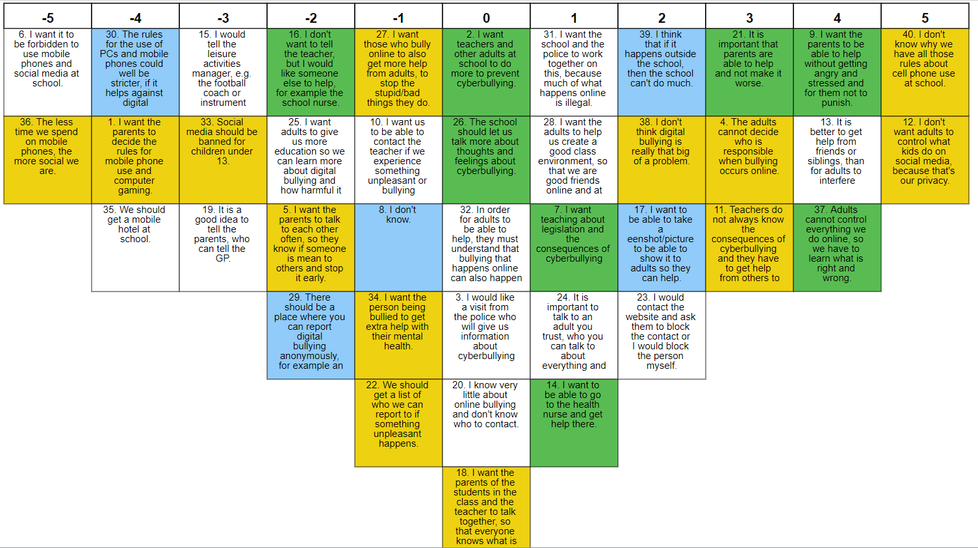
Results
Figure 2: Summary of viewpoint two – the independent digital enthusiasts

Slide 19
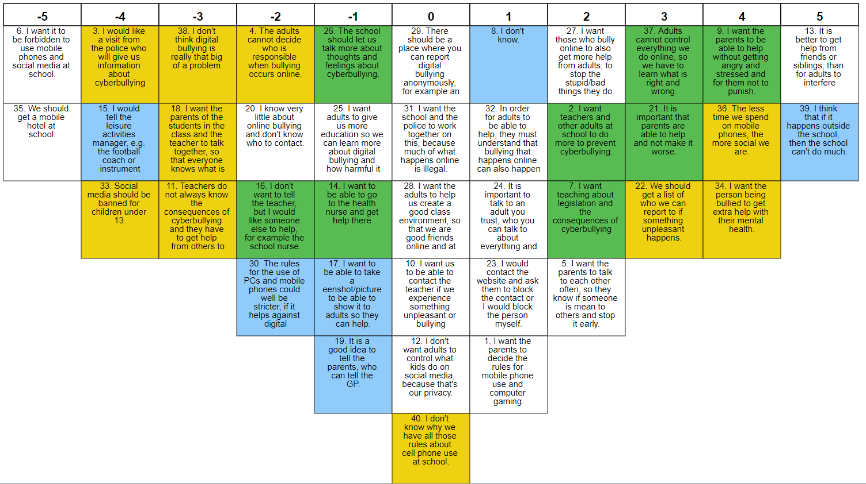
Results
Figure 3: Summary of viewpoint three - the peer-oriented users

