Slide 1
The Italian Law 71/2017 on Preventing
and Contrasting Bullying:
Protections, Strategies, Practices and Monitoring Activities for all and for each one
Elena Ferrara, Rosanna Di Gioia, Guillermina Nora Carnicina, Andrea Donati

Slide 2
In this Symposium
Legal tools
<<<
>>>
Community involvement
Education Digital skills
<<<
>>>
<<<
>>>
Multi-level approach
to prevent cyberbullying
<<<
>>>
<<<
>>>
Psycho-social support
Participatory research

Slide 3
In this Symposium
Elena Ferrara, former Senator of the Italian Republic (XVII legislature) and promoter of the Italian law 71/2017
The Italian Law 71/2017: Multi-level Governance for Participatory Prevention

Slide 4
In this Symposium
Rosanna Di Gioia, Scientific Officer at the Joint Research Centre of the European Commission
Happy Onlife: The European Commission’s Gamified Experience to Prevent Harmful behaviour, Improve Digital Skills and Dialogue Between Generations

Slide 5
In this Symposium
Elena Ferrara, Andrea Donati – Contorno Viola Association
The Smartphone License as a New Proposal for Digital Education. Good Practices for the Development of Alliances in the Educational Community

Slide 6
In this Symposium
Guillermina Nora Carnicina – Psychologist and Honorary Judge at the Court of Appeal of Bari
Micropedagogy of Discomfort. Reparative Interventions for Victims of Bullying and Cyberbullying

Slide 7
In this Symposium
Andrea Donati – Psycologist and Psychoterapist and Community Educator
Prevention and Community Education. Prevent Peer Bullying, Activate Intervention Strategies that Include Collective Support

Slide 8
The Italian Law 71/2017 on Preventing
and Contrasting Bullying:
Protections, Strategies, Practices and Monitoring Activities for all and for each one
Elena Ferrara, Rosanna Di Gioia, Guillermina Nora Carnicina, Andrea Donati

Slide 9
This law aims to contrast cyberbullying in all its manifestations, with preventive actions and with a strategy of attention, protection and education of the minors involved, as both victims and perpetrators of illicit acts [...]
Art. 1, Law 71/2017

Slide 10
Framework and Principles
Convention on the Rights of the Child UNCRC, 1989
Recommendation n. 2006/962/EC On key competences for lifelong learning European Parliament and of the Council
General comment No. 13 The right of the child to freedom from all forms of violence UNCRC, 2011
Decision n. 1351/2008/EC Establishing a multiannual Community programme on protecting children using the Internet and other communication technologies European Parliament and of the Council

Slide 11
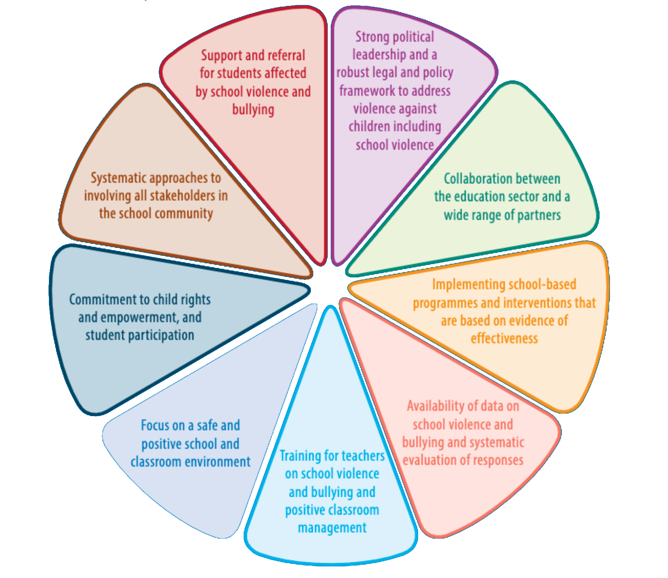
A Common Context
Resolution A/RES/70/1 Transforming our world: the 2030 Agenda for Sustainable Development UN General Assembly, 2015
Guidelines for National Effective Responses UNESCO, 2019
Regulation (EU) 2016/679 General Data Protection Regulation European Parliament and of the Council
Factors that contribute to effective national responses

Slide 12
A Common Context
Recommendation CM/Rec(2018)7 On Guidelines to respect, protect and fulfil the rights of the child in the digital environment Committee of Ministers to member States
General comment No. 25 On children’s rights in relation to the digital environment UNCRC, 2021
Strategy for the Rights of the Child (2022-2027) Council of Europe

Slide 13
Strategies, Practices and Monitoring in EU
“1. Providers of online platforms accessible to minors shall put in place appropriate and proportionate measures [...]
4. The Commission, after consulting the Board, may issue guidelines to assist providers of online platforms [...]”
Art. 28 - Online protection of minors
Regulation (EU) 2022/2065 On a Single Market For Digital Services and amending Directive 2000/31/EC (Digital Services Act) European Parliament and of the Council

Slide 14
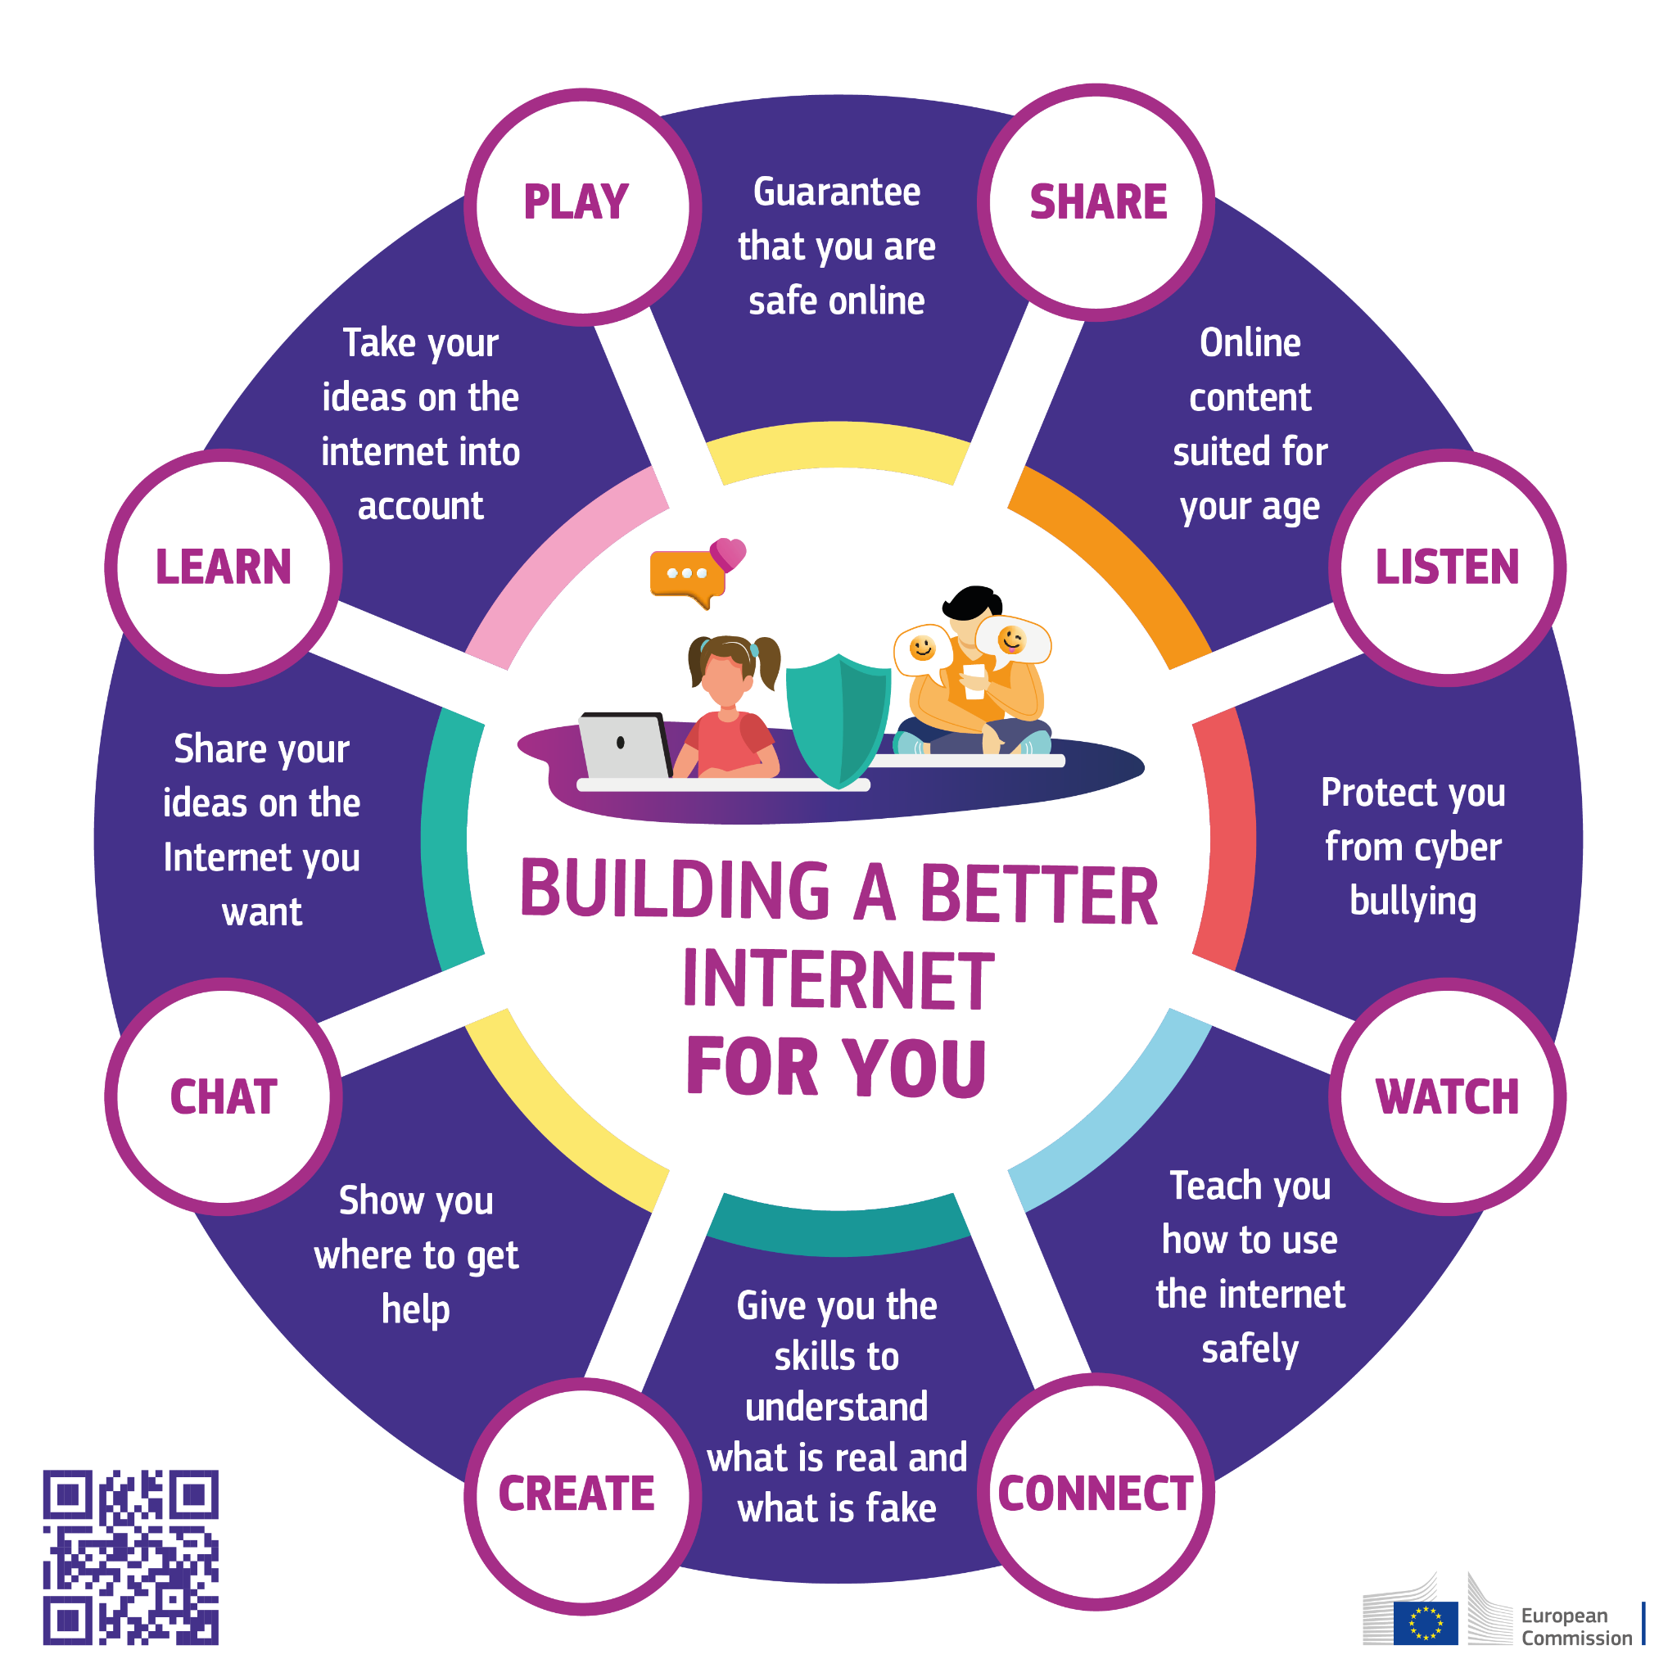
Strategies, Practices and Monitoring in EU
Recommendation (EU) 2024/1238 On developing and strengthening integrated child protection systems in the best interests of the child European Commission
Better Internet for Kids (BIK+) European Commission, 2022

Slide 15
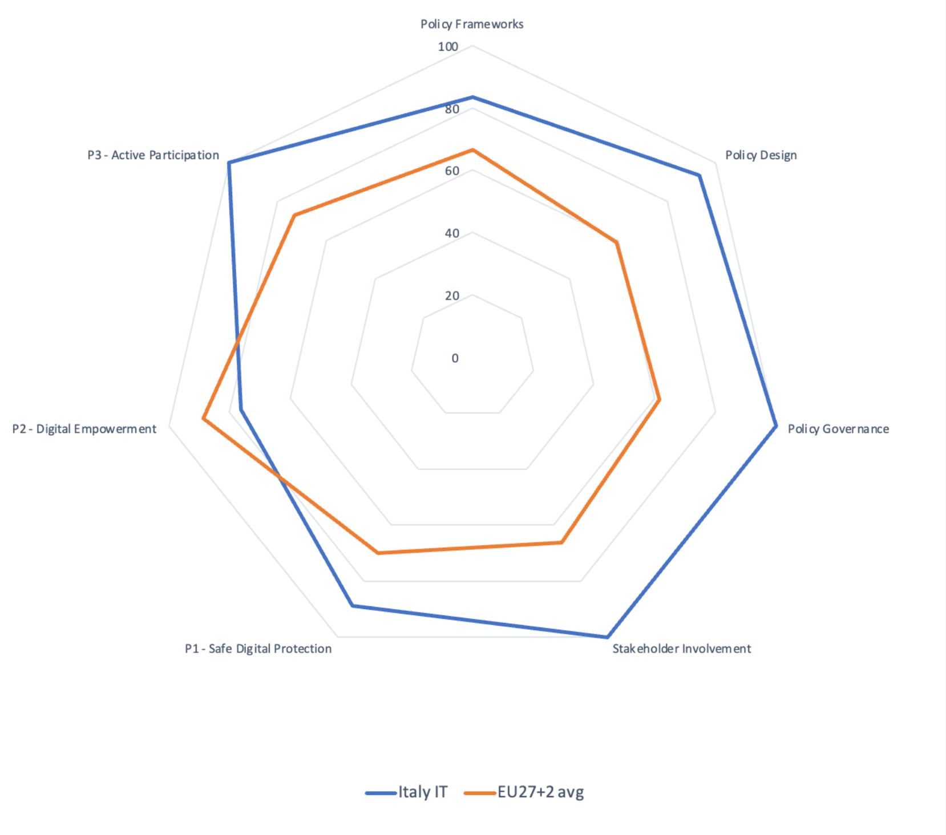
Italy Policy Monitor Country Profile
BIK+ Index 2025: Italy
The BIK+ Index has been developed to provide an aggregated at-a-glance overview of the levels of implementation across the two dimensions, BIK policies and BIK+ actions, in Italy compared to the EU27+2 average. Values are shown in per cent.
Data collected in February 2025

Slide 16
In this Symposium
The Italian Law 71/2017
Multi-level governance
Integrated systems and good practices
Right to agency for every child

Slide 17
Multi-level Governance for Participatory Prevention
The Italian Law 71/2017 on Preventing
and Contrasting Bullying
Elena Ferrara
Former Senator of Italy and proponent of the Law 71/2017 on (cyber)bullying

Slide 18
"Why this? Bullying, that’s all."
— Carolina Picchio, victim of cyberbullying who committed suicide at 14 years old

Slide 20
“Victims of homophobic bullying often isolate themselves because of the absence of adults who can understand the condition of the offense”
Guidelines for Preventing and Combating Cyberbullying
Ministry of Education, 2015

Slide 21
“Words hurt more than blows”

Slide 22
“RESPECT DIFFERENCES”, 2017
National Plan for Education on Respect Ministry of Education

Slide 23
The Restorative Justice Program
The juvenile judge still proposes a restorative justice program, leaving it to the defendant to choose whether or not to adhere to such a path, a choice that will mature before mediators are appropriately involved.

Slide 24
The Observatory for the Prevention of Bullying
PROPOSE AND REALIZE:
Actions to prevent bullying
Raising awareness of legality
Training students/school staff/families
Training of trainers
Alternatives to disciplinary sanctions
PERMANENT REGIONAL OBSERVATORY FOR THE PREVENTION OF BULLYING
Operational Technical Group
8 Local Project Teams
REALIZE:
Projects to prevent bullying
Projects to raise awareness of legality
Training students/school staff/families
Collaborate with Local Institutions and Police
NETWORK 12 schools as Bullying Prevention Hubs
Memorandum of Understanding
Regional and Local Institutions
Memorandum of Understanding for the School Network

Slide 25
The Project “Generazioni Connesse”
The project is co-financed by the European Commission under the program Digital Europe, and is a member of a network promoted by the European Commission which takes the form of the online platform Better Internet for Kids managed by European Schoolnet, in close collaboration with INSAFE and Inhope.

Slide 26
Members of the Advisory Board

Slide 27
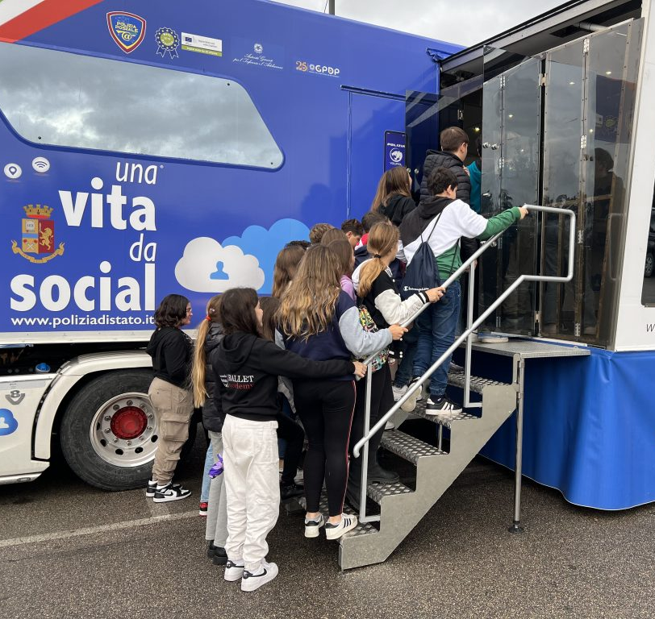
The Project “Una Vita da Social”
Una Vita da Social proposes and implements information campaigns on web risks with a multi-target approach including:
> students of all age
> parents
> teachers

Slide 28
The Draft Law 1261 (Future Law 71/2017)
Protection of personal data and dignity
Protection of identity and web reputation
Development of critical conscience and sense of responsibility
NOT AGAINST THE WEB
Create a system of alliances with tech companies
Increase knowledge right and duties on the internet
Guarantee freedom of expression
Promoting child-friendly information services
TO SUPPORT TECH INNOVATION

Slide 29
[...] «cyberbullying» means any form of pressure, aggression, harassment, blackmail, insult, denigration, defamation, identity theft, alteration, unlawful acquisition, manipulation, unlawful processing of personal data to the detriment of minors, carried out by digital devices, as well as the dissemination of on-line content also having as object one or more members of the family of the child whose intended and predominant purpose is to isolate a minor or a group of minors by committing serious abuse, a malicious attack, or their ridicule.
Law 71/2017 - Art. 1

Slide 30
An Integrated System to Prevent and Combat Cyberbullying
Why?
To protect all children on the web by guaranteeing them old and new rights.
INTEGRATED INSTITUTIONAL SYSTEM
System governance is envisaged to coordinate a national response plan: a technical table for the prevention and combating of the phenomenon
How?
> Co-design interventions between the institutions involved.
> Digital education and prevention of risky behavior starting from school and family environment.

Slide 31
The Technical Committee
MINISTRIES AND REGIONAL GOVERNMENTS
SUPERVISOR ENTITIES
TECH COMPANIES
CHILDREN RIGHTS ORGANIZATIONS
STUDENTS COMMITTEES
PARENTS ASSOCIATIONS
SECTORIAL PROFESSIONALS
Permanent Inter-ministerial Board

Slide 32
Law 71/2017 and UNESCO Guidelines for National Effective Responses
Right to Oblivion (Art. 2) and School Cyberbullying Referent (Art. 4)
Systematization of the legal system (Art. 1) and Action Plan for a new governance and co-regulation with tech companies (Art. 3)
Involvement of the entire school community (Art. 4) and specific tasks for head teachers and collegial bodies
Collaborative projects for a coordinated governance (Art. 4)
Procedure of admonishment (Art. 7) and youth protagonism (peer education approach)
Anti-Bullying Policies for schools (Art.4)
Monitoring Committee (Art. 3)
Promotion of an inclusive environment and conflict mediation
School staff training and ELISA platform (Art. 4)

Slide 33
The Enacting Terms of the Law 71/2017
Art. 1
Art. 3
Art. 4/5
Art. 2/7
> Purpose of the Law
> Definition of cyberbullying
> Definition of bullying (Law 70/2024)
> Technical Board
> Autoregulation Code for new media operators
> Monitoring Committee
> Awareness of citizenship
> Systemic formative actions
> Guidelines:
- training of referents
- educational continuity
- network of services
- Anti-Bullying Internal Code
> Privacy and legal liability protection devices (Right to Oblivion)
> Privacy Supervisor intervention after unanswered request for removal to operators
> Procedure of admonishment

Slide 34
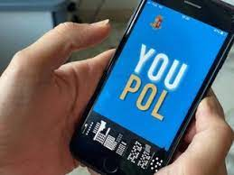
Recommendation CM/Rec(2009)10 of the Committee of Ministers
“A child should be able to file a report without the consent of her or his parent or guardian.”
— Law 71/2017
New rights for the adolescents: at 14 years of age the minor can apply on his own to request the removal of an offensive content (right to oblivion) and the procedure of admonishment.

Slide 35
Intervention Strategies for Schools
How to deal with bullying as a social phenomenon?
> Working on groups, cultures and contexts of the individual cases
> Educate to responsibility and coexistence, in the framework of a good school climate
> Train teachers, students, parents and school staff
> Care for the relationship with others
> Constant reflection on any form of discrimination and promotion of differences
> Involvement of the community in collective projects of research and dialogue
> Building a successful educational alliance between school, family and other non-school education agencies
> Integrate the educational perspective with that of reparation and sanction, taking into account the complexity of phenomena

Slide 36
Intervention Strategies: ELISA Platform
School Organization
> Head Teacher
> School Cyberbullying Referent
> Intervention Plan
> Anti-Bullying Team
> Emergency Team
> Collegial bodies (teachers, ATA staff, families, students)
> Regulations (school and families alliance)
> Anti-Bullying E-Policy

Slide 37
Intervention Strategies: ELISA Platform
In-depth assessment
Monitoring activities
First reporting
Case management:
> Educational approach to the class
> Personal education plan with the bully and the victim
> Restoring of the relationship
> Involvement of families
> Intensive long-term and network support

Slide 38
12. [...] In a whole-school approach to well-being, mental health and non-violent language are key to prevent bullying, including cyberbullying, and violence, in collaboration with mental health professionals and families.
Recommendation (EU) 2024/1238 - Art. 12

Slide 39
The Virtuous Case of Tuscany Region
Regional Laws have included among the actors of the interventions:
> Individual or associated municipalities
> Schools of all levels and grades
> Regional health service companies
> Research institutes and universities
> Private non-profit legal entities with proven experience in the field or representative of municipalities

Slide 40
Questions from the Youth Panel to the Privacy Supervisor
What can be the additional tools and ways to make children over 14 years autonomous in making alerts?
Is it possible to foresee that the child who reports abuse will be contacted by telephone by an operator, so as to provide immediate and "human" feedback?
Is it possible to have an estimate of reports from unauthenticated users that were not completed?

Slide 41
“We need to simplify and we can help you!”
— Youth Panel (15-19 years old)

Slide 42
We must act in dialogue with people and institutions at all levels.

Slide 43
more informations and updates
elena.ferrara58@gmail.com
www.elenaferrara.it

Slide 44
What governance strategies should a Country adopt to systematize preventive and supportive interventions for all and for each one?

