Slide 1
The Smartphone License as a New Proposal for Digital Education.
Good Practices for the Development of Alliances in the Educational Community.
The Italian Law 71/2017 on Preventing
and Contrasting Bullying
— Elena Ferrara
— Andrea Donati

Slide 2
Why do cyberbullying cases occur in this area?
Some background elements:
> The social isolation of adolescents
> The need for parents to monitor their children as they travel to and from the city to study has led to the early provision of mobile phones
> Lack of awareness of network risks
> Absence of digital citizenship education projects

Slide 3
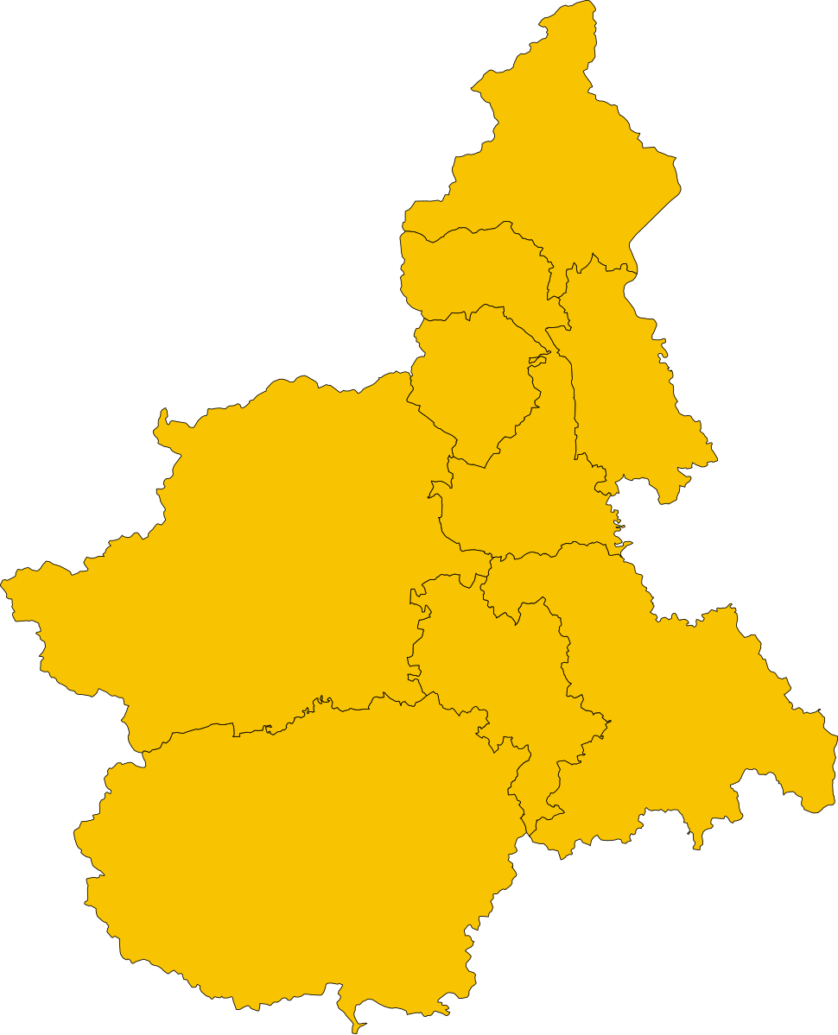
The Project
From 2017 in Verbania, Piedmont - Italy
Why?
In response to the growing incidence of cyberbullying and cyberstupidity at school
How?
With a flexible work model in which parents and teachers can build educational practices at school and at home

Slide 4
The Work Model: How the Project Started
Needs
Methodology
Beneficiaries
> Families asked for support to understand "at what age to give the first mobile phone"
> Teachers asked for more support to address issues related to mobile phone use at school
> Creation of an inter institutional expert group: teachers, psychologists, pedagogues, media educators, stakeholders, university lecturers and IT security workers
> The Project is realised thanks to the contribution of a social private sponsor
> Originally, the licence was designed for students in the first grade of primary secondary school (11-12 years old)

Slide 5
Teachers Training and Toolkit
> The training (synchronous and asynchronous) is aimed at teachers, who will carry out relapse interventions in the identified classes
> In each school, the Cyberbullying Referent established by Law 71/2017 coordinates the project
> The training modules are structured with a normative and psycho-pedagogical approach
> The course topics are:
- sensitive data management
- identity and sexting
- grooming
- cyberstupidity - cyberbullying
> The Teaching Kit provides:
- stimulus material for in class laboratories (4 learning unit of at least two hours each)
- questions database for the Final competence test
- Student-Parent Pact

Slide 6
The Work Model at School
Final competence test
Public ceremony for the award of the Smartphone Licence
In-class laboratory activities realized with the stimulus materials of the Toolkit
Training meeting for parents and sharing of the Co-Responsibility Agreement between students and parents

Slide 7
Smartphone Licence:
a Pink Tile with Strong Symbolic Value
The Licence has the same form of a driving licence, in terms of shape, colours, dimensions and materials.
On the back, the card is personalized with the name of the student and school.
It is the first licence that the student receives and, for this reason, it also constitutes a first step in his growth towards adulthood.

Slide 8
The aim of the project is to develop digital citizenship and build an educational alliance.

Slide 9
From the School to the Community
2019
"Digital Citizenship" forum: integrated regional training for school staff, health personnel and police
2022
II° Level:
14 yrs trial
2017
First trial in Verbania
2021
I° Level
Community
Welfare
2020
Extension to other Regions thanks to Ass. Contorno Viola
2023
New target groups: over 65 and disabled adults
2018
Law Rossi:
Extension in Piedmont
2021
"Digital Citizenship" Vol. 2

Slide 10
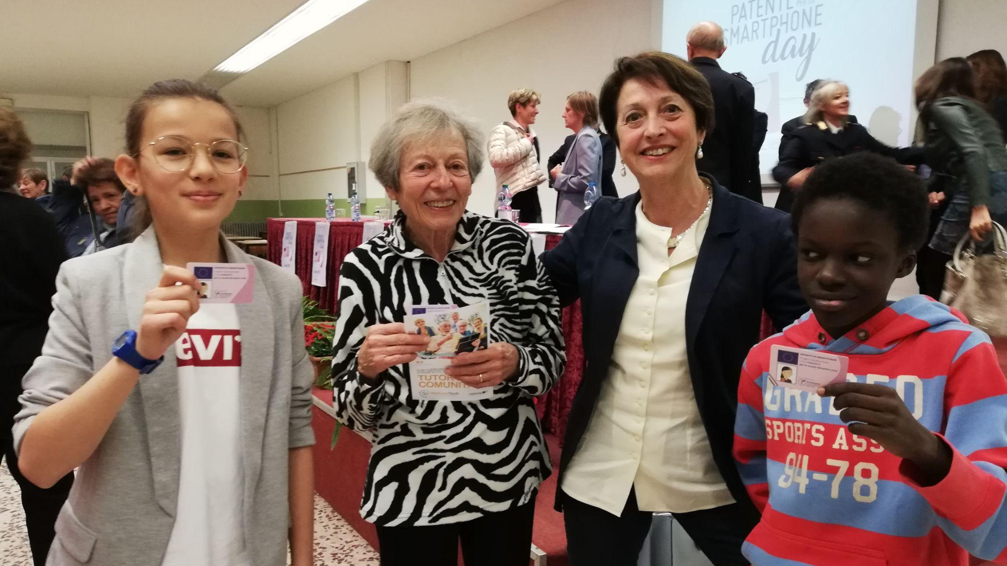

Slide 11
more than
100.000
Smartphone Licences issued in Piedmont from 2017 to 2025

Slide 13
140.000
Students
8
Regions from North to South Italy
4.000
Teachers
4.000
Parents
Extension of the project by Ass. Contorno Viola

Slide 14
Educational Pact of Co-responsibility
The first part, from child to parent, is a promise of trust and responsibility
> I will not use technology to lie, mock or deceive another human being... (not to use technology in a distorted way)
> I will not write in messages or mail something that I would not say in person... (not to use technology as a shield)
> I will not send or ask for photos of private parts... (awareness of the reputational consequences of online actions)
> You will always know my passwords... (full confidence in adults)
> I will learn to use the web and the smartphone without being used by them (acquisition of critical sense and autonomy)

Slide 15
Educational Pact of Co-responsibility
The second part, from parent to child, is an educational and protective commitment
> The best antivirus is your brain
> I promise not to abandon you
> If something happens that you can’t handle, talk about it... together we’ll find a solution
> Be polite, stay in the real world, live your own experiences and not just watch others from a monitor, use the net to expand your knowledge
> Remember that it is easy to publish images and words on the web, but difficult to delete them
> Parents are still the guarantors of the good use of the tool

Slide 16
Smartphone License and Care for Students with BES
Training and examination make even more sense for the most fragile and thus most vulnerable.
For students with special educational needs, the instructions provided in the Personalized Teaching Plans are applied.
For the text of the questions a high legibility font was used, with the intention to favor all students and in particular those with specific learning disabilities.

Slide 17
Suspension or Withdrawal of the Licence
In the event of a breach of the agreement, the licence may be suspended or withdrawn
By parents Parents - Children’s Agreement (including temporary withdrawal of the smartphone)
From the school Educational Pact of Co-responsibility and Discipline Regulation

Slide 18
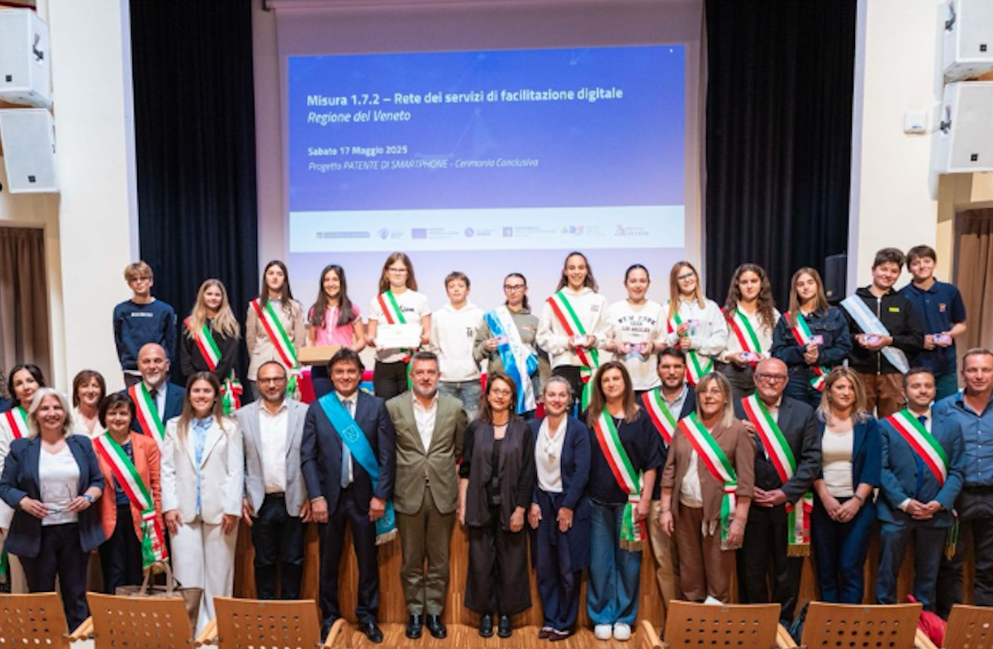
Delivery Ceremony
Solemn recognition of the achieved awareness by students.
The ceremonies follow a common protocol: parents, teachers and the Head of School, local authorities are present.
The Student-Parent Pact is made.

Slide 19
What Next?
Learner's Permit (primary school)
Smartphone Licence (I degree)
Licence Renewal (II degree)
License for Parents
Licence for Vulnerable Groups

Slide 20
Results of the Research of “Preventing Problematic Smartphone Use: Effectiveness Evaluation of the Smartphone Licence Program for Italian Preadolescents”
Journal of Psychological and Educational Research JPER - 2024, 32 (2), November, 34-51 e-ISSN: 2821-4099
Paolo Bozzato, University of Insubria, Italy
Mauro Croce, University of Applied Sciences and Arts of Southern Switzerland, Switzerland
Nicolas Leanza, Foundation IRCCS Ca' Granda Ospedale Maggiore Policlinico, Italy

Slide 21
2
Regions
1
Group who received the Smartphone License
11-13
Years old
1
Control group
11
Schools
49.1%
Males
48.6%
Females

Slide 22
The Questionnaire
Experimental group
Questionnaire
Time 1
Smartphone Licence Program
Questionnaire
Time 2
Control group

Slide 23
The Questionnaire
The questionnaire was composed of different measures:
Smartphone utilisation
Socio-demographic measures: age, gender, school grade, nationality and residence (urban vs. rural), social status ETC.)
Knowledge of the negative consequences associated with smartphone use

Slide 24
Knowledge About Risks of the Smartphone
3,0
Experimental group
2,5
Control group
2,0
Percentage of error
1,5
1,0
0,5
0,0
T1
T2

Slide 25
Misconceptions Related to Smartphone Use
3,0
Experimental group
2,5
Control group
2,0
Percentage of error
1,5
1,0
0,5
0,0
T1
T2

Slide 26
Total Results of the Questionnaire
6,0
Experimental group
5,0
Control group
4,0
Percentage of error
3,0
2,0
1,0
0,0
T1
T2

Slide 27
more informations on the research on
Journal of Psychological and Educational Research JPER - 2024, 32 (2), November, 34-51 e-ISSN: 2821-4099
https://www.marianjournals.com/files/JPER_articles/
JPER_32_2_2024/Bozzato_et_all_JPER_2024_32_2_34_51.pdf
A book under publication by M. Croce and F. Paracchini ed. Franco Angeli: «La patente di smartphone. Proposte e strumenti per il benesseere digitale in adolescenza»

