Slide 1
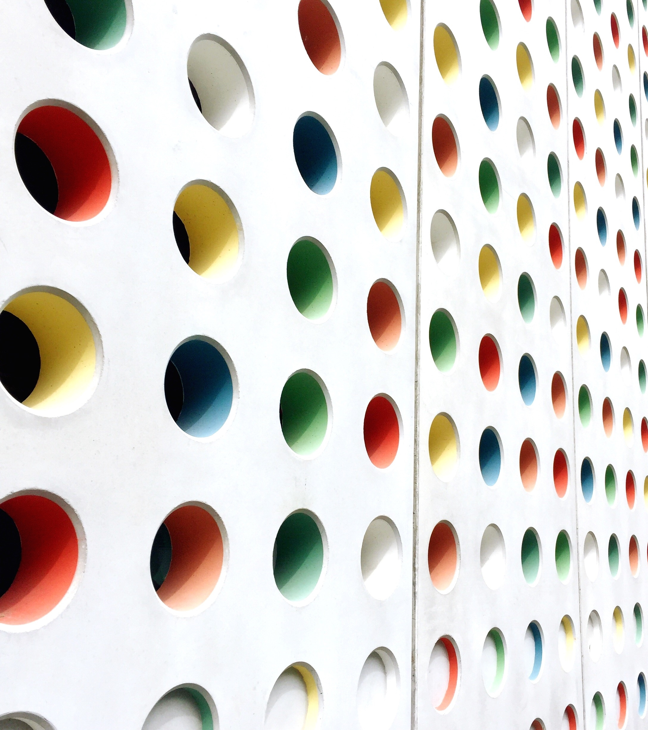
Evaluation of an AI-EEG based Photo-Paroxysmal Response solution on healthy subjects
when false positive really matters
Authors: Moncada et al
Speaker: José R. Villar
OES2025 – Stavanger University, Norway

Slide 2
Evaluating an AI-EEG based PPR solution on healthy subjects
Table of contents
Photo-Paroxysmal Response (PPR)
Previous studies
AI-based anomaly detection
Conclusions and future work
OES2025 – Stavanger University, Norway

Slide 3
Evaluating an AI-EEG based PPR solution on healthy subjects
Photo-Paroxysmal Response
OES2025 – Stavanger University, Norway

Slide 4
Evaluating an AI-EEG based PPR solution on healthy subjects
Photo-Paroxysmal Response (PPR) and Intermittent photic stimulation (IPS)
OES2025 – Stavanger University, Norway

Slide 5
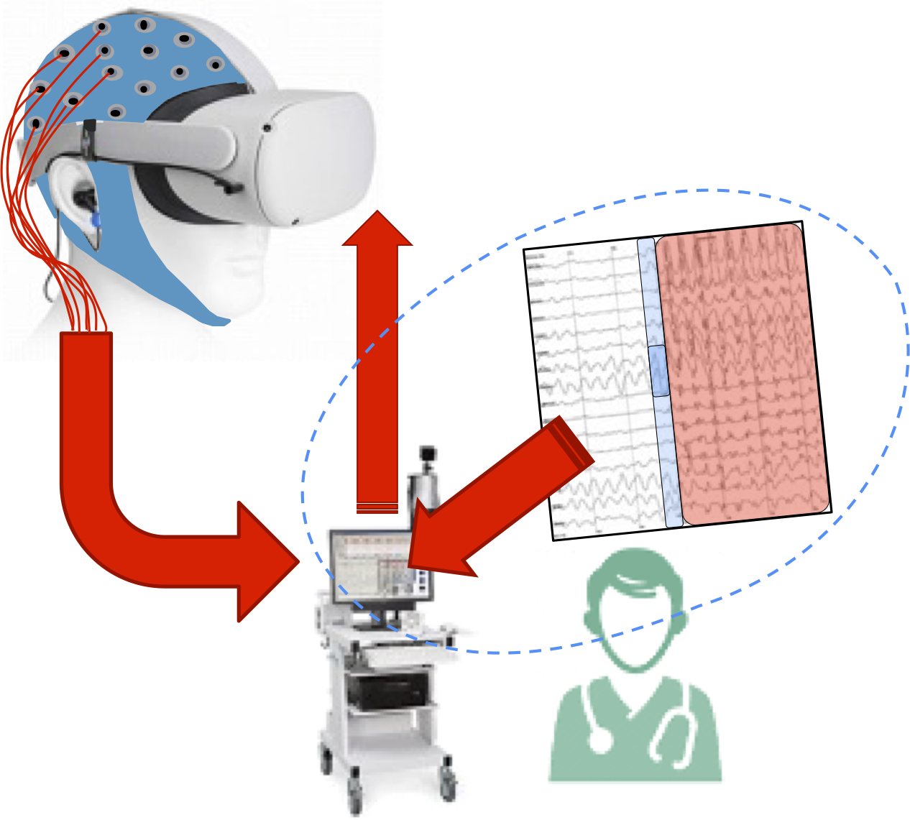
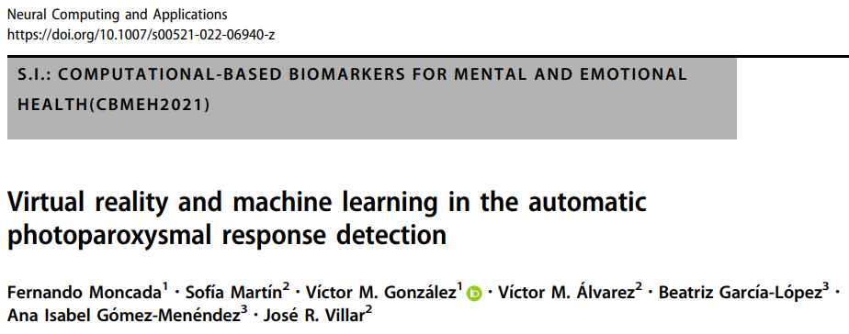
Evaluating an AI-EEG based PPR solution on healthy subjects
Previous studies
OES2025 – Stavanger University, Norway

Slide 6
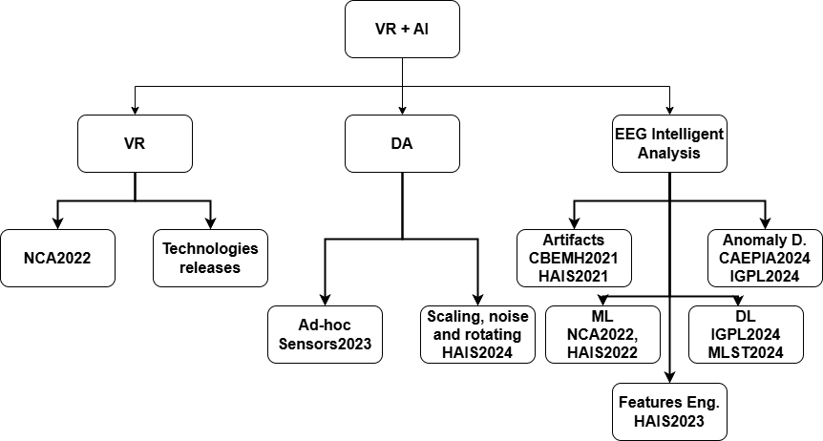
Evaluating an AI-EEG based PPR solution on healthy subjects
OES2025 – Stavanger University, Norway
Previous studies

Slide 7
Evaluating an AI-EEG based PPR solution on healthy subjects
AI-based anomaly detection
Data set: Phot_Data (9 p, 256 Hz), NONPhot_Data (5 p, 128 Hz) under IPS
Pre-processing:
6th order Butterworth band-pass filter (0.5-120 Hz)
Notch cut-off filter at 50 Hz
1 second length sliding Windows, overlap 90%.
Classification using a distance function:
Reconstruction error: mean square error $rmse(X_{j},\hat{X_{j}} )$
Mahalanobis distance in the latent space
Anomaly proposed for high values of the total distance
OES2025 – Stavanger University, Norway

Slide 8
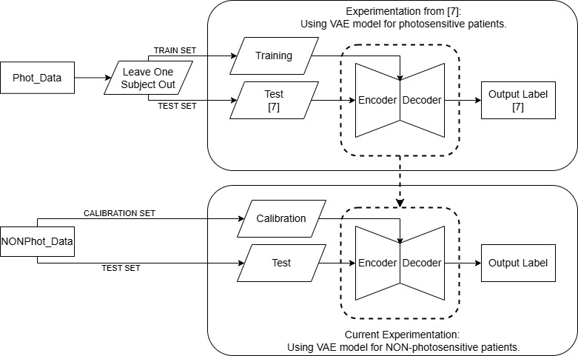
Evaluating an AI-EEG based PPR solution on healthy subjects
AI-based anomaly detection
Experimentation design CAEPIA2024
Experimentation design OES2025
Experimentation design HAIS2025
LOSO
Training on the IPS’ stimulation stage.
Tuning on the pre-stimulation stage of the testing individual.
Reusing models from CAEPIA2025
Testing on NONPhot_Data patients.
Training on normal windows from NONPhot_Data.
Testing on IPS windows from Phot_Data.
OES2025 – Stavanger University, Norway

Slide 9
Evaluating an AI-EEG based PPR solution on healthy subjects
AI-based anomaly detection
EXPERIMENTATION DESIGN CAEPIA2024
Experimentation design OES2025
Experimentation design HAIS2025
OES2025 – Stavanger University, Norway

Slide 10
Evaluating an AI-EEG based PPR solution on healthy subjects
AI-based anomaly detection
EXPERIMENTATION DESIGN CAEPIA2024
EXPERIMENTATION DESIGN OES2025
Experimentation design HAIS2025
OES2025 – Stavanger University, Norway

Slide 11
Evaluating an AI-EEG based PPR solution on healthy subjects
AI-based anomaly detection
EXPERIMENTATION DESIGN CAEPIA2024
EXPERIMENTATION DESIGN OES2025
Experimentation design HAIS2025
OES2025 – Stavanger University, Norway

Slide 12
Evaluating an AI-EEG based PPR solution on healthy subjects
Conclusions
It is possible to employ this tool in assisting the manual labelling. We are working on this topic now.
A non-negligible number of False Negatives yet.
Thresholds are still needed, so AI would help in this as well.
Future
Labelling both data sets with all the anomalies allows classifying the windows with its correct anomaly.
Perhaps zero-shot learning is required to face the PPR detection.
Training and tunning only with normal windows Will surely improve the system:
So pretrained models filter tunning windows including any type of anomaly.
A more sofisticated classifier than just the total distance.
Conclusions and future work
OES2025 – Stavanger University, Norway

Slide 13
Evaluating an AI-EEG based PPR solution on healthy subjects
Thank you!
This is the end
University of Oviedo
OES2025 – Stavanger University, Norway

