Slide 1

Intelligent Analysis of Software Team Performance:
An Agentic Approach
Comparing Sequential vs. Agentic LLM Paradigms for Repository Analysis
Lucas Krause & Vincil C. Bishop III
Colorado State University
OES2025 - 2nd Olympiad in Engineering Science
University of Stavanger, Norway
June 10-14, 2025
Notes:
Be Prepared to Discuss:
1. Cost Comparison
Sequential: Lower token usage, more predictable costs
Agentic: Higher costs due to agent interactions
Trade-off depends on value of insights gained
2. CrewAI Implementation Details
Data Analyst Agent: Metrics gathering
Reporting Analyst Agent: Synthesis
Manager Agent: Coordination
Challenge: Black box nature of framework
3. Generalization to Other Domains
Method works for any temporal performance data
Key requirement: Meaningful metrics over time
Validation needed in each new domain
4. Human Expert Validation
Future work: Compare with expert analyses
Establish performance baselines
Identify where AI adds most value

Slide 2
Can AI agents analyze software teams as effectively as structured sequential approaches?
The Challenge
Why This Matters:
Growing complexity of software repositories
Need for automated performance insights
Balance between precision and strategic understanding
This research explores LLM-based approaches to unlock insights from engineering data

Slide 3
Core Research Question
Research Overview
How do sequential and agentic LLM approaches compare for analyzing software team performance through repository data?
What We'll Cover:
Methodology: Time-Delta Method + LLM analysis framework
Comparison: Sequential (structured) vs. Agentic (autonomous) approaches
Findings: Quantitative metrics and qualitative insights
Implications: When to use each approach
Key Innovation: First empirical comparison of LLM paradigms for engineering performance analysis

Slide 4
Traditional Challenges in Repository Analysis
Background & Motivation
Current Limitations:
Manual analysis is time-consuming
Quantitative metrics miss context
Difficult to scale across teams
Limited semantic understanding
LLM Opportunities:
Semantic code understanding
Pattern recognition at scale
Contextual interpretation
Automated insight generation
Research Gap
No prior work has empirically compared sequential versus agentic LLM approaches for software team performance analysis
Our Contribution
Combining the Time-Delta Method with multimodal LLM analysis to evaluate both paradigms

Slide 5
Dataset
Methodology Overview
Repository | Total Commits | Time Period | Duration (Days)
Repo 1 | 2,769 | Sep 2017 - Aug 2018 | 339
Repo 2 | 1,211 | Jul 2021 - Jul 2023 | 740
Repo 3 | 371 | Apr 2020 - Feb 2021 | 301
Metrics Extracted
Contribution Rate (Time-Delta Method)
Estimated Effort Hours
Commits per Contributor
Mean Lines Delta Ratio
Word Change (Levenshtein Distance)
Unique Contributors
Temporal Activity Patterns
Code Change Distributions

Slide 6
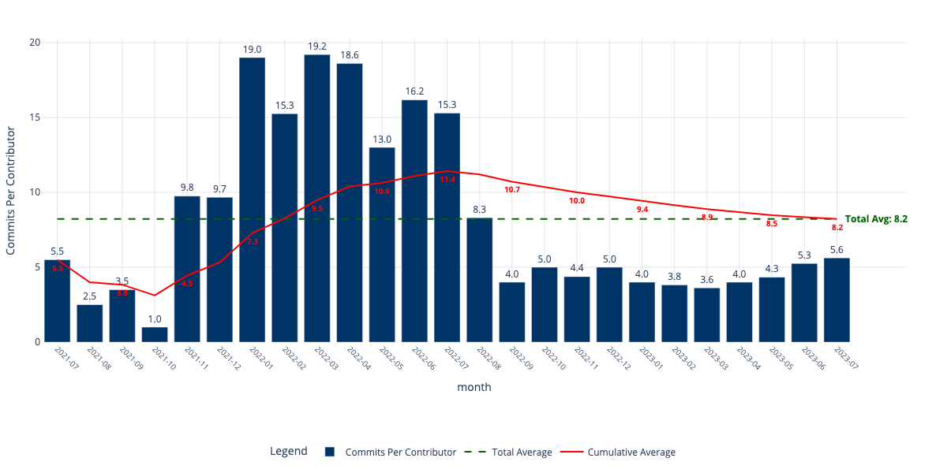
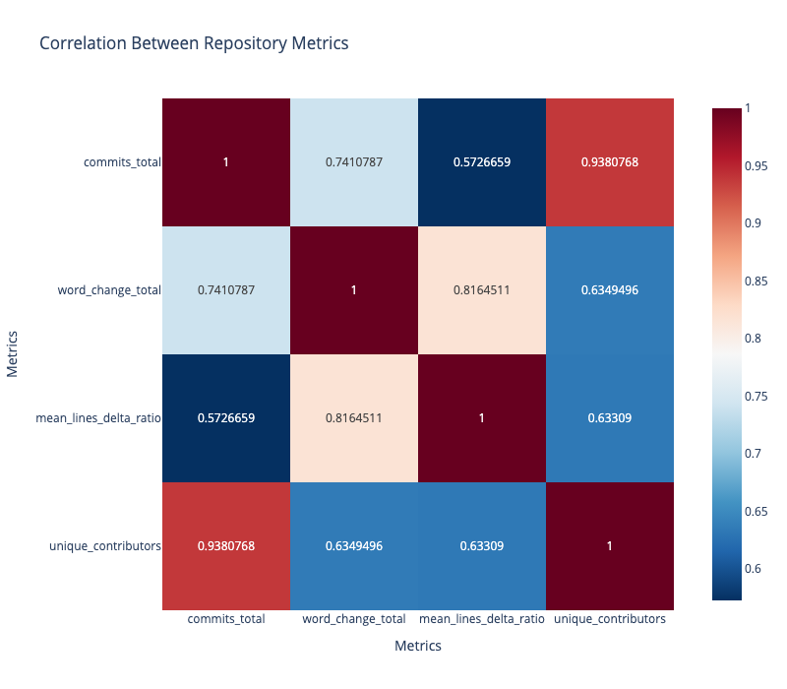
Multimodal LLM Processing
Visual Data Analysis Approach
Sample Bar Chart
Sample Heat Map
Staged Analysis Process
Macro Level: Repository-wide patterns by month
Micro Level: Deep dive into anomalies
Root Cause: Synthesis and conclusions

Slide 7
Performance Comparison
Key Findings: Quantitative Results
Repository | Accuracy | Recall | Precision | F1 Score
Repo 1 | 0.34 | 0.562 | 0.462 | 0.507
Repo 2 | 0.254 | 0.421 | 0.390 | 0.405
Repo 3 | 0.244 | 0.440 | 0.355 | 0.393
Determinism Analysis
Sequential Consistency
76-88%
Self-agreement (Recall)
Agentic Consistency
62-63%
Self-agreement (Recall)

Slide 8
Complimentary Analytical Strengths
Key Findings: Qualitative Patterns
Sequential Approach
Agentic Approach
Technical Precision: Code-level details
Quantitative Focus: Exact metrics
Deterministic: Reproducible results
Risk Identification: Burnout concerns
Strategic Context: Business alignment
Team Dynamics: Collaboration patterns
Exploratory: Novel insights
Process Insights: Methodology shifts
Key Observation
Neither approach is universally superior
They offer complementary perspectives on team performance

Slide 9
Same Event, Different Insights
Case Study: Repository 1 July 2018 Spike
Context: Major activity spike with 52.7 effort hours per contributor (315% increase)
Sequential Analysis Found:
Angular framework optimizations
ContentChild → ViewChild migration
Mean lines delta ratio: 0.3 → 0.2
Potential burnout risk flagged
33 unique contributors active
Agentic Analysis Found:
Team scaling from 25 → 33 members
Commits/contributor stable (13.6 → 13.0)
Effective onboarding processes
Strategic milestone achievement
Coordinated team effort patterns
Both perspectives are valuable for complete understanding

Slide 10
Root Causes of Variation
Analysis: Why Do Approaches Differ?
Commit Selection Differences
Agentic agents autonomously choose which commits to analyze
Strength: Can identify novel patterns
Weakness: May miss critical technical details
Information Prioritization
Agentic approach draws on general software engineering knowledge
Provides broader context and best practices
Sometimes less grounded in specific repository data
Trade-offs Identified
Determinism vs. Exploration
Technical depth vs. Strategic breadth
Reproducibility vs. Novel insights
Precision vs. Contextualization

Slide 11
When to Use Each Approach
Implications for Practice
Use Sequential When:
Use Agentic When:
Audit trails required
Regulatory compliance
Technical deep dives
Reproducibility critical
Quantitative precision needed
Strategic planning
Team optimization
Exploratory analysis
Understanding dynamics
Novel pattern discovery
Optimal Solution: Hybrid Approach
Combine both approaches:
Sequential for technical accuracy and metrics
Agentic for context and strategic insights
Synthesis provides comprehensive understanding

Slide 12
Beyond Software Engineering
Future Work & Broader Applications
Applicable to Any Temporal Performance Data:
Manufacturing process optimization
Supply chain performance
Healthcare process improvement
Infrastructure reliability
Financial system analysis
Service delivery efficiency
Educational performance
Energy system optimization
Next Steps:
Framework Improvements:
Transparent agentic systems (LangGraph, Pydantic.ai)
Cross-domain validation studies
Ensemble methodologies
Human expert validation
Key Contribution: Framework for LLM-based temporal data analysis

Slide 13
Key Takeaways
Conclusions
1. Visual Data Summarization Works
Multimodal LLM analysis effectively processes complex temporal engineering data
2. Neither Approach is Superior
Sequential offers precision and determinism; Agentic provides context and exploration
3. Complementary Strengths
Hybrid approaches can leverage the best of both paradigms
Research Contributions
First empirical comparison of LLM paradigms for engineering analysis
Standardized evaluation methodology with LLM-as-Judge
Framework applicable across engineering domains
Thank you! Questions?

Slide 14
Lucas Krause
Systems Engineering Ph.D. Student
Colorado State University

