Slide 1
A Time-Aware CNN-BiLSTM-Attention Model for Short-Term Track Geometry Irregularity Deterioration Prediction
2nd Olympiad in Engineering Science – OES 2025
Xiaolin Li , Yuanjie Tang , Lifen Yun , Yong Zhuang
Beijing Jiaotong University
11 June 2025
Notes:
Good noon. I‘m Xiaolin Li from Beijing Jiaotong University. Today I'll present our research on track geometry irregularity prediction, which addresses a practical problem in railway maintenance: how to accurately predict short-term changes in track conditions.

Slide 2
CONTENT
01
Background and Motivation
02
Methodology
03
Case Study
04
Conclusion and Future Work
Notes:
The presentation covers four sections: problem background, technical methodology, experimental validation, and conclusions.

Slide 3
01
Background and Motivation
Notes:
Let's begin with the background and motivation of our research.

Slide 4
Background and Motivation
01
02
Economic Powerhouse
Track Geometry Irregularity: Safety Hazards
Sustainable transportation infrastructure, pillar of national economic development
Affects train operation safety and comfort
Global railway sector allocates over $32 billion annually toward track maintenance
03
Challenges of Traditional Maintenance Models
Low detection frequency(twice monthly in China, biannually in Netherlands), difficult to achieve timely condition monitoring.
Notes:
Global railway maintenance investment exceeds $32 billion annually, yet detection frequency remains insufficient. China conducts track inspections twice monthly, the Netherlands twice yearly. This low-frequency detection cannot timely identify track condition changes, creating safety risks between inspections. We need predictive models to bridge these detection gaps and enable continuous condition monitoring. Track geometry irregularities directly affect train operation safety and passenger comfort, making accurate prediction crucial for proactive maintenance strategies.

Slide 5
Background and Motivation
The problems we need to solve are:
Addressing the Challenge of Short-Term Track Geometry Irregularity Deterioration Prediction
Limitations of Existing Methods
Traditional methods: Statistical regression and stochastic process models have limited optimization space when dealing with multi-source heterogeneous factors
Existing deep learning methods: Focus on single parameters, ignore parameter coupling, assume equidistant sampling
Notes:
Traditional methods face three technical challenges: First, track geometry involves 7 interrelated parameters - left/right longitudinal level, left/right alignment, rail gauge, track cross level, and twist - requiring simultaneous modeling of their coupling relationships. Second, actual detection data has irregular time intervals ranging from days to months, making traditional deep learning assumptions of equidistant sampling inapplicable. Third, track condition evolution exhibits complex spatiotemporal characteristics requiring specialized feature extraction methods that can capture both local patterns and long-term dependencies.

Slide 6
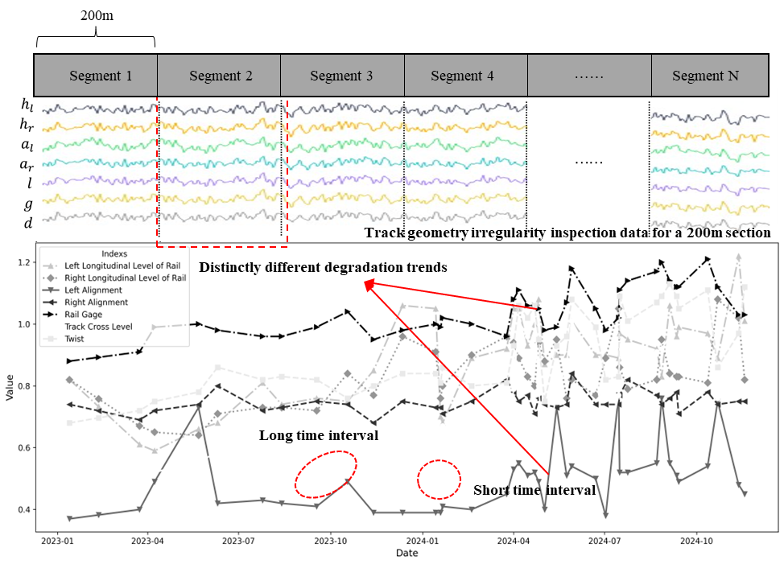
Background and Motivation
Main Challenges
Track geometry irregularity deterioration
Coordinated Multi-parameter Analysis
Need to consider coupling effects among 7 key geometric parameters.
Non-equidistant Detection Intervals
Real detection data exhibits irregular time interval characteristics.
Spatiotemporal Feature Extraction
Need to capture complex spatiotemporal evolution patterns.
Notes:
We face three main challenges: First, coordinated multi-parameter analysis - we need to consider coupling effects among 7 key geometric parameters. Second, non-equidistant detection intervals - real detection data exhibits irregular time interval characteristics. Third, spatiotemporal feature extraction - we need to capture complex spatiotemporal evolution patterns.

Slide 7
02
Methodology
Notes:
Now let me introduce our proposed methodology.

Slide 8
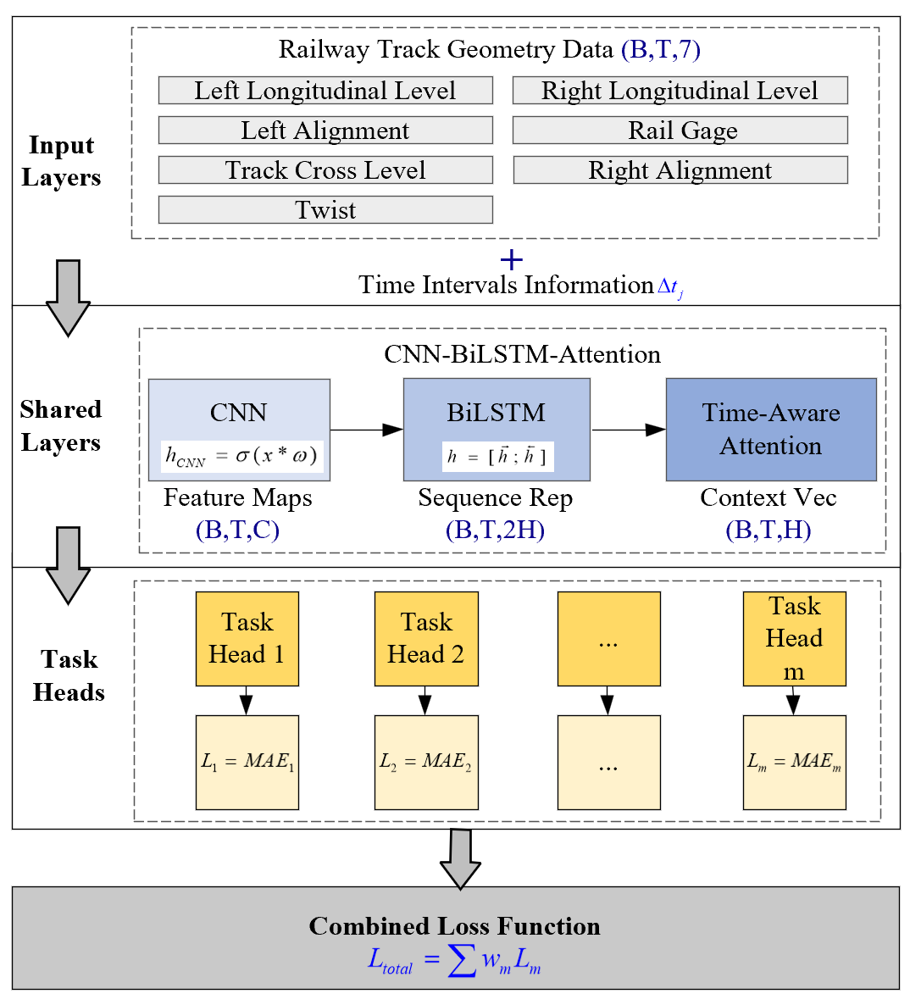
Methodology
Multi-task Learning Framework
Simultaneous prediction of seven key parameters including left/right longitudinal level, left/right alignment, rail gauge, track cross level, and twist through a unified feature extraction network.
Hard Parameter Sharing
Employs CNN-BiLSTM-Attention as shared backbone network to extract generalizable feature representations, with task-specific heads generating specialized predictions.
Task-specific Prediction Heads
Dedicated prediction modules designed for each geometric parameter, adapting to unique evolutionary characteristics and distribution properties of each parameter.
Equal weighting strategy to balance parameter importance.
Notes:
Our solution is a multi-task learning framework. Instead of predicting each parameter separately, we design a shared feature extractor with 7 specialized prediction heads. The shared layers learn common patterns among parameters, while specialized heads handle parameter-specific characteristics. This design is based on a key observation: although track parameters have different physical properties, their deterioration processes share common underlying mechanisms driven by traffic loads, environmental conditions, and material aging. The hard parameter sharing approach allows effective feature reuse while maintaining parameter-specific adaptations.

Slide 9
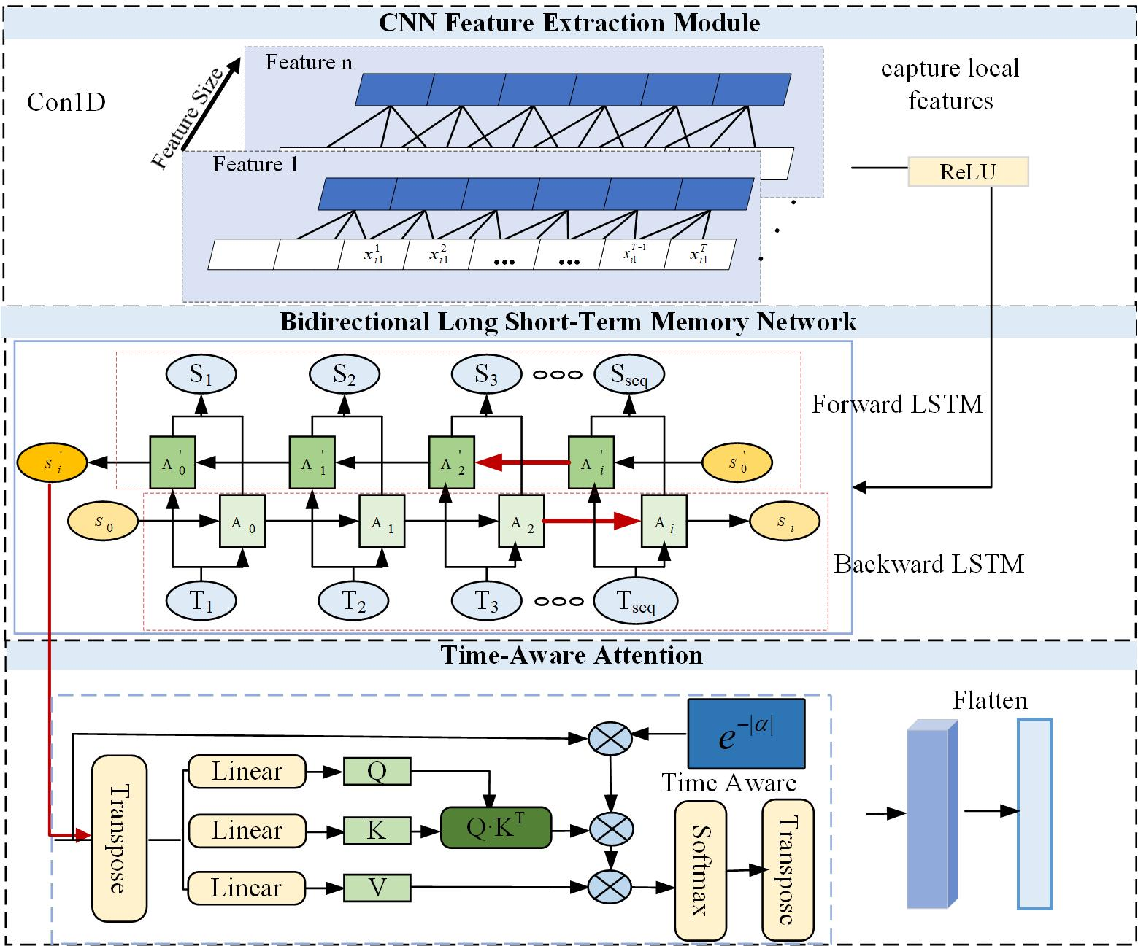
Methodology
CNN-BiLSTM-Attention
Effectively integrate spatiotemporal features and adapt to non-equidistant sampling data.
CNN (Convolutional Neural Network)
Employs one-dimensional convolution operations to extract local features from input time series.
BiLSTM (Bidirectional Long Short-Term Memory)
Based on CNN-extracted features, the bidirectional LSTM network simultaneously utilizes historical and future contextual information to capture long-term temporal dependencies, enhancing the model's understanding of track geometry parameter evolution patterns..
TAAM (Time-Aware Attention Mechanism)
Transforms irregular detection interval information into attention weight adjustment factors, addressing the issue of non-uniform temporal intervals in track inspection data and enhancing model adaptability to non-equidistant time series..
Notes:
The CNN-BiLSTM-Attention model effectively integrates spatiotemporal features and adapts to non-equidistant sampling data. CNN employs one-dimensional convolution operations to extract local features from input time series. Based on CNN-extracted features, the bidirectional LSTM network simultaneously utilizes historical and future contextual information to capture long-term temporal dependencies, enhancing the model's understanding of track geometry parameter evolution patterns. TAAM transforms irregular detection interval information into attention weight adjustment factors, addressing non-uniform temporal intervals in track inspection data and enhancing model adaptability to non-equidistant time series.

Slide 10
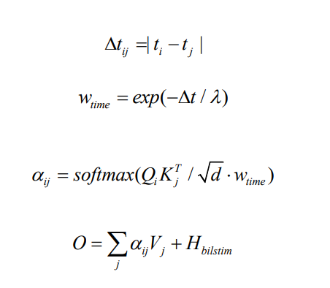
Methodology
TAAM (Time-Aware Attention Mechanism)
Integrating temporal interval information into attention weight computation
Adaptively adjusting attention weights for different time points
By transforming non-equidistant temporal intervals into decay weight factors, this mechanism effectively addresses irregular sampling intervals in track inspection data and enhances the model's adaptive capability for temporal dependency modeling.
Notes:
The core concept of TAAM is integrating temporal interval information into attention weight computation. By transforming non-equidistant temporal intervals into decay weight factors, this mechanism effectively addresses irregular sampling intervals in track inspection data and enhances the model's adaptive capability for temporal dependency modeling, adaptively adjusting attention weights for different time points.

Slide 11
03
Case Study
Notes:
Now let's examine our case study results.

Slide 12
Case Study
Jin-Shan Railway Line Engineering Practice
Study Area: China Jin-Shan Railway K193-K240+600 Section (47.6km)
Data Source: Track inspection data from March 2023 to October 2024
Data Characteristics: Contains seven track geometry parameters, detection timestamps, maintenance intervention records, etc.
Notes:
We selected the China Jin-Shan Railway K193-K240+600 section as our study area, covering 47.6 kilometers. Our data source consists of track inspection data from March 2023 to October 2024. The data characteristics include seven track geometry parameters, detection timestamps, and maintenance intervention records. The figures show spatiotemporal distribution heatmaps of left/right longitudinal level parameters before and after maintenance.

Slide 13
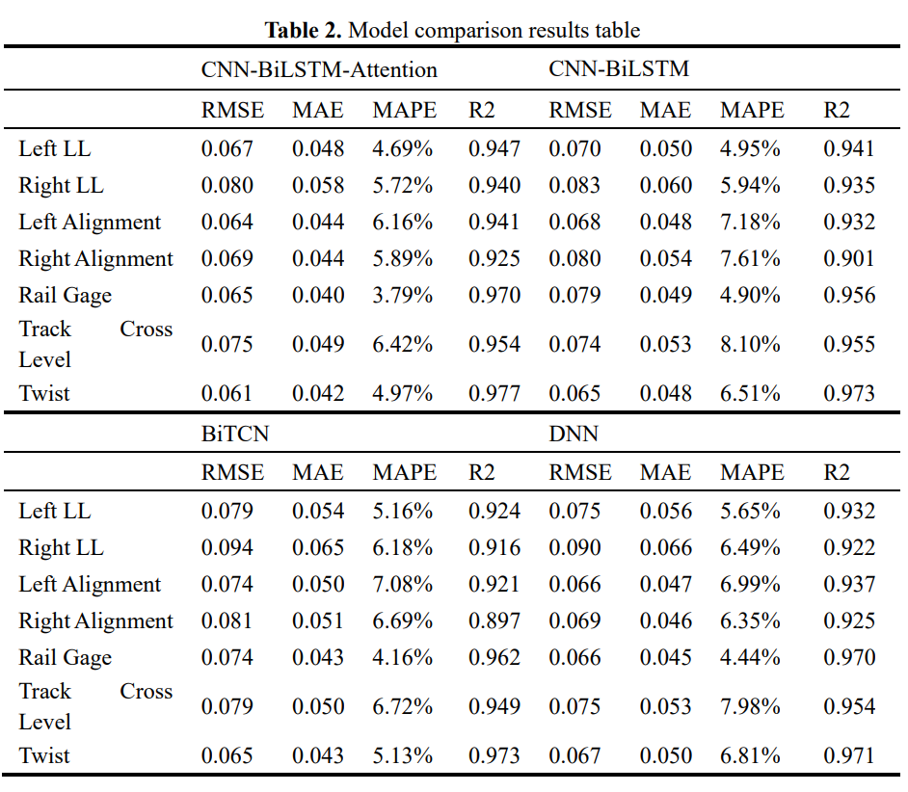
Case Study
Validate the CNN-BiLSTM-Attention model's performance in track geometry prediction through comparative experiments.
Model comparison results
Experimental Configuration
Data Split: 70% training set, 30% validation set
Hyperparameter Optimization: Using Optuna framework
Loss Function: Mean Absolute Error (MAE)
Evaluation Metrics: RMSE, MAE, MAPE, R²
Comparison Models
CNN-BiLSTM
BiTCN
DNN
CNN-BiLSTM-Attention demonstrates optimal performance with time-aware attention mechanism effectively improving prediction accuracy.
Notes:
We validate the CNN-BiLSTM-Attention model's performance through comparative experiments. The experimental configuration includes a 70% training set and 30% validation set, hyperparameter optimization using the Optuna framework, Mean Absolute Error as the loss function, and RMSE, MAE, MAPE, and R² as evaluation metrics. Comparison models include CNN-BiLSTM, BiTCN, and DNN. Results show that CNN-BiLSTM-Attention achieves optimal performance on most parameters, with the time-aware attention mechanism effectively improving prediction accuracy.

Slide 14
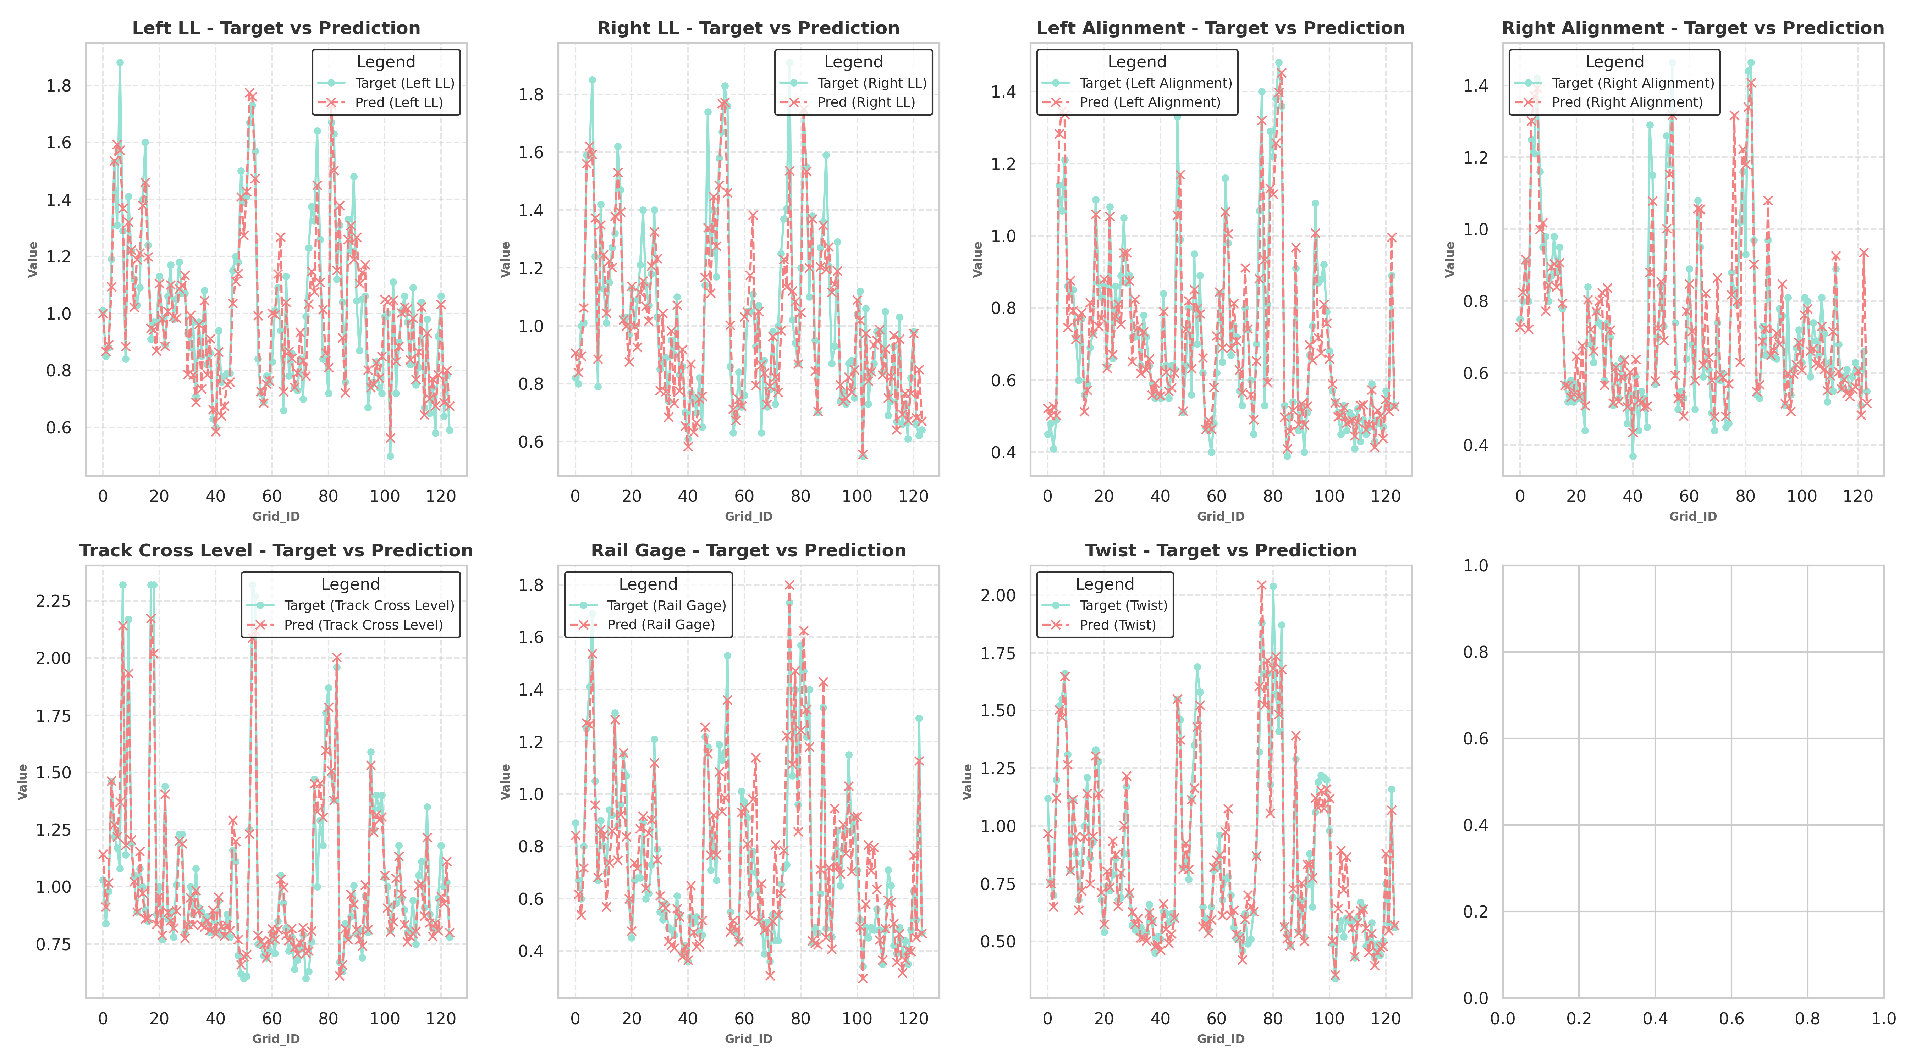
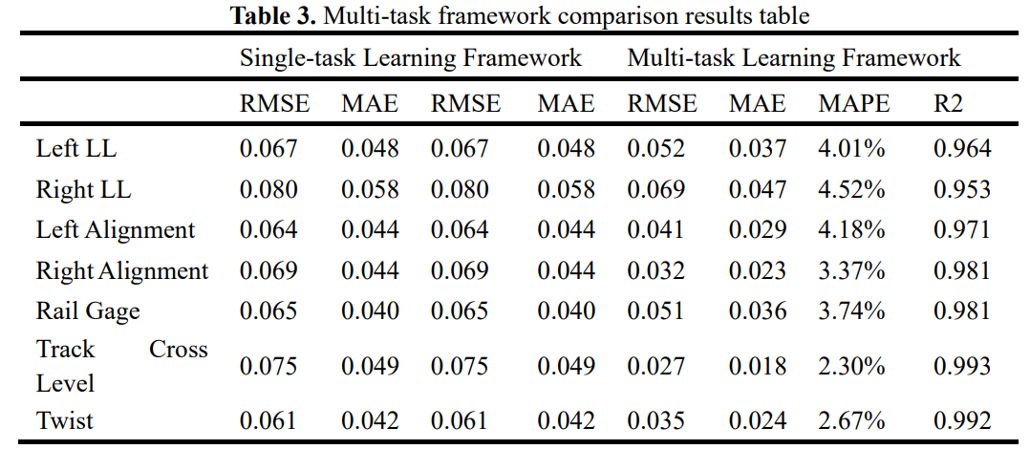
Case Study
Multi-Task Learning Performance Validation
Results
Multi-task framework demonstrates superior performance across all tasks.
Effectively shares feature information, enhancing generalization capability.
Reduces training errors and enhances prediction accuracy.
Notes:
Multi-task learning performance validation results show that the multi-task framework demonstrates superior performance across all tasks. It effectively shares feature information, enhances generalization capability, reduces training errors, and improves prediction accuracy. The comparison table shows detailed performance comparisons between single-task and multi-task learning frameworks, along with corresponding prediction result visualizations.

Slide 15
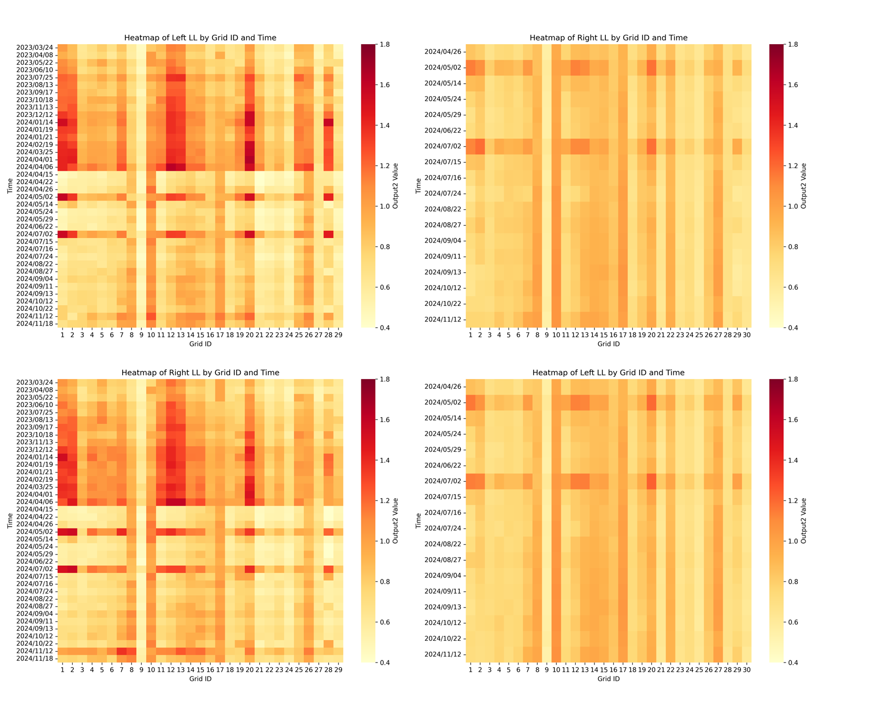
Case Study
Practical Application Results：Using left/right longitudinal level as primary analytical indicators for a representative 6-kilometer segment
Maintenance Effect Analysis
Significant amplitude reduction in left/right longitudinal level parameters
Measurable deceleration in deterioration rates.
Maintenance（Tamping）
Effects Following April 2024 Maintenance Intervention
Maintenance（Tamping）
Notes:
In practical applications, we use left/right longitudinal level as primary analytical indicators for a representative 6-kilometer segment to analyze maintenance effects. The effects following April 2024 maintenance intervention are significant: amplitude reduction in left/right longitudinal level parameters and measurable deceleration in deterioration rates. This demonstrates that our model can effectively learn and evaluate the impact of maintenance interventions.

Slide 16
04
Conclusion and Future Work
Notes:
Finally, let me summarize our conclusions and discuss future work directions.

Slide 17
Conclusion and Future Work
Key Conclusions
Research Limitations
Future Work
The proposed multi-task CNN-BiLSTM-Attention model is effective.
Time-aware mechanism enhances modeling capability for non-equidistant sampling data.
Limited temporal scope of dataset, long-term prediction capability needs improvement.
Parameter coupling mechanism research requires further investigation.
Expand dataset for long-term monitoring.
In-depth study of parameter coupling mechanisms to enhance model accuracy.
Provide technical support for railway engineering departments
Notes:
Key conclusions include: the proposed multi-task CNN-BiLSTM-Attention model is effective; the time-aware mechanism enhances modeling capability for non-equidistant sampling data. Research limitations include: limited temporal scope of dataset requiring improvement in long-term prediction capability; parameter coupling mechanism research requires further investigation. Future work includes: expanding datasets for long-term monitoring; in-depth study of parameter coupling mechanisms to enhance model accuracy; providing technical support for railway engineering departments.

Slide 18
THANK YOU!
Notes:
Thank you for your attention! I'm Xiaolin Li from Beijing Jiaotong University. I welcome any questions or discussions.

