Slide 1
Modeling of Air-Fuel Mixture Flow in a Marine Four-Stroke Diesel Engine to Optimize Performance and Minimize Pollutant Emissions
UNIVERSITY OF PATRAS
DEPARTMENT OF MECHANICAL ENGINEERING & AERONAUTICS
DIVISION OF DESIGN AND MANUFACTURING
Laboratory of Machine design
Prepared by Antonios Gavalas,
Under the supervision of Professor Pantelis Nikolakopoulos

Slide 2
TABLE OF CONTENTS
01
02
03
04
05
06
INTRODUCTION
RESEARCH METHODOLOGY
SIMULATION SETUP
RESULTS
CONCLUSIONS
Future
Research

Slide 3
01
INTRODUCTION

Slide 4
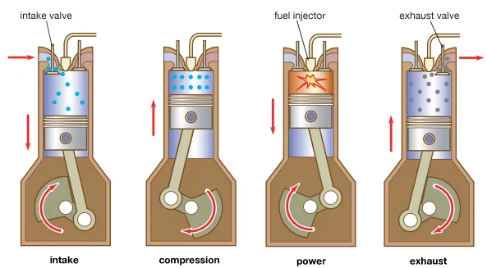
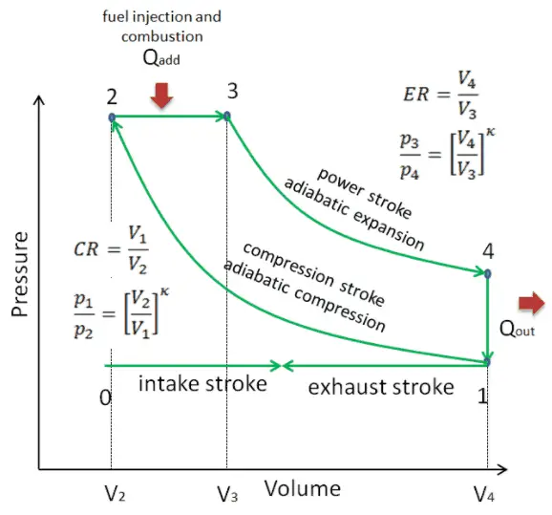
THEORITICAL OVERVIEW
Four-Stroke Diesel Engine
Performance:
Power output
Fuel efficiency
Combustion efficiency
Thermal efficiency
Specific fuel consumption
Generated Emissions:
NOx
CO
Particulate Matter (Soot)
Unburned hydrocarbons (UHC)
Volatile organic compounds (VOC)
4

Slide 5
MARINE DIESEL ENGINES
Importance :
Essential for global transportation
Power a wide range of vessels
Challenges:
Fuel efficiency
Pollutants formation
Environmental regulations
Need for optimization:
Improved performance
Reduced emissions
Enhanced sustainability
5

Slide 6
OBJECTIVES
OUR AIM
THE GOAL
A comprehensive analysis of the interrelationship between engine parameters and emissions formation in marine diesel engines, with the objective of optimizing performance and minimizing environmental impact.
Developing a framework for optimizing the air-fuel mixture flow and combustion process in marine diesel engines, leading to improved fuel efficiency, reduced harmful emissions, and enhanced overall engine performance, thereby contributing to sustainable marine operations and environmental protection.
6

Slide 7
02
RESEARCH METHODOLOGY

Slide 8
Research Approach
Literature Review and Problem Identification
Computational Model Definition
Base-Speed Simulations
Conclusions
Engine Selection and Case Study Setup
Simulation Model Development
Parametric Simulations
Future Work
8

Slide 9
ANALYSIS OF PREVIOUS WORK
Combustion Optimization
Improvements to Engine Geometry
Improvements in in-cylinder air motion, fuel injection tactics, and combustion timing have resulted in lower emissions and increased fuel efficiency [1,2].
Engine geometry modifications, such as piston shape and combustion chamber design, have improved performance and reduced emissions. These changes enhance fuel-air mixing and combustion efficiency through optimized swirl and tumble ratios [3].
Alternative Fuels
Techniques to Reduce Emissions
Alternative fuels like biodiesel and bioethanol have shown potential for reducing emissions and improving fuel economy in marine diesel engines [4].
Particle filters and SCR have significantly reduced NOx and particulate matter emissions from marine diesel engines, aiding compliance with stricter environmental regulations [5,6].
9

Slide 10
Current investigation
Inspiration
Rationale
Case Study Setup
Experimental study:
«The performance and the gaseous emissions of two small marine craft diesel engines fueled with biodiesel» [8]
Simulate the performance of the experimental study’s real engine with a different fuel injection system
Perkins 404D-22 engine was selected as the case study, and its performance was simulated with direct fuel injection system.
10

Slide 11
03
SIMULATION SETUP

Slide 12
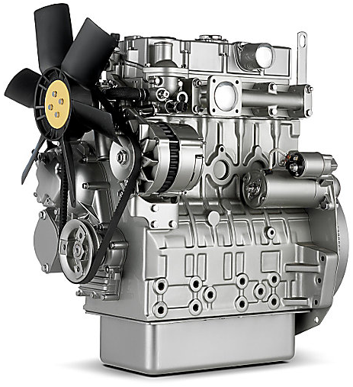
Perkins 404D-22
ENGINE UNDER STUDY
General
Number of cylinders | 4
Valves per cylinder | 2
Cylinder arrangement | Verticle in line
Cycle | 4 Strokes
Induction system | Naturally Aspirated
Combustion System | Common Rail fuel injection system (Direct Injection)
Compression ratio | 23.3:1
Bore | 84.0 mm (3.30 in)
Stroke | 100.0 mm (3.93 in)
Cubic capacity | 2.216 litres (135 in³)
Power rating
Maximum Power | 38 kW @ 3000 rpm
Maximum Torque | 142.7 Nm @ 1800 rpm
Rated Speed | 2200-3000 rpm
Minimum Power | 31 kW
Emissions Standards
Emissions | EU Stage IIIA/U.S. EPA Tier 4 Interim equivalent, China NRIII [7]
12

Slide 13
COMPUTATIONAL MODEL
CONSERVATION EQUATIONS FOR TURBULENT REACTING FLOW
SPECIES CONSERVATION EQUATION
FLUID CONTINUITY EQUATION
$$\begin{aligned}\frac{∂{\overline{ρ}}_{k}}{∂t}+∇\left({\overline{ρ}}_{k}\overline{u} \right)=∇\left[\overline{ρ}D∇{\overline{y}}_{k}\right]+∇Φ+{\dot{\overline{ρ}}}_{k}^{C}+{\dot{\overline{ρ}}}_{k}^{S} \left(k=1,⋯,K\right)\end{aligned}$$
$$\frac{∂\overline{ρ}}{∂t}+∇\left(\overline{ρ}\overline{u} \right)={\dot{\overline{ρ}}}^{S}$$
MOMENTUM CONSERVATION EQUATION
GAS-PHASE MIXTURE EQUATION OF STATE
$$\frac{∂\overline{ρ}\overline{u}}{∂t}+∇\left(\overline{ρ}\overline{u}\overline{u} \right)=−∇\overline{p}+∇\overline{σ}−∇Γ+{\overline{F}}^{S}+\overline{ρ}\overline{g}$$
$$\overline{p}=R_{u}\overline{Τ}\sum_{k}{\left(\frac{{\overline{ρ}}_{k}}{W_{k}}\right)}$$
ENERGY CONSERVATION EQUATIONS
CHEMICAL KINETICS FORMULATION
$$\frac{∂\overline{ρ}\overline{I}}{∂t}+∇\left(\overline{ρ}\overline{u}\overline{I}\right)=−\overline{p}∇\overline{u}−∇\overline{J}−∇H+\overline{ρ}\overline{ε}+{\dot{\overline{Q}}}^{C}+{\dot{\overline{Q}}}^{S}−{\dot{\overline{Q}}}_{rad}$$
$$\sum_{k=1}^{K}{{\acute{v}}_{ki}χ_{k}}↔\sum_{k=1}^{K}{\acute{\acute{v_{ki}}}}χ_{k} (i=1,⋯,I)$$
TURBULENCE MODEL (REYNOLDS-AVERAGE-NAVIER-STOKES APPROACH)
TURBULENCE-KINETICS INTERACTION MODEL
$$Γ=−\overline{ρ}v_{T}\left[∇\overline{u}+{\left(∇\overline{u}\right)}^{T}−\frac{2}{3}\left(∇\overline{u}\right)I\right]+\frac{2}{3}\overline{ρ}\overline{k}I$$
$${\tilde{\dot{ω}}}_{k,eff}=\frac{Y_{k,EQ}−Y_{k}}{τ_{eff}}$$
13

Slide 14
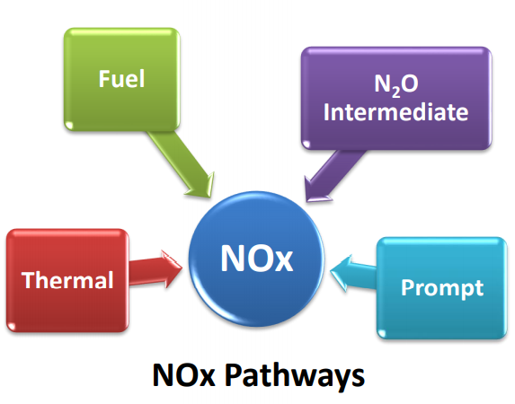
POLLUTANT FORMATION
NOx FORMATION
Thermal NOx formation
Prompt NOx formation
Fuel NOx formation
NOx formation from intermediate N₂O
NOx formation in turbulent flows
SOOT FORMATION
The two step Soot formation model
14

Slide 15
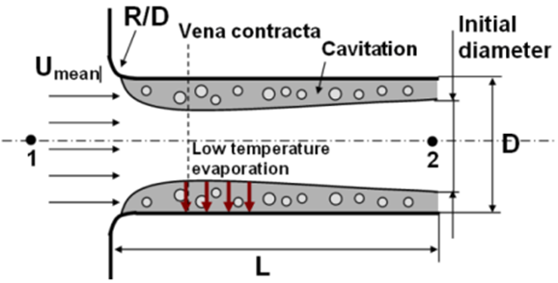
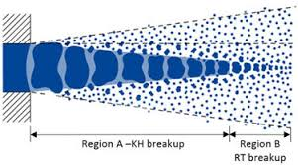
BOUNDARY CONDITIONS
INITIAL CONDITIONS
Wall Boundaries
Periodic Boundaries
Axis of Symmetry Boundaries
Initialization of the Fluid Properties
Swirl Profiles
SPRAY MODELS
DISCRETIZATION AND SOLUTION METHODS
Solid-Cone Spray Model
Kelvin-Helmholtz / Rayleigh-Taylor Breakup Model
Discretization of the Governing Equations
Simple Method
Chemistry Solver
15

Slide 16
Simulation Process
01
02
03
04
05
Geometric Modeling
Model Selection
Parameterization
Execution of the Simulation
Post-processing
16

Slide 17
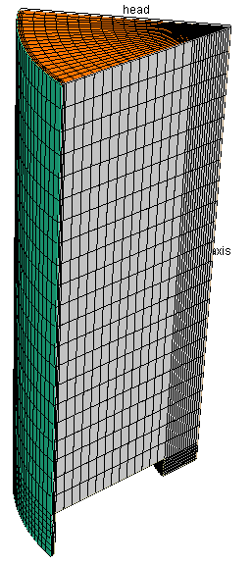
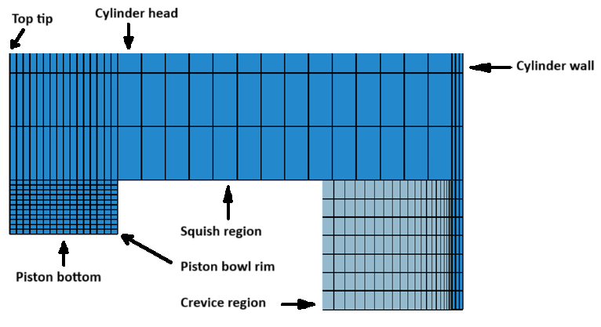
MODEL GEOMETRY AND MESH CONSTRUCTION
Mesh Parameters
Bowl Profile
Cylinder Bore | 84mm
Stroke Length | 100mm
Squish | 4.5mm
Crevice Width | 1mm
Crevice Height | 12mm
45-degree sector
17

Slide 18
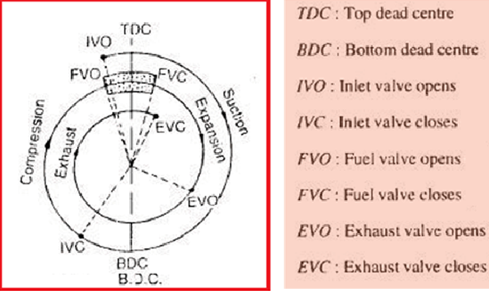
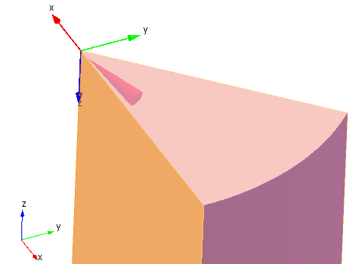
SPRAY MODEL
General Parameterization
Surrogate for Diesel Fuel | n-Tetradecane
Injected Parcel Count | 4000
Inflow Droplet Temperature | 368K
Compression Ratio | 23.3:1
Injection Timing | 22.5 degrees before TDC
Injection Duration | 7.75 degrees
Injection Type | Pulsed
Injector Nozzle Cross-Sectional Area | 0.000302 cm²
Spray Pattern | Solid cone
Initial Fuel Mass | 0.015 grams per cycle per cylinder
18

Slide 19
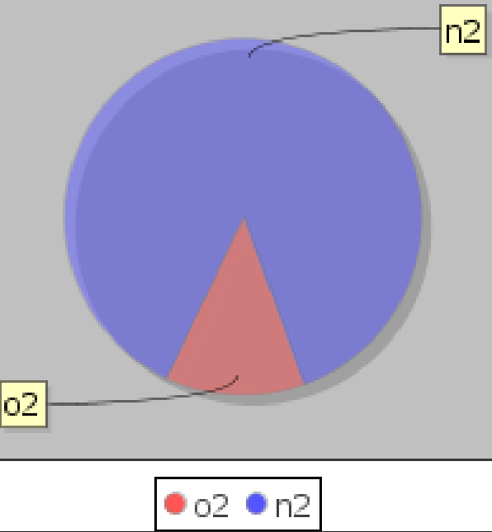
BOUNDARY CONDITIONS
INITIAL CONDITIONS
Piston Head
Temperature | 500K
Roughness Height | 1 micron
Roughness Constant | 0.5
Air Initial Conditions
Temperature | 308.15 K
Pressure | 95kPa
Turbulent Kinetic Energy | 150 m²/sec²
Turbulent Length Scale | 4.2 cm
Initial Swirl Ratio | 0.5
Initial Swirl Profile Factor | 3.11
Air’s Initial Composition | 87.4% N2 , 12.6% O2
Cylinder Head
Temperature | 470K
Roughness Height | 1 micron
Roughness Constant | 0.5
Cylinder Wall
Temperature | 420K
Roughness Height | 1 micron
Roughness Constant | 0.5
19

Slide 20
Simulation Approaches
Base-Speed Simulations
Parametric Simulations
Variables of interest:
Inlet air temperature
Inlet air pressure
Fuel injection quantity
20

Slide 21
SIMULATIONS RESULTS
04
Engine Performance and Emission Parameters
Pressure and Temperature Variations During Combustion
Pollutant Mass Formation During the Combustion

Slide 22
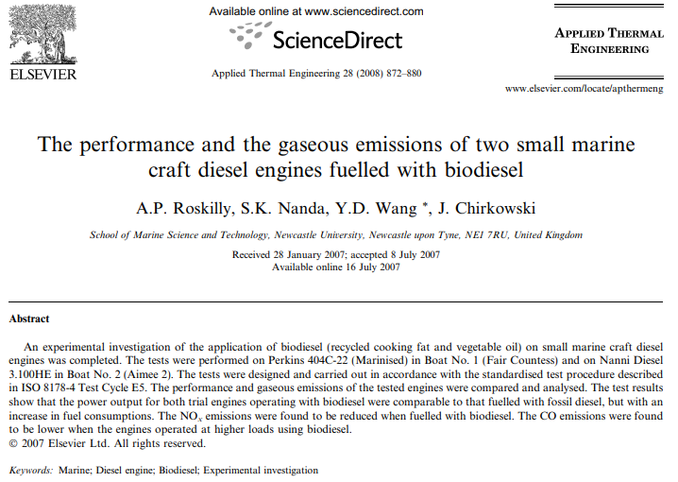
Evaluating Simulation Performance
Comparison of Simulation and Experimental Study [8]:
Qualitative accuracy: The simulation model effectively captured the overall behavior of the engine.
Quantitative discrepancies: Differences were observed due to fuel injection strategies and incomplete parameter knowledge.
Direct fuel injection benefits: The simulation's use of direct fuel injection led to lower emissions and improved performance compared to the experimental study's indirect fuel injection [9].
22

Slide 23
PARAMETRIC STUDY OF INLET AIR TEMPERATURE EFFECTS
2200 RPM | T=30 C (303.15 K) | T=35 C (308.15 K) | T=40 C (313.15 K)
Gross Indicated Work [kJ] | 0.28625 | 0.28042 | 0.27515
Gross Indicated Power [kW] | 5.24788 | 5.1411 | 5.04442
IMEP [MPa] | 0.51653 | 0.50602 | 0.4965
Max Pressure [MPa] | 8.9755 | 9.5904 | 10.3157
Max Temperature [K] | 1441.8 | 1485.4 | 1536.2
Soot @ EVO [g] | 1.52E-06 | 1.85E-06 | 2.33E-06
EINOx @ EVO [g] | 9.63E-06 | 1.34E-05 | 2.13E-05
CO @ EVO [g] | 2.24E-03 | 2.57E-03 | 2.72E-03
UHC @ EVO [g] | 3.86E-04 | 4.31E-04 | 4.68E-04
VOC @ EVO [g] | 4.00E-04 | 4.42E-04 | 4.78E-04
Reduced Engine Performance: Lower power output due to decreased oxygen availability.
Reduced Combustion Efficiency: Incomplete combustion due to slower flame spread and less oxygen.
Increased Emissions: Higher in-cylinder temperatures lead to increased pollutant production.
23

Slide 24
PRESSURE AND TEMPERATURE VARIATIONS DURING COMBUSTION
Key Finding: Higher intake air temperature leads to delayed combustion, as evidenced by the shifted pressure and temperature curves. This suggests changes in fuel-air mixture, ignition timing, or flame propagation.
24

Slide 25
POLLUTANT MASS FORMATION DURING THE COMBUSTION CYCLE
Soot: Increased emissions due to delayed combustion and incomplete fuel oxidation.
CO: Increased emissions likely due to changes in air-fuel ratio and oxygen availability.
25

Slide 26
POLLUTANT MASS FORMATION DURING THE COMBUSTION CYCLE
NOx: Formation influenced by temperature-dependent reactions.
26

Slide 27
PARAMETRIC STUDY OF INLET AIR PRESSURE EFFECTS
2200 RPM | P=90 kPa | P=95 kPa | P=100 kPa
Gross Indicated Work [kJ] | 0.27303 | 0.28042 | 0.28522
Gross Indicated Power [kW] | 5.00556 | 5.1411 | 5.22906
IMEP [MPa] | 0.49268 | 0.50602 | 0.51468
Max Pressure [MPa] | 8.4807 | 9.5904 | 10.9348
Max Temperature [K] | 1453.7 | 1485.4 | 1509.3
Soot @ EVO [g] | 1.76E-06 | 1.85E-06 | 1.97E-06
EINOx @ EVO [g] | 9.81E-06 | 1.34E-05 | 2.12E-05
CO @ EVO [g] | 3.09E-03 | 2.57E-03 | 2.01E-03
UHC @ EVO [g] | 5.66E-04 | 4.31E-04 | 3.42E-04
VOC @ EVO [g] | 5.82E-04 | 4.42E-04 | 3.50E-04
Increased power output: Higher intake pressure leads to improved engine performance.
Improved combustion: More complete combustion and better energy conversion.
Emissions: Decreased levels of CO, UHC, and VOC in contrast to Soot, NOx levels.
27

Slide 28
PRESSURE AND TEMPERATURE VARIATIONS DURING COMBUSTION
Key Finding: Increased intake pressure leads to higher peak pressure and temperature. This is primarily due to the increased energy content of the denser air-fuel mixture and potentially faster flame propagation.
28

Slide 29
POLLUTANT MASS FORMATION DURING THE COMBUSTION CYCLE
Soot Emissions increased and CO Emissions decreased, due to :
Increased fuel-air mixing: Denser air-fuel mixture can lead to richer zones where incomplete combustion occurs.
Slower flame propagation: Higher pressure may slow down the flame front, allowing more time for Soot formation.
Changes in combustion chamber conditions: Increased pressure and temperature can affect the formation of Soot and CO.
Incomplete oxidation: The richer air-fuel mixture may not be fully oxidized, leading to increased CO emissions.
29

Slide 30
POLLUTANT MASS FORMATION DURING THE COMBUSTION CYCLE
NOx Emissions increased, due to :
Increased in-cylinder temperatures: Higher pressure and temperature can lead to increased thermal NOx formation.
Faster combustion: While faster flame propagation can generally improve combustion, it can also lead to higher peak temperatures, which can promote NOx formation.
Changes in air-fuel ratio: Higher intake pressure can affect the air-fuel ratio, potentially leading to conditions that favor NOx formation.
30

Slide 31
PARAMETRIC STUDY OF FUEL INJECTION MASS EFFECTS
2200 RPM | m=0.01 g | m=0.015 g | m=0.02 g
Gross Indicated Work [kJ] | 0.11858 | 0.28042 | 0.34416
Gross Indicated Power [kW] | 2.17394 | 5.1411 | 6.30958
IMEP [MPa] | 0.21397 | 0.50602 | 0.62103
Max Pressure [MPa] | 6.5869 | 9.5904 | 12.3758
Max Temperature [K] | 962.7 | 1485.4 | 1686.4
Soot @ EVO [g] | 6.46E-08 | 1.85E-06 | 5.32E-06
EINOx @ EVO [g] | 1.17E-06 | 1.34E-05 | 4.18E-05
CO @ EVO [g] | 1.78E-03 | 2.57E-03 | 5.10E-03
UHC @ EVO [g] | 2.03E-03 | 4.31E-04 | 1.09E-03
VOC @ EVO [g] | 2.26E-03 | 4.42E-04 | 1.11E-03
Fuel Injected Mass Increase:
0.010 to 0.015 g: Improved performance, efficiency, and emissions (except Soot, NOx, CO).
0.015 to 0.020 g: Increased power, decreased efficiency and combustion, increased emissions.
31

Slide 32
PRESSURE AND TEMPERATURE VARIATIONS DURING COMBUSTION
Key Finding: Variations in fuel mass significantly impact combustion dynamics. This is evident in the observed shifts in pressure and temperature peaks after TDC. The optimal fuel mass (0.015 grams in this case) likely provides the ideal air-fuel mixture for efficient combustion and peak performance.
32

Slide 33
POLLUTANT MASS FORMATION DURING THE COMBUSTION CYCLE
Soot, CO Emissions increased, due to :
Incomplete combustion: Insufficient oxygen for complete fuel oxidation.
Rich air-fuel mixture: Difficult to achieve complete combustion.
Higher temperatures: Can promote Soot and CO formation.
33

Slide 34
POLLUTANT MASS FORMATION DURING THE COMBUSTION CYCLE
NOx Emissions increased, due to :
Higher in-cylinder temperatures: More fuel leads to increased combustion intensity and higher temperatures.
Thermal NOx formation: Higher temperatures promote the formation of thermal NOx.
Air-fuel ratio: Changes in air-fuel ratio due to increased fuel mass can influence NOx formation.
34

Slide 35
POLLUTANT MASS FORMATION DURING THE COMBUSTION CYCLE
Unburnt Hydrocarbon, Volatile Organic Compound Emissions increased, due to :
Incomplete combustion: More fuel means a greater chance of incomplete combustion, especially with richer mixtures.
Quenching: Excess fuel can cool the combustion process, preventing complete oxidation.
35

Slide 36
POLLUTANT MASS FORMATION DURING THE COMBUSTION CYCLE
Key Finding: While increased fuel mass generally correlates with higher Soot, CO and NOx emissions, UHC and VOC levels can exhibit more complex trends. Improved fuel-air mixing and combustion efficiency may lead to decreased UHC and VOC emissions at certain fuel mass levels. However, factors such as incomplete combustion and engine design can influence these emissions in varying ways.
36

Slide 37
05
CONCLUSIONS

Slide 38
Main conclusions
Intake Air Temperature Increase
Intake Air Pressure Increase
Fuel Injected Mass Increase
Engine performance: Generally negative impact on power, efficiency, and combustion.
Emissions: Increased.
Combustion timing: Delayed combustion.
Engine performance: Improved power, efficiency, and combustion.
Emissions: Reduced CO, UHC, and VOC; potential for increased NOx and Soot.
Combustion timing: Advanced combustion.
Engine performance: Increased power, but potential for reduced efficiency at higher levels.
Emissions: Increased Soot, NOx, CO; mixed effects on UHC and VOC.
Combustion: Impacts timing, completeness, and heat release.
38

Slide 39
Significance of the Research Findings
Key Contributions to the Field
Potential Applications and Benefits
Enhanced understanding of engine dynamics
Informed decision-making
Advancements in engine technology
Improved engine design
Enhanced operational efficiency
Compliance with regulations
Sustainable shipping
39

Slide 40
06
Future Research

Slide 41
Future Research Directions
Model Validation and Refinement
Experimental validation
Model improvement
Parameter refinement
Enhanced Simulation Capabilities
Incorporate advanced models
Improve turbulence modeling
Consider variable parameters
Optimization and Analysis
Sensitivity analysis
Machine learning and data-driven modeling
Expand simulation scope
41

Slide 42
References
Myung, C. L., Choi, K. H., Hwang, I. G., Lee, K. H., & Park, S. (2009). Effects of valve timing and intake flow motion control on combustion and time-resolved HC & NOx formation characteristics. International Journal of Automotive Technology, 10(2), 161–166. https://doi.org/10.1007/s12239-009-0019-z
Mohan, B., Yang, W., & Chou, S. K. (2013). Fuel injection strategies for performance improvement and emissions reduction in compression ignition engines—A review. Renewable and Sustainable Energy Reviews, 28, 664–676. https://doi.org/10.1016/j.rser.2013.08.051
Mishra, A., Kulshrestha, S., Patel, F. M., Tiwari, N., & Sharma, A. (2023). Effect of piston bowl geometry and spray angle on engine performance and emissions in HCCI engine using multi‐stage injection strategy. Environmental Progress & Sustainable Energy, 43(2). https://doi.org/10.1002/ep.14203
Sagin, S., Karianskyi, S., Madey, V., Sagin, A., Stoliaryk, T., & Tkachenko, I. (2023). Impact of biofuel on the environmental and economic performance of marine diesel engines. Journal of Marine Science and Engineering, 11(1), 120. https://doi.org/10.3390/jmse11010120
Zhou, J., Zhang, J., Jiang, G., & Xie, K. (2024). Using DPF to Control Particulate Matter Emissions from Ships to Ensure the Sustainable Development of the Shipping Industry. Sustainability, 16(15), 6642. https://doi.org/10.3390/su16156642
Paz, C. (2025, February 21). SCR engines clean up diesel emissions for a greener drive. Mansfield Energy. https://mansfield.energy/2023/03/30/scr-engines-clean-up-diesel-emissions-for-a-greener-drive/
404D-22 Industrial Diesel Engines | Perkins. (n.d.). https://www.perkins.com/en_GB/products/new/perkins/industrial/industrial-diesel-engines/1000002510.html.
Roskilly, A., Nanda, S., Wang, Y., & Chirkowski, J. (2007). The performance and the gaseous emissions of two small marine craft diesel engines fuelled with biodiesel. Applied Thermal Engineering, 28(8–9), 872–880. https://doi.org/10.1016/j.applthermaleng.2007.07.007
Glenn, M. (2023). Gasoline Direct Injection vs. Fuel Injection: A Comparative Analysis. Longdom. https://doi.org/10.35248/2167-7670.23.12.232
42

Slide 43
Thank you for your attention and participation!
Do you have any questions?
Primary Author:
Antonios Gavalas
University of Patras
Laboratory of Machine Design
Email: gavalasantonis19@gmail.com
Co-author & Supervisor:
Professor Pantelis Nikolakopoulos
University of Patras
Laboratory of Machine Design
Email : pnikolakop@upatras.gr

