Slide 1
Comparative Analysis of Deep Learning Techniques for Breast Tumor Segmentation in DW-MRI Images
Pablo García Marcos
Paula Puerta González
Sara Fernández Arias
Rebeca Oliveira Suarez
Guillermo Lorenzo
Héctor Gomez
José R. Villar
Victor M. González
Angel Rio-Alvarez
OES 2025 – University of Stavanger

Slide 2
Cancer
First or second cause of death in
91/172 countries
According to OMS
20 million estimated new cases in 2022
9.7 million cancer-related deaths

Slide 3
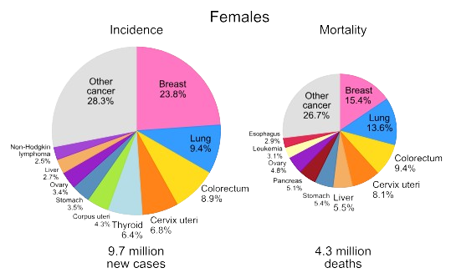
Cancer

Slide 4
Breast Cancer
Uncontrolled proliferation of malignant cells in the breast
This cells may:
Form tumours
Invade nearby tissue
Metastasize (spread) to other organs
Highly heterogeneous
Different behaviour, shape, etc…
Early diagnose is critical to improving prognosis

Slide 5
MRI
Magnetic resonance imaging
Non-invasive
Enables the detection of abnormalities
Such as tumors in breast tissue
Used in high-risk patients
Adequate for assessing tumor size and spread

Slide 6
DCE-MRI
Dynamic contrast-enhanced MRI
Contrast enhances the visualization of blood flow patterns
Often irregular in cancer tissue

Slide 7
DW-mRI
Diffusion Weighted MRI
Images based on the diffusion of water molecules
Doesn’t require the use of contrast
Lower operation cost
Safer, as some patients may be allergic

Slide 8
ADC maps
Apparent Diffusion Coefficient maps
Measure water molecules diffusion across different b-values

Slide 9
Computer vision
A field of artificial intelligence
Uses machine learning algorithms to:
Extract,
interpret, and
process Information from images and videos

Slide 10
Semantic Segmentation
Computer vision technique
Performs pixel level classification
Each pixel is assigned to a class
Commonly performed using CNNs
Well suited for processing grid-like image data
Capture spatial patterns effectively
Preserve both local and global context

Slide 11
ACRIN 6698
Multicentre clinical dataset
Designed to assess the reliability of DWI for monitoring response to neoadjuvant chemotherapy
406 breast cancer patients
Several series (time points) for patient
Several studies for series (DW-MRI, DCE-MRI, etc…)
Includes segmentation masks for DW-MRI and ADC maps

Slide 12
Acrin 6698

Slide 13
Pretreatment

Slide 14
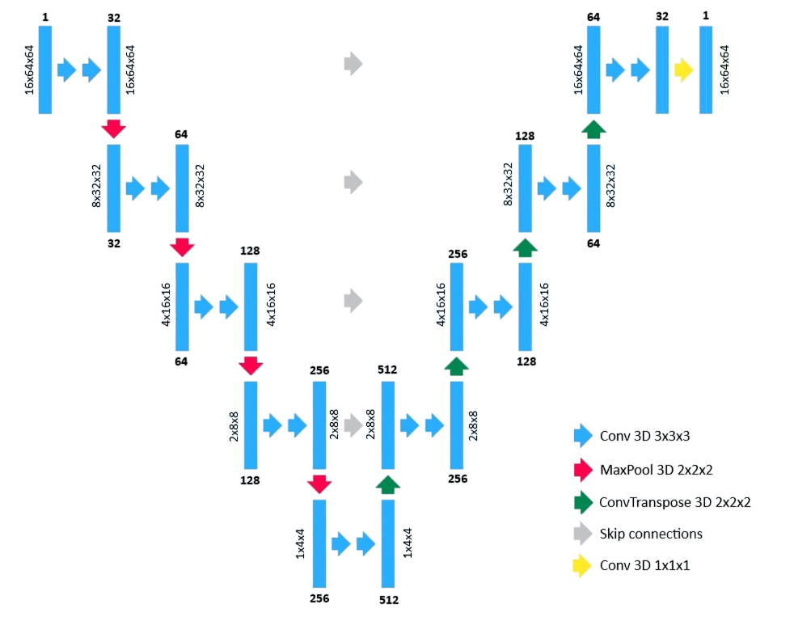
U-net
Convolutional Neural Network
Prominent with medical image
Encoder-decoder path
Skip connections to recover spatial details

Slide 15
Metrics
Dice
IoU
Accuracy
Precision
Specificity
Recall

Slide 16
Results

Slide 17
Results analysis
2D outperformed 3D in:
Accuracy (0.92%)
Dice (31,53%)
IoU (46.03%)
Specifity (1.02%)
Precision (65.46%)
No difference was found in:
Recall

Slide 18
Results analysis
2D outperforms 3D
Annotations on individual slices
ADC maps
Present sizable inter-slice distance
Are:
Irregular
Heterogeneous
Complex

Slide 19
Future Work
Improvements
Over the dataset
Over the techniques employed
Use of new techniques in ADC maps

Slide 20
Thank you for you attention Questions?

