Slide 1
Early Detection of Biploar Disorder through fMRI Analysis employing Machine Learning Algorithms: A Comparative Study
Iulia-Andreea Ion¹, Camelia Chira¹
¹Faculty of Mathematics and Computer Science, Babes-Bolyai University, Mihail Kogalniceanu 1, 400084, Cluj-Napoca, Romania

Slide 2
INTRODUCTION – MOTIVATION & SIGNIFICANCE
mental illness is a growing global issue, significantly impacting both adults and youth
leading cause of death among young people due to suicide
early intervention and fMRI scans are crucial for timely detection and prevention
in the US, 1 in 5 adults is diagnosed every year, being so severe it can be the cause of disability, while the proportion of patients in the EU suffering from depression typically rises with age
fMRI uses low-frequency BOLD signals to quantify brain activity by tracking changes in blood circulation and neuronal energy consumption

Slide 3
INTRODUCTION – AIM OF THE ARTICLE
Investigates machine learning-based classification of Bipolar Disorder using functional connectivity features from resting-state fMRI data
Compares two preprocessing pipelines: SPM-CONN and MELODIC, evaluating their efficacy in preserving clean and reliable brain connectivity patterns
Benchmarks performance of SVM and Random Forest classifiers, identifying optimal combinations for neuropsychiatric diagnosis
Contributes a reproducible analytical framework for fMRI-driven feature extraction and classification in psychiatric research

Slide 4
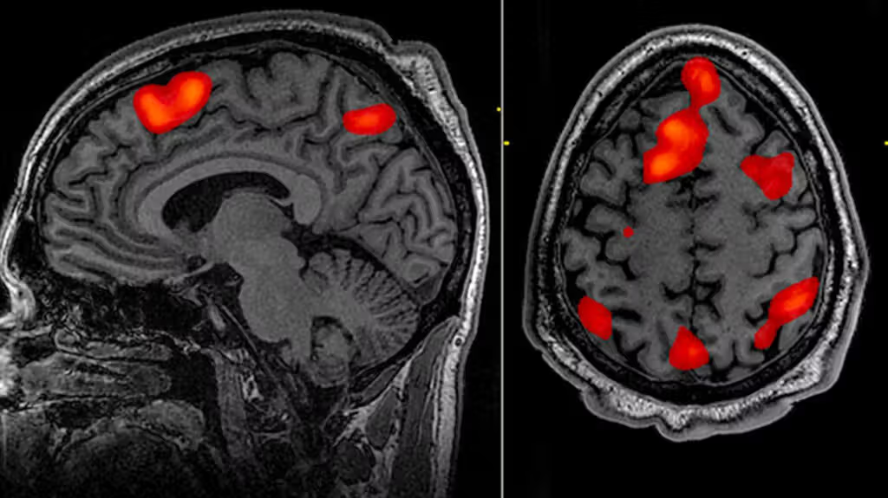
FUNCTIONAL MAGNETIC RESONANCE IMAGE (fMRI)
fMRI effectively detects mental disease by recording brain alterations at rest or in response to stimuli
measures brain activity by detecting BOLD signals, mapping neuronal movement related to energy consumption, and observing changes in blood circulation
the non-invasive nature of fMRI, which doesn't require surgery, radiation, or medication ingestion led to its popularity
tracks blood flow and neural activity intensity with color codes during rest and activity
fMRI Scan

Slide 5
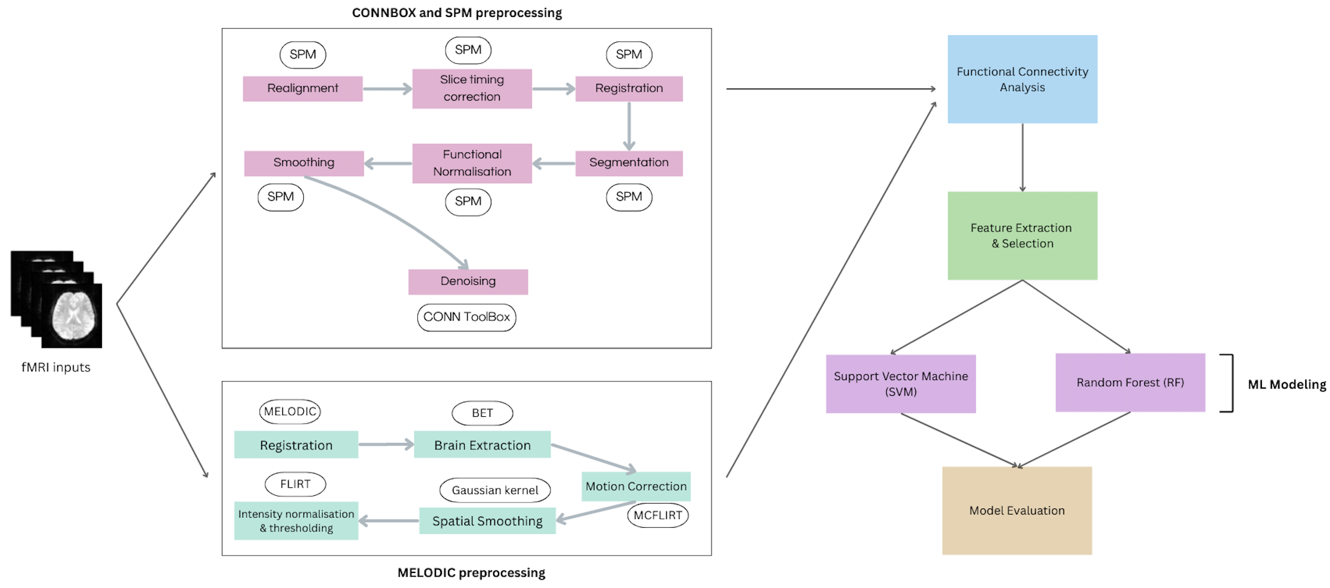
PROPOSED APPROACH
introducing the proposed approach in this article - a combination of preprocessing (Connbox-SPM and Melodic) and ML algorithms (SVM and RF)

Slide 6
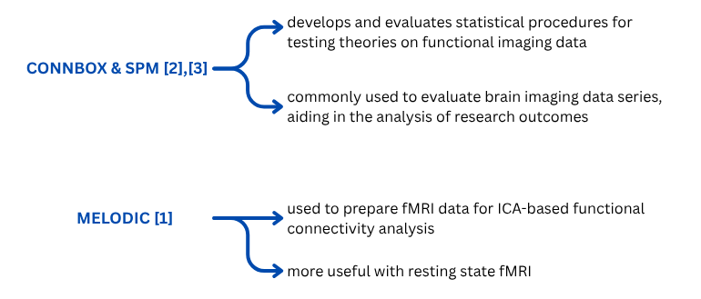
PREPROCESSING
The proposed approach implies two different preprocessing techniques:

Slide 7
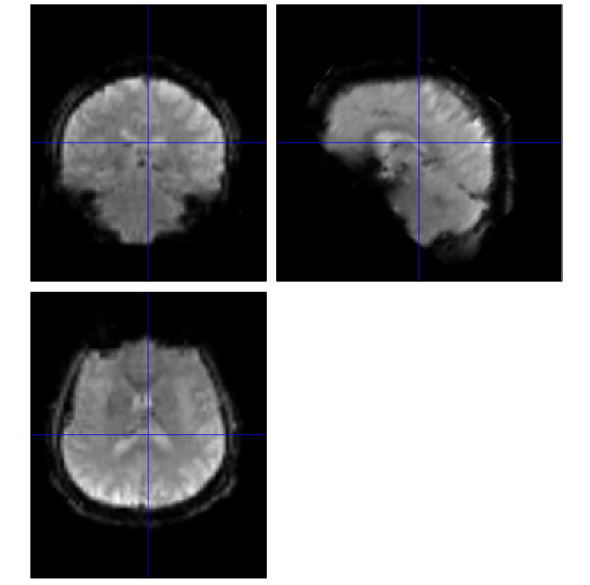
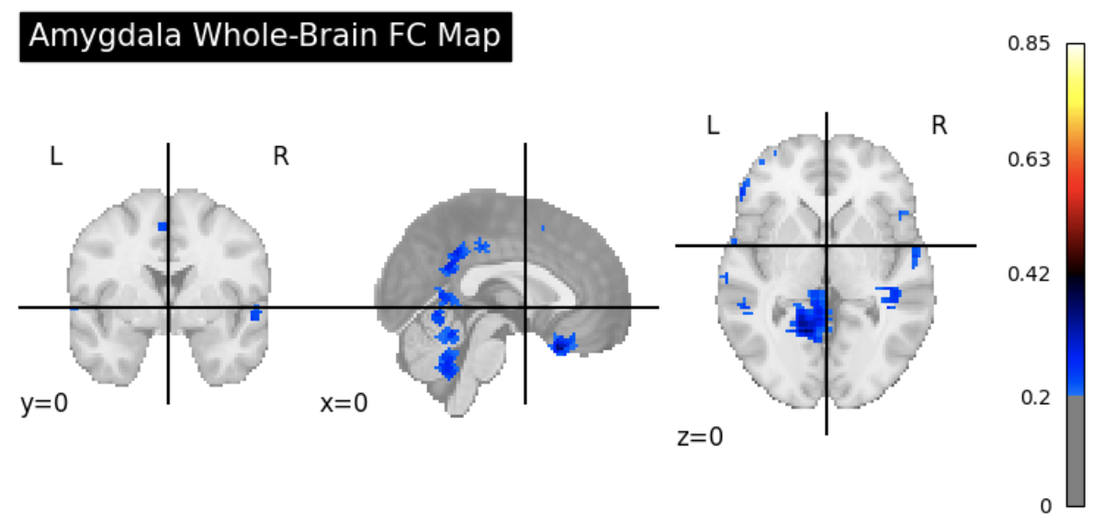
PREPROCESSING: CONNBOX-SPM
Realignment corrects head motion using 6 rigid-body parameters:
  Translations: x, y, z
  Rotations: pitch, roll, yaw
Aligns volumes to reference (first or mean image)
Unwarping adjusts for susceptibility-by-motion interactions
Outputs motion-corrected images + motion parameters (used as covariates)
Slice Timing Correction aligns voxel time series to a common time point
  Corrects for sequential slice acquisition in EPI
  Improves timing precision for event-related designs
Slice timing correction for sub-60001 [4]
Amygdala Functional Connectivity map for Connbox-SPM preprocessed data

Slide 8
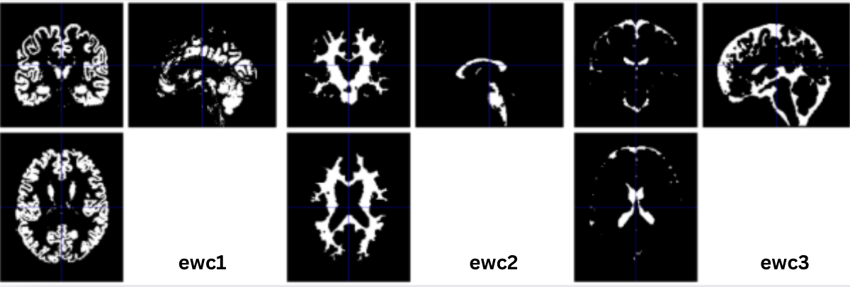
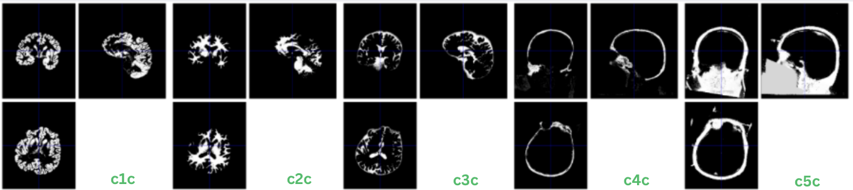
PREPROCESSING: CONNBOX-SPM
Registration aligns anatomical and functional data to MNI space
  Enables inter-subject comparisons and group-level analysis
Segmentation produces probability maps
  Supports voxel-based morphometry and structural analyses
  Quality control recommended for non-brain tissue intensity issues
Registration for sub-60001 [4]
c1c: Gray Matter probability map.
c2c: White Matter probability map.
c3c: Cerebrospinal Fluid probability map.
c4c: Probability map for bone or skull.
c5c: Probability map for soft tissues
Segmentation for func/sub-60001 [4]
Amygdala Functional Connectivity map for Connbox-SPM preprocessed data

Slide 9
PREPROCESSING: CONNBOX-SPM
Normalization applies deformation fields from segmentation to fMRI data
Warps functional images into MNI space
Spatial smoothing with Gaussian kernel (6 mm FWHM)
  Enhances signal-to-noise ratio
  Reduces anatomical variability between subjects
  Improves statistical power for group-level tests
Denoising removes non-neuronal signal components:
  Motion artifacts, scanner drifts, physiological noise
Improves voxel time-series stability and global signal quality
Effectiveness measured by % of BOLD variance explained
Output: clean, denoised data for functional connectivity analysis
Amygdala Functional Connectivity map for Connbox-SPM preprocessed data

Slide 10
PREPROCESSING: MELODIC
fMRI data registered to MNI152 using:
–regstandard (template), –mmthresh=0.5 (intensity masking), –bgthreshold=10 (background noise reduction)
Motion correction via MCFLIRT (rigid-body transformation)
      Mean absolute displacement: 0.17 mm
      Mean relative displacement: 0.07 mm
      No movement exceeded 0.3 mm → no scrubbing needed
Brain extraction with FSL BET:
      Generated clean brain mask, removed skull, CSF, extracerebral tissue
      Verified in axial, sagittal, and coronal views
Registration for func/sub-60001 [2]
Amygdala Functional Connectivity map for Connbox-SPM preprocessed data

Slide 11
PREPROCESSING: MELODIC
Applied voxel intensity normalization across scans
Thresholded voxel intensities:
        Lower bound: 2nd percentile
        Upper bound: 98th percentile
Removed low-signal voxels and restricted analysis to brain regions
Improved signal consistency and reduced scanner-induced variability
Integrated spatial smoothing with ICA via MELODIC
Extracted independent spatial components from resting-state fMRI
        First ICA component explained 5.23% of total variance
        Showed cortical and subcortical activations
ICA maps thresholded at p = 0.5 to isolate robust functional networks
Enhanced signal quality, reduced noise, supported network-level analysis
Amygdala Functional Connectivity map for Connbox-SPM preprocessed data

Slide 12
FUNCTIONAL CONNECTIVITY ANALYSIS – CONNBOX-SPM
performed using Python library nilearn
Approach: Seed-based analysis from left amygdala
Preprocessing Highlights:
    Applied structured noise regression (WM, CSF, motion, rest)
    Focus on clean, anatomically accurate signals
FC maps showed localized connectivity in limbic and subcortical regions
Strong links to medial temporal lobe and ventromedial PFC
High biological plausibility → ideal for ML use
Amygdala Functional Connectivity map for Connbox-SPM preprocessed data

Slide 13
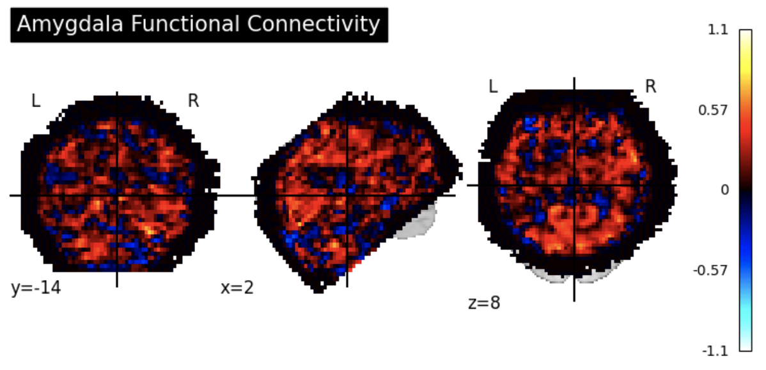
FUNCTIONAL CONNECTIVITY ANALYSIS – MELODIC
performed using Python library nilearn
Approach: Seed-based analysis from left amygdala
Preprocessing Highlights:
    Used automated ICA-based denoising (via FSL MELODIC)
    Minimal manual curation
FC maps showed widespread positive correlations across cortex
Evidence of global signal effects / residual noise
Reduced specificity - ML performance less efficient
Amygdala Functional Connectivity map for Melodic preprocessed data

Slide 14
ML CLASSIFICATION
Models Used:
  Support Vector Machine (SVM)
    Linear kernel suited for high-dimensional voxelwise features
    Input features were z-scored (zero mean, unit variance)
    Reduces overfitting; captures clear decision boundaries
  Random Forest (RF)
    Handles non-linear interactions and unscaled data
    Aggregates predictions from multiple decision trees
    Automatically incorporates feature importance

Slide 15
EVALUATION – NUMERICAL RESULTS
- Experiments performed on UCLA LA5c Study
(138 healthy, 49 bipolar, ages 21–50) [4]
- Dataset Split: 80/20
Train: 110 controls, 39 bipolar
Test: 28 controls, 10 bipolar
- best performance: Connbox-SPM and SVM
- Structured noise regression (Connbox-SPM) produced clean, localized functional connectivity features
- SVM excels with high-dimensional, clearly separable data
 | Connbox-SPM and SVM | Connbox-SPM and RF | Melodic and SVM | Melodic and RF
Accuracy | 72.3% | 70.5% | 67.8% | 69.8%
Precision | 80.6% | 79.8% | 77.2% | 79.4%
Sensitivity | 70.9% | 69.2% | 65.6% | 67.5%
AUC | 79.8% | 76.6% | 75.8% | 76.5%

Slide 16
CONCLUSIONS
Deep learning demonstrates high efficacy in neuroimaging segmentation, yet standardization remains elusive
Integrating structured preprocessing (e.g., CONNbox-SPM) with high-dimensional classifiers (e.g., SVM) enhances sensitivity to functional connectivity alterations
Synergistic alignment between preprocessing pipelines and classifier properties yields measurable gains in model precision
Methodological emphasis on anatomical specificity and structured noise regression is critical for reproducibility and translational validity

Slide 17
REFERENCES
[1] - https://web.mit.edu/fsl_v5.0.10/fsl/doc/wiki/MELODIC.html
[2] - https://web.conn-toolbox.org/
[3] - https://www.fil.ion.ucl.ac.uk/spm/
[4] - Bilder, R., Poldrack, R., Cannon, T., London, E., Freimer, N., Congdon, E., Karlsgodt, K., Sabb, F.: UCLA Consortium for Neuropsychiatric Phenomics LA5c Study. OpenNeuro (2018).

Slide 18
Thank you!
iulia.ion@ubbcluj.ro
Iulia-Andreea Ion

