Slide 1
Modelling System Availability of Series Configuration with Implicit Temporary Redundancy - Agent-based Simulation Approach
Olympiad in Engineering Science - OES 2025
Yasmine Khattab
Idriss El-Thalji

Slide 2
Table of Content: - Parallel & Series Configurations in Industries. - RAM Analysis Methods. - Reliability Block Diagram (RBD). - Agent-based Modeling (ABM). - Case Study with RBD and ABM Application. - State Chart Description. - Failure Modes, Failure rates, and MTTRs. - Simulation Results of System Availability. - Conclusion
Olympiad in Engineering Science - OES 2025

Slide 3
Parallel & Series Configurations in industries

Slide 4
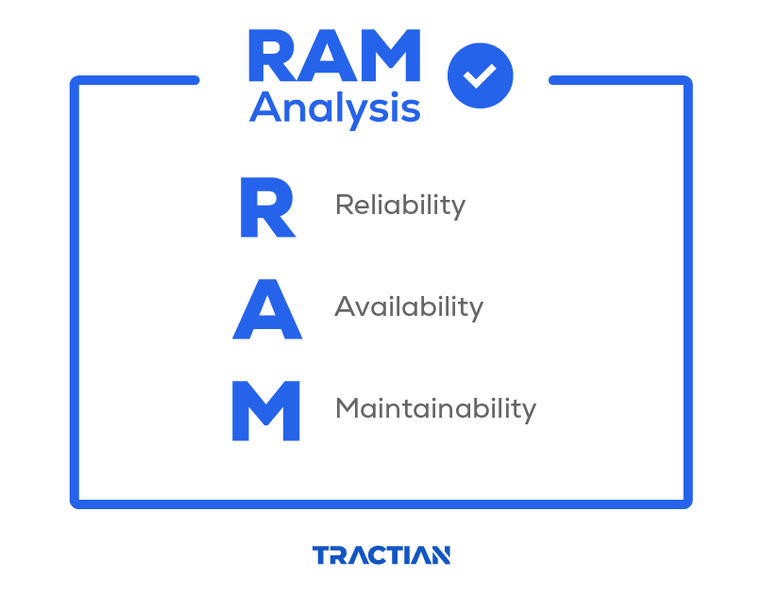
RBD
Markov Models
FTA
Agent-based Modeling
Petri-Nets Models

Slide 5
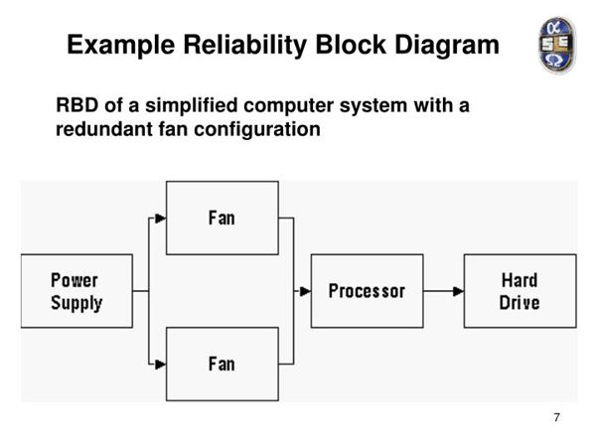
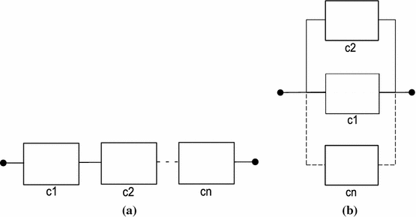
Reliability Block Diagram (RBD)
RBD
DRBD
ABM

Slide 6
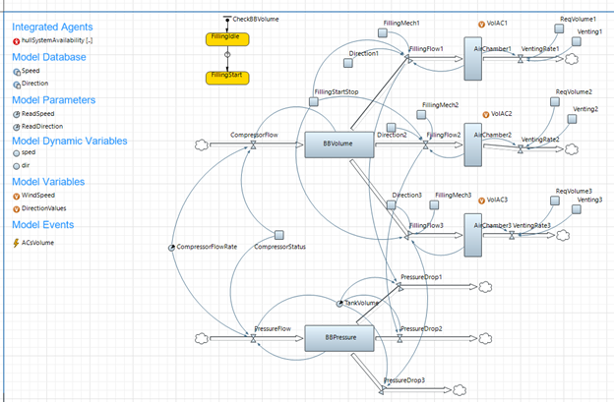
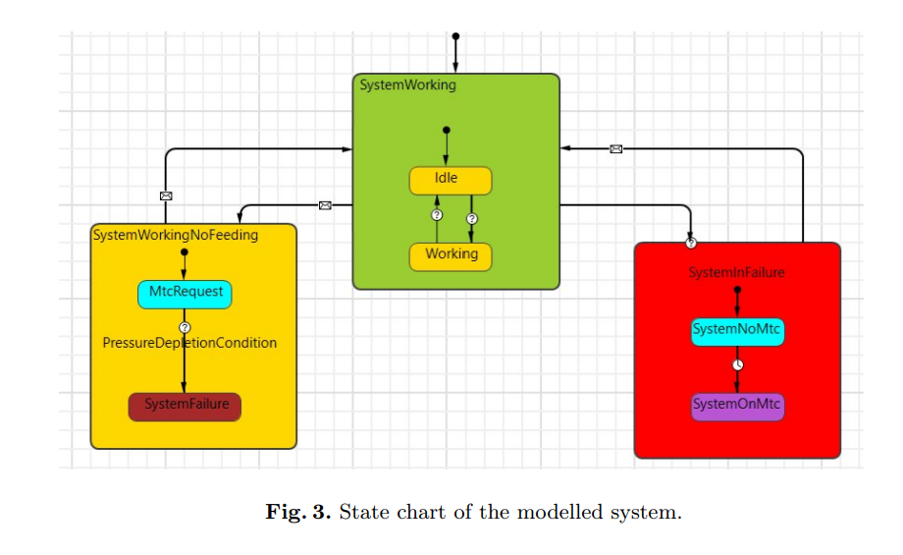
Agent-based Modeling ABM

Slide 7
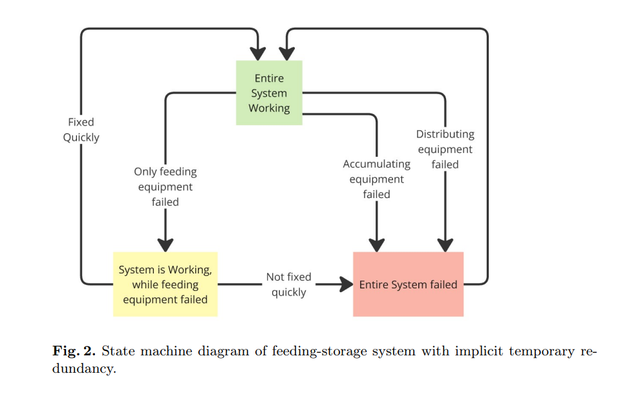
RBD System Configuration Vs. ABM System Configuration

Slide 8
State Chart – Agent-based Model

Slide 9
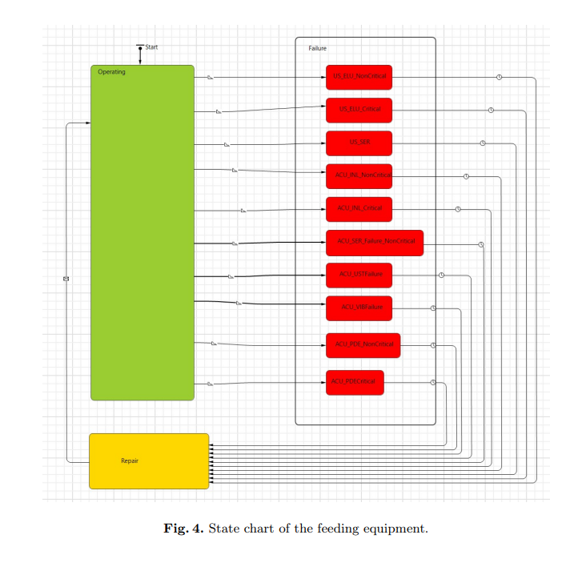
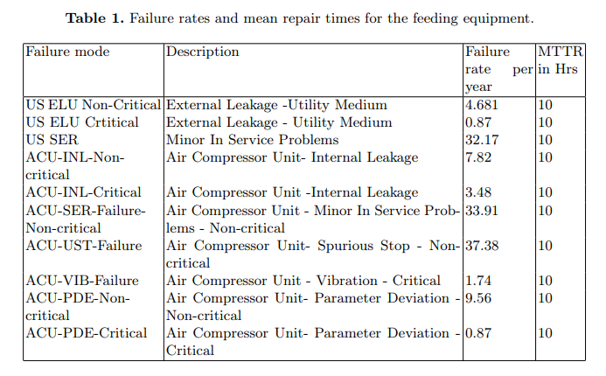
Failure modes, Failure rates, and MTTRs – Feeding Equipment

Slide 10
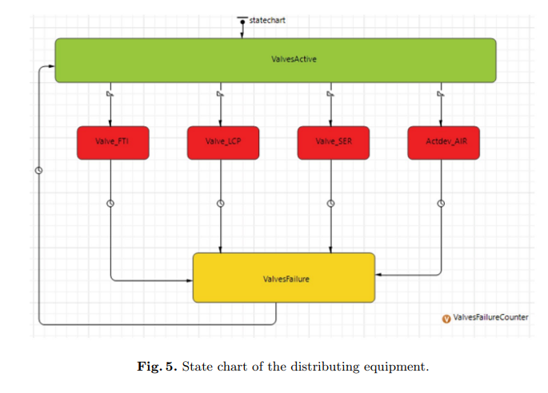
Failure modes, Failure rates, and MTTRs – Distributing Equipment

Slide 11
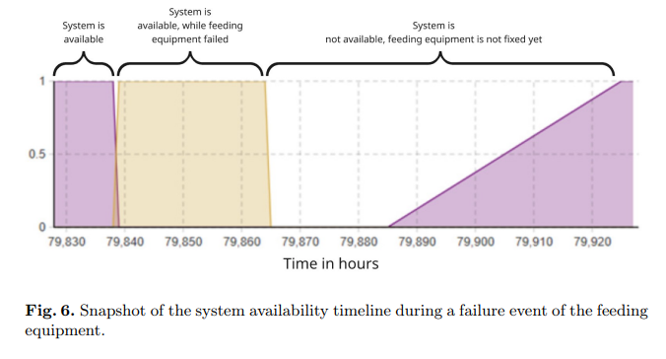
Simulation Results – System Availability

Slide 12
Conclusion
RBD
Provides an Overestimate of system availability.
Focuses on structure of components and how they connect to perform a function
ABM
Provide more acuurate availability estimation considering the interaction between system components and state/event dependency.
Focuses on the dynamic behavior of the system components over time.
Captures emergent behavior – how local actions affect the whole system.

Slide 13
Thank you.

