Slide 1
Modelling System Availability of Unmanned Platform Under Fixed Maintenance Intervals.
NAME, title
Taofik Sanusi
Authors: Taofik Sanusi, Idriss El-Thalji.
Affiliation: Department of Mechanical and Structural Engineering and Materials
Science, University of Stavanger, Norway
Conference: 2nd Olympiad ,Stavanger

Slide 2
Background & Motivation
Objectives
Methodology
System Modelling Techniques
Scenarios
Results
Conclusion
Content

Slide 3
The offshore oil and gas industry has long been challenged by the high operational costs associated with manned offshore platforms. Traditional manned platforms require significant investment in infrastructure, personnel, and ongoing maintenance to ensure operational efficiency and safety. The design and maintenance of these platforms have often been characterized by substantial topsides equipment, high CAPEX investments ranging from $70 to $100 million, and frequent offshore visitation, driving up OPEX expenditures and posing inherent safety risks (2). However, recent advancements in unmanned platform technology have sparked considerable interest in exploring alternative approaches to offshore asset management. Unmanned Offshore Platforms with single-annual or Bi-annual maintenance interventions are expected to become standard in 5-10 years due to their numerous advantages in relation to cost savings, Reliability, Safety, reducing complexity, flexibility, and maintaining High availability and reliability under limited maintenance (6-12 months) intervals.
Background & Motivation

Slide 4
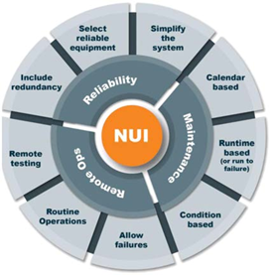
Background & Motivation Contd.
Demanning approach and Impact on Project cost
More POB
Fewer POB
More Facilities
Fewer Facilities
Fig 1. How Personnel affect Platform Facility requirement (Nicholson et al., 2021)
Fig 2. NUI Philosophy
Simpler Design
Lower Capex
Reduce equipment
Lower weight
TOTEX Saving
>50%
Fig 1 shows clearly how the reduction in personnel leads to a reduction in equipment count and complexity.
Fig 2 Briefly explains the Philosophy behind NUI which is Mainly Reliability, Maintenance requirements, and Remote Operations.
Fig 3 Shows the expected savings NUI has on Total project cost.
High reliability Low maintenance
Lower Opex
Fewer visits
Reduce offshore work
Remote Operations
Increase availability
Continuous monitoring and control
Predictive Maintenance
Fig 3. Impact of NUI on Total Project Cost

Slide 5
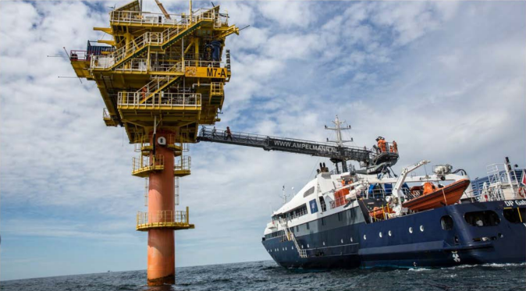
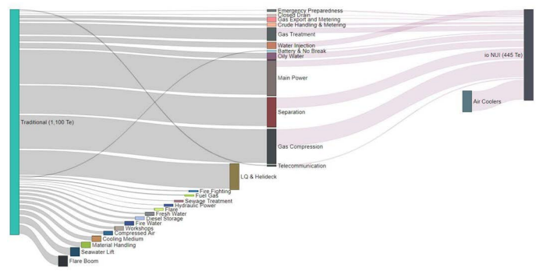
Facility Access and Weight Comparison of OPTIMISED NUI over Traditional Manned Platform
Dyson & Varney, 2020)
Fig 4. Walk to Work Vessel and Gangway (Dyson & Varney, 2020)
Fig 5. Optimized NUI vs Traditional Manned Platform Equipment Weight Reduction. (Dyson & Varney, 2020)

Slide 6
Objectives
To simulate and estimate availability and Maintenance Workload for unmanned Assets.
Analyze different redundancy scenarios ( 2 to 5 pumps)
Access the effects of 6 months vs. 12 months intervals.

Slide 7
Methodology
Output: Maintenance Visits, Availability, and Other measurable parameters (CO2 Emission, Manning, and OPEX)
The High-Pressure (HP) pump in the Hydraulic Power Unit (HPU) is purposely selected as the main industrial system for this study
Simulation Model: Agent-Based Model (ABM)
Tools/Software Used: AnyLogic
Inputs: Historical Failure/ Repair Data

Slide 8
Reliability Block Diagram (RBD) Fundamentals: Traditional RBDs are static and exhibit several limitations when state dependency, dependent events, non-series-parallel topologies, and load-sharing aspects are involved, which complicate analysis and hinder efficiency in large-scale systems. Traditional RBDs are suitable for timely repair and have a common MTTR value for all failure events, but have a challenge in handling unknown and variable MTTRs.
System Modelling Techniques
Reliability Block Diagram (RBD): Limited with Variable MTTR and Complex topologies
Agent-Based Modeling (ABM): Flexible, Models agents and their interactions dynamically. Suitable for complex systems.

Slide 9
Agent-Based Modeling and Simulation (ABMS): Modelling with agents is the simplest modelling technique. After determining which elements of the real system are crucial to the problem's solution, you replicate those elements in the model. Agents can be individuals, homes, cars, trucks, machinery, goods, businesses, or anything else that is pertinent to the system. 1. Modelling Manned Redundant System: Redundant systems can be modeled using a state chart, as shown in Figure 6. The system has two main states: (1) Active, (2) Downtime. However, the "active" state has internal states that represent redundant equipment, as shown in Figure 6. The "HP1 Working" state represents the first pump, and the "HP2 Working" state represents the second pump. If both pumps fail, the entire system will fail and go to a "Downtime" state. The maintenance policy in Figure 6 is modelled to offer a direct repair action. This means that if one pump fails, it will be immediately repaired, and the system goes to the "Downtime" state only if both pumps fail. Therefore, the system availability is high for this configuration with a high level of maintenance service.
System Modelling Techniques Contd.

Slide 10
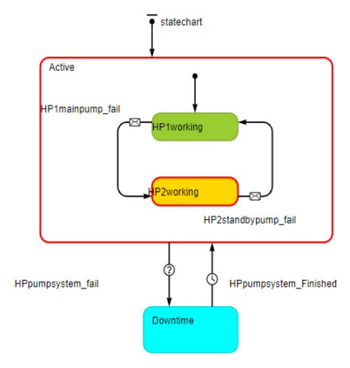
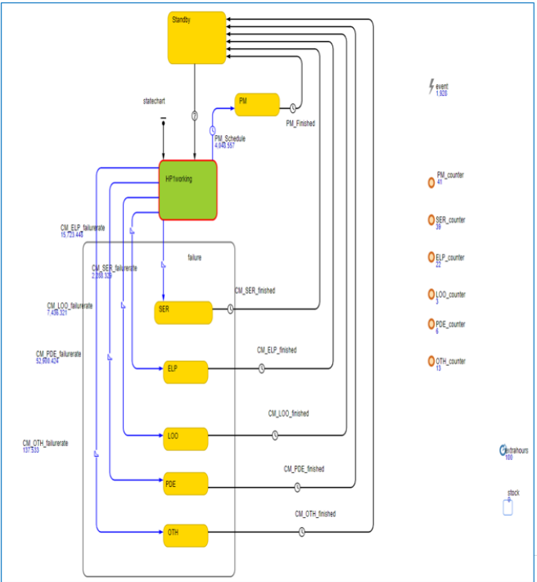
System Modelling Techniques Contd.
Fig.6 HPU pump System state chart for Manned Redundant System
Fig.7 State chart for Redundant Pump (HP1)

Slide 11
System Modelling Techniques Contd.
The pump is also modelled as an individual agent. Each pump has mainly four main states: working, standby, failure (different failure modes), and Preventive Maintenance (PM). The pump has several failure modes (5 modes are modelled, Figure 7 above), and each has a specific failure rate and mean repair time, as described in Table 1
Table 1.
2. Modelling Unmanned Redundant System: The unmanned systems are modeled using a state chart, as illustrated in Figure 8. It has the same states as the manned systems. However, the main difference is the transition between the "Downtime" and "Maintenance" states, where a condition rule has replaced a timeout rule. The condition rule keeps the system in the downtime state until a planned maintenance visit is triggered.
Failure Mode | Description | Failure Rate Per Year | MTTR in Hours
SER | Minor In-Service problems | 3.66 | 2.45
ELP | External Leakage-Process Medium | 1.67 | 5.40
LOO | Low Output | 0.33 | 6.00
PDE | Parameter Deviation | 0.67 | 3.00
OTH | Other: Breakage, Instruments Failure | 1.33 | 8.00

Slide 12
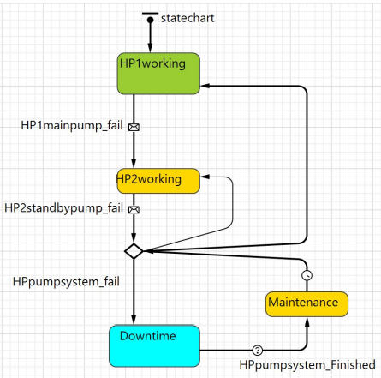
Fig. 8
System Modelling Techniques Contd.

Slide 13
Scenarios
Scenario 1: 2 pumps, direct repair (baseline). The first scenario represents the two redundant pump systems under normal manned maintenance, where timely repair is provided.
Scenarios 2–5: 2–5 pumps, 12-month interval. Scenarios 2 to 5 represent redundant pump systems operating under unmanned maintenance conditions, with only a single annual visit. These scenarios consider systems with 2, 3, 4, and 5 pumps, respectively.
Scenarios 6–9: 2–5 pumps, 6-month interval. Scenarios 6 to 9 represent redundant pump systems operating under unmanned maintenance conditions, with only a single bi-annual visit. These scenarios consider systems with 2, 3, 4, and 5 pumps, respectively.

Slide 14
Table 2 below provides a detailed summary of the simulation results for both the Baseline and Redundancy scenarios, covering a 20-year maintenance timeline where 9 scenarios are compared. Scenario 1 represents the baseline estimates, where the system is modeled as a parallel configuration of two pumps and a direct repair policy (direct after failure, and has a deterministic repair time). Scenarios 2 to 5 represent the redundancy scenario for 2, 3, 4, and 5 pump systems with a fixed maintenance interval (Once every 12 months). It will be observed that the direct maintenance policy for the baseline scenario 1 ensures 99% availability compared to 26.50%, 35.70%, 62.60%, and 87.00% for 2 to 5 pumps, respectively, with a fixed maintenance interval. Availability increases with an increase in redundancy. Scenarios 6 to 9 represent the redundancy scenario for 2, 3, 4, and 5 pump systems with a fixed maintenance interval (Once every 6 months). Availability increases whenever shorter maintenance intervals are introduced. With a 6-month maintenance interval, availability of the 2 pump system is about 67%, while it is 98.10%, 99.50%, and 99.70% for the 3, 4, and 5 pump systems, respectively. Also, Table 2 shows the gains for the fixed maintenance intervals in terms of CO2 emissions, OPEX, and other associated expenses like manning, CO2 taxes, and vessel rent. The result clearly shows that More Redundancy leads to Higher Availability. 4 4-pump redundant system with a 6-month interval fixed maintenance gives better availability than the 2-pump system with direct repair, and Overall reduction in the number of visits leads to reduced OPEX, CO2 emissions, and overall safety assets and personnel.
Results

Slide 15
Table 2: Summary of KPI Over 20 years for Baseline and Redundancy Scenario
Results Contd.
Figure 9: OPEX Comparison Between Baseline and Redundancy Scenarios for 12 Months Maintenance Interval

Slide 16
Results Contd.
Figure 10: Availability trend for 12-month intervals
Figure 11: Availability trend for 6-month intervals

Slide 17
Conclusion
An agent-based simulation model for estimating the availability of unmanned assets is presented in this paper. Since the next potential maintenance visit may occur in two weeks, three months, etc., the primary difficulty in evaluating the availability of unmanned assets is the unpredictable repair time. When the incident happened and when the potential maintenance visit is scheduled, determine how long the repair will take. The repair time can be configured as a condition that continuously checks when the next maintenance visit is active, thanks to the flexibility of agent-based simulation modeling. We can conclude that the introduction of more redundant equipment and shorter maintenance intervals results in increased availability. Redundancy is unquestionably a useful design technique to guarantee unmanned asset availability.
Future work is to explore the Flexible maintenance interval and condition-based policy. It may be possible to use a more flexible policy to manage the annual maintenance interval, such as requiring maintenance anytime three of the four pumps fail. More research will be done on the flexible maintenance interval policy.

Slide 18
THANK YOU

