Slide 1
2nd Olympiad in Engineering Science – OES 2025
Extended Reality for tunnel Inspection using BIM
Nicola Rimella¹, Pang-jo Chun²
¹Politecnico di Torino, Department of Building, Structural and Geotechnical Engineering
(DISEG), Turin, Italy
²University of Tokyo, Department of Civil Engineering, Tokyo, Japan

Slide 2
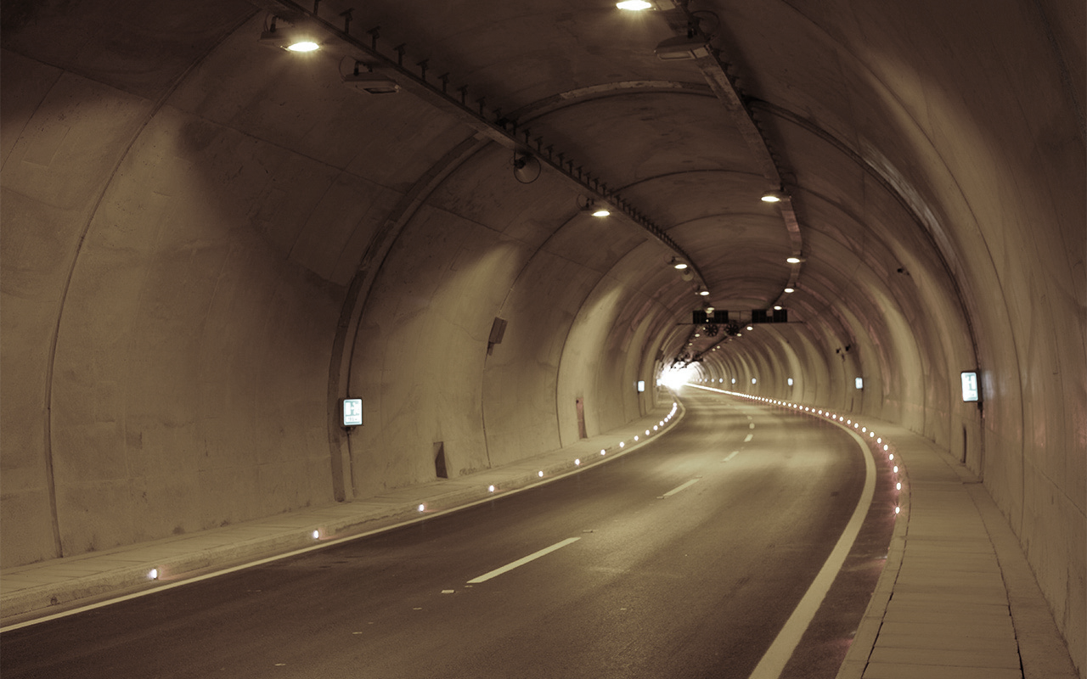
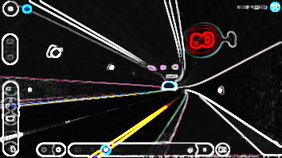
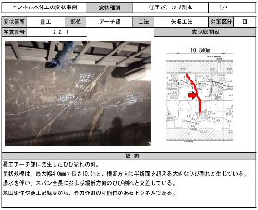
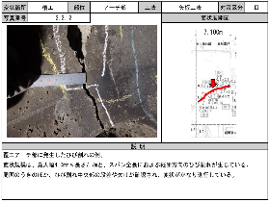
Introduction
Extended Reality (XR) is an umbrella term that includes all immersive technologies that extend or replace our perception of reality
Enables new ways of visualization, interaction and analysis
Increasingly used in medicine, architecture, industry and education
Improves accessibility by offering new ways to experience information for users with different needs

Slide 3
Objectives of the Study
Data visualization and collection
Inspection
Historical inspection data and tunnel damage information can be input into a BIM model of the infrastructure for rapid visualization during inspection.
The BIM model can be use to collect data directly on site, improving the accuracy of defect location and speeding up the creation of technical reports.
Current statement
New statement
BIM
Construction
Intervention
design

Slide 4
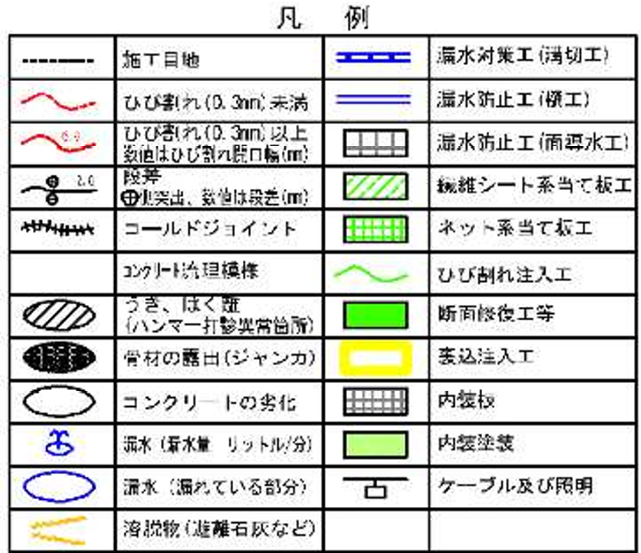
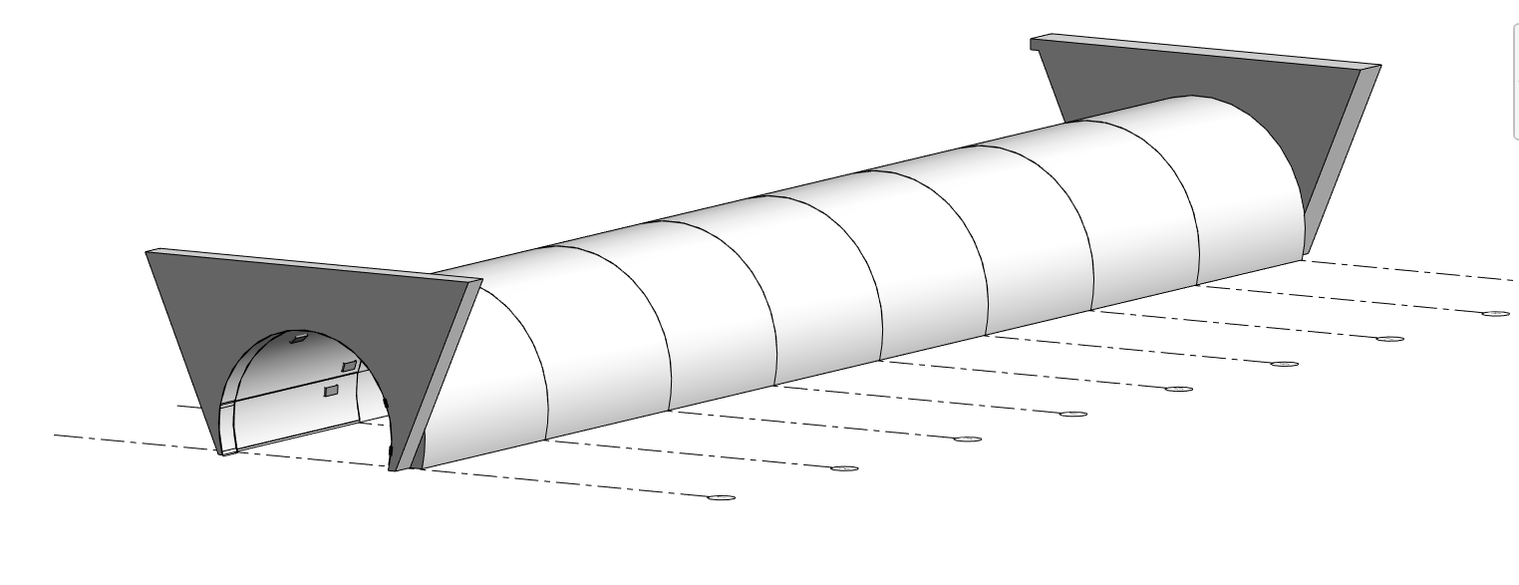
BIM modelling
71 damages noted

Slide 5
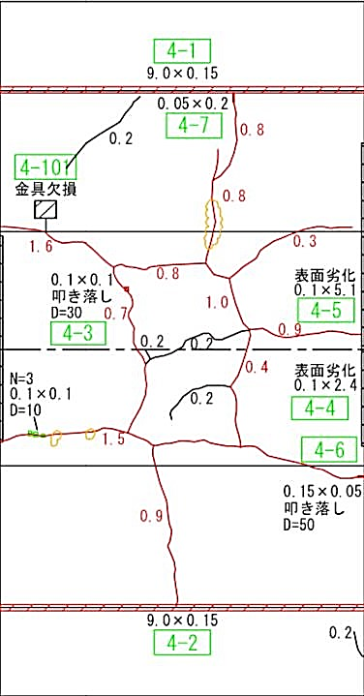
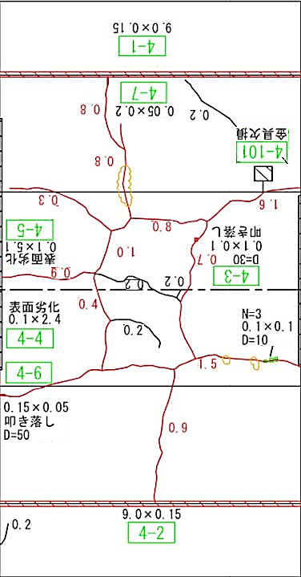
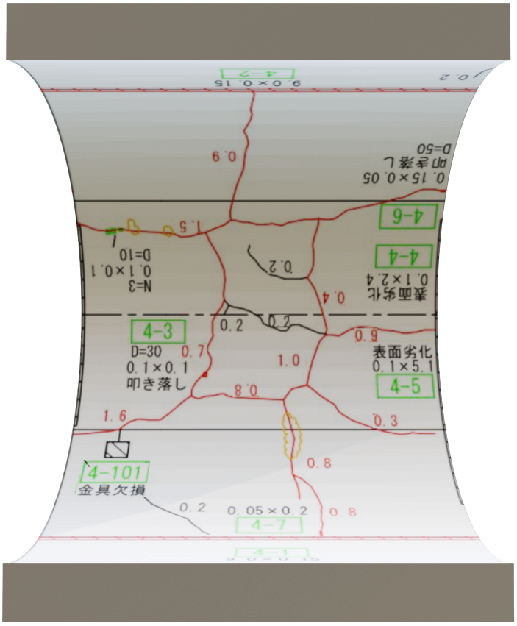
Damages map texturing
Original map
Mirrored map
Text adjustment
UV mapping

Slide 6
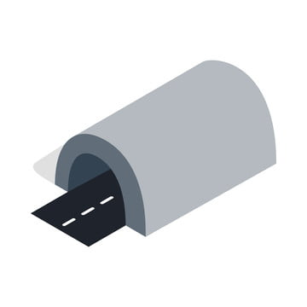
Information enrichment
Defect’s Code Regex syntax:
[Segment number]_[Defect number]
Defect’s Code
Tunnel DB
Web request
Segment number
Affected part
Area affected
Defect number
Defect type and cause
Actual condition
Defect’s Report
Target location
Risk Class
Note

Slide 7
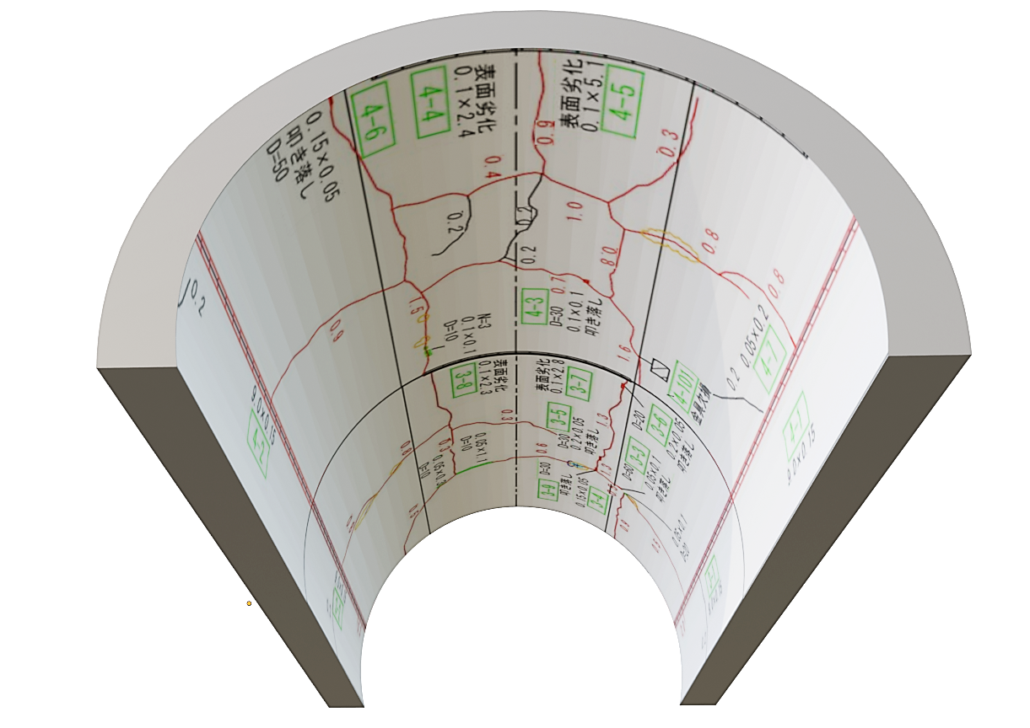
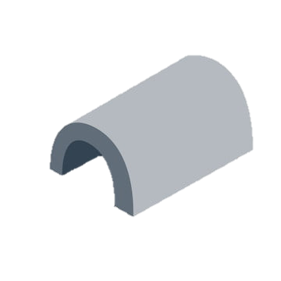
Overlay strategy
Sidewalk line
Possible anchor points
Z
X
Y
Sidewalk surface detection
Anchor placement
Geometry loading

Slide 8
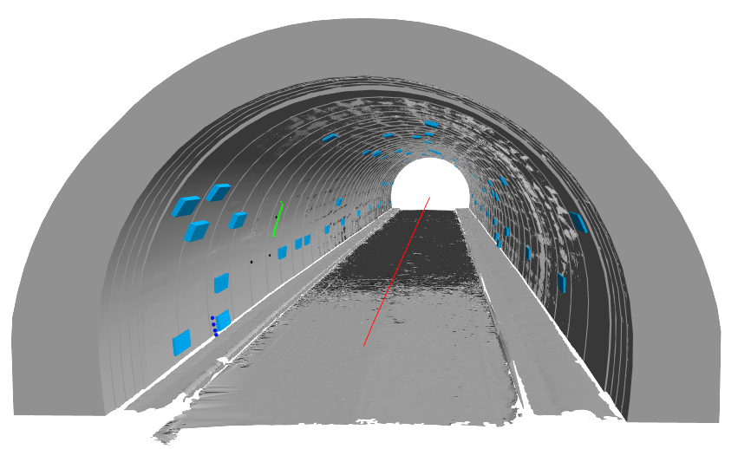
Data collection
Visual inspection
New defects in BIM model
AR defect drawing
Adding Information
Data Export

Slide 9
System architecture
Conversion
BIM
3D
model
Text data
AR
application
Report data
Tunnel database
Damages map
UV mapping model
Defects data

Slide 10
Application testing
Features
Model Placement using plane detection
Overlay and transparency between virtual and reality
Report data request using BIM code
New information data collection
Data export

Slide 11
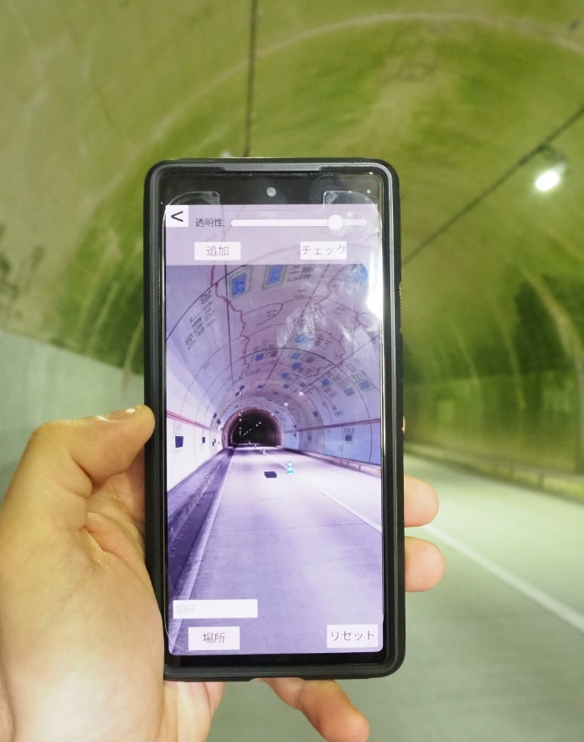
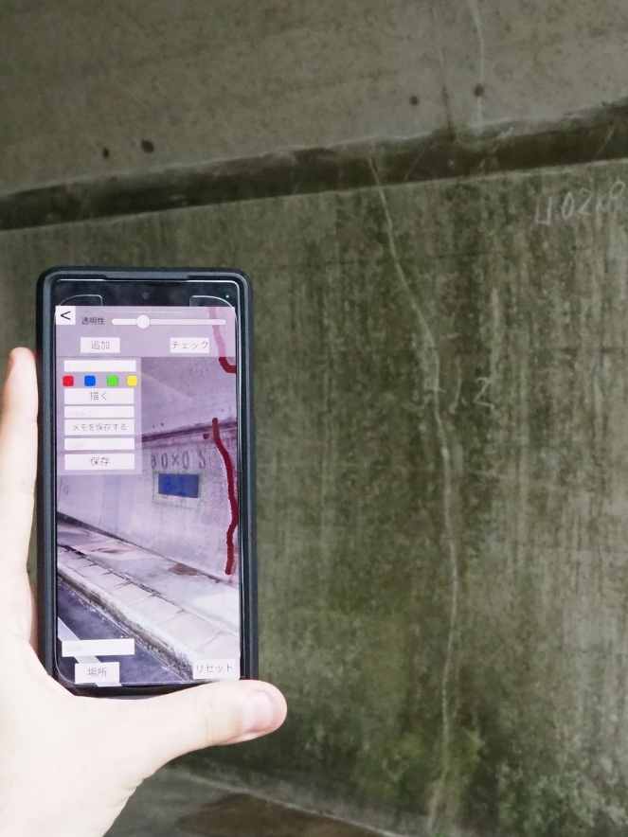
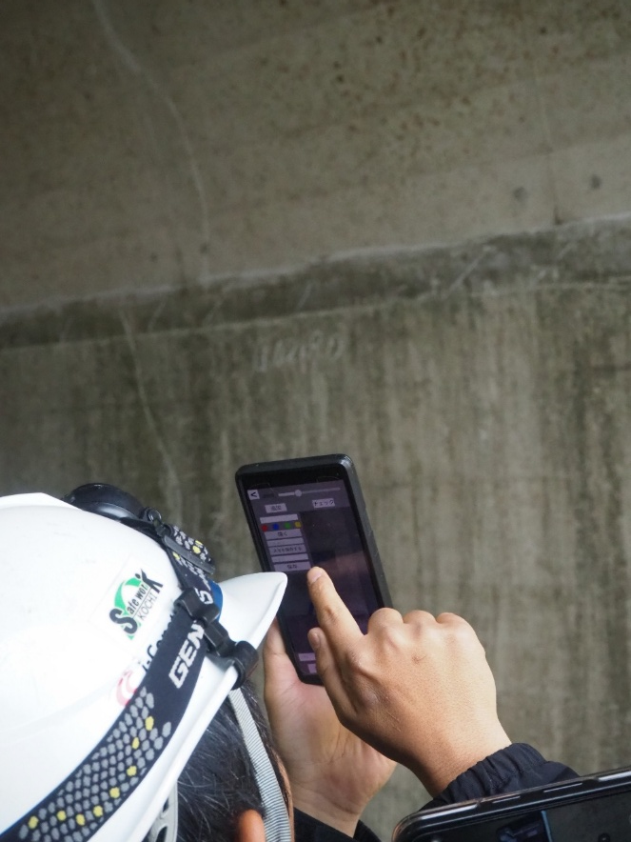
Application testing

Slide 12
Conclusion
Improved Inspection Workflow
The integration of XR and BIM streamlines the inspection process by enabling real-time visualization of structural data and overlaying past reports directly on the infrastructure, reducing errors and time spent searching for information.
Enhanced Data Collection and Accessibility
The XR application allows users to both access and add inspection data in the field, ensuring up-to-date records and supporting data-driven maintenance decisions.
Cost-Effective and User-Friendly
Unlike complex robotic or laser systems, the proposed solution is developed for smartphones and tablets, making it accessible and practical even for small and medium-sized companies.
Future Potential for AI and Collaboration
The prototype lays the groundwork for future enhancements such as automatic defect detection through AI and multi-user collaboration, moving towards a more intelligent and resilient infrastructure management system.

Slide 13
Thanks for your attention

