Slide 1



IMPROVING THE PREDICTIONS ON CONCRETE STRENGTH VIA ULTRASONIC PULSE VELOCITY
Bogdan Bolborea, Cornelia Baeră, Aurelian Gruin, Ana-Cristina Vasile, Alexandra Marina Barbu

Slide 2
CONTENT
1
Introduction
2
Materials and Methods
3
Results and discussions
4
Conclusions

Slide 3

INTRODUCTION
Reinforced concrete (RC) structures are prevalent in construction, and ensuring their long-term performance requires rigorous quality control. Since lab tests may not reflect real conditions, non-destructive testing (NDT) has become a preferred method for assessing concrete properties like density, strength, and elasticity without damaging the structure.
As a result, non-destructive testing (NDT) methods have gained traction as viable alternatives for structural assessment that do not cause material damage.

Slide 4
INTRODUCTION
This research relies on previous studies and aims to further validate a proposed method for estimating the compressive strength of concrete using ultrasonic pulse velocity (UPV).
The approach relies on a series of mathematical relationships in which the UPV values are used to determine ultrasonic-based density, which helps calculate the dynamic modulus of elasticity, from which the static modulus of elasticity is derived, ultimately allowing for the estimation of concrete compressive strength.
The proposed methodology aims to improve the accuracy and reliability of NDT techniques in assessing concrete properties, contributing to the development of more effective evaluation methods for structural integrity.
UPV testing
Ultrasonic-based density
Dynamic modulus of elasticity
Concrete compressive strength
Static modulus of elasticity

Slide 5
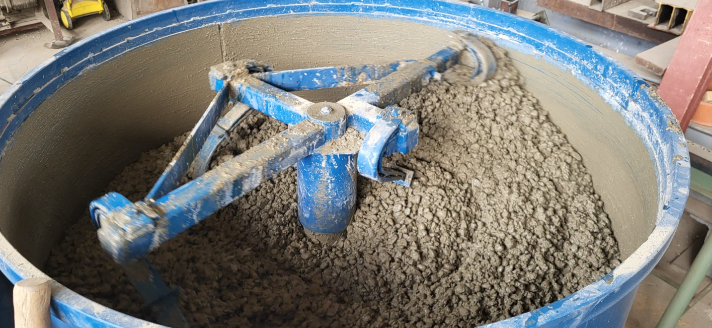
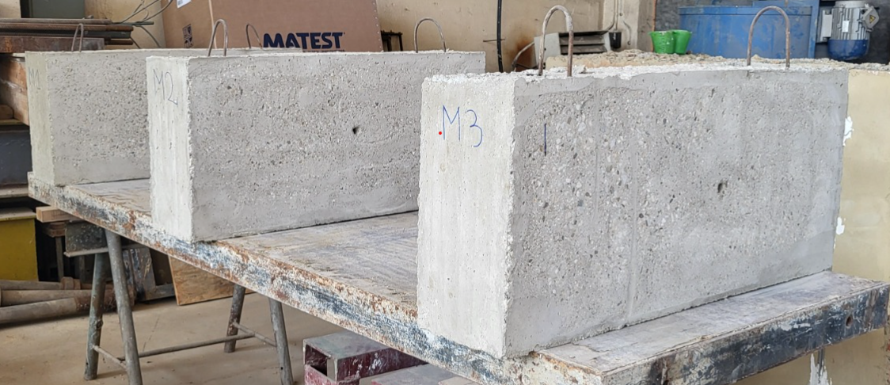
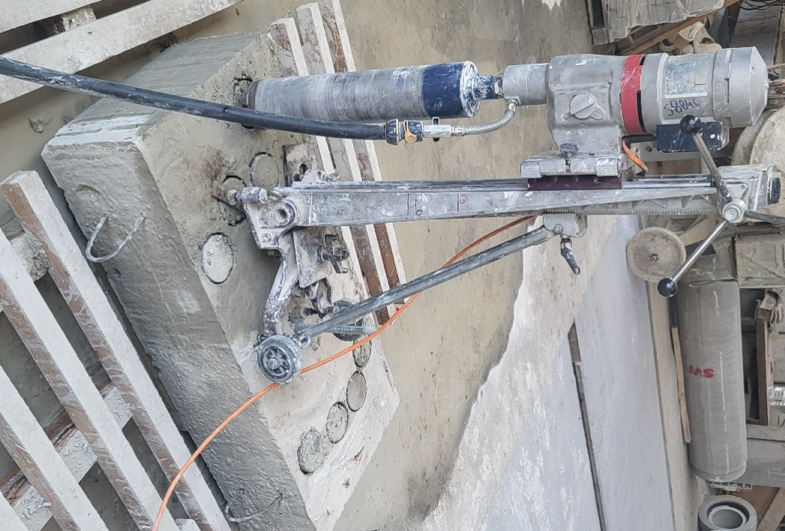
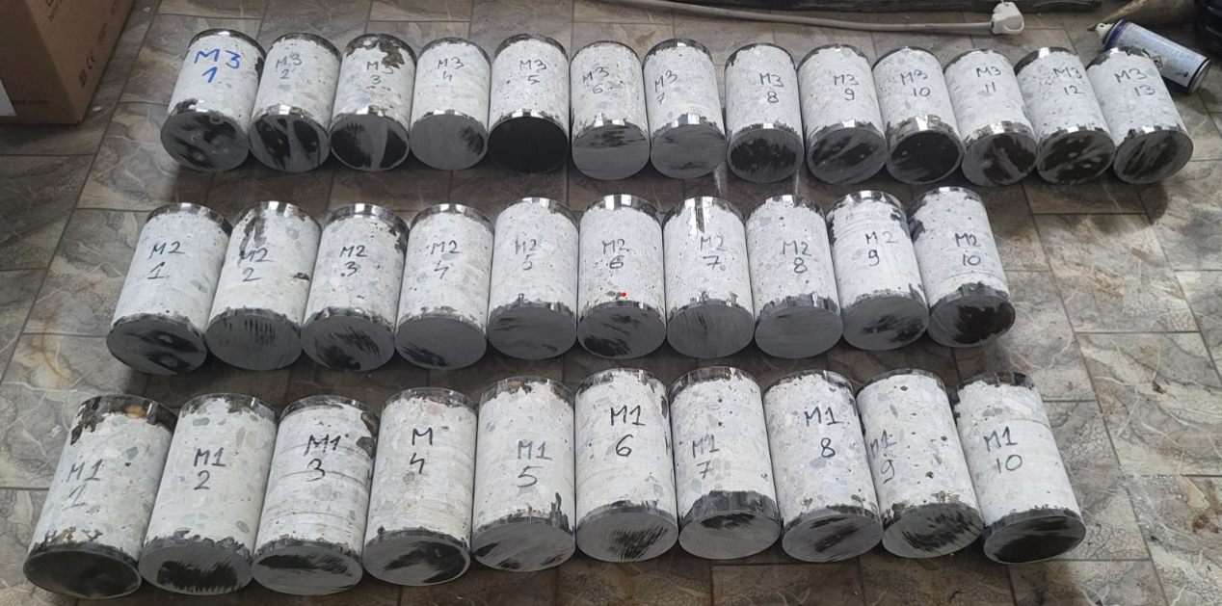
MATERIALS AND METHODS
Concrete mix design and specimen preparation
Three concrete mixtures were prepared, differing only in the sand-to-gravel ratio.
The variable parameter was the sand-to-gravel ratio, which was set at 30/70, 40/60, and 50/50 %.
All mixtures have a fixed cement dosage of 300 kg/m³ and a water-to-cement (W/C) ratio of 0.3.
A chemical admixture, Master Rheobuild, was added at 1% of the cement mass to improve the workability of the concrete.
This variation aimed to examine whether changes in the fine-to-coarse aggregate ratio influence the viability of the proposed method to determine the compressive strength of the hardened concrete.
Mix 1 |  | Mix 2 |  | Mix 3
Cement | 300 kg/m³ | Cement | 300 kg/m³ | Cement | 300 kg/m³
W/C ratio | 0.3 | W/C ratio | 0.3 | W/C ratio | 0.3
Sand (0-4 mm) | 30% | Sand (0-4 mm) | 40% | Sand (0-4 mm) | 50%
Gravel (4-16 mm) | 70% | Gravel (4-16 mm) | 60% | Gravel (4-16 mm) | 50%
Additive | 1% | Additive | 1% | Additive | 1%
Concrete Mix Design

Slide 6
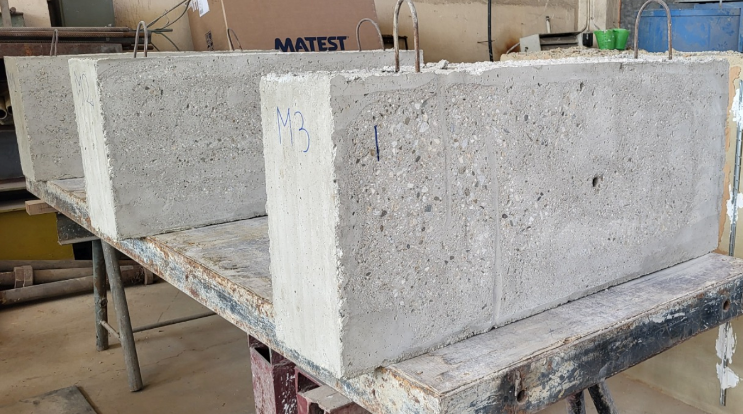
MATERIALS AND METHODS
Concrete mix design and specimen preparation
Three concrete beams, each measuring 150 × 25 × 50 cm (length × width × height), were cast, with each specimen corresponding to one of the designed mix compositions.
The resulting experimental data are meant to serve as a comparative benchmark, reinforcing the validity of the proposed method by illustrating how varying sand-to-gravel ratios impact concrete performance, particularly in terms of compressive strength.
Concrete elements after formwork removal.

Slide 7
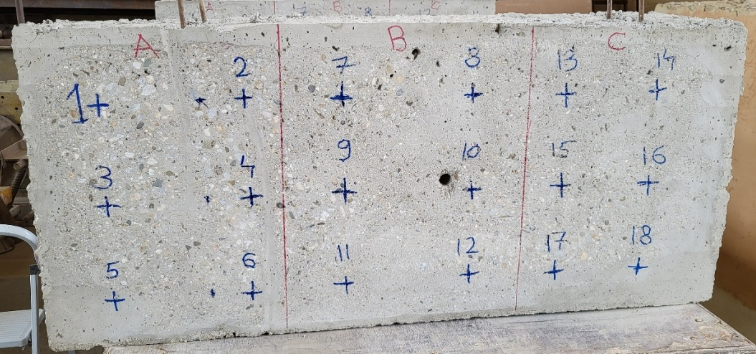
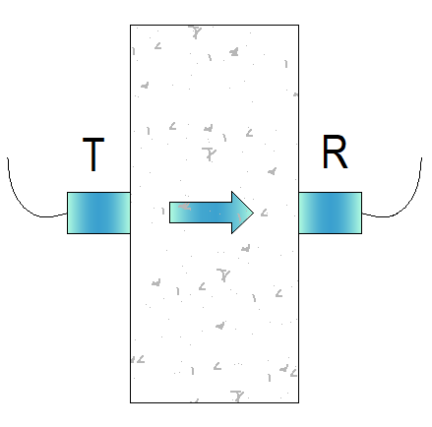
MATERIALS AND METHODS
1. SonReb testing on beams
Before applying the SonReb method, the beam surfaces underwent preparation, which involved grinding with a circular disc to achieve a smooth finish and eliminate surface contaminants.
Following Romanian Standard NP 137-2014, each beam face was subdivided into three testing zones.
Within each zone, the following data were collected:
- 9 rebound hammer (RH) readings;
- 6 ultrasonic pulse velocity (UPV) measurements.
The 54 kHz transducers were positioned on opposing faces of the concrete elements to facilitate direct wave transmission.
Surface preparation for the SonReb method.
Direct placement of transducers.

Slide 8
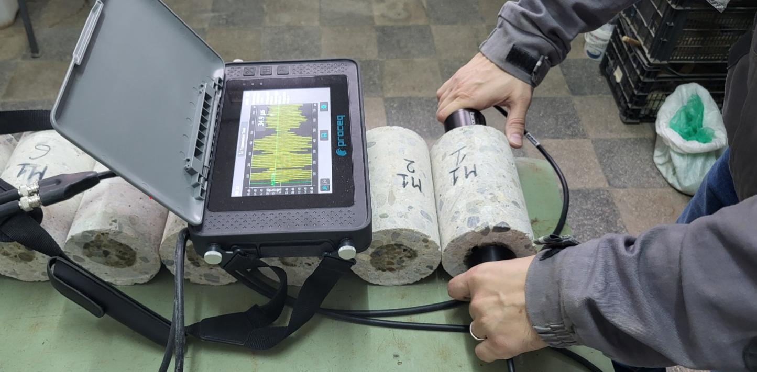
MATERIALS AND METHODS
2. UPV testing on concrete cores
Ultrasonic Pulse Velocity (UPV) testing was performed on the core specimens with several objectives:
to estimate the material density, which helps to determine the dynamic modulus of elasticity;
to derive the static modulus of elasticity and further estimate compressive strength.
For this purpose, 54 kHz P-wave transducers were used.
Concrete cores tested with 54 kHz P-wave transducers.

Slide 9
MATERIALS AND METHODS
3. Density measurements
Ultrasonic Pulse Velocity (UPV) is a well-established non-destructive method for estimating concrete density.
Studies, such as Salman’s work on carbon fiber-reinforced concrete, confirmed a positive correlation between UPV and density, leading to an equation (Eq. 1) for estimating ultrasonic-based density (UBD) from UPV data.
$$Equation 1. γ=114.8∙V_{L}+1813$$
Based on the known weight and geometric dimensions of each core specimen, the mass-based density (MBD) was calculated using Eq. 2.
$Equation 2. ρ=\frac{m}{V}$

Slide 10
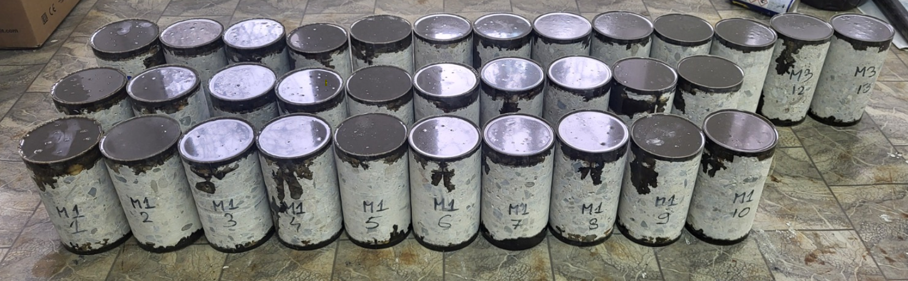
MATERIALS AND METHODS
4. Destructive testing (DT)
Following the core extraction, both ends of each specimen were trimmed using a wet diamond saw to ensure uniformity. The cores were then stored under controlled laboratory conditions, with a temperature of (21 ± 3) °C and relative humidity of (50 ± 5) %, resulting in samples with an approximate height of 150 mm and a diameter of 94 mm.
Upon completion of the non-destructive testing procedures, the ends of each core were coated with epoxy resin to improve the parallelism of the bearing surfaces.
Concrete cores processed with epoxy resin.

Slide 11
MATERIALS AND METHODS
4. Destructive testing (DT)
Destructive testing is limited for preserving building structural integrity, so only few cores can be extracted —often not enough to be representative for the whole structure.
Moreover, core extraction can be technically challenging or unfeasible in certain situations, due to the location of the structural member, limited accessibility for drilling equipment, or other operational constraints.

Slide 12
RESULTS AND DISCUSSIONS
1. Mass-based density (MBD) and
ultrasonic-based density (UBD)
The current study uses the mass-based density (MBD) as the reference approach for determining concrete density.
This technique involves calculating the density by measuring the mass of the core specimen and determining its volume from its geometric dimensions.
As a non-destructive alternative, the ultrasonic-based density (UBD) estimates concrete density using Salman’s Equation.

Slide 13
RESULTS AND DISCUSSIONS
1. Mass-based density (MBD) and
ultrasonic-based density (UBD)
The comparative analysis of the the obtained results demonstrated a high degree of consistency in the measured data, as indicated by the low coefficient of variation (CoV), which ranges between 0.36% and 1.33%. These values reflect minimal dispersion around the mean, suggesting uniformity in the physical properties of the tested concrete samples.
Additionally, the calculated accuracy of 98% supports the validity of Salman’s theoretical model. The strong correlation between mass-based (MBD) and ultrasonic-based density (UBD) measurements confirms the potential of the ultrasonic method as a viable, non-destructive alternative for evaluating concrete density.
Mix | MBD [kg/m³] | UBD [kg/m³] | Accuracy [%]
 | CoV [%] | CoV [%]
M1 | 1.33 | 0.81 | 98
M2 | 1.00 | 0.48 | 98
M3 | 0.66 | 0.36 | 98
MBD and UBD values and accuracy.

Slide 14
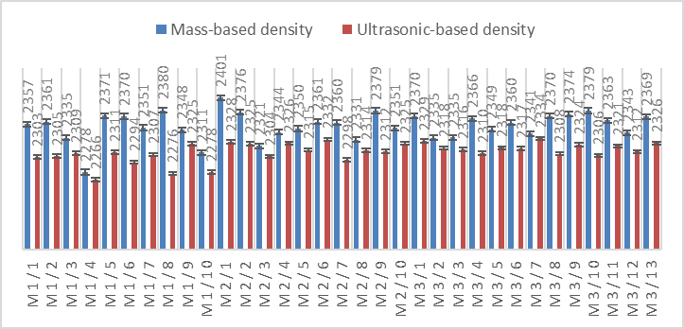
RESULTS AND DISCUSSIONS
1. Mass-based density (MBD) and
ultrasonic-based density (UBD)
Given the limited variability among results, it can be inferred that the ultrasonic-based density (UBD) estimation approach proposed by Salman produces consistent and reproducible values. This supports its continued application in calculating the dynamic modulus of elasticity within the present experimental framework.
Graphical representation of the two densities paired for each core.

Slide 15
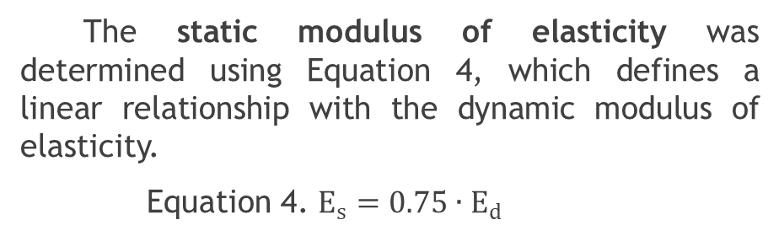
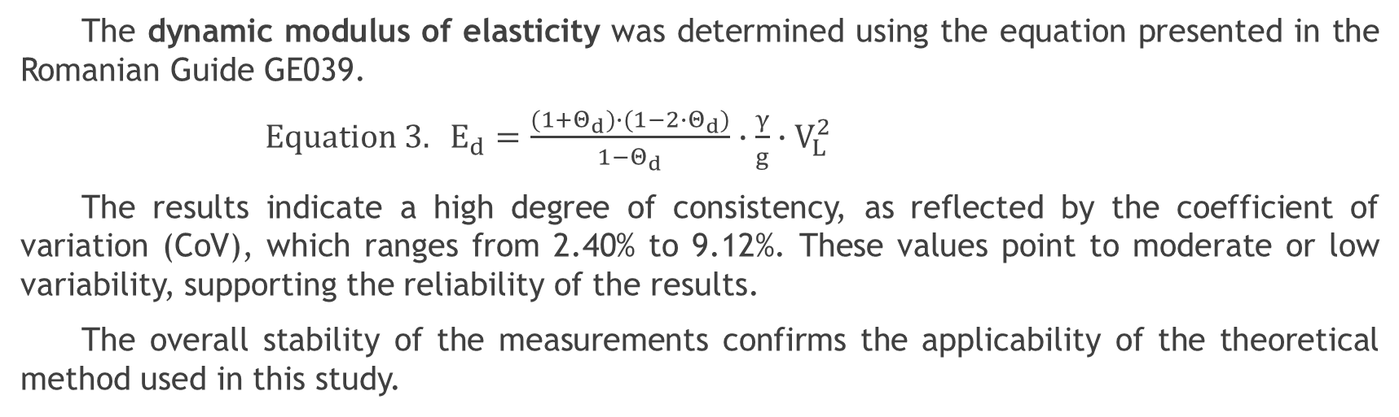
RESULTS AND DISCUSSIONS
2. Modulus of elasticity (Dynamic and Static)
The dynamic modulus of elasticity was determined using the equation presented in the Romanian Guide GE039.
${Equation 3. E}_{d}=\frac{(1+Θ_{d})∙(1−2∙Θ_{d})}{1−Θ_{d}}∙\frac{γ}{g}∙V_{L}^{2}$
The results indicate a high degree of consistency, as reflected by the coefficient of variation (CoV), which ranges from 2.40% to 9.12%. These values point to moderate or low variability, supporting the reliability of the results.
The overall stability of the measurements confirms the applicability of the theoretical method used in this study.
Mix | Theoretical E_{d} [GPa]
 | Min | Mean | Max | CoV [%]
M1 | 29.83 | 34.66 | 39.06 | 8.37
M2 | 34.72 | 37.95 | 40.28 | 4.84
M3 | 35.90 | 38.01 | 40.59 | 3.67
The static modulus of elasticity was determined using Equation 4, which defines a linear relationship with the dynamic modulus of elasticity.
Equation 4. $E_{s}=0.75∙E_{d}$
Dynamic modulus of elasticity.

Slide 16
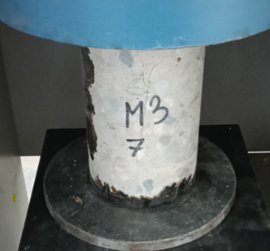
RESULTS AND DISCUSSIONS
3. Compressive strength:
Destructive testing (DT)
The compressive strength of concrete was assessed using both destructive and nondestructive methods.
For the destructive evaluation, core samples were extracted from the concrete beams. The Table presents the mean values obtained through destructive testing.
Destructive testing
Mix | Mean values [MPa]
M1 | 31.8
M2 | 36.5
M3 | 35.4
Table 4. Compressive strength determined through DT testing.

Slide 17
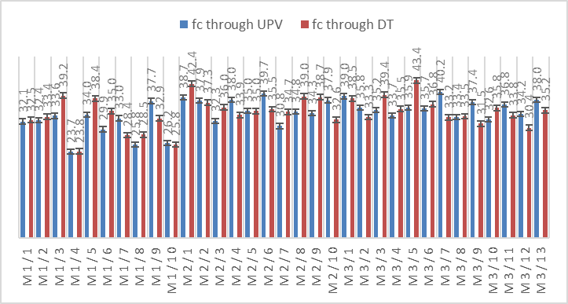
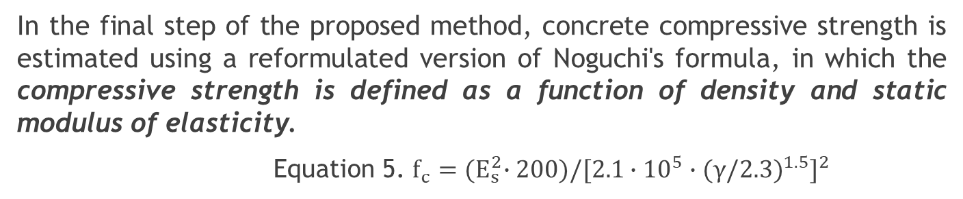
RESULTS AND DISCUSSIONS
4. Compressive strength:
Theoretical approach by UPV testing
In the final step of the proposed method, concrete compressive strength is estimated using a reformulated version of Noguchi's formula, in which the compressive strength is defined as a function of density and static modulus of elasticity.
Equation 5. $f_{c}={(E}_{s}^{2}∙200)/[2.1∙{10}^{5}∙(γ/2.3)^{1.5}]^{2}$
The graphical representation on the left illustrates the comparison between compressive strength values derived from UPV measurements and those obtained through DT on core samples (reference method).
Graphical representation of the two approaches used to determine the concrete com-pressive strength paired for each core.

Slide 18
RESULTS AND DISCUSSIONS
4. Compressive strength:
Theoretical approach by UPV testing
The comparative analysis of compressive strength values obtained through destructive testing and the UPV-based method indicates a satisfactory level of consistency, as reflected by the coefficient of variation (CoV), which ranges from 6.27% to 16.08%. These values point to moderate variability, suggesting the reliability of the obtained results.
Accuracy levels of 91% and 92% further confirm the strong correlation between the two evaluation methods, supporting the applicability of the proposed approach.
Based on the observed variability and accuracy, the proposed method can be considered reliable and capable of producing reproducible results

Slide 19
RESULTS AND DISCUSSIONS
5. Compressive strength:
SonReb vs proposed UPV approach
Mix | SonReb [MPa] | UPV [MPa] | Accuracy [%]
M1 | 26.0 | 30.8 | 84
M2 | 30.5 | 35.9 | 85
M3 | 37.4 | 36.0 | 96
Non-destructive testing was performed using both the SonReb method applied directly to the concrete elements and the Ultrasonic Pulse Velocity (UPV) method applied to core samples extracted from the structure.
This comparative approach allowed for a broader evaluation of the UPV-based method used to estimate compressive strength.
Compressive strength determined through both NDT testing.
The table presents the average compressive strength values obtained from each nondestructive method, along with the associated accuracy.

Slide 20

CONCLUSIONS
This study demonstrates the practical applicability of non-destructive methods for assessing concrete characteristics, with particular focus on density, modulus of elasticity, and compressive strength.
The ultrasonic-based approach achieved an accuracy of 98% when compared with the destructive testing (as Reference method), indicating a strong correlation between the two techniques.
The low values of the coefficient of variation, ranging from 0.36% to 1.33%, confirm the consistency of the recorded data and support the use of ultrasonic measurements as a viable non-destructive alternative for density evaluation.

Slide 21
CONCLUSIONS
The study aimed to investigate whether the proposed method maintains a high level of accuracy under varying sand-to-gravel ratios by examining whether the estimated compressive strength values reflect the corresponding variations and align closely with those obtained through destructive testing.
When comparing compressive strength values obtained through destructive testing with those estimated via UPV and SonReb methods, the UPV technique demonstrated higher accuracy, ranging from 91% to 92%, as opposed to 82% to 95% for the SonReb method.
These results suggest that UPV offers a more consistent and reliable alternative for estimating compressive strength under non-destructive testing conditions.

Slide 22
CONCLUSIONS
Moreover, the comparison between the two NDT approaches showed that UPV consistently achieved higher accuracy levels (97% – 98%) than the SonReb method, further supporting its use as a dependable tool for strength evaluation.
Overall, the results confirm that ultrasonic techniques provide stable and repeatable measurements for characterizing concrete properties.
As such, these methods can be effectively incorporated into structural monitoring systems for ongoing evaluation and maintenance of reinforced concrete elements.

Slide 23
ACKNOWLEDGEMENTS
This work was carried out within the Nucleu Programme of the National Research Development and Innovation Plan 2022-2027, supported by MCID, "ECODIGICONS" project no. PN 23 35 04 01: “Fundamental-applied research into the sustainable development of construction products (materials, elements, and structures, as well as methods and technologies) that utilizes current national resources to enhance the eco-innovative and durable aspects of Romania's civil and transport infrastructure”, financed by the Romanian Government.

Slide 24
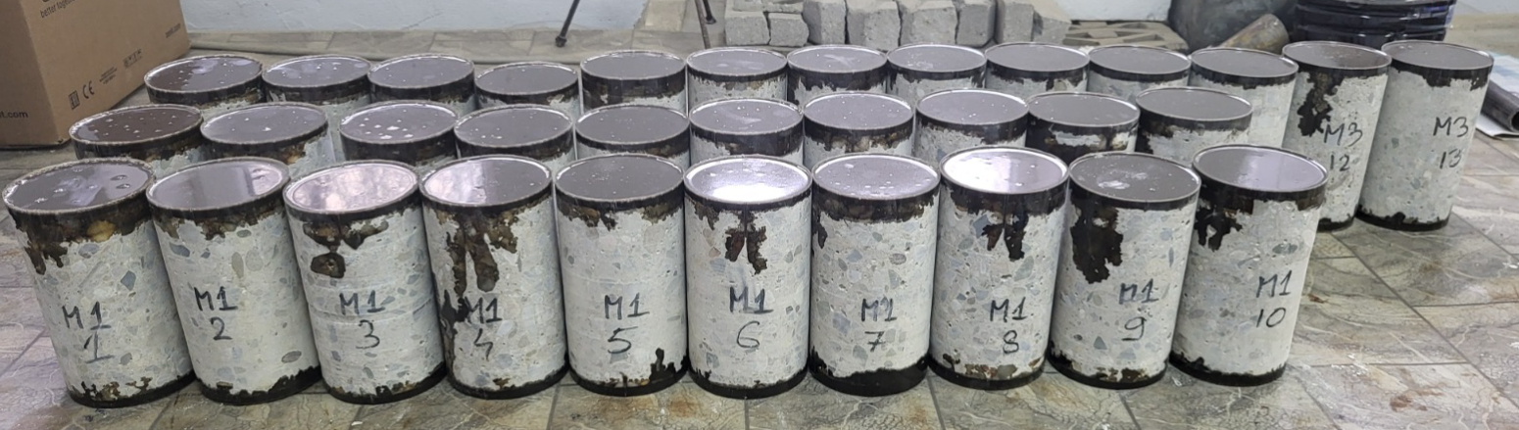
Thank you for your attention!

