Slide 1





COMPREHENSIVE STUDY ON ROMANIAN SPENT GARNET WASTES AS SAND SUBSTITUTION IN CEMENTITIOUS MATERIALS – AN OVERVIEW
Cornelia BAERĂ^{1,2}, Ana-Cristina VASILE^{1,3}, Aurelian GRUIN^{1,3}, Bogdan BOLBOREA^{1,3}, Luiza VARGA⁴, Alexandra Marina BARBU⁵
¹N.I.R.D. URBAN-INCERC, Timisoara Branch, Romania
²Politehnica University of Timișoara, Faculty of Management in Production and Transportation, Timișoara Romania
³Politehnica University of Timișoara, Faculty of Civil Engineering, Timișoara Romania
⁴"Ion Mincu" University of Architecture and Urban Planning, Bucharest, Romania
⁵N.I.R.D. URBAN-INCERC, Bucuresti Branch, Romania

Slide 2
I
INTRODUCTION
II
MATERIAL AND METHODS
CONTENT
III
RESULTS AND DISCUSSIONS
IV
CONCLUSIONS

Slide 3
I. INTRODUCTION
Research project PN 23 35 04 01, component of “ECODIGICONS” Programme, financed by the Romanian government:
“Fundamental-applied research into the sustainable development of construction products (materials, elements, and structures, as well as methods and technologies) that utilizes current national resources to enhance the eco-innovative and durable aspects of Romania's civil and transport infrastructure.”
Design of technological algorithms specific to construction and supporting industries, by fast and efficient interaction to all stakeholders, directly or indirectly connected to the outcomes of the study:
- The academic and research media;
- The entrepreneurs (main market or support market, as well);
- The users (clients: the business-to- business (B2C) type of costumer, namely the industry and also business-to-consumer (B2C) as end-users of the products or services);
- The suppliers;
- The social, economic and politic compounds, local and central authorities.

Slide 4

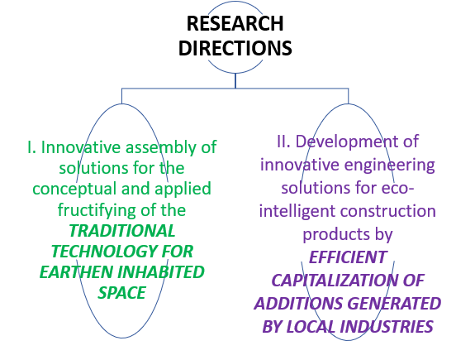
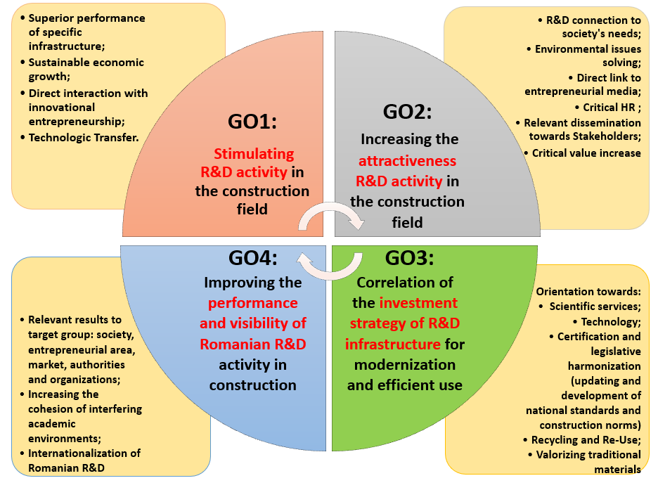
I. INTRODUCTION
4 GENERAL OBJECTIVES (GO)
14 SPECIFIC OBJECTIVES (SMART)
2 RESEARCH DIECTIONS
16 PHASES (ASOCIATED MILESTONES)
Solutions to the current problems in the construction sector:
Development of products and services (materials, elements and structures, processes and technologies, etc.),
with superior overall performance and increased energy efficiency,
for the Circular Economy (EC) principles implementing in Romania.

Slide 5
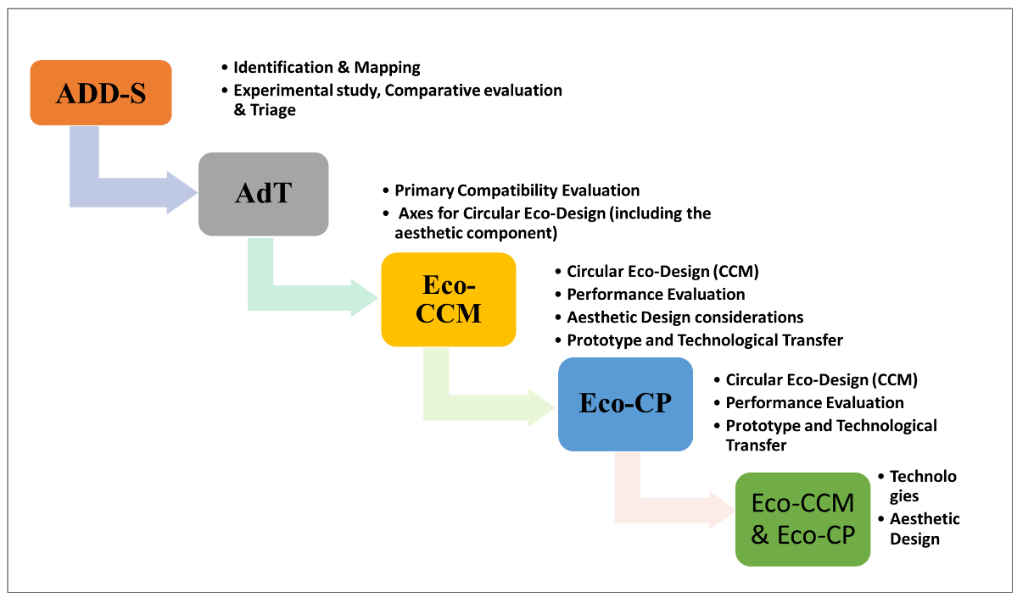
I. INTRODUCTION
Axis II. Development of innovative engineering solutions for eco-intelligent construction products by an efficient capitalization of additions generated by local industries
Preliminary evaluation of the current directions with potential in the capitalization, at regional / national level, of ADD-S additions (in the development of eco-intelligent materials and products for constructions)
Eco-CP Flowchart: The logical scheme for structural implementation of specific project objectives associated to Axis II

Slide 6
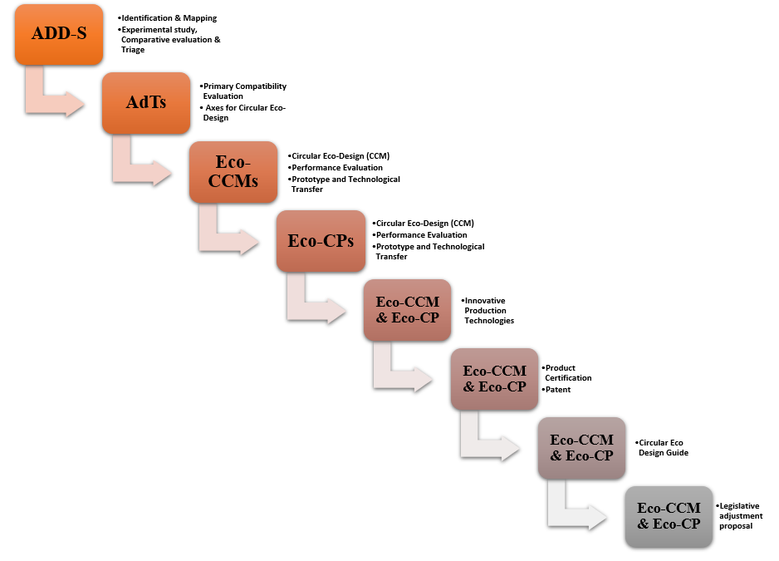
I. INTRODUCTION
3. Preliminary evaluation of the current directions with potential in the capitalization, at regional / national level, of ADD-S additions
(in the development of eco-intelligent materials and products for constructions)
Legend:
- AdT: Target Additions (AdT), with high potential for capitalization in circular design for eco-intelligent construction products;
- ADD-S: Additions Derived from Waste and Industrial Byproducts (inert / hydraulically latent / pozzolanic, etc.), and/or derived from Demolition and/or decommissioning of buildings;
- Eco-CCM: Eco-intelligent Composite Materials for Constructions, with advanced functionality (Eco-Composite Materials for Constructions);
- Eco-CP: Eco-intelligent Construction Products, with advanced functionality, made by using Eco-CCM (Eco-Construction Products)
Extended Eco-CP Flowchart:
The logical scheme for structural implementation of specific project objectives associated to Axis II

Slide 7
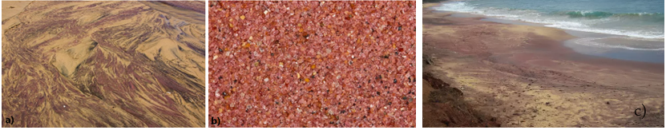
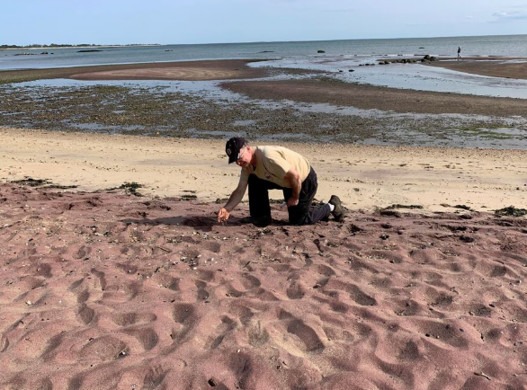
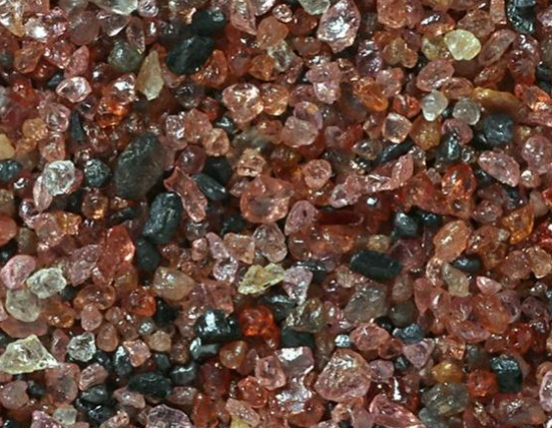
I. INTRODUCTION
Abrasive Garnet sands for industrial application and the derived waste (Spent Garnets):
Garnet - is a silicate rock-forming mineral, occurring in many rock types
Granular sands of Garnet type (Garnets):
abrasive materials, generally with reddish - pink range of colors;
- alluvial materials or derived from rock crushing processes.
Usually sand contains low quantities of Garnet, with some exceptions, when indeed Garnet can be the sand-forming mineral.
a) Coastline of Pfeiffer Beach, California, USA - Garnet mineral sand;
b) Australian Garnet sand, general aspect; c) Garnet sand beach in Sri Lanka;
d) Garnet sand deposits, Long Island Sound in Madison, Connecticut, USA;
e) Garnet sand grains (aspect and colour variation) (https://fredmhaynes.com/2021/03/11/a-sea-of-garnet-sand/)
d)
e)

Slide 8
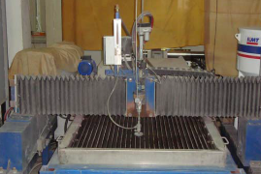
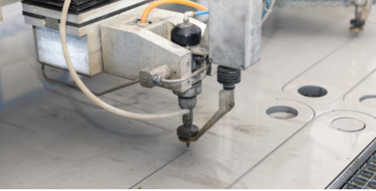
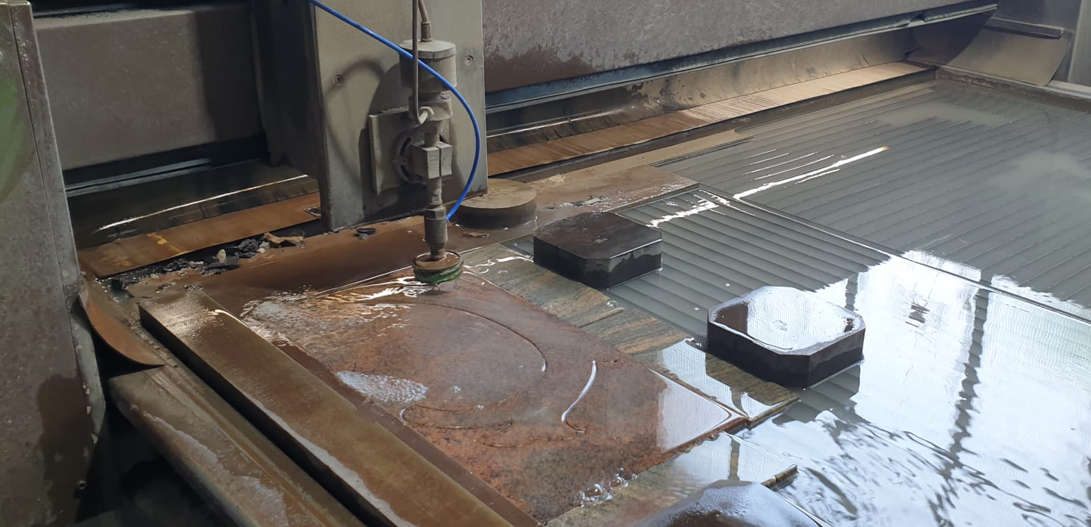
I. INTRODUCTION
Granular sands of Garnet type (Garnets) & The derived waterjet cutting Garnet wastes
The waterjet cutting operations used for material processing were improved by using abrasive granular sands of Garnet type as complementary cutting material.
Unique features of the Garnets as complementary cutting material :
grain hardness;
edge sharpness;
specific grain size distributions.
Garnets determine:
the steady abrasive flows ;
no blockages in the focusing tube.
Advantages for the cutting procedure :
quality gain, speed, accuracy.
Waterjet cutting operations with complementary abrasive Garnets

Slide 9
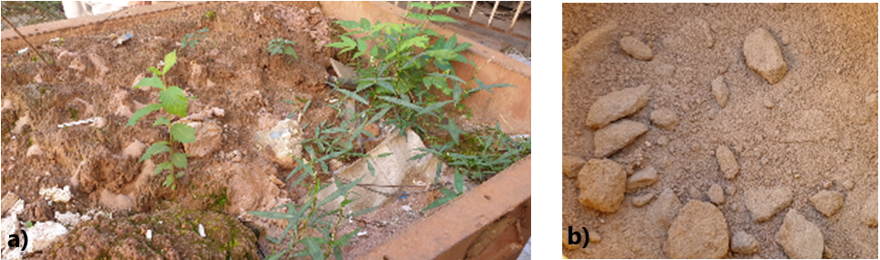
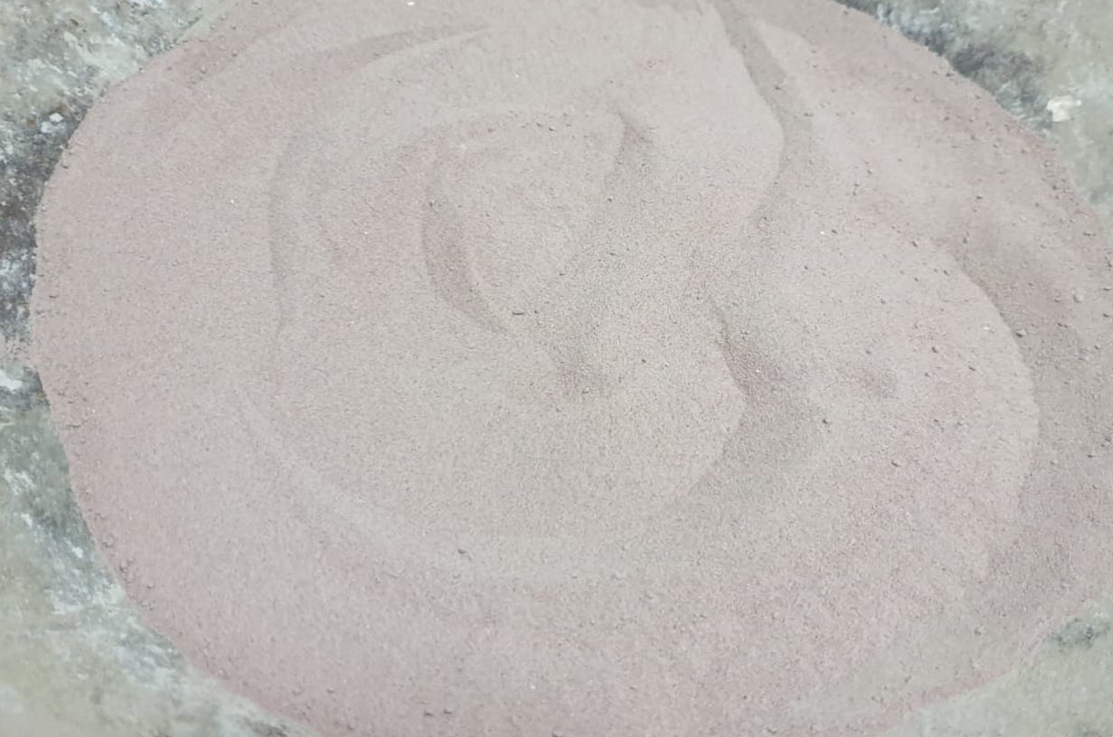
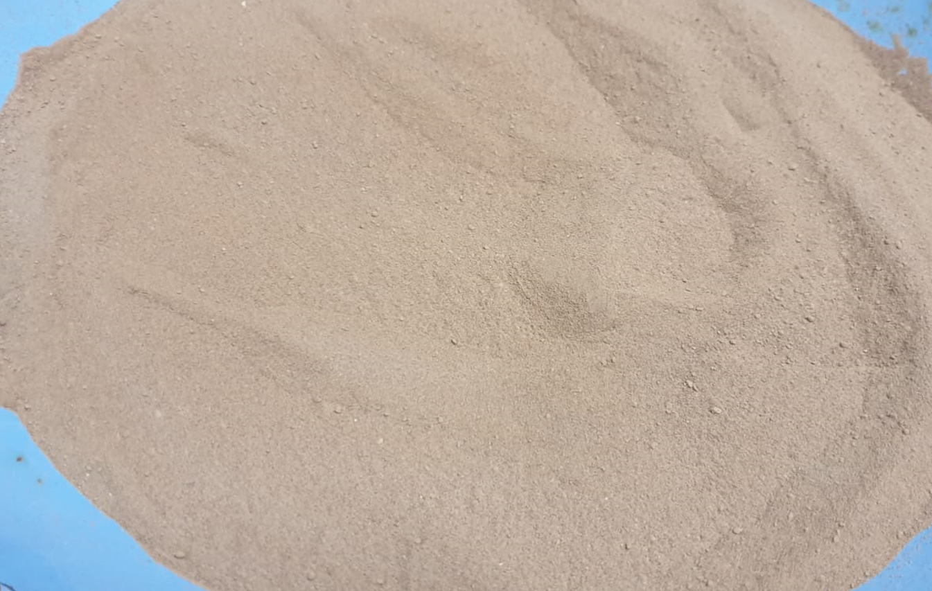
I. INTRODUCTION
Granular sands of Garnet type (Garnets) & The derived waterjet cutting Garnet wastes
The slurry:
- collected in recipients underneath the cutting equipment,
- randomly evacuated, generating the waste dumps after the natural drying process
Waterjet cutting Garnet wastes: a) waste dumps; b) Dry raw state of Garnet wastes (ISIM source)
Dry raw state of Garnet wastes, local sources

Slide 10
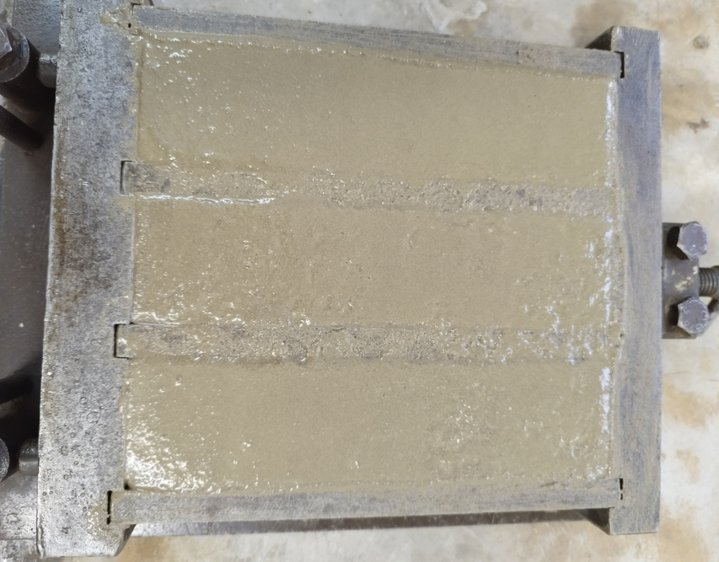

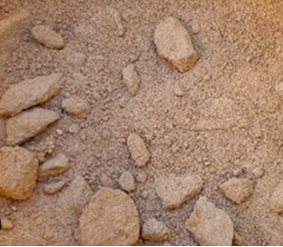
II. MATERIAL AND METHODS
General approach of the experimental study
Research performed in the last decade shows the potential of Spent Garnets as a fine aggregate replacement in construction materials, mortar and concrete.
They indicated that incorporating Spent Garnets (SGs) in the concrete or mortar mixture can improve their physical and mechanical properties, such as densities and workability, flexural and compressive strength, while also contributing to environmental sustainability.
This can be seen as an eco-friendly alternative to natural sand, which represents an exhaustible, natural resource. In this context, Garnet waste, a byproduct of abrasive waterjet cutting in the material processing industry, can be effectively repurposed in the construction sector.
Natural Sand
Garnet Waste - Spent Garnet (SG)
Cement-based Composition with Garnet Wastes Substitutions

Slide 11
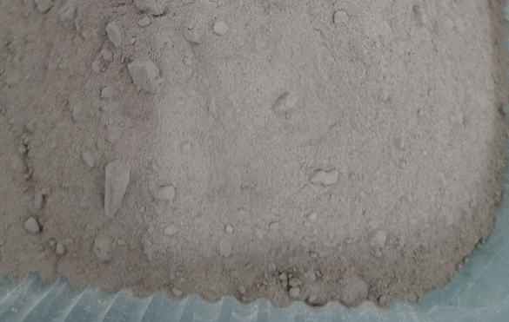
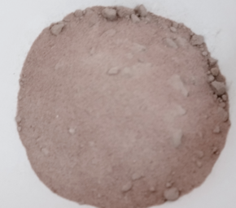
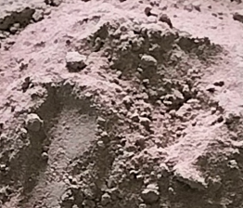
II. MATERIAL AND METHODS
General approach of the study
1. EXTENDED COMPATIBILITY EVALUATION: comprehensive experimental procedure for the purpose of evaluating the potential of SG wastes, locally produced, as partial replacement of sand in a regular cement-based mortar.
SG 5
SG 2
SG 6
The current study incorporates three more adiacent sources of Spent Garnet waste, identified as SG 2, SG 5 and SG 6, with respect to initial, preliminary study.

Slide 12
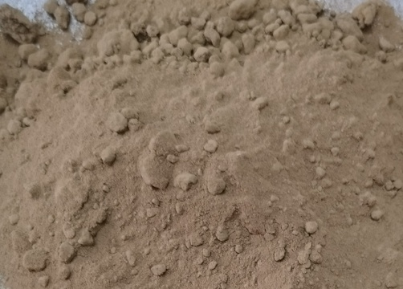
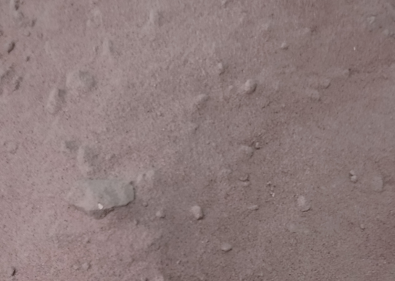
II. MATERIAL AND METHODS
General approach of the study
2. VALIDATION STAGE: experimental approach destined to validate the conclusions reached in the preliminary phases of the research.
SG 3
SG 1
SG 1 and SG 3 were provided from the same local provider, but they were collected at different times—SG 1 in April 2022 and SG 3 in August 2023, over a year apart.

Slide 13
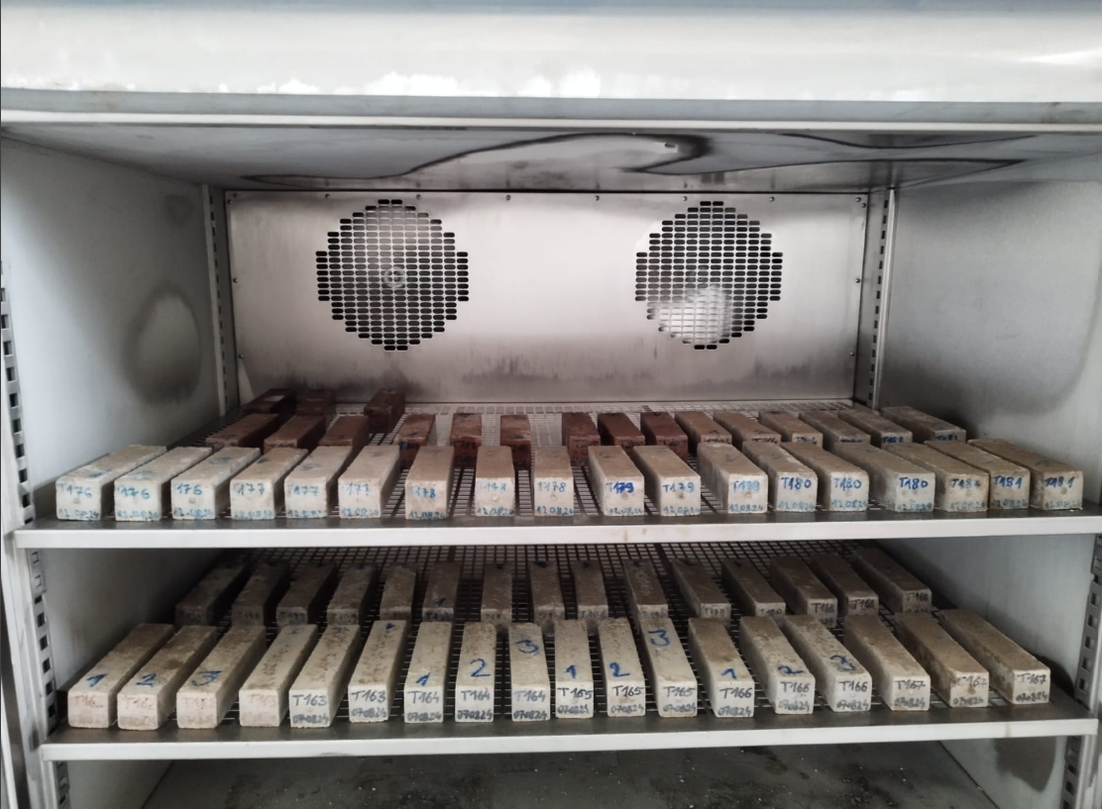
II. MATERIAL AND METHODS
General approach of the study
3. DURABILITY EVALUATION: experimental procedure destined to analyze the material freez-thaw resistance as relevant durability performance.
Prismatic specimens exposed to freeze-thaw cycling testing
All SG types of wastes, SG1 …. SG 6 were included in the durability test, which consisted in specific exposure to 50 freeze-thaw cycles and corresponding testing.

Slide 14
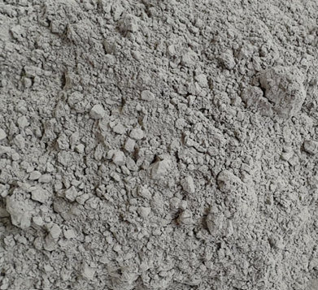
II. MATERIAL AND METHODS
Raw materials
The research protocol is simple and in accordance to previous study in the topic: Two Reference mix was proposed (R1 and R2), followed by the relevant parametric variation, namely the sand partial substitution with the considered SG wastes (SG1 - SG6).
a
b
The natural, regular sand substitution was performed by weight and it ranged from 10% to 50%, with respect to the reference, in accordance to previous studies’ classical approach.
c
The Reference and the SG mixes were produced with locally available raw materials:
- Portland Cement, CEM II/A-LL 42.5 R (C), (a);
- Natural sand, (Granular class 0/4, (S)), (b);
- Spent Garnets (SGs), namely SG wastes collected from four distinct local sources: SG 1 (c), SG 2 (d), SG 3 (e), SG 5 (f); and SG 6 (g).
- Water (tap water).
g
d
f
e
The substitution is performed at 10%, 30% and 50% by mass, following the standard methodology established in previous studies, and the mixing procedure is in accordance with EN 196-1 and 1015-11.

Slide 15
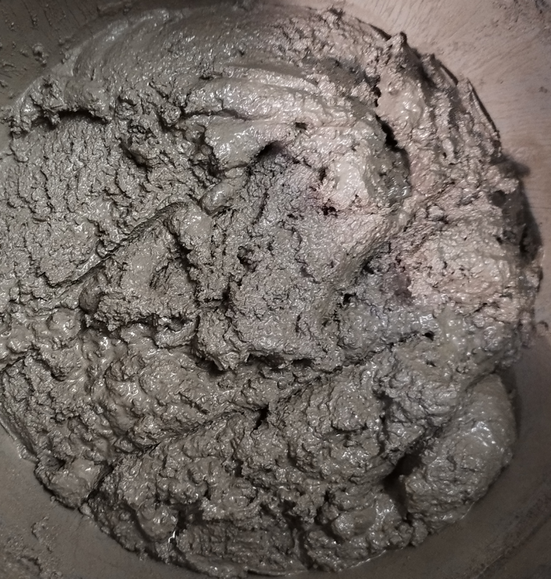
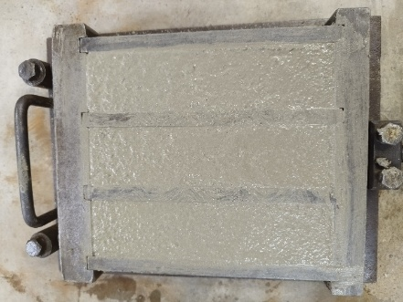
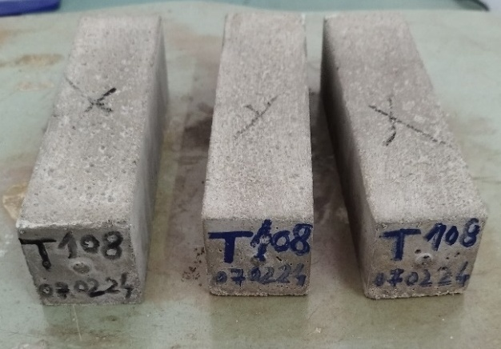
II. MATERIAL AND METHODS
Mix proportion and specimen preparation
After 24 hours, the prismatic specimens were removed from the moulds and cured by water immersion at the temperature T (20±1) °C, until testing ages, performed at 7, 28 and 112 days.
The mixing sequences were established considering the typical laboratory mixture suitable for low volume batches, in accordance to the EN 196-1 specifications.
The mortars were cast into prismatic, metallic moulds, and placed for initial 24 h curing at the temperature T (20±1)°C and relative humidity RH (90±5)%.

Slide 16
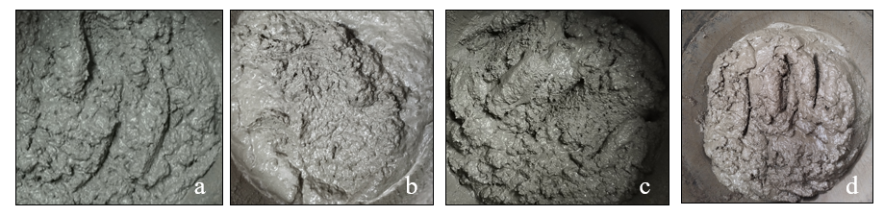
III. RESULTS AND DISCUSSIONS 1. Extended compatibility evaluation
Fresh state evaluation of the SG mixes
The experimental results indicate that all mortar mixtures displayed a homogeneous fresh state, with SG mortars showing improved cohesiveness and a creamier texture compared to the reference mixes R1 and R2.
This enhancement became more pronounced with higher levels of sand replacement and is attributed to the increased presence of fine particles in the SG material, as noted in initial study.
Fresh state aspect of the mortars: a) R2; b) SG 1, 10%; c) SG 1, 30%; d) SG 1, 50%

Slide 17
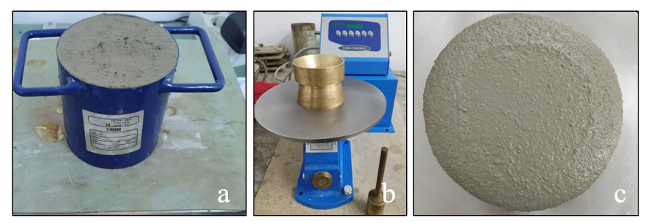
III. RESULTS AND DISCUSSIONS 1. Extended compatibility evaluation
Fresh state evaluation of the SG mixes
The fresh bulk density for SG 30% and SG 50% mixes was determined according to SR EN 1015-6 by weighing the freshly poured material into a container of predetermined volume and reporting its volume, 1 l.
The consistency of the SG 30% and SG 50% fresh mortars was determined by the reference method, i.e. spreading mass according to SR EN 1015-3 .
Fresh state characteristics: a) fresh state density b) and c) material consistency determined by flow table

Slide 18
III. RESULTS AND DISCUSSIONS 1. Extended compatibility evaluation
Fresh state evaluation of the SG mixes
Fresh state characteristics - Fresh State Density

Slide 19
III. RESULTS AND DISCUSSIONS 1. Extended compatibility evaluation
Fresh state evaluation of the SG mixes
Fresh state characteristics - Mortar consistancy

Slide 20
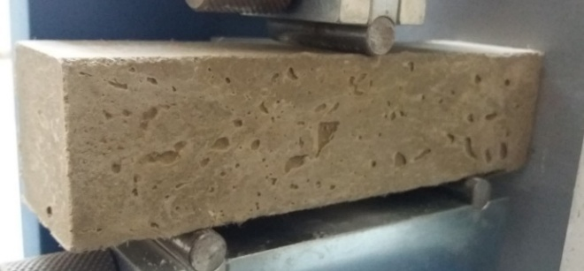
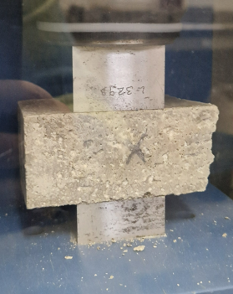
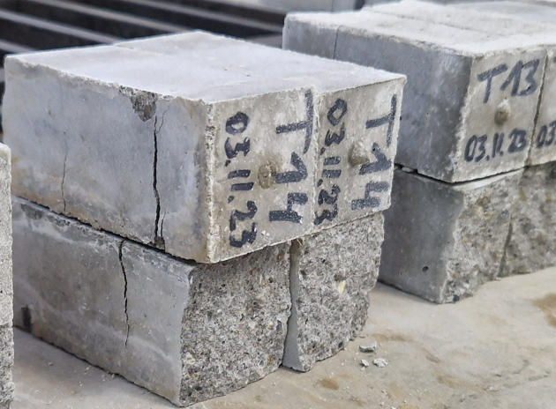
III. RESULTS AND DISCUSSIONS 1. Extended compatibility evaluation
Mechanical performance of the SG mixes
The mechanical performance, evaluated via flexural strength and compressive strength of the SG substitution mortars, is performed based at early age (7 days), at regular age of 28 days and at late age (112 days).
The flexural strength was determined using the three-point bending (3PB) test performed on whole specimens, followed by the compression test on the resulting half-prism specimens.

Slide 21
III. RESULTS AND DISCUSSIONS 1. Extended compatibility evaluation
Mechanical performance of the SG mixes

Slide 22
III. RESULTS AND DISCUSSIONS 1. Extended compatibility evaluation
Mechanical performance of the SG mixes

Slide 23
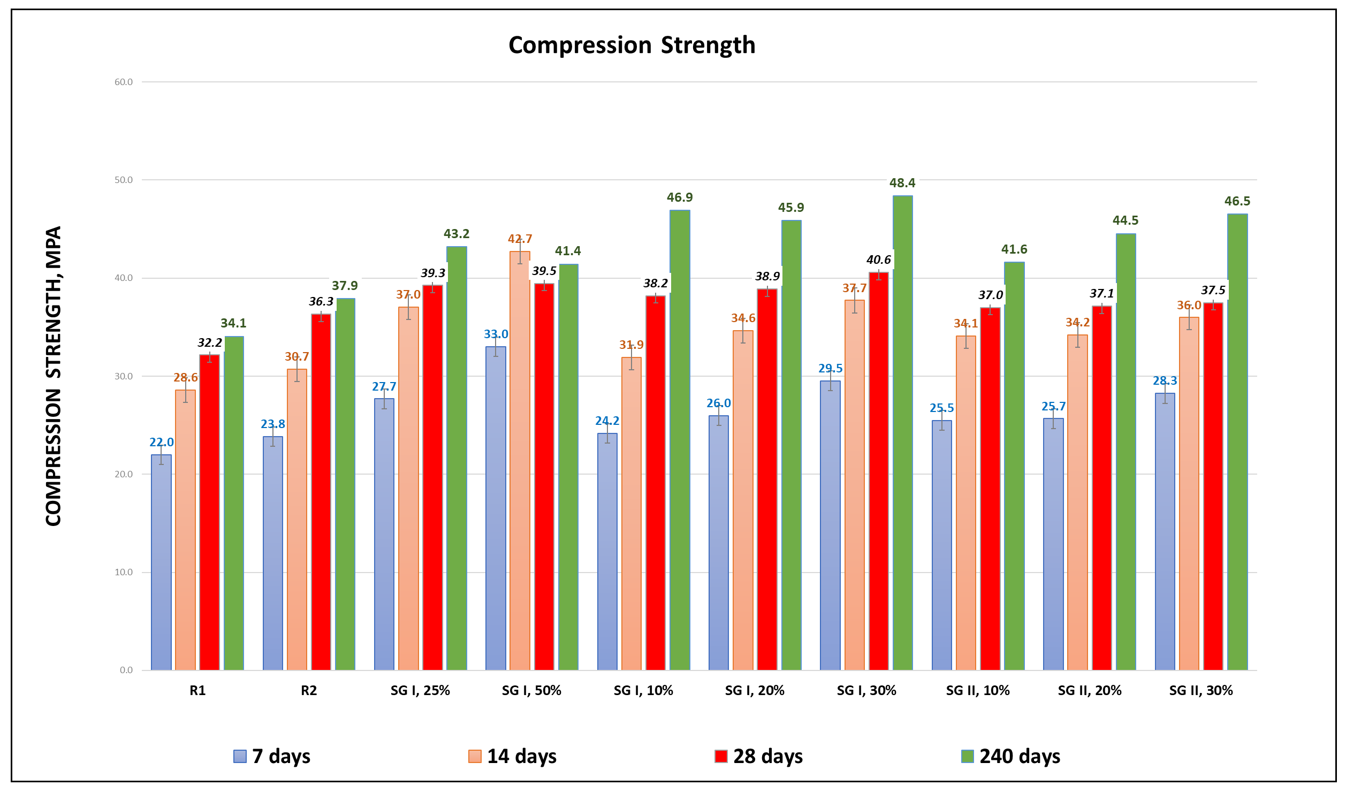
II. MATERIAL AND METHODS: 2. Validation stage
Background of current research:
Evaluating substitution percentages, ranging from 10% to 50% of spent Garnet waste in cement mortars
The preliminary studies included tests carried out for different substitution percentages, ranging from 10% to 50%.
CONCLUSIONS ON THE PRELIMINARY STUDY
The general analysis of the preliminary stage concluded that the low percent substitutions (bellow 30%) are not convenient;
Overall performance (fresh state and hardened state) of the medium percent substitution mortars (ranging from 30% to 50%) are showing a good behavior.

Slide 24
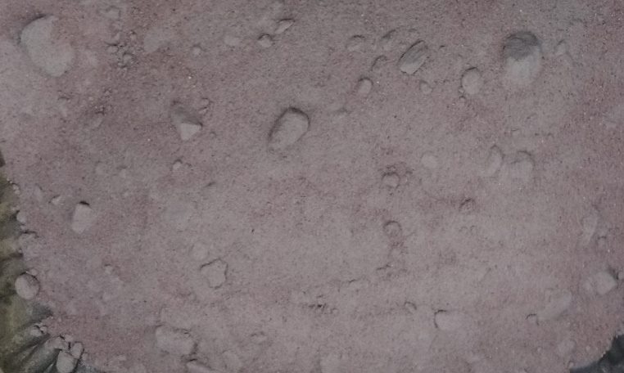

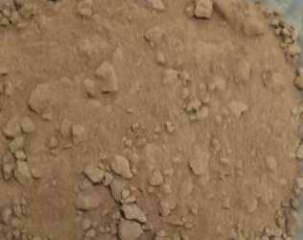
II. MATERIAL AND METHODS: 2. Validation stage
The current focus is on the medium percent substitution mortars (30% and 50%), after the triage is performed.
The validation methodology represents a comprehensive comparative analysis applied on:
raw materials;
SG materials;
resulted substitution mortars.
Portland Cement
Natural sand (0/4), S
It includes:
visual aspects;
physical and mechanical characteristics.
SG 1
SG 5
SG 3

Slide 25
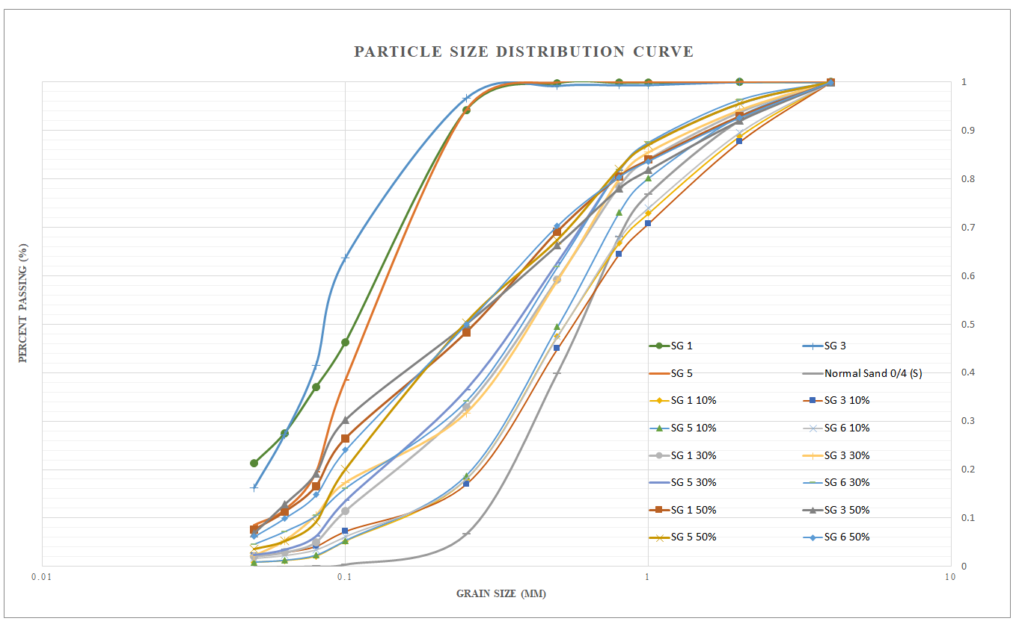
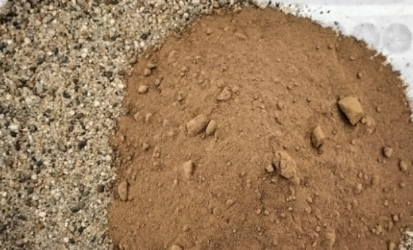
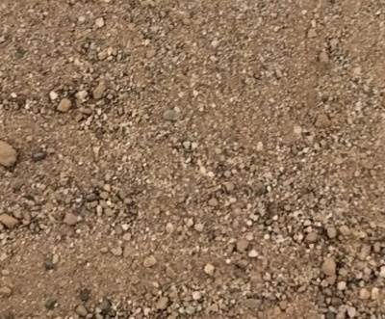
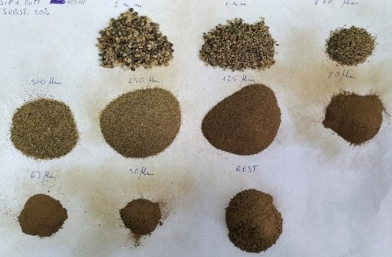
II. MATERIAL AND METHODS / III. RESULTS AND DISCUSSIONS: 2. Validation stage
Grain size analysis of the aggregates
The sieving analysis is performed according to EN 933-1 method for the usual sand 0/4 (S), for the considered substitution SG materials, SG 1, SG 3, and SG 5 and additionally for the S+SG blended aggregate, containing 10%, 30% and 50% replacement levels of the sand (S).
Determination of particle size distribution for SG 1 50% mixture: a) component materials, S+ SG 1, before mixing; b) S+SG 1, after mixing; c) particle size fractions (retained on sieve) resulting from the sieving operation.
Aggregate grading: Natural sand 0/4 (S), SG 1, SG 3, SG 5 and blended aggregate mixture of S+SG (1, 3 or 5) (10%, 30% and 50%)
The natural sand 0/4 (S) has a lower fine grain content, as anticipated. Replacing 10% natural sand (S) with SG material does not influence the overall grain size distribution, but 30% and 50% sand replacement by SG helps balance the aggregate grading curve.
All SG materials exhibit a consistent grain size distribution pattern, with minimal variation, enhancing the reliability of the proposed substitution.

Slide 26
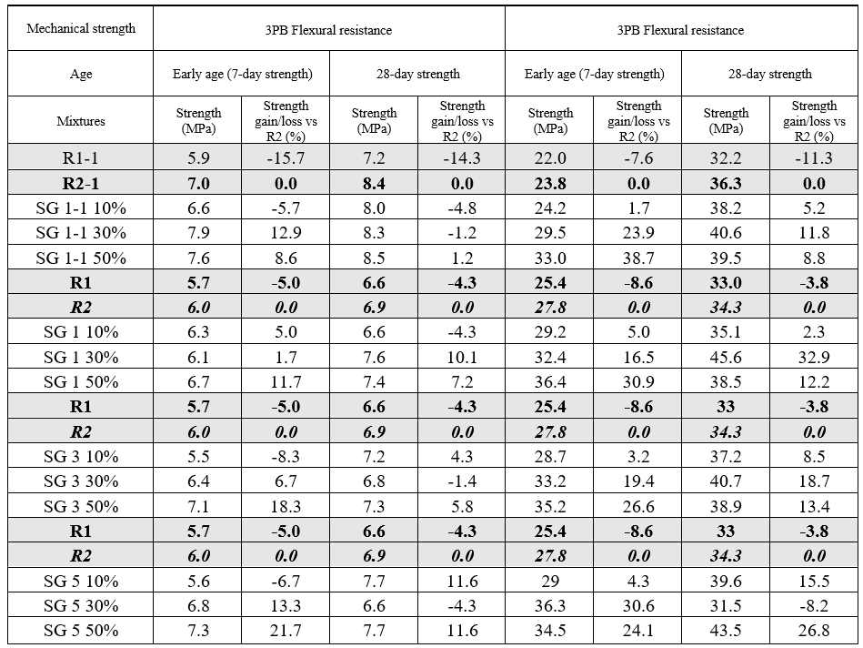
III. RESULTS AND DISCUSSIONS 2. Validation Stage
Mechanical evaluation of the SG mixes
Hardened state evaluation – Compressive and Flexural strength at 7 and 28 days
Legend:
R1-1 and R2-1: Reference mortars produced during the initial mechanical testing of SG 1 material (source 1, ISIM Timisoara, initial sampling) – PRELIMINARY STAGE
SG 1-1 10%, SG 1-1 30%, SG 1-1 50%: Substitution mortars produced during the initial mechanical testing of SG 1 material (source 1, ISIM Timisoara, initial sampling) – PRELIMINARY STAGE
R1 and R2: Reference mortars produced during the secondary mechanical testing of SG 1 material (source 1, ISIM Timisoara, initial sampling), SG 3 (source 1, ISIM Timisoara, secondary sampling); SG 5 (source 2, Tim Cut SRL, Timisoara, initial sampling) – VALIDATION STAGE
SG 1, SG 2, SG 3 (10%, 30%, 50 %): Substitution mortars produced during secondary mechanical testing of SG 1 material (source 1, ISIM Timisoara, initial sampling), SG 3 (source 1, ISIM Timisoara, secondary sampling); SG 5 (source 2, Tim Cut SRL, Timisoara, initial sampling) – VALIDATION STAGE.

Slide 27
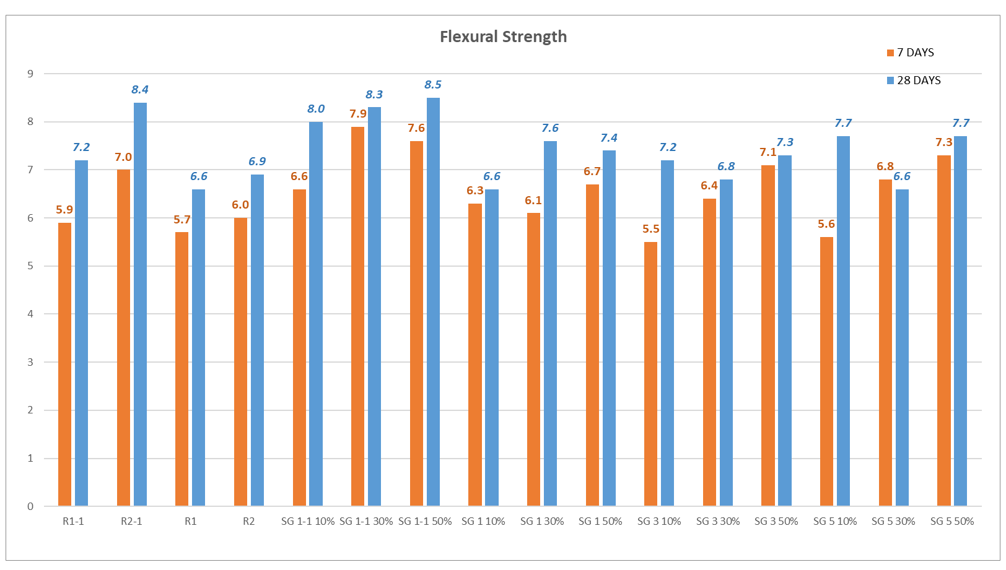
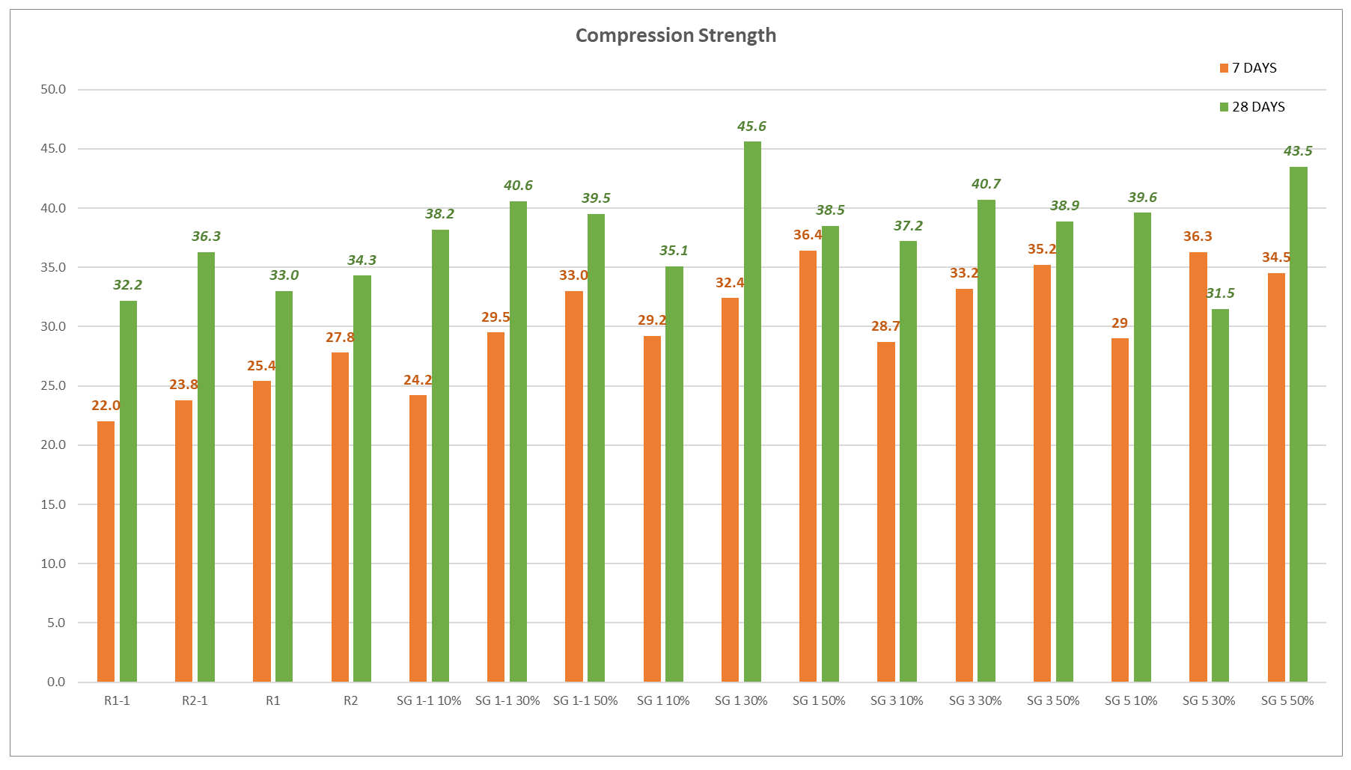
III. RESULTS AND DISCUSSIONS 2. Validation Stage
Mechanical evaluation of the SG mixes
Hardened state evaluation – Compressive and Flexural strength at 7 and 28 days
Comparative analysis of mechanical strength evaluation for the SG material sourced 1 (SG 1 and SG 3), sourced 2 (SG 5) and Reference: a), c) 7-day and 28-day flexural strength; b), d)7-day and 28-day compression strength;

Slide 28
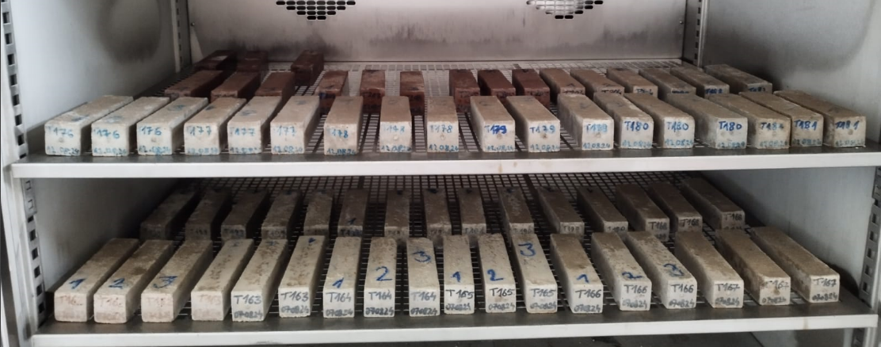
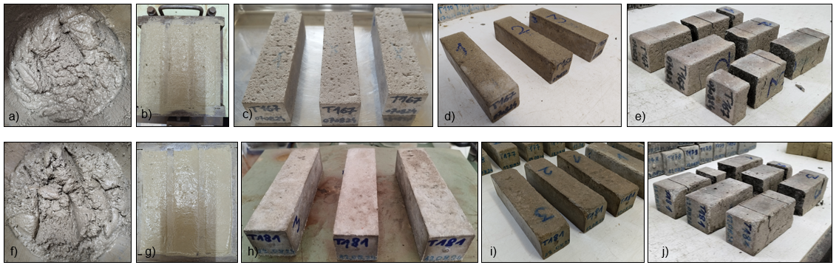
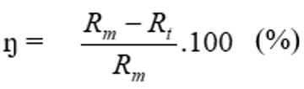

II. MATERIAL AND METHODS: 3. Durability evaluation
Freeze-thaw resistance
Evaluation of durability performance for SG prototype mortars:
Determination of material freez-thaw resistance (50 cycles)
The freez-thaw resistance was determined in accordance with Romanian SR 3518: 2009 specifications, using the destructive method to assess the flexural and compressive strength losses of the Test Specimens (exposed to 50 freeze-thaw cycles) in relation to the control specimens (conditioned by immersion at a temperature of T (20 ± 2) °C until the mechanical test was performed).
The destructive test is performed on 40 x 40 x 160 mm prisms aged 28 days, followed by 50 freeze-thaw cycles. The conditioning of the test specimens, from the moment of demoulding until they reach the age of 28 days, is performed by immersion at a temperature of T (20 ± 2) °C.
The strength loss is calculated with the relation:
Rm – Reference (water conditioning);
Rt – Test Specimens (Freez-Thaw, FT exposure);
Strength loss with respect to the considered Reference

Slide 29
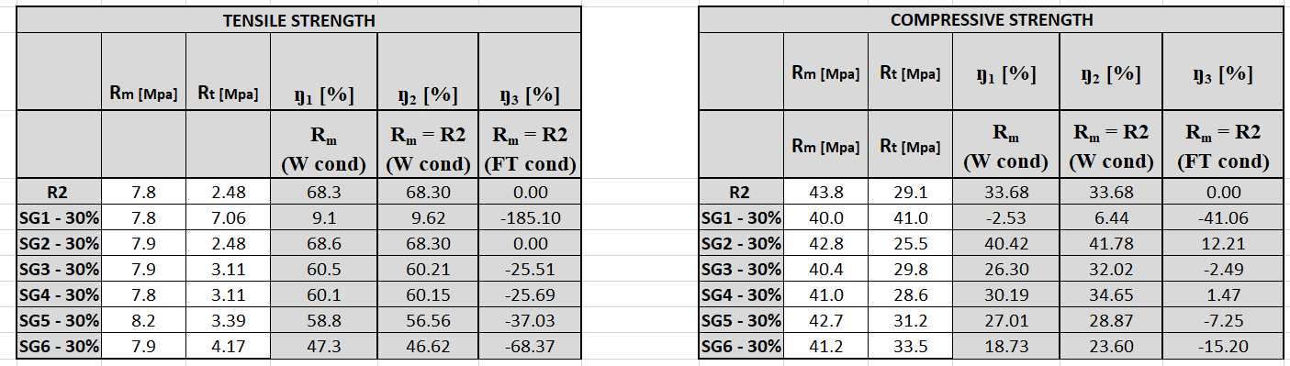
III. RESULTS AND DISCUSSIONS 3. Durability evaluation
Freeze-thaw resistance
Evaluation of durability performance for SG prototype mortars:
Determination of material freez-thaw resistance (50 cycles)
Comparative analysis of mechanical strength loss after the 50 freez-thaw cycles: Tensile Strength and Compressive Strength

Slide 30
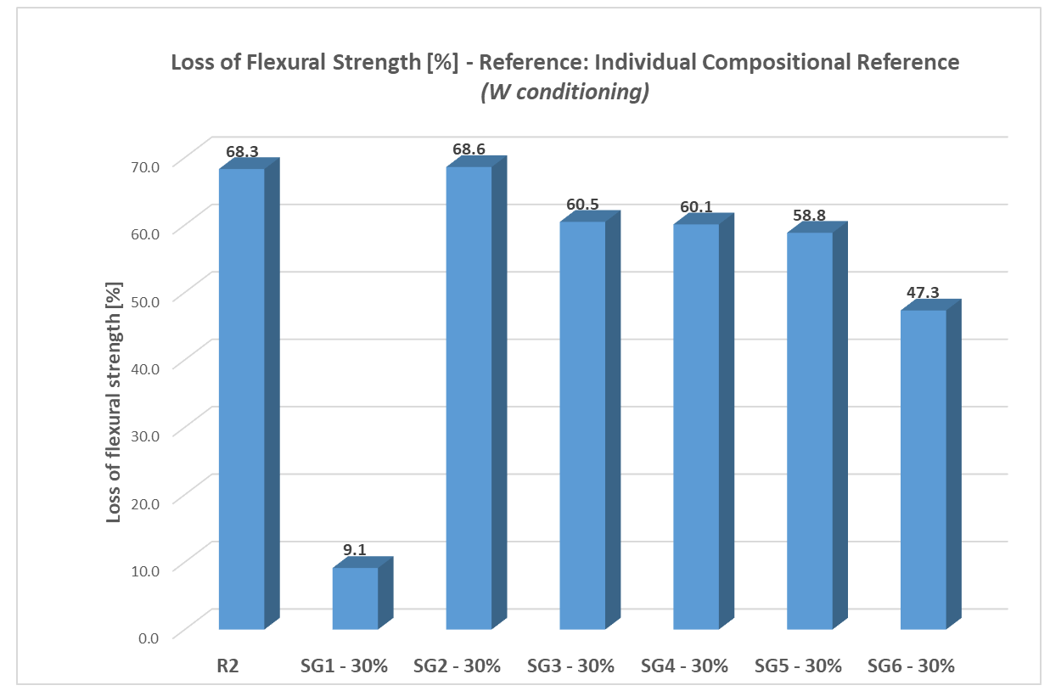
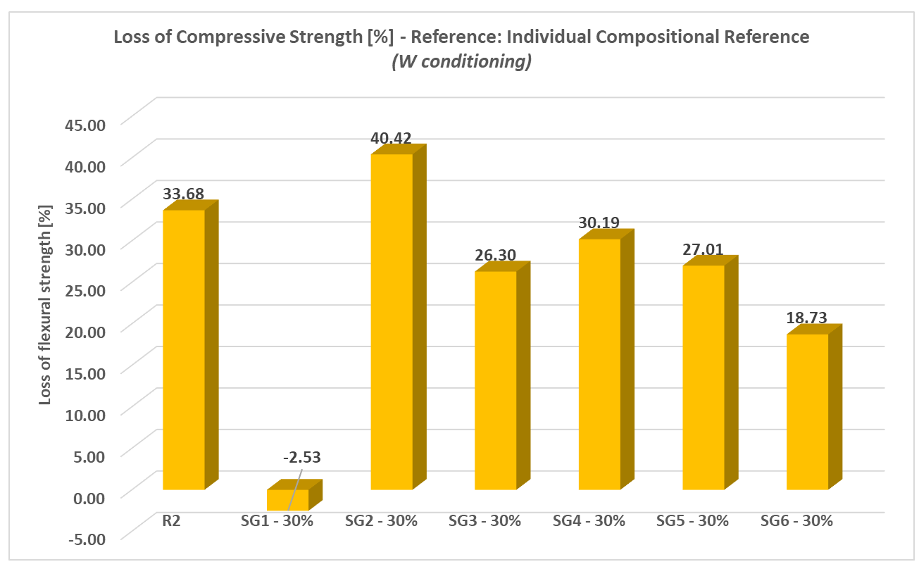
III. RESULTS AND DISCUSSIONS 3. Durability evaluation
Freeze-thaw resistance
Evaluation of durability performance for SG prototype mortars:
Determination of material freez-thaw resistance (50 cycles)
Comparative analysis of mechanical strength loss after the 50 freez-thaw cycles:
Reference: Individual Compositional Reference (W conditioning)

Slide 31
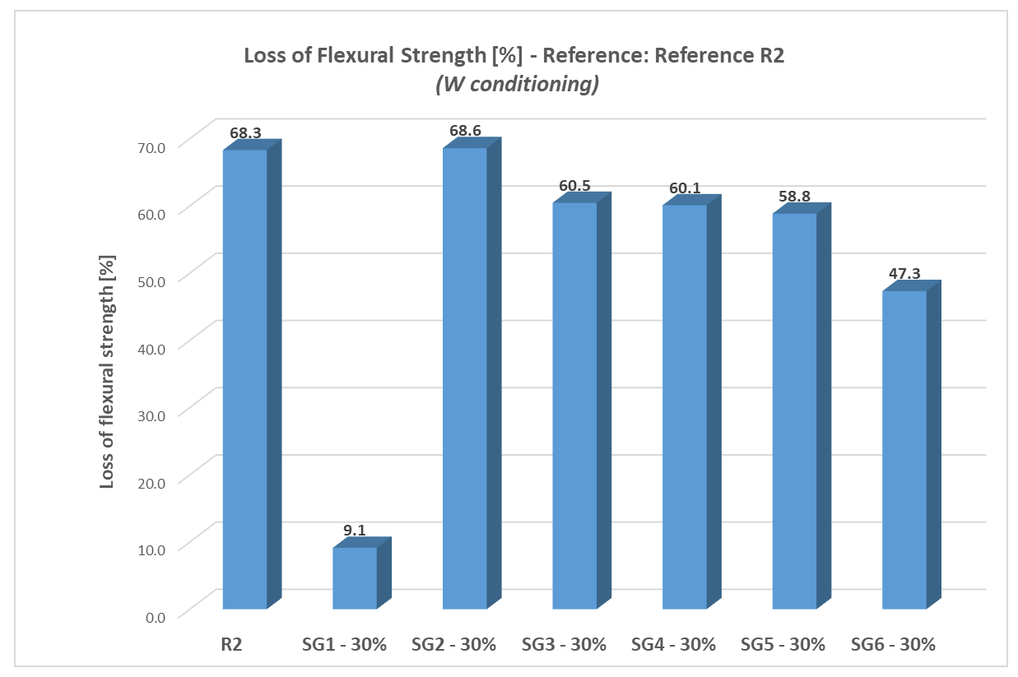
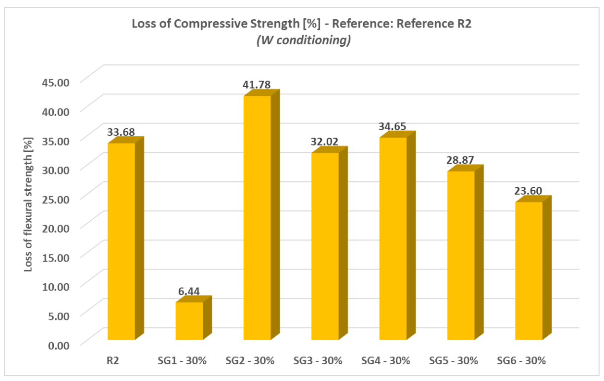
III. RESULTS AND DISCUSSIONS 3. Durability evaluation
Freeze-thaw resistance
Evaluation of durability performance for SG prototype mortars:
Determination of material freez-thaw resistance (50 cycles)
Comparative analysis of mechanical strength loss after the 50 freez-thaw cycles:
Reference: Mortar Reference R2 (Water conditioning)

Slide 32
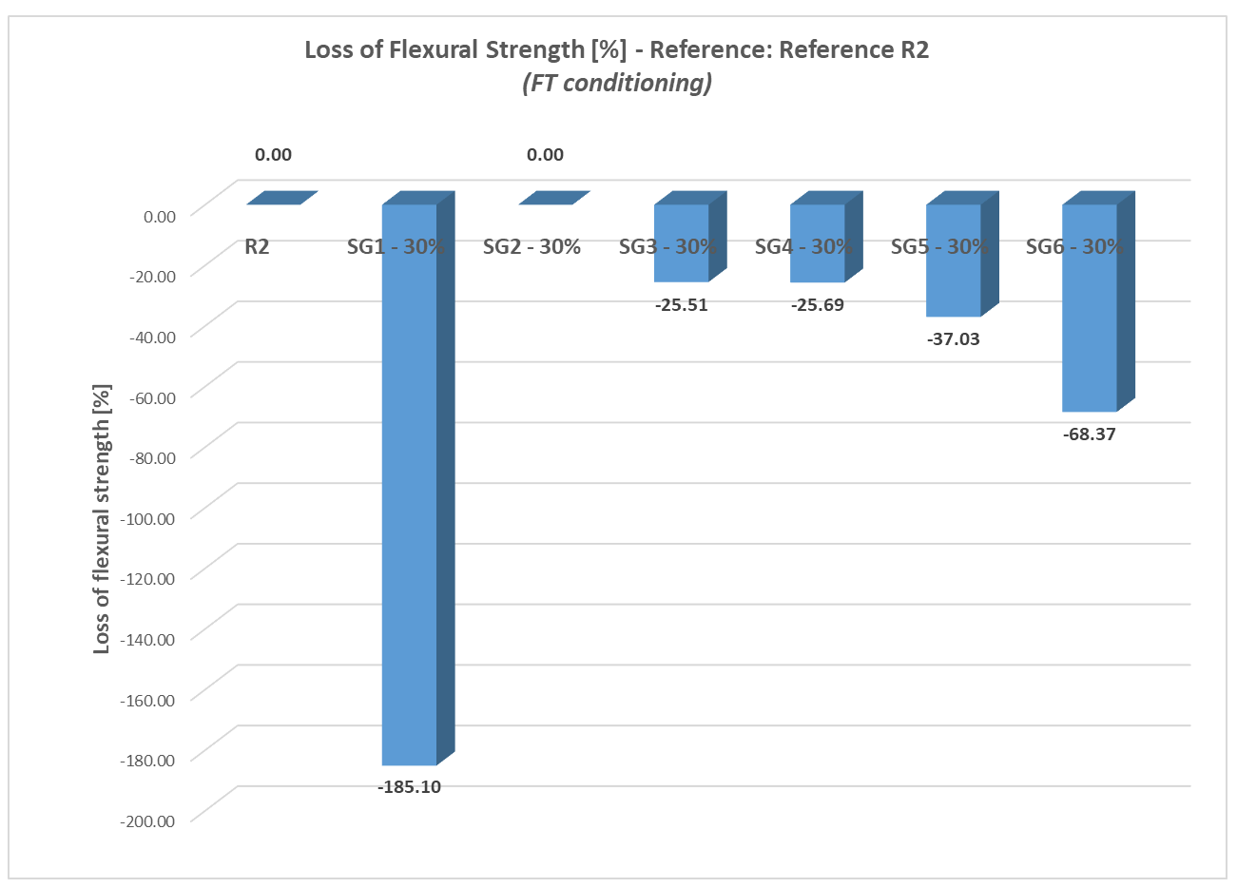
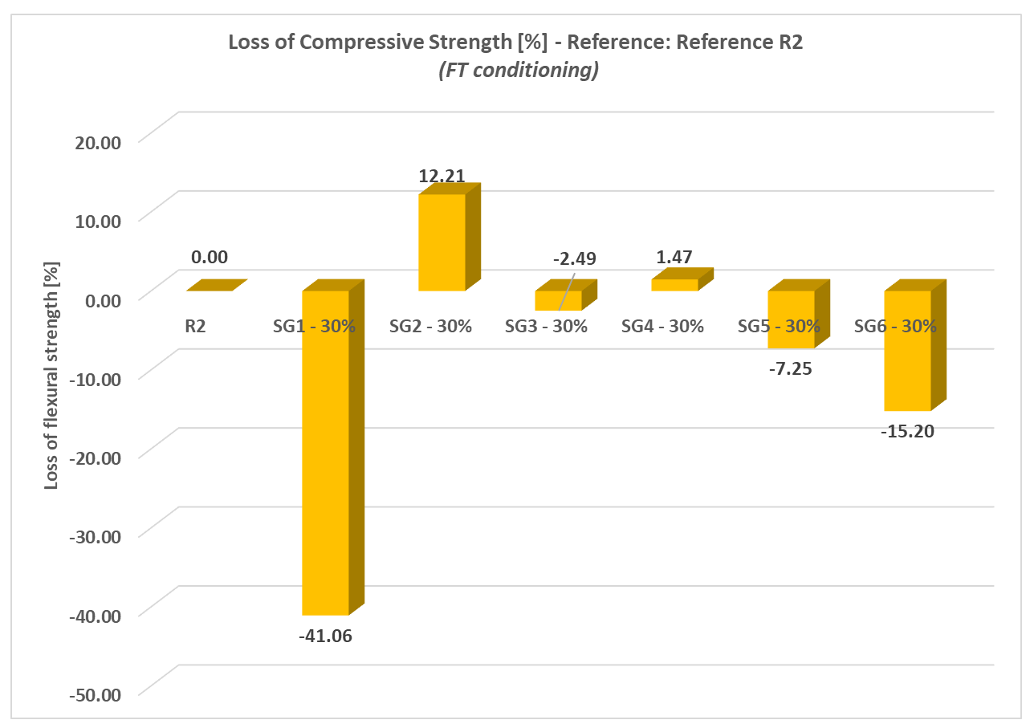
III. RESULTS AND DISCUSSIONS 3. Durability evaluation
Freeze-thaw resistance
Evaluation of durability performance for SG prototype mortars:
Determination of material freez-thaw resistance (50 cycles)
Comparative analysis of mechanical strength loss after the 50 freez-thaw cycles:
Reference: Mortar Reference R2 (Freeze-thaw, FT conditioning)

Slide 33
IV. CONCLUSIONS:
The experimental program explored the use of Spent Garnet (SG) waste as a partial replacement for natural sand in cement-based mortars, expanding upon prior research and validating earlier observations. The study generated five compositions with 10%, 30%, and 50% substitution levels, enabling comparative assessment of fresh and hardened state properties.
Comparative tests between the initial and current experimental phases confirmed a consistent positive trend in performance, particularly in terms of density, cohesiveness, and mechanical strength.
The 10% substitution showed minimal improvements but was useful in confirming the progression trend and identifying potential mix anomalies. Also, it can be useful for technology transfer in the compositional area of common mortars and micro mortars.
The durability evaluation is emphasizing positive results, encouraging the transition towards concrete mixes development.
Among all compositions, SG 30% and SG 50% demonstrated the most favorable results and were selected as the prototype mixes and Eco-CCM: Eco-intelligent Composite Materials for Constructions, with advanced functionality (Eco-Composite Materials for Constructions), with consistent use for further development and potential application. These mixes balanced improved mechanical behavior with feasible material substitution, supporting both performance enhancement and sustainability goals.

Slide 34

IV. CONCLUSIONS and future perspectives
Direct field of application is considered in terms of PAVING BLOCKS developing by the means of SG integration in the concrete mix.
This could generate a viable and more accessible field of use, with less associated risk in terms of population health, due to exterior use of the products; simultaneously, direct and fast information could be offered in terms of durability of the product, in real exposure and serviceability conditions;
This approach could also be aligned to the dynamic of the national market, characterized by a fast growth, considering the huge demand in terms of necessities of public pavement systematic improvement, mostly in urban media, but also in rural, as well.
The sustainable approach of waste prevention and reduction of natural resource consumption is perfectly aligned to the Circular Economy principles.

Slide 35




IV. CONCLUSIONS and future perspectives
Direct field of application in terms of PAVING BLOCKS developed by the means of SG integration in the concrete mix: ONGOING RESEARCH
Development of Eco-CPs: Eco-intelligent Construction Products, with advanced functionality, made by using Eco-CCM (Eco-Construction Products)
The results and support the viability of Spent Garnet as a sustainable, aligning with circular economy principles.

Slide 36


IV. CONCLUSIONS and future perspectives
Acknowledgments:
This work was carried out within Nucleu Programme of the National Research Development and Innovation Plan 2022-2027, supported by MCID, "ECODIGICONS" project no. PN 23 35 04 01: Fundamental-applied research into the sustainable development of construction products (materials, elements, and structures, as well as methods and technologies) that utilizes current national resources to enhance the eco-innovative and durable aspects of Romania's civil and transport infrastructure.
Contact:
https://incd.ro/
Aurelian GRUIN (Branch Manager, Project Manager): aurelian.gruin@incd.ro
Cornelia BAERA (Scientific Manager of Timisoara Branch: cornelia.baera@incd.ro; cornelia.baera@upt.ro
Thank you for your attention!

