Slide 1
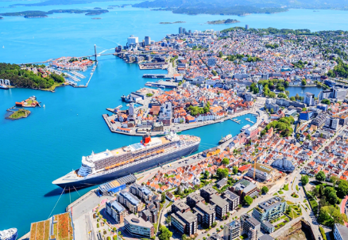
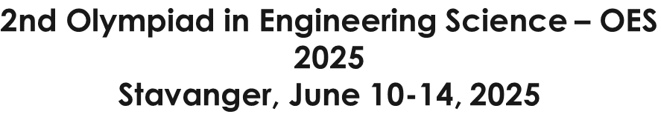



CARLO SCARPA RESTORATIVE CONCEPT APPLIED TO THE PAVEMENT LOCATED IN THE PIAZZA OF SIENA (ITALY): A CASE STUDY / A SUSTAINABLE APPROACH
Luiza VARGA¹, Cornelia BAERĂ^{2,3}, Aurelian GRUIN^{2,4},
Bogdan TOFAN¹ , Tommaso VENTURINI⁵
¹"Ion Mincu" University of Architecture and Urban Planning, Bucharest, Romania
²N.I.R.D. URBAN-INCERC, Timisoara Branch, Romania
³Politehnica University of Timișoara, Faculty of Management in Production and Transportation, Timișoara Romania
⁴Politehnica University of Timișoara, Faculty of Civil Engineering, Timișoara Romania
⁵Freelancer artist, Marconi 4/1, 61121 Pesaro, Italy

Slide 2
I
INTRODUCTION
II
CONCEPT AND METHODS
CONTENT
III
SUSTAINABLE MATERIALS
IV
CONCLUSIONS

Slide 3
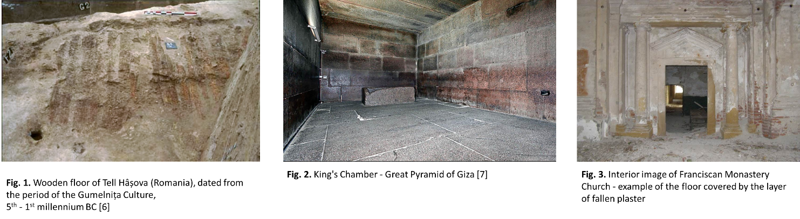
I. INTRODUCTION
Pavement can be generically defined as the hard layered structure, forming a path, a track, a road or a paved pedestrian area.
Pavement, from civil engineering perspective, can be defined as the hard layered structure, which forms a path, a track, a road or a paved pedestrian area.
Generally, the term is associated with outdoor spaces (pedestrian paths, squares, inner courtyards, access roads in the vicinity of routes for mechanized vehicles, etc.), but it may also include indoor spaces, generally known as floors, i.e., the horizontal interior surface of spaces, used as a walking and resting element, with a consistent decorative role in addition to its obvious functionality.
From the architectural point of view, the floor is a fundamental bi-valent element, structural and aesthetic as well, a synergetic binder for the rest of components.

Slide 4
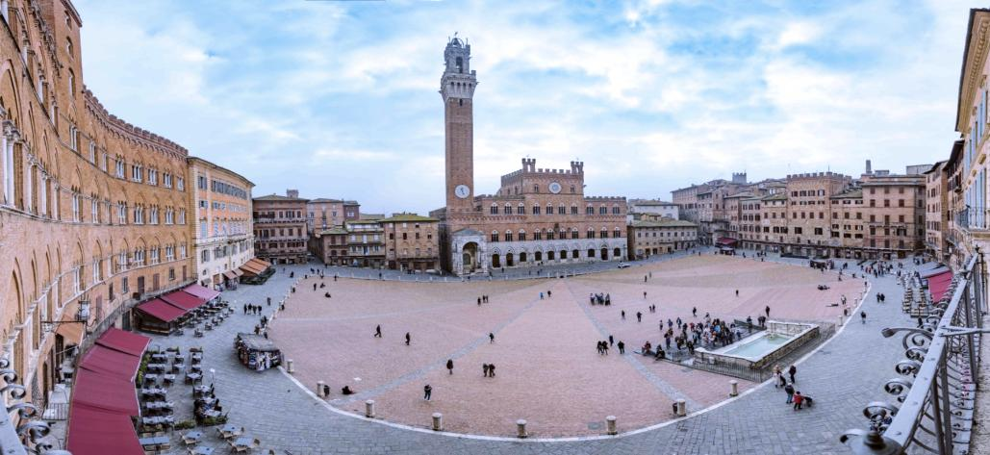
I. INTRODUCTION
Piazza del Campo in Siena is universally recognized as one of the most beautiful and iconic medieval urban spaces.
Its shape, symbolism, and architectural integration serve as a reference point in the contemporary discourse on restoration.
This study proposes a sustainable and context-sensitive intervention that respects the site's layered history while meeting present-day requirements.
The guiding framework is the restorative philosophy of Carlo Scarpa, with an emphasis on the clarity between old and new, creative reversibility, and material integrity.

Slide 5
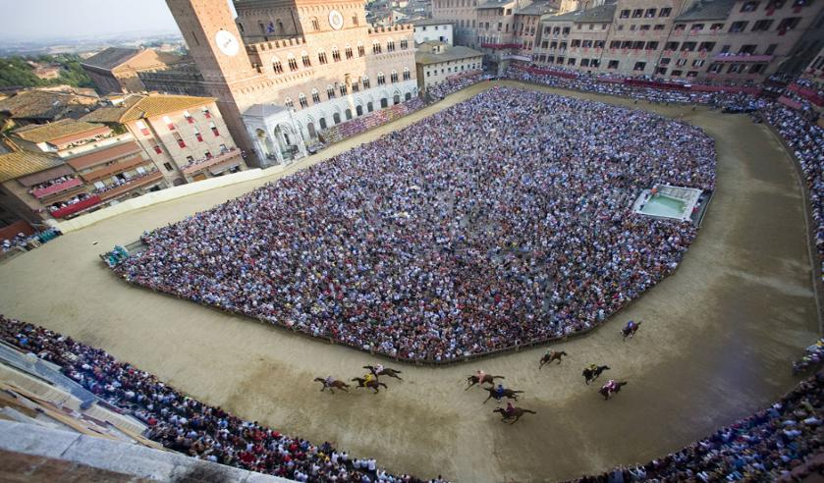
II. CONCEPT AND METHODS
The proposed restoration concept applicable to the pavement of the Central Market of Siena, Italy, starts from the theoretical research of restoration concepts as well as the particular historical witness on some elements of aesthetic importance and visual identity of the considered pavement.
These have led to decisions to treat the surfaces by analyzing several pre-sustainable restoration concepts, with the aim that the restoration process should be in line with the principles of conservative restoration and contemporary restoration, using sustainable, tradition-based materials, and also that it should comply with the application of the regulations for the protection of monuments. The proposed restoration model is characterized by durability, creativity and efficiency. The creative nature of the restoration process is based on the idea of not creating a fake by proposing for restoration elements that have no historical and visual support.

Slide 6
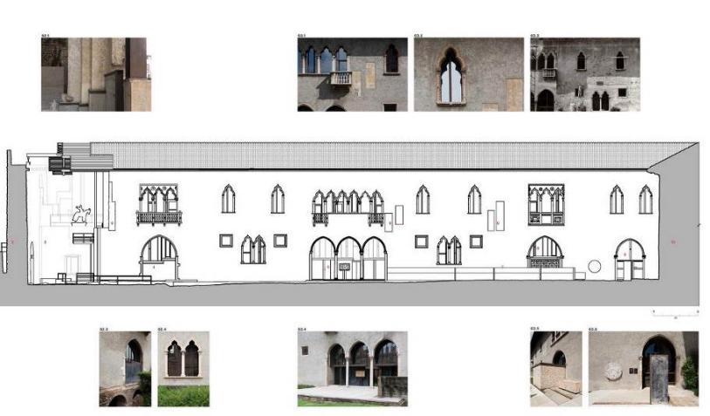
II. CONCEPT AND METHODS
Presentation of the Carlo Scarpa Creative Restorative concept
The Carlo Scarpa Creative Restoration finds support in a personalized creative model in which the emphasis shifts conservation within a context. In the landscape of modern restoration, Carlo Scarpa is a generator of non-invasive creative models based on respect for the old and new intervention as well, considering the cultural identity. Carlo Scarpa's monument is embodied in an architectural model in which the value of conservation is maintained over time through the quality of the concept's creativity, that specific modality of approaching specific cultural elements by simultaneously accessing tradition and modernity. The proposed restoration mode is an extension of the context, not of the content based on the reflection drawing of the mental project used for reasoning purpose.
Carlo Scarpa Conceptual scheme - exterior aesthetics of restoration of Castelvecchio (Verona, Italy

Slide 7
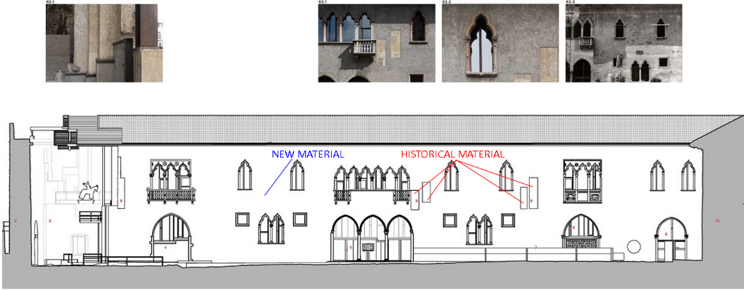
II. CONCEPT AND METHODS
Scarpa conceives a personal commentary using the scientific knowledge of conservation and consolidation, identity, remembrance, personal history of the work of art, the architectural space of the historical monument that becomes a reflection of the historical context within a new project. His restorative conception has three personal themes:
- The Design, which is the conceptual stage trespassing through drawing, sketching, concept arranging of the new image of the monument, but with deep respect towards architecture, classical shapes and to the historical monument, generally.
- The subject of restoration is reopened as an exact science and, at the same time, proposes an art form, revealing the importance of the architect in the interpretation of historical material. The mechanism of Carlo Scarpa's thinking in restoration is based on creative reassemblies and decompositions.
- The reassembly of spaces through areas of spatial communication, resulting via differently directed spaces, different spaces, from the detail as a formal event marking the creation (the floor), by superposition or juxtaposing individual elements, by using the ornament in a modern register, achieved by using basic but powerful symbols: the spiral, the ziggurat, the eye, etc.
Carlo Scarpa Conceptual scheme - exterior aesthetics of restoration of Castelvecchio (Verona, Italy) – detail for insertion of novelty into the original, (after R Murphy, Carlo Scarpa and Castelvecchio Revisited, Breakfast Mission Publishing, 2017, p. 384)

Slide 8
II. CONCEPT AND METHODS
Scarpa conceives a personal commentary using the scientific knowledge of conservation and consolidation, identity, remembrance, personal history of the work of art, the architectural space of the historical monument that becomes a reflection of the historical context within a new project. His restorative conception has three personal themes:
- The Design, which is the conceptual stage trespassing through drawing, sketching, concept arranging of the new image of the monument, but with deep respect towards architecture, classical shapes and to the historical monument, generally.
- The subject of restoration is reopened as an exact science and, at the same time, proposes an art form, revealing the importance of the architect in the interpretation of historical material. The mechanism of Carlo Scarpa's thinking in restoration is based on creative reassemblies and decompositions.
- The reassembly of spaces through areas of spatial communication, resulting via differently directed spaces, different spaces, from the detail as a formal event marking the creation (the floor), by superposition or juxtaposing individual elements, by using the ornament in a modern register, achieved by using basic but powerful symbols: the spiral, the ziggurat, the eye, etc.
Carlo Scarpa Conceptual scheme - exterior aesthetics of restoration of Castelvecchio (Verona, Italy) – detail for insertion of novelty into the original, (after R Murphy, Carlo Scarpa and Castelvecchio Revisited, Breakfast Mission Publishing, 2017, p. 384)

Slide 9
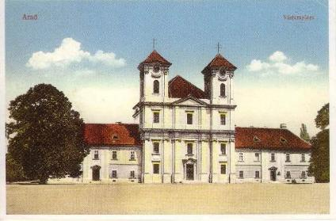
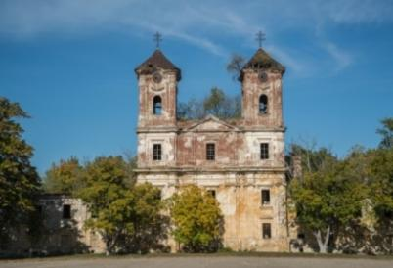
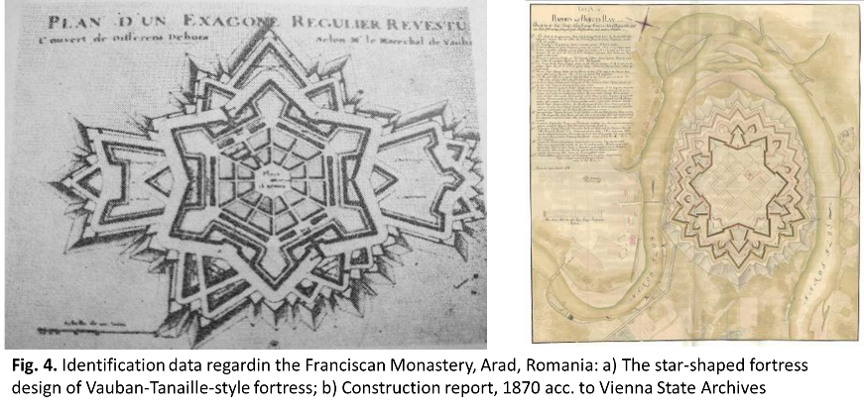
II. CONCEPT AND METHODS
CASE STUDY – Franciscan Monastery from Arad Fortress
The principles of creative restoration, whose viability is conclusively demonstrated by the Venetian architect Carlo Scarpa in the process of restoring the Castelvecchio monument (Verona, Italy), can also be used in the case of the Franciscan Monastery in Arad, Romania, its church and with particularization on the church floor, as an essential structural and architectural element within the specified monument.
Main facade of the Franciscan Monastery, Arad, Romania: then (left side); and now (right side)
The church of the Franciscan Order was built by the monks of the St. Francis Order of Assisi, the year of consecration being 1734; later on, the two side wings were built, including the fortress. The construction of the Vauban-Tanaille-style fortress started in 1763, in the river Mureș loop, around the Franciscan Church already existing at that time.
The Arad Fortress is a fortification in the shape of a double star in six corners. The map provided by the Vienna State Archives in 1780 demonstrates the thoroughness of the design, which ensured the efficient use of 300 pieces of artillery.

Slide 10
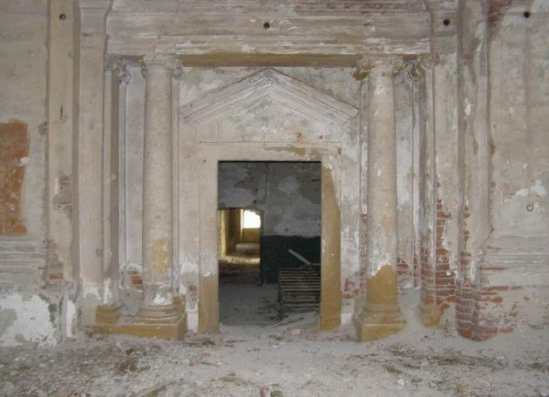
II. CONCEPT AND METHODS
Restoration intervention proposal - the floor of the Franciscan Church – Carlo Scarpa Creative Method
The creative restoration applied to the Franciscan Monastery monument and explicitly associated with the pavement, started considering the lack of clear, proven and argued information of some defining elements related to the aesthetic aspect of the monastery, essential in its restoration and also to the desire not to generate a false model. The proposed measures aim preserving in the spirit of minimal intervention, pursuing reversibility, according to the Venice Charter and the documents accepted by the Romanian state.
The restoration proposal, after establishing the concept of intervention, allows the development of a creative space, by combining historical elements, with symbolic, aesthetic value, which give identity to the monument, with contemporary elements, by marking the intervention (where the historical witness is missing) and with unexpected, surprising, reversible elements, able to mark the moment and the power of the present time, respectively with elements produced by technology and art of the present moment.
Interior image of Franciscan Monastery Church - example of the floor covered by the layer of fallen plaster

Slide 11
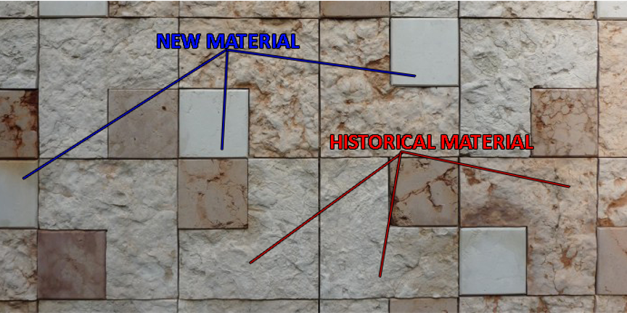
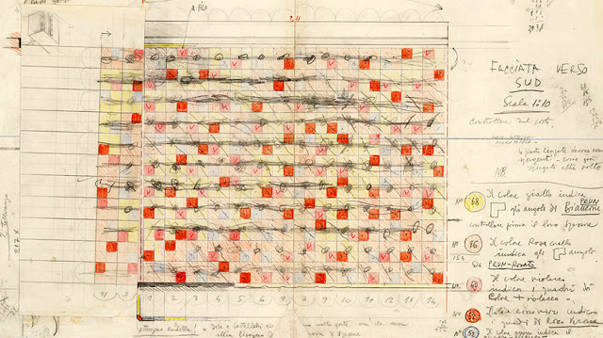
II. CONCEPT AND METHODS
CASE STUDY – Franciscan Monastery from Arad Fortress
At floor level, the intervention area requires two proposals:
a) The first proposal refers to the hypothesis identified by means of visits and photographic documentation, in which the floor surface is the direct beneficiary of an important level of conservation made of fallen pieces of lime plaster, and requiring specific cleaning actions and additions on different surfaces’ dimensions, according to those found in the in-situ status of the monument, at the beginning of the project.
The proposal emerges from the perspective of the creative method practiced by Carlo Scarpa on the Castelvecchio building. The treatment is carried out by preserving the original material, the intervention being made through areas of intercalation of the new material, with a difference in texture and shade.
Carlo Scarpa Intervention sketch (Materiality), Castelvecchio (Verona, Italy)
Proposal - Sketch of creative restoration intervention, for the floor of the Franciscan Church, Arad - scenario 1

Slide 12
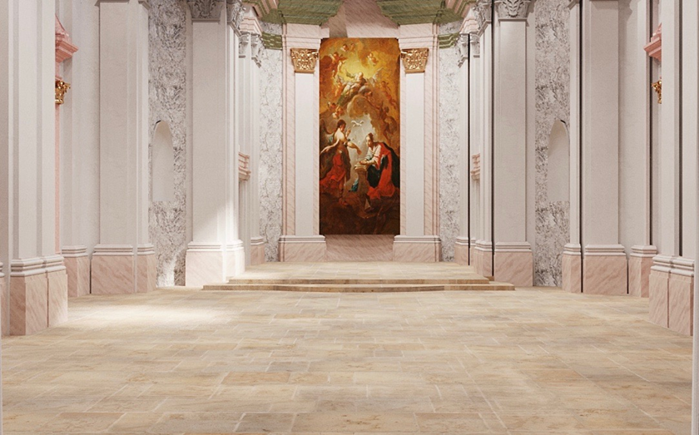
II. CONCEPT AND METHODS
CASE STUDY – Franciscan Monastery from Arad Fortress
a) The first proposal
The intervention is proposed at floor level, determining the delimitation of the old and the new .
The proposed intervention is creative, reversible, in accordance with the requirements of conservative restoration and, at the same time, it allows the application of continuity promoted by Scarpa, giving the public the opportunity to look inside the architecture and restoration, by visualizing the elements and materials. The restoration proposal is built on the principle of authenticity, wanting to highly combine the conservation, the scientific restoration and the contemporary design.
the perspective of a creative restoration in the conditions of a relevant historical witness.

Slide 13
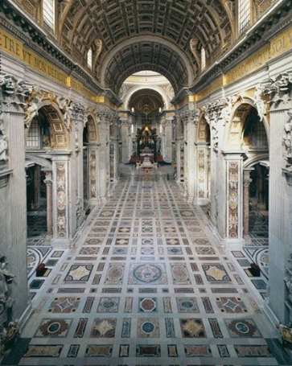
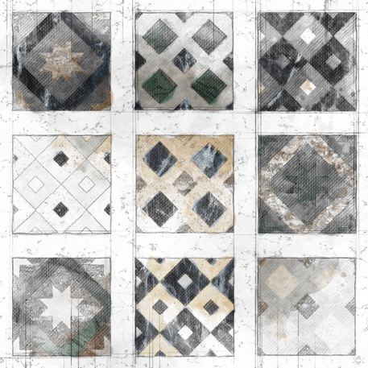
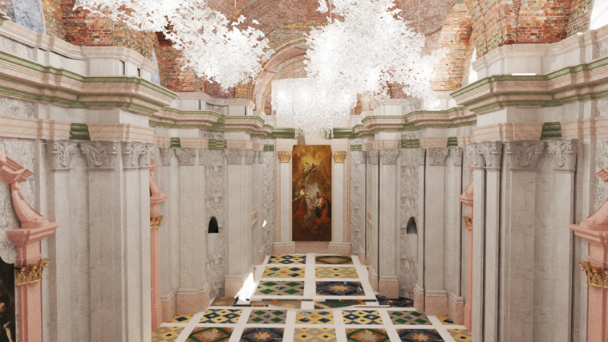
II. CONCEPT AND METHODS
CASE STUDY – Franciscan Monastery from Arad Fortress
b) The second proposal for restorative intervention comes in the context in which the historical finishing layer is completely compromised, and its preservation is impossible, this fact generating the need for a new floor surface.
The design of the new floor is built based on the historical and cultural sources of the site, identified and consulted by the restoration team: architectural description, history of Baroque art, Baroque architecture and historical influence on the building, to which the creative concept identified as appropriate for implementation is added.
Thus, the proposed concept sketches a baroque polychrome marble floor, with inlaid mosaics.
Proposal - Creative restoration simulation when the historical witness is not available
St Peter Basilica, Rome, Vatican - baroque floor example .

Slide 14
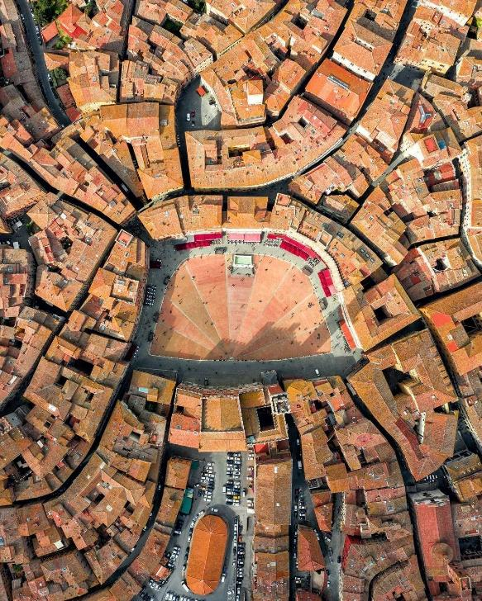
II. CONCEPT AND METHODS
The shape of the market is hemispherical, resembling a shell with nine segments delimited by white stripes.
The brick pavement of the square is divided into nine roughly equal triangular sections by gray travertine lines that converge on a drain. The travertine lines taper in width, from about 3 feet (90 cm) at the edges of the square to less than one (30 cm) where they enter the drain area; they are aligned with the brick joints, and the surfaces of the nine wedges are filled with bricks laid in a herringbone pattern. If the surface of the square were flat, those lines could be seen as radiating outward from a source, but the sloped pavement reinforces the sense of convergence. The lines visually emphasize the square’s concave slope and link the Piazza to Siena’s topography. Since the travertine lines function as drainage channels, they are set slightly lower than the bricks, which are tilted slightly toward them. This scalloped effect may also be why so many writers have compared Piazza del Campo to the shape of a shell.

Slide 15
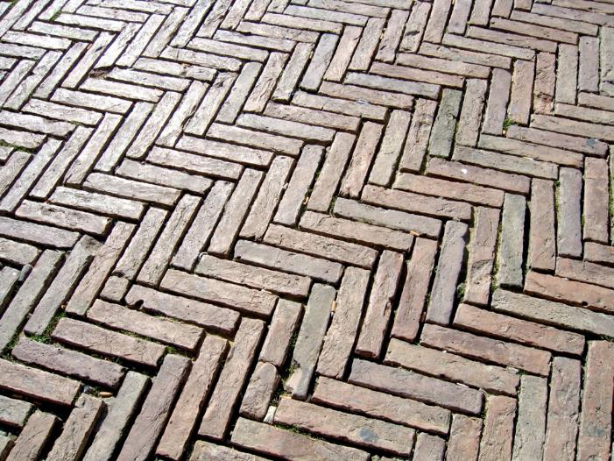
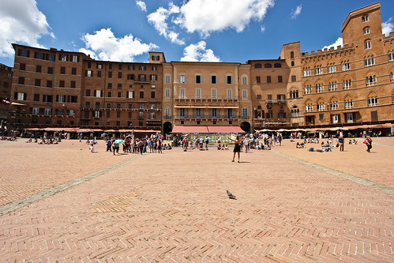
II. CONCEPT AND METHODS
Creative Restoration and Conservative Restoration: Theoretical Framework: Carlo Scarpa’s Restorative Concept
Restoration through juxtaposition allows us to distinguish between the spirit of the past and society’s demands for the future of the studied monument.
A restoration project is a way to rediscover the past in the present; it is the result of the creativity involved in interpreting the monument.

Slide 16
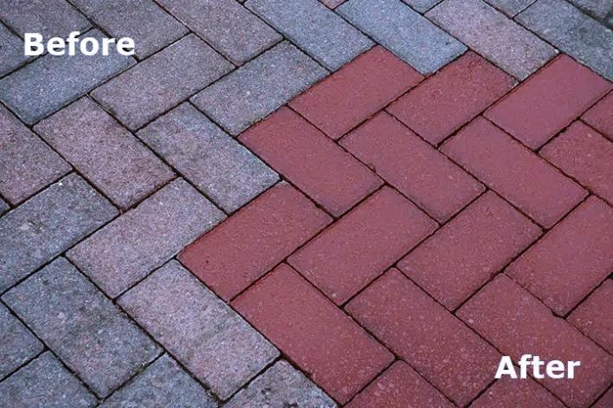
II. CONCEPT AND METHODS
Creative Restoration and Conservative Restoration
Scarpa’s work, especially the restoration of Castelvecchio, demonstrates that restoration can become an act of creation.
His principles include:
The reversibility of interventions;
The contrast between old and new materials;
The use of modern techniques to highlight historical layers;
Emphasis on context and narrative continuity.
These ideas form the foundation of the present study’s methodology, which proposes a restoration strategy for the paving of Piazza del Campo that reflects Scarpa’s legacy.

Slide 17

II. CONCEPT AND METHODS
Proposal for the Restoration of the Paving in Piazza del Campo
The intervention is conceived around two main scenarios:
1. In areas where the original paving is well preserved underneath, a careful cleaning and selective repair are proposed, using differentiated materials and textures inspired by Scarpa’s approach.
2. In areas where the paving is completely lost, a new composition is proposed, based on Baroque aesthetics and the use of sustainable materials, such as polychrome marble mosaic.
In both cases, visual and tactile contrast will mark the boundary between old and new, preserving the principles of creative clarity and narrative layering proposed by Scarpa.
The restoration proposal, once the intervention concept has been established, allows for the creation of a creative space where symbolic, aesthetic, and identity-bearing historical elements are combined with contemporary components. The intervention is clearly marked (where historical traces are absent) and includes unexpected, reversible elements that reflect the present moment—integrating technology and contemporary art.

Slide 18
III. SUSTAINABLE / TRADITIONAL MATERIALS
The considered materials for the proposed restauration concept involve a consistent sustainable character, involving the use of <earth> as a raw material in construction, namely on earth floorings by the rammed earth technique.
The development of sustainable pavement elements through the innovative optimization of traditional earth construction techniques is in agreement with:
the objectives of the project PN 23 35 04 01, conducted within NIRD URBAN-INCERC Timișoara Branch, Romania;
conceptual directions specified in the PhD thesis "Pavement from utility to meaning, a determining factor in defining the aesthetic qualities of architectural spaces” (PhD Luiza Varga )
It resulted the prospects of sustainable earth-based pavements, assimilated to "terazzo" techniques for instance, can be built for specific structural and aesthetic evaluation, in order to increase the overall product performance and its viability in the proposed restoration concept.

Slide 19
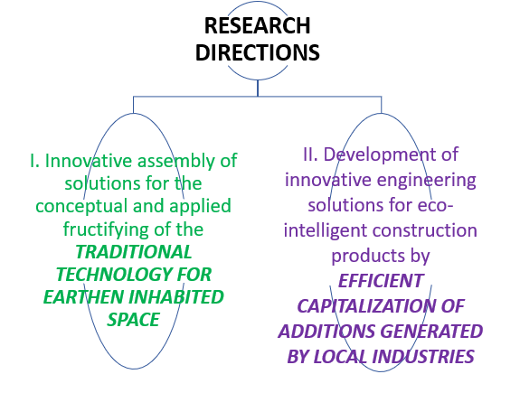
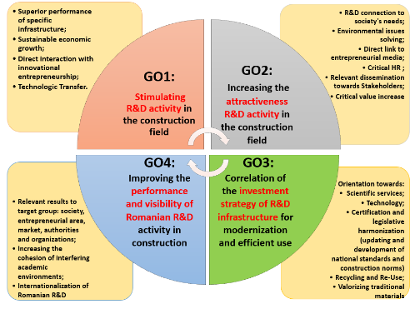
III. SUSTAINABLE / TRADITIONAL MATERIALS
4 GENERAL OBJECTIVES (GO)
14 SPECIFIC OBJECTIVES (SMART)
2 RESEARCH DIECTIONS
16 PHASES (ASOCIATED MILESTONES)
Solutions to the current problems in the construction sector:
Development of products and services (materials, elements and structures, processes and technologies, etc.),
with superior overall performance and increased energy efficiency,
for the Circular Economy (EC) principles implementing in Romania.

Slide 20
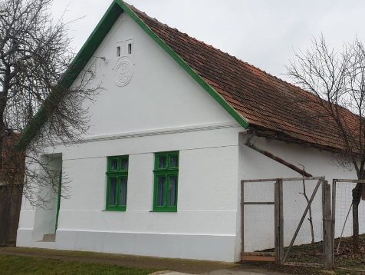
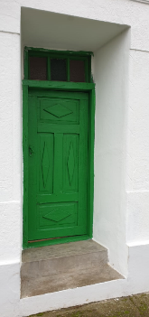
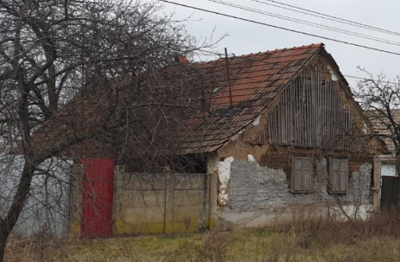
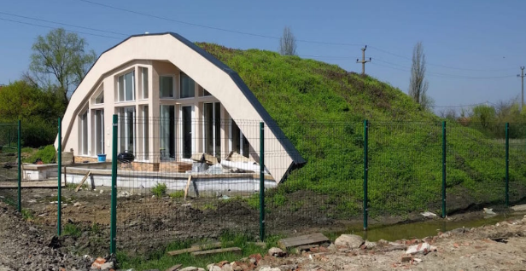
III. SUSTAINABLE / TRADITIONAL MATERIALS
Axis I. Innovative assembly of solutions for the conceptual and applied valorization of the traditional technology for earthen inhabited space
Context of research & business – the Romanian Context
OPPORTUNITY & NECESSATY
At the national level, according to data from the Romanian National Institute of Statistics regarding the 2011 population and housing census, almost half of Romanian population leaves in rural areas and approximately 2 million residential buildings are made of earth, of which approx. 75% are located in rural areas.

Slide 21
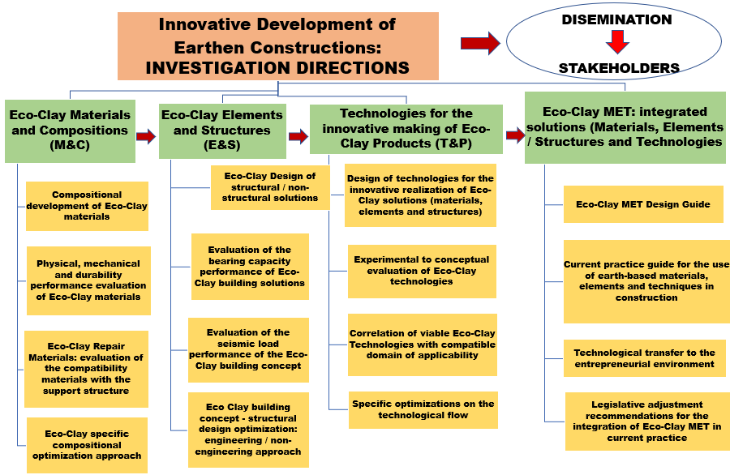
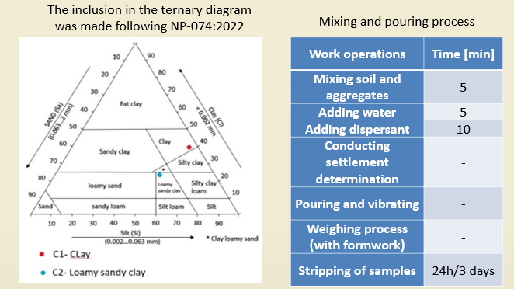
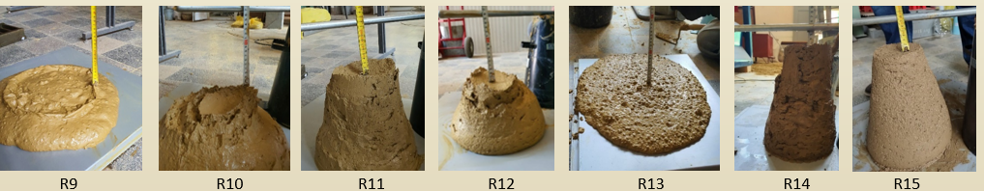
III. SUSTAINABLE / TRADITIONAL MATERIALS
Axis I. Innovative assembly of solutions for the conceptual and applied valorization of the traditional technology for earthen inhabited space
EXPERIMENTAL APPROACH: evaluation of Eco-Clay compositions
EXPERIMENTAL RESULTS

Slide 22
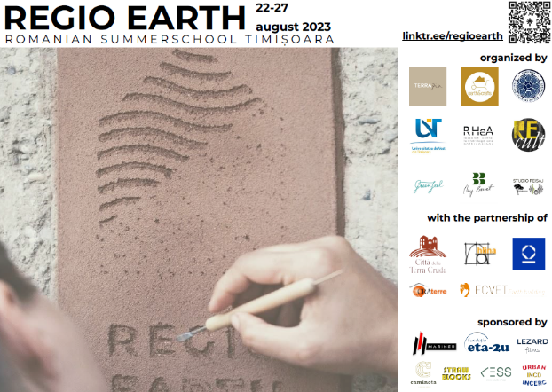
III. SUSTAINABLE / TRADITIONAL MATERIALS
Sustainable paving elements made from ‘earth’
The use of <Earth> as a raw material in construction, whether for structural purposes, filling, finishing or repair and reinforcement, either on its own or in combination with materials that are compatible in terms of composition and structure, requires a multidisciplinary scientific approach that has gained considerable momentum in recent years, both internationally and nationally.
The REGIO EARTH 2023 Summer School programme (22-27 August 2023) includes:
decorative plastering,
rammed earth flooring;
Japanese construction techniques;
earth oven, offering the prospect of capitalising on sustainable flooring by using earth as a raw material.
REGIO EARTH 2023 Summer School, (22-27 august 2023)

Slide 23
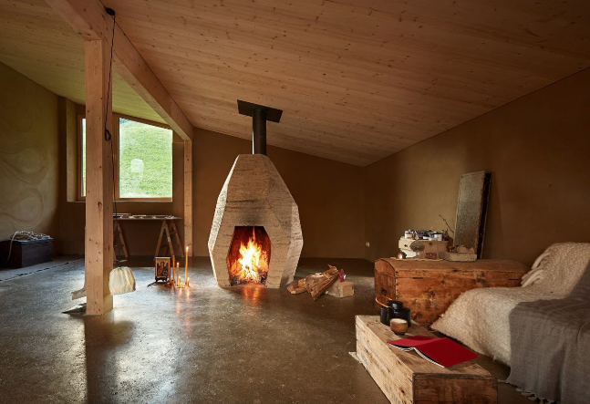
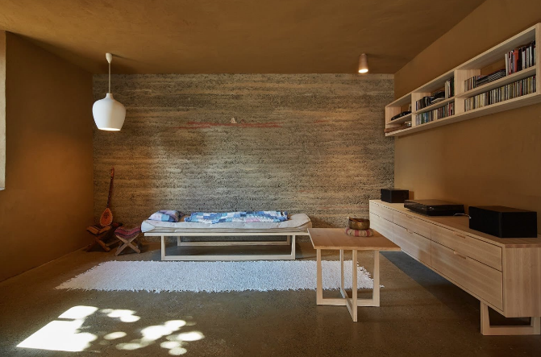
III. SUSTAINABLE / TRADITIONAL MATERIALS
Sustainable paving elements made from ‘earth’
Examples of vernacular architecture being used in modern interiors that include rammed earth flooring, by Tommaso Venturini
Thus, based on established research, prospects for sustainable earth-based pavements can be developed by evaluating various specific techniques and optimising them to increase overall product performance.
Preliminary discussions with specialist Tommaso Venturini and specialists from INCERC Timișoara, etc. open up opportunities for the production of prefabricated earthen tiles, similar to ‘terrazzo’ techniques, for the construction of floors intended mainly for use inside buildings.

Slide 24
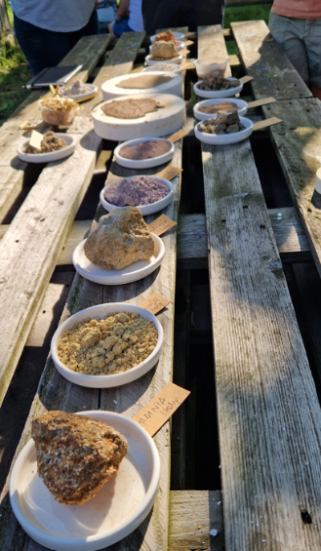
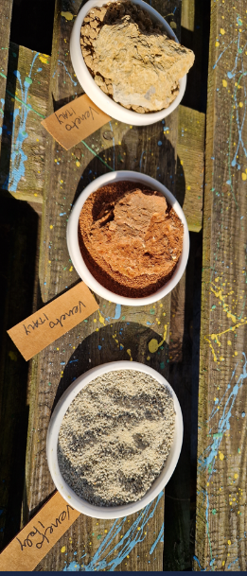
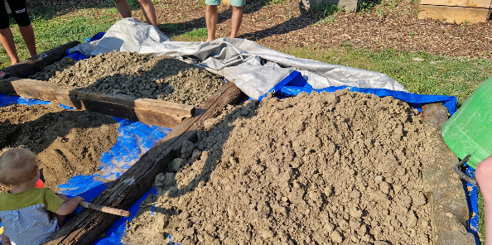
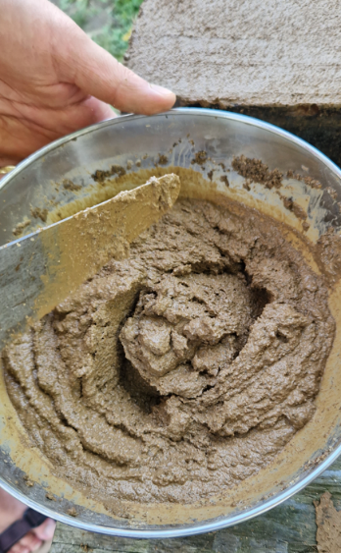
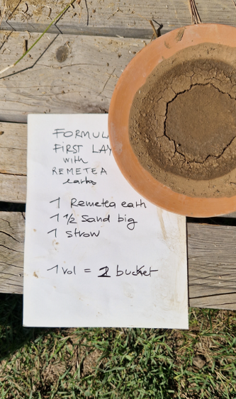
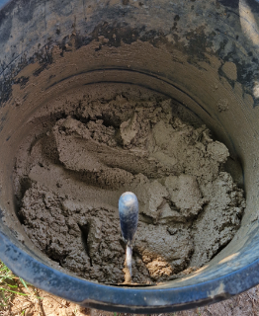
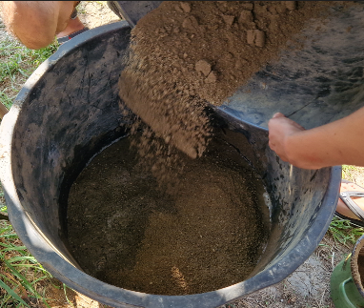
III. SUSTAINABLE / TRADITIONAL MATERIALS
Specific elements from the workshop on rammed earth flooring techniques, by Tommaso Venturini, as part of Regio Earth 2023

Slide 25
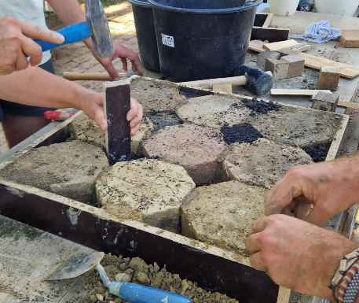
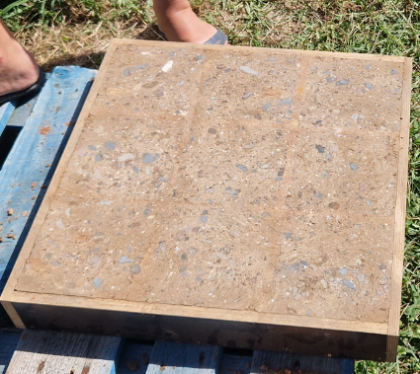
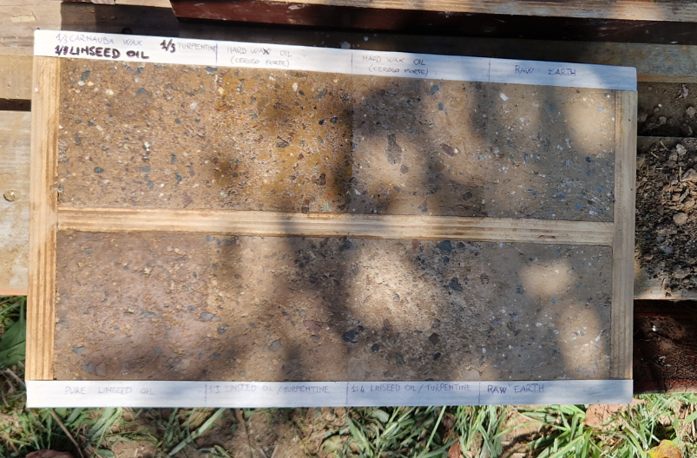
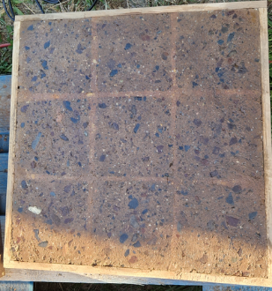
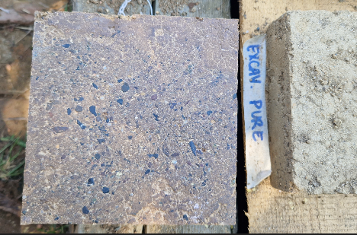
III. SUSTAINABLE / TRADITIONAL MATERIALS
Specific elements from the workshop on rammed earth flooring techniques, by Tommaso Venturini, as part of Regio Earth 2023

Slide 26
IV. CONCLUSIONS:
The current multidisciplinary study presented by the paper is focused on preparing the historical monument for future survival in the problematic, dynamic and contrasting context of contemporary developments, also considering the sustainable feature of the materials and techniques, their structural performance and potential viability within the proposed concept.
The current paper performs an analysis of the theory of concepts and methods of conservation and restoration, as well as the possibility and opportunity of applying them on historical monuments, in Romania, European Union and worldwide, considering the in-force legislation and also the agreed practice in the mentioned topic. Restoration proposed by Carlo Scarpa and performed within the national and international theories and legislation in the restauration field gives us the opportunity to preserve and enhance historic beauty throughout creative restoration.
The best possible scenario is to have available the historical witness of the surface/space considered for creative intervention, so that the reporting to the witness could be easily performed. The historical witness can be a floor surface sample, which can provide information related to materiality, texture, color, degradation, and nevertheless the overall aesthetic components associated to the edifice, personal artistic drive of the original artist being also included in the mix. In this case, the historical witness can be preserved with minimum intervention and the rest of the restoration process can be executed via direct applicability of creative restoration tools.

Slide 27
IV. CONCLUSIONS:
The second scenario assumes that, within the same architectural space the historical witness does not exist, determining that a proposal would be made in order to create a completely new surface, complying from an aesthetic point of view to the architectural style of the original monument. This example is applicable following an in-depth historical study of the monument.
Future research in the creative restauration process, in the topic of the Franciscan Church in Arad and PIAZZA OF SIENA, considers the use of Virtual reality (VR) tools, for a more accurate state of proposal, which allows fast and accurate changes in accordance to the decision making process as well, of all involved parties: local authorities, experts, architects, historians, society representatives, etc.

Slide 28
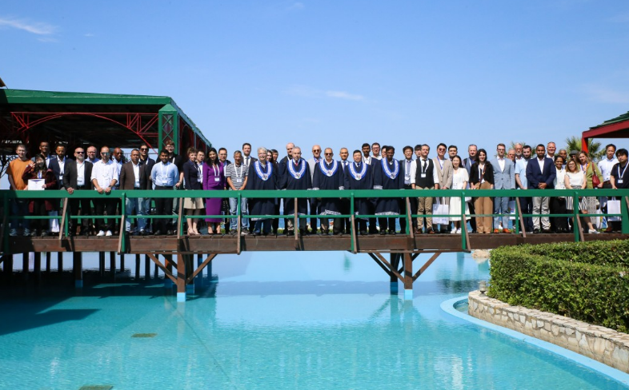
IV. CONCLUSIONS and future perspectives
Acknowledgments:
This work was carried out within Nucleu Programme of the National Research Development and Innovation Plan 2022-2027, supported by MCID, "ECODIGICONS" project no. PN 23 35 04 01: Fundamental-applied research into the sustainable development of construction products (materials, elements, and structures, as well as methods and technologies) that utilizes current national resources to enhance the eco-innovative and durable aspects of Romania's civil and transport infrastructure.
Thank you for your attention!

