Slide 1
Finite Element Analysis and Simulation of Lag Screw Insertion by Robotic Arm for Basicervical Hip Fractures
Olympiad of Engineering Science 2025, University of Stavanger, Norway
10-14 June 2025
Filippos Vlontakis¹, Pantelis Nikolakopoulos¹, Panagiotis Koustoumpardis¹, Antonios Kouzelis², Antonis Sakellarios¹
¹University of Patras, Greece, ²General University Hospital of Patras, Greece

Slide 2
Presentation Contents
Introduction to hip fractures
Surgical Technique for Basicervical Fractures
Methodology
Results

Slide 3
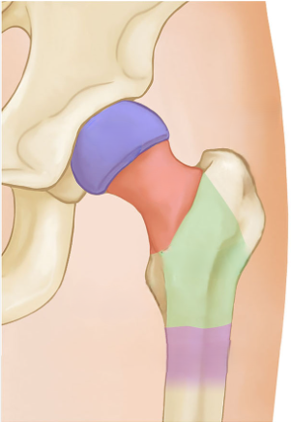
Introduction
3/17
Proximal Femur Fractures
By 2050, estimated occurrence rate of 4.5 million incidents/year [Cooper et al., 2011]
Great economic burden to healthcare systems (12.000$ average cost per incident in the US in 2022 [Ferris et al., 2022])
Result of impact trauma and/or pathological conditions (osteoporosis)
Basicervical Fractures
Femoral
Head
Neck
Basicervical Femur Fractures
Relatively rare subtype of proximal femur fractures (1.8 – 7.6% of total incidences [Dekhne et al., 2021])
Unstable fractures, weightbearing promotes development of shear stress along fracture line
~50% of cases treated with osteosynthesis
During surgical operation, reported relative rotation of the femoral head with respect to stem
Intertrochanteric area

Slide 4
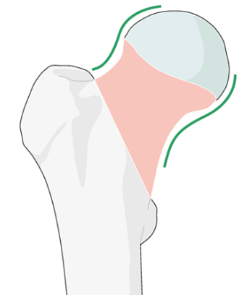
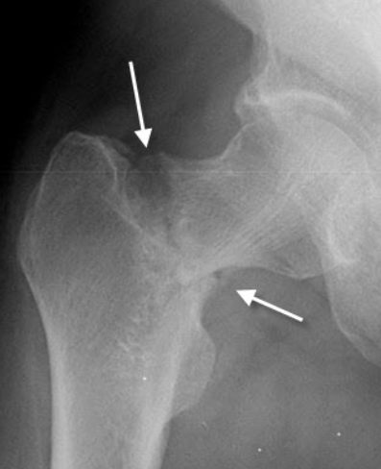
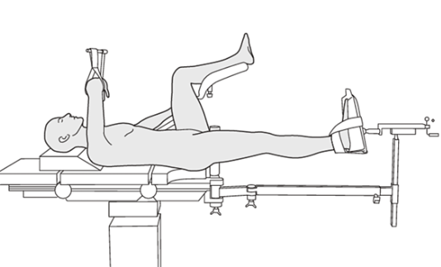
Surgical Procedure
4/17
Fracture reduction
Restoration of anatomical morphology of proximal femur prior to commencement
Displaced fracture
Closed reduction using fracture table

Slide 5
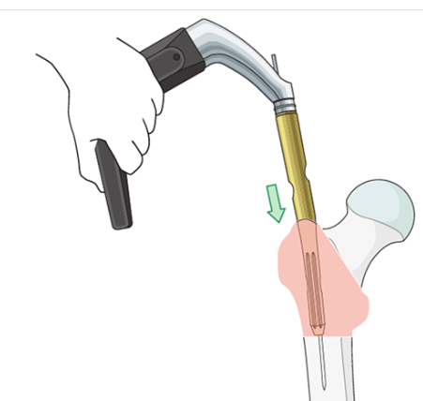
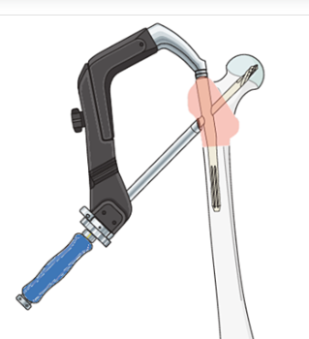
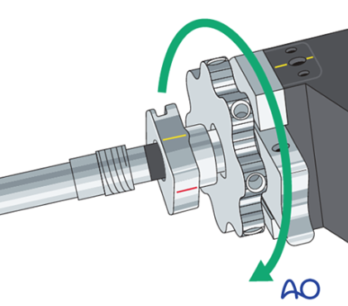
Surgical Procedure
5/17
Implant insertion
Intramedullary canal reaming and nail insertion (not modelled)
Drilling and lag screw insertion
Lag Screw
Aiming Arm
Insertion Handle
Intramedullary nail
As lag screw gains purchase in femoral neck, compression nut is used to generate compression force along the fracture surface

Slide 6
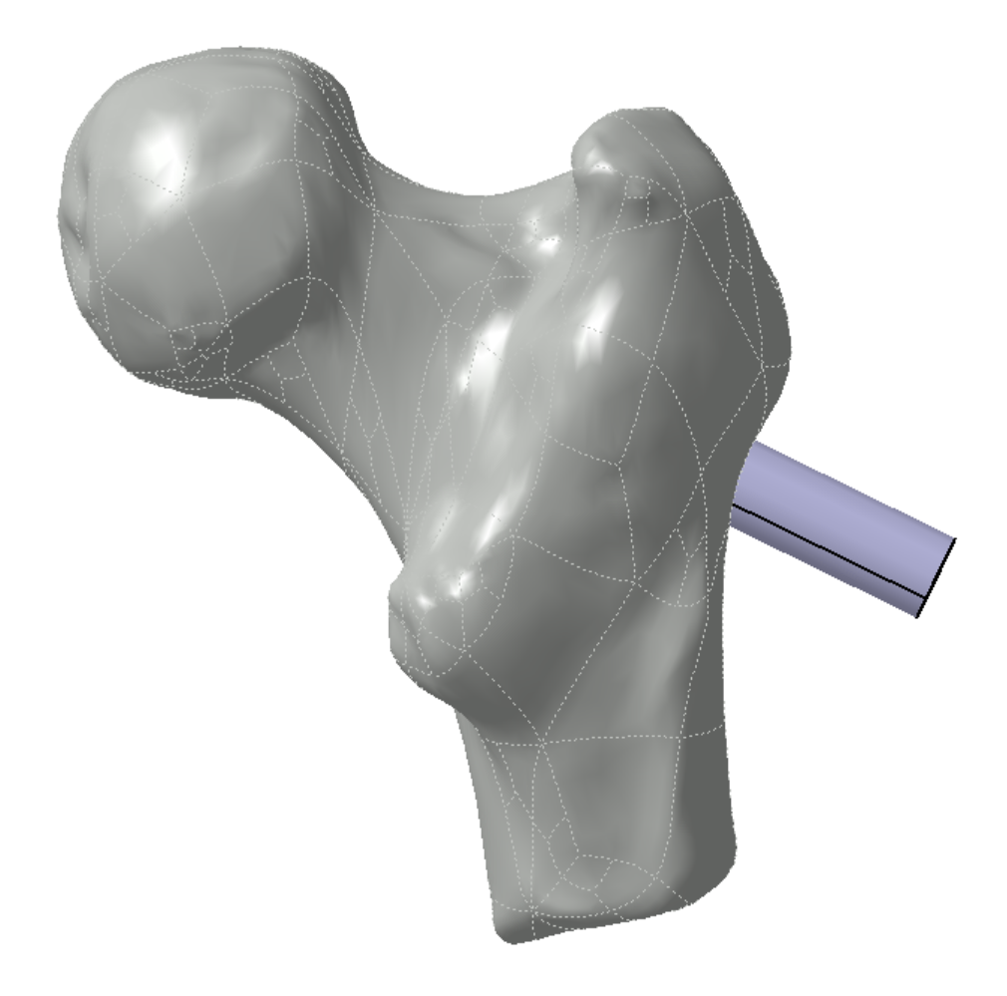
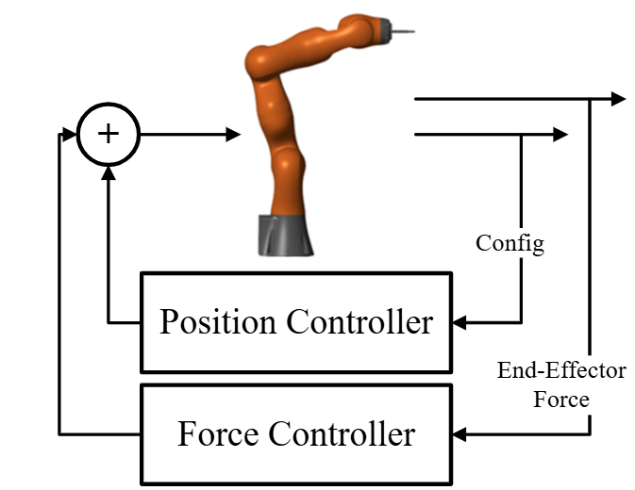
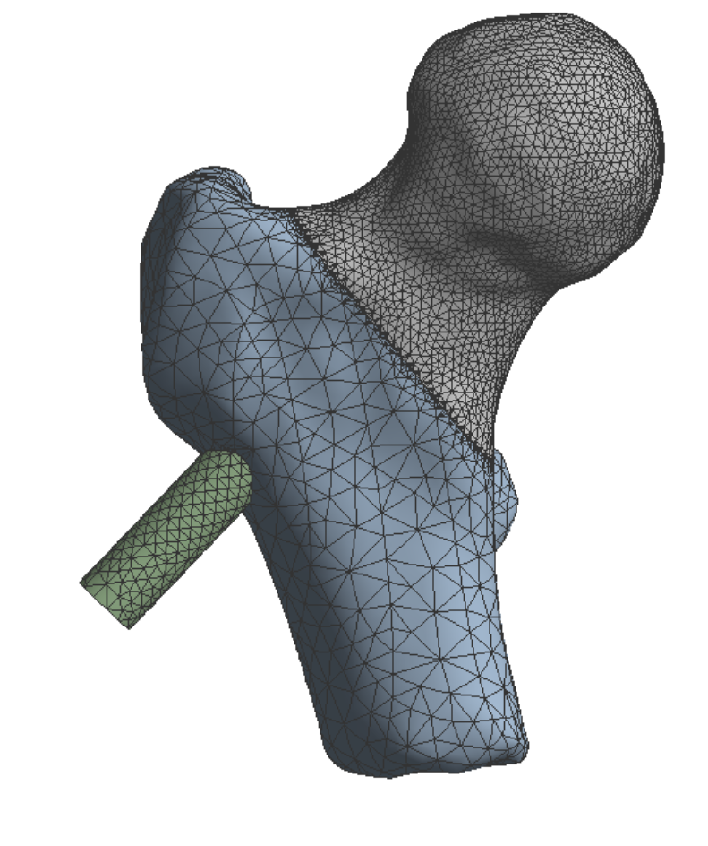
Methodology Overview
6/17
Development of FE model to investigate biomechanical behavior of system during lag screw insertion
Simulation of robotic arm control loop for semi-automated surgical procedure
Geometry Reconstruction
3. Transition to control
4. Manipulator control
QCT
1. Pre-Processing
CAD model
Constitutive
modelling of bone
Discretization
Config
Position Control
2. FE model
End-Effector Force
Relative motion
Stress
Strain
Force Control

Slide 7
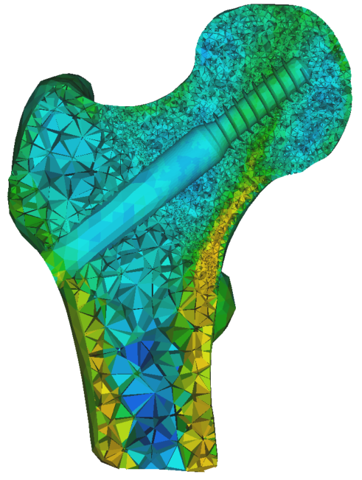
1. Preprocessing
7/17
Segmented QCT proximal femur scans, from osteoporotic patient (no fracture)
Calibration phase
$$ρ_{QCT}= −0.004$$
$$+0.0008HU [g/{{cm}^{3}}]$$
Radiological bone to ash density
$$ρ_{ash}= 0.008+$$
$$0.877ρ_{QCT} [g/{{cm}^{3}}]$$
Ash density to Young’s modulus
$$E= 14664{ρ_{ash}}^{1.49}$$
$$\left[MPa\right]$$
CAD geometry, introduction of virtual fracture line
Inhomogeneous distribution of bone material properties
Virtual implant insertion to position of interest
Coronal View
Axial View
Meshing using 10-node tetrahedral elements
(360k elements, 550k nodes)

Slide 8
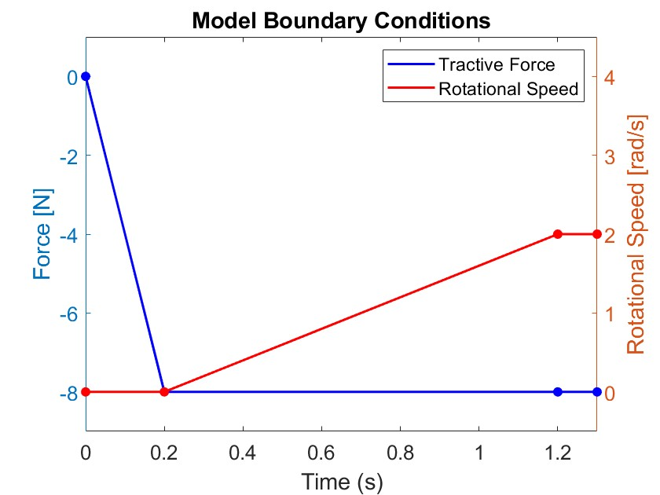
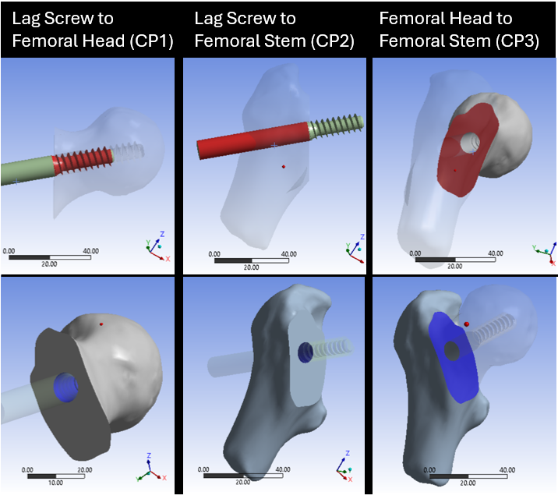
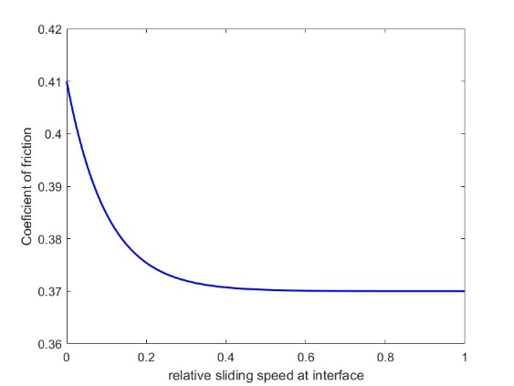
2. Finite Element Modelling
8/17
Static Friction
From experimental data [Eberle et al., 2010]
$$μ_{s}=0.47$$
𝝁_𝒔=𝟎.𝟒𝟕
Boundary Conditions
Contact Definition
Static-Dynamic Friction
$μ\left(v\right)= μ_{d}+(μ_{s}$ - $μ_{d})e^{−cv}$
𝝁(𝒗)= 𝝁_𝒅+(𝝁_𝒔 - 𝝁_𝒅)𝒆^(−𝒄𝒗)
$$μ_{d}=0.37, μ_{s}=0.41, c=10$$
𝝁_𝒅=𝟎.𝟑𝟕, 𝝁_𝒔=𝟎.𝟒𝟏, 𝒄=𝟏𝟎
From experimental data [Grant et al., 2007]
(1)
(2)
(3)
3 load steps
Tractive force development
Rotational acceleration of lag screw
Stabilization

Slide 9
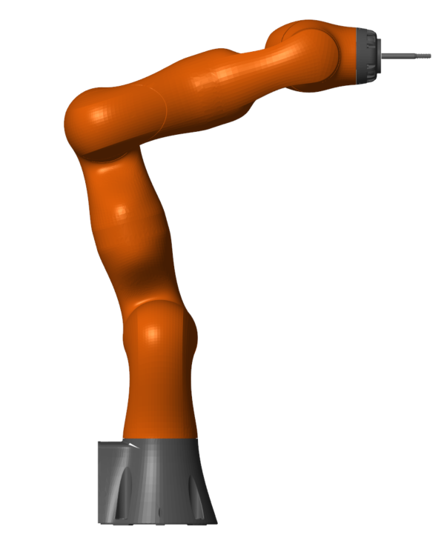
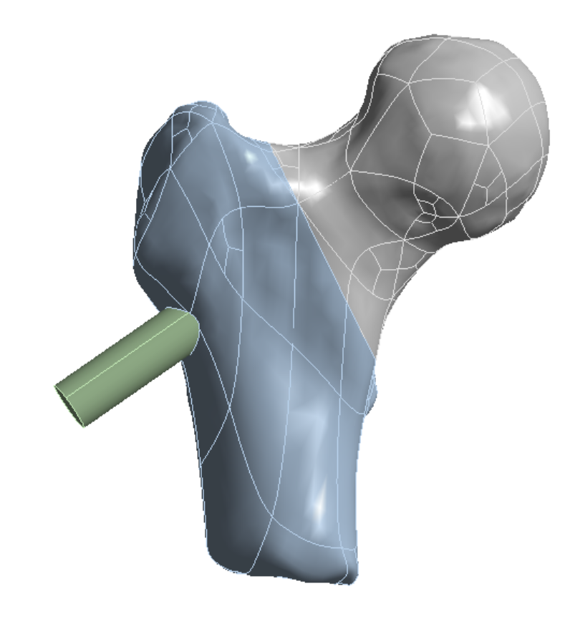
3. Transition to control of robotic arm
9/17
Estimation of equivalent elastic constant due to end effector interaction with environment
$$k= \frac{ΔF}{Δx}$$

Slide 10
4. Robotic Arm Control Scheme
10/17
Centralized control scheme in cartesian space
(6 DoF of end-effector)
Multibody Dynamics model of the arm
Position Control (1 DoF)
Force Control (5 DoF)

Slide 11
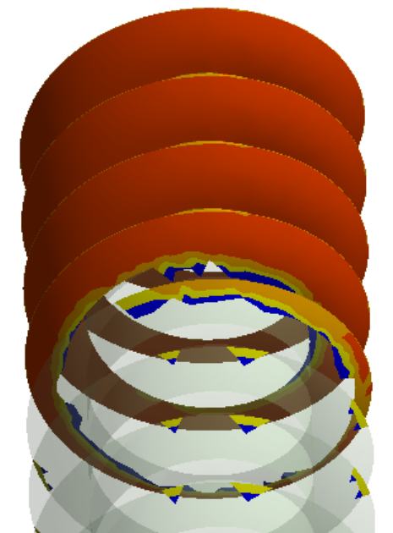
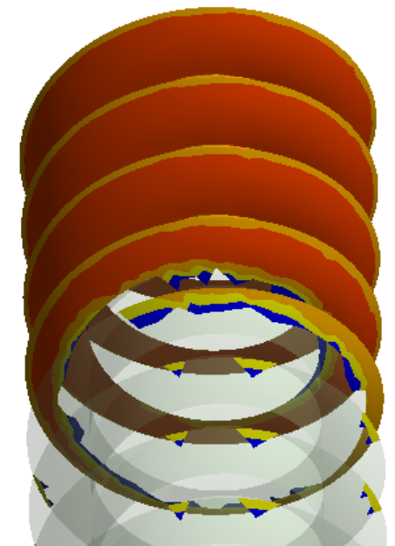
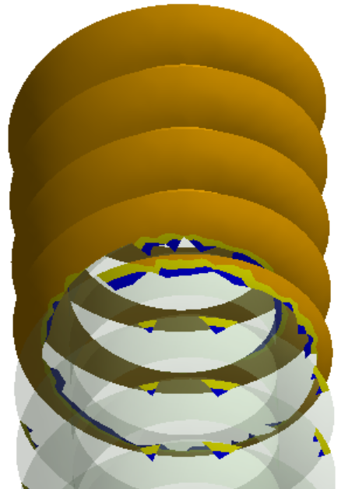
Results – Friction at Bone Implant Interface
11/17
Tractive Force Development
Rotational Acceleration of Lag Screw
Steady Rotational Speed Rotation of Lag Screw
[0 - 0.2sec]
No relative motion at the interface
[0.2 – 0.3 sec]
Partial Sliding until max static friction
[0.3 – 1.3 sec]
Full sliding at the interface

Slide 12
Results – Contact at the Fracture Area
12/17
Contact Pressure Stabilization
Relative Sliding Stop
Maximum Relative Displacement
$$1.55μm$$

Slide 13
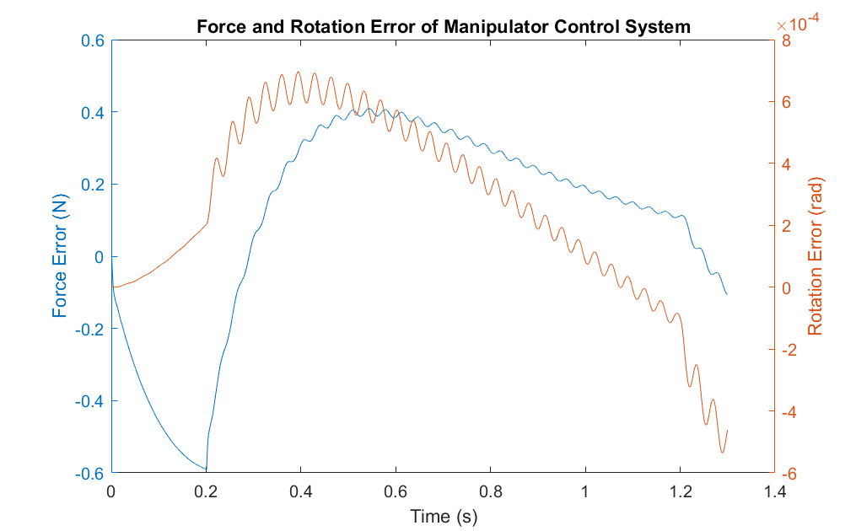
Results – Robotic Arm Control System Errors
13/17
Maximum absolute force error in x-axis
$$7.5\%$$
Tractive Force Development
Rotational Acceleration of Lag Screw
Steady Rotational Speed Rotation of Lag Screw

Slide 14
Conclusions
14/17
Finite Element Model
Sliding at fracture governed by frictional forces at the bone-implant interface
Novel surgical method application results in very small femoral head rotation relative to the stem, improving post-surgical fracture reduction
Robotic Arm Simulation
Position control system showed very good response with minimal errors
Force control system introduced errors (-7.5% to 5%), at critical points for the procedure

Slide 15
Future Work
15/17
Generalization of findings
Use of more CT scans (varying degrees of osteoporosis)
Vary the fracture patterns
Model validation
Work with clinicians to determine realistic constraints for the movement of the robotic arm
Coupling Simulink and ANSYS models

Slide 16
Thank you!

Slide 17
Literature
25/25
Cooper, C., Cole, Z.A., Holroyd, C.R. et al. Secular trends in the incidence of hip and other osteoporotic fractures. Osteoporos Int 22, 1277–1288 (2011). https://doi.org/10.1007/s00198-011-1601-6.
Ferris, H., Brent, L. & Sorensen, J. Cost of hospitalisation for hip fracture-findings from the Irish hip fracture database. Osteoporos Int 33, 1057–1065 (2022). https://doi.org/10.1007/s00198-021-06294-7
Dekhne MS, Thomas HM, Haider T, et al. Treatment and outcomes of basicervical femoral neck fractures: A systematic review. Journal of Orthopaedic Surgery. 2021;29(1). https://doi.org/10.1177/23094990211003344
Kijima H et al. Characteristics and Treatment Strategies for Basicervical and Transcervical Shear Fractures of the Femoral Neck. Journal of Clinical Medicine. 2023; 12(22):7024. https://doi.org/10.3390/jcm12227024
Young-Kyun Lee et al., Risk factors of fixation failure in basicervical femoral neck fracture: Which device is optimal for fixation?, Injury. 2018;49(3). https://doi.org/10.1016/j.injury.2018.02.009
Massoud, E.I.E. Fixation of basicervical and related fractures. International Orthopaedics (SICOT) 34, 577–582 (2010). https://doi.org/10.1007/s00264-009-0814-1
Konya MN, Verim Ö., Numerical Optimization of the Position in Femoral Head of Proximal Locking Screws of Proximal Femoral Nail System; Biomechanical Study. Balkan Med J. 2017 Sep 29;34(5):425-431. https://doi.org/10.4274/balkanmedj.2016.0732.
Stryker Corporation, “Gamma3 Trochanteric Nail 170 & 180, Operative Technique.”
J.A. Grant et al., Artificial composite bone as a model of human trabecular bone: The implant–bone interface, Journal of Biomechanics, 2007;40(5) https://doi.org/10.1016/j.jbiomech.2006.04.007.
Eberle S et al., A Biomechanical Evaluation of Orthopaedic Implants for Hip Fractures by Finite Element Analysis and In-Vitro Tests. Proceedings of the Institution of Mechanical Engineers, Part H: Journal of Engineering in Medicine. 2010;224(10):1141-1152. https://doi.org/10.1243/09544119JEIM799
J. Y. S. Luh, M. W. Walker, and R. P. C. Paul, “On-Line Computational Scheme for Mechanical Manipulators,” J Dyn Syst Meas Control, vol. 102, no. 2, pp. 69–76, Jun. 1980, https://doi.org/10.1115/1.3149599.

