Slide 1
Influence of High-Volume Cement Replacement with Silicon Manganese Slag on Mechanical, Autogenous and Drying Shrinkage performance of Composite Mortar
DILEEPA HETTIARACHCHI , Phd Fellow
S.M Samindi M.K Samarakoon, Kjell Tore Fosså and Kidane F. Gebremariam
Department of Structural & Mechanical Engineering & Material science, University of Stavanger, Norway
2nd Olympiad in Engineering Science – OES 2025

Slide 2
Content
Introduction
Strategies to reduce CO₂ emissions in cement production
Global average estimates of cement composition today and tomorrow
Silicon Manganese Slag
Objectives
Experimental setup with results
Conclusions
References
1/26

Slide 3
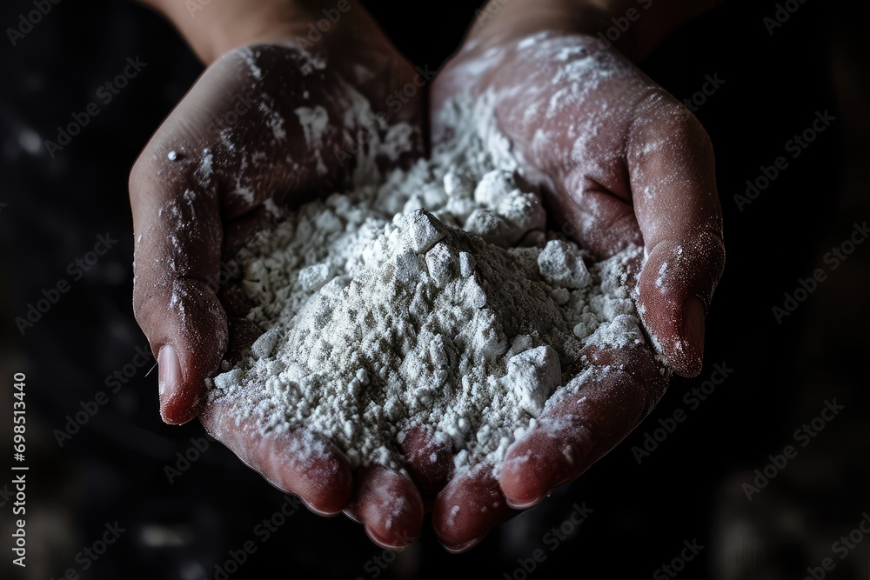

2nd Most
Cement is second only to water as the most consumed resource in the world
2.2 Billion
The worldwide production of cement produces 2.2 billion tons of CO2 per year
Introduction
https://stock.adobe.com
8.0 %
Cement is the source of 8% of the world’s CO2 emissions as the core ingredient of concrete
-16%
Annual emissions from cement must reduced by 16% by 2023

Slide 4
2nd Most
Cement is second only to water as the most consumed resource in the world
2.5 Billion
The worldwide production of cement produces 2.5 billion tons of CO₂ per year
8.0 %
Cement is the source of 8% of the world’s CO₂ emissions as the core ingredient of concrete
-16%
Annual emissions from cement must reduced by 16% by 2025
2/26

Slide 5
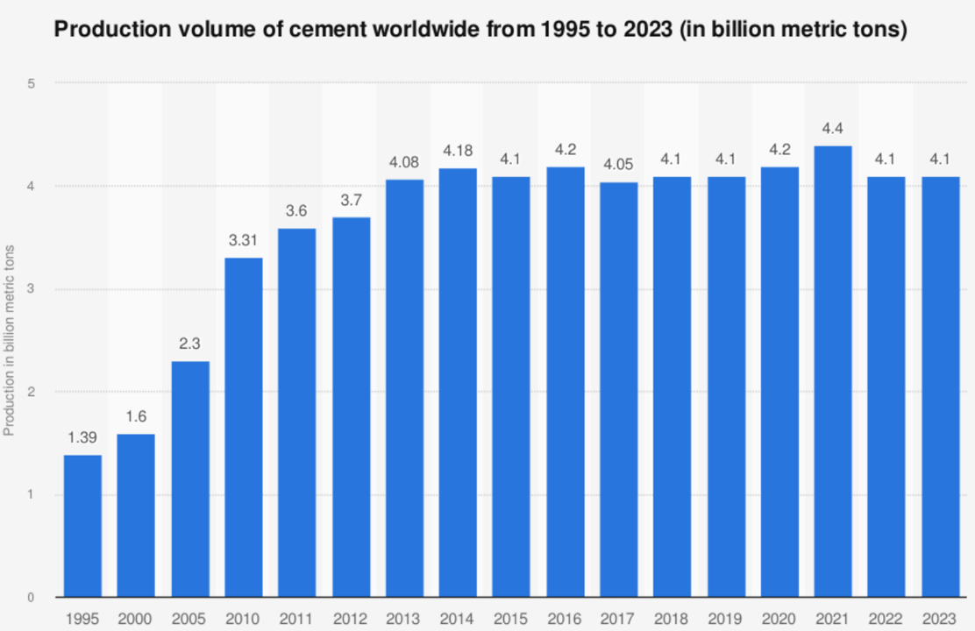
Publication
Published by | US Geological Survey
Publication date | January 2024
Original source | USGS - Mineral Commodity Summaries 2024, page 55
Add new graph
Demand on concrete and hence on cement is increasing along with global urbanization
Need for significant reduction of direct CO₂ emissions from the global cement manufacture
Need for continue collaboration with all stakeholders to accelerate the sustainable transition
3/26

Slide 6
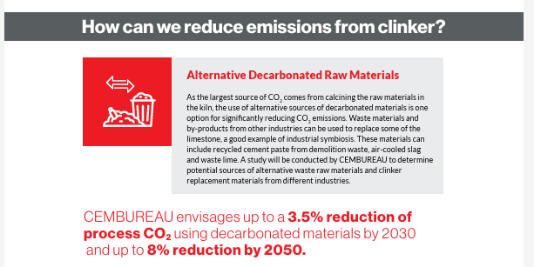
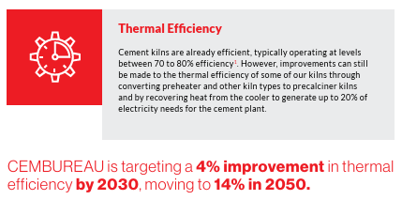
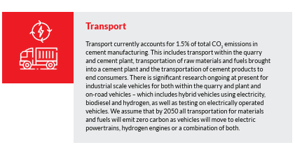
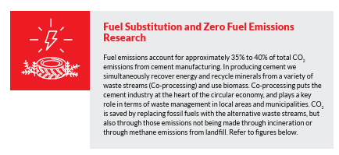
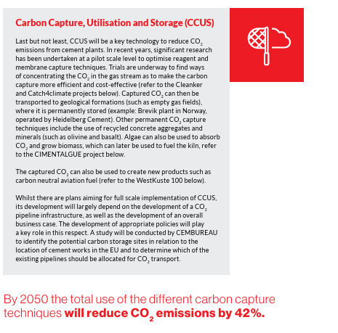
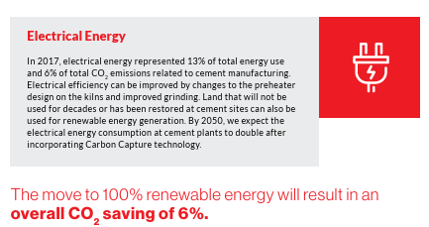

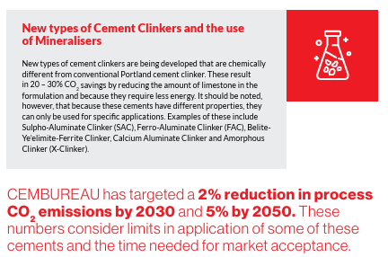
4/26
https://cembureau.eu/library/reports/cembureau-s-net-zero-roadmap

Slide 7
Strategies to reduce CO₂ emissions in cement production
Energy efficiency
Reducing clinker to cement ratio
Reduction of CO₂ emissions in cement
Switch to Alternative fuels
Innovative technologies
Ref: IEA-CSI, 2018
5/26

Slide 8
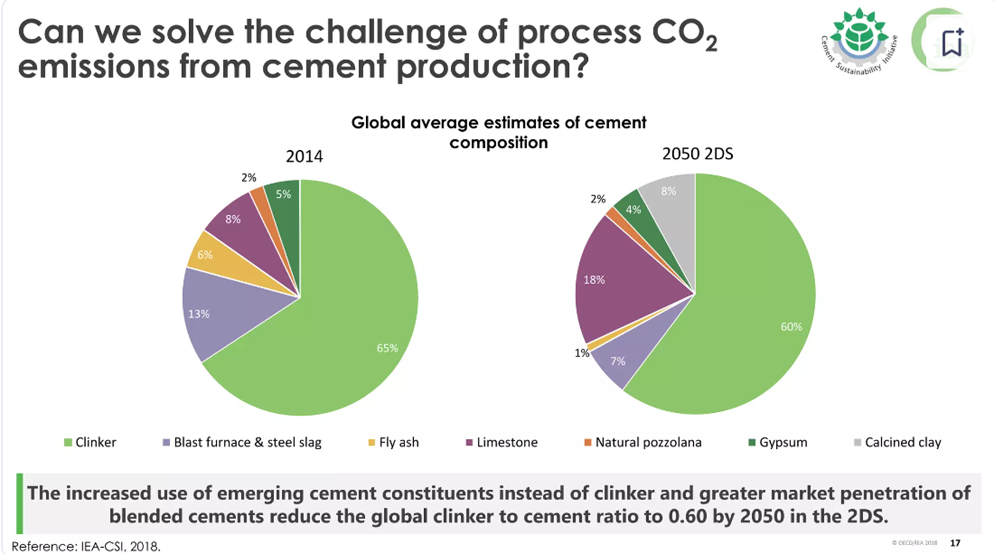
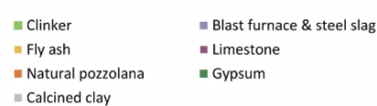
Global average estimates of cement composition
2014
2050
Ref: IEA-CSI, 2018
6/26

Slide 9
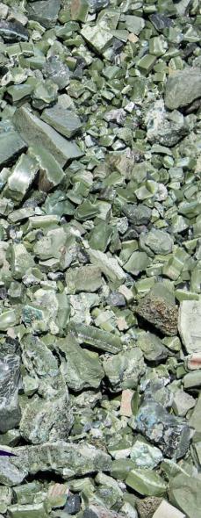
Silicon Manganese Slag
SiMn slag from ERA MET –Norway
SiGS is classified as a byproduct during the production of silicomanganese.
At Eramet Kvinesdal & Porsgrunn plants, produce about 0.3 Mt per of SiGS per year during the production process of manganese alloy
Currently they are mainly used as a land fill material.
Investigating on to utilize in asphalt road construction works and use as a SCM in concrete replacing cement likely to GGBFS
SiMn slag used in this investigation was processed from water quenched, granulated SiGS, then dried and grinded to a powder
General
SiMn Slag is a waste discharge in the process of ferro-manganese silicon production.
Rapid increase in steel production drives the fast development in ferro-manganese silicon production
The compound as an annual growth rate (CAGR) of 6.7% from 2024 to 2031.
(Ref; https://www.intellectualmarketinsights.com/report/ferro-alloys-market-growth-and-trends/imi-002996)
7/26

Slide 10
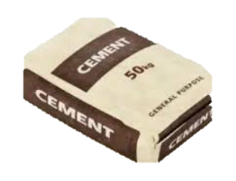
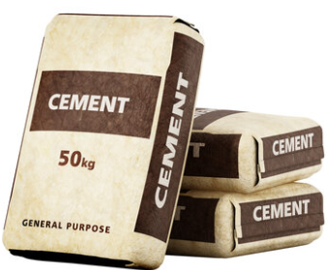


Objectives
The objective of the study is to develop a low-carbon composite binders by incorporating SiMn slag, as well as combinations of SiMn slag and GGBFS, to replace the maximum amount of cement feasible.
Then investigate the Influence of the high-volume cement replacement with studied SCMs on mechanical, autogenous and drying Shrinkage performance of composite mortar.
Obtain at least similar performance
SCM
Strength performance
Autogenous and drying Shrinkage performance
8/26

Slide 11
Experimental setup
Binder- Phase
Mortar- Phase
  Selection of SCMs & proportions
  Particle size distribution
  Chemical composition
  Prepare specimens with different cement replacement levels
  Investigates Mechanical properties
  Eg: Compressive strength
  Microstructure & Mineralogy studies
Concrete Phase
9/26

Slide 12
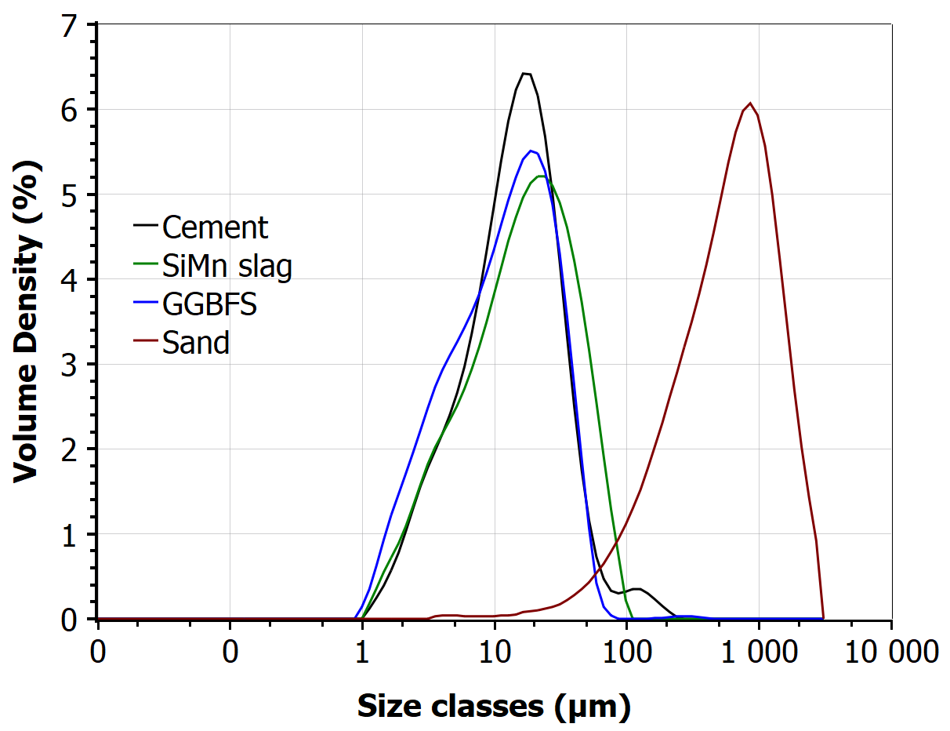
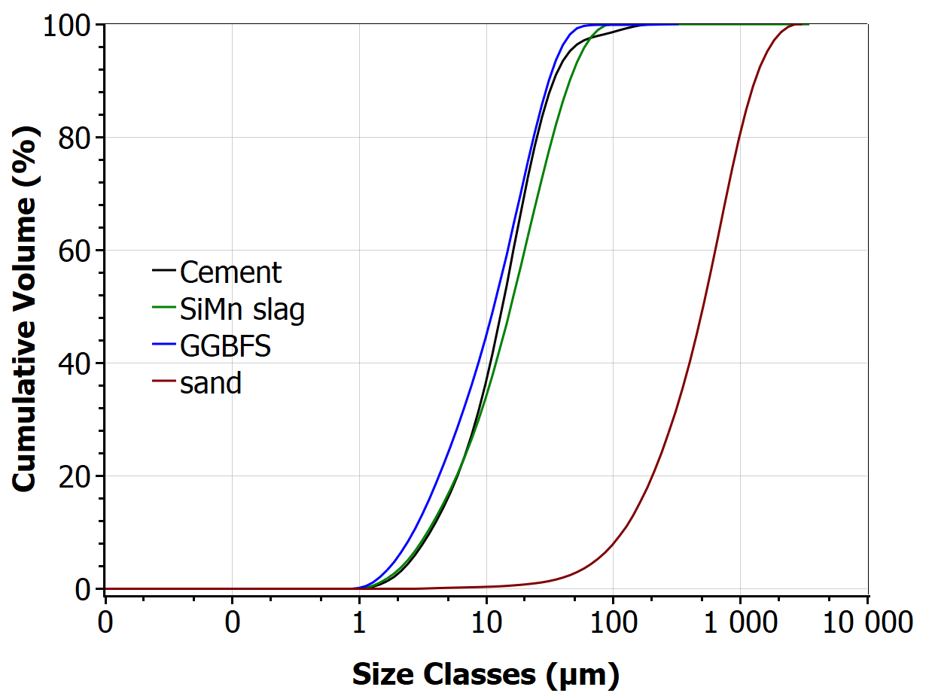
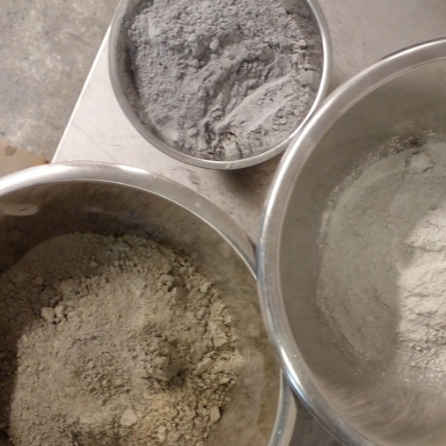
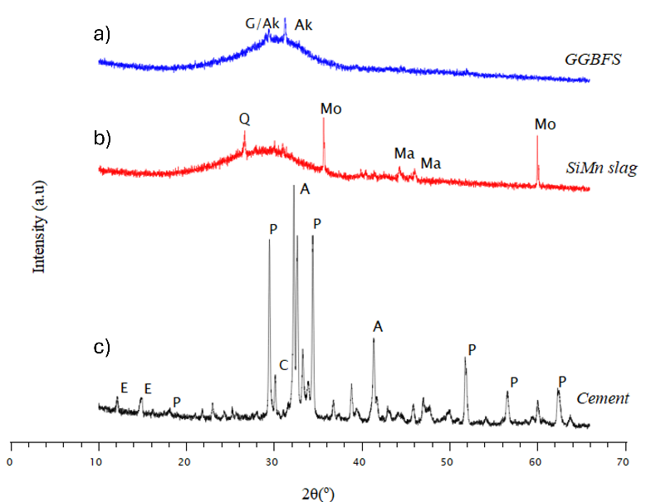
Physical properties of raw materials
PSD
a)
b)
SiMn slag
XRD patterns
GGBFS
Cement
P-portlandite, C-calcite, E-ettringite, A-alite, Mo- Moissanite,Ma- Mavlyanovite, Ak-Akermanite, G-Gehleite.
10/26

Slide 13
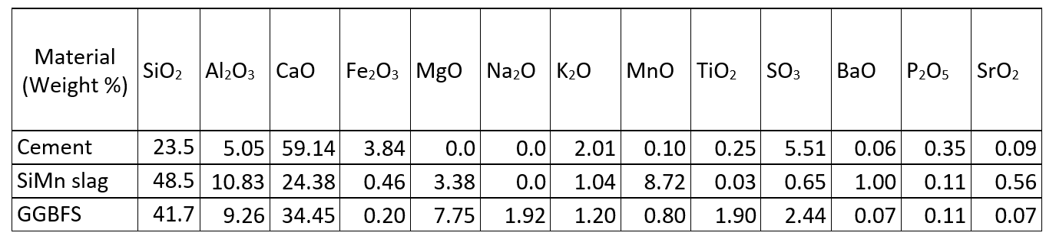
XRF studies cement and SCMs used
Appx. 85 %
SiO₂, CaO and Al₂O₃ are the main components of the two types of slags comprising together approximately 85% of total composition, similar to cement
composition of CaO in SiMn slag is 24.4%, which is lower than cement and GGBFS
SiMn slag and GGBFS have MgO content of 3.4% and 7.7% respectively
SiMn slag contains MnO 8.7% of total composition compared with 0.8 % of GGBFS
11/26

Slide 14
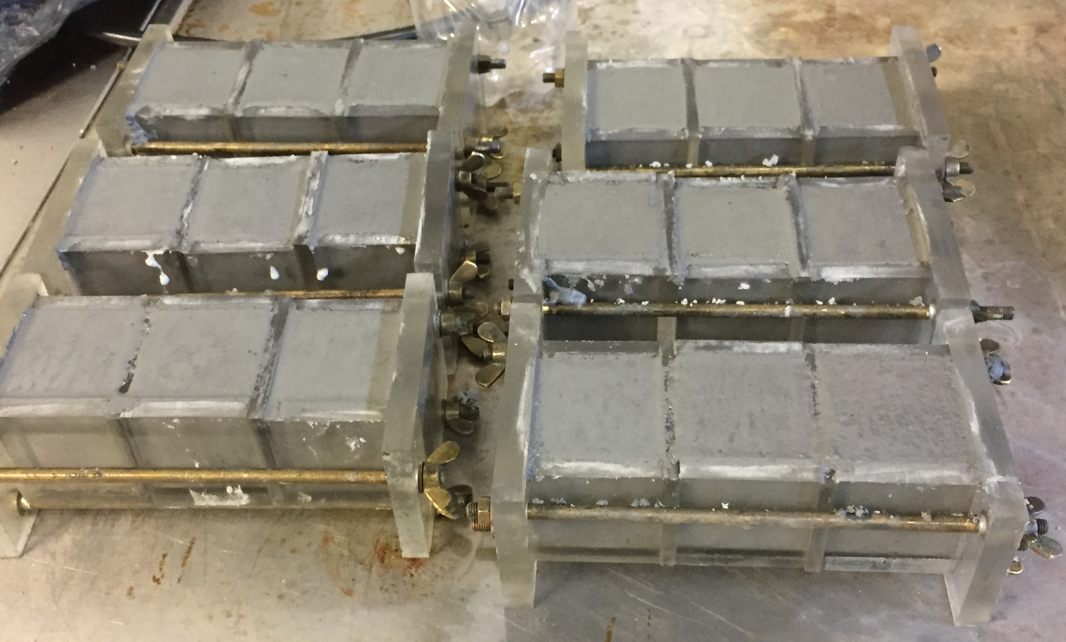
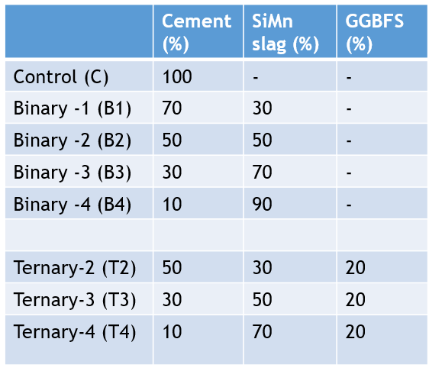
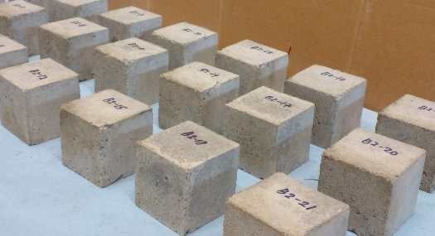
Mix Proportions
W/C ratio = 0.35
SP dosage = 1% of wt.
Specimen size= 50x 50x 50 mm
Binary Binders (50 % - 90%)
Cement + [ SiMn slag ] at 3 different replacement levels
Ternary Binders (50 % - 90%)
Cement + [SiMn slag ] + GGBFS (20%) at 3 different replacement levels
12/26

Slide 15
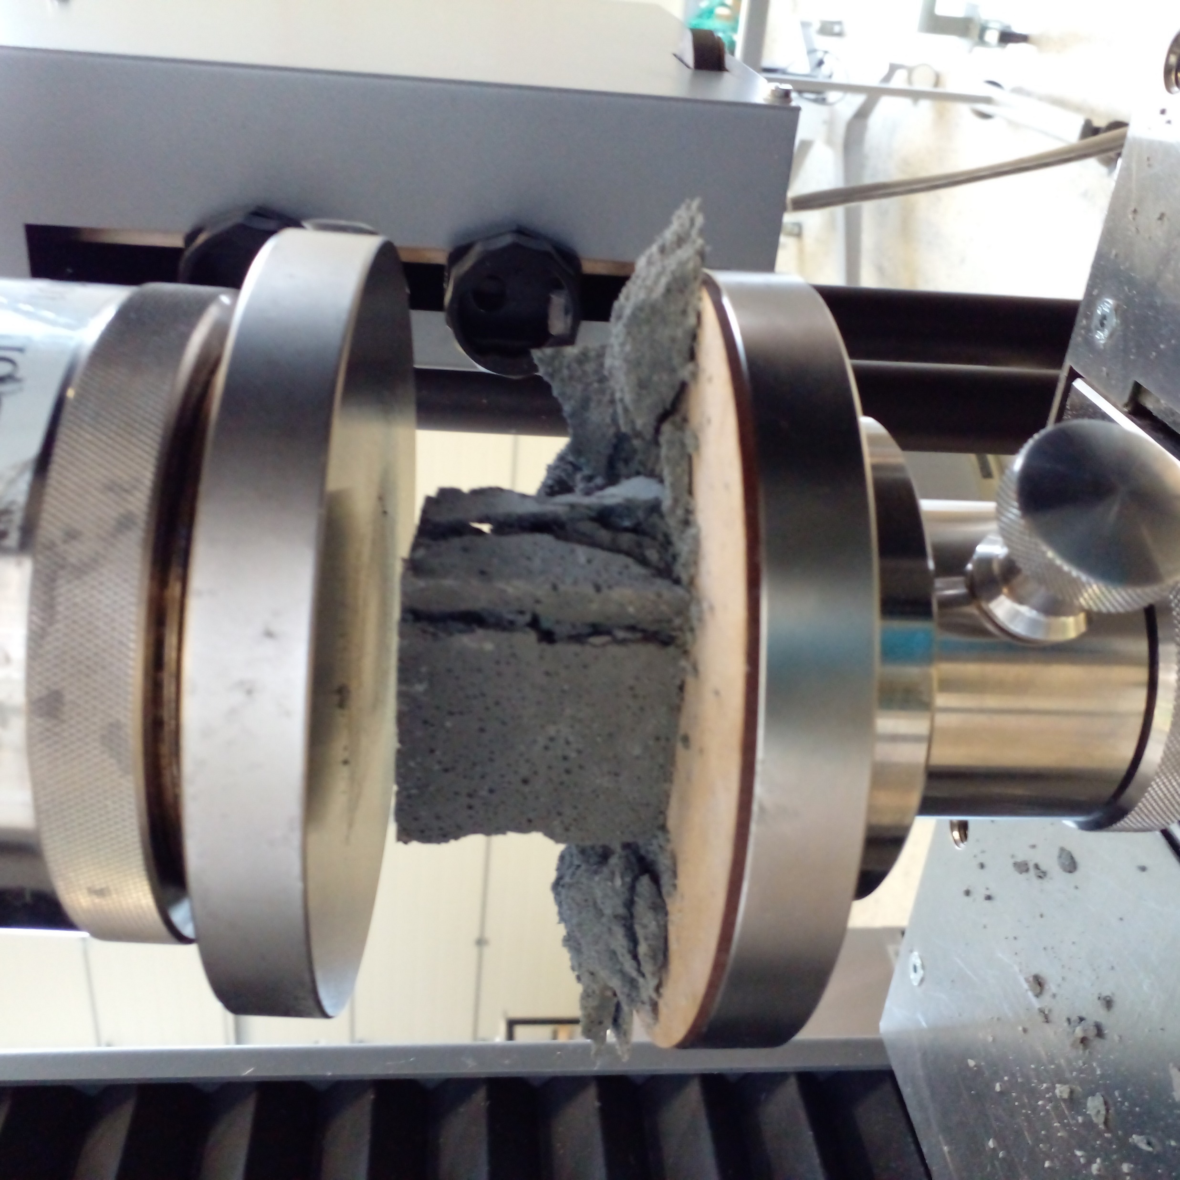
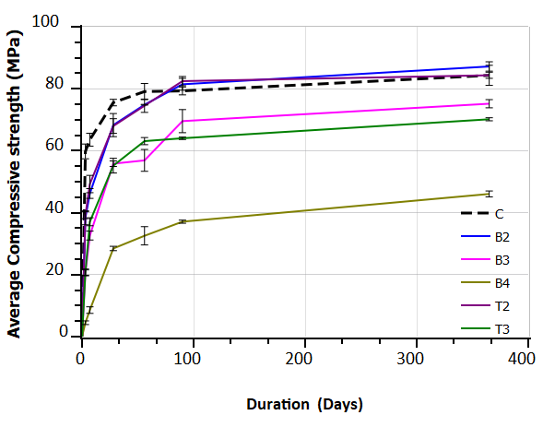
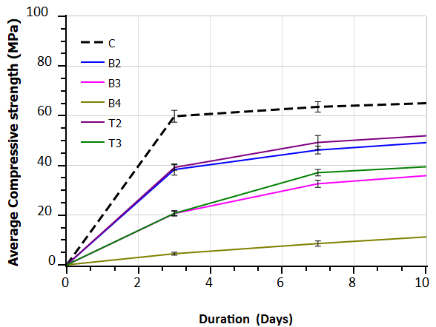
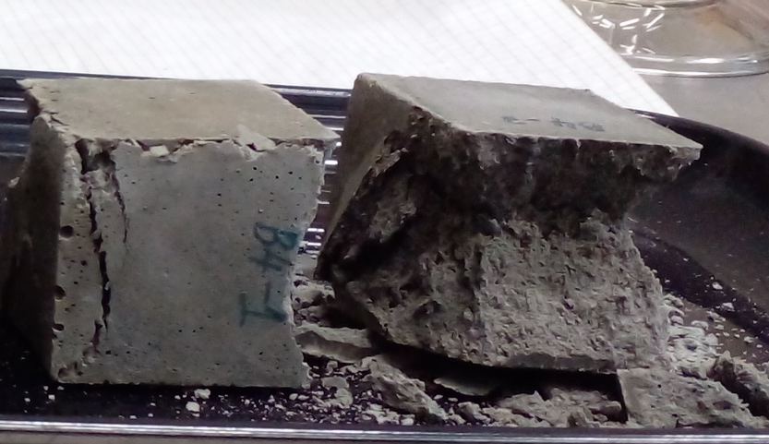
Compressive strength (ASTM C 305-6)
Early age strength is less in mortars with SCMs than control
Higher the cement replacement lower the strength development
B2 & T2 achieved compressive strengths higher than or equal to the control (apx. 85 Mpa)
B3 & T3 with higher replacement of 70% achieved compressive strengths over 65 Mpa.
B4 with 90% replacement levels showed a strength higher than 40 Mpa.
13/26

Slide 16
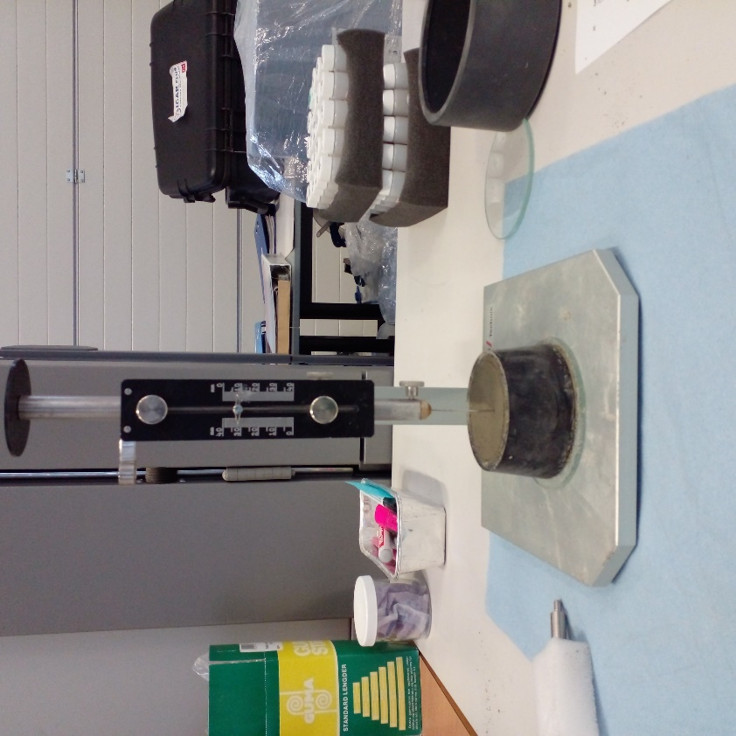
Final setting time (ASTM C191-21)
ID of Mortar type | Average final setting time (hrs.) | Standard deviation (min)
C | 07:25 | 8.50
B2 | 11:15 | 6.25
B3 | 14:45 | 4.75
B4 | 20:50 | 14.5
T2 | 10:50 | 1.25
T3 | 14:35 | 13.10
14/26

Slide 17
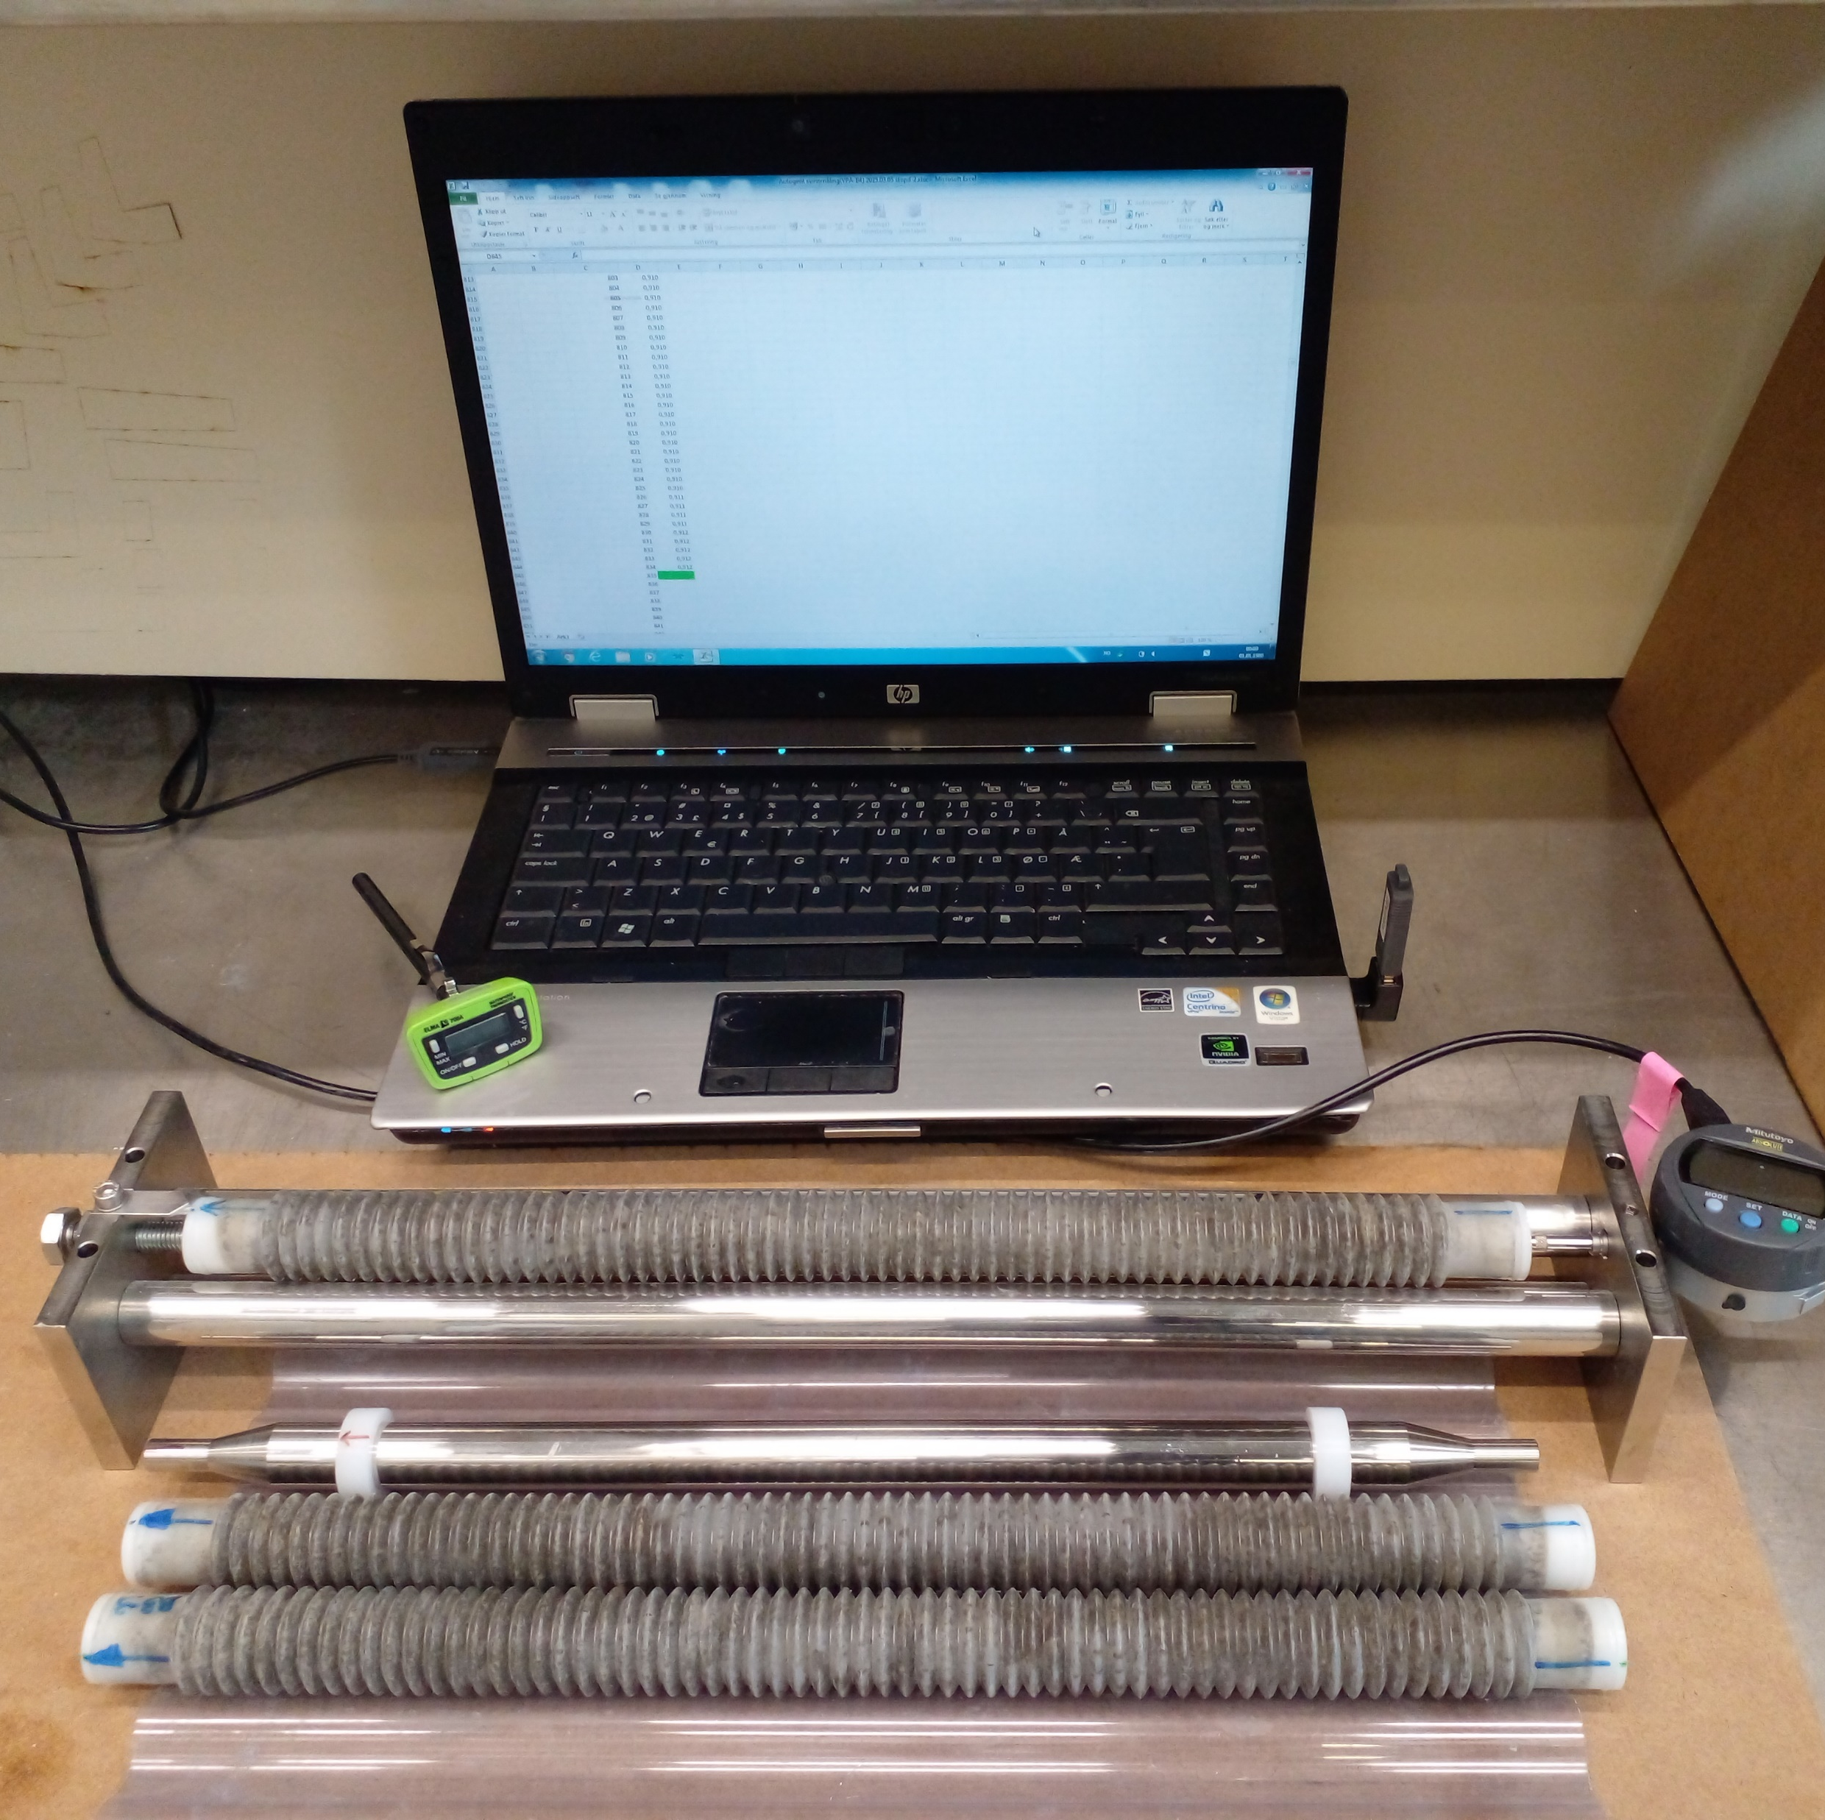
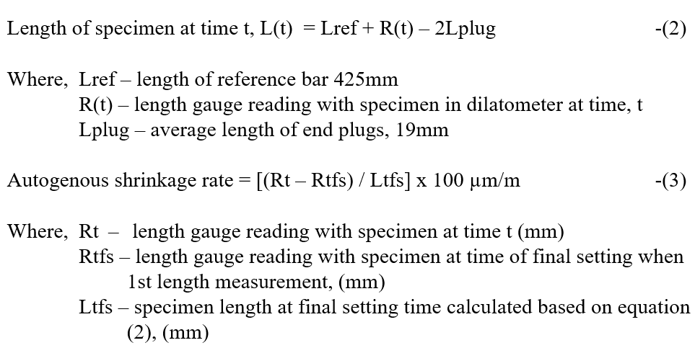
Autogenous Shrinkage
(ASTM C1698-09 )
15/26

Slide 18
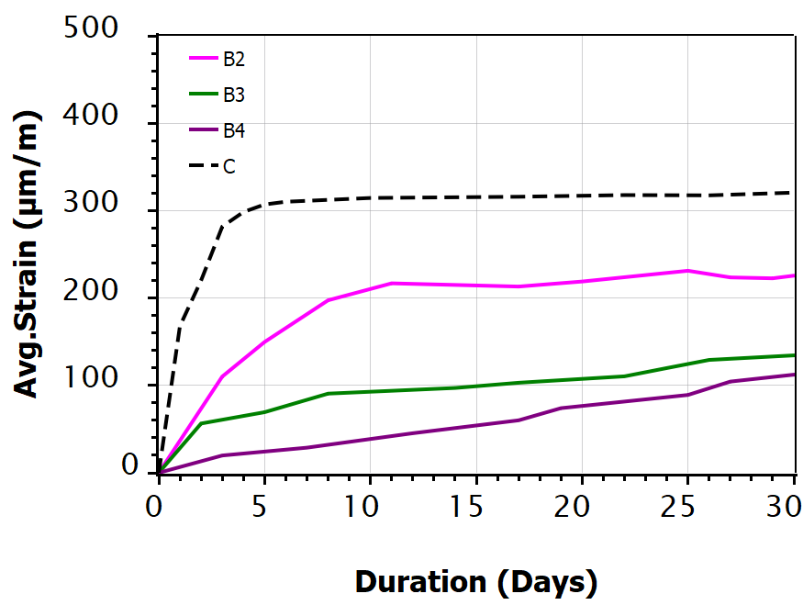
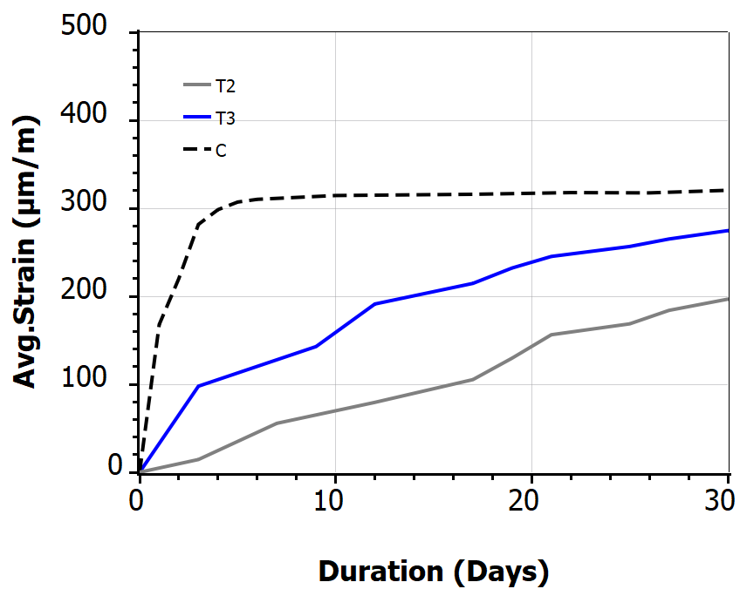
Autogenous shrinkage of test specimens
Binay mortar with SiMn slag
Ternary mortar with SiMn slag & GGBFS
significantly reduced level of autogenous shrinkage compared to the control which is slightly below 320 µm/m particularly at early ages is observed
followed by an increasing with fluctuations over time
Reduction in early-age autogenous shrinkage can be attributed to the lower heat of hydration associated with increased SCM content
This is reducing the risk of early-age cracking in the paste
16/26

Slide 19
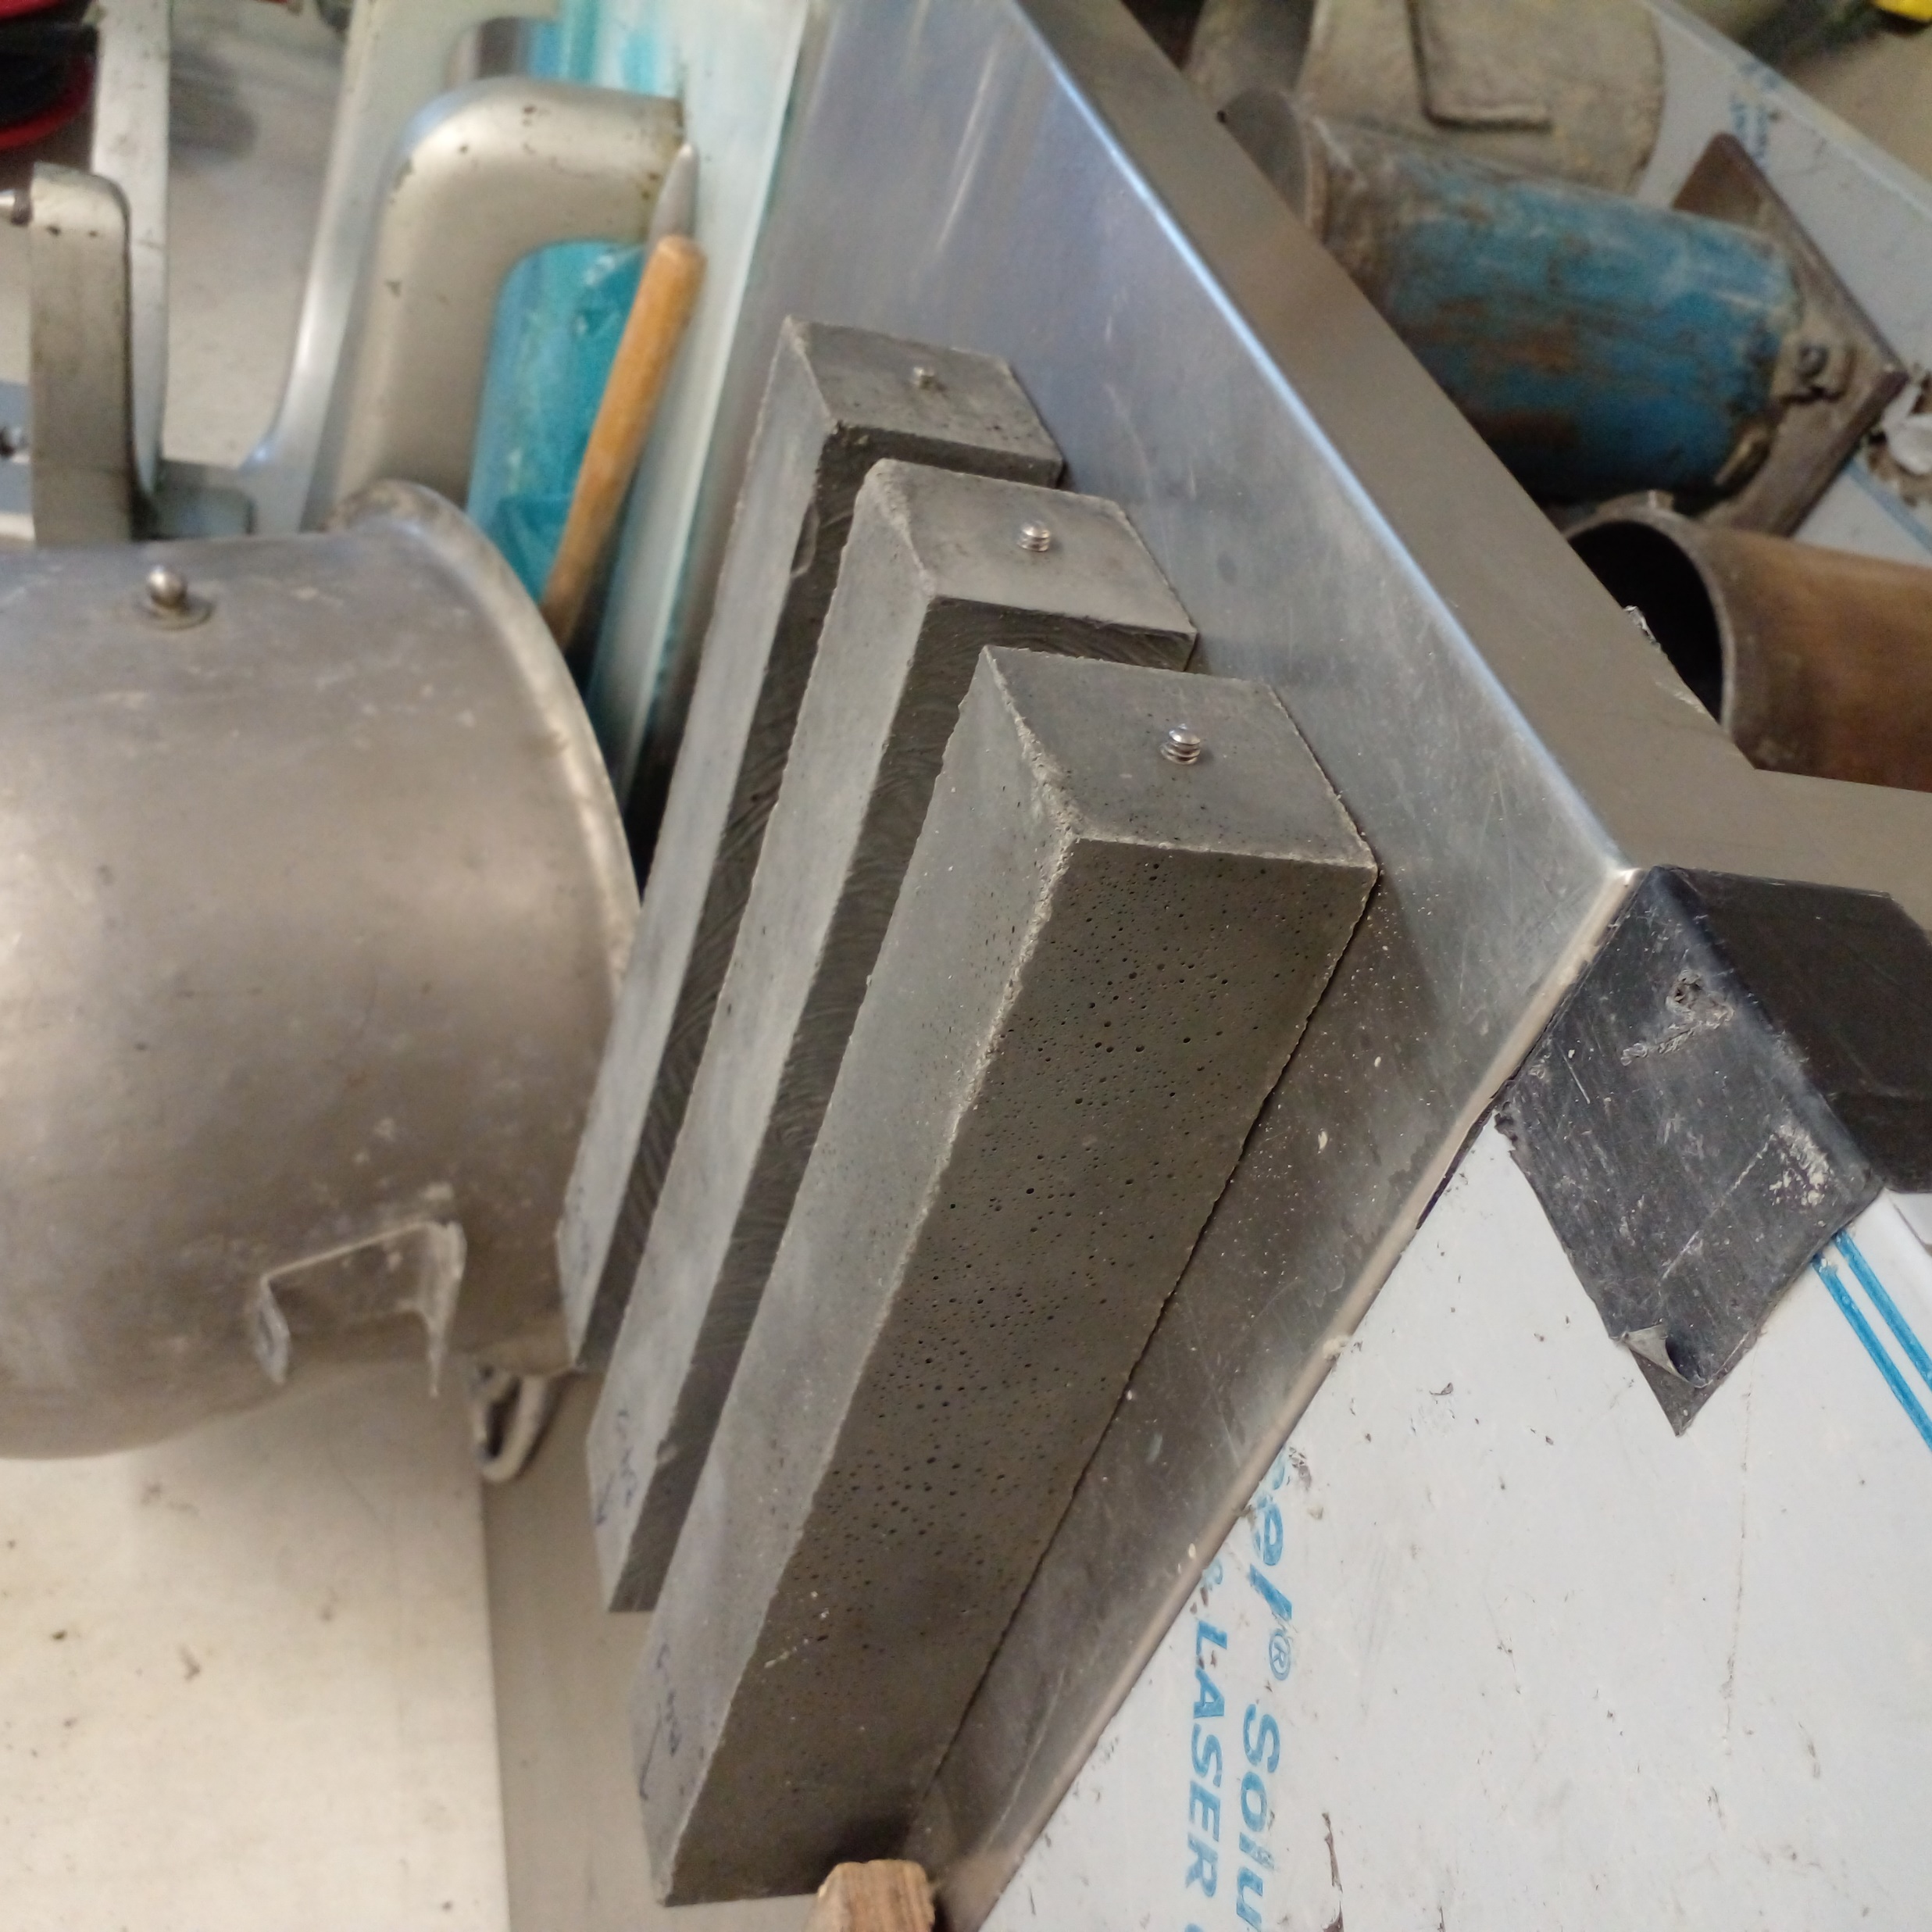
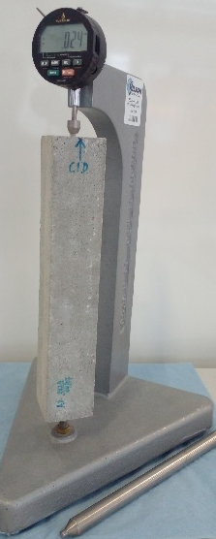
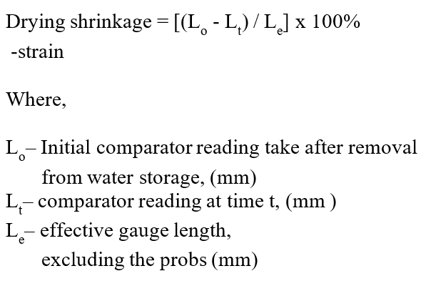
Drying Shrinkage of Test
(ASTM C 596-07)
17/26

Slide 20
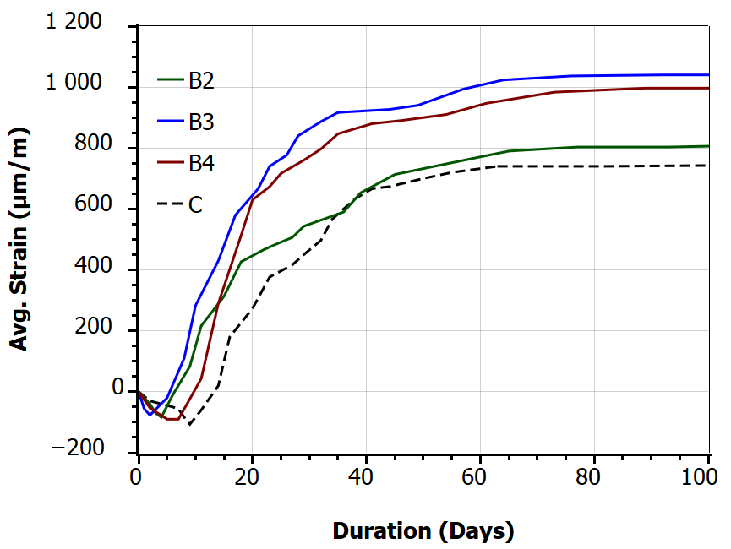
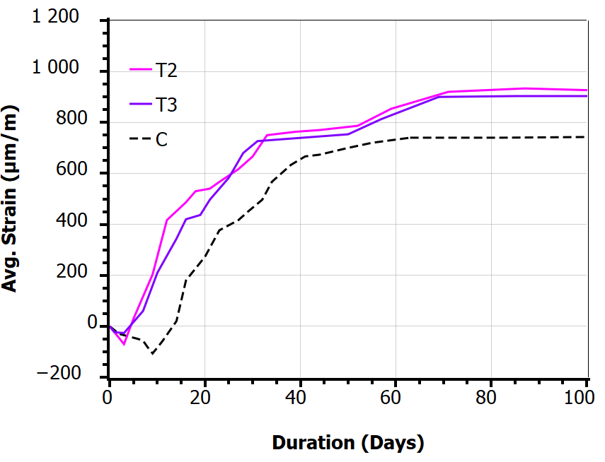
Drying Shrinkage of Test Specimens at 90 days
Binay mortar with SiMn slag
Ternary mortar with SiMn slag & GGBFS
drying shrinkage observed to be higher than control and continued the same trend even after one year
The observed drying shrinkage of composite mortars within a range of 900-1000 µm/m at 90 days
It increase approximately 1200 µm/m after one year
18/26

Slide 21
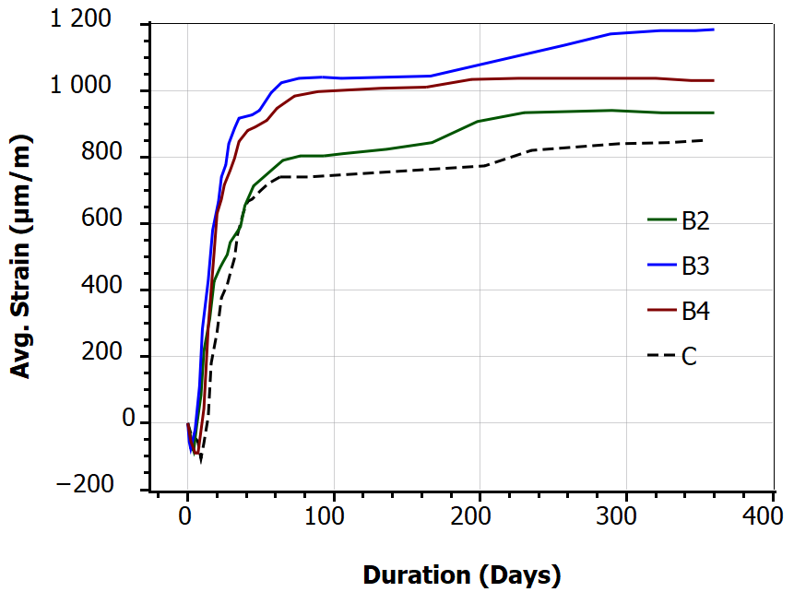
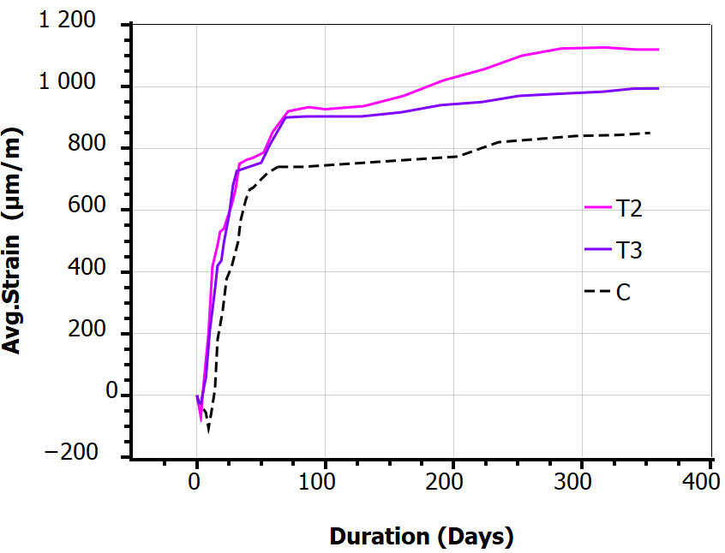
Drying Shrinkage of Test Specimens at 365 days
Binay mortar with SiMn slag
Ternary mortar with SiMn slag & GGBFS
refinement of the pore structure due to densification from the formation of secondary hydration products
these systems consume less amount of mixing water, relying more on pozzolanic reactions than cement hydration, which makes them more susceptible to water loss and elevated early-age drying shrinkage until sufficient matrix stiffness develops
19/26

Slide 22
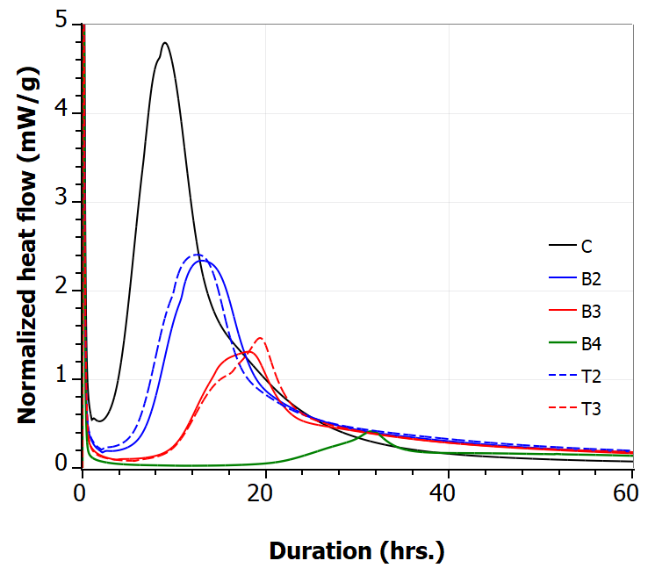
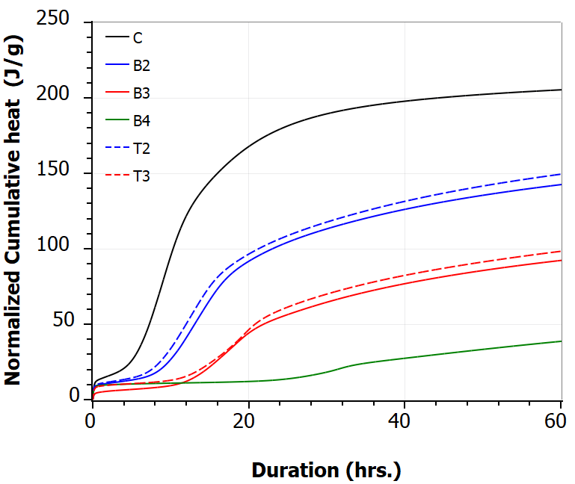
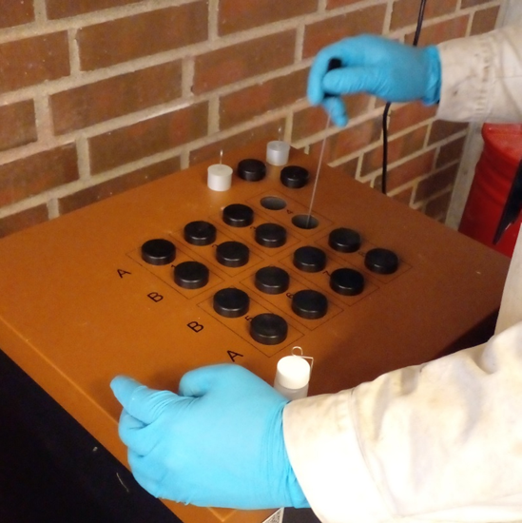
Isothermal Calorimetry
IC study on cementitious mixtures
Normalized heat flow
Normalized cumulative heat
2nd peak
23 ⁰C for
120 hours
2nd peak(s) attributed to precipitation of C-S-H gel with time
The heat evolution during the reaction periods decreased in the following order:
C, T2, B2, T3, B3, and B4.
This is correlated to the strength characteristics of the specimens noted in same order
Less hydration has taken place with increasing percentage of cement replacement
20/26

Slide 23
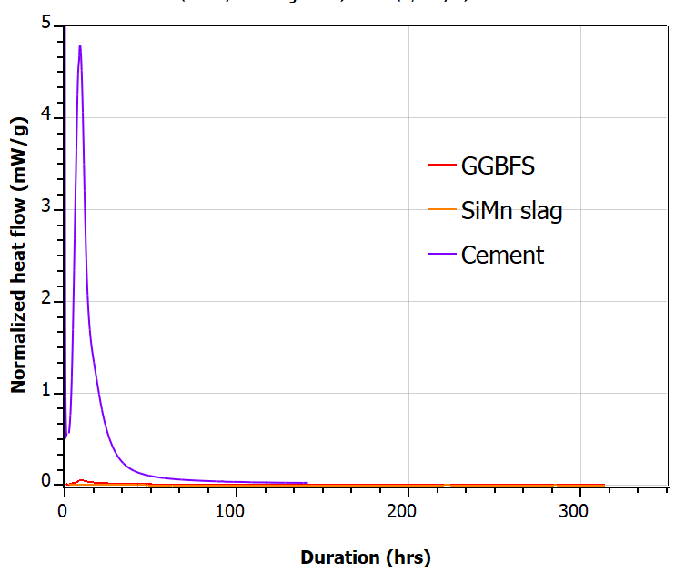
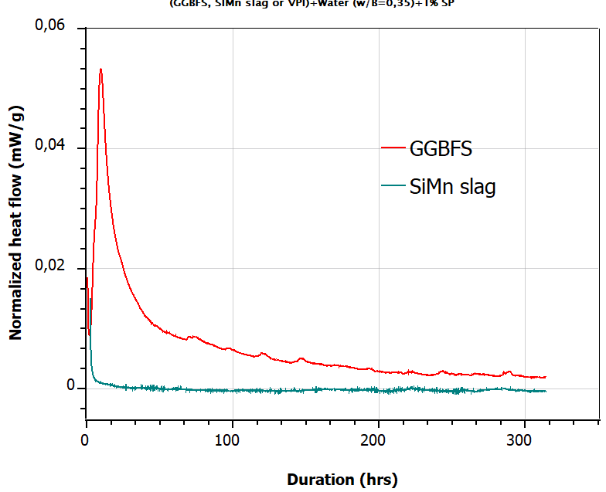
IC study on materials
21/26

Slide 24
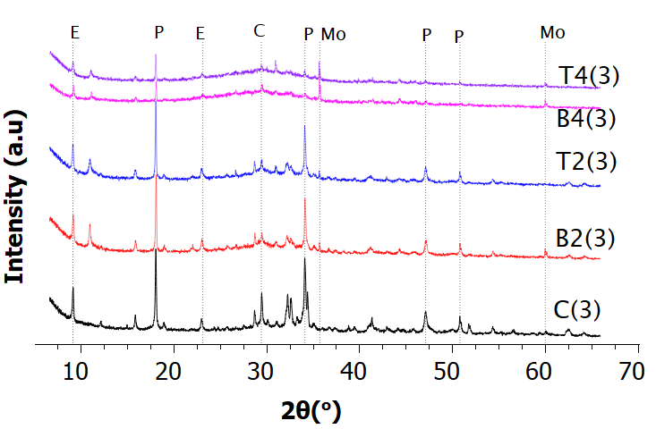
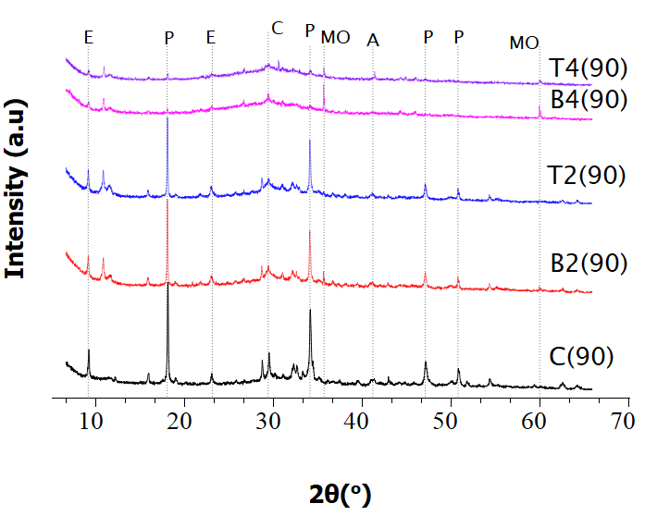
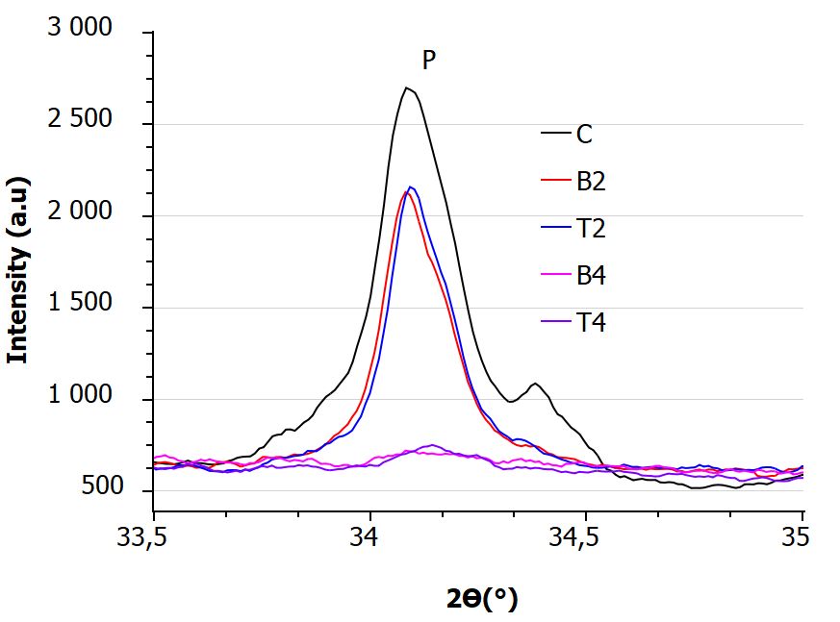
  XRD Analysis
(b)
(a)
XRD patterns of binders at 3 days (b) 90 days of curing.
The existence of hydration products is clearly identifiable in the control specimen
the presence of lesser amounts of hydration products and remains of unreacted particles are clearly visible with increase of cement replacement.
22/26

Slide 25
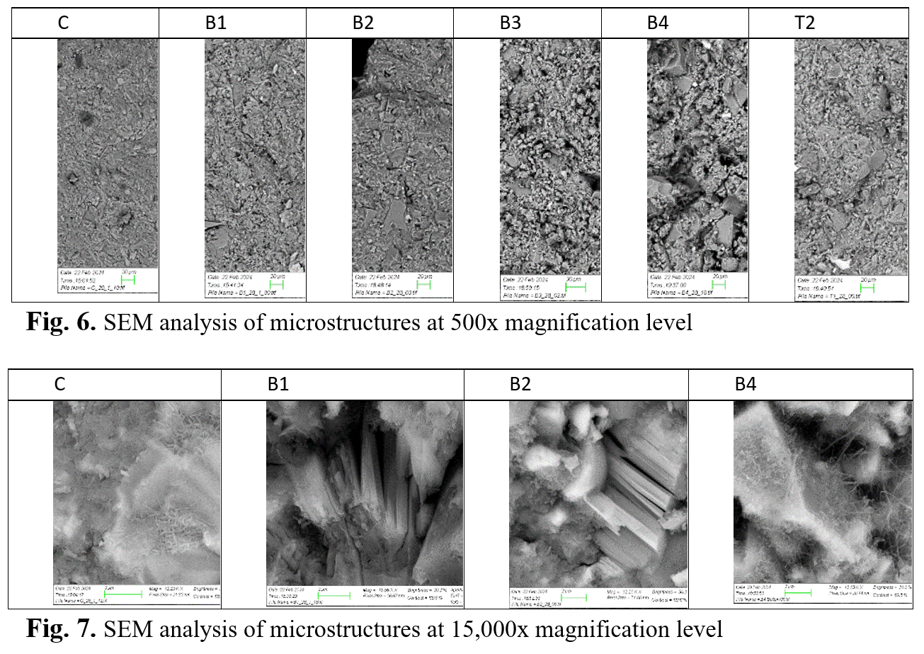
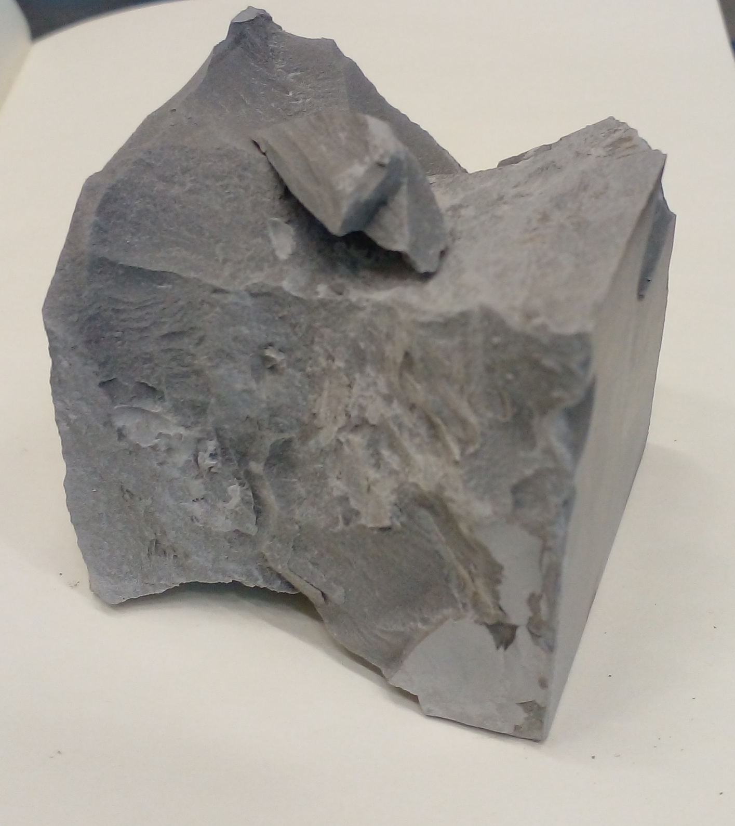
Scanning Electron Microscopy (SEM) observation
Microstructure at 500 x Magnification
Microstructure at 15,000 x Magnification
23/26

Slide 26
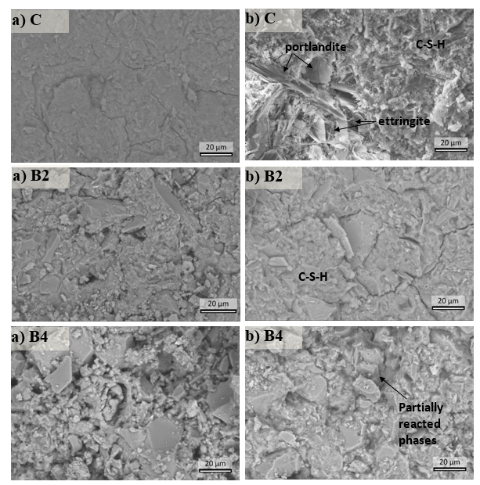
  SEM-EDS observations
add
BSE microstructures images of C, B2 & B4 at 2kx magnification (a) at 7-days) and (b) at 90-days.
24/26

Slide 27
Conclusions
Binary binder (B2) with SiMn slag replaced cement by up to 50% and ternary binder T2 comprised of 30% of SiMn slag and 20% GGBFS, replaced cement by 50%, achieved compressive strengths higher than 60 Mpa (10% less than control), after 28 days. Strength continued to develop and exceed the control by 4% after 90 days (85 Mpa)
Moreover, utilizing even higher cement replacement proportions like 70% , binary and ternary binders gained compressive strengths exceeding 55 Mpa, after 28 days. Ended up with 12-20% less strength than control (70-65 MPa) after 90 days
Further higher replacement proportions like 90%, binary binder achieved a strength above 25 MPa, after 28 days and reached to 37 MPa at 90 days
Several strength classes identified along with different higher replacement percentage of cement with SiMn slag and GGBFS. Their varied combinations needs to further research
Autogenous shrinkage initially decreased but tended to increase with time
Drying shrinkage consistently increased with elevated level than control
25/26

Slide 28
Acknowledgement.
The author would like to express gratitude to Mr. Leif Hunsbedt and Mr. Kjorkleiv Oyvind Karstein of ERAMET, Norway for providing the ground SiMn slag necessary to conduct this study.
8. Kumar, S., García-Triñanes, P., Teixeira-Pinto, A., and Bao, M.: ‘Development of alkali activated cement from mechanically activated silico-manganese (SiMn) slag’, Cement and Concrete Composites, 2013, 40, pp. 7-13
9. Marsh, A.T.M., Yang, T., Adu-Amankwah, S., and Bernal, S.A. ‘11 - Utilization of metallurgical wastes as raw materials for manufacturing alkali-activated cements’, in de Brito, J., Thomas, C., Medina, C., and Agrela, F. (Eds.) ‘Waste and Byproducts in Cement-Based Materials’ (Woodhead Publishing, 2021), pp. 335-383
10.Nath, S.K., Randhawa, N.S., and Kumar, S. ‘A review on characteristics of silico manganese slag and its utilization into construction materials’, Resources, Conservation and Recycling, 2022, 176
11.Jiang, Y., Ling, T.-C., Shi, C., and Pan, S.-Y. ‘Characteristics of steel slags and their use incement and concrete—A review’, Resources, Conservation and Recycling, 2018, 136, pp. 187-197
12.Al-Duais, I.N.A., Ahmad, S., Al-Osta, M., Maslehuddin, M., Saleh, T., and Al-Dulaijan, S.‘Optimization of alkali-activated binders using natural minerals and industrial wastematerials as precursor materials’, Journal of Building Engineering, 2023, pp. 106230
13.Oh, T., Kim, M.-J., Banthia, N., and Yoo, D.-Y. ‘Influence of curing conditions on mechanical and microstructural properties of ultra-high-performance strain-hardening cementitious composites with strain capacity up to 17.3%’, Developments in the Built Environment, 2023, 14, pp. 100150
14.Boháč, M., Palou, M., Novotný, R., Másilko, J., Všianský, D., and Staněk, T. ‘Investigation on early hydration of ternary Portland cement-blast-furnace slag–metakaolin blends’, Construction and Building Materials, 2014, 64, pp. 333-341
15.Yang, K.-H., Moon, G. D., and Jeon, Y.-S. ‘Implementing ternary supplementary cementing binder for reduction of the heat of hydration of concrete’, Journal of Cleaner Production, 2016, 112, pp. 845-852
16.Sikora, P., Cendrowski, K., Abd Elrahman, M., Chung, S.-Y., Mijowska, E., and Stephan,D. ‘The effects of seawater on the hydration, microstructure and strength development of Portland cement pastes incorporating colloidal silica’, Applied Nanoscience, 2019, 10
References
1. I.E.A. ‘Net Zero by 2050, A Road Map for the Global Energy Sector’, in Editor ‘Book NetZero by 2050, A Road Map for the Global Energy Sector’ (2021, edn.)
2. Zhang, Y., Zhang, J., Luo, W., Wang, J., Shi, J., Zhuang, H., and Wang, Y. ‘Effect of compressive strength and chloride diffusion on life cycle CO2 assessment of concrete containing supplementary cementitious materials’, Journal of Cleaner Production, 2019, 218, pp. 450-458
3. Anurag, Kumar, R., Goyal, S., and Srivastava, A. ‘A comprehensive study on the influence of supplementary cementitious materials on physico-mechanical, microstructural and durability properties of low carbon cement composites’, Powder Technology, 2021, 394, pp. 645-668
4. Juenger, M.C.G., and Siddique, R. ‘Recent advances in understanding the role of supplementary cementitious materials in concrete’, Cement and Concrete Research, 2015, 78, pp. 71-80
5. Sankar, B., and Ramadoss, P. ‘Mechanical and Durability Properties of High Strength Concrete Incorporating Different Combinations of Supplementary Cementitious Materials A Review’, ‘Proceedings of Fourth International Conference on Inventive Material Science Applications’ (2022), pp. 543-557
6. Ramzi, S., Moradi, M.J., and Hajiloo, H. ‘The Study of the Effects of Supplementary Cementitious Materials (SCMs) on Concrete Compressive Strength at High Temperatures Using Artificial Neural Network Model’, Buildings, 2023, 13, (5)
7. Juenger, M., Provis, J.L., Elsen, J., Matthes, W., Hooton, R.D., Duchesne, J., Courard, L.,He, H., Michel, F., Snellings, R., and Belie, N.D. ‘Supplementary Cementitious Materials for Concrete Characterization Needs’, MRS Proceedings, 2012, 1488
26/26

Slide 29

Thank you
Cement is not the problem. It is the solution

