Slide 1



2nd Olympiad in Engineering Science
OES 2025
Stavanger, Norway, June 10-14, 2025
Structural Integrity Issues at Repurposing Gas Pipelines for Hydrogen Service
Viacheslav Bogdanov ¹, Zinoviy Nazarchuk ², Olha Zvirko ²
¹ S.P. Timoshenko Institute of Mechanics of the NAS of Ukraine
² Karpenko Physico-Mechanical Institute of the NAS of Ukraine

Slide 2

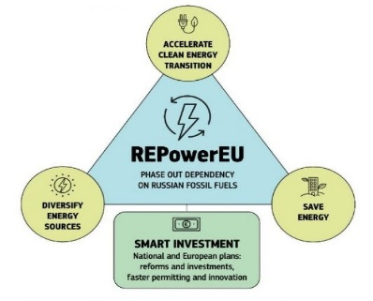
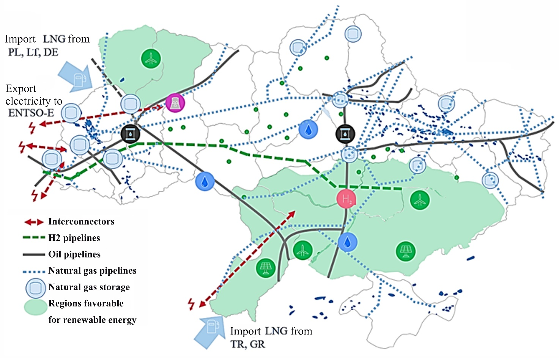
Prospects for the use of the Ukrainian gas transmission network for the transportation of green hydrogen
The European Green Deal
2019
European Hydrogen Backbone
2020
REPowerEU
2022
Ukrainian natural gas transportation system
Hydrogen could play a key role in Ukraine’s green reconstruction and future development plans
REPowerEU Plan – a plan to rapidly reduce dependence on Russian fossil fuels and fast forward the green transition
Europe’s goal by 2050 is to achieve a 13% share of hydrogen energy in the union’s energy balance
European Hydrogen Backbone vision – operating network of hydrogen pipelines in Europe by 2040
https://www.kmu.gov.ua
The construction of new dedicated hydrogen pipelines will be complemented with the repurposing of existing gas networks. According to the European Hydrogen Backbone, 70% could be repurposed by 2030.
2

Slide 3
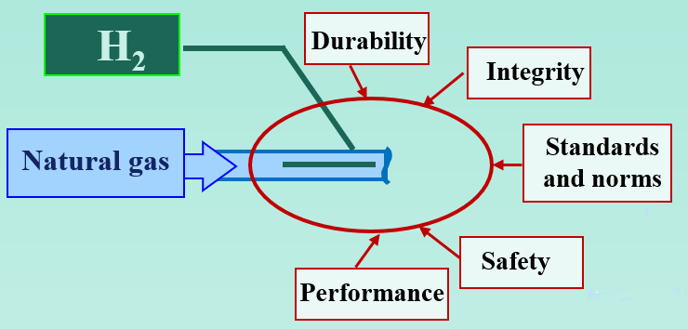
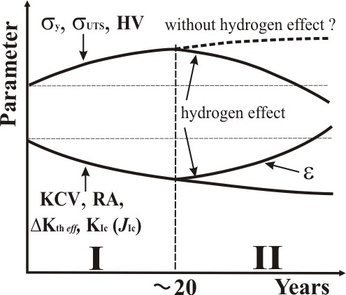
Ageing and in-service degradation of pipeline steels
Effect of hydrogen blending on existing gas pipelines
Issues at hydrogen transportation
In-service degradation of pipeline steels
Influence of hydrogen on mechanical behaviour of pipeline steels
Time of operation of gas transit pipelines
Deformation aging
Damage accumulation
Stages of operational degradation of pipeline steels
3

Slide 4
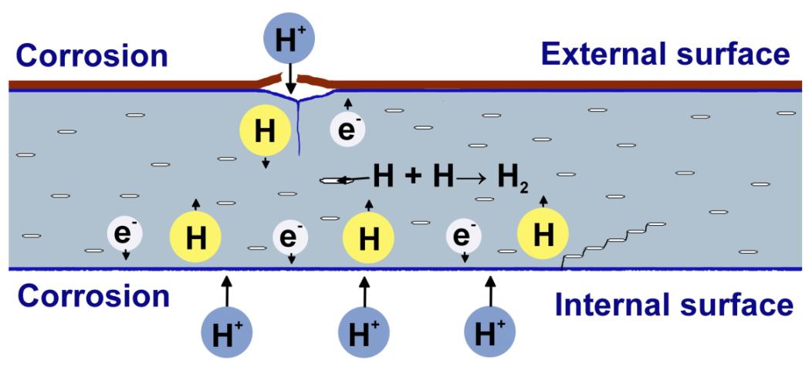
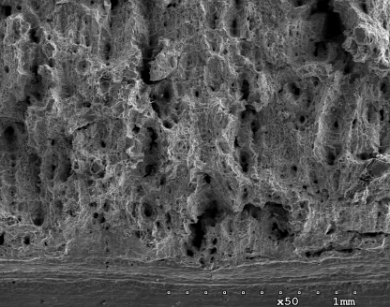
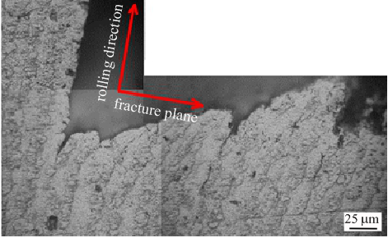
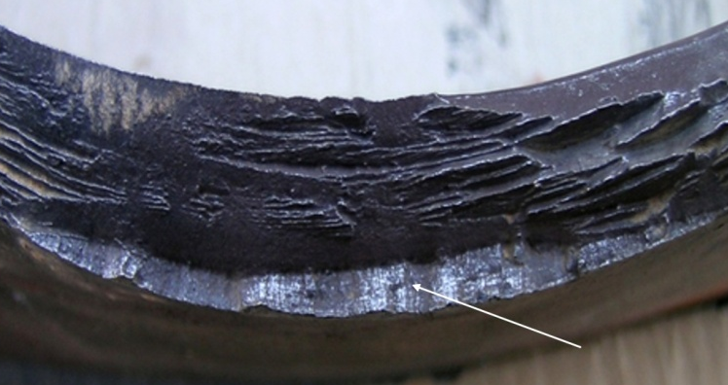
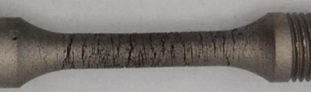
Hydrogen assisted degradation of pipeline steels
Hydrogen uptake and damage accumulation in pipeline steels during their long-term service
Ways of hydrogen charging
of steels
Hydrogen evolution
under corrosion
Dissociation
of molecular hydrogen
Steel pipe
Damage accumulation
HCO₃⁻ + e⁻ = H + CO₃²⁻
H₂ = H + H
H₂О + e– = H + ОH–
Crack branching due to delamination in rolling direction
Hydrogen
In-bulk damaging of operated steels
SCC
4

Slide 5
Sensitivity of mechanical properties of steels to hydrogen assisted degradation
Steel | State | σ_{ys}, MPa | σ_{UTS}, MPa | RA, % | δ, % | KCV, J/cm² | J_{ІС}, MPa∙√m | C_{H}, ppm
17H1S (eq. API 5L X52) | As-received | 378 | 595 | 79.0 | 20.2 | 200 | 322 | 1.6
 | Operated 29 years | 345 | 547 | 71.0 | 19.6 | 138 | 175 | 2.5
 | Operated 40 years | 302 | 515 | 69.0 | 26.3 | 125 | - | 3.6
API 5L X52 | As-received | 355 | 475 | 72,9 | 22.7 | 350 | 412 | 1.5
 | Operated 30 years | 261 | 455 | 63.4 | 21.9 | 186 | 127 | 1.9
 | Operated 30 years | 349 | 537 | 54.8 | 29.3 | 142 | 79 | 5.1
The most sensitive characteristics for an evaluation of in-service degradation of pipeline steels by destructive methods are fracture toughness and impact strength.
Relative changes in mechanical characteristics of API 5L X52 pipeline steels, caused by in-service degradation
5

Slide 6
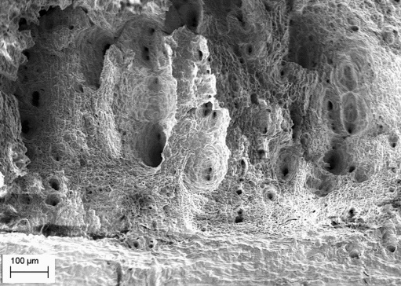
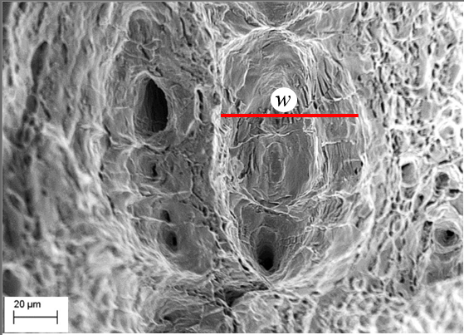
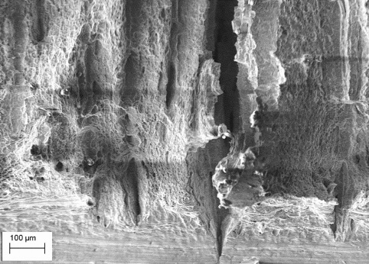
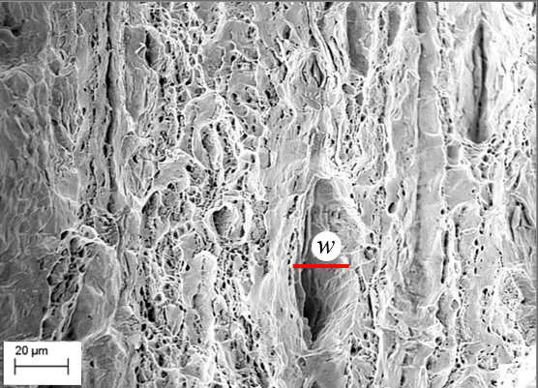
Operational degradation of mechanical properties
17H1S pipeline steel (0.17% C, 1.2% Mn), eq. API 5L X52, 38 years of operation
Steel state | Specimen type | KCV, J/cm² | J_{cr}, N/mm
As-delivered | Longitudinal | 129 | 215.0
 | Transversal | 71 | 72.3
Post-operated | Longitudinal | 103 | 108.0
 | Transversal | 65 | 81.4
Longitudinal specimen
Transverse specimen
Fracture surfaces of the operated steel specimens after the Charpy testing
6

Slide 7
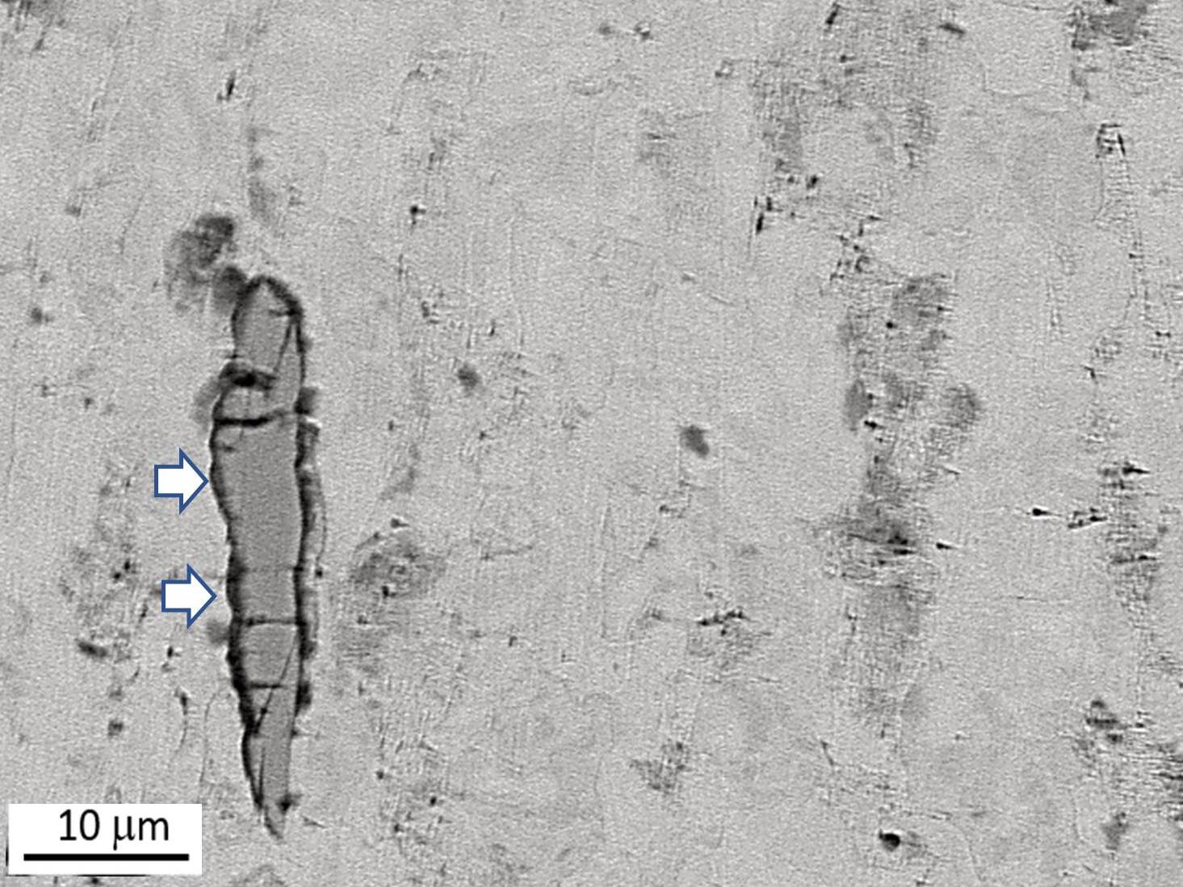
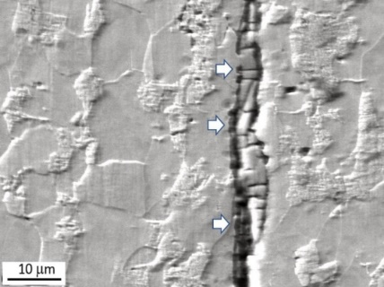
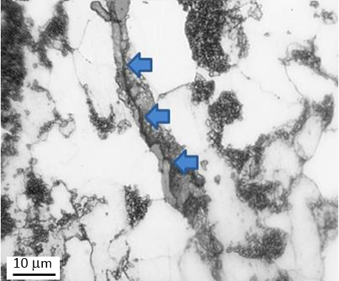
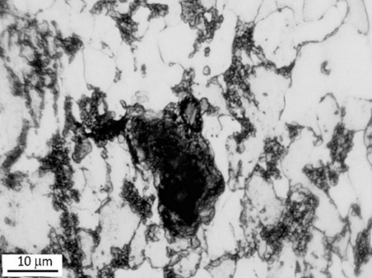
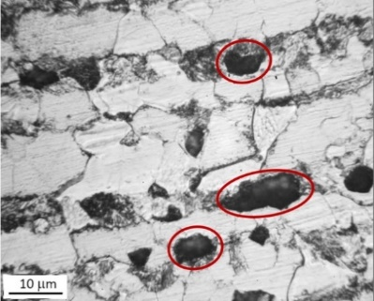
Hydrogen embrittlement susceptibility
Hydrogen pre-charging:
Electrolyte – H₂SO₄ (pH1) + 10 g/l thiourea (NH₂)₂CS
1) i = 0.05 mA/cm² (moderate mode)
2) i = 1 mA/cm² (intensive mode)
Duration - 120 h
17H1S pipeline steel (0.17% C, 1.2% Mn), eq. API 5L X52,
38 years of operation
i = 0.05 mA/cm² (moderate mode)
H pre-charged
i, mA/cm²
Post-operated steel
Hydrogen embrittlement susceptibility
i = 1 mA/cm² (intensive mode)
Cracking of non-metallic inclusions and defects in the structure of the operated steel after hydrogen charging
7

Slide 8
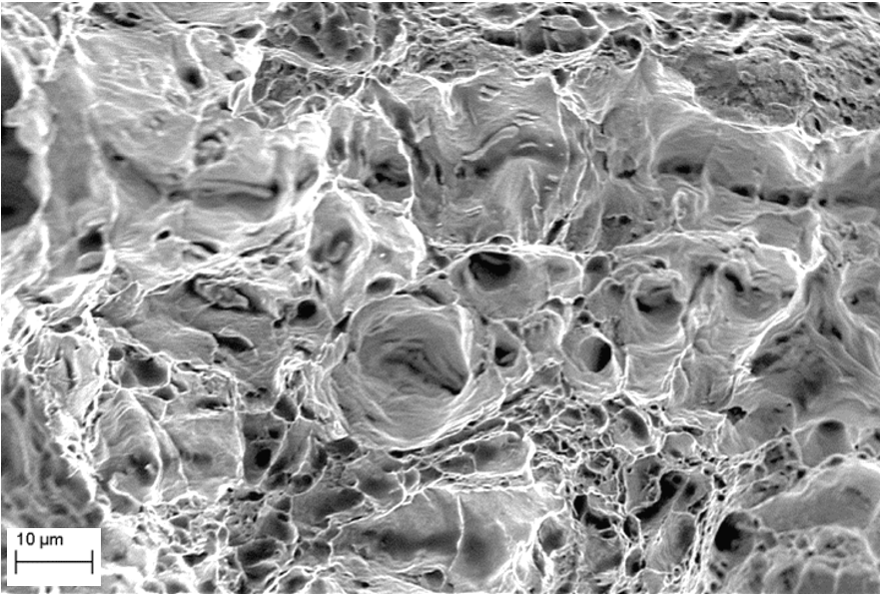
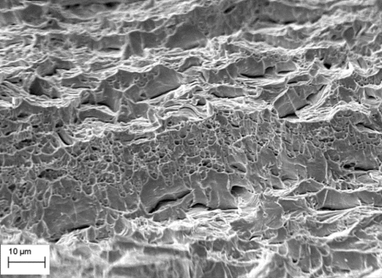
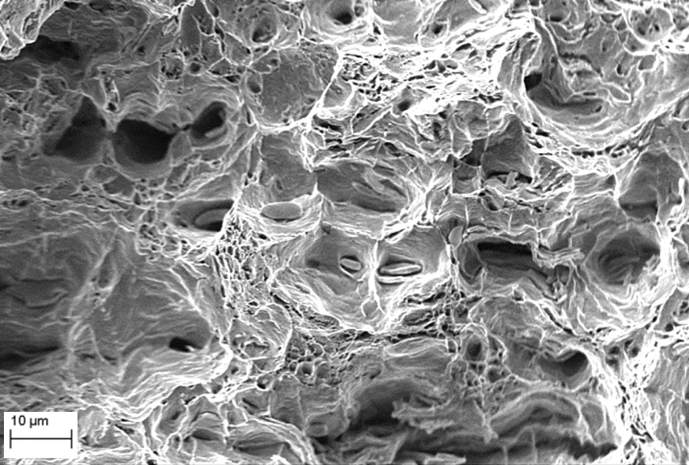
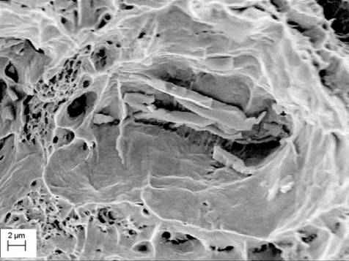
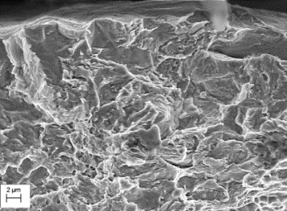
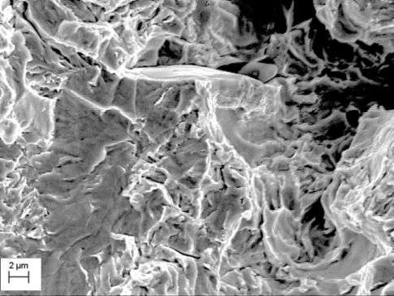
Hydrogen embrittlement susceptibility
Fractographic signs of embrittlement
Without pre-charging
H-precharged at i = 0.05 mA/cm²
H-precharged at i = 1.0 mA/cm²
As-delivered steel
Post-operated steel
Typical SEM images of the fracture surfaces of the transverse specimens
8

Slide 9
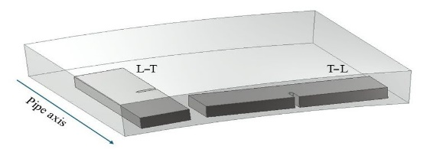
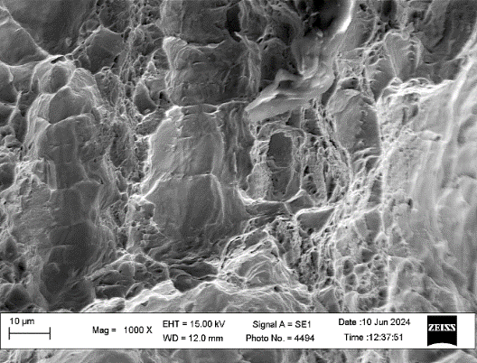
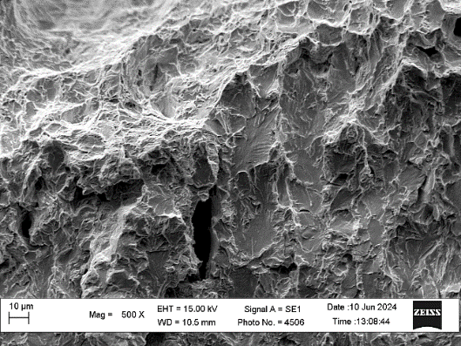
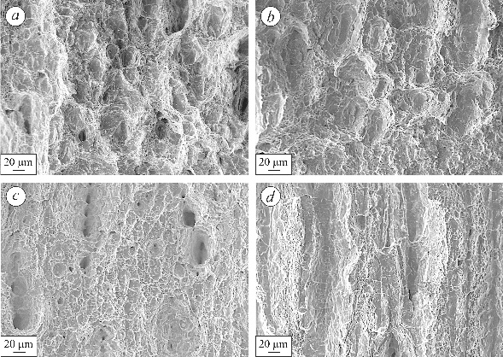
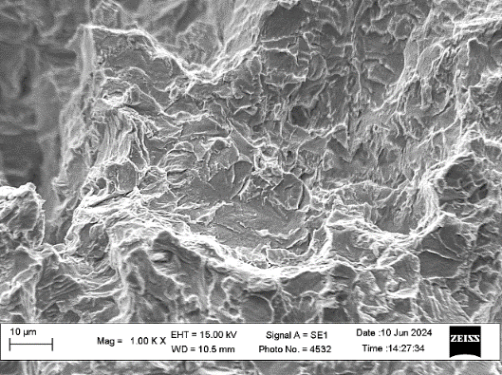
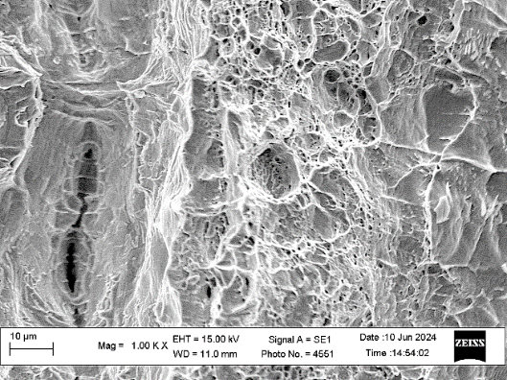
Hydrogen influence on fracture toughness of pipeline steels
17H1S pipeline steel (0.17% C, 1.2% Mn), eq. API 5L X52, 38 years of operation
Longitudinal L-T
Transverse T-L
J – Δa curves of pipe steels for L–T and T–L specimens (displacement rate of 0.5 mm/min) without (1) and after hydrogen charging at i = 0.05 (2) and 1.0 mA/cm² (3)
Hydrogen pre-charging in H₂SO₄ (pH1) + 10 g/l (NH₂)₂CS
Duration - 120 h
Reserve pipe
Reserve pipe
Longitudinal L-T
Transverse T-L
Fractograms of the steel in (a, c) as-delivered and (b, c) operated states under fracture toughness tests of (a, b) L–T and (c, d) T–L specimens
Operated for 38 years pipe
Operated for 38 years pipe
9

Slide 10

Hydrogen influence on fracture toughness of pipeline steels
Fracture toughness J_{cr} [N/mm] of the 17H1S steel, depending on its state, displacement rate and the influence of hydrogen (L-T specimens)
Steel state | Test condition | Displacement rate, mm/min
 |  | 0.5 | 0.05 | 0.005
As-delivered | Without hydrogen charging | 215.0 | - | -
As-delivered | Hydrogen pre-charged (i = 0.05 mА/cm²) | 117.2 | 92.5 | 77.5
Operated for 38 years | Without hydrogen charging | 108.0 | - | -
Operated for 38 years | Hydrogen pre-charged (i = 0.05 mА/cm²) | 75.6 | 60.3 | 43.6
${HES}^{J_{cr}}=(1−\frac{J_{cr}^{H}}{J_{cr}})·100\%$
HES of the 17H1S steel depending on the displacement rate of
L–T specimens after hydrogen charging under i_{cat} = 0.05 mА/сm² and 1.0 mА/сm²
Displacement rate - 0.005 mm/min
10

Slide 11
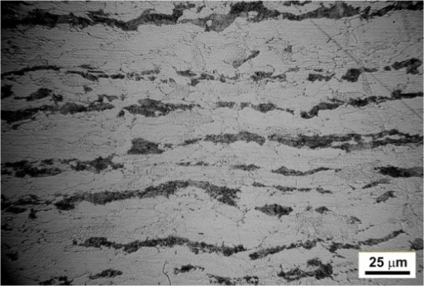
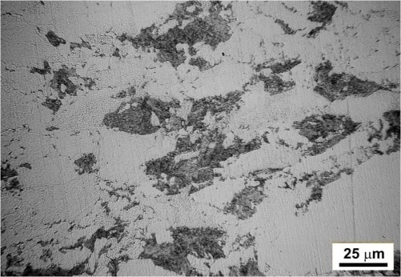
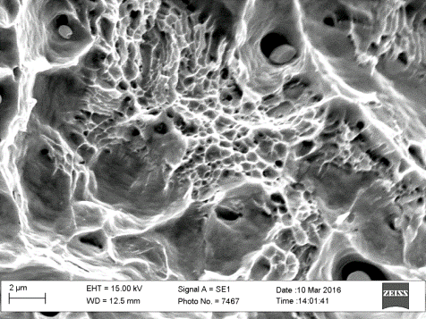
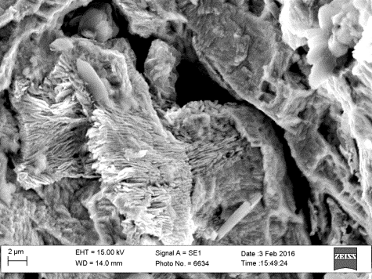
Role of hydrogen-induced stresses in strain ageing of pipeline steels
Testing: The steel 17H1S (0.17% C, 1.5% Mn; API 5L X52) was studied in different states: 1) in the as-delivered state; 2) after low-temperature tempering (LTT) by keeping the samples at a temperature of 250°C for 1 h; 3) pre-electrochemically hydrogen charged (PEH) in H₂SO₄ (рН = 2) at і = 50 mA/cm², 100 h followed by heating under the same mode (PEH + LTT) and holding 30 days in air for removal of diffusible hydrogen.
DSTU 9166:2021, strain aging: preliminary plastic deformation (10%) with the following heating to 250°C and holding 1 h.
Mechanical properties of the studied pipeline steel in different states
Microstructure
Steel state | Envi-ronment | σ_{UTS}, MPa | σ_{Y}, MPa | RA, % | KCV, J/cm² | J_{0.2}, N‧mm | β_{SCC}, %
As-delivered state | Air | 531 | 428 | 71 | 129 | 322
LTT |  | 535 | 433 | 72 | 125 | 330
PEH + LTT |  | 533 | 435 | 74 | 131 | 286
As-delivered state | NS4 solution | 529 | 429 | 69 | - | - | 3
LTT |  | 538 | 431 | 68 | - | - | 4
PEH + LTT |  | 537 | 434 | 53 | - | - | 25
Longitudinal direction
The studied steel after PEH + LTT is susceptible to SCC in NS4 solution
Transversal direction
As-delivered state
PEH + LTT
11

Slide 12
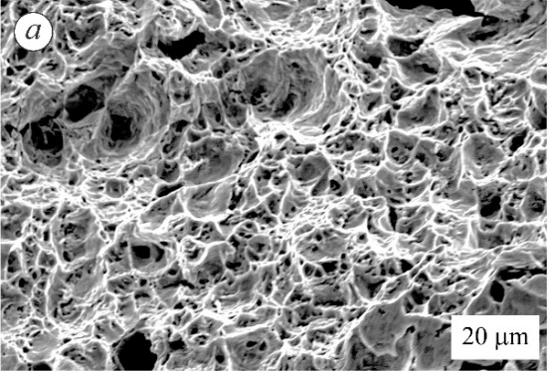

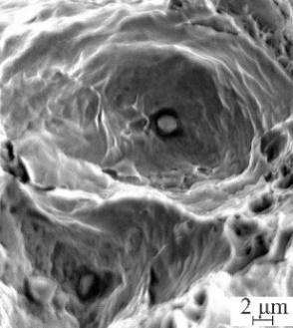
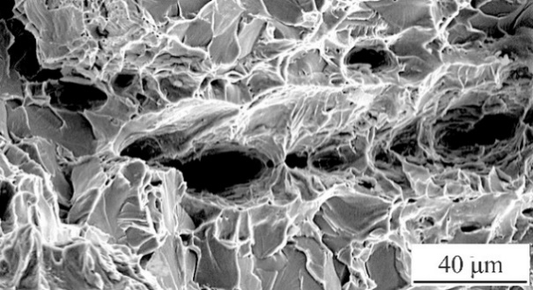
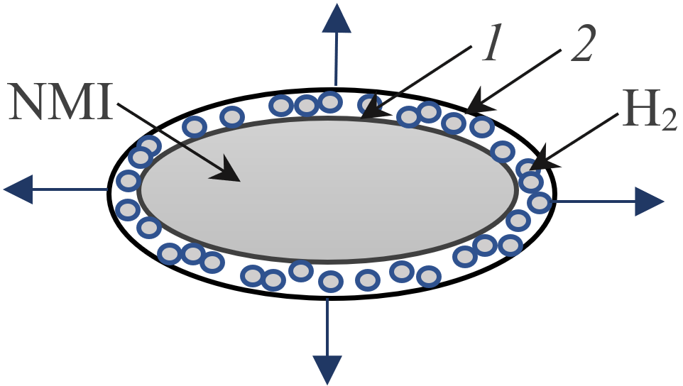
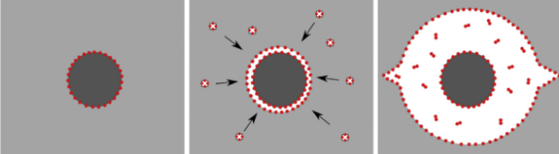
Hydrogen-induced defects in low-strength pipeline steels
Steel Х52
Steel Х70
Susceptibility to SCC in NS4 test solution:
RA_{SCC} , RA_{air} – reduction in area, determined by tensile testing in NS4 solution and air, respectively
Steel Х52
As-delivered state
Strain rate in air 3·10⁻³ s⁻¹; in NS4 solution - 3·10⁻⁷ s¹
29 years of operation
The dominant mechanisms of hydrogen degradation in pipeline steels depending on the strength:
Hydrogen-deformation damaging in low-strength steel
σ_{Y}/σ_{UTS} < 0.7
– Hydrogen-Induced Deformation
σ_{Y}/σ_{UTS} > 0.8
– Hydrogen-Induced Cracking
0.7 < σ_{Y}/σ_{UTS} < 0.8
– Combination of different mechanisms
Crack initiation under hydrogen¹
12
¹M.C. Tiegel, et al., Acta Mater. 115 (2016) 24–34.

Slide 13
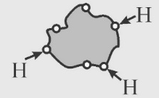
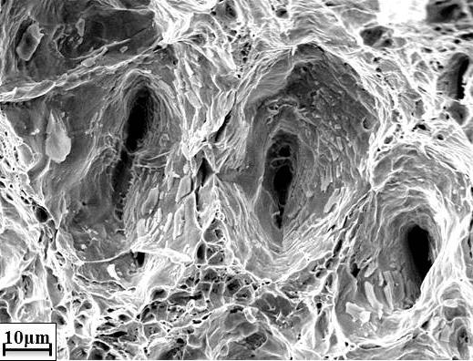
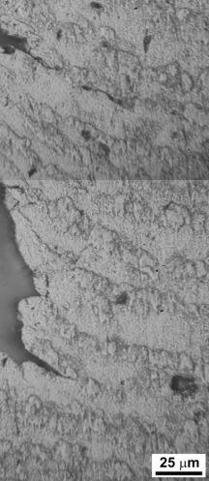
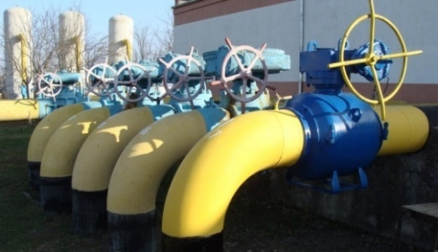
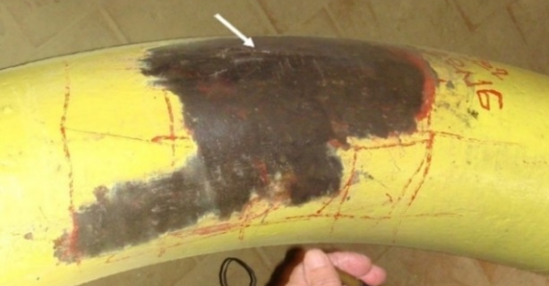
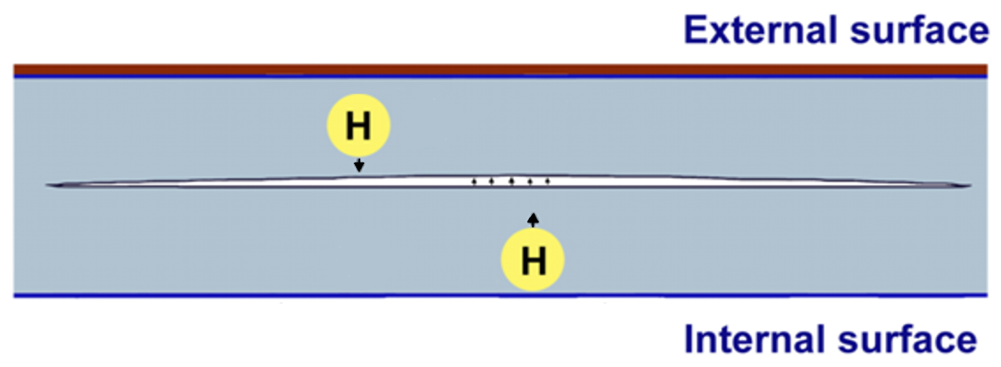
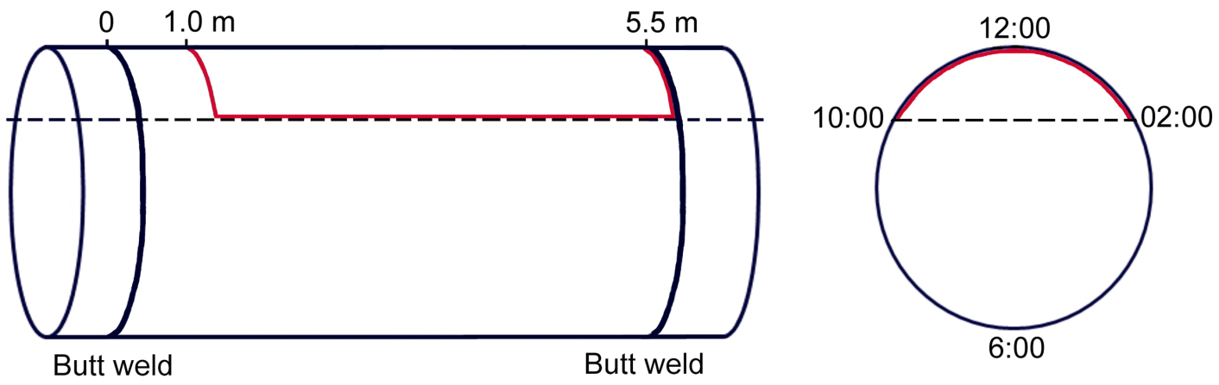
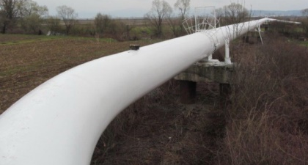
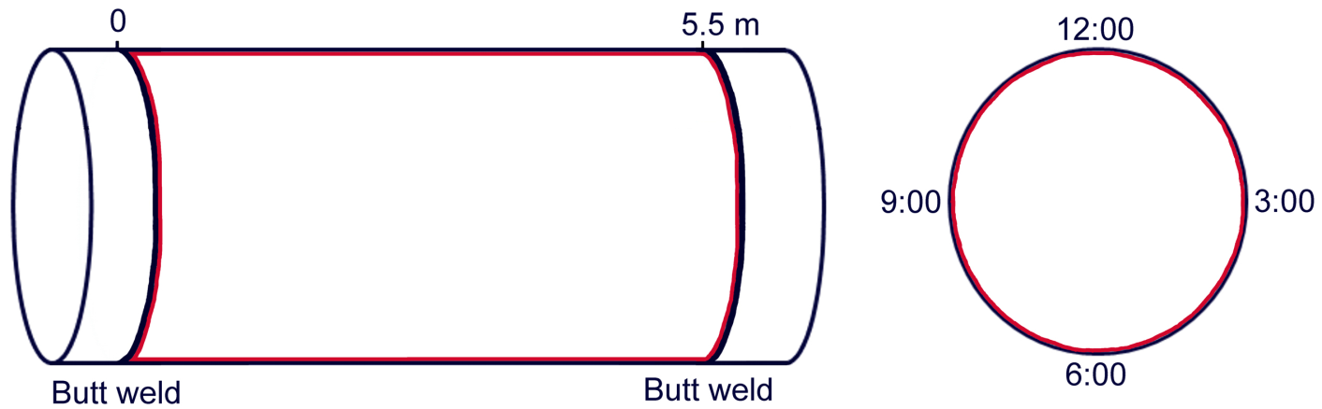
Hydrogen-induced large-scale delamination in pipeline steels
The lateral pipelines of gas transit pipelines system, 40 years of operation
P_{max} = 5.5 MPa
OD = 219 mm, t = 18 mm
Crack
Delaminations
High pressure hydrogen
Aboveground section of 30 years operated natural gas transit pipeline:
OD = 1420 mm,
t = 20 mm
Steel Х60
13

Slide 14
Concluding remarks
Hydrogen assisted degradation of pipeline steels caused a deterioration of the mechanical properties and an increase in susceptibility to hydrogen embrittlement.
The implementation of the decohesive-deformation mechanism of damage in low-strength pipeline steels during long-term operation is substantiated, explaining an increase in hydrogen embrittlement susceptibility of long-term operated steels.
Hydrogen-induced stresses accompanied by dislocation generation are sufficient for strain aging of pipeline steels, which could occur under operation.
Using experimental studies of the fracture toughness of pipeline steels, determined by the J-integral method, a significant effect of the displacement rate of specimens on the values under hydrogen exposure is defined.
Aboveground natural gas pipelines are susceptible to hydrogen-induced large-scale delaminations.
Transportation of hydrogen via existing gas pipelines could enhance hydrogen charging of pipeline steels and, as a result, accelerate hydrogen assisted degradation, delamination and damage of pipeline steels, which can influence on the safe operation of pipelines and should be considered at assessment of the possibility of usage of the existing network for hydrogen transportation.
14

Slide 15
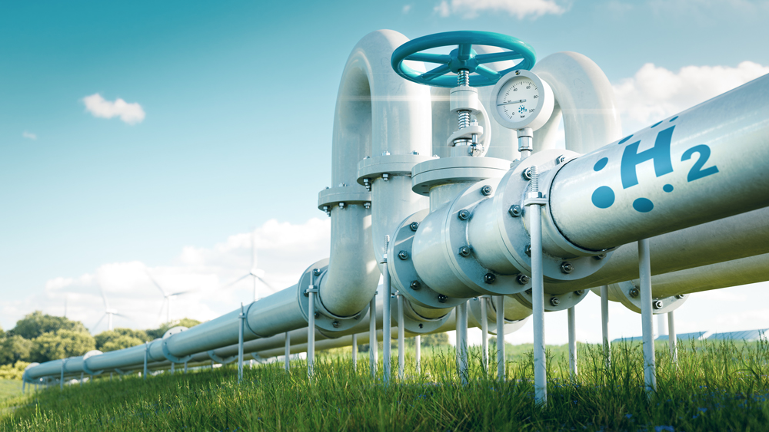
Focus on the Ukrainian gas pipeline system but results potentially applicable to other systems
https://pgjonline.com/media/9912/hydrogen-pipe.jpg
15

Slide 16

2nd Olympiad in Engineering Science
OES 2025
Stavanger, Norway, June 10-14, 2025
                Thank you for your attention!
Karpenko Physico-Mechanical Institute of the National Academy of Sciences of Ukraine
Department of Diagnostics of Materials Corrosion-Hydrogen Degradation
The research has been partially financially supported by the National Academy of Sciences of Ukraine and the National Research Foundation of Ukraine under the Project No. 2022.01/0099
Olha ZVIRKO
​Prof., D.Sc., Corr. Member of the NASU, Head of Department
​E-mail: olha.zvirko@gmail.com

