Slide 1




INTEGRATING STEEL FURNACE SLAGS (SFS) WASTE AS AGGREGATE SUBSTITUTION IN CEMENT-BASED MATERIALS AND PRODUCTS FOR CONSTRUCTION INDUSTRY
Cornelia BAERĂ^{1,2}, Ana-Cristina VASILE^{1,3}, Aurelian GRUIN^{1,3},
Bogdan BOLBOREA^{1,3}, Alexandru ION¹
¹N.I.R.D. URBAN-INCERC, Timisoara Branch, Romania
²Politehnica University of Timișoara, Faculty of Management in Production and Transportation, Timișoara Romania
³Politehnica University of Timișoara, Faculty of Civil Engineering, Timișoara Romania

Slide 2
I
INTRODUCTION
II
MATERIAL AND METHODS
CONTENT
III
RESULTS AND DISCUSSIONS
IV
CONCLUSIONS

Slide 3

I. INTRODUCTION
Research project PN 23 35 04 01, component of “ECODIGICONS” Programme, financed by the Romanian government:
“Fundamental-applied research into the sustainable development of construction products (materials, elements, and structures, as well as methods and technologies) that utilizes current national resources to enhance the eco-innovative and durable aspects of Romania's civil and transport infrastructure.”
Design of technological algorithms specific to construction and supporting industries, by fast and efficient interaction to all stakeholders, directly or indirectly connected to the outcomes of the study:
- The academic and research media;
- The entrepreneurs (main market or support market, as well);
- The users (clients: the business-to- business (B2C) type of costumer, namely the industry and also business-to-consumer (B2C) as end-users of the products or services);
- The suppliers;
- The social, economic and politic compounds, local and central authorities.

Slide 4

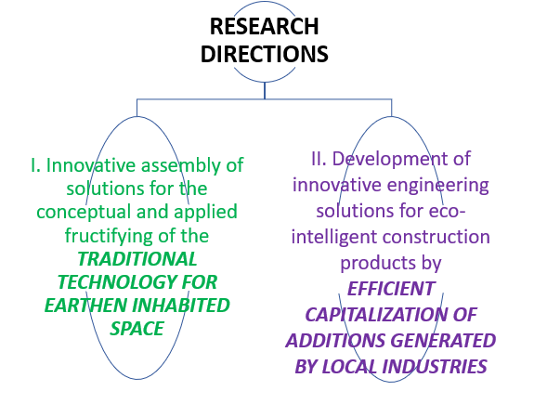
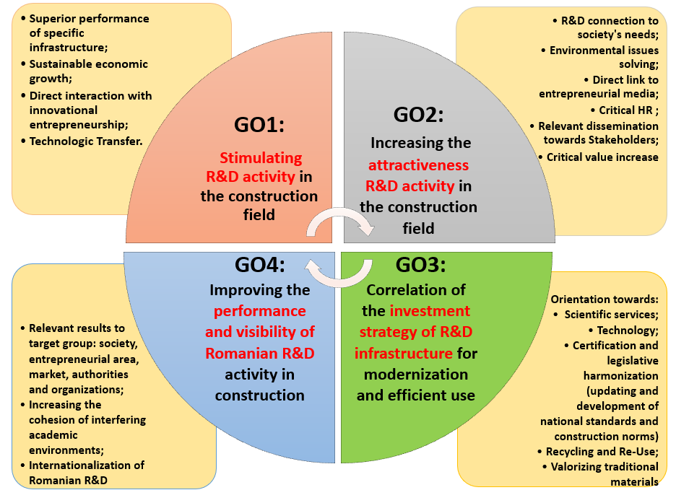
I. INTRODUCTION
4 GENERAL OBJECTIVES (GO)
14 SPECIFIC OBJECTIVES (SMART)
2 RESEARCH DIECTIONS
16 PHASES (ASOCIATED MILESTONES)
Solutions to the current problems in the construction sector:
Development of products and services (materials, elements and structures, processes and technologies, etc.),
with superior overall performance and increased energy efficiency,
for the Circular Economy (EC) principles implementing in Romania.

Slide 5
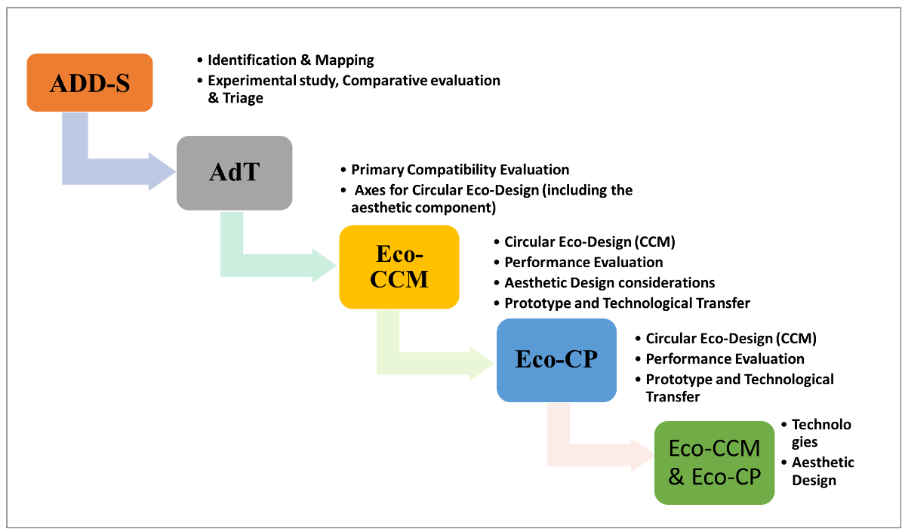
I. INTRODUCTION
Axis II. Development of innovative engineering solutions for eco-intelligent construction products by an efficient capitalization of additions generated by local industries
Preliminary evaluation of the current directions with potential in the capitalization, at regional / national level, of ADD-S additions (in the development of eco-intelligent materials and products for constructions)
Eco-CP Flowchart: The logical scheme for structural implementation of specific project objectives associated to Axis II

Slide 6
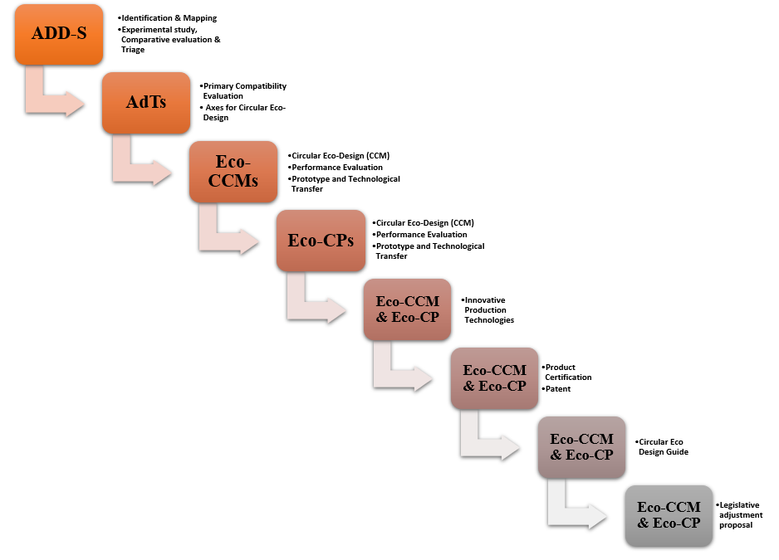
I. INTRODUCTION
3. Preliminary evaluation of the current directions with potential in the capitalization, at regional / national level, of ADD-S additions
(in the development of eco-intelligent materials and products for constructions)
Legend:
- AdT: Target Additions (AdT), with high potential for capitalization in circular design for eco-intelligent construction products;
- ADD-S: Additions Derived from Waste and Industrial Byproducts (inert / hydraulically latent / pozzolanic, etc.), and/or derived from Demolition and/or decommissioning of buildings;
- Eco-CCM: Eco-intelligent Composite Materials for Constructions, with advanced functionality (Eco-Composite Materials for Constructions);
- Eco-CP: Eco-intelligent Construction Products, with advanced functionality, made by using Eco-CCM (Eco-Construction Products)
Extended Eco-CP Flowchart:
The logical scheme for structural implementation of specific project objectives associated to Axis II

Slide 7
I. INTRODUCTION
Steelmaking slags such as Basic Oxygen Furnace Slag (BOF) and Electric Arc Furnace Slag (EAF) have gained increasing attention in the construction sector because they can substitute natural aggregates or represent supplementary cementitious material (SCM) in cement-based composites, thereby diverting an industrial by-product toward a high-value, sustainable application.
The overall conclusions related to slag use in concrete production research indicate that not all SFS additions are identical and consequently, they should be categorized or qualified based on their intended purpose or use, especially when considering applications such as concrete, mortar, alkali-activated material, or soil stabilization.
For EAF slag, its favourable physico-chemical characteristics allow it to replace natural coarse aggregates in concrete while delivering mechanical performance comparable to, or even better than, conventional mixtures. Several studies further report improvements in compressive strength and long-term durability when EAF slag is incorporated.

Slide 8
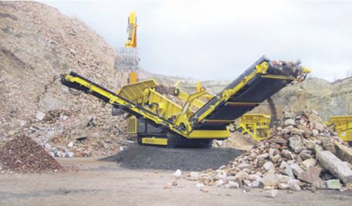
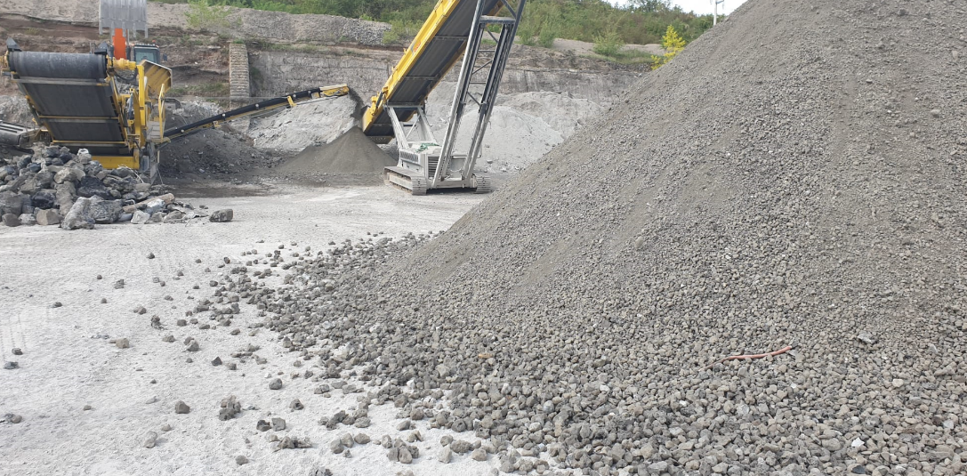
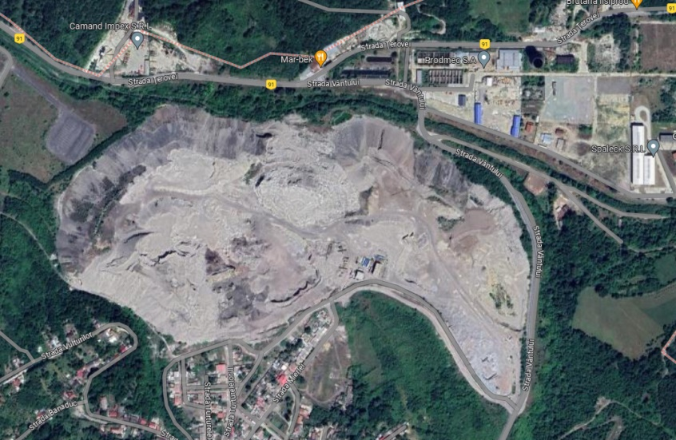
I. INTRODUCTION
AdT 2: Steel Furnace slag (SFS): (Electric Arc Furnace (EAF) Slag and/or basic oxygen furnace (BOF) Slag) - (waste / by-product)
As potential slag source is considered the Steel mill slag dump from Reşita (Terova area, Caraş-Severin county) – EAF Slag.

Slide 9
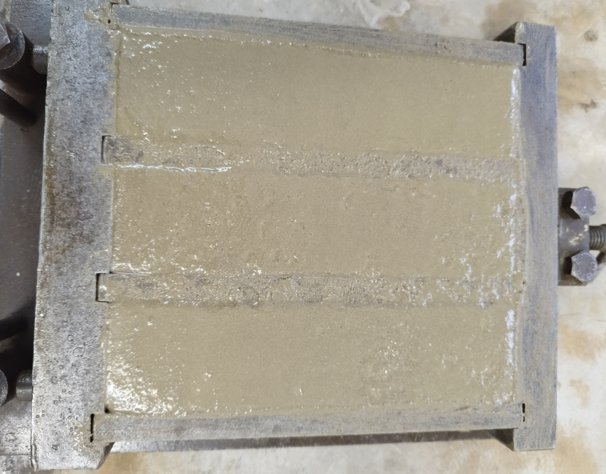
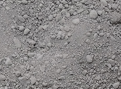

II. MATERIAL AND METHODS
General approach of the experimental study
The major goal of this experimental study is to evaluate the opportunity to capitalize on the targeted addition (AdT), namely the EAF slag derived from local industries from the Romanian Western Region (Caraș-Severin County) in cement-based materials for constructions.
The mineral waste particularly used for the study is abbreviated as RS1, representing the Reșita EAF slag of granular class 0/4.
The applied procedure consists in developing of regular mortar mixes, References (R) and also test mortars, RS1 mortars, developed by using RS1 addition.
The References (R) mortars represent usual cementitious mixes (mortars) of aggregate (sand), binder (cement) and water.
The RS1 test mortars are produced by considering the RS1 addition as a partial substitute for sand in the reference (R), aiming to fast evaluate the elementary compatibility of the RS1 material with the cementitious matrix and thus, the viability of the research direction.
Selected AdT: RS1 (derived from the aggregate crushing line, Caraș-Severin County
Natural Sand (S)
Cement-based Composition RS1 Substitutions

Slide 10
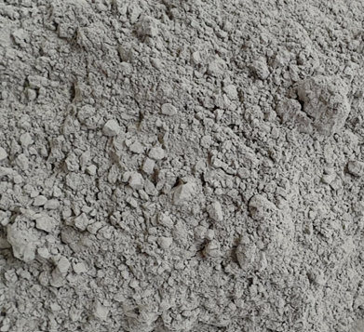
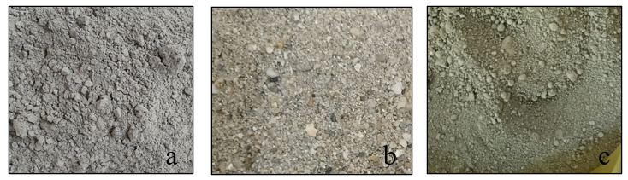
II. MATERIAL AND METHODS
Raw materials
The research protocol is simple and in accordance to previous study in the topic: Two Reference mix was proposed (R1 and R2), followed by the relevant parametric variation, namely the sand partial substitution with the considered RS1 wastes.
The substitution is performed at 25% and 50% by mass, following the standard methodology established in previous studies, and the mixing procedure is in accordance with EN 196-1 and 1015-11.
a
b
Natural aggregates of granular class 0/4 (sand, S);
Portland Cement, CEM II/A-LL 42.5 R (C), Carpatcement;
AdT: EAF slag derived from local industries from the Romanian Western Region (Reșița, Caraș-Severin County), RS1;
Water (tap water);
No additives were used in this preliminary compositional design approach
c

Slide 11
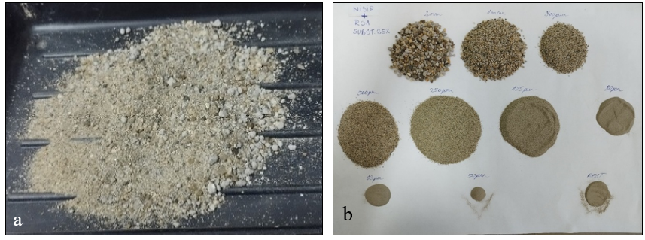
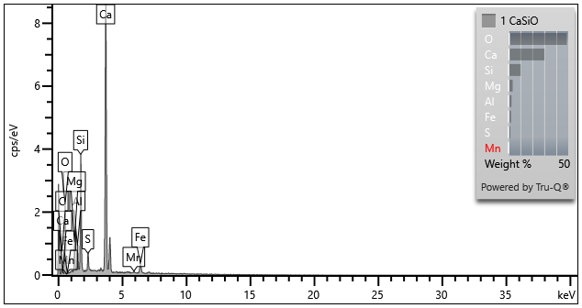
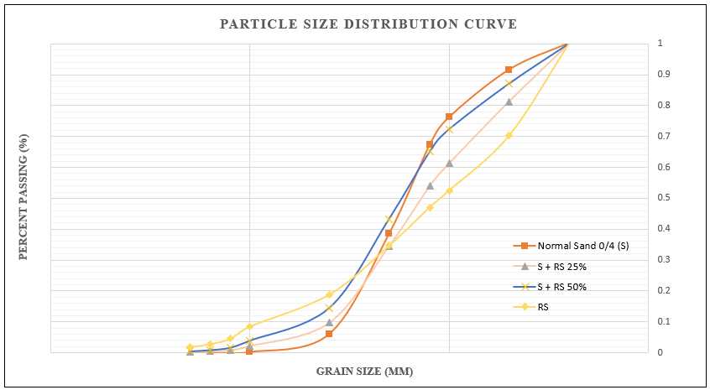
II. MATERIAL AND METHODS
Raw Materials Evaluation
Particle size curves were realized by sieving method according to SR EN 933-1.
Sieve analysis was carried out for both the usual 0/4 (S) sand and the substitution by-product RS. In addition, particle size curve determination tests are carried out for S + RS mixtures in the chosen substitution proportions: RS 25% and RS 50%.
CaSiO
Element | Signal Type | Wt% | Wt% Sigma
O | EDS | 48.78 | 0.71
MG | EDS | 3.65 | 0.17
Al | EDS | 2.63 | 0.14
Si | EDS | 10.36 | 0.23
S | EDS | 1.71 | 0.10
Ca | EDS | 30.19 | 0.46
Mn | EDS | 0.36 | 0.11
Fe | EDS | 2.31 | 0.16
Total |  | 100.00
SEM analysis: Chemical analysis of RS1

Slide 12
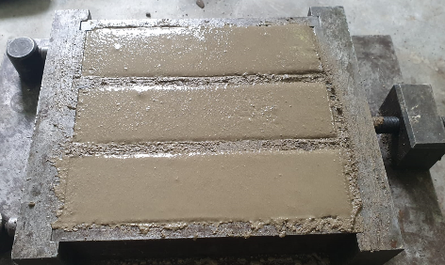
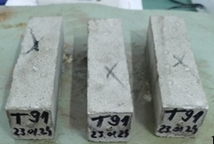
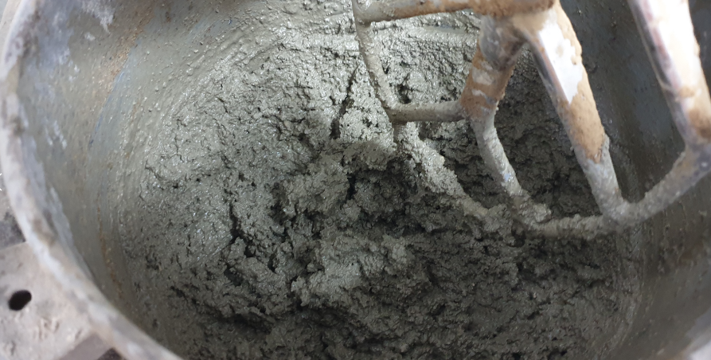
II. MATERIAL AND METHODS
Mix proportion and specimen preparation
After 24 hours, the prismatic specimens were removed from the moulds and cured by water immersion at the temperature T (20±1) °C, until testing ages, performed at 7, 28 and 112 days.
The mixing sequences were established considering the typical laboratory mixture suitable for low volume batches, in accordance to the EN 196-1 specifications.
The mortars were cast into prismatic, metallic moulds, and placed for initial 24 h curing at the temperature T (20±1)°C and relative humidity RH (90±5)%.

Slide 13
II. MATERIAL AND METHODS
Mix proportion and specimen preparation
Mix proportions of the considered mortar mixtures: References and RS1 mixtures
The reference mortar mixes, with classic raw materials: regular sand 0/4 (S), cement and water are produced.
The initial reference mix R2, was produced, characterized by the water-to-cement ratio W/C = 0.56.
Further on, considering the dynamics of the research, R1 (W/C = 0.61) was developed.
Components | C | S 0/4 | RS1 | W/C | A/C
Mixtures
R1 | 1 | 3 | - | 0.61 | 3
R2 | 1 | 3 | - | 0.56 | 3
RS1-25%-0.56 | 1 | 2.25 | 0.75 | 0.56 | 3
RS1-25%-0.61 | 1 | 2.25 | 0.75 | 0.61 | 3
RS1-50%-0.61 | 1 | 1.5 | 1.5 | 0.61 | 3
Development of the RS1 mortar mixes implied incremental replacement, by mass, of the usual aggregate (S), with RS1 additions. The considered substitution proportions are RS1 25% and RS1 50%.
The fresh state characteristics of the RS1 mixes show an alteration of workability, especially when using the 50% RS1 substitution, which determined the use of R1 (W/C = 0.61) suitable for relevant specific evaluation.

Slide 14
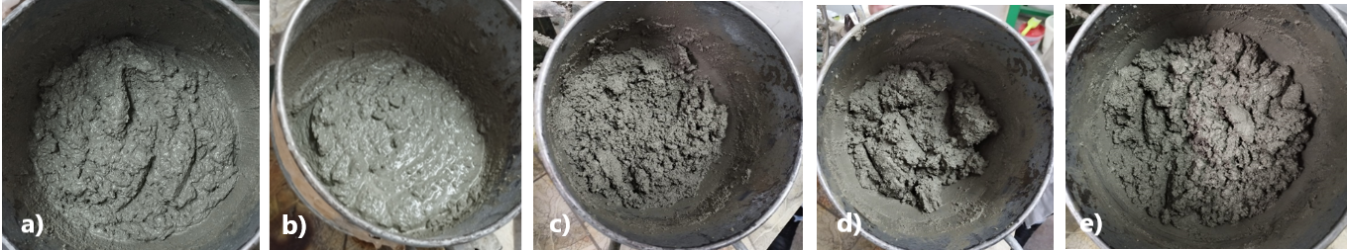
III. RESULTS AND DISCUSSIONS 1. Extended compatibility evaluation
Fresh state evaluation of the RS1 mixes
Fresh state aspect of the mortars: a) R1; b) R2; c) RS1-25%-0.56; d) RS1-25%-0.61; e) RS1-50%-0.61
The visual evaluation of the compositions developed with the RS1 addition indicates an alteration of the workability of the mortar when using the RS1 as sand substitution in the mix.
The workability of the fresh mortar alters considerably when increasing the RS1 substitution percent from 25% to 50%.
The highly stiff consistency of the RS-25%-1 composition, produced with a water-to-cement (W/C) ratio of 0.56, similar to that of the reference mix R2, led to the development of the RS-25%-2 mix with a water addition, resulting a higher W/C ratio, of 0.61, directly comparable to the reference R1, which has a similar W/C ratio.
However, reference R1 exhibits an extremely fluid consistency due to the high water content, showing initial signs of compositional segregation.

Slide 15
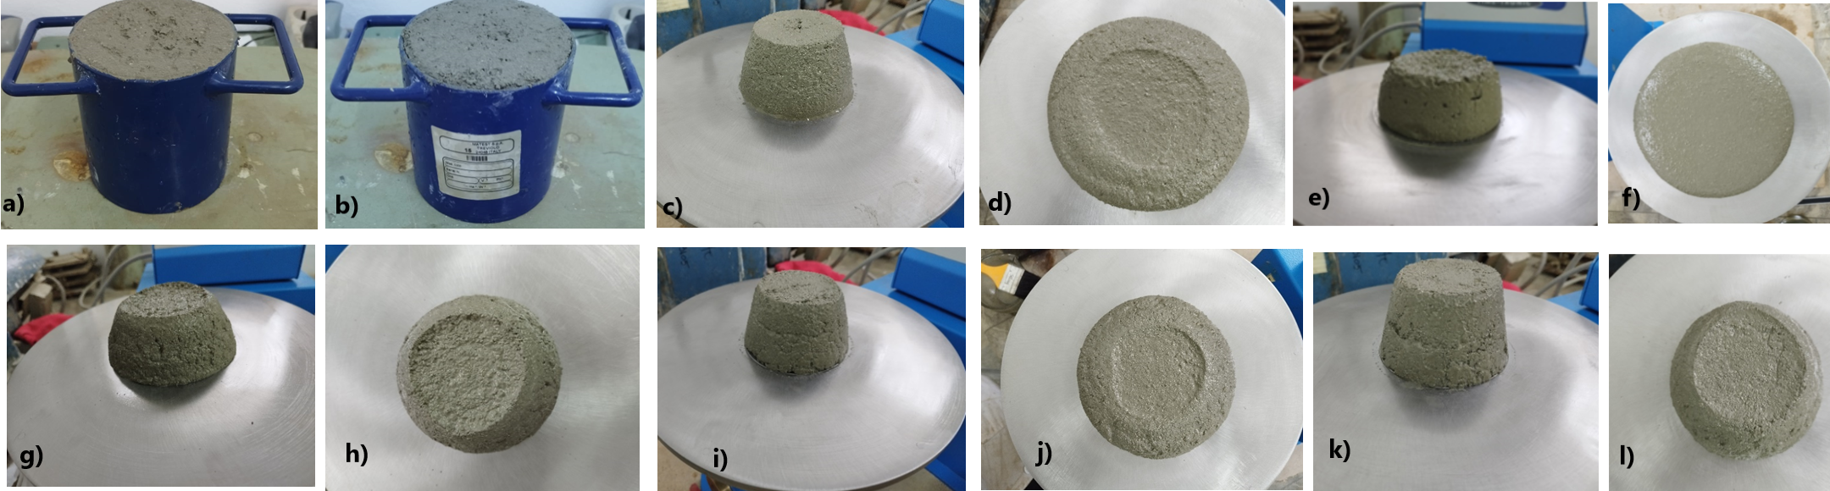
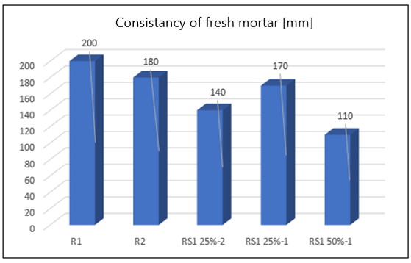
III. RESULTS AND DISCUSSIONS 1. Extended compatibility evaluation
Fresh state evaluation of the RS1 mixes
Consistency of the mortar mixes
Fresh state characteristics of the mortars: a) and b) determination of fresh state density for RS1-25%-0.56 and RS1-50%-0.61; c) to l) mortar consistency (before and after the shocks): c) and d) R1; e) and f) R2; g) and h) RS1-25%-0.56; i) and j) RS1-25%-0.6; k) and l) RS1-50%-0.61
The results are confirming the previous conclusions, namely the workability alteration of the mix when introducing/increasing the RS1 addition as sand partial replacement.

Slide 16
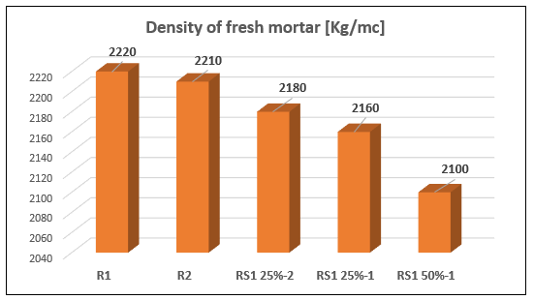
III. RESULTS AND DISCUSSIONS 1. Extended compatibility evaluation
Fresh state evaluation of the RS1 mixes
Fresh state densities
Fresh state apparent density of the mortars: References and SG mixtures
The fresh state determinations lead to the conclusion that the targeted addition, AdT RS1 induces, along with the integration in cementitious compositions, a consistent requirement for mix water increase, in order to regulate the workability. This fact is considered to lead to the deterioration of the mechanical resistances.
Therefore, the need to evaluate the RS1 addition, in the field of real densities and masses, as well as the water absorption coefficient, prior to compositional optimization determinations through specific procedures, including addition, is identified.

Slide 17
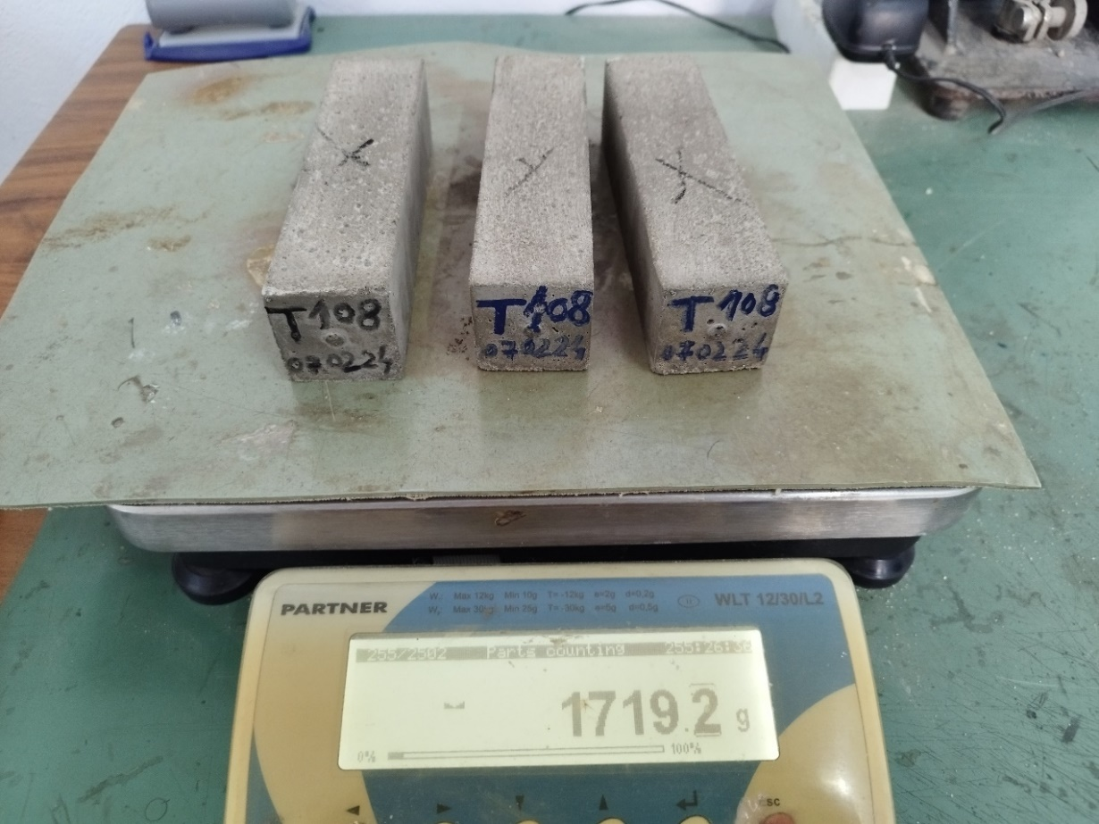
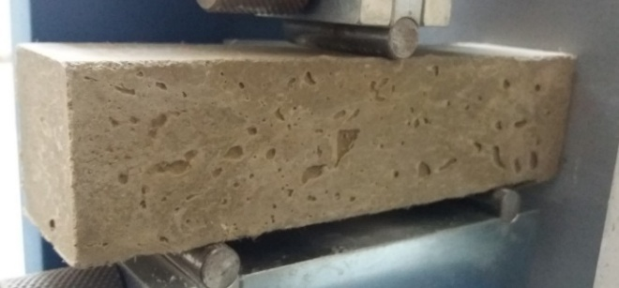
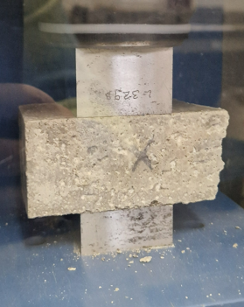
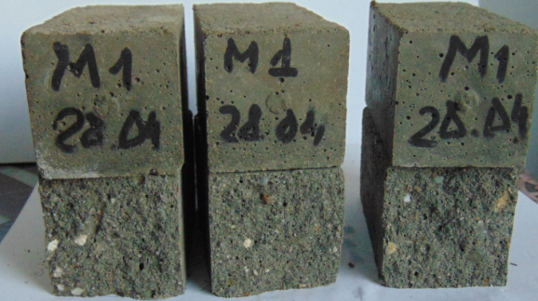
III. RESULTS AND DISCUSSIONS 1. Extended compatibility evaluation
Mechanical performance of the RS mixes
The mechanical performance, evaluated via flexural strength and compressive strength of the RS1 mortars, is performed based at early age (7 days), at regular age of 28 days and at late age (112 days).
The flexural strength was determined using the three-point bending (3PB) test performed on whole specimens, followed by the compression test on the resulting half-prism specimens.

Slide 18
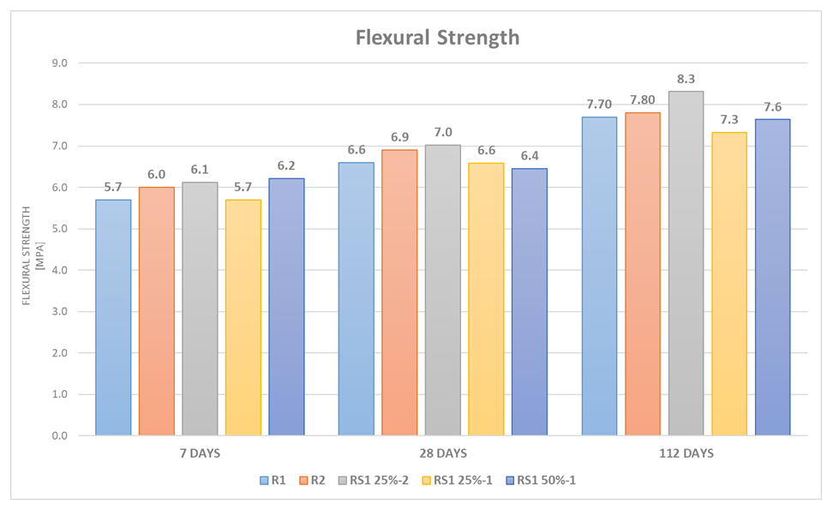
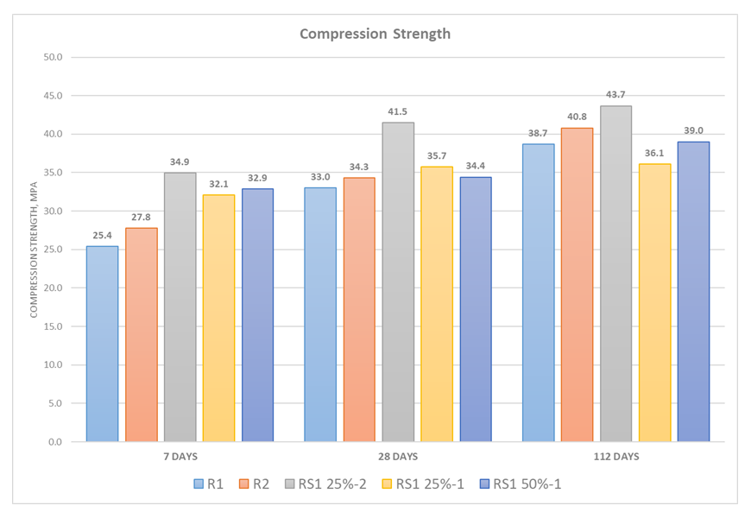
III. RESULTS AND DISCUSSIONS 1. Extended compatibility evaluation
Mechanical performance of the SG mixes

Slide 19
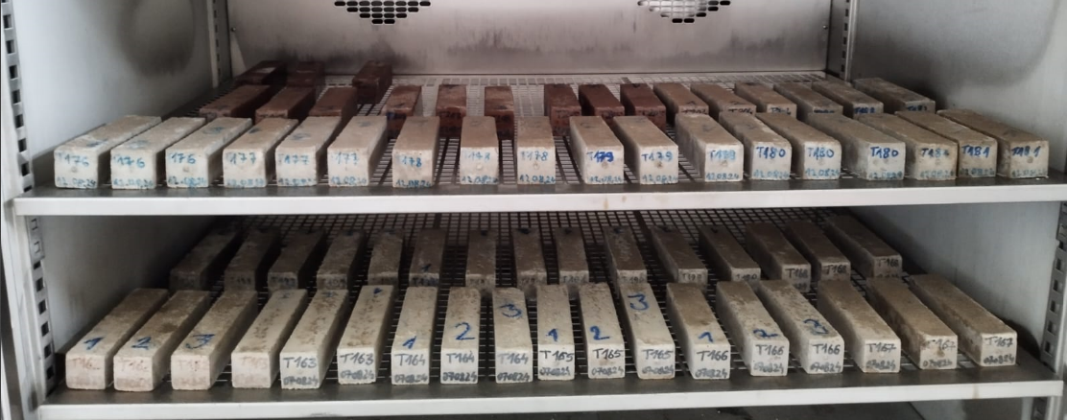
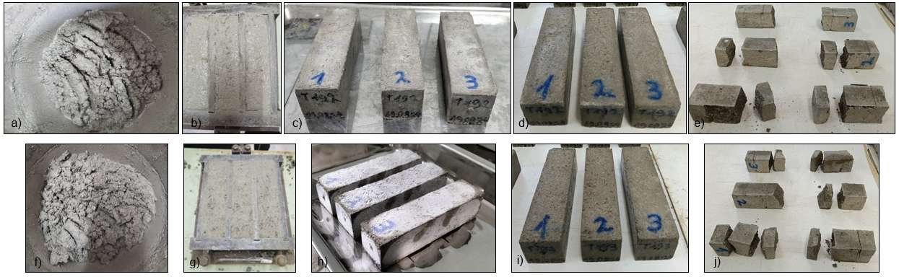
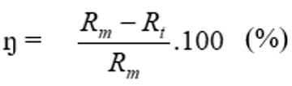

II. MATERIAL AND METHODS: 3. Durability evaluation
Freeze-thaw resistance
Evaluation of durability performance for RS1 prototype mortars:
Determination of material freez-thaw resistance (50 cycles)
The freez-thaw resistance was determined in accordance with Romanian SR 3518: 2009 specifications, using the destructive method to assess the flexural and compressive strength losses of the Test Specimens (exposed to 50 freeze-thaw cycles) in relation to the control specimens (conditioned by immersion at a temperature of T (20 ± 2) °C until the mechanical test was performed).
The destructive test is performed on 40 x 40 x 160 mm prisms aged 28 days, followed by 50 freeze-thaw cycles. The conditioning of the test specimens, from the moment of demoulding until they reach the age of 28 days, is performed by immersion at a temperature of T (20 ± 2) °C.
The strength loss is calculated with the relation:
Rm – Reference (water conditioning);
Rt – Test Specimens (Freez-Thaw, FT exposure);
Strength loss with respect to the considered Reference

Slide 20
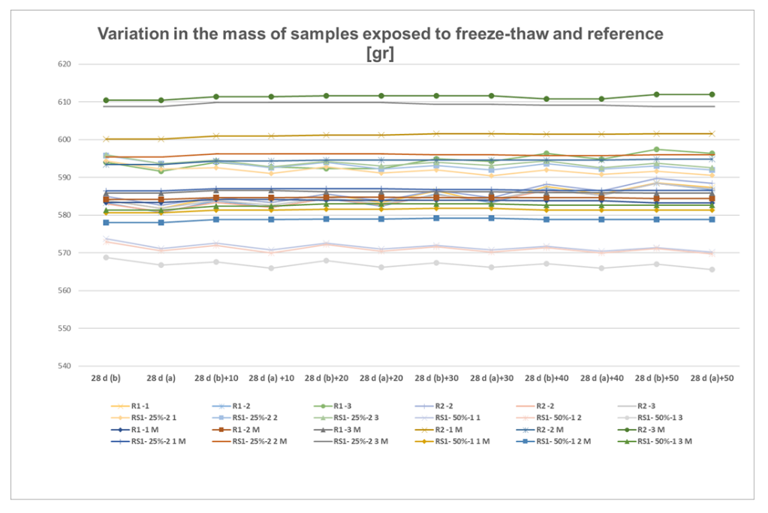
III. RESULTS AND DISCUSSIONS 3. Durability evaluation
Freeze-thaw resistance
Evaluation of durability performance for SG prototype mortars: Variation in the mass of RS samples exposed to freeze-thaw and control

Slide 21
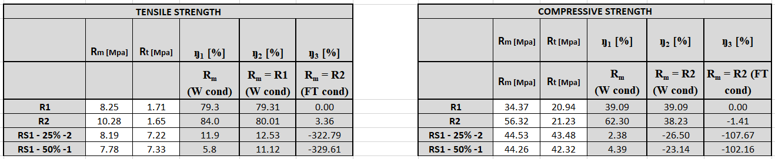
III. RESULTS AND DISCUSSIONS 3. Durability evaluation
Freeze-thaw resistance
Evaluation of durability performance for RS1 prototype mortars:
Determination of material freez-thaw resistance (50 cycles)
Comparative analysis of mechanical strength loss after the 50 freez-thaw cycles: Tensile Strength and Compressive Strength

Slide 22
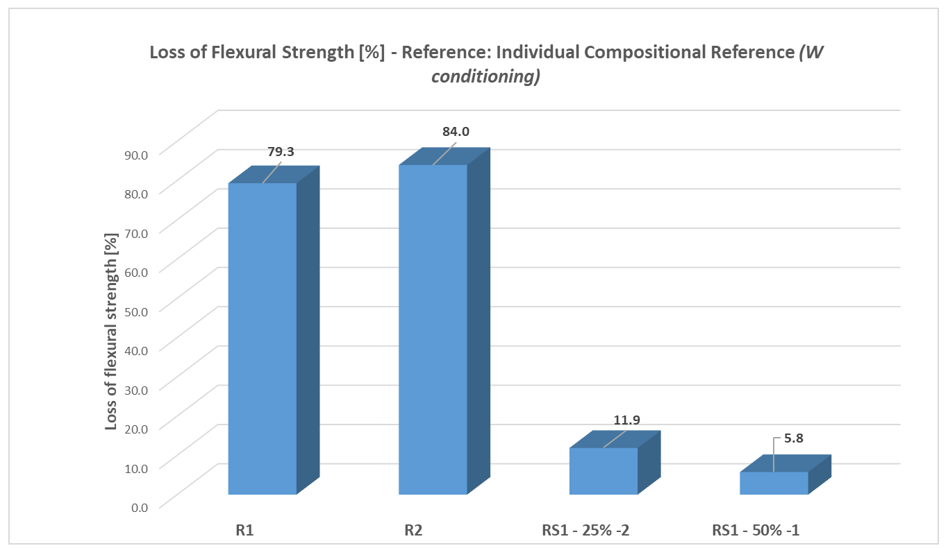
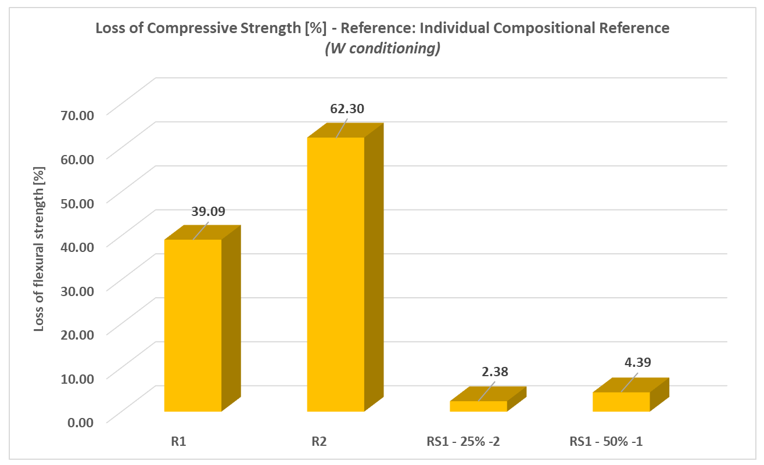
III. RESULTS AND DISCUSSIONS 3. Durability evaluation
Freeze-thaw resistance
Evaluation of durability performance for RS1 prototype mortars:
Determination of material freez-thaw resistance (50 cycles)
Comparative analysis of mechanical strength loss after the 50 freez-thaw cycles:
Reference: Individual Compositional Reference (W conditioning)

Slide 23
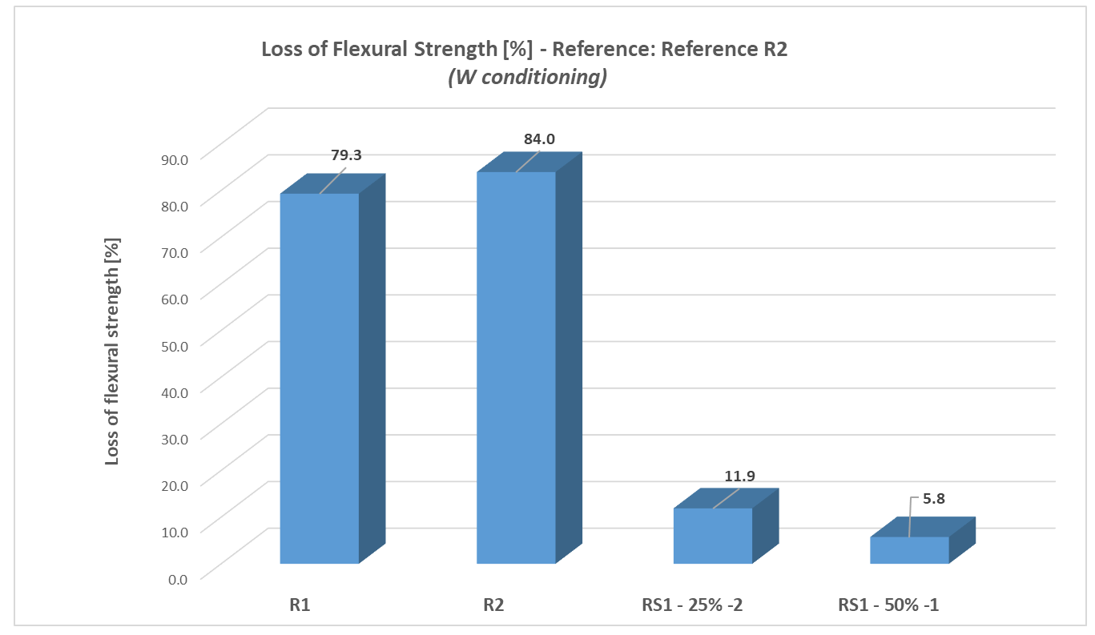
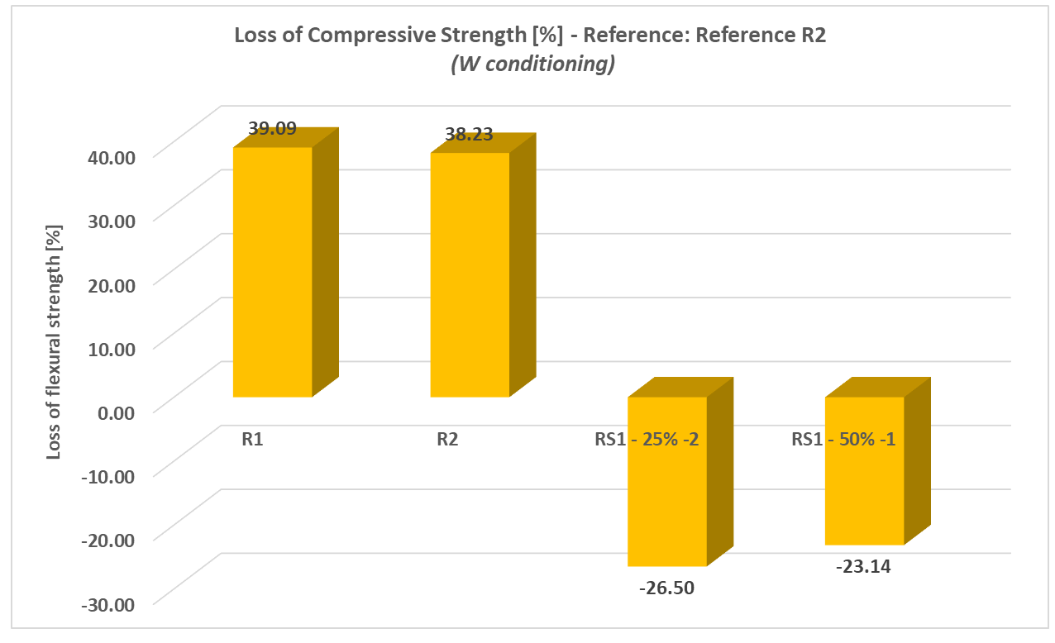
III. RESULTS AND DISCUSSIONS 3. Durability evaluation
Freeze-thaw resistance
Evaluation of durability performance for SG prototype mortars:
Determination of material freez-thaw resistance (50 cycles)
Comparative analysis of mechanical strength loss after the 50 freez-thaw cycles:
Reference: Mortar Reference R1 (Water conditioning)

Slide 24
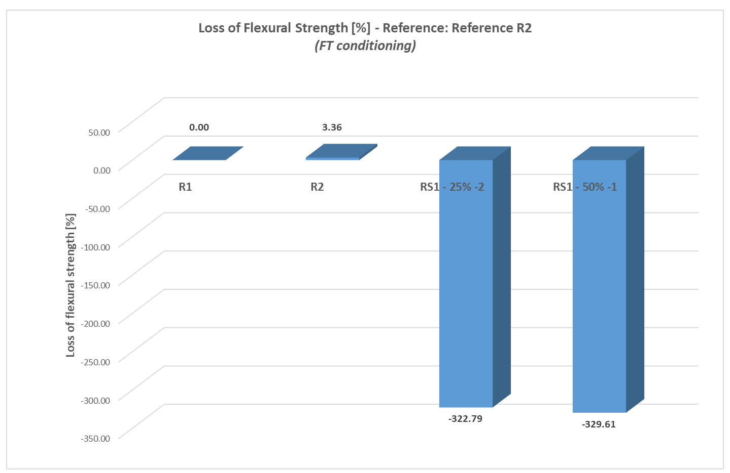
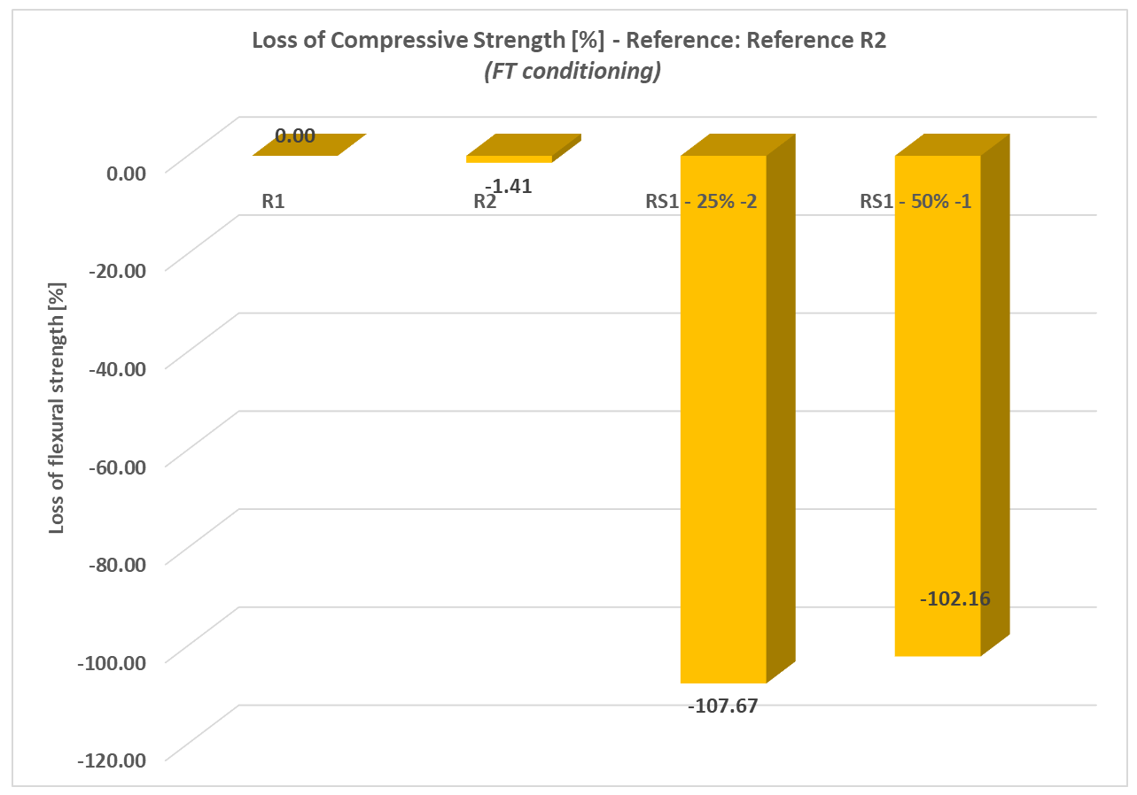
III. RESULTS AND DISCUSSIONS 3. Durability evaluation
Freeze-thaw resistance
Evaluation of durability performance for SG prototype mortars:
Determination of material freez-thaw resistance (50 cycles)
Comparative analysis of mechanical strength loss after the 50 freez-thaw cycles:
Reference: Mortar Reference R1 (Freeze-thaw, FT conditioning)

Slide 25
IV. CONCLUSIONS:
The preliminary testing and the corresponding results are offering encouraging conclusions regarding the viability of the concept.
The RS1 wastes can be positively integrated in cement-based materials, as they prove themselves compatible to the binding, cementitious system and also to the regular sand.
The comparative analysis of the results allows the following synthetic conclusions to be drawn:
The increase in the water content, respectively the A/C ratio from 0.56 to 0.61 induces, predictably, the alteration of the mechanical performances, both in the control area (R2 vs. R1) and in the case of the compositions with the addition: RS1-25%-0.56 vs. RS1-25%-0.61. The results after 7, 28 and 112 days are conclusive in this regard.
The compression strength results indicate the promising potential of the compositional integration of the RS1 material, namely the electric arc furnace slags (EAF), produced and stored in the western part of Romania, in Reșita, Caraș-Severin County, in cementitious materials.
The compositional behaviour developed with an RS1 sample supports the compatibility of the addition with the usual components of cementitious composites, with a high potential for use in construction products.
The durability evaluation is emphasizing positive results, encouraging the transition towards concrete mixes development.
At the same time, relevant characteristics of mechanical performance, together with specific tests regarding the evaluation of contamination with potentially harmful materials for the health of the population, of RS1 additions taken from several locations of the Reșita dump, are critical considerations in the evolution of the subsequent scientific approach, in direct correlation with the applicability guidelines for the valorisation of the electric arc furnace slags (EAF) for valorisation in the circular design for eco-intelligent construction products.

Slide 26
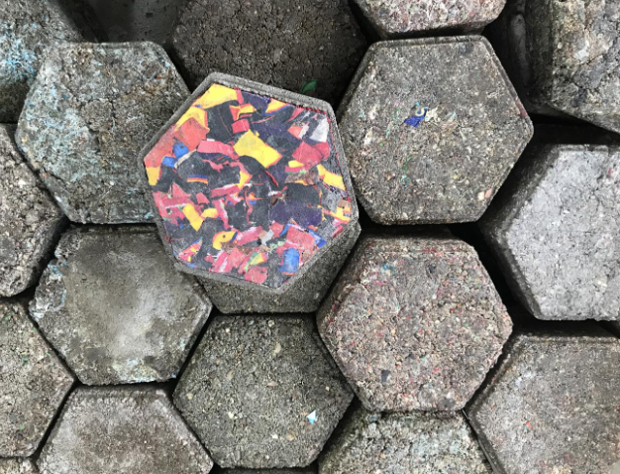
IV. CONCLUSIONS and future perspectives
Direct field of application is considered in terms of PAVING BLOCKS developing by the means of SG integration in the concrete mix.
This could generate a viable and more accessible field of use, with less associated risk in terms of population health, due to exterior use of the products; simultaneously, direct and fast information could be offered in terms of durability of the product, in real exposure and serviceability conditions;
This approach could also be aligned to the dynamic of the national market, characterized by a fast growth, considering the huge demand in terms of necessities of public pavement systematic improvement, mostly in urban media, but also in rural, as well.
The sustainable approach of waste prevention and reduction of natural resource consumption is perfectly aligned to the Circular Economy principles.

Slide 27
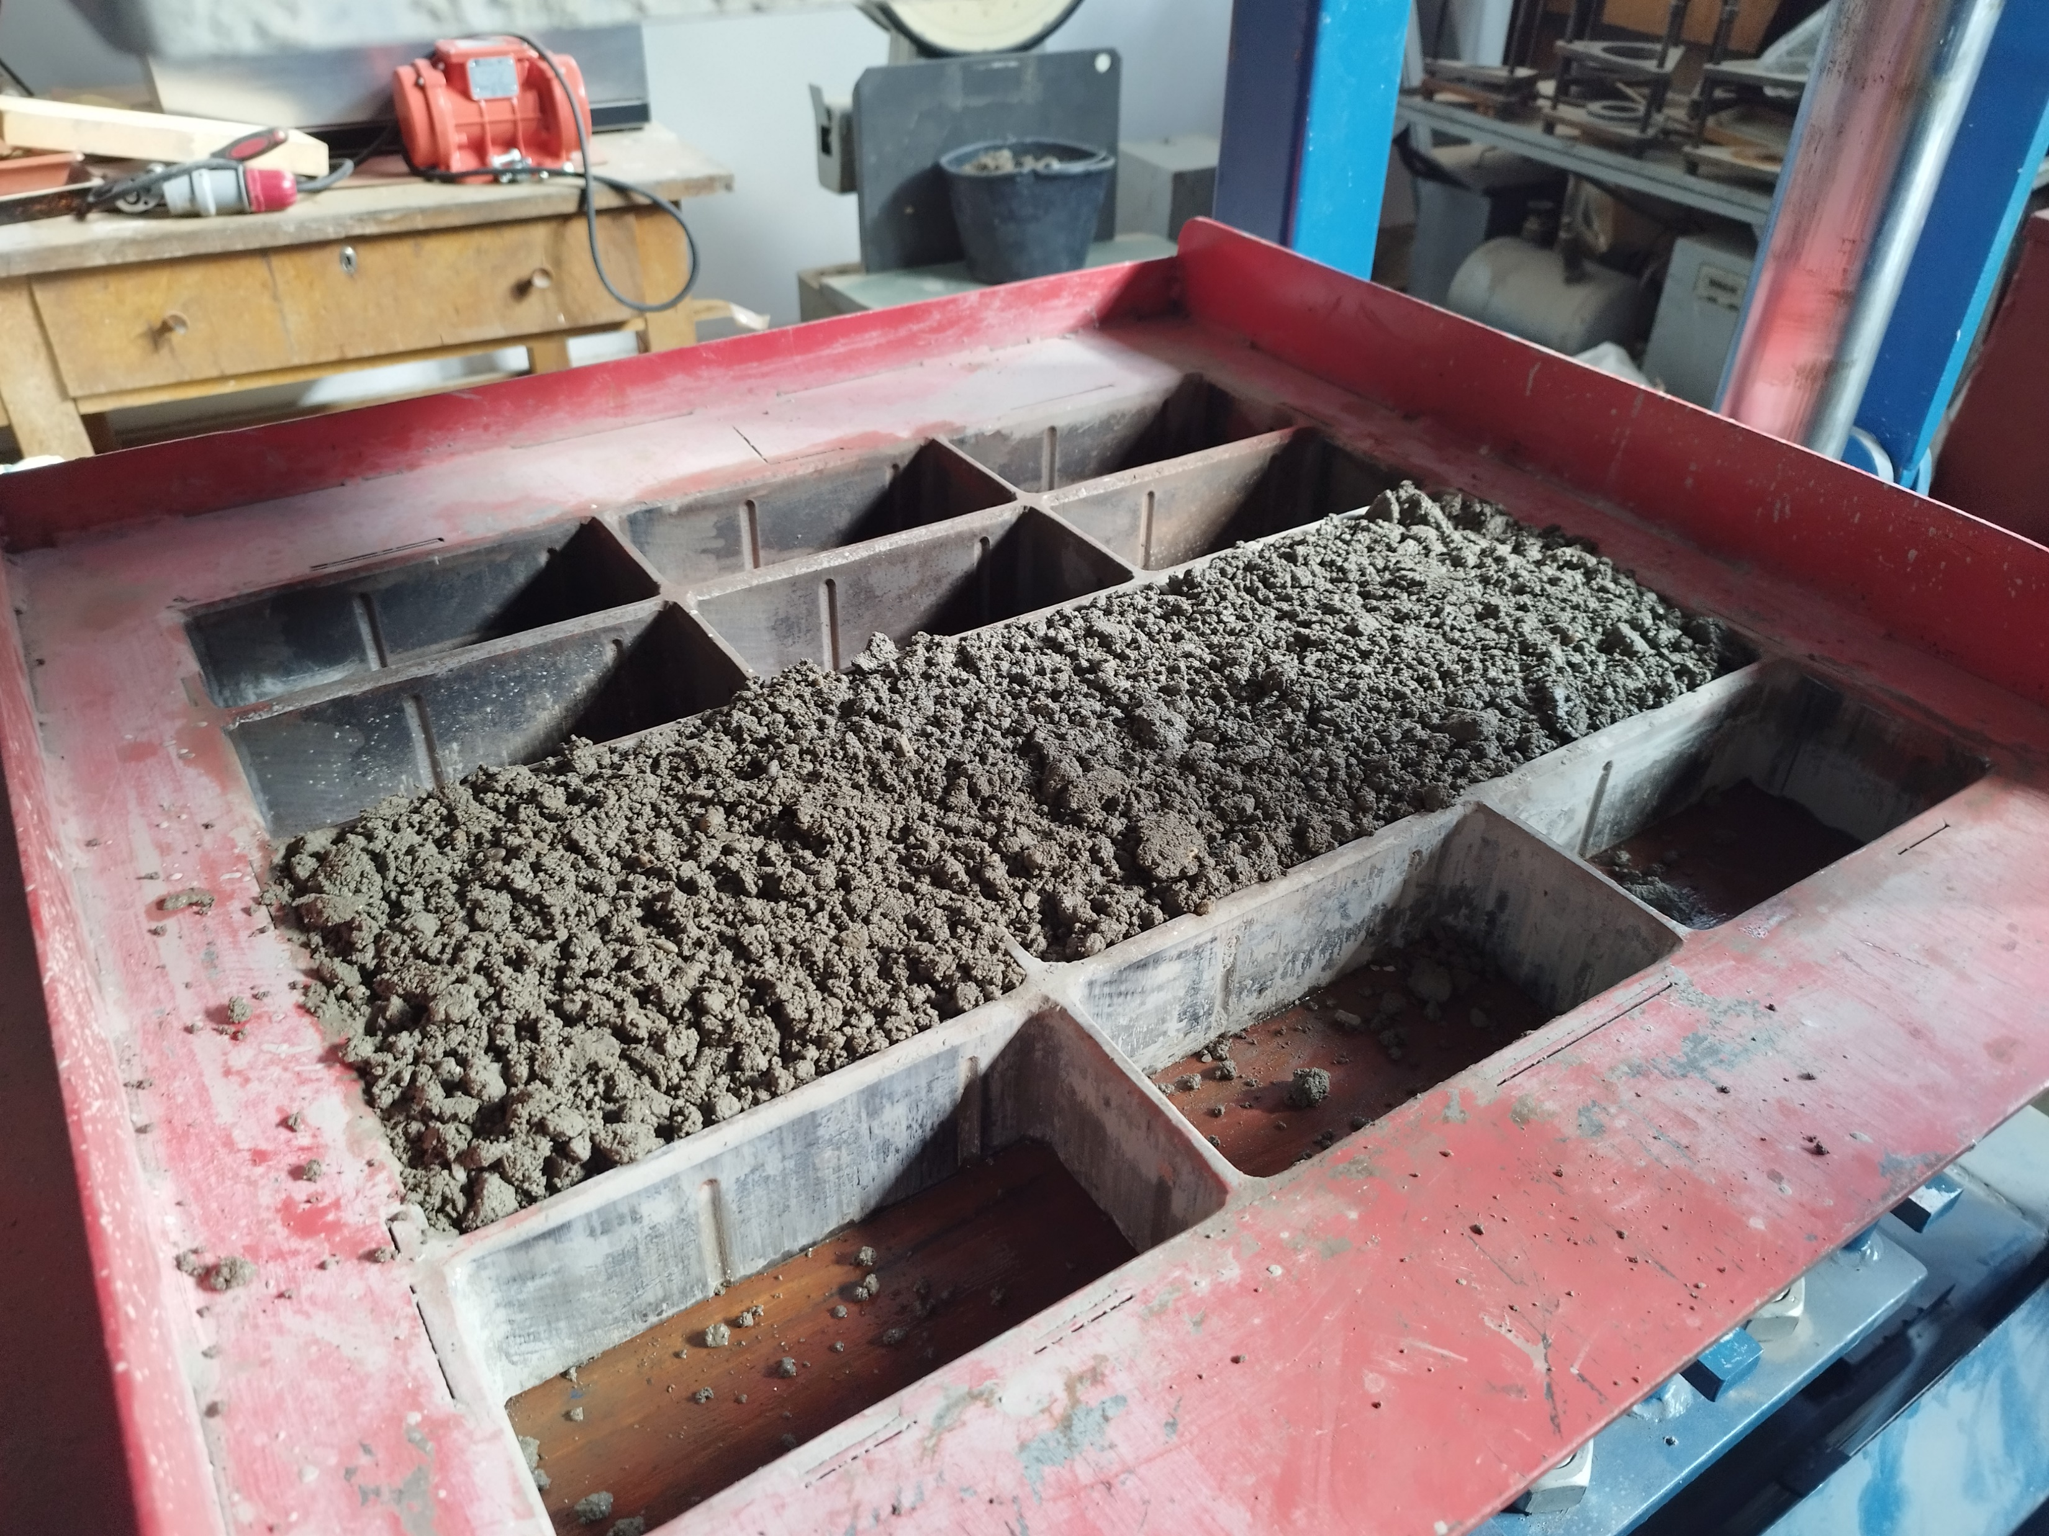
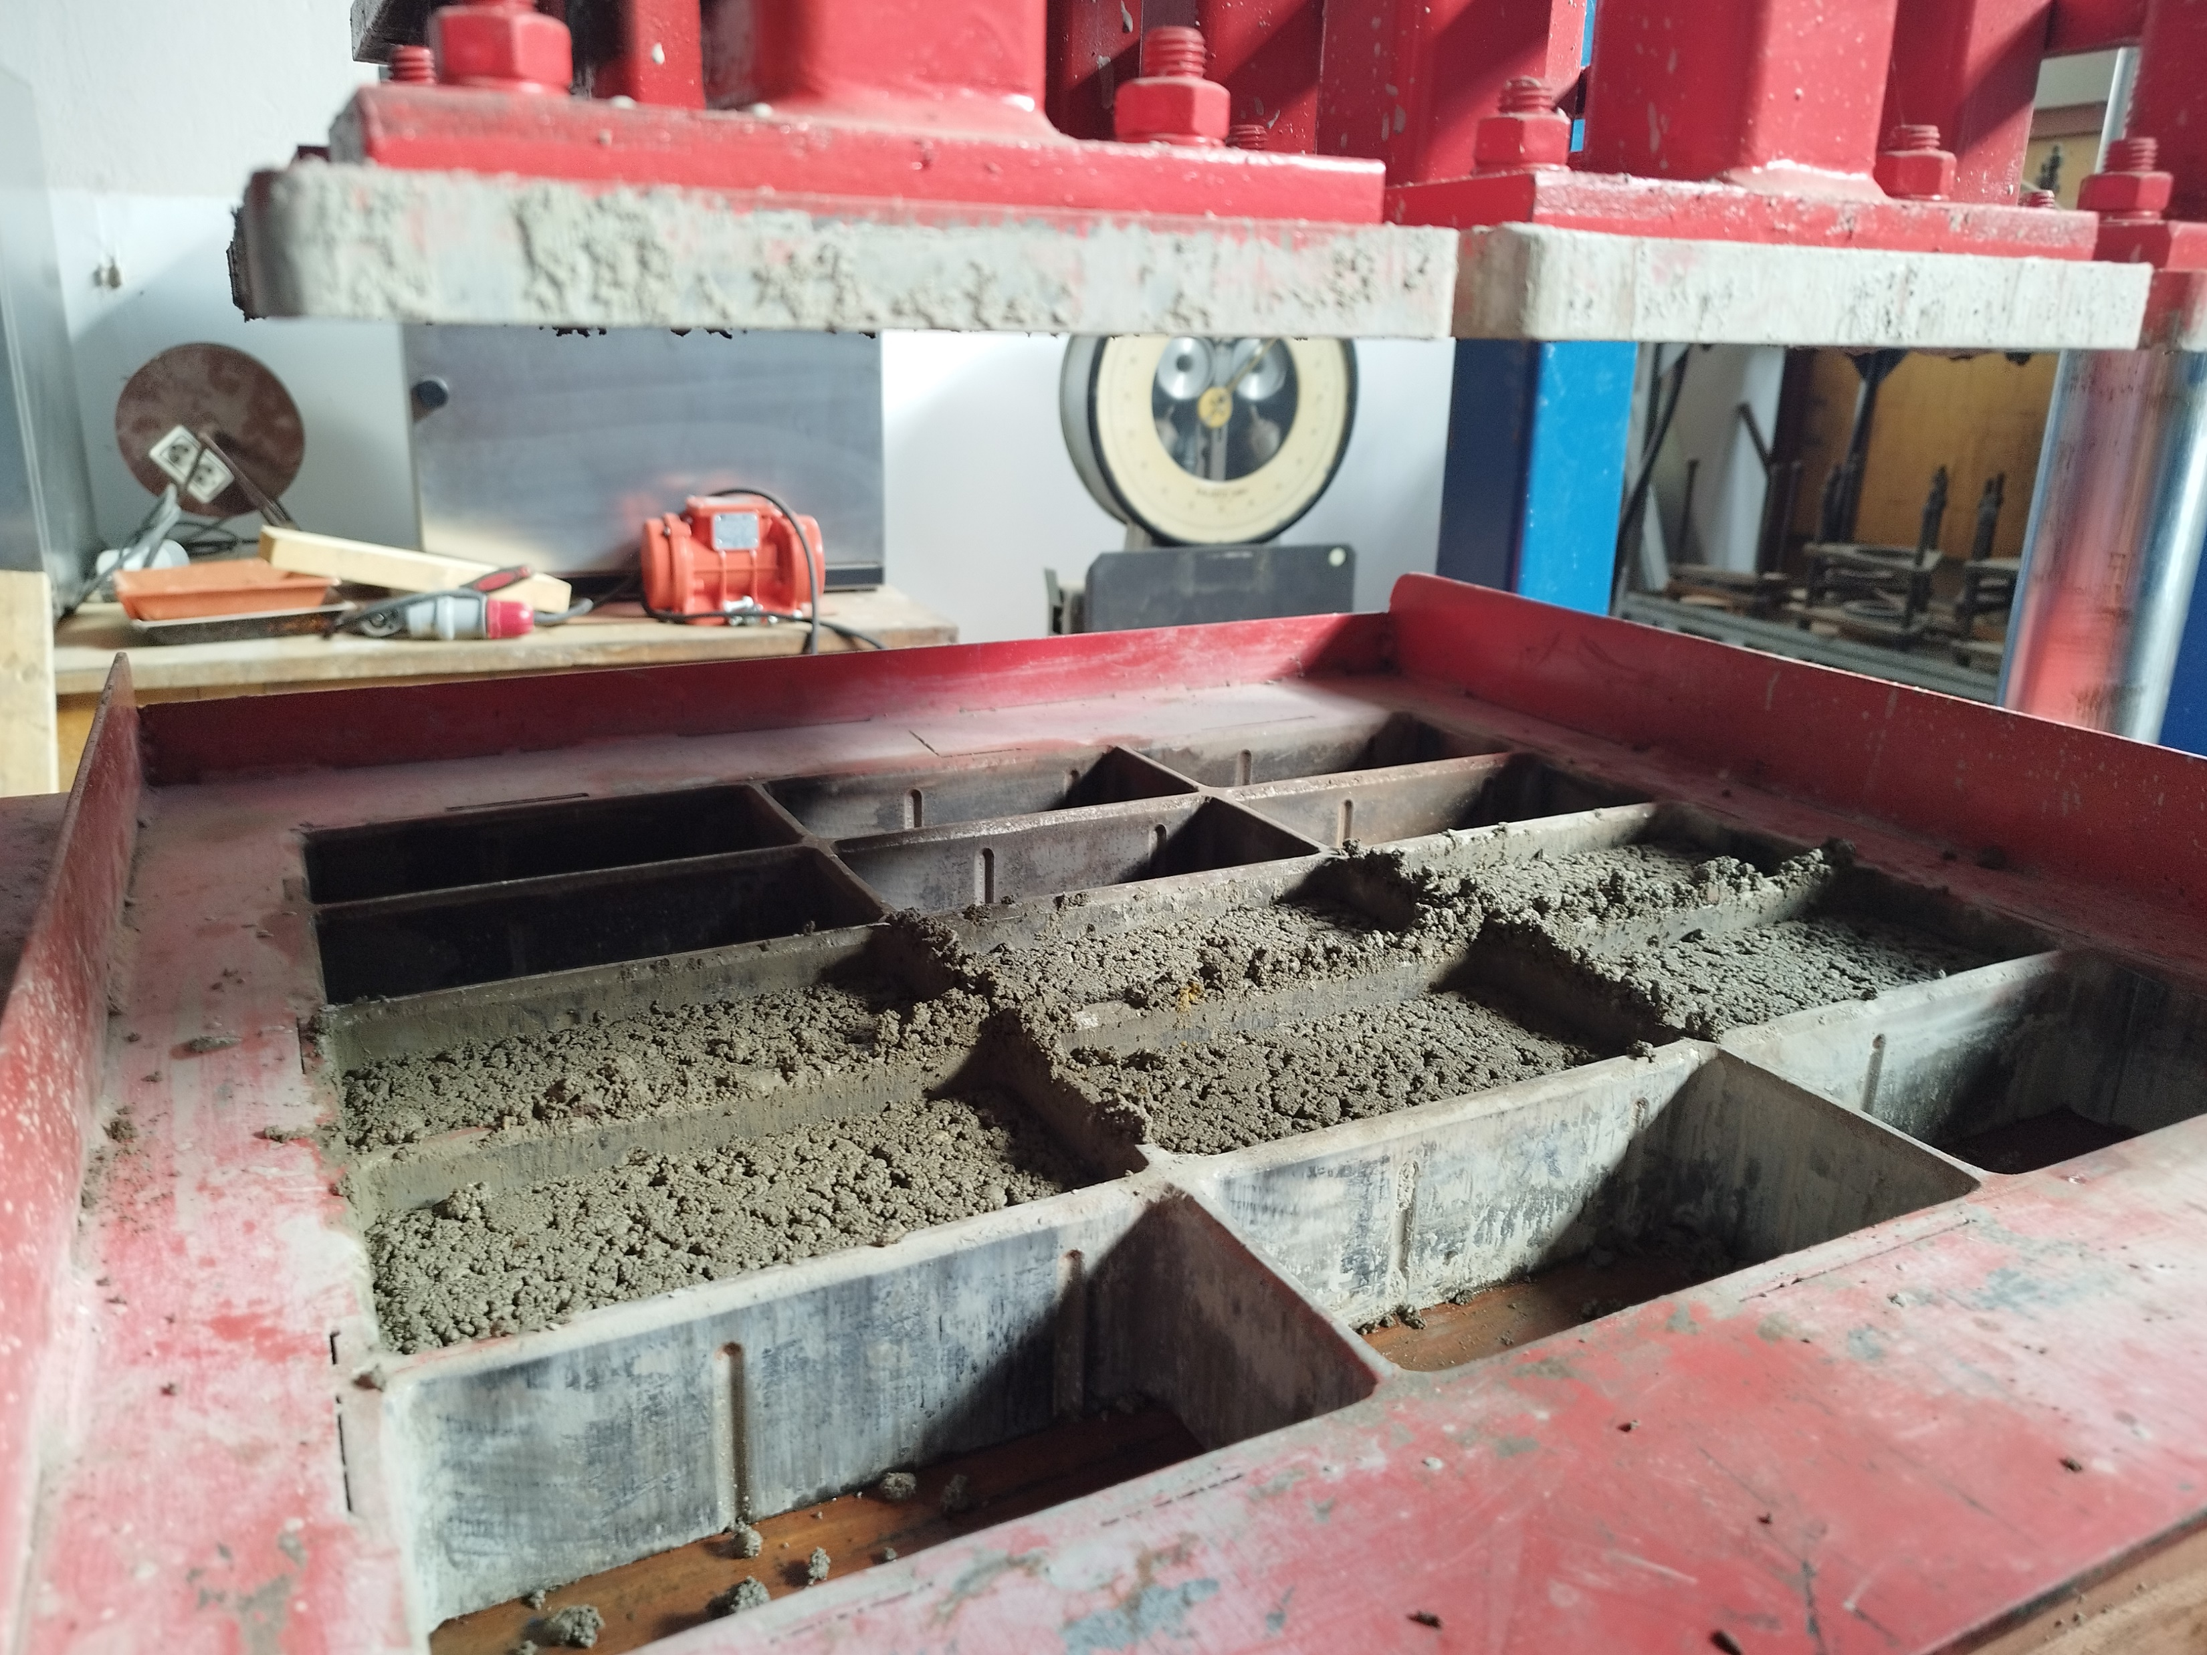
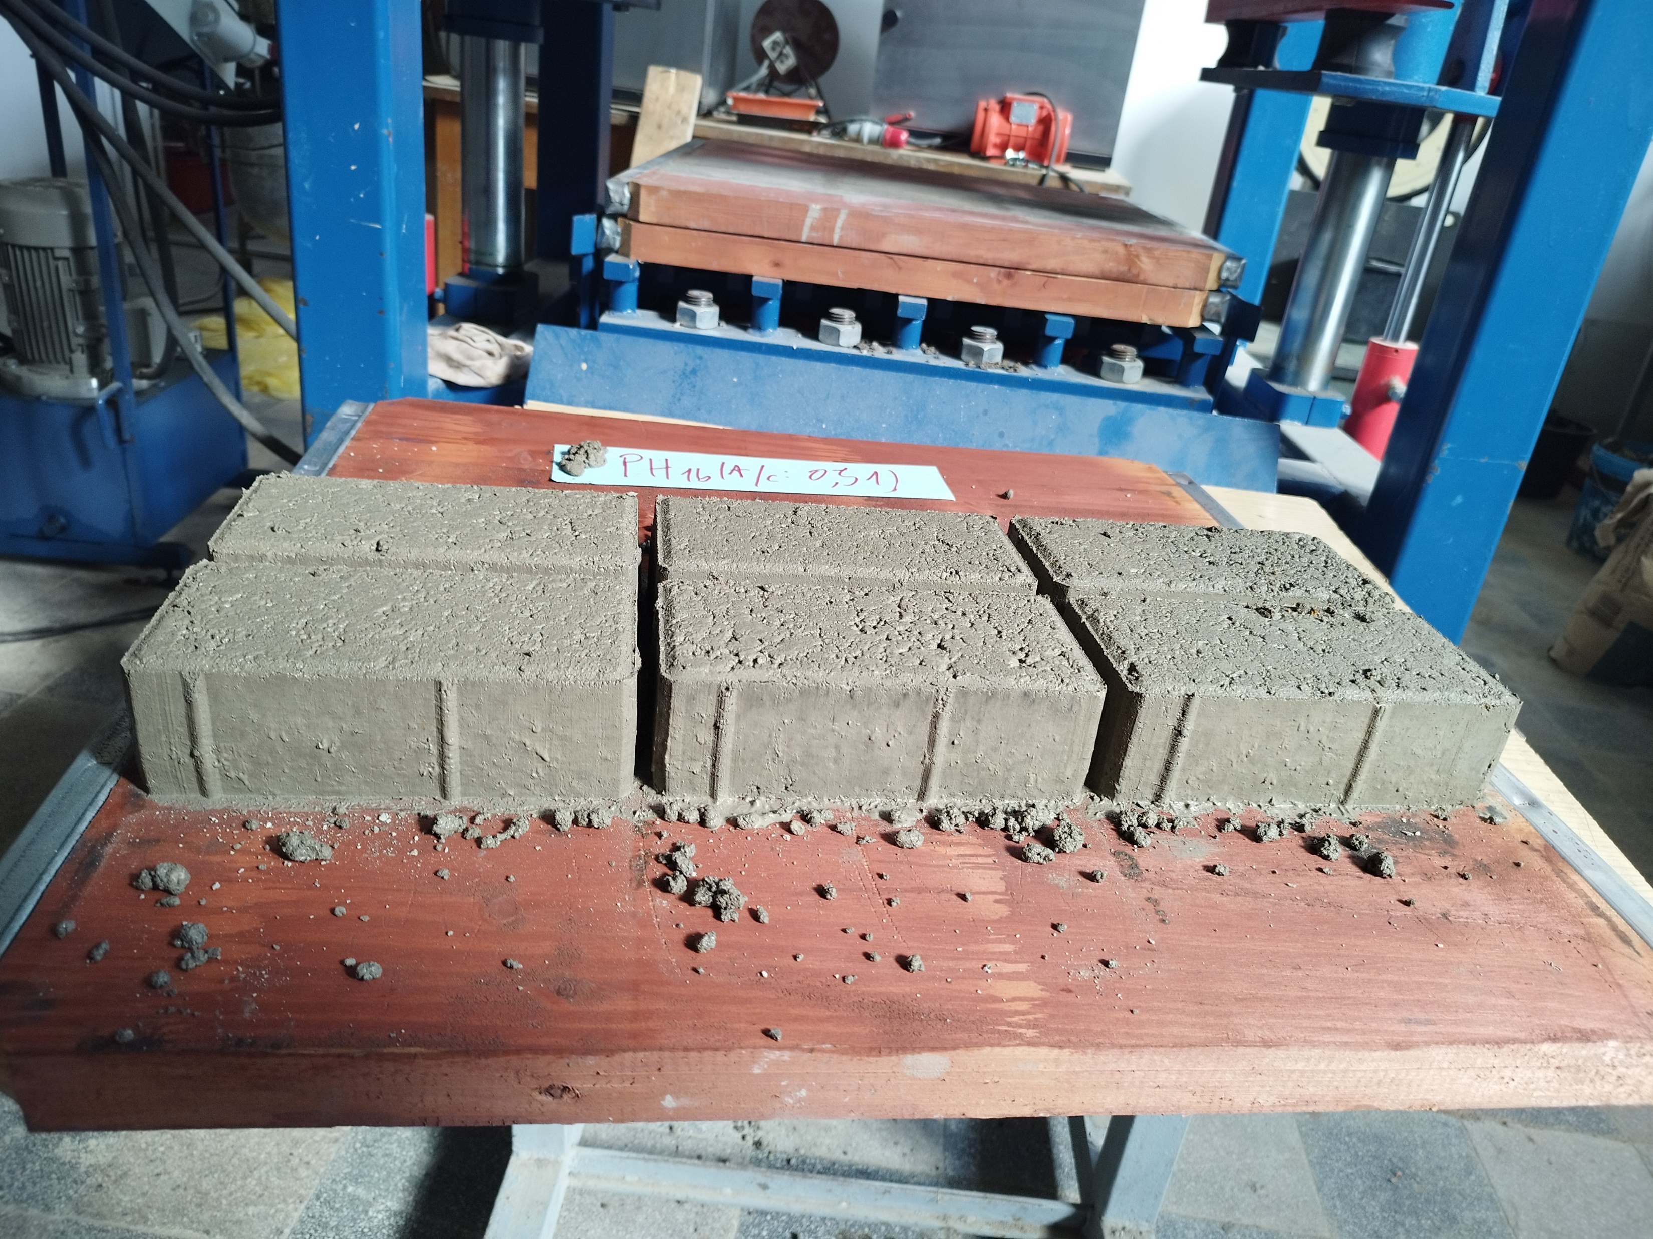
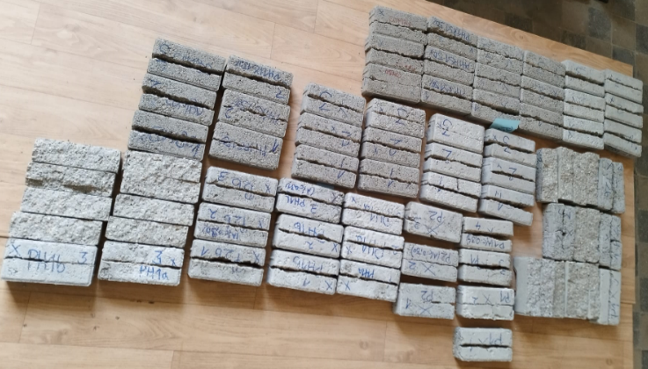
IV. CONCLUSIONS and future perspectives
Direct field of application in terms of PAVING BLOCKS developed by the means of SG integration in the concrete mix: ONGOING RESEARCH
Development of Eco-CPs: Eco-intelligent Construction Products, with advanced functionality, made by using Eco-CCM (Eco-Construction Products)
The results and support the viability of Spent Garnet as a sustainable, aligning with circular economy principles.

Slide 28
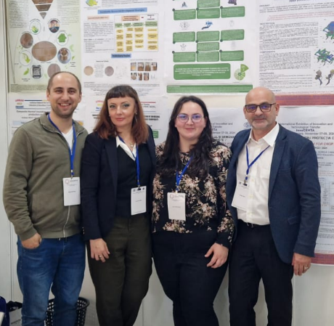

IV. CONCLUSIONS and future perspectives
Acknowledgments:
This work was carried out within Nucleu Programme of the National Research Development and Innovation Plan 2022-2027, supported by MCID, "ECODIGICONS" project no. PN 23 35 04 01: Fundamental-applied research into the sustainable development of construction products (materials, elements, and structures, as well as methods and technologies) that utilizes current national resources to enhance the eco-innovative and durable aspects of Romania's civil and transport infrastructure.
Contact:
https://incd.ro/
Aurelian GRUIN (Branch Manager, Project Manager): aurelian.gruin@incd.ro
Cornelia BAERA (Scientific Manager of Timisoara Branch: cornelia.baera@incd.ro; cornelia.baera@upt.ro
Thank you for your attention!

