Slide 1

Prediction of mechanical properties of 3D printed parts using machine learning model
Adugna D Akessa, Wakshum M Tucho, Chao Ren
Department of Mechanical, Structural Engineering, and Materials Science, Stavanger University

Slide 2
Contents
1. Introduction
2. Objective
3. Methodology
3.1 Material
3.2 3D printing and mechanical testing
3.3. Experimental design
3.4. Machine learning
4. Results
5. Conclusion

Slide 3
Introduction
3D printing (Additive manufacturing) is revolutionizing prototyping and part production.
Fused deposition modeling (FDM):
  popular and widely used method
  simple to operate,
  accessible
  low energy consumption &
  cost-effective compared to other 3D printing methods.

Slide 4
Introduction cont..
The mechanical properties of 3D printed parts vary among many based on:
  Printing parameters: raster angles, printing temperature, printing speed, infill density, infill pattern, etc.
Challenges:
Identifying the optimal combination of printing parameters from a multitude of options,
Physical testing is time-consuming and costly.

Slide 5
2. Objective
To develop a machine learning model that can:
Predict flexural strength and strain
Reduce the need for costly laboratory testing using ML models.

Slide 6
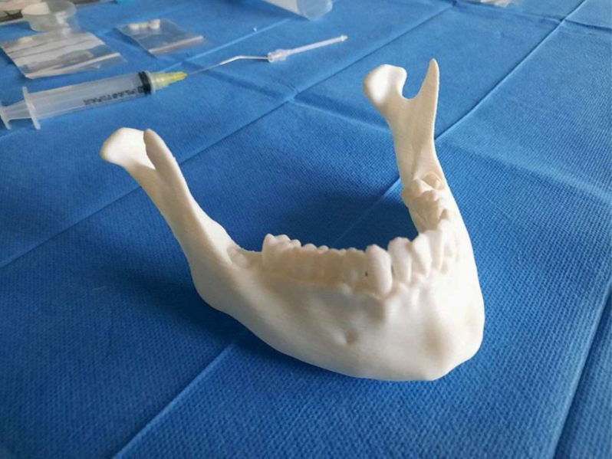
3. Methodology
3.1. Materials
Polylactic acid (PLA+)
Biodegradable
Strong chemical resistance
Cost-effective
Biocompatible (i.e., used in medicine for surgical
planning and simulation).
https://dbe.unibas.ch/en/research/core-facility-3d-print-lab

Slide 7
3. Methodology cont..
3.2 3D printing and mechanical testing
  The specimens were printed and tested according to the ASTM D790 standard method.
  To reduce the likelihood of errors, five specimens were printed for each test
  Bambulab X1 FDM printer used to print the specimens
  Printing parameters examined:
    Printing speed (PS) (mm/s) 300, 400, and 500
    Printing plate temperature (PT) (°c) 60, 70, and 80
    Raster angle (RA) (°) 0, 45, and 90

Slide 8
3. Methodology cont..
Machine learning (ML):
  ML variables were:
    Input /independent variables (PS, PT, and RA)
    Output/dependent variables (Bending strength and Strain) collected from the experiment
  Minitab software was used to generate the number of runs.

Slide 9
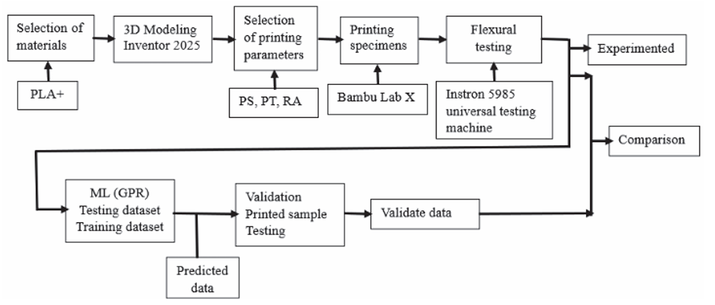
Experimental flowchart of the study.

Slide 10
Machine learning model employed
  GPR
    Limited number of datasets available
    Nonlinear relationship between input and output variables
    The simplicity of the model

Slide 11
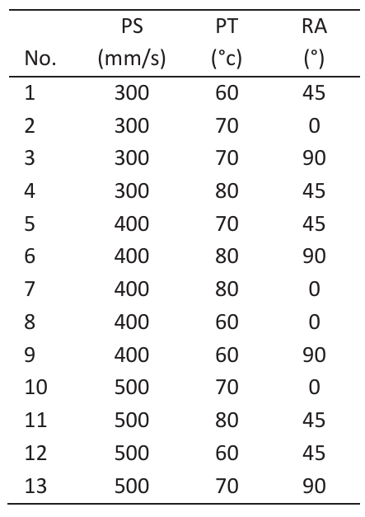
Printing parameter setting

Slide 12
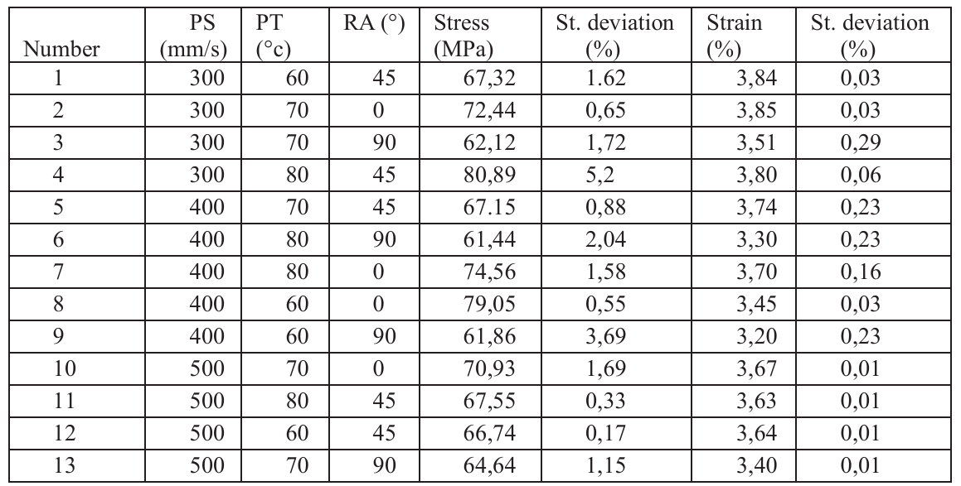
4. Results
Experimental test results

Slide 13
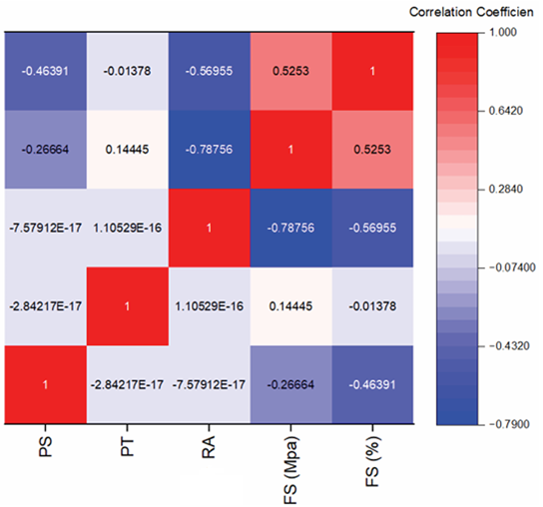
4. Result cont..
Python code developed on a free cloud-based platform called ’Colaboratory’ was used for data analysis in the study.
Heatmap showing correlation between input and output variables.

Slide 14
Result cont..
The experimental data and predicted data are compared.

Slide 15
Results cont..
The performance of the ML model is evaluated using ML model evaluation metrics, R-squared, and mean absolute error
  R-squared 99.16%
  MSE 0.6%, the model demonstrates better accuracy.
  The top five maximum combinations of input and output variables were selected and experimentally validated.

Slide 16
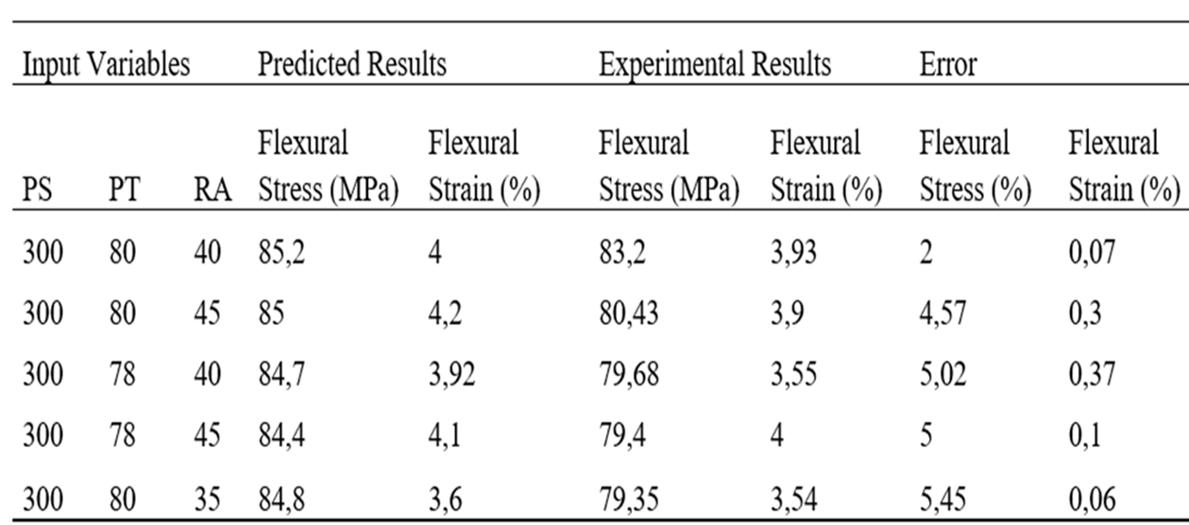
The top five maximum combinations were validated with an experimental test.

Slide 17
Conclusion
Flexural specimens were produced using the FDM 3D printing method, varying the printing process parameters. The Flexural strength and strain were predicted using the GPR ML model. The findings present a reliable approach for optimizing FDM process parameters, thereby reducing the need for extensive experimental trials and accelerating the design and manufacturing process.
This research indicates that the flexural strength and strain improved by 0.2% and 28 MPa, respectively.

Slide 18
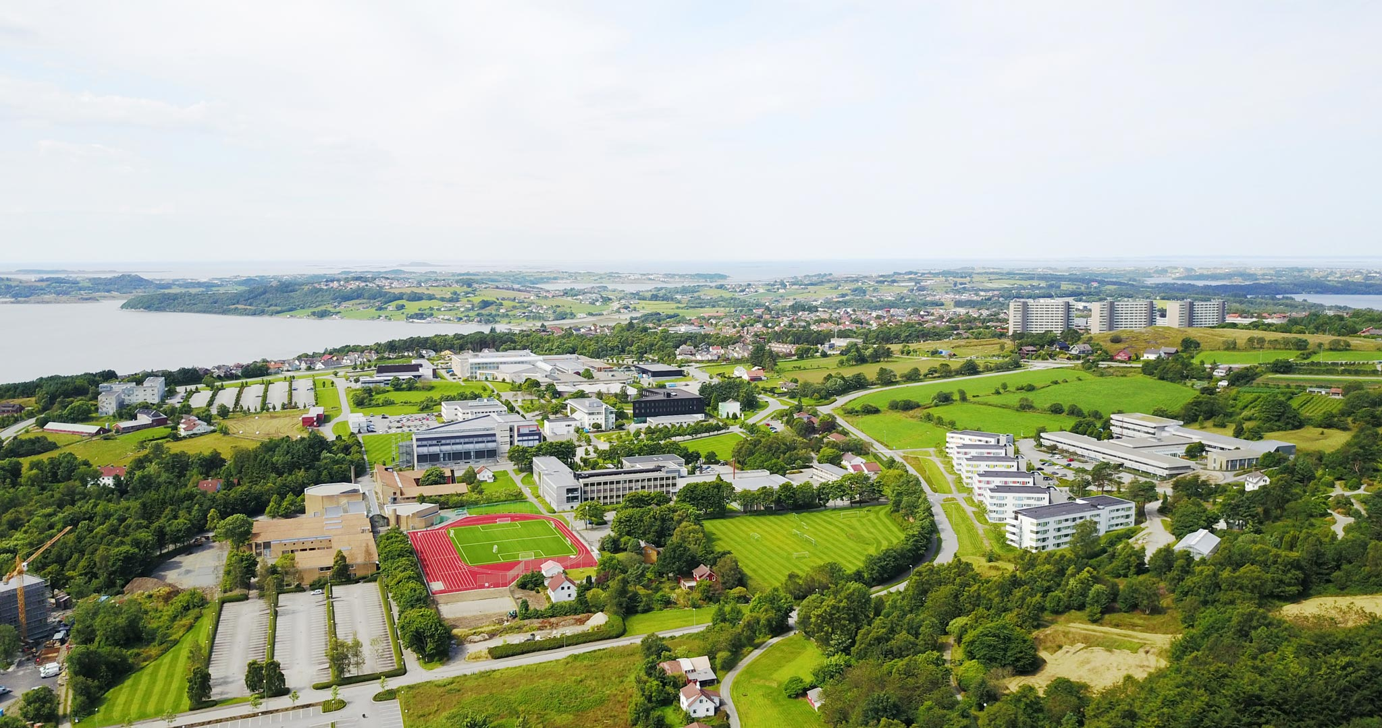

Thanks for your attention!

