Slide 1


Integrating AI, Digitalization, and the European Product Passport for Sustainable Trade and Circular Economy
Authors: Jan Frick, Kenn Steger-Jensen, Hans-Henrik Hvolby
Affiliations: University of Stavanger; Aalborg University; University College of Northern Denmark
June 12th, 2025. J. Frick

Slide 2
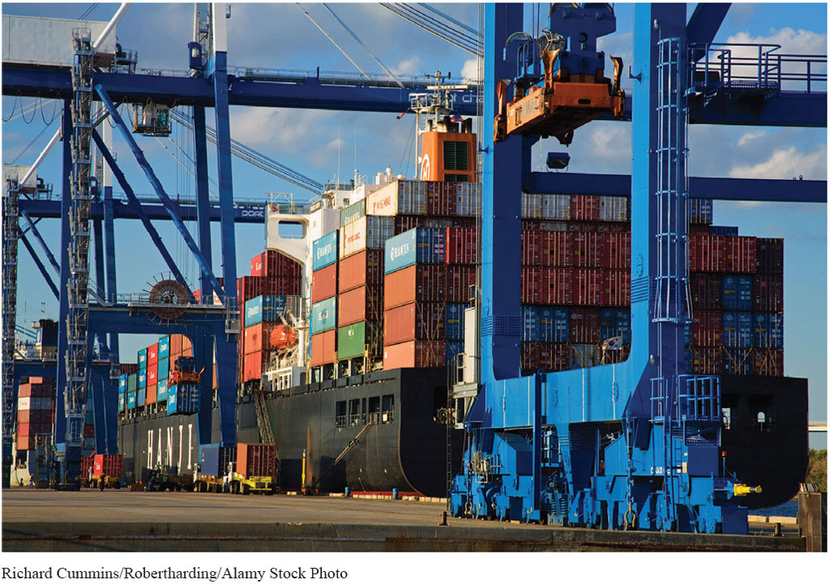
Purpose & Motivation
Global trade faces
  climate goals,
  consumer demands,
  regulatory shifts.
Customs processes are fragmented and manual.
Opportunity:
  Combine AI, digitalization, and EPP for sustainable, circular supply chains.
Notes:
Explain the core question: Why combine AI, digitalization, and EPP?
Highlight the global context: climate targets, regulatory pressure, consumer expectations.
Introduce the challenge: Customs and supply chains struggle with fragmented, trust-based systems.

Slide 3
European Policy Landscape
European Green Deal,
Circular Economy Action Plan,
EU Battery Regulation,
CBAM,
CSRD
ETS
Digital-first, sustainability-focused solutions.
  EU Single Window Environment for Customs
  European Maritime Single Window environment
Notes:
Describe key EU initiatives: European Green Deal, Circular Economy Action Plan,
CBAM, Carbon Border Adjustment Mechanism,
CSRD. Corporate Sustainability Reporting Directive
ETS.( european union emissions trading system)
Explain why these policies push digital-first, sustainability-oriented solutions.
Connect these policies to the rise of the European Product Passport.

Slide 4
What is the European Product Passport (EPP)?
Dynamic digital record:
  materials, manufacturing, use, end-of-life.
Single source of accurate sustainability + compliance data.
Stakeholders: manufacturers, logistics, regulators, consumers.
Notes:
The European Product Passport is a digitally accessible "profile" designed to follow products throughout their entire life cycle — encompassing the phases of design, production, distribution, use, repair, reuse, and recycling or disposal.
The fundamental objective of the Passport is to:
• Improve Transparency: By providing accessible, verifiable, and andardized information on material composition, origins, environmental footprint, and other attributes.
• Encourage Sustainability: By promoting design for durability, repairability, and recyclability, and by reducing resource consumption and waste generation.
• Enable Regulatory Oversight: By furnishing customs officials, market surveillance authorities, and consumers with the data needed to confirm compliance with EU laws.

Slide 5
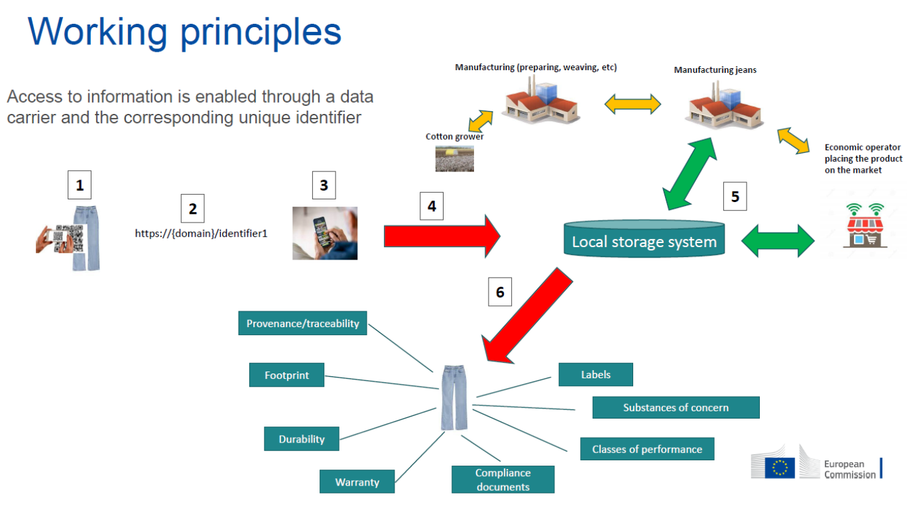
Notes:
Define the EPP: A digital record tracking materials, production, use, and disposal.
Describe stakeholders: Who uses EPP data and why (manufacturers, customs, consumers)?
Explain why EPP is central for transparency and compliance.

Slide 6
How AI Enhances the EPP
Automated compliance monitoring.
Predictive lifecycle + maintenance analytics.
Real-time supply chain optimization.
Consumer insights + gamified sustainability nudges.
Notes:
Detail key AI functions:
• Automated compliance monitoring.
• Predictive maintenance and lifecycle insights.
• Real-time supply chain optimization.
• Personalized consumer engagement and sustainability nudges.
Explain how AI transforms EPP from passive data storage to active decision support.

Slide 7

AI + Digitalization in Customs
Shift from tariffs/security to sustainability + ethics.
Digital tools: blockchain, IoT, e-documents.
AI-driven risk profiling and document checks.
Notes:
Describe the shift: Customs now enforce sustainability and ethical rules, not just tariffs.
List key tools: Blockchain, IoT sensors, digital documents, AI-based risk profiling.
Explain how these tools help balance security, speed, and sustainability.

Slide 8
Circular Economy Opportunities
Track reuse, repair, recycling via DPP.
AI manages material recovery, recycling routes.
Financial incentives shaped by verified sustainability metrics.
Notes:
Explain how DPP enables reuse, repair, remanufacturing, and recycling.
Describe how AI identifies recyclable materials, optimizes recycling routes, and connects stakeholders.
Highlight financial benefits: Verified sustainability data affects loans and investment.

Slide 9
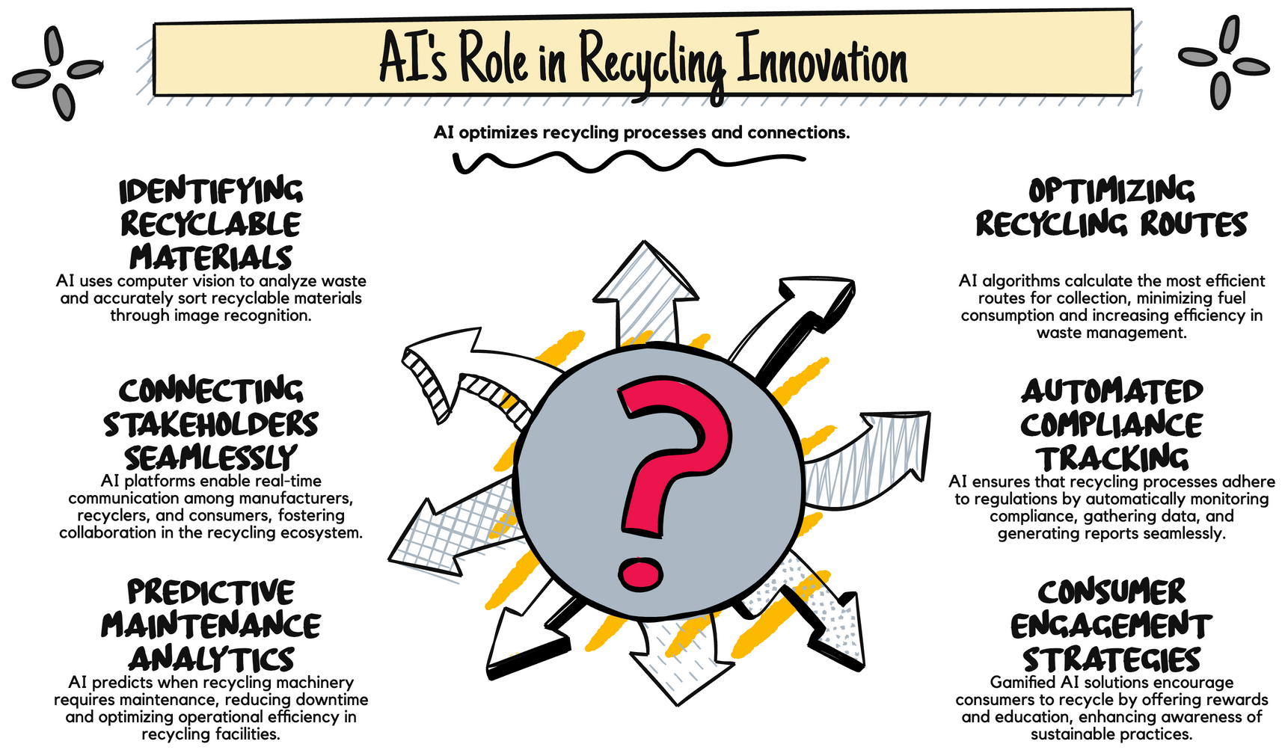

Slide 10
Challenges in Verification
Lack of accredited verifiers for CO₂ and SDG data.
Customs rely on importer declarations.
Proposal:
  Expand verifier roles + harmonized digital systems with AI + EPP.
Notes:
Identify the problem: Customs currently lack accredited verifiers for import CO₂ and SDG, Sustainable Development Goals data.
Explain the consequences: Risk of inaccurate reporting, greenwashing, tax evasion.
Propose solutions: Expand verifier roles, standardize verification tools using AI + EPP.

Slide 11
Customs as Catalyst for Circular Trade
AI-based risk management.
Green incentives: fast lanes, tax reductions.
Customs as data hubs enabling material exchanges.
Notes:
Describe how AI-based risk management allows selective, focused inspections.
Explain green incentives: Fast lanes, tax cuts, certifications for sustainable goods.
Describe customs as data hubs, enabling material exchanges across sectors.

Slide 12
Policy & Practice Recommendations
Harmonize standards across EU.
Invest in digital + AI infrastructure.
Train stakeholders in AI literacy.
Build public-private partnerships.
Notes:
Summarize key recommendations:
• Harmonize EU-wide sustainability standards.
• Invest in digital infrastructure and scalable AI systems.
• Train customs, companies, and SMEs in AI literacy.
• Build public-private partnerships for innovation.

Slide 13
Key Takeaways
AI + EPP transform static data into dynamic sustainability engines.
Customs evolve into facilitators of circular trade.
Alignment of policy, technology, and collaboration is critical.
Notes:
Restate main insights:
• AI + EPP create smarter, more sustainable supply chains.
• Customs can move from enforcement to facilitation.
• Policy, tech, and collaboration alignment is essential.

Slide 14
Acknowledgments + Contact
Research supported by Value4Sea, Interreg, European Regional Development Fund.
Contact: Jan.Frick@uis.no.
Thank you! Questions welcome.

