Slide 1
Preliminary study on scour protection for offshore wind turbines co-located with aquaculture
Filipe da Costa Miranda
Paulo Jorge Rosa Santos
Francisco de Almeida Taveira Pinto
Tiago João Fazeres-Ferradosa

Slide 2
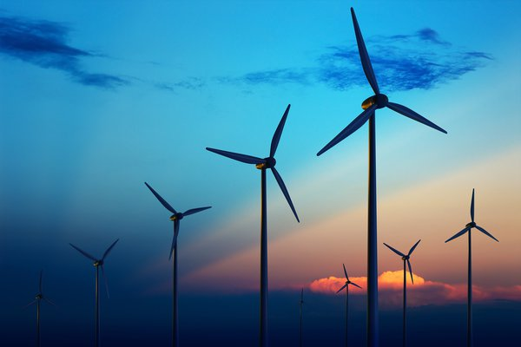
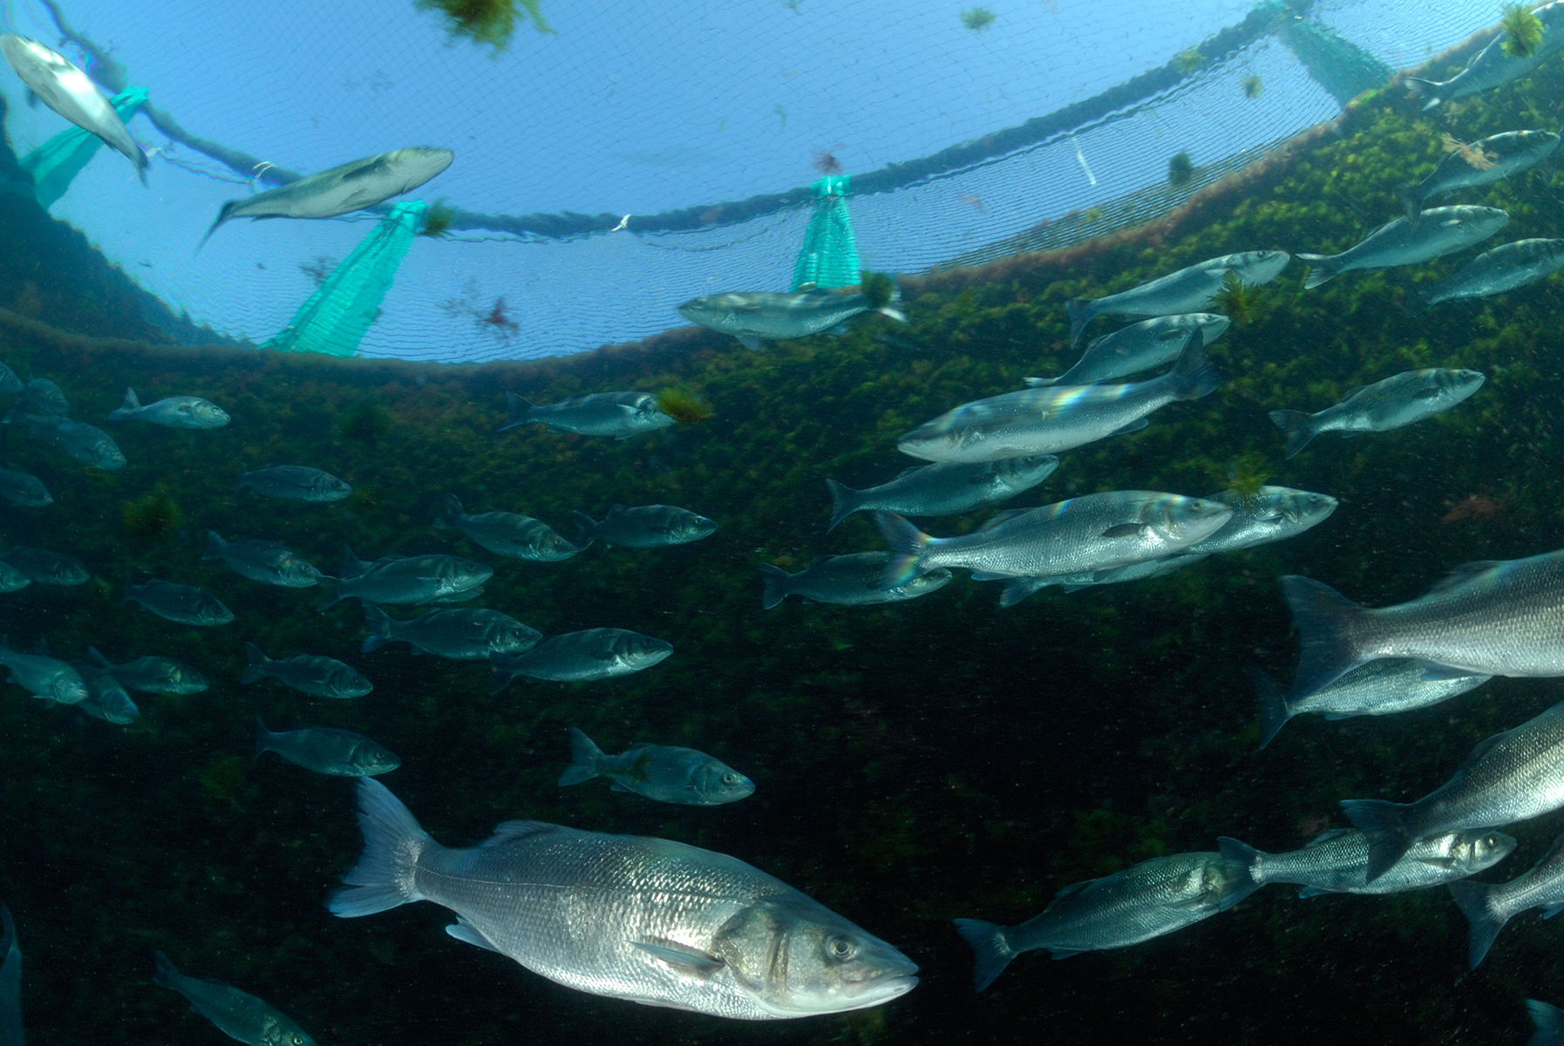
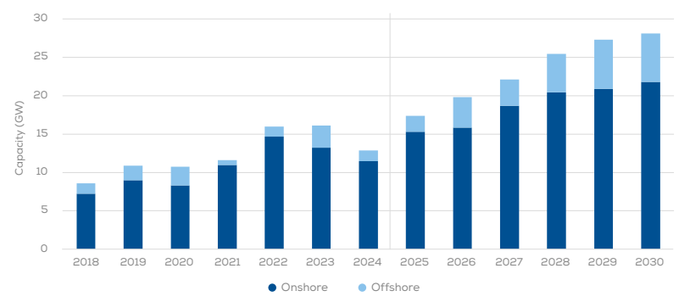
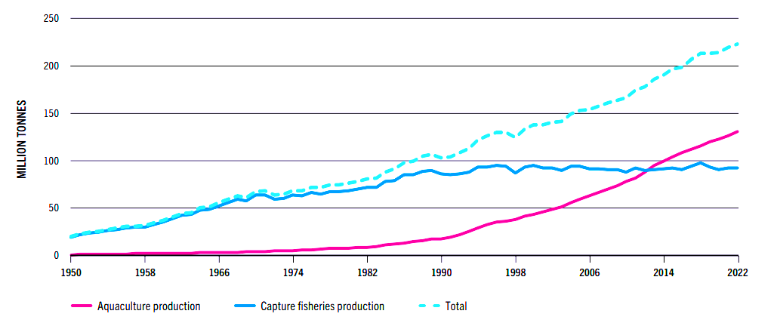
Wind energy
Aquaculture
Sustainable seafood
Food security
Clean energy
Energy transition
Capture fisheries
Aquaculture
Wind Europe
FAO

Slide 3
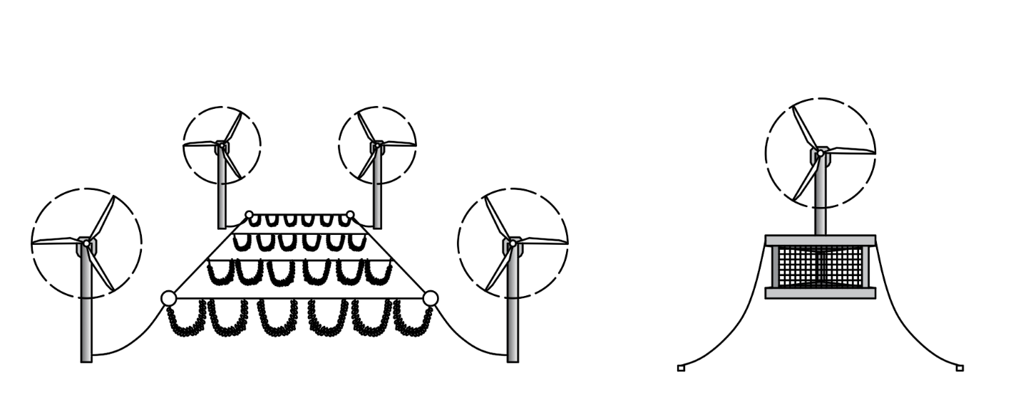
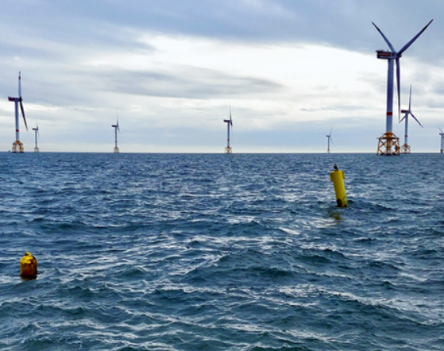
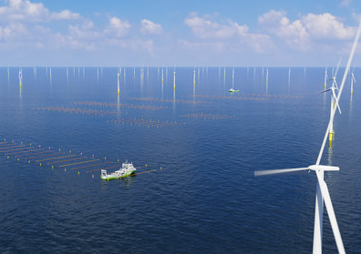
Co-location
Aquawind project (Spain)
Co-location
Multi-use
Fish cage
Edulis project (Belgium)
North sea farmers (North sea)
Advantages:
- Optimization of marine space
- Shared operations
- Energy synergies
Mussel longlines
Seaweed longlines

Slide 4
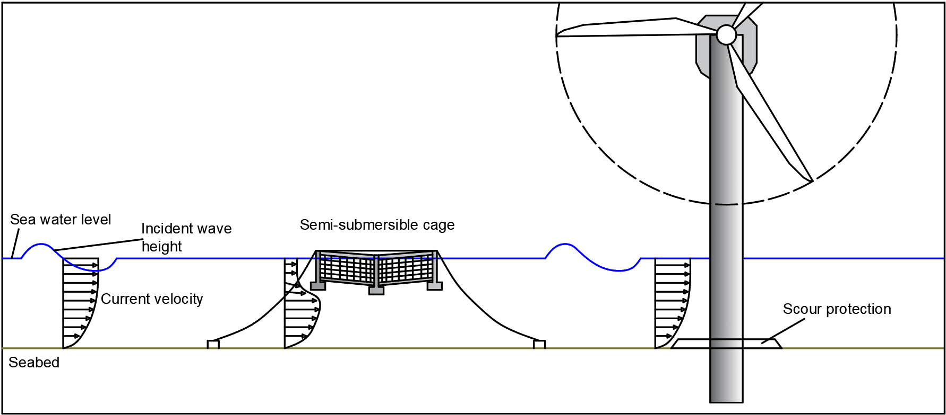
Implications for offshore wind ??
Increased vessel traffic
Increased marine mammals' presence
Risk of collision
etc…
Uncertain hydrodynamic variations
Scour protection ???

Slide 5
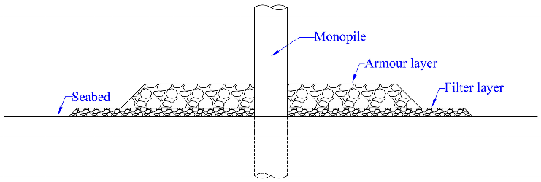
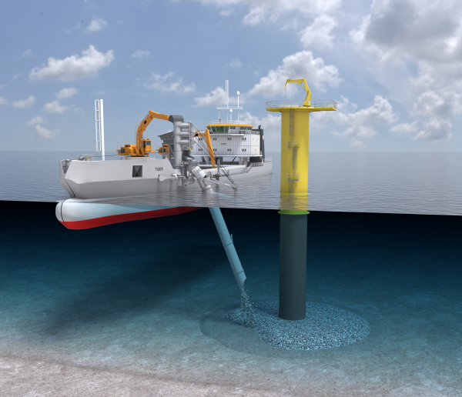
Scour Protection
Rock mattress stone size depends on hydrodynamic loading (waves, currents, water depth etc..)
© Jan de nul

Slide 6
Scour Protection
Static:
Does not allow stone
Larger stones
Less risk
Dynamic:
Allows stone movement
Smaller stones
Generally, less expensive

Slide 7
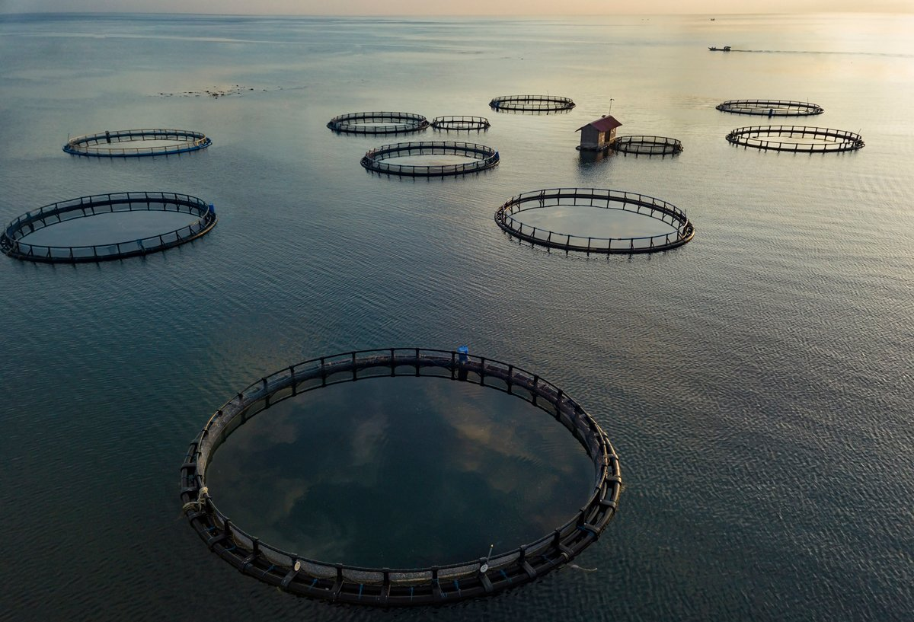
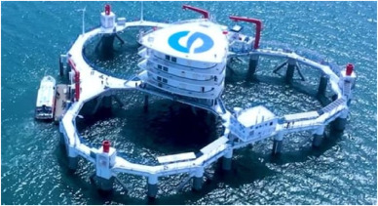
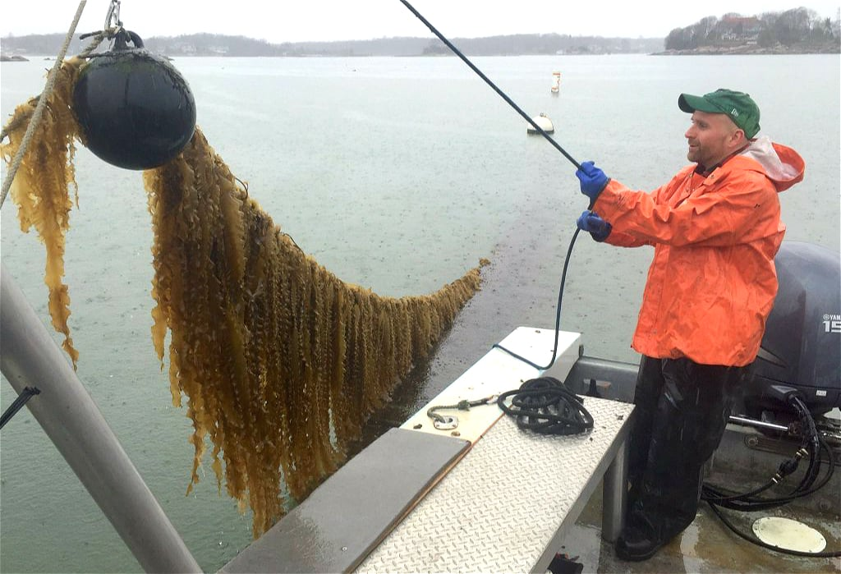
3 co-location scenarios (Aquaculture + offshore wind turbine)
Semi-submersible cage
Bottom fixed cage
Floating kelp farm
Reduce wave height
Reduce surface current velocity
Increase bottom current velocity
Reduce wave height
Reduce surface current velocity
Reduce bottom current velocity
Reduce wave height
Reduce surface current velocity
Increase bottom current velocity

Slide 8
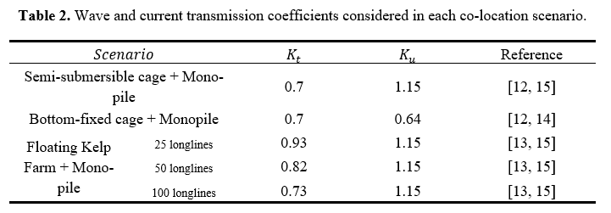
Wave and current transmission coefficients
Assumptions and simplifications:
The aquaculture system survives design storm conditions
The aquaculture system is positioned upstream of the main storm direction
Fully grown kelp farm

Slide 9
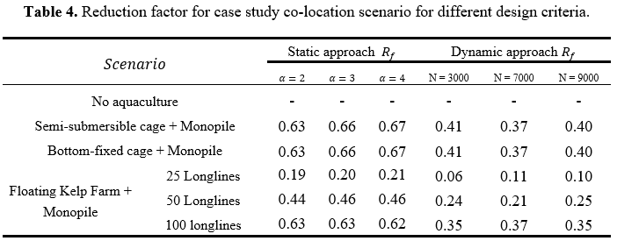
Semi-submersible + Monopile foundation
Reduction of the scour protection stone size by:
65% for the static design approach
39% for the dynamic approach

Slide 10
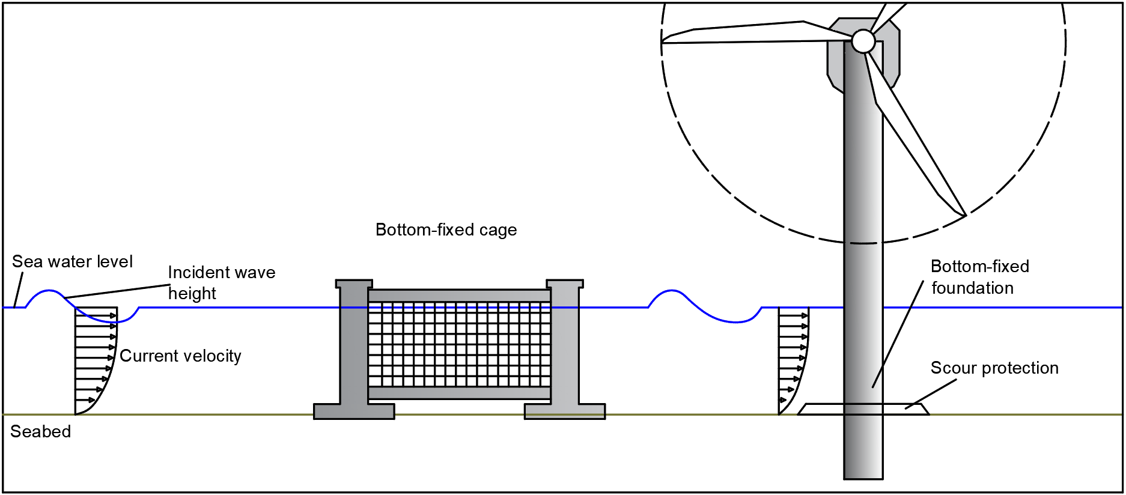
Semi-submersible + Monopile foundation
Reduction of the scour protection stone size by:
65% for the static design approach
39% for the dynamic approach

Slide 11
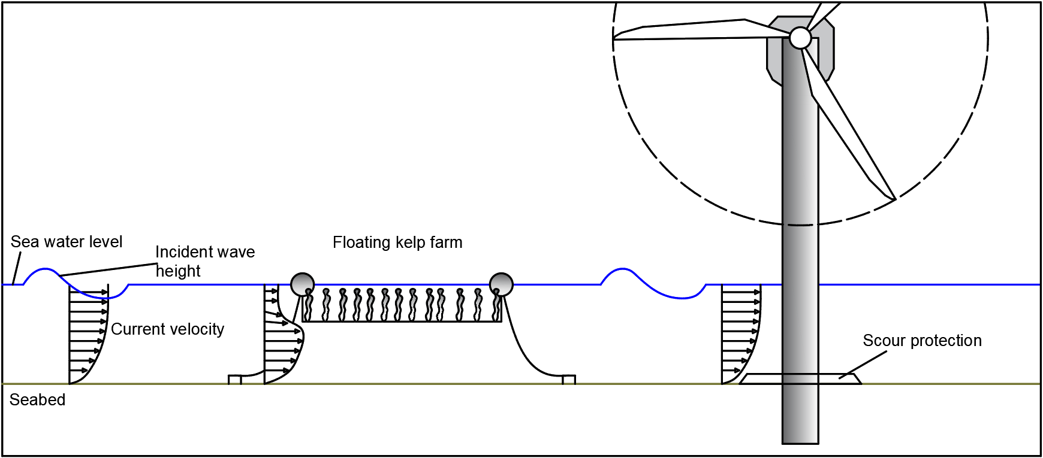
Semi-submersible + Monopile foundation
Reduction of the scour protection stone size by:
19 - 62% for the static design approach
6 - 35% for the dynamic approach

Slide 12
Concluding remarks
Stone size reduction of 19 – 67% achievable using the static design approach
Stone size reduction of 6 – 37% achievable using the dynamic design approach
In co-location scenarios, scour protections designed using a dynamic approach may behave as static protections
Lower risk of failure in existing scour protections
Assumptions and simplifications:
The aquaculture system survives design storm conditions
The aquaculture system is positioned upstream of the main storm direction
Fully grown kelp farm

Slide 13
Preliminary study on scour protection for offshore wind turbines co-located with aquaculture
Filipe da Costa Miranda
Paulo Jorge Rosa Santos
Francisco de Almeida Taveira Pinto
Tiago João Fazeres-Ferradosa

