Slide 1
DEVELOPMENT OF DYNAMICAL MODELSFOR GUIDANCE AND CONTROL OF OCEAN VEHICLES
$${Nikolaos I. Xiros}^{(1)},{Miguel Trejos}^{(1)},{Erdem Aktosun}^{(2)}$$
(1) University of New Orleans , Boysie Bollinger School of Naval Architecture and Marine Engineering
(2) İzmir Katip Çelebi University, Department of Shipbuilding and Ocean Engineering
Presenter: Asst. Prof. Erdem Aktosun
Notes:
.

Slide 2
Motivation
Why we have modeled surface watercraft dynamics?
As we know traditional physics-based models are complex, time-consuming, and mostly rely on simplifications/assumptions.
Accurate modeling of surge and yaw dynamics is essential for autonomous guidance and control.
We show a new model for neural networks offering a data-driven approach to model nonlinear, high-dimensional systems.
Realistic dynamic models improve performance in:
Path following
Collision avoidance
Swarm coordination
Our goal:
Develop a new novel data-driven dynamic model of a surface vessel for control, simulation, and autonomous navigation.

Slide 3
State-Space Model
General state-space model
$\dot{x}=f(x,u)$
x is the state vector containing the state variables
u is the input vector
Formulate nonlinear state equations using neural networks
State-space model for yaw and forward acceleration
Inputs
Forward velocity
Yaw rate
Left motor
Right motor
NN
Outputs:
Forward acceleration
Yaw acceleration
$$f(∙)$$
NN Model Structure:
Architecture: 4 inputs 9 neurons 1 output (Single hidden layer with ReLU)
Trained separately for:
$Forward Acc.=f_{net}(inputs)$
$Yaw Acc. =f_{net}(inputs)$

Slide 4
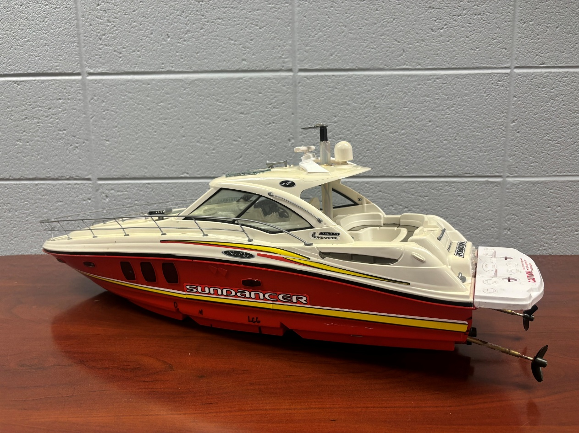
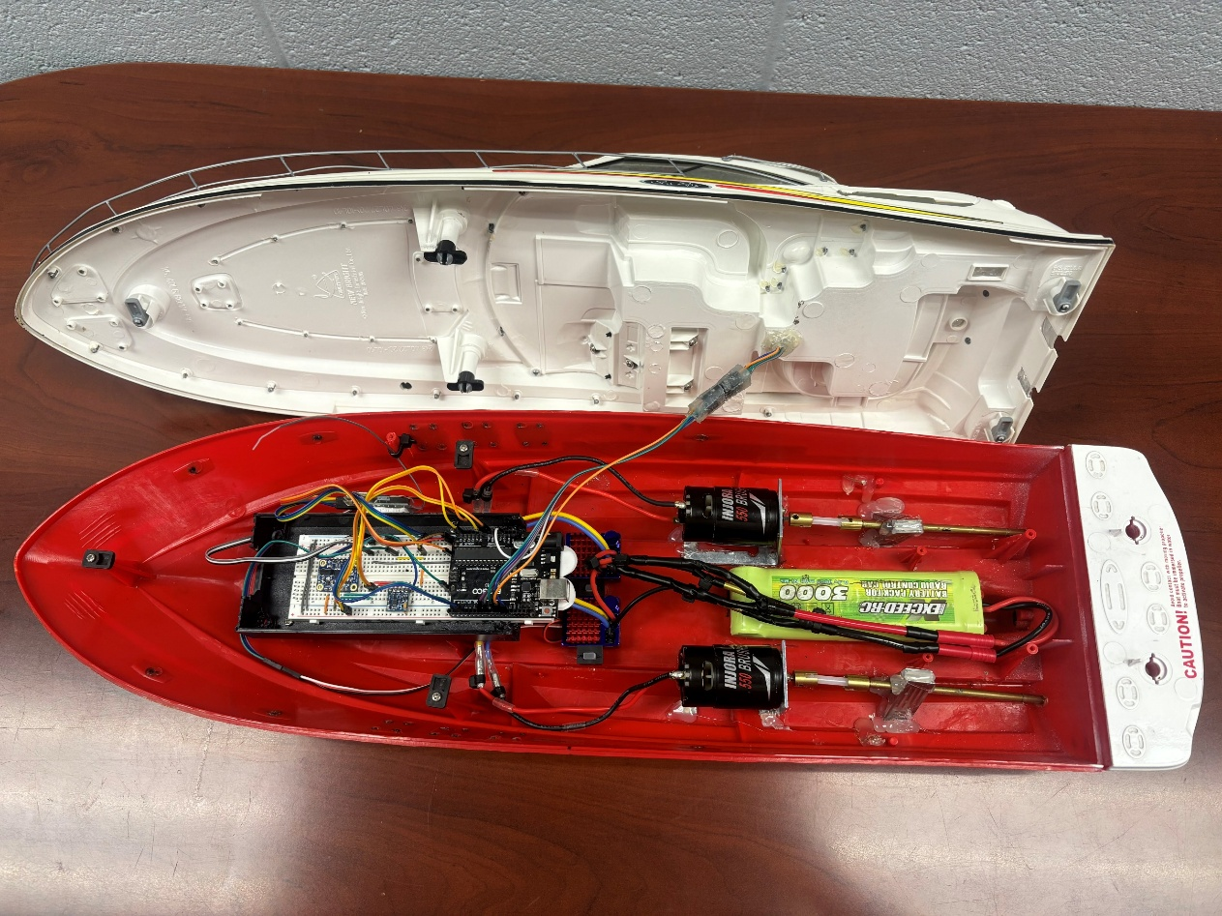
Surface Watercraft Construction
Vessel’s hull is New Bright’s Sea Ray Sundancer 29” remote control (RC) speed boat
Our vessel for our study is a 29-inch Sea Ray Sundancer RC speed boat by New Bright. This vessel was ideal due to its size, accessibility, and adaptability for sensor integration and propulsion control.
Notes:
It is also does not require the steering gear because it has two propellers so it can differential thrust.

Slide 5
Boat’s data collection setup
The operational receiver receives signals from RC controller and sends them to the motor controllers
Data is collected through the IMU (inertial measurement unit) and compass modules
3-dimensional acceleration parsed into x,y,z components and normalized due to gravity
Angular velocities from Coriolis forces
Azimuth angle
The transceiver relays the data to the on-shore microcontroller for storage
Diagram of surface watercraft electronics

Slide 6
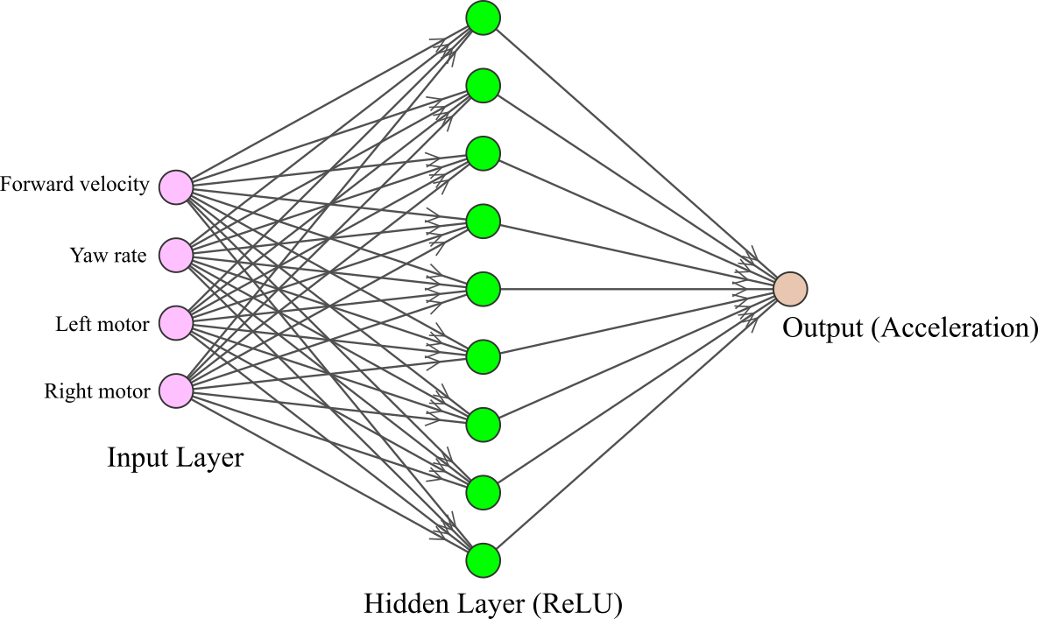
Neural Networks
Architecture
1 hidden layer
4 input neurons, 9 hidden layer neurons, 1 output neuron
Activation function: ReLU
Data split into training, validation, and testing [20% for training].
Normalization to [0, 1]
Cost Function: Mean Squared Error
L2 Regularization
Optimization Algorithm: Adam optimization

Slide 7
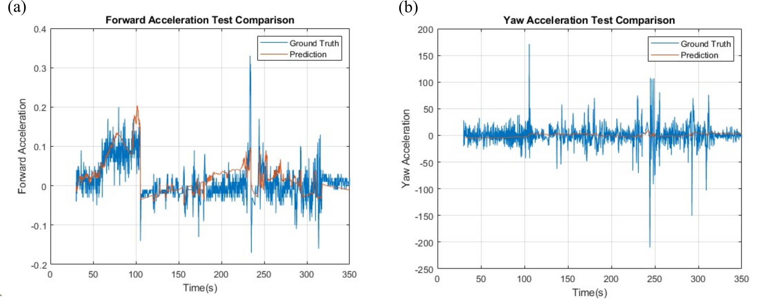
Neural Network Test Data Comparison
Here, we show comparisons between measured (ground truth-real data) and predicted values (red) for forward and yaw accelerations. The neural network predictions closely follow the actual data eliminating the noises so it just keeps the trend.

Slide 8
Simulink Model
We have implemented a Simulink model including our trained neural network. This allowed us to simulate the surface watercraft's dynamic response to control inputs and test different scenarios for position and heading estimation.

Slide 9
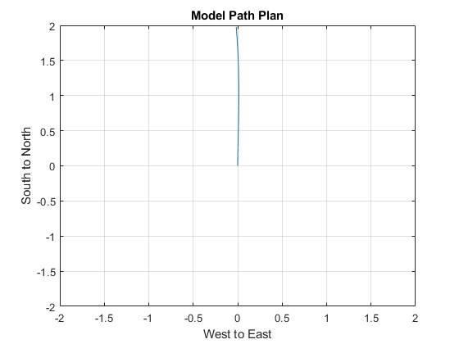
Results: Forward Run
Model Input Interpretation: The input values range from 0 to 2⁸ and can be negative; negative values indicate reverse motion while positive values determine heading which gives this aligns with expected boat behavior.
Model Validation & Insight: Even though we could not run long experiments, the model behaves as expected based on the existing references in the literature. It even captures subtle effects, like how two motors running at the different speed can still behave expected path.
Starting point
L: max 255 and R: 47.5

Slide 10
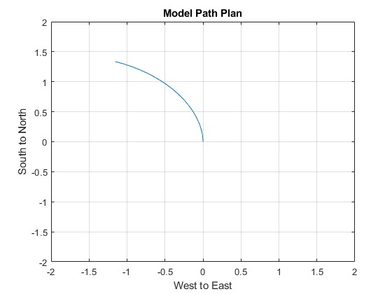
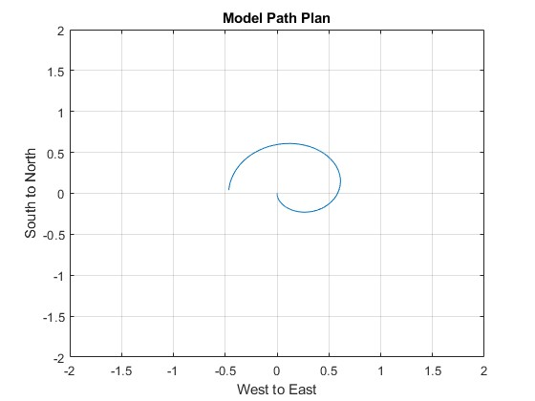
Results: Port Circle
Run trail 1
Run trail 2: We have better achievement
Arrows?
L: 0 and R: 255
L: -255 and R: 0
To generate a port (left) turning circle, we changed between running only the right motor at full power and reversing the left motor at full power. This produced a continuous circular motion to the left.

Slide 11
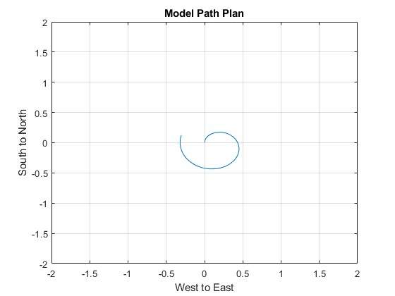
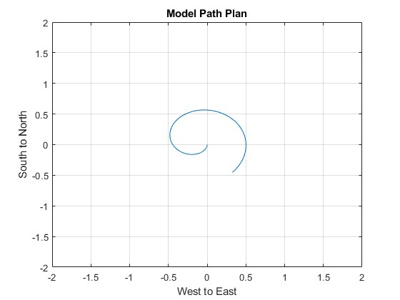
Results: Starboard (Clockwise) Circle
L: 255 and R: 0
L: 0 and R: -255
Here we have starboard settings: This is the same setup but using the starboard motor. Due to motor asymmetry, the resulting paths are not perfect mirror paths of each other.

Slide 12
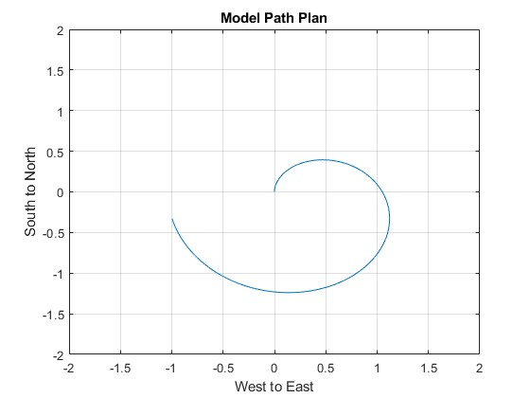
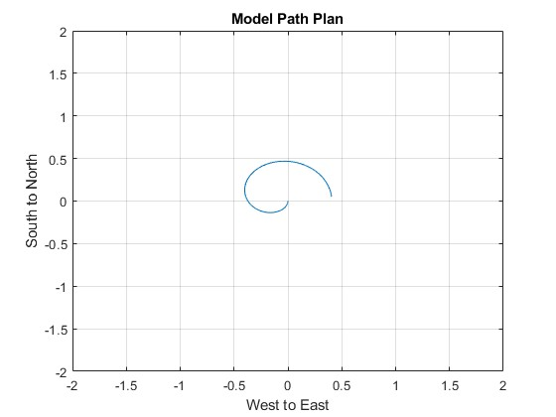
Additional Tests: Extreme cases
L: 255 and R: 255
L: 0 and R: 0
Additional tests included scenarios with both motors off and both at full speed. We observe the path under different thrust configurations. These extreme cases helps us to evaluate the system's range of response.

Slide 13
Conclusion
Summary
Successfully developed and validated a data-driven, nonlinear state-space model for a small-scale surface watercraft.
Used filtered IMU and compass sensor data to train neural networks capturing surge and yaw dynamics.
Implemented a Simulink-based simulation that accurately reproduced experimental trajectories under various thrust conditions.
Contributions
Demonstrated the effectiveness of neural networks for system identification in marine vehicles.
Provided a low-cost, scalable framework for real-time guidance and control modeling.
Highlighted how such models can act as digital twins for autonomous navigation development.
Future Work
Extend modeling to include heave, roll, and pitch for full 6-DOF dynamics.
Run long-duration experimental data.
Integrate real-time feedback control and path-planning algorithms.
Explore swarm behaviors using multi-vessel coordination models.

Slide 14
Acknowledgements
We would like to express our sincere gratitude to the H2theFuture program for funding this research by Greater New Orleans Development Foundation (08-79-05681 – 03)/U.S. Economic Development Administration (08-79-05681-03). Special thanks to Jonathan Freels for building the prototype and running the trials that made this study possible.

Slide 15
Thank you very much
OES, Stavanger-Norway, 2025, June 10-14
Corresponding authors:
nxiros@uno.edu
matrejos@uno.edu
erdem.aktosun@ikcu.edu.tr

