Slide 1




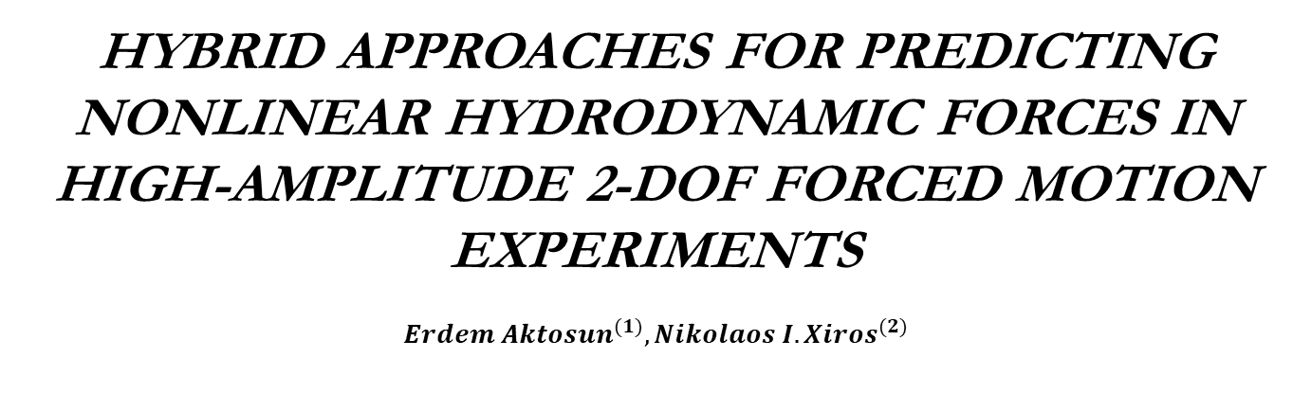
HYBRID APPROACHES FOR PREDICTING
NONLINEAR HYDRODYNAMIC FORCES IN
HIGH-AMPLITUDE 2-DOF FORCED MOTION
EXPERIMENTS
$${Erdem Aktosun}^{(1)},{Nikolaos I. Xiros}^{(2)}$$
(1) Department of Shipbuilding and Ocean Engineering, İzmir Kâtip Çelebi University,
Havaalanı Şosesi Cd, 35620, Izmir, Türkiye
(2) Bollinger School of Naval Architecture & Marine Engineering, University of New
Orleans, New Orleans, LA, 70148, USA
(3) Department of Ocean Engineering, University of Rhode Island, Rhode Island, RI,
02882, USA
Presenter: Asst. Prof. Erdem Aktosun
Experimental Fluid Mechanics Laboratory, URI
Notes:
.

Slide 2
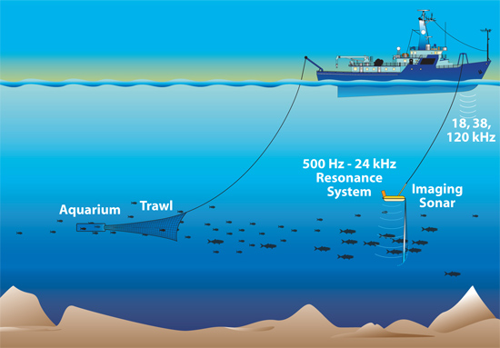
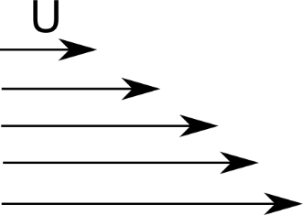
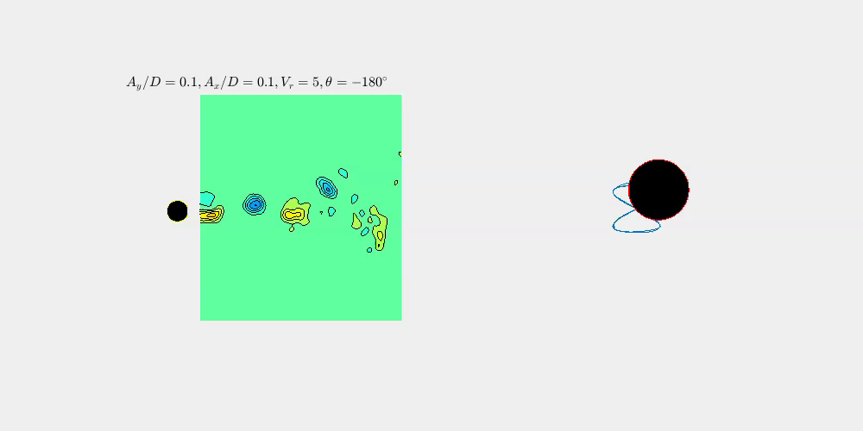
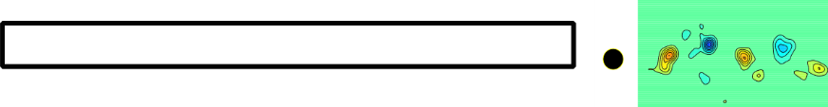
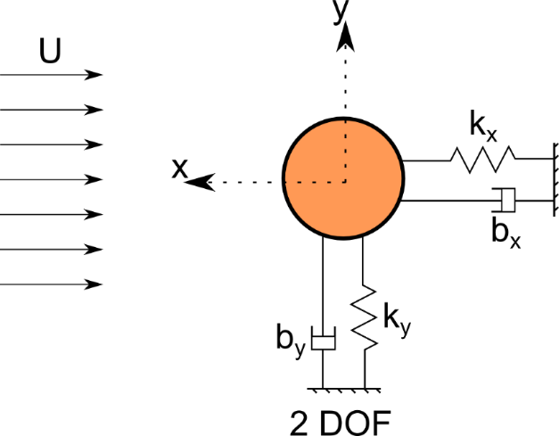
Introduction
Fundamentals – What is VIVs?
VIV is the interaction of vortex shedding with the structural dynamics.
The periodic shedding of vortices results in oscillating hydrodynamic forces acting on the body and it causes its vibration.
This phenomena can exist in many engineering applications especially for long and slender structures.
If the ocean structures go deeper and deeper, they undergo VIV that can cause fatigue problems for this kind of structures
Structure motions are modeled by considering a small slice of the riser with cylindrical cross section
(Aktosun et al, 2024)
[Journal of Fluids and Structures
Volume 124, January 2024, 104035]
Notes:
.

Slide 3
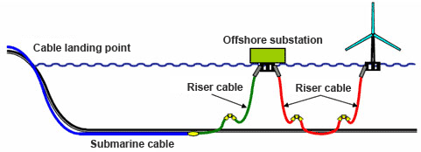
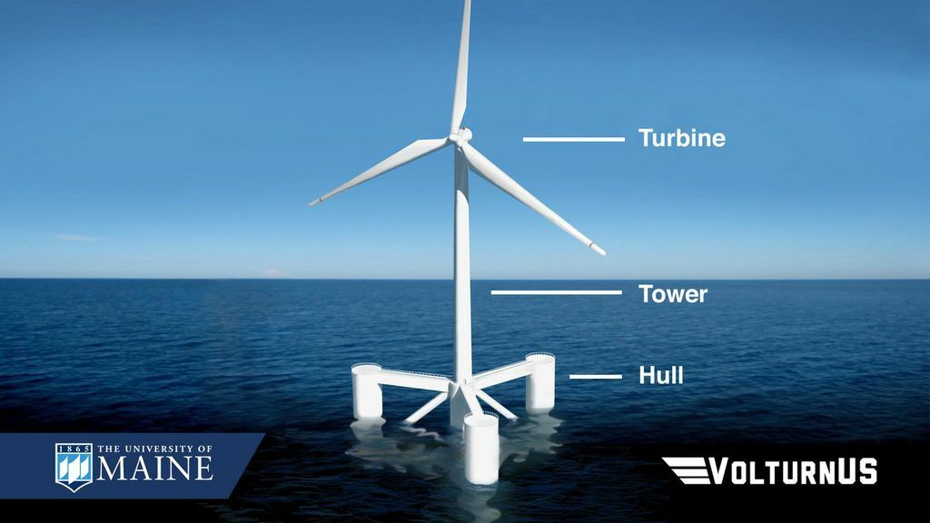
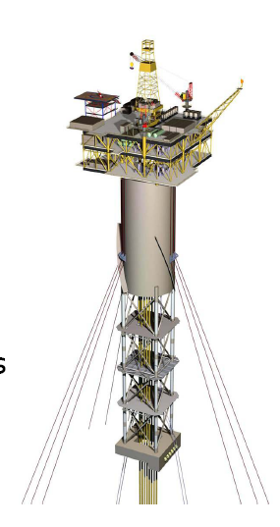
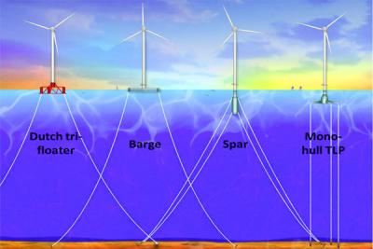
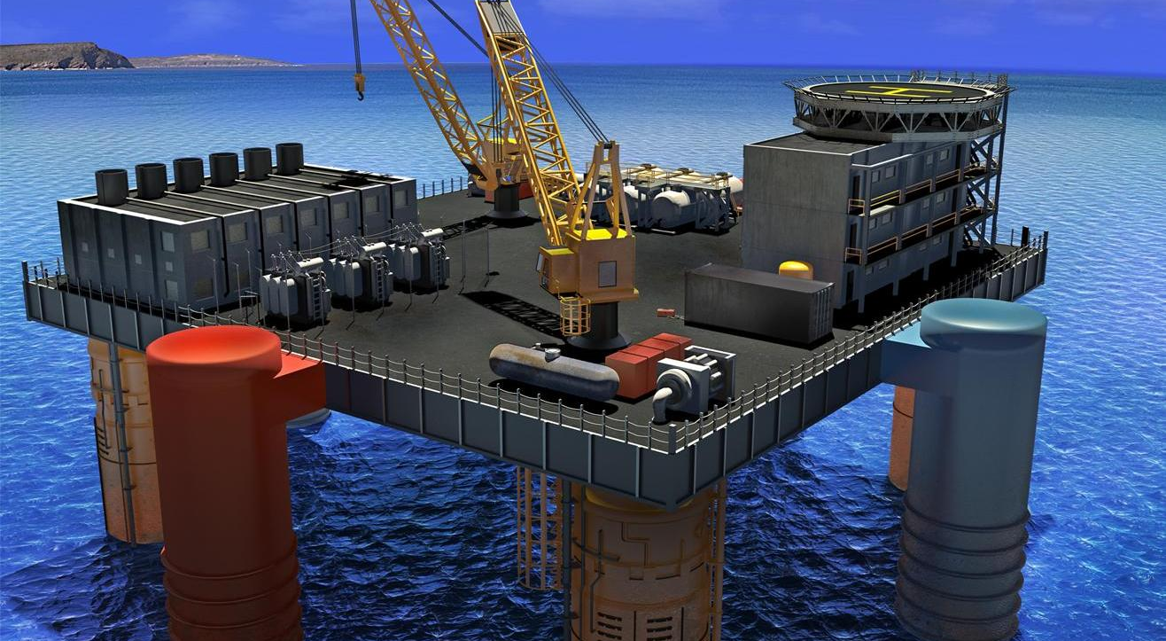
Introduction
Applications
Notes:
.

Slide 4
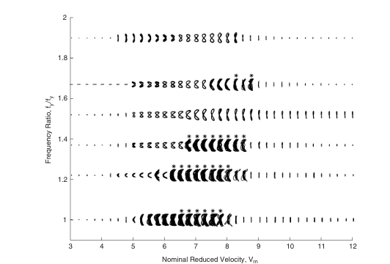

Introduction and motivation
Motivation
Recent studies show the importance of considering combined in-line and cross-flow motions rather than one degree freedom system.
Resulting forces on the body is completely different if we include inline motion to our model. Then, we may have better estimation for the problem.
Existing VIV models in literature struggle with non-linear in-line motion dynamics.
Accurate force prediction is crucial for structural stability.
A hybrid model combines neural networks and physics-based parametric methods for better accuracy and prediction.
Aktosun et al, 2024
{Unknowns are measured force Fx and Fy}
Jason Dahl et al (2006)
Set up forced motion experiments to determine Fx and Fy and measure wakes behind the cylinder by varying motion parameters
Notes:
.

Slide 5
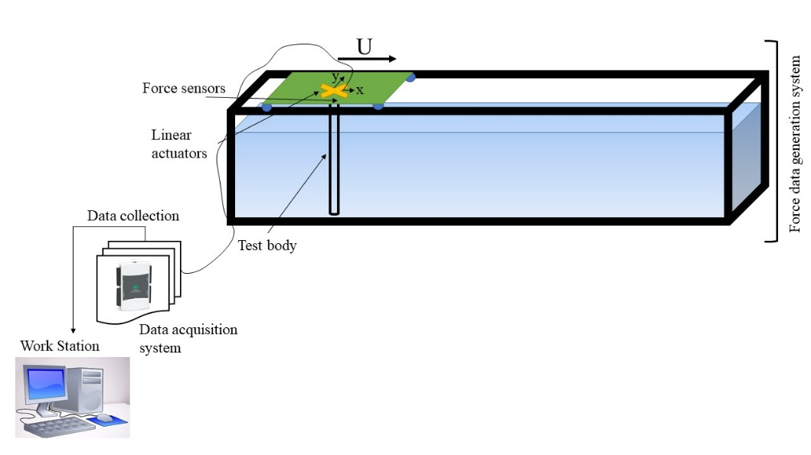
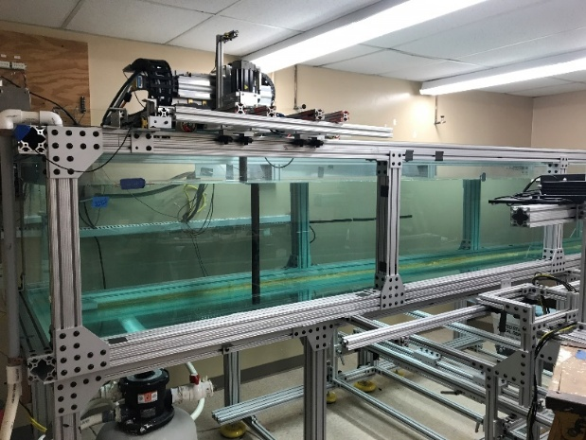
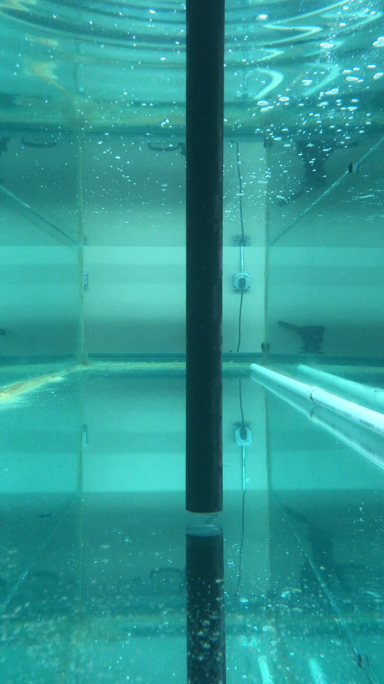
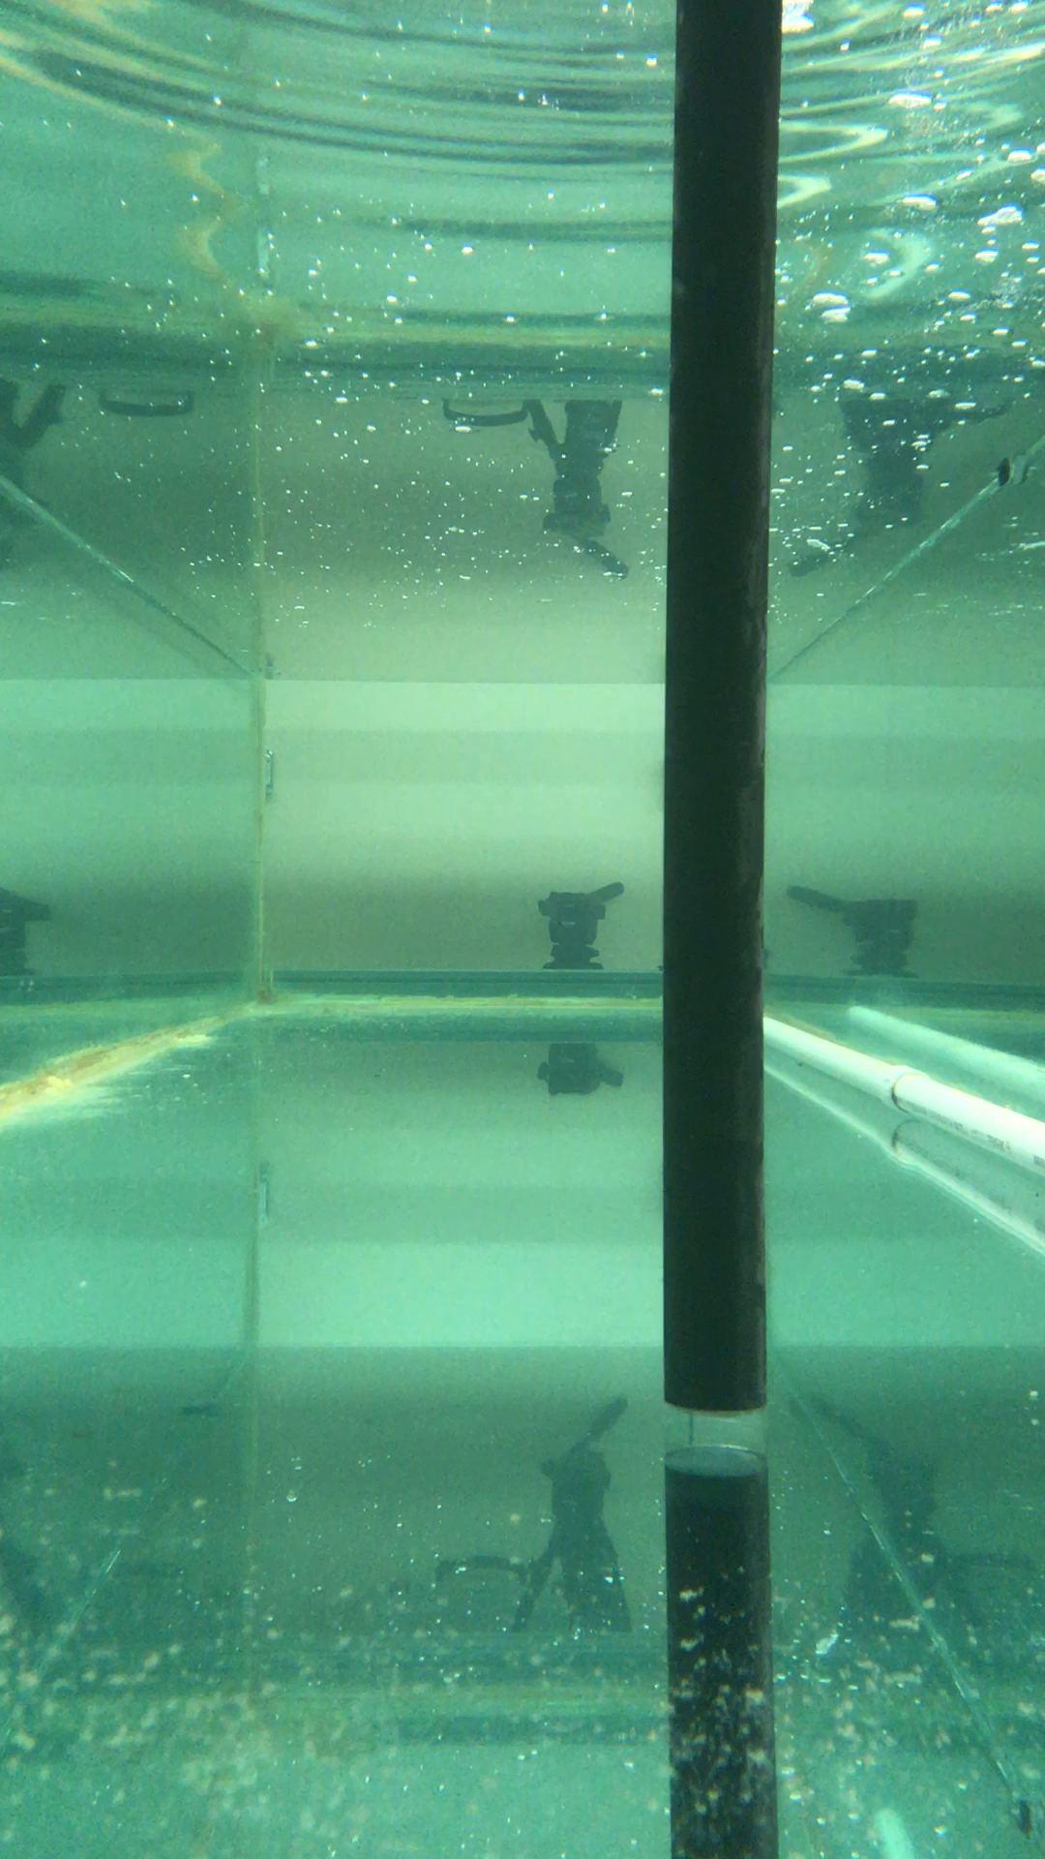
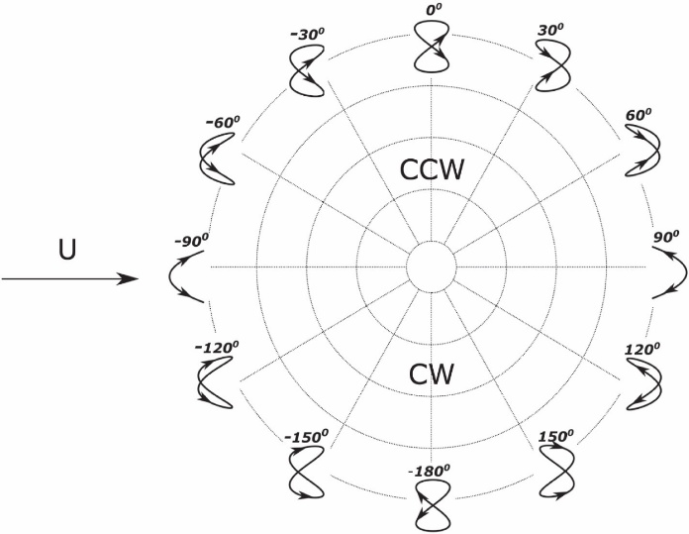
Experimentation of forces responses from 2-DOF forced motion of a circular cylinder in a free stream
Motion Parameters
Low amplitude motion
High amplitude motion
U=0.2 m/s, Re=7620
9555 runs for forced 2D-DOF VIV and 819 runs for PIV experiment
(Aktosun et.al., 2024)

Slide 6
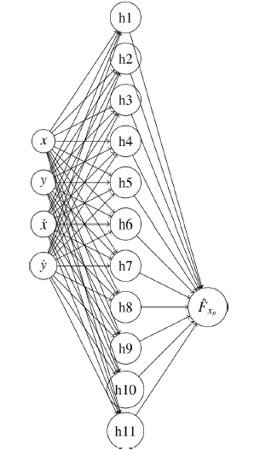
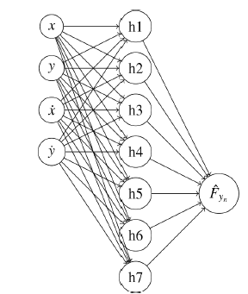
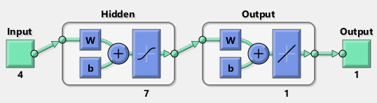
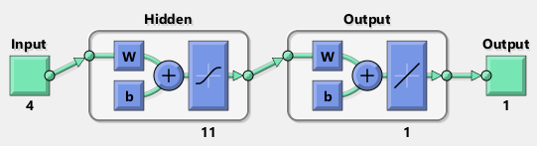

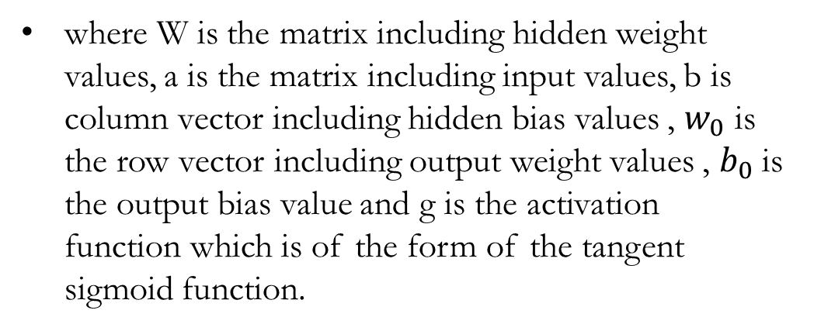
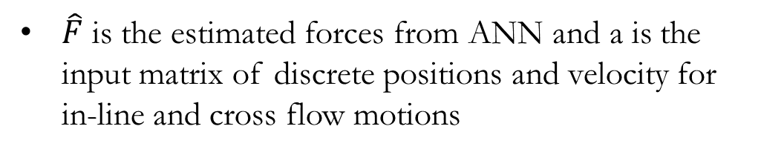
Dynamic model- Neural Network model
A discrete, time-dependent, non-linear force model is developed from the experimental data set by applying a feed forward Artificial Neural Network (ANN)
$$T_{s}=0.001s$$
$\hat{F}$ is the estimated forces from ANN and a is the input matrix of discrete positions and velocity for in-line and cross flow motions
where W is the matrix including hidden weight values, a is the matrix including input values, b is column vector including hidden bias values , $w_{0}$ is the row vector including output weight values , $b_{0}$ is the output bias value and g is the activation function which is of the form of the tangent sigmoid function.
Architecture of the neural network with three layers for lift force
Architecture of the neural network with three layers for lift force
40% of data points are used to train ANN model to avoid over training

Slide 7

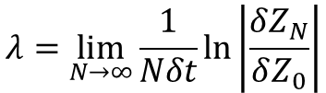

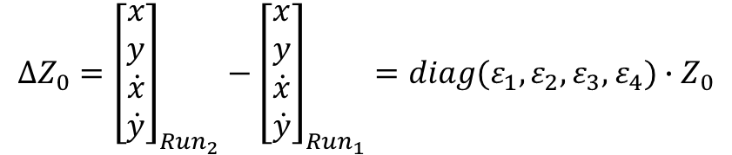

Dynamic Model- Quadratic Drag Force Modeling
Our approach begins with the formulation of equations of motion which are then applied to simulated experiments involving a 2-DOF system
$$f_{y}+m\ddot{y}+b_{y}\dot{y}+k_{y}y={\hat{F}}_{y}$$
$$f_{x}+m\ddot{x}+b_{x}\left|\dot{x}\right|\dot{x}+k_{x}x={\hat{F}}_{x}$$
Each simulated experiment consists of two trials, Run1 and Run2, which start with slightly different initial conditions. The perturbation applied to the initial positions and velocities is described by:
$$∆Z_{0}={\left[\begin{matrix}x \\ y \\ \begin{aligned}\dot{x} \\ \dot{y}\end{aligned}\end{matrix}\right]}_{{Run}_{2}}−{\left[\begin{matrix}x \\ y \\ \begin{aligned}\dot{x} \\ \dot{y}\end{aligned}\end{matrix}\right]}_{{Run}_{1}}=diag(ε_{1},ε_{2},ε_{3},ε_{4})∙Z_{0}$$
Stability Check using Lyapunov Exponent $λ$:
$$λ=\lim_{N→∞}{\frac{1}{Nδt}\ln\left|\frac{δZ_{N}}{δZ_{0}}\right|}$$
𝜆>0 → Chaotic behavior
Captures chaotic, nonlinear force dynamics, essential for predicting structural responses in VIV conditions.

Slide 8
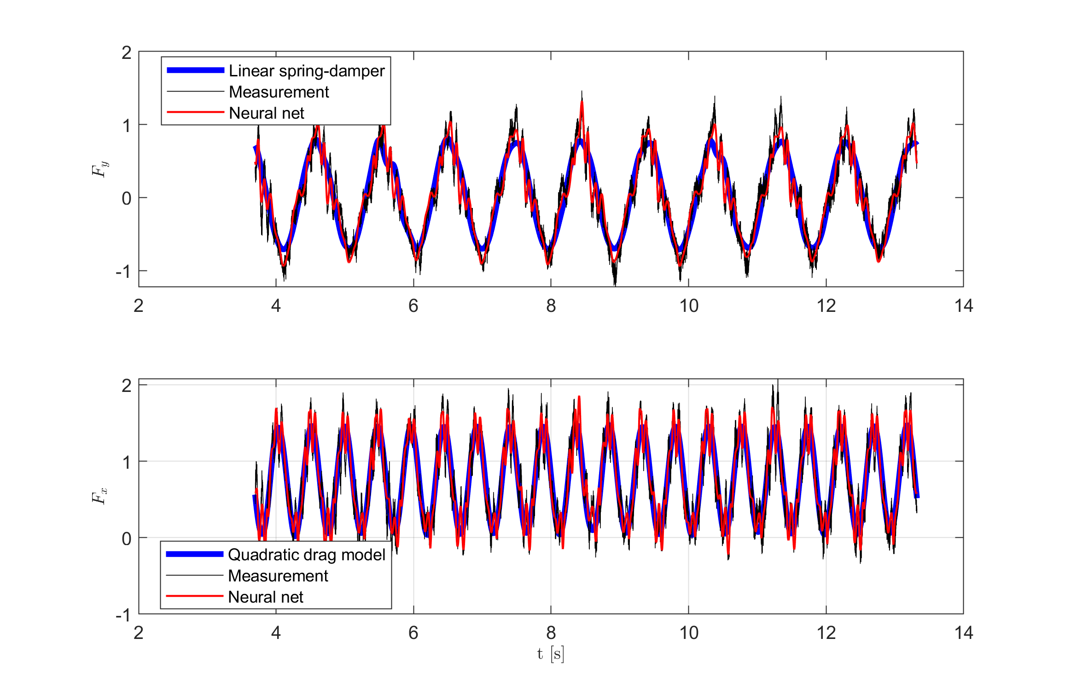
Results- Low in-line motion amplitude case
The quadratic drag model shows strong accuracy in modeling drag forces, especially in low in-line motion condition.
Neural network-based models effectively predict both lift and drag forces, with results closely matching experimental data from forced oscillation tests. However, it captures actuator noises as well.
ANN drag force models achieved target MSE (~0.026) within 145 epochs, with consistent training using 40% of the dataset and detailed performance tracking (MSE, gradient, Mu).
Unit | Initial Value | Stopped Value | Target Value
Epoch | 0 | 145 | 1000
Elapsed Time | - | 0:00:00 | -
Performance | 2.16 | 0.026 | 0
Gradient | 5.14 | 0.00495 | 1.00E-07
Mu | 0.001 | 1.00E-08 | 1.00E+10
Validation Checks | 0 | 6 | 6
 | k | b | offset
y | 186.0141 | 9.24655 | 0.006545
x | 188.8231 | -6.73568 | 0.721794

Slide 9
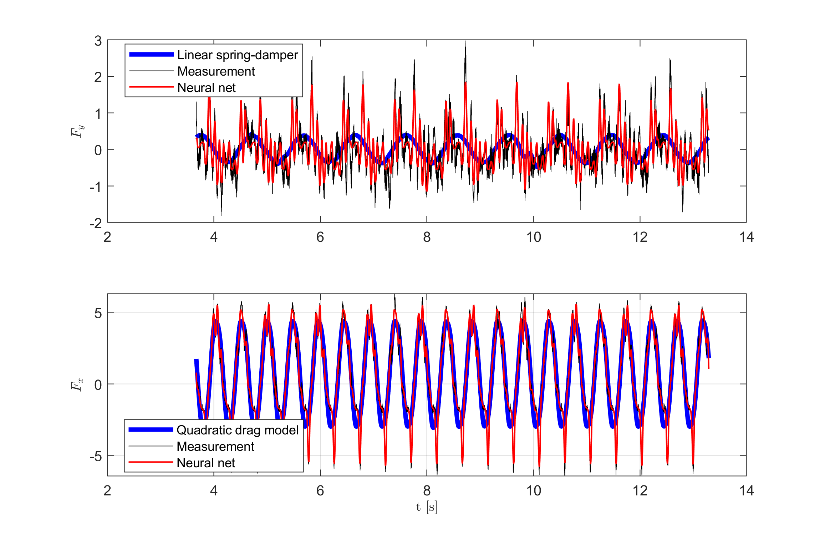
Results- High in-line motion amplitude case
At higher in-line motion amplitudes, actuator-induced noise introduces nonlinearities, affecting force predictions: neural networks reflect this noise, while the linear spring-damper model struggles with lift force accuracy.
Despite sharp peaks and noise in drag response, the quadratic drag model remains effective, accurately capturing dominant drag force characteristics in high-motion scenarios.
ANN drag force models achieved target MSE (~0.124) within 149 epochs, with consistent training using 40% of the dataset and detailed performance tracking (MSE, gradient, Mu).
Unit | Initial Value | Stopped Value | Target Value
Epoch | 0 | 149 | 1000
Elapsed Time | - | 0:00:00 | -
Performance | 14 | 0.124 | 0
Gradient | 13.1 | 0.000334 | 1.00E-07
Mu | 0.001 | 1.00E-05 | 1.00E+10
Validation Checks | 0 | 6 | 6
 | k | b | offset
y | 84.06506 | -8.21814 | 0.005435
x | 195.3478 | -19.6264 | 0.683395

Slide 10
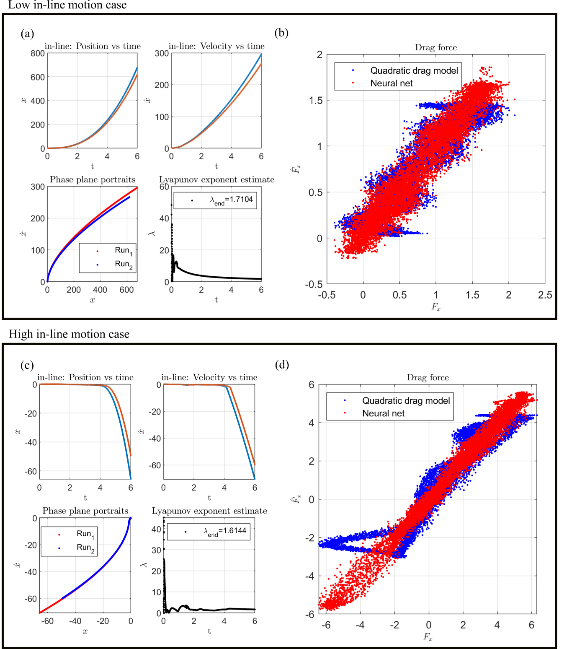
Results
Under low in-line motion, simulations with perturbed conditions show diverging trajectories and a positive Lyapunov exponent, indicating instability in VIV dynamics.
Neural network and quadratic drag models closely match experimental data in both-motion runs, showing good predictive agreement.
At high in-line motion amplitudes, discrepancies emerge between models due to sharp spikes in drag force, affecting prediction consistency.
Mean values
Cases | Drag model | ANN model | Measurement
Low in-line motion | 0.7497 | 0.7552 | 0.7497
High in-line motion | 0.7057 | 0.6914 | 0.7057
Variance values
Cases | Drag model | ANN model | Measurement
Low in-line motion | 0.2463 | 0.2766 | 0.3005
High in-line motion | 7.2961 | 8.3319 | 8.4628

Slide 11
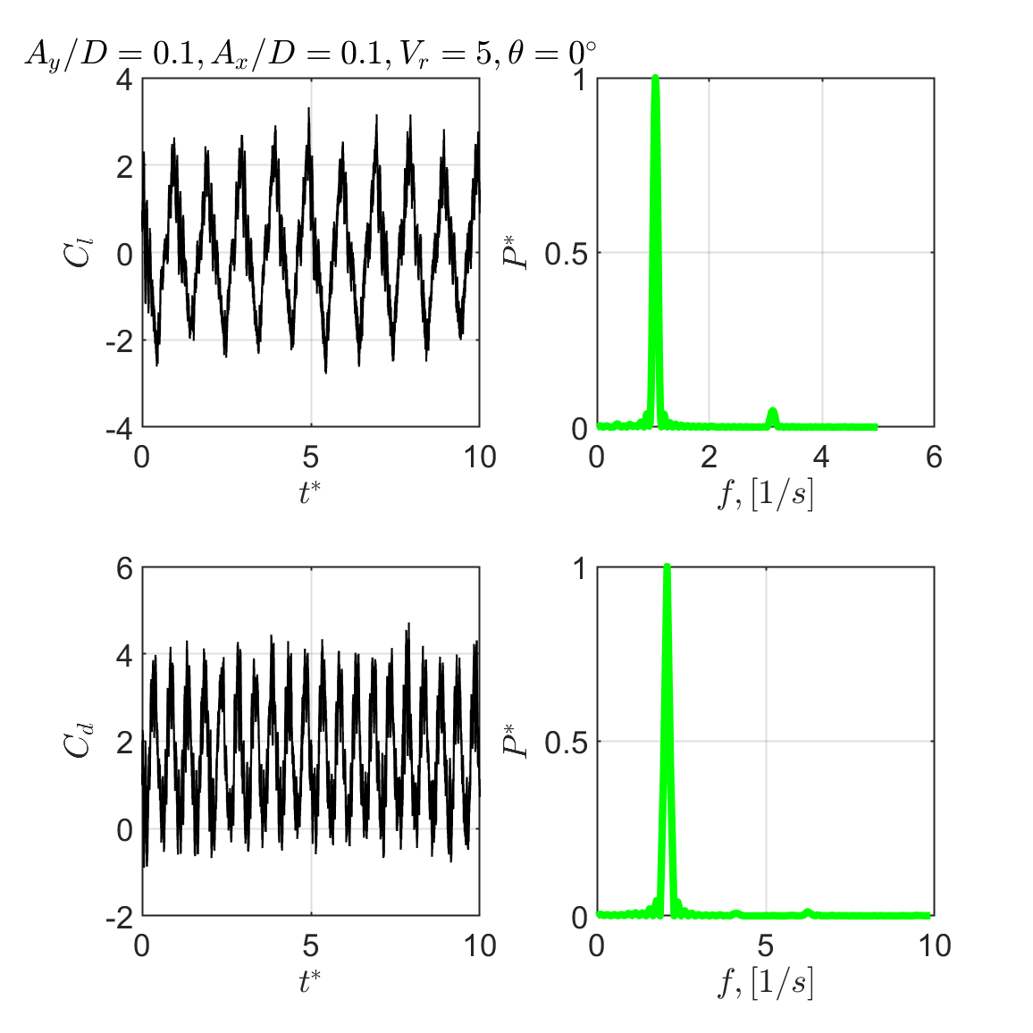
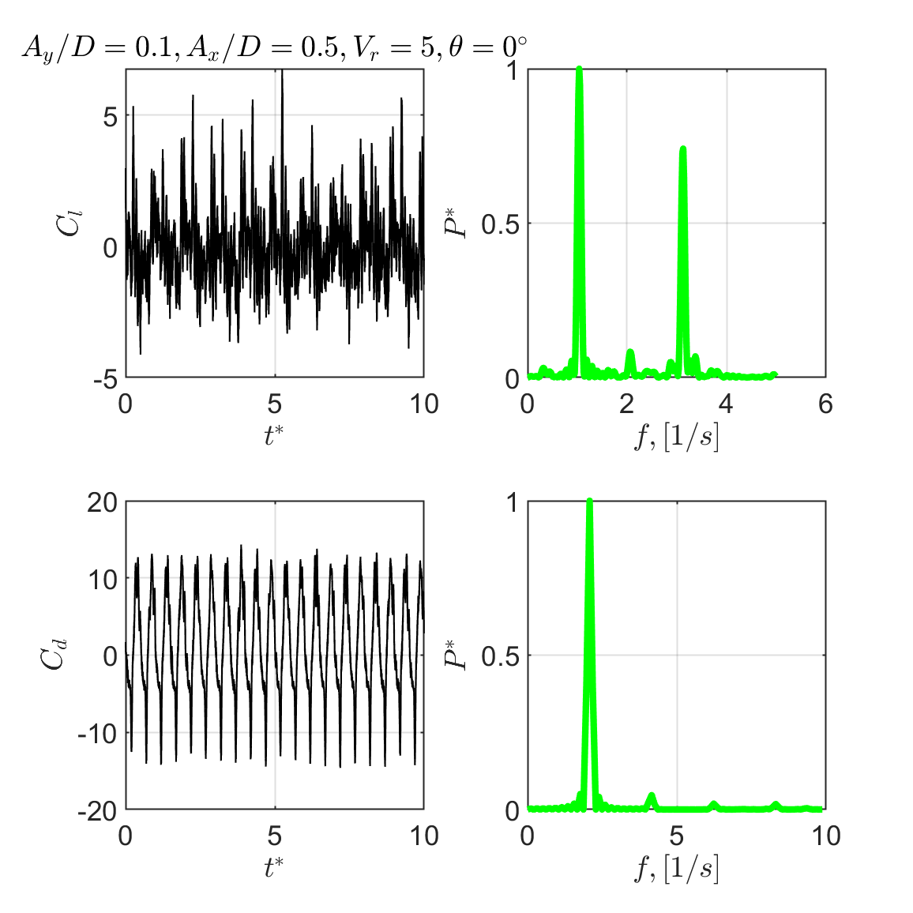
Results
Low in-line motion amplitudes show a one dominant frequency in lift and drag forces, showing simple periodic behavior with low nonlinear effects.
High in-line motion introduces more complex dynamics with a dominant third harmonic in lift force where it highlighs strong nonlinear interactions and force coupling.
Constant Re number makes sure consistency, but with higher values could improve VIV modeling and wake resolution through enhanced simulations.
Integrating neural networks with nonlinear analytical methods enhances VIV predictive modeling by improving data quality, capturing complex hydrodynamic forces, and enabling more novel, accurate simulations despite challenges from noise and chaotic dynamics.
Dahl et.al.(2008), The effect of third harmonic lift forces
Modarres-Sadeghi et.al.(2009), The effect of higher harmonic forces

Slide 12
Conclusion
  Summary
  We have applied a hybrid modeling approach combining neural networks and parametric models to predict nonlinear hydrodynamic forces on a 2-DOF oscillating cylinder.
  Our neural networks accurately capture force dynamics but it lacks physical capturing due to actuator noises.
  Parametric models give better result particularly under high in-line motion.
  Future work:
  We could improve/adjust our models to evaluate dominant multiple frequency cases where we observe in the force database.
  We could alter Re number which helps us to improve VIV prediction model and wake observations.
  We could expand experimental datasets with DPIV setup to explore wake dynamics with physics-informed machine learning.

Slide 13

Acknowledgements
We thank to İzmir Kâtip Çelebi University for financial support under Project No.2024-KDP-GİDF-0021.

Slide 14


Thank you very much
OES, Stavanger-Norway, 2025, June 10-16
Corresponding authors:
erdem.aktosun@ikcu.edu.tr
nxiros@uno.edu

