Slide 1
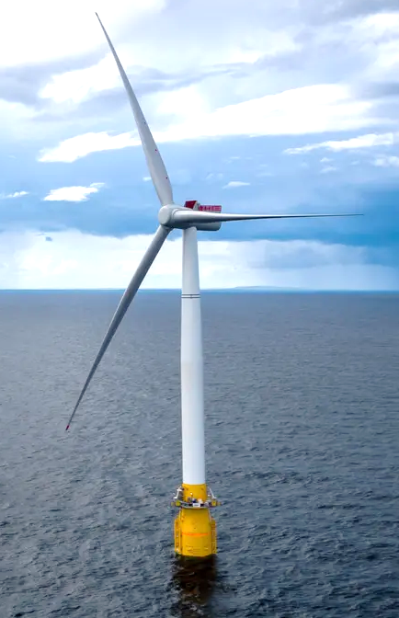
10MW Floating offshore wind turbine: Damage detection & damage magnitude estimation in the tower-base connection under varying operating conditions
Christos S. Sakaris, Rune Schlanbusch
Darwin research group, Energy and Technology Division,
Norwegian Research Centre - NORCE AS, Grimstad, Norway
John S. Sakellariou
Department of Mechanical & Aeronautical Engineering, University of Patras, Patras, Greece
Yang Yang
Faculty of Maritime and Transportation, Ningbo University, Ningbo, P.R. China
Musa Bashir
School of Engineering, Faculty of Science and Engineering, University of Liverpool, UK
Analytics for Asset Integrity Management in Wind farms (AIMWind)
Adaptation and implementation of floating wind energy
conversion technology for the Atlantic Region (ARCWIND)
© Colourbox
2nd Olympiad in Engineering Science (OES) 2025
© Equinor

Slide 2
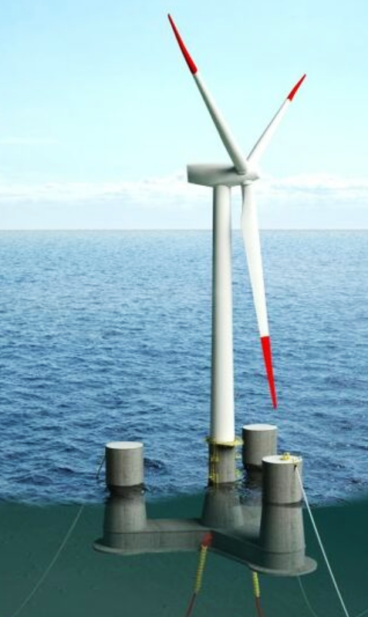
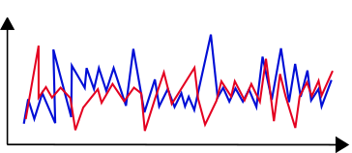
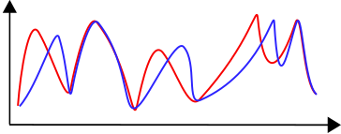
Introduction
The problem and its importance
Damaged components (blades, nacelle, mooring system and tower) of Floating Offshore Wind Turbines (FOWTs) ⇾ disruption of the FOWTs operation, costly transfer to land for repair ⇾ Early damage diagnosis (detection, localization, magnitude estimation) being vital
Investigated in a limited degree and via vibration-based methods constant or varying operating conditions (OCs)
Fundamental principle of damage diagnosis methods based on vibration signals
Operating Conditions (OCs)
Changes in the FOWT’s structural dynamics
Changes in the FOWT’s vibration characteristics
Presence of a damage
Damage diagnosis
Varying OCs
Partially or fully “masking” the effects of damages on the FOWT structural dynamics
Damage
Healthy / Damage
Healthy / Damage
Vibration signal
Spectrum magnitude (dB)
Highly challenging damage diagnosis
Time (sec)
Frequency (Hz)
Simulated damages: stiffness reduction, Damage detection: Power Spectral Density, Damage localization and damage quantification : mode shapes from a finite element model (Kim et al. 2019)

Slide 3
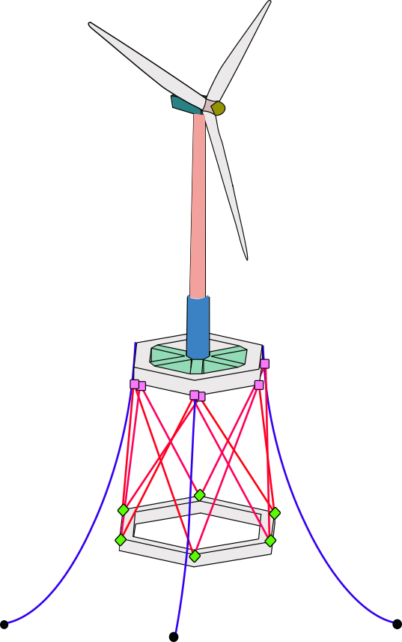
Goal
Goal of the current study
Past work: Structural Health Monitoring (SHM) framework for detection and damage magnitude estimation in the tendons of a 10 MW FOWT with vibration signals from one measuring point (Sakaris et al. 2021)
Goal: Extension of the SHM framework to its multivariate form for detection and damage magnitude estimation in the critical connection area of the FOWT tower with the platform using vibration signals from two measuring points
Varying operating conditions (OCs): wind speed and wave height
10 MW FOWT supported by the TELWIND platform
Employed statistical method for damage detection and damage magnitude estimation
Functional Model Based Method (FMBM) equipped with two multivariate Functional Models (subspace selected via Genetic Algorithm, Particle Swarm Optimization, Bayesian Optimization)
Selection of the most sensitive to damage direction of measurement via three Power Spectral Density (PSD) based criteria

Slide 4
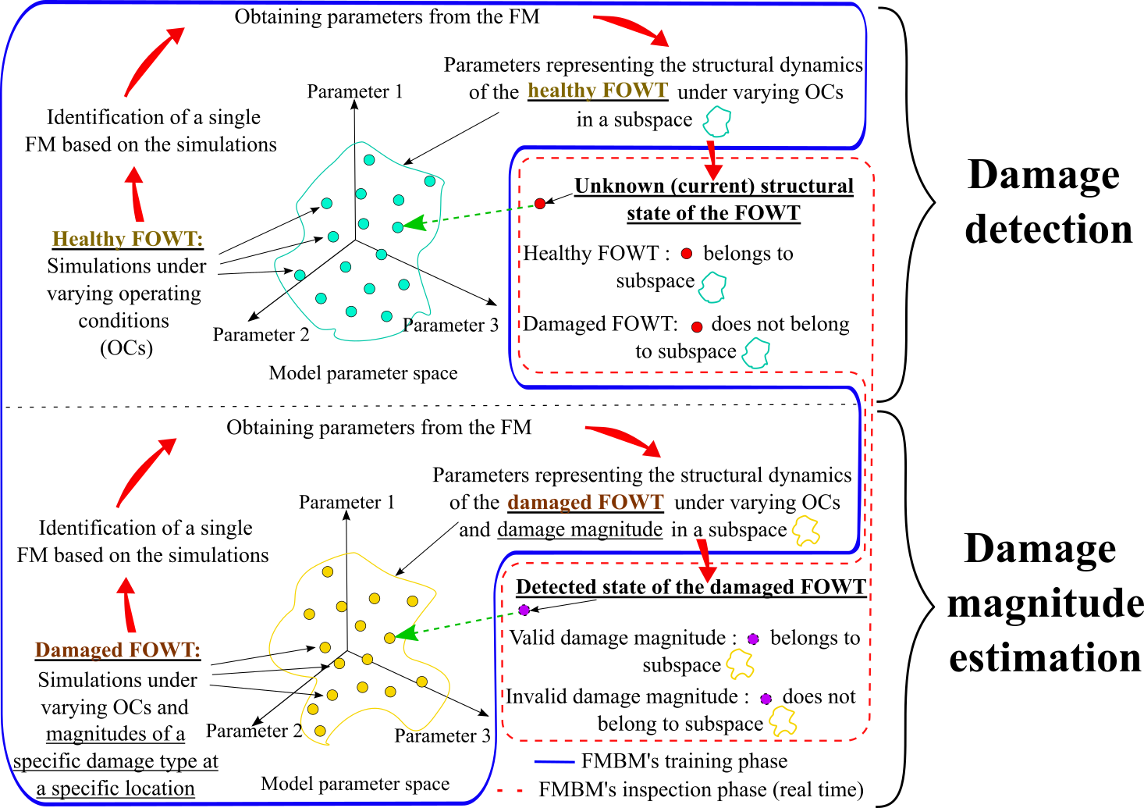
Damage detection and magnitude estimation methodology
Concept of the FMBM

Slide 5
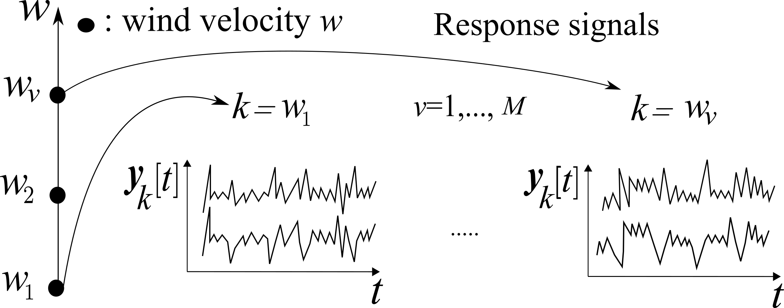
Damage detection and magnitude estimation methodology
Functional Model Based Method (FMBM)
Baseline / Training phase
Healthy FOWT: response signals $y_{k}\left[t\right]$ under a sample of wind velocity values $w_{v}∈w_{1}, w_{2},…, w_{M}$ ($k=w_{v}$) covering range $[w_{min},w_{max}]$
Identification of a Functionally Pooled - Vector AutoRegressive (FP-VAR) (Hios et al. 2014) :
i) Model order 𝑛𝑎 selection (Bayesian Information Criterion)
ii) Selection of the proper basis functions (optimization algorithm)
iii) Validation of the selected model (residual uncorrelatedness test)
The coefficients of projection $A_{i,j}$ are estimated through Ordinary Least Squares
Data acquisition
Modelling
$$t$$
Form of a FP-VAR model
: discret time, $t=1,…,N$
$$na$$
$$y_{k}\left[t\right]$$
: model order
: response signals for $k$
$$e_{k} [t]$$
$$y_{k}\left[t\right]+\sum_{i=1}^{na}{A_{i}(k)}⋅y_{k}\left[t−i\right]=e_{k}\left[t\right]$$
: residual (error) signal for$k$ with $e_{k}\left[t\right]∼ 𝒩\left(0,Σ_{e}(k)\right)$
: residual covariance
$A_{i}\left(k\right)=\sum_{j=1}^{p}{A_{i,j}}⋅G_{j}\left(k\right)$
$Σ_{e}(k$)
: model parameters
$A_{i,j}$ : coefficients of projection
$G_{j}\left(k\right)$
: basis functions (orthogonal polynomials of one variable)

Slide 6
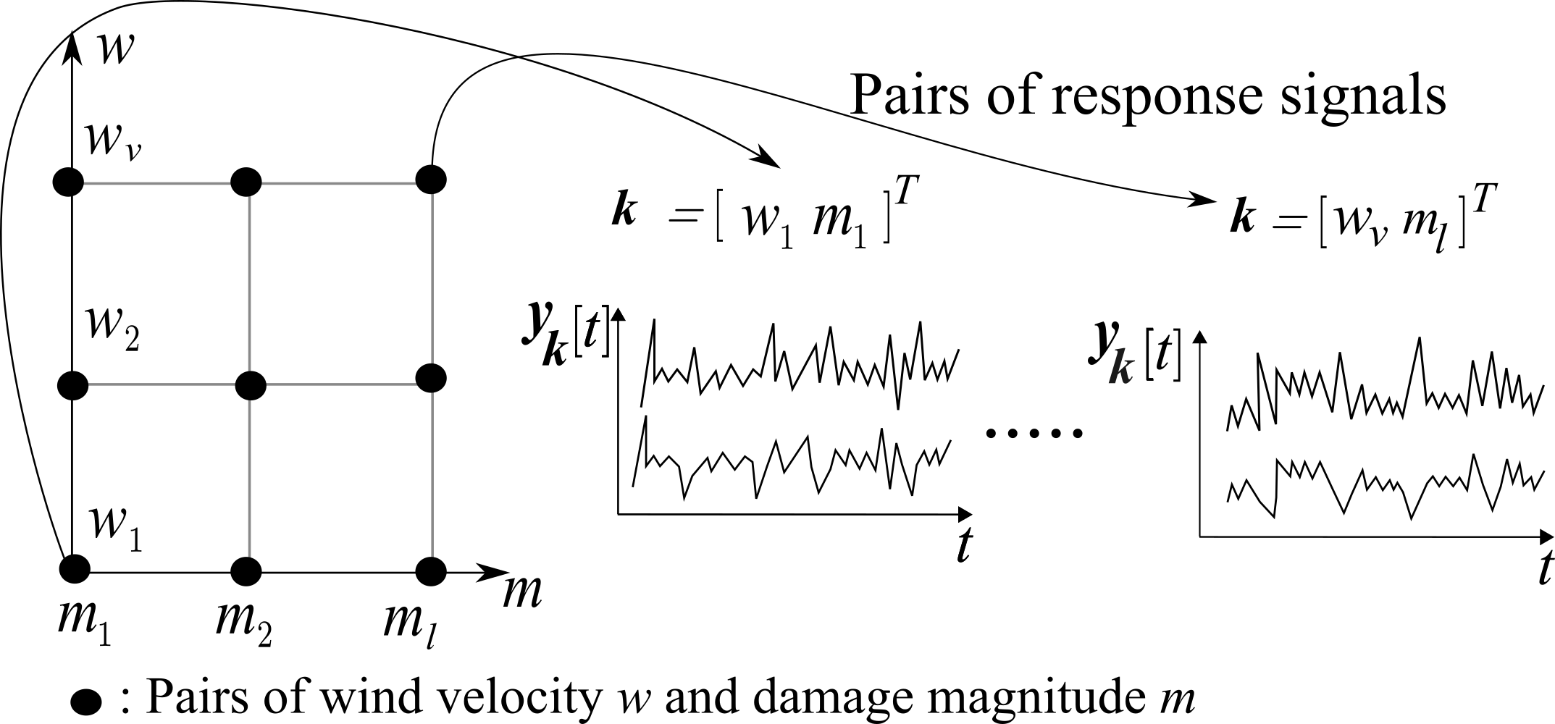
Damage detection and magnitude estimation methodology
Damaged FOWT: response signals $y_{k}\left[t\right]$, under a sample of wind velocities $w$ and damage magnitudes $m$ ($k=\left[w_{v} m_{l}\right]$) covering ranges $\left[w_{min},w_{max}\right], [m_{min},m_{max}]$
Training phase
Identification of a Vector Functionally Pooled - Vector AutoRegressive (VFP-VAR) (Dutta et al. 2020) :
i) Model order 𝑛𝑎 selection (Bayesian Information Criterion)
ii) Selection of the proper basis functions (optimization algorithm)
iii) Validation of the selected model (residual uncorrelatedness test)
The coefficients of projection $A_{i,j}$ are estimated through Ordinary Least Squares
Data acquisition
Modelling
$$t$$
Form of a VFP-VAR model
: discret time, $t=1,…,N$
$$na$$
$$y_{k}\left[t\right]$$
: model order
: response signals for $k$
$$e_{k} [t]$$
$$y_{k}\left[t\right]+\sum_{i=1}^{na}{A_{i}(k)}⋅y_{k}\left[t−i\right]=e_{k}\left[t\right]$$
: residual (error) signal for$k$ with $e_{k}\left[t\right]∼ 𝒩\left(0,Σ_{e}(k)\right)$
: residual covariance
$A_{i}\left(k\right)=\sum_{j=1}^{p}{A_{i,j}}⋅G_{j}\left(k\right)$
$Σ_{e}(k$)
: model parameters
$A_{i,j}$ : coefficients of projection
$G_{j}\left(k\right)$
: basis functions (orthogonal polynomials of two variables)

Slide 7
Damage detection and magnitude estimation methodology
FP-VAR model
VFP-VAR model
Training phase
Current FOWT structural state: Response signals $y_{u}\left[t\right]$
FP-VAR model & estimation of $k=w$
Inspection phase
Data acquisition
Modelling
Use of the Portmanteau test for checking the uncorrelatedness (whiteness) of the FP-VAR model’s residual signals based on estimated $k$
$$Q≤χ_{1−α,n_{y}^{2}⋅h}^{2}$$
(White residual signals)
Healthy structure
w$ith χ_{1−α,n_{y}^{2}⋅h}^{2}$ the critical limit, $α$ the risk level, $n_{y}^{2}$ the number of response signals
Else
(Non-white residual signals)
Damaged structure
Damage detection
Detected damaged FOWT state: Response signals $y_{u}\left[t\right]$
VFP-VAR model & estimation of $k=[w m]$
Data acquisition
Modelling
Use of the Portmanteau test for checking the uncorrelatedness (whiteness) of the VFP-VAR model’s residual signals based on estimated $k$
$$Q≤χ_{1−α,n_{y}^{2}⋅h}^{2}$$
(White residual signals)
Valid estimated $k$
Confidence intervals for estimated $k$
Else
(Non-white residual signals)
Invalid estimated $k$
Damage magnitude estimation

Slide 8
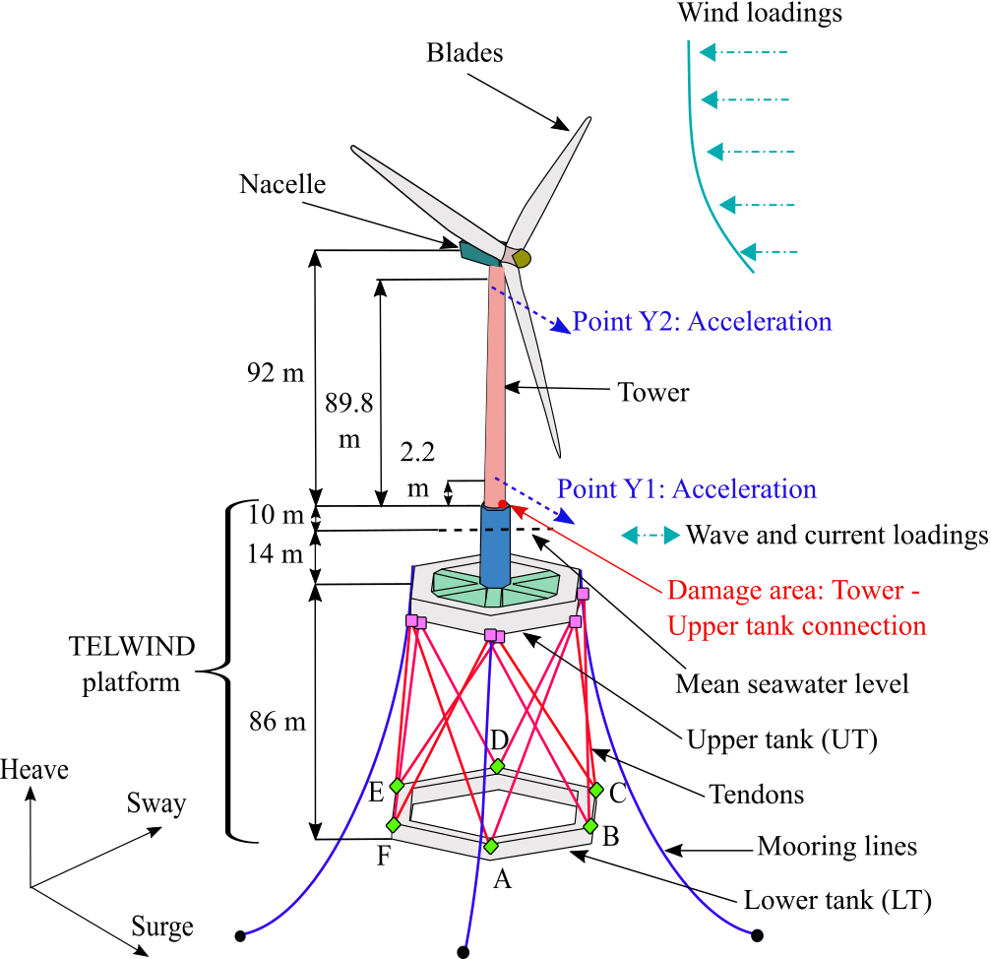
Simulated FOWT supported by TELWIND floater (ARCWIND project)
Simulated TELWIND floater based FOWT
The Structure and Damage
Tower of a FOWT based on the TELWIND floater (Esteyco)
Single damage (buckling at bottom of the tower): Stiffness reduction (%)
Measurements: Acceleration at bottom (Y1) & top of tower (Y2)
Simulation details
Varying operating conditions: wave height and wind velocity
Sampling frequency : fs = 10 Hz
Operational bandwidth : [0 – 5] Hz
Signal length : $N$ = 20 000 samples
Number of simulations: 40 (healthy state under various wind velocities (WVs) )
228 : (various damage states under various wind velocities)

Slide 9
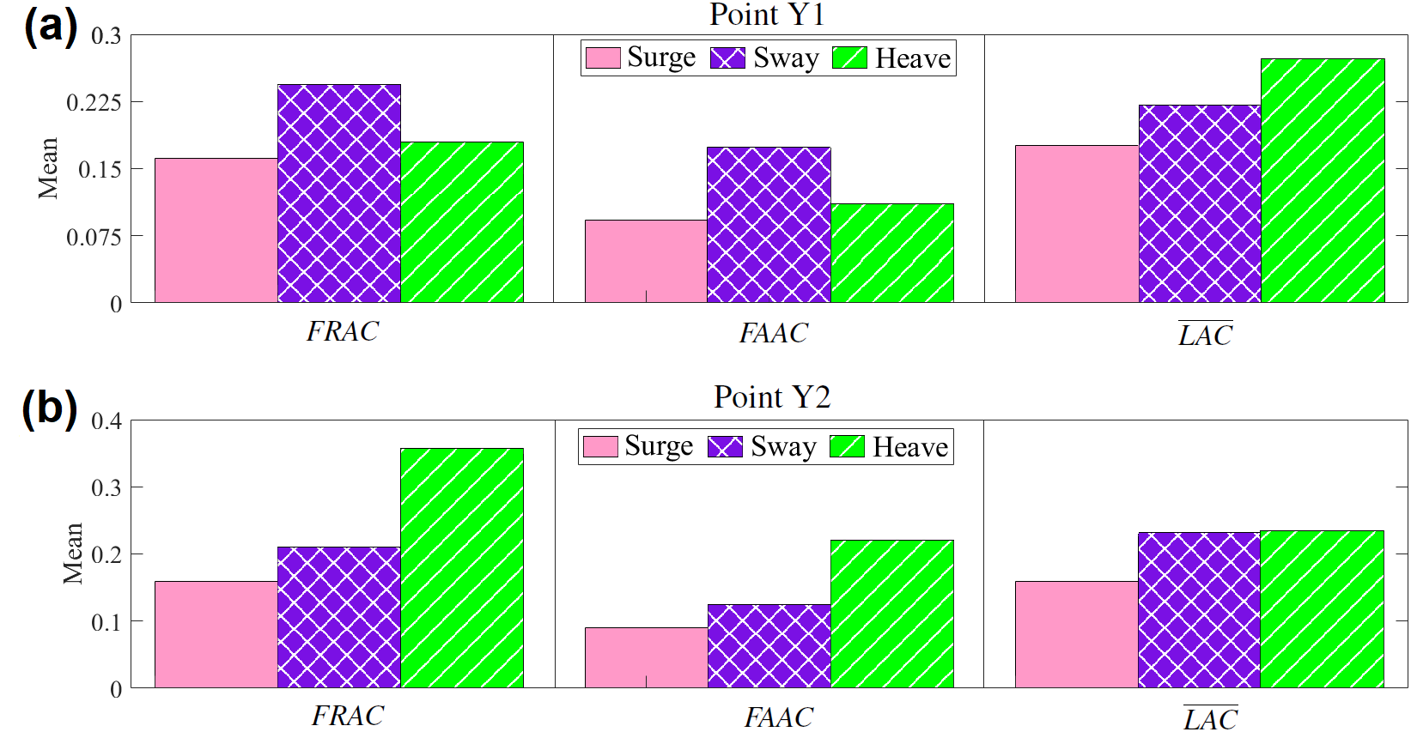
Selection of the most dominant motion
Motion selection
Selection of the most dominant motion based on its sensitivity to damage (Zang et al. 2001) :
Frequency Response Assurance Criterion (FRAC)
Frequency Amplitude Assurance Criterion (FAAC)
Average Local Amplitude Criterion ($\overline{LAC}$)
The most sensitive motion leads to criteria values maximally deviating from unity!
160 healthy-damaged combinations
4 simulations from the healthy FOWT, one per wind speed [4, 11.4, 18, 25] m/s
40 simulations from the damaged FOWT, one per combination between the damage magnitudes [10, 20, 30, 40, . . . , 100] % stiffness reduction and the wind speeds [4, 11.4, 18, 25] m/s
Selected motion: Surge

Slide 10
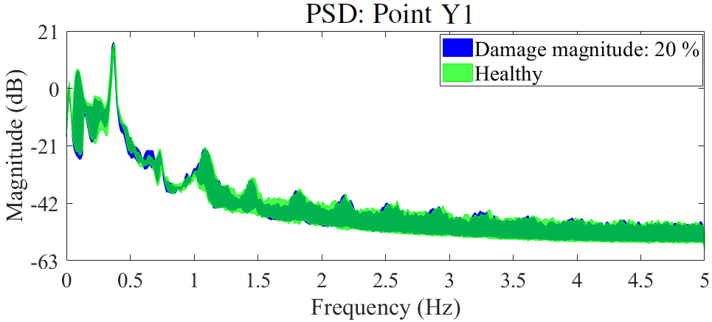
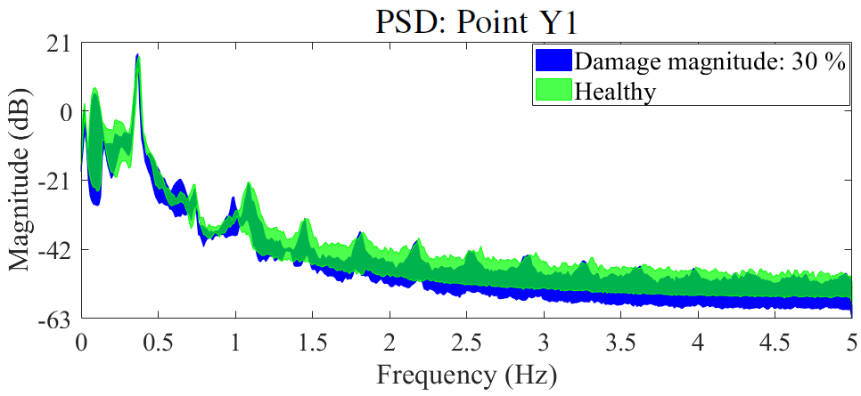
FOWT dynamics
Effects of four different wind speeds on the healthy FOWT’s dynamics though a comparison of Power Spectral Densities (PSDs)
(a)
Comparison of the PSDs for the healthy FOWT and FOWT with damage of magnitudes 20 % & 30 % under the four wind speeds
(b)
(c)
Highly challenging damage detection

Slide 11
Results / Training phase
Models
$M$= 4 simulations from the healthy FOWT, one per wind speed [4, 11.4, 18, 25] m/s (FP-VAR model identification)
$M$= 40 simulations from the damaged FOWT, one per combination between the damage magnitudes [10, 20, 30, 40, . . . , 100] % stiffness reduction and the wind speeds [4, 11.4, 18, 25] m/s (VFP-VAR model identification / Three optimization algorithms: Bayesian optimization (BO), Particle Swarm Optimization (PSO), Genetic Algorithm (GA))
FOWT structural state | Optimization algorithm | Identified model | No. of simulations | Bayeian Information Criterion
Healthy | - | VAR(170) | 1 | -20.42
Healthy | Genetic Algorithm (GA) | FP-VAR(170)3 | 4 | -79.42
Damaged | Genetic Algorithm (GA) | VFP-VAR(170)15 | 40 | -810.68
Damaged | Particle Swarm Optimization (PSO) | VFP-VAR(170)19 | 40 | -810.34
Damaged | Bayesian Optimization (BO) | VFP-VAR(170)16 | 40 | -810.24

Slide 12
Detection results
Inspection phase
36 simulations from the healthy FOWT, nine per wind velocity [10, 11.7, 12, 14.8, 16, 17.3, 18] m/s
188 simulations from the damage FOWT (damage magnitudes: [10, 15, 20, 25, 30, . . . , 95, 100] % stiffness reduction, wind velocities: [4, 11.4, 18, 25] m/s)
Damage detection

Slide 13
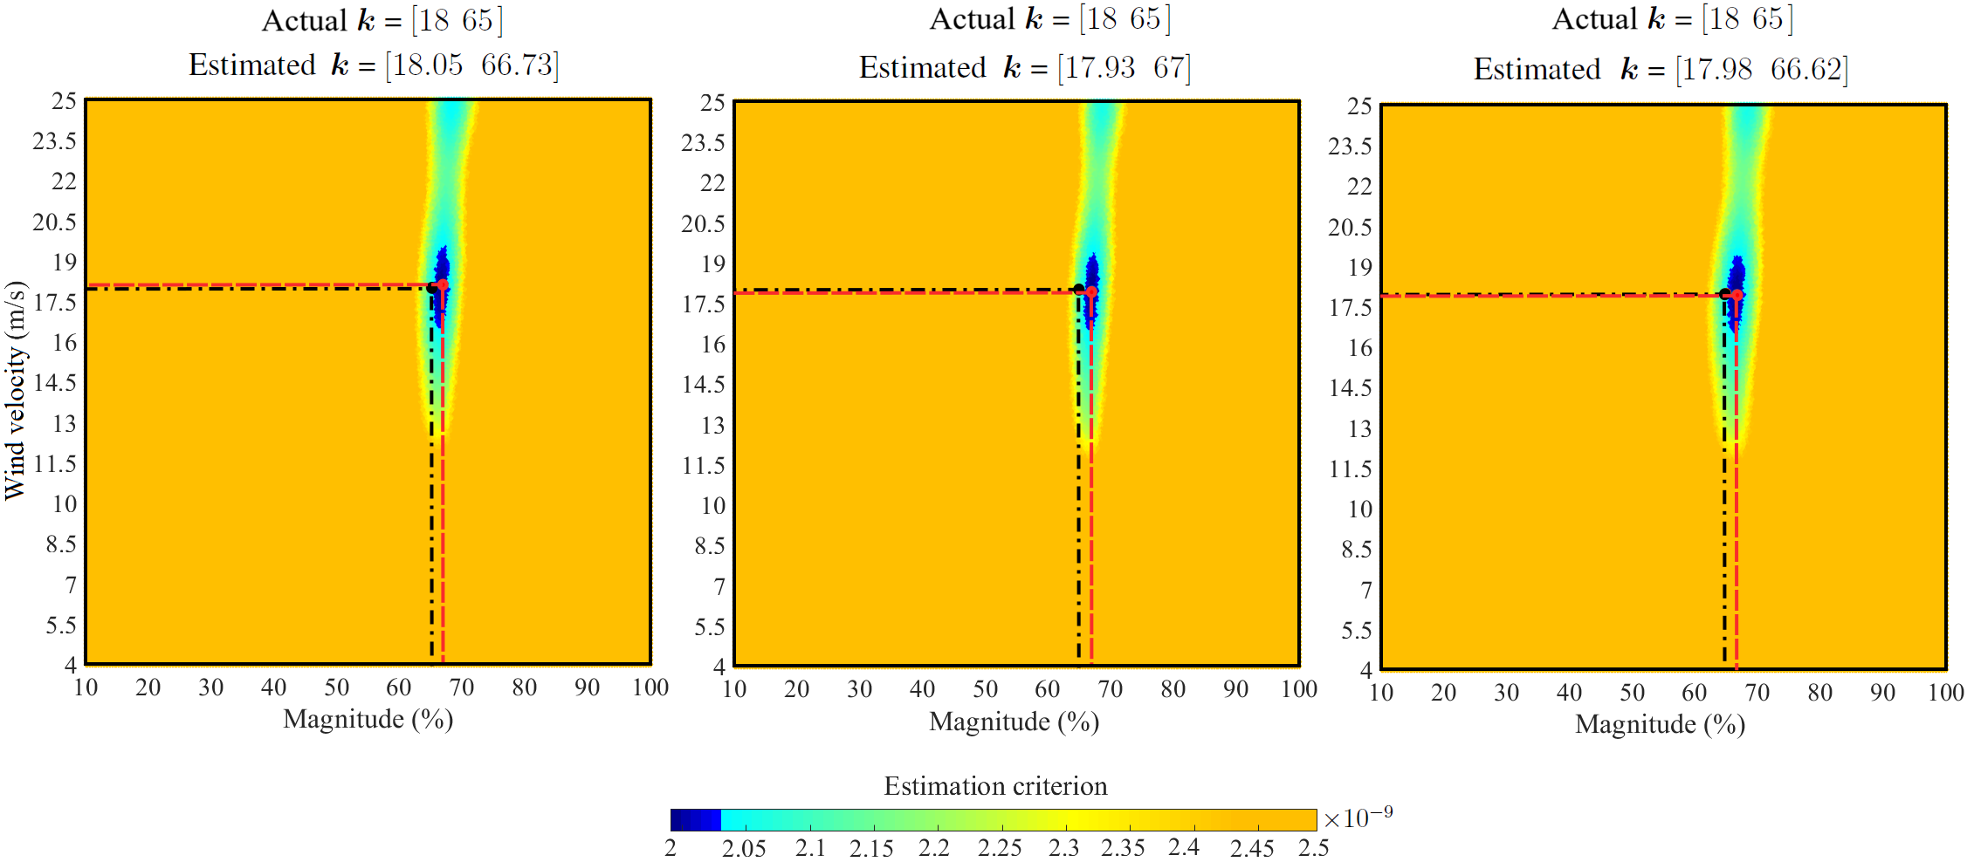
Damage magnitude estimation results
Estimation of damage magnitude and wind speed
(BO)
(PSO)
(GA)

Slide 14
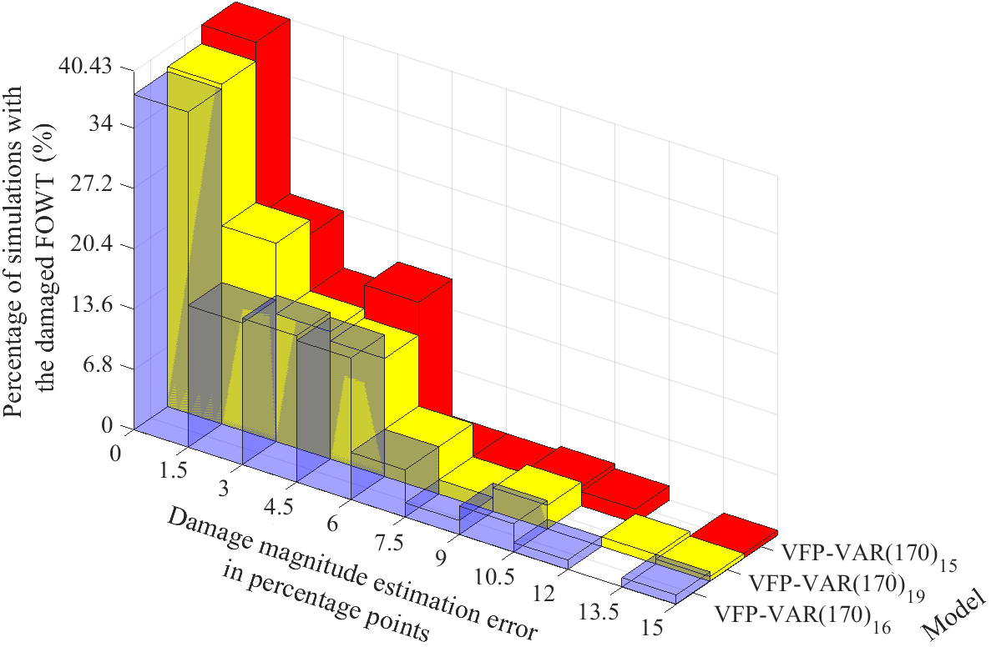
Damage magnitude estimation results
Model | Mean estimation error for wind velocity (m/s) | Mean estimation error for damage magnitude (percentage points)
VFP-VAR(170)15 (GA) | 0.17 | 3.28
VFP-VAR(170)19 (PSO) | 0.08 | 2.93
VFP-VAR(170)16 (BO) | 0.07 | 2.79

Slide 15
Conclusions
Concluding remarks
Three formulated PSD-based criteria for the selection of the measurement direction being the most sensitive (dominant) to damages
Damage magnitudes smaller than 30% of stiffness reduction to the tower base → very similar effects to the dynamics as the varying OCs to the healthy FOWT → challenging damage detection
Achievement of 100% correct detection of the FOWT health state in all considered simulations with the healthy and damaged FOWT through the multivariate version of the FMBM
Remarkably low (∼ 3%) mean damage magnitude estimation error from the damaged FOWT, with all actual damage magnitudes being within or very close to the constructed confidence intervals
Performance of the FMBM in damage magnitude estimation almost unaffected by the optimization algorithms (BO, PSO, GA) used for the selection of the functional models’ basis functions
Acknowledgement: This work is part of two projects: i) ”Adaptation and implementation of floating wind energy conversion technology for the Atlantic region (ARCWIND)” funded by the Interreg Atlantic Area, European Regional Development Fund (grant num- ber: EAPA 344/ 2016) and the European Union’s Horizon 2020 (Marie Sklodowska- Curie grant no. 730888) and ii) ”Analytics for asset Integrity Management of Windfarms (AIMWind)”, a collaboration between University of Agder, Norwegian Research Center - NORCE AS and Technical University Delft, funded by the Research Council of Norway (grant no. 312486).

Slide 16
Damage detection and magnitude estimation methodology
Coefficients of projection $A_{i,j}$ of the FP-VAR model
Coefficients of projection $A_{i,j}$ of the VFP-VAR model
Training phase
Inspection phase
Current FOWT structural state $k=w$ → Response signals $y_{u}\left[t\right]$
$$y_{u}\left[t\right]+\sum_{i=1}^{na}{A_{i}(k)}⋅y_{u}\left[t−i\right]=e_{u}\left[t,k\right]$$
$$\hat{k}=\arg{\min_{k}{det\frac{1}{N}\sum_{t=1}^{N}{e_{u}\left[t,k\right]e_{u}^{T}\left[t,k\right]}}}$$
Data acquisition
Modelling (FP-VAR model)
Check of the uncorrelatedness (whiteness) of ${ e}_{u}\left[t,\hat{k}\right]$though the Portmanteau test which detects changes in the autocorrelation matrix $R_{e}\left[τ\right]$ ($τ=1,…,h lag)$of${ e}_{u}\left[t,\hat{k}\right]$:
w$ith χ_{1−α,n_{y}^{2}⋅h}^{2}$ the critical limit, $α$ the risk level, $n_{y}^{2}$ the number of response signals
$Q≤χ_{1−α,n_{y}^{2}⋅h}^{2}$ $→ H_{0}:R_{e}\left[τ\right]$ = 0
(White residual signals)
Healthy structure
Else
$→ H_{1}:R_{e}\left[τ\right]≠$ 0
(Non-white residual signals)
Damaged structure
Damage detection
Detected damaged FOWT state $k=[w m]$ → Response signals $y_{u}\left[t\right]$
$$y_{u}\left[t\right]+\sum_{i=1}^{na}{A_{i}(k)}⋅y_{u}\left[t−i\right]=e_{u}\left[t,k\right]$$
$$\hat{k}=\arg{\min_{k}{det\frac{1}{N}\sum_{t=1}^{N}{e_{u}\left[t,k\right]e_{u}^{T}\left[t,k\right]}}}$$
Data acquisition
Modelling (VFP-VAR model)
Check of the uncorrelatedness (whiteness) of ${ e}_{u}\left[t,\hat{k}\right]$though the Portmanteau test which detects changes in the autocorrelation matrix $R_{e}\left[τ\right]$ ($τ=1,…,h lag)$of${ e}_{u}\left[t,\hat{k}\right]$ :
Confidence intervals for valid $\hat{k}$
$$\left[\hat{w}±t_{1−\frac{α}{2}, N−1}⋅{\hat{σ}}_{w}\right],$$
$$\left[\hat{m}±t_{1−\frac{α}{2}, N−1}⋅{\hat{σ}}_{m}\right]$$
$Q≤χ_{1−α,n_{y}^{2}⋅h}^{2}$ $→ H_{0}:R_{e}\left[τ\right]$ = 0
(White residual signals)
Valid $\hat{k}$
${\hat{Σ}}_{k}$ : Cramer-Rao lower bound
Else
$→ H_{1}:R_{e}\left[τ\right]≠$ 0
(Non-white residual signals)
Invalid $\hat{k}$
Damage magnitude estimation

