Slide 1
Image background filtering for concentrated damage detection via fusion with point cloud data
2nd Olympiad in Engineering Science – OES 2025
Chao Lin
The University of Tokyo
June 11, 2025

Slide 2
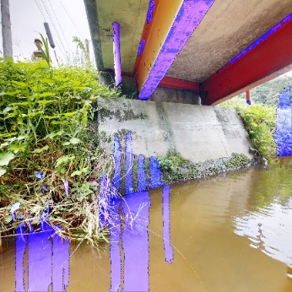
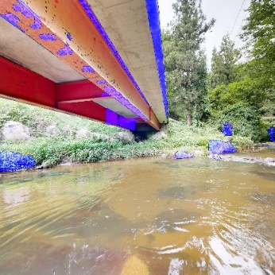
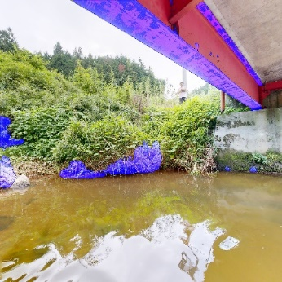
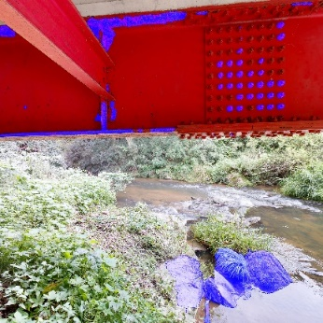
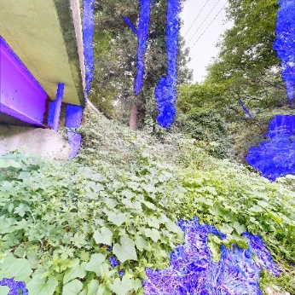
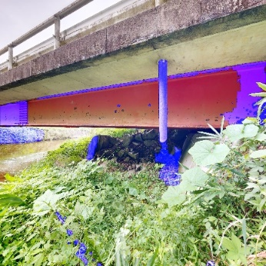
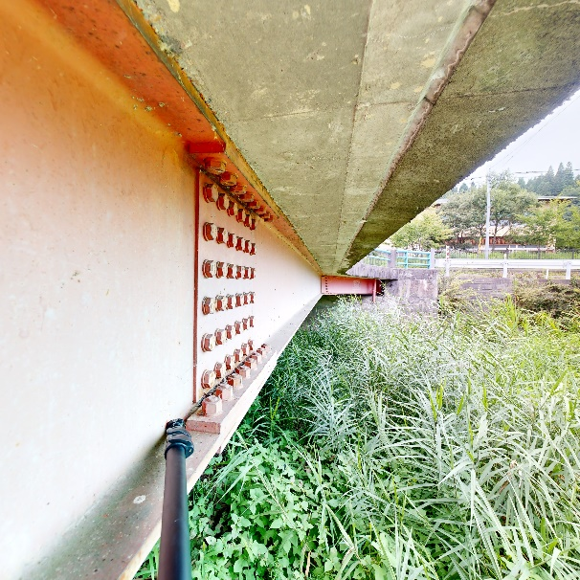
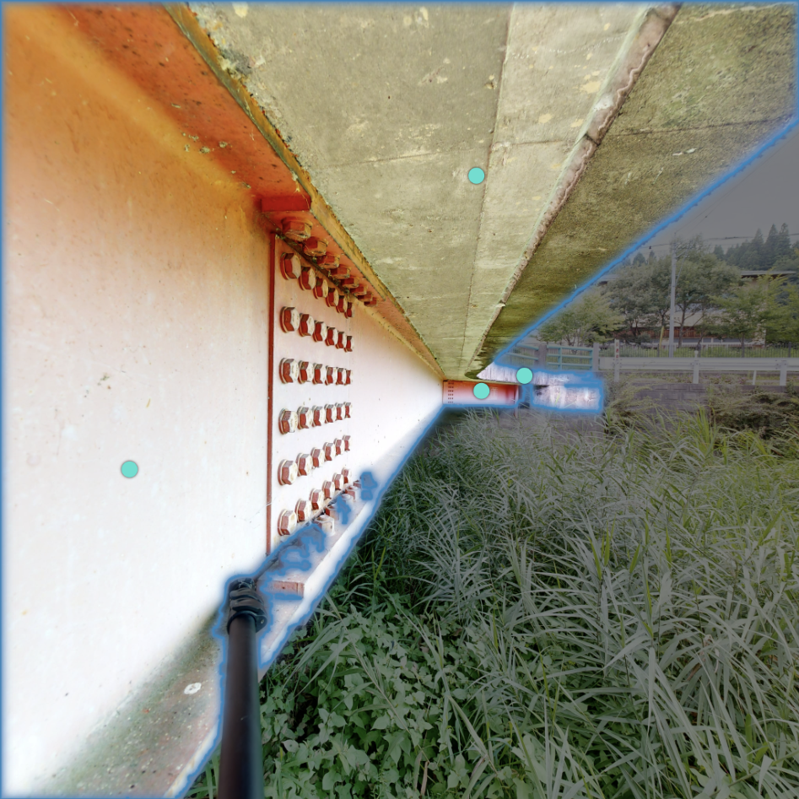
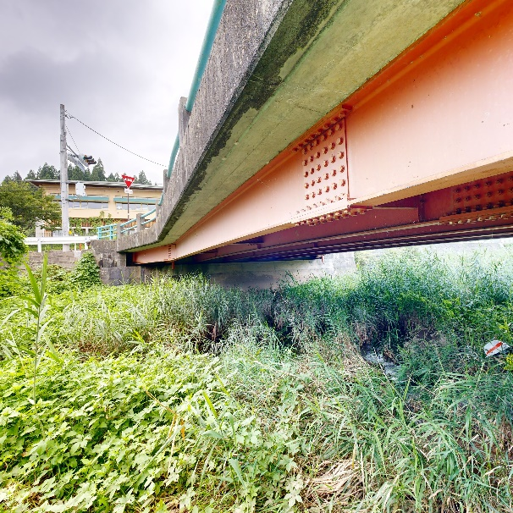
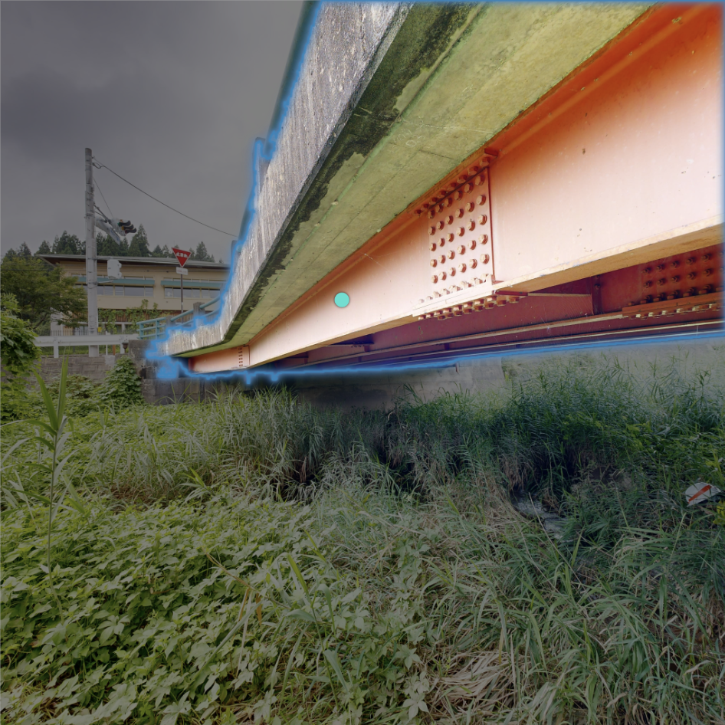
1
Background
Impact of background disturbance on damage detection
False positive
Overall accuracy
Limitation of image semantic segmentation (Segment Anything Model, SAM)
Overlapping objects, variations in lighting conditions, coarse masks, limited transferability, …
1
Notes:
Image-based methods have become the mainstream for damage detection in civil engineering, but one big challenge is

Slide 3
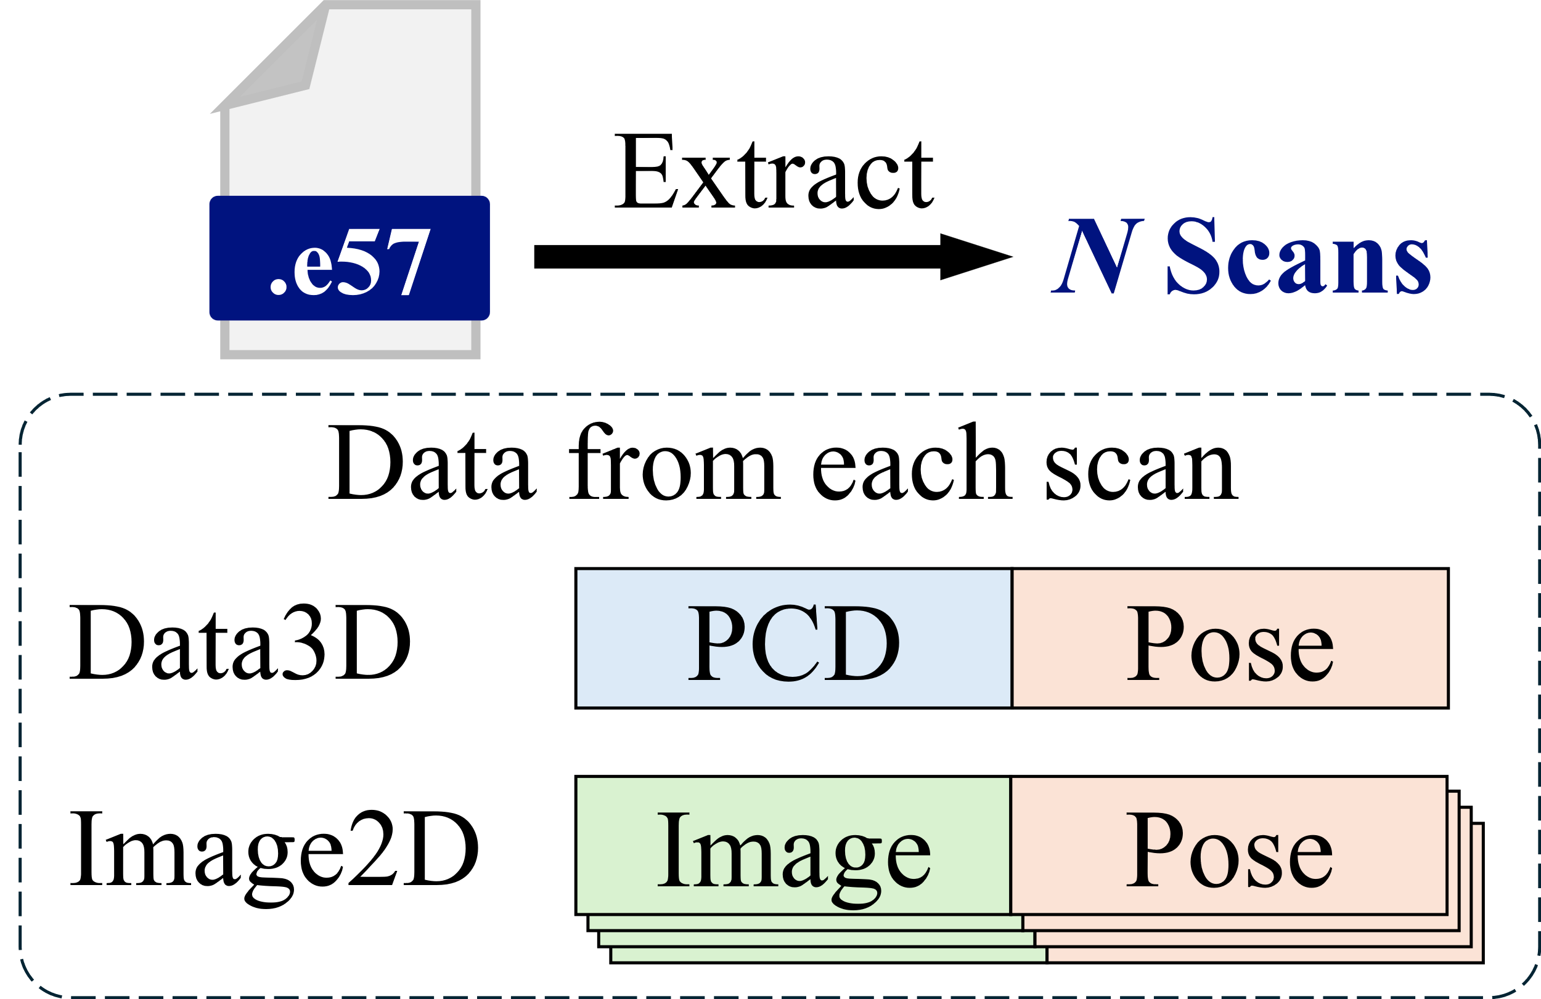
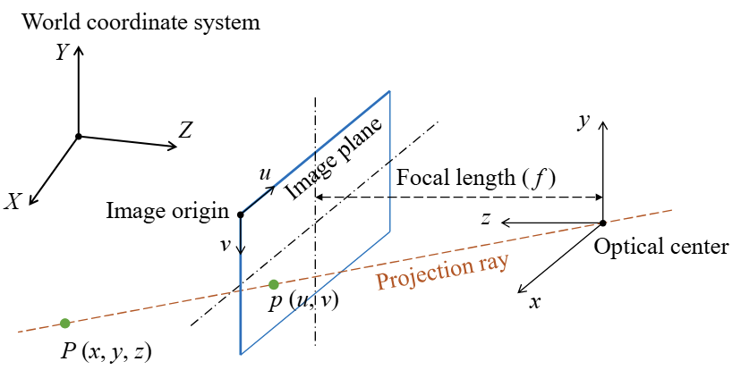
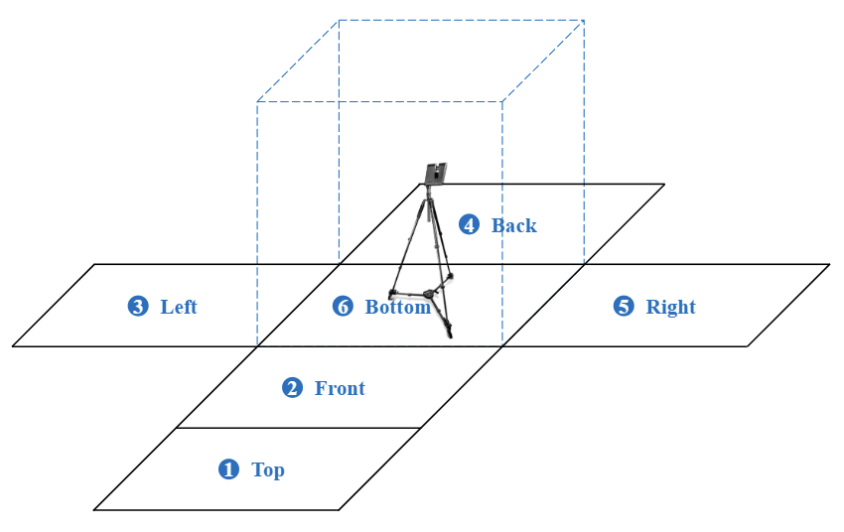
2
Methodology
2D-3D bidirectional projection between image and point cloud data
$$\left[\begin{matrix}u \\ v \\ 1\end{matrix}\right]=K\left[R\left|T\right.\right]\left[\begin{matrix}\begin{matrix}X \\ Y\end{matrix} \\ \begin{matrix}Z \\ 1\end{matrix}\end{matrix}\right]$$
(u, v): p in the image coordinate system
(x, y, z): P in the camera coordinate system
(X, Y, Z): P in the world coordinate system
K, $\left[R\left|T\right.\right]$: intrinsic, extrinsic parameter matrices
LiDAR 3D camera
2
Notes:
Point cloud can be used to filter out the background in images. To do so, we need to understand 2D-3D bidirectional projection first.

Slide 4
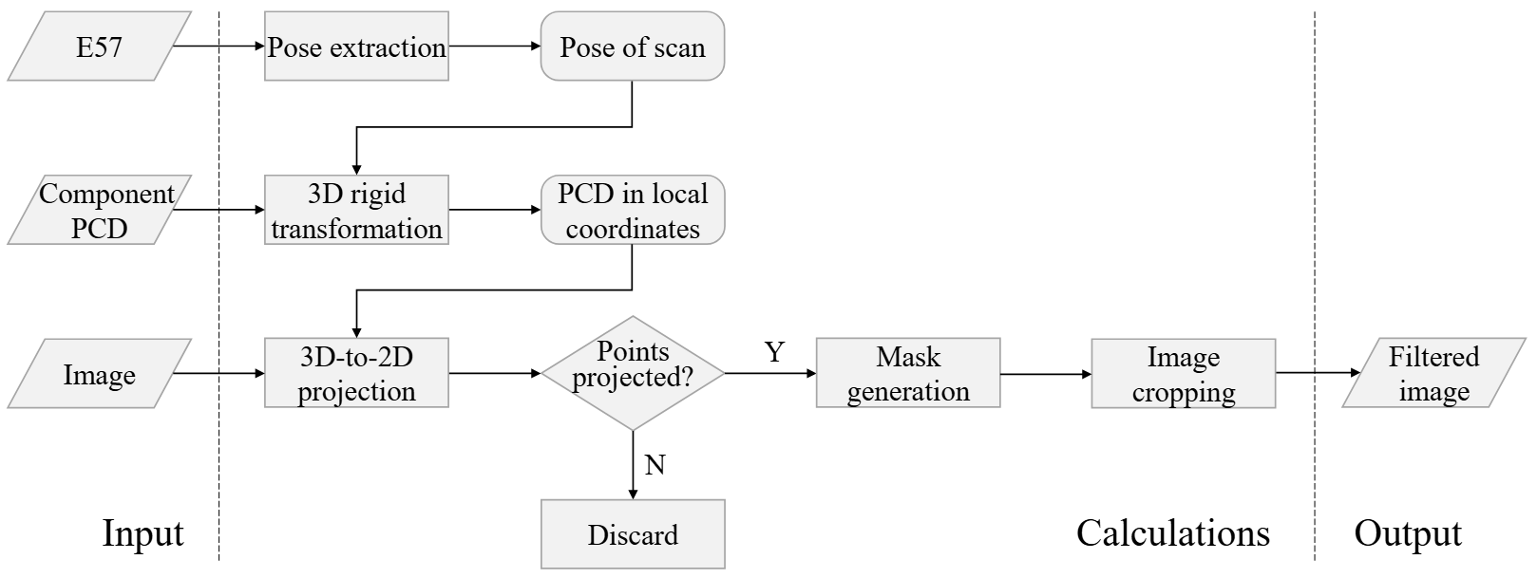
2
Methodology
Image selection and background filtering workflow (3D-to-2D projection)
3

Slide 5
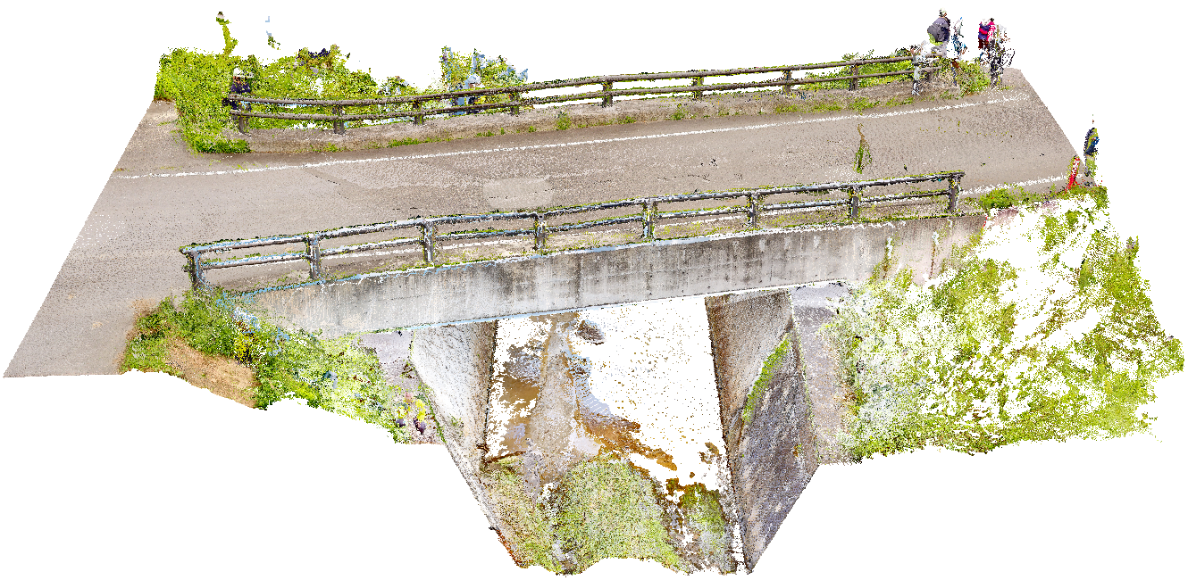
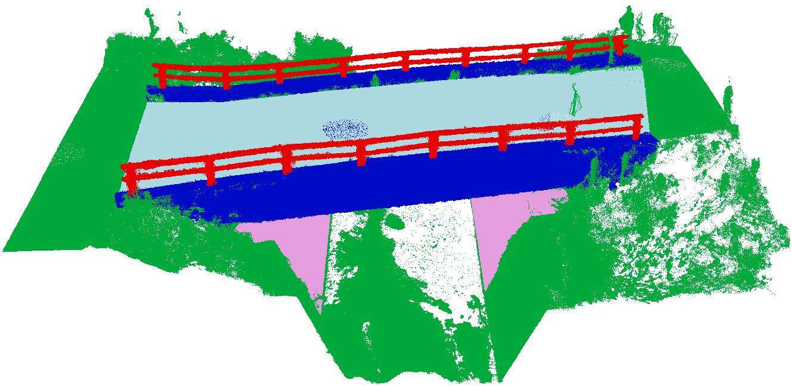
3
Experimental validation
Experimental subject: Kizuna Bridge
Abutment
Girder
Deck
Parapet
Noise
Original
Annotated
Locates at Fukushima Prefecture, Japan, built in 2011, length of 11.1 m, width of 6.7 m, scanned from 22 spots
Crack detection, girder and deck as target components
4

Slide 6
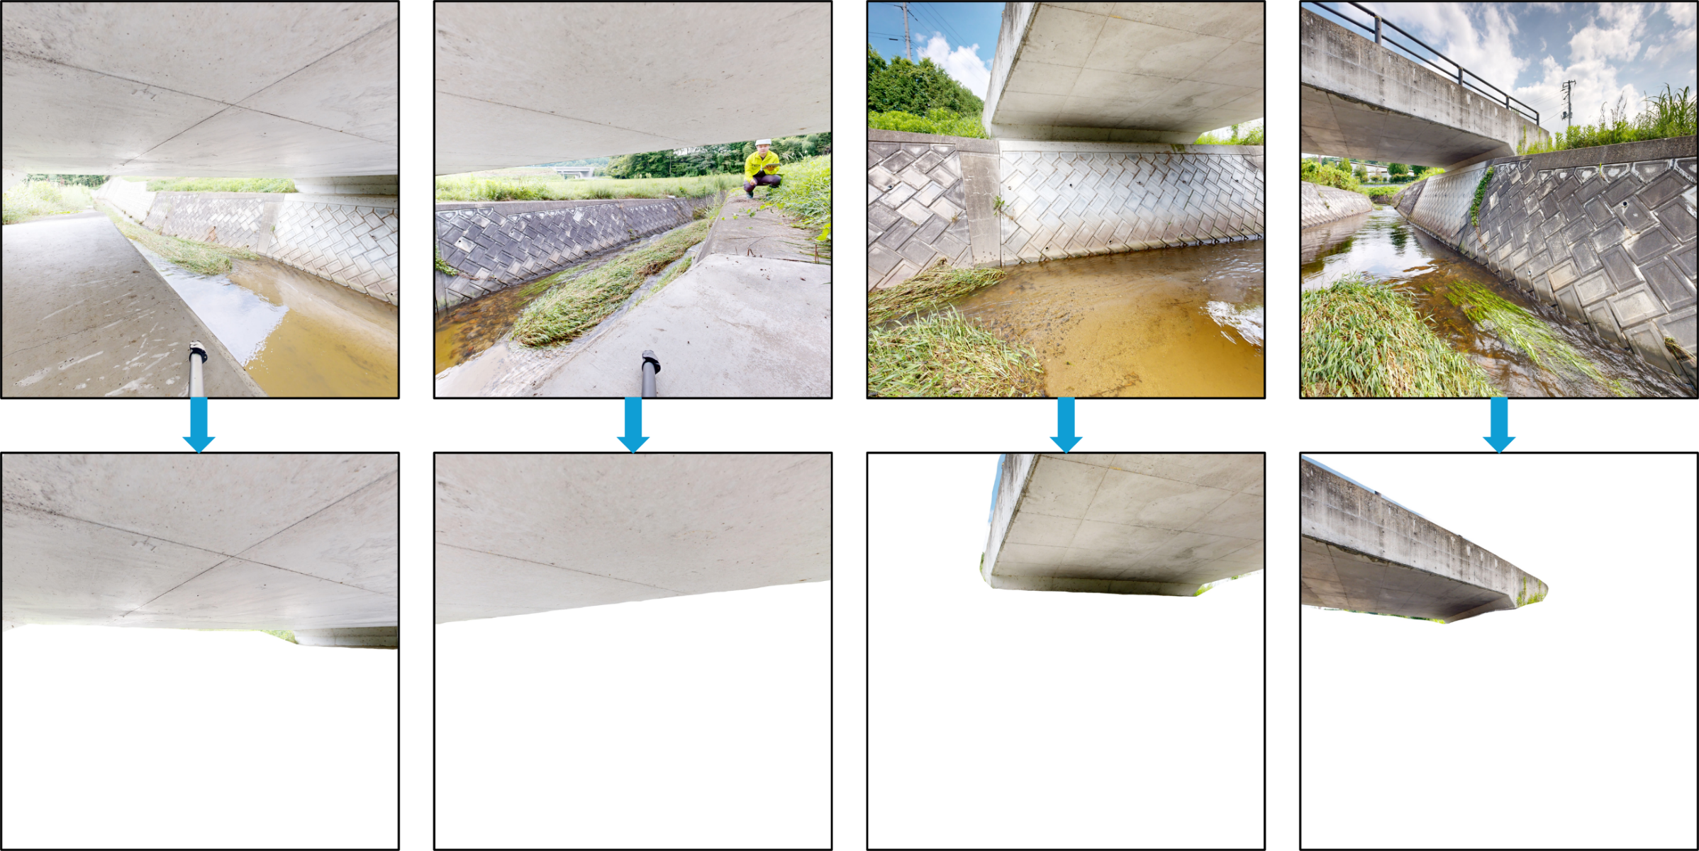
3
Experimental validation
Image background filtering results
5

Slide 7
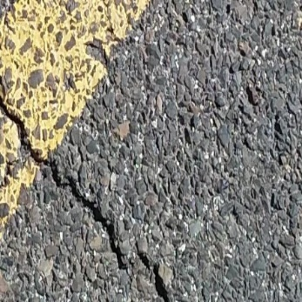
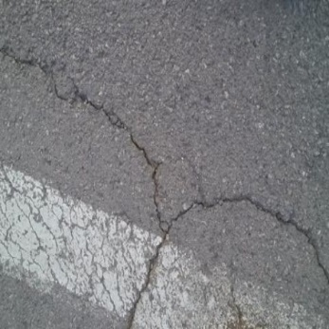
3
Experimental validation
Crack detection
Model: DeepLabv3+
Dataset: Concrete Crack Conglomerate Dataset, over 10,000 images, 90% for training and 10% for testing
Training results (%)
Overall accuracy | Mean accuracy | Mean Intersection over Union
98.15 | 81.64 | 73.84
6

Slide 8
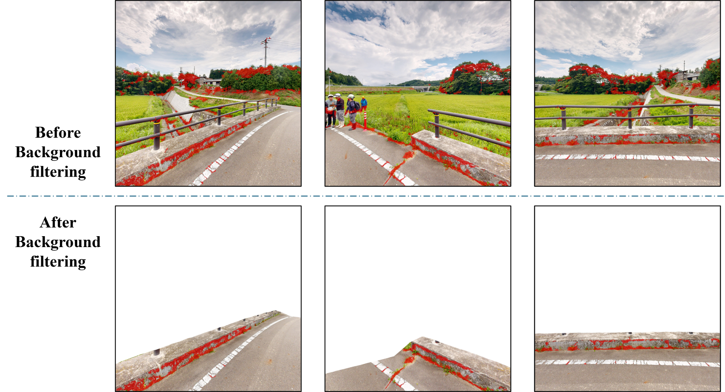
3
Experimental validation
Crack detection results
7

Slide 9
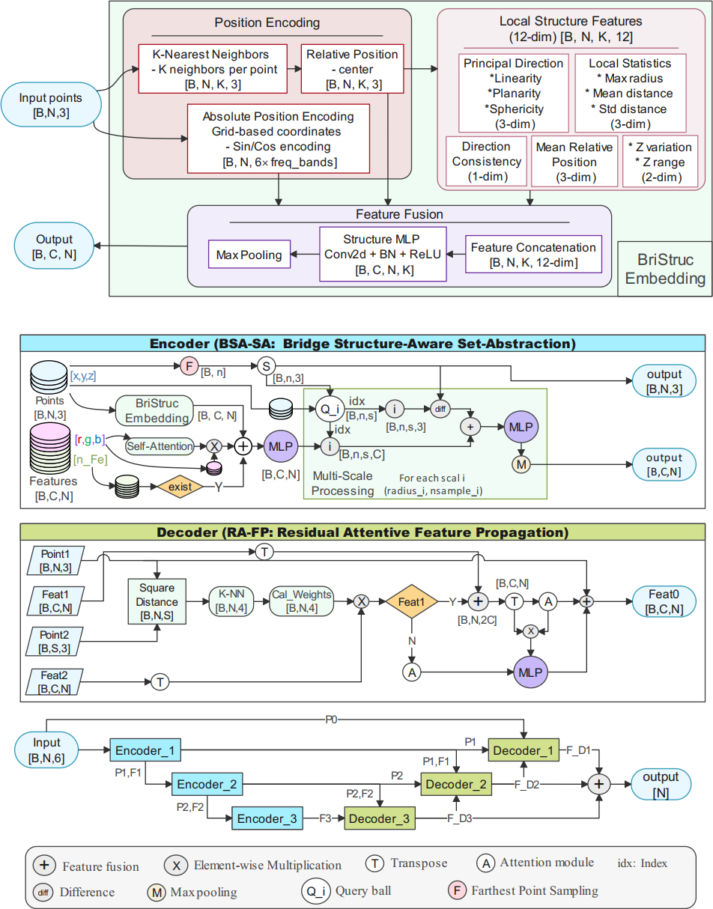
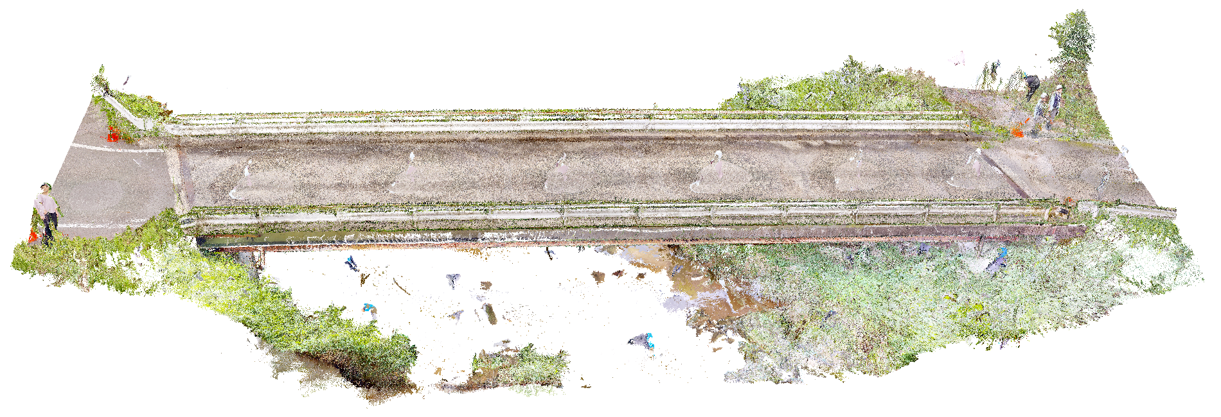
4
Future work
Deep learning models for point cloud semantic segmentation
Original
Segmentation
8
Notes:
Manual annotation is very time-consuming and labor-intensive

Slide 10
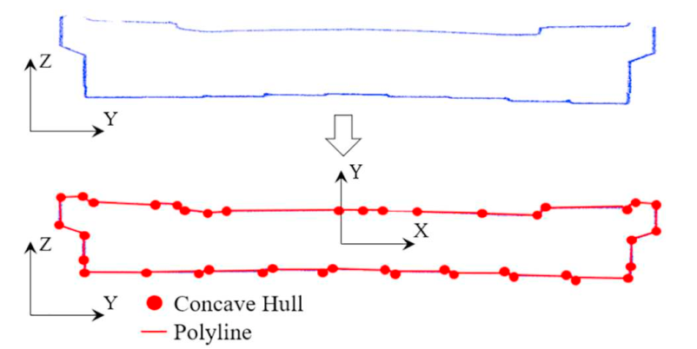
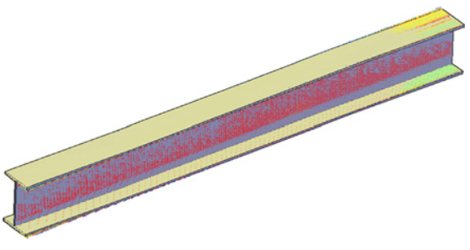
4
Future work
Damage registration on point cloud data and bridge information model (2D-to-3D projection)
9
Notes:
The bridge PCD with registered corrosion serves as a versatile foundation for a wide range of downstream applications, including structural condition assessment, maintenance planning, DT construction, and long-term deterioration tracking.

Slide 11
Thank you!
Chao Lin
The University of Tokyo
June 11, 2025

