Slide 1
PSHA incorporating near-fault effects for a soil site with embedded lava layers in South Iceland
Rajesh Rupakhety
Victor Hernández-Aguirre
12 June 2025

Slide 2
Presentation Outline
Overview
Site characterization
PSHA
Physics-based simulations
Seismic actions
Conclusions

Slide 3

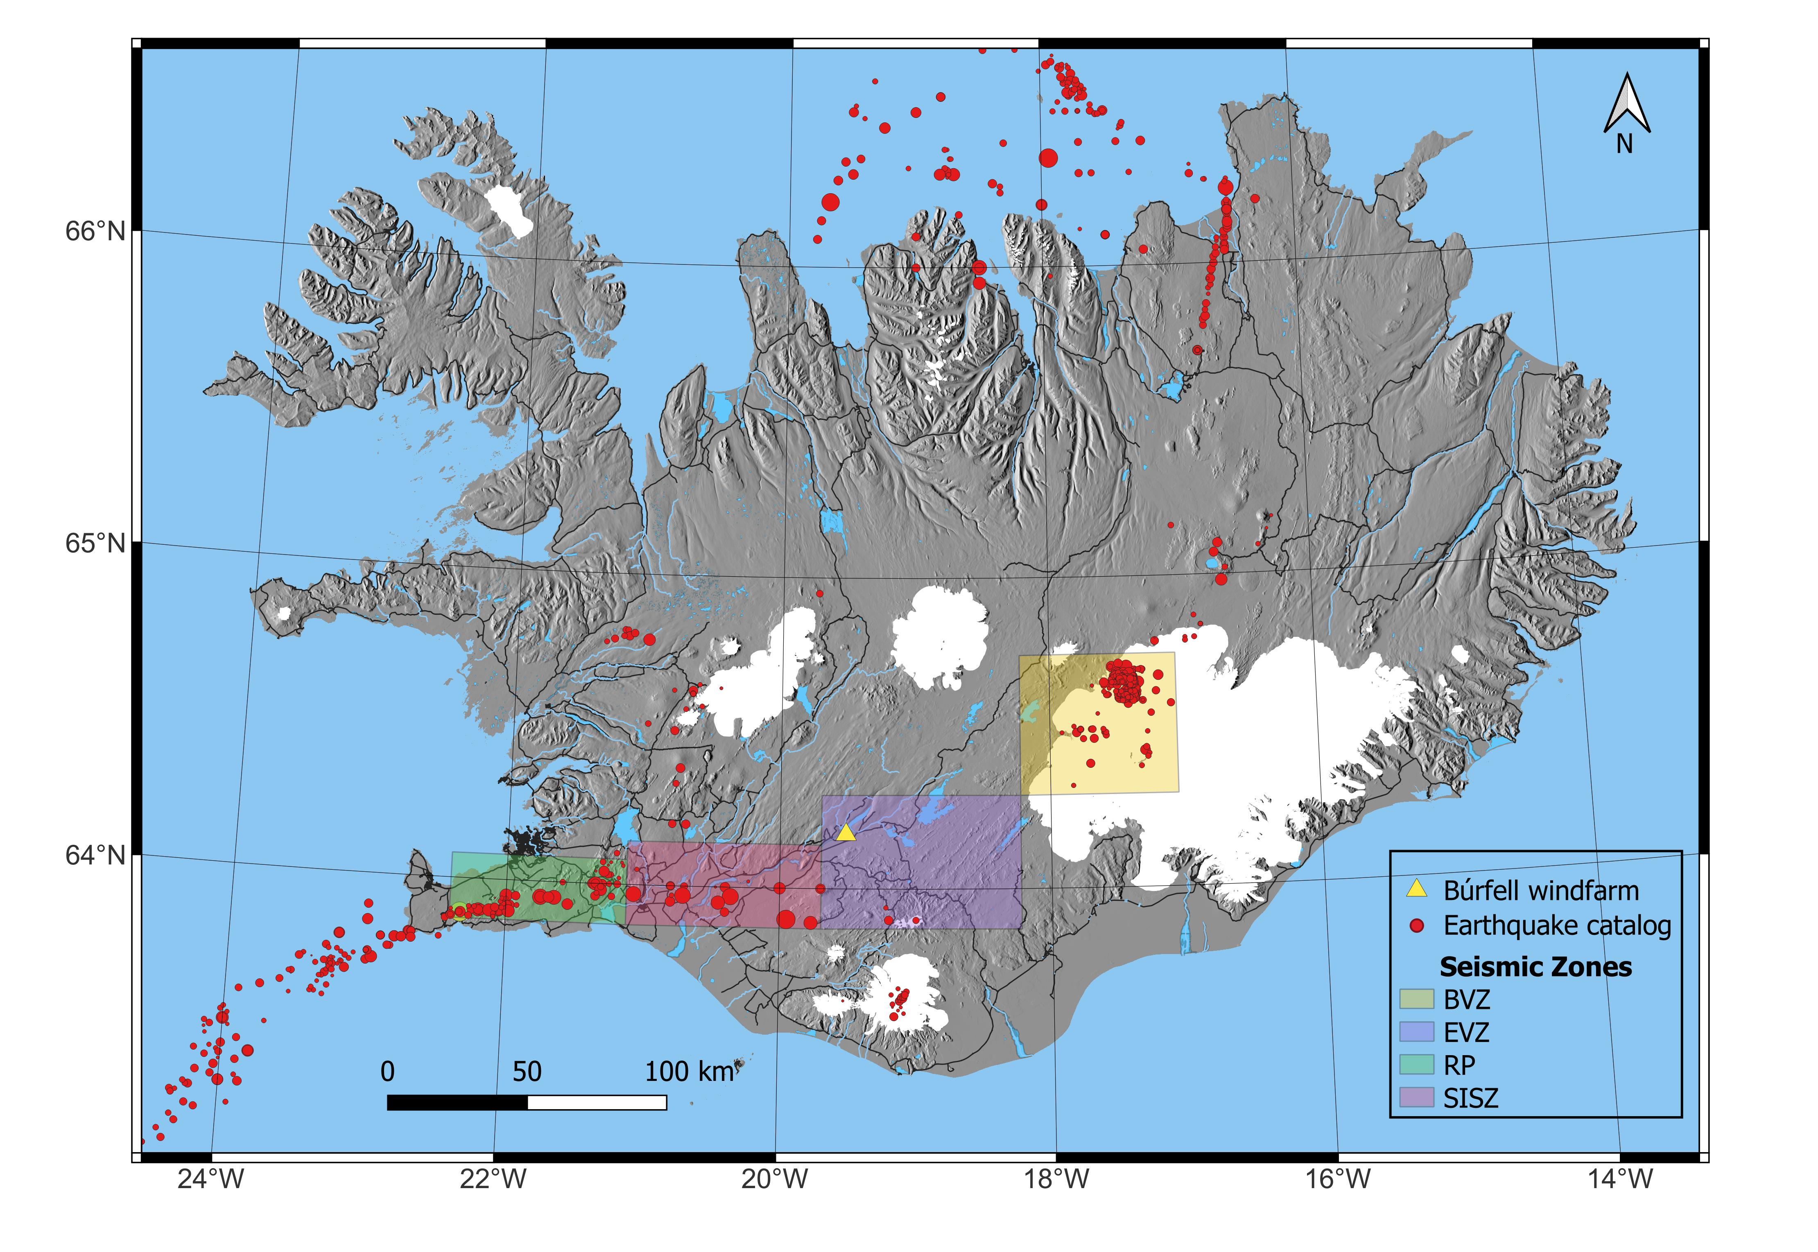
1. Overview
5 MW
T₁=3,5-4 s
~80 m

Slide 4
1. Overview
Probabilistic Seismic Hazard Assessment (PSHA)
Uniform hazard spectra with site effects
Site-effects
Near-fault effects
Site characterization
Physics based simulations
Design spectrum for near-fault conditions
Controlling scenarios
Amplification functions
Artificial neural network (ANN)
Long-period motions
Non-linear site response
Near-fault ground motions with site effects
Broad-band ground motions

Slide 5
Presentation Outline
Overview
Site characterization
PSHA
Physics-based simulations
Seismic actions
Conclusions

Slide 6
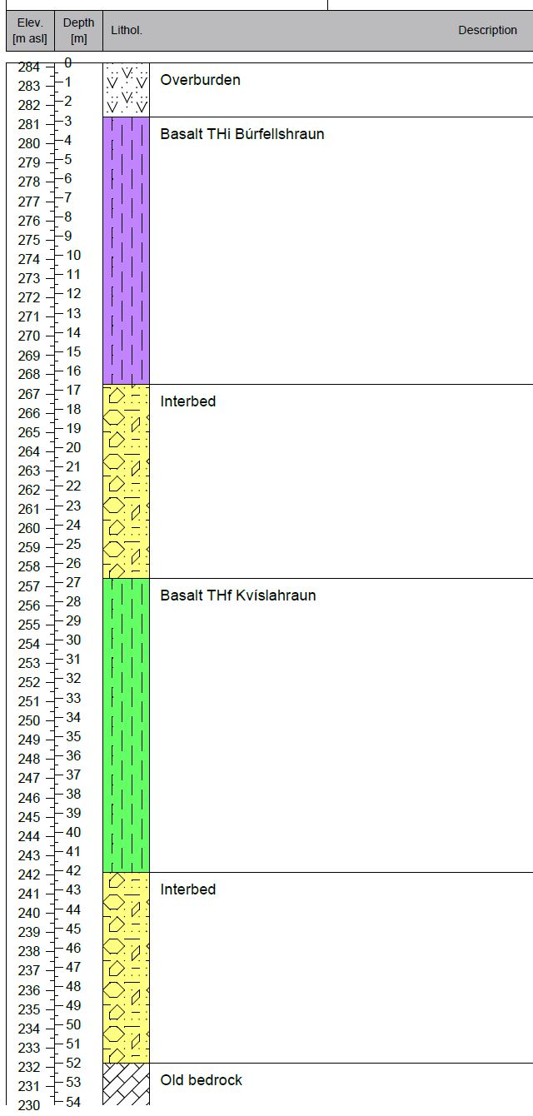
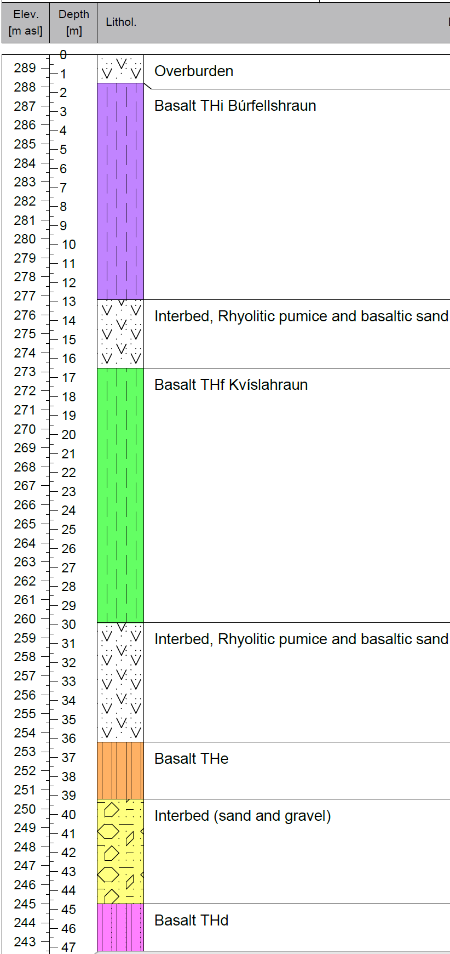
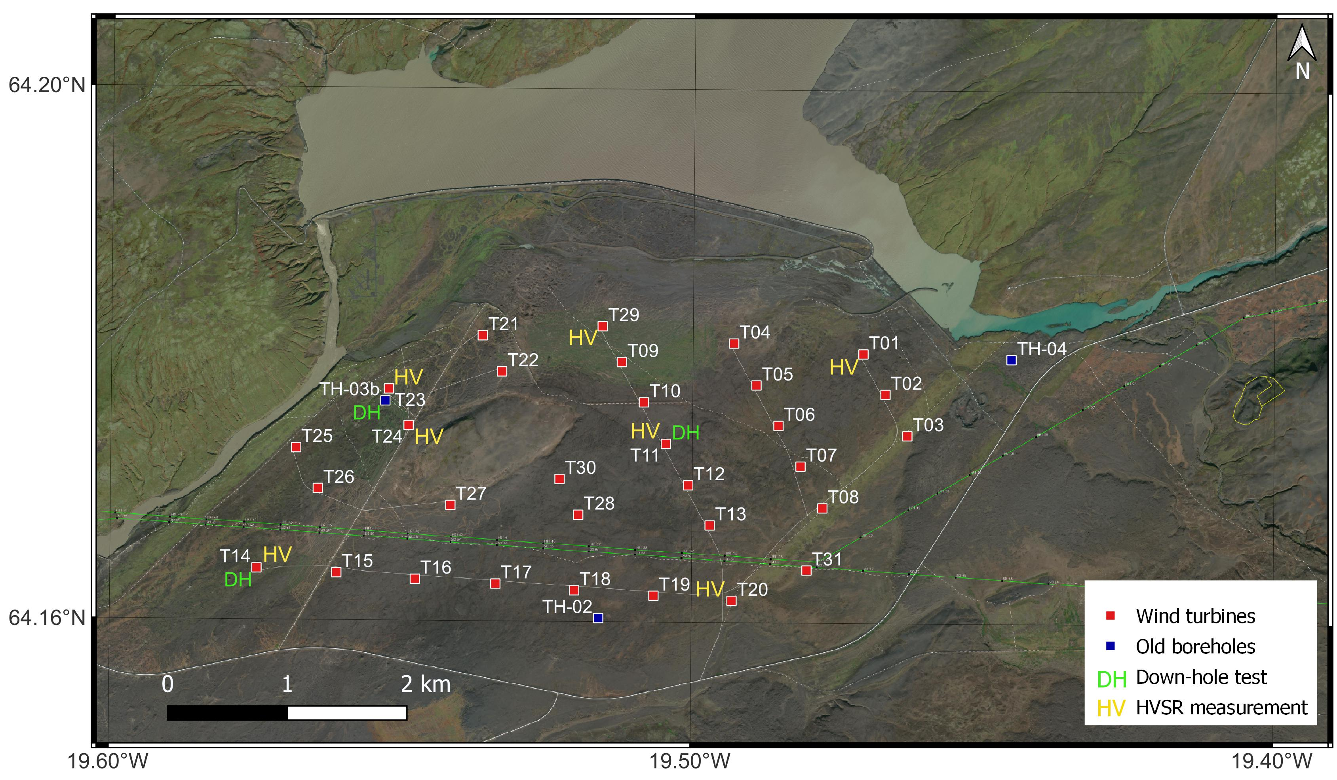
2. Site characterization
Geotechnical information
Sultartangalón
Vaðalda
Notes:
borehole logs from the earlier site investigations are available.

Slide 7
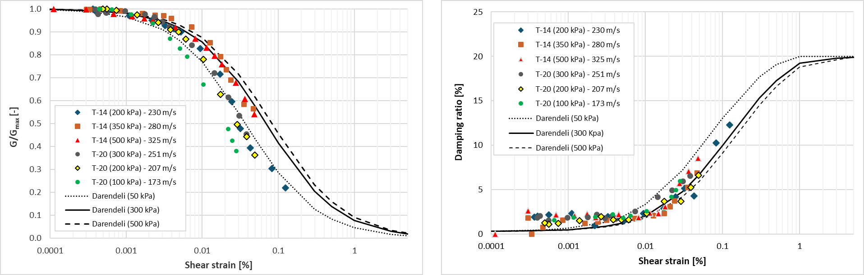
2. Site characterization
Resonant column tests

Slide 8
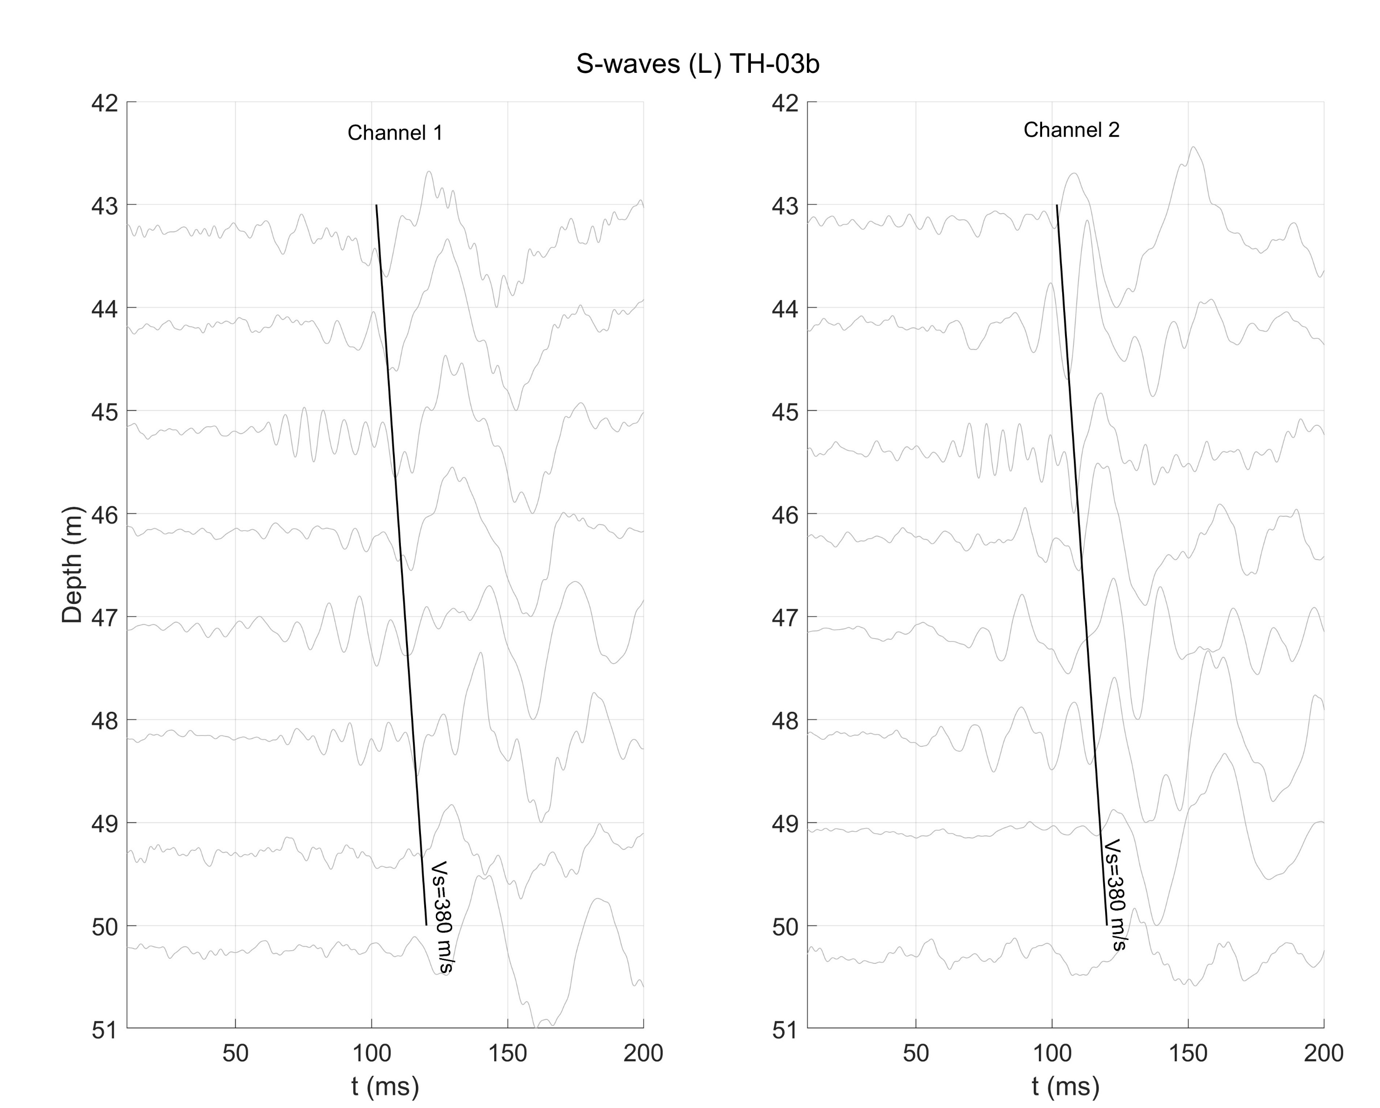
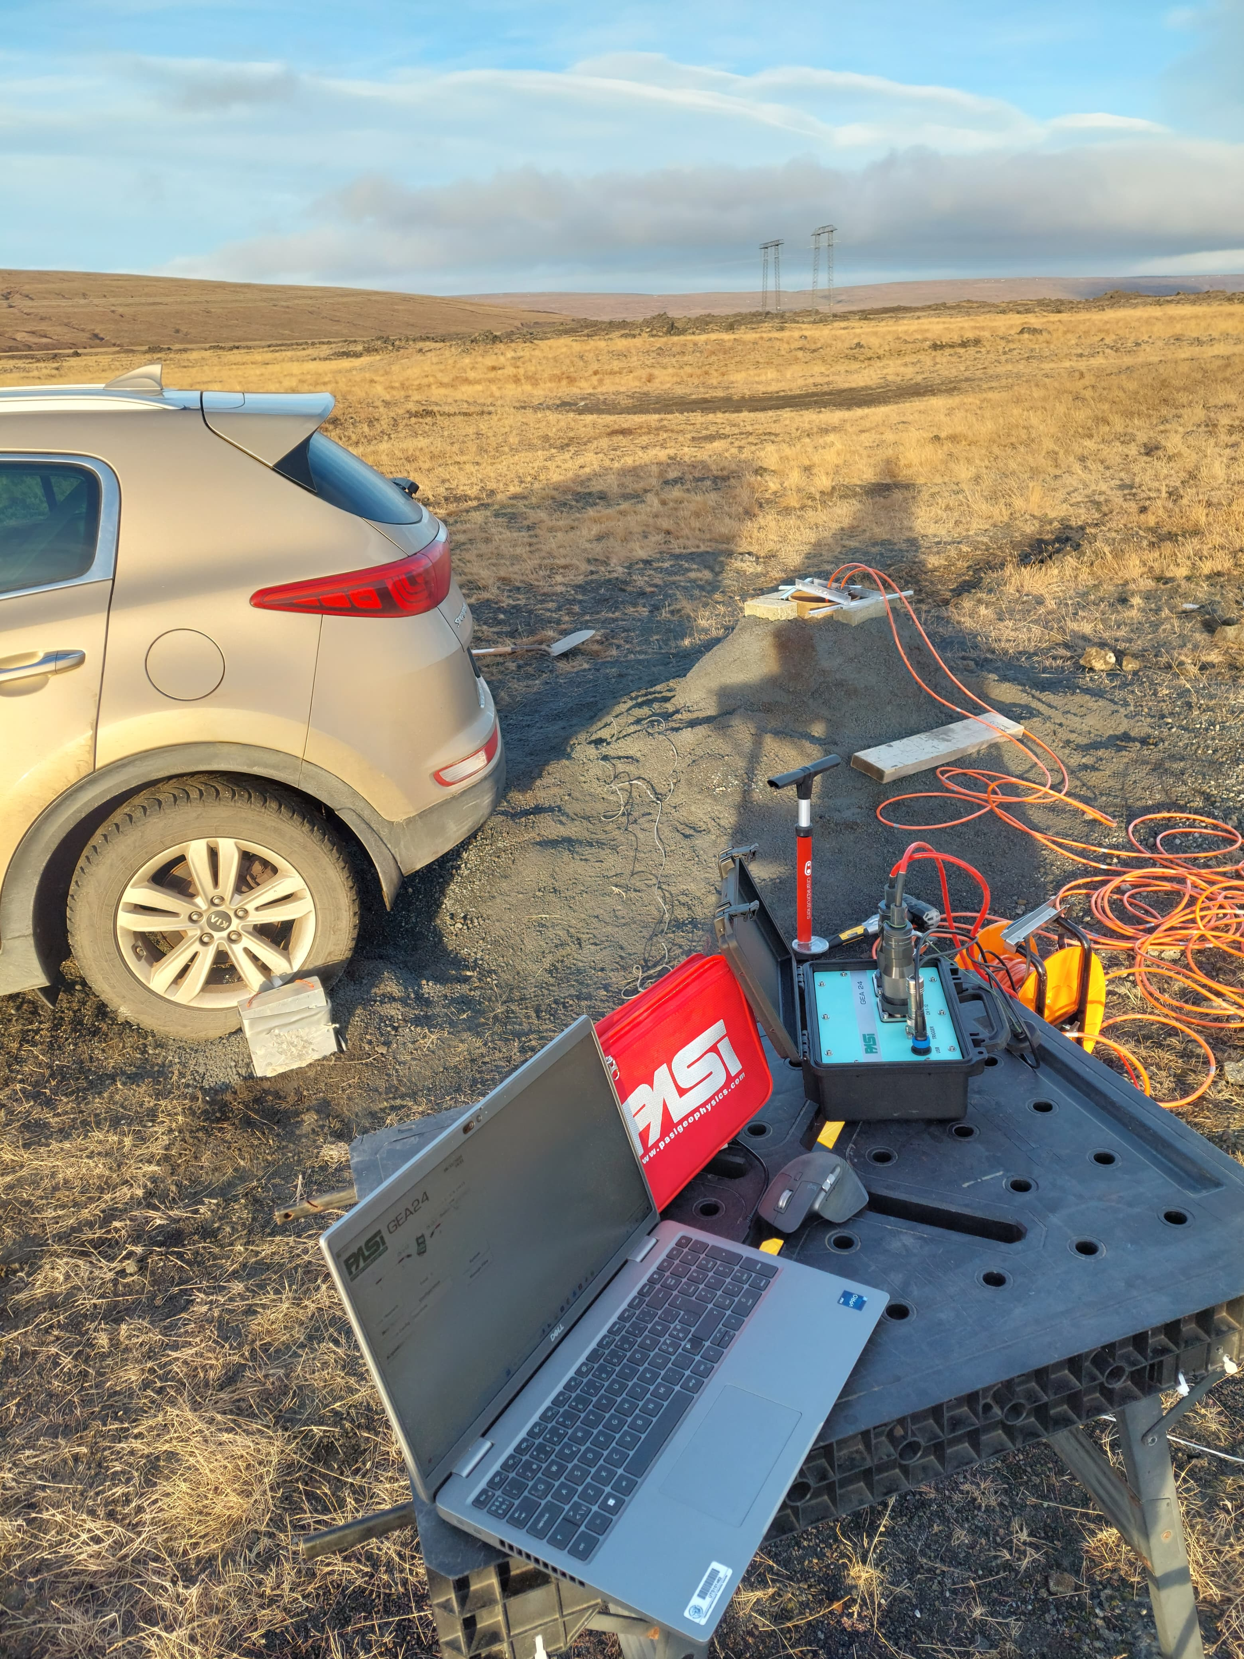
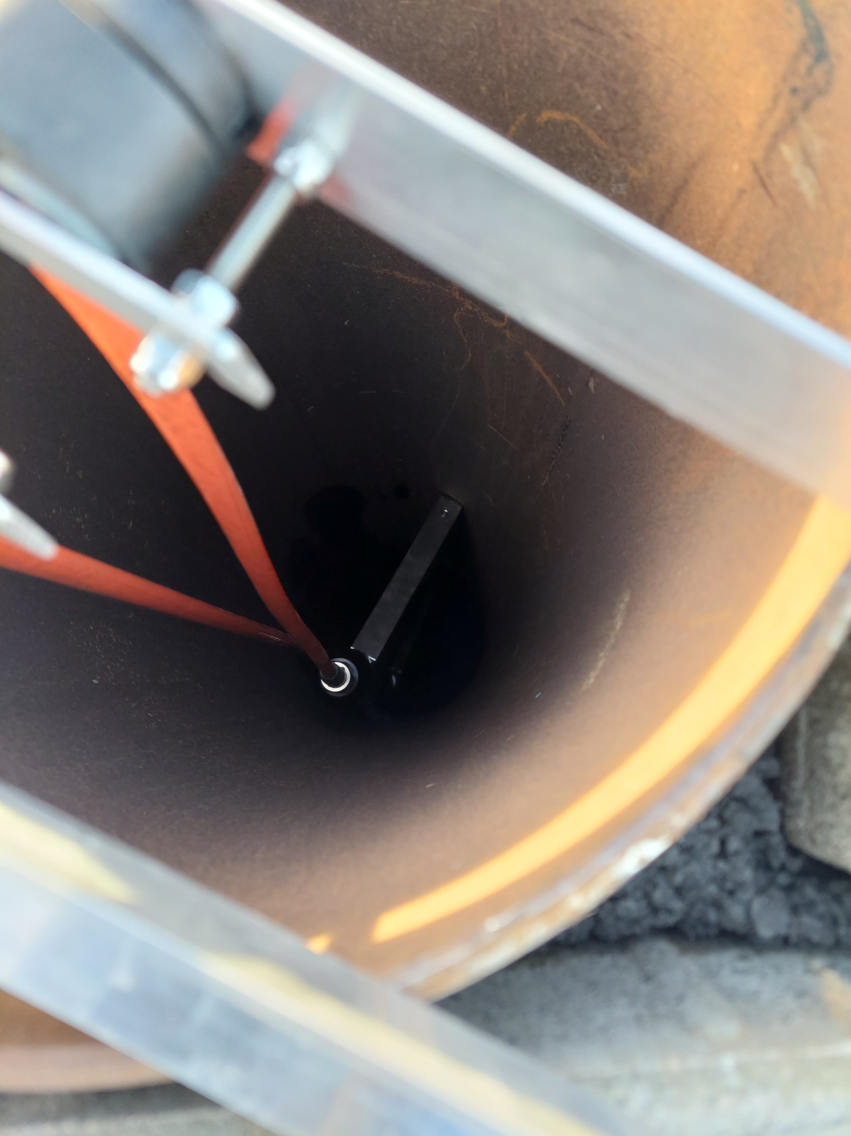
2. Site characterization
Down-hole tests

Slide 9
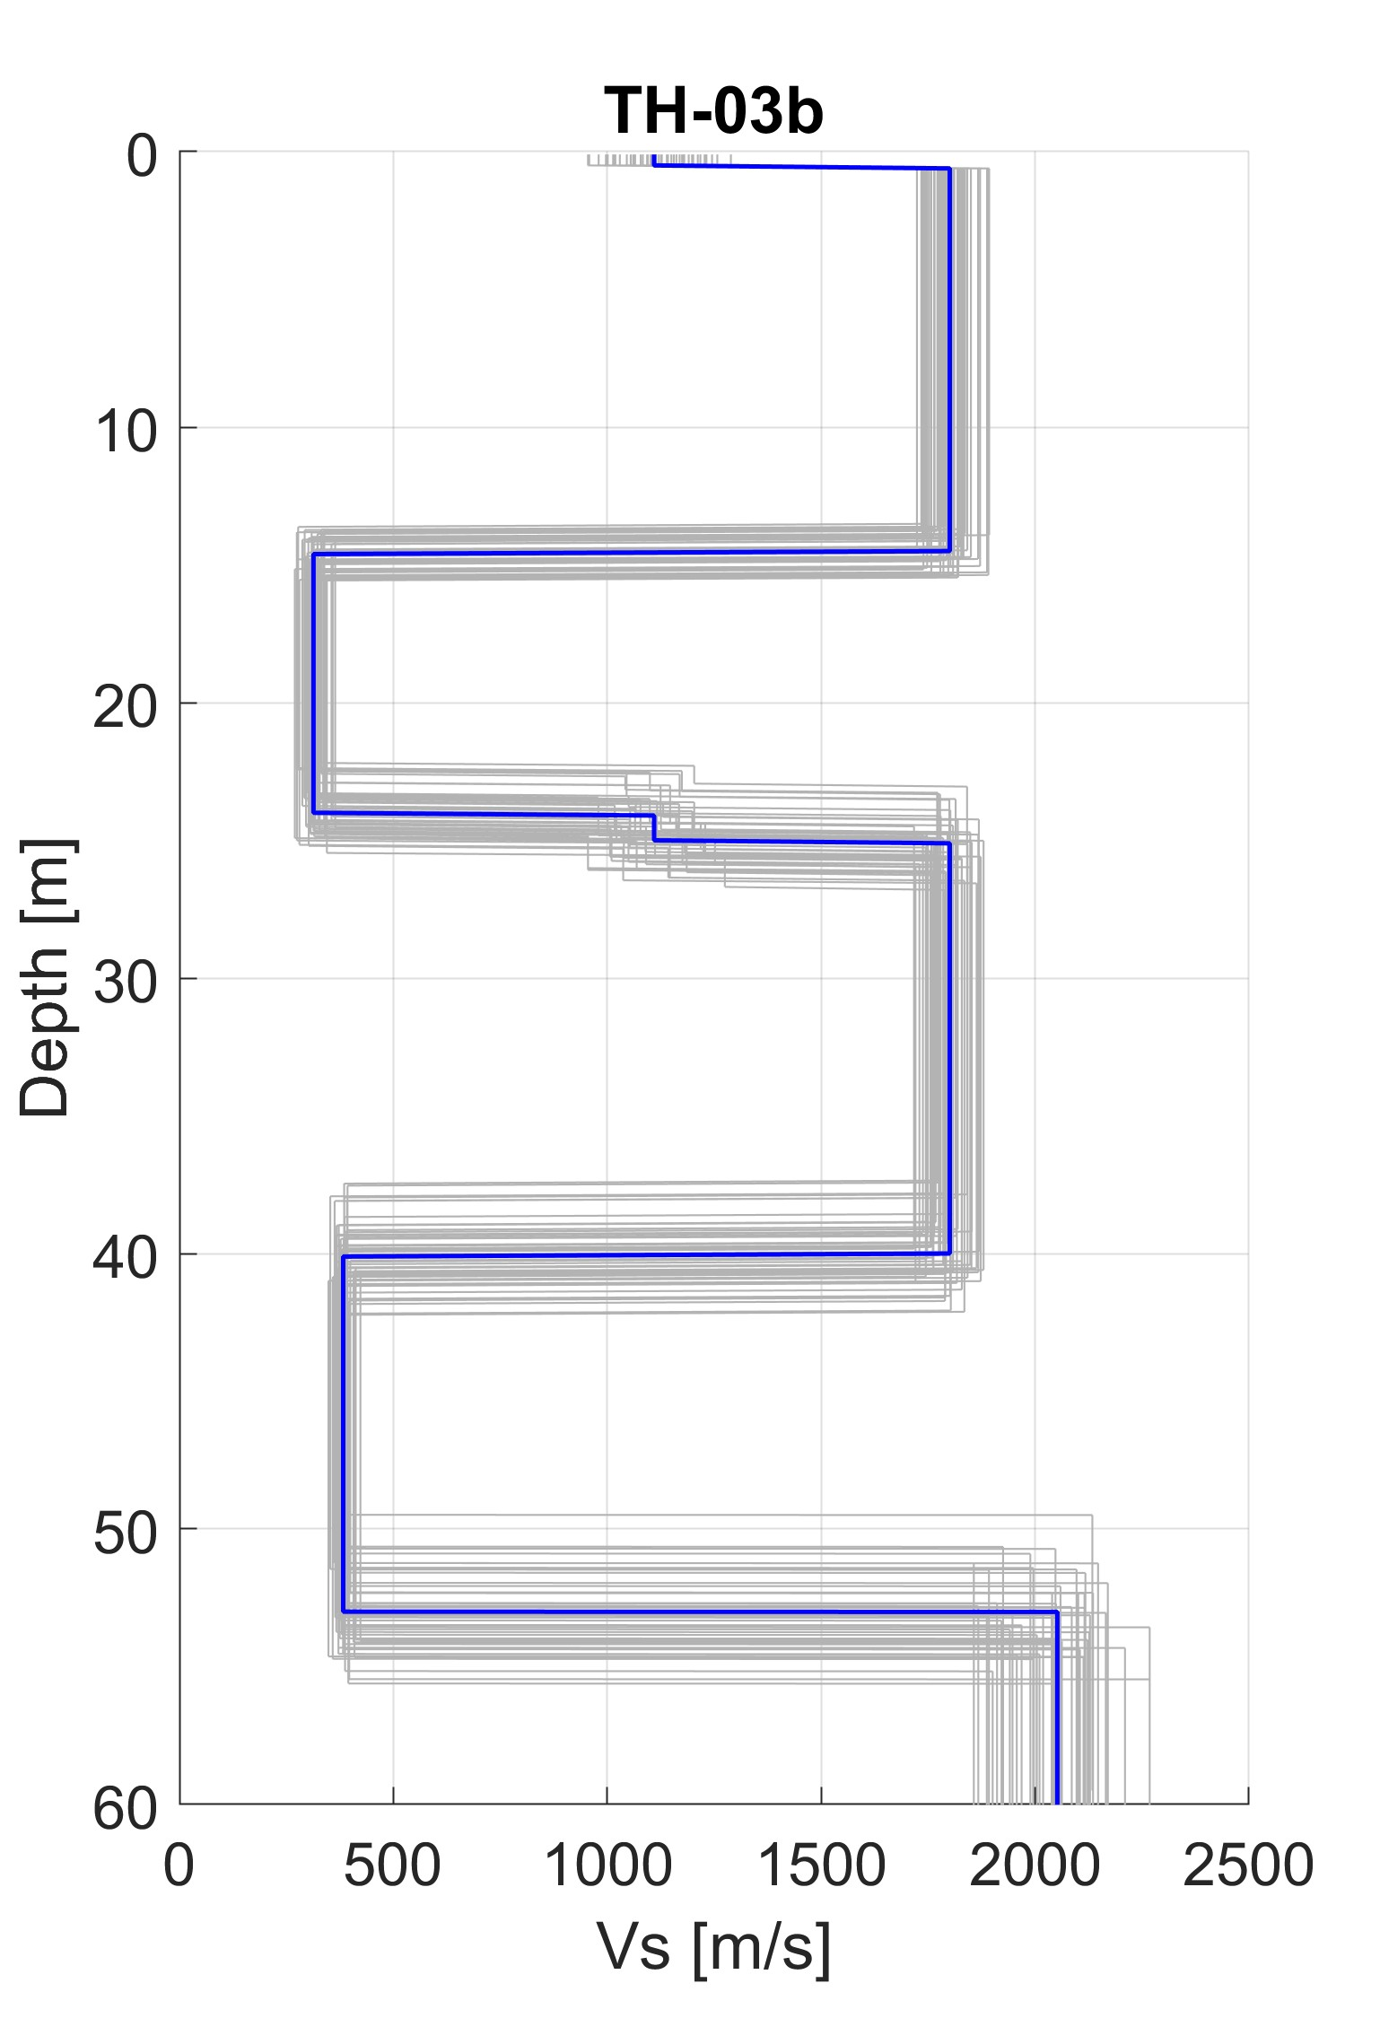
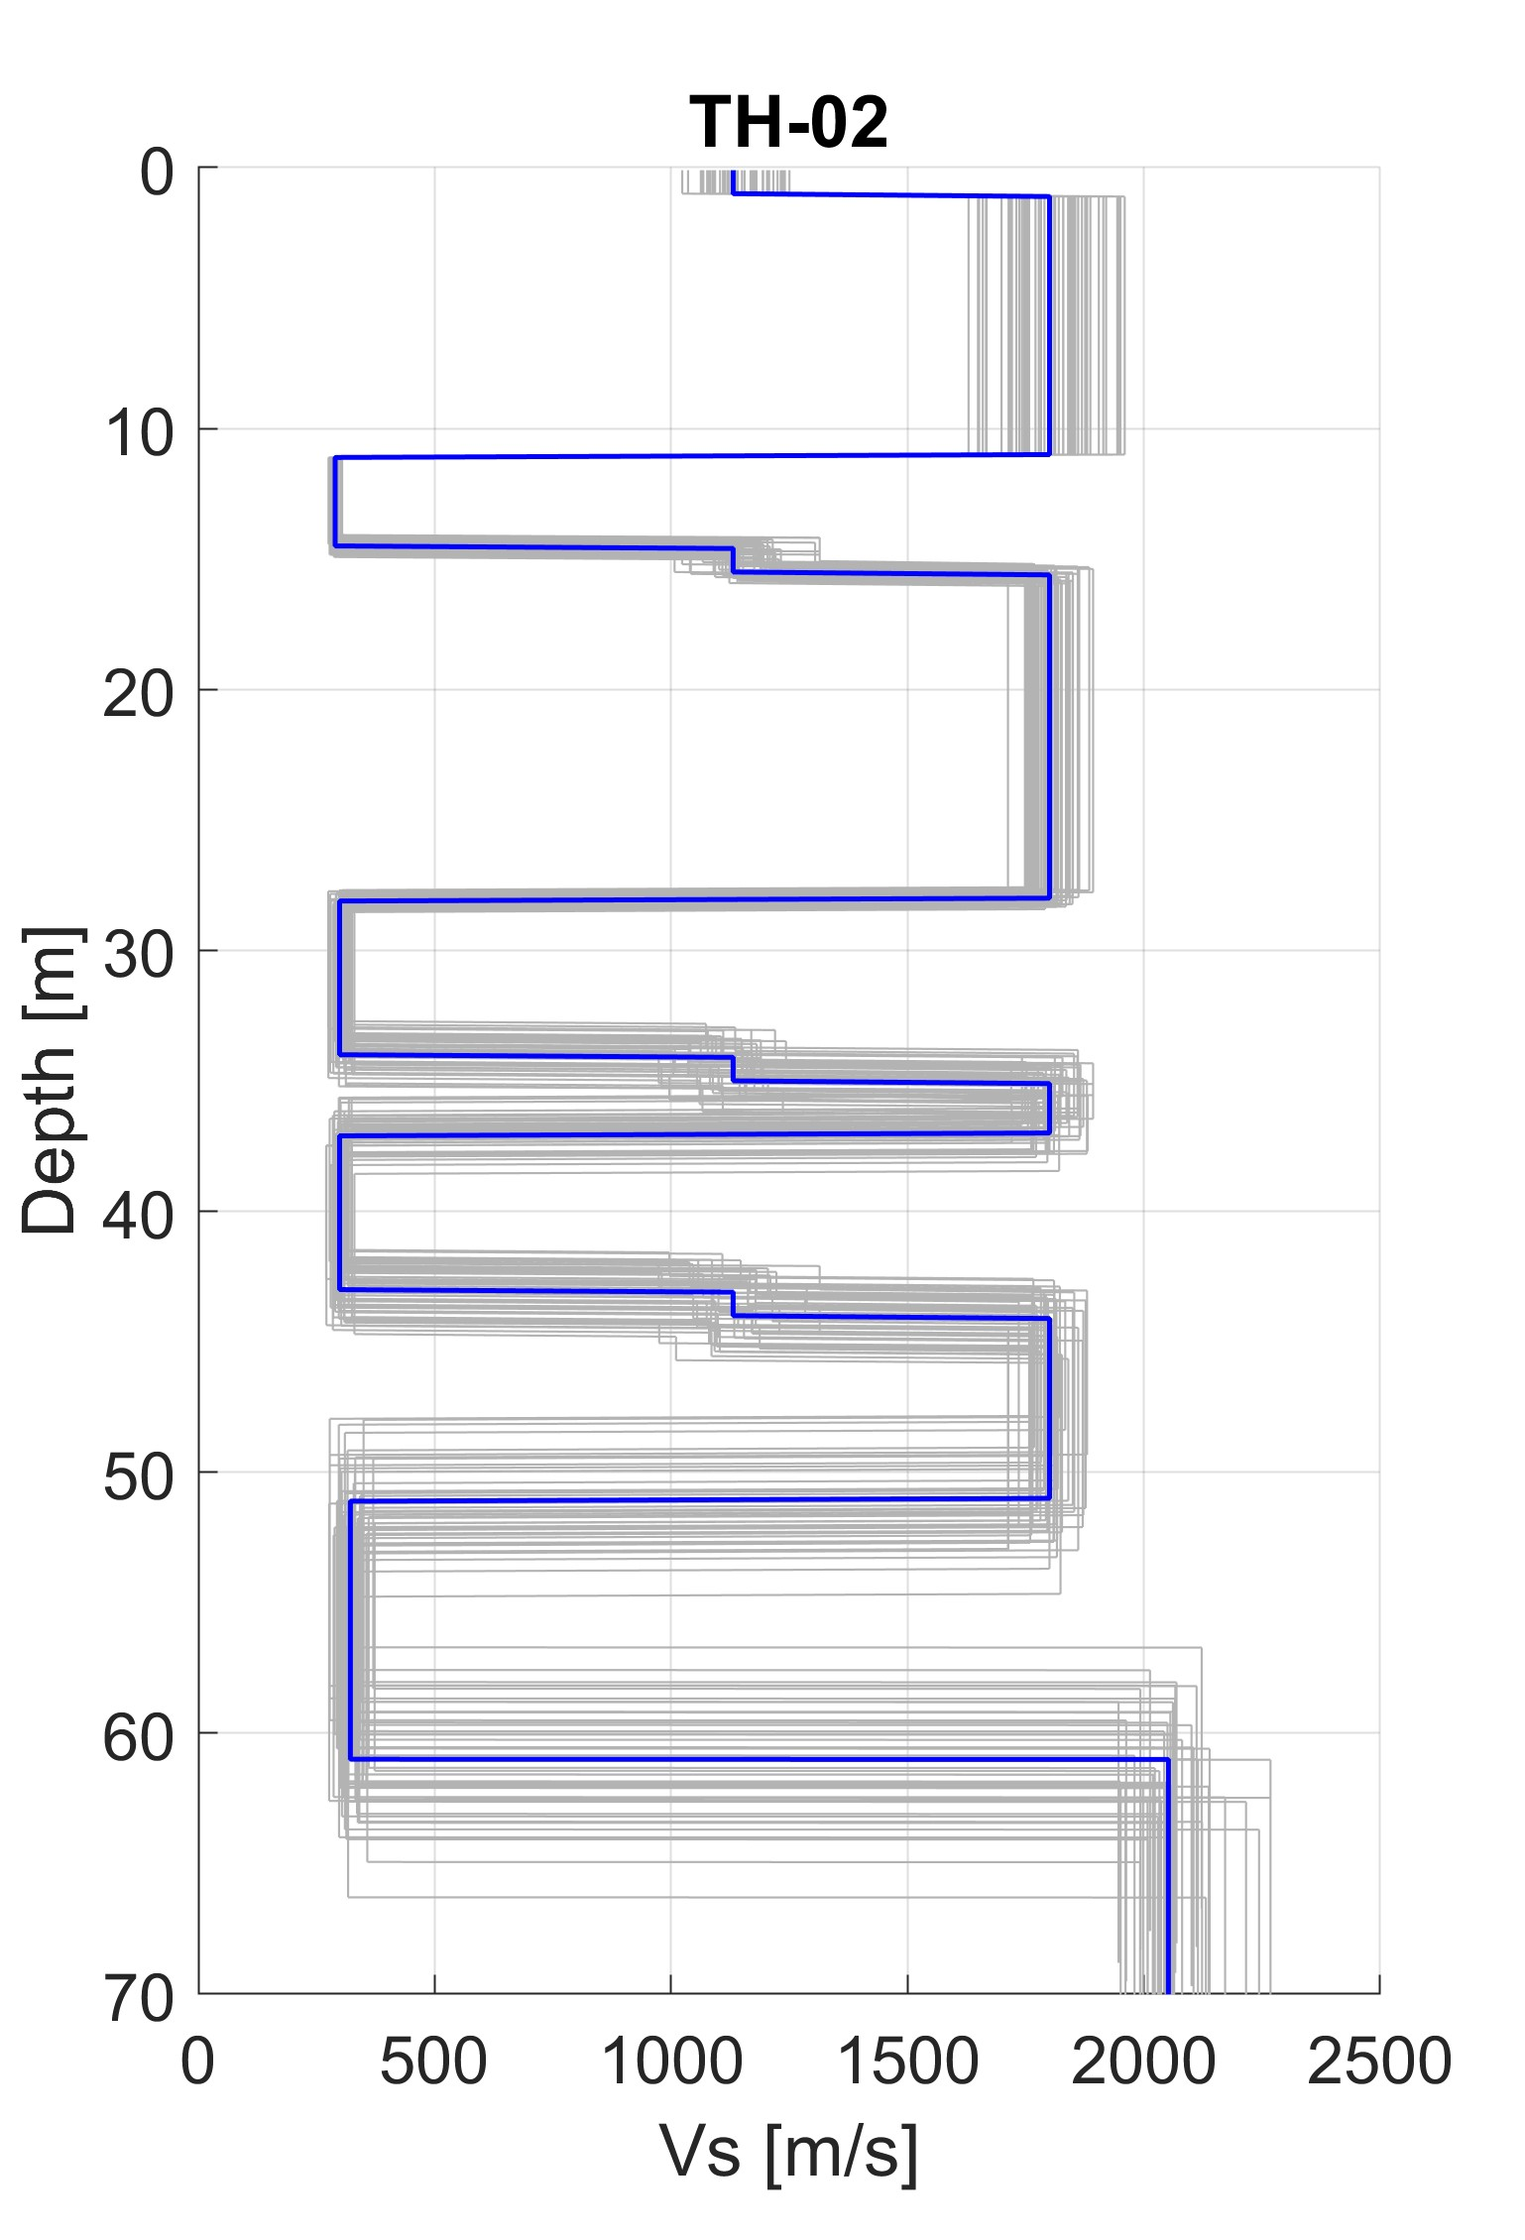
2. Site characterization
Shear-wave velocity (Vs) profiles
Vs₃₀ ~700 m/s
EC8 ground type B

Slide 10
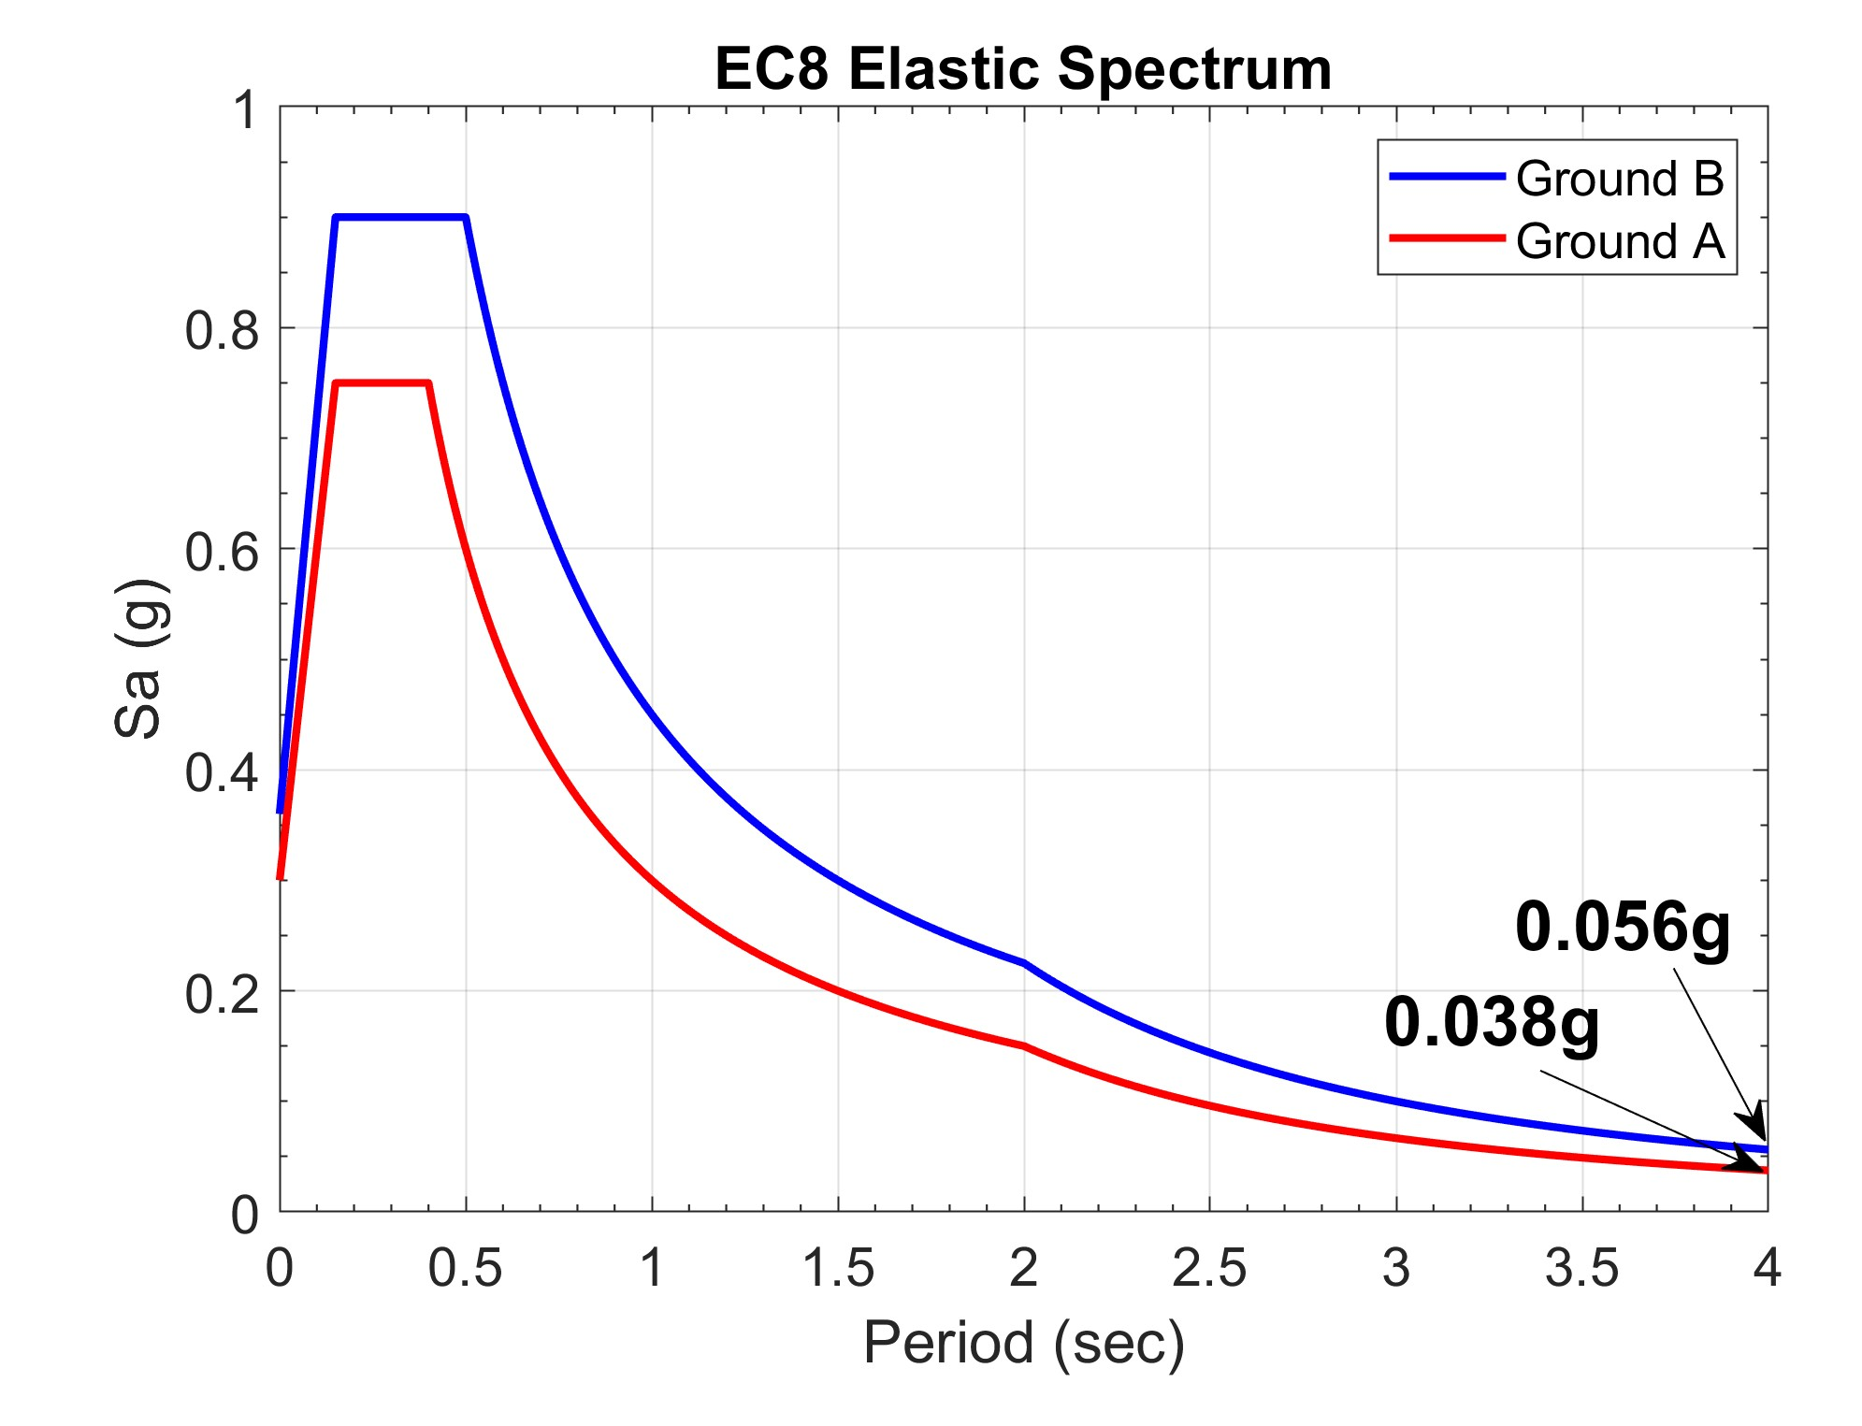
2. Site characterization
EC8 Elastic Spectrum
Vs₃₀ ~700 m/s
EC8 ground type B

Slide 11
Presentation Outline
Overview
Site characterization
PSHA
Physics-based simulations
Seismic actions
Conclusions

Slide 12
3. PSHA
Seismic zones

Slide 13
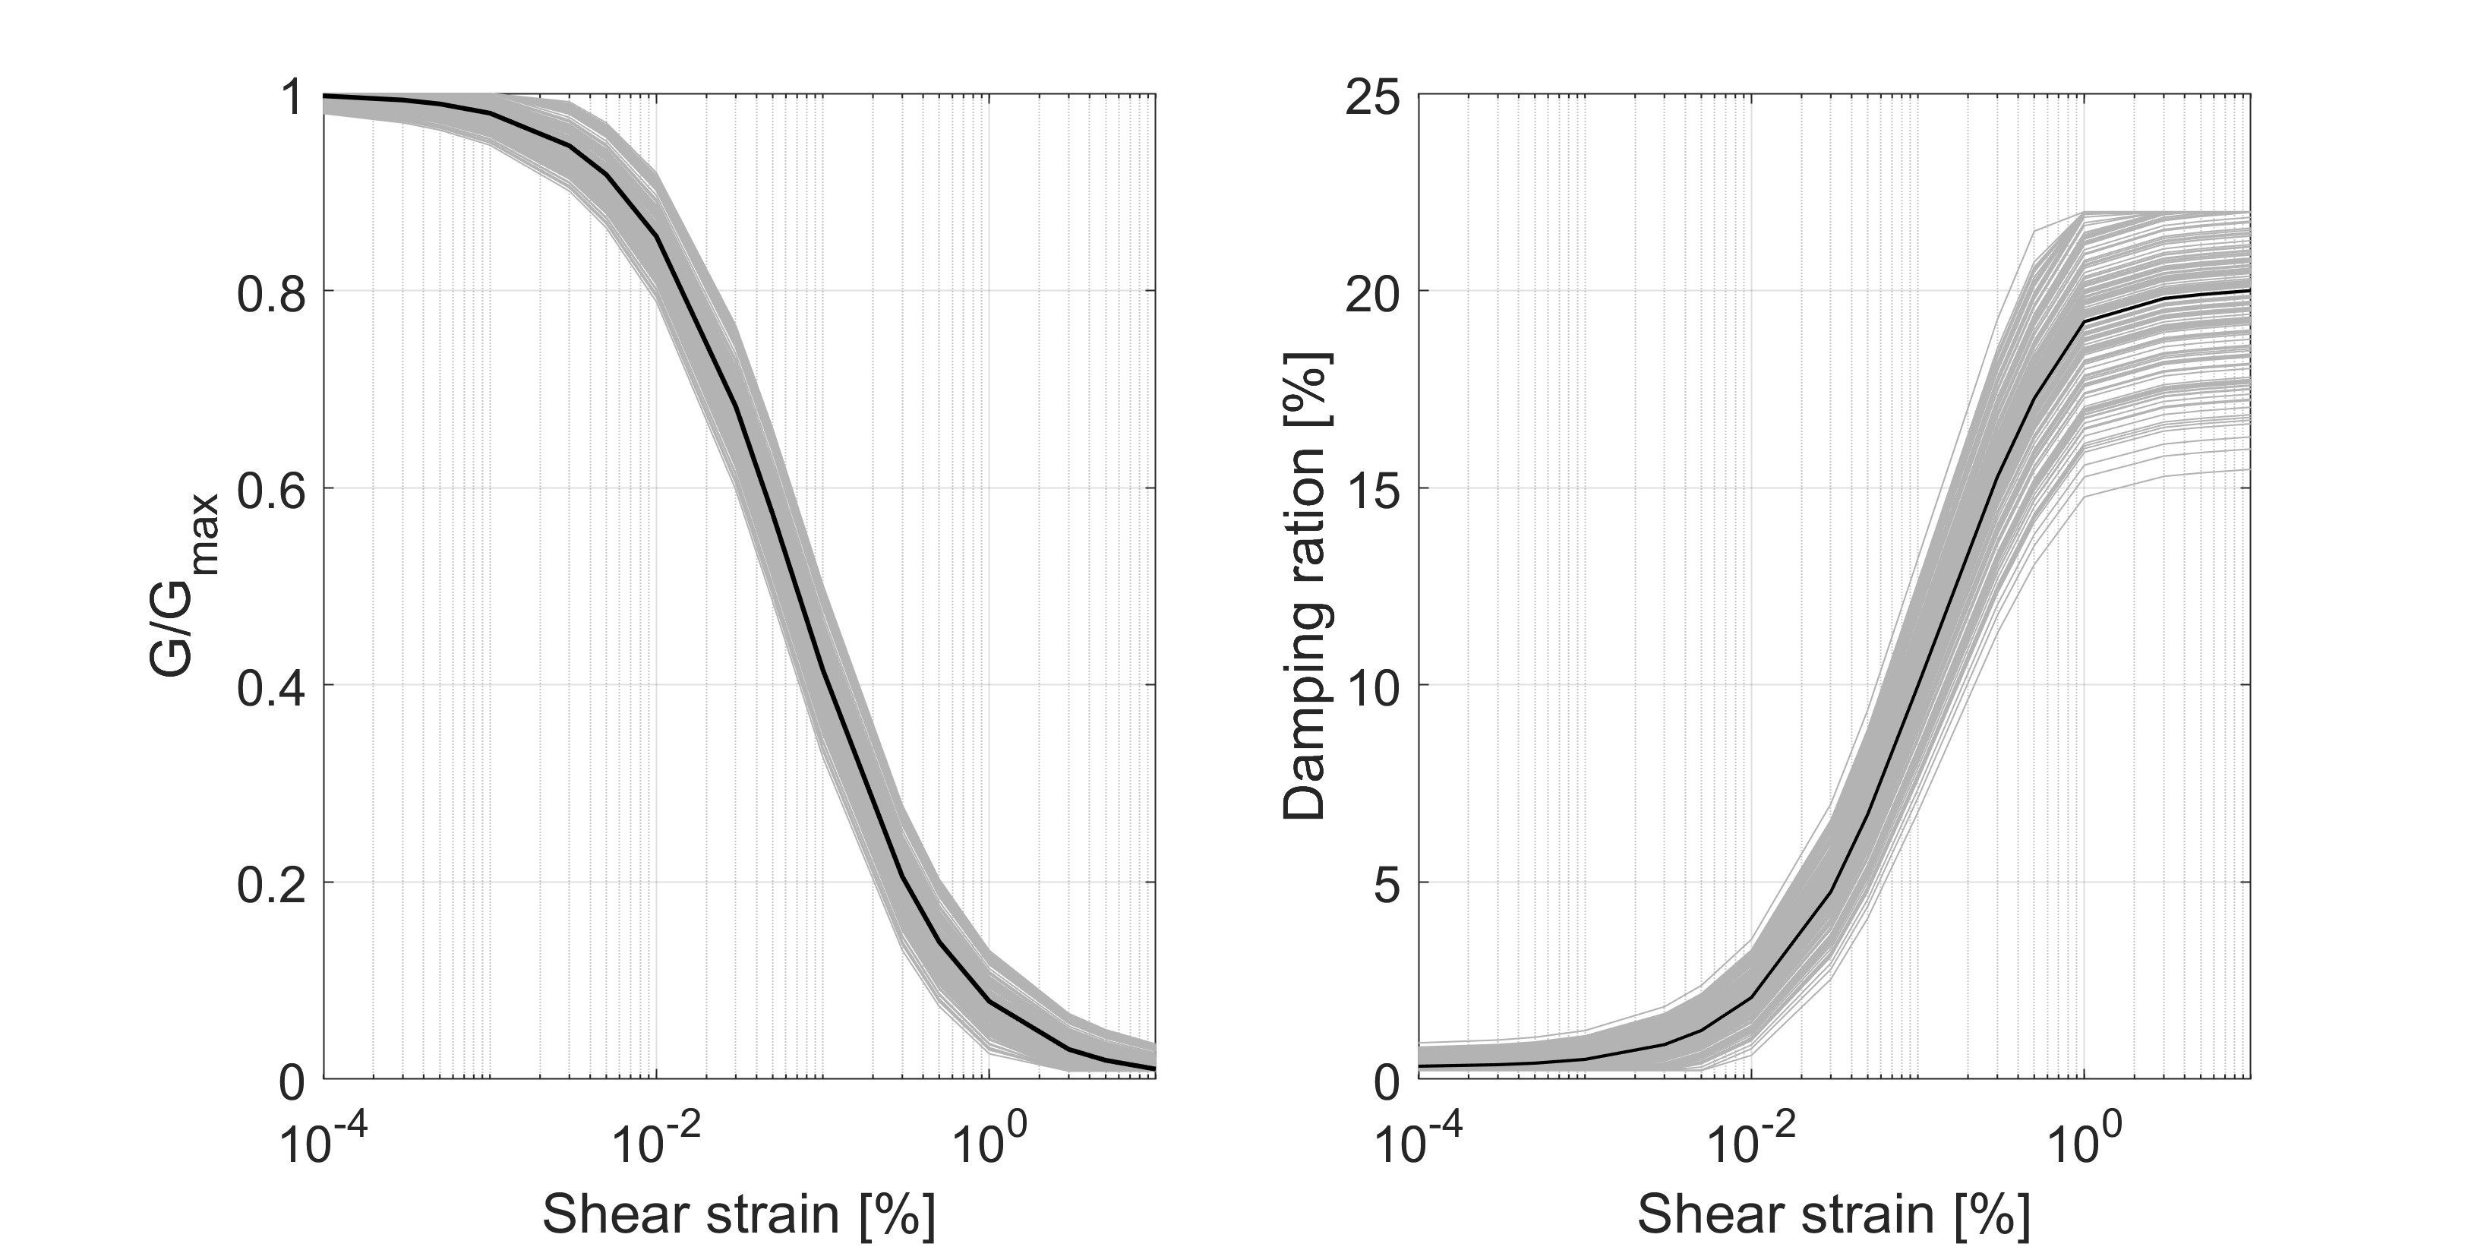
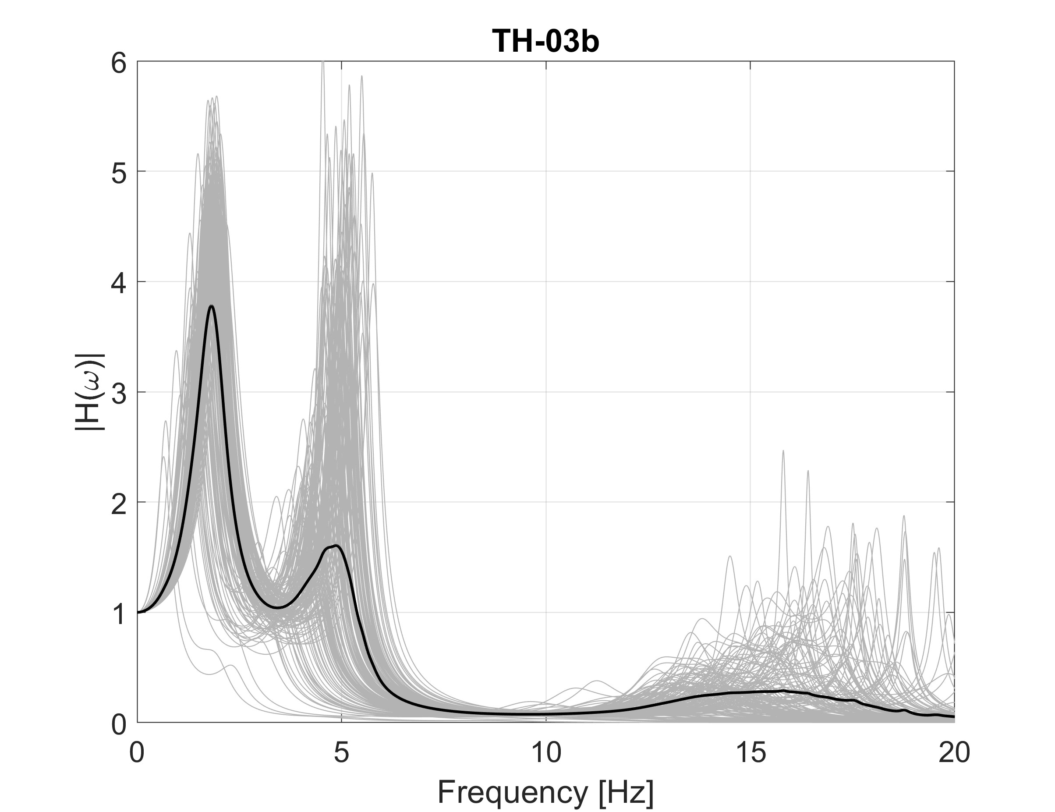
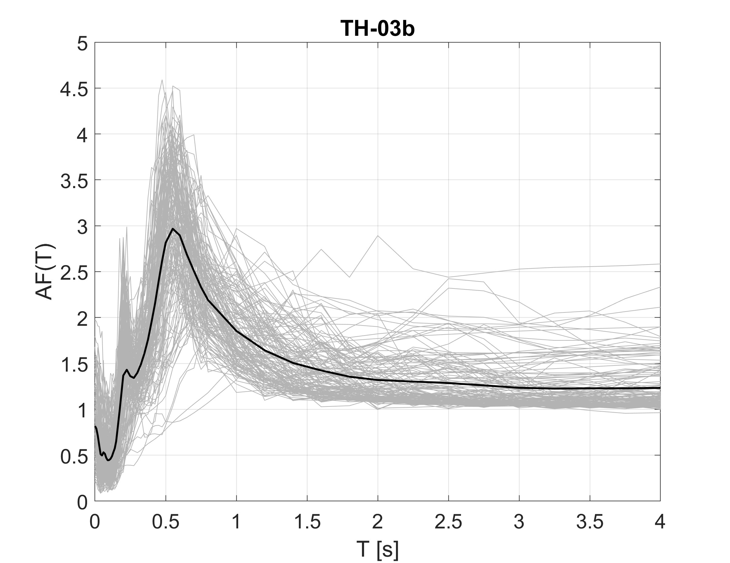

3. PSHA
Including non-linear site response
$$AF\left(T\right)=\frac{{Sa}_{soil}^{}(T)}{{Sa}_{rock}^{}(T)}$$

Slide 14
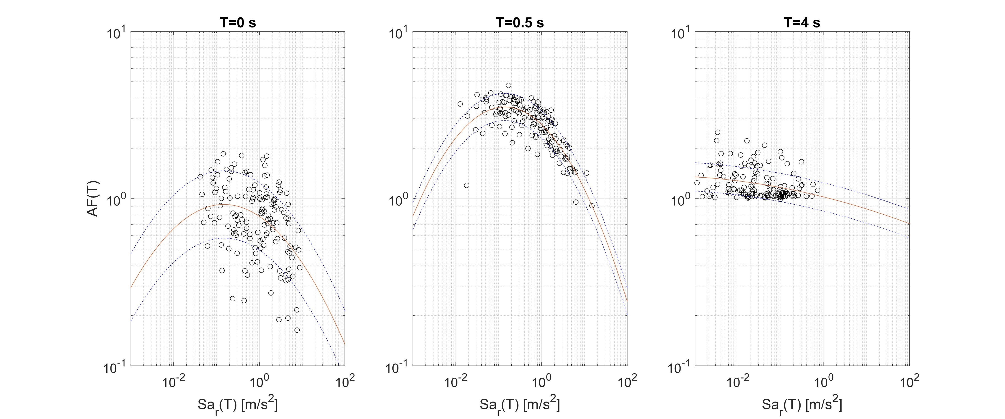

3. PSHA
Including non-linear site response
log(AF)=a+b*log(Sa_{r})+c*log(Sa_{r})²+ɛσ
$${Sa}_{s}^{}\left(T\right)=AF\left(T\right)∙{Sa}_{r}^{}(T)$$

Slide 15
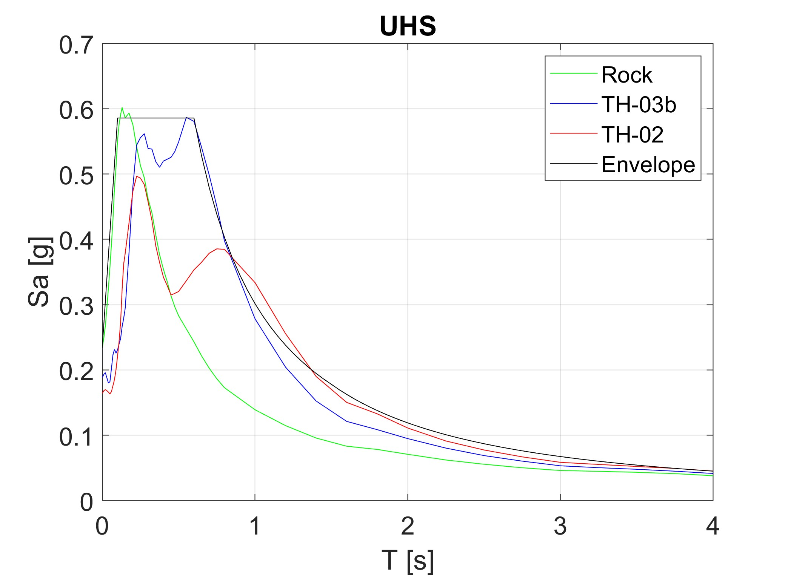
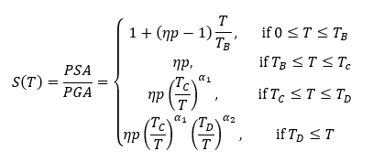
3. PSHA
PGA | T_{B} | T_{C} | T_{D} | p | η | α₁ | α₂
0.234 | 0.1 | 0.22 | 2.5 | 2.5 | 1.0 | 1.3 | 0.1

Slide 16
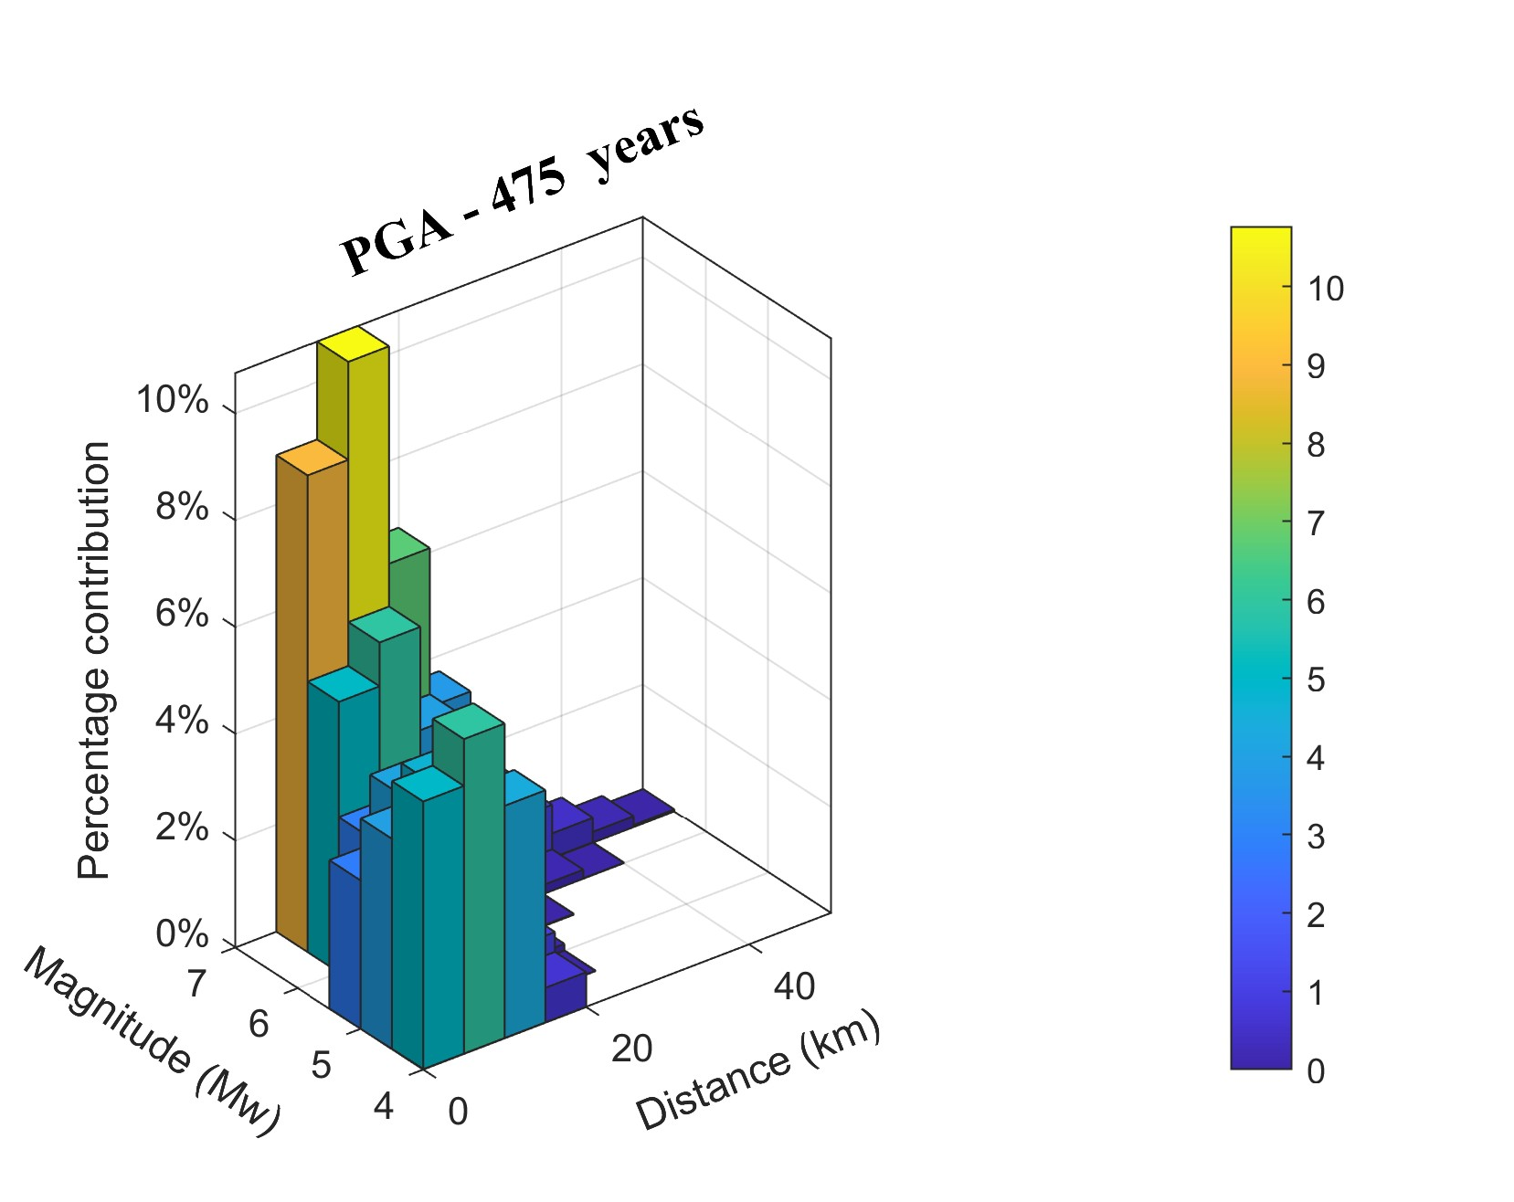
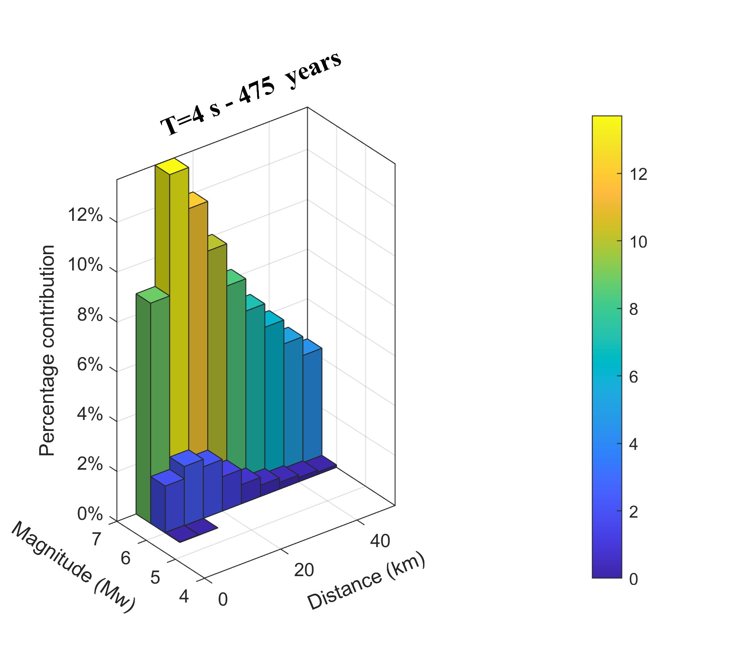
3. PSHA
Deaggregation

Slide 17
Presentation Outline
Overview
Site characterization
PSHA
Physics-based simulations
Seismic actions
Conclusions

Slide 18
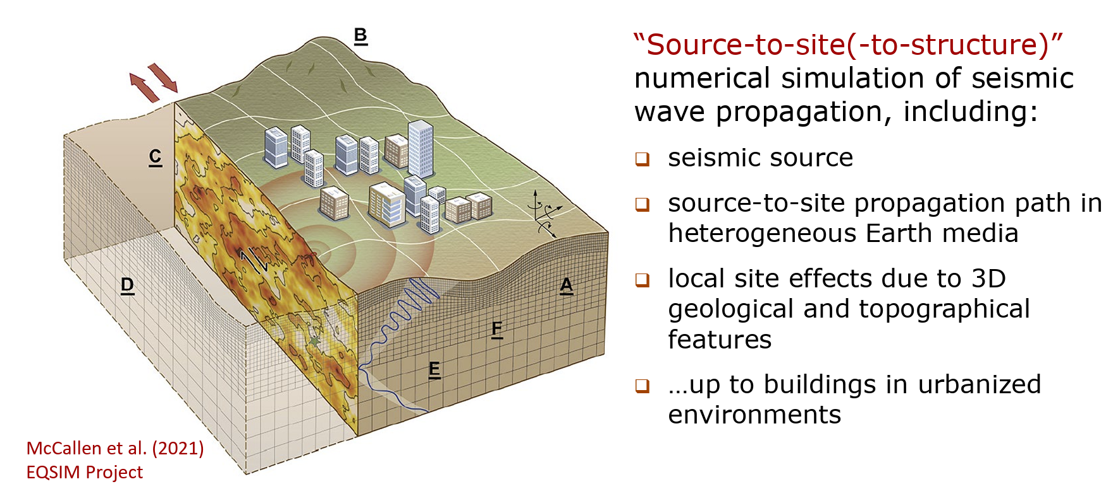
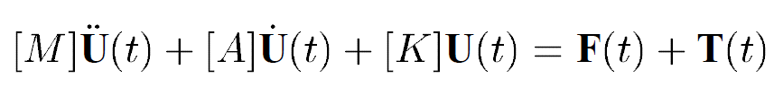
4. Physics-based simulations (PBS) a
Notes:
We incorporated aleatory uncertainties in key parameters defining the seismic rupture

Slide 19
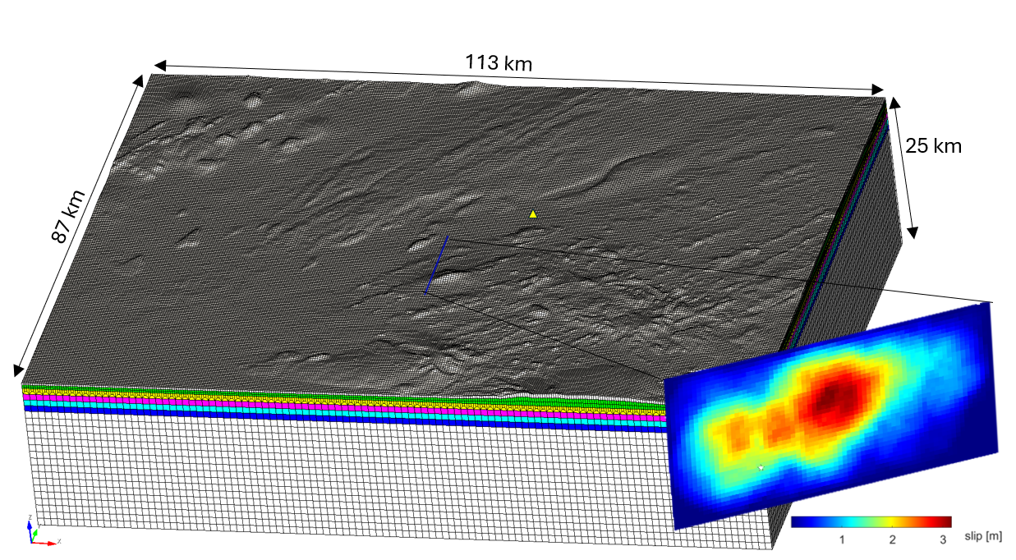
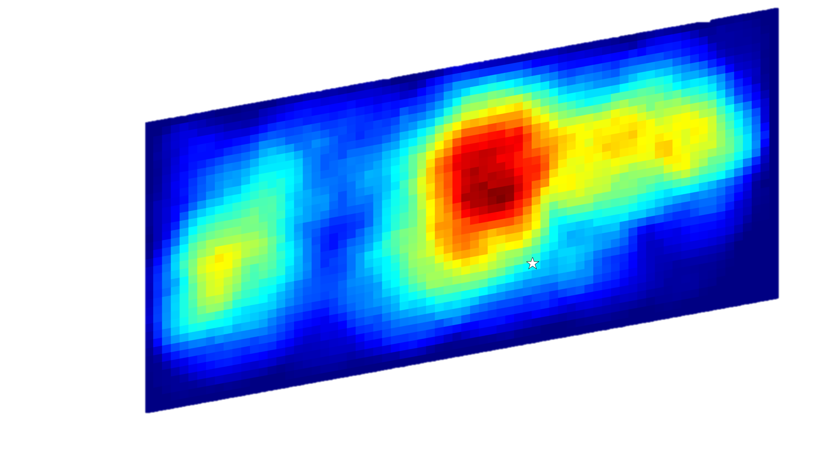
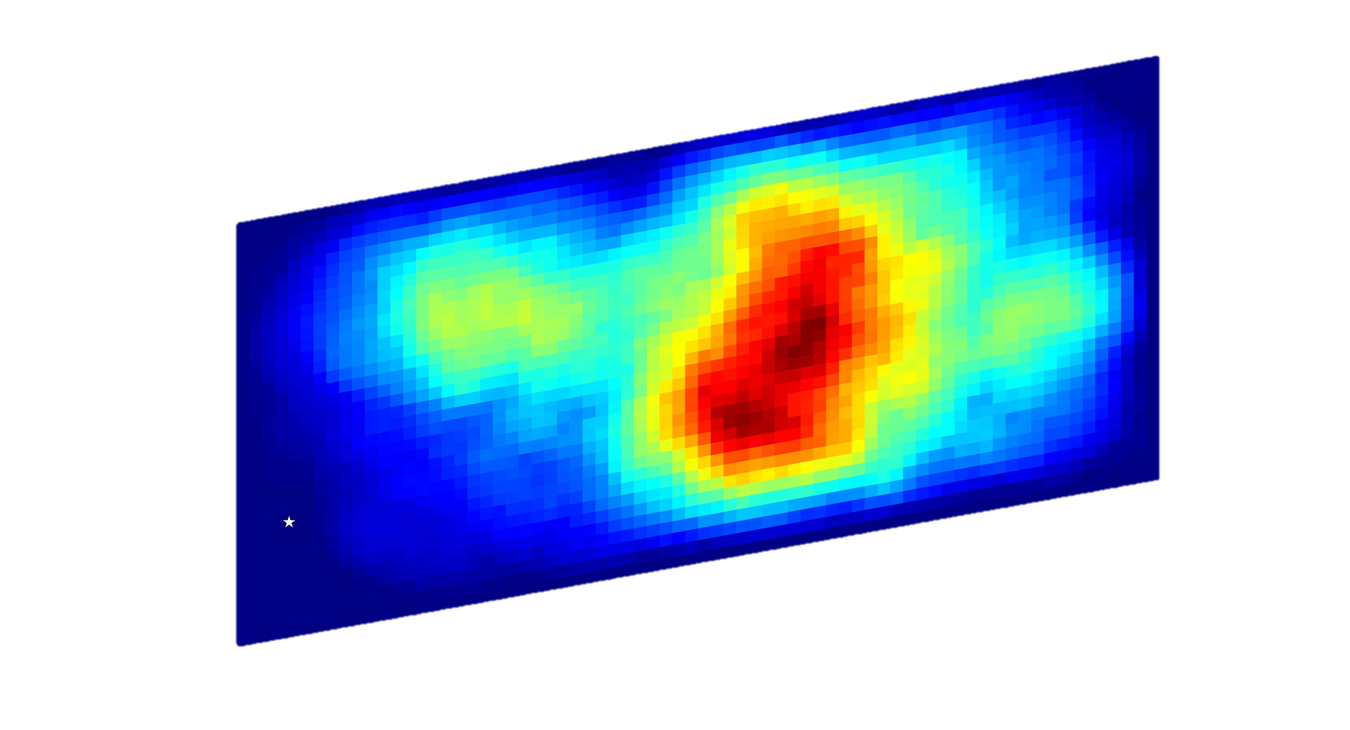
4. Physics-based simulations (PBS)
Numerical model
10-15 km
Notes:
We incorporated aleatory uncertainties in key parameters defining the seismic rupture

Slide 20
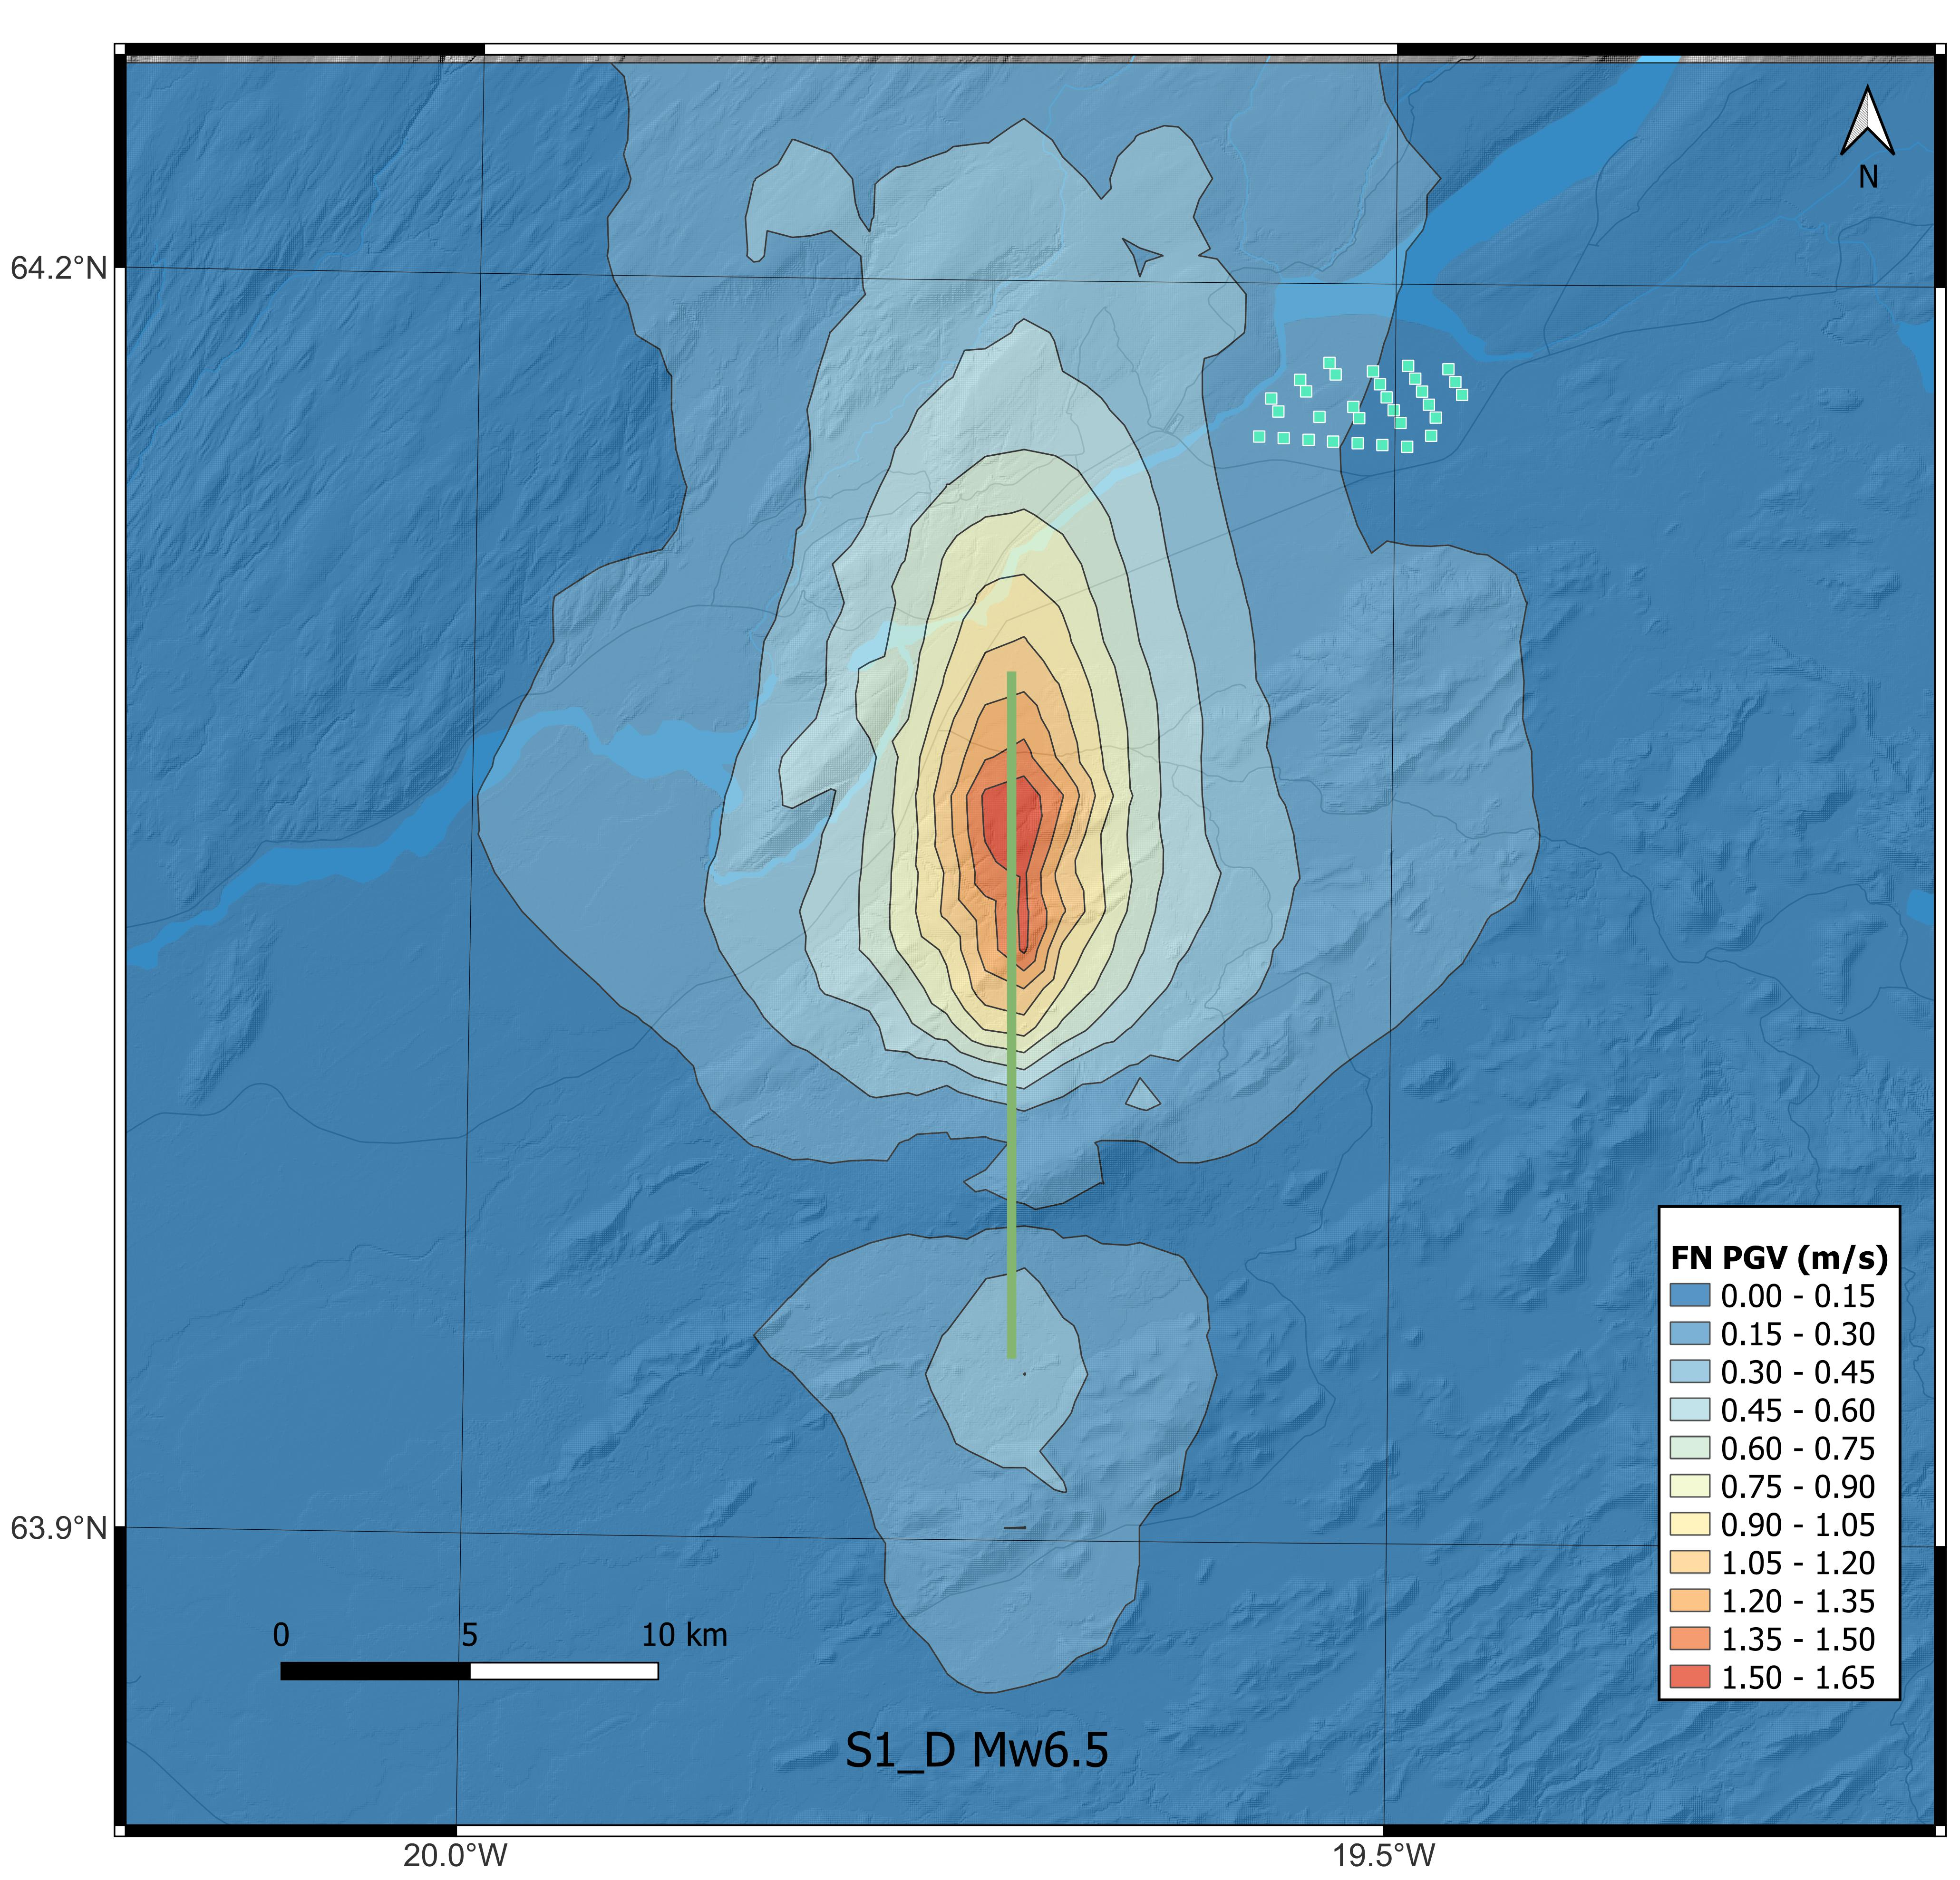
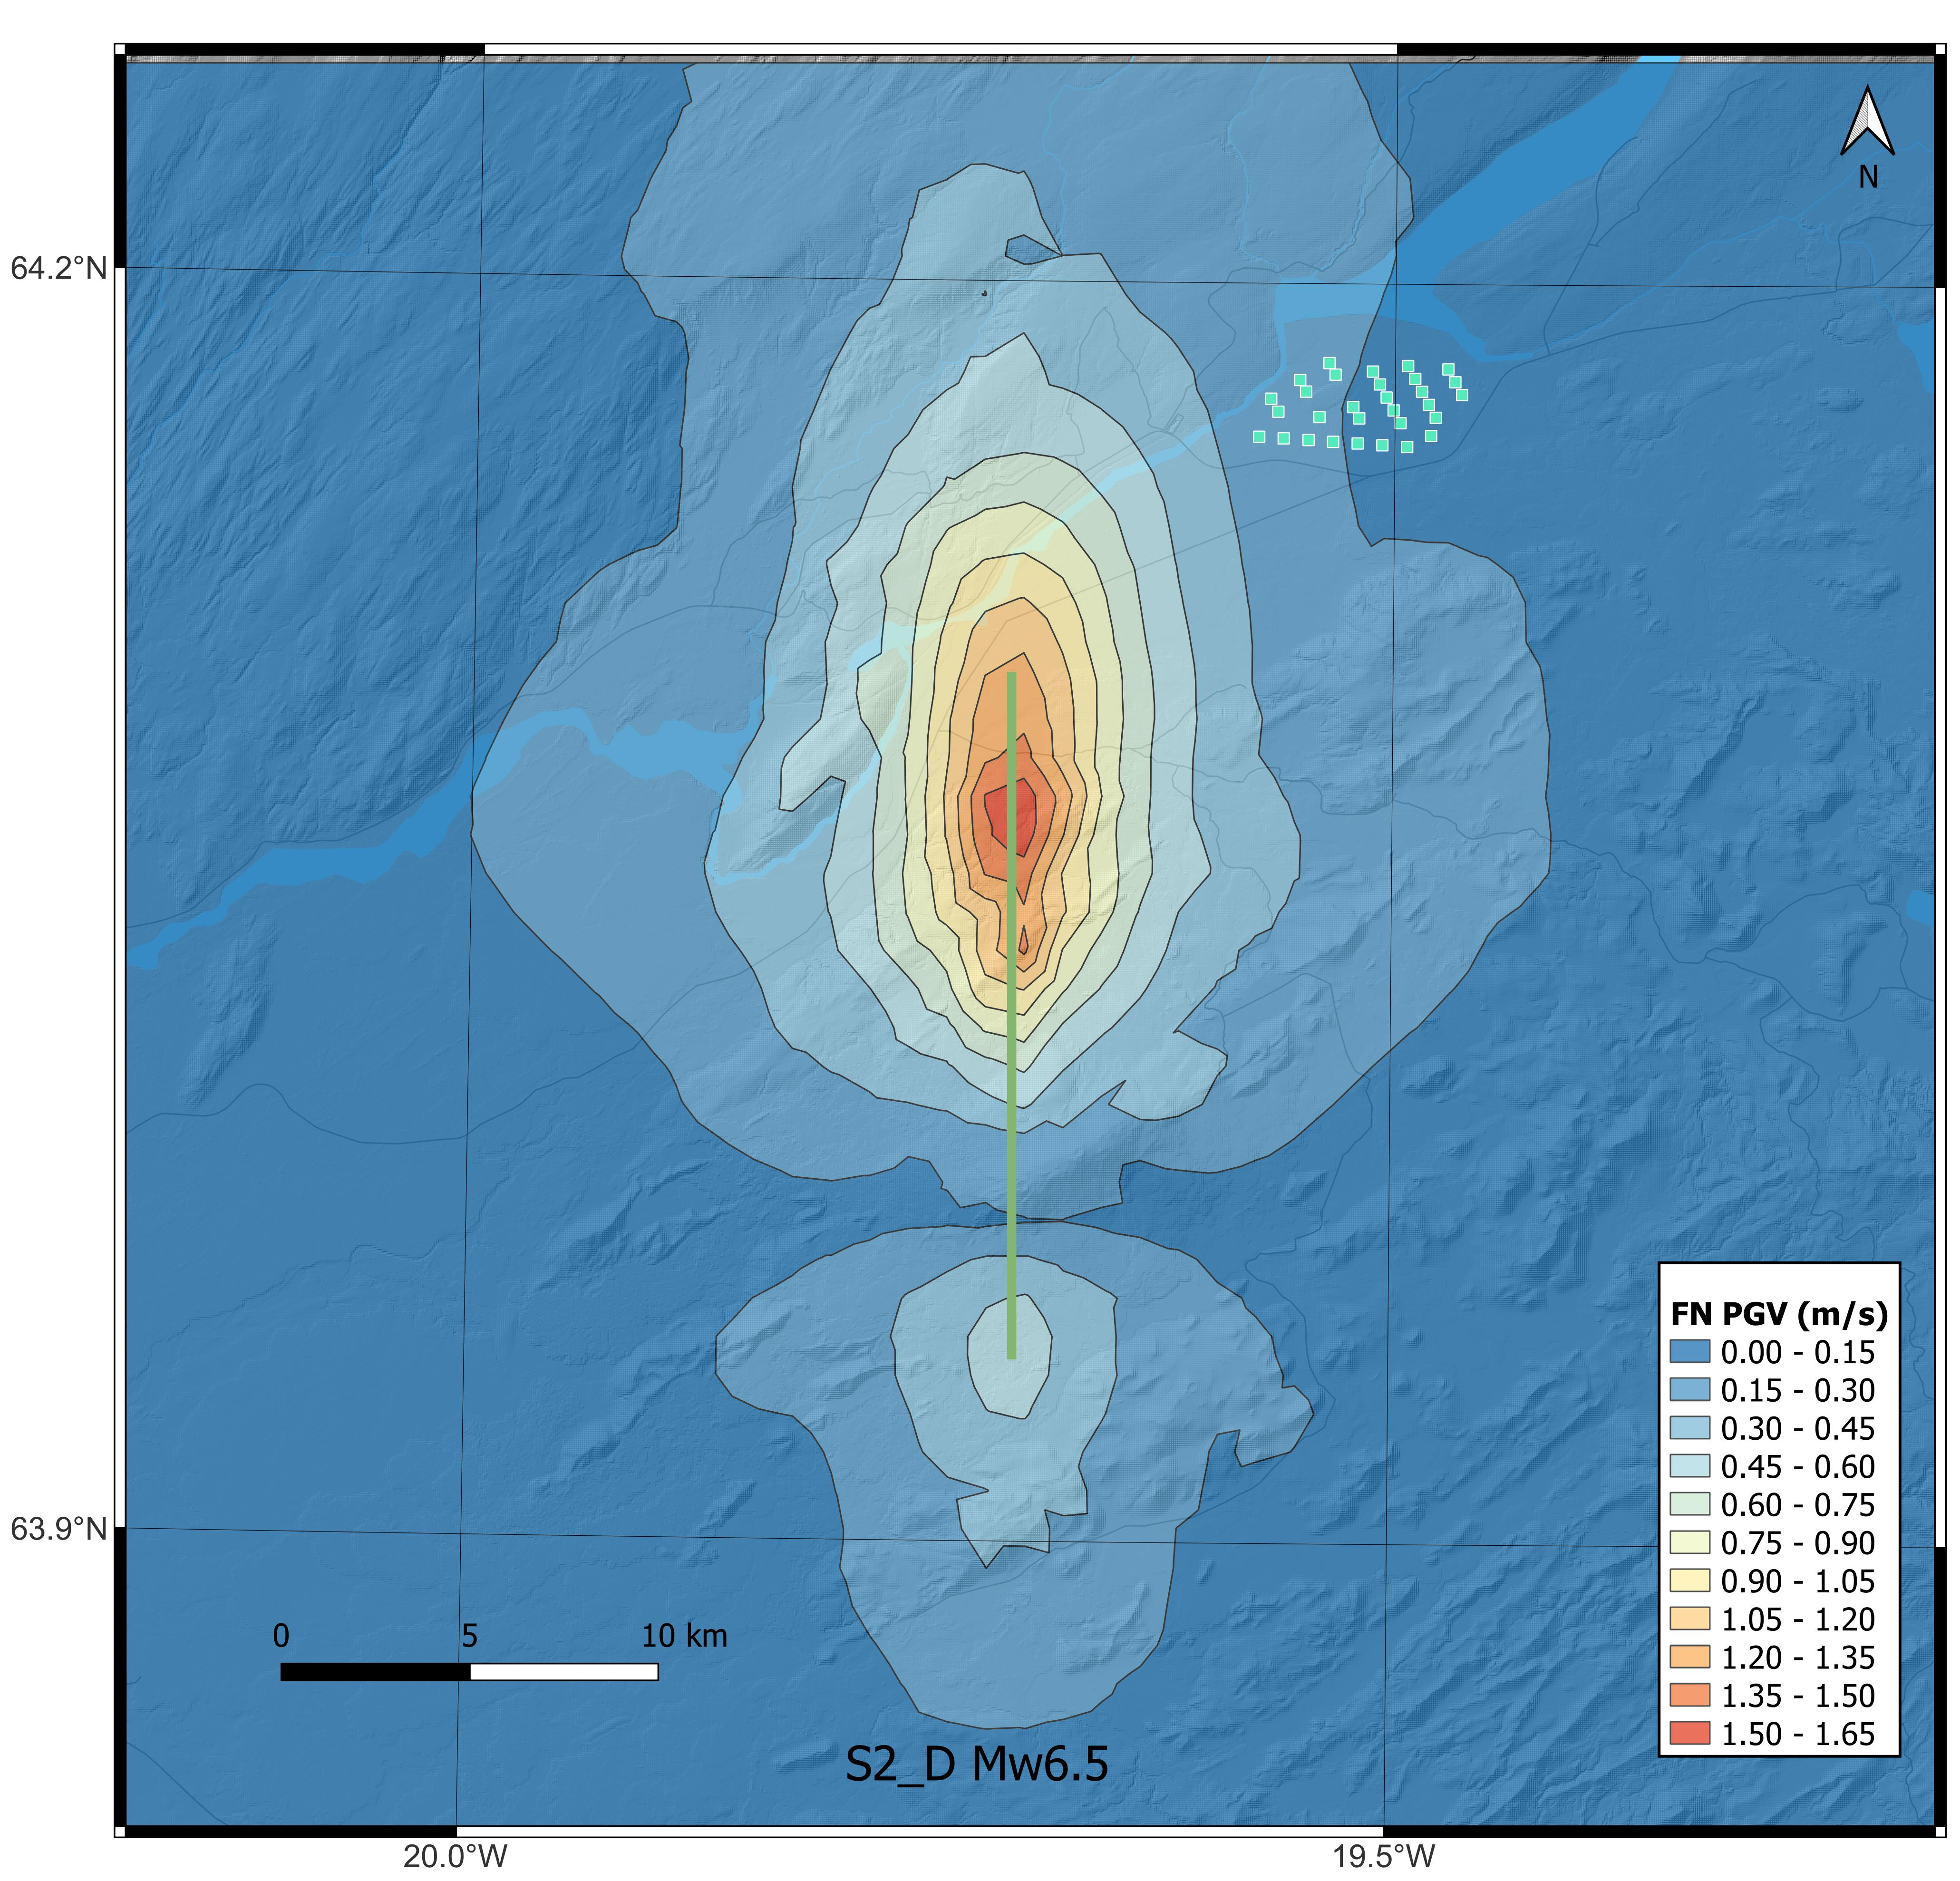
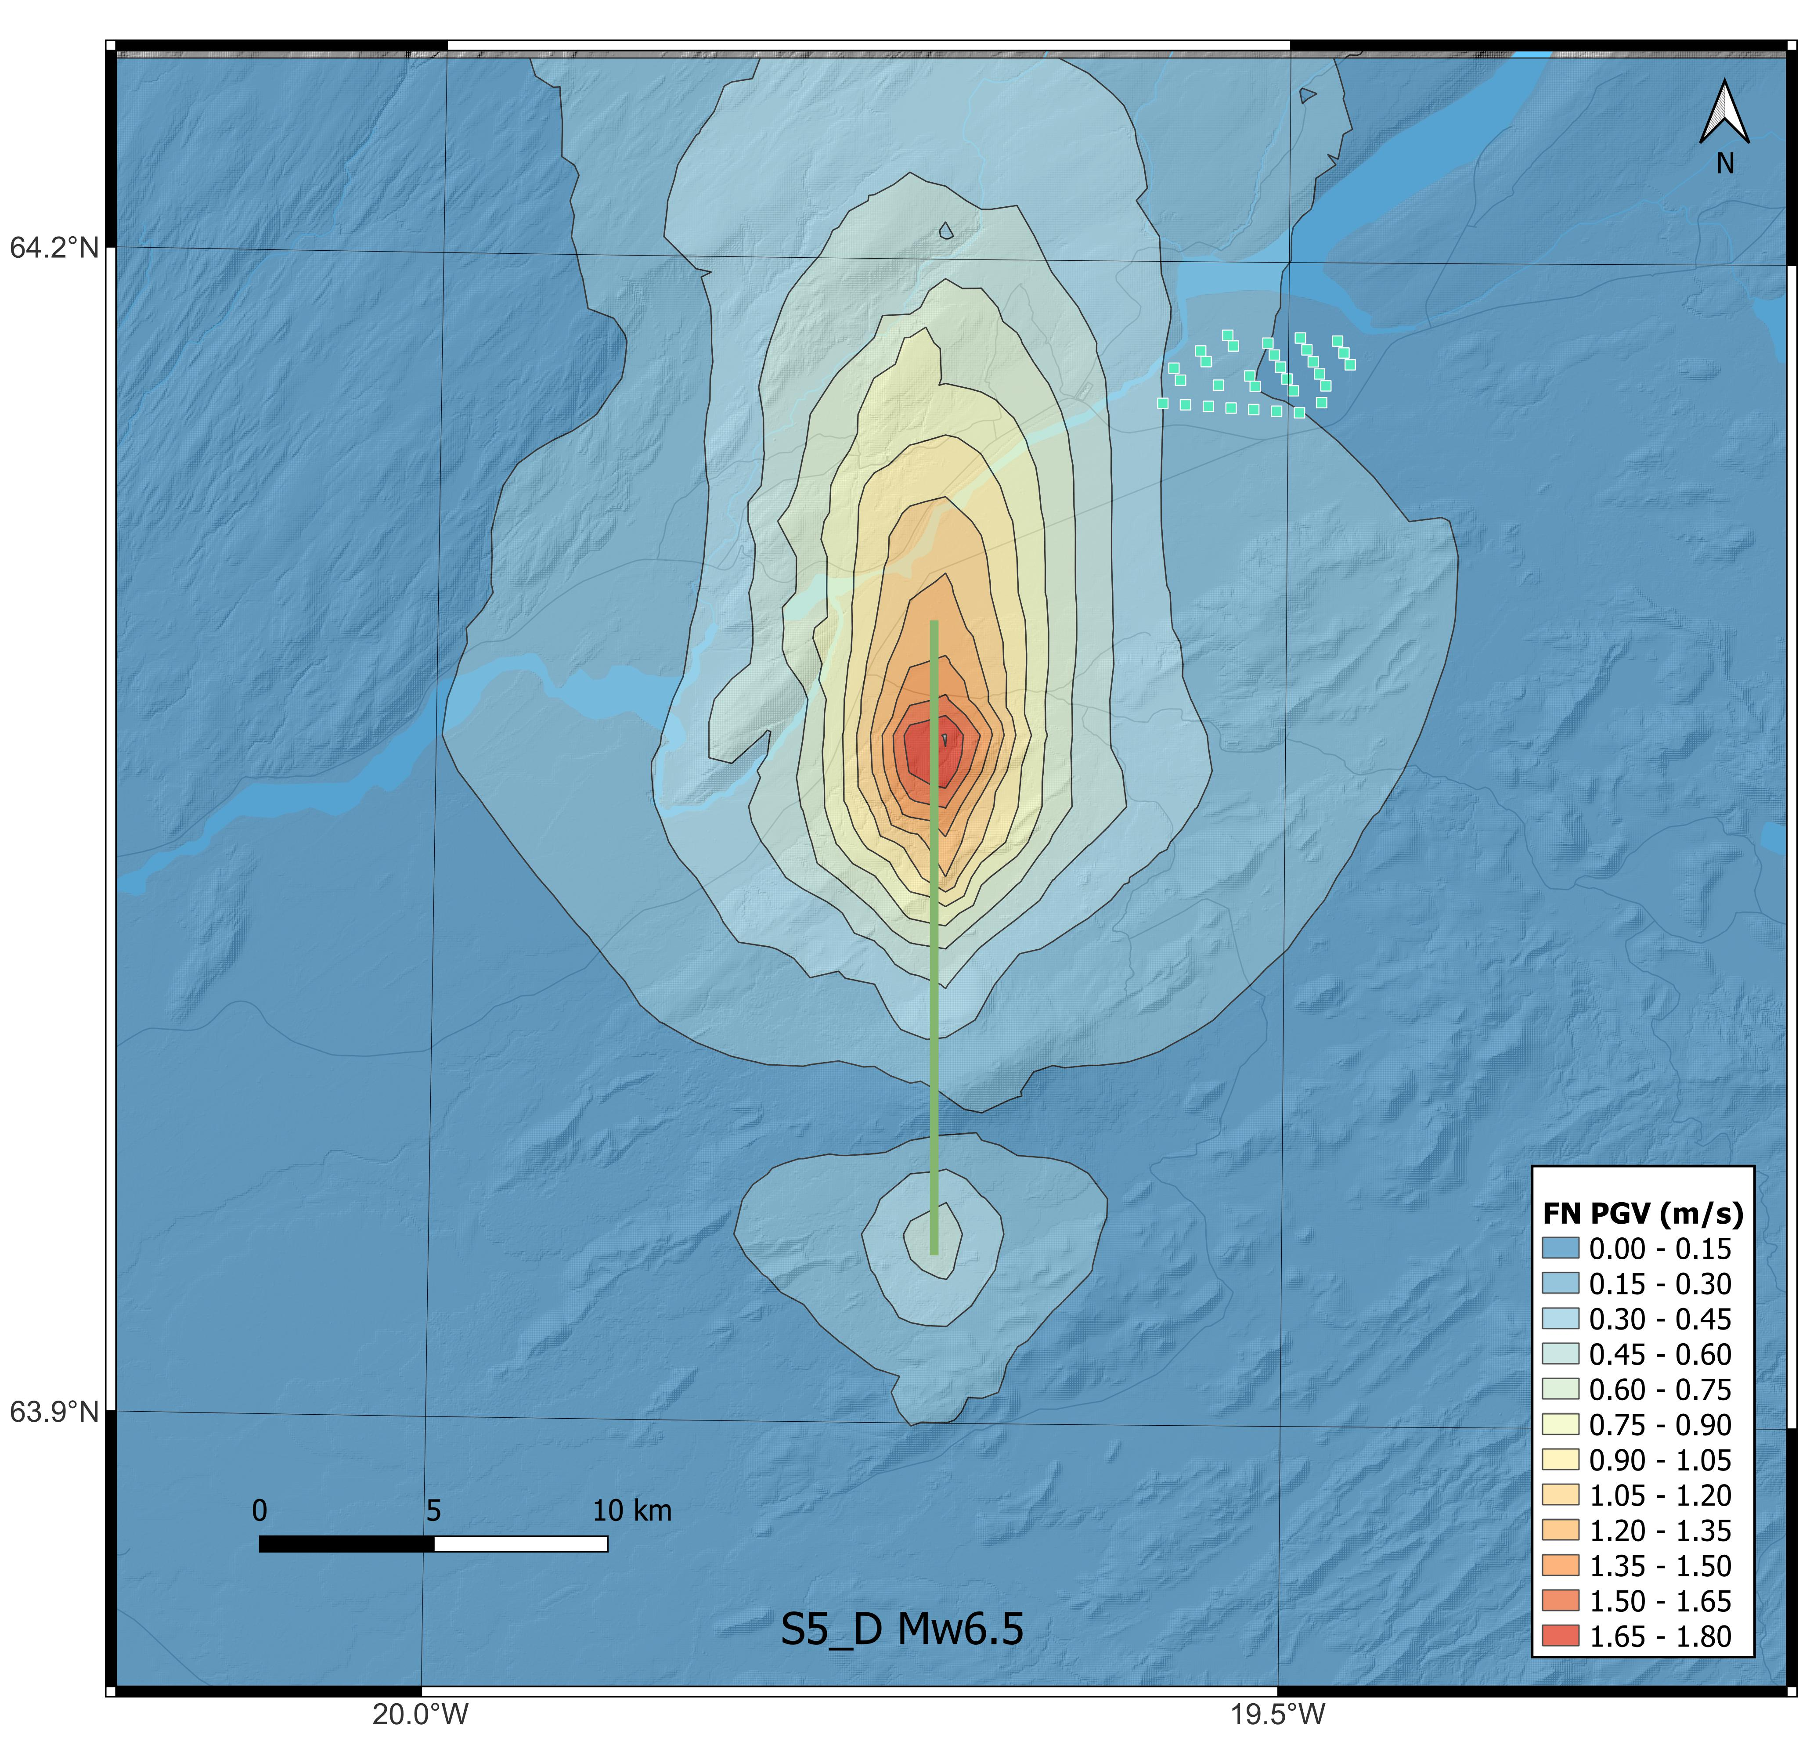
4. Physics-based simulations
Fault-normal PGV – Mw6.5

Slide 21
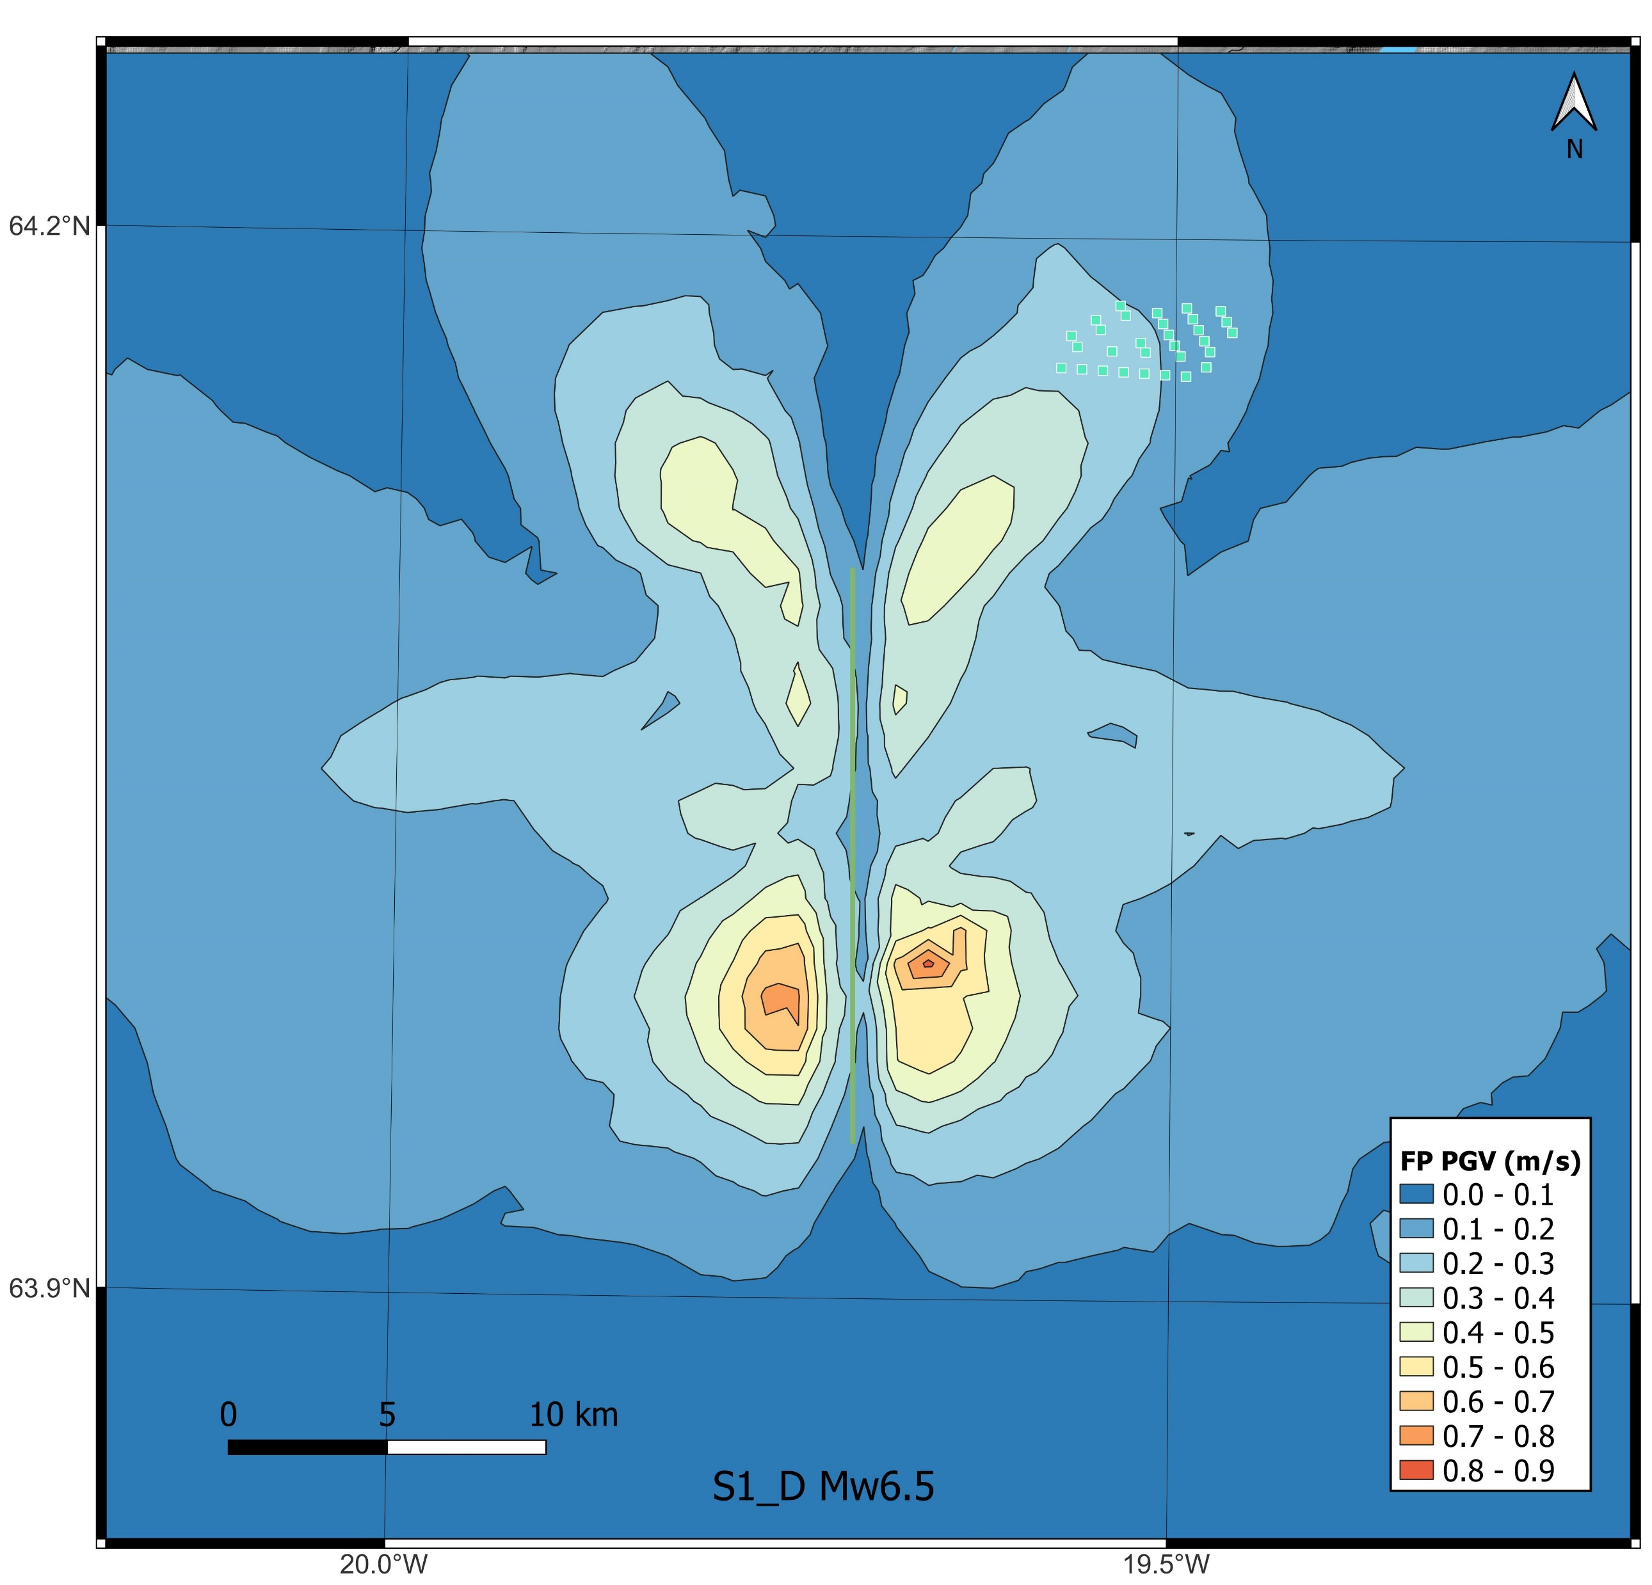
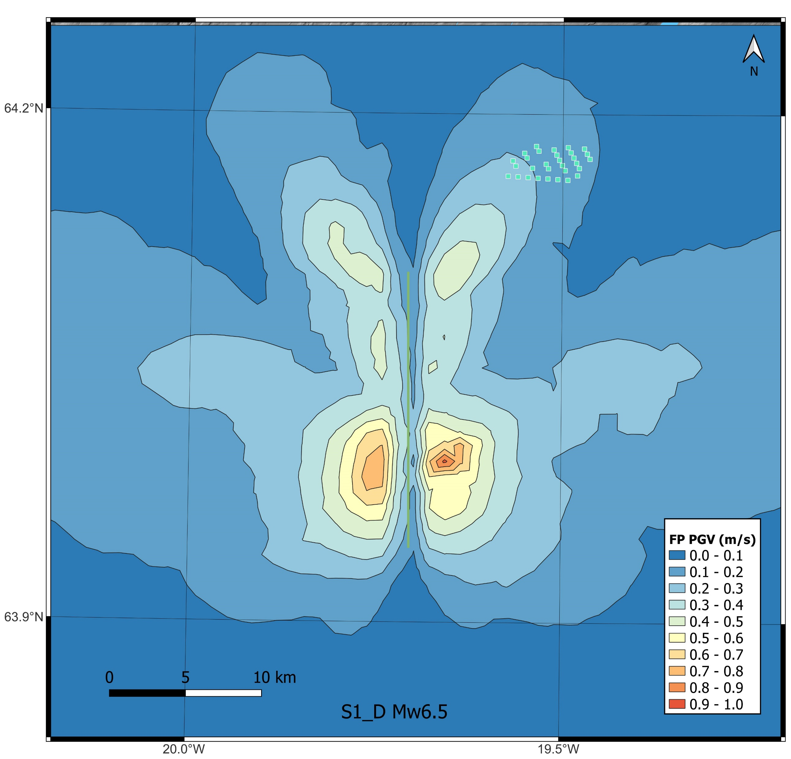
4. Physics-based simulations
Fault-parallel PGV – Mw6.5

Slide 22
Presentation Outline
Overview
Site characterization
PSHA
Physics-based simulations
Seismic actions
Conclusions

Slide 23
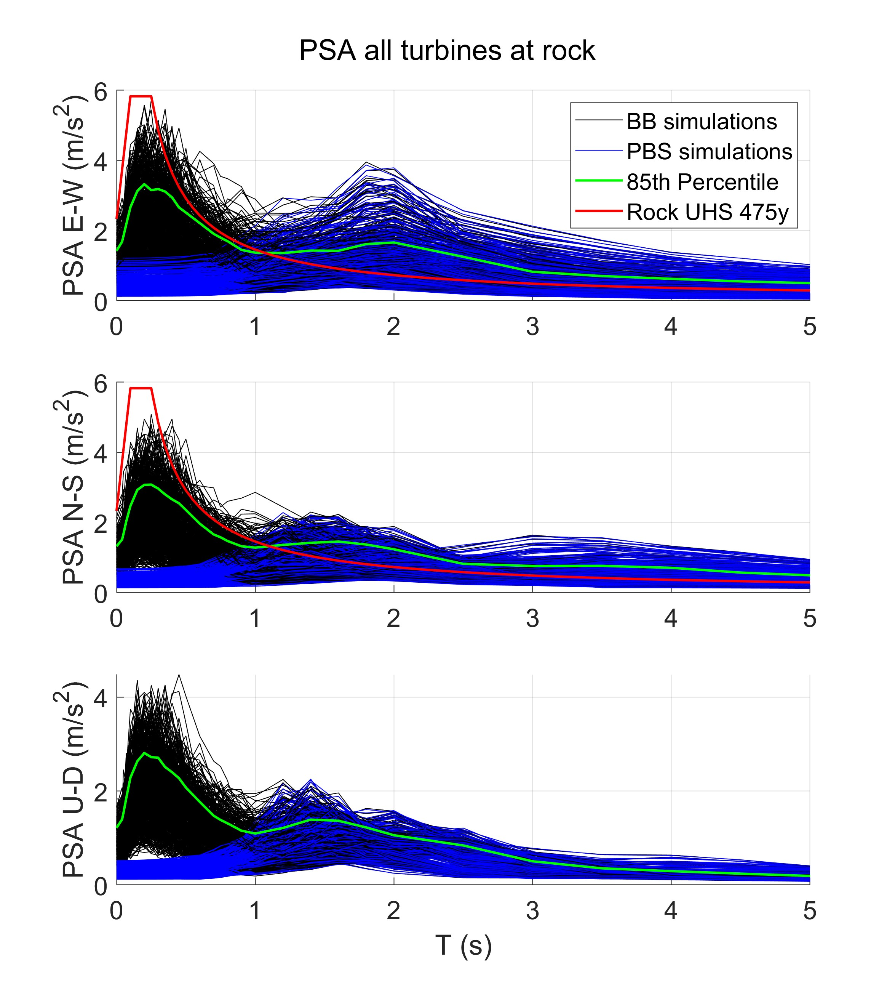
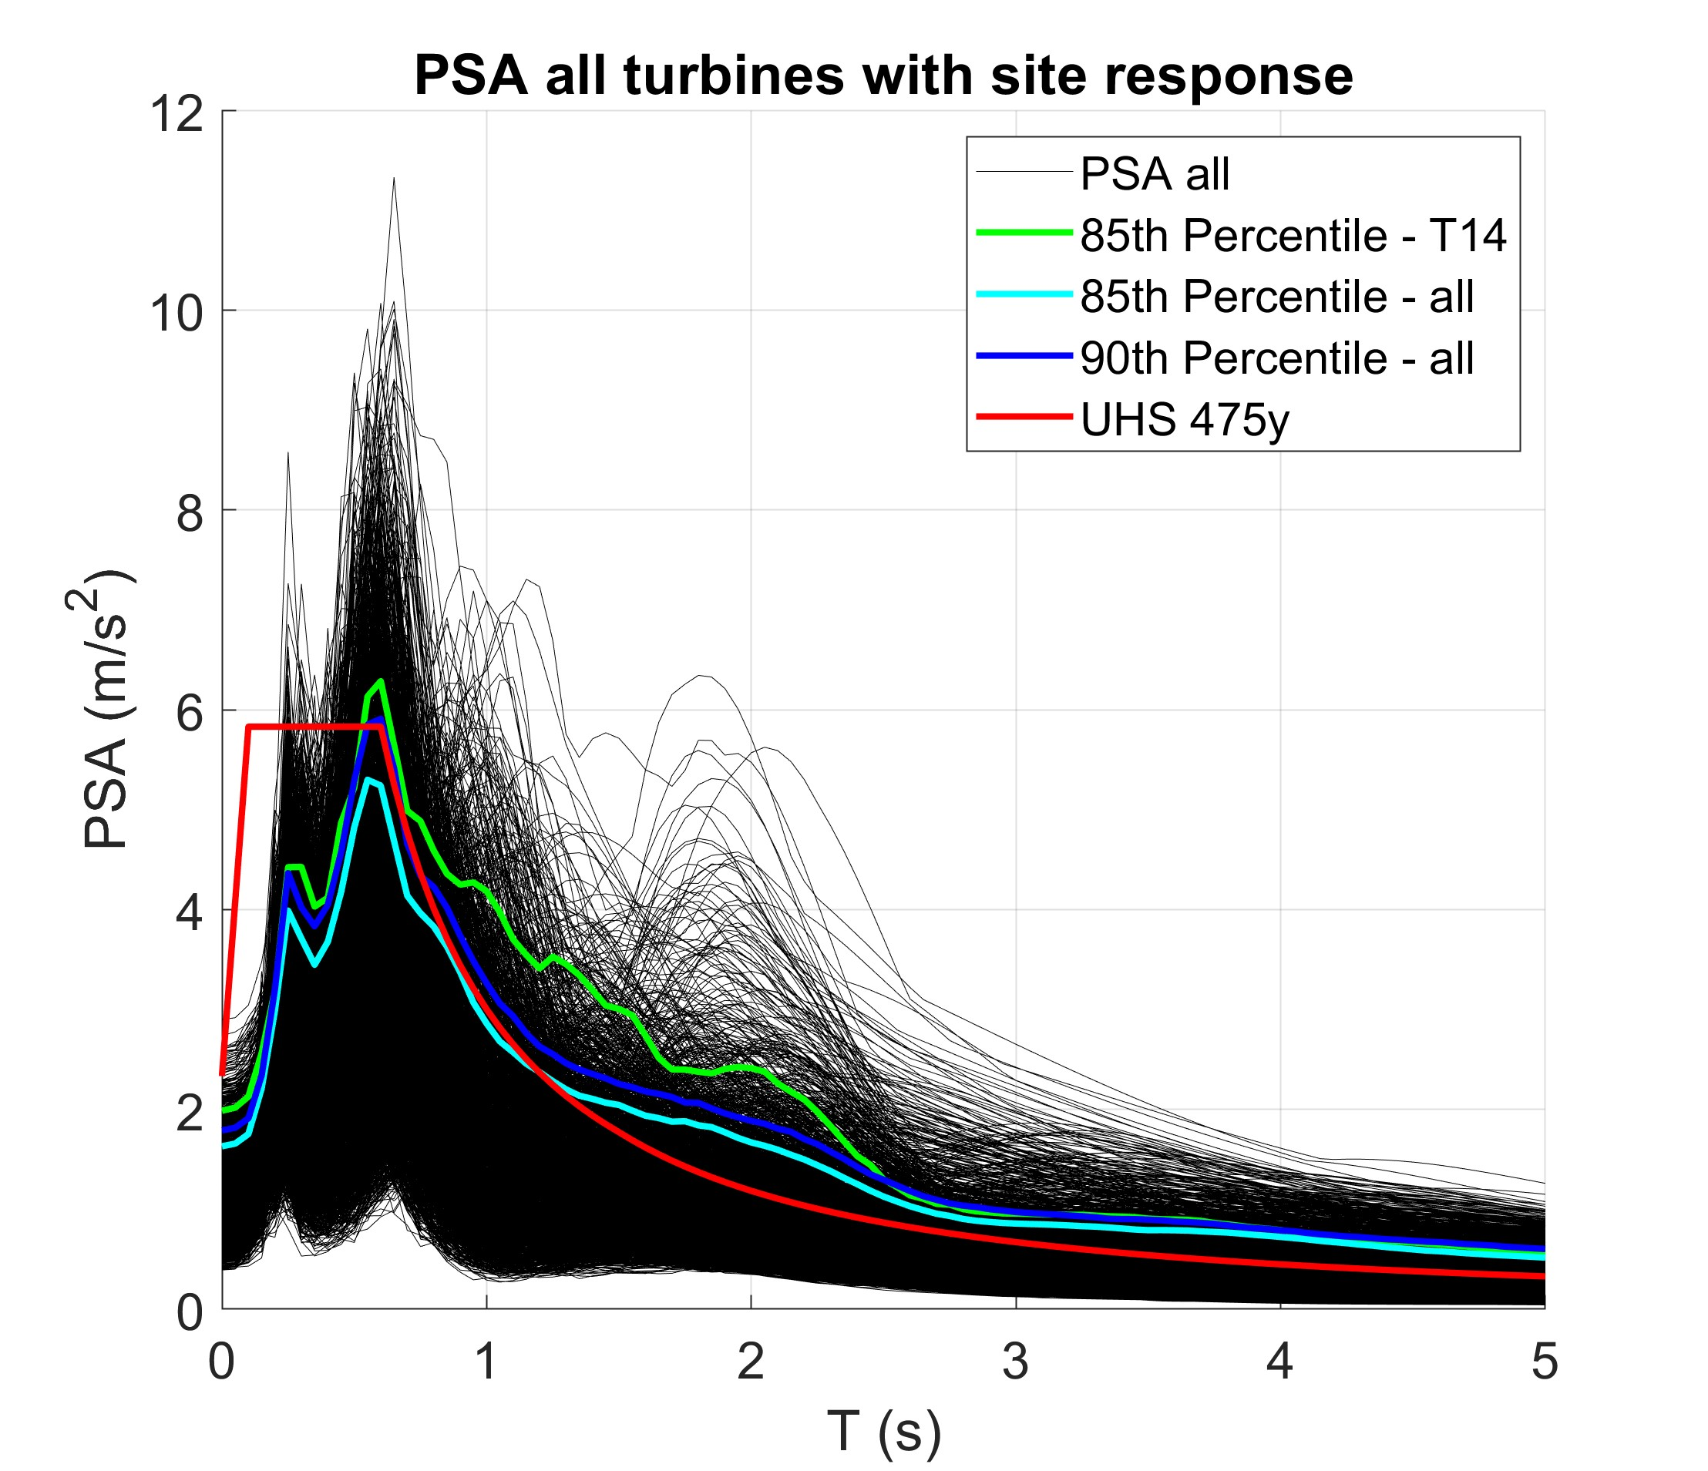
5. Seismic actions
Acceleration response spectra (PSA)

Slide 24
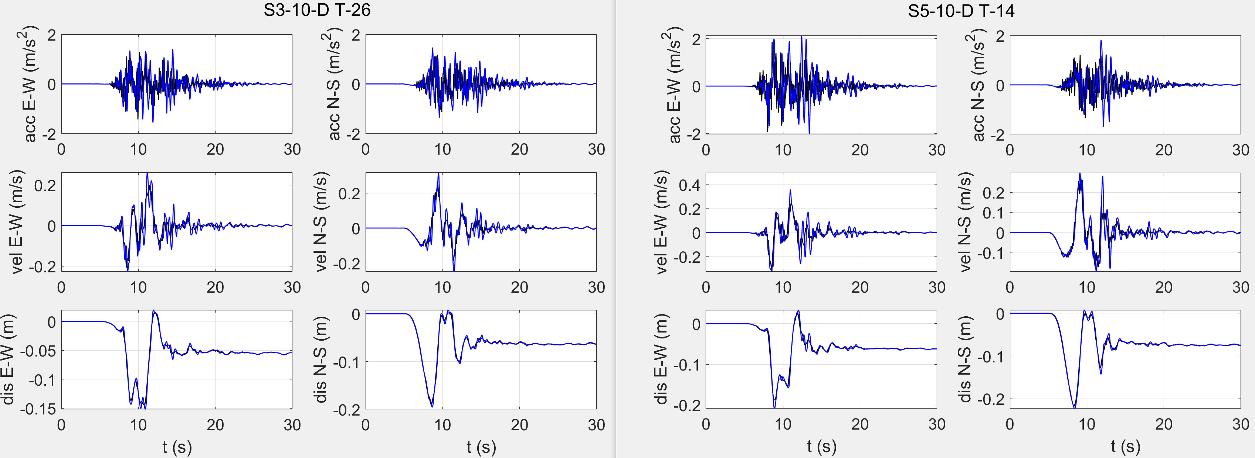
5. Seismic actions
Time histories

Slide 25
5. Seismic actions
Design spectra for near-fault conditions

Slide 26
Presentation Outline
Overview
Site characterization
PSHA
Physics-based simulations
Seismic actions
Conclusions

Slide 27
6. Conclusions
The site was characterized using ambient vibration measurements, resonant column and down-hole testing.
The effect of local geology on expected ground motion is included into PSHA by means of period-dependent soil (de)amplification functions.
Since near-fault effects can severely impact tall structures like wind turbine towers, these effects are incorporated deterministically through PBS.
Design ground motions and design spectra are defined from a combination of PSHA and simulation of potential scenario earthquakes.
Near-fault effects result into an increase in the long-period PSA, of approximately two times the EC8 PSA for ground type A.

Slide 28
Thank you!
Victor Hernández, vmh5@hi.is
Rajesh Rupakhety, rajesh@hi.is

