Slide 1
2nd Olympiad in Engineering Science – OES 2025
Visual Programming Language for
hydropower plants Facility Management
Anna Osello, Francesco Loddo
Politecnico di Torino

Slide 2
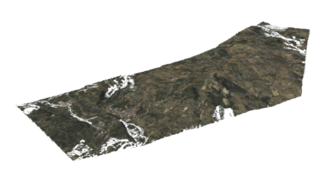
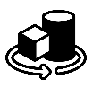
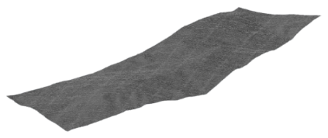
Key concepts
Real environment
Building information modeling (BIM)
Visual Programming Language (VPL)
data processing

Slide 3
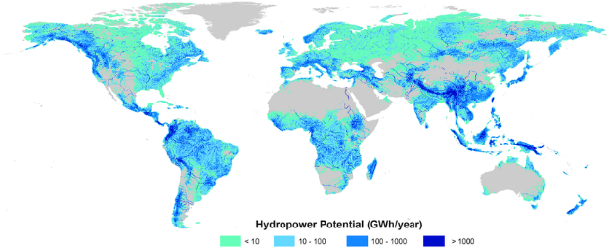
Hydropower plants characteristics
Important role in the energy transition process
Hydroelectric energy is the only fully programmable renewable source and can be stored through pumped storage power plants
Renewable electricity generation by energy source in 2020
Well established in many countries
Since its first applications in the late 1800s, in many countries hydroelectric energy supported the industrial development
High installation costs but long lifespan
Hydropower plants are characterized by long lifespan (over 200 years) and relatively short payback period (5-10 years)
Essential scheduled maintenance activities
During operational phases, hydroelectric power plants may encounter bearing failures, unbalance, stator winding short circuits, excessive cavitation. These issues can cause severe damage to turbine-generator units
Hoes, O., et al.: Systematic high-resolution assessment of global hydropower potential (2017)
Notes:
Riferimento all’immagine

Slide 4
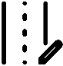
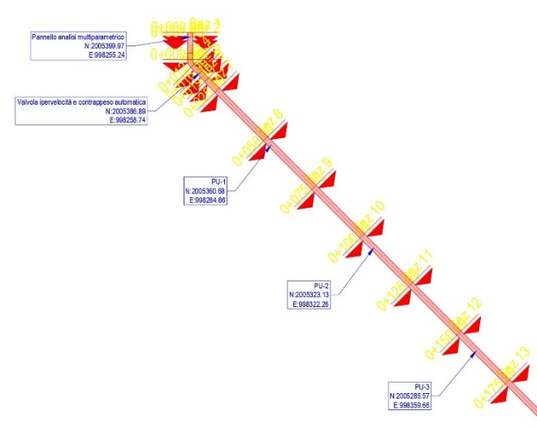
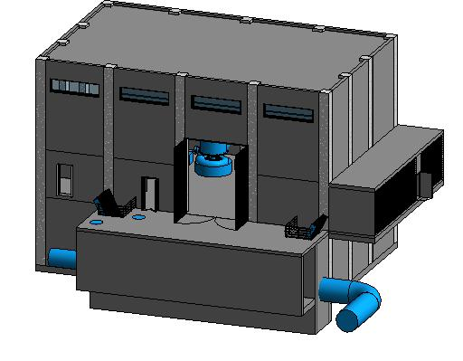
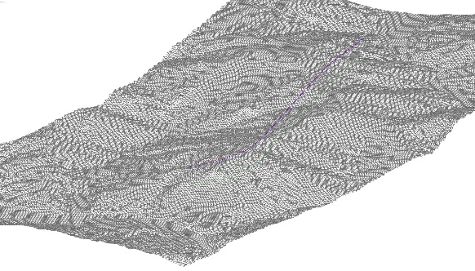
BIM workflow for linear infrastructures
Topographical data
Alignments and profile design
3D geometries modeling
Data integration

Slide 5
Visual Programming Language
Type of programming language that allows users to create programs by manipulating graphical elements
Common uses in literature
Design
Input node
Complex geometry modeling
Repetitive task automation
Computation node
Data extraction
Digital Twin
Performance simulation
Output node
Data collection
Management
Notes:
Servirebbe un modo bellino per rappresentare gli usi del VPL nelle fasi di progetto e gestione

Slide 6
Transient flow phenomena
1
Steady-state flow
Constant flow out of a reservoir.
Reservoir
v = v₀

Slide 7
Transient flow phenomena
2
An occlusion interrupts the flow
Ex: a downstream valve instantly closes.
Reservoir
v = v₀

Slide 8
Transient flow phenomena
3
Beginning of unstady-state
The water sections closest to the occlusion begin to stop;
A pressure wave begins to propagate upstream, since water is nearly incompressible and has inertia.
Reservoir
v = v₀
v = 0

Slide 9
Transient flow phenomena
4
Pressure wave propagation
The pressure wave keeps propagating upstream.
Reservoir
v = v₀
v = 0

Slide 10
Transient flow phenomena
5
Pressure wave propagation
The pressure wave reaches the reservoir. From this moment, the pressure-related energy begins to dissipate.
Reservoir
v = 0

Slide 11
Transient flow phenomena
6
Pressure wave dissipation
The water starts flowing from the pipe to the reservoir, dissipating the pressure wave.
Reservoir
v = - v₀
v = 0

Slide 12
Transient flow phenomena
7
Pressure wave dissipation
Once that the pressure wave is exhausted, a non-balanced situation is reached.
Reservoir
v = - v₀

Slide 13
Transient flow phenomena
8
Negative pressure wave propagation
This situation generates a negative pressure wave, that starts propagating upstream. Vacuum conditions may occur.
Reservoir
v = 0
v = - v₀

Slide 14
Transient flow phenomena
9
Negative pressure wave propagation
The pressure wave keeps propagating upstream.
Reservoir
v = 0
v = - v₀

Slide 15
Transient flow phenomena
10
Pressure wave propagation
The pressure wave reaches the reservoir. From this moment, the pressure-related energy begins to dissipate.
Reservoir
v = 0

Slide 16
Transient flow phenomena
11
Negative pressure wave dissipation
The water starts flowing again from the reservoir, dissipating the negative pressure wave.
Reservoir
v = 0
v = v₀

Slide 17
Transient flow phenomena
12
Negative pressure wave dissipation
Once that the negative pressure wave is exhausted, due to inertia new cycles begins.
Pressure values will be lower due to friction and head losses in the system.
Reservoir
v = v₀

Slide 18
Mathematical model - Method of Characteristics
$$\frac{δH}{δt}+\frac{a^{2}}{gA}\frac{δQ}{δx}=0$$
Transient flows are governed by the continuity and momentum partial differential equations (PDE)
Transformation in ordinary differential equations (ODE) through the Method of Characteristics (MoC)
$$\frac{δQ}{δt}+gA\frac{δH}{δt}+RQ\left|Q\right|=0$$
MoC calculation grid
Horizontal axis: spatial discretization (dx)
Vertical axis: temporal discretization (dt)
$\frac{dx}{dt}=±a$ (a = wave speed in circular pipes)
t
Initial conditions
Flow and Head values in steady state conditions, considering minor and distributed head losses along the system
t=2∆t
Boundary conditions
Conditions in discontinuity sections or specific points within the system (ex: reservoir, downstream valve)
t=∆t
C₋
C₊
Calculation nodes
Positive and Negative Characteristics computation in every central node
t=0
x
∆x

Slide 19
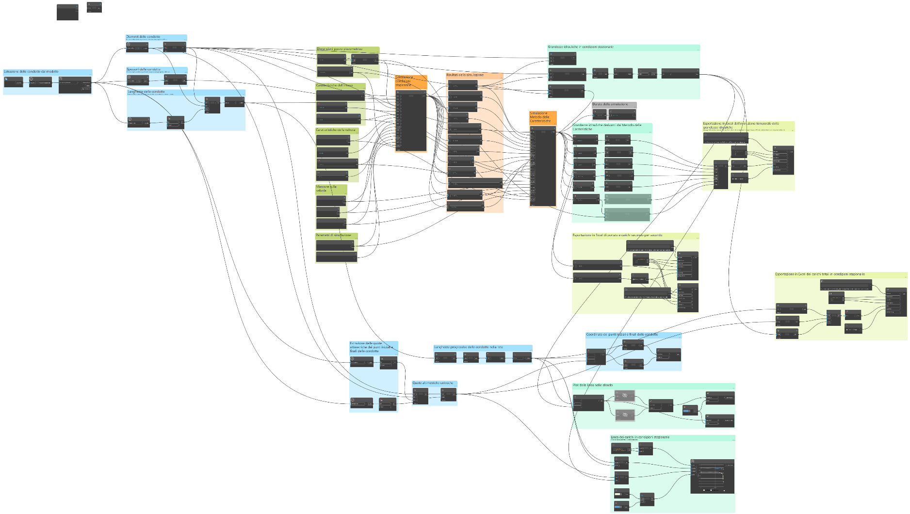
Dynamo
Dynamo:
Visual programming interface that allows customization of workflow related to building and infrastructure information through the use of preset nodes or textual programming codes written in Python.
Data extraction from BIM Model
Definition of simulation parameters
Programming code
Results export
Results Visualization
Notes:
Dynamo usato per prendere i dati dal modello BIM

Slide 20
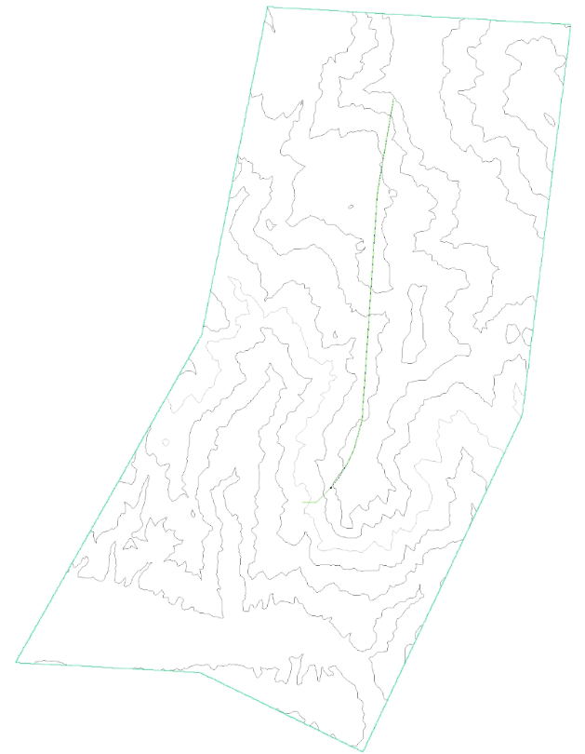
Application in a real case study
Surge Tank
Boundary conditions
Reservoir
Adduction tunnel inlet
Adduction tunnel
Penstock
Turbine
19,3 m
7238,7 m
DN1800
DN2200
Surge Tank
949,2 m
Hydropower plant
DN1800
Notes:
Foto del caso reale?

Slide 21
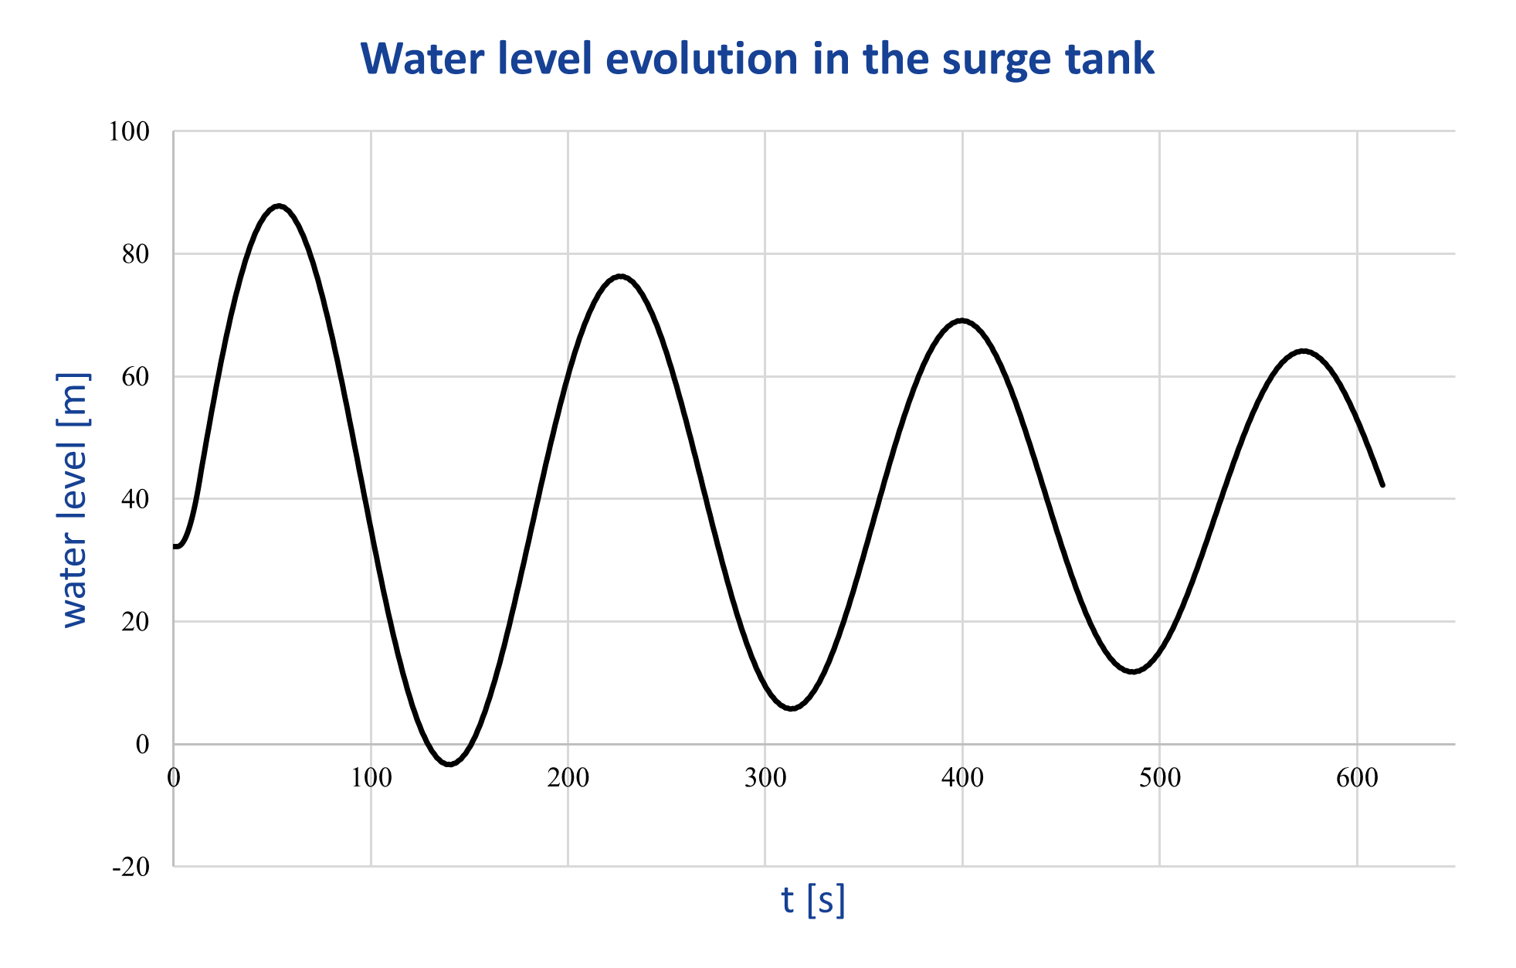
Results
Simulated manoeuvre: total downstream valve closure in 12 s with an initial flow of 7,6 m³/s
VPL tool used to store results in matrices. The rows of these matrices correspond to a specific simulated time instant, while the columns refer to the spatial nodes of the system. This format allows to plot flow and head values at specific points of the calculation mesh or flow and head values along the system at a specific time instant.

Slide 22
Conclusions
Unique platform in which data are taken directly from a BIM model and used as input for hydraulic simulations
Any changes in the model geometry are automatically reflected in the inputs of the programming code used for hydraulic simulations
Design
Facility Management
Evaluate valve maneuvers to ensure correct flow rates are distributed to utilities
Simulate effectively manage extraordinary situations
Geometry optimization
Sizing components

Slide 23
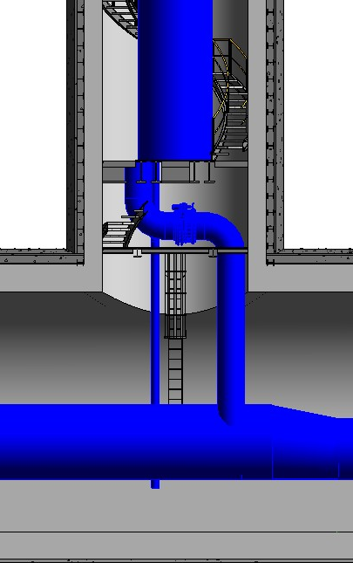
Future steps
Programming code improvement
Virtual Reality (VR) visualization
More accurate head losses estimations at discontinuity points, such as the Surge Tank inlet
VR’s goals:
Design support
Formation of the maintenance workforce
raising awareness of the role of hydropower
Surge Tank

Slide 24
Thanks for your attention
Prof. Anna Osello Politecnico di Torino anna.osello@polito.it
Dr. Francesco Loddo Politecnico di Torino francesco.loddo@polito.it

