Slide 1
Predicting Structural Data of Bridge Utilizing Large Language Model
2nd Olympiad in Engineering Science- OES 2025
Paper ID: 62
Speaker:
Shreejan Maharjan
Notes:
Good afternoon everyone. My name is Shreejan Maharjan, and Today, I’m excited to share my work on Predicting Structural Data of Bridges Using Large Language Models.

Slide 2
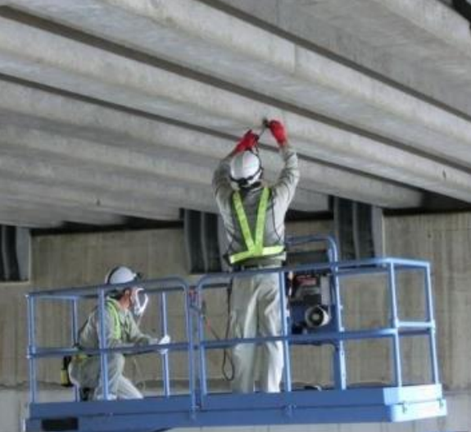
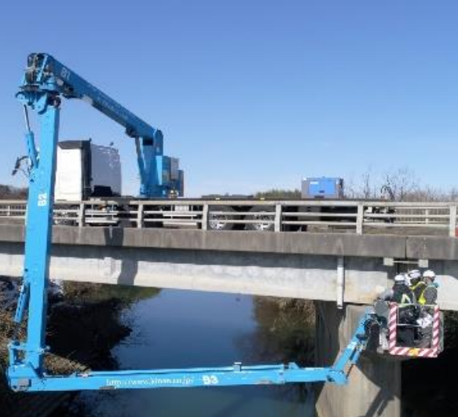
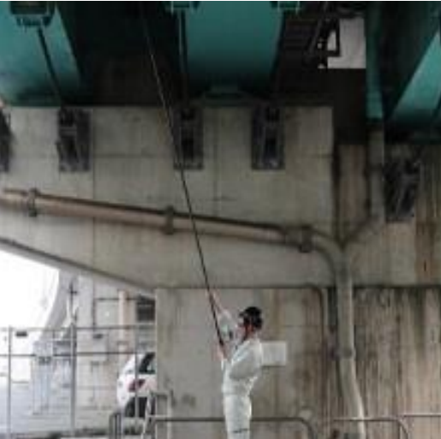
1
BACKGROUND
Global Issue of Infrastructure Aging crisis
(e.g., 42% of bridges in Japan are over 50 years or old)
Traditional inspection methods → Resource expensive
Lack of data availability of existing structures
Incomplete or missing data limits the monitoring and maintenance strategies
Notes:
To begin, a pressing global issue is the aging infrastructure crisis that threatens the safety, economy, and sustainability of our built environment.
for example, in Japan, over 42% of all bridges are now more than 50 years old. That means nearly half of this critical transportation network is operating well beyond its originally intended lifespan. And Japan isn’t alone. Similar trends are visible in the U.S., Europe, and many parts of the world. And these aging structures are vulnerable to: Structural fatigue, Corrosion, Seismic impacts, and Increasing traffic loads they weren’t designed for. Traditionally, we rely on manual inspections — inspectors physically examining bridge components with lifts, scaffolding, and even heavy machineries. These methods are not only labor-intensive, but also: Expensive, Risky, and Time-consuming. What’s even more challenging is the lack of digital documentation for many of these structures. A large number of older bridges either: Have incomplete design records, or Lack any digital representation at all — no CAD files, no BIM, no structured models. And Without that information, we’re flying blind. Due to which deploying automated inspection systems are impossible due to no foundation to work from. And that’s the gap this research aims to fill.

Slide 3
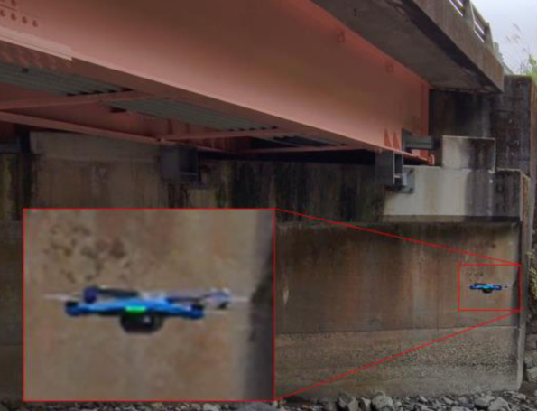
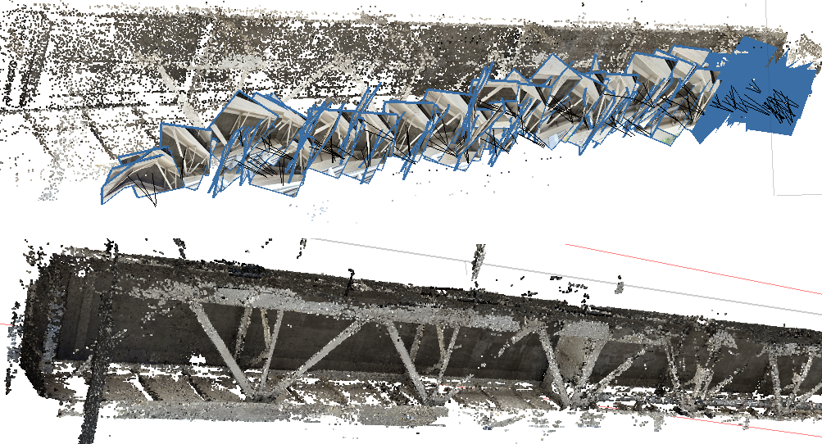
1
BACKGROUND
Potential of new advanced inspection systems in AEC
Unmanned aerial inspection
ML/DL → damage detection
Point Cloud → 3D models
Major challenge in application: Data availability / Data quality
Approach : Large Language Model → Predict and complete bridge data
LLM Data
Domain Knowledge
Existing Data
Notes:
Fortunately, the Architecture, Engineering, and Construction (AEC) industry is undergoing a digital transformation — a shift toward smarter, automated, and more scalable solutions. What’s currently available is : we have drones that capture high quality visual data that helps us reduce inspection time. Then we have the deep learning models that can analyse damages and offer a automated and consistent inspection method that manual inspection often lack. And more recently, 3D points cloud data are being used to generate digital model of the infrastructures that can be used for inspection, maintenance and analysis. But there is a critical catch. All these technologies rely on one foundational resource that is high quality bridge data, without which none of these methods can reach their full potential. So, answer to this challenges lies in the use of Large Language models. These models can be adapted to predict, infer and reconstruct bridge data using existing documents, engineering domain knowledge and patterns learned from previous bridge data.

Slide 4
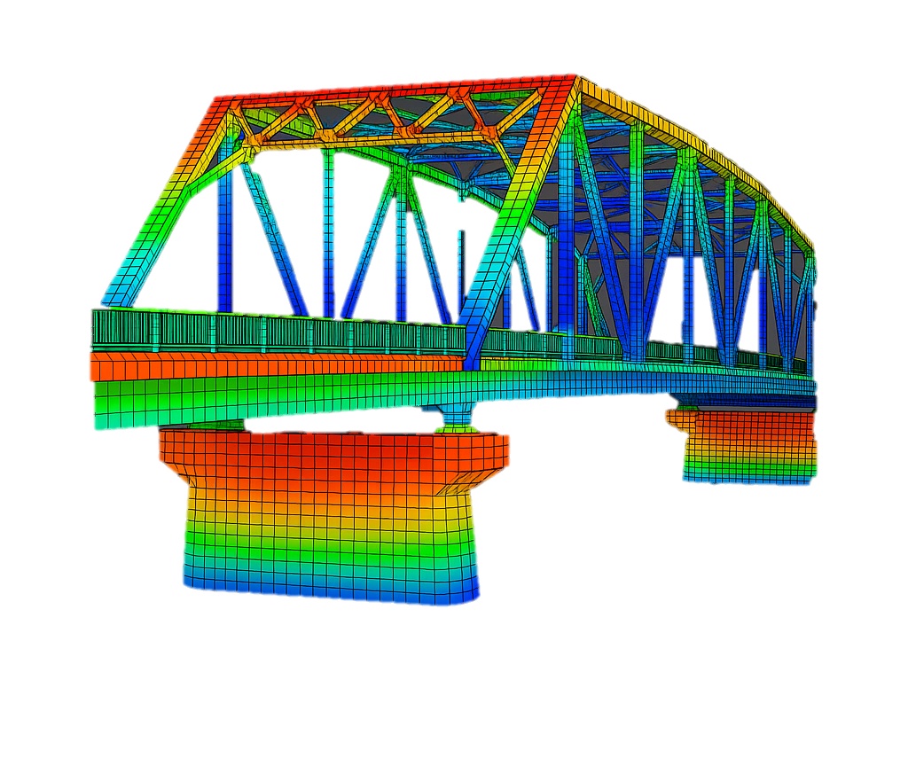
2
OBJECTIVES
Goal: Accelerate digital model development for bridges
via LLM-driven parameter inference to enhance inspection frameworks
LLM retrieves bridge data from the available domain data
Information
Extraction
LLM predicts bridge data based on the retrieved data and domain knowledge
LLM
Data validation through simulation
Validation
Notes:
Our goal is to accelerate the digital modeling of bridges. We do this in three main steps: Extract data from existing documents,- Use LLMs to infer missing or incomplete data, and Validate the predicted data using simulations like Finite Element Models (FEM). The final output is a structured, machine-readable format — like JSON — ready for downstream tasks.”

Slide 5
3
METHODOLOGY
5
Information Extraction
Data
Information Extraction
Context aware information extraction
Context Aware
Information extraction
Computational Inference
GPT-4o model → Extract data from unstructured documents
Bridge Data
(Unstructured Documents)
Prompting:
→ raw text content from the document,
→ targeted extraction instructions,
→ a predefined JSON schema for output
Extracted
Bridge Data Prediction
Hybrid AI + Engineering Prediction
Extracted Data
Feature-based similarity search
LLM-based optimized prediction
(Structured JSON Data)
Computational inference
Indirect data extraction: involve computational inference
e.g.,:
Slab width = Left overhang + ∑ (beam spacing) + Right overhang)
Bridge Data Prediction
(Structured JSON Data)
Notes:
Getting into the detail of the methodology, our first critical step is extracting information from raw, unstructured documents. In practice, the kind of documents we deal with are engineering reports, design manuals, and construction drawings — which are often scanned PDFs, not easily parsed by machines. To handle this, we leverage the GPT-4o model for context-aware information extraction. What does this mean is: Rather than simply looking for keywords, the LLM understands the semantics of engineering language. Let say If the document reads ‘the slab is supported by five I-girders spaced evenly across 12 meters’, it can infer the key value like type of beam, beam spacing, etc. It then maps these values to a predefined JSON schema — turning natural language into structured machine-readable data. Beyond direct mentions, we also implement computational inference — calculating values that are not explicitly stated. Take slab width as an example: It may not be directly given, but we can compute it by summing the left and right overhangs and the beam spacings in between. This stage ensures we have a clean, filled JSON dataset as a starting point.

Slide 6
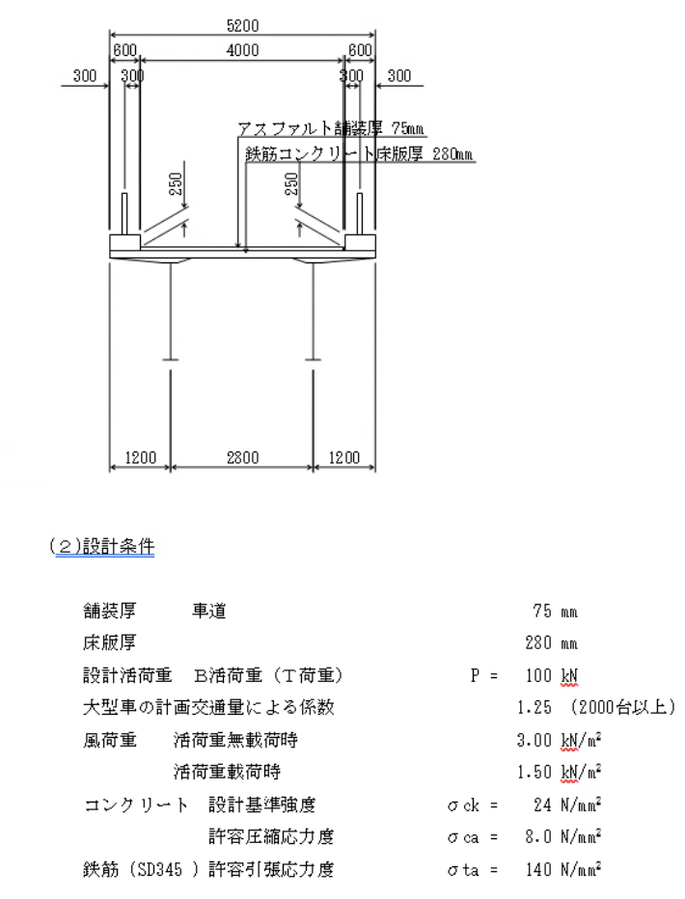
3
METHODOLOGY
6
Data
Information Extraction
Context Aware
Information extraction
Computational Inference
Bridge Data
(Unstructured Documents)
Extracted
Bridge Data Prediction
Hybrid AI + Engineering Prediction
Extracted Data
Feature-based similarity search
LLM-based optimized prediction
(Structured JSON Data)
Output from LLM
Structural type Key dimensions and materials Applied loads
Bridge Data Prediction
(Structured JSON Data)
Notes:
This is the example of the documents that we use to extract the information through LLM. Once the extraction process completes, we have a structured JSON dataset which contains valuable information like the structural type of brides, key dimension and materials and the applied loads for the design.

Slide 7
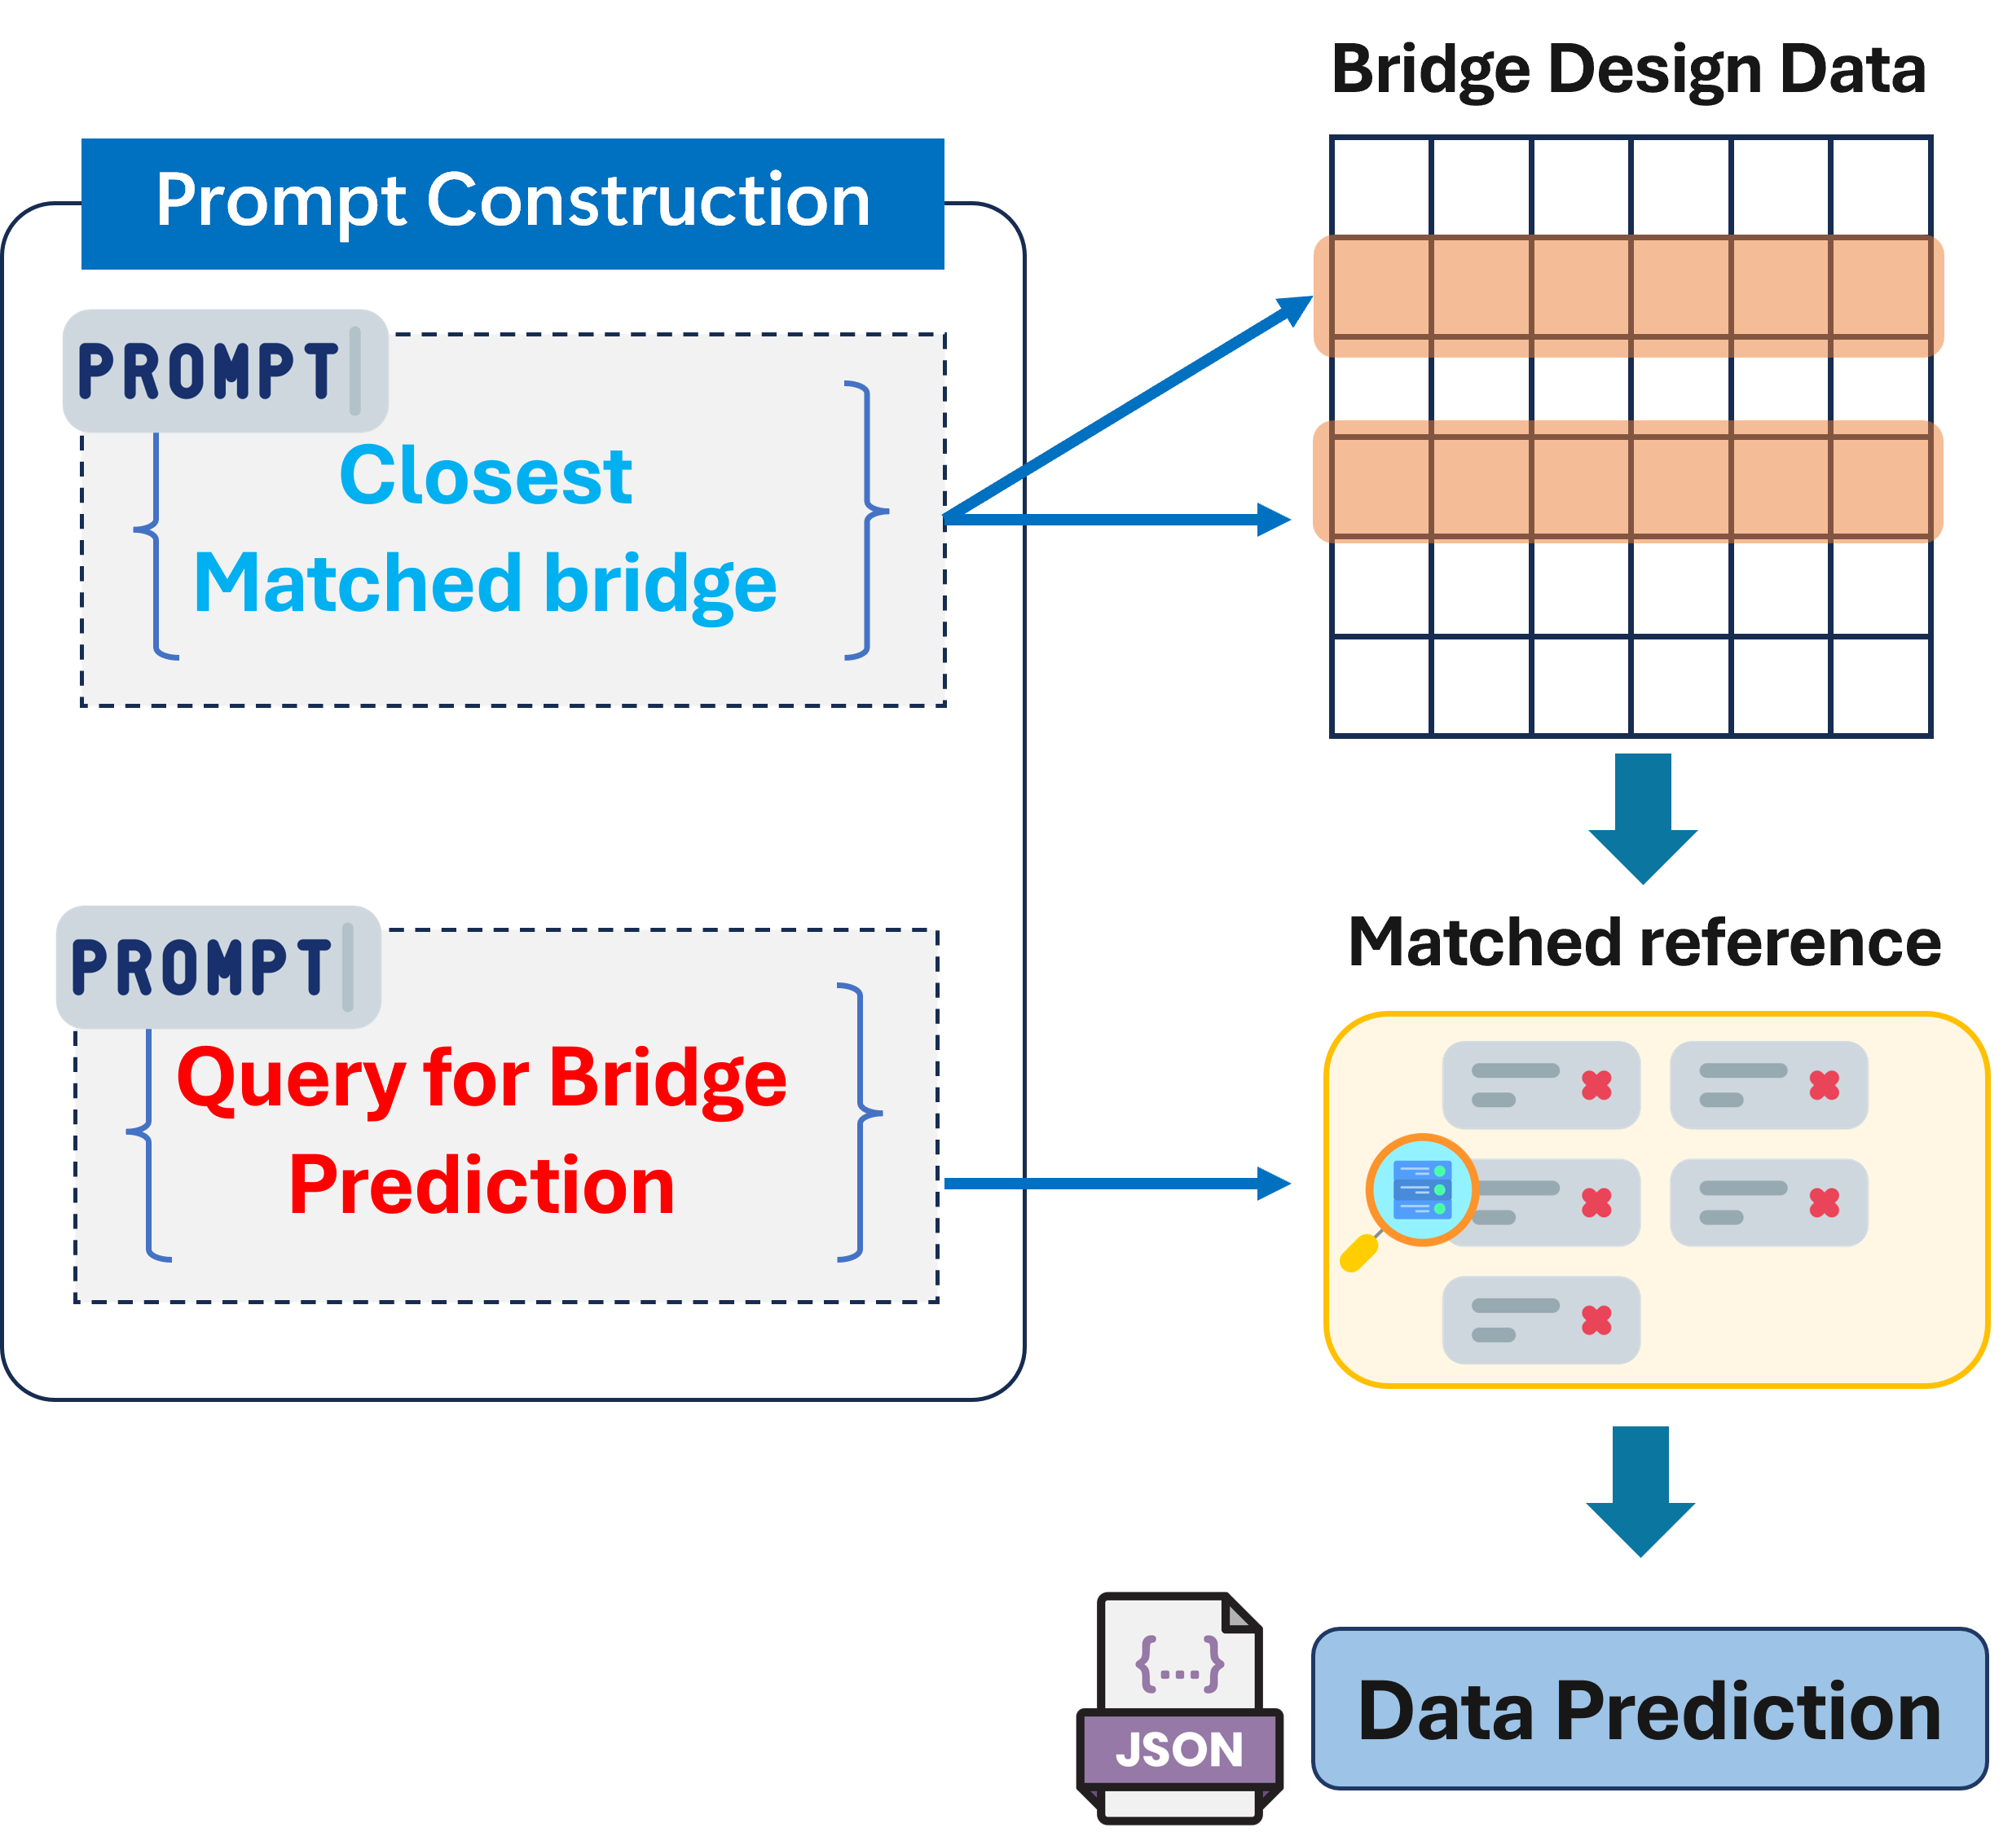
3
METHODOLOGY
7
Bridge Data Prediction
Data
Information Extraction
Context Aware
Information extraction
Computational Inference
Bridge Data
(Unstructured Documents)
Extracted
Bridge Data Prediction
Hybrid AI + Engineering Prediction
Extracted Data
Feature-based similarity search
LLM-based optimized prediction
(Structured JSON Data)
Bridge Data Prediction
(Structured JSON Data)
Notes:
The next stage of our study is predicting the bridge data. At this point, we have the extracted bridge documents which plays a key role by serving as domain knowledge to effectively become the engineering brain for the LLM. In other words, the extracted values and context from real bridge documents become a localized knowledge base that guides the LLM’s reasoning. For example: If the LLM sees that the deck width is 11 meters and beam type is I-girder, it pulls information from domain knowledge to understand what slab thickness or girder depth typically go with such configurations. So for this we apply the feature-based similarity search — comparing known parameters like span length, width, or girder type to a reference set of existing bridges. Then, with the help of LLM-based optimization, we infer the values of the bridge. This process isn’t just statistical guessing — it’s more of a context-sensitive, influenced by both: Patterns observed across real bridge datasets, and Engineering relationships derived from the extracted information itself.

Slide 8
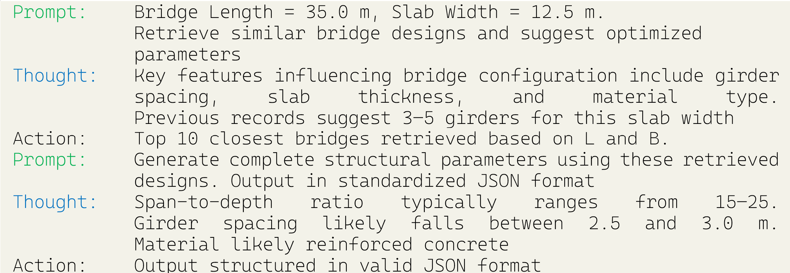
3
METHODOLOGY
8
Bridge Data Prediction
Notes:
So how this stage work is, first we construct prompts that guides the LLM for the processing. We tell the LLM to retrieved the closest matched bridge design based on our query which retrieves 10 similar design types. Then from the 10 matched reference, the LLM examines the data based on the engineering constraints and rules that we have provided during the prompt construction which then finally results in the output in Standard JSON format.

Slide 9
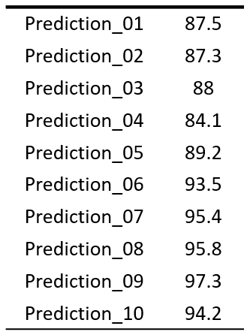
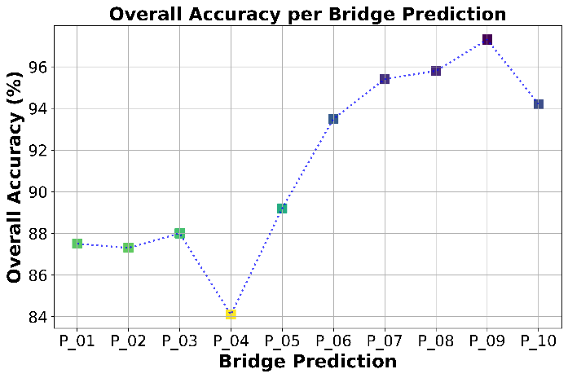
4
RESULTS
9
LLM Prediction Performance
Evaluation Metrics
Mean Absolute Percentage Error (MAPE)
$${MAEP}_{i}= \frac{\left|T_{i}− P_{i}\right|}{T_{i}+ {10}^{−9} }$$
$$Component Accuracy=$$
$$\left(1−\min\left({MAEP}_{i},1\right)\right)×100$$
$$Weighted Overall Accuracy=$$
$$\frac{\sum_{i=1}^{N}{w_{i}∙ {Accuracy}_{i}}}{\sum_{i=1}^{N}{w_{i}}}$$
(Overall accuracy score of predicted bridge data)
10 individual bridge datasets generated by the LLM, compared against the 57 reference datasets
Different importance weights assigned to each bridge parameter based on its engineering significance
Notes:
To evaluate the effectiveness of our LLM-driven prediction framework, we conducted a comparative analysis using: 10 bridge datasets generated by our system — meaning bridges whose structural parameters were predicted based on partial input data, and 57 real-world reference bridges, which served as ground truth datasets for benchmarking. Here we used two carefully chosen metrics: Mean absolute percentage error to calculate component wise accuracy was utilized. And the overall accuracy per bridge prediction was evaluated based on the weighted component accuracy, where different components of the bridge had different weights according to the engineering significance. The performance of our method was highly promising:
Across all datasets, the prediction accuracy ranged from 84% to 97%. In fact, the majority of predictions exceeded 90% accuracy — even for parameters that were not explicitly mentioned in the input documents.

Slide 10
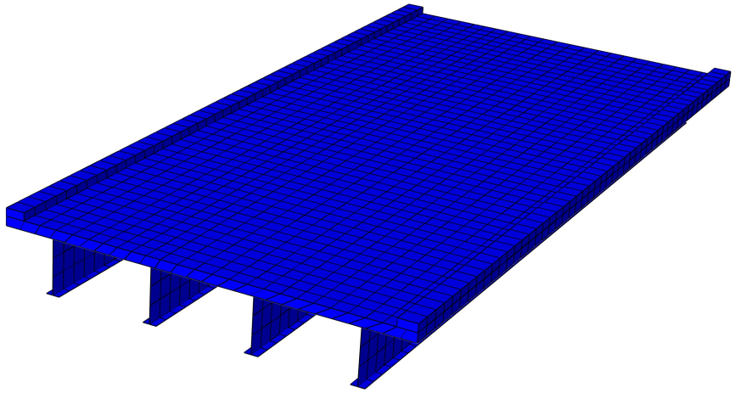
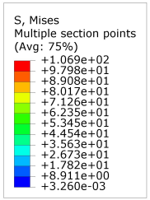
4
RESULTS
10
Predicted Bridge Data
Parameters
data
Create Geometry
Predicted Bridge Data
Model Generation
Meshing
Assemble Geometry
Load | Conditions
Analysis
FEM Simulation
JSON to ABAQUS
Notes:
While generating predictions with a Large Language Model is a powerful first step, in engineering applications, prediction alone is not enough. What’s important is validation — to ensure that the model doesn’t just output plausible numbers, but values that actually hold up under physical simulation and structural loading. Once we’ve predicted a complete set of bridge parameters and get output in JSON format. This JSON serves as the input to a fully automated simulation workflow, where it’s used to: Generate the bridge geometry — based on the predicted data. Mesh the model. Apply boundary conditions and external loads — such as supports, fixed ends, traffic loading, or dead loads. And Run a complete static FEM analysis using Abaqus. This allows us to evaluate how the predicted structure behaves under real-world loading conditions. This image is the result of the bridge data which was predicted by the LLM model. From the Mises stress contours, the maximum stress observed was 106.9 MPa, which remains below the typical yield strength of structural steel (200 MPa) confirming that the design remains safely within the elastic range, with no plastic deformation occurring under the simulated loading conditions.

Slide 11
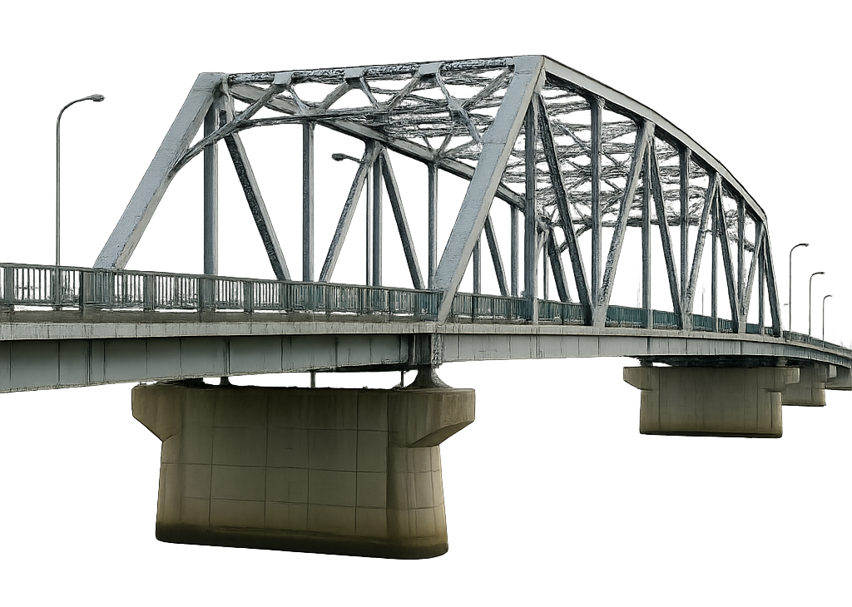
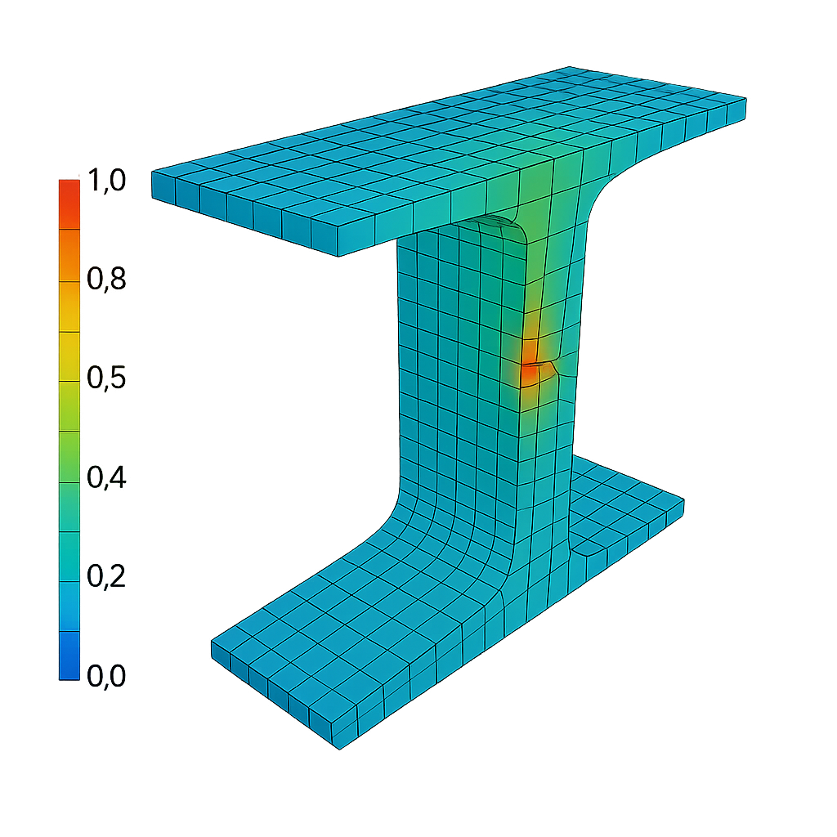
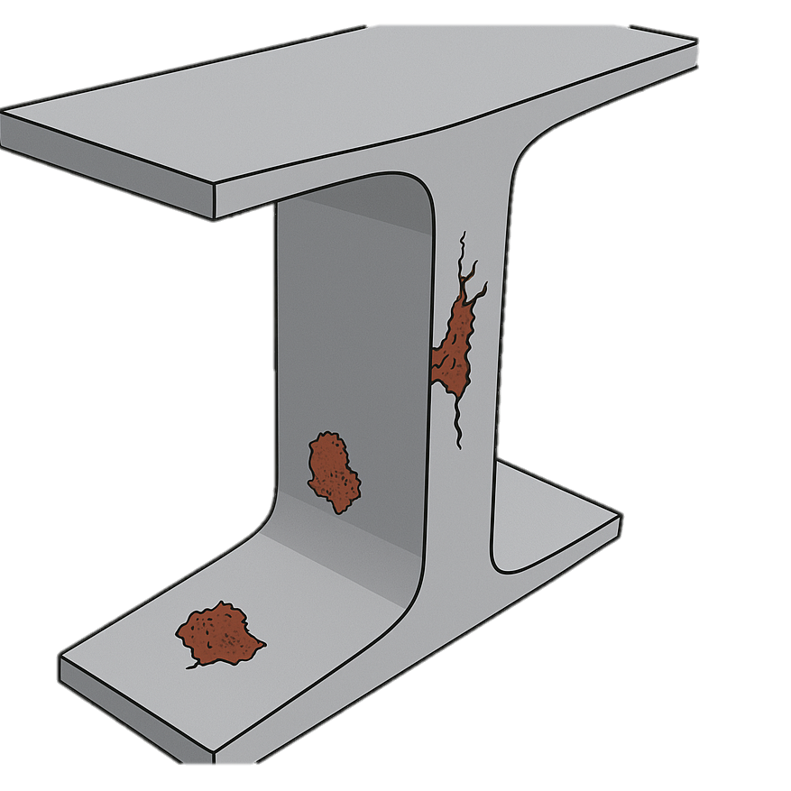
5
FUTURE DIRECTION
11
(Bridge Data)
[Prediction]
(Data Validation)
(Damage Data
in simulation model)
Bridge Data
LLM
Simulation
(JSON)
[JSON > FEM]
(LLM predict future damages)
(Domain Data)
Notes:
As we look toward the future, our aim is to evolve this framework into something far more impactful — a system that not only predicts structural data but also actively contributes to bridge maintenance, and management. The first extension focuses on incorporating real-world damage data into the simulation environment. Currently, our model takes predicted structural parameters and validates them under idealized load conditions. But in the future, we plan to: Integrate observed damage patterns— collected to assess how damage affects load-bearing capacity, stress distribution, and failure risk. From there, we can derive actionable insights for: Maintenance prioritization, Repair planning, and Service life extension. second future direction is more AI-centric. We aim to train the LLM not just to infer structure, but to predict future deterioration — based on historical trends, environmental exposure, material properties, and inspection records. This opens the door to proactive maintenance — allowing infrastructure managers to intervene before failures occur. Together, these directions represent a shift from reactive maintenance to data-driven, simulation-validated, AI-enhanced infrastructure management.

Slide 12
Thank you for Listening

