Slide 1
A Study on Positional Embeddings and Ordinal Regression for Transformer-Based Bridge Deterioration Prediction Considering Component Locations
OES2025 Norway
Shogo Inadomi PhD student
Pang-jo Chun Professor

Slide 2
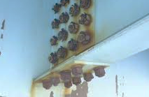
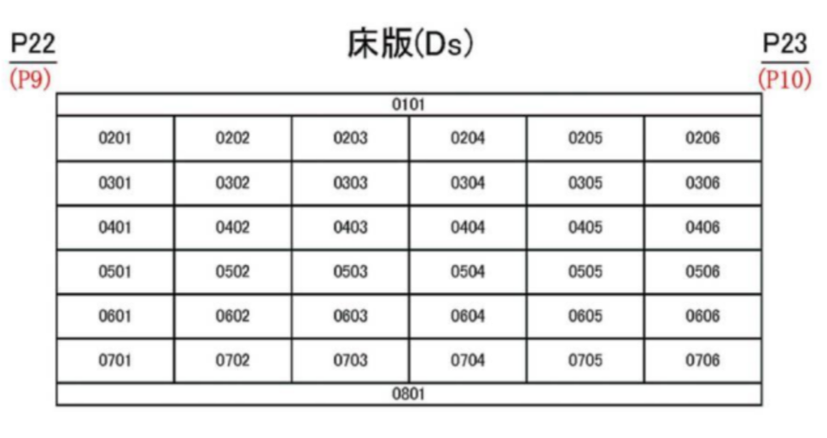
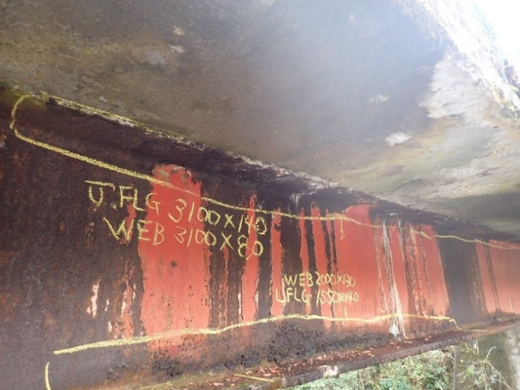
Problems of current bridge inspection records
👷
Damage Predictions
Inspection
Maintenance Plans
Texts / 2D figures
😣
- Human-based judgement for maintenance timing
- Component & damage positions are not included in prediction.
AI-based prediction with spatial information 😊
Notes:
Deterioration of bridges has become a growing issue in recent years. It is imortant to conduct proper inspections and carry out repairs efficiently while minimizing costs.
The current workflow involves engineers inspecting the bridges and compiling their findings into documents, including 2D diagrams. Based on these documents, maintenance plans are formulated.
Not optimized.
Repair scheduling depends on the judgment by individual engineers.
Also, 2D documents are not effectively used. Without positional information, it’s hard to understand the structural health of the bridge.
To overcome these challenges, we need AI-based prediction.

Slide 3
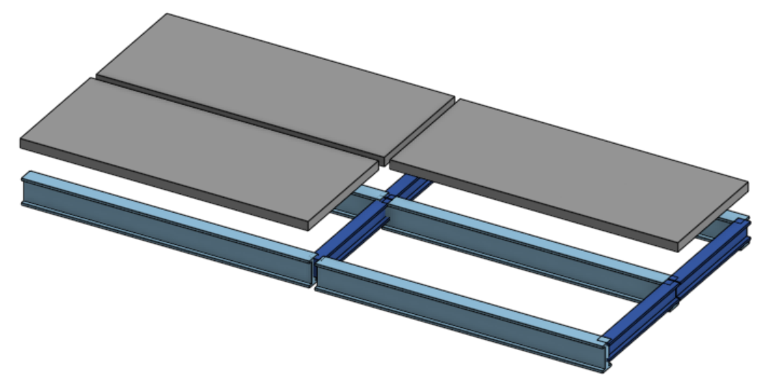
Damage prediction considering 3D position
a
b
c
d
e
Sound
Damaged
Component | Damage | Level
Girder | Corrosion | b
Slab | Crack | c
… | … | …
Component | Damage | Level
Girder | Corrosion | c
Slab | Crack | e
… | … | …
Damage severity (Now)
Damage severity (+5years)
・Damage & factors spread
・Sparse distribution
For enhancing prediction performance …
Spatial relationship of members
Notes:
Here we estimate future damage severity rate for each structural components like this table.
… because damage and its contributing factors often propagate to adjacent members. Also, they are sparsely distributed across the entire structure.

Slide 4
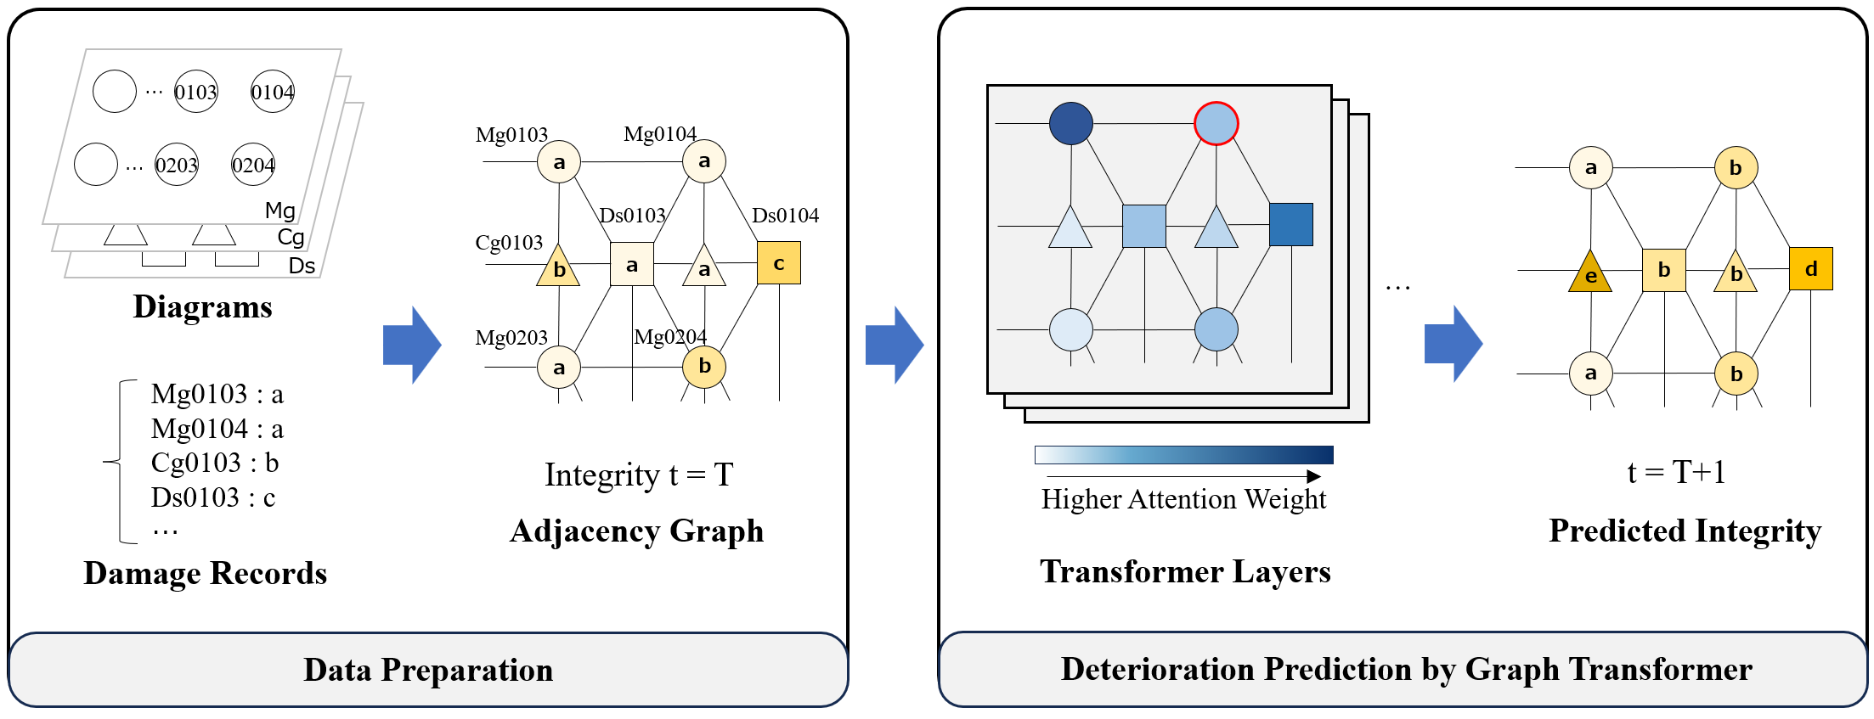
Damage prediction considering 3D position
$$P_{ij}$$
Markov Transition Matrix
(Deterioration Speed)
Inadomi, S., & Chun, P. J. (2025). Spatially aware Markov chain‐based deterioration prediction of bridge components using a Graph Transformer. Computer-Aided Civil and Infrastructure Engineering. https://doi.org/10.1111/mice.13497
Notes:
This is our recent publication using Graph Transformer model for prediction.
We have developed a Transformer-based damage prediction model that considers the spatial relationships between structural elements.
Because some damage propagates to another part of the bridge, 3D position can be a good clue for deterioration prediction.
I’ll explain this work first.

Slide 5
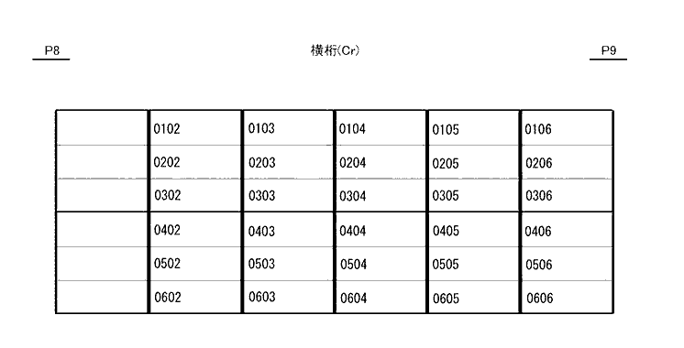
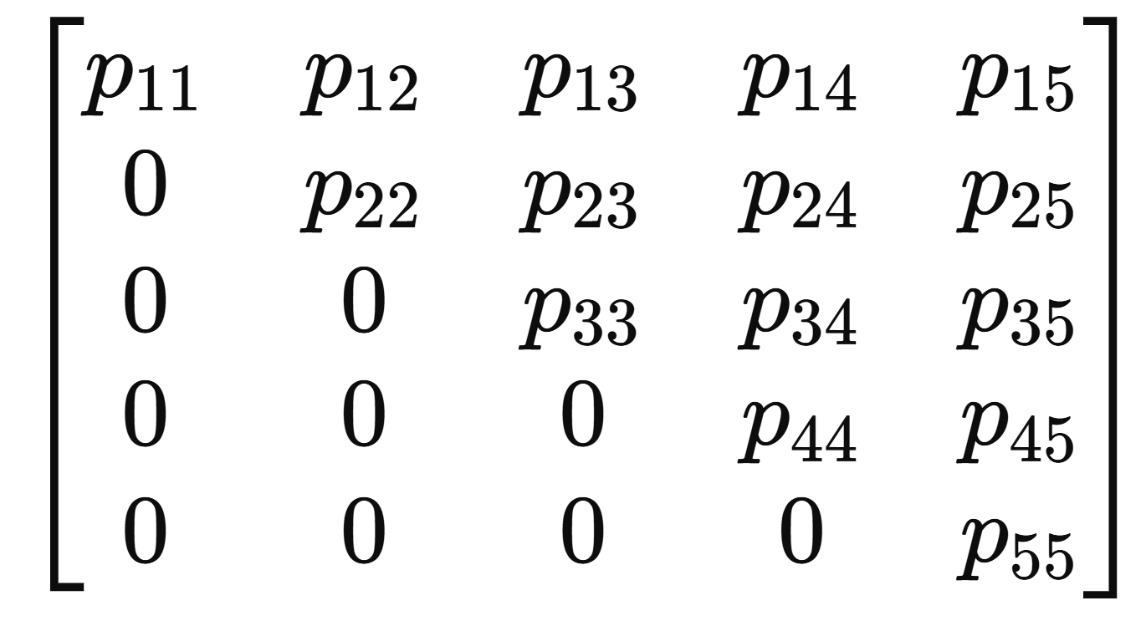
Methods
OCR & GPT-4
Diagrams & Damage records
Graph
Graph Transformer
Analysis
$$P=$$
Markov Transition Matrix
Visualized Attention
Notes:
Our analysis starts with damage records and diagrams that show spatial positions. The diagrams are processed to graphs that shows spatial relationship. Then, it is fed into Graph Transformer, which allows us to build a Markov Transition Matrix representing deterioration transitions.
We not only get prediction results but introduced analysis to reveal co-relations between damages so that we can learn the model’s internal state.
It’s achieved by looking into the Transformer model’s attention weight.

Slide 6
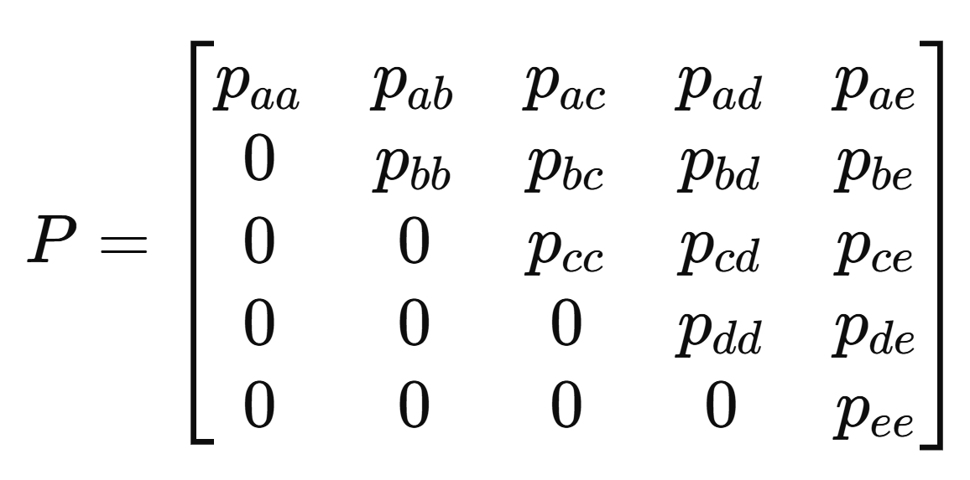
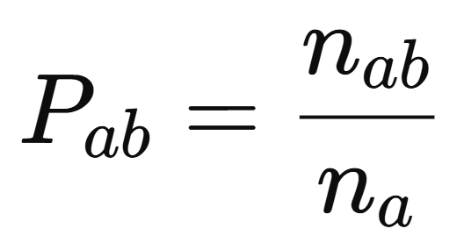
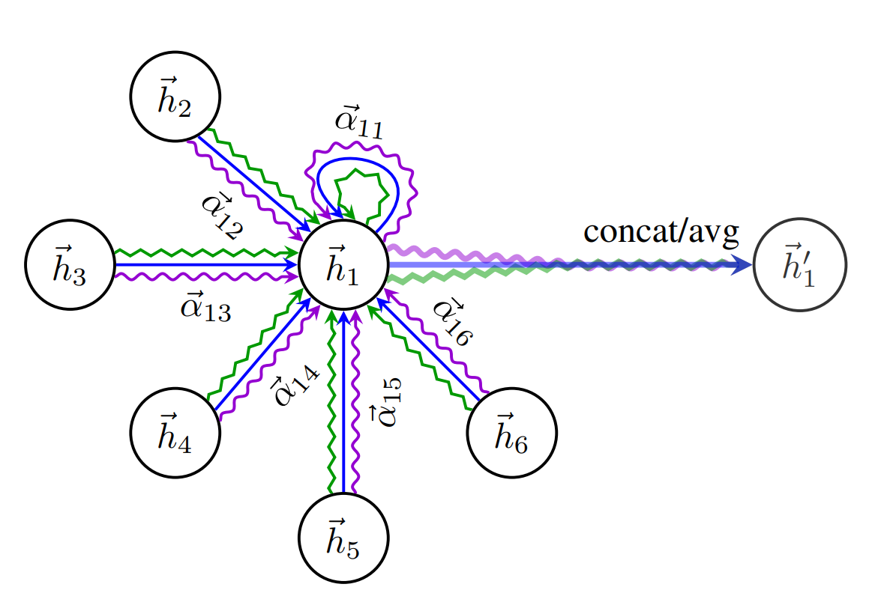
Models to predict Markov transition matrix
Markov transition matrix
shows the transition probability from now to 5years later
Models to calculate the matrix
Damage level: a → b
Percentage Prediction Method
Graph Neural Network
Graph Attention Networks (GAT) Veličković et al. (2017)
Transformer
Without Positional Encoding
Graph Transformer
Notes:
Here, we present our model and the baseline models for comparison.
Here we utilized 3 types of models.
PPM just counts transitions patterns and divide these transitions by total number of transitions.
This calculation is performed in an average manner, without considering the position of each element.
GNN
It can consider adjacent relationships but cannot consider long-range relationships.
Because some damages in a bridge can propagate not only to near components but also far ones, this model is sub-optimal
Transformer
It can take all damages and elements into account
These are our proposal models, although I skip the model details today.

Slide 7
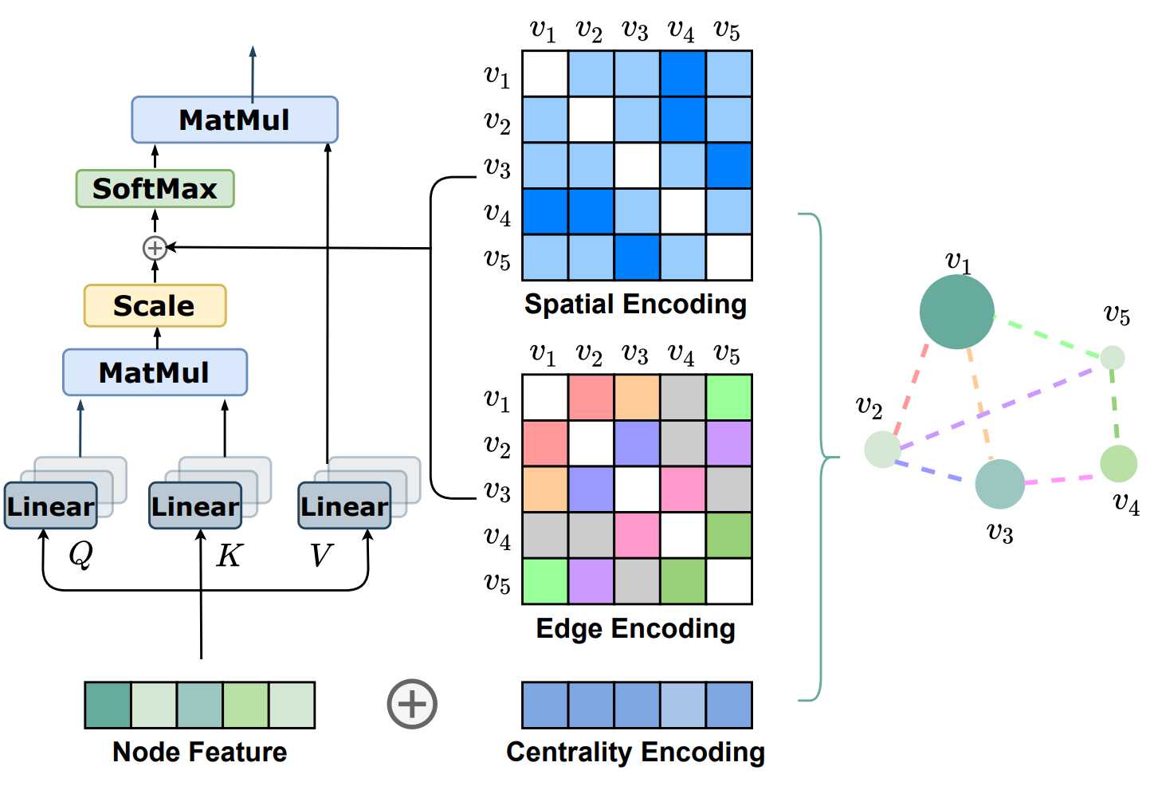
Graph Transformer
Graph data
Transformer
2
0
2
1
1
2
2
1
1
1
0
1
Focal Node
Notes:
We implemented Graph Transformer model to make predictions with positional information.
The relative positions of components were represented by a graph, and adjacency degree was calculated based on it.
Adjacent node is represented 1. On the other hand, far away nodes have high adjacency index number.
We input this information to Transformer model, which is famous for the basic technology of GPT.

Slide 8
Prediction results on real-bridge datasets
Model | Metrics
 | ND Accuracy | DE precision | DE recall
Baseline | 0.9764 | 0.0701 | 0.2962
GAT | 0.9755 | 0.2614 | 0.2663
Transformer w/o PE | 0.9796 | 0.3835 | 0.3556
Graph Transformer | 0.9809 | 0.4331 | 0.3958
x6 DE precision
Positional information
Notes:
Compared to the baseline, there was a significant performance improvement in DE Precision/Recall. DE Precision increased by approximately 0.3 points, indicating enhanced prediction accuracy.
Referring to the entire graph and capturing node positional relationships contributed positively to the predictions.
Although ND Accuracy is high, DE Precision/Recall is not high score.
This suggests that while graph and element positional information is beneficial, it remains challenging to extract transition rules in the real dataset.

Slide 9
Attention Analysis (Example.1)
Degradation of the anticorrosion function: c → d
c
Crack: c
Referring to nodes with a small adjacency degree
remarkable damages in other nodes
Notes:
Model focused on spatially close nodes, and nodes with remarkable damage.
We visualized Attention for the Tokyo dataset.
In the focal node, a Degradation of the anticorrosion function: c → d transition occurred, which the Graph Transformer successfully predicted.
The intensity of the blue color in the figure indicates the relative magnitude of the attention weight.
It was observed that the model is focusing on nodes with a small adjacency degree.
Additionally, when examining the damage states of the nodes it focused on, it was found that the Degradation of the anticorrosion function was at state c, and there was also a nearby node with crack: c.
This suggests that the model is responding not only to neighbor nodes but also to significant damage present in other nodes.
Tokyo datasetについてAttention の可視化を行った。
注目ノードでは、Degradation of the anticorrosion function: c → dが発生しており、Graph Transformerではこれを正しく予測することができた。
図の青色の濃さはattention weightの相対的な大きさを示している。
隣接次数の小さなノードの注目していることがわかる。
また、注目しているノードの損傷状態を確認すると、Degradation of the anticorrosion functionがcであり、また、近傍にはcrack: cのノードも存在した。
このことから、他のノードに存在する顕著な損傷に反応していることもわかる。

Slide 10
Attention Analysis (Example.2)
Degradation of the anticorrosion function: a → e
Delamination & Rebar exposure : b
Water leakage & Free Lime: d
Graph Transformer reflects damage propagation mechanism.
Notes:
Water leakage can triger…
It’s helpful to see the mechanism of damage propagation.
Another example of visualization on a different graph is shown.
In the focal node, a transition of Degradation of the anticorrosion function: a → e occurred. At the same time, the nearby slab element was with high attention scores with Delamination & Rebar Exposure: b and Water Leakage & Free Lime: d.
In actual bridges, water leakage from the floor slab above can cause damage to the waterproofing function of the girder below.
This suggests that the prediction process of the Graph Transformer reflects an underlying degradation mechanism.
他のグラフでの可視化の例を示す。
注目ノードではDegradation of the anticorrosion function: a → eが発生。
その際、注目度の高い床版要素では、Delamination & Rebar exposure : b、Water leakage & Free Lime: d
が発生していた。
実際の橋梁では、上部にある床版から漏水が発生して、そのせいで下にある桁の防水機能に損傷が発生したことがわかる。
このことから、Graph Transformerの予測過程には、劣化メカニズムが見え隠れすることがわかる。

Slide 11
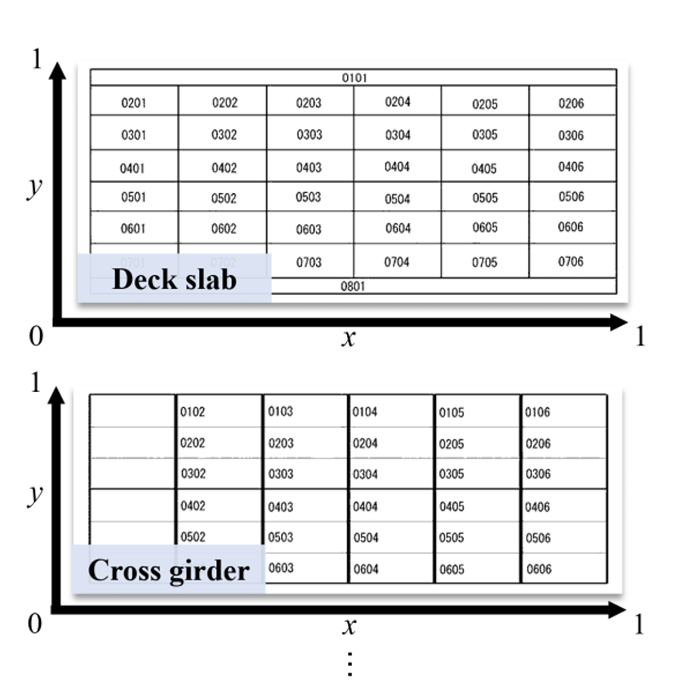
This time : Transformer-based prediction
Using positions of element numbers as its representative position
Similar prediction performance to graph representations
Deck Element 0306 : [x,y]=[0.95,0.7]
Notes:
This time we further improved the model performance by introducing two refinements into Transformer model.
We used the XY coordinates of element numbers on the drawing / text position obtained by OCR as direct positional input, alternatively to the graph representation. We found that the performance is quite similar, although adjacency is not explicitly represented in the representation compared to a graph,

Slide 12
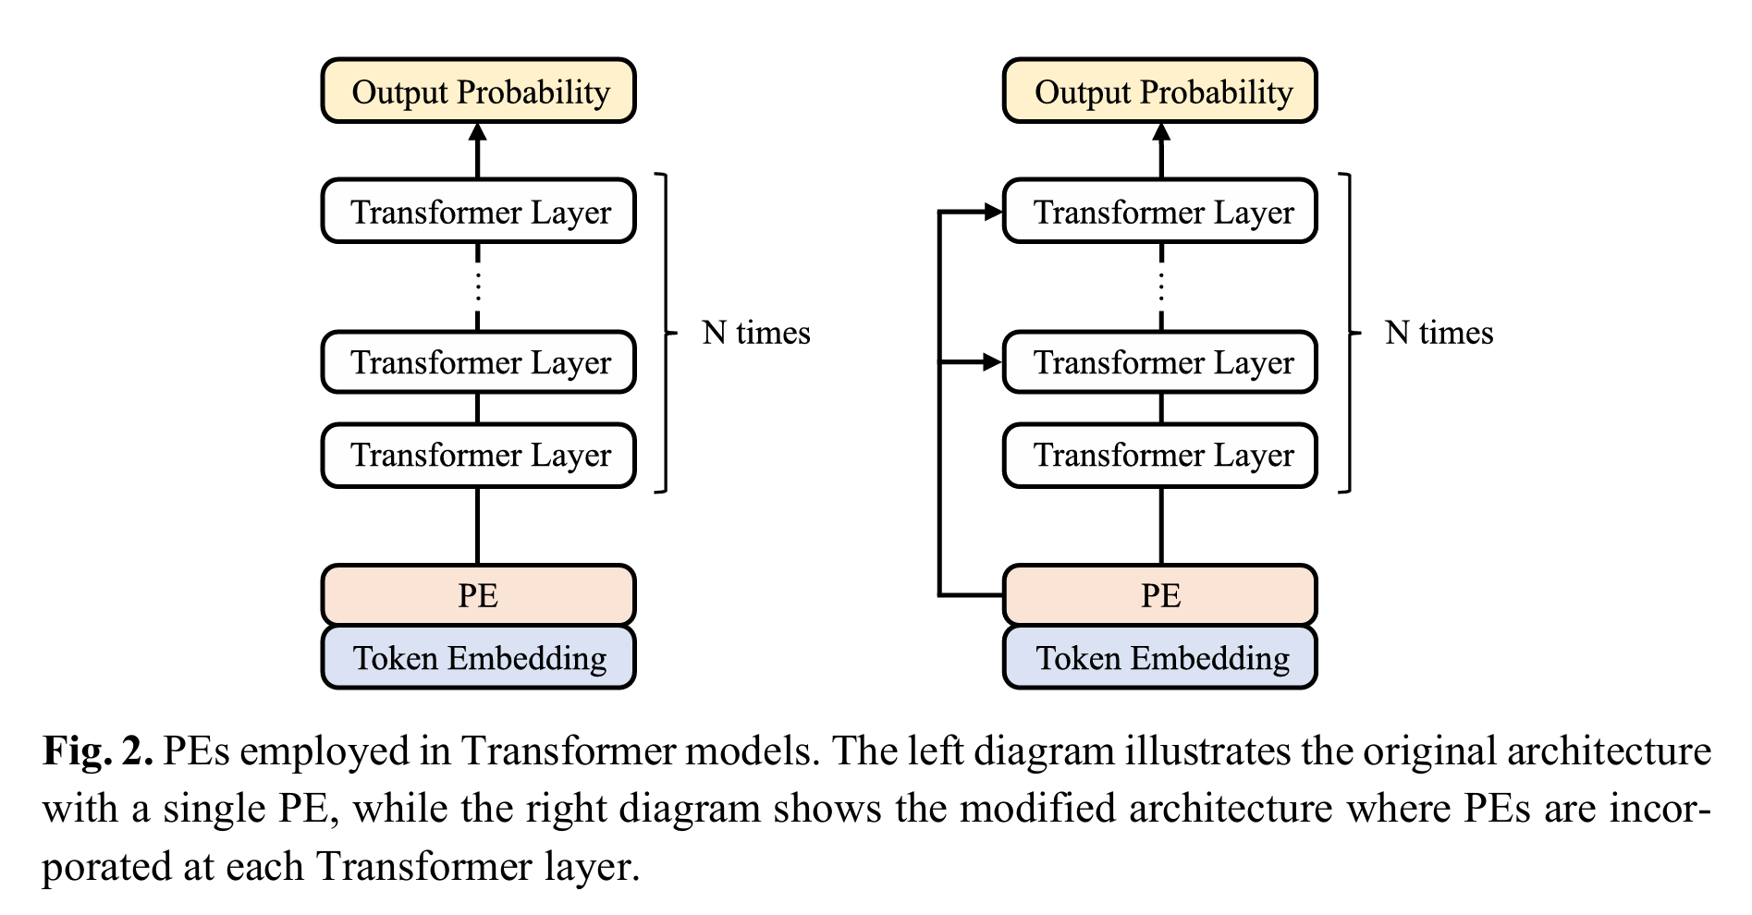
Refinement 1: Positional Encoding
Original architecture
Modified architecture
Single Positional Encoding
Multiple Positional Encoding
Graphormer, Point Transformer, DETR
Notes:
We changed the structure of Transformer model.
PEs is employed in Transformer models.
The left diagram illustrates the original architecture with a single PE, that is PE is used only one in the beginning.
On the other hand, the right diagram shows the modified architecture where PEs are incorporated at each Transformer layer.
This structure was employed in studies like….
For deterioration prediction, accurately capturing spatial relationships within the model is considered essential, so we follow that strategy.

Slide 13
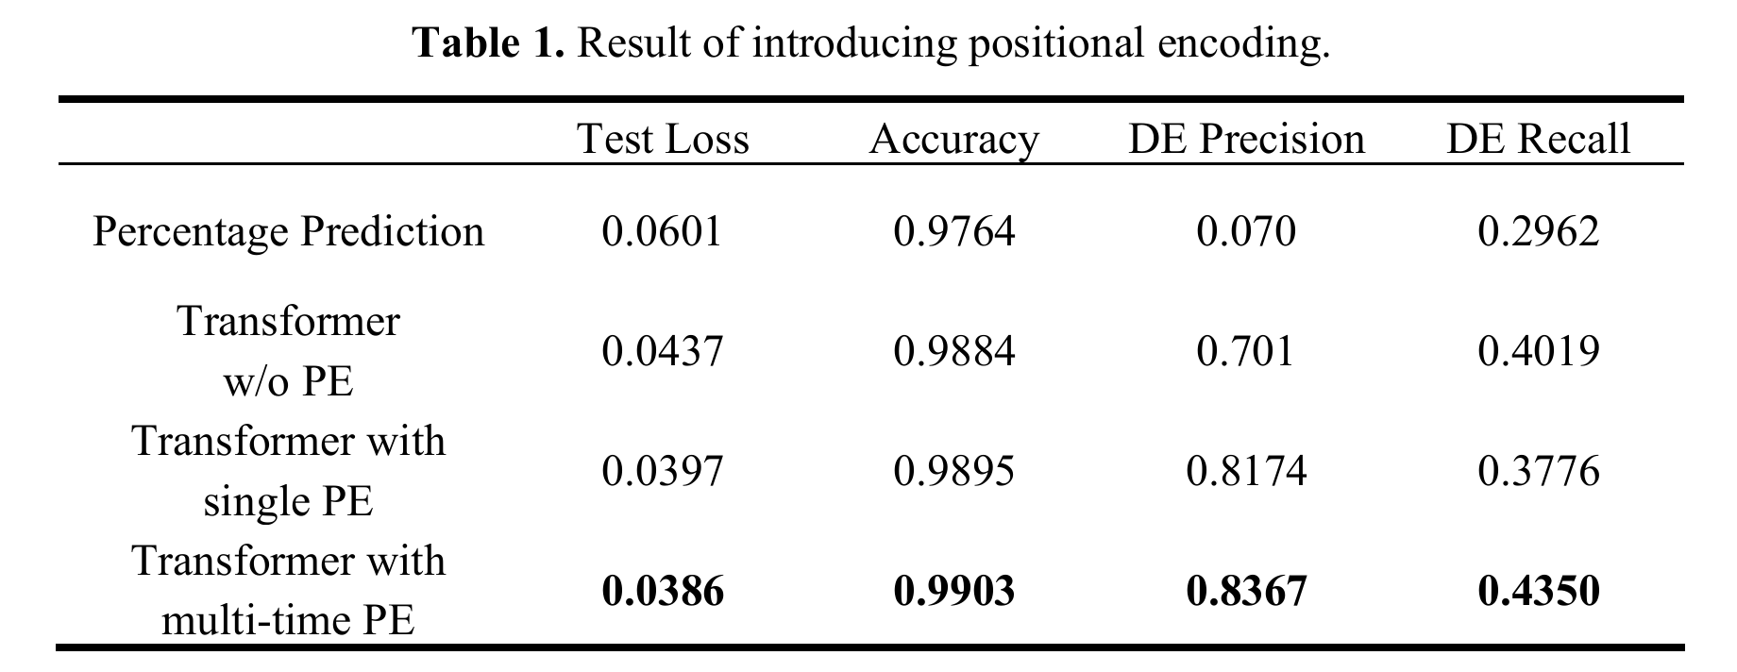
Results
Percentage Prediction < Transformer < + Multiple PE
Notes:
Percentage prediction : not a neural method.
△ Element adjacency may become unclear.
But it still worked better than the Graph-based one.

Slide 14
Refinement 2: Classification vs Ordinal Regression
Ordinal Regression takes the order of classes (a–e) into account.
a
b
c
d
e
Same value
Distance aware
Sound
Damaged
Ground Truth | Prediction | Classification Loss | Ordinal Loss
a | a | 0 | 0
a | b | 0.5 | 0.1
a | e | 0.5 | 0.5
Result
Notes:
The second refinement is introduction of ordinal regression in the output layer.
In the previous experiments we just used softmax classification layer to obtain the final probability of each class.
Damage severity gradually progresses from a to e.
Ordinal Regression takes the order of classes (a–e) into account
Reliable experiments via 2-Nested,3-Fold Cross Validation (6 in total)

Slide 15
Summary
Transformer-based deterioration prediction
Graph structures are not strictly required.
Further scaling up of the dataset
Refinements:
Positional Encoding,
Ordinal Regression
Ordinal Regression
Multiple-time
Positional E.
XY coordinate
Notes:
We will further trying to improve the model by introducing Physical models and parameters.

Slide 19
Predicting Bridge Deterioration for Efficient Management
2 years
Bridge inspection is scheduled for every
5 years
$$P_{ij}$$
・
Timing of Actions
Inspection
Database
Markov Transition Matrix
(Deterioration Speed)
・
$$$
Repairment
Losses to Economy
The accuracy of prediction model is crucial.
How is it achieved?
Notes:
First, it’s noticed that predicting bridge deterioration is crucial for effective management. In the U.S., bridge inspections are typically scheduled every two years, while in Japan, the interval is five years. The process of prediction begins with collecting data from inspections. The data is then fed into a Markov chain model to predict the speed of bridge deterioration. That is useful for deciding the timing for maintenance actions. Also, accurate predictions help minimize both direct and indirect losses. The former is about the timing and cost of repairs, and the latter is about negative impacts on the area like traffic congestion caused by road closure.
Therefore, ensuring the accuracy of this prediction model is essential for efficiently managing repair schedules and reducing the overall economic impact.
Our research interest is how to achieve the accuracy.

Slide 20
Research Goals and Highlights
Goals
Improve prediction accuracy
Discover hidden rules that contribute to degradation
Highlights
Element-level damage grading
Graph Transformer
$$P_{ij}$$
Spatial position of elements
Inspection
Database
Transition Matrix
(Deterioration Speed)
+0.363 better DE Precision on data of girder bridges in Tokyo
(Damage Evolution)
The Graph Transformer model reacts to a situation where one type of damage triggered another.
Attention analysis
Notes:
This slide is about the goals and highlights of our research. Our goals include improving prediction accuracy and uncovering hidden patterns that contribute to degradation.
We utilize element-level damage grading and spatial position of elements obtained by the inspection data. They are input into Graph Transformer to predict Markov transition matrix.
These are key results:
Our approach resulted in a 0.363 improvement in DE precision for girder bridges in Tokyo.
Through the analysis of attention weights in Graph Transformer, we could see that the model's attention mechanism allowed it to adapt when one type of damage triggers another.

Slide 21
Related Work of Improving Prediction Accuracy
Enhancement with time-series information
Incorporating statistical model to Markov chain
Y. Tsuda et al. (2005), S. Ranjith et al. (2013)
Relaxation of the condition of Markov chain
G. Fu et al. (2008), G. Morcous (2006)
Enhancement with spatial information
Fewer trials
Pavement degradation considering adjacent road sections
L. Gao et al. (2023)
Damages at substructures by inspection of superstructures
T. Minami et al. (2018)
Damage prediction was conducted at the member scale.
Element
Element-level damage prediction with spatial information has potential.
Notes:
There has been much effort for improving prediction accuracy in the past literatures.
The main approach involves time-series information, with enhancements like integrating statistical models like Weibull distribution and Bassian update into Markov chains and relaxing certain conditions of Markov chain for better accuracy, which includes introducing non-homogeneous transition matrix and adjusting for irregular inspection intervals.
On the other hand, there are a few studies about enhancement by incorporating spatial information such as considering pavement degradation in connection with adjacent road sections and analyzing substructure damages based on superstructure inspections. However, the use of spatial information regarding structural members for temporal predictions based on bridge inspection data has not been examined.
We explore this approach by using Graph Transformer model.
Previous research utilized damage scores of member scale or whole structure scale. But we believe more detailed analysis with element-scale data improves prediction performance.
Our work emphasizes damage prediction at more detailed element scale, with leveraging spatial data.
Damage prediction is a topic that has been tackled for a long time.
The researches of damage prediction can be categorized into either of the two: One is temporal damage predictions, and the other is damage detection in indirect manners, which includes analysis incorporating spatial relationships.
Temporal damage prediction includes transition probability prediction using hazard model and prediction of…
Their target was usually the soundness of whole structures or the soundness of most damaged components.
The other is damage detection in indirect manners, which includes….
From these examples spatial relationship has been though to be useful for damage prediction.
This alighns with the fact that damage often results from interactions among neighboring parts.
For example, corrosion can be initialized by water leakage from the above component.
Also, the amount of damage factors and the resistance to damage tend to be similar among adjacent members.
However, more detailed unit of the structure, which is called element is not employed for damage prediction so far.
In this research, we aim to analyze damage progression at element-level.

Slide 22
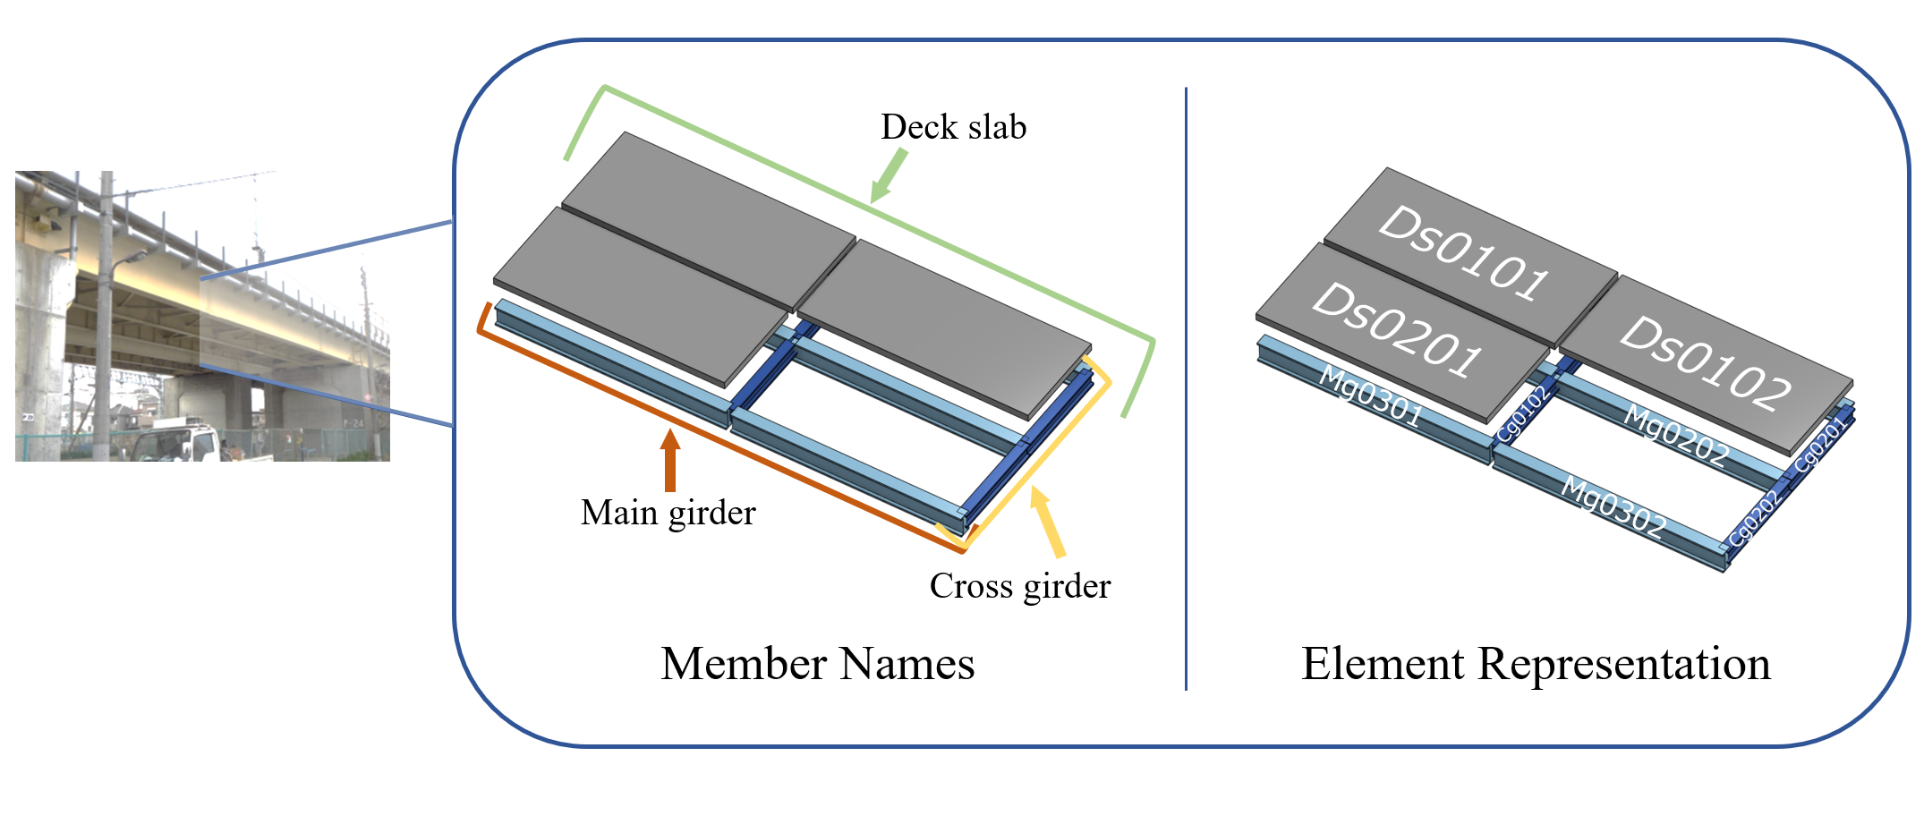
Terms
Components
Damages
Crack: c,
Free lime: e
Damage level
a
b
c
d
e
Sound
Highly deteriorated
Notes:
Before proceeding to the details, let’s clarify the terms about bridge inspection
A bridge span is composed of members, like ….
And members are further divided into sub-components, called element.
Elements are managed by element numbers, which are represented by 4-digit numbers.
Damage level is recorded regarding each element number.
The soundness of the structure is defined with 5 categories. ‘a’ means the soundest state and ‘e’ is most severe state.
The bridge inspection database of Japan stores all inspection reports since 2003.

Slide 23
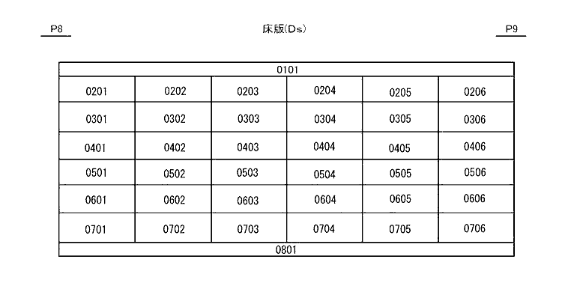
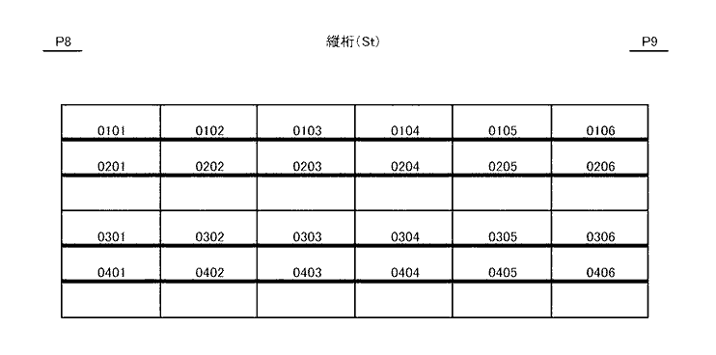
① Creation of graphs illustrating adjacency relationships
Element number diagrams
Element Adjacency Graph
Semi-automatic image parser with assistance of OCR and GPT-4
Notes:
This is about the first method of how we convert diagrams into graph representations.
On the database we can obtain diagrams for each component type.
We can see the arrangements of elements and infer their adjacency relationships.
Using the information, we can create graphs in which each element is represented as a node.
We implemented..

Slide 24
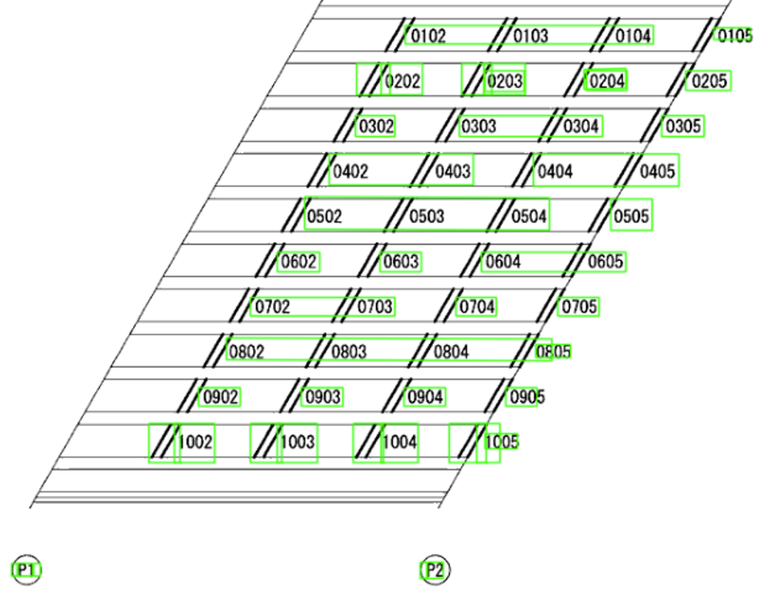
① (FYI) Graph Creation
Retrieving element numbers and their spatial relationships from diagrams
Text reading by Optical Character Recognition (OCR)
OCR noise
misrecognizing element number
e.g., '0101' as '010’,
‘0101’ ‘0102’ as ‘01010102’
Unnecessary texts e.g., ‘P1’, ‘横桁’
Notes:
About Graph creation
We will retrieve…
Element adjacency is not explicitly recorded in other than element number diagrams.
We will use…
Green bounding box represents position of recognized words each bounding box has words, here element numbers.
But OCR sometimes makes mistake, misrecognition.
- recognized in a incomplete way
- Multiple element nums are connected as one single element number
The diagram contains texts other than elem nums, they need to be removed.

Slide 25
① (FYI) Graph Creation
GPT-4 for curation of OCR outputs
OCR outputs
GPT-4 modification
…, ‘0201’, ‘0202’, ‘020’, ‘0204’, …
…, ‘0201’, ‘0202’, ‘0203’, ‘0204’, …
…, ‘0301’, ‘/03020303’, ‘0304’, …
…, ‘0301’, ‘0302’, ’0303’, ‘0304’, …
Utilize context
Element nums are composed of 4-digits.
Neighbor nums can be a hint for interpolation
The implementation of semi-automated process for this task is completed.
Notes:
Deficient number
For this kind of operation, utilizing context is important.
GPT is well suited for utilizing text contexts.
Although both OCR and GPT are not perfect,they can reduce the task for getting better graph representation.

