Slide 1
Automated 3D Bridge Modeling from Non-Layered
Drawings Using Transformer-Based Deep Learning
National Institute of Technology, Tokuyama College
Taniguchi Keitaro
Yamane Tatsuro
Notes:
My name is Keitaro Taniguchi at National Institute of Technology, Tokuyama College, in Japan.
I’d like to talk about “Automated 3D Bridge Modeling from Non-Layered Drawings Using Transformer-Based Deep Learning”.

Slide 2
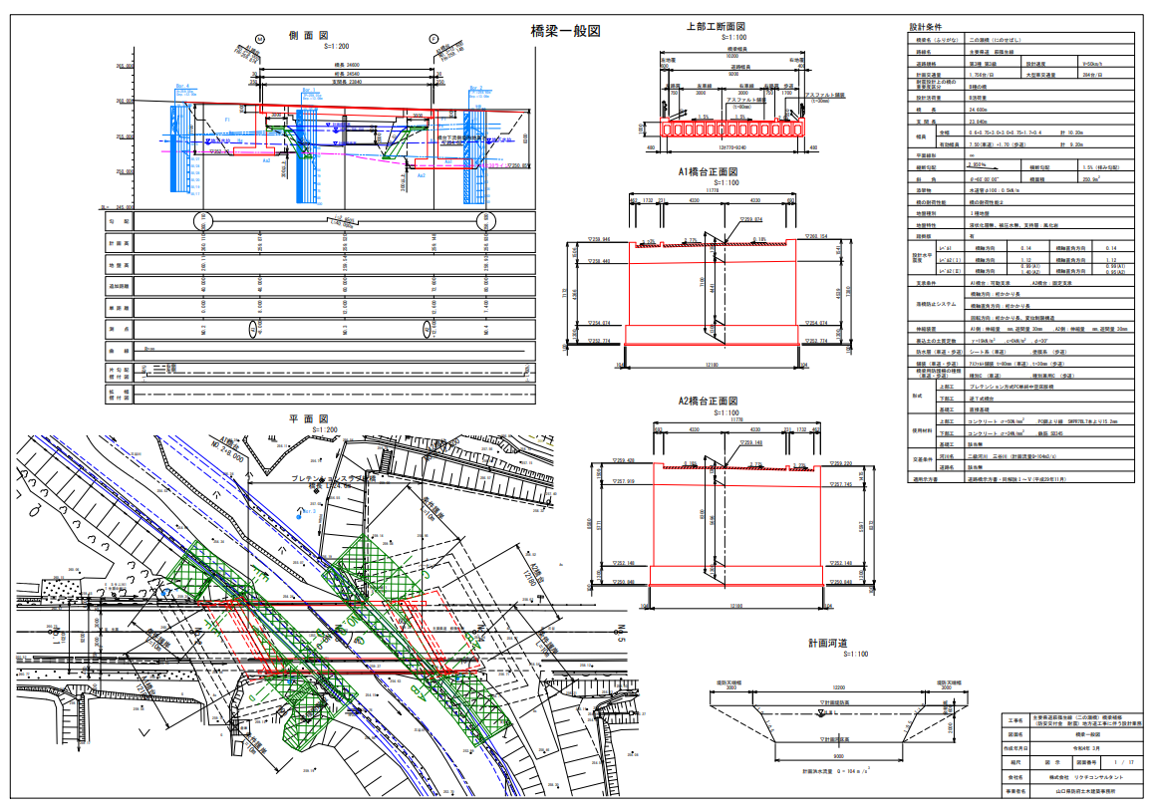
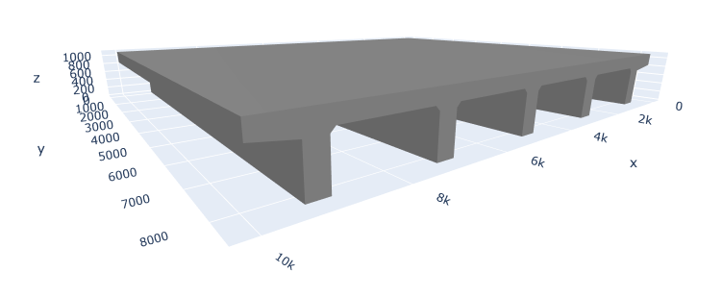
3D models for maintenance
Streamlining maintenance with 3D model is being explored.
SfM, MVS, and LiDAR
→ commonly used to acquire accurate 3D data
→ require collecting and processing large volumes of data
If 3D models can be constructed directly from existing documents, the cost for data collection can be reduced.
Notes:
In recent years, the aging of infrastructure has become a serious issue.
The use of 3D models to streamline maintenance is actively being explored in many studies.
SfM, MVS, and LiDAR are commonly used to acquire accurate 3D data, but they typically require collecting and processing large volumes of data．
On the other hand, if 3D models could be constructed directly from existing construction documents and inspection reports, the cost required for data collection can be reduced.

Slide 3
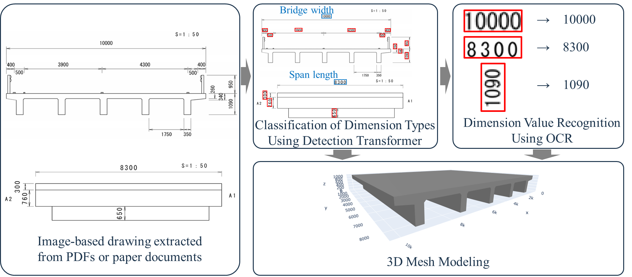
Automated 3D modeling method
In many cases, existing documents are stored in PDFs or paper documents.
Image-based drawing extracted from them, making it difficult to extract information.
Extracting dimensional information from drawings using an Object Detection Model and OCR.
3D models can be automatically constructed.
Flow diagram of proposed method
Notes:
In many cases, existing construction documents and inspection reports are stored as PDFs or paper-based documents, rather than editable digital formats.
As a result, Image-based drawings extracted from them are non-layered, which makes it difficult to mechanically extract information.
Therefore, in this study, dimensional information is extracted from drawings using object detection and OCR, and used to automatically construct 3D models.
Here is the flow diagram of proposed method.

Slide 4
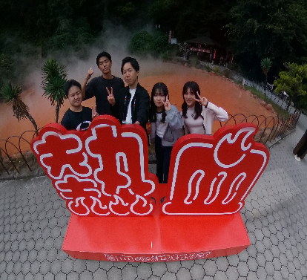
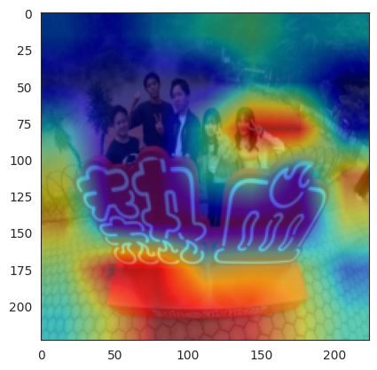
Classification of dimension types
Using an object detection model
CNNs are used in object detection to estimate regions and classify objects by extracting feature maps.
Detection Area
CNN
Prediction
Dimension values consist of digit sequences and lack distinct visual features.
A dimension value’s meaning depends on its position in the drawing.
Classification based on positional relationships is possible
Notes:
First, I will explain the classification of dimension types using an object detection model.
CNNs are commonly used in object detection to estimate regions and classify objects by extracting feature maps.
However, since dimension values consist of digit sequences, they lack distinct visual features, which makes it hard to recognize them just by how they look.
On the other hand, since a dimension value’s meaning depends on its position in the drawing, it’s possible to classify them based on their positional relationships.

Slide 5
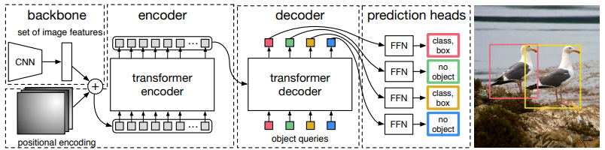
Classification of dimension types
Using an object detection model
Transformer
Attention-Based Deep Learning Model for
Focusing on important parts of the input.
DETR(Detection Transformer)
Transformer-based Object Detection Model
It is possible to classify based on the positional
relationships of dimension values.
Carion, N. et al: End-to-End Object Detection with Transformers. In European conference on computer vision, pp.213–229, 2020.
Notes:
Therefore, in this study we use DETR which is a Transformer-based Object Detection Model.
Transformer is a Deep Learning model based on the Attention mechanism, which focuses on important parts of the input.
By using DETR, It is possible to classify based on the positional relationships of dimension values.

Slide 6
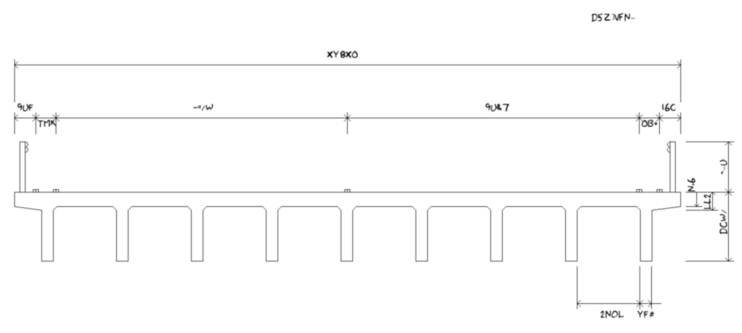
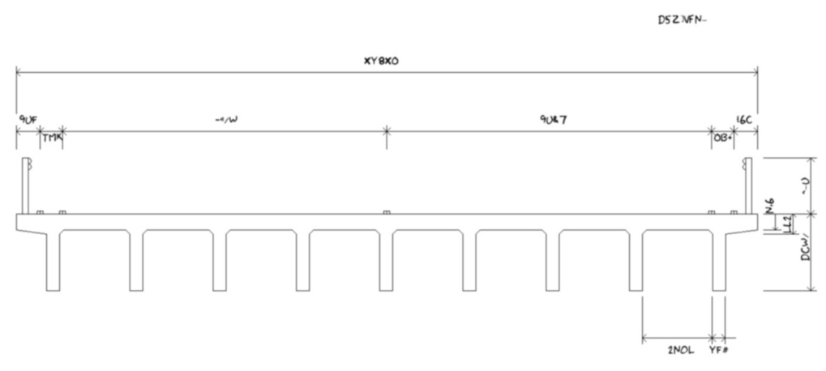
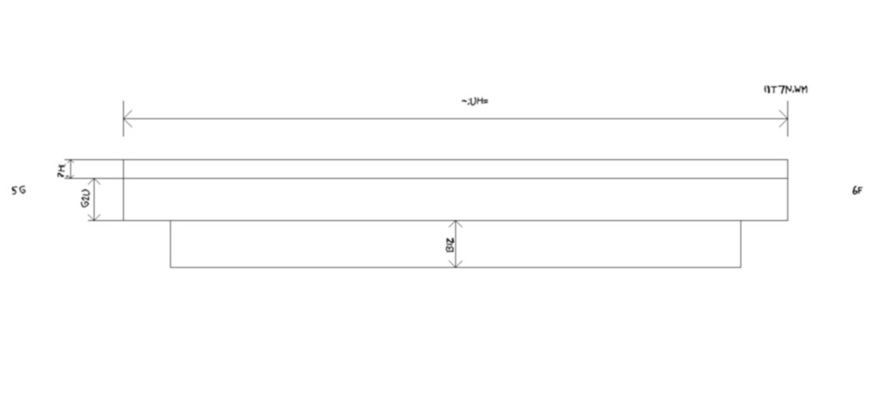
Classification of dimension types using DETR
Training Data
Created synthetic drawing images and annotations
for dimension types and positions.
Random text strings used to encourage position-based learning.
Image for cross-sectional view analysis
Image for side view analysis
2000 images for training
100 images for validation
500 images for training
25 images for validation
Notes:
To train the model, synthetic drawing images were created, along with annotations indicating the types and positions of dimension values.
Since cross-sectional and side views contain different dimension types in different positions, separate datasets were prepared for each view and two models were built: one for cross-sectional analysis and another for side view analysis.
In addition, To encourage position-based learning , dimension values were replaced with random text strings so the model wouldn't rely on the text itself.

Slide 7
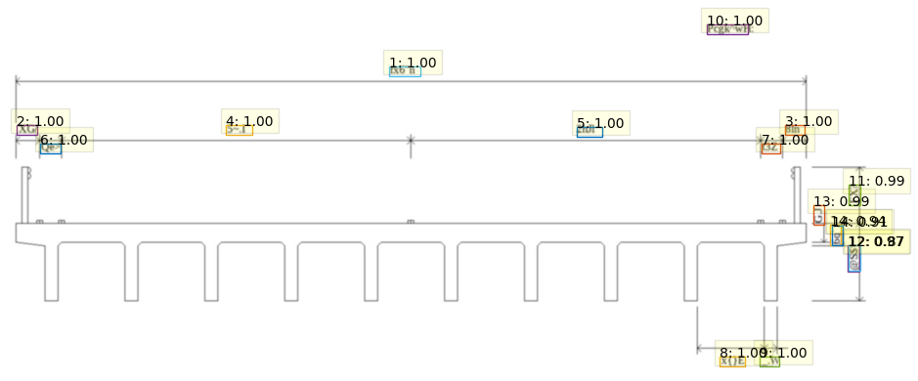
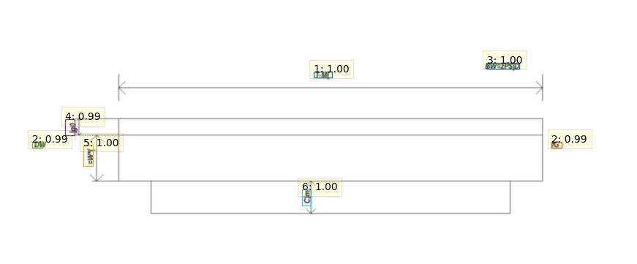
Classification of dimension types using DETR
Detection results on test images created in the same way as training data.
Label：Confidence Score
Label：Confidence Score
1:Width 2:Left Wheel Guard 3:Right Wheel Guard
4:Left Lane Width 5:Right Lane Width 6:Left Roadside 7:Right Roadside 8:Grider Interval 9:Grider Width 10:Scale 11:Railing 12:Grider Height 13:Slab Thickness 14:Slab and Haunch
1:Span Length 2:Symbol 4:Slab Thickness
5:Grider Height-Slab Thickness 6:Clearance
All dimension types were accurately classified
Notes:
After training, the trained models were applied to test images created in the same way as the training data.
As a result, all dimension types were accurately classified.
Both the cross-sectional and side view models achieved high accuracy in detecting and classifying dimension values.

Slide 8
Detection Accuracy
Detection accuracy of each model evaluated using 100 test images
Accuracy decreases as the IoU threshold becomes more stringent.
An IoU of around 50% is sufficient for dimension value recognition
→ practically acceptable performance.
Notes:
Next, the detection accuracy of each model was evaluated using 100 test images.
When the IoU threshold was set to 50%, the cross-sectional view model achieved about 90% accuracy, while the side view model achieved around 70%.
Naturally, the accuracy decreases as the IoU threshold becomes more stringent.
However, as I will explain later, for dimension value recognition, an IoU of around 50% is sufficient, so the model’s accuracy is practically acceptable.

Slide 9
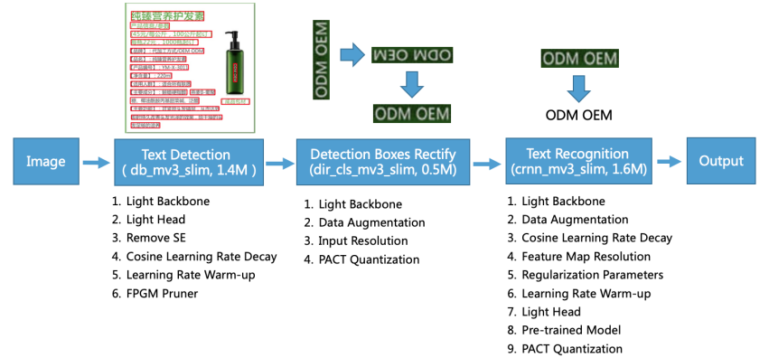
Dimension Value Recognition Using OCR
Dimension values are recognized by applying OCR to images cropped from the detected bounding boxes.
PaddleOCR : Deep Learning-based OCR algorithm
OCR results are linked to dimension types based on DETR classification.
Notes:
Next, I will explain the Dimension Value Recognition Using OCR.
In this step, OCR is applied to each image cropped from the bounding boxes of the detected dimension values.
In this study, we use PaddleOCR to recognize dimension values.
PaddleOCR is an OCR algorithm based on deep learning.
OCR results are linked to dimension types based on DETR classification.

Slide 10



Dimension Value Recognition Using OCR
600 synthetic test images were used to evaluate PaddleOCR’s recognition accuracy.
Recognition | 26 | 540 | 2896
Correct answer | 26 | 540 | 72896
Overall recognition accuracy : 84%
The size of the text area and font visibility affect recognition accuracy.
Higher accuracy is expected in real bridge drawings due to clearer fonts.
Notes:
To evaluate OCR accuracy, 600 test images simulating cropped dimension values were created.
The overall recognition accuracy was 84%, indicating high performance in number recognition.
Misrecognitions and undetected values mainly occurred in images with short digit strings, thin strokes, or visually similar characters such as '1' and '7’.
These results suggest that the size of the text area and font visibility affect recognition accuracy.
However, since actual bridge drawings typically use clearer fonts, even higher recognition accuracy is expected.

Slide 11
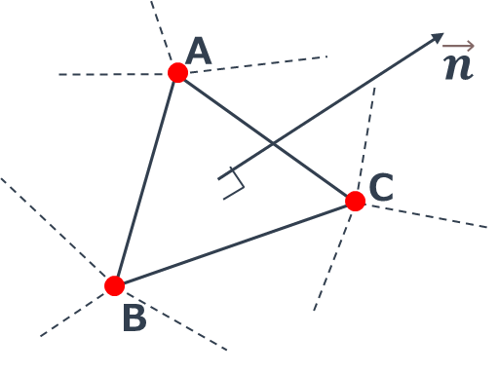
3D Mesh Modeling
Simplified 3D model generated in STL format using extracted data.
STL Format
Format describing the vertex coordinates and normal vectors of each triangle.
Inspection drawings lacked detailed dimensions.
Missing values were set using related dimensions.
Notes:
Next, I will explain the construction of the 3D mesh model.
A 3D mesh model is composed of a series of connected triangular surfaces.
In this study, the constructed model is saved in STL format, which describes the vertex coordinates and normal vectors of each triangle.
Since the inspection drawings used in this study lacked detailed dimension values, the coordinates of each point were set by making assumptions based on the available related values.

Slide 12
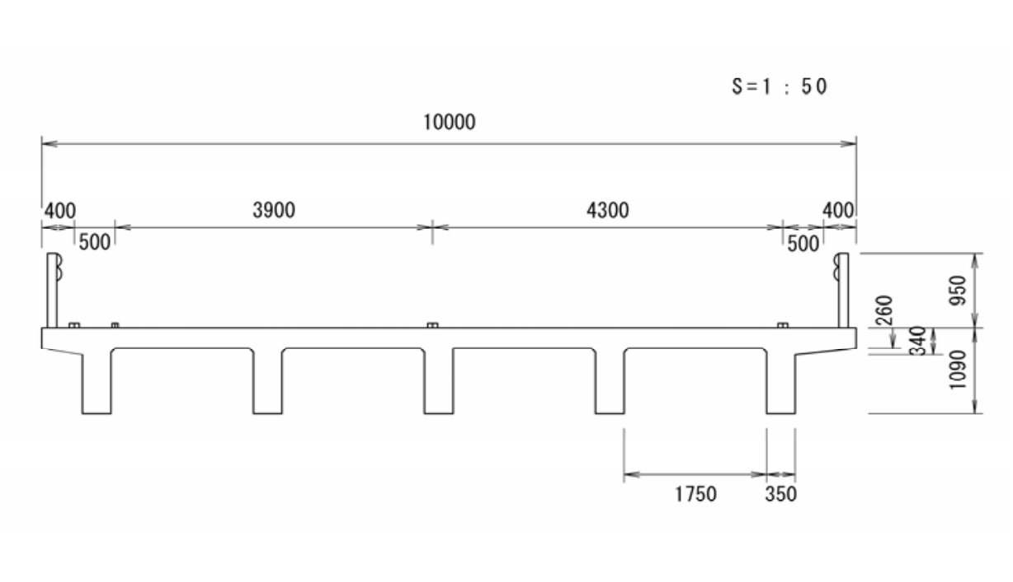
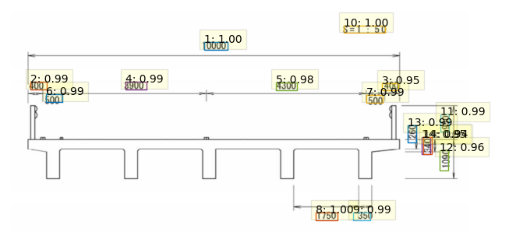
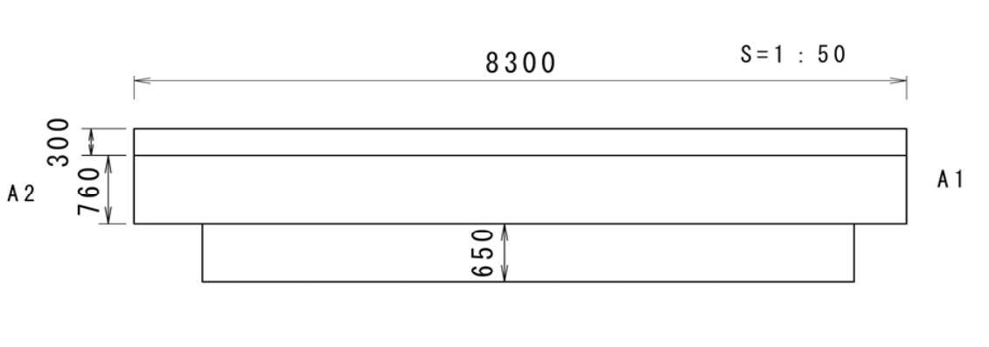
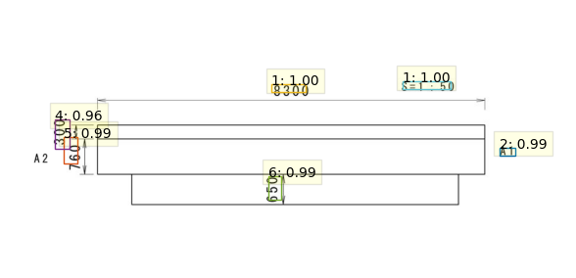
Application to Actual Bridge Drawings
Schematic drawings included in the bridge inspection report were used as input.
1:Width 2:Left Wheel Guard
3:Right Wheel Guard 4:Left Lane Width 5:Right Lane Width 6:Left Roadside
7:Right Roadside 8:Grider Interval
9:Grider Width 10:Scale 11:Railing 12:Grider Height 13:Slab Thickness 14:Slab and Haunch
1:Span Length 2:Symbol 3:Scale 4:Slab Thickness
5:Grider Height-Slab Thickness 6:Clearance
The model accurately classified dimension values even in actual bridge drawings.
Notes:
Next, I will explain Application to Actual Bridge Drawings
The proposed method was applied to drawings from an actual bridge inspection report, and a 3D mesh model was constructed.
First, here are the classification results of dimension types using DETR.
As a result, each model accurately classified dimension values even in actual bridge drawings.

Slide 13








Application to Actual Bridge Drawings
Each dimension value was recognized by applying PaddleOCR to images cropped from the detected regions.
Width: 10000
Grider Height : 1090
Right Roadside : 500
Clearance : 650
Railing: 950
Slab Thickness : 950
Right Lane Width: 4300
Left Lane Width : 3900
etc…
All extracted images were correctly recognized,
demonstrating the accuracy of the OCR process.
Notes:
Next, here are the results of applying PaddleOCR to each cropped image.
As a result, all dimension values were correctly recognized.

Slide 14
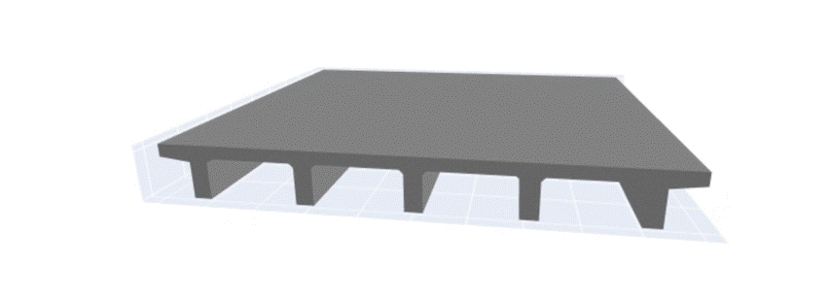
Application to Actual Bridge Drawings
The automatically constructed 3D model based on recognized dimension values and types.
The 3D model was successfully constructed, confirming the method's effectiveness.
Notes:
Then, using the dimensional information extracted through object detection and OCR, a 3D mesh model was constructed.
In this way, 3D mesh model was automatically constructed from actual bridge drawings.

Slide 15
Conclusion
Proposed a method to automatically construct 3D models from imaged drawings using a Transformer-based object detection model and OCR.
Successfully constructed accurate 3D mesh models from actual bridge inspection drawings.
Extracted dimension types and values can be structured (e.g., in JSON) to define bridge specification schemas.
Structured data enables BIM/FEM model creation for advanced infrastructure management.
Notes:
Finally, I will explain the conclusion of this study.
In this study, we proposed a method to automatically construct 3D models from imaged drawings by applying a Transformer-based object detection model and OCR.
Using this method, accurate 3D mesh models were successfully constructed from cross-sectional and side view drawings in an actual bridge inspection report.
The extracted dimension types and values can be structured—for example, in JSON format—to define bridge specification schemas.
This structured data can be used to create BIM and FEM models, contributing to more advanced infrastructure management.

