Slide 1
45 Years of Modelling Gas Explosions with the PDR Concept – Current Status and Future Prospects
Helene Hisken (UiB), Anand Zambare (IIT Madras), Anish A. Pophale (IIT Madras), Vagesh D. Narasimhamurthy (IIT Madras), Kees van Wingerden (Vysus Group), Trygve Skjold (UiB), Bjørn J. Arntzen (UiB, Gexcon), and Melodia Lucas (UiB, Gexcon)
2nd Olympiad in Engineering Science, 10-14 June 2025, Stavanger

Slide 2
The co-authors
Anand Zambare, IIT Madras
Helene Hisken, UiB
Melodia Lucas, Gexcon and UiB
Vagesh D. Narasimhamurthy, IIT Madras
Bjørn J. Arntzen, UiB and Gexcon
Anish Pophale, IIT Madras
Trygve Skjold, UiB
Kees van Wingerden, Vysus Group

Slide 3
Overview
Gas explosions
The PDR concept
PDR model systems for gas explosion applications – highlights
Recent developments
Summary and prospects

Slide 4
Gas explosions

Slide 5
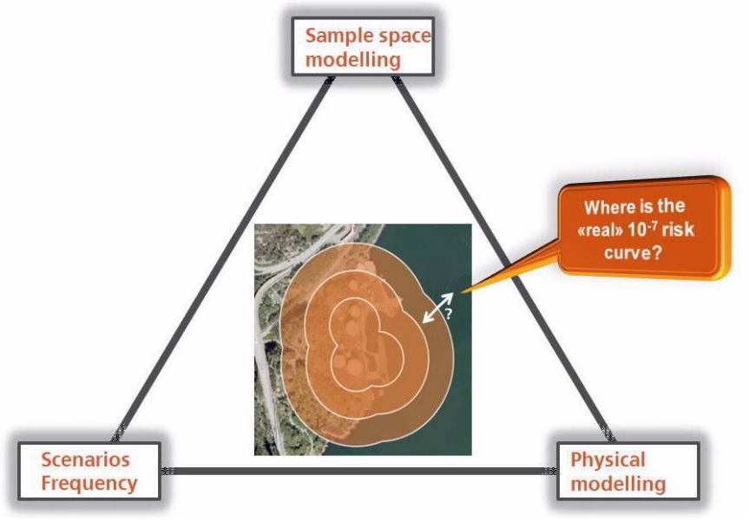
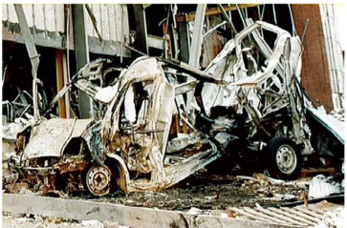
Gas explosions
The potential for fuel-air explosion events must be assessed in systems where flammable gases and liquids are present.
Risk analyses of systems with hazardous materials are mandatory.
Consequence analysis requires models.
From Chamberlain et al. (2019)
From Vysus Group (2021)

Slide 6
Gas explosions
Gas explosions involve complex, multiscale phenomena.
Highly transient, high turbulence numbers, chemical reactions, shock waves, etc. Non-linear dependence on spatial scale, boundary- and initial conditions.
Effect of small-scale geometry details cannot be neglected.

Slide 7
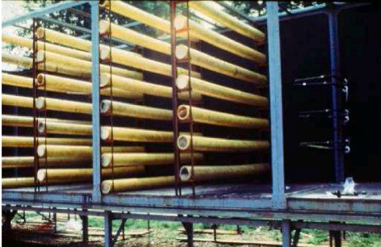
Gas explosions
From the review by Johnson et al. (2024): Large scale experimental research of VCEs – A summary from
one viewpoint.

Slide 8
Consequence models
van Wingerden (2024) describes four classes of consequence models for explosions:
far-field blast models
venting guidelines
phenomenological models
dedicated CFD models

Slide 9
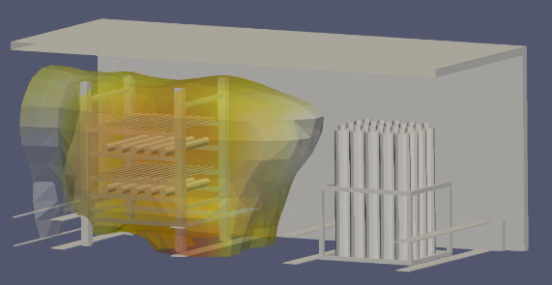
Consequence models
van Wingerden (2024) describes four classes of consequence models for explosions:
far-field blast models
venting guidelines
phenomenological models
dedicated CFD models

Slide 10
History of CFD models for gas explosion applications

Slide 11
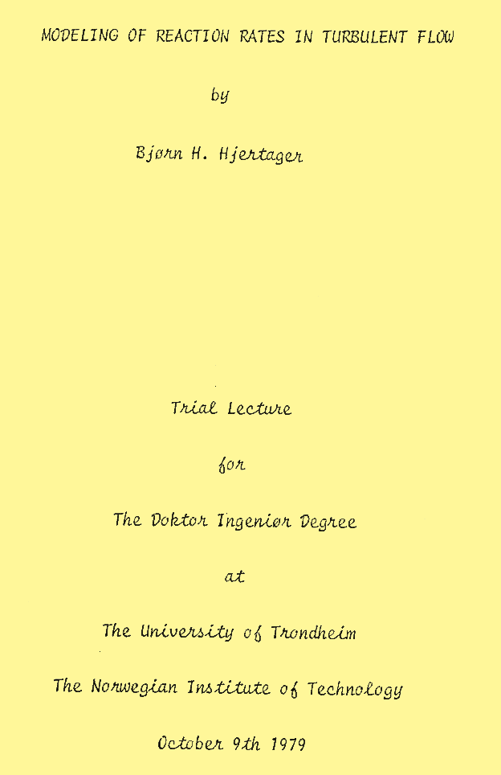
1979
Bjørn H. Hjertager defends his PhD at NTH (NTNU).
He begins developing FLACS, the first CFD model for representing industrial-scale gas explosions, in 1980 at Chr. Michelsen Institute (CMI) in Bergen.

Slide 12
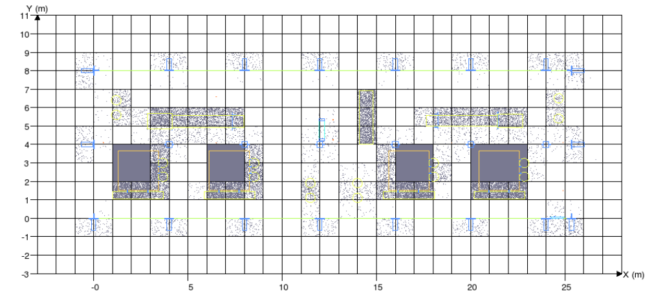
The brilliant idea…
The porosity/distributed resistance (PDR) concept used to represent geometry that cannot be resolved on the computational grid.
First proposed by Patankar and Spalding (1974) for heat exchanger applications, extended by Sha et al. (1982).
Area and volume porosities, β_{i} and β_{v,} represent the effect of geometry on the Navier-Stokes equations for fluid flow + other parameters for sub-grid objects.
Requires a pre-processor step before solving the equations.
$$\frac{∂}{∂t}\left(β_{v}ρΦ\right) +\frac{∂}{∂x_{j}}\left(β_{j}ρu_{j}Φ\right)=\frac{∂}{∂x_{j}}\left(β_{j}Γ_{Φ}\frac{∂Φ}{∂x_{j}}\right)+β_{v}\left(S_{Φ}+R_{Φ}\right)$$
Notes:
such as the total wetted surface area of obstructions, characteristic dimension of obstructions, drag factors for different obstacle types, number of obstacles in the grid cell, etc.

Slide 13
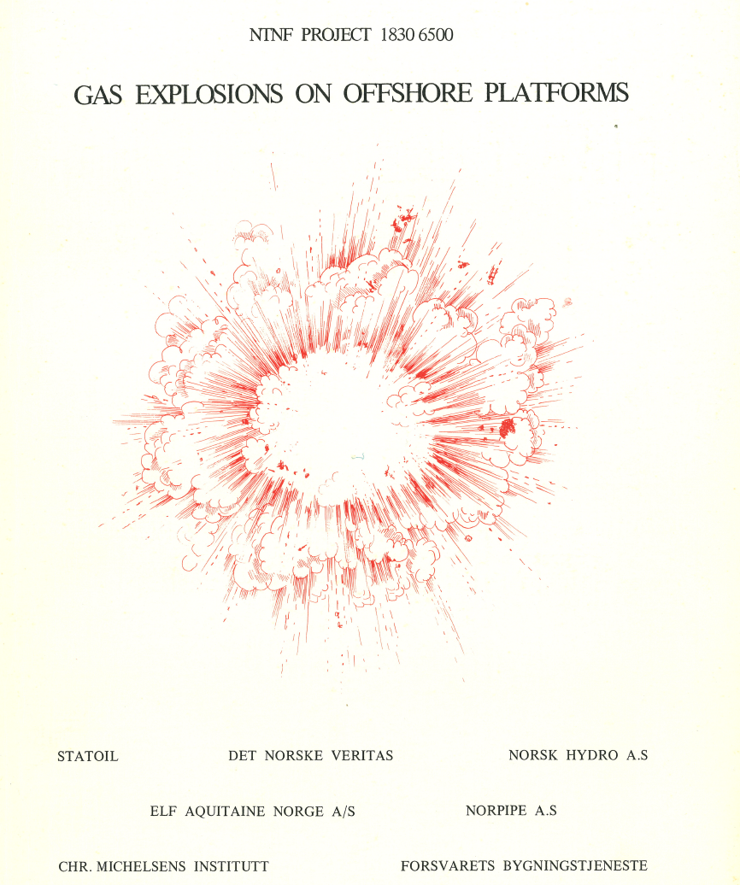
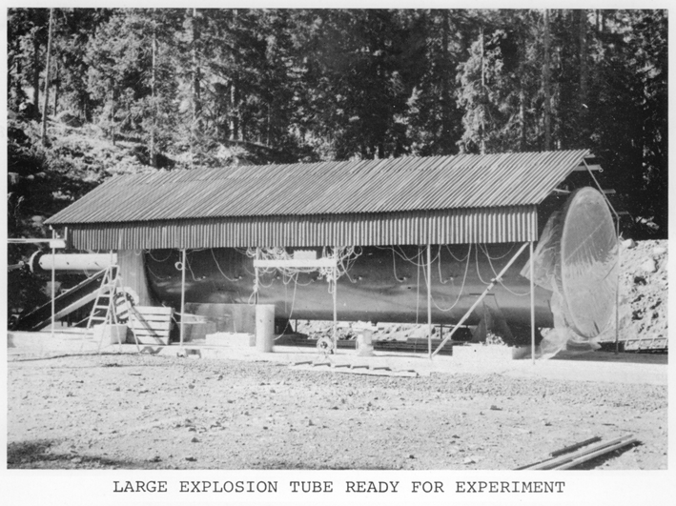
Research activities in the 1970s – early 1980s
Research on dust explosions at CMI established in the 1970s, led by Rolf K. Eckhoff.
In 1976, CMI was asked by Statoil to conduct a preliminary scientific assessment of the potential for gas and mist explosions at installations for oil and gas production.
This provided the starting point for the extensive “Gas Safety Programmes” at CMI in the 1980s.
Hjertager led the first “Gas Safety Programme” from 1980-86, exploring the mechanisms of flame-turbulence interaction and flame acceleration in large-scale explosions. The first version of FLACS was released in 1986.

Slide 14
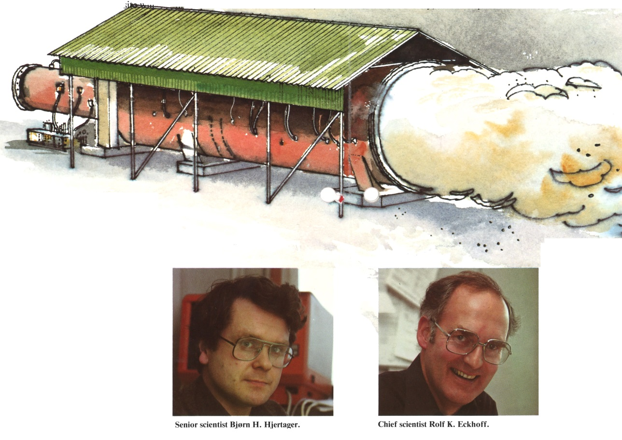
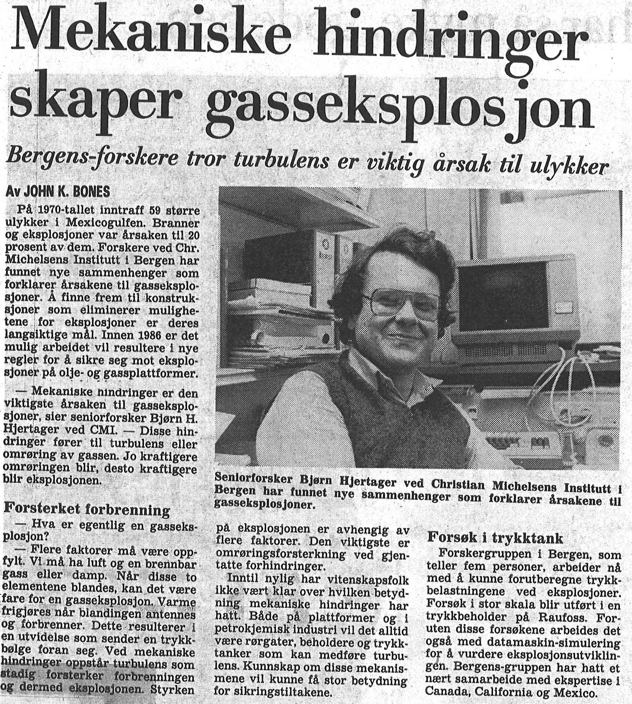
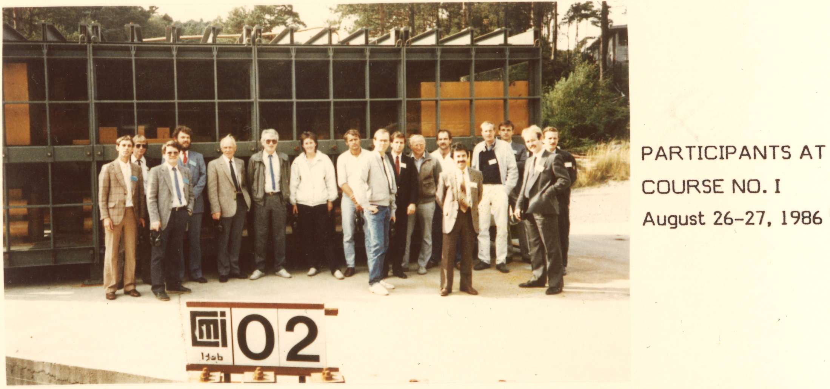

Slide 15
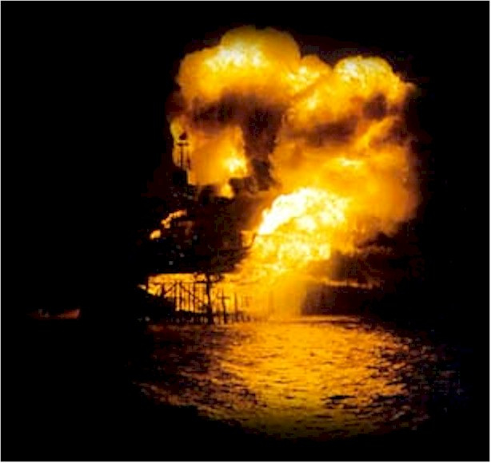
Piper Alpha (1988) and the aftermath
The development of models for predicting gas explosion effects was accelerated after the Piper Alpha disaster in 1988, which claimed 167 lives.
Over the next two decades, several consequence models were developed in parallel with extensive experimental investigations.

Slide 16
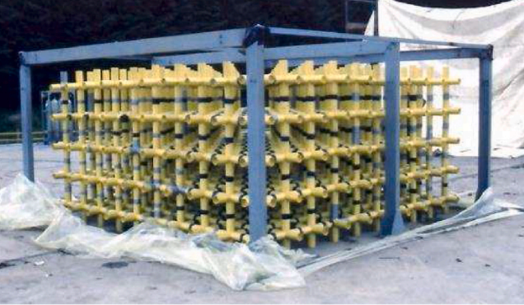
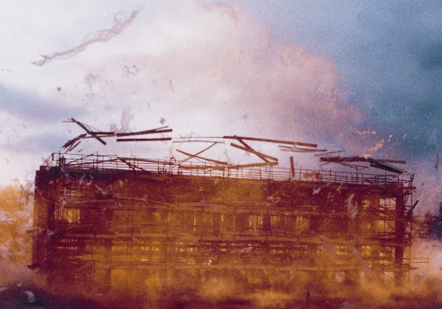
Model development in the 1990s
Four CFD models for industrial-scale gas explosion applications were further developed and tested as part of the CEC (Commission of the European Community)-sponsored research programmes MERGE (Modelling and Experimental Research into Gas Explosions) and EMERGE in the 1990s:
FLACS
EXSIM
AutoReaGas
COBRA
Notes:
EXSIM was developed by Hjertager at Tel-Tek in cooperation with Shell, and is now commercially available from DNV.
The PDR model AutoReaGas was developed by TNO Prins Maurits Laboratory in the Netherlands [34, 66]. The gas explosion model was integrated with tools to also describe propagation of blast waves, blast loading, and structural response [7]. According to van den Berg et al. [65] and Salzano et al. [66], AutoReaGas mainly applied the same modelling approaches as EXSIM and the earlier versions of FLACS.
COBRA was developed by British Gas Research and Development [37, 38, 39], and seems to have applied adaptive mesh refinement (AMR) to resolve the flame front and the flow around obstacles. The primary references in the open literature do not mention how the PDR concept is used in the model. COBRA is therefore not discussed in further detail here.

Slide 17
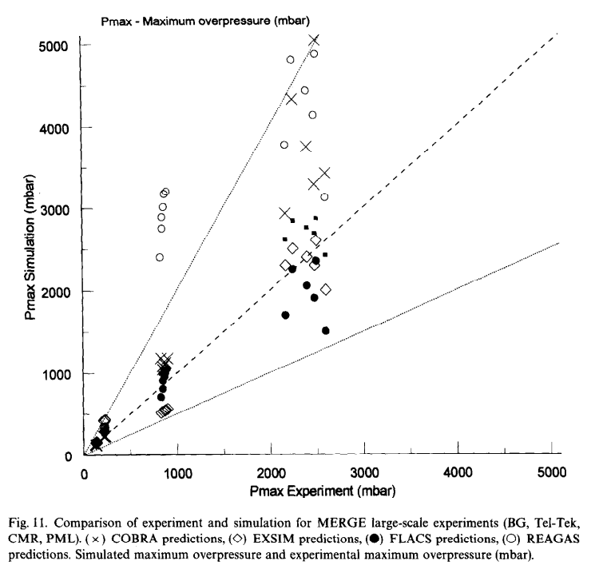
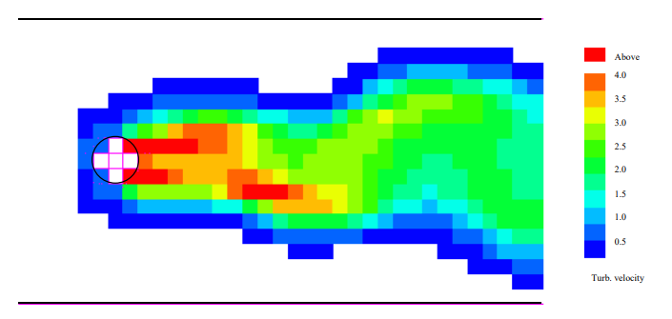
Model development in the 1990s
PDR models were developed in parallel by different groups.
Various approaches were chosen for representing premixed combustion, as well as turbulence generation in areas with sub-grid geometry.
FLACS (commerical tool, now developed by Gexcon) and EXSIM (commerical tool, now developed by DNV) continued after the 1990s to the present.
From Popat et al. (1996)
From Arntzen (1998)
Notes:
Magnussen and Hjertager [25] argued that for fast chemistry, the reaction rate in the fuel mass fraction equation (R_{FU}) can be expressed in terms of a limiting mass fraction m_{lim}, where m_{lim} is the smallest of the mass fractions for fuel, oxygen or burnt products. Hence, R_{FU} = -A ρ ε/k m_{lim}, where A is a constant. Furthermore, Hjertager [19] presented a modified expression for the reaction rate to account for quenching, where the criterion for combustion relates to the ratio of a chemical timescale (τ_{ch}) to a timescale representing the lifetime of the turbulent eddies (τ_{e}). A model for representing the quasi-laminar phase of combustion in the initial phase of flame propagation, and the transition from laminar to turbulent combustion, was developed and implemented by Bakke and Hjertager (1986) [30, 31].
The development of COBRA stopped in 1997 [Lea and Ledin, 2002]. The development of AutoReagas slowed down and has stopped completely since 2005.

Slide 18
2000-2010
Models applying the PDR concept have become the de-facto industry standard for assessing explosion loads in the offshore sector.
Increased focus on hydrogen explosion modelling, and criteria for DDT in FLACS in this period.

Slide 19
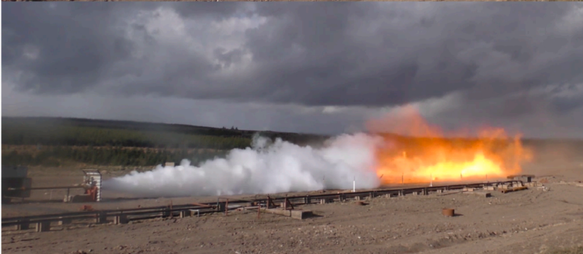
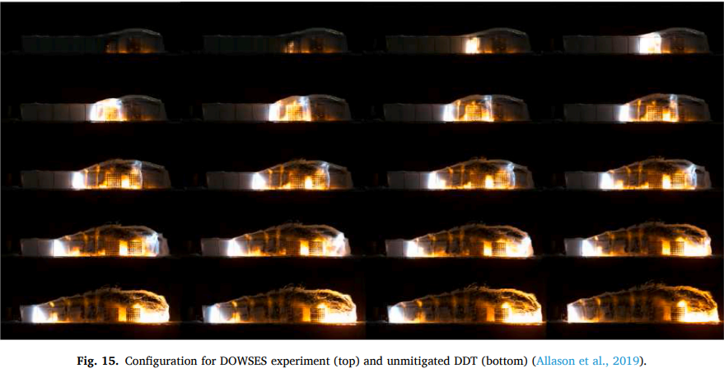
2010-2020
New initiatives were undertaken to fundamentally update the model system in FLACS – both turbulence and combustion models.
Parameter optimisation of model responses emulated by neural networks.
Parallel modelling initiatives with experimental studies on flame acceleration in elongated congested regions (trees), safety gaps, realistic releases, vented hydrogen explosions, etc.

Slide 20
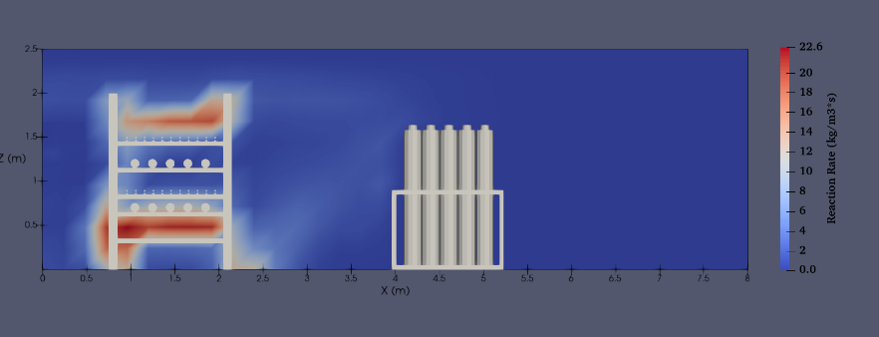
An open-source PDR model
PDRFoam applies the PDR concept with the XiFoam model for turbulent combustion. The model system was first presented in 2014.
Initially developed by Shell.
In XiFoam, flame surface area is a transported quantity.
Several academic institutions (USN, IIT Madras) are currently exploring the use of PDRFoam.
Notes:
The ambition was to combine the PDR concept for gas explosion modelling with up-to-date solution techniques and a wide community of contributors on the open-source platform OpenFOAM. PDRFoam applies the PDR concept with the XiFoam model for turbulent combustion [68]. The XiFoam model calculates the variable Ξ, which for every control volume is the ratio of the average flame area per unit volume to the average flame area projected onto the mean direction of propagation per unit volume.
Puttock et al. [22] listed several convenient aspects of using the XiFoam model to simulate gas explosions. For example, the reaction rate is independent of flame thickness, and it is straightforward to add contributions to Ξ that represent different phenomena. The developers of PDRFoam have added the flame surface area due to sub-grid obstructions as a separate flame wrinkling factor, Ξ_{s}, to separate it from flame wrinkling due to turbulence, Ξ_{t}.

Slide 21
STOKES
STOKES (Shock Towards Kinetic Explosion Simulator), an in-house solver from the University of Campinas (UNICAMP), Brazil.
Porosities in STOKES are calculated using a Gilbert-Johnson-Keerthi (GJK) distance algorithm, which checks for collisions between an element of the mesh and each solid of the geometry.
Representation of sub-grid geometry in the governing equations is similar to that presented for the other PDR models.
Quaresma et al. (2022)

Slide 22
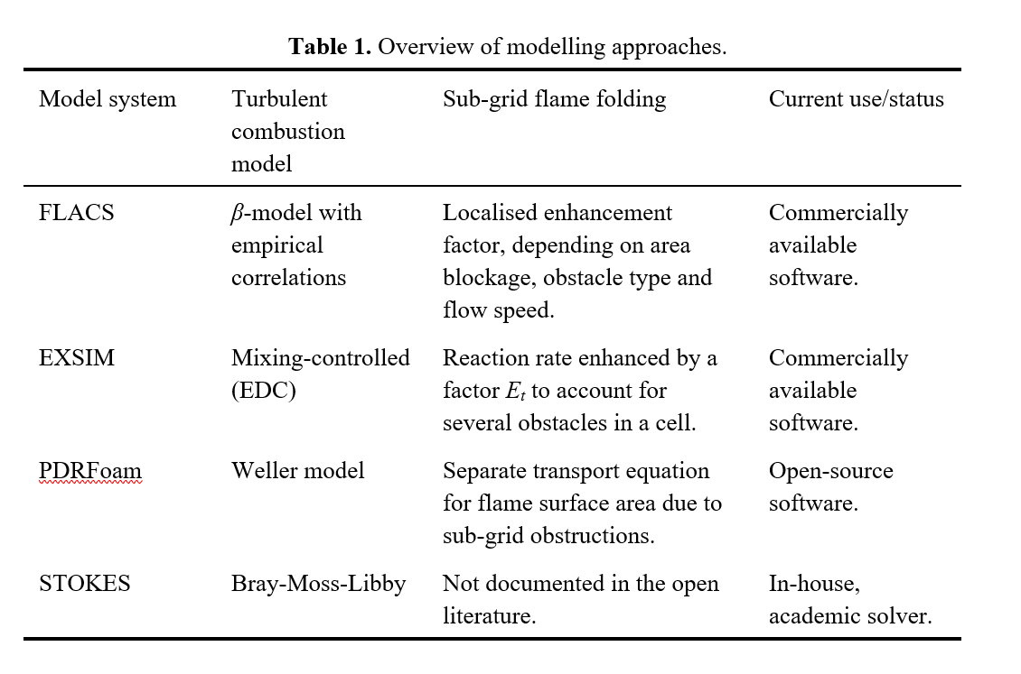
Current PDR models for gas explosions

Slide 23
Current status and future prospects

Slide 24
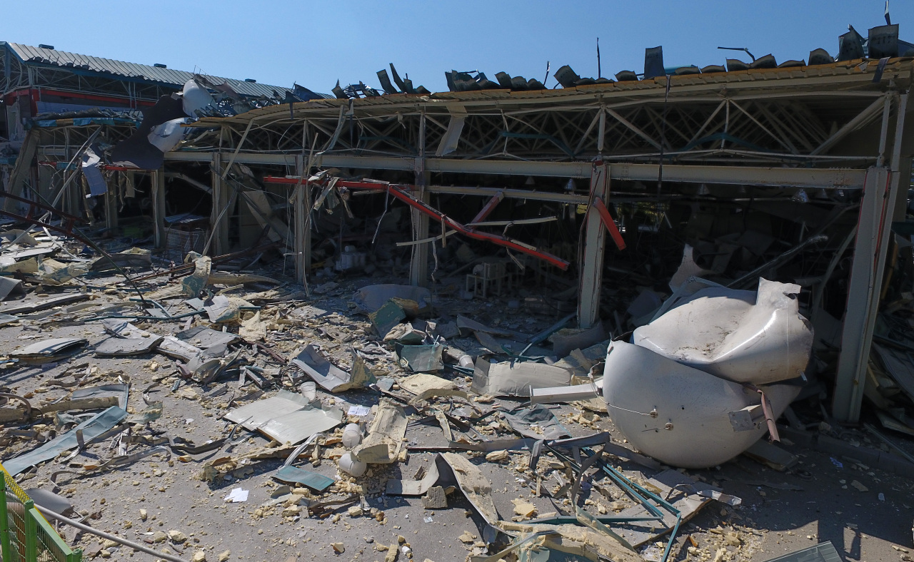
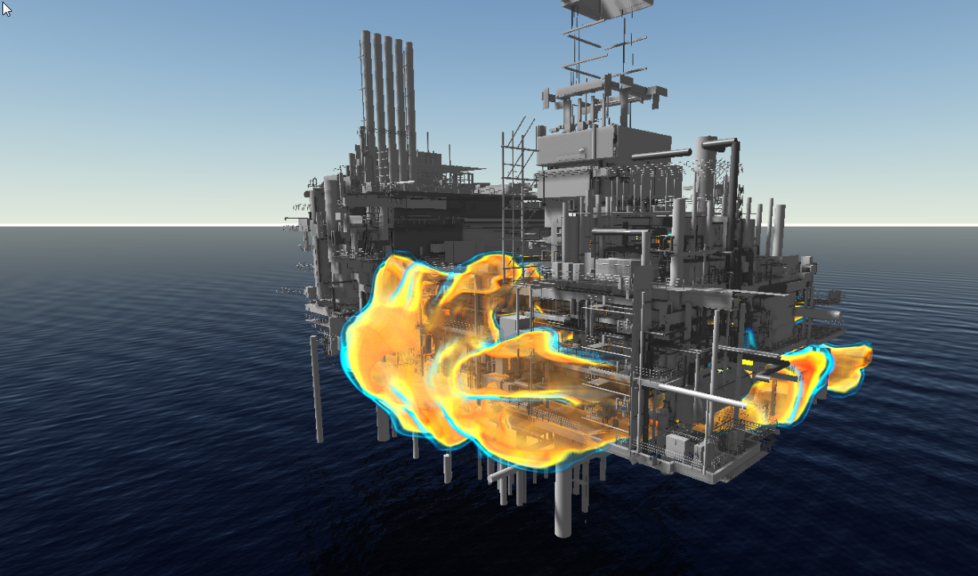
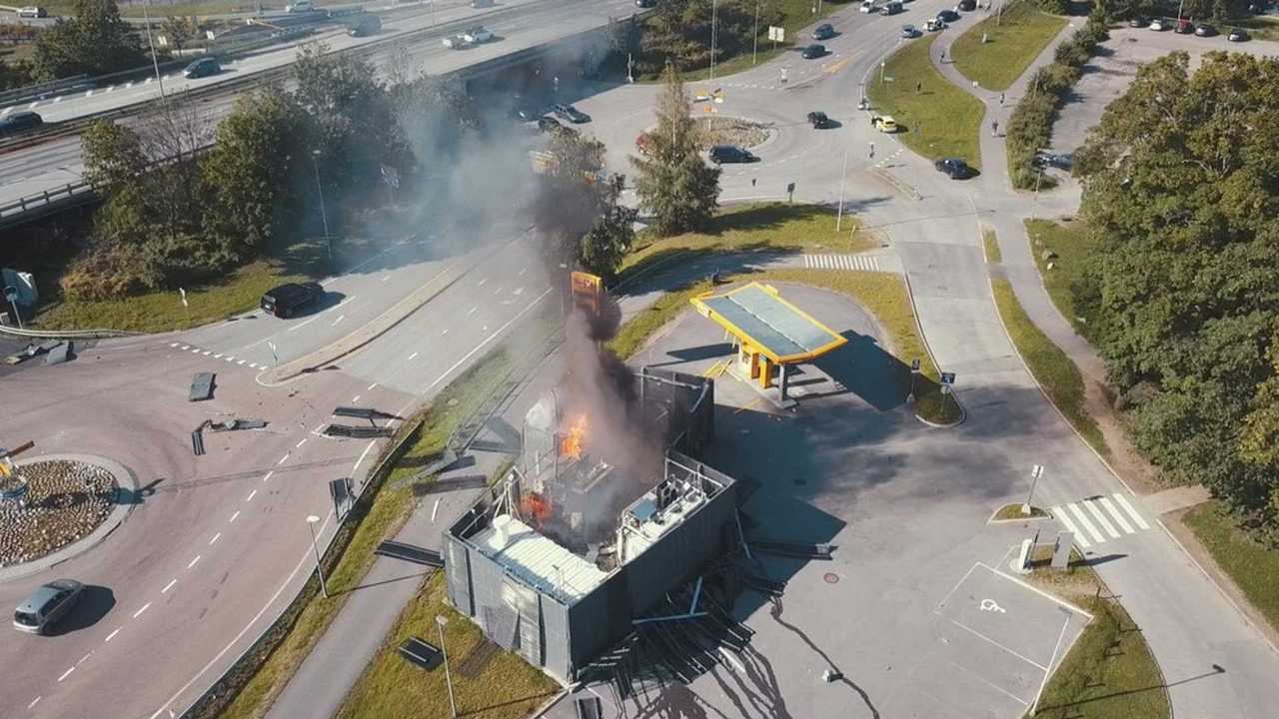
Status so far…
PDR models for gas explosion applications balance accuracy and complexity with computational efficiency.
The three-dimensional and time-dependent nature of results allow for effective communication of risk to stakeholders.
The commercial tools are developed to be highly robust and user-friendly.

Slide 25
Some modelling challenges
Grid dependency of results – requires clear guidelines based on validation.
Handling the on-grid to sub-grid transition in a transient flow field.
Numerical effects associated with modelling the reaction zone.
Actual use of the models often extend the domain of validation against experiments – focus on representing physics.
Hydrogen applications may pose additional challenges from a modelling perpective (high reactivity, sensitive to changes).
Challenging to quantify the uncertainty associated with the model results.

Slide 26
Prospects and further developments
Increased use of automatic methods for setting up and running simulations.
Addressing three main challenges in gas explosion modelling:
Representing the flame propagation past regions with different congestion density («safety gaps»).
Representing the effects of flame propagation in mixtures with high initial flow speeds and turbulence levels (explosions in realistic releases).
Representing DDT and detonation effects in arbitrary mixtures and situations.
Potential for development of new knowledge through
Experimental work on different scales.
Performing detailed simulations with other models (e.g. applying LES).

Slide 27
«PDR Alliance»
Community for pre-competitive, collaborative research where developers of PDR models, researchers, risk owners and experimentalists can share knowledge, experiences, resources, experimental data, suggest and prioritise experimental studies, develop joint research proposals, etc.
Take the good experiences and lessons from the 1990s with us into the future!
☺

Slide 28
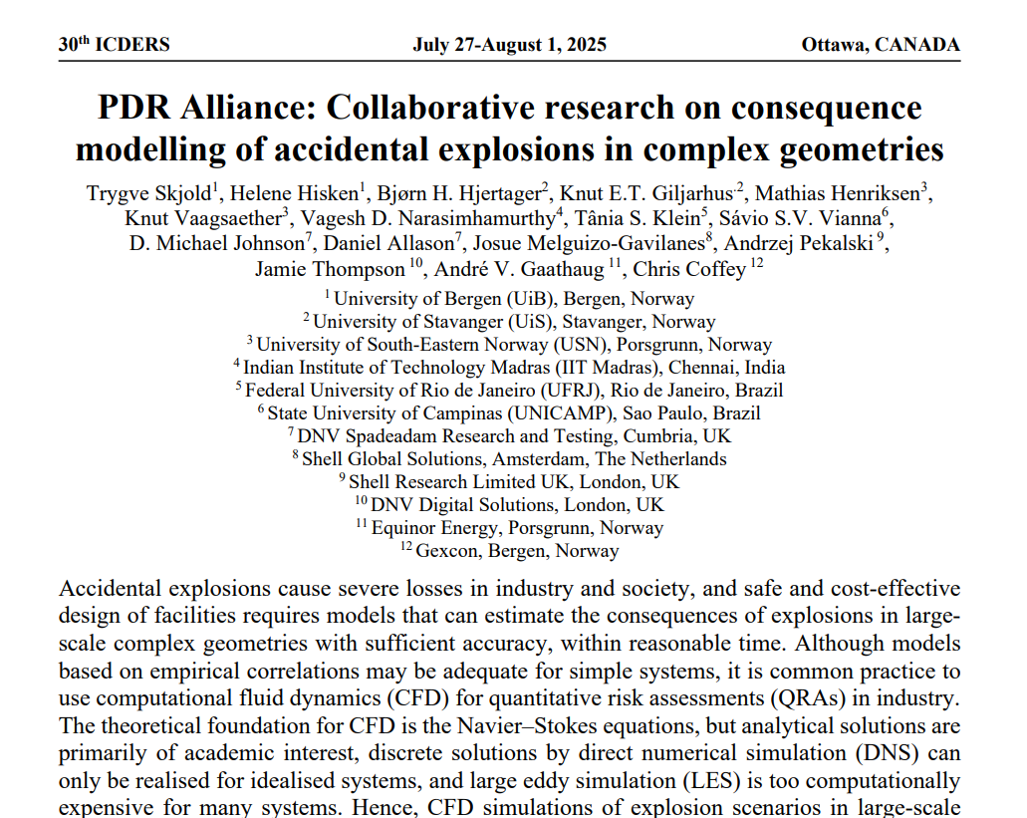

Slide 29
References
Johnson, D.M., Allason, D., Cronin, P.M.: Large scale experimental research of VCEs – A summary from one viewpoint. Journal of Loss Prevention in the Process Industries, 89, 105287 (2024).
van Wingerden, K.: Gas explosion modelling – Looking back. Presentation at the International Process Safety Week (IPSW), 2-6 December 2024.
Patankar, S. V., Spalding, D. B.: Heat Exchangers: Design and Theory Sourcebook, chapter "A calculation procedure for the transient and steady-state behavior of shell-and-tube heat exchangers", pages 155–176. McGraw-Hill (1974).
Sha, W. T., Yang, C. I., Kao, T. T., Cho, S. M.: Multidimensional numerical modeling of heat exchangers. Journal of Heat Transfer, 104(3), 417–425 (1982).
Arntzen, B. J.: Modelling of turbulence and combustion for simulation of gas explosions in complex geometries. PhD thesis, Department of Energy and Process Engineering, Norwegian University of Science and Technology, Norway (1998).
Popat, N. R., Catlin, C. A., Arntzen, B. J., Lindstedt, R. P., Hjertager, B. H., Solberg, T., Saeter, O., Van den Berg, A. C.: Investigation to improve the accuracy of computational fluid dynamic based explosion models. Journal of Hazardous Materials, 45, 1–25 (1996).

Slide 30
Thank you so much for your attention!

