Slide 1
Wind Induced Fatigue of Flare Booms: Evaluation of Different Methods and Software Alternatives
Stavanger, 12.06.2025
Ahmed Radwan, Nikolas Bentzen
Sudath C. Siriwardane

Slide 2
Overview
Research Gaps and Main Objective
Fatigue Assessment Approaches
Structural Description of the Case Study Flare Boom
Wind Load Simulation
Parametric Comparison
Comparison of Results
Conclusions
Notes:
We will explore the motivation and main objectives, the fatigue assessment approaches used in analysis, including spectral method and nonlinear time history analysis.
The structural description of the flare boom case study will be outlined,
wind load input into the software
parameters used in comparison
Results and comparison.
Finally, we’ll take a look at drawn conclusions.

Slide 3
Research Gaps and Main Objectives
Wind-induced fatigue is usually the governing design basis in slender structures such as flare booms.
Different software are used to estimate fatigue damage based on two approaches:
    Power spectral density approach.
    Time domain nonlinear dynamic analysis.
A comparison between software results, using the 2 approaches, is not clear.
Main objective is to make a parametric comparison between FRAMEWORK (spectral method) and USFOS (time domain dynamic analysis) based on some parameters.
Notes:
In slender structures such as flare booms, wind-induced fatigue is usually the governing design basis. Flare booms consist mainly of tubular members which give high stress concentrations at the joints where fatigue cracks usually take place.
Different types of software are used in the industry to estimate fatigue life of offshore slender structures using two different approaches.
However, there is no clear comparison between the two approaches and if one is in favor.
So our main objective is to make a parametric comparison between FRAMEWORK (spectral method) and USFOS (time domain dynamic analysis) based the effects of drag coefficient, weight factor, wind block configuration.

Slide 4
Overview
Research Gaps and Main Objective
Fatigue Assessment Approaches
Structural Description of the Case Study Flare Boom
Wind Load Simulation
Parametric Comparison
Comparison of Results
Conclusions

Slide 5
Fatigue Assessment Approaches
Fatigue Assessment Approaches
  This study compares the spectral method in SESAM FRAMEWORK with nonlinear time history analysis in USFOS for offshore structures.
Parametric Analysis
  A detailed parametric analysis evaluates effects like drag coefficient, weight factor, and wind block configuration.
Notes:
two established fatigue assessment approaches: the spectral method implemented in SESAM FRAMEWORK, and the nonlinear time history analysis performed using USFOS. Both rely on the hot spot stress approach and are applied to the same structural model of a North Sea flare boom.
A detailed parametric analysis was conducted to assess the effects of drag coefficient, weight factor, wind block configuration.

Slide 6
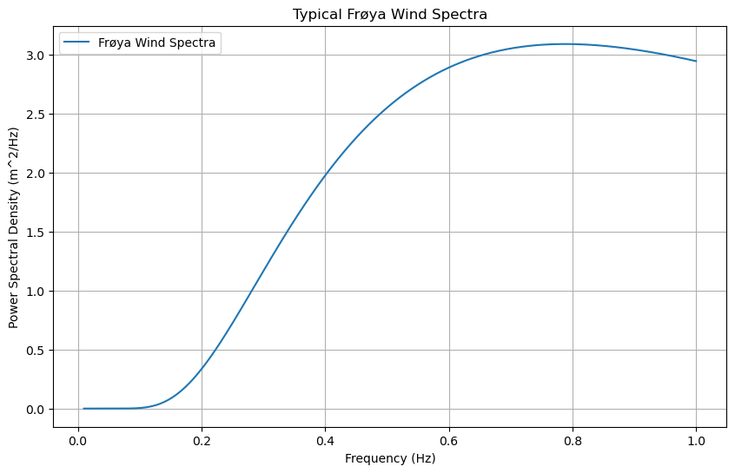
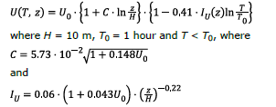
Spectral Method in SESAM FRAMEWORK
Power spectral method
  FRAMEWORK uses power spectral density method to analyze fatigue due to buffeting loads coming from wind gusts.
  The spectra used in the analysis is Frøya spectra, based on DNV-RP-C205.
Input
  Eigen modes and eigen frequencies.
  structural data and drag factors.
  Annual wind distribution.
  Assumptions
  Low frequency modes at resonance.
  SCF is calculated using parametric equations (Efthymiou).
  All structural members need to be tubular.
Damage Evaluation
  FRAMEWORK calculates hotspot stresses. And Miner’s rule is used to estimate the damage, using SN curves.
Ref: DNV-RP-C205
Notes:
FRAMEWORK uses wind loads derived from the Frøya spectra and analyze for fatigue buffeting using power spectral density method.
FRAMEWORK requires input information of the eigenmodes, eigen frequencies and structural data along with statistical information about the wind distribution as scatter diagram and drag factors.
Assumptions:
1. Low frequency modes at resonance are the main contributors to buffeting damage.
2. stress concentrations factors at the joints are calculated using parametric SCF equations.
3. All structural members need to be tubular members with welded connections.
Damage:
FRAMEWORK calculates hotspot stresses. Miner’s rule and SN cuve are used to estimate the damage due to stress cycles. The annual damage for any frequency and direction can be estimated. the overall annual damage is the sum of the damages across all wind states and frequency bands.

Slide 7
Nonlinear Time History Analysis in USFOS
Time history method
  USFOS uses time domain approach to perform a full nonlinear dynamic analysis under the effect of wind buffeting.
Input
  Wind field in time domain.
  structural data and drag factors.
  Annual wind distribution.
  SCF.
Damage Evaluation
  Hotspot stresses are calculated by FATAL using the SCF input.
  FATAL uses rainflow cycle counting method to estimate accumulated fatigue damage.
  Miner’s rule is used to estimate the damage, using SN curves.
Notes:
USFOS is one of DNV SESAM package’s software and uses time domain approach to perform a full nonlinear dynamic analysis under the effect of wind buffeting.
*Input:
USFOS uses specific input data such as detailed wind fields for the location of interest around the year.
the structure model including all the materials and cross-sections and the drag factors are used as input.
To account for mean wind forces from different directions, crosswind interaction and the probability, annual wind speeds and directions are used as input.
Then nonlinear dynamic analysis is run to calculate stresses using SCF as input.
*Damage Evaluation:
Hotspot stress is calculated at each joint by FATAL using the input SCFs and the output stresses from USFOS.
FATAL also uses the time domain rain flow cycle counting method for estimation of fatigue accumulated damage.
Damage is estimated using Miner rule and SN curves.

Slide 8
Overview
Research Gaps and Main Objective
Fatigue Assessment Approaches
Structural Description of the Case Study Flare Boom
Wind Load Simulation
Parametric Comparison
Comparison of Results
Conclusions

Slide 9
Structural Description of the Case Study Flare Boom

Slide 10
Flare Boom Model
Flare Boom
  The flare boom on an existing platform in service. Modelled in DNV Sesam GeniE.
Structural components
  Flare boom consists of tubular members.
  Supporting structure consists of box-section and I-section beams, connected to topside.
Elevation and Dimensions
  The flare boom's base is 24.6 m above sea level, reaching a tip elevation of 119.8 m. Total height of 95.2m.
Material Properties
  σy = 420MPa
  E = 210 GPa
  Poisson’s ratio ν = 0.3
Structural Weight and Damping
  The total weight is 398.15 metric tons, and a structural damping ratio of 0.005 is used to manage vibrations.
Notes:
The flare boom considered in this study is taken from an existing offshore platform. It consists of two main components: (i) tubular members and (ii) a supporting structure made of box- and I-section beams forming a box frame,. The supporting structure connects to the platform topside via tubular link members.
The base of the flare boom is at an elevation of 24.6 m above sea level (LAT), and its tip reaches 119.8 m.
The yield strength is 420MPa, modulus of elasticity 210GPa, Poisson’s ratio is 0.3.
The total weight is 398.15 metric tons, with point masses added to match the target weight and center of gravity. A structural damping ratio of 0.05 is used.

Slide 11
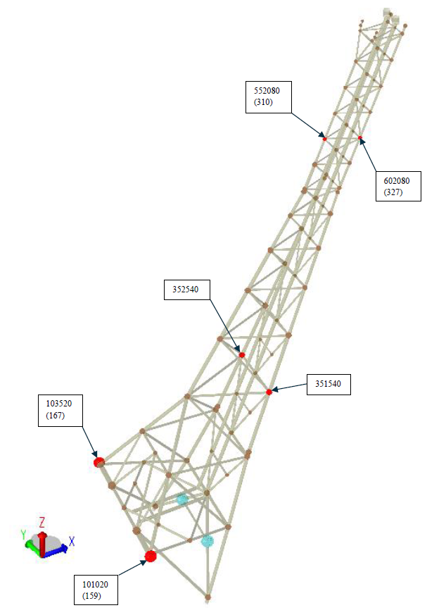
Flare Boom Model
Parametric Comparison
  The fatigue lives of critical points from FRAMEWORK and USFOS software are compared using a parametric approach.
Critical Points Variation
  Five most critical joints are used in the results comparison. The joint numbering system used is shown.
S-N Curve Application
  The S-N curve for tubular members (T-air) (DNV-RP-C203) is used for determining fatigue lives of tubular joints.
Notes:
Analyses are run. Fatigue lives at the five most critical points from each software (FRAMEWORK and USFOS) are used for a parametric comparison.
These points do not align due to differences in how each software identifies critical nodes.
Six nodes are displayed to reflect this variation. Joint numbers differ between the two software: FRAMEWORK uses a six-digit numbering system, while USFOS numbers are shown in parentheses for reference.
The S-N curve for tubular members in air (T-curve) is used for all tubular joints, in accordance with DNV-RP-C203.

Slide 12
Overview
Research Gaps and Main Objective
Fatigue Assessment Approaches
Structural Description of the Case Study Flare Boom
Wind Load Simulation
Parametric Comparison
Comparison of Results
Conclusions

Slide 13
Wind Load Simulation

Slide 14
Wind Data and Wind Profiles
Wind Data Extraction
  Wind data is extracted from the Metocean Design Basis.
  All-year wind rose.
  Scatter Diagram
All-Year Wind Rose
  Dominant wind directions are South, South-east, and North.
Wind Profile and gust
  Characteristic wind velocity is calculated according to NORSOK N-003
Notes:
Wind data is extracted from Metocean Design Basis for the corresponding field. This includes the wind profile; all-year wind rose and the scatter diagram. As the wind rose shows, the dominant wind directions are South, South-East and North, respectively. While the least-occurring wind comes from the East direction.
Wind profile and gust are based on the NORSOK Standard N-003. wind profiles are established for different wind speeds varying with height at the location of interest.

Slide 15
Wind Data and Wind Profiles
Wind Scatter Diagram
  Annual distribution of non-exceedance of 1-hr average wind speed.
  Used as input in both software.
Notes:
The annual direction sample distribution of non-exceedance (%) of 1-hour average wind speed at 10 m above sea level is extracted from the Metocean report.

Slide 16
Overview
Research Gaps and Main Objective
Fatigue Assessment Approaches
Structural Description of the Case Study Flare Boom
Wind Load Simulation
Parametric Comparison
Comparison of Results
Conclusions

Slide 17
Parametric Comparison

Slide 18
Comparison Parameters
Parameters used in the study:
Drag Coeffecient
  Cd = 0.65
  Cd = 1.0
  Cd = 1.2
  Cd = Reynold’s dependent..
Weight Factor
  WF = 0.5
  WF = 1.0
  WF = 1.1
  WF = 1.5
Number of Wind Blocks
  8 wind blocks
  10 wind blocks
  12 wind blocks
  16 wind blocks (valid only for USFOS)
Parameters NOT used in the study:
Relative velocity
  Relative velocity between the structure and wind may be of interest in time domain dynamic analysis.
  Has most impact in very dynamic structures (ex wind turbines).
Notes:
To ensure reliable comparisons, multiple cases were generated by varying key parameters. A total of 48 FRAMEWORK cases and 64 USFOS cases were analyzed, based on:
Key parameters: Drag Factor (Cd): Values of 0.65, 1.0, 1.2, and a Reynolds number–dependent Cd, which varies with wind speed and height using software-defined equations.
Weight Factor (Wf): Values of 0.5, 1.0, 1.1, and 1.5, applied to the structure’s density to adjust mass, affecting response and natural frequency.
Number of wind blocks, the most impactful block group is used in the study.
All cases are applied to all wind speeds and directions, weighted annually according to the scatter diagram.
Parameters not included:
Relative velocity,

Slide 19
Overview
Research Gaps and Main Objective
Fatigue Assessment Approaches
Structural Description of the Case Study Flare Boom
Wind Load Simulation
Parametric Comparison
Comparison of Results
Conclusions

Slide 20
Comparison of Results

Slide 21
Comparison of Results
Notes:
Fixing Cd and comparing according to windblocks, showing the weight factor on x-axis against fatigue life on y-axis:
• FRAMEWORK predicts higher fatigue life in each corresponding wind block case.
• The biggest drop in fatigue life is observed in the weight factor range from 0.5 to 1.0.
•There is a significant drop in fatigue life between weight factor 1.0 and 1.1 in FRAMEWORK. However, this trend is not similar in the corresponding USFOS results as fatigue life drop seems linear between weight factor 1.0 and 1.5.
• Fatigue life results in USFOS 16 wind blocks is highest among all USFOS results.
•Both software results seem to show the same trend of decrease in fatigue life between weight factor of 1.1 and 1.5 especially in the case of 12 wind blocks.

Slide 22
Comparison of Results
Notes:
Fixing weight factor and comparing according to windblocks, showing the Cd on x-axis against fatigue life on y-axis:
• FRAMEWORK predicts higher fatigue life in each corresponding wind block case.
• Fatigue life is closer in value for all cases when Cd=1.2.
• Fatigue life of 8 wind block in FRAMEWORK and 16 wind block in USFOS are close.

Slide 23
Comparison of Results
FRAMEWORK predicts higher fatigue life than USFOS.
On average, USFOS predicts 66% of the fatigue life that FRAMEWORK predicts.
The most critical joint in FRAMEWORK is the mirror of the most critical joint in USFOS. Due to the difference in treating the wind input.
USFOS 16 wind blocks case could have the most accurate representation of reality. FRAMEWORK case of 8 wind blocks correlates closest to the 16 wind blocks case in USFOS.
There seem to be a large difference in fatigue life sensitivity in FRAMEWORK around weight factor range of 1.0 and 1.1. Related to natural frequency?

Slide 24
Overview
Research Gaps and Main Objective
Fatigue Assessment Approaches
Structural Description of the Case Study Flare Boom
Wind Load Simulation
Parametric Comparison
Comparison of Results
Conclusions

Slide 25
Conclusions

Slide 26
Key Findings
The time history method in USFOS predicts a shorter fatigue life than the spectral density method in FRAMEWORK using corresponding input.
Use of more wind blocks generally means higher predicted fatigue life. This is due to less conservative roundups.
On average, the use of relative velocity formula in USFOS gives an increase of 196% in fatigue life.
USFOS is computationally demanding, where the analysis can take up to 24 hours to run in case of fine time increment.
FRAMEWORK is slightly easier to setup and requires less input data. USFOS needs simulated wind field.
Notes:
* USFOS predicts shorter fatigue life than FRAMEWORK.
* more wind blocks predict higher fatigue life. Due to less conservative roundups.
relative velocity formula in USFOS gives an increase of 196% in fatigue life.
USFOS is computationally demanding.
FRAMEWORK is slightly easier to setup and requires less input data.

Slide 27
Future Recommendations
FRAMEWORK yields the most critical joint in fatigue analysis as the mirror of the most critical joint resulting from USFOS analysis. Further investigation could be done by applying wind in opposite directions in one of the software.
This study is based on wind blocks with highest wind speed in each block to give the most conservative results. Different cases of wind block arrangement are therefore encouraged to be studied further for better understanding of the effect in change in wind blocks
Accuracy of both methods can only be confirmed through experimental testing, which can confirm integrity of both method. Too expensive and impractical? Use of machine learning or AI to predict damage based on existing damage records?
Further studies on the effect of relative velocity on slender structures with relatively small displacements are recommended.
Notes:
*Because results are mirrored, it could be wise to investigate further by applying the wind loads in opposite directions and test for results.
*Different wind block arrangement is encouraged to be studied to better understand the effect on fatigue life.
*results can only be confirmed through experimental testing, to confirm the integrity of both methods. Could machine learning be used to predict damage based on existing records?
*Relative velocity effect on dynamic analysis of flare booms is encouraged to be studied further.

