Slide 1
Environment-Assisted Cracking of Pipeline Steel in Hydrogen-Prone Environment
Erange Guruge
Faculty of Science and Technology
Notes:
I am Erange Guruge from UiS and I will be presenting about “Title”

Slide 2
Content
2. Pipeline material
4. EAC of H₂ pipelines
5. Experimental methods
1. Background
6. Discussion
3. Conceptual framework

Slide 3
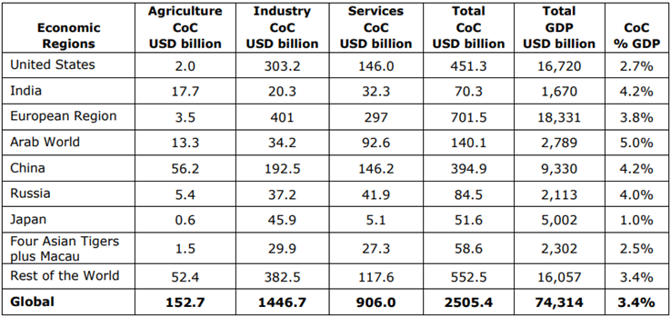
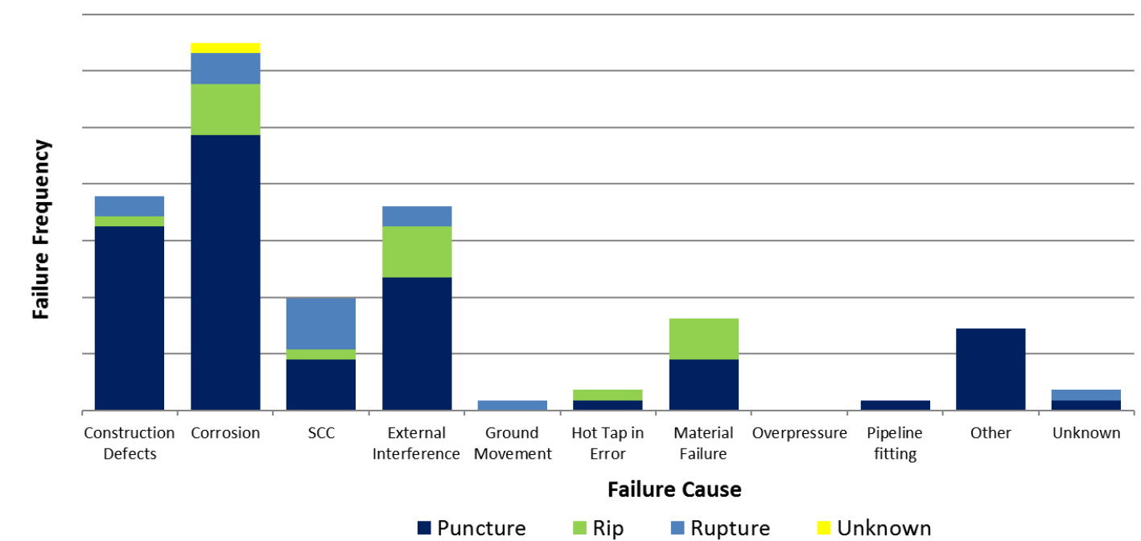
1. Background
Types of Corrosion
Stress Corrosion Cracking (SCC)
(Roffey & Davies, 2014)
Hydrogen Embrittlement
(HE)
(BSEE, 2017)
Corrosion Fatigue
(CF)
(Murakami et al., 2008)
Uniform corrosion
Pitting corrosion
Galvanic corrosion
Crevice corrosion
Intergranular corrosion
Erosion corrosion
Environment-Assisted Cracking (EAC)
Fig 1. Pipeline failures by failure cause within the Failure Frequency Analysis database from 2008 to 2015
Table 1. Global Cost of Corrosion by Region by Sector (Billion USD 2013) (NACE, 2016)
(Acton, 2017)
Notes:
First I will quickly go through the background of this study.
Let's begin by defining corrosion and understanding its significance.
Corrosion is a chemical or electrochemical reaction between a metal and its environment that leads to the degradation of the metal, forming corrosion products such as oxides, sulfides, and hydroxides.
The global impact of corrosion is substantial, as highlighted by the statistics presented.
Several types of corrosion can be identified. But here our main focus is on EAC.
EAC is a degradation mechanism of steel in corrosive environments with simultaneously applied stress.
Furthermore, environmentally assisted cracking (EAC) can be categorized into three main types: stress corrosion cracking (SCC), hydrogen embrittlement (HE), and corrosion fatigue (CF).
In the figure provided, you can see that SCC is identified separately as a primary failure mode, highlighting its significance.

Slide 4
1. Background
Effects of EAC
Degradation of Structural Integrity
  Yield strength
  Tensile strength
  Ductility
  Fracture toughness
  Fatigue strength
  Hardness
Crucial for the safety and reliability of engineering applications
  Steel and suspension bridges
  Nuclear power plants
  Fossil fuel power plants
  Pipelines
  Offshore oil production platforms
  Aircraft
  Aerospace technologies
  Chemical plants
  Similar facilities and etc.
Fig. 2. Requirements for EAC
Pipelines
Oil and gas pipelines
Hydrogen pipelines
  Repurposing of the existing natural gas pipeline system for H₂ transportation
An economical and sustainable solution than building a new pipeline system
Notes:
Let's examine the effects of Environmentally Assisted Cracking (EAC).
As illustrated in Figure 2, there are three key requirements for the initiation of EAC: the presence of susceptible materials, a corrosive environment, and applied stress.
EAC can significantly compromise the structural integrity of steel structures and materials. It can lead to reductions in various mechanical properties, including yield strength, tensile strength, ductility, fracture toughness, fatigue strength, and hardness.
This effect is critical for the safety and reliability of engineering applications such as..... Read the list….
Our main focus among these is the pipelines. Pipelines are primarily used for transporting oil and gas, and recently, hydrogen transportation through pipelines has gained popularity.
To provide a more economical and sustainable solution than constructing new pipeline systems, industries and researchers are now exploring the repurposing of existing natural gas pipelines for hydrogen transportation.

Slide 5

1. Background
Transition towards a hydrogen economy
The EU is aiming at enhancing the hydrogen economy through infrastructure development
Hence, rapid growth of hydrogen infrastructure is expected in the future
Hydrogen value chain
  Production
  Distribution (transport and storage)
  End-use applications
  Pipelines
    Building new hydrogen-carrying pipelines
    Repurposing existing natural gas pipelines for the transportation of pure hydrogen
    Deterioration of pipelines due to EAC
      Hydrogen embrittlement (HE)
Fig. 3. Average hydrogen demand projections in Europe(Clean hydrogen partnership, 2024)
prominent problem
(a)
(b)
Fig. 4. Europe’s hydrogen infrastructure projects interactive map (a) existing, (b) proposed plan (Clean hydrogen partnership, 2024)
Notes:
As shown in Figure3, there is a global transition towards hydrogen economy.
As a result, significant growth in hydrogen infrastructure is anticipated in the future as given in figure 4.
Also as a one key stage of hydrogen value chain distribution through pipelines has faced a prominent problem of EAC specially HE.

Slide 6
1. Background
Research Gap
A comprehensive general guideline is not available for hydrogen transport pipelines, and the repurposing of existing NG pipelines for hydrogen transportation
  Available guidelines developed by various institutes:
    ASME B31.12
    EIGA DOC/121/14
    IGEM/TD/01 Edition 6
Guidelines are not available to assess and prevent the effects of EAC to ensure the structural integrity of NG pipelines before repurposing them as hydrogen pipelines
Lack of a comprehensive testing procedure specifically designed to assess EAC in hydrogen-rich environments.
Lack of understanding of the integrated effect of SCC and CF in hydrogen-rich environments
Lack of experimental test results due to limited availability of specialized testing machines equipped with gas chambers and associated inherent risks of high-pressure hydrogen gas
Notes:
Here, I would like to mention what the research gaps are that I have identified.
EUROPEAN INDUSTRIAL GASES ASSOCIATION (EIGA)
Institution of Gas Engineers and Managers (IGEM)
American Society of Mechanical Engineers (ASME)

Slide 7
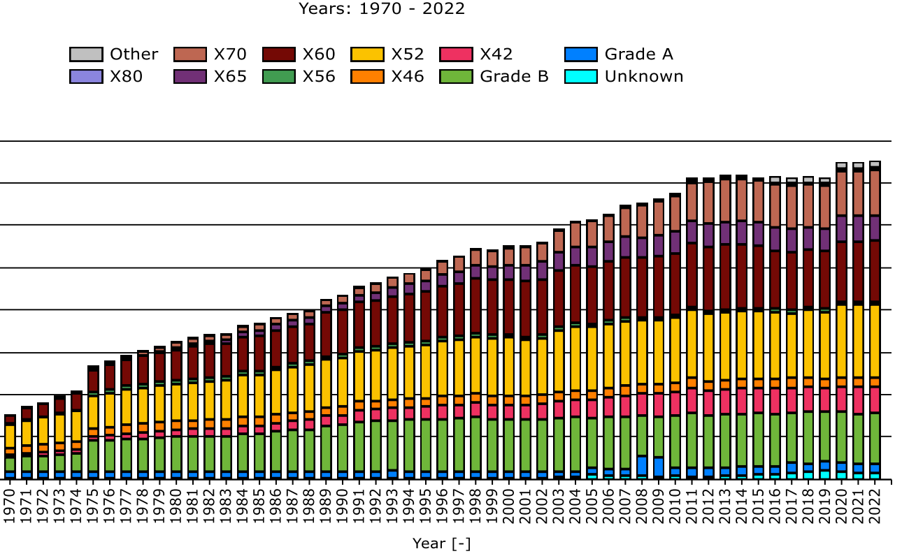
2. Pipeline Material
The American Petroleum Institute's (API) API 5L standard is widely adopted by steel manufacturers
Oil and Gas pipelines
  API 5L X52 to X80
  Onshore – X70/X80
  Offshore – X60-X70
H₂ pipelines
  Common materials - API 5L X52, ASTM A106 Grade B
  Essential factors to consider
    Cost
    Mechanical properties
    Corrosion resistance
      Temperature, pressure, water quality, and the presence of gases like CO₂, CH₄, and H₂S
Fig. 5. Onshore material usage by grade – total length (European Gas Pipeline Incident Data Group EGIG, 2023)
Recommended material properties by existing guidelines
Maximum hardness and carbon equivalent – 250(HB), 0.43 (EIGA,IGEM)
Maximum tensile strength - 690 MPa by IGEM and 800 MPa by EIGA
Maximum steel grade - X52 by ASME, EIGA, and X70 by IGEM
(Bai & Bai, 2014), (Zhao et al., 2018), (The American Society of Mechanical Engineers, 2023), (IGEM, 2021), (European Industrial Gases Association, 2014)
Notes:
Then I would like to discuss about the pipeline materials used for oil and gas pipelines and hydrogen pipelines.
The American Petroleum Institute's (API) API 5L standard is widely adopted by steel manufacturers and used in most of the existing pipelines.
Pipe grades from X52-X80 have been successfully used in most of the pipelines and widely used grades in recent years are X70 and X80 for onshore pipelines and X60-X70 for offshore and sour services.
When it comes to the hydrogen pipelines, X52 is the widely utilized grade.
Several factors should be considered in the material selection such as cost, mech prop, and corrosion rest. Corrosion rest of the material can be vary with the Temperature, pressure, water quality, and the presence of gases like CO₂, H₂, and H₂S.
Further, existing guidelines have also recommended some material properties as mentioned here. read

Slide 8
3. Conceptual framework
For the experimental evaluation of the structural integrity of existing natural gas (NG) pipelines, intended for repurposing to hydrogen transportation
Designed to support future experimental studies aimed at assessing the integrated effects of EAC in hydrogen-prone environments
Notes:
Here is the conceptual framework that I have developed For the experimental evaluation of the structural integrity of existing natural gas (NG) pipelines, intended for repurposing to hydrogen transportation. This will support future experimental studies aimed at assessing the integrated effects of EAC in hydrogen-prone environments.

Slide 9
4. EAC of H₂ pipelines
Factors affecting EAC
presence of alloying elements
Higher σ_{y}, σ_{u} / high hardness
Microstructural features like phases, inclusions, precipitates, and grain size
Surface and internal defects
Impurities in the gas
Composition of the gas mixture
Type of environment
  Subsea
  Coastal
  Urban, rural
  Underground
Cathodic current density
Negative potentials than -1.15 V relative to Ag/AgCl/ seawater can be detrimental (DNV)
Stresses – Sustained, cyclic, residual, due to temperature effects
Notes:
EAC is one of the main degradation processes of pipelines.
Phase 1 of the framework involves identifying the factors that affect the EAC..
There are three main types of factors affecting the EAC of hydrogen pipelines.

Slide 10
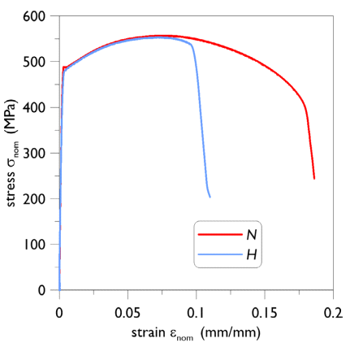
4. EAC of H₂ pipelines
Types of EAC of H₂ pipelines
Fig. 6. Stress-strain of X65 steel in N₂ and H₂ environments (Nazar et al., 2025)
Fracture occurs at sustained loads below the yield strength of the material
accelerated by local flaws, including joints, dents, and uneven surfaces, by increasing the local stress concentration
Can occur even under very low pressures
Cause - decrease in crack tip ductility in the presence of hydrogen
Notes:
And the phase two of the framework involves identifying the types of EAC and its effects.

Slide 11
5. Experimental Methods
HE
SCC
CF
EAC
Challenging
accountability for the effects of all three mechanisms
complex interactions among these processes and the practical difficulties associated with laboratory experiments.
Notes:
During phase 3, the identification of required test methods can be done. It is challenging to define a test procedure to evaluate the effect of EAC, as it requires the accountability of all three EAC mechanisms. Further, due to the complex cracking mechanism which are not fully understood and interactions between each type of corrosion. However, Comprehensive testing and material qualification are essential before repurposing existing pipeline infrastructure for hydrogen transport to identify the degraded mechanical properties.

Slide 12
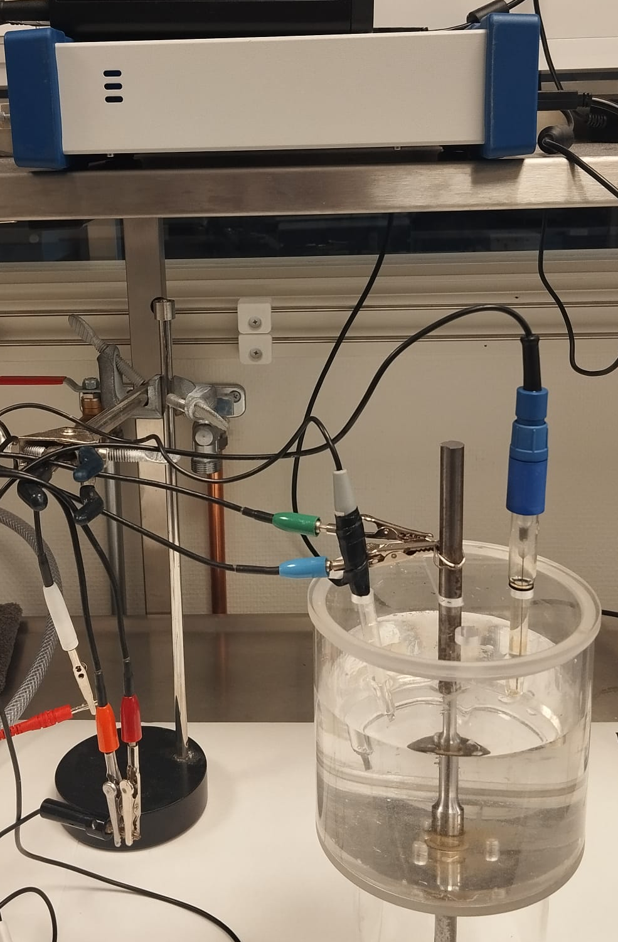
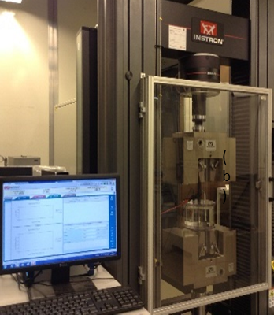
5. Experimental Methods
Electrochemical hydrogen charging
Hydrogen charging techniques
Simulate hydrogen gas exposure in hydrogen transport pipelines
Water electrolysis through cathodic potential
Two scenarios
  Internal hydrogen charging (pre-charging)
  External continuous charging
Gaseous
Electrochemical
Limited availability of test facilities | Locally available simple procedure
Risks associated with hydrogen gas | Low risk
Cost | Economical
Fig. 7. Electrochemical charging setup
Electrochemical reactions are governed by the
applied potential
charging time
metal surface
used electrolyte solution
pH value of the solution
presence of oxygen
type of counter electrodes, etc
Notes:
Now let's look at the advantages of electrochemical hydrogen charging technique.
There are two hydrogen charging techniques: gaseous and electrochemical. In order to compare these two methods,
let’s look at gaseous hydrogen charging. For gaseous experiments available test facilities are limited due to the associated high risk of using hydrogen gas and higher cost.
But electrochemical test apparatus can be fabricated locally, operational risk is very low, and also economical.
Several experiments have successfully proved the utilisation of electrochemical hydrogen charging to simulate hydrogen gas exposure. The mechanism is water electrolysis through cathodic potential.
Here two hydrogen charging scenarios were proposed. Internal precharging and external continuous charging until the failure or the termination of the test.
Electrochemical charging is governed by ……. Read the list.

Slide 13
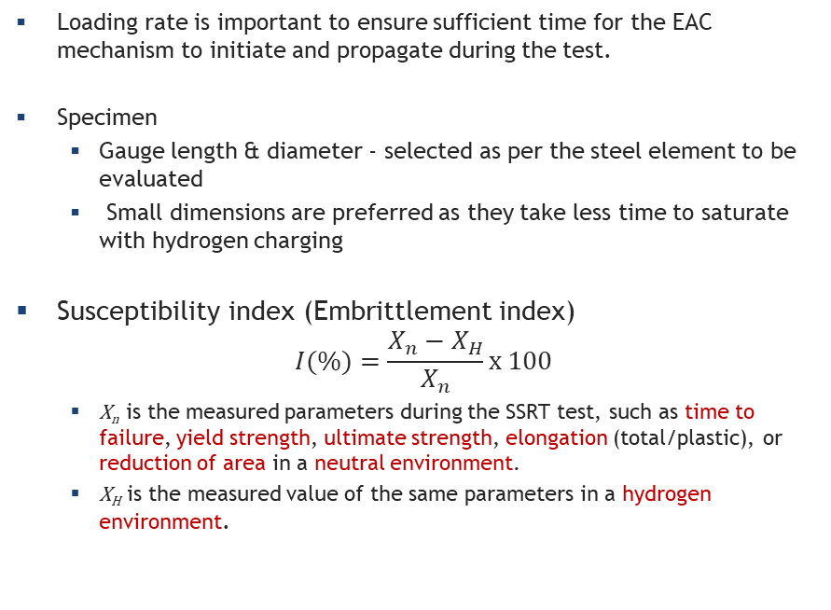
5. Experimental Methods
Slow strain rate testing- SSRT
Loading rate is important to ensure sufficient time for the EAC mechanism to initiate and propagate during the test.
Specimen
  Gauge length & diameter - selected as per the steel element to be evaluated
  Small dimensions are preferred as they take less time to saturate with hydrogen charging
Susceptibility index (Embrittlement index)
$$I(\%)=\frac{X_{n}−X_{H}}{X_{n}}x 100$$
  X_{n} is the measured parameters during the SSRT test, such as time to failure, yield strength, ultimate strength, elongation (total/plastic), or reduction of area in a neutral environment.
  X_{H} is the measured value of the same parameters in a hydrogen environment.
Hardness
The maximum value of hardness for hydrogen services
  250 HV - IGEM/TD/1 and EIGA DOC/121/14
  235 HV - ASME B31.12
Notes:
Eg- Recommended strain rates->10⁻⁴s⁻¹ - 10⁻⁷s⁻¹ (ASTM, 2021), 10⁻⁵s⁻¹ (ISO, 2022), to start with 10⁻⁶s⁻¹ (ISO, 2013).
Uncharged measurements shall be taken in neutral environments such as inert gas conditions, etc
Susceptibility to EAC increases with increasing hardness
An experimental investigation needs to be carried out to assess the effect of hardness
Brinell, Rockwell, and Vickers

Slide 14
5. Experimental Methods
Fracture toughness
Ref | Steel | Used standard | Strain/disp. rate / Frequency | Electrolyte solution | Current density (mA cm⁻²) | Outcomes of the study
(Bolzoni et al., 2023) | X65, 2.5Cr1Mo steel | ASTM E1820 | Not specified | 0.2M CH₃COOH/ 0.2M CH₃COONa/ 1.5g/L Na₂S·9H₂O | 0.6 | Significant fracture toughness reduction was observed in both steels at all testing temperatures
(Haeberle & Dolley, 2020) | AISI 4340 | ASTM E1820 | 4 x 10⁻⁴ mm/s | 3.5 wt.% NaCl | Potential -950, 1050, - 1250 mV (Ag/AgCl) | More negative potentials led to decreased tensile fracture loads regardless of the bolt coating.
(Chiradeep Gupta, 2024) | Cr-Mo-V-Ni steel | ASTM E1820 | 8.33 x 10⁻⁶ s⁻¹ | 1N H₂SO₄ + As₂O₃ | 20 | Tensile strength and fracture toughness values have reduced by over 50%
(Colombo et al., 2016) | AISI 4130 | ASTM E1820 | Not specified | CH₃COOH/CH₃COONa/sulphides | 0.5 | Fracture toughness has decreased to a quarter due to the hydrogen charging
(Wang, 2009) | X70 | ASTM E399 | 1.67 x 10⁻⁴ mms⁻¹ | 0.5 M H₂SO₄ | 1, 10, 100, 1000 | Critical hydrogen concentration was obtained, and the relationship between hydrogen and fracture toughness was determined
(Myhre et al., 2024) | X65 | ASTM E399 | 2 × 10⁻⁴ mm/s | 3.5 wt.% NaCl | potential− 1050 mV (Ag/AgCl) | A comparison was made between increasing SSRT, stepwise increasing, and constant loading systems for fracture toughness
(Catalano et al., 2025) | X52 | BS 8571 | 0.05 mm/min | 0.01M H₂SO₄ + 2.00 g/L CSN₂H₄ | 10 | The fusion (weld) zone has absorbed most hydrogen in all charging times
(Hagen et al., 2024) | X65 | BS 8571 | 2 × 10⁻⁴ mm/s | 3.5 wt.% NaCl + 2 g/L CH₄N₂S | Potential -1050, -1125 mV (Ag/AgCl) | Investigated the feasibility of electrochemical hydrogen charging for equivalent gas charging
Evaluated by the parameters
  Critical stress intensity factor (K_{IC})
  J-Integral (J_{IC})
  Crack tip opening displacement (CTOD)
A pre-cracked specimen is loaded in tension,
  constant force or constant displacement tests
  increasing loading conditions
  K_{IH}, the threshold stress intensity factor- The minimal applied stress intensity factor capable of causing crack propagation can be used to assess resistance to hydrogen-assisted cracking
The maximum recommended K_{IH} by ASME B31.12 is 55 MPa·√m.
Table 2. Previous experimental details of fracture toughness testing
Notes:
A significant degradation of fracture toughness has been observed in pipeline steel because of environmental hydrogen
IGEM-QSRT (Quasi-strain rate testing) or SSRT (Slow strain rate testing) for the determination of fracture toughness, but in the absence of the above two methods, Charpy impact test values have been proposed to evaluate fracture toughness. The maximum value should be the lowest of 50% of the measured impact test value or 27J.

Slide 15
5. Experimental Methods
Fatigue testing
Ref | Steel | Frequency | Electrolyte solution | Current density (mA cm⁻²) | Outcomes of the study
(Yang et al., 2025) | X80 | 1 | 0.5M H₂SO₄/ Na₂S | 5 | Fatigue life decreased with increased hydrogen content under different strain amplitudes.
(Chu et al., 2025) | Q420B | 1-10 | 3.5 wt% NaCl | Open circuit | Provide useful information about corrosion fatigue damage and mechanism, also found that fatigue degradation is higher when the peak stress is lower
(El May et al., 2018) | X12CrNiMoV12-3 | 10, 120 | 0.1 M NaCl + 0.044 M Na₂SO₄ | Free potential | Crack initiation is due to (i) the local de-passivation of the passive film and (ii) the corrosion pitting.
(Hénaff et al., 2018) | AA6061-T6 alloy | 5 | 3.5 wt.% NaCl | Immersion only | Hydrogen promotes crack tip embrittlement and accelerates crack growth rate in mixed intergranular and trans granular cracking
(Colombo et al., 2016) | AISI 4130 | 0.1, 1, 10 | 0.4M,0.2M CH₃COONa/ Sulphides | 0.5 | Hydrogen charging has increased fatigue crack growth rate by two or three orders of magnitude. Test done as per ASTM E647.
(Fassina et al., 2013) | X65, F22 | 10,20 | 0.4M,0.2M CH³COONa / Sulphide | 0.5 | Hydrogen charging has increased the crack growth rates in both materials. Test done as per ASTM E647.
(El May et al., 2013) | X12CrNiMoV12-3 | 10, 120 | 0.1M NaCl/ 0.044M Na₂SO₄ | Free potential | Provide details about effect of loading frequency on the corrosion fatigue crack initiation mechanism
(Liu et al., 2011) | Spring steels | 20x10³ | 3 wt% NaCl / 3g/L NH₄SCN | 0.6, 1, 2 | The size granular-bright-facet (GBF) is greatly affected by the hydrogen content inside the steel
(Igwemezie & Mehmanparast, 2020) | S355 | 0.2, 0.3, 0.5 | Sea water | Immersion only | Tests performed as per ASTM E647 and BS 7910. Provides experimental results of the effect of waveform and frequency on CF.
Two distinct measures of fatigue performance
  Fatigue crack growth rate
  Fatigue endurance limit
Specimens
  Compact tension
  Center-cracked tension
  Single-edge notch tension
  Three-point single-edge notch bend
  Four-point single edge notch bend, etc.
Loading frequency - crack growth rates are higher in lower loading frequencies
For some materials, the fatigue endurance limit was not observed, indicating that even at very low stress levels, below the fatigue limit in air, fatigue failure may occur in hydrogen environments
Table 3. Previous experimental details of fatigue testing
Notes:
To evaluate the effect of HAF, Fatigue tests with hydrogen charging can be carried out.
Main two parameters measured during test are fatigue crack growth rate and endurance limit.
Due to the effects of hydrogen, the fatigue crack growth rate increases while the fatigue endurance strength decreases compared to the corresponding neutral environment values, which threatens the structural integrity of pipelines
Consideration shall be given for the selection of frequency as per the expected loading conditions. Generally crack growth rates are higher in lower loading frequencies.
Details about previous fatigue testings are given in the table 3.

Slide 16
6. Discussion
Finally, phase four includes the assessment of the structural integrity of the pipe using the obtained results from the experiments and performing local and global analyses to check the feasibility.
The outcomes allow for informed decisions regarding the repurposing of natural gas pipelines for hydrogen transportation, along with recommendations for the necessary transformations.
The framework and review outcomes of this study provide a strategic guide/framework for future investigations and contribute to the development of more resilient hydrogen infrastructure.
Experimental investigations are underway using the proposed framework…

Slide 17
Acknowledgments
Associate Prof. Nirosha D. Adasooriya
Prof. Dimitrios Pavlou
Prof. Vidar Hansen
Dr. Lars Magne Halderson
UiS Lab Engineers and staff

Slide 18
Thank You

Slide 19
References
Acton, M. R., Wattis, Z.E. (2017). New International Failure Frequency Analysis (FFA) Database for Gas
Transmission Pipelines (HAZARDS, Issue.
ASTM. (2021). Standard Practice for Slow Strain Rate Testing to Evaluate the Susceptibility of Metallic Materials to Environmentally Assisted Cracking. In ASTM G129 − 21: ASTM.
Bai, Q., & Bai, Y. (2014). Subsea Pipeline Design, Analysis, and Installation. Gulf Professional Publishing. https://doi.org/https://doi.org/10.1016/C2010-0-67706-6
CGA, C. G. A. (2013). Hydrogen Pipeline Systems CGA G-5.6-2005. In: CGA.
Clean hydrogen partnership. (2024). The European hydrogen market landscape. https://observatory.clean-hydrogen.europa.eu/sites/default/files/2024-11/The%20European%20hydrogen%20market%20landscape_November%202024.pdf
European Gas Pipeline Incident Data Group EGIG. (2023). GAS PIPELINE INCIDENTS (12th Report of the European Gas Pipeline Incident Data Group (period 1970 – 2022), Issue.
European Industrial Gases Association. (2014). Hydrogen Pipelines Systems. In IGC Doc 121/14: EIGA.
IGEM, T. I. o. G. E. a. M. (2021). High-Pressure Hydrogen Pipelines. In IGEM/TD/1 Edition 6: IGEM.
NACE. (2016). International Measures of Prevention, Application, and Economics of Corrosion Technologies Study.
Nazar, S., Lipiec, S., & Proverbio, E. (2025). FEM modelling of hydrogen embrittlement in API 5L X65 steel for safe hydrogen transportation [Article]. Journal of Materials Science: Materials in Engineering, 20(1), Article 9. https://doi.org/10.1186/s40712-025-00221-y
Pourazizi, R., Mohtadi-Bonab, M. A., & Szpunar, J. A. (2020). Investigation of different failure modes in oil and natural gas pipeline steels. Engineering Failure Analysis, 109, 104400. https://doi.org/https://doi.org/10.1016/j.engfailanal.2020.104400
Roffey, P., & Davies, E. H. (2014). The generation of corrosion under insulation and stress corrosion cracking due to sulphide stress cracking in an austenitic stainless steel hydrocarbon gas pipeline. Engineering Failure Analysis, 44, 148-157. https://doi.org/10.1016/j.engfailanal.2014.05.004
The American Society of Mechanical Engineers, A. (2023). Hydrogen Piping and Ppelines. In ASME B31.12-2023: ASME.
Zhao, W., Yang, M., Zhang, T., Deng, Q., Jiang, W., & Jiang, W. (2018). Study on hydrogen enrichment in X80 steel spiral welded pipe. Corrosion Science, 133, 251-260. https://doi.org/10.1016/j.corsci.2018.01.011

Slide 20
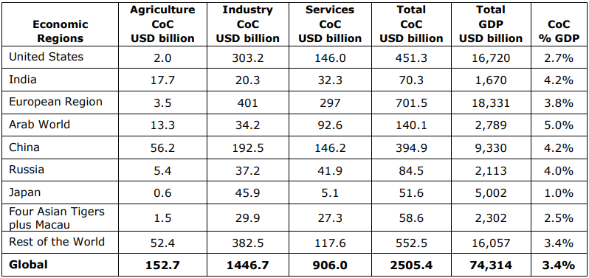
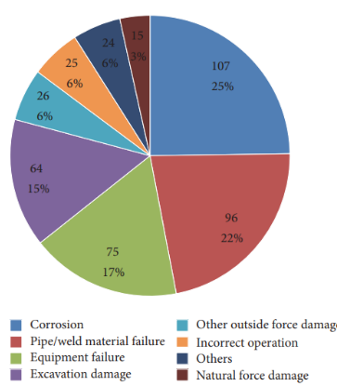
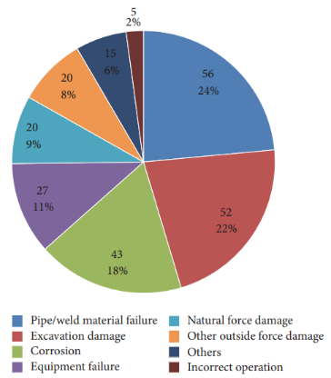
1. Background
Corrosion
Table 1. Global Cost of Corrosion by Region by Sector (Billion USD 2013) (NACE, 2016)
Corrosion is the destructive attack of a metal by chemical or electrochemical reaction with the environment. It decays metals by producing various corrosive products such as sulfides, oxides, and hydroxides
Failures and degradation
    Socio-economic losses
      Cost of maintenance,
      cost of replacement,
      indirect losses
        shutdown of a facility,
        loss of a product,
        loss of efficiency,
        contamination of a product,
        safety, etc
Oil pipeline (Acton 2017)
Gas pipeline (Acton 2017)
Fig. 1. Causes of ONG pipeline incidents
Notes:
In the first part of this discussion, I will explore the background of the study.
Let's begin by defining corrosion and understanding its significance.
Corrosion is a chemical or electrochemical reaction between a metal and its environment that leads to the degradation of the metal, forming corrosion products such as oxides, sulfides, and hydroxides.
The global impact of corrosion is substantial, as highlighted by the statistics presented.
In Europe, the annual cost of corrosion amounts to approximately 3.8% of the annual GDP, while the global cost stands at about 3.4% of annual GDP.
Additionally, an examination of failure types in oil and gas pipelines reveals that corrosion is a leading cause of failures, which has significant socioeconomic implications, such as the Cost of maintenance.. Read…

Slide 21
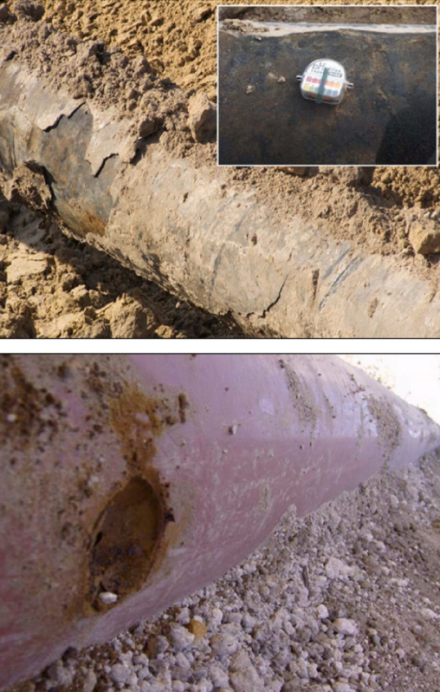
4. EAC of H₂ pipelines
External and other types of corrosion
External Corrosion
  is typically influenced by environmental factors and is generally not affected by the hydrogen gas being transported
  Pipes contact with the environment externally,
    Soil
    Seawater
    Atmosphere, etc.
  As the hydrogen concentration is lower compared to the internal levels SCC is prominent externally.
Other types of corrosion in a hydrogen environment
  Hydrogen attack
  Hydrogen blistering
  Sulfide stress cracking
  Hydrogen-induced cracking
  Precipitation of metal hydrides
Fig. 8. External corrosion (Wasim & Djukic, 2022)
Notes:
There are additional types of corrosion in hydrogen environments under specific conditions, such as high temperatures. Those are … read the list.

Slide 22
Table 1. Previous experimental studies of electrochemical charging.
Ref | Steel | Electrolyte solution | Current density (mAcm⁻²) | Test details | Outcomes of the study
[25] | X65 | 3.5 wt.% NaCl + 2 g/L CH₄N₂S | Potential -1050, -1125 mV (Ag/AgCl) | The test setup has been developed to investigate the equivalent electrochemical charging conditions for hydrogen gas pressure | Obtained the equivalent hydrogen gas charging conditions using the stated solution, providing important information about hydrogen uptake and diffusion
[74] | X65 | 3.5 wt.% NaCl+ 2 g/L CH₄N₂S | Potential -1050 - -1275 mV (Ag/AgCl) | An electrochemical charging test was used to calculate the equivalent hydrogen pressure by analytical method | Electrochemical charging condition successfully simulated equivalent hydrogen pressure of 12.3 bar at room temperature.
[77] | Armco iron, L80 | NaCl, H₂SO_{4,} CH₄N₂S, H₂S | 1,10 | An electrochemical charging with different solutions and cathodic currents was tested to observe the hydrogen uptake | Using acidic solutions and increasing current density has more influence on the hydrogen uptake in both metals
[27] | Pressure vessel alloy | 0.5 M H₂SO₄ + 1 g/l CH₄N₂S | 2.5 - 50 | Disk-shaped thin specimens were tested in an electrochemical charging setup to investigate hydrogen flaking | Information on the effect of electrochemical charging on hydrogen cracking and flaking
[54] | 3.5NiCrMoV steel | 0.1 M NaOH/ 0.1 M Na₂SO₄ | Potential -1090 - -2228mV (Hg/Hg₂SO₄) | Hydrogen concentration inside the steel was measured after electrochemical and gaseous charging | Hydrogen concentration increased with potential and gas pressure due to increased fugacity
[80] | X70 | 0.5 M H₂SO₄ / 250mg/L NaAsO₂ | 50 | Electrochemical charging was used to investigate the formation of hydrogen-induced cracks and blisters | Cracking was found to be highly dependent on microstructure, and crack initiation sites were mostly inclusions and ferrite-pearlite interfaces
[76] | X70 | 5 wt.% NaCl / 0.5wt.% CH₃COOH | 0.5 - 2 | modified Devanathan–Stachurski cell was used to perform hydrogen permeation test to investigate effect of H₂S partial pressure, pH and current density on HIC | The hydrogen permeation rate was affected by both H₂S partial pressure and pH of the test solution
[81] | X70, 16Mn steel | 0.5 M H₂SO₄ | 0 - 70 | Electrochemical oxidation method test was used to determine the absorbed hydrogen under cathodic charging | Observed that the hydrogen concentration increased approximately linearly with the logarithm of pre-charging time
[82] | Carbon steel | H₂SO₄+ H₂SeO₃ | 100, 500 | Electrochemical charging setup was used to study the hydrogen absorption and distribution in steel | Hydrogen concentration profile in steel was established
[83] | Iron, HT-80 steel | 5 wt.% H₂SO₄ / 5 mgl⁻¹ As₂O₃ | 50 | Electrochemical hydrogen charging was used to determine the diffusible hydrogen in iron and steel | Apparatus developed to measure the diffusible hydrogen in steel

Slide 23
Table 2. Previous experimental investigations of EAC with gaseous hydrogen charging
Ref | Steel | Type of test | Strain/disp. rate / Frequency | Gas pressure (MPa) | Outcomes of the study
[52] | Type 304, 316 | Tensile | 10⁻⁵ s⁻¹ | 1, 40 | Ductility reduction by hydrogen charging is higher for the steels with lower nickel content and external hydrogen than internal hydrogen
[64] | X65 | Fatigue crack growth | 1 Hz | 10 | Test done as per ASTM E647. The fatigue crack growth rate was more than ten times higher after hydrogen charging than in uncharged samples.
[77] | Armco iron, L80 | Charging only | - | 20, 100 | A significant hydrogen absorption has not been observed
[84] | Spring steels | Fatigue | 20kHz | 10 | Information about the effect of hydrogen on granular-bright-facet (GBF) size has provided
[85] | Type 304, 316 | Fatigue | 0.0015, 1.5 Hz | 63 | Basic mechanism for HE was identified as hydrogen-induced slip deformation due to hydrogen concentration near crack tips
[61] | X65, X70 | Fracture toughness | 0.14-0.57 MPa√m/h | 130, 150 | A master curve for fracture toughness design for pipelines has been proposed. ASTM E1820, E1681 was used for fracture toughness testing.
[61] | X65, X70 | Fatigue | 1 Hz | 60, 100,200 | Test done as per ISO 12108. Fatigue endurance properties have reduced significantly by hydrogen gas.
[86] | X70 | Fatigue | 0.1, 1 Hz | 34 | Test done as per ASTM E647. For values of ΔK between 7 and 15MPa√m, the FCGR has increased by two orders of magnitude in hydrogen exposure.

Slide 24
Table 3. Mechanical testing of EAC with electrochemical charging
Ref | Steel | Type of test | Strain/disp. rate / Frequency | Electrolyte solution | Current density (mA cm⁻²) | Outcomes of the study
[51] | X80 | Tensile | Constant load | 3.5 wt% NaCl | Open circuit | Crack initiation and growth details were obtained with changing loads
[88] | 9Cr ferritic/martensitic steel | SSRT | 10⁻⁵s⁻¹ | 0.2 N NaOH + 0.3g/L NH₄SCN | 10 | Resistance to HE increased initially and decreased with the increased Si content, reaching its highest at 0.7% Si content.
[91] | 13Cr stainless steel | Tensile | Constant load | 3.5 wt.% NaCl | Open circuit | Susceptibility to pitting corrosion increases and passive film's performance degrades with increasing applied stress.
[92] | AISI 420 | Tensile | Constant load | 0.3 M NaCl | Immersion only | Proposed mixed SCC and HE mechanism as the cause of EAC
[79] | 718 alloy | SSRT | 2×10^{–5} s ^{–1} | 2:1 mixture of glycerol + H₃PO₄ | 15 | Information about the effects of cathodic charging
[93] | dual-phase steel | SSRT | 5 mm/min | 0.5 M H₂SO₄+ 1 g/l CH₄N₂S | 0.8 | Increased loss of ductility maximum 50% was observed with increased pre-charging time
[75] | X100 | SSRT | 0.02 mm/s. | 0.05 M, 0.5 M H₂SO₄ +As₂O₃ | 20, 200 | Hydrogen charging has increased the susceptibility to HIC and cracks were initiated from inclusions in the steel
[89] | X70 | SSRT | 1.36×10⁻⁶ s⁻¹ | 0.1,0.05, 0.01, 0.005 M NaHCO₃+100 ppm As₂O₃ | 0.1 | SCC mechanism governed by film rupture and anodic dissolution in the as-received and water-sprayed conditions, and by HE for quenched, quenched tempered ones,
[94] | SA508 Cl.3 | SSRT | 10⁻⁵-10⁻³ s⁻¹ | 1 M H₂SO₄ / 0.25gl⁻¹ As₂O₃ | 10, 100 | Significant decrease in ductility at the low strain rate was observed, with quasi-cleavage or cleavage features appearing near the inclusions.
[95] | Vanadium steel | Tensile | Constant load | 3 wt% NaCl / 3 g/l NH₄NCS | 0.02 / 1.0 | Trapped and diffusible-hydrogen content increased with charging time and became steady at about 100 h for 5mm diameter specimens
[59] | X80 | SSRT | 5.7×10⁻⁶ s ⁻¹ | 0.5 M H₂SO₄ / 0.25gl⁻¹ As₂O₃ | 2-20 | Additional tensile stress provided by hydrogen, which advances linearly with increasing hydrogen content, was observed to act together with the external stress to induce plastic deformation.
[96] | A508.3 | Tensile | Not specified | HCl | 5 | A model was developed for hydrogen-induced microcracking and the formation of fisheye cracks
[97] | AISI-1045 | SSRT | 0.51 mm/min | 1N HaBO3, 0.05 M KCI + 0.5 CH₄N₂S,1 M H₂SO₄ +10 mgl⁻¹ As₂0₃ | 4.5 | Found that hydrogen reduces the extent of deformation and raises the slope of the stress-strain curve.

Slide 25
Table 4. Experimental test standards of EAC investigation
Ref | Designation | Material | Type of EAC | Type of test | SSRT | Electrolyte | Cathodic current / Potential
[70] | BS ISO 16573‑2:2022 | HSS | HE | SSRT | 10⁻⁵s⁻¹ | NaCl 30g/l + NH₄SCN 3g/l | 0 - 20 Am⁻² for 48 h
[98] | ASTM G47 − 22 | Aluminium Alloy | SCC | Tensile | - | 3.5 % NaCl alternate immersion | Immersion only
[87] | ASTM G129 − 21 | Metals | SCC, HE, SSC | SSRT | 10⁻⁴s⁻¹ - 10⁻⁷s⁻¹ | Not specified | Not specified
[99] | ASTM G44 − 21 | Metals and Alloys | SCC | Not specified | - | 3.5 % NaCl, alternate immersion | Immersion only
[100] | ISO 7539-9 | Metals and Alloys | SCC | Tensile | Not specified | Not specified | Not specified
[71] | ASTM F1624 − 12 | Steel | HE | SSRT, Fracture | Step loading | 3.5 % NaCl | 0.0 to −1.2 V vs. SCE
[101] | ISO 7539-6 | Metals and Alloys | SCC | Tensile | Not specified | Not specified | Not specified
[72] | ANSI/NACE TM0177-2016 | NA | SCC, SSC | Tensile | Not specified | NaCl, CH₃COOH, CH₃COONa | Not specified
[102] | ISO 7539-11 | Metals and Alloys | HE, HAC | SSRT | start with 10⁻⁶s⁻¹ | Not specified | Not specified
[103] | ISO 7539-7 | Metals and Alloys | SCC, HIC | SSRT | start with 10⁻⁶ s⁻¹ | Not specified | Not specified
[104] | ASTM E 1681 – 03 | Metals | EAC | Tensile | Not specified | 3.5 % NaCl alternate immersion | Not specified

Slide 26
