Slide 1


Evaluation of Specimen Geometry for Accurate Fatigue Testing of Girth Welds Fabricated at Close Proximity Using Numerical Modelling
ICIEA24-000049
Presenter: Even Englund
Even Englund,
Chandima Ratnayake Mudiyanselage
University of Stavanger

Slide 2

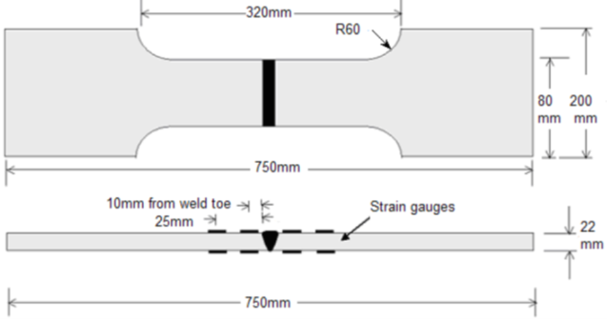
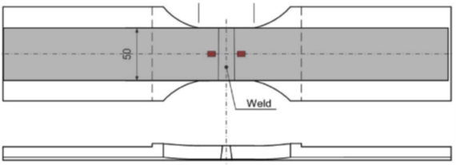
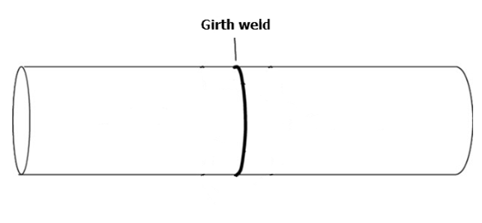
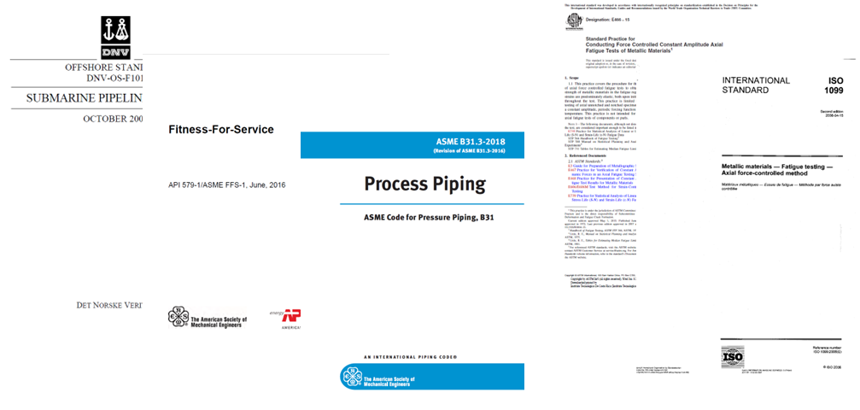
Introduction and background
The given standards lack detailed guidance on testing procedures and specimen geometries for fatigue testing of girth welds.
Studies have shown a difference in fatigue strength between small-scale and full-scale tests of welded tubes at low stress ranges (≤110 MPa), with full-scale tests exhibiting lower fatigue performance than small-scale specimens.
Comparative studies between full-scale and small-scale fatigue tests have been conducted to investigate the causes of these differences in fatigue limits.

Slide 3
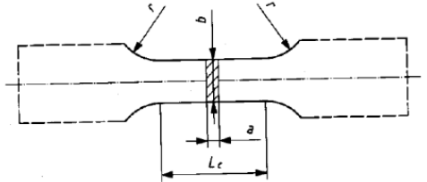
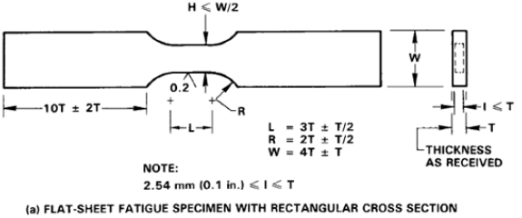
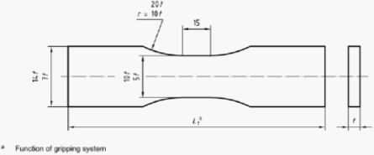
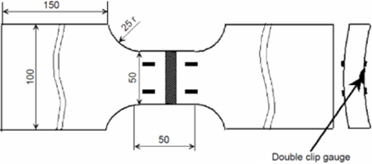
Standards for fatigue testing
Standards describing small-scale fatigue test geometries cut from tubular sections with different variation in geometric relationships.
Key factors to consider sample size when testing welds is sample thickness, length and width, weld bead profile, stress concentrations, material variations, and residual stress levels.
DNV-RP-F108 offers specific guidance on the fatigue testing geometry of single girth welds but has limitations for larger weld sizes.

Slide 4
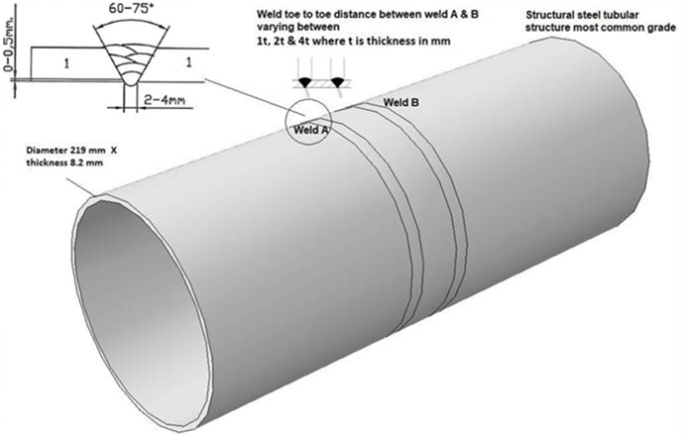
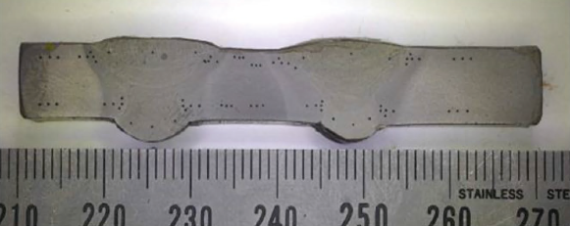
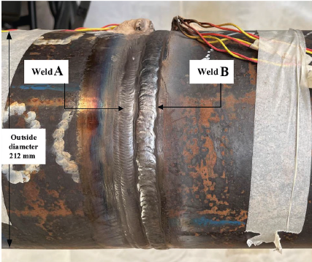
Repair welds and welds in proximity
Repair welds and welds performed in close proximity further complicate testing, and existing standards offer little guidance.
Accurately replicating real service conditions in fatigue testing requires careful specimen geometry selection to capture proximity effects realistically.
Specimen design must account for weld profile, material variations and irregular stress concentrations to ensure realistic fatigue test results.

Slide 5
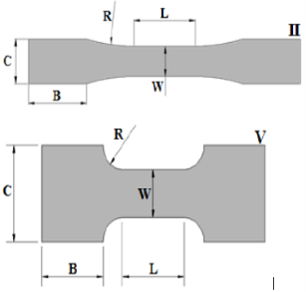
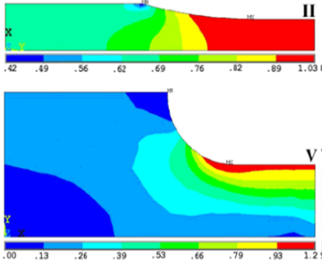
Geometrical evaluations of Fatigue Specimens
The following criteria should be considered when designing small-scale fatigue specimens:
The transient radii should ensure unnecessary stress concentrations and a uniform distribution of forces trough the girth section.
Weld size, Heat affected zone, and Base material should also be represented in the girth section.
The girth section should not experience unnecessary bending during testing and should have appropriate buckling resistance.
Finite element analysis is valuable tool for evaluating and assessing stress concentrations in complex geometries and optimizing notch radii for the final design of test specimens.

Slide 6
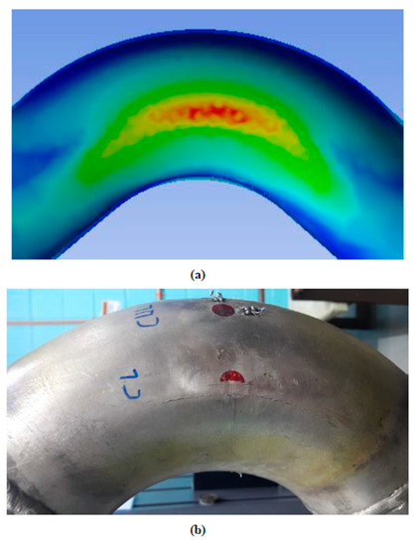
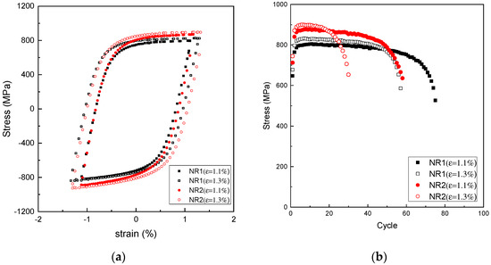
Evaluation of Fatigue performance using Continuum damage modeling (CDM)
CDM allows evaluation of how spacing between girth welds influences stress interaction and damage accumulation under cyclic loading.
Weak locations and cyclic response can be identified, but exact cycles to failure show a difference.
Incorporates material-specific properties (e.g., hardening, softening, mean stress sensitivity), leading to results that correlate well with real-life experiments.
While absolute cycles to failure may differ from real tests, CDM gives a comparative indication of the performance across configurations.

Slide 7

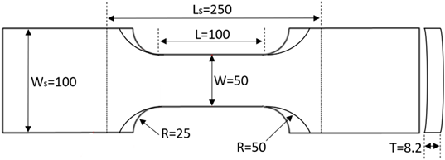
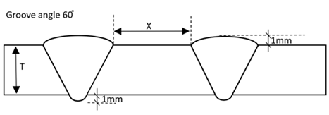
Evaluation of Fatigue Specimens for Girth welds in close proximity
The reliability of two different specimen with the same girth length but different transient radii of 25mm and 50mm was investigated.
Three different proximity distances of 5, 10 and 15mm was included in the investigation in cases where the proximity distance varies.
Two full-scale sections with different total test length of 125mm and 150mm were modeled for comparison of representative strain response.
The weld profile in the study was modeled in accordance with the requirements outlined in EN ISO 5817, for welded joints subjected to fatigue loading.

Slide 8
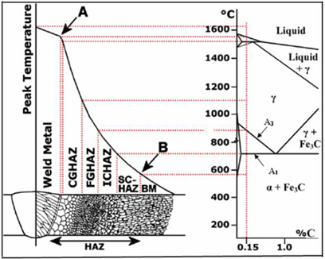
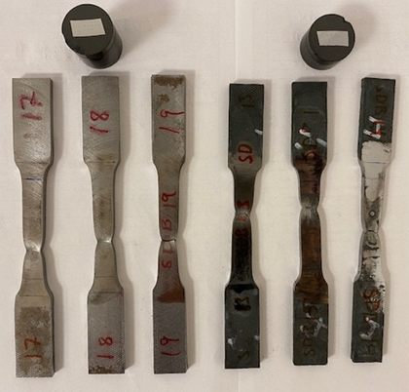
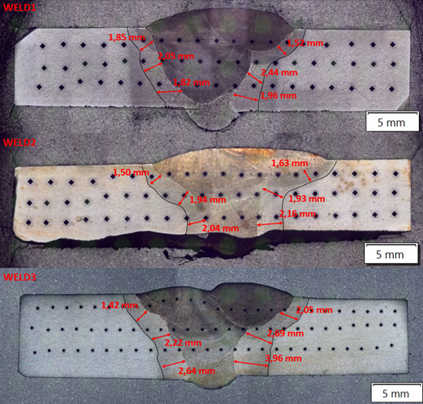
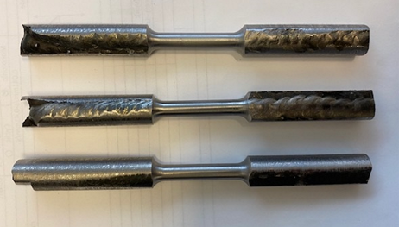
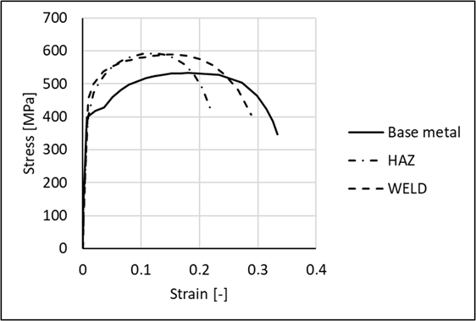
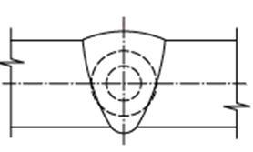
Material Data
Material data for the base material, heat-affected zone (HAZ), and weld material of a girth-welded tubular steel section were tested.
The width of the HAZ was determined through hardness testing and macroscopic analysis.
In order to replicate the material characteristics of the HAZ, tensile test specimens made from the base material were heat-treated to 1200 °C above the A3 temperature (850 °C) and air-quenched. The resulting hardness was then compared to that of the actual HAZ.

Slide 9
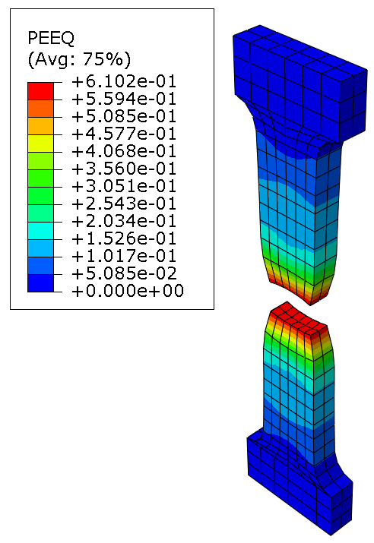
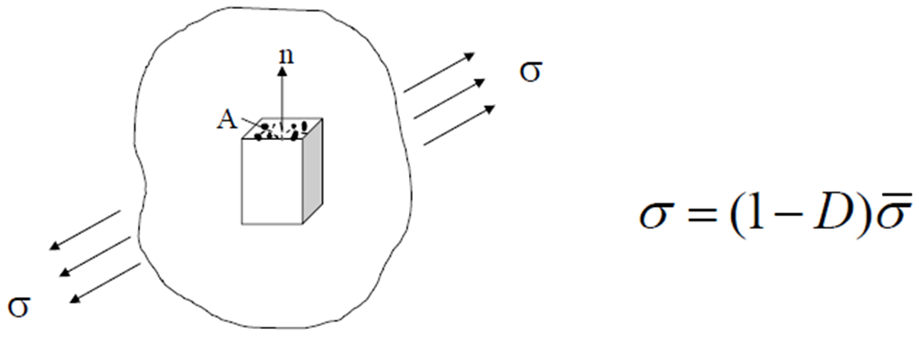
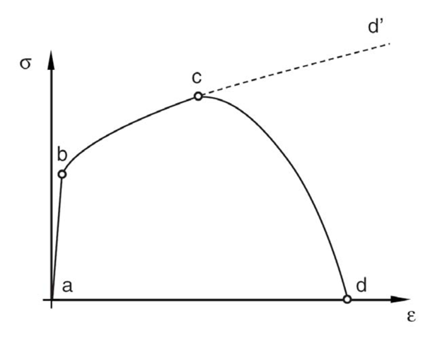
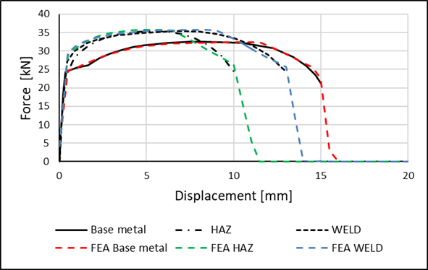
Implementation and validation of material characteristics for the Numerical model
Abaqus/Explicit was used as the simulation platform, employing an uncoupled ductile damage model. Damage initiation was defined based on fracture strain, stress triaxiality, and strain rate from experiments.
The Ductile Damage model was employed to simulate material behavior up to final failure, with the plasticity model calibrated and implemented based on experimental test data.
A numerical “twin” of the tensile test specimens was developed to validate the material plasticity implemented in the simulations.

Slide 10
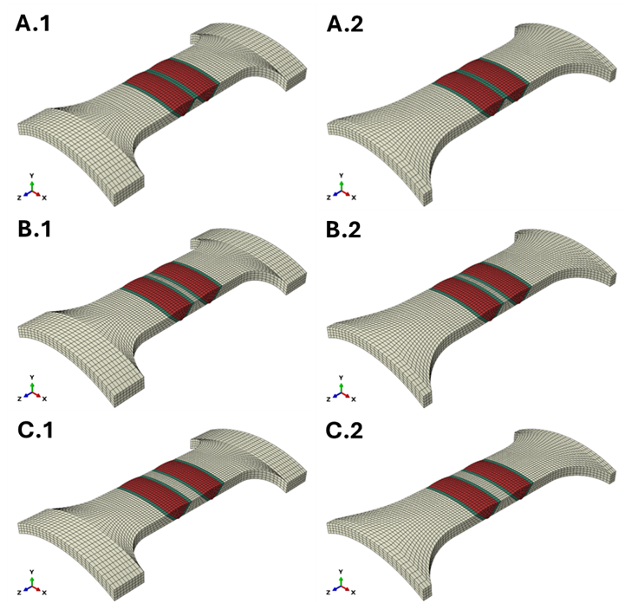
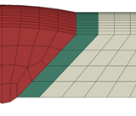
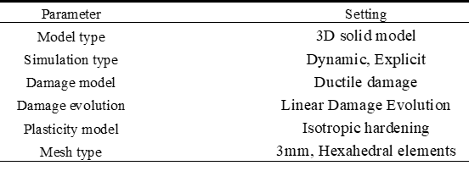
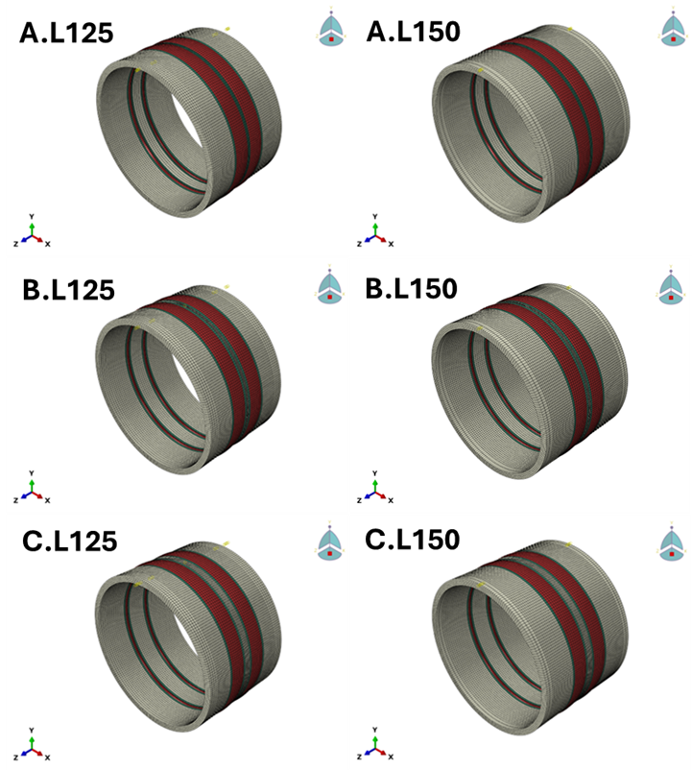
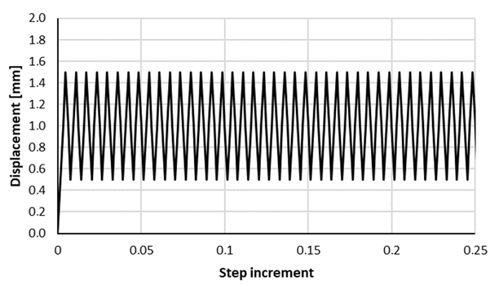
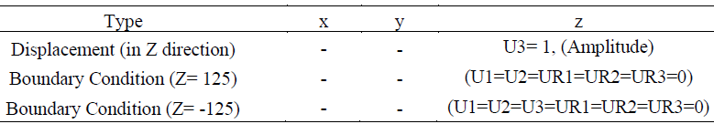
Numerical simulations
A mesh convergence analysis was performed on one of the small-scale samples, with a 2% convergence.
Loading of the small-scale specimens was in the low-cyclic range, using a recommended strain-based loading for sheet specimens with a displacement amplitude of 0.5%.
All simulations was run in tension with a mean displacement of +1.0% to account for potential harmful residual stress as recommended DNV-RP-203 when testing girth welds.

Slide 11
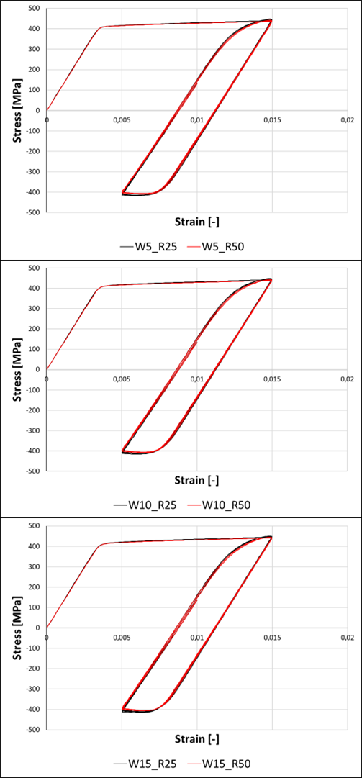
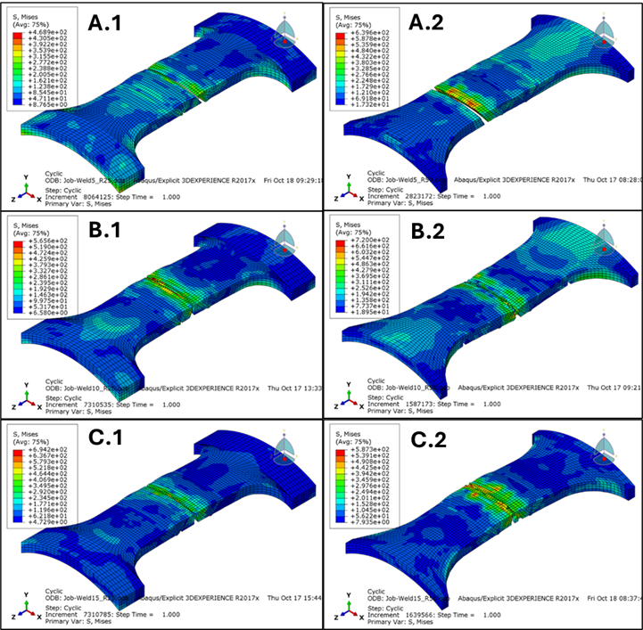
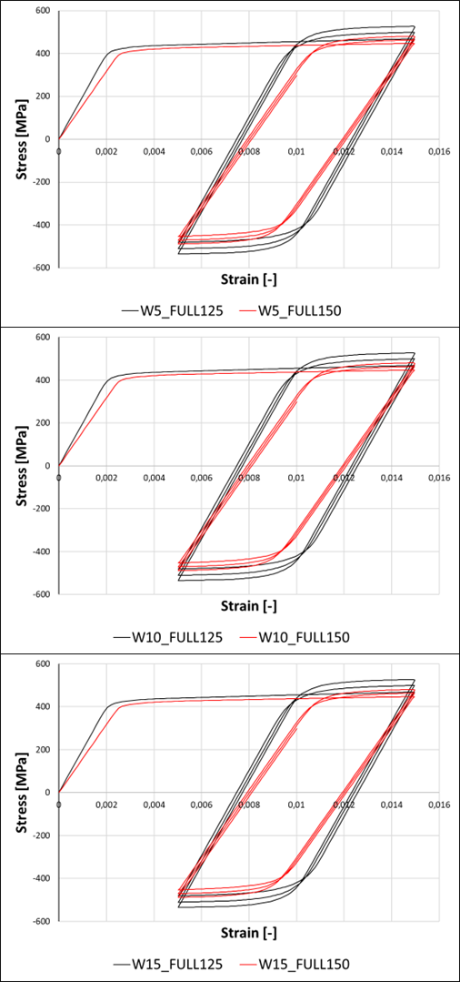
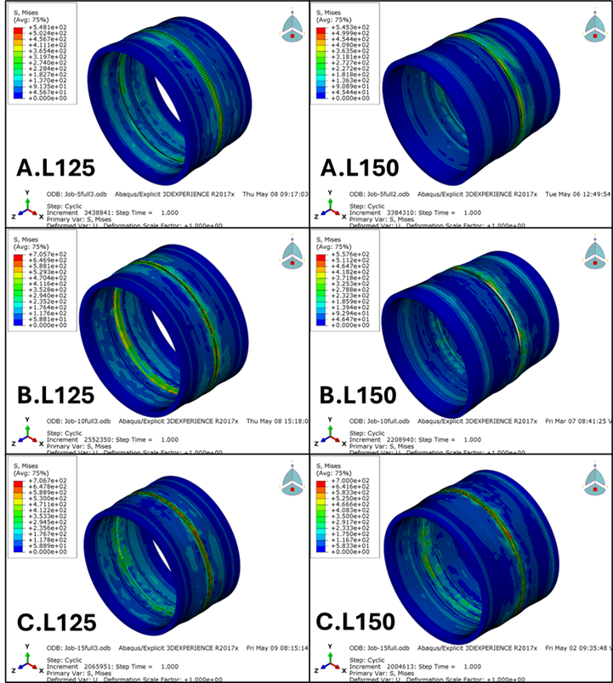
Simulation results
All the simulations followed the expected cyclic loading behavior.
The failure occurred in the welded center region of both the small-scale and full-scale simulated models.
The results indicated buckling behavior when using a 50 mm radius under the loading conditions applied in this study, supporting the utilization of the 25 mm radius.

Slide 12
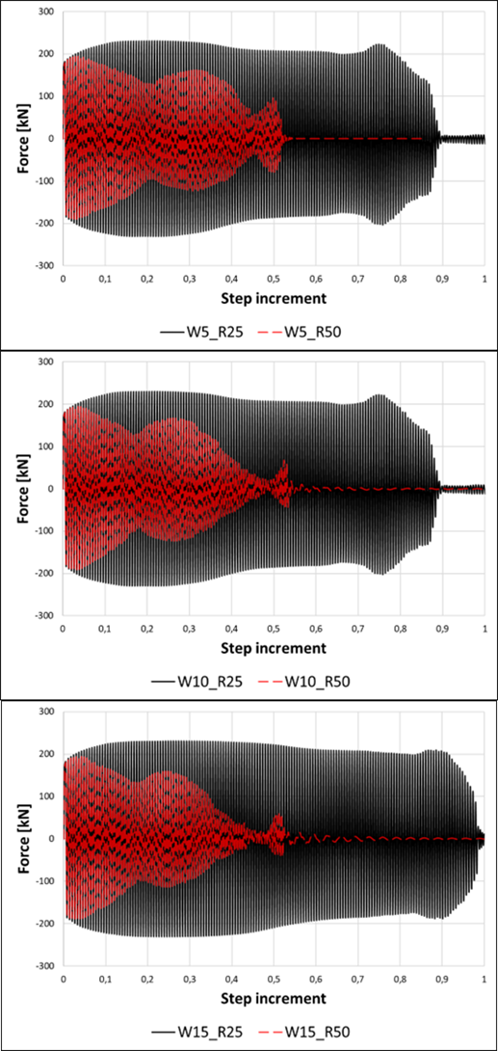
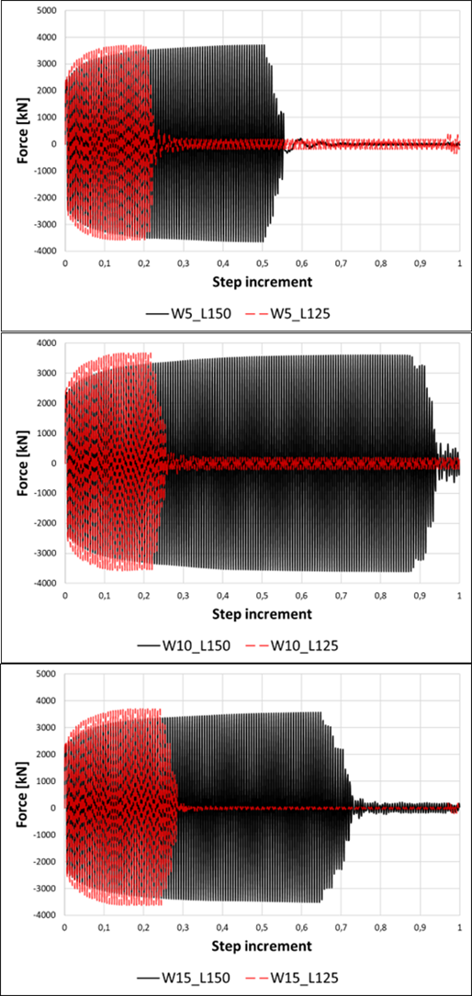
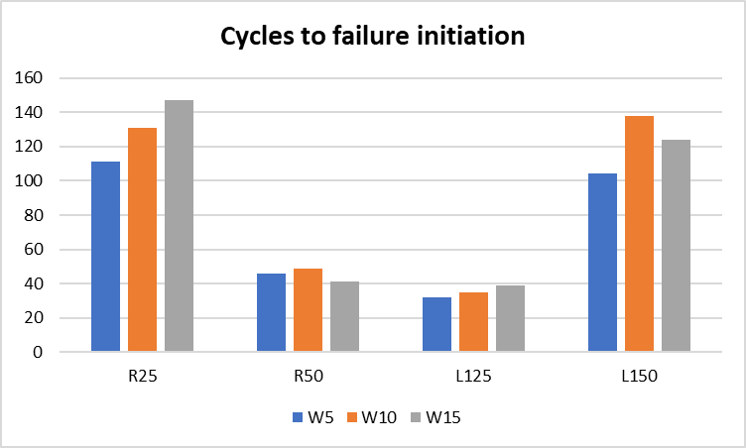
Simulation results
The 5 mm proximity resulted in fewer cycles to failure overall, for both the small-scale specimens and the full-scale sections.
Due to various geometric factors, the 10 mm and 15 mm proximity distances showed the highest number of cycles to failure.
The small-scale specimen with a 25 mm radius exhibited a higher number of cycles to failure compared to both full-scale sections and performed closest to that of the 150 mm full-scale section, despite having a gauge section that is 50 mm shorter.

Slide 13
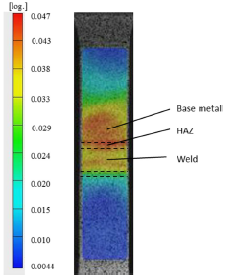
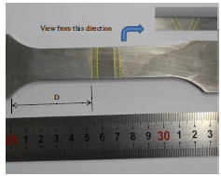
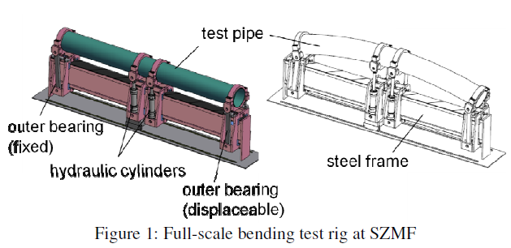
Limitations and future work
Even if previous studies shows similar strain response of the numerical simulations as experimental tests, the Strain validation of the combined material behavior and Mesh dependency was not investigated.
Residual stress is not incorporated in the simulations and is to be investigated and implemented in future work.
Future work would sugest both experimental tests on small-scale samples and full-scale sections to fully validate the findings.

Slide 14
Conclusion
For low-cycle fatigue and high strain loading a transient radius of 25mm would be more favorable, considering the high buckling behavior experienced for the 50mm radius.
There is a variation in fatigue strength between the tested proximity distances, where 5mm shows the lowest fatigue strength, and a possible shift in fatigue strength between 10 and 15mm.
The simulations shows the same tendencies of small-scale specimens resulting in more cycles to failure compared to full-scale sections even when the same displacement load is considered, and residual stress is not incorporated in the model.
The findings emphasize the limitations of numerical simulations when analyzing welded fatigue samples, given that the simulations rely on assumptions of uniform material toughness and defect-free welds, which may differ in real-world conditions witch only can be verified by actual experimental tests.

