Slide 1
Numerical modelling of H₂ deflagrations in EXSIM
Jamie Thompson, DNV Stockport
Bjørn Erling Vembe, DNV Stavanger

Slide 2
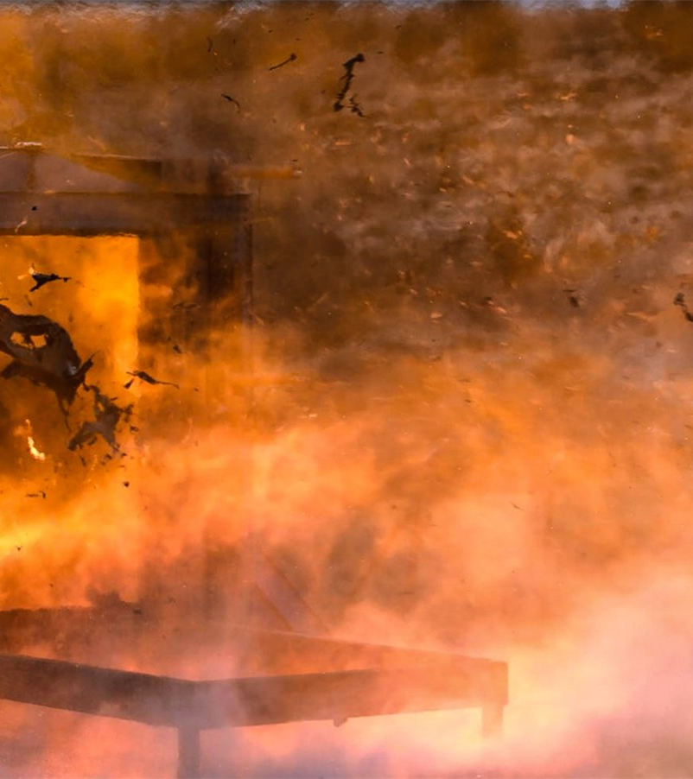
Agenda
Introducing EXSIM
What is EXSIM?
What can you do with it?
Code validation
Focus on hydrogen
Summary

Slide 3
Introducing EXSIM

Slide 4
Overview
What is EXSIM?
Advanced CFD-based simulator for calculation of gas explosion consequences in complex geometries
A bit of History…
Originally developed in 1989 by Professor Bjørn Hjertager at Tel-Tek/Telemark University (Norway)
Further developed as joint IP with Shell
Subsequently used for more than 20 years as Shell’s primary explosion simulator for complex geometries
IP acquired by ComputIT (now DNV) in 2014, becoming commercially available as integrated part of KFX suite in 2015

Slide 5
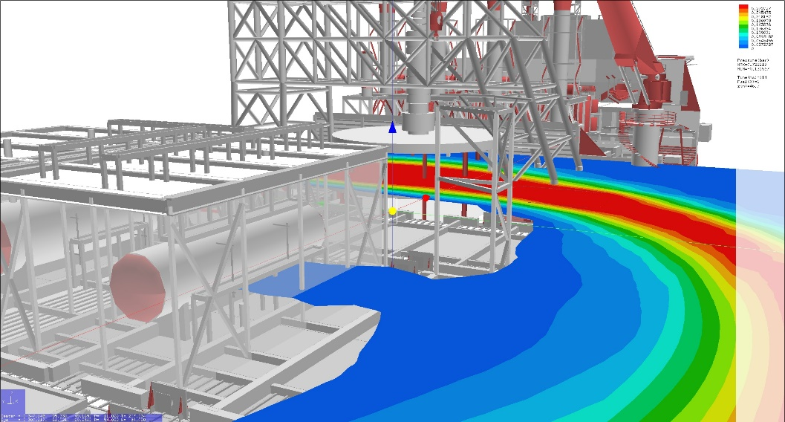
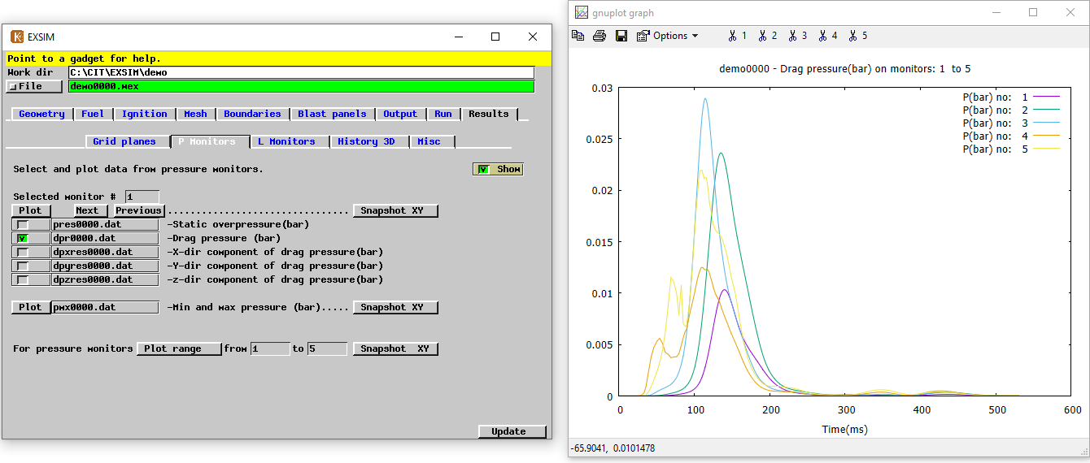
Capabilities
Accurate prediction of consequences of gas explosions in complex geometries
Both offshore and onshore
Range of fuel types (including hydrogen)
Overpressure predictions:
As a function of space and time
Averaged over surfaces (e.g. loading on walls)
Dynamic pressure predictions:
Drag loading on piping, structures etc.
Effects of wall failure, opening of blast panels etc.

Slide 6
Validation (EXSIM 7.0)

Slide 7
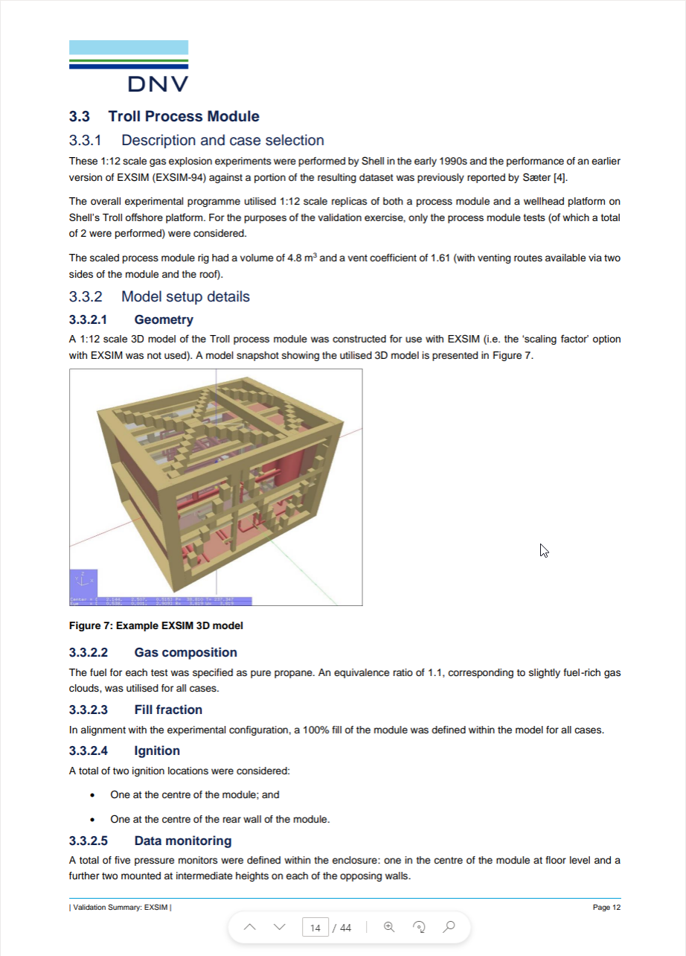
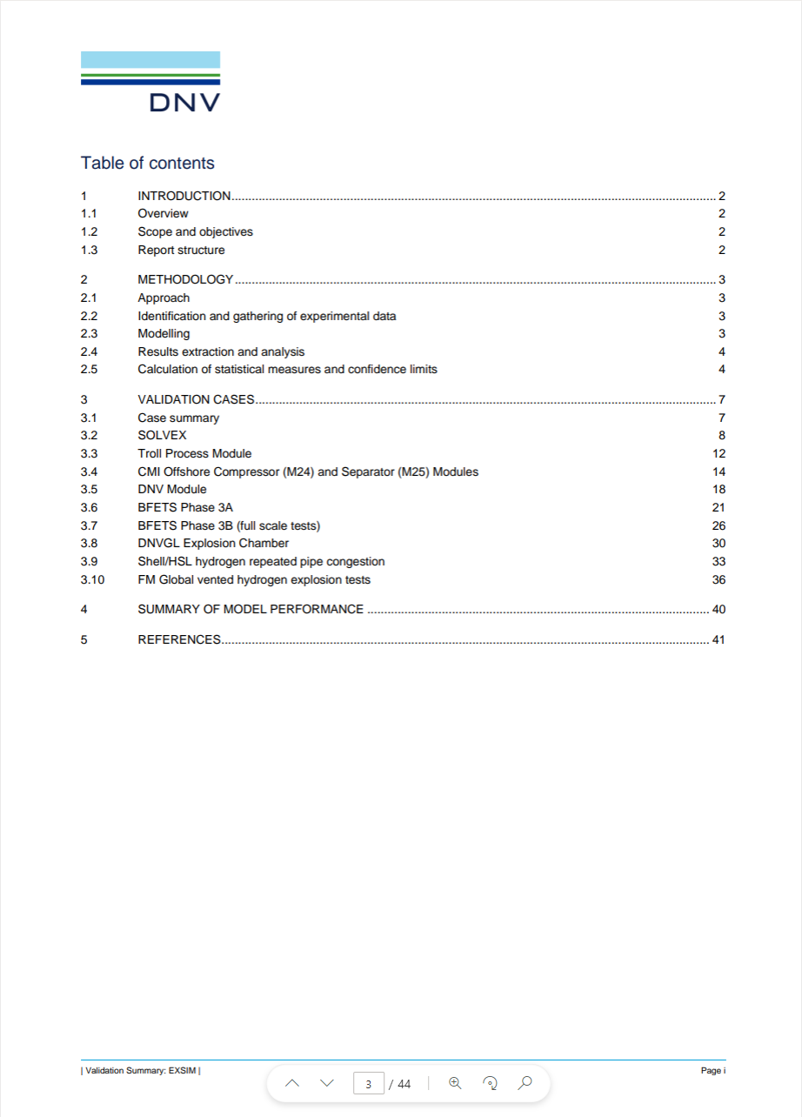
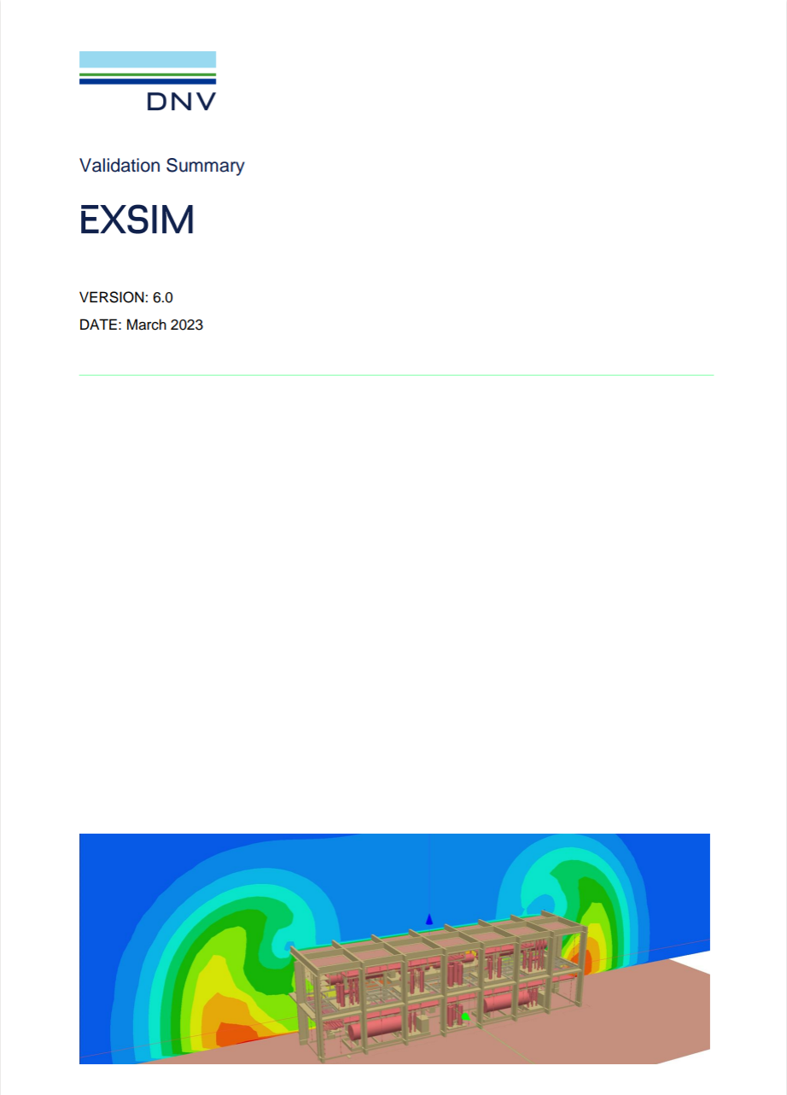
Model Validation
EXSIM is actively being developed and validated
Recently completed a multi-year JIP focused on improving predictive capabilities for hydrogen explosions
Improved quasi-laminar combustion model
Revision of underlying PDR/k-ε formulation
Updated meshing guidelines
The following slides summarise the results of recent validation work for hydrogen explosions in both highly and lightly congested environments
Note: Presented results obtained from upcoming release, EXSIM 7.0

Slide 8
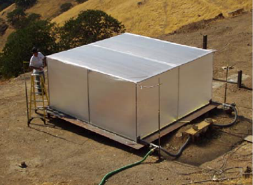
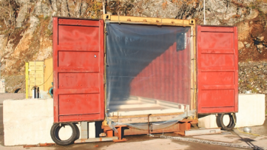
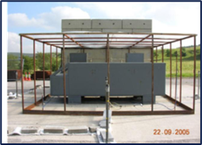
Hydrogen deflagration modelling validation
SATO MEDIUM SCALE H₂ TEST
Hysea homogeneous H₂ TESTS
Shell h₂ refuelling station mock-up

Slide 9
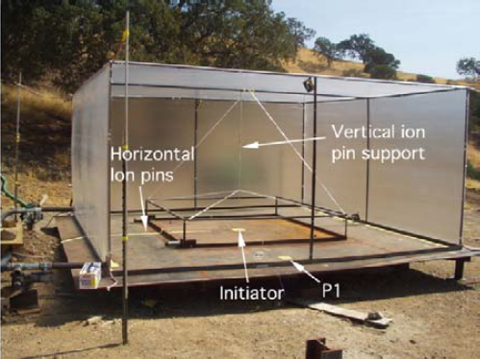
Sato medium scale tests
Test performed by Sato et al. in 2006
Fuel-air mixture contained in ‘empty’ tent
Dimensions: 4.3 m x 4.3 m x 2 m
Some limited framing/fixtures
Rig engulfed in fuel-air mixture
Ignited centrally (ground level)
Test was well instrumented
Ionisation pins for flame position measurement
Pressure transducers at distances of 2 – 41 m from ignition point
Photos: Sato et al. (2006)

Slide 10
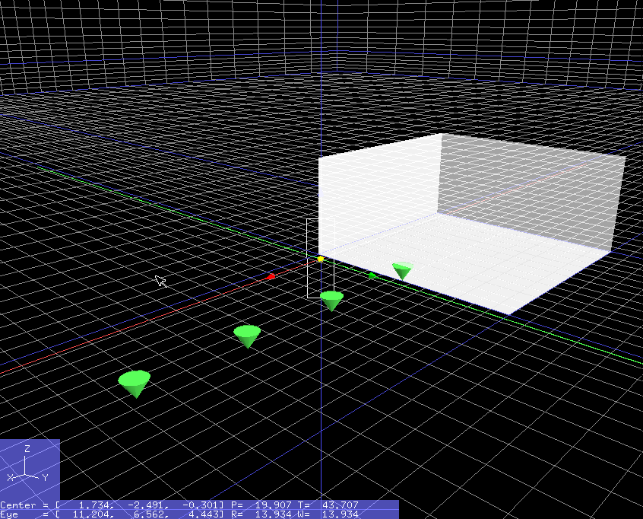
Simulation setup
No geometry required
Framing not considered significant
(Insufficient detail anyway…)
Mesh:
Core region: 0.25 m
Monitor region: 0.50 m
Expansion factor: 1.05
Fuel:
Hydrogen
Equivalence ratio: 1.02

Slide 11
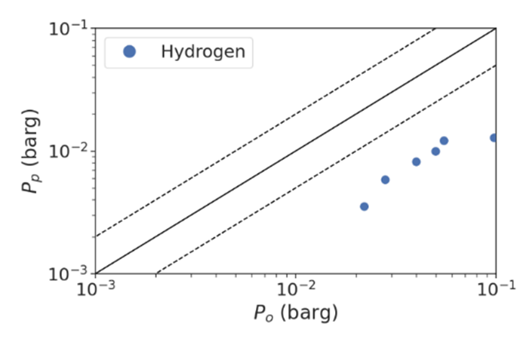
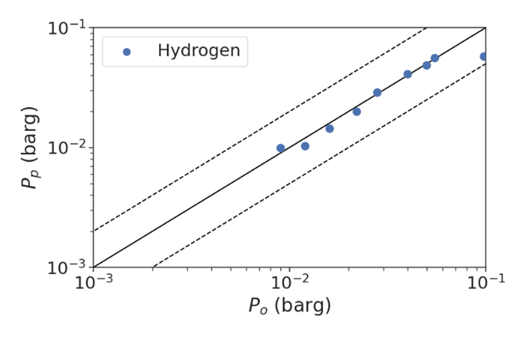
Sato medium scale: results
Significant underprediction observed for pre-JIP version
No predictions within a factor of 2 of experimental values
Likely to be attributable to QL model for H₂
Predictions for updated model generally in excellent agreement with experimental data
Some underprediction in near-field, however
Predicted within factor of 2 of experimental value 100% of the time
Pre-JIP
Updated

Slide 12
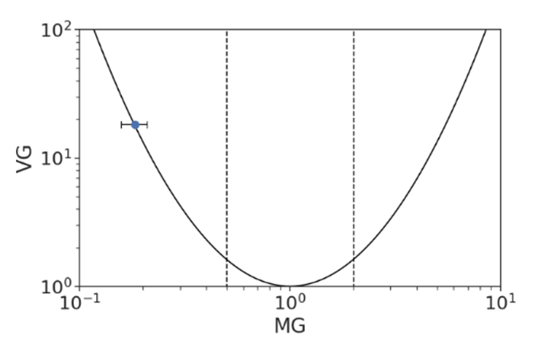
Sato medium scale: results
Significant underprediction observed for pre-JIP version
No predictions within a factor of 2 of experimental values
Likely to be attributable to QL model for H₂
Predictions for updated model generally in excellent agreement with experimental data
Some underprediction in near-field, however
Predicted within factor of 2 of experimental value 100% of the time
Pre-JIP
Updated

Slide 13
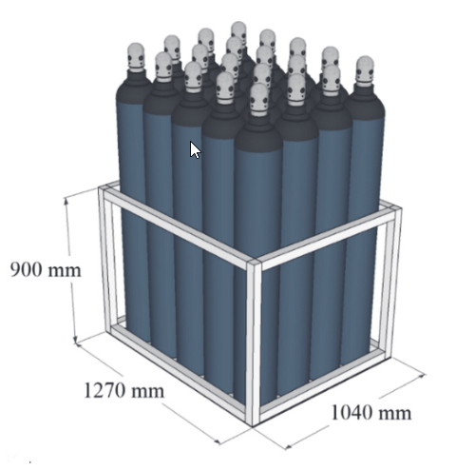
HySEA homogeneous tests
HySEA project ran from 2016-2019
Aim was to ‘provide pre-normative research on vented deflagrations in enclosures and containers for hydrogen energy applications’
Model validation tests performed by Gexcon
Two tests assessed
Both previously used for ‘blind predictions’ exercise
Test rig comprised 20 ft ISO-container
Doors open, with steel framing at floor level
Test A: Frame only (‘empty’)
Test B: bottle basket with 20 50-litre cylinders included
Container filled with lean H2-air mixture
Equivalence ratio: 0.42
Ignited at rear face of container
Images: Skjold et al. (2017)

Slide 14
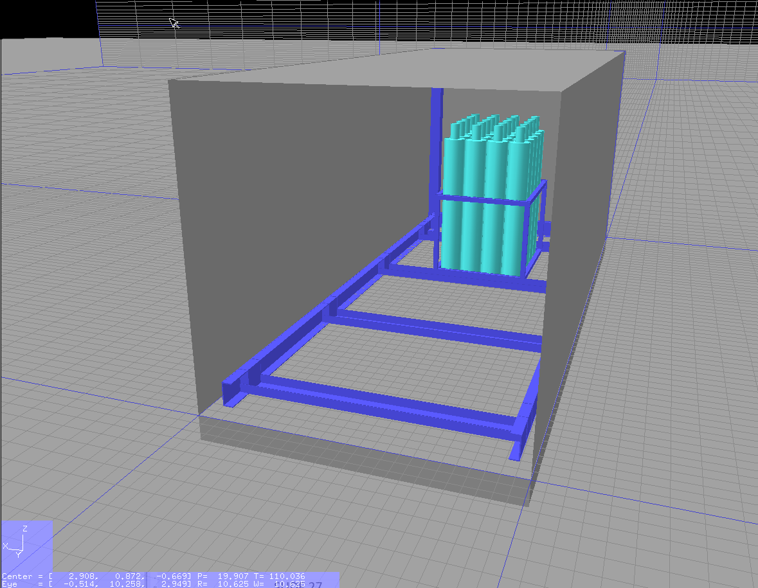
Simulation setup
Fuel:
Hydrogen
Equivalence ratio: 0.42
Mesh:
Core region: 0.16 m
Monitor region: 0.5 m
Expansion factor: 1.05

Slide 15
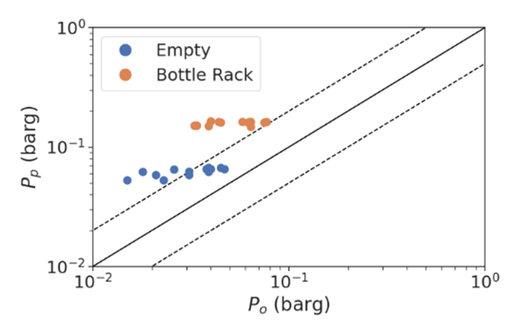
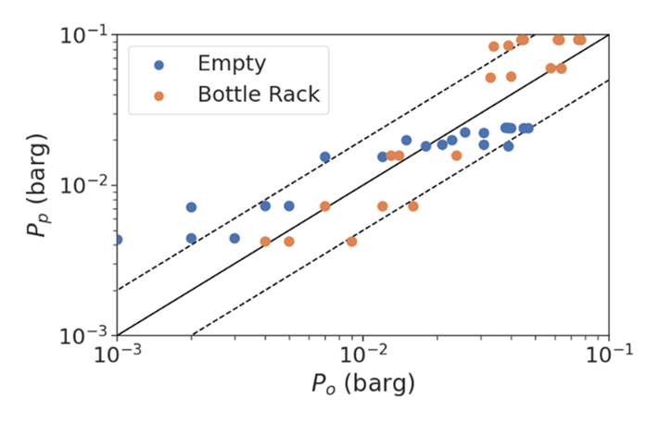
HySEA homogeneous: results
Clear tendency to overpredict for both tests observed for pre-JIP version
Correct trends observed as congestion level is varied, however
Able to predict within a factor of 2 only 30% of the time
Good performance observed updated model for both cases
Both near-field and far-field
Code correctly captures trends as congestion level is varied​
Predicted within factor of 2 of experimental value 75% of the time
Pre-JIP
Updated

Slide 16
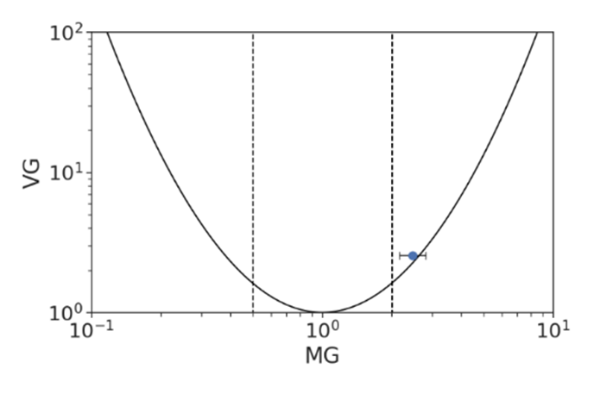
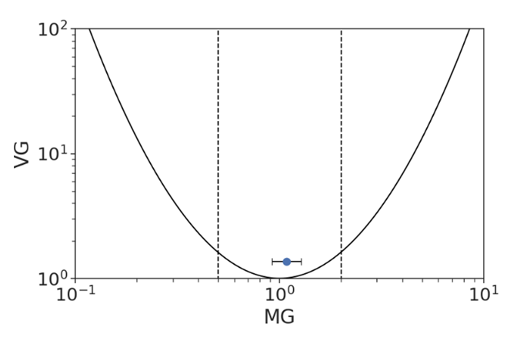
HySEA homogeneous: results
Clear tendency to overpredict for both tests observed for pre-JIP version
Correct trends observed as congestion level is varied, however
Able to predict within a factor of 2 only 30% of the time
Good performance observed updated model for both cases
Both near-field and far-field
Code correctly captures trends as congestion level is varied​
Predicted within factor of 2 of experimental value 75% of the time
Pre-JIP
Updated

Slide 17
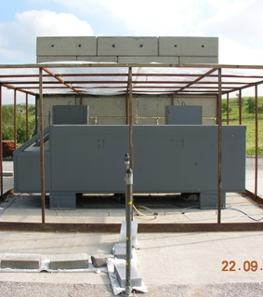
H₂ refuelling station mock-up
H₂ Refuelling Station mock-up tests published by Shell Global Solutions and HSL in 2006
Experiments included two tests:
High pressure H₂ jet; and
Pre-mixed stoichiometric H₂-Air gas cloud
Pre-mixed case used as basis for EXSIM validation exercise

Slide 18
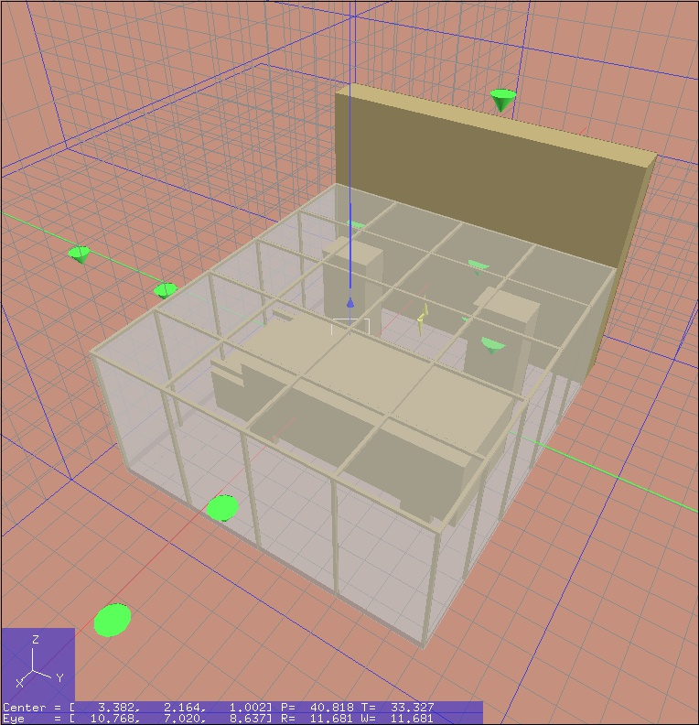
Simulation parameters
Slightly rich H₂-air cloud (shown by semi-transparent box)
Ignition location between fuel dispensers (indicated by lightning strike symbol)
Pressures monitored at a range of locations (green cones)
3 additional monitors underneath mock-up car
Mesh resolution: 436 mm

Slide 19
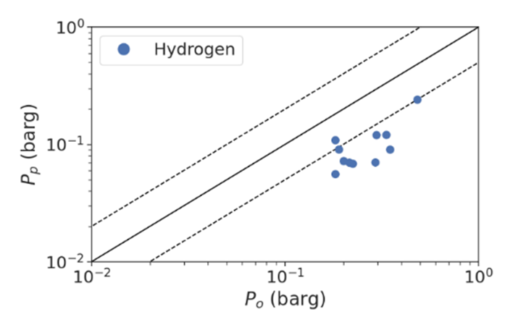
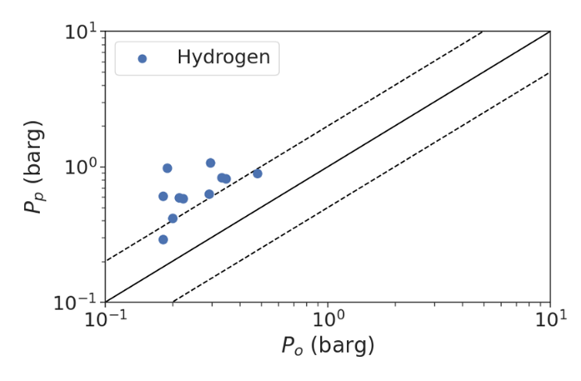
Refuelling station: results
Significant underprediction for majority of measurement points observed for pre-JIP version
Predicted within factor of 2 of experimental value 9% of the time
Updated model observed to significantly overpredict for this case
Predicted within factor of 2 of experimental value 18% of the time
Investigation into overpredictions ongoing
May require introduction of turbulence limiter
Pre-JIP
Updated

Slide 20
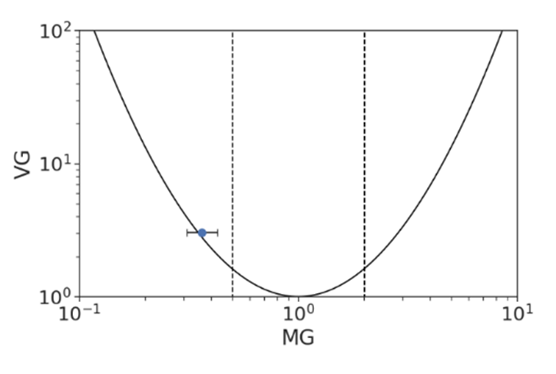
Refuelling station: results
Significant underprediction for majority of measurement points observed for pre-JIP version
Predicted within factor of 2 of experimental value 9% of the time
Updated model observed to significantly overpredict for this case
Predicted within factor of 2 of experimental value 18% of the time
Investigation into overpredictions ongoing
May require introduction of turbulence limiter
Pre-JIP
Updated

Slide 21
Summary
Predictive performance of EXSIM for H₂ deflagrations improved as part of multi-year JIP
Dramatically improved performance over pre-JIP version for H₂
Updated model generally performs well across set of modelled cases
Both in near- and far-field
Further work required to understand and address cause of observed overprediction for refuelling station mock-up case

Slide 22
SAFEGUARD LIFE, PROPERTY AND THE ENVIRONMENT
bjorn.erling.vembe@dnv.com

