Slide 1

OES 2025
DA-RF based multi-class signal recognition method for water supply pipes
Speaker：Kuankuan Zhang
Email: zkk_zzu@outlook.com
Major：Zhengzhou University
Notes:
Hello，everyone.
I am honored to have the chance to share my work.
My name is kuankuan zhang. I come from zhengzhou university in China
The title of my presentation is DA-RF based multi-class signal recognition method for water supply pipes

Slide 2
1、Background
2、Methodology
3、 Conclusion
Outline
Notes:
Next, I will elaborate from three aspects: research background, research methods and conclusions.

Slide 3

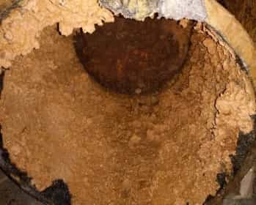
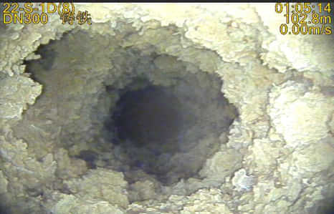
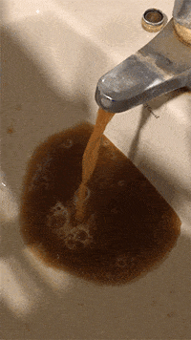
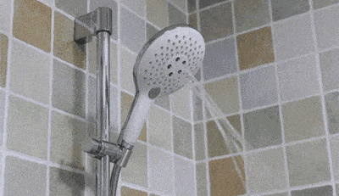
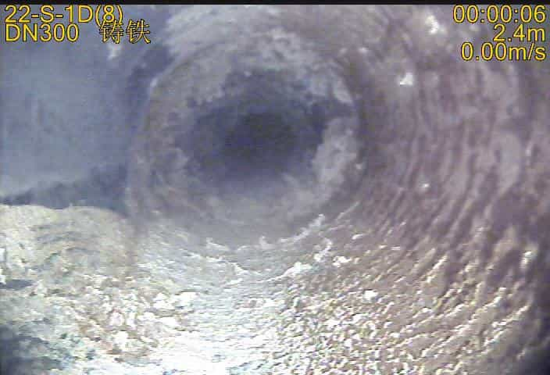
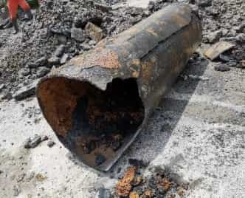
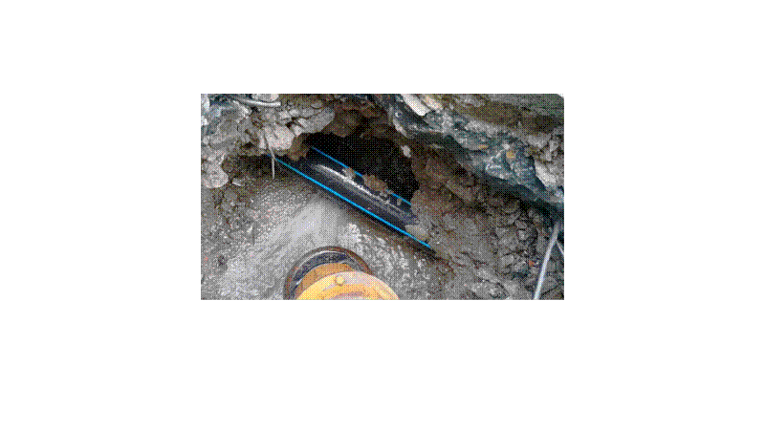
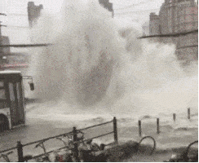
1.Background
Water supply networks often suffer from diseases such as scaling, corrosion, damage, and deformation, which cause leakage and other situations, leading to functional deterioration and reduced safety performance, hindering social and economic development, and even threatening personal safety.
Functional deterioration
Pipe scale
Overcurrent descent
Deterioration of water quality
Low water pressure
Reduced safety performance
Corrosion
Damaged
Leakage
Burst pipe
large scale
strong concealment
high complexity
high complexity
significant harm
Notes:
Water supply networks often suffer from diseases such as scaling, corrosion, damage, and deformation, which cause leakage and other situations, leading to functional deterioration and reduced safety performance, hindering social and economic development, and even threatening personal safety. Their main characteristics are large scale, strong concealment, high complexity, great randomness, and significant harm. Therefore, leakage detection of the network is of great significance.

Slide 4
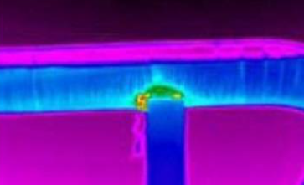
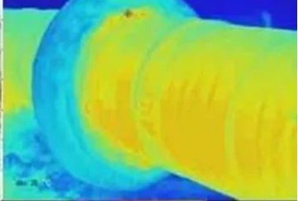
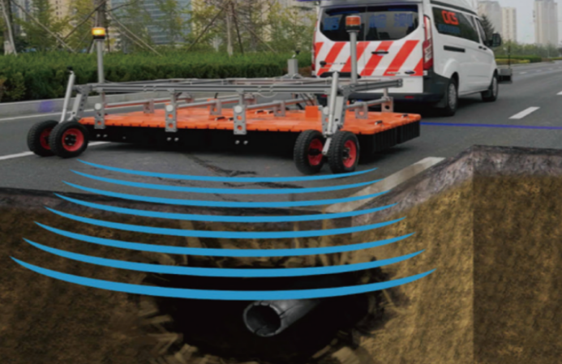
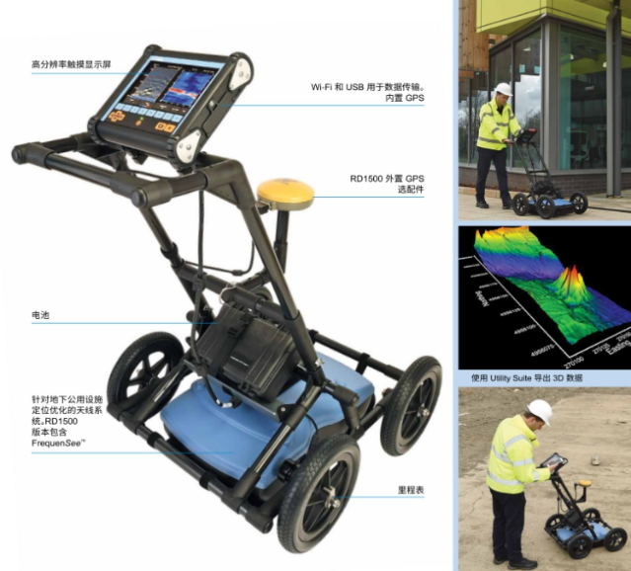
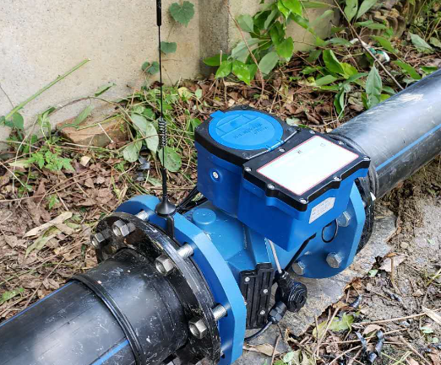
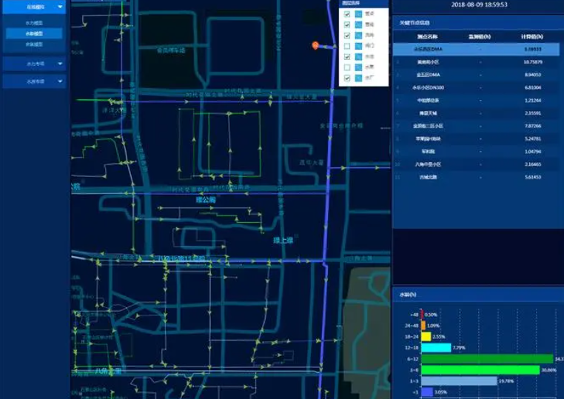
1.Background
Infrared spectroscopy (IR) method
Ground Penetrating Radar(GPR) Method
Non-contact, simple to operate, but limited by weather, road conditions and soil conditions, and susceptible to being affected by other heat sources
Hydraulic model method
The data detected by the flowmeter and water pressure gauge are compared with the values of the model. Abnormal values trigger an alarm for leakage detection
Notes:
The current mainstream methods include IR, which has the advantages of non-contact and simple operation, but is limited by weather, road conditions and soil conditions, and is susceptible to interference from other heat sources; the hydraulic model method, which compares the data detected by flow meters and water pressure gauges with the values of the model, and alarms for abnormal values to detect leaks; and GPR method.

Slide 5
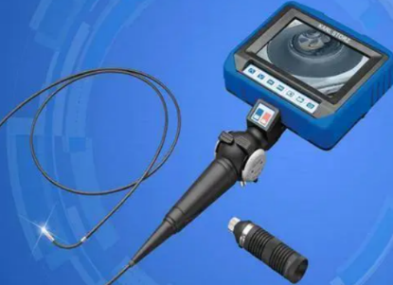
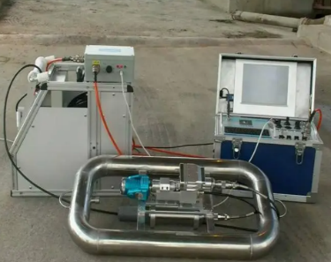
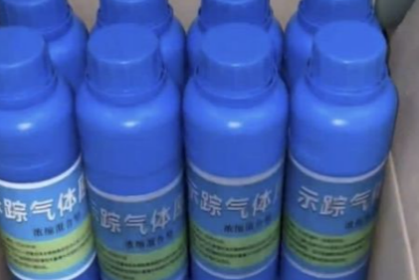
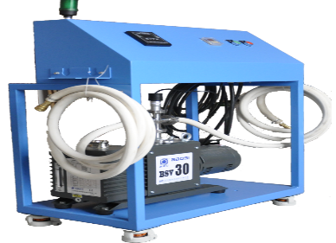
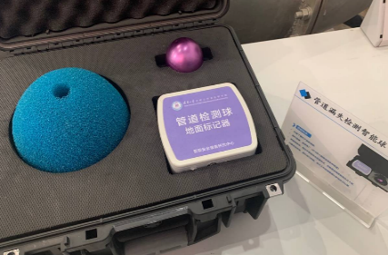
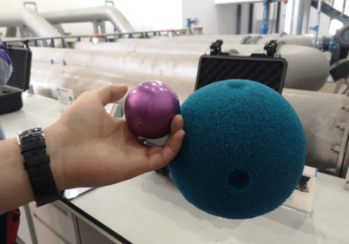
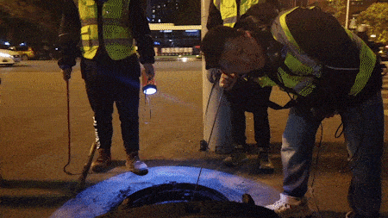
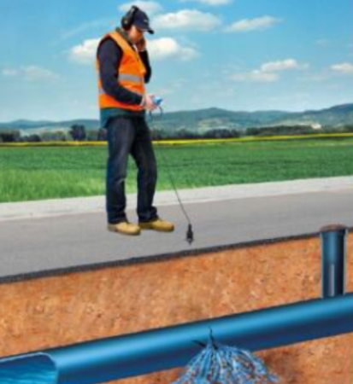
1.Background
Pipeline inspection method
Tracer gas method
The pipe inspection method has a high accuracy rate, but it involves high time costs and detection costs
Applicable to low-pressure pipelines. Since the gas cannot be reused, the detection cost is high.
Smart Ball
Acoustic detection method
The detection is simple and highly sensitive, but it cannot be used when the pipe diameter is too small, and there is a possibility of polluting the water quality.
Due to its simple operation, wide adaptability and low cost, it has become the most popular method for leak detection.
Notes:
In addition, there is the pipe inspection method ; the smart ball method, the tracer gas method and Acoustic detection method.

Slide 6
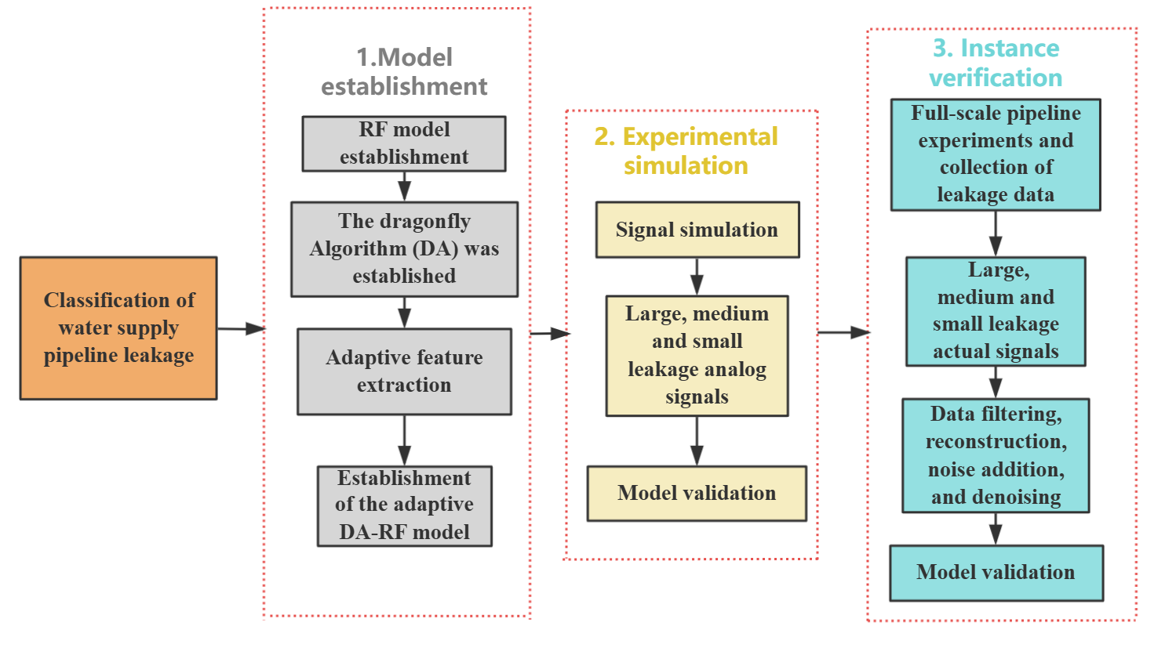
2. Methodology- Based on hydrophone equipment
Notes:
Based on hydrophone equipment，we gradually established the adaptive DA-RF adaptive feature extraction model, which is capable of extracting various features of the signal;Then, Gaussian random signals are used to simulate signals with different leakage degrees to verify the classification performance of the model; Finally, by screening the signals collected from the on-site full-scale experiments, reconstructing abnormal data, adding noise, and denoising, the model was verified through examples.

Slide 7
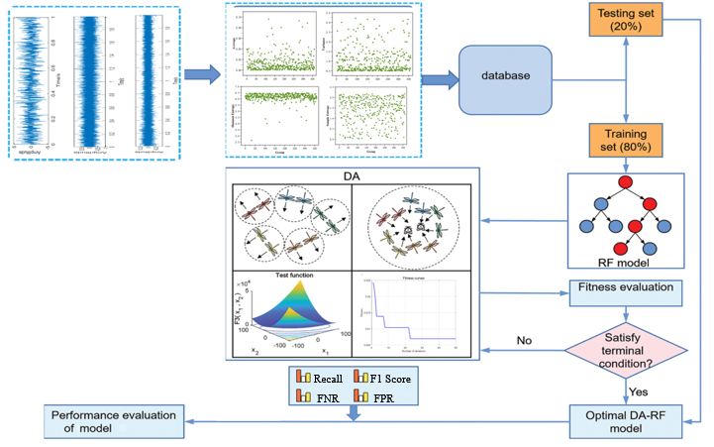
2. Methodology- Based on hydrophone equipment
Notes:
We established an adaptive feature extraction DA-RF model, and for a total of 360 (Three-hundred-and-sixty)groups of leakage analog signals with three leakage degrees of large, medium and small, and divided the data set into 80(Eighty)%(percent) of the training set and 20(Twenty)%(percent) of the test set. Through the established adaptive function, adaptive feature extraction and recognition classification were carried out, and finally the performance of the model was evaluated and verified by evaluation indicators such as recall rate.

Slide 8
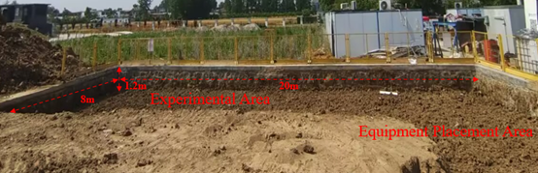
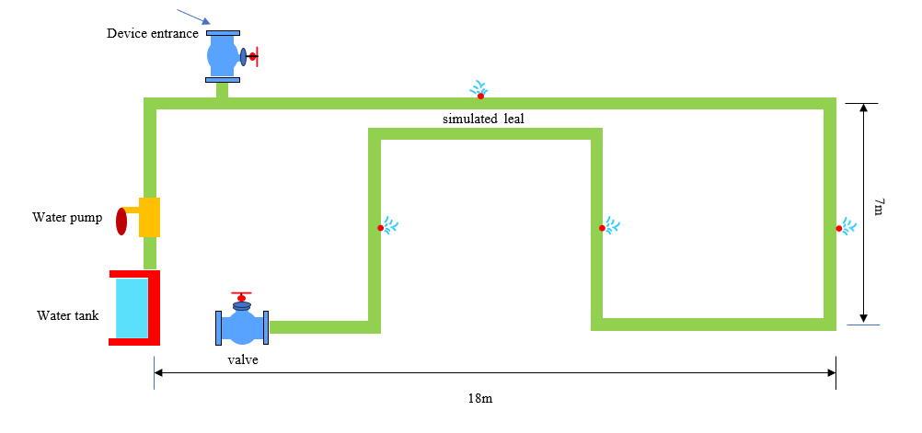
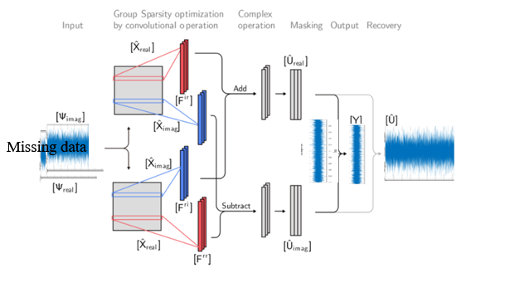
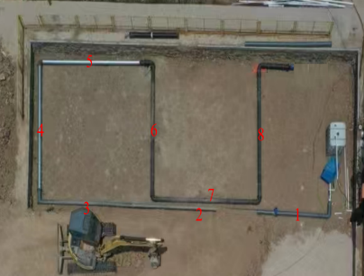
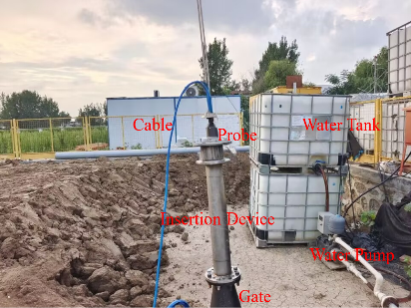
2. Methodology- Based on hydrophone equipment
We established an underground water supply pipeline system in a site that is 20 meters long, 8 meters wide and 1.2 meters deep.
GS_aware-CNN
Notes:
We established an underground water supply pipeline system in a site that is 20(Twenty) meters long, 8 meters wide and 1.2 (one point two)meters deep. Different leakage conditions were simulated through pressure, and then the data were collected by the equipment inside the pipeline. And the GS_aware-CNN model is utilized to reconstruct the collected abnormally missing data and construct the leaked data set.

Slide 9
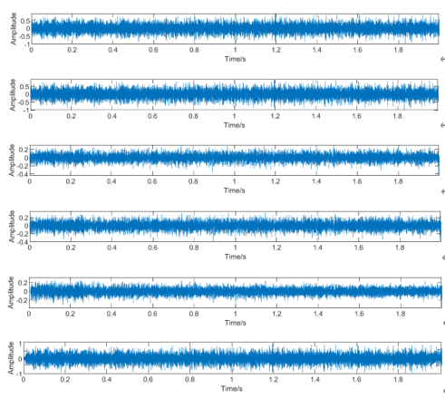
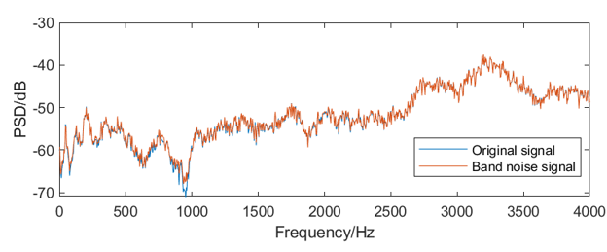
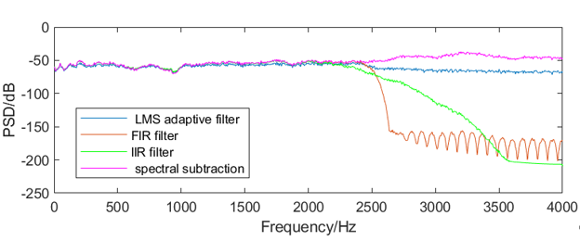
2. Methodology- Based on hydrophone equipment
During the acquisition process, noise is often present.
Notes:
During the acquisition process, noise is often present. Therefore, we use various methods such as LMS, FIR, and IIR to denoise the signal, and utilize the signal-to-noise ratio (SNR) as an evaluation index to determine the effectiveness of each method.

Slide 10
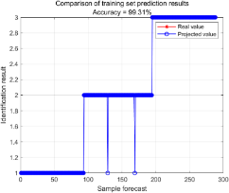
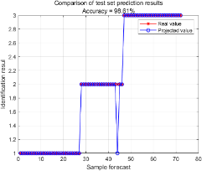
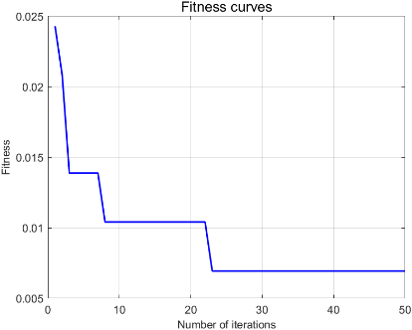
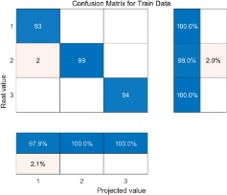
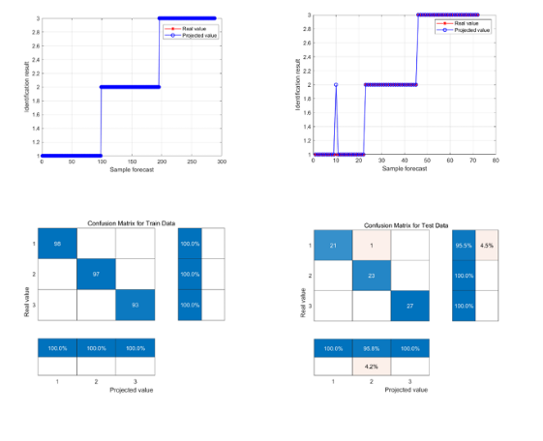
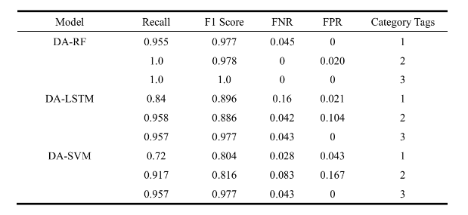
3. Conclusion- Based on hydrophone equipment
Simulation
Comparison of denoising performance
Classification accuracy
Performance evaluation of each model
Experiment
We selected the spectral subtraction method to denoise the signal through comparison, which has obvious advantages over the other methods.
Notes:
We selected the spectral subtraction method to denoise the signal through comparison, which has obvious advantages over the other methods. Moreover, after data pre-processing, the optimized DA-RF model through dragonfly optimization can completely distinguish between large, medium and small leaks.

Slide 11
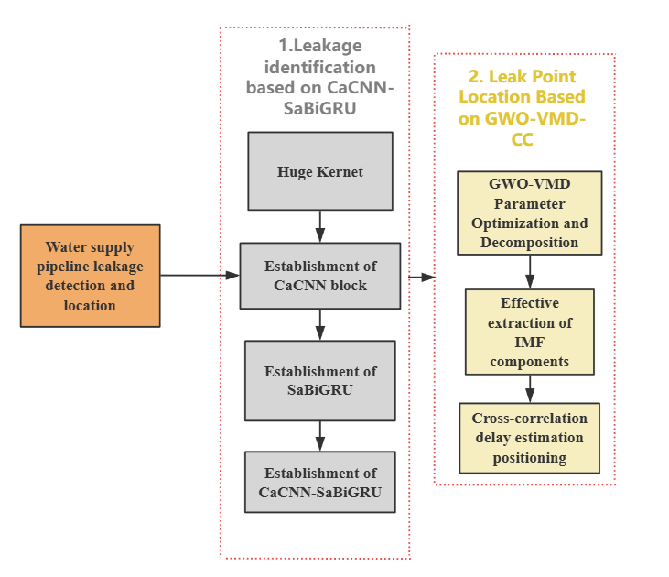
4. Methodology- Based on sensors
Notes:
Based on sensors. Above, we used the in-tube acquisition equipment to identify the leakage signal; we also used the data collected by the sensors, and through the established CaCNN-SaBiGRU end-to-end model, identified the leakage signal, and used the GWO-VMD plus cross-correlation method to locate the leakage signal under low signal-to-noise ratio conditions.

Slide 12
4. Methodology- Based on sensors
Design the experiment as shown in the figure. A total of 6 valves were set up to simulate 6 different leakage sources.
Notes:
Our design the experiment as shown in the figure. A total of 6(six) valves were set up to simulate 6 (six)different leakage sources. The number of leakage sources was controlled through the valves. Three-axis acceleration sensors were placed on both sides of the leakage source pipeline to collect the leakage signals.

Slide 13
4. Methodology- Based on sensors
CaCNN-SaBiGRU
Notes:
We proposed an end-to-end adaptive noise-resistant neural network framework named CaCNN-SaBiGRU, which is used for the intelligent identification of the number of water supply pipeline leaks in noisy environments.

Slide 14
4. Methodology- Based on sensors
The above model consists of four main parts, namely the first layer of large convolution kernels, the CaCNN module, the SaBiGRU module, and the fully connected layer.
The first layer of large kernel convolution: captures global features, which is beneficial for extracting wide-area temporal features and suppressing high-frequency noise.
The CaCNN module: extracts features and adaptively enhances the attention of important channels.The SaBiGRU: further learns the extracted features and selectively focuses on important features.
The fully connected layer: maps the feature representations to the final category labels.
CaCNN
SaBiGRU
Notes:
The above model is mainly divided into four parts: the huge kernel convolution, the CaCNN module, the SaBiGRU module and the fully connected layer.

Slide 15
5. Conclusion -Based on sensors
The accuracy rate of this model is higher than that of the advanced benchmark model
Notes:
The accuracy rate of this model is higher than that of the advanced benchmark model, and the overall recognition rate has reached 91%(Ninety-one percent). Different categories are more distinctly distinguished in this model.

Slide 16
5. Conclusion -Based on sensors
The proposed model has the strongest anti-noise ability compared to the baseline model, and achieves the highest recognition accuracy under low leakage conditions.
The influence of signal-to-noise ratio on the model
The impact of leakage level on the model
Notes:
And the proposed model has the strongest anti-noise ability compared to the baseline model, and achieves the highest recognition accuracy under low leakage conditions.

Slide 17
5. Conclusion -Based on sensors
Through ablation experiments, it was verified that the main modules have a significant effect in improving the performance of the model.
The influence of channel attention
The influence of the size of the first layer's large convolution kernel on the model
The influence of SaBiGRU
Notes:
Next，through ablation experiments, it was verified that the main modules have a significant effect in improving the performance of the model.

Slide 18
5. Conclusion -Based on sensors
The right figure shows the measured signal graph, and there is a very significant low-frequency noise signal present in its frequency.
Cross-correlation function graph
Notes:
Finally, the GWO-VMD-CC algorithm was used to locate the single leakage point under the condition of low signal-to-noise ratio.

Slide 19
5. Conclusion -Based on sensors
The right figure shows the processed signal and its frequency graph. It can be observed that the low-frequency noise has been filtered out.
Cross-correlation function graph
Notes:
After being processed by the GWO-VMD-CC algorithm, the cross-correlation function shows a distinct peak, and the estimated delay is 30(thirty). By substituting the parameters of the pipeline, the wave velocity of the cast iron pipe is calculated to be 1160 m/s(one thousand one hundred and sixty meters per second). Combining with the linear formula, the location of the leakage is determined to be 12.04 (Twelve point o four) m, which is very close to the actual leakage point position of 12.2(Twelve point two) m. Thus, precise positioning has been achieved.

Slide 20
OES 2025
Thank you all for listening
Speaker：Kuankuan Zhang
Email: zkk_zzu@outlook.com
Major：Zhengzhou University
Notes:
That is all of my presentation. If there are any questions we can discuss privately, here is my email address.

