Slide 1
2nd OLYMPIAD in ENGINEERING SCIENCE-
OES 2025-SHM III
Cloud-Based Strain Monitoring Using Micro Image Strain Sensing Method
Bo Lu
Ph.D. Candidate in Structural Engineering
Advisor: Professor Xuefeng Zhao
Institute of Smart Structural Systems
Dalian University of Technology, China
June 12, 2025
Notes:
Good afternoon, everyone!
It's a great honor to be here today at the 2nd Olympiad in Engineering Science – Structural Health Monitoring Session III.
My name is Bo Lu, and I am a fourth-year Ph.D. candidate in Structural Engineering at Dalian University of Technology, China. I work under the advisor of Professor Xuefeng Zhao, and I belong to the Institute of Smart Structural Systems.
I am now in the final stage of my Ph.D. studies and preparing for graduation.
Today, I’m very pleased to present my research titled: "Cloud-Based Strain Monitoring Using Micro Image Strain Sensing Method."
Yes, that’s right — this is a vision-based method for monitoring structural strain.

Slide 2
Outline
Research Background
Micro-Image Strain Sensing Method
Laboratory Validation
Outdoor Monitoring Experiment
Cloud Platform
Conclusion
Notes:
Here is the outline of my talk:
1. Research Background
2. Micro-Image Strain Sensing Method
3. Laboratory Validation
4. Outdoor Monitoring Experiment
5. Cloud Platform
6. Conclusion
So with that overview, let’s begin with the research background.

Slide 3
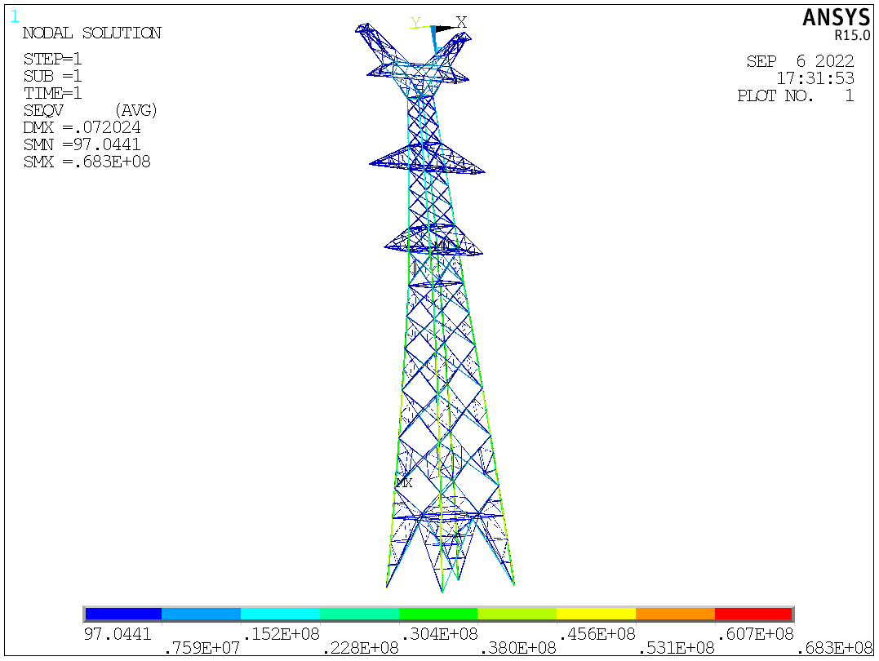
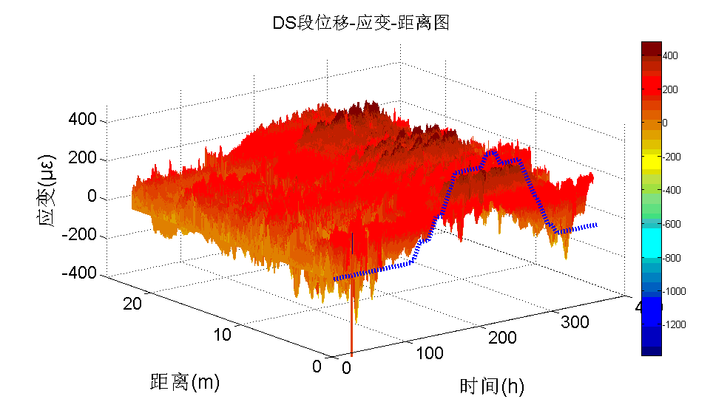
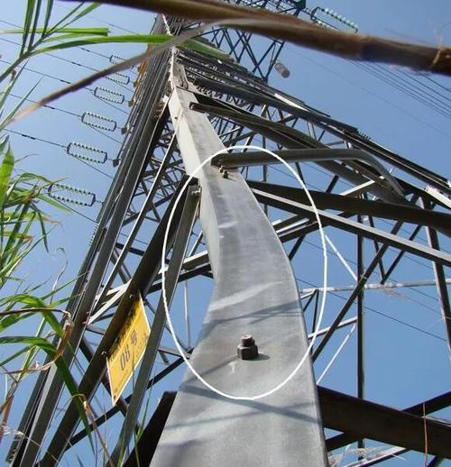
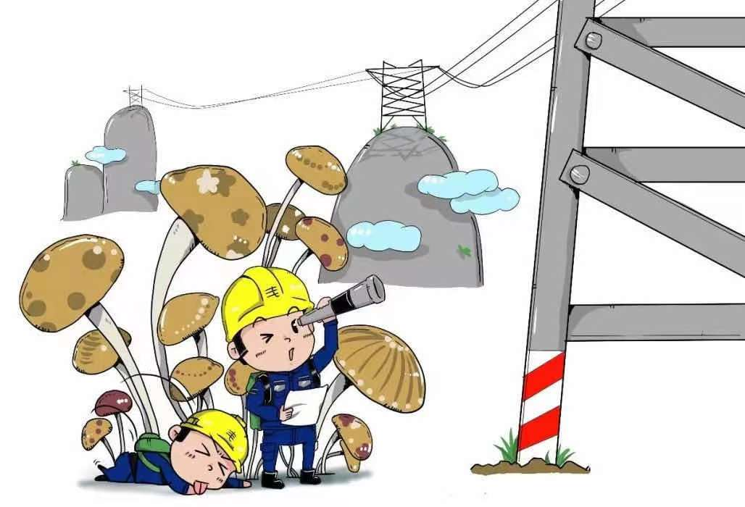
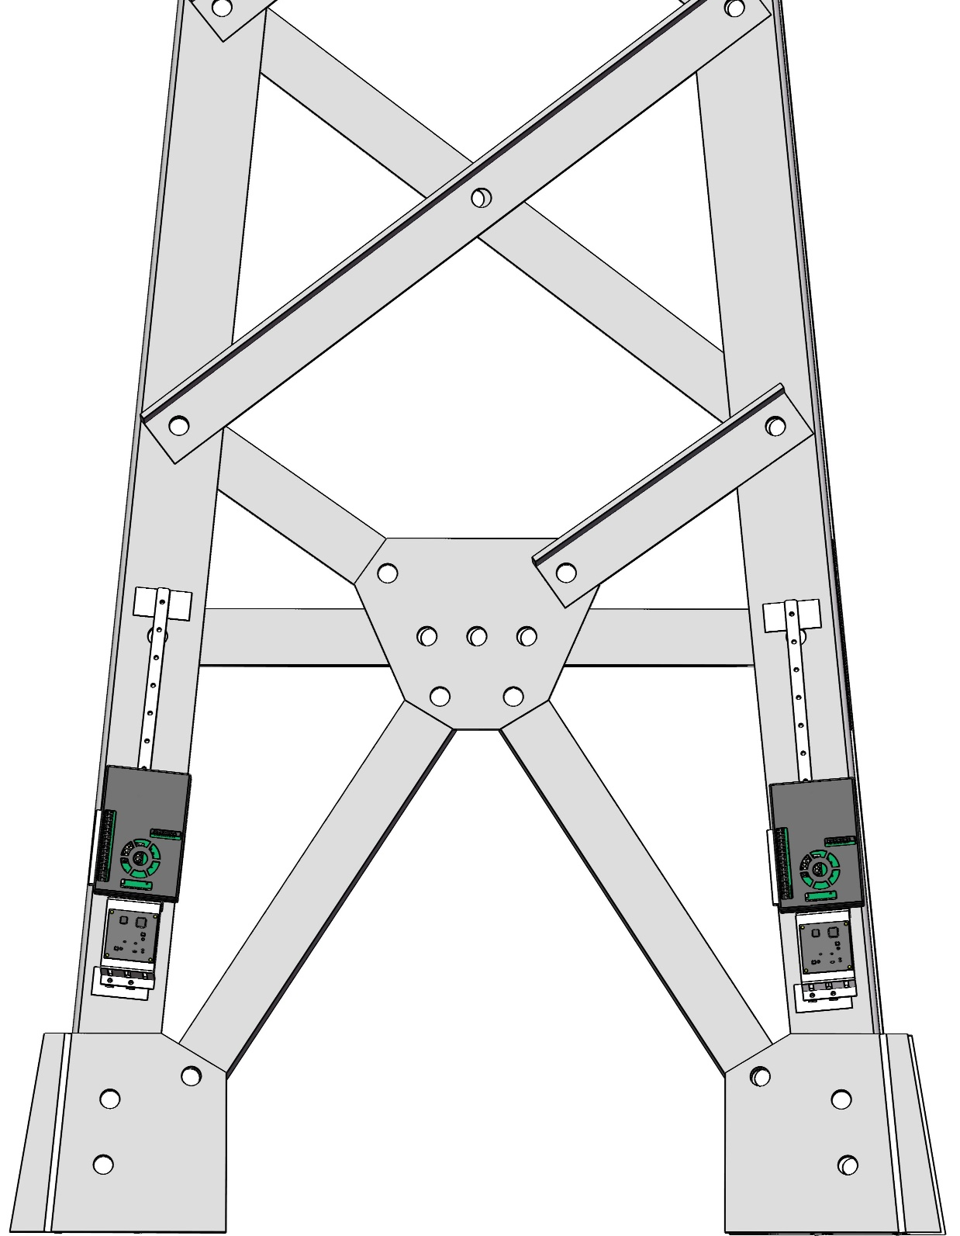
1. Research Background
1. Strain is a key indicator of structural health
2. Many critical failures are preceded by abnormal strain
Why is strain?
3.Conventional visual inspection is limited
4.Strain data enables informed maintenance and safety decisions
Sensor
Cloud
Center
Max
strain
Tilt
Sensor
Notes:
Why is strain so important?
To answer this question, let me walk you through four key points.
1.Strain is a key indicator of structural health conditions
On the left is a stress/strain distribution map of a transmission tower. On the right, you can see the spatiotemporal evolution of strain on a nuclear containment structure.
These examples show that strain reflects how internal forces are distributed inside a structure.
2. Many critical failures are preceded by abnormal strain
Here, we see a steel member of a tower starting to deform slightly, and cracks gradually spreading on the surface of concrete.
These small changes often happen before visible damage appears.
3. Conventional visual inspection is limited
Early-stage strain is very subtle — it's almost invisible to our eyes.
Without sensors, it’s hard to detect until the structure is already severely damaged.
4. Strain data enables informed maintenance and safety decisions
Here, using a transmission tower as an example, when the structure begins to tilt, the strain sensor on its leg quickly detects the sudden change, sends the data to the cloud, and triggers an alert at the monitoring center.
This is how strain monitoring helps us take timely action before serious failures happen, helping to reduce potential damage and loss.

Slide 4
1. Research Background
Current Research Status
They perform well — just not cheaply！
Table 1. The technical specifications and costs of the commonly used strain sensors.
Sensor type | Resolution ($με$) | Measurement range ($με$) | Data acquisition requirement | Acquisition device Price (USD) | Acquisition Mode
VWSG | 1 | 3000 | Vibrating wire acquisition instrument | 1,000-7,000 | Static
RSG | 1 | 10000 | Resistance strain acquisition instrument | 1,000-15,000 | Dynamic
FBG | 1 | 3000 | FBG demodulator | 5,000-60,000 | Dynamic
MISS | 0.2 | $±$10000 | No need | 132 | Dynamic
Notes:
Now let’s take a quick look at the current strain sensing technologies that are widely used today.
This table compares several commonly used methods, including vibrating wire gauges, resistance strain gauges, and fiber Bragg grating sensors.
We list their technical specifications and their costs.
These methods have been successfully applied in many engineering applications. However, one common limitation remains: The cost is relatively high, especially for large-scale deployments.
So, there is still a clear gap in the current research landscape —we lack a low-cost sensor that can reliably monitor dynamic strain responses of civil structures in real time and over long periods.
This is the motivation behind our study. So, to address the gap, we proposed a new method called the Micro-Image Strain Sensing Method

Slide 5
2. Micro-Image Strain Sensing Method
MISS Sensor Structure Diagram
Raspberry Pi 4B
Industrial camera & lens
?
LED beads
DHT 22 Temperature-Humidity sensor
Raspberry Pi
mounting tray
Optical target
Industrial camera
mounting bracket
Slider strain sensing mechanism
Notes:
At the core of this method is our self-developed MISS sensor.
Now, let me walk you through a little thought experiment.
Imagine I give you an LED light panel. Then, an industrial camera. Next, a Raspberry Pi. Then a DHT22 temperature and humidity sensor, and a slider strain mechanism —on which we’ve mounted brackets to hold the Raspberry Pi and the camera. Finally, we add a optical target.
Now you may wonder — what do all these parts build together? They form the MISS sensor.

Slide 6
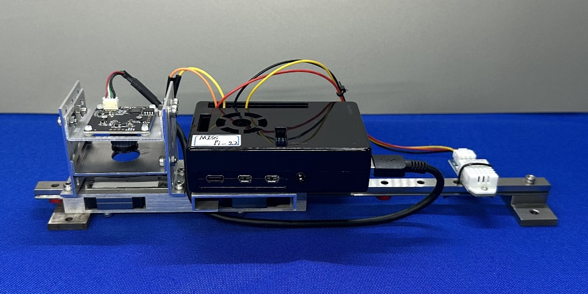
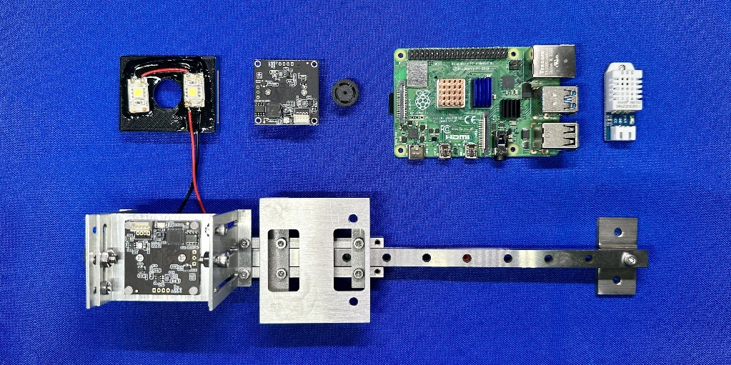
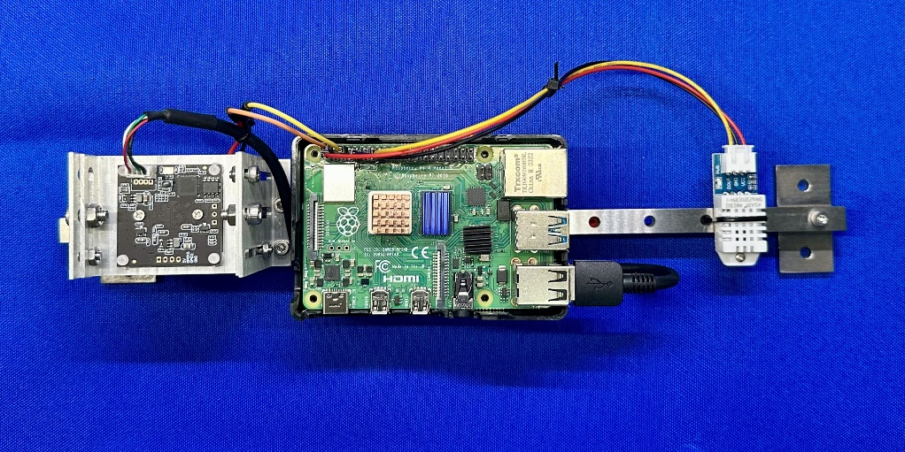
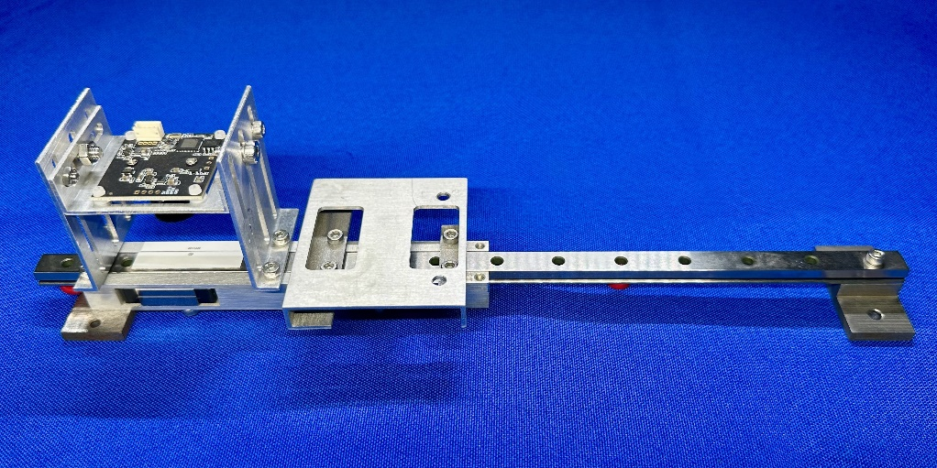
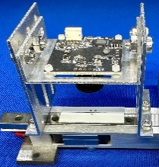
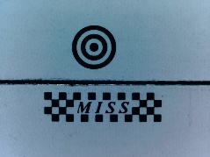
2. Micro-Image Strain Sensing Method
Completed MISS Sensor
(a)
(b)
MISS Sensor
1
2
3
4
7
LED
beads
Industrial
camera & lens
2
1
8
6
3
5
4
6
Raspberry Pi
mounting tray
(c)
(d)
8
7
Industrial camera
mounting bracket
Optical target
4
3
Raspberry Pi 4B
DHT 22
Temperature-
Humidity sensor
Slider
Linear guide rail
Inverted T bracket
5
Slider strain sensing mechanism
Actual view of the MISS sensor: (a) overall view of the MISS sensor (b) exploded view of the components, (c) top view of the MISS sensor, (d) detailed view of the SSSM, industrial camera mounting bracket and optical target.
Notes:
Here is the completed version of our MISS sensor.
You can see:
(a) the overall view of the miss sensor.
(b) an exploded view
(c) a top-down view, and (d) a close-up of the strain sensing mechanism
This prototype is fully functional and ready for deployment. It combines all the modules we mentioned, and it’s compact, low-cost, and easy to install in the field.

Slide 7
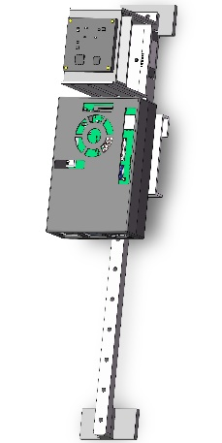
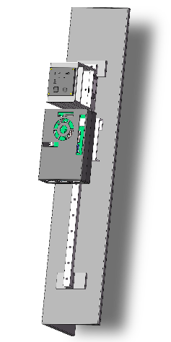
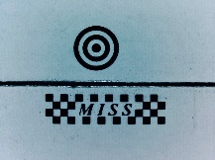
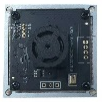
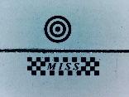
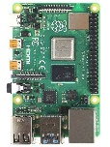
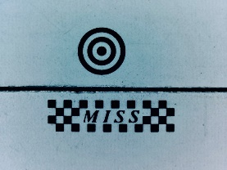
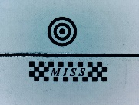
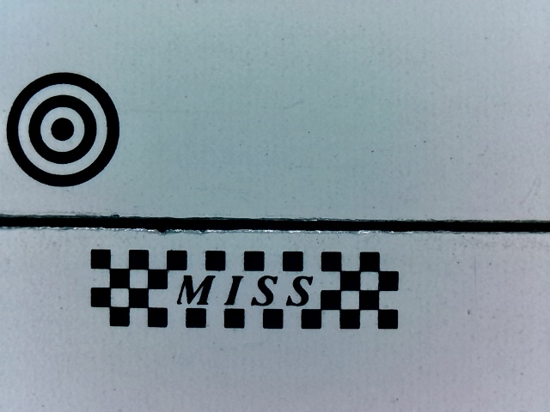
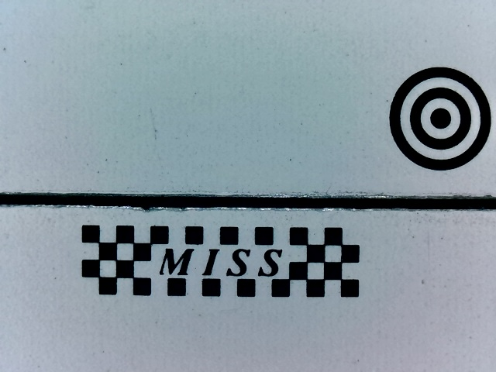
2. Micro-Image Strain Sensing Method
Theoretical Framework
Step1: Image data acquisition
Step3: Strain calculation
(a)
Optical target
(b)
Tension
(c)
Initial image
(e)
Industrial camera
($x_{m_{0}},y_{m_{0}}$)
($x_{m_{t}},y_{m_{0}}$)
Movement along
X-axis only
$$l_{x_{t}}$$
Moving target template
$$l_{x_{0}}$$
($x_{c_{0}},y_{c_{0}}$)
($x_{c_{t}},y_{c_{0}}$)
2r=1.5mm
ROI 1
Moving target
Raspberry Pi 4B
ROI 2
D=4mm
Image data
Initial image
Deformed image
Calibration target
Compression
Calibration target template
Step2: Template matching
(d)
Scaled image
$$w+8/β$$
$$D=4 mm$$
Template image
$β$=0.2
Coarse
($x_{1},y_{1}$)
Scaling
($x_{2},y_{2}$)
$$h$$
matching
restoration
$$h+8/β$$
$$w$$
ZNCC
$$x_{2}=\left\lceil {x_{1}}/β\right\rceil$$
$$D^{′}=n px$$
$$y_{2}=\left\lceil {y_{1}}/β\right\rceil$$
(e)
(f)
($x_{m},y_{m}$)
ZNCC
Fine
matching
10749.51 $με$
$−$10715.53 $με$
Coordinate
mapping
($x_{o},y_{o}$)
Original image to be matched
Single-scale scaling
Max tensile strain
Max compressive strain
Target location
Refined matching region
Notes:
The principle of the MISS sensor is to convert micro deformation between two monitored points into measurable relative displacement between two optical targets, which is captured by a camera though the strain sensing mechanism. This enables visual measurement of average strain in the structure.
The process includes three key steps:
Step 1: Image Acquisition
As shown in the figure, we use two optical targets: A moving target, shaped like a ring (1.5 mm in diameter). And a calibration target, a checkerboard (4 mm in length). The moving target shifts slightly as the structure deforms, while the calibration target remains fixed relative to the camera. The MISS sensor is mounted on the monitored structure and continuously captures image to track both targets.
Step 2: Template Matching
We apply the Zero-mean Normalized Cross-Correlation (ZNCC) template matching method to efficiently locate the optical targets within the region of interest.
Step 3: Strain Calculation
We then calculate the relative displacement between the two targets and convert it into physical displacement using camera calibration. Finally, dividing this displacement by the miss sensor’s gauge length gives us the average strain between the two measured points.
With this method, the MISS sensor can effectively measure both tensile and compressive strains over ±10,000 microstrain.

Slide 8
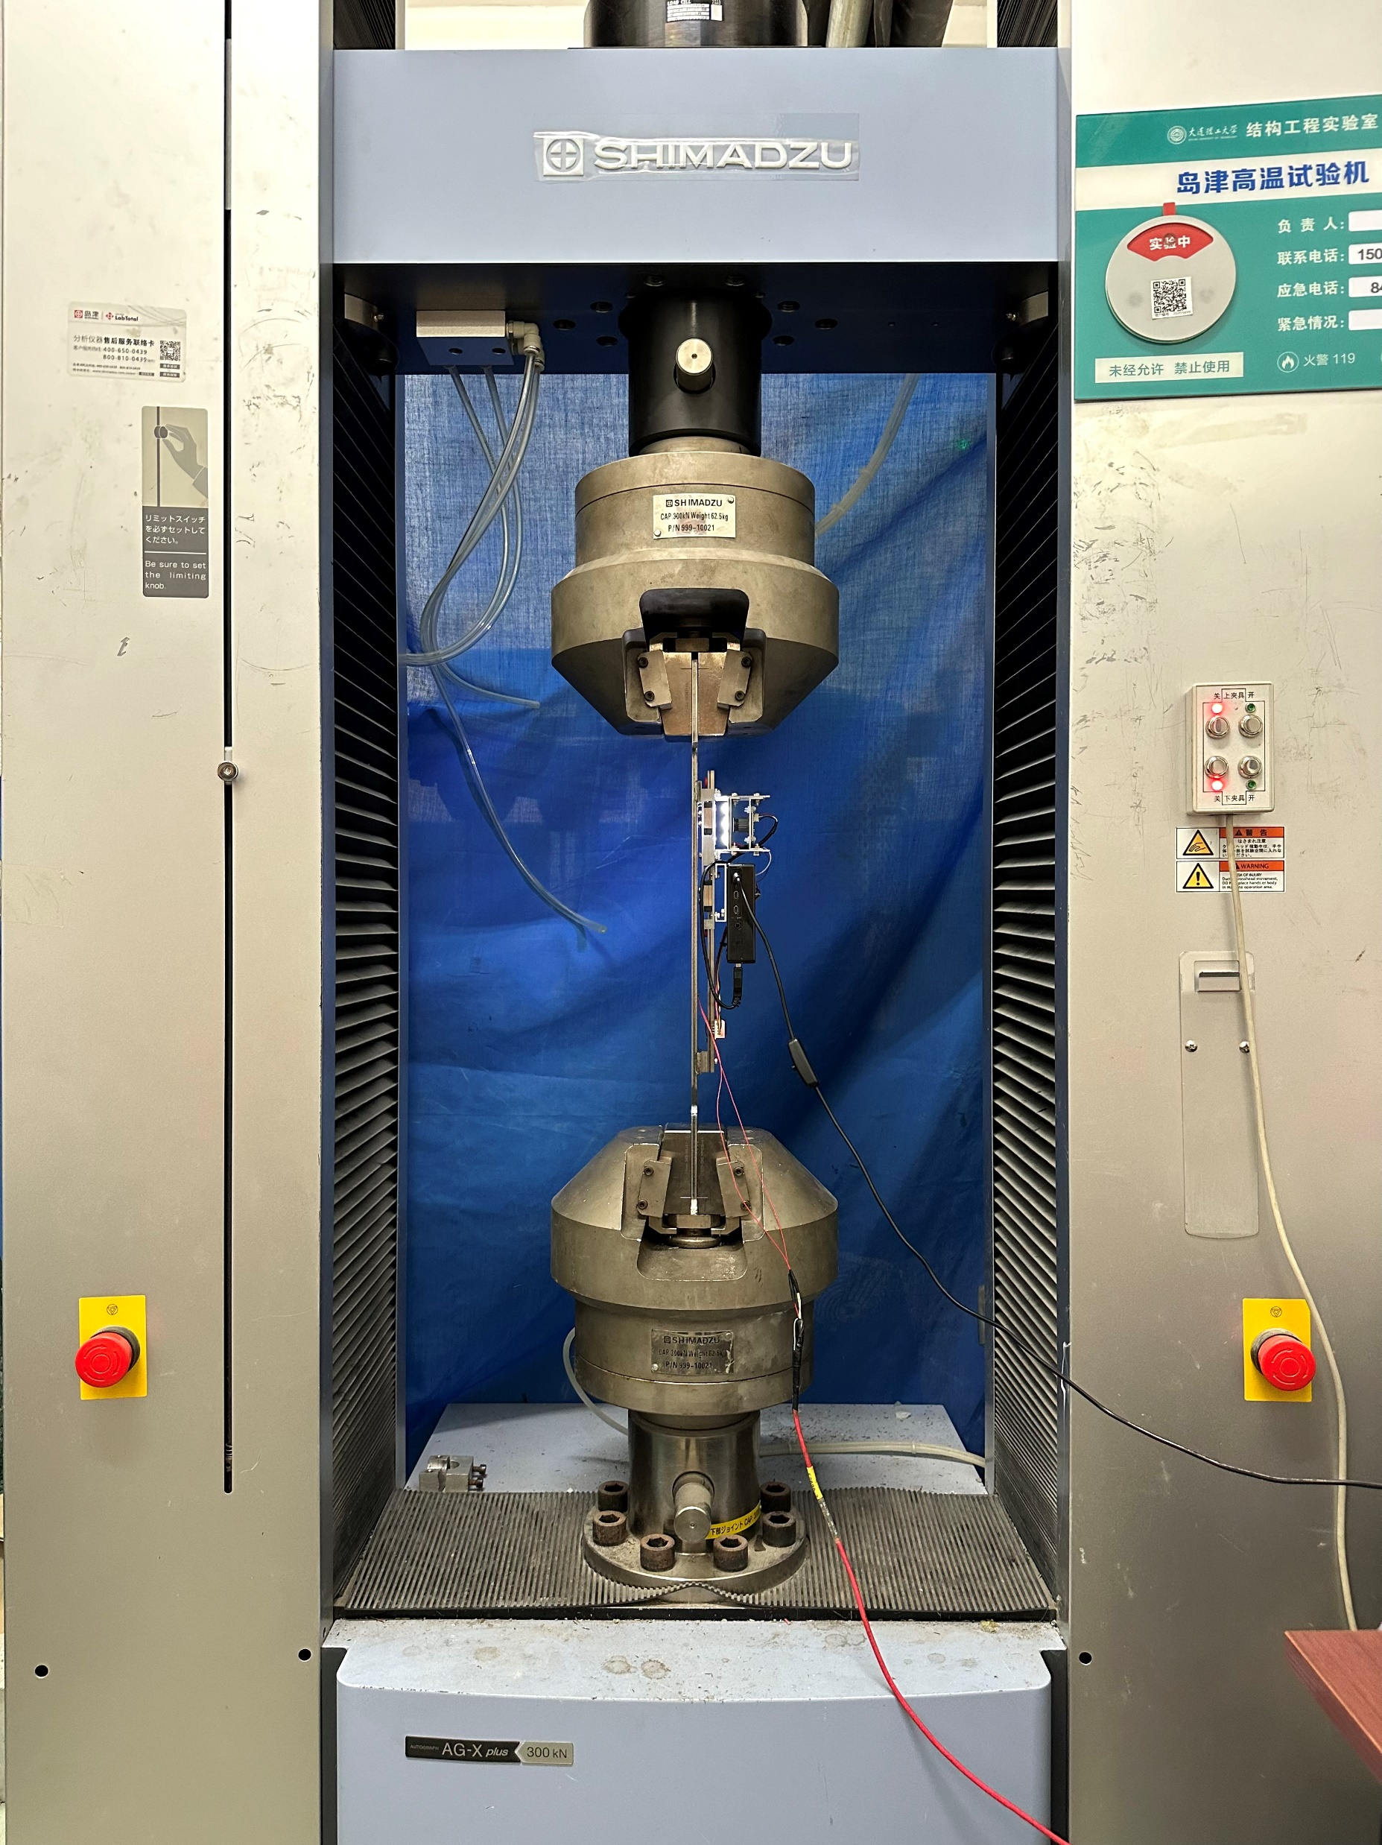
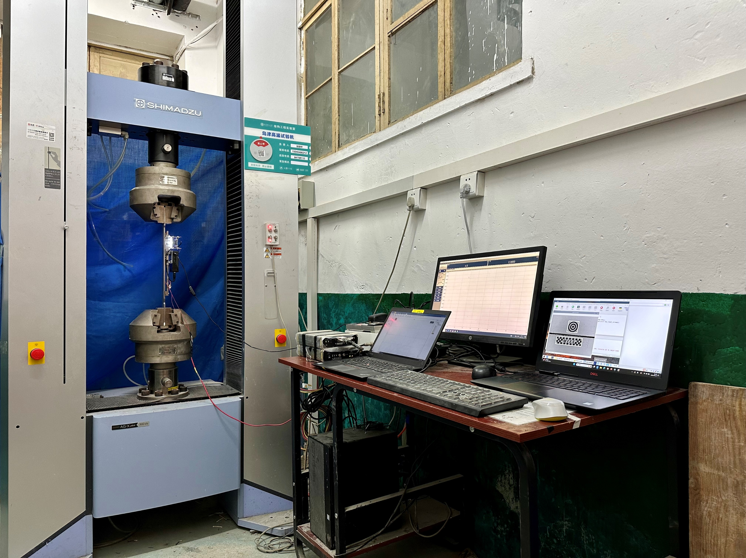
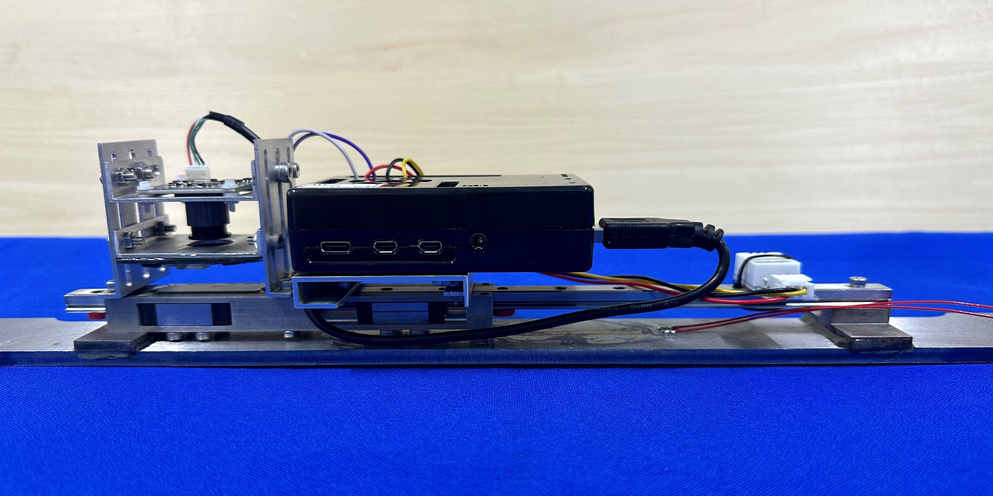
3. Laboratory Validation
Steel Specimen Tensile Test: MISS vs. RSG
(a)
320mm
(d)
(e)
100mm
50mm
AG-X SHIMADZU
Universal testing machine
75mm
RSG 00
r=12mm
(b)
Specimen 01
Desktop computer
for AG-X
Laptop for DH3820
(c)
MISS 04
DH3820 strain data acquisition instrument
Laptop for remote MISS -PRO
Epoxy resin
Installation of MISS 04 on specimen 01
Experimental setup for steel components tensile test: (a) detailed view, (b) overview setup.
Notes:
To validate the accuracy of the MISS sensor, we conducted a tensile test on a steel specimen.
As shown in figures (a) and (b), both the MISS sensor and a resistance strain gauge were installed on the specimen. The test was carried out on a universal testing machine, and we performed three repeated trials.

Slide 9
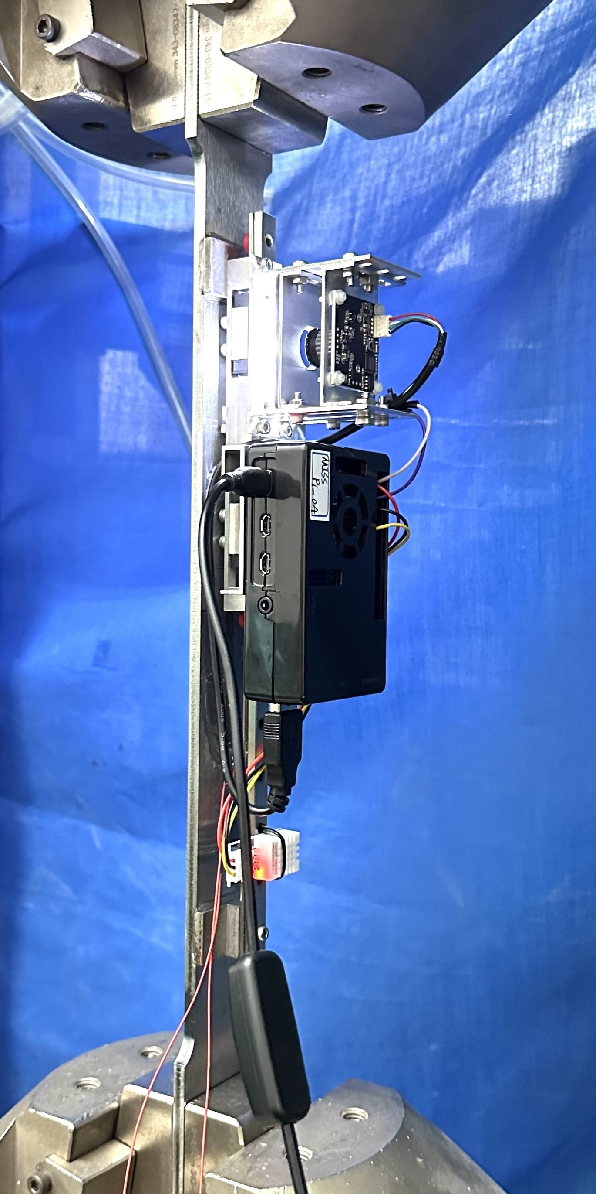
3. Laboratory Validation
Tensile Test Results：MISS vs. RSG
(a)
(b)
(d)
(f)
Epoxy resin
MISS 04
(c)
(e)
(g)
Specimen 01
MISS 04 installed on specimen 01 using epoxy resin, compared with RSG 00: (a) detailed view of experimental setup, (b) trial 1 results, (c) linear fitting curve for trial 1, (d) test 2 results, (e) linear fitting curve for trial 2, (f) trial 3 results, (g) linear fitting curve for trial 3.
Notes:
As you can see, the strain results curves from the MISS sensor match well with those from the strain gauge. The max Mean Absolute Error (MAE) occurred in Trial 2, with a value of only 7.101 microstrain, which is a very small error.

Slide 10
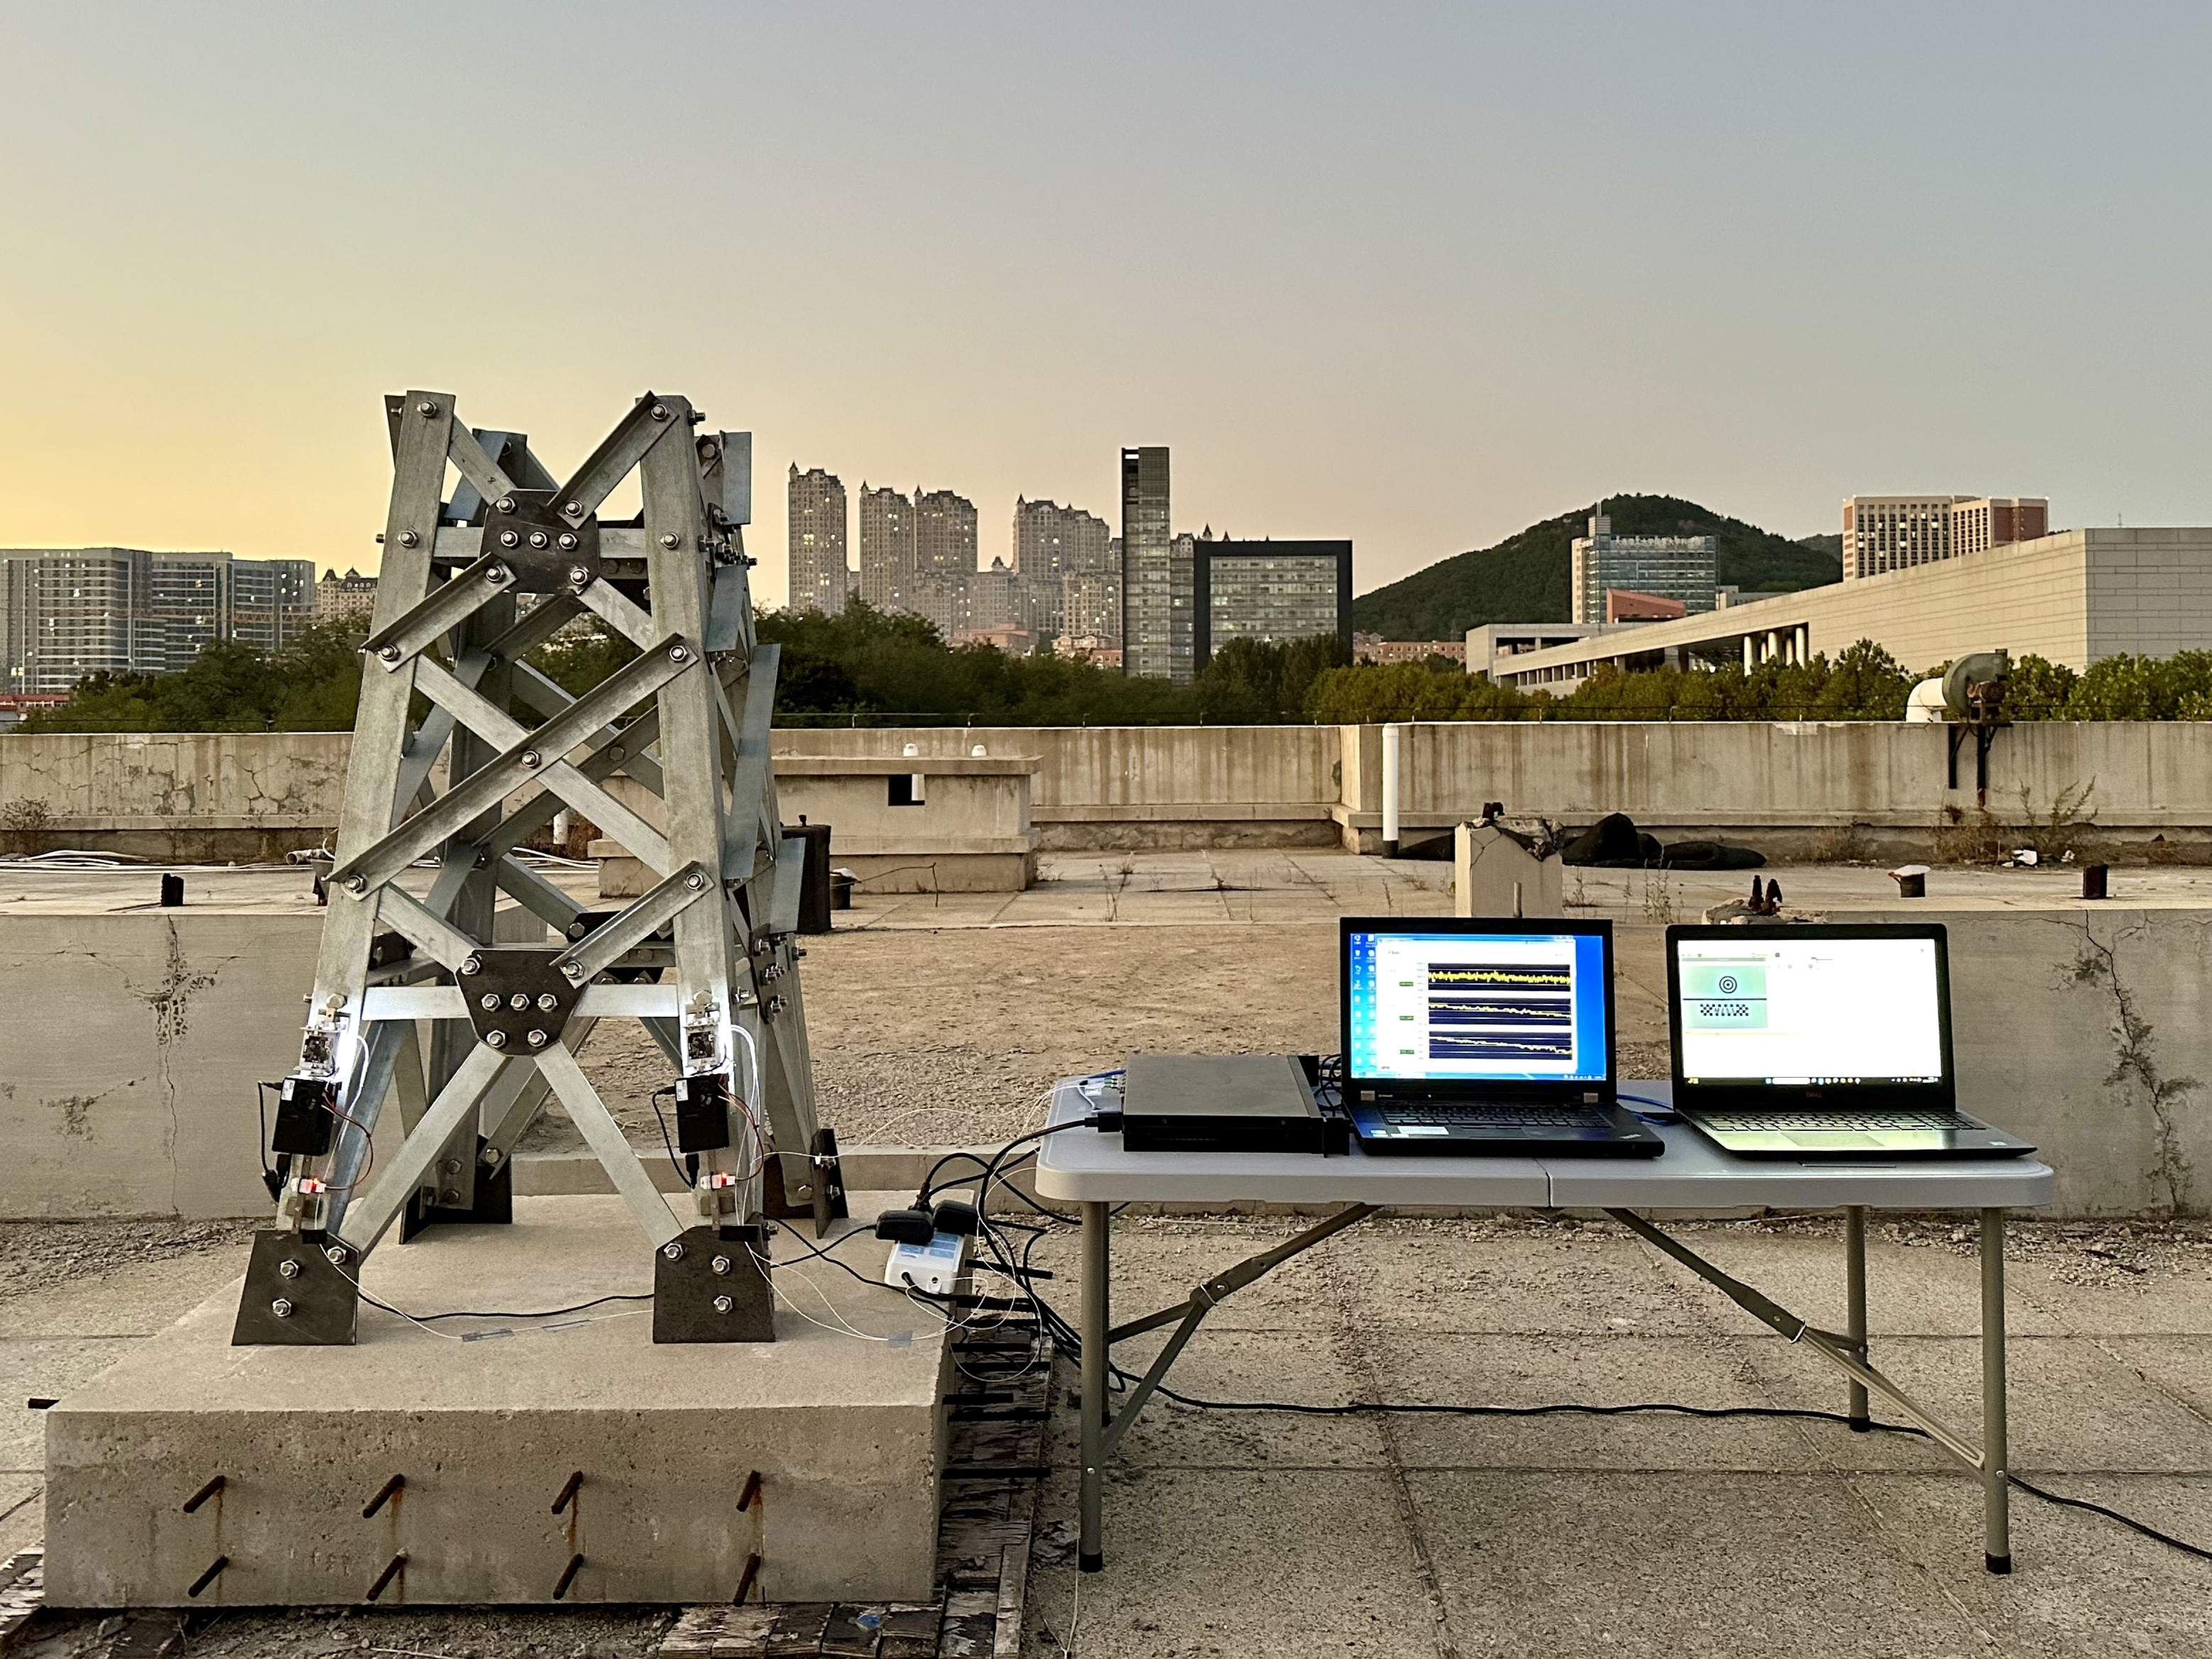
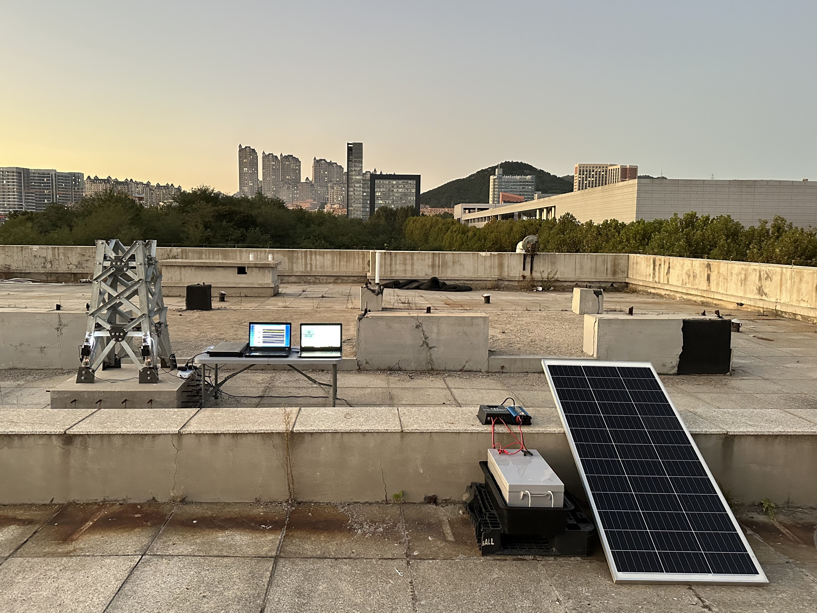
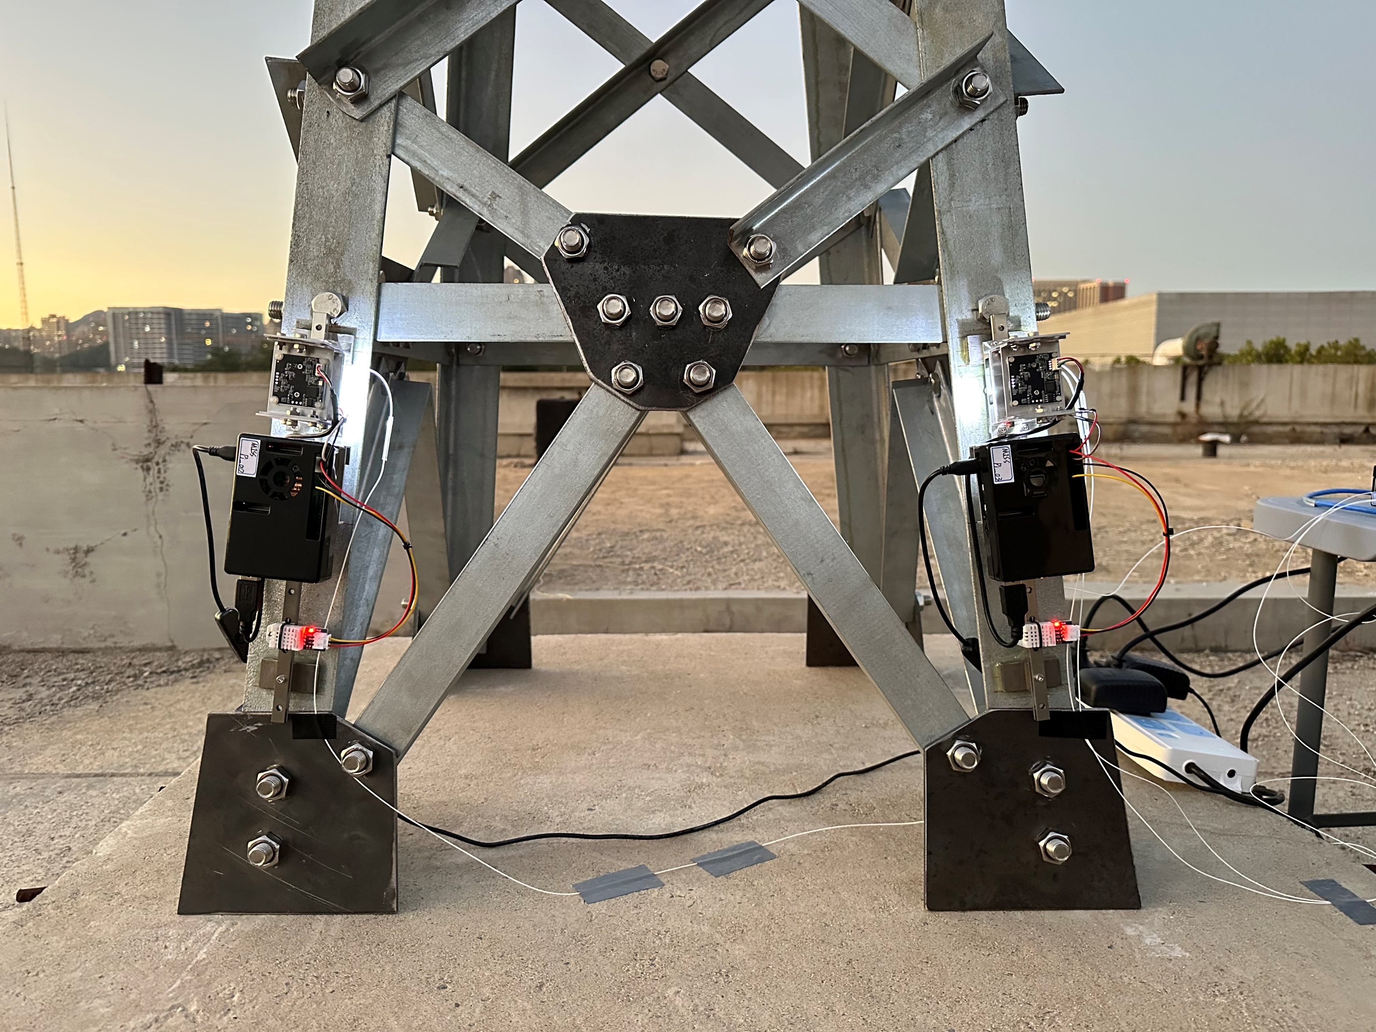
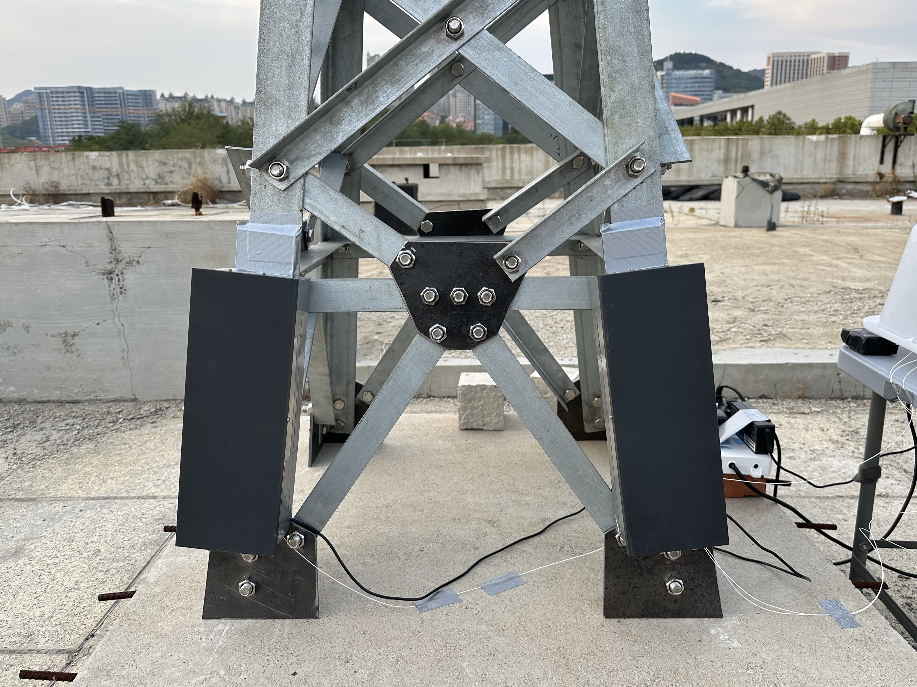
4. Outdoor Steel Truss Monitoring Experiment
Experimental Setup
(a)
(b)
Laptop for remote MISS sensor
FBG demodulator with laptop
Solar panel
(c)
Power inverter &
Solar charge controller
Solar gel battery
MISS 03
Encapsulated
Outdoor strain monitoring of the truss: (a) FBG demodulator with a laptop, (b) overview of the cloud-based strain monitoring system, (c) installation and encapsulation details of the MISS sensor
Notes:
We then carried out a 24-hour outdoor monitoring experiment on a steel truss placed on a rooftop. The entire system was powered by a solar energy supply. This time, we compared the MISS sensor with a Fiber Bragg Grating (FBG) sensor.

Slide 11
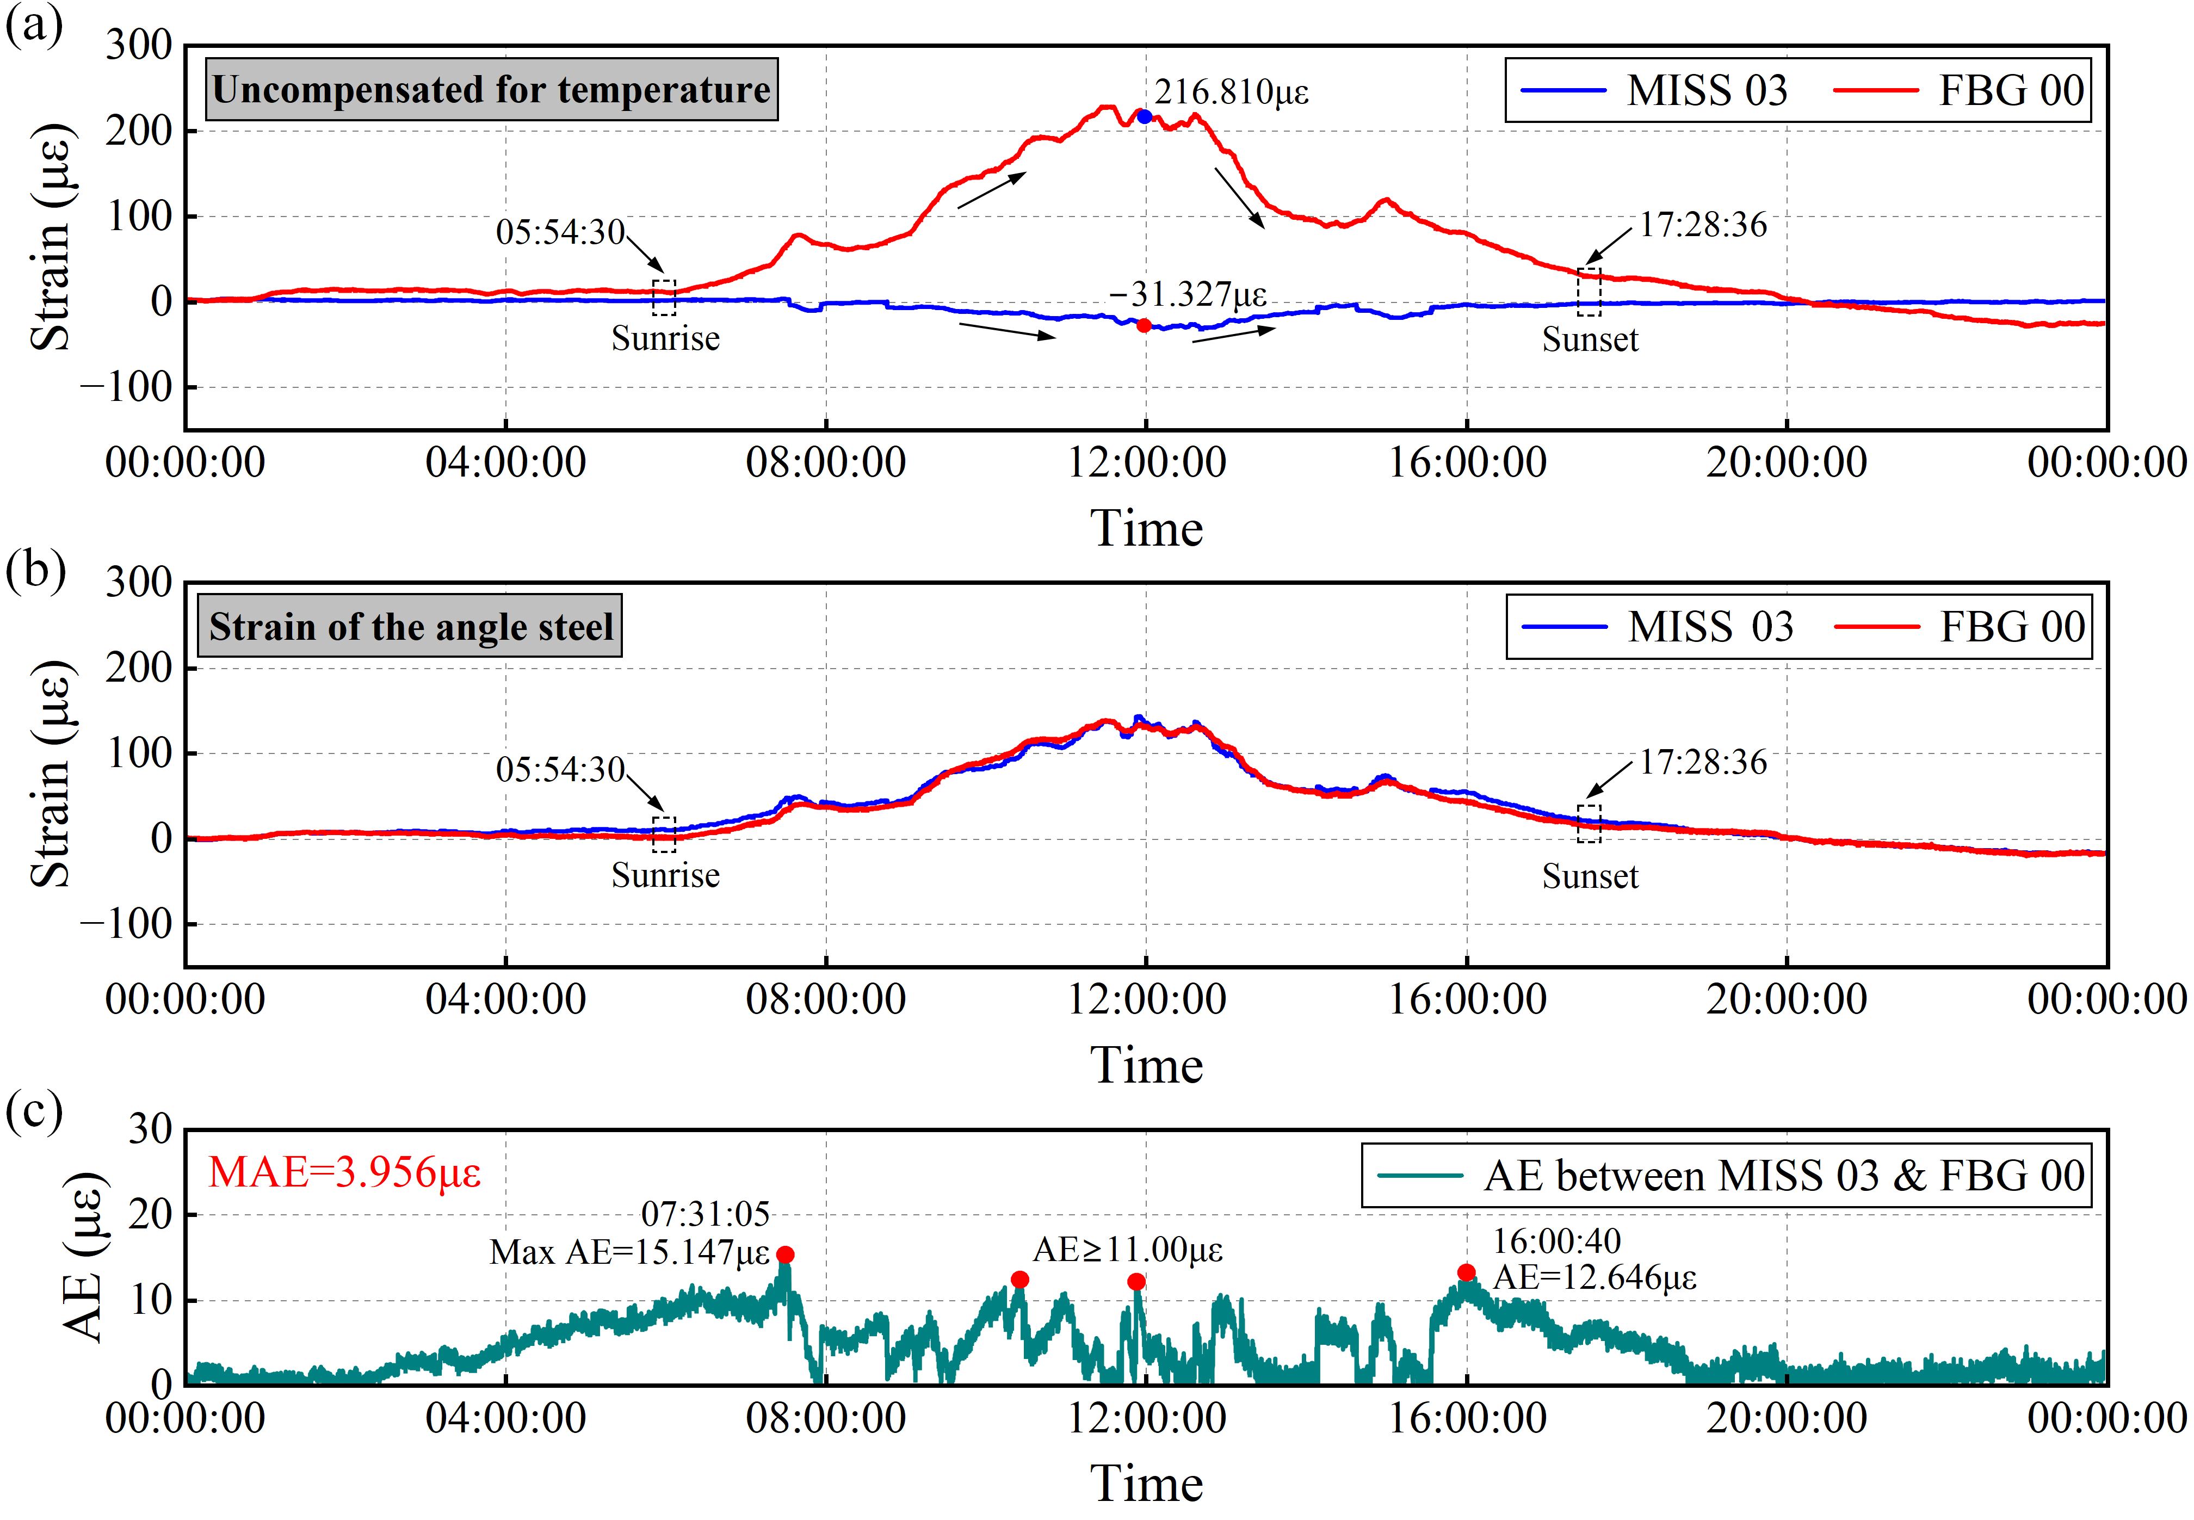
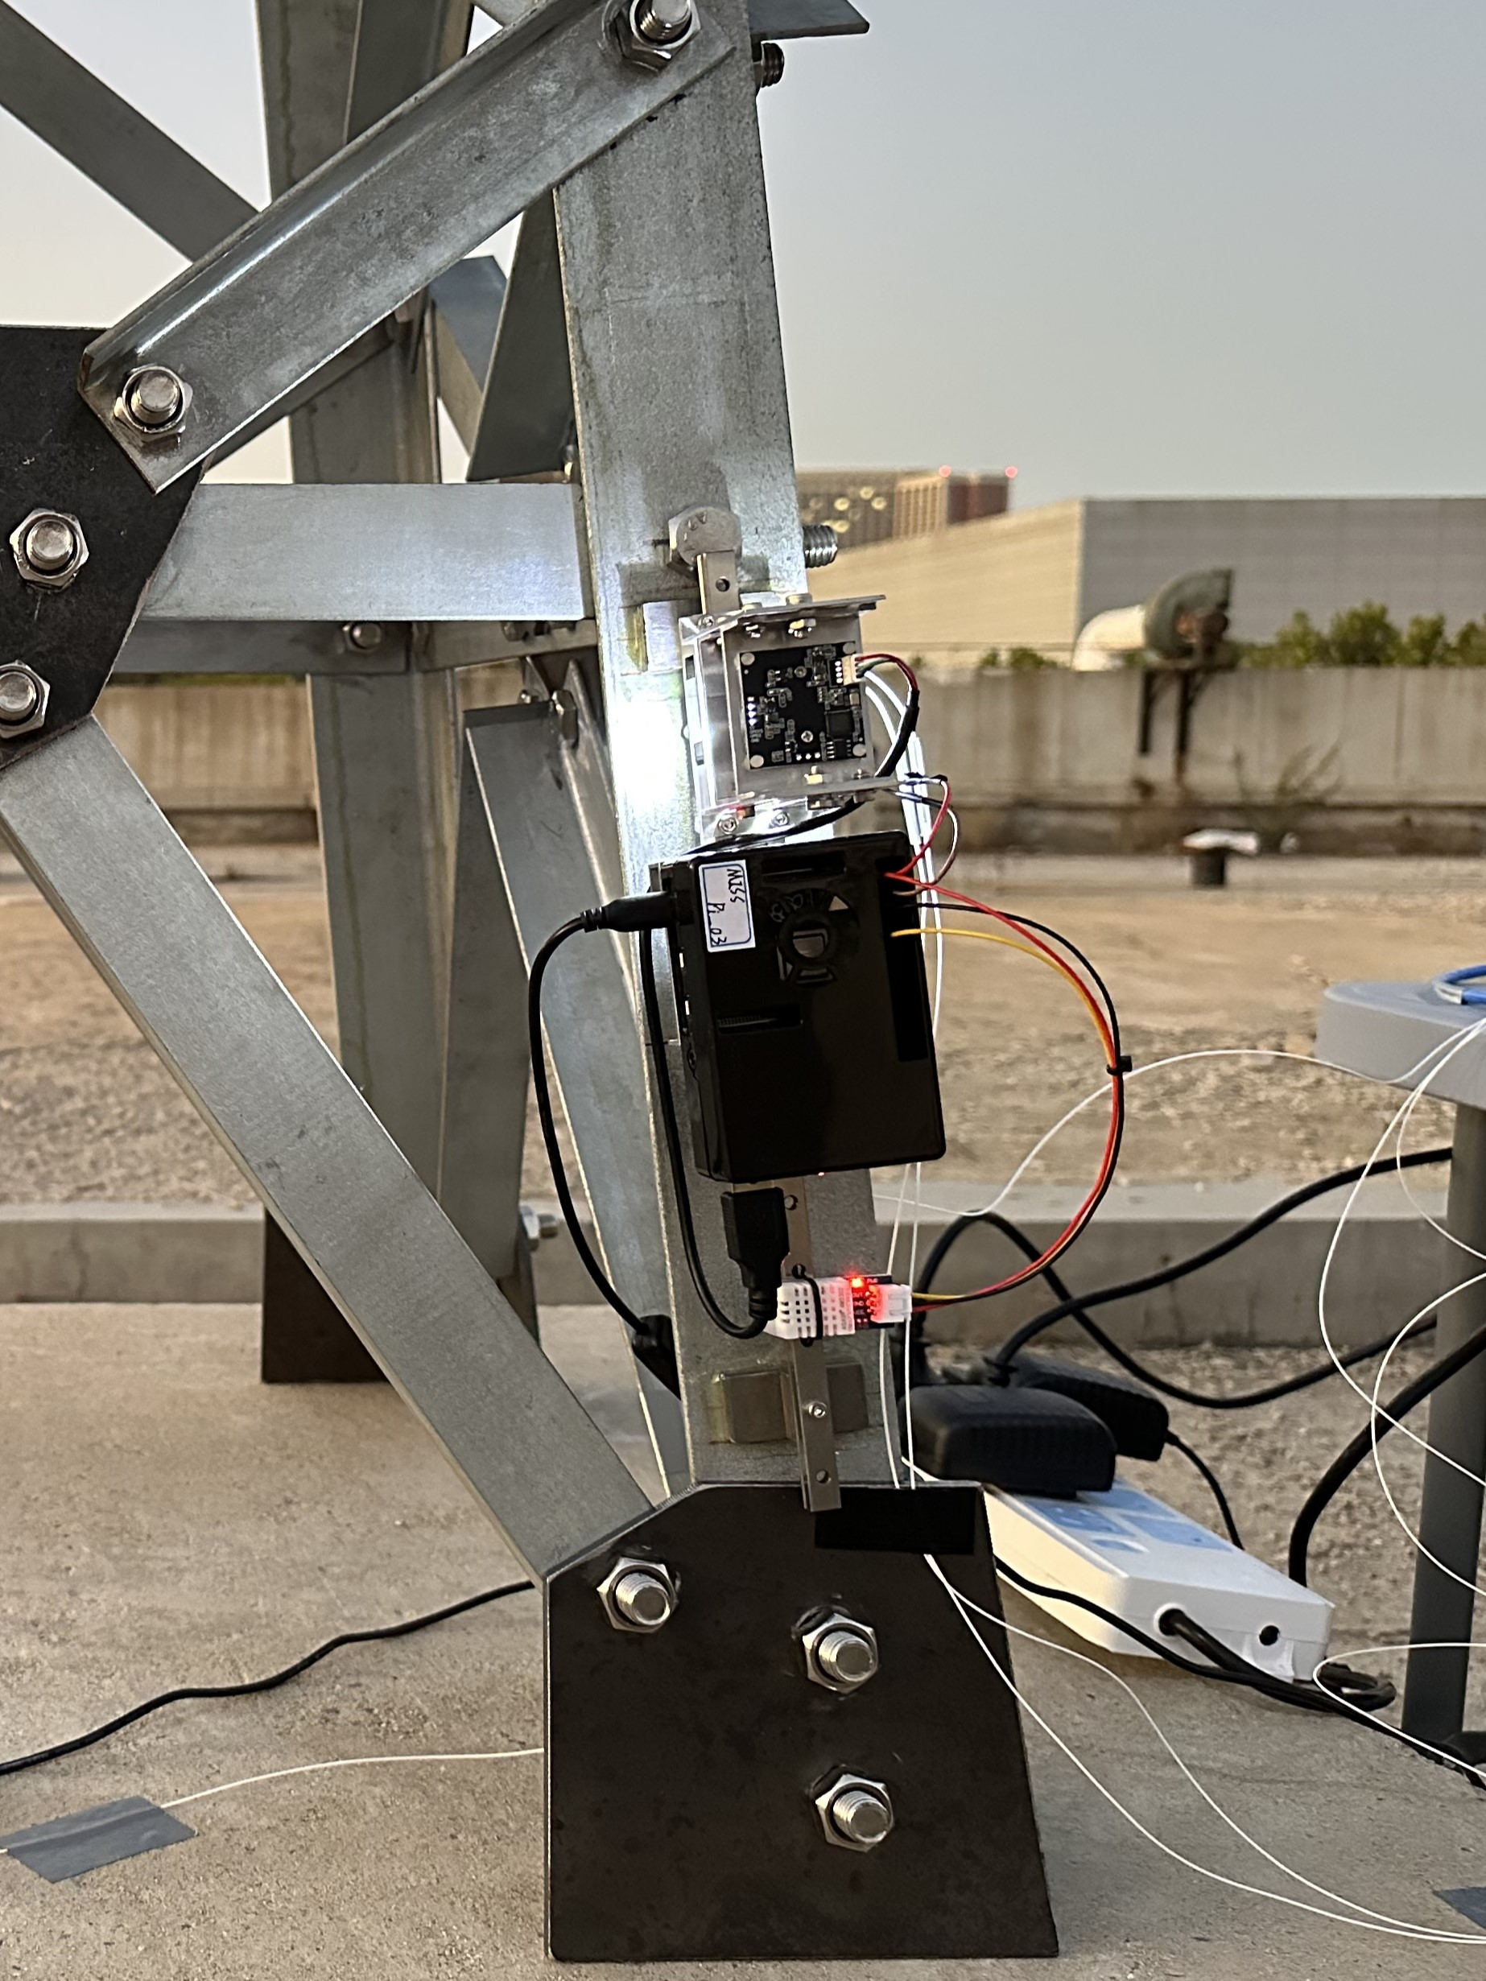
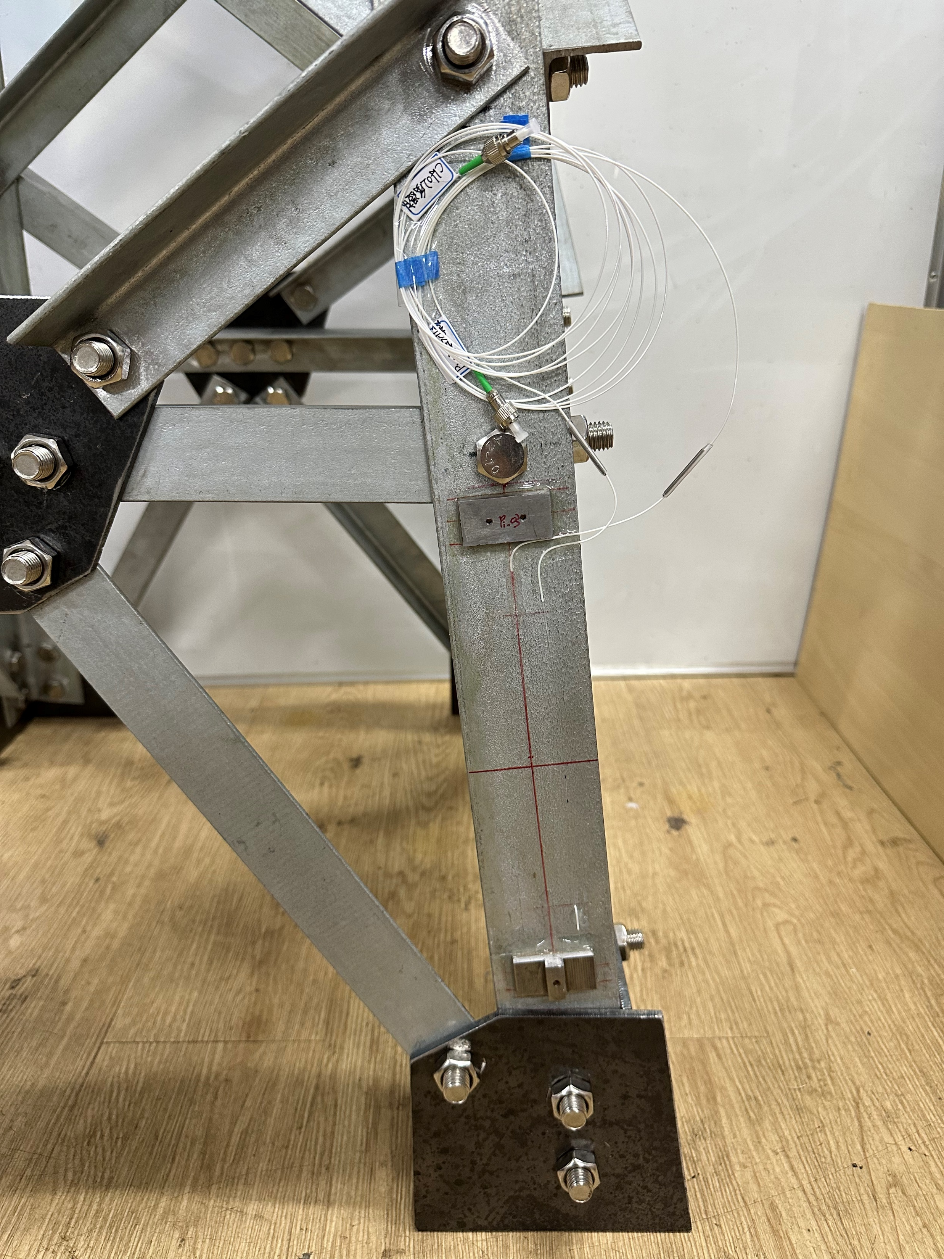
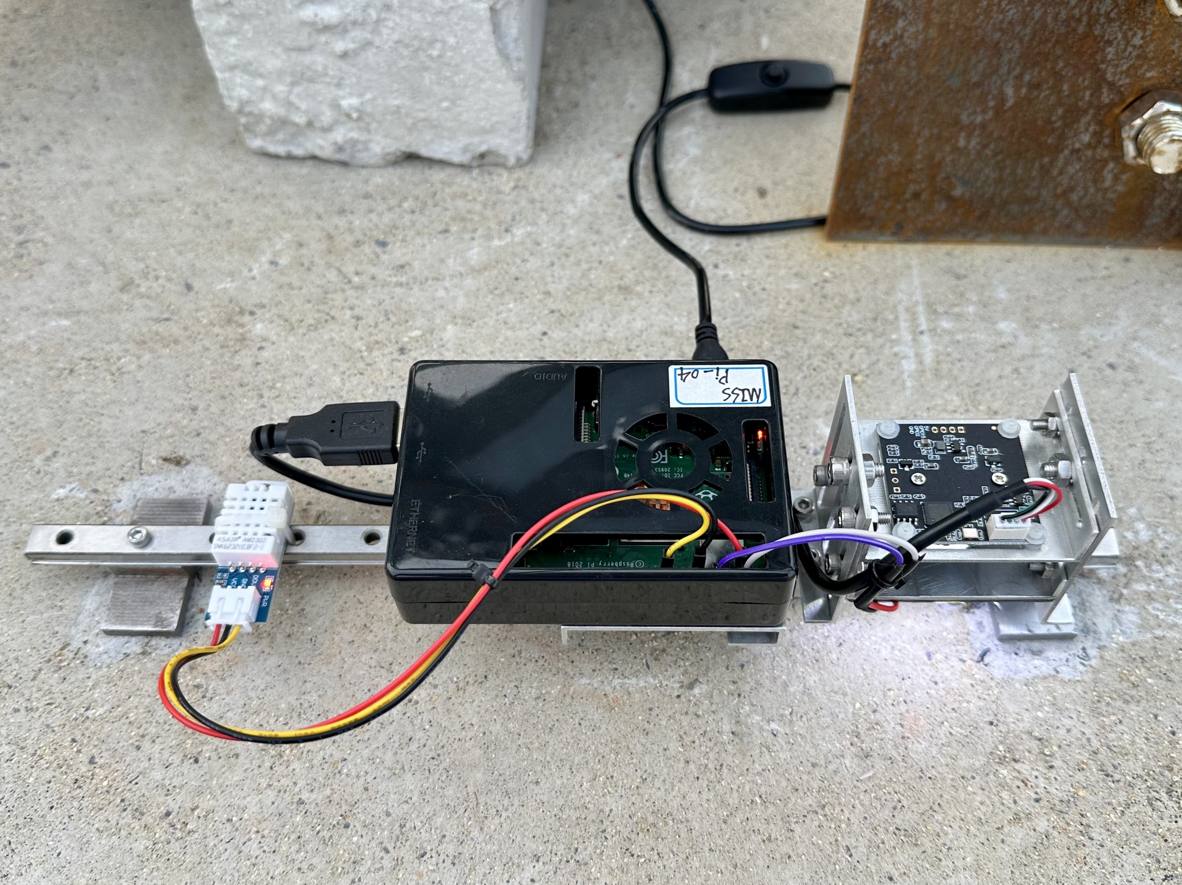
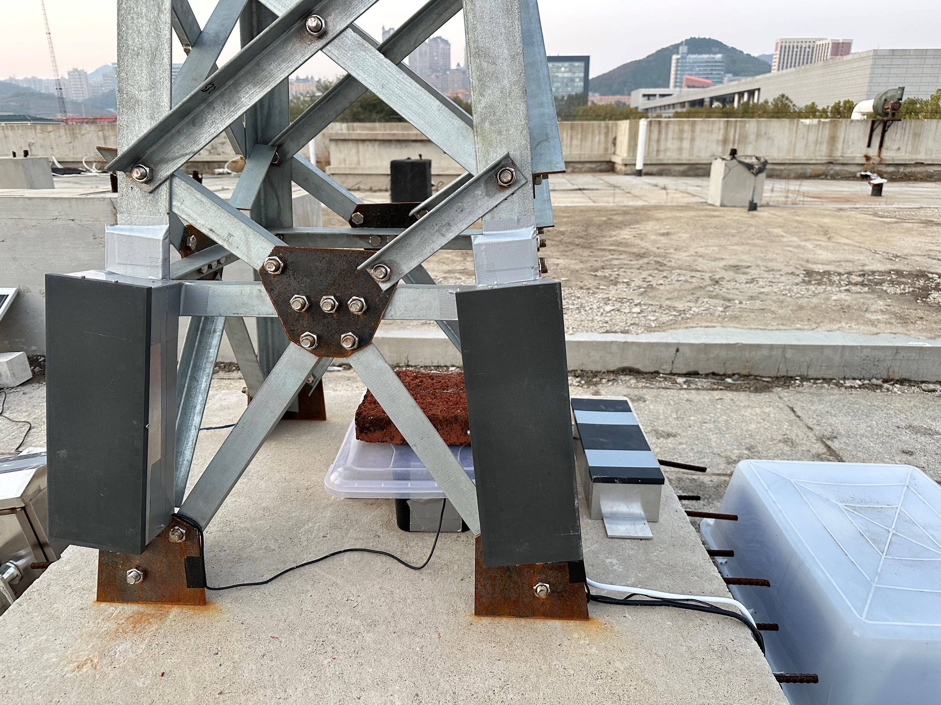
4. Outdoor Steel Truss Monitoring Experiment
Outdoor Monitoring Results: MISS vs. FBG
(a)
(b)
(d)
MISS 03
FBG 01
FBG 00
(e)
(c)
MISS 04
(f)
MISS 03
Monitoring results: (a) before temperature compensation, (b) after temperature compensation, (c) absolute error.
Notes:
In this setup, FBG 00 was used to measure strain, while FBG 01 was used to compensate for the temperature effect on FBG 00. At the same time, MISS 04 was used to compensate for MISS 03. Here are the monitoring results, which include:
(a) before temperature compensation
(b) after compensation
(c) absolute error between MISS and FBG results.
As shown, after compensation, the max mean absolute error was only 4 microstrain — demonstrating that the MISS sensor performs reliably even in outdoor environmental conditions.

Slide 12
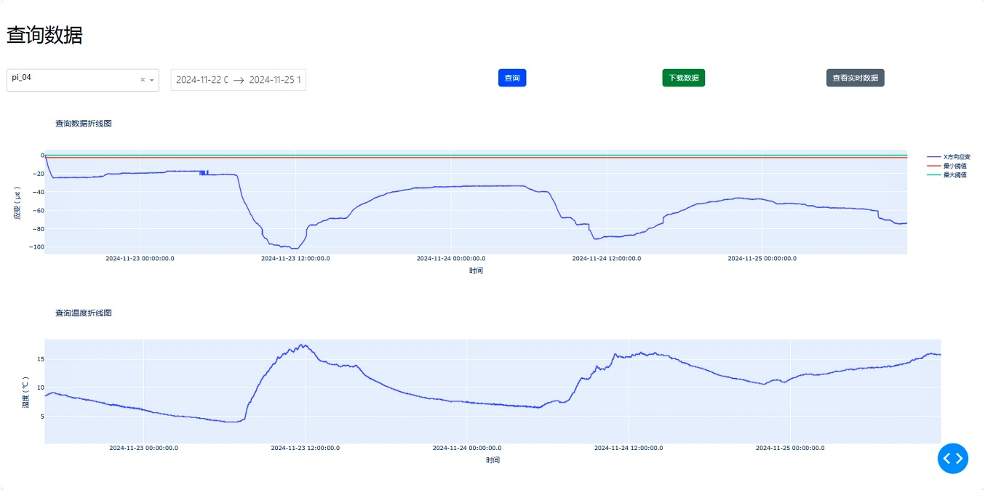
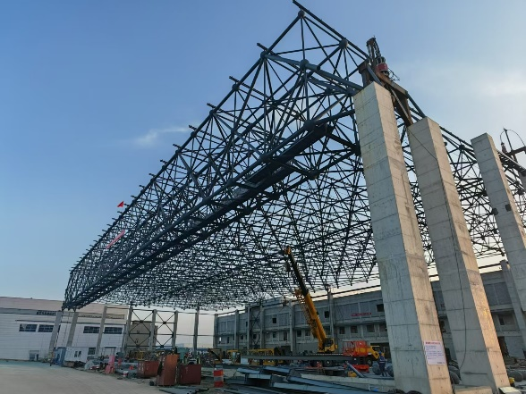
5. Cloud Platform
Web Interface and Field Validation
(a)
Access MISS Data
(c)
Sensor ID
Data and Time
Query
Data Download
Real-time Data
(b)
View Strain Line Chart
Login
Strain($με$)
Time
View Temperature Line Chart
Interface Design of the Strain Monitoring System Website
Temperature($℃$)
Time
Web interface: (a) homepage, (b) login Interface, (c) data viewing and download interface.
(d)
(e)
(f)
Application to frame structure monitoring
Field deployment for the bridge health monitoring
Notes:
To complement the MISS sensor, we developed a cloud-based platform to support remote data transmission, visualization, and management.
On the web interface, users can: (a) access the homepage, (b) log , and (c) view and download real-time strain data.
This platform ensures that users can track sensor data anytime, anywhere, with automatic uploads from the field.
The system has already been applied in real-world structures, such as: monitoring a steel frame structure, and long-term field deployment on a bridge for health monitoring.

Slide 13
6. Conclusion
A novel low-cost strain sensor (MISS, approx. USD 132) and a cloud-based platform were developed for real-time strain monitoring and early warning.
The MISS sensor integrates an industrial camera, Raspberry Pi, temperature sensor, and a slider strain sensing mechanism.
Validation through tensile and field tests demonstrated high accuracy and reliability compared to RSG and FBG sensors.
The sensor supports solar power and wireless transmission, enabling long-term remote monitoring.
Future work will enhance electromagnetic shielding and conduct long-term field deployment.
Notes:
To summarize:
1. We proposed a novel, low-cost strain sensor, MISS, with a total hardware cost of only about USD 132. Along with it, we built a cloud platform for real-time strain monitoring and early warning.
2. The MISS sensor integrates multiple components: an industrial camera, Raspberry Pi, temperature sensor, and a slider-based strain sensing mechanism.
3. Through both laboratory tensile tests and field experiments, the MISS sensor showed high accuracy and consistency, compared to Resistance strain gauge and FBG sensors.
4. It supports solar power and wireless communication, making it ideal for long-term, unattended deployment.
In the future, we plan to improve the system’s electromagnetic shielding, and conduct longer-term field monitoring to further validate its performance in harsh environments.
To conclude, this research validates a reliable, low-cost, and scalable Micro Image Strain Sensing Method for structural strain monitoring.

Slide 14
2nd OLYMPIAD in ENGINEERING SCIENCE-
OES 2025-SHM III
Thank you for your attention!
Notes:
Thank you very much for your kind attention.

Slide 15
2nd OLYMPIAD in ENGINEERING SCIENCE-
OES 2025-SHM III
Q & A
（Bo Lu: 21906047@mail.dlut.edu.cn）
Notes:
I’d also like to thank the organizers for this opportunity. Now, I’d be happy to answer any questions.

