Slide 1

Piezoelectric impedance intelligent sensing method and monitoring technology for corrosion of steel structures
12th June, 2025
Stavanger, Norway
Speaker: Weijie Li
Ph.D., Associate Professor
Email: liweijie@dlut.edu.cn
School of Infrastructure Engineering, Dalian University of Technology
Notes:
11.24 4:35-4:50 15 minutes

Slide 2
Contents
1. Background and significance of corrosion research on steel structures
2. Piezoelectric impedance intelligent sensing method
3. Corrosion monitoring of reinforced concrete structures
4. Corrosion monitoring research of pipelines
5. Conclusions and prospects
Notes:
My presentation includes: Background and significance of corrosion research on engineering structures
Piezoresistance intelligent sensing method
Corrosion monitoring of reinforced concrete structures, internal and external corrosion monitoring of metal pipelines
Conclusions and prospects

Slide 3
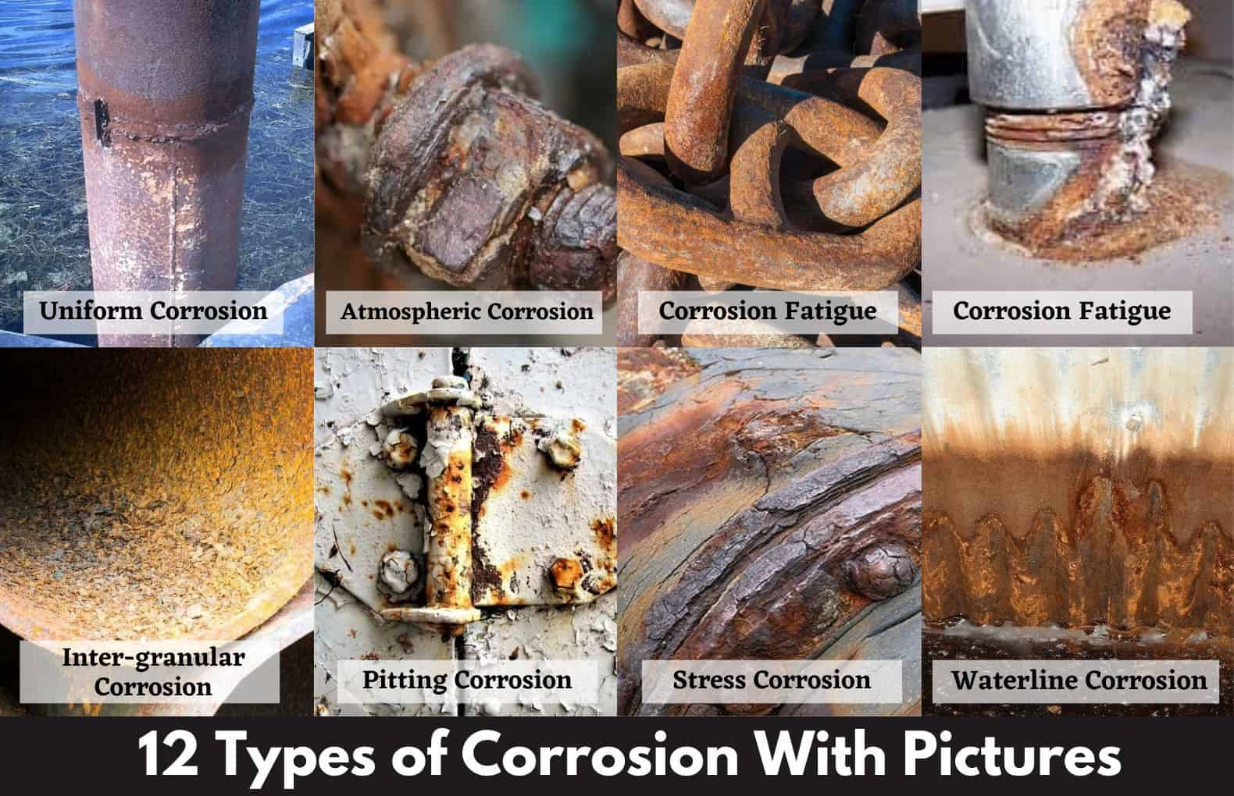
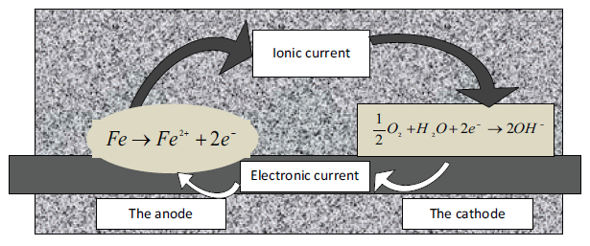
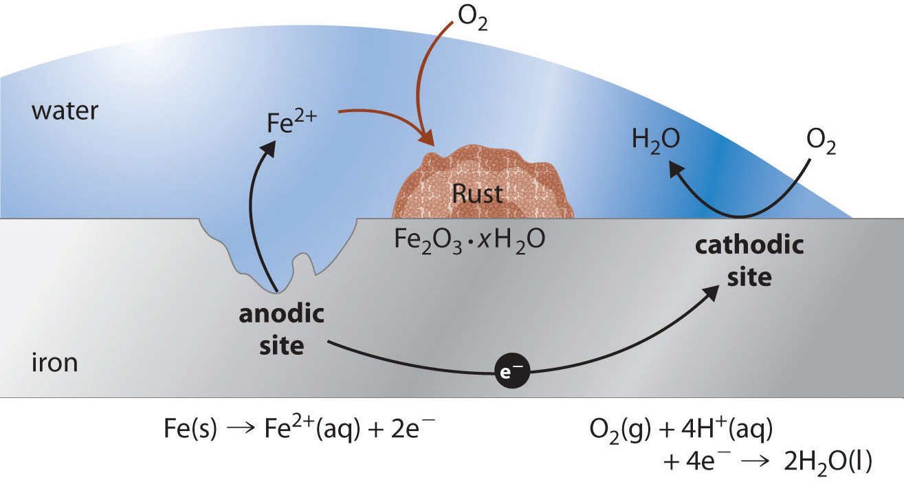
1. Background and significance
Metal/steel corrosion
Steel corrosion is a naturally occurring phenomenon
Iron ore - Melt - Steel (energy increase) - Thermodynamic instability - Return to natural state - Corrosion
Half-cell
Elements: metals, electrolytes, potential differences
Anode: oxidation reaction
Cathode: reduction reaction
Different types of corrosion
Notes:
金属/钢材腐蚀是一种自然发生的现象。 氧化物就是钢材的自然状态。 铁矿到钢材的锻炼过程提高了它的能量等级，钢材在大气环境下处于一种热力学不稳定的状态，从钢材返回到自然状态氧化物状态的过程就是腐蚀。
有不同的腐蚀类型，包括均匀腐蚀、大气腐蚀、疲劳腐蚀、点蚀、应力腐蚀等，其危害程度不一。
Steel corrodes because it is not a naturally occurring material. Rather, iron ore is smelted and refined to produce steel. The production steps that transform iron ore into steel add energy to the metal.
Steel, like most metals except gold and platinum, is thermodynamically unstable under normal atmospheric conditions and will release energy and revert back to its natural state—iron oxide, or rust. This process is called corrosion.
https://saylordotorg.github.io/text_general-chemistry-principles-patterns-and-applications-v1.0/s23-06-corrosion.html
https://www.cement.org/learn/concrete-technology/durability/corrosion-of-embedded-materials
Corrosion of reinforcing steel and other embedded metals is the leading cause of deterioration in concrete. When steel corrodes, the resulting rust occupies a greater volume than the steel. This expansion creates tensile stresses in the concrete, which can eventually cause cracking, delamination, and spalling.
Steel corrodes because it is not a naturally occurring material. Rather, iron ore is smelted and refined to produce steel. The production steps that transform iron ore into steel add energy to the metal.
Steel, like most metals except gold and platinum, is thermodynamically unstable under normal atmospheric conditions and will release energy and revert back to its natural state—iron oxide, or rust. This process is called corrosion.
For corrosion to occur, these elements must be present:
There must be at least two metals (or two locations on a single metal) at different energy levels
an electrolyte
a metallic connection
In reinforced concrete, the rebar may have many separate areas at different energy levels. Concrete acts as the electrolyte, and the metallic connection is provided by wire ties, chair supports, or the rebar itself.
Corrosion is an electrochemical process involving the flow of charges (electrons and ions). At active sites on the bar, called anodes, iron atoms lose electrons and move into the surrounding concrete as ferrous ions. This process is called a half-cell oxidation reaction, or the anodic reaction, and is represented as:
2Fe → 2Fe2+ + 4e-
The electrons remain in the bar and flow to sites called cathodes, where they combine with water and oxygen in the concrete. The reaction at the cathode is called a reduction reaction. A common reduction reaction is:
2H2O + O2 + 4e- → 4OH-
To maintain electrical neutrality, the ferrous ions migrate through the concrete pore water to these cathodic sites where they combine to form iron hydroxides, or rust:
2Fe2+ + 4OH- → 2Fe(OH)
This initial precipitated hydroxide tends to react further with oxygen to form higher oxides. The increases in volume as the reaction products react further with dissolved oxygen leads to internal stress within the concrete that may be sufficient to cause cracking and spalling of the concrete cover.
Corrosion is responsible for up to 90% of damage to reinforced concrete structures.
https://yjy.ccement.com/detail/1101907.html
当金属与电解质溶液接触时，由于金属与杂质的电位不同，在金属表面形成许多微小的原电池。 金属在腐蚀是金属作为阳极的自溶解过程，它必然要有共轭的阴极相配合，无论金属如何活泼，如果没有共轭的阴极存在，金属的腐蚀也不会发生。
(2) 日常遇到的大量的腐蚀现象往往是有氧存在，pH 值接近中性的条件下发生的腐蚀。 这是铁腐蚀的共轭阴极，是氧化还原反应。 反应式如下：
阳极反应：2FeO→ Fe2＋＋4e
阴极反应：O2＋2H2O＋4eo Fe2＋→ 4OH－
https://civiconcepts.com/blog/types-of-corrosion
https://www.theengineerspost.com/types-of-corrosion/

Slide 4

1. Background and significance
Global corrosion loss statistics
Domestic corrosion losses in 2014 were 2.13 trillion yuan (3.34% of GDP)[3]
The UK loses an average of £80 billion (about 3% of GDP) to corrosion every year[4]
The U.S. lost $0.5 trillion (3.1% of GDP) in corrosion in 2013 [2]
Australia's average annual corrosion loss is 2-3% of GDP)[5]
The global cost of corrosion in 2013 was US$2.5 trillion, equivalent to 3.4% of global GDP [1]
Studies have also shown that at least 30% of corrosion losses can be controlled with protection and monitoring techniques
[1] International measures of prevention, application, and economics of corrosion technologies study. NACE international, 2016, 216: 2-3 [2] Corrosion Costs and Preventive Strategies In the United States [3] 腐蚀成本及控制策略研究[J]. 海洋科学, 2021, 45(2): 161-168 [4] Materials study targets industry corrosion and wear [5] https://www.steel.org.au/what-we-do/focus-areas/steel-and-design/corrosion-protection/
Notes:
In 2013, the global cost of corrosion was $2.5 trillion, equivalent to 3.4% of global GDP.
In 2014, domestic corrosion caused economic losses of 2.13 trillion RMB, equivalent to 3.34% of the country's GDP that year
If effective corrosion protection measures and detection and monitoring technologies are adopted, 15-35% of losses can be avoided
According to statistics, the annual economic loss caused by corrosion in the world accounts for about 3~5% of the gross national product, and the annual economic loss caused by corrosion in China accounts for about 3.4~5% of China's GDP, and the corrosion problem has become one of the important factors affecting the sustainable development of the national economy and society.
Studies have shown that at least 30% of corrosion can be controlled through science, research, and technical applications.
"Scientific and Technological Innovation to Accelerate the Development of Corrosion Protection Industry"
The United Nations World Corrosion Organization announced: the global annual economic cost of material corrosion accounts for about 3%~5% of the gross national product (GDP). In China, the annual loss caused by corrosion accounts for 3.34%~5.00% of GDP, about 3 trillion yuan/year ~ 5 trillion yuan/year, but at least 30% of the corrosion loss can be controlled by protection technology
Read more
With more than 2 trillion yuan a year, the cost of corrosion in China is staggering
https://www.mengneng.cn/paintnewsinfo_348_5106.html
The global cost of corrosion is about $4 trillion How to meet the challenge of marine corrosion?
https://baijiahao.baidu.com/s?id=1655691792411476697&wfr=spider&for=pc
"Corrosion" quietly eroded away 5 trillion yuan? Science Masters Unravel the Mystery Behind Corrosion......
https://baijiahao.baidu.com/s?id=1697160109343337918&wfr=spider&for=pc
Science Station | Corrosion is ubiquitous, causing economic losses of 3% of global GDP every year
https://baijiahao.baidu.com/s?id=1698178142131210792&wfr=spider&for=pc

Slide 5


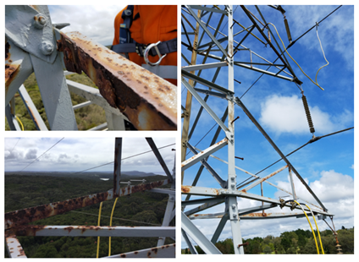

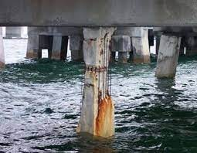
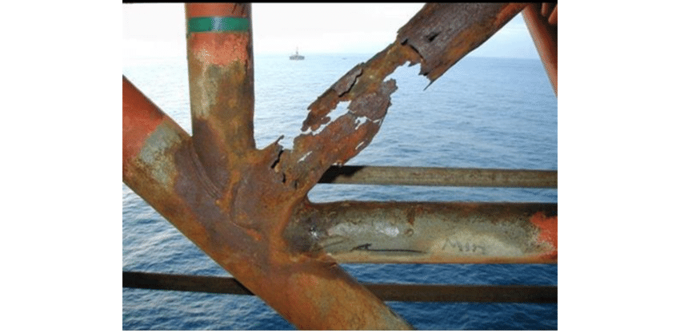
1. Background and significance
Hazards of Corrosion
Oil and gas pipeline leakage and explosion
Corrosion and leakage of water supply pipes
The transmission tower line collapsed
Failure of reinforced concrete structures
Suspension bridge collapsed
Offshore platform failure
Notes:
Severe corrosion will not only lead to structural damage and shortening of the life of engineering structures and facilities and equipment, but also cause catastrophic accidents, environmental pollution, and cause major property losses and casualties
Corrosion accident: Shiyan gas pipeline corrosion explosion in 2021
Direct cause: The gas steel pipe is seriously corroded and ruptured, leaks, and detonates when it encounters an ignition source
Losses: 26 people died, 138 people were injured, and the economic loss was 53.9541 million yuan
Corrosion accident: In 2013, Qingdao oil pipeline corroded and deflagrated
Direct causes: Pipeline corrosion, thinning, rupture, crude oil leakage, sparks and explosions
Losses: 62 people died, 136 were injured, and the direct economic loss exceeded 700 million yuan
In 2013, the "11.22" oil pipeline leakage incident occurred in Qingdao, Shandong Province, resulting in a serious explosion, and after the accident analysis and identification, it was found that the oil pipeline was caused by the reduction of pipeline wall thickness due to corrosion, and the pipeline ruptured, and the spark contact generated by the spark of the on-site personnel after the crude oil leak occurred, which brought great loss of life and property, and caused a serious impact.
The collapse of the Yilan Bridge in Taiwan on October 1, 2019
Six were killed and 12 were injured

Slide 6
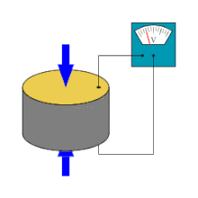
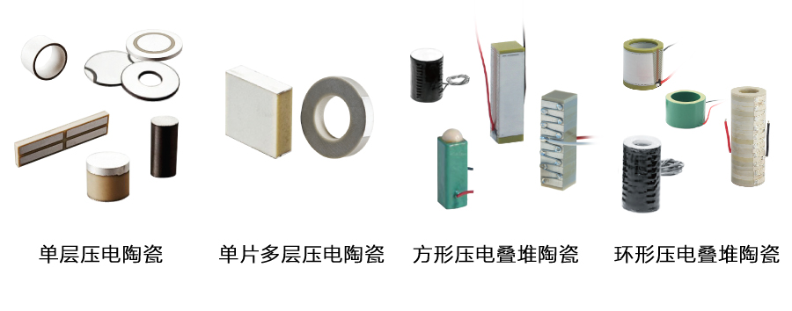
2. Piezoelectric impedance intelligent sensing
Piezoelectric smart materials
Direcy piezoelectric effect: When a force or deformation is applied to a piezoelectric material, an electric potential or voltage is generated on the surface
Inverse piezoelectric effect: Mechanical deformation occurs when a voltage is applied to the surface of a piezoelectric material
Piezoelectric effect
Advantages: good linear relationship, fast response, high frequency, high sensitivity, large bandwidth
It is widely used in structural health monitoring and damage diagnosis

Slide 7
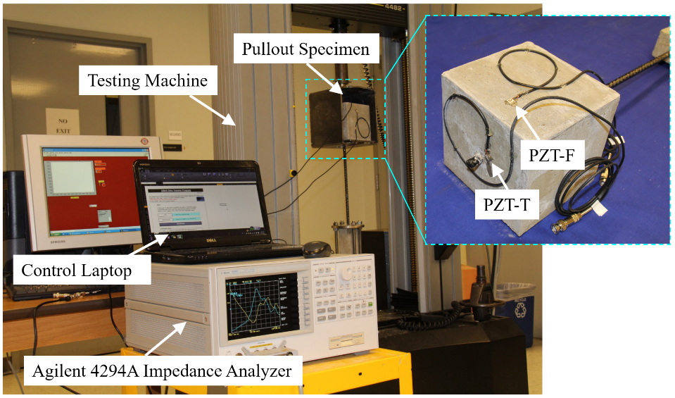
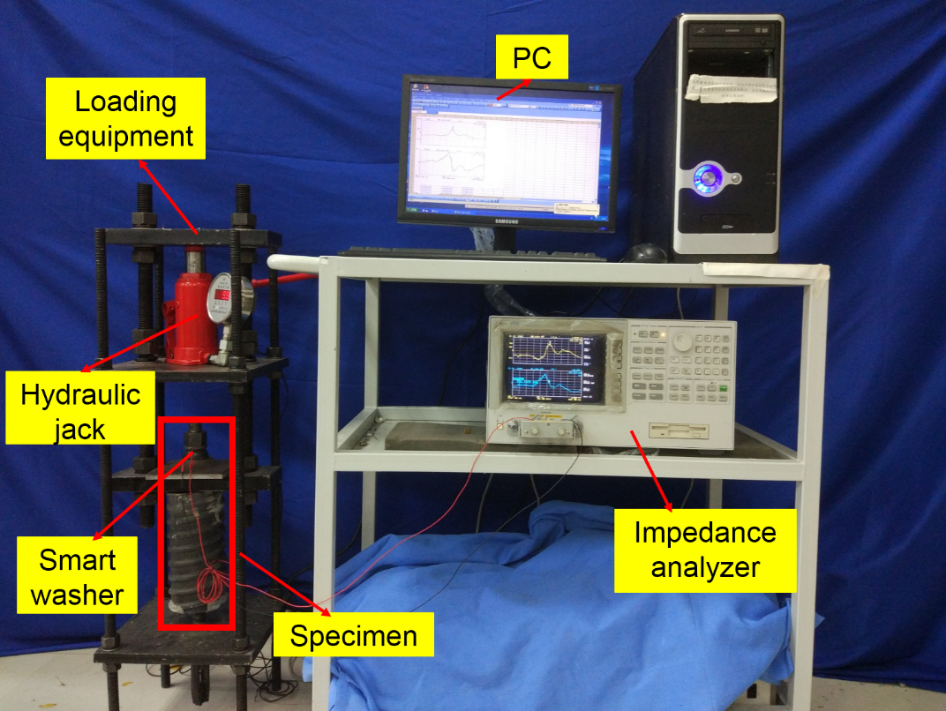
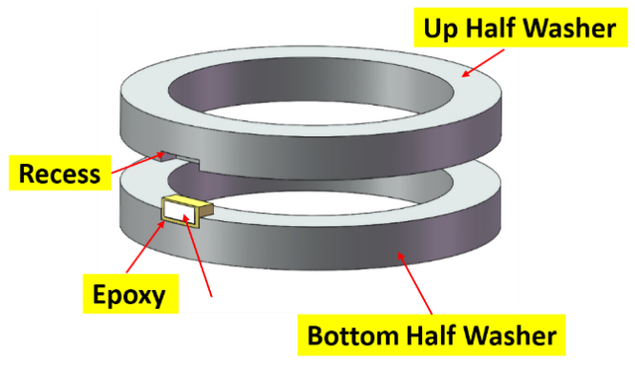
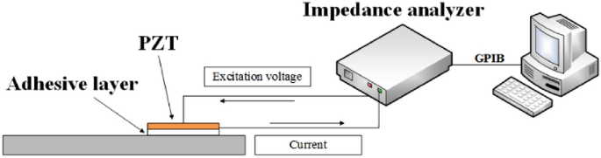

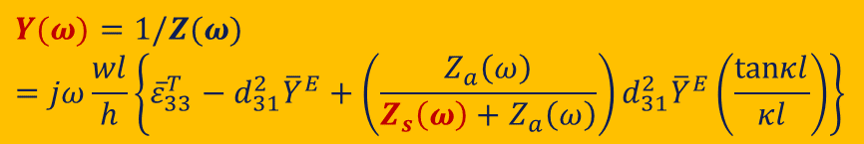
2. Piezoelectric impedance intelligent sensing
Principles of Piezoelectrical Impedance Structural Health Monitoring
Monitoring of debonding of FRP-reinforced concrete
Bolt preload monitoring
Impedance spectra
RMSD
$$Y(ω)=1/Z(ω)=jω\frac{wl}{h}\left\{{\overline{ε}}_{33}^{T}−d_{31}^{2}{\overline{Y}}^{E}+\left(\frac{Z_{a}\left(ω\right)}{Z_{s}\left(ω\right)+Z_{a}\left(ω\right)}\right)d_{31}^{2}{\overline{Y}}^{E}\left(\frac{tanκl}{κl}\right)\right\}$$
$Y\left(ω\right) ：$Admitance
$Z_{s}\left(ω\right)$：Mechanical impedance of host structure
$Z_{a}\left(ω\right)$：Mechanical impedance of PZT
It is sensitive to local micro-damage of the structure, and has the advantages of fast response and real-time online monitoring
Notes:
Piezoelectrical impedance (EMI) is a monitoring method for impedance analysis based on the electromechanical coupling characteristics of piezoelectric materials.
By pasting a piezoelectric sheet on the surface or inside of the structure, the mechanical impedance of the structure is coupled with the electrical impedance of the piezoelectric sheet, and the piezoelectric impedance is expressed in the form of piezoelectric impedance. When the structure is damaged, the mechanical impedance changes, which is reflected in the electrical impedance of the piezoelectric sheet, and the structural health monitoring can be realized by measuring the electrical impedance of the piezoelectric sheet in real time and comparing it with the initial state of health.
The piezoelectrical impedance method uses the piezoelectric coupling effect of the piezoelectric material and the structure to be measured, and the piezoelectric paste on the structure
When the piece is excited by AC voltage, the piezoelectric sheet vibrates due to the piezoelectric effect, and at the same time drives the structure itself
Mechanical vibration. Due to mechanical coupling, this mechanical vibration in turn changes the piezoelectric impedance response of the piezoelectric sheet.
Center for Intelligent Materials Systems and Structures at Virginia Institute of Technology and State University, USA, early 90s
Liang et al. [25] pioneered the study of piezoelectrical impedance technology for structural health monitoring. And with a single degree of freedom spring-
The mass-damping system was taken as the research object, and the piezoelectric impedance formula of the piezoelectric sheet and the structural coupling system was successfully derived.
The verification of the theoretical formula was completed by the cantilever beam experiment.
In recent years, he has studied abroad
Based on piezoelectrical impedance technology, a large number of application studies have been carried out in the field of structural health monitoring, and it has been successfully applied
Various complex structures in civil engineering, such as concrete structures [27-31], steel structures [32-34], prestressed structures [35-36],
composite structures [37-38], etc. The piezoelectrical impedance method has the advantages of fast response, accurate measurement, and real-time online monitoring.
It enables large-scale structural damage monitoring at low cost.

Slide 8
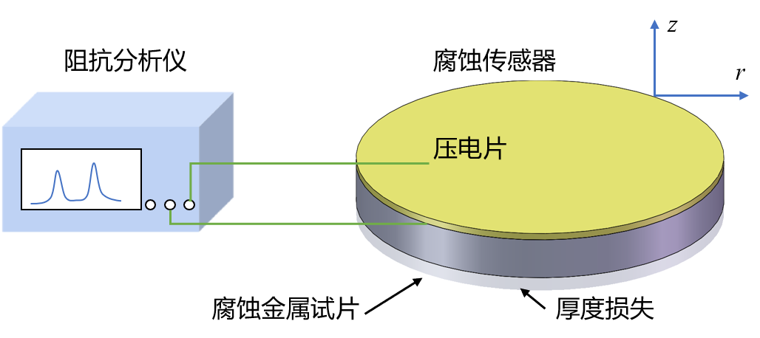
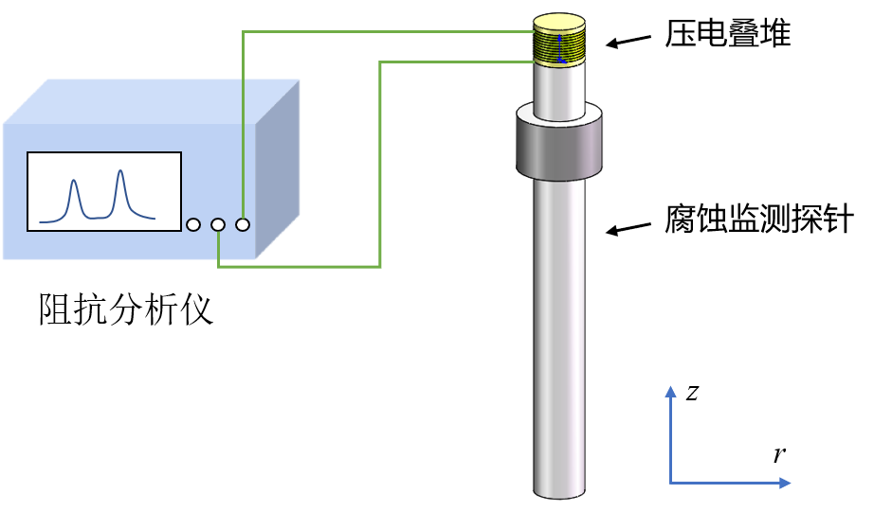
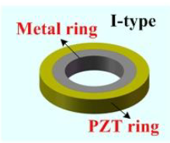
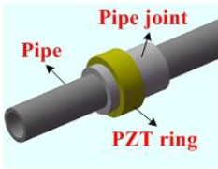
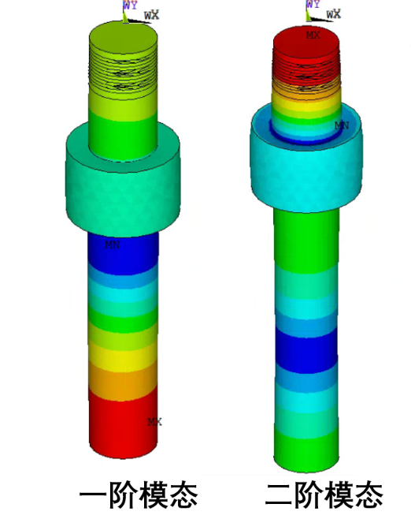
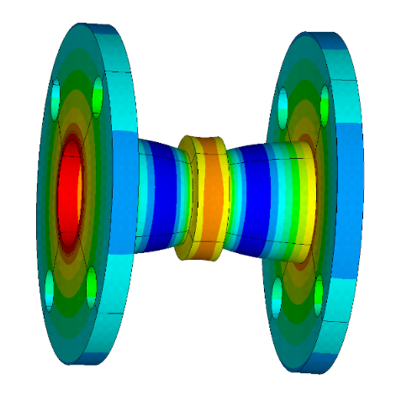
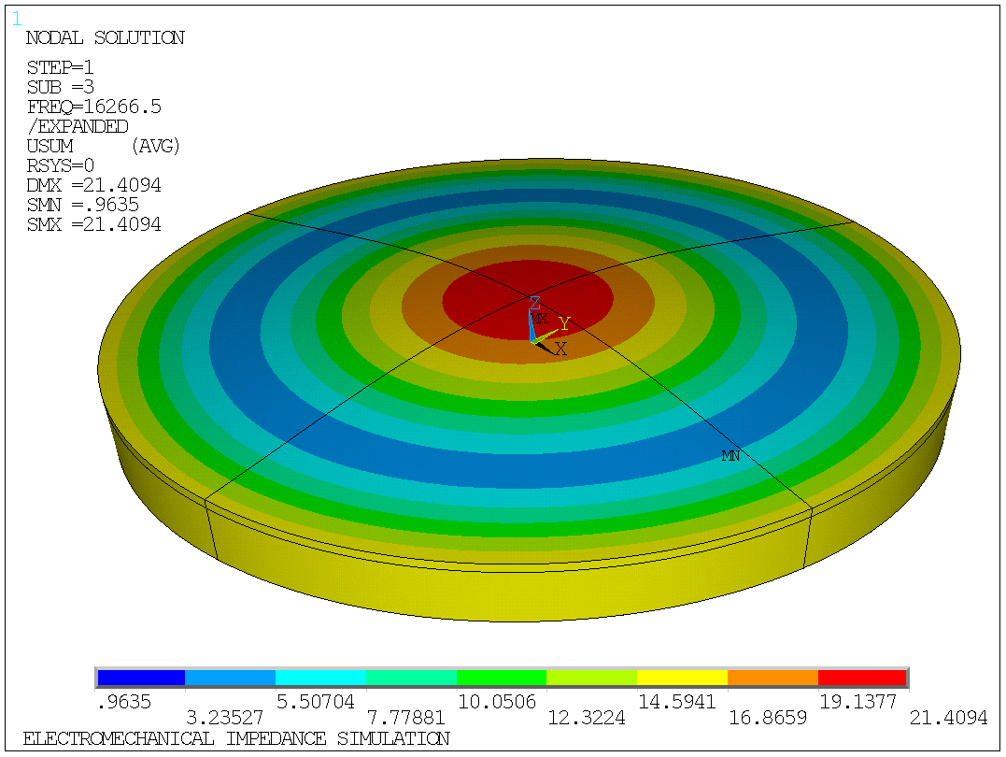
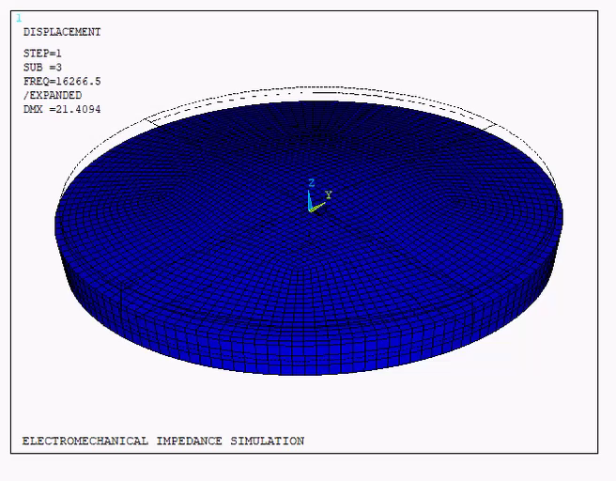
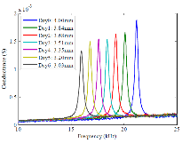
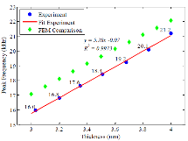
2. Piezoelectric impedance intelligent sensing
Piezoelectric impedance intelligent sensing
Plate: piezoelectric-metal plate
Rod: piezoelectric-corrosion probe
Ring: piezoelectric-metal ring
Bending vibration mode
Axial vibration mode
Radial vibration mode
Resonant frequency vs. length/mass
Resonant frequency vs. thickness/mass
Resonant frequency vs. thickness/mass
Effectively solve the problem of low-cost, high-precision and on-line quantitative monitoring of corrosion

Slide 9
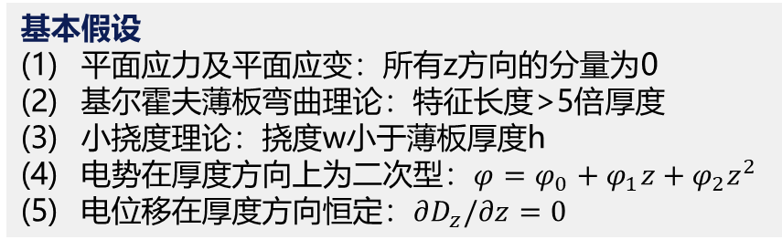
2. Piezoelectric impedance intelligent sensing
Piezoelectric-Metal Plate: Theoretical Modeling (Bending Vibration)
Bending vibration
Kirchhoff Thin Plate Theory
Linear piezoelectric theory
Basic equations
Solving
process
A simple harmonic voltage excitation is applied
Piezoelectric constitutive equations
Transverse displacement:
Constitutive equation of corrosion specimens
Governing
equations
The amount of charge
Equilibrium Equation (Bending Vibration)
Strain-displacement relationship
Current
Radial strain
Circumferential
strain
Admittance
LI W, WANG J, LIU T, et al. Electromechanical impedance instrumented circular piezoelectric-metal transducer for corrosion monitoring: modeling and validation. Smart Materials and Structures, 2020, 29(3): 035008
基本假设
平面应力及平面应变：所有z方向的分量为0
基尔霍夫薄板弯曲理论：特征长度>5倍厚度
小挠度理论：挠度w小于薄板厚度h
电势在厚度方向上为二次型：$φ=φ_{0}+φ_{1}z+φ_{2}z^{2}$
电位移在厚度方向恒定：$∂D_{z}/∂z=0$
Notes:
Let the radial axial force be 0 and solve for the neutral axis position
The surface area of the piezoelectric sheet electrode is integrated to obtain the amount of charge
The effective capacitance of a piezoelectric sheet
The amount of charge is derived from time and the expression for current is obtained
Finally, admittance is obtained

Slide 10
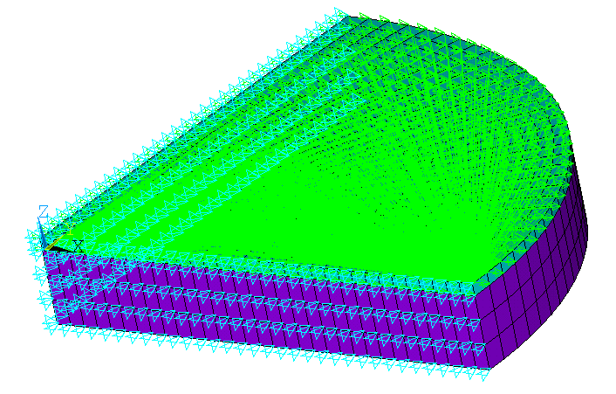
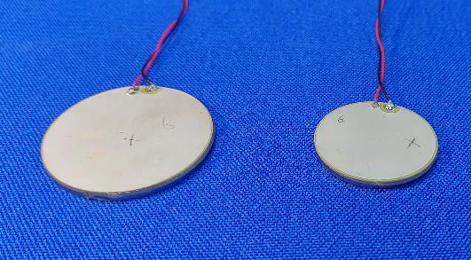
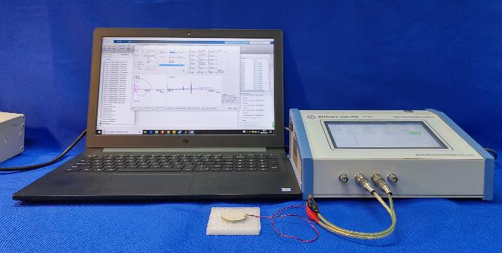
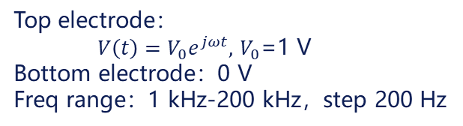

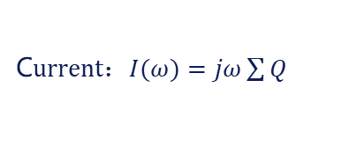
2. Piezoelectric impedance intelligent sensing
Finite element simulation and experimental verification
Finite element analysis parameters
Test analysis parameters
ANSYS piezoelectric analysis and coupled field analysis
Sensor diameter: 40 mm, 30 mm
Piezoelectric sheet thickness: 0.5 mm
Piezoelectric sheet: SOLID5 (piezoelectric coupling unit); Rust specimens: SOLID45 (structural unit)
Sheet thickness: 3.0 mm, 2.5 mm, 2.0 mm, 1.5 mm, 1.0 mm
Harmonic Response Analysis: Obtain the piezoresistive impedance response
Top electrode：
$V\left(t\right)=V_{0}e^{jωt},$ $V_{0}$=1 V
Bottom electrode：0 V
Freq range：1 kHz-200 kHz，step 200 Hz
Piezoelectric Plate
Impedance analyzer
C$urrent：I(ω)=jω\sum{Q}$
A$dmittance：Y(ω)=I(ω)/V_{0}$
Analysis Type: Harmonic Response Analysis
D=40mm
D=30mm
Corrosion sensors
LI W, WANG J, LIU T, et al. Electromechanical impedance instrumented circular piezoelectric-metal transducer for corrosion monitoring: modeling and validation. Smart Materials and Structures, 2020, 29(3): 035008

Slide 11
2. Piezoelectric impedance intelligent sensing
Theoretical, numerical, and experimental comparisons
The correlation coefficient of linear fit R^2=0.99
First-order bending: 8.20 kHz/mm
Second-order bending: 27.48 kHz/mm
Theoretical, numerical, and experimental comparisons
Peak frequency vs. thickness loss
LI W, WANG J, LIU T, et al. Electromechanical impedance instrumented circular piezoelectric-metal transducer for corrosion monitoring: modeling and validation. Smart Materials and Structures, 2020, 29(3): 035008
Notes:
The finite element simulation results are in good agreement with the experimental measurement results, and the difference is within 4.29%. The reason for the difference between the simulation results and the measured results is that the material parameters used in the simulation may be different from the actual ones, or they may be caused by local defects in the specimen preparation during the test. Observing the theoretical results, it can be concluded that the theoretical calculation results of the first-order peak frequency are in good agreement with the finite element simulation results and the experimental measurement results, and the difference is kept within 6.03%. However, the theoretical results of the second-order peak frequency are quite different from the other two results, and the difference reaches 26.48%. It is also worth noting that for theoretical calculations, the higher the modal order, the smaller the sensor diameter and the thicker the thickness, the more obvious the difference between the calculated results and the experimental results. The reason for this discrepancy is that the Kirchhoff thin plate hypothesis is used in the theoretical derivation process, which requires that the diameter-to-thickness ratio of the thin plate need to meet a certain value. However, the diameter-to-thickness ratio of some specimens does not meet these conditions. It can be seen that the thickness and diameter of the sensor have a certain influence on the theoretical calculation. If we design specimens with a large diameter-to-thickness ratio, this difference can be minimized as much as possible. Another possible reason for this discrepancy is that we ignore the influence of electricity when determining the neutral plane process that is theoretically derived, thus simplifying the calculation. This is somewhat different from the actual situation, and will also have a certain impact on the accuracy of the theoretical calculation results.

Slide 12
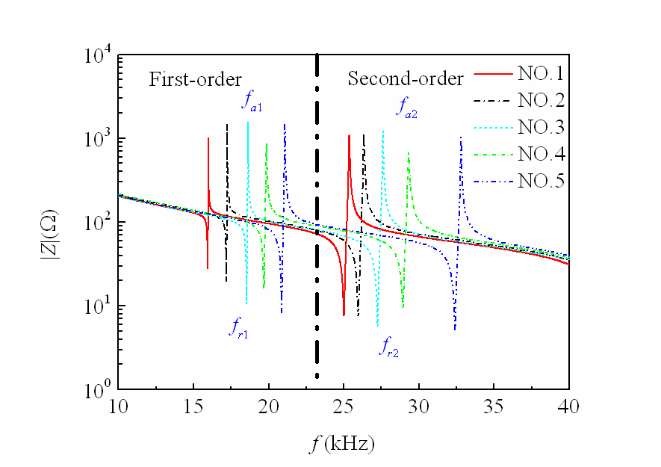


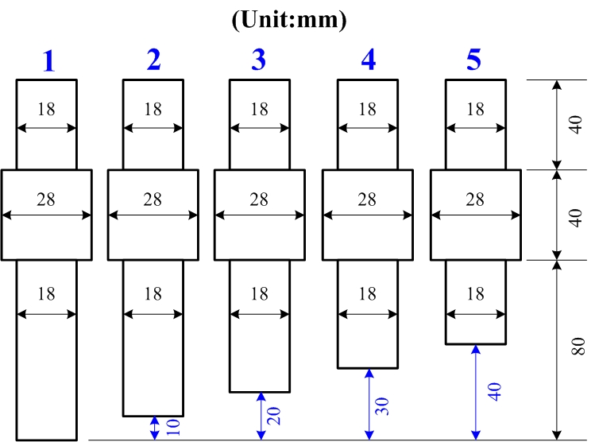

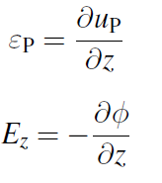
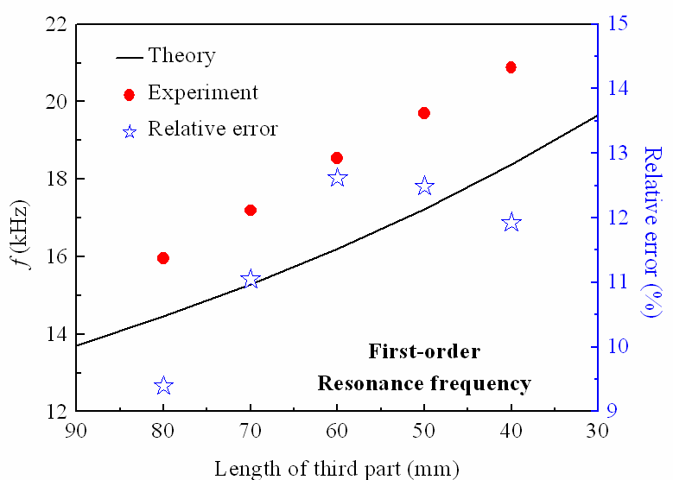
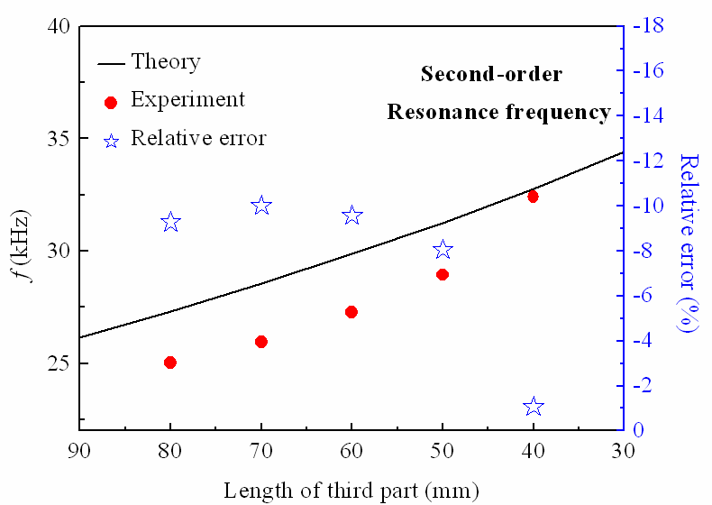


2. Piezoelectric impedance intelligent sensing
Piezoelectric-Corrosion Probes: Theoretical and Experimental Comparison (Axial Vibration)
Axial vibration
Piezoelectric stacking
Linear piezoelectric theory
Theoretical vs. experimental comparison
Impedance spectra of different lengths of probes
Basic equations
Equilibrium Equation (Axial Vibration)
PZT constitutive equations
Constitutive equation for metal rings
Strain-displacement relationship
Errors
Equation of electrical displacement
Admittance expressions
WANG J, WEN L, LIU Z, et al. Design and performance evaluation of electromechanical impedance instrumented quantitative corrosion measuring probe based on conical rods [J]. Smart Materials and Structures, 2022, 31(12): 124001.
Notes:
A harmonic voltage V(t) = V0ejωt is applied to the piezoelectric stack using an impedance analyzer to activate the whole structure in longitudinal vibration mode.

Slide 13
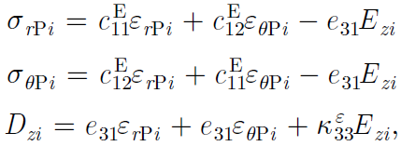

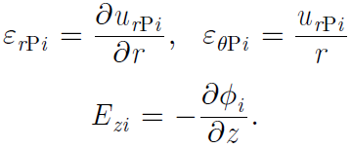
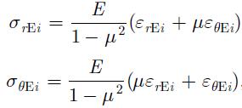

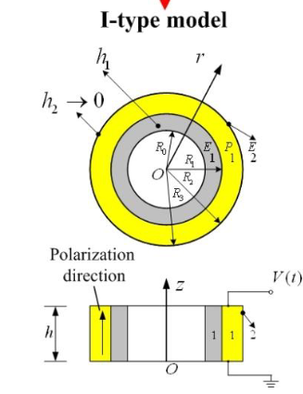
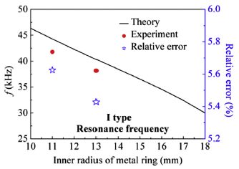

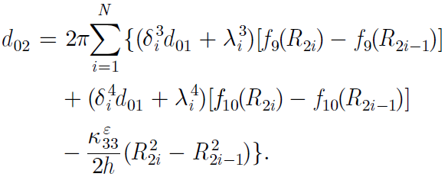

2. Piezoelectric impedance intelligent sensing
Piezoelectric-corrosion rings: a theoretical and experimental comparison
Radial vibration
Small diameter pipes
Basic equations
Theoretical vs. experimental
PZT constitutive equations
Equilibrium Equation (Radial Vibration)
Impedance spectra of corrosion rings with different internal diameters
conception
extend
Strain-displacement relationship
Constitutive equation for metal rings
Equation of electrical displacement
Errors
theory
simplification
Governing equations
Admittance expressions
J Wang, W Li, C Lan, P Wei, W Luo. Sensors and Actuators A: Physical, 2020, 315, 112276
Notes:
Dynamic Characteristics of an Axially Polarized Multilayer Piezoelectric/Elastic Composite Cylindrical Transducer

Slide 14
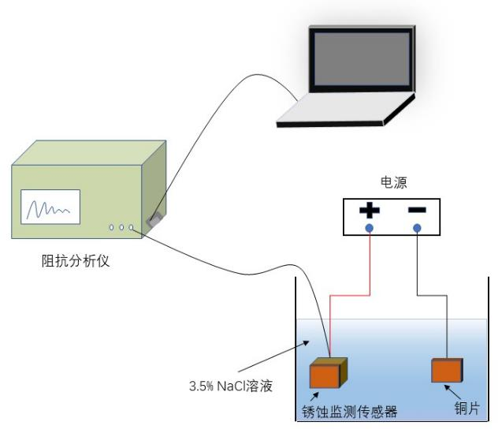
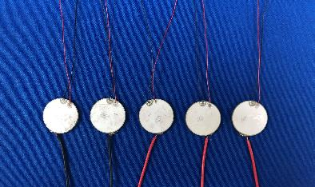
3. Corrosion monitoring of reinforced concrete structures
Sensor preparation and test
The manufacturing process of a corrosion sensor
Accelerated corrosion test principle
Schematic diagram of the energized accelerated corrosion test
Finished sensors
Notes:
The sensor is composed of two parts: piezoelectric sheet and corroded metal sheet.
The metal sheet is made of industrial iron, and the two are bonded with epoxy resin glue
In the sensor performance test, the electrochemical accelerated corrosion test method is mainly used.
The test process is a seven-day period, with measurements taken every 24 hours

Slide 15
3. Corrosion monitoring of reinforced concrete structures
Accelerated Corrosion - Simulates uniform corrosion
15
As the corrosion deepens, the admittance peak frequency shifts to the left, and there is a good linear relationship between the peak shift and mass loss
Notes:
When the thickness of the corroded metal sheet is reduced due to rust damage,
The bending stiffness of the coupling system decreases, and the resonance frequency of the bending mode shape of the sensor changes.
The most obvious effect is the change in the frequency of the bending mode shape corresponding to the thickness,
It is manifested in the impedance spectrum, which is the corresponding change in the peak frequency of the first and second order;
However, the mode shape corresponding to the third-order peak frequency in the impedance spectrum is the in-plane contraction mode shape, which does not change significantly when the damage occurs.

Slide 16
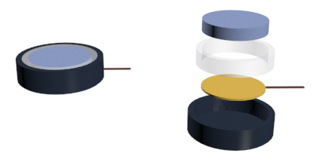
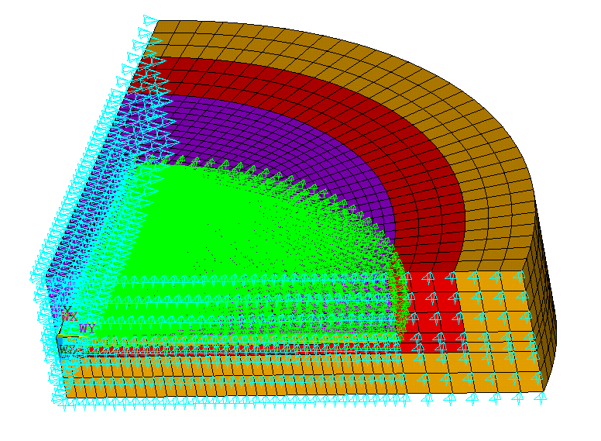
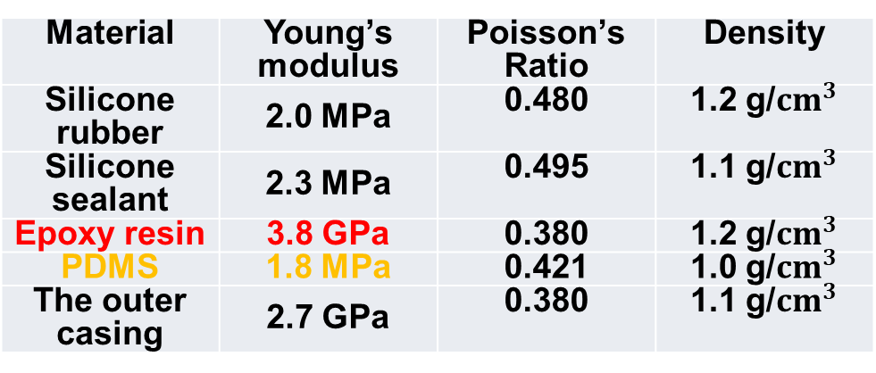
3. Corrosion monitoring of reinforced concrete structures
Encapsulation Material Influence Analysis - To reduce interference from external loads or environmental factors, investigate the performance of waterproof encapsulation materials
EMI response simulation of sensors in different waterproof materials
Silicone rubber,
Silicone sealant,
Epoxy resin,
Polydi-methylsiloxane (PDMS)
Metal Plate
Waterproof Filling
Cable
PZT Patch
Material | Young’s modulus | Poisson’s Ratio | Density
Silicone rubber | 2.0 MPa | 0.480 | 1.2 g/${cm}^{3}$
Silicone sealant | 2.3 MPa | 0.495 | 1.1 g/${cm}^{3}$
Epoxy resin | 3.8 GPa | 0.380 | 1.2 g/${cm}^{3}$
PDMS | 1.8 MPa | 0.421 | 1.0 g/${cm}^{3}$
The outer casing | 2.7 GPa | 0.380 | 1.1 g/${cm}^{3}$
Encapsulated Sensor
Outer Casing
Waterproof Material
Metal Plate
Outer Casing
PZT Patch
Notes:
In order to reduce the interference of external loads or environmental factors, the performance of waterproof packaging materials was explored, and the piezoelectric sheet-corroded metal specimen was encapsulated, and four waterproof materials were used to study through experiments and numerical simulations

Slide 17
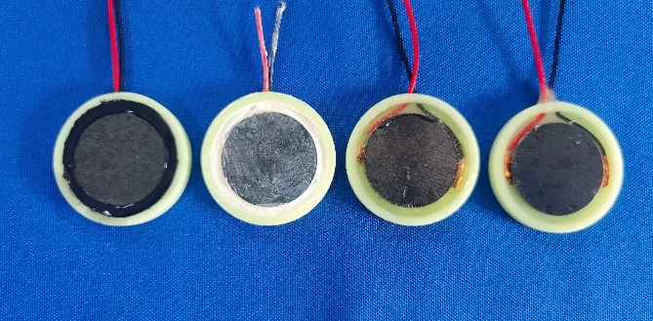
3. Corrosion monitoring of reinforced concrete structures
EMI response of sensors with different waterproof materials
A 3D-printed outer casing was designed to waterproof the corrosion sensor to reduce interference from the external loading or environmental factors.
Four types waterproof materials: silicone rubber, silicone sealant, epoxy resin, and PDMS.
Notes:
In order to reduce the interference of external loads or environmental factors, the performance of waterproof packaging materials was explored, and the piezoelectric sheet-corroded metal specimen was encapsulated, and four waterproof materials were used to study through experiments and numerical simulations

Slide 18
3. Corrosion monitoring of reinforced concrete structures
The conductance signatures of the sensor packaged with silicone rubber, silicone sealant, and PDMS.
by FEM
by Experiments
Mode 1
Mode 2
Mode 1
Mode 2
Notes:
In order to reduce the interference of external loads or environmental factors, the performance of waterproof packaging materials was explored, and the piezoelectric sheet-corroded metal specimen was encapsulated, and four waterproof materials were used to study through experiments and numerical simulations

Slide 19
3. Corrosion monitoring of reinforced concrete structures
Encapsulation material impact analysis
Comparison of different waterproof packaging materials
The comparison of data before and after waterproof packaging.
The maximum error of simulation is 2.13 %, and the errors of experiment are between 0.70 % and 3.56 %.
Among the three waterproof materials, PDMS has the best waterproof packaging effect.
Peak frequency before and after encapsulation
by FEM
Peak frequency before and after encapsulation
by experiment
 | Peak Frequency (kHz)
Material | FEM |  | Error
 | Mode1 | Mode2 | Mode1 | Mode2
Silicone rubber | 28.8 | 102.2 | 2.13 % | 0.97 %
Silicone sealant | 27.6 | 103.0 | 2.13 % | 0.19 %
PDMS | 28.2 | 102.2 | 0.00 % | 0.97 %
Unwrapped | 28.2 | 103.2 | 0.00 % | 0.00 %
 | Peak Frequency (kHz)
Material | Unwrapped |  | wrapped |  | Error
 | Mode1 | Mode2 | Mode1 | Mode2 | Mode1 | Mode2
Silicone rubber | 28 | 100.6 | 27.2 | 98.4 | 2.86 % | 2.19 %
Silicone sealant | 28 | 101.0 | 27.4 | 97.4 | 2.14 % | 3.56 %
PDMS | 28.4 | 99.2 | 28.6 | 95.8 | 0.70 % | 3.43 %
Notes:
In order to reduce the interference of external loads or environmental factors, the performance of waterproof packaging materials was explored, and the piezoelectric sheet-corroded metal specimen was encapsulated, and four waterproof materials were used to study through experiments and numerical simulations
After epoxy treatment, the peak conductance drop is particularly noticeable, and the first-order peak is almost discernible. Limit the free vibration of the sensor
The silicone rubber treated sensor has little impact on the signal and can meet the conditions of free boundaries.
Silicone rubber materials are treated more optimally
The peak frequency is almost unchanged after encapsulation, indicating that the silica gel has good isolation

Slide 20
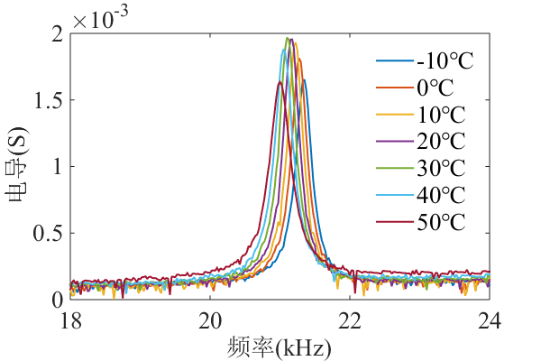
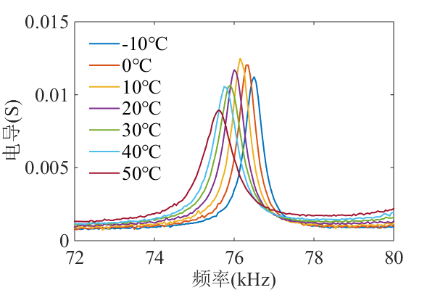
3. Corrosion monitoring of reinforced concrete structures
Temperature Effects Analysis
-10°C - 50°C
conductance (s)
conductance (s)
frequency (kHz)
frequency (kHz)
The greater the temperature change, the greater the frequency offset.
The second-order frequency offset is significantly larger than the first-order frequency offset.
The variation range of the first-order frequency offset rate is about 1.2%, while the variation range of the second-order frequency offset rate is less than 0.8%.
Good temperature stability
Notes:
60 $℃$温度变化内，峰值频率变化量小于0.5kHz，说明温度稳定性好
同样的，60 $℃$温度变化内，峰值频率变化量小于1 kHz，说明温度稳定性好
如需精确测量，可进行温度补偿
由于压电材料温感特性明显，复杂的地下环境中周围环境温度变化，对压电片可能造成干扰，甚至造成压电片的损坏，所以进行了不同温度对传感器阻抗响应影响试验。
由导纳谱分析发现，一、二阶峰值频率随温度上升发生向左偏移的现象。
一、二阶峰值频率随温度升高而减小，变化幅度近似均匀；二阶峰值频率量明显大于一阶频率偏移量，最大降幅接近1 kHz，而最大一阶频率偏移量在0.4 kHz左右。
与锈蚀损伤频率偏移量比较，温度影响下峰值频率偏移量很小。

Slide 21
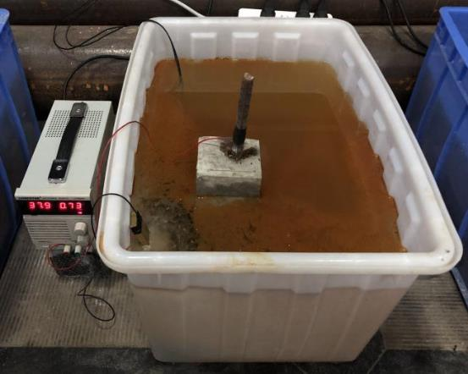
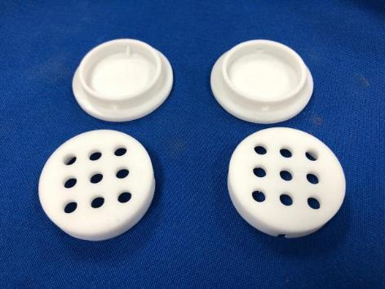



3. Corrosion monitoring of reinforced concrete structures
3D printed protective enclosure
Electricity accelerates corrosion
Sensor mounting
Electricity accelerates corrosion
Notes:
Through the frequency offset relationship of the sensor, the relationship between the frequency offset rate and the corrosion loss rate, the corrosion of the anchor and the quality loss of the anchor are judged.
The control energizing current is 1 A;
Adjustable DC regulated power supply;
The electrolyte solution is a concentration of 10% NaCl;
The metal copper sheet is connected to the negative pole of the power supply
Refer to the electrochemical acceleration corrosion test of the sensor, and use the energizing method to accelerate the corrosion of the anchor.
The power-on time is one week, and monitoring is carried out every 24 hours, and the loss of bolt quality is expected to be about 20%.
Due to the fact that when the bolt is energized, there are more stray currents in the concrete, which causes great interference to the impedance measurement and accelerates the damage of the sensor
The analysis found that the monitoring data was seriously disturbed, and the peak frequency statistics were extracted after noise reduction processing
With the increase of energizing time, the anchor rod gradually corrodes, the first-order peak frequency disappears, and the curve is flat without peak.
The second-order peak gradually shifted to the left and decreased with the deepening of the corrosion degree. There was no significant shift in the third-order peak.
The corrosion bolt monitoring platform consists of two parts, the sensor and the anchor to be corroded.
Under laboratory conditions, the concrete test block is treated as a rock embedded by the bolts.
By reserving holes during pouring, the process flow of bolt drilling and grouting is simulated.
In order to obtain as much data as possible, three sensors are placed at different positions on the same bolt.
The test was carried out by salt solution immersion to accelerate the corrosion of the anchor, which was divided into three groups: full immersion, semi-immersion and normal temperature control.
Once the arrangement is complete, monitoring begins

Slide 22
3. Corrosion monitoring of reinforced concrete structures
Analysis of corrosion monitoring results of reinforced concrete structures
10-500kHz conductance spectroscopy
Peak frequency offset rate vs. mass loss rate
corrosion days
conductance (s)
peak frequency offset rate
frequency (kHz)
mass loss rate
The corrosion quality loss of steel bars is judged by the relationship between the frequency offset rate and the corrosion loss rate
Using the actual frequency offset rate of the sensor, the mass loss rate is 22.64%
After the test, the actual mass loss rate of the sensor was 23.61%, and the results were similar
According to Faraday's law, the mass loss of reinforcement is about 20%, which is consistent with the sensor monitoring data
Notes:
Using the actual frequency offset rate of the sensor, the mass loss of the sensor was backcalculated and analyzed according to the law of packaging test, and the calculated mass loss rate of the sensor was 22.64%.
It is similar to the actual mass loss rate of 23.61% measured by the sensor after the test.
In addition, due to the hardening of the grouting fluid inside the bolt, the specific loss mass of the anchor cannot be measured, so the theoretical loss mass of the bolt is calculated by Faraday's law, which is about 20.07%, and there is a certain amount of rust loss in the early soaking process.
Therefore, the actual mass loss of the bolt is slightly greater than 20%.
The actual mass loss of the sensor is similar to the calculated mass loss and the theoretical mass loss of the bolt, and it can be judged that the corrosion of the sensor and the anchor is roughly similar under the condition of accelerated corrosion.
This test verifies that the sensor can work normally under complex working conditions, but its stability needs to be improved.
The liquid illustrates that the mass loss of the sensor can be inferred from the shift change of frequency during the corrosion monitoring process.
However, due to the complexity of the actual bolting process, the specific sensor quality loss and the actual corrosion law of the bolt need to be further explored.

Slide 23





4. Corrosion monitoring research of pipelines
Piezoelectric impedance pipeline corrosion monitoring study: piezoelectric stack-corrosion probe
Modal analysis
Accelerated corrosion testing
Finite element model
Before corrosion After corrosion
Harmonic response analysis
Numerical simulation of artificial uniform corrosion
The lengths of the probe models were set to 16 cm, 15 cm, 14 cm, 13 cm, and 12 cm, respectively, and the length loss caused by corrosion was simulated by reducing the length of the probe, and the conductance spectrum was calculated by harmonic reaction analysis
Notes:
For the improvement of the piezoelectric sheet-luffing rod, a piezoelectric stack with stronger driving force was adopted, and a new corrosion monitoring probe was designed, and its characteristics were studied by accelerated corrosion test and numerical simulation
Remarks: Accelerated corrosion test current 80 mA, 21 days, 2g per day

Slide 24
4. Corrosion monitoring research of pipelines
Piezoelectric impedance pipeline corrosion monitoring study: piezoelectric stack-corrosion probe
Accelerated corrosion testing
Numerical simulation of artificial uniform corrosion
Axial Vibration: The peak frequency increases relatively uniformly with increasing corrosion days/length loss
Notes:
The conductivity spectra of the test and numerical simulation are shown in the figure, and it is found that the peak frequency of the first three orders of the probe increases uniformly with the increase of corrosion time. The finite element analysis results also show that the peak frequency of the first three orders of the probe increases uniformly with the decrease of the probe length. The shift of the first-order peak frequency shows good characteristics, which is the focus of this study
Note: After 21 days of corrosion, the probe's first-order peak frequency was shifted by 2.1 kHz. In the numerical simulation, the offset of the first-order peak frequency is 4.95 kHz.

Slide 25
4. Corrosion monitoring research of pipelines
Piezo electrical impedance (Piezoelectrical Impedance Pipeline Corrosion Monitoring): Analysis of the Effect of Preload
Preload effect test
Use a torque indicator wrench to tighten the threads to set different preloads, and measure the piezoelectrical impedance characteristics of the corrosion monitoring probe by an impedance analyzer
The conductance spectrum is very messy under the preload, and the effects of the preload must be overcome in order to obtain a clear peak frequency

Slide 26
4. Corrosion monitoring of pipelines
Corrosion monitoring study in piezoelectrical impedance pipelines: optimization of connection mechanism
Accelerated corrosion testing
Current: 2A
Duration: 14 days
Mass loss per day: 50g
Optimization: The connection between the probe and the connection mechanism does not adopt threaded coupling connection, but adopts the design of the card slot, which ensures that the two systems of the probe and the pipeline are independent of each other, so that the probe can vibrate freely
verify
Corrosion monitoring performance of the probe
The overcoming of the preload allows the probe to obtain a clear conductance spectrum of the peak frequency
Notes:
In order to eliminate the influence of preload, the corrosion monitoring probe is improved, a new type of connection mechanism connecting the pipeline and the probe is designed, and the connection between the probe and the connecting mechanism does not adopt threaded coupling connection, but adopts the design of the card groove type, so as to ensure that the two systems of the probe and the pipeline are independent of each other, so that the probe can vibrate freely. Accelerated corrosion testing was performed to verify the corrosion monitoring performance of the probe.

Slide 27
4. Corrosion monitoring of pipelines
Corrosion monitoring study in piezoelectrical impedance pipelines: optimization of connection mechanism
days
Offset 0.3kHz
conductance (ms)
peak frequency
frequency (kHz)
days
The probe's first-order peak frequency offset is 0.3kHz
Quantitative monitoring of corrosion in pipelines: The peak frequency increases relatively evenly with the increase in corrosion days
Notes:
Through conductance spectroscopy, the peak frequency increases relatively uniformly with the increase of corrosion days, and the amount of corrosion of the probe is linearly related to the peak frequency. The first-order peak frequency shift of the probe is 0.3kHz after 21 days of corrosion. Therefore, the peak frequency of pipeline corrosion when it is in the serviceability limit state is determined, and the corrosion monitoring probe can be used to quantitatively evaluate the corrosion of oil and gas pipelines

Slide 28

4. Corrosion monitoring of pipelines
Design of corrosion sensors for small pipe diameters
Piezoelectric - corrosion rings
MON
Concept extension
pipeline
Corrosion monitoring nodes
Flange
Theoretical simplification
In the early stage of design, in order to eliminate the boundary influence between the pipe connector and the sensing node, the threaded connection was adopted.
The formal test is welding, to ensure the tightness and corrosion accuracy of the corrosion test process

Slide 29

4. Corrosion monitoring of pipelines
Intelligent Corrosion Piezoelectric Ring Uniform Corrosion Condition Finite Element Simulation
(Finite Element Modeling)
(Modal Result)
The finite element modeling of the intelligent corrosion piezoelectric ring sensor was carried out, and the wall thickness setting of the metal pipe node was reduced from 3 mm to 2 mm to simulate the wall thickness loss under uniform corrosion.
The simulation results show that the peak frequency of the sensing node shifts to the left and the conductivity value increases. Its linear regularity is very good.

Slide 30




4. Corrosion monitoring of pipelines
Accelerated corrosion test of pipeline test specimens
Diagram of conductivity curve under accelerated corrosion experiment
The installation of the entire pipeline specimen was subjected to the energized accelerated corrosion test, and the corrosion time was 14 days. The impedance of the probe is measured every 24 hours using the developed wireless impedance measurement device.
After corrosion
Inner wall of the pipe
The state of the pipeline corrosion test is inspected daily to ensure that the inner wall of the pipeline is fully corroded
WIMS measurements
Impedance analyzer measurements
Linear fit curves under accelerated corrosion
(Accelerated Corrosion Test Environment Setting)
(WIMS Monitoring)
WIMS measurements
Impedance analyzer measurements

Slide 31

5. Corrosion monitoring of steel structures
Wireless monitoring system based on IoT and cloud platform technology
Wireless systems compared to traditional impedance analyzer
Consistency index: correlation coefficient
CC=99.58%

Slide 32



5. Corrosion monitoring of steel structures

Slide 33
5. Corrosion monitoring of steel structures
the average thickness loss of the corrosion sensor is estimated to be 31.59 μm
3D morphology and 2D profile of the gusset plate surface corrosion depth is 35.95 μm
error: 12.1%
Notes:
decreasing by a total of 216.1 Hz over the 100-day period. Based on the sensitivity analysis of the WIMS presented in Section 5.3, the average thickness loss of the corrosion sensor is estimated to be approximately 31.59 μm, derived from the resonant frequency shift. Based on the coordinate data acquired from the roughness scans before and after corrosion of the gusset plate, the 3D morphology and 2D profile of the gusset plate surface are presented in Figure 23. A uniform corrosion depth of approximately 35.95 μm was calculated.
minor discrepancy exists between the predicted and actual corrosion loss values, with the sensor's prediction being approximately 12.1% lower than the measured value.

Slide 34
6. Conclusions and prospects
Representative Papers
Weijie Li, Tiejun Liu*, Dujian Zou, Jianjun Wang, Ting-Hua Yi. PZT based smart corrosion coupon using electromechanical impedance. Mechanical Systems and Signal Processing, 2019, 129: 455-469.
Weijie Li, Jianjun Wang, Tiejun Liu*, Mingzhang Luo. Electromechanical impedance instrumented circular piezoelectric-metal transducer for corrosion monitoring: modeling and validation. Smart Materials and Structures, 2020, 29(3): 035008.
Jianjun Wang, Weijie Li*, Wei Luo, Jianchao Wu, Chengming Lan. Modeling and experimental validation of a quantitative bar-type corrosion measuring probe using piezoelectric stack and electromechanical impedance technique. Measurement, 2022, 188, 110546.
Wei Luo, Tiejun Liu, Weijie Li*, Mingzhang Luo. Pitting corrosion prediction based on electromechanical impedance and convolutional neural networks. Structural Health Monitoring, 2023, 22 (3), 1647-1664.
Xuanming Fu, Weijie Li*, Luyu Li, Jianjun Wang, Bo Lu, Jianchao Wu. Cloud-based pipe corrosion monitoring using electromechanical impedance instrumented piezoelectric ring sensor. Automation in Construction, 2023, 156: 105124.
Bo Lu, Weijie Li*, Zhishun Liu, and Xuefeng Zhao. Corrosion monitoring for transmission line based on electromechanical impedance instrumented circular piezoelectric corrosion sensor. Sensors and Actuators A: Physical, 2024, 378: 115785.
Yanpeng Si, Weijie Li*, Zeping Sun, Jianjun Wang Xuefeng Zhao. Electromechanical impedance based intelligent corrosion sensing and monitoring method for steel structures. Smart Materials and Structures, Accepted on 10 June.
Notes:
代表性论文
Weijie Li, Tiejun Liu*, Jianjun Wang, Dujian Zou, Shasha Gao. Finite-Element Analysis of an Electromechanical Impedance-Based Corrosion Sensor with Experimental Verification. Journal of Aerospace Engineering, 2019, 32(3): 04019012.
Weijie Li, Tiejun Liu*, Shasha Gao, Mingzhang Luo, Jianjun Wang, Jianchao Wu. An electromechanical impedance-instrumented corrosion-measuring probe. Journal of Intelligent Material Systems and Structures, 2019, 30(14): 2135-2146.
Weijie Li, Tiejun Liu*, Dujian Zou, Jianjun Wang, Ting-Hua Yi. PZT based smart corrosion coupon using electromechanical impedance. Mechanical Systems and Signal Processing, 2019, 129: 455-469.
Weijie Li, Jianjun Wang, Tiejun Liu*, Mingzhang Luo. Electromechanical impedance instrumented circular piezoelectric-metal transducer for corrosion monitoring: modeling and validation. Smart Materials and Structures, 2020, 29(3): 035008.
Jianjun Wang, Weijie Li*, Chengming Lan, Peijun Wei, Wei Luo. Electromechanical impedance instrumented piezoelectric ring for pipe corrosion and bearing wear monitoring: A proof-of-concept study. Sensors and Actuators A: Physical, 2020, 315, 112276.
Jianjun Wang, Weijie Li*, Wei Luo, Jianchao Wu, Chengming Lan. Modeling and experimental validation of a quantitative bar-type corrosion measuring probe using piezoelectric stack and electromechanical impedance technique. Measurement, 2022, 188, 110546.
Jianjun Wang, Lijjie Wen, Zhishun Liu, Mingzhang Luo, Sihui Jia, Weijie Li*, Chengming Lan. Design and performance evaluation of electromechanical impedance instrumented quantitative corrosion measuring probe based on conical rods. Smart Materials and Structures, 2022, 31 (12), 124001.
Huaibing Xu, Lijie Wen, Jianjun Wang, Weijie Li, Chengming Lan. Modeling and electromechanical performance of improved smart aggregates using piezoelectric stacks. Journal of Physics D: Applied Physics, 2023, 56 (5), 054002.
Wei Luo, Tiejun Liu, Weijie Li*, Mingzhang Luo. Pitting corrosion prediction based on electromechanical impedance and convolutional neural networks. Structural Health Monitoring, 2023, 22 (3), 1647-1664.
Weijie Li, Zhishun Liu, Jianjun Wang, Xuanming Fu, Xuefeng Zhao*. EMI instrumented conical corrosion measuring probe for pipeline corrosion monitoring: Experiments with FEM validation. Sensors and Actuators A: Physical, 2023, 362: 114678.
Xuanming Fu, Weijie Li*, Luyu Li, Jianjun Wang, Bo Lu, Jianchao Wu. Cloud-based pipe corrosion monitoring using electromechanical impedance instrumented piezoelectric ring sensor. Automation in Construction, 2023, 156: 105124.

Slide 35
6. Conclusions and prospects
It has been concluded
In this study, a piezoelectric impedance intelligent sensing method for corrosion monitoring was proposed, and the vibration and modal characteristics of the corrosion specimen excited by piezoresistive impedance were applied to corrosion monitoring.
Through the combination of theoretical modeling, finite element simulation and experimental research, the corrosion sensing monitoring mechanism was verified.
The corrosion monitoring research of typical engineering structures such as reinforced concrete structures and steel pipelines was carried out.
This technical method can effectively solve the problems of low-cost, high-precision and on-line quantitative monitoring of corrosion monitoring.
Next Research Plans:
To be applied in engineering, long-term verification, and continuous improvement;
Adaptation for corrosion monitoring of various important steel engineering structures (embedded, surface).

Slide 36

Thank you. Questions!
Speaker: Weijie Li
Ph.D., Associate Professor
Email: liweijie@dlut.edu.cn
School of Infrastructure Engineering, Dalian University of Technology
Notes:
The above is my report, welcome criticism and correction, and welcome to write and exchange, thank you!

